Slide 1

Solid electrolyte interface formation on Lithium metal anode in gel polymer electrolytes
Elena Ushakova ^{1,2} , Daniil Itkis ^{1,2} , Mihail Avdeev² , Vladimir Sergeev ¹, Evgenij Karpushkin ¹, Ekaterina Korneeva ²
Lomonosov Moscow State University, Moscow, Russia
Joint Institute for Nuclear Research, Dubna, Russia

Slide 2
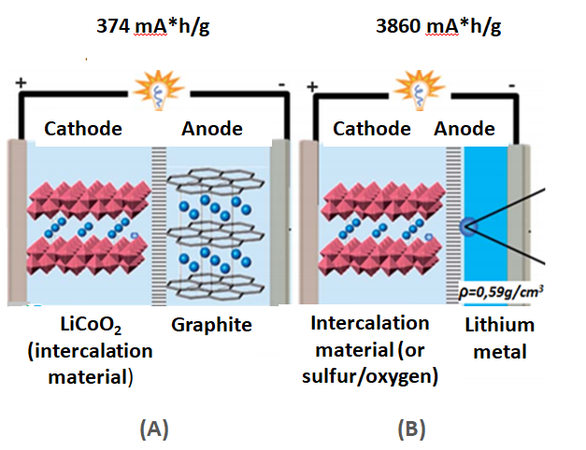
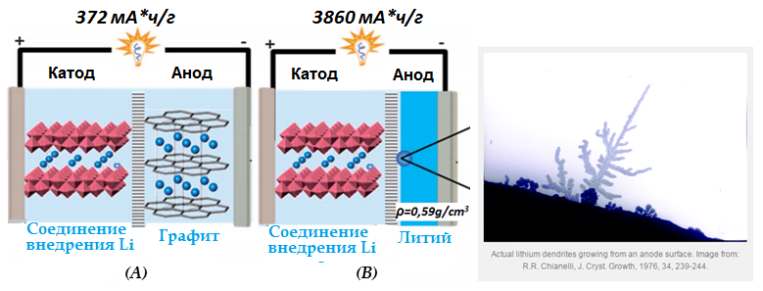
Li-ion and Li-metal batteries
374 mA*h/g 3860 mA*h/g
Specific Energy
Li-ion
~ 250 Wh/kg
Li-metal
~ 5 times higher!
Specific Energy
Cathode Anode
Cathode Anode
LiCoO₂ (intercalation material)
Graphite
Intercalation material (or sulfur/oxygen)
Lithium metal
(A) (B)
[W. Xu, J. Wang. // Energy Environ. Sci. 7, 2014, 513]

Slide 3
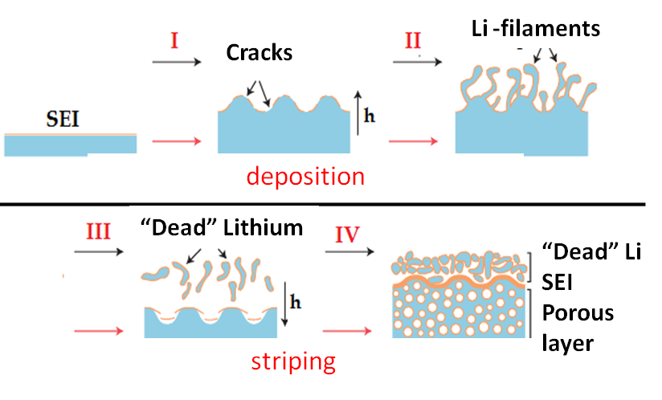
Problems caused by uneven lithium deposition
Lithium deposition/striping processes
[J. Song et al. // Sci. Rep. 125, 2015, 19]

Slide 4
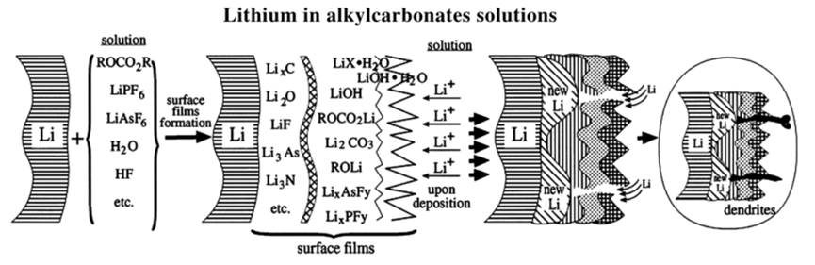
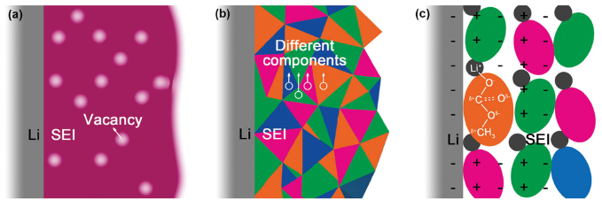
Образование SEI (solid-electrolyte interphase) на Li
H.S. Choe,// Electrochim. Acta 40.1995. 2289
G. B. Appetecchi, J. Electrochem. Soc. 1998, 145, 12, 4126
T. Sato, T. Maruo//J. Power Sources, 138 253 (2004),
D. M. Tigelaar, M. A. B. Meador and W. R. Bennett.// Macromolecules, 2007, 40, 4159–4164.
R.L. Laval //J. Power Sources, 195 5761(2010)
S.Liu, H. Wang, //J. Power Sources, 2011, 7682
Kim, S.-H. et al. // J. Mater. Chem. A 2013, 1 (16), 4949–7
1-2nm 10nm
[D. Aurbach,// J. Power Sources, 2000, vol. 89, pp. 206-218
X.B.Cheng// Adv. Sci. 2015, 1500213 pp.1-20
SEI - stabilization
Polymer/ Gel – Polymer electrolytes (except ordinary liquid-type)

Slide 5
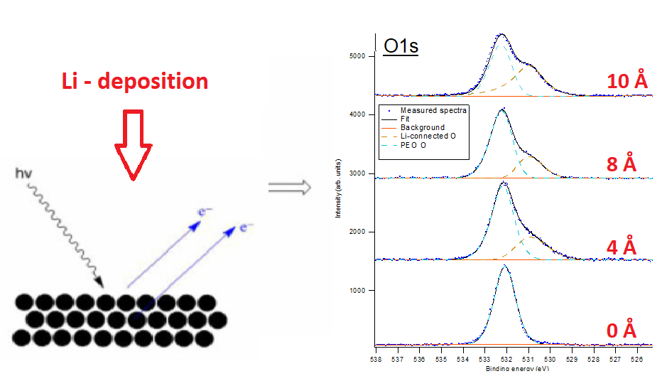
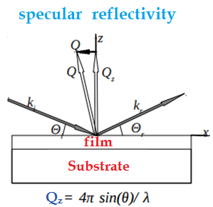
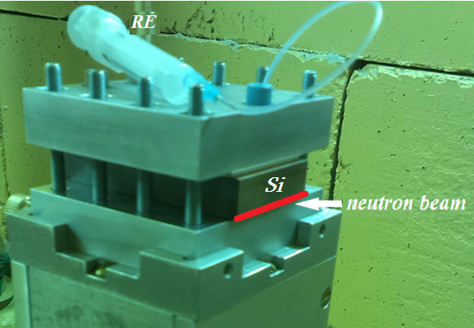
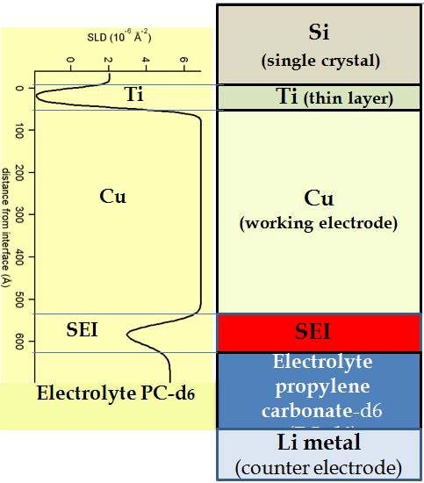
Methods of study SEI
Indirect research methods: Electrochemical methods (Chronopotentiometry and Impedance Spectroscopy) (conductivity etc.)
Direct methods: In-situ X-ray photoelectron spectroscopy (XPS) + Li-metal PVD
(layer composition,
SEI evolution)
In- Situ Neutron Reflectometry (surface roughness)
(A)
(B)

Slide 6
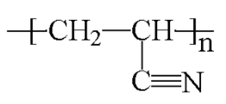
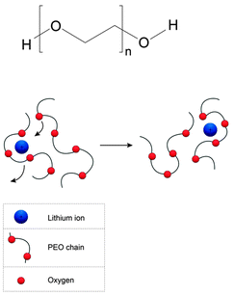
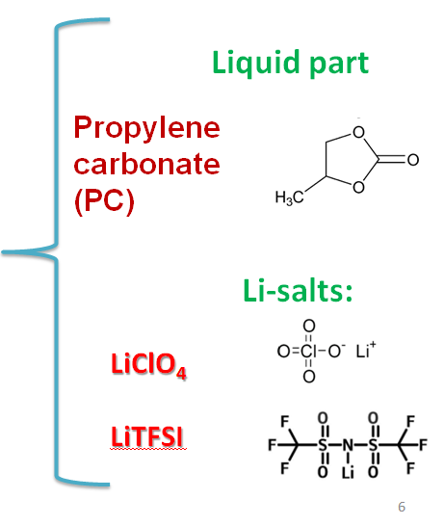
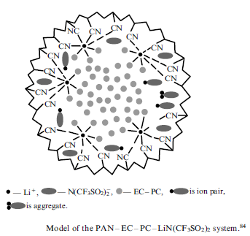
Polymer electrolytes :structure and conductivity
Mechanical support
Poly(ethylene oxide) (PEO)
Polyacrylonitrile (PAN)
+ Li -salt

Slide 7
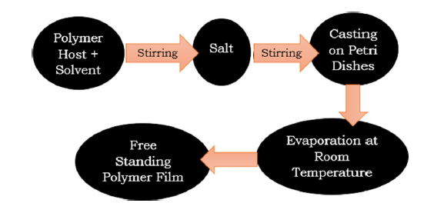
Flow chart of solution cast technique
LiClO₄ or LiTFSI
in EC/PC
PEO or PAN/DMF
100-150 °C
Electrolyte composition:
PAN (Mw 150000) or PEO (Mw 1*10⁶) – polymer membrane moistened with LiClO₄/PC
PAN – LiClO₄/PC/EC gel (EC:Li 2:1) polymer moistened with PC

Slide 8
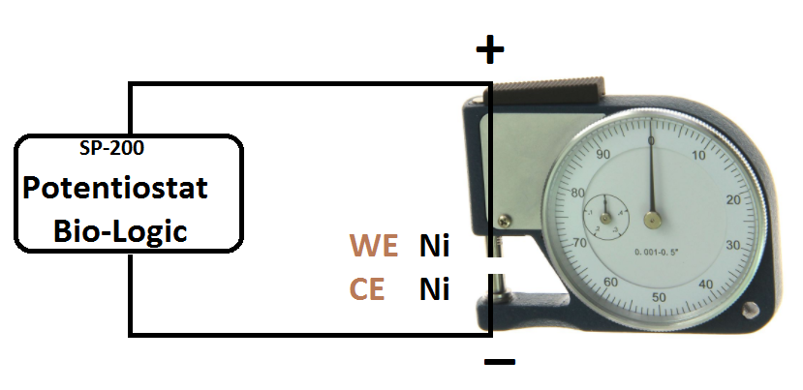
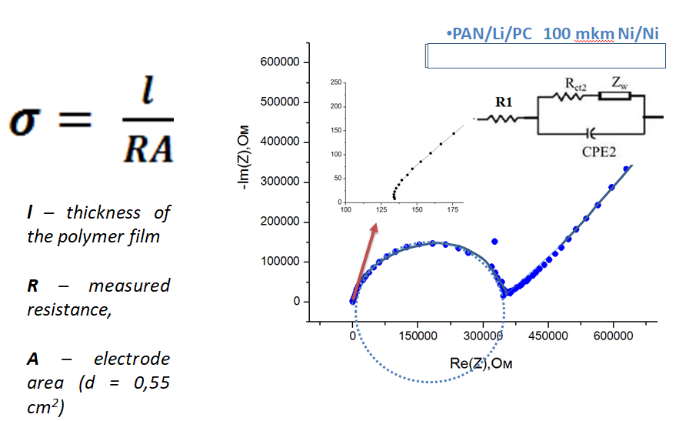
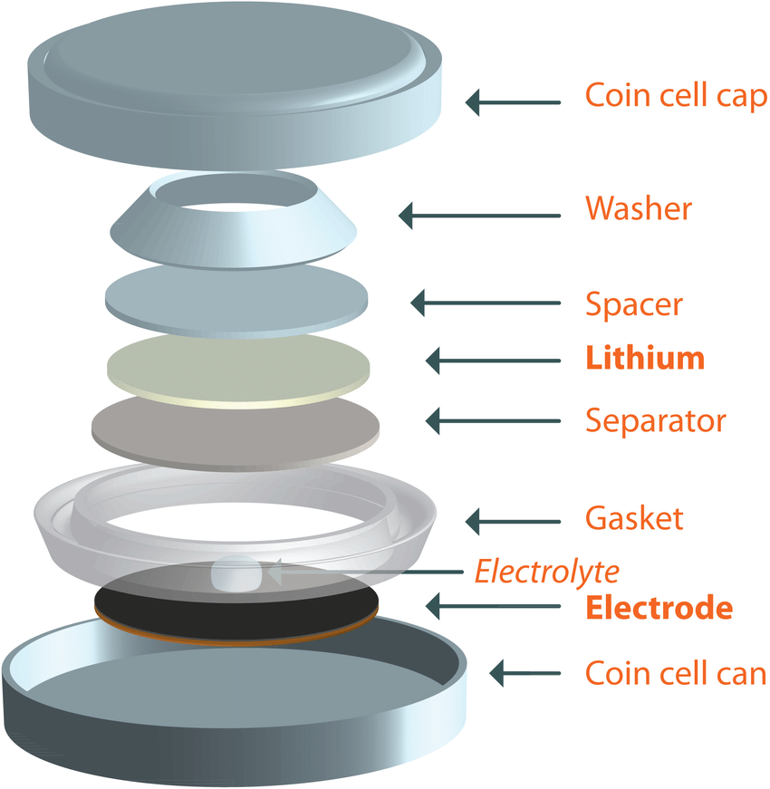
Impedance measurement
1) Conductivity measurement Ni/Ni cell symmetric cell
Polymer
membrane
Polymer conductivity
2) Coin-type
Li/Li symmetric cell
Polymer
film

Slide 9
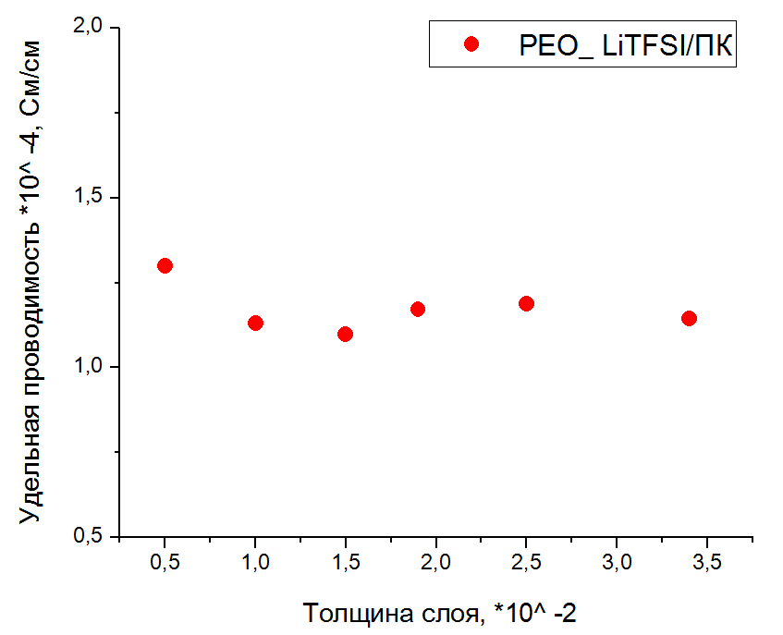
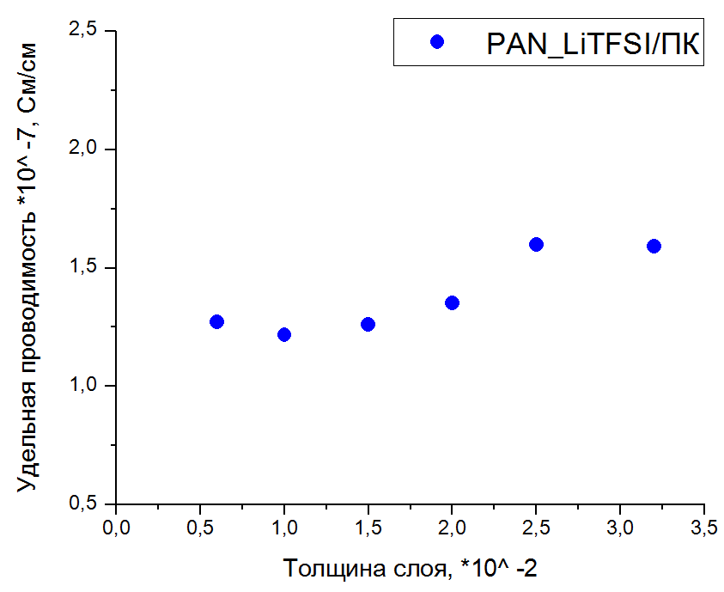
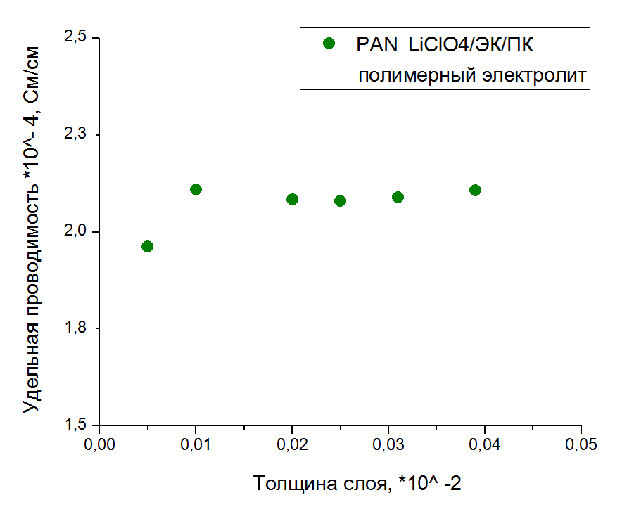
Polymer conductivity (Ni/Ni symmetric cell)
PEO_LiClO₄/PC
PAN_LiClO₄/PC
σ, *10⁻⁴ Sm/cm
σ, *10⁻⁷ Sm/cm
h, *10⁻² cm
h, *10⁻² cm
Substance | Conductivity
PEO film | 1,18*10⁻⁴
PAN film | 1,45*10⁻⁷
PAN/LiClO₄/ EC/PC/ | 2,07*10⁻⁴
σ, *10⁻⁴ Sm/cm
PAN_LiClO₄/EC/PC
h, *10⁻² cm

Slide 10
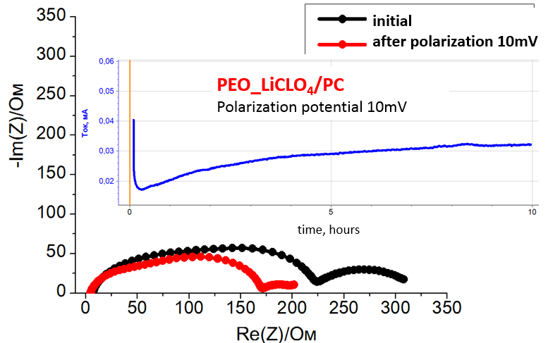
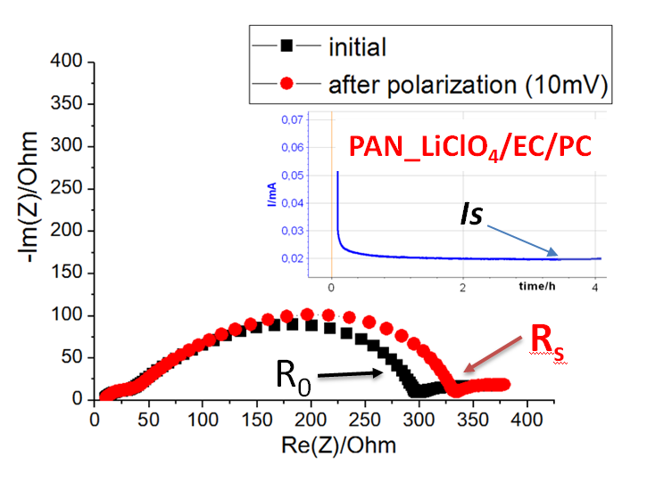

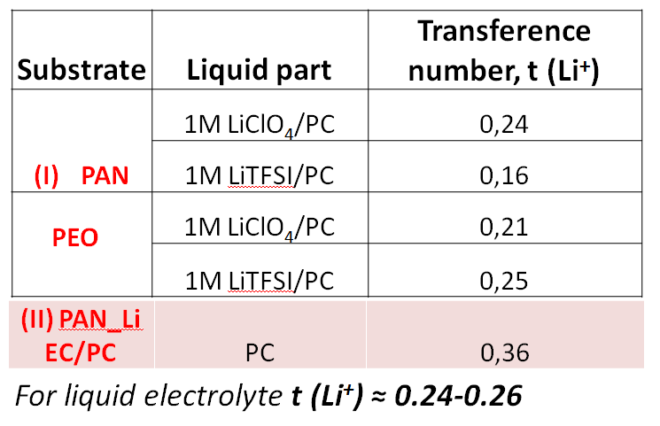
Ion transference number, t (Li⁺)
Io – initial current (t=t₀)
Ro – initial passivation layer resistance
ΔV – polarization potential
I_{S} – residual constant current (for mixed ionic/electronic conductor I≠0) (t=t₁)
R_{S} – passivation layer resistance after polarization (t=t₁)
Notes:
We mesured before and after and thus calculated t(Li+), that is the main contribution to chardge transfer

Slide 11
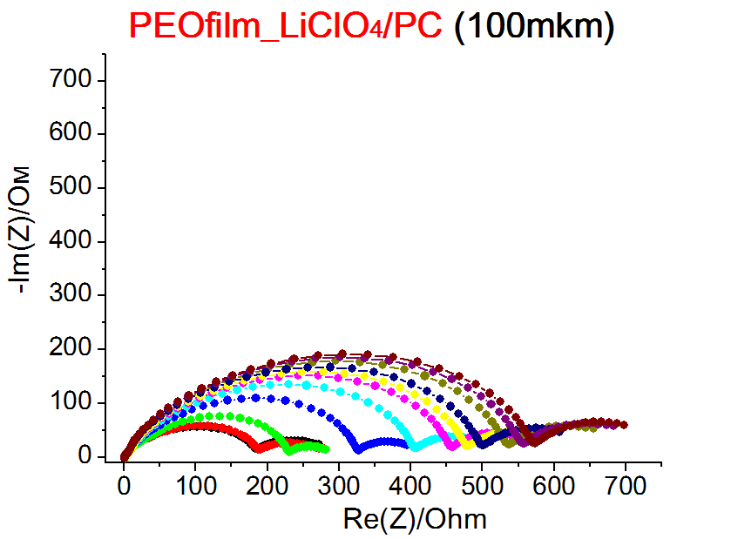
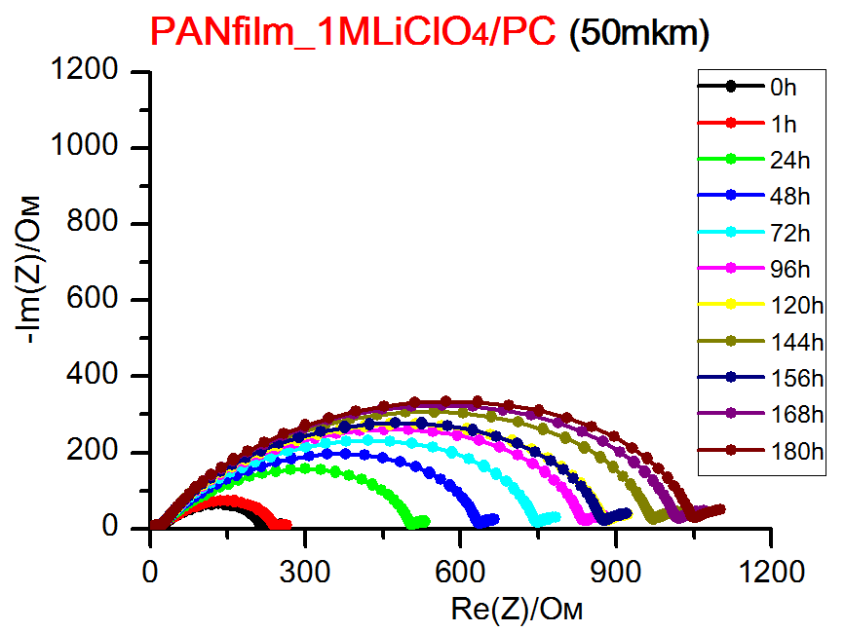
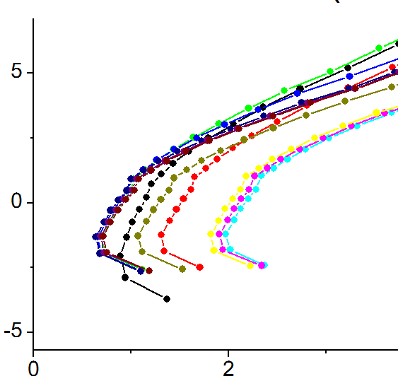
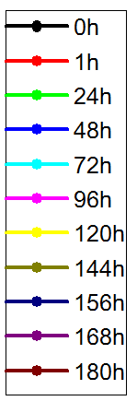
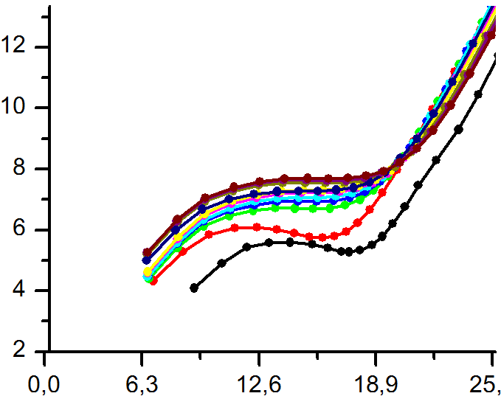
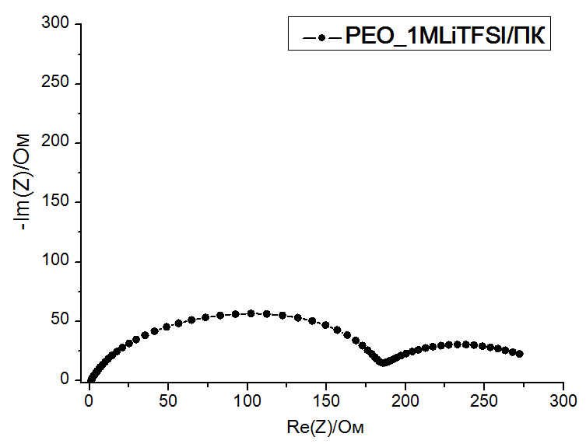
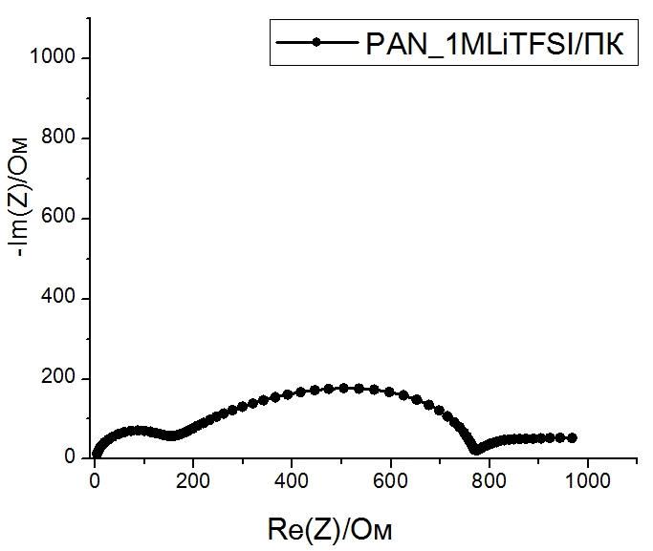
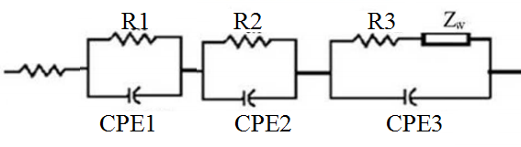
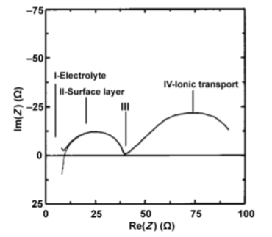
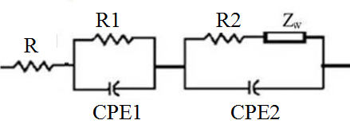
Electrode passivation in Li//Li symmetric cell
S electrode = 2cm²
Li-ion transport through SEI film
Charge transfer at the electrode/electrolyte interface
Li-ion diff. in electrode/electrolyte phase
100mHz
Electronic conductivity/Li-ion conduction in electrolyte
1MHz
1kHz
10Hz

Slide 12
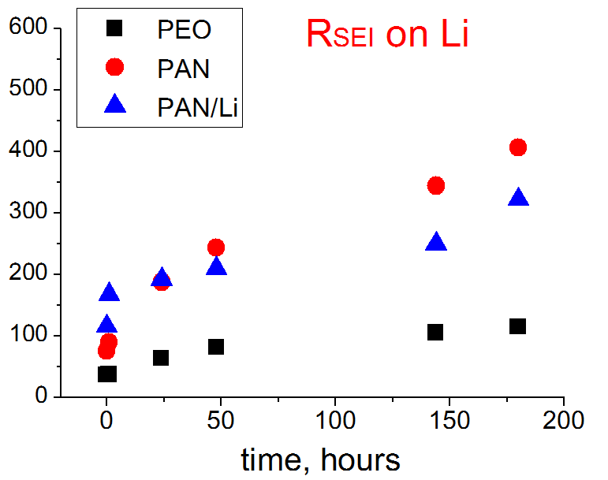
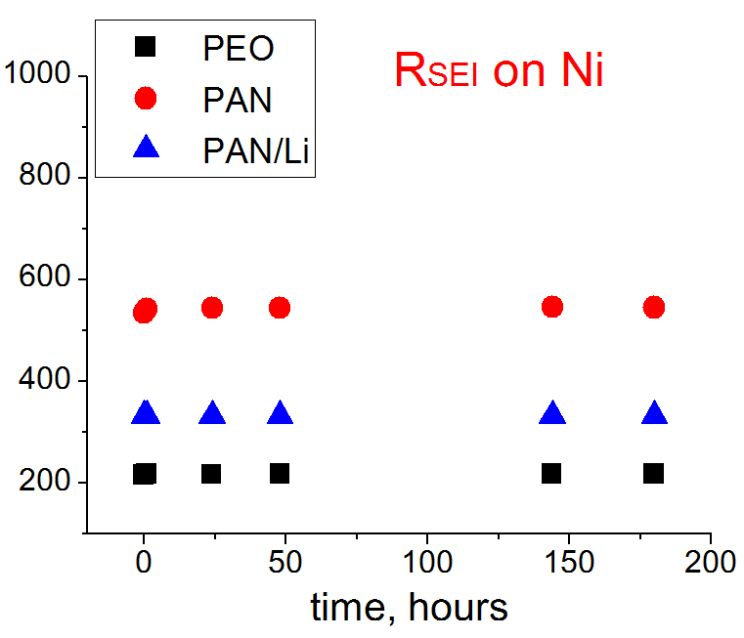
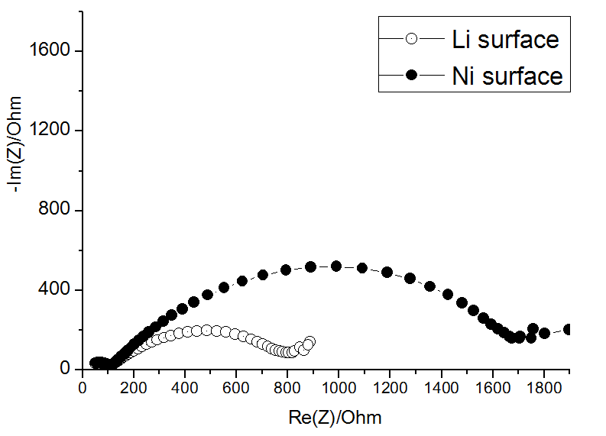
Time passivation of SEI-layer on Li and Ni
R_{SEI}, Ohm*cm*10³
R_{SEI}, Ohm*cm*10³
PAN_LiClO4/EC/PC

Slide 13
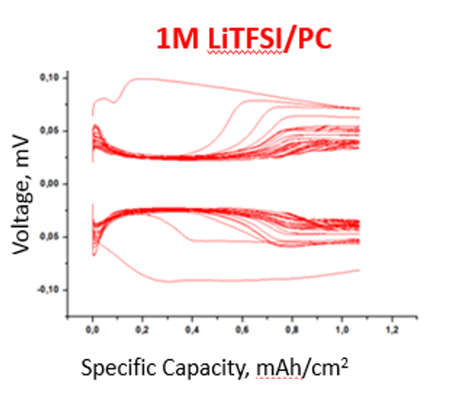
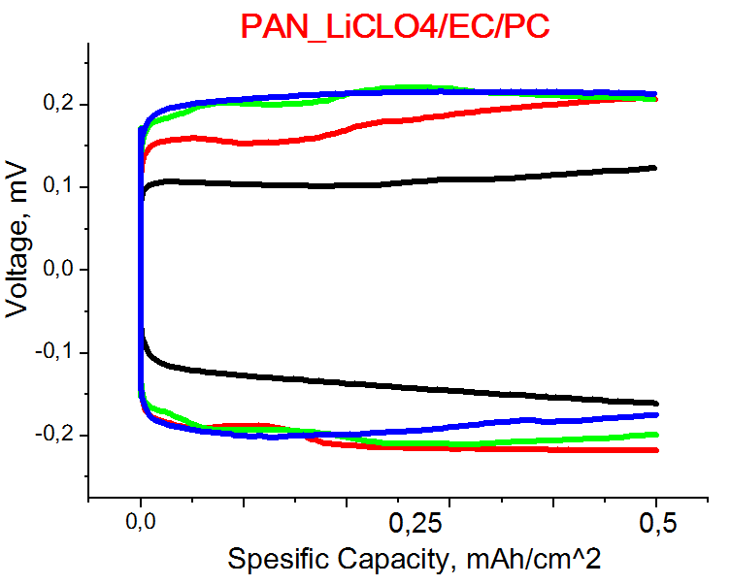
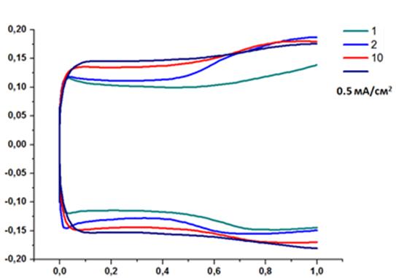
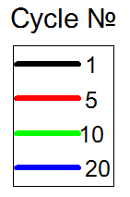
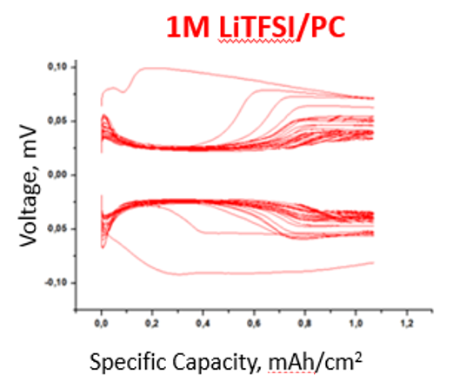
Polymer electrolyte behavior during cycling in Li/Li symmetric cell
PAN_LiCLO₄/EC/PC
PEO_LiCLO₄/EC/PC

Slide 14

In-situ XPS - spectroscopy PEO/PEO -Li
Li-metal PVD process
C1s
O1s
10Å
10Å
8Å
8Å
Li-C
Li-O (L₂O / RCOLi)
O-C=O
4Å
4Å
(Li₂CO₃₎
C-O-C
С-O
C-C sp²
0Å
0 Å
initial
0Å

Slide 15
In-situ XPS - spectroscopy PAN/PAN-Li
PAN film after Li-metal deposition
C1s
N1s
10 Å
10 Å
?
8 Å
8 Å
C-C sp^{2 (free carbon)}
Li-N (L₃N)
Li-C
4 Å
4 Å
C-N sp
(-С≡N
PAN)
C-N
(-С≡N PAN)
C-C sp³
(-C-С-) PAN)
0 Å
0 Å

Slide 16
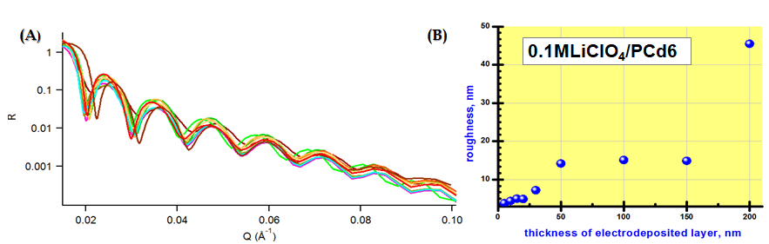
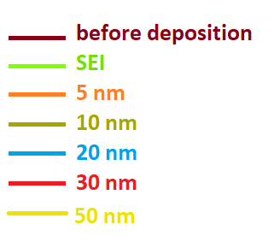
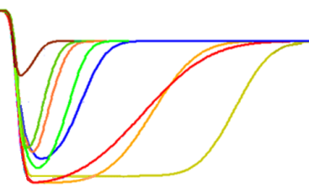
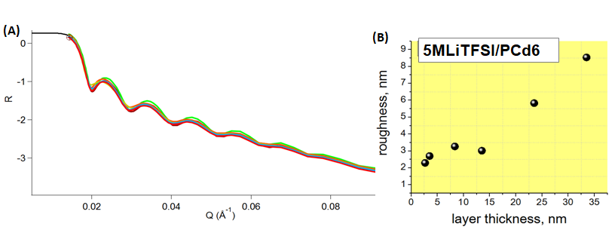

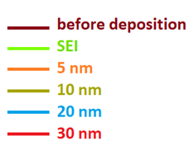
Future plans
Neutron reflectometry: surface layer evolution
SLD
The real-space profile of the SLD as a function of depth for the deposited layers, showing the evolution of the thickness and interface roughness with charge growing.
SLD
scattering lengty density

Slide 17
Conclusions
At the present work the possibility of SEI stabilization formed on Li-metal anode in contact with PEO and PAN-based PE-s, salt LiClO₄ (LTFSI) and plasticizers (EC/PC) has been investigated and conformed
Fundamentally new complex approach to the Li - SEI study has been developed including indirect electrochemical methods (chronopotenciometry and impedance spectroscopy techniques) and direct physical methods (In-situ XPS, in-situ NR), that is going to help us to develop high energy Li-metal polymer batteries
In-situ X-ray photoelectron spectroscopy was first time applied to detect Li-metal/polymer SEI composition and stability after Li-metal PVD step-by-step process.
In-situ Neutron Reflectometry method has been introduced, developed and tested for Li/polymer average surface layer evolution study

Slide 18
Special thank!
Dr. Daniil Itkis ^{1,2}
Dr. Mikhail Avdeev²
Prof. Vladimir Sergeev ¹,
Dr. Evgenij Karpushkin ¹,
Ekaterina Korneeva ²
Lomonosov Moscow State University (MSU), Moscow, Russia
Joint Institute for Nuclear Research (Frank Laboratory of Neutron Physics (JINR, FLNP)), Dubna, Russia

Slide 19
Thank you for your attention!

Slide 20



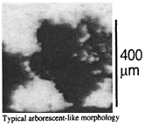




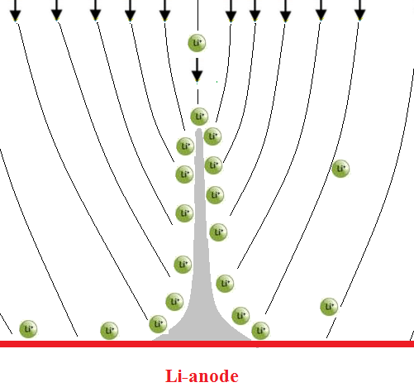
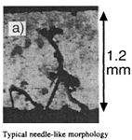

Non-uniform electrodeposition of lithium metal: Theoretical background
1. Diffusion
2. Electromigration
,
J↑
J↓
[C. Monroe, J. Newman//
J. Electrochem. Soc., 2004, vol. 151, pp. A880 - A886]
Рост дендритов
[J. Chazalviel // Phys. Rev. A., 1990,vol42,12,pp.7355-7367]

Slide 21
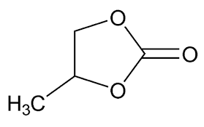



The comparison of PAN (-CN) и PEO (-O-) polymer ending groups on Li-SEI stability
Mechanical support
Liquid part
1) Polyacrylonitrile (PAN)
2) Poly(ethylene oxide) (PEO)
Propylene carbonate (PC)
Li-salts:
LiClO₄
LiTFSI

Slide 22











Initial Polymer Surface (SEM)
PAN Li
C:N:O 2:1:1
PAN
C:N 1:0
PEO
C:O 1:1

Slide 23





Polymer conductivity
Ni//PEO or PAN, LiClO₄ or LiTFSI in PC//Ni
PAN/Li/PC 100 mkm Ni/Ni
l – thickness of the polymer film
R – measured resistance,
A – electrode area (d = 0,55 cm²)

Slide 24
Ion transference number, t (Li⁺)
Substrate | Liquid part | Transference number, t (Li⁺)
PAN | 1М LiClO₄/PC | 0,24
 | 1М LiTFSI/PC | 0,16
 | 1М LiClO₄/PC | 0,21
 | 1М LiTFSI/PC | 0,25
PEO
(II) PAN_Li EC/PC | PC | 0,36
For liquid electrolyte t (Li⁺) ≈ 0.24-0.26

Slide 25




FTIR-spectroscopy
PEO
PAN
PAN_Li

Slide 26






Element analisis
C:N:O 2:1:1
Element analisis
C:O 1:1

Slide 27

Solid-electrolyte interphase(SEI)on Li-surface
[D. Aurbach,// J. Power Sources, 2000, vol. 89, pp. 206-218
J. Song // Scientific Reports. V.125, 2015, 19
Polymer/Gel – Polymer electrolytes (except ordinary liquid-type)
SEI - stabilization

Slide 28
Real-life call for proposals
https://ninesights.ninesigma.com/
“Next Generation Li-ion Battery Separator”
Parameter | Desired value
Melting temperature | > 220°C
Air permeability | < 150 s / 100 mL air
Pore size | < 30 nm
Porosity | >40%
Tensile strength | > 1000 kg/cm²
Thickness | < 20 µm
Chemical resistance | little or no degradation in contact with lithium salts in ethylene carbonate
Flexibility | separator: can be enrolled with metal foil electrodes, should not be broken during assembly, should withstand “some” pressure after rolling

Slide 29
Gel electrolytes based on PEO
The first and the most studied system
PEO–Li⁺ in the absence of solvent
  σ 10^{–8} to 10^{–4} S/cm at 40–100°C
  not applicable at room temperature
Addition of a plasticizer: increase in σ due to reduced crystallinity
  σ 10^{–3}–10^{–4} S/cm at rt for PEO–Li(CF₃SO₃)–propylene carbonate [Prosini, Solid State Ionics, 146:65 (2002)], PEO–LiClO₄–ethylene carbonate–diethyl carbonate [Aihara, J. Electrochem. Soc., 149:A849 (2002)], PEO–LiBF₄–ethylene carbonate–γ-butyrolactone [Zaghib, Indian J. Chem. A, 44:983 (2005)]

Slide 30
Gel electrolytes based on PAN
Both homogeneous and heterogeneous gels
Polymer is active in Li⁺ conduction (complex with nitrile)
σ > 10^{–3} S/cm (rt)
High chemical stability, electrochemical stability up to 4.5 V (vs. Li⁺/Li)
High transference number t(Li⁺) 0.5–0.7
Inflammable (safety)
Developed electrospinning processing
Polymer-in-salt systems
Certain issues with interfacial stability

Slide 31


initial
after polarization 10mV
PEO_LiCLO₄/PC
Polarization potential 10mV
time, hours
 | R1 | R2 | Ro/Ом | R1 | R2 | Rs/Ом | Io/мА | Is/мA | ΔV | T Li+
PEO_2MLiTFSI/ПК | 5,5 | 224 | 218 | 4,8 | 171 | 166 | 0,04 | 0,03 | 0,01 | 0,2

Slide 32


Slide 33


 | R1 | R2 | Ro/Ом | R1 | R2 | Rs/Ом | Io/мА | Is/мA | ΔV | T Li+
PAN_1MLiClO4/ПК | 1,5 | 286 | 285 | 1,5 | 425 | 424 | 0, 129 | 0,059 | 0,05 | 0,24

Slide 34


initial
after polarization 10mV
I, mA
PAN_LiCLO₄/PC
Polarization potential 10mV
time, hours
 | R1 | R2 | Ro/Ом | R1 | R2 | Rs/Ом | Io/мА | Is/мA | ΔV | T Li+
PAN_1MLiTFSI/ПК→ | 13 | 475 | 462 | 18 | 782 | 764 | 0, 081 | 0,029 | 0,05 | 0,16

Slide 35



Slide 36
Conclusions
The resistance of the electrolyte/electrode interface on Li-metal in contact to PAN PE-s was found to be more than one order greater than that for PEO PE-s; R_{SEI} increased over time (even without electrochemistry) for both types. While time development of the R_{SEI} on inert Ni-electrode was not observed presumably due to the larger surface area of PAN PE-s
T(Li+) and overall conductivity of the formed PE-s defined by means of DC polarization and AC impedance methods PE-s was two times higher in case of Li-PAN gel PE-s.
Cycling PAN PE-s behavior in contact to Li-metal in Li/Li cells was investigated. The possibility of more stable surface layer formation on Li anode during electrodeposition (preventing further fast Li-nucleation) was presumed.
Fundamentally new approach to the Li - SEI study has been created including indirect electrochemical methods and direct physical methods (In-situ XPS,NR), that is going to help us to develop high energy Li-metal polymer batteries:
In-situ X-ray photoelectron spectroscopy was first time applied to detect Li-metal/polymer SEI composition and stability after Li-metal PVD step-by-step prosess.
In-situ Neutron Reflectometry method has been introduced, developed and tested for Li/polymer everage surface layer evolution study

Slide 37
Conclusions
The resistance of the electrolyte/electrode interface on Li-metal in contact to PAN PE-s was found to be more than one order greater than that for PEO PE-s; R_{SEI} increased over time (even without electrochemistry) for both types. While time development of the R_{SEI} on inert Ni-electrode was not observed presumably due to the larger surface area of PAN PE-s
T(Li+) and overall conductivity of the formed PE-s defined by means of DC polarization and AC impedance methods PE-s was two times higher in case of Li-PAN gel PE-s.
Cycling PAN PE-s behavior in contact to Li-metal in Li/Li cells was investigated. The possibility of more stable surface layer formation on Li anode during electrodeposition (preventing further fast Li-nucleation) was presumed.
Operando X-ray photoelectron spectroscopy was first time used to detect Li-metal/polymer SEI composition and stability during Li-metal PVD prosess.
Surface layer evolution of complicated composition during Li-deposition was detected for both PAN and PEO PE-s.

