Slide 1

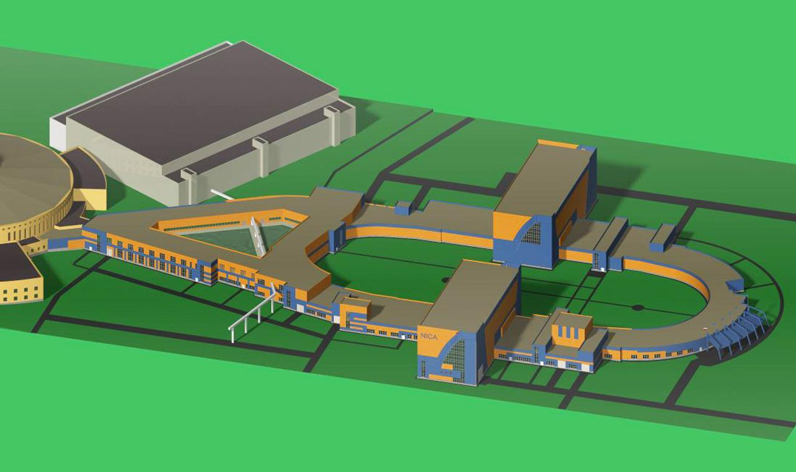

Progress towards realization of the Nuclotron-NICA project

Slide 2

Facility components – status
2015-2018
KRION
Linac HILAc
KRION
Linac HILac
Ion sources
Booster (25 Tm)
1(2-3) single-turn injection,
storage of (2 ÷ 4)×10⁹ ions,
acceleration up to 100 MeV/u,
electron cooling, acceleration
up to 600 MeV/u
Ion sources
Booster (25 Tm)
1(2-3) single-turn injection,
storage of (2 ÷ 4)×10⁹ ions,
acceleration up to 100 MeV/u,
electron cooling, acceleration
up to 600 MeV/u
Linac LU-20
Linac LU-20
Fixed Target Area
Fixed Target Area
Slow resonance extraction
Stripping (80%) ¹⁹⁷Au³¹⁺ => ¹⁹⁷Au⁷⁹⁺
IP-2
Nuclotron (45 Tm)
injection of one bunch
of ≤ 2×10⁹ ions,
acceleration up to
1 - 4.5 GeV/u max.
Nuclotron (45 Tm)
injection of one bunch
of ≤ 2×10⁹ ions,
acceleration up to
1 - 4.5 GeV/u max.
Collider
L ≥ 10²⁷ см⁻²с⁻¹
IP-1
work in progress
assembly
commissioned / existing

Slide 3
Facility components – status
2019
KRION
Linac HILac
KRION
Linac HILac
Ion sources
Booster (25 Tm)
1(2-3) single-turn injection,
storage of (2 ÷ 4)×10⁹ ions,
acceleration up to 100 MeV/u,
electron cooling, acceleration
up to 600 MeV/u
Ion sources
Booster (25 Tm)
1(2-3) single-turn injection,
storage of (2 ÷ 4)×10⁹ ions,
acceleration up to 100 MeV/u,
electron cooling, acceleration
up to 578 MeV/u
Linac LU-20
Linac LU-20
Fixed Target Area
Fixed Target Area
Slow resonance extraction
Stripping (80%) ¹⁹⁷Au³¹⁺ => ¹⁹⁷Au⁷⁹⁺
IP-2
Nuclotron (45 Tm)
injection of one bunch
of ≤ 2×10⁹ ions,
acceleration up to
1 - 4.5 GeV/u max.
Nuclotron (45 Tm)
injection of one bunch
of ≤ 2×10⁹ ions,
acceleration up to
1 - 4.5 GeV/u max.
Collider
L ≥ 10²⁷ см⁻²с⁻¹
IP-1
work in progress
assembly
commissioned / existing

Slide 4
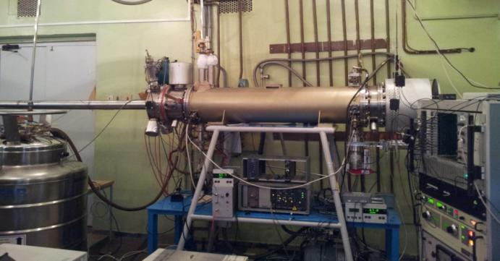
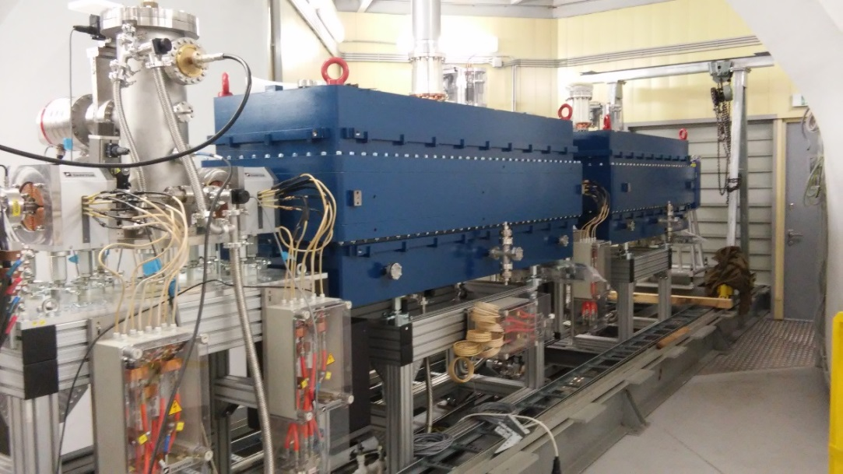
Injection - chain
for heavy ions
KRION
Linac HILAc
KRION
Linac HILac
Heavy ion source KRION ESIS type project up to 1.5·10⁹ Au³¹⁺ particles per cycle (achived 5·10⁸ Au³¹⁺ )
at repetition frequency up to 10 Hz
Booster (25 Tm)
up to 578 MeV/u
Overall commissioning
3.2 MeV/u, Au³¹⁺, 10.2016
Nuclotron (45 Tm)
up to 4.5 GeV/u

Slide 5
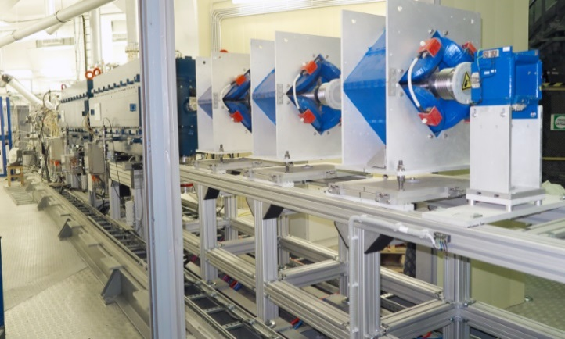
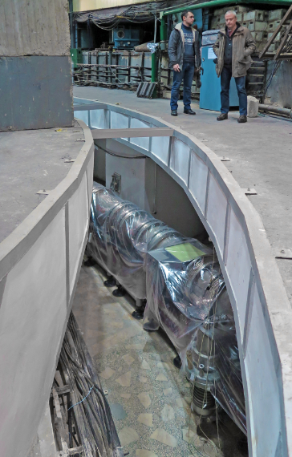
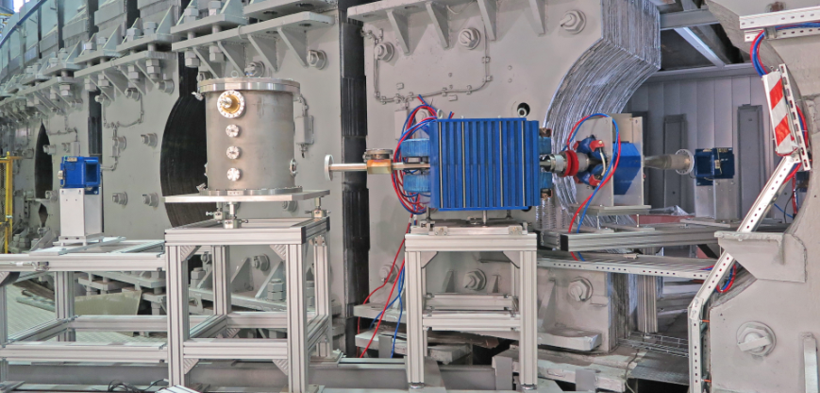
Injection - chain
for heavy ions
KRION
Linac HILAc
KRION
Linac HILac
HiLac – Booster
channel
mounting started
Booster (25 Tm)
up to 578 MeV/u
Nuclotron (45 Tm)
up to 4.5 GeV/u
17.01.19
Booster - Nuclotron
channel contracted to BINP
commissioning at end of 2019

Slide 6
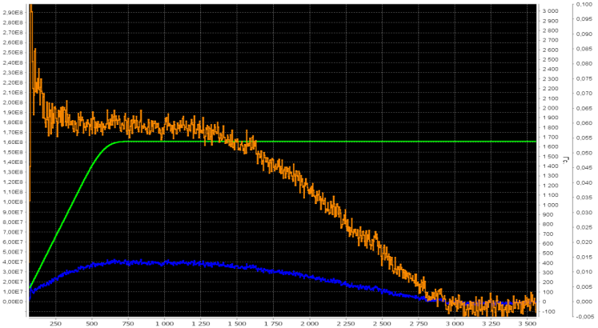
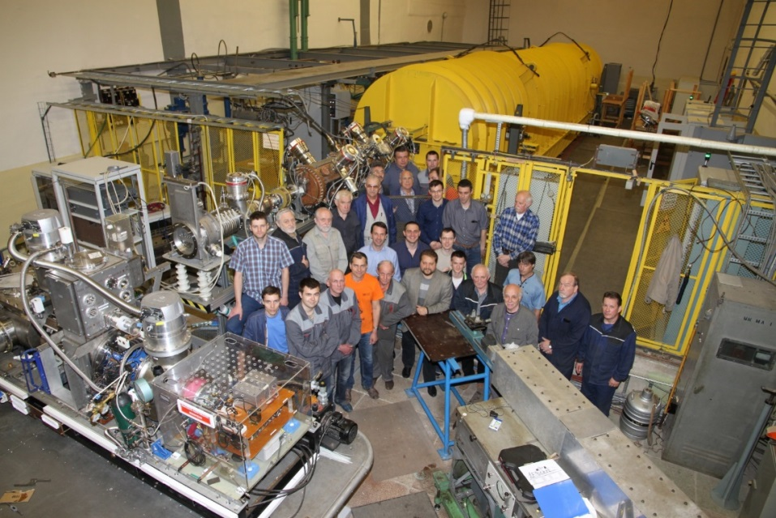
Injection - chain
for light ions
New fore-injector for LU-20 with buncher + Source of Polarized Ions
1.8 E8
Ion sources
Ion sources
Linac LU-20
Linac LU-20
Polarized protons
JINR, INR, ITEP, MEPHI,
Resonator is fabricated in Sneshinsk
Nuclotron (45 Tm)
up to 4.5 GeV/u
3 runs in 2016-2017 (#52-54) with d↑, 1 run (#54) with stable p↑ beam
 | Polarized deutrons | Polarized protons
Obtained beam current in 2017 (source) | 2 mA | 0.4 mA
Project beam current (source) | 5-6 mA | 5-6 mA
Obtained beam intensity in 2017 (Nuclotron) | 2.2x10⁹ ppc | 1.8x10⁸ ppc
Project beam intensity (Nuclotron) | 1-2x10¹⁰ ppc | 1-2x10¹⁰ ppc

Slide 7
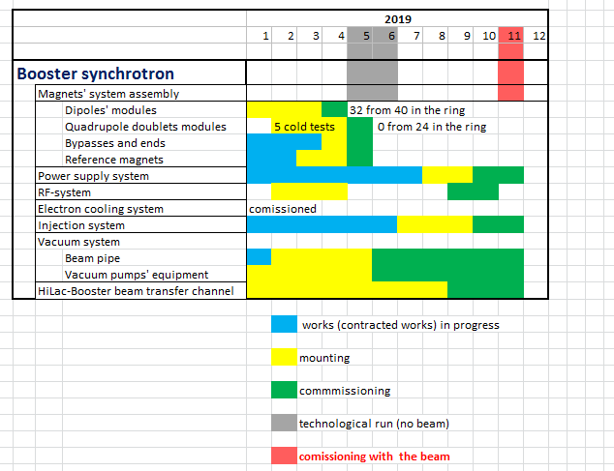
Time-schedule
Booster
Booster (25 Tm)
up to 578 MeV/u
Apr-May 2019 –
technological run
Oct-Nov 2019
- commissioning with the beam

Slide 8
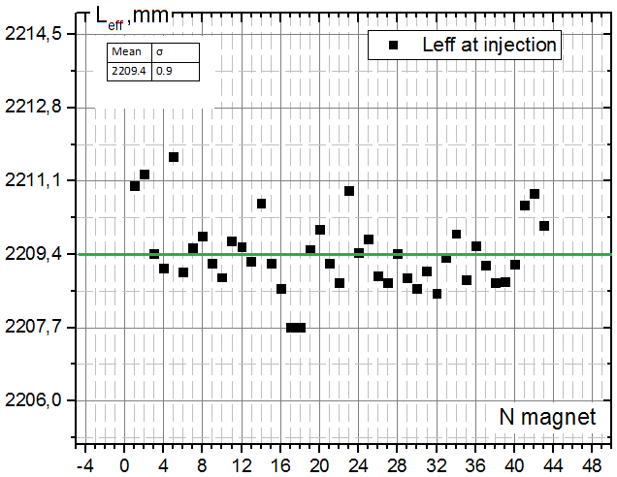
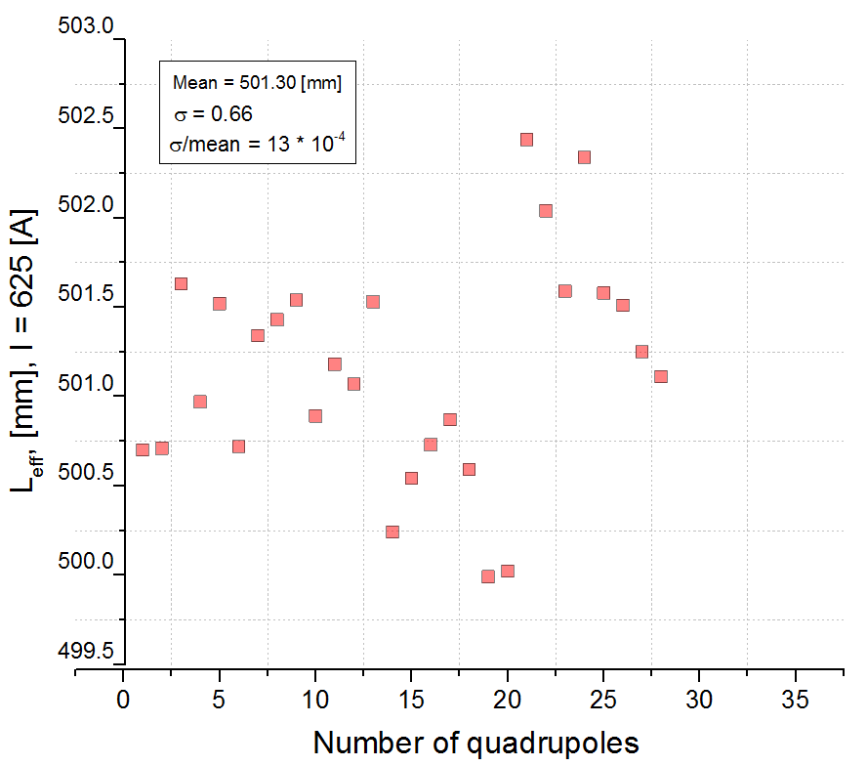
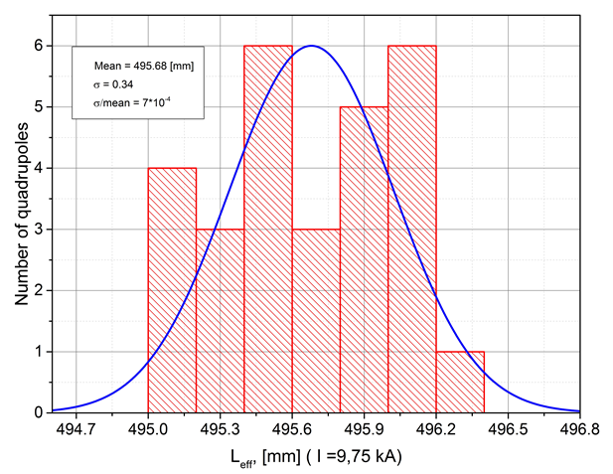
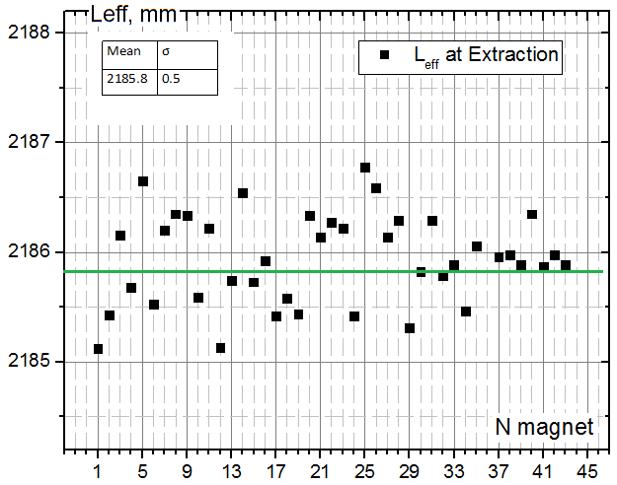
Booster dipoles
Testing results
Booster quadrupoles
Leff. @ 625 A
σrms = 4*10^(-4)
Leff. @ 9745 A
σrms = 2.3*10^(-4)

Slide 9
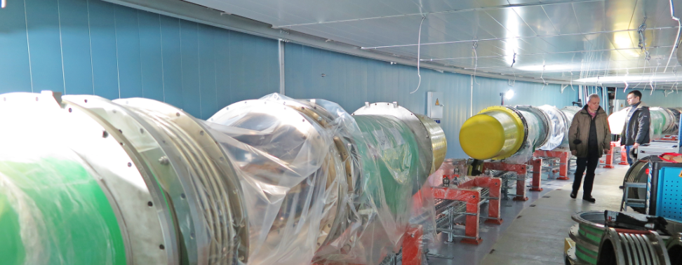
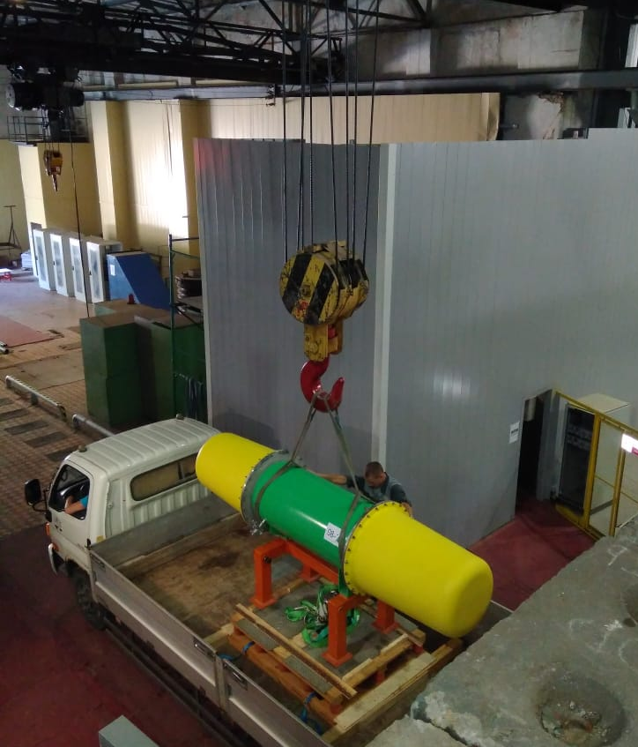
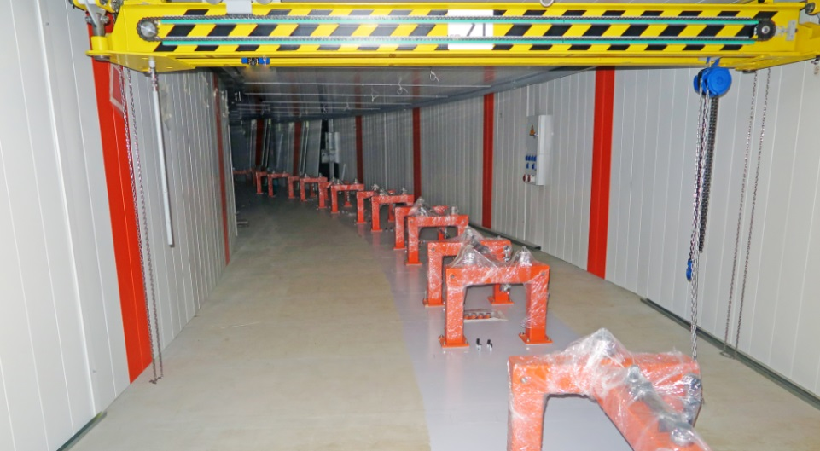
Booster
20 dipoles’ units delivered to the tunnel
Booster (25 Tm)
up to 578 MeV/u
17.01.19

Slide 10
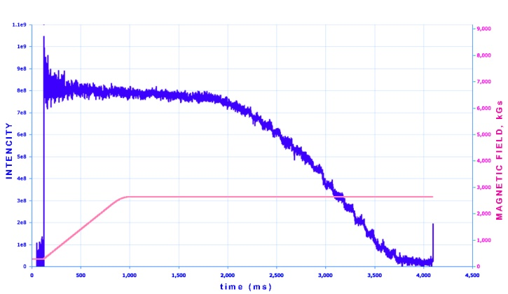
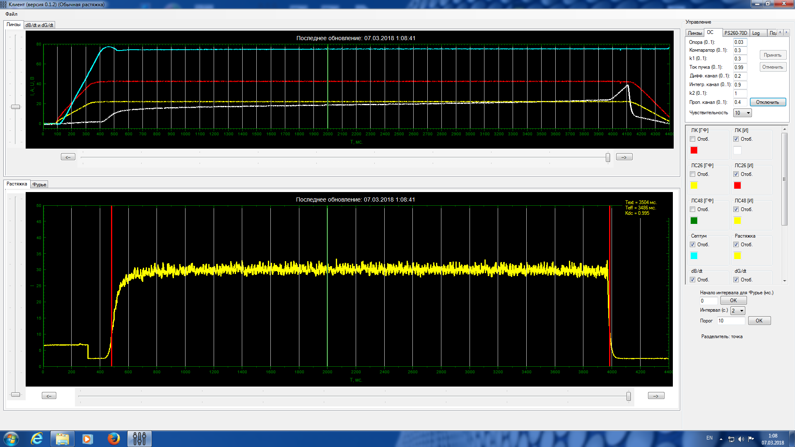
Nuclotron: polarized deuterons and protons
8E8
Routine operation of SPI and new fore-injector
Polarized deuterons acceleration: Intensity up to 2*10⁹ per cycle
Nuclotron: slow extraction
¹²C⁺⁶ beam extraction (3,5 Gev/u) RUN #55 (05.02.18-05.04.18)
¹²C⁺⁶ 5*10⁸ T_{spill} = 4s, k_{dc}= 99,5%
Nuclotron: tasks
for 2020
Acceleration of ¹⁹⁷Au⁷⁹⁺ up to 4.5 GeV/u
Injection system for ¹⁹⁷Au⁷⁹⁺ from Booster at 578 MeV/u
Slow extraction system for ¹⁹⁷Au⁷⁹⁺ at 1 ÷ 4.5 GeV/u

Slide 11
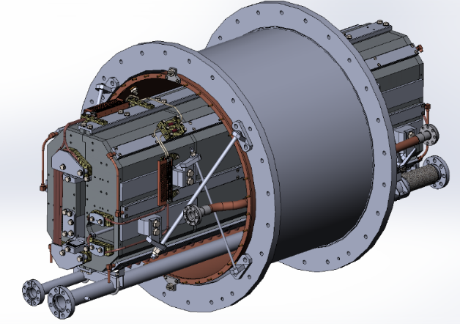
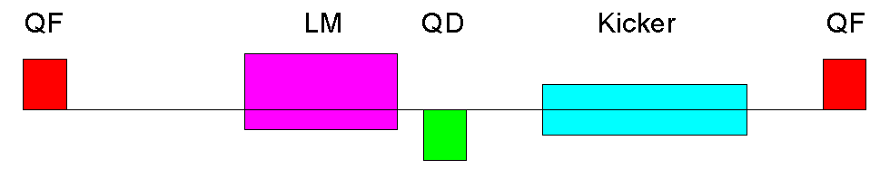
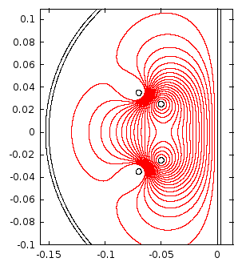
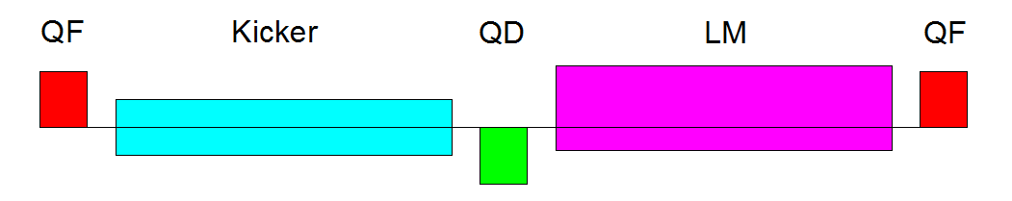
Nuclotron high energy beam injection system
Lambertson magnets are based on existing spare yokes for slow extraction system of Nuclotron
Concept has been developed
Nuclotron fast extraction system
Design of a cold kickers is in progress
Warm prototype for mechanical tests has been manufactured
Nuclotron (45 Tm)
up to
4.5 GeV/u max.
11

Slide 12
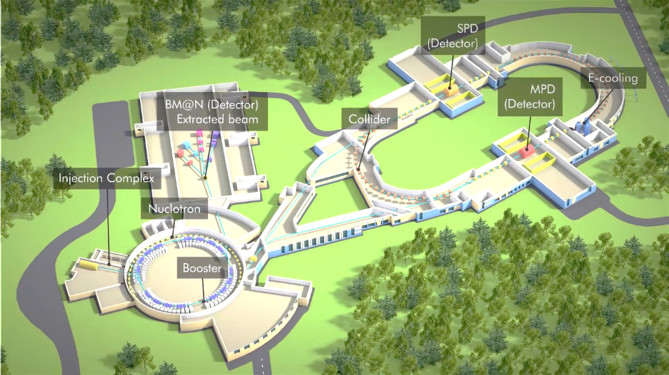
Nuclotron-Collider beam transport channel
Magnetic element | Number | Effective length, m | Max. magnetic field (gradient), T (T/m)
Long dipole | 21 | 2 | 1.5
Short dipole | 6 | 1.2 | 1.5
Quadrupole Q10 | 22 | 0.353 | 31
Quadrupole Q15 | 6 | 0.519 | 31
Steerer | 33 | 0.466 | 0.114
Magnets of the Nuclotron-Collider channel are in development by SigmaPhi.

Slide 13
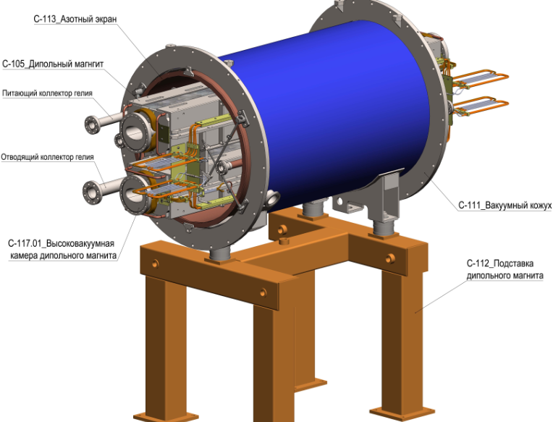
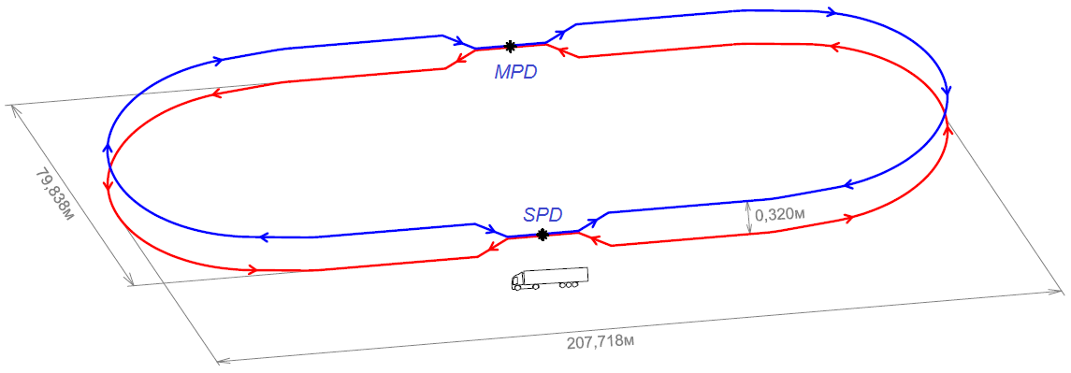
NICA Collider
Nuclotron magnets’ technology
Racetrack of 503.04 m circumference
2 Interaction points
0.32 m vertical beam separation
double-aperture sc-magnets with 1.8 T max field
45 T·m magnetic rigidity
ion kinetic energy range from 1 GeV/u to 4.5 GeV/u for Au⁷⁹⁺
vacuum: 10⁻⁹ Pa;
Average luminosity 10²⁷ cm⁻²·s⁻¹ for gold ion collisions at √s_{NN} = 9 GeV.

Slide 14
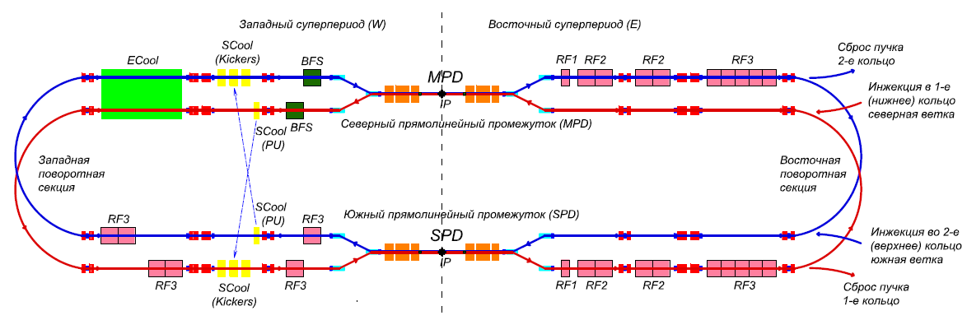
NICA Stage II-a (basic configuration):
1. Injector chain: KRION => Booster => BTL BN => Nuclotron
2. BTL Nuclotron => Collider
3. Collider equipped with
RF-1 (barrier voltage system) for ion storage
RF-2 in a reduced version: 2 cavities per ring instead 4 (50 kV RF amplitude instead 100 kV)
1 channel of S-cooling per ring (cooling of longitudinal deg. of freedom)
Result: 22 bunches of the length σ ∼ 2 m per collider ring that = 5e25 cm⁻²⋅s⁻¹.
NICA Stage II-b (full configuration):
Collider
+ RF-2 systems in the project version
+ RF-3 systems in the project version
+ S-cooling (transverse)
+ E-cooling
Result: 22 bunches of the length σ = β-star = 0.6 m per collider ring that = 1e27 cm⁻²⋅s⁻¹.

Slide 15
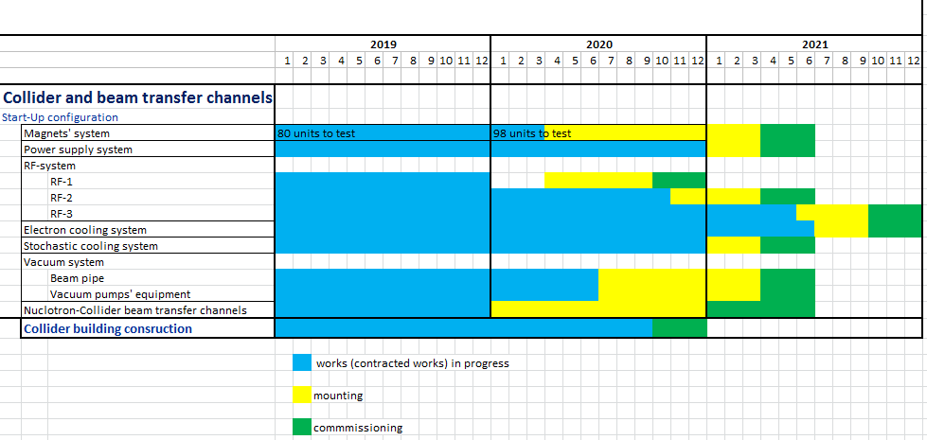
Time-schedule
Collider
IP-2
Collider
L ≥ 10²⁷ см⁻²с⁻¹
IP-1

Slide 16
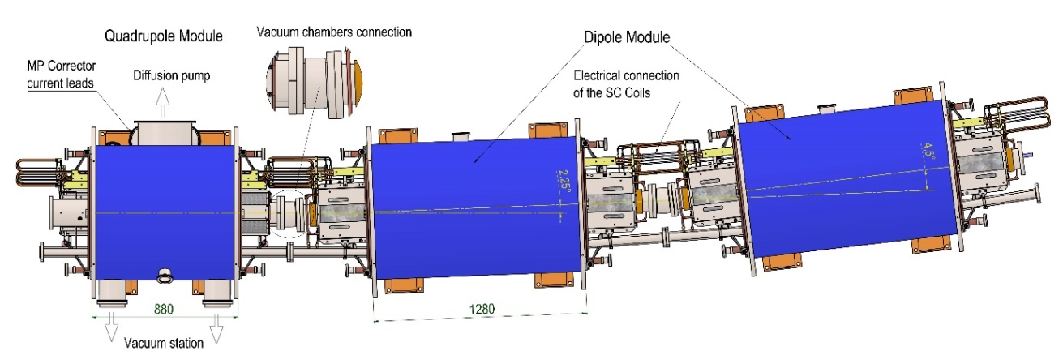
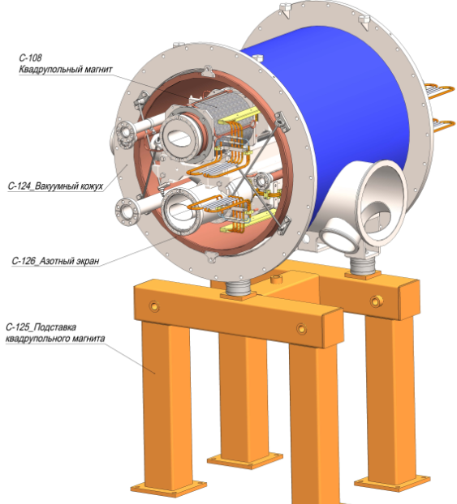
Collider magnets’ system
Assembly and testing
Parameter | Dipole | Lens
Number of magnets | 80+8* | 78+12**
Max. magnetic field (gradient) | 1.8 T | 23.1 T/m
Effective magnetic length | 1.94 m | 0.47 m
Beam pipe aperture (h/v) | 120 mm / 70 mm
Distance between beams | 320 mm
Overall weight | 1670 kg | 240 kg
*- beams vertical elevation dipoles
**- final focus quadrupoles
178 structural sc-magnets to assemble and test

Slide 17
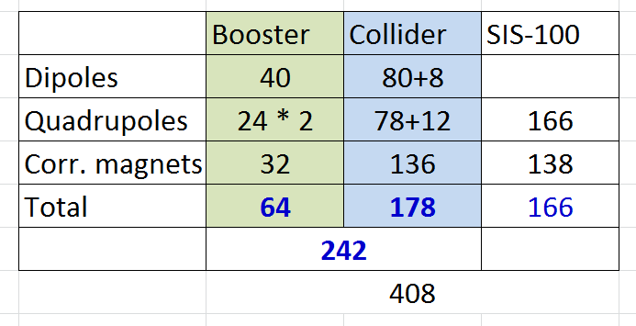
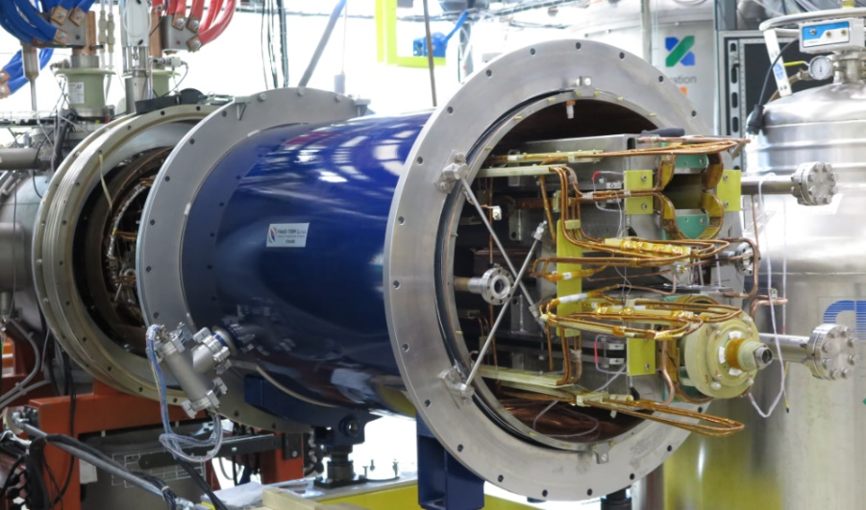
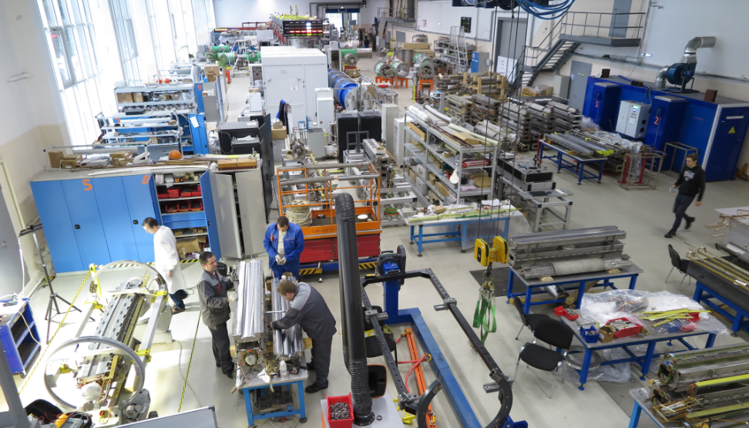
SC-magnets to assembly and testing

Slide 18
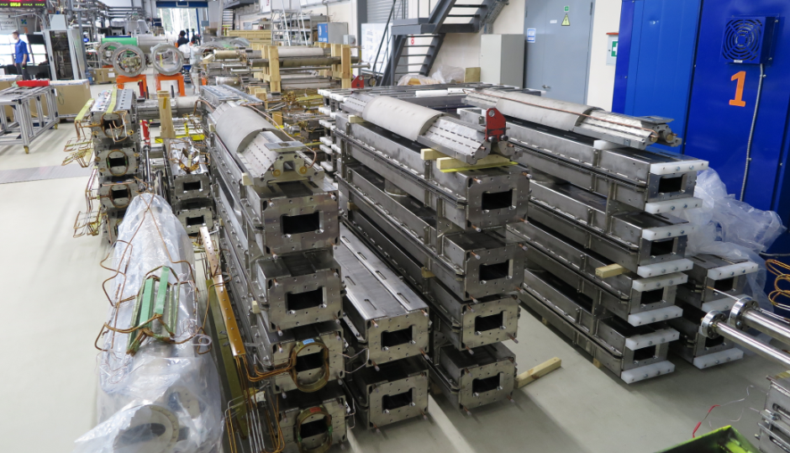
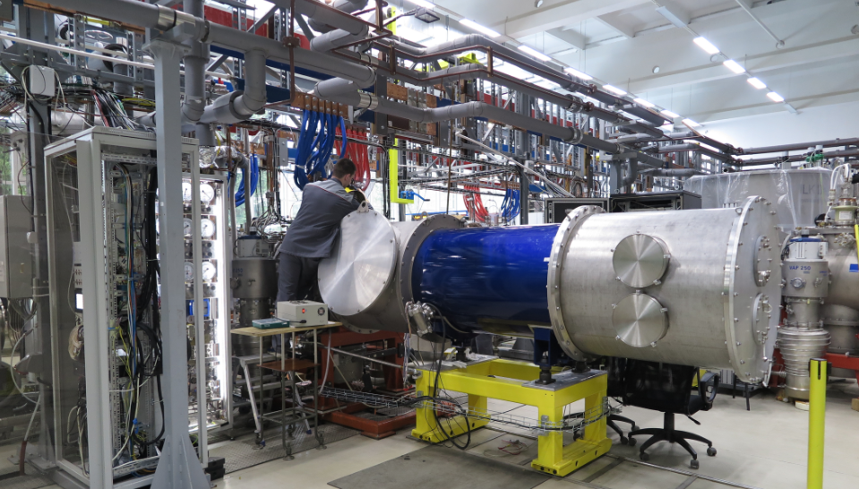
NICA Collider magnets testing
26 dipoles’ yokes delivered to JINR
5 dipoles’ successfully passed cryogenic tests
testing results

Slide 19
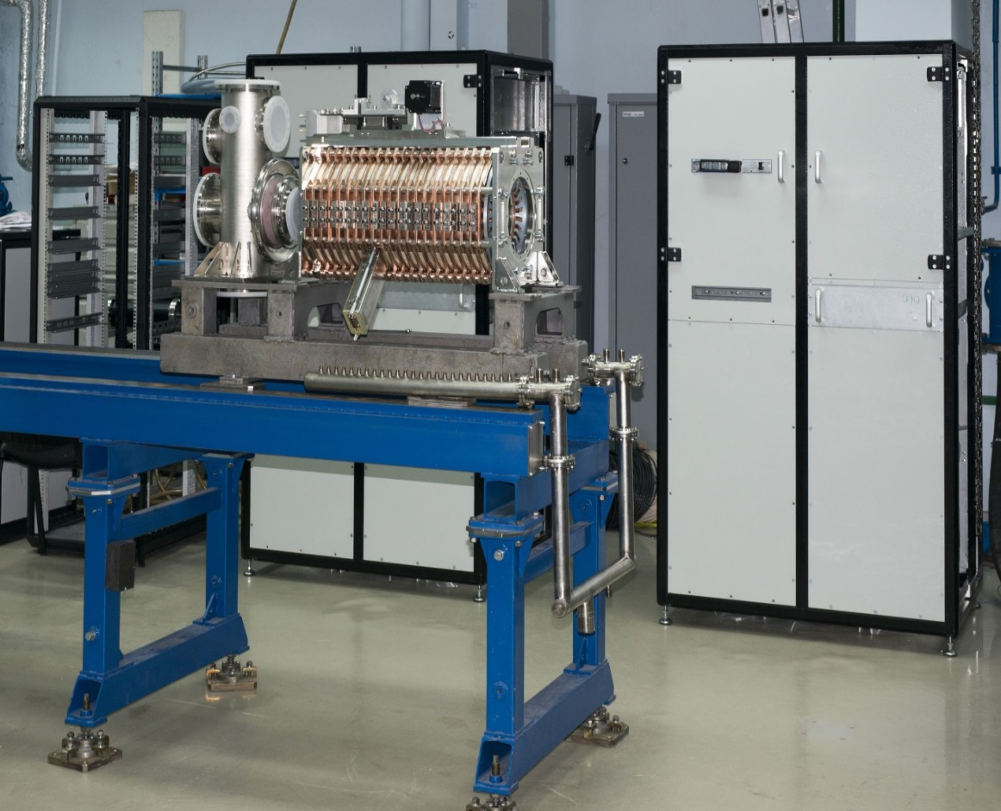
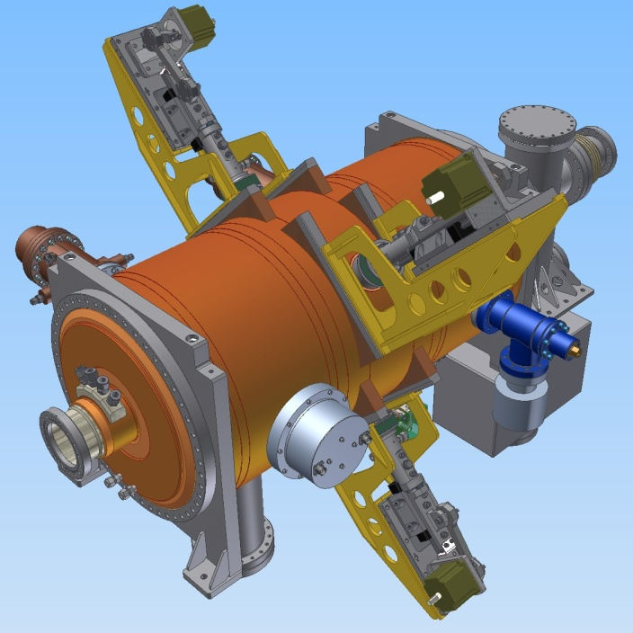
RF-system
RF system for basic configuration is under construction at BINP – 2020
RF system for project configuration is under development at BINP – 2021
RF1 station: preparation for the tests
3D model of RF3 station

Slide 20
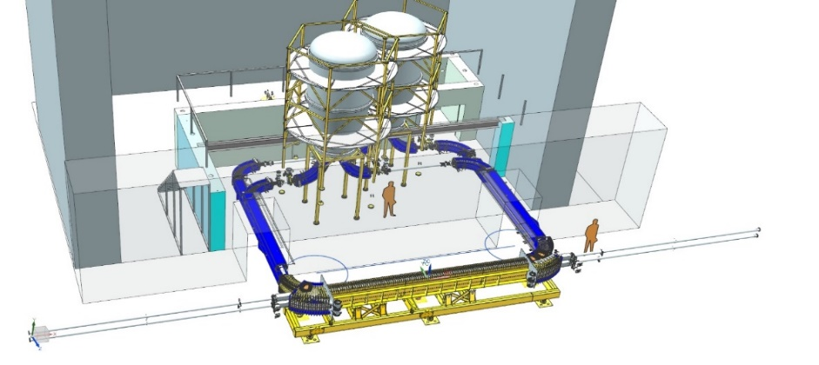
Electron Cooling System of NICA Collider, Ions ¹⁹⁷ Au⁷⁹⁺
HV Electron Cooler for NICA Collider
Design and construction at BINP
Installation at NICA in 2021
together with 4 RF2 and 16 RF3 stations
Parameter | Value
Electron energy, MeV Energy instability, ΔE/E | 0.2 – 2.5 ≤ 1⋅10⁻⁴
Electron beam current, A | 0.1 – 1.0
Cooling section length, m | 6.0
Solenoid magnetic field, T Field inhomogeneity, ΔB/B | 0.05 – 0.2 ≤ 1⋅10⁻⁵

Slide 21
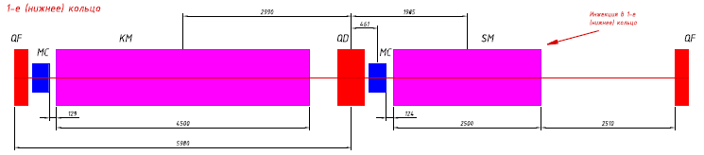
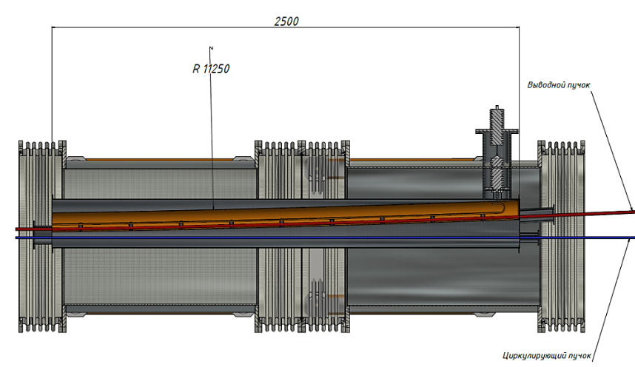
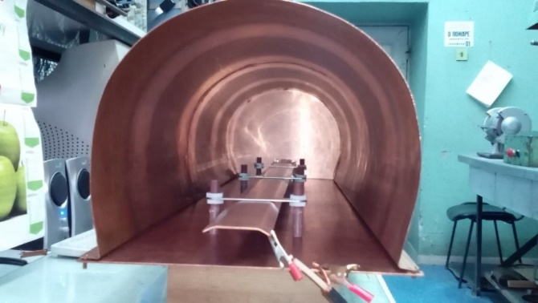
Injection-system
Length, m | 2.5
Max magnetic field, T | 1
Aperture, mm×mm | 45×45
Septum thickness, mm | 3
Pulse shape | semisinusoidal
Pulse duration, μs | ~ 10
Septum
Technical design development is in progress.
Concept of power supply has been developed.

Slide 22
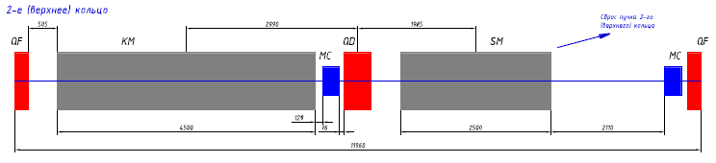
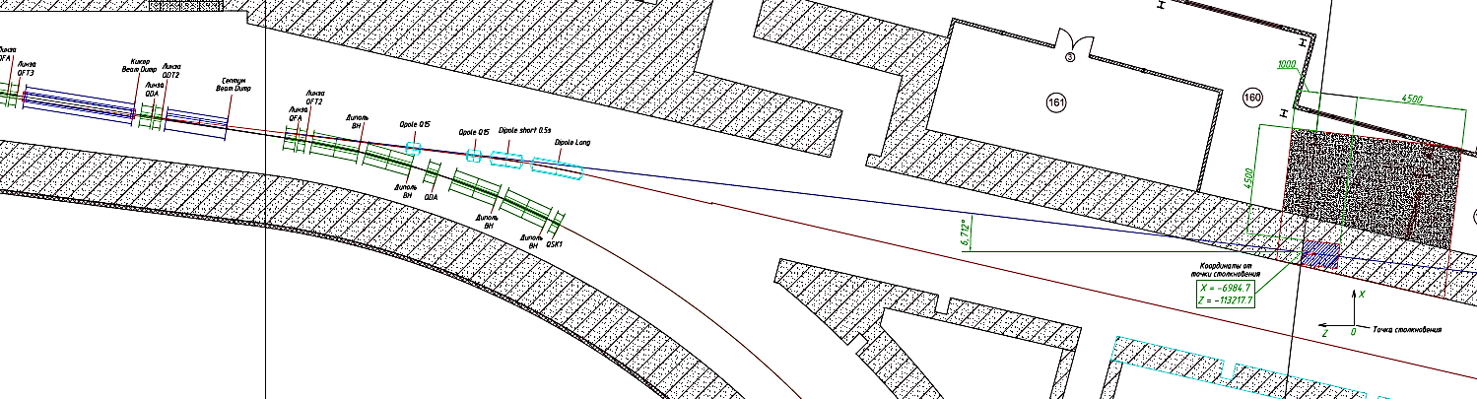
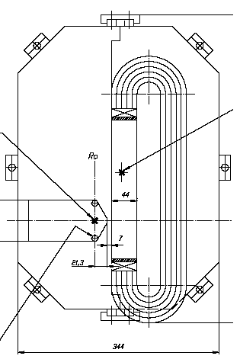
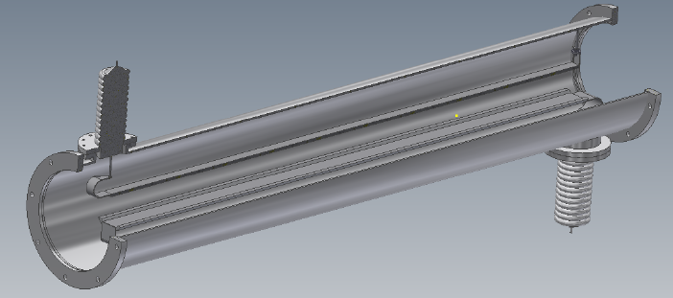
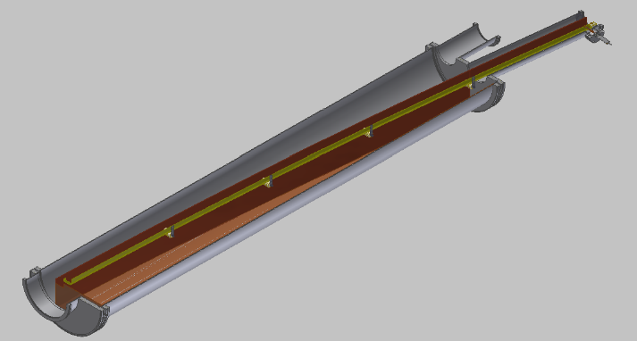
Beam-dump system
Beam dump system – under designing
Kickers
Lambertson magnet
Septa

Slide 23
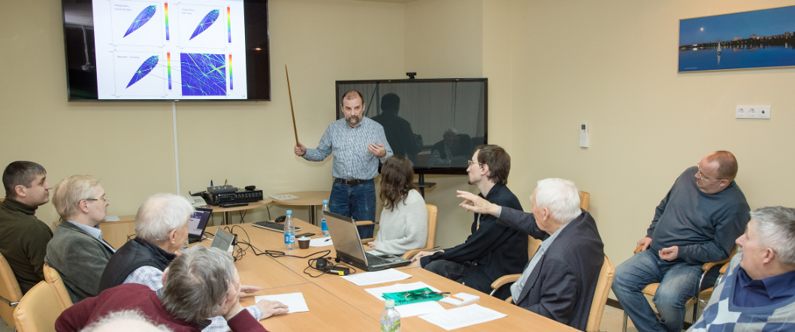
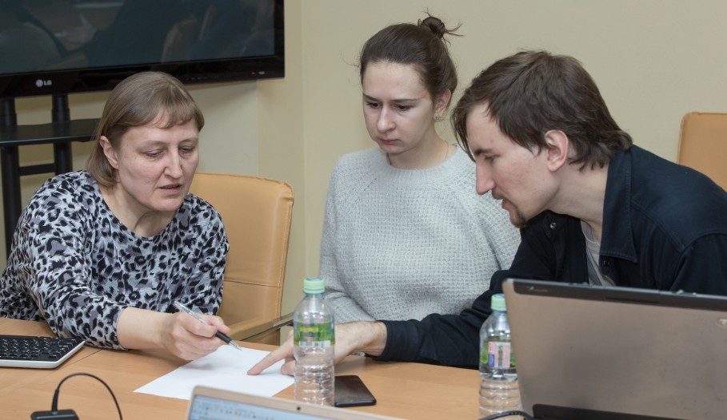
24 of Dec 2018 final annual JINR-BINP-ITEP meeting took part at LHEP
Joint work on the NICA collider physics continued

Slide 24
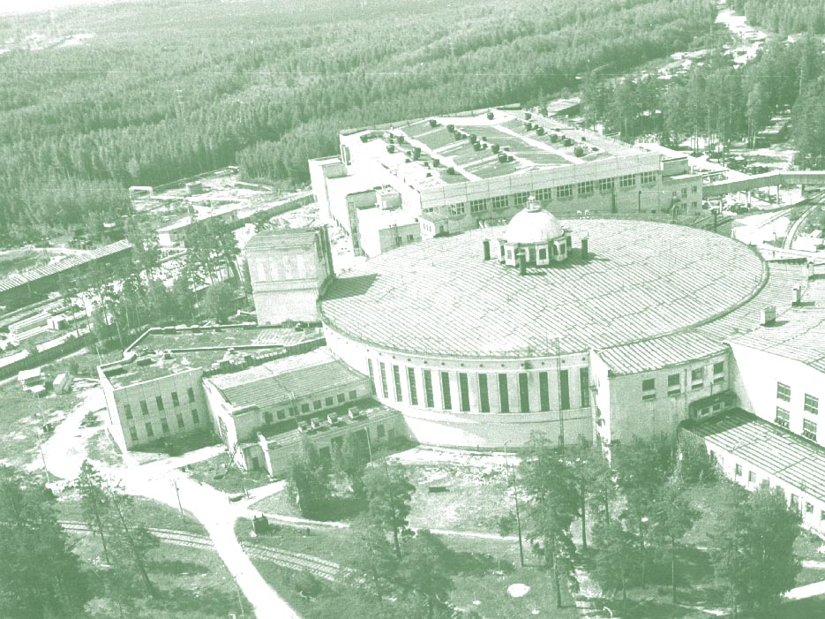
Thank you

Slide 25
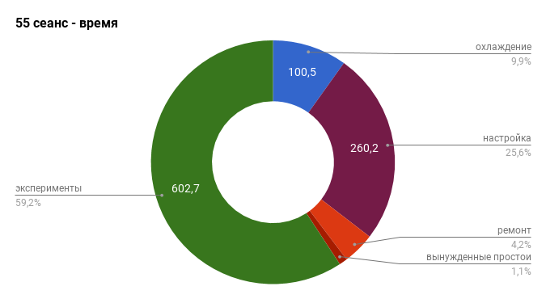
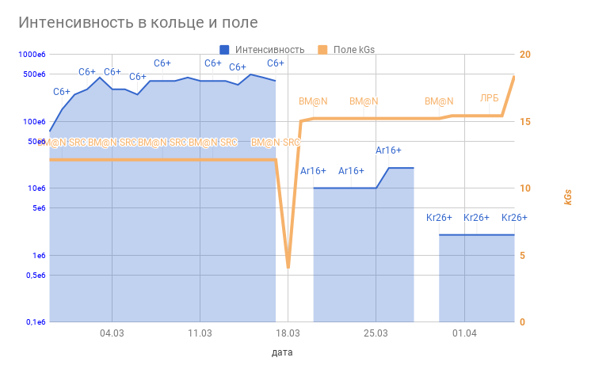

Run 55: February – April 2018
the first run with startup configuration of BM@N
experiment BM@N SRC
30/03/2018
Kr²⁶⁺
0,5
1,0
1,5
2,0
2,5
3,0
s
¹²C BM@N SRC
⁴⁰Ar ⁸⁴Kr BM@N
03.04

