Slide 1
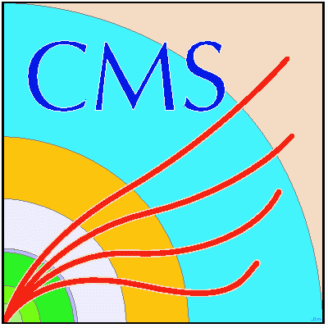


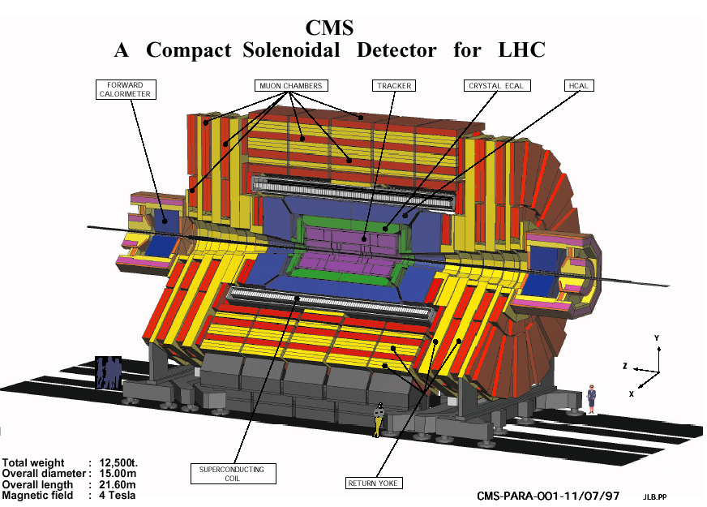
Reports on the Scientific Results
JINR Participation in Compact Muon Solenoid at the LHC
Topic 02-0-1083-2009/2019
Igor Golutvin - scientific leader
Anatoly Zarubin - project leader
Sergei Shmatov - physics coordinator
  Vadim Alexakhin JINR PAC, January 21, 2019
Project “CMS” (2010-2019)
Project ”Upgrade of the CMS Detector” (2013-2020)

Slide 2
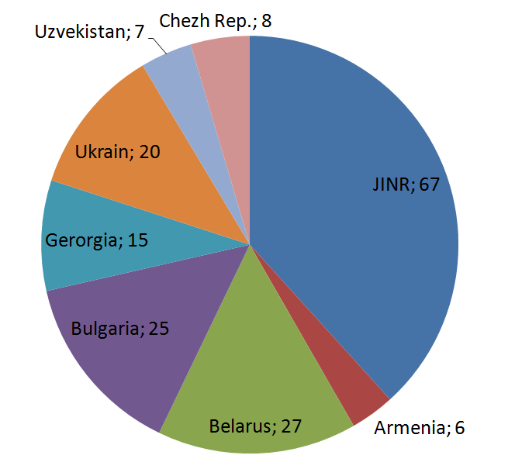
Outline
JINR Participation in Data Taking and CMS Operation
JINR Participation in CMS Physics Analyses
  Tests of the Standard Model
    Drell-Yan
    Physics with jets (calibrations, charge multiplicity studies etc.)
  Search for New Physics Beyond the SM
    Physics with dimuons (Z’, KK modes of gravitons)
    New physics in a multijet channel
Computing and Data Processing
Participation in CMS Upgrade Programme
Summary
67 participants from JINR
108 participants from JINR member states
14 paid authors and 4 unpaid authors (Ph.D.)
from JINR
10 paid authors and 1 unpaid authors (Ph.D.)
from JINR member states

Slide 3
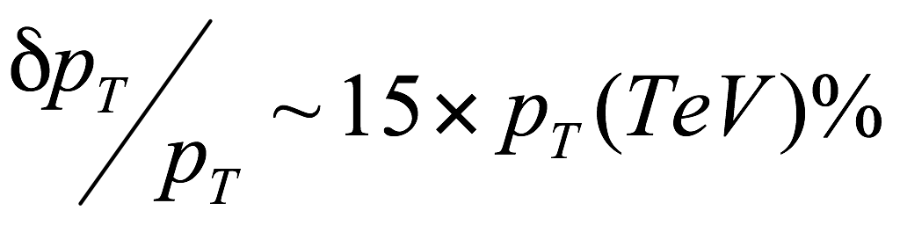
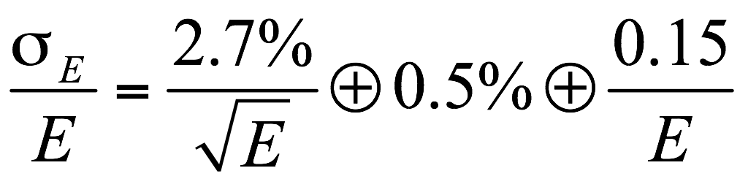
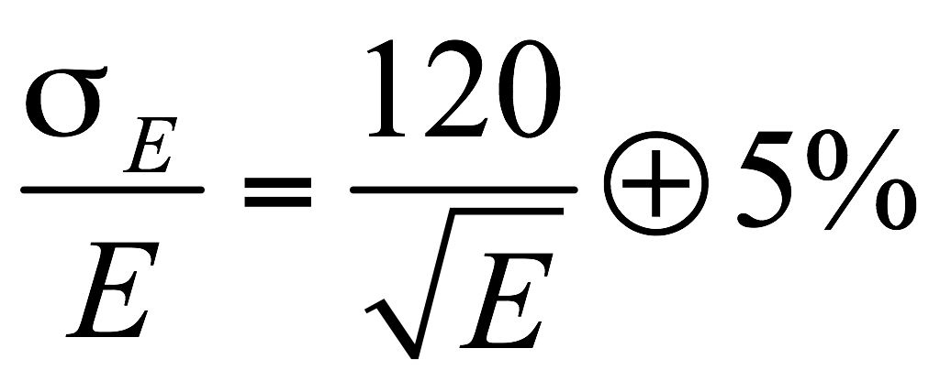
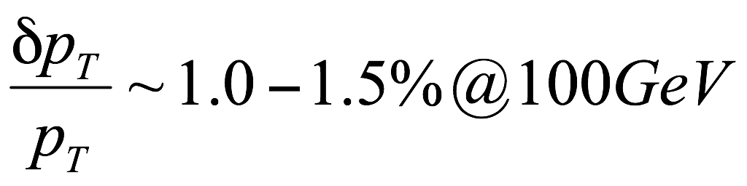
Compact Muon Solenoid - CMS
Silicon Tracker
Detector subsystems are designed to measure: the energy and momentum of photons, electrons, muons, jets, missing E_{T} up to a few TeV
Forward Calorimeter, HF
Muon Chambers
Tracker
Electromagnetic calorimeter, ECAL
Hadron calorimeter HCAL
PbWO₄ ECAL
sampling brass HCAL
weight - 14500 t
diameter – 14.60 m,
length – 21.60 m,
B-field – 3.8 Т
MUON Chambers
Superconducting Coil
diameter 6 m, length 13 m
Return Yoke

Slide 4
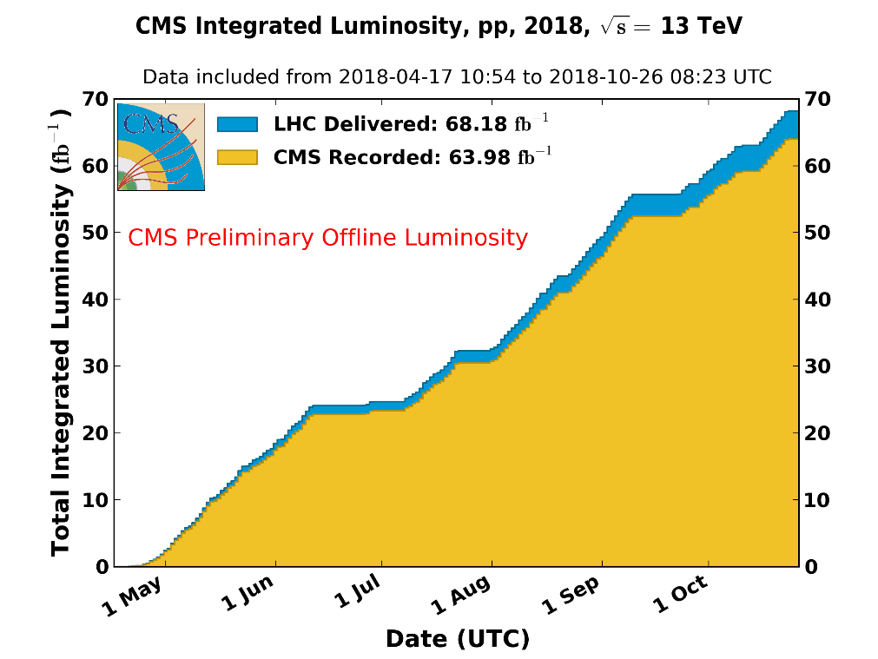
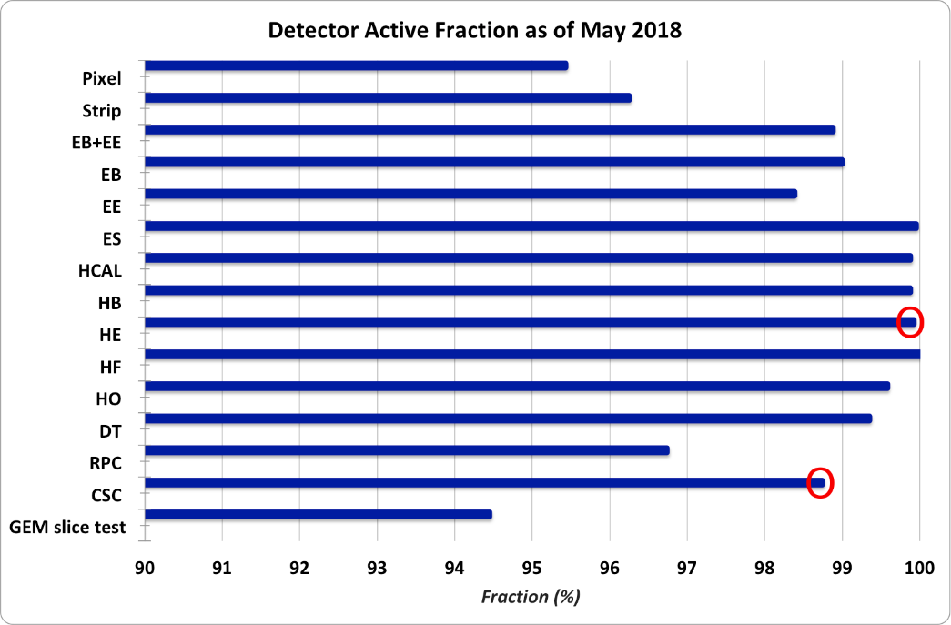
Run II Data Taking (2018)
Data Taking
Experimental data on pp-collision:
  √s=13 TeV – 68.18 fb⁻¹ delivered by LHC
94% - average data taking efficiency
95% of recorded luminosity was used for
the physics analysis (depends of scenario)
pp-collisions
L_{max} ≈ 2.1x10³⁴cm⁻²s⁻¹
140 detector shifts by JINR (43 remote)
Sub-Detectors Operations
Operation efficiency of detector systems
including detectors of full RDMS
responsibility (Endcap Hadron
Calorimeter & Forward Muon Stations)
was very high

Slide 5
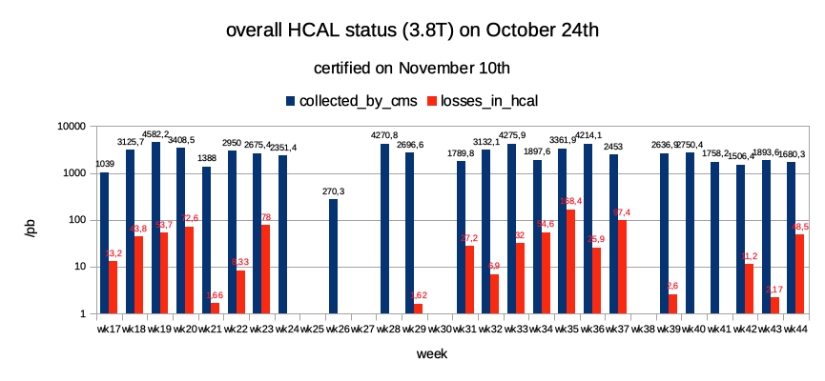
Data certification for HCAL
In 2018 JINR CMS group also leaded in data quality monitoring and data certification process for CMS hadron calorimetry
  full year coverage for data quality monitoring “day shifts” (EU daytime) by RDMS shifters and experts from JINR ROC (remote operational center) and RDMS ROCs (Erevan, Moscow, Protvino)
  full year data certification (proton-proton and heavy ions interactions, data reprocessing) by JINR expert
Data certification based on proper amplitudes of signals and capacitors rotations control, correct signals digitizing and reconstructing, SiPM parameters monitoring, etc.
Losses/recorded pp-collisions data week by week for 2018 (in log scale)
From the recorded CMS data (~64 fb-1) ~99% were selected as satisfying the data taking condition for CMS hadron calorimetry (good/bad for physics). Means losses due to HCAL issues are ~1% only. Efficiency of muon system is about 98%
In addition, after the data certification from all subsystems of the CMS detector, 95% were selected as satisfying the data taking conditions of the CMS detector as a whole.
5

Slide 6
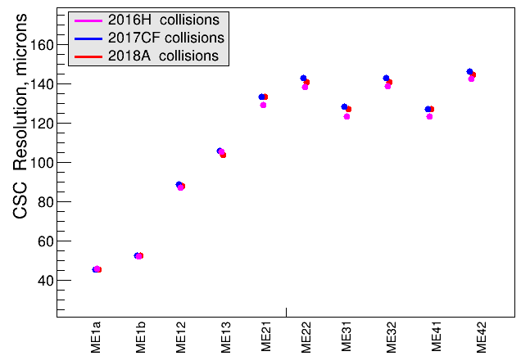
Study of the CMS CSC spatial resolution in p-p collisions
The cathode strip chambers (CSCs) are the part of the CMS Endcap muon system. There are 540 CSCs of different types and sizes composing 4 ME stations.
The Endcap muon system has been upgraded during LHC long stop period (LS1, 2013-2014). That time ME4/2 station has been installed and ME1/1 CSCs were equipped with the newer, faster readout electronics.
The CSC spatial resolution study has been done during the Run2 data taking period.
The presented results show that the spatial resolution in 2016-2018 period was stable.
6

Slide 7
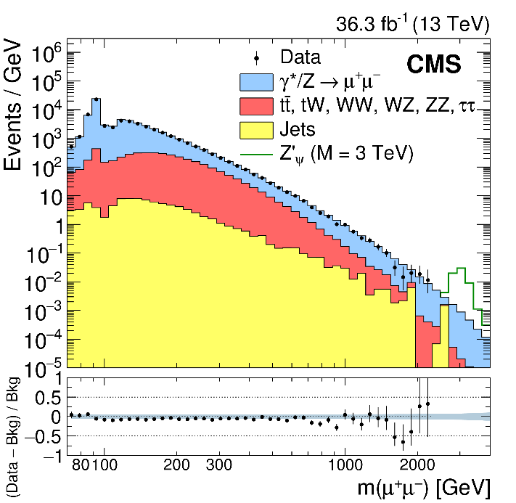
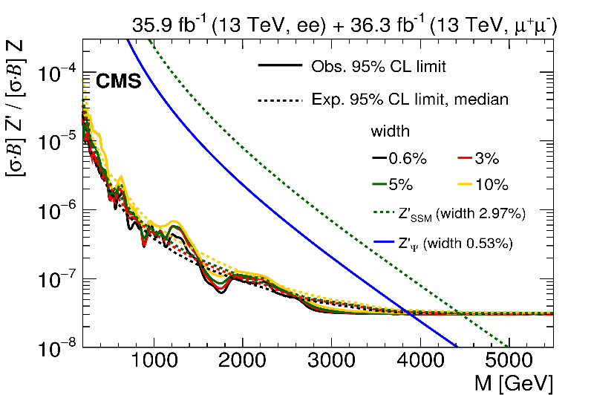
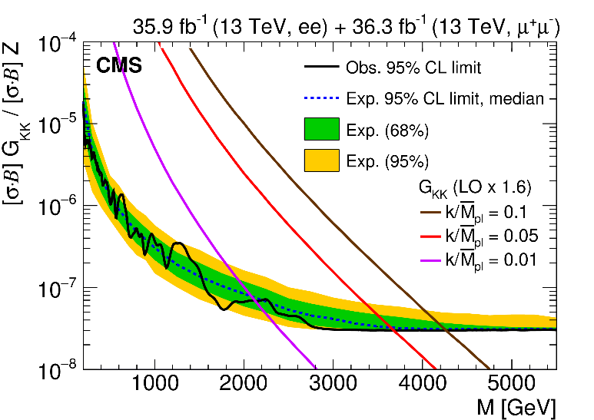
Search for New Physics with Di-Muons
In 2018 JINR CMS group concentrated on data processing and analysis @ 13 TeV within few selected physics topics
  studies of Drell-Yan pair production to verify the Standard Model predictions for the new energy region
  searches for signals of new physics beyond the SM: new resonance states in dimuon channel and TeV-scale gravity in multiparticle production
Extra gauge bosons mass limits:
3.9 - 4.5 TeV
JHEP 1806, 120 (2018)
Drell-Yan mass spectrum
KK-graviton mass limits: 2.1 – 4.25 TeV
2 PhD St (from JINR)
7

Slide 8
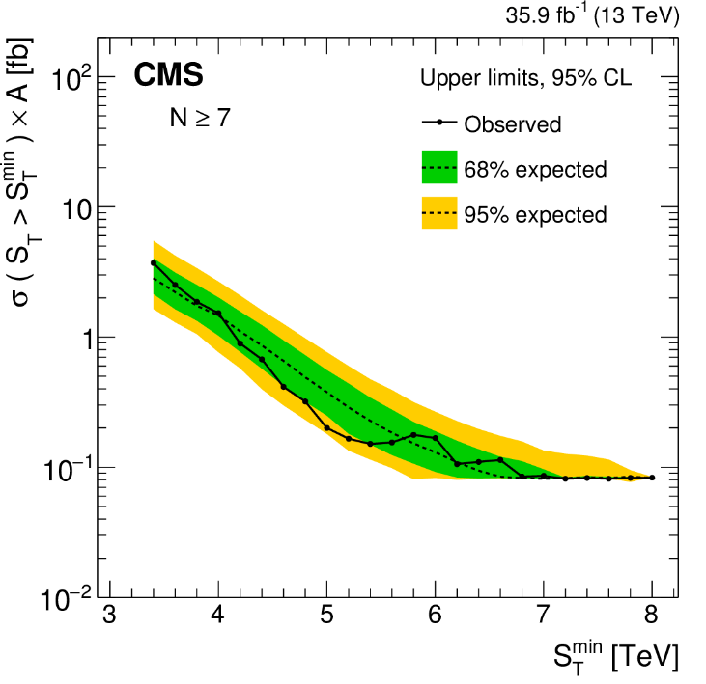
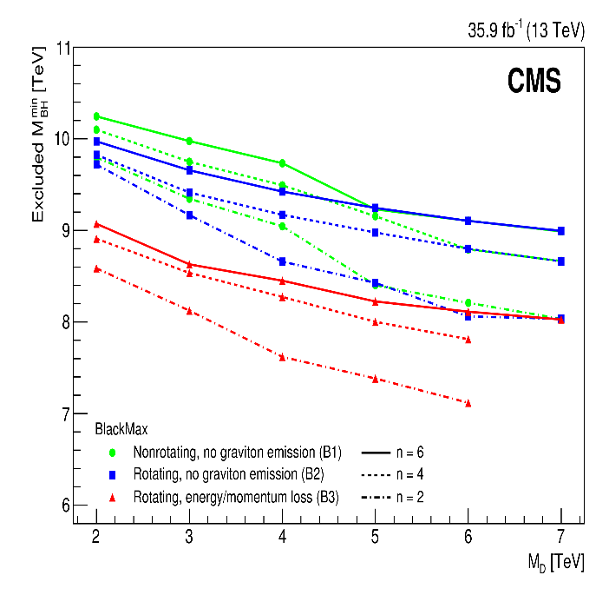
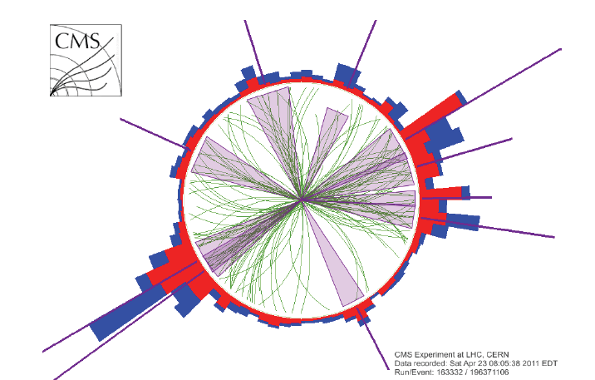
Search for New Physics with Multi-Jets
Upper limits at 95% CL on the multijet production cross section: N ≥ 2–11
In channel with high-multiplicity final states semiclassical black are excluded by this search.
The discriminating variable between a signal and a dominant QCD multijet background is the scalar sum of the transverse energies of all reconstructed objects in the event, S_{T}
JHEP 11, 042 (2018)
Jets, photons and leptons,
E_{T} > 50 GeV, missing E_{T} > 50 GeV
we exclude minimum microscopic black holes masses below 7.0–10.5 TeV
The JINR group is participates in this CMS analyses (and initiates this work in part) since 2009.
1 PhD St + 1 MSc (from JINR)

Slide 9
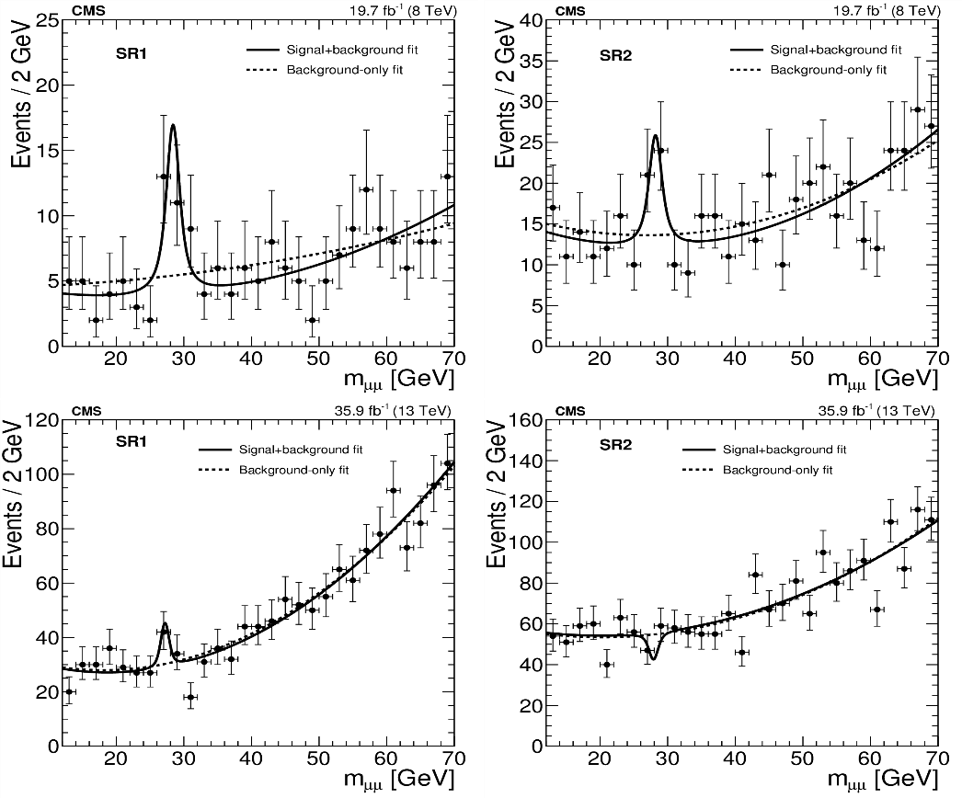
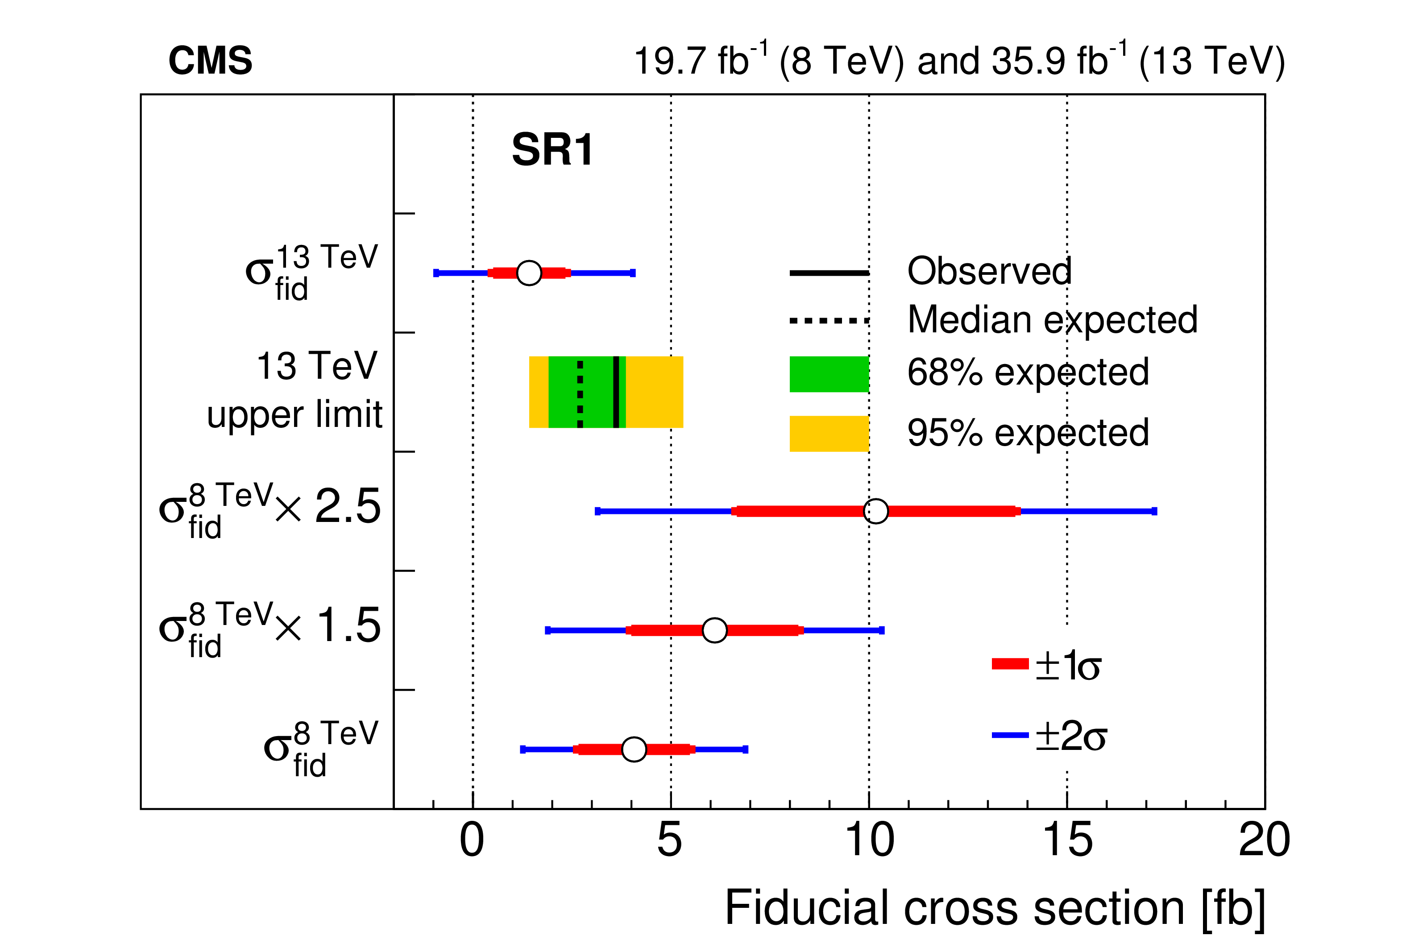
Search for Low-mass Resonances with CMS
In 2018 JINR CMS group also contributed in search for resonances in the mass spectrum of muon pairs produced in association with b quark jets
an excess of events above the background near a dimuon mass of 28 GeV is observed in the 8 TeV data, corresponding to local significances up to 4.2σ and 2.9σ for two mutually exclusive
b-quark event categories
similar analysis conducted with the 13 TeV
data results: in the first event category
corresponding to a local significance of
2.0σ, while the second category results in
a 1.4σ deficit
The fiducial cross section and 95% confidence level upper limits
JHEP 11, 161 (2018)
In the lack of a realistic signal model, the 13 TeV results are not sufﬁcient to make a deﬁnitive statement about the origin of the 8 TeV excess. Therefore, more data and additional theoretical input are both required to fully understand the results presented in this paper.
1 PhD St (from JINR)
9

Slide 10
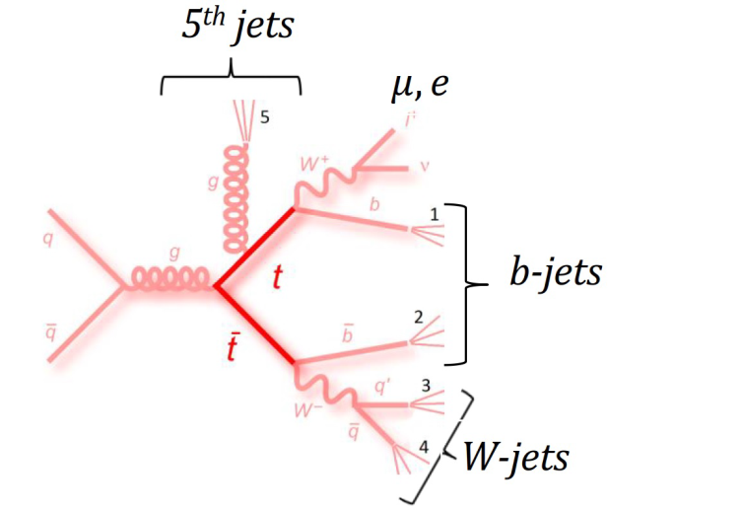
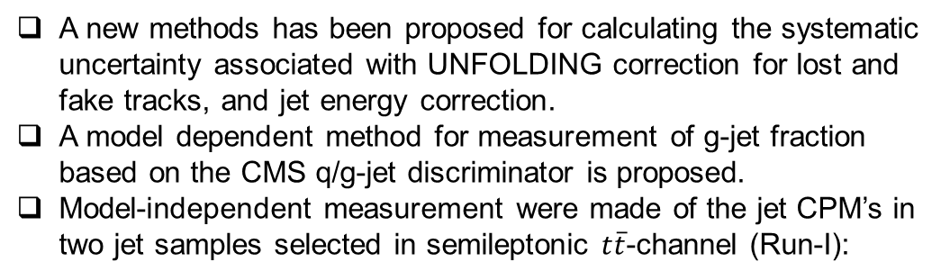
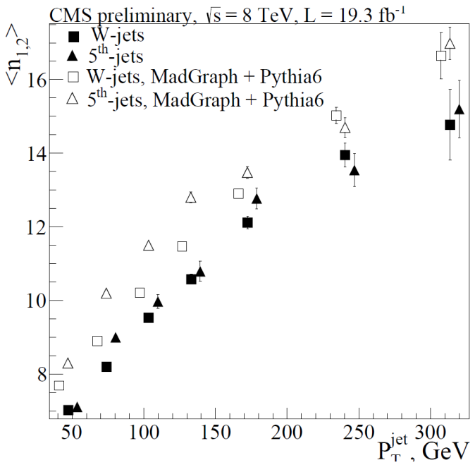
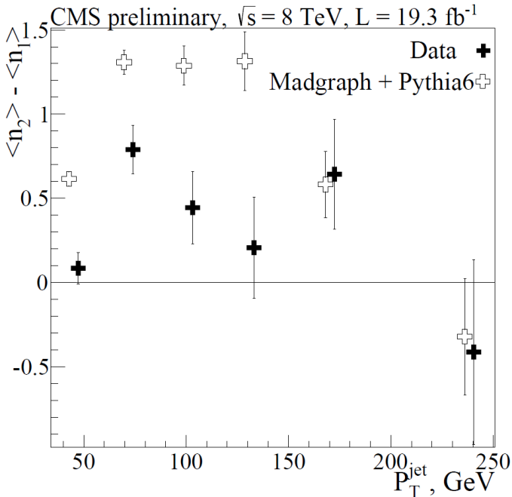
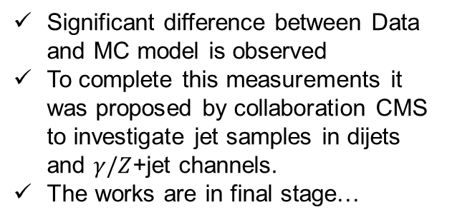
Measurement of particle multiplicity in jets with CMS
CMS group continued methodical works and measurement of jet
properties related to Charged-particle multiplicity (CPM) in jets:
Fig. 1: Mean jet CPM’s in q- and g-enriched jets. Data – full markers, MC – empty markers.
Fig. 2: Difference of mean jet CPM’s between q- and g-enriched jets.

Slide 11
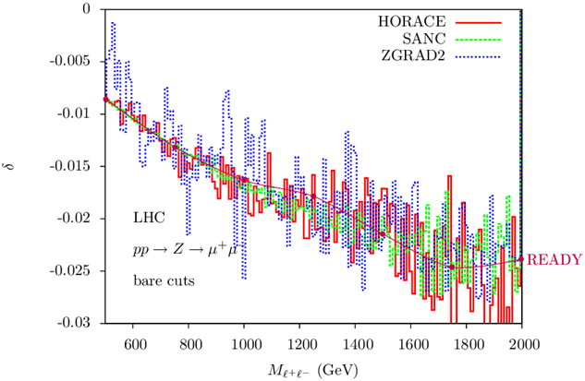
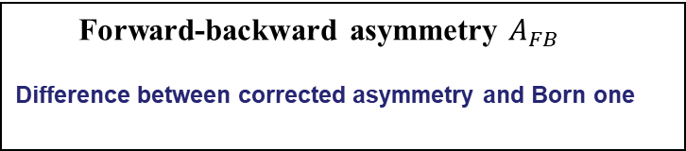
Radiative corrections for the Drell-Yan process
Drell-Yan cross section
Relative correction to cross section
Forward-backward asymmetry $A_{FB}$
Difference between corrected asymmetry and Born one
Invariant mass of dilepton
“Electroweak high-order corrections for Drell-Yan processes at LHC”, PEPAN 49, 1267 (2018).
11

Slide 12
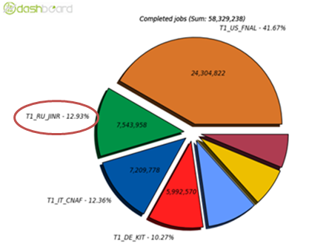
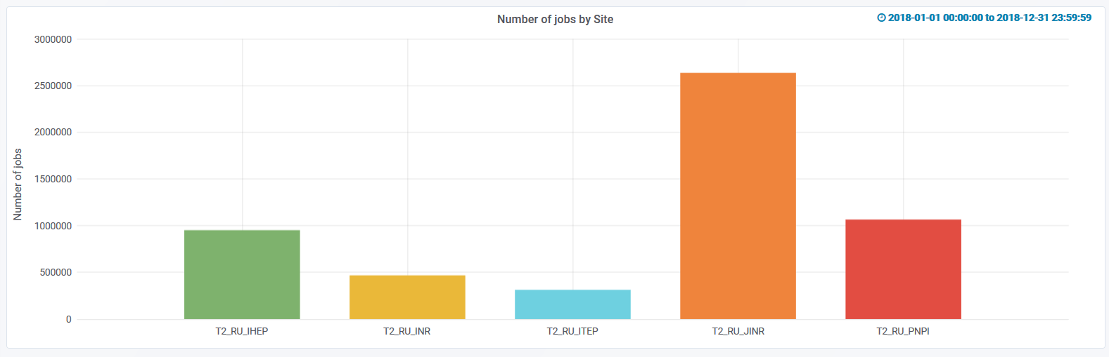
Reconstruction and Computing
The development of the CMS experiments data processing system is developed in parallel with the Physics and Upgrade Programs.
It is necessary to provide the experiments with the long-term storage petabytes of data and the facility to process and analyze the data.
The JINR are actively involved in study, utilization, and development of both the Tier-1 and Tier-2 sites to ensure full-scale participation in CMS data processing and analysis for the JINR physicists, JINR Member States, and whole RDMS CMS Collaboration.
JINR Tier-1/Tier-2
are stable and relevant
JINR Tier-1 provides ~12.9% of Tier-1 CMS performance (completed jobs)
JINR Tier-2 provides above 59% of RDMS Tier-2 Computing facilities (completed jobs)
12

Slide 13
The JINR Group Results of 2018
2015-2018 data @ 13TeV (up to ~ 36 fb-1)
  Search for High-Mass Resonances Decaying to Dilepton Pairs in pp Collisions at 13 TeV (JHEP 1806, 120 (2018), JINST 13, P06015 (2018), CMS AN-2018/011)
  Search for Microscopic Black Holes at 13 TeV (JHEP 11, 042 (2018))
  Drell-Yan pair production: x-sections, AFB etc. (CMS AN-2018/192)
  Low mass resonance µ+µ- decays with b-jets (JHEP 11, 161 (2018))
18 authors from JINR (4 PhDs) + 11 from DMS
3 public papers and 3 CMS Analysis Notes
3 review papers
19 talks for the CMS (5 talks by the PhD stud.)
Above 202 papers were published in J. High Energy Phys, Phys. Rev. Lett., Phys. Lett. B, Eur. Phys. J. based on data of Run1-Run2
2012 data @ 8TeV analyses were fully completed (up to ~ 20 fb-1)
  except for charged-particle multiplicities in quark and gluon jets at 8 TeV (not approved yet)

Slide 14

Our life with LHC
2011-2013:
  Energy per beam 3.5 – 4 TeV → Low Lumi CМS Detector
  Integrated luminosity ~ 30 fb⁻¹ → main result - discovery of Higgs Boson
2013-2015:
  Long shutdown1 (20 months)→ 6.5TeV, luminosity 10³⁴сm⁻²s⁻¹
2015-2016:
  Run 2. Integrated luminosity 37.8 fb⁻¹. Energy per beam 6.5 TeV
2017-2018:
  Run 2. Integrated luminosity reached 160 fb⁻¹
2019-2020:
  Long shutdown2 (18 months), luminosity 2-3x10³⁴ сm⁻² s⁻¹ End of Phase 1
2021-2023:
  Run 3. Integrated luminosity 300 fb⁻¹
2024-2025:
    Long shutdown3 (30 months ), luminosity 4-6x10³⁴ сm⁻² s⁻¹
    → High Lumi CМS Detector – Phase 2
2026-2029
    Run 4. Integrated luminosity 3000 fb⁻¹
Today

Slide 15
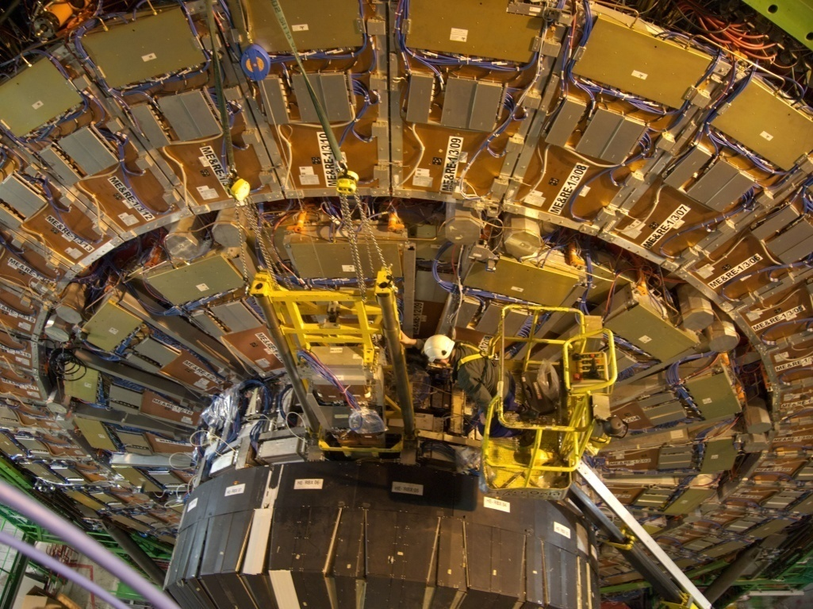
Participation in CMS Upgrade Program
EYETS2018(Jan-Apr): Within the JINR Project “CMS Upgrade up to 2020” (phase I) upgrade works have been performed to enable effective operation of experiment at high luminosity 1–2×10³⁴sm⁻²s⁻¹ and nominal LHC energy up to 14 TeV
  Upgrade of HE was completed (installation and tests of new electronics, silicon photomultipliers (SiPM) ).
Phase II: Upgrade to enable effective
operation of experiment at very high
luminosity 5×10³⁴sm⁻²s⁻¹ and integrated
luminosity up to 3–5 ab⁻¹ (attobarn physics).
  Endcap Hadron Calorimeter
    Studies of radiation field in HE
    Studies of scintillator macrotile
    Software development
    Optimization of future hadron
    calorimeter segmentation
  Forward Muon Station
    Longetivity test ME1/1 CSC at
    GIF++ irradiation facility for HL LHC
.
15

Slide 16

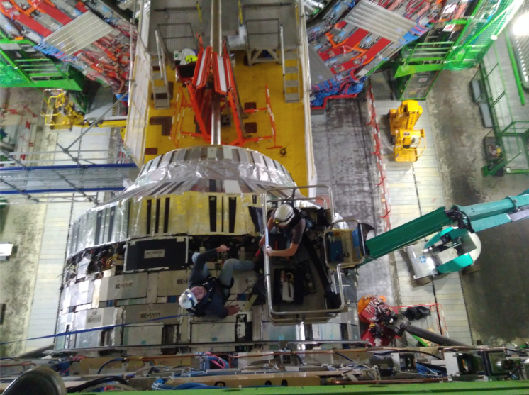
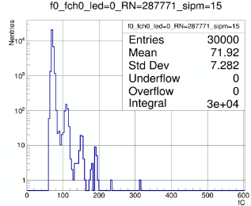
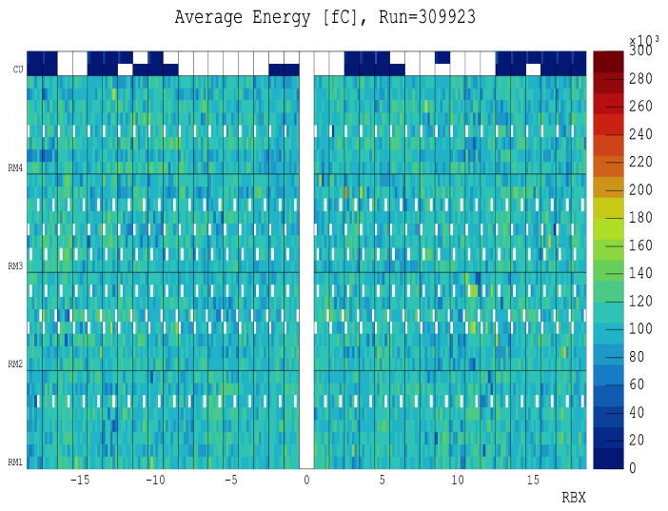
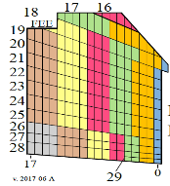
HCAL Phase 1 upgrade
In EYETS 2018 (Jan-April) JINR CMS group has contributed on Hadron Endcap (HE) electronics upgrade under Phase 1 program
  New electronics components based on SiPM (silicon photomultipliers) instead of used HPD (hybrid photodiode) have been assembled and tested on specialized test-stand
  All test-passed SiPMs modules have been installed on HE and commissioned with cosmics, splash and Co60 radioactive source data
Mean signal distribution for entire HE
Installation process
Dark-current spectra for a single SiPM
Commisioning showed that the Hadronic Endcap was ready for proton-proton and heavy ion data.
During 2018 data-taking HE showed solid running. New components provide higher calorimetry granularity, have two-three orders of magnitude higher gain than HPD, also have better radiation hardness in strong radiation fields.
New readout segmentation of HE
Phys. Part. Nucl. 48 , 5 (2017) 748-751
JINST Volume 12, P12034
16

Slide 17
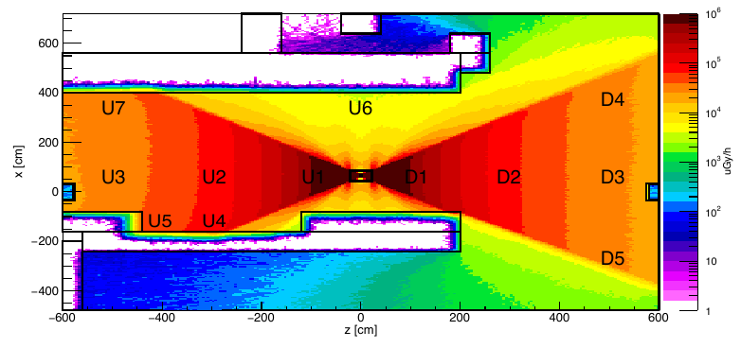


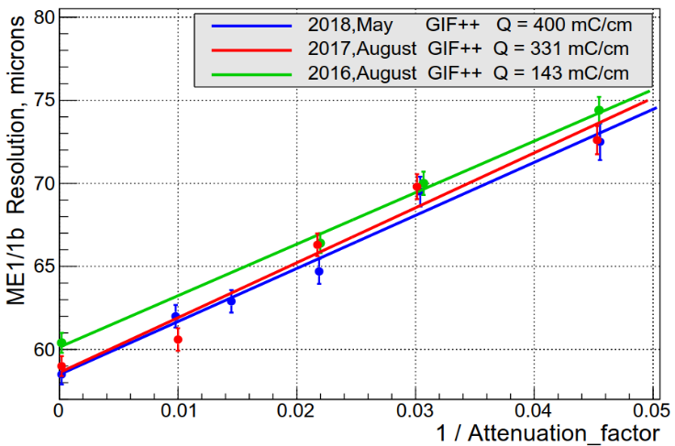
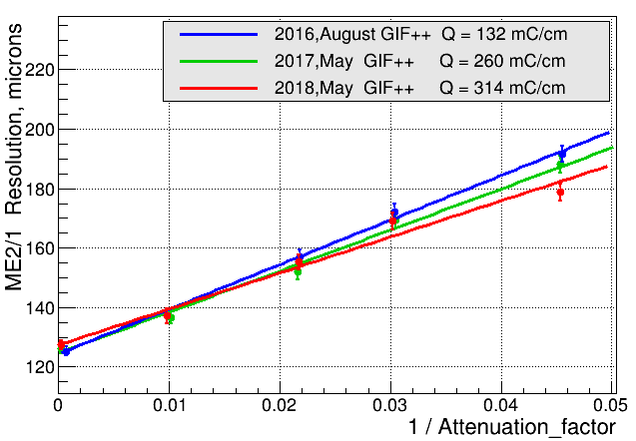
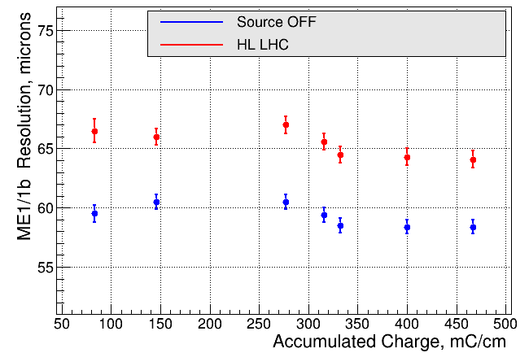
Study of the degradation of the CSC spatial resolution with high background rates and large accumulated charge at GIF ++ setup
GIF++ irradiation intensity map
Gamma Irradiation Facility (GIF++) built in 2015 at the CERN SPS North Area. At this facility the detectors could simultaneously be exposed to the photons from the 14 TBq Cs¹³⁷ γ-source and to a high-energy SPS muon beam.
For the CSC longevity studies the two spare chambers of the two most background populated stations ME1/1 and ME2/1 were taken.
Also the CSC operation vs uncorrelated background rate has been studied.
DT
RPC
ME1/1
GE1/1
ME2/1
4×HL LHC
HL LHC
HL LHC
CSC spatial resolution vs. GIF++ source intensity (the inversed value of gamma attenuation factor as x).
The arrows mark the source intensities corresponding to the operation with HL LHC where the expected degradation of the spatial resolution for ME1/1 and ME2/1 is not critical - 10% and 16% correspondingly.
ME1/1 spatial resolution vs accumulated charge in 2016-2018 measured with source off (blue) and calculated for HL LHC conditions (red). For the accumulated charge equivalent to 4 HL LHC periods (1/Attenuation factor = 0.018) no spatial resolution deterioration observed.
17

Slide 18
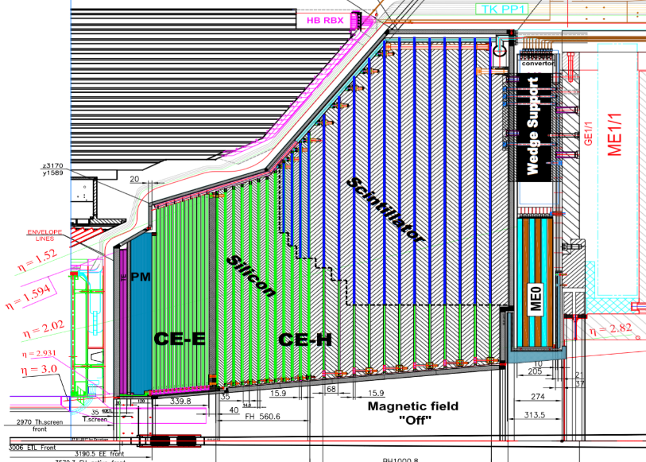
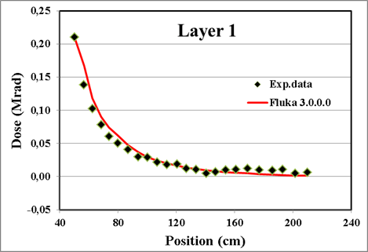
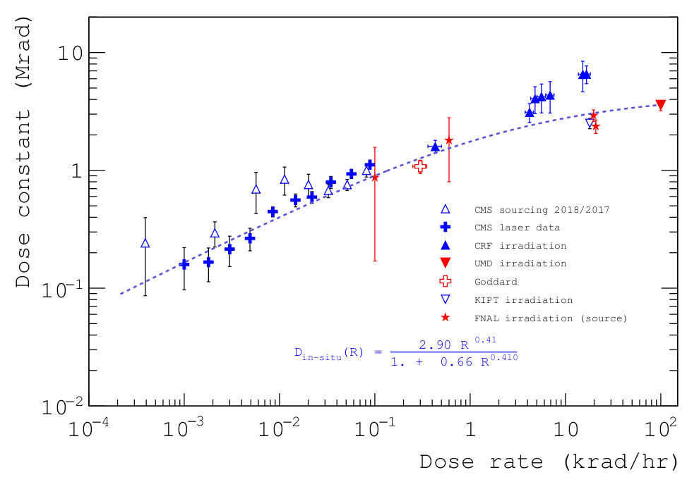
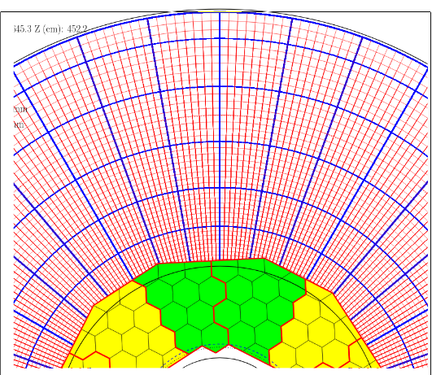
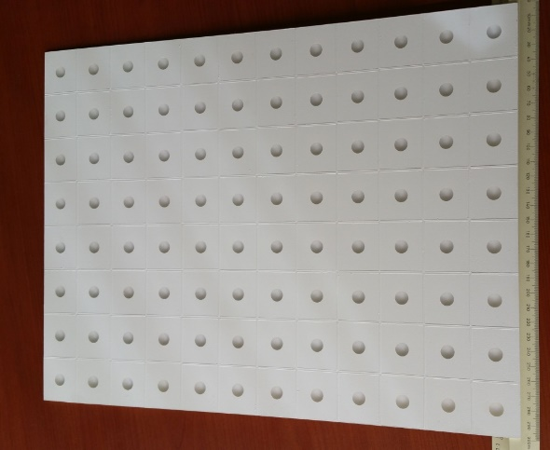
Studies for Phase II upgrade
In 2018 JINR CMS group participated in scintillator radiation hardness investigations and performed R&D for High Granularity Endcap Calorimeter (HGCAL)
  Understanding of radiation damage for present hadron calorimeter HE
  Investigation of scintillator materials and electronics for HGCAL
  Development of scintillator module prototype
HGCAL
In-situ measurement
absorbed dose in HE
CMS DN2018/008
Mixed (Si, Sci) casette
Scintillator macrotile
Dose constant
CMS DN2018/001
18

Slide 19
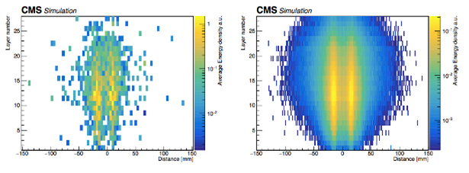
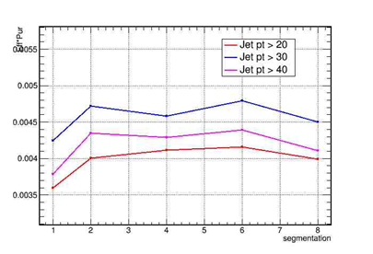
HGCAL software development and optimization
In 2018 JINR CMS group contributed to calorimeter reconstruction, testing and validation software. We continued to develop software for modeling and reconstruction of jets and for detector optimization.
Angular resolutions of the modernized calorimeter obtained with different reconstruction algorithms.
Reconstruction of close photon pair was studied
Energy resolution for pion jets for as function of various conditions was investigated
Further studies of optimal transverse segmentation were performed
Product of VBF jets reconstruction efficiency and purity of jet selection
One photon pair (d=30mm) 1000 photon pairs
Step in pseudorapidity 0.03 and 1 degree in azimuthal angle
19

Slide 20
Summary
The CMS analyses based on 2015-2017 data are almost completed
  ~ 202 papers are published or submitted to publish, many analyses are going to be public
JINR participation in the CMS is very successful:
Phase I upgrade of HE finished
JINR physicists are involved in whole CMS chain from data taking (shifts) and to final data analysis
we contributed in six CMS physics analyses
  3 CMS public papers and 3 CMS AN Notes
  3 review papers
  19 talks for CMS
young physicists are involved actively
The first-priority JINR physics tasks include long-term campaigns to look for new physics with
  Di-muons (since 2002)
  Multijet studies (since 2009)
In 2019 (and beyond) we expect plenty of results on 13 TeV beams with above 150 fb⁻¹ !
20

Slide 21
Thank you for your attention
21

Slide 22
BACKUP
SLIDES

Slide 23
CMS Upgrade program

Slide 24
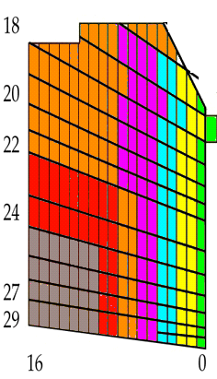
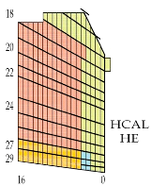
Front-end electronics upgrade
In front-end the replacement of HPD to the silicon photomultiplier (SiPM).
Main advantages of SiPM’s usage over HPDs:
Provide a higher photon detection efficiency (twice more than HPD) and gain (50-500 times higher).
Signal to noise ratio can be increased by order of magnitude.
Provide an operation at voltage ~70V as compared to ~ 8 kV for HPD.
Work without additional noise in presence of magnetic field up to 4 T.
SiPMs are compact and relatively inexpensive.
The upgraded FEE will have next major improvements:
To increase the number of channels (~2.5 times) and redundant readout.
To provide better timing information – resolution of ~2ns instead of 25 ns.
To encode an energy value into 8 bits instead of 6 bits as now.
To increase a bandwidth of data transfer to back-end from 1.6 Gbit/s to 4.8 Gbit/s.
The increasing number of channels will allow better detector segmentation.
An increase in segmentation will help mitigate radiation darkening effects of scintillators.
24

Slide 25
Study of HCAL Scintillator Radiation Hardness
The studies show that scintillator damage is a complex function of Dose and Dose Rate.
Direct measurement is not possible (takes too much time).
The goal of our program of radiation hardness studies is
the results extrapolation to the real condition of CMS operation in 2012–2030.
The program is in progress.
JINR and member states have several irradiation facilities
which we use for studies of radiation hardness of scintillators of various types:
IBR-2, pulsed nuclear reactor (JINR);
IREN, source of neutrons and γ quanta (Intense REsonance Neutron source, JINR);
10 MeV electron linac (National Scientific Center, Kharkov Institute of Physics&Techn., Ukraine);
4 MeV electron linac (NCPHEP, Minsk, Belarus);
Intense Co⁶⁰ source (INP, Tashkent, Uzbekistan).
There are 3 questions to be answered:
Radiation damage of “fingers” up to 2500-3000 fb⁻¹ (survivability by the end of LHC).
Radiation damage of existing scintillator tiles at 700 fb⁻¹ (survivability by the LS3).
Understanding radiation damage of the used now scintillator/shifter SCSN81/Y11 at 30 fb⁻¹

Slide 26
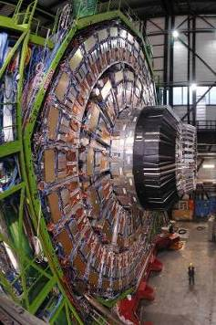
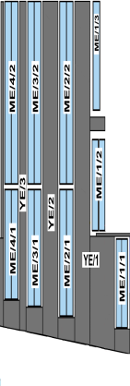
CMS Upgrade Technical Proposal
ME1/1
    recover trigger up to eta=2.4
      3 cards instead of 1 ORed in bottom CSC part
    minimize dead time, removes rate worries
      replace ADC/SCA with flash ADC, digital storage
    readout robustness
      optical readout instead of 50-pin scewclear cables
  Joint US-RDMS new electronics project
    LV and interfaces (Dubna, Minsk)
  Dubna, Minsk responsibility to re-install CSC with new electronics
    Be ready by mid of 2015
HE
    Increase dynamic range, rate capability, sub-ns timing, muonID
      SiPM instead of HPD
    Update longitudinal segmentation to increase Particle Flow capability and 1-level HW trigger
      With new electronics
    Optimize ECAL/HCAL interface
  RDMS responsibility to install new phototransducers, FE and BE electronics
    Be ready by end of 2020
Access to inner endcap require:
  Integration development and full opening of the CMS detector
  Strong support of engineering and technical coordination team
Require detailed R&D and Radiation Tests for Phase 2 at HL-LHC
  to measure performance in extreme conditions to understand compatibility with future
26

Slide 27
Accelerated ageing of HE
RDMS team:
  JINR (Dubna) in cooperation with
  KIPT (Kharkov), NCPHEP (Minsk), INP (Tashkent), MEPhI (Moscow)
investigated possible causes of HE damage
  Results collected in CMS NOTE 2015/001
A set of possible causes was identified (and others were disproved)
  Dose-rate effect: significant
    EJ-260 (green scintillator) showed a better performance than BC-408 (blue scintillator)
  Effect of neutron irradiation: increase damage by factor 2 w.r.t. gamma irradiation alone
  Induced radiation from brass absorber: negligible
A finger-style tile is accepted to increase radiation tolerance by reducing the light path in active material
  Quick solution that could be implemented during LS2
27

Slide 28
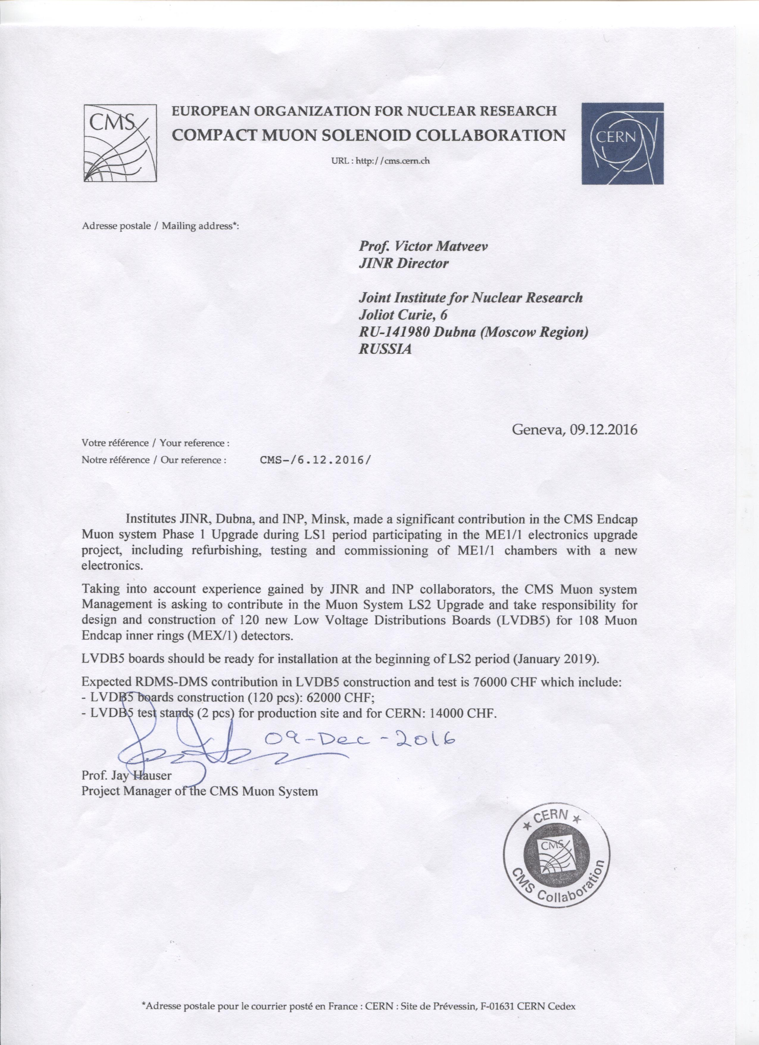
Muon LS2 Upgrade
Significant contribution of JINR and Minsk
in the CMS Endcap Muon System Phase 1
Upgrade
The CMS Muon System Management is asking to contribute in the Muon System LS2 Upgrade
- responsibility for design and construction of new Low Voltage Distribution Board (LVDB) for 108 Muon inner rings (MEX/1) detectors
28

Slide 29
