Slide 1
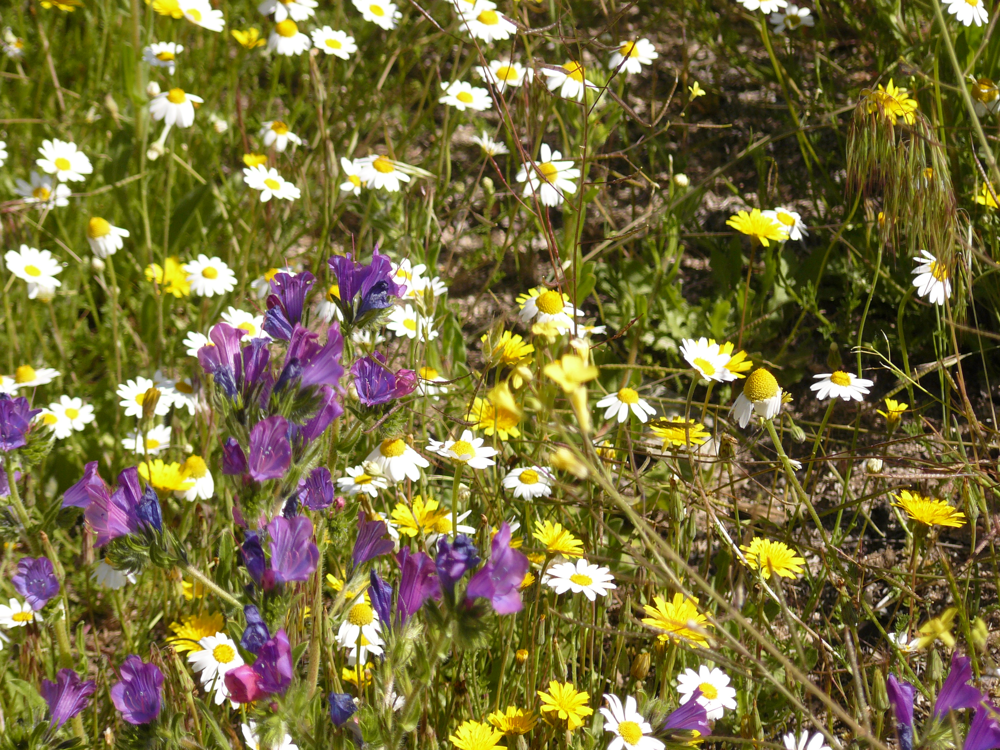

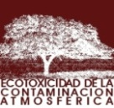
Establishing critical levels for effects of ozone on biodiversity
Ignacio González Fernández, Héctor Calvete-Sogo, Javier Sanz, Susana Elvira, Victoria Bermejo, Rocío Alonso

Slide 2
Plant biodiversity global and European scale
Species richness of vascular plants
Europe: Mediterranean basin, Balkans, Alps
Source: Mutke et al., 2010

Slide 3
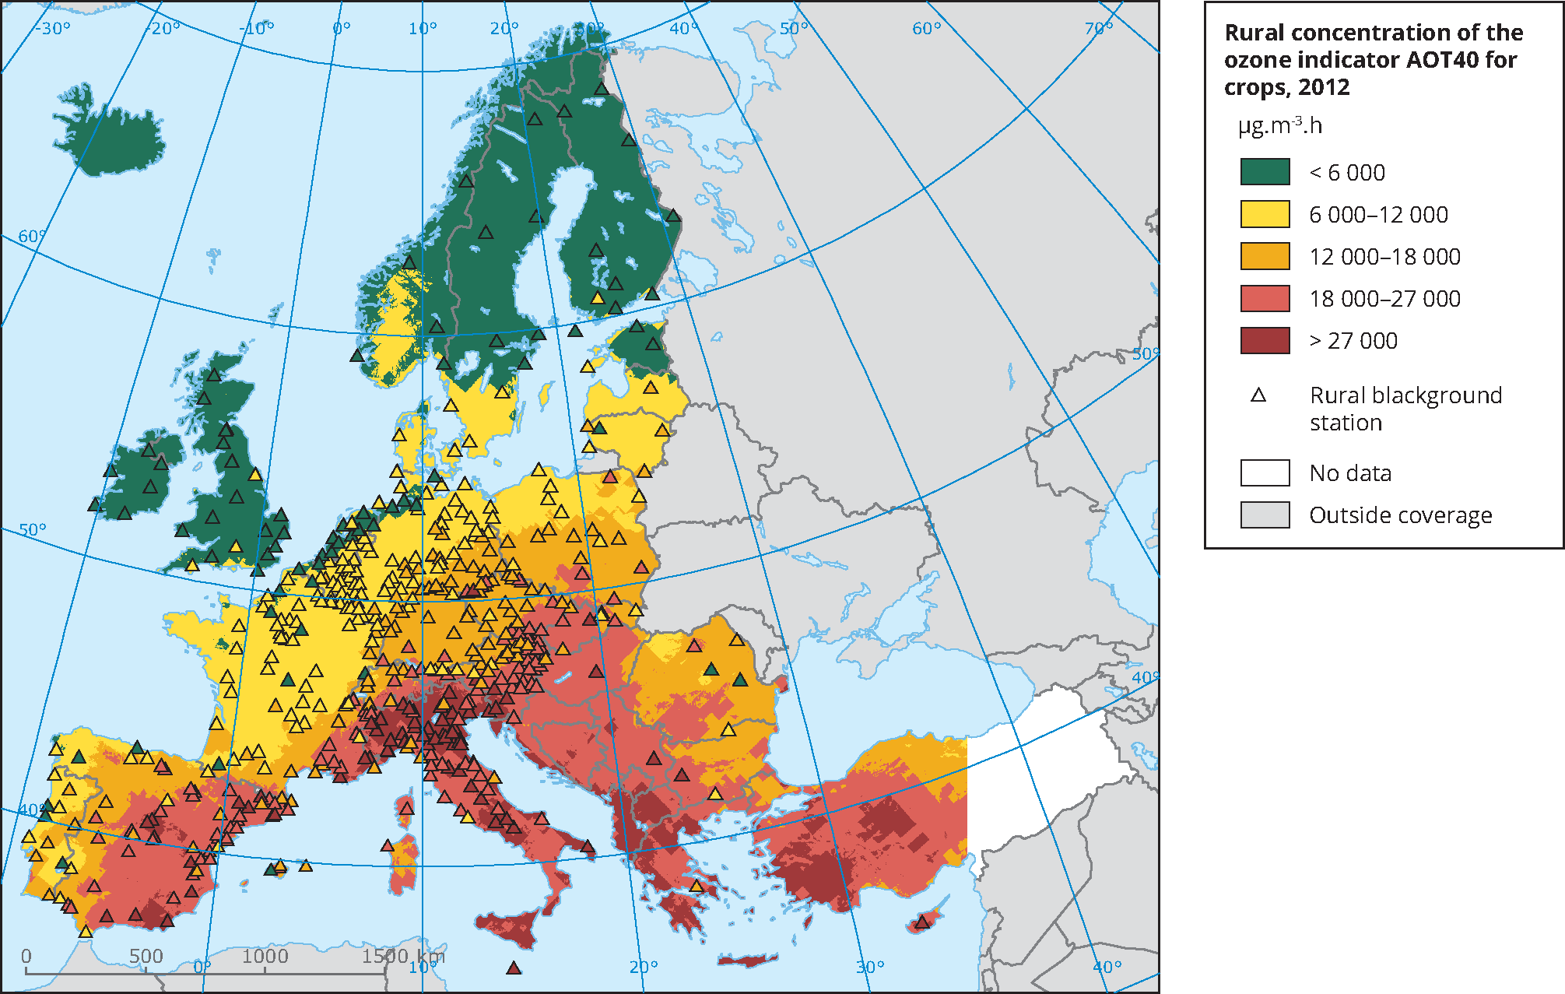
Plant biodiversity global and European scale
Ozone concentration in rural areas of Europe
Europe: Mediterranean basin, Balkans, Alps
Source: EEA, 2015

Slide 4
Ozone effects on biodiversity
Attempts to show O3 effects on biodiversity focus on semi-natural vegetation mainly biomass growth and species composition
Growth response of individual species
Biomass composition of mixtures of species
Biomass composition of intact communities
Gradient studies: multivariate analysis
Increasing complexity
Sensitive species or ecosystems inferred from physiological or functional traits and presence of sensitive component species

Slide 5
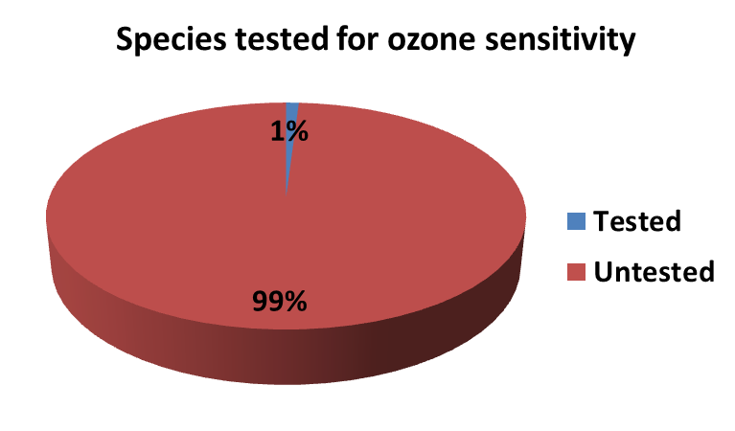
Ozone effects on biodiversity
Previous attemps to show O3 effects on biodiversity focus on semi-natural vegetation mainly biomass growth and composition
Limited amount of species and ecosystems tested: many are productive species or crops
Limited evidence from Mediterranean areas but O3 sensitive species have been identified
Source: Mutke et al., 2010; Mills et al., 2007, Hayes et al., 2007; Buker et al., 2015

Slide 6
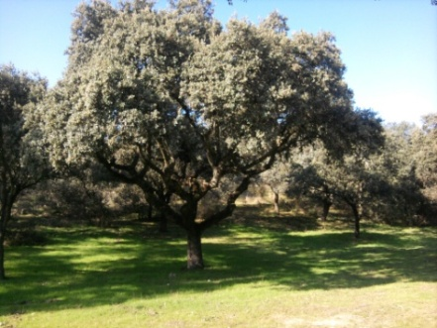
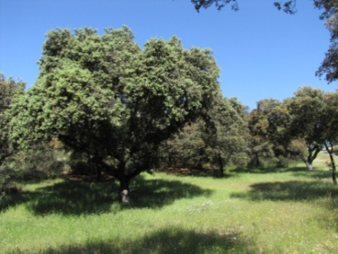
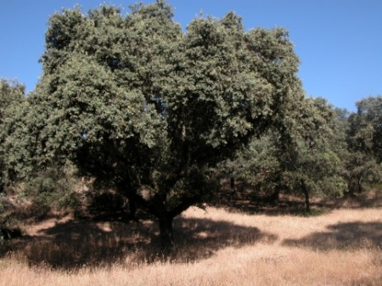
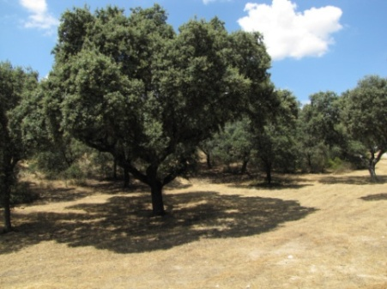
Ozone effects on biodiversity: annual Med pastures
6310 – Dehesas Quercus spp
Dehesa: Sparsley sclerophyllous wooded pasture
Protected habitat EU Directives: 92/43/CEE (habitats) and 2009/147/CE (birds)
Iberian peninsula: 4·10⁶ ha
Pasture dominated by therophytes following annual cycle regrowth, seeding and dry out
November
May
July
August

Slide 7
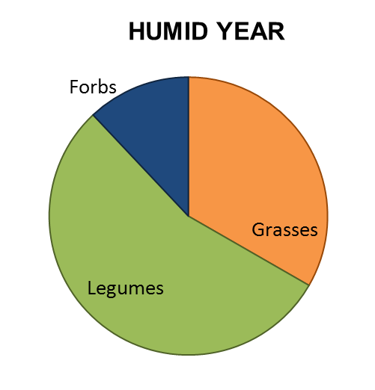
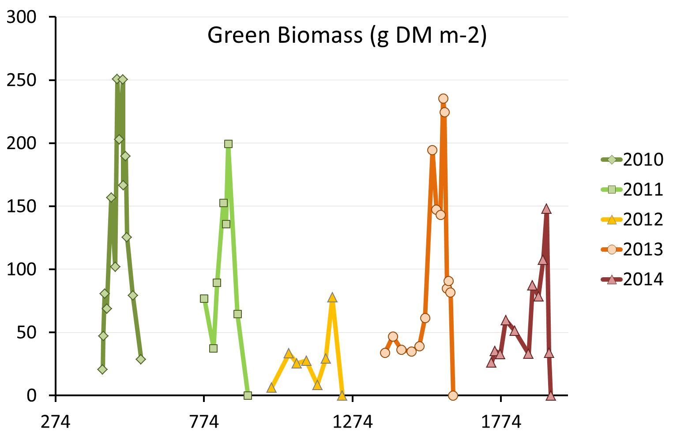
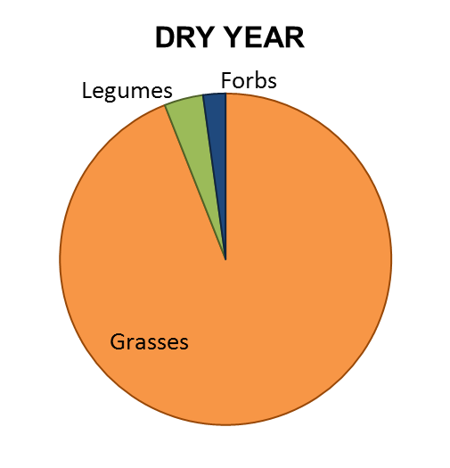
Ozone effects on biodiversity: annual Med pastures
Plant water availability controls annual pasture dynamics
Oct-09 Feb-11 Jul-12 Nov-13

Slide 8
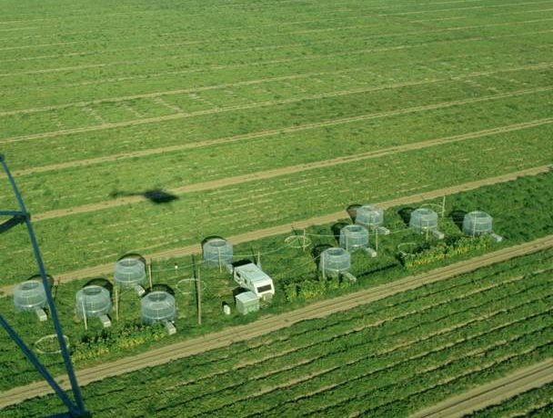
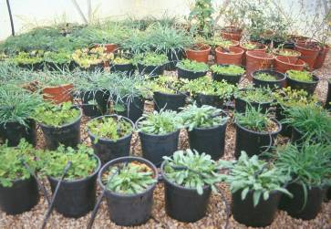
Ozone effects on biodiversity: annual Med pastures
OTC experiments: O3 (x N), CFA, NFA, NFA+20, +40, N0, N15, N30
19 species annual Mediterranean pastures
5 experiments: individual species or 2 spp mixtures
Pots
Source: Sanz et al., submitted

Slide 9
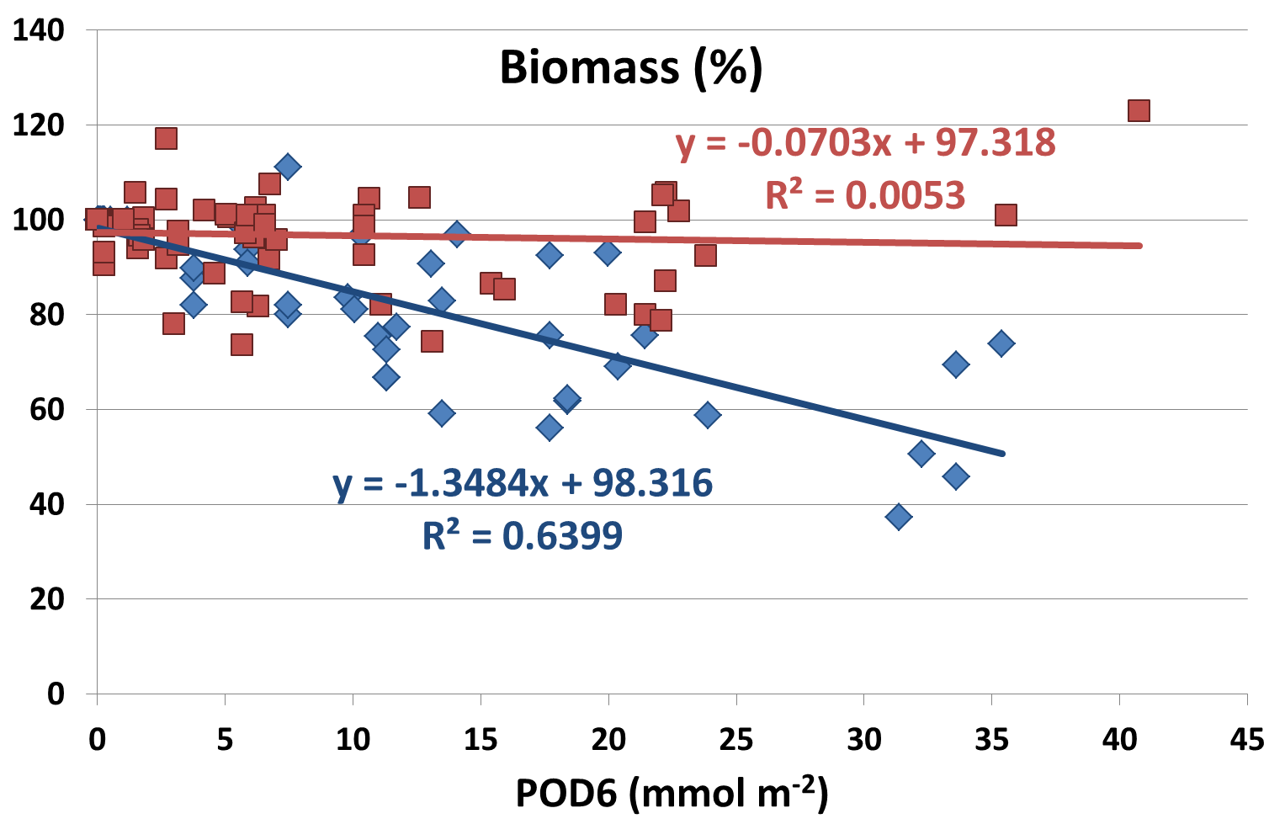
Ozone effects on biodiversity: annual Med pastures
Sensitive and tolerant species: no clear traits for O3 sensitivity
(e.g. sensitive and tolerant legume species)
O₃-sensitive
O₃-tolerant
Source: Sanz et al., submitted

Slide 10
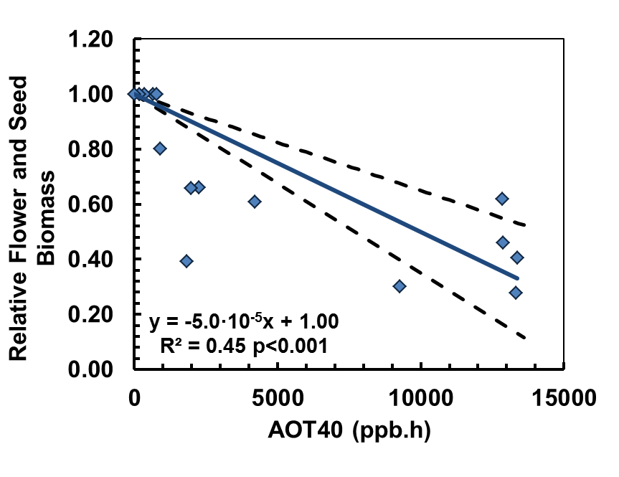
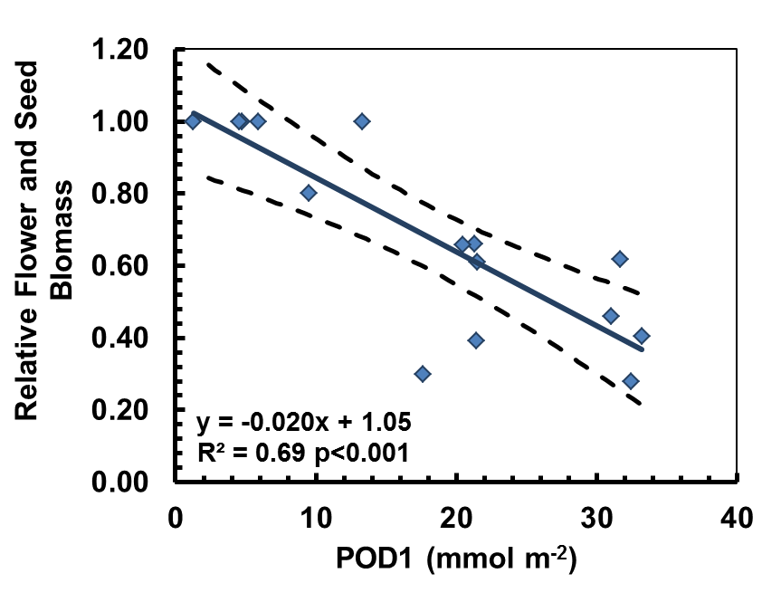
Ozone effects on biodiversity: annual Med pastures
Relevant for biodiversity: flower and seed production (3 spp, 3 expts)
Annual pasture (10% effect) | Total aboveground biomass | Flower and seed biomass
AOT40 (ppm.h) – 45 days | 3.1 (2.6, 3.8) | 2.0 (1.5, 2.8)
POD1 (mmol m⁻²) – 45 days | 12.2 (8.9, 15.5) | 7.2 (1.1, 13.3)
Source: Sanz et al., submitted

Slide 11
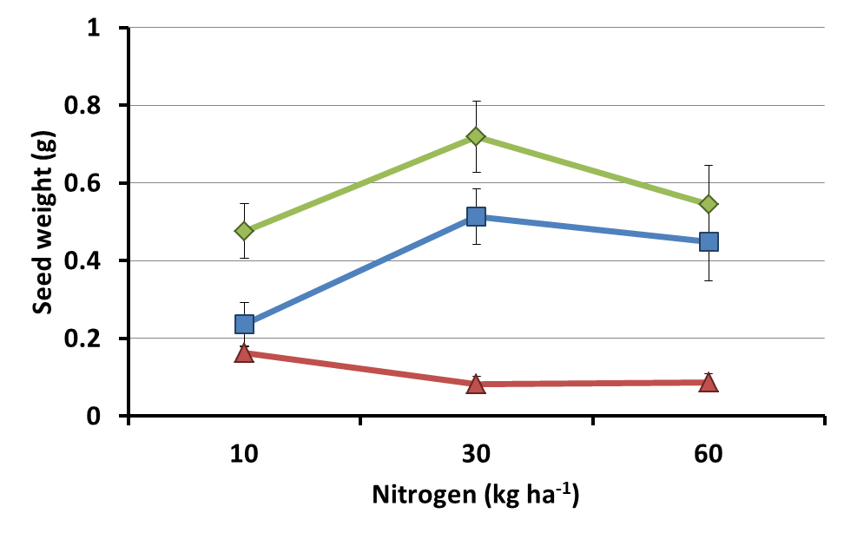
Ozone effects on biodiversity: annual Med pastures
Seed production O3 x N interaction: Trifolium striatum
● CFA ■ NFA ▲NFA+40ppb
Source: Sanz et al., 2007

Slide 12
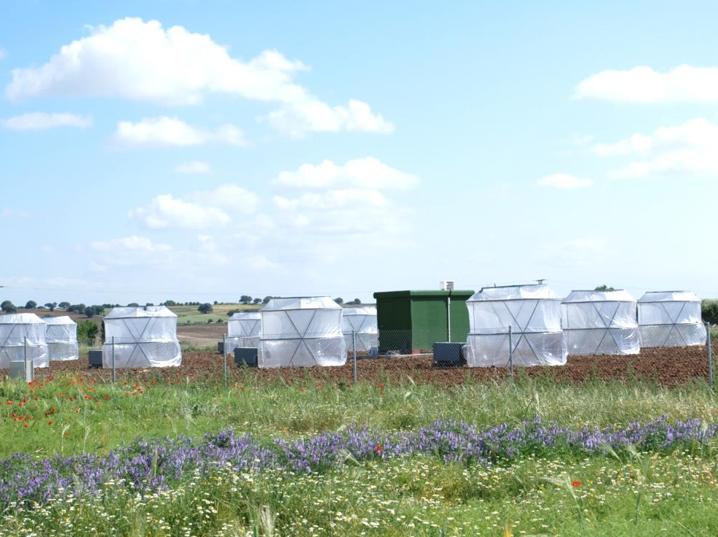
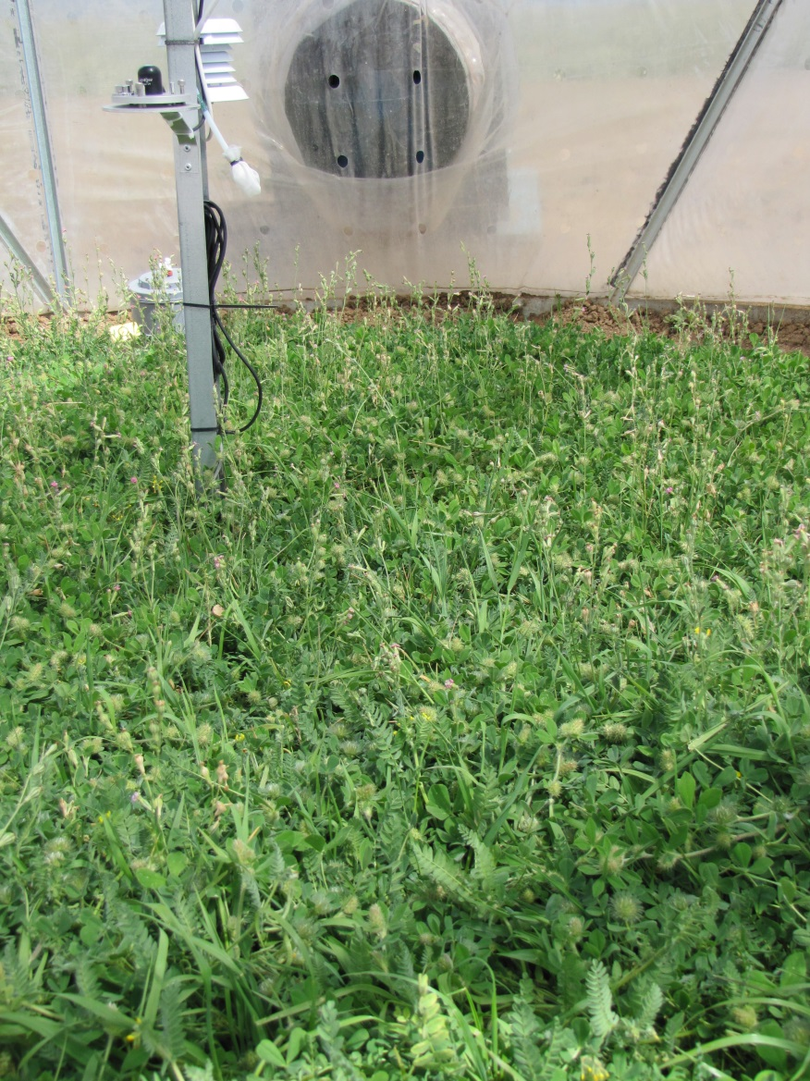

Ozone effects on biodiversity: annual Med pastures
OTC experiment: O3 x N, CFA, NFA, NFA+20, +40, N0, N20, N40
6 species annual Med pastures: legumes, grasses, non-legume forbs, different O3 sensitivity
Two growing seasons
Natural soil
Sources: Calvete-Sogo et al, 2014; 2016

Slide 13
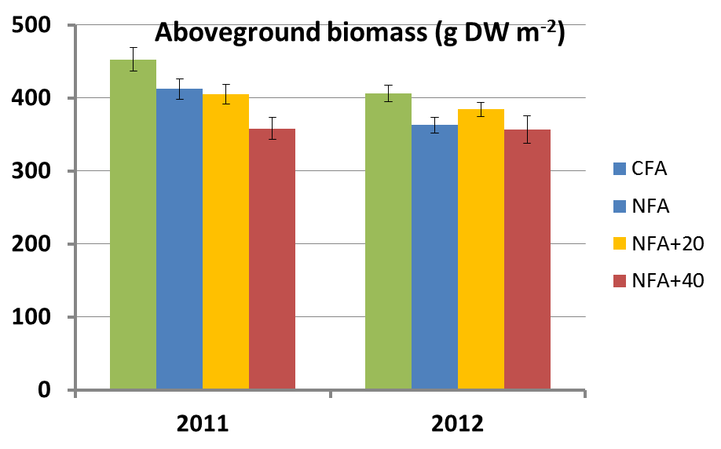
Ozone effects on biodiversity: annual Med pastures
Overall decrease in aboveground biomass in both seasons
Sources: Calvete-Sogo et al, 2014; 2016

Slide 14
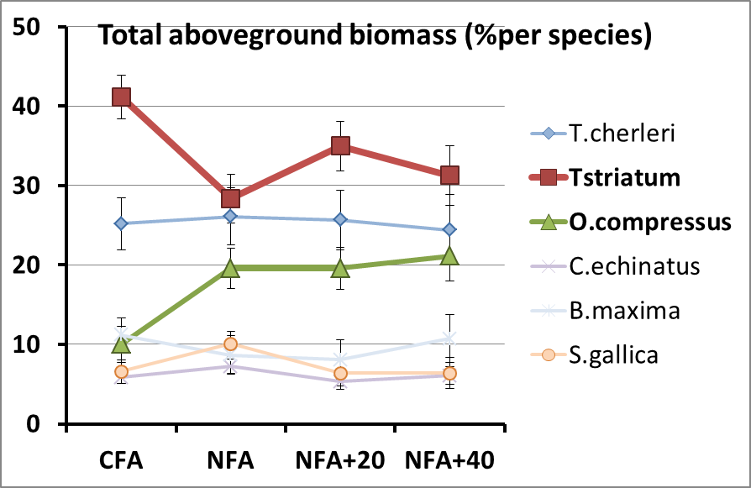
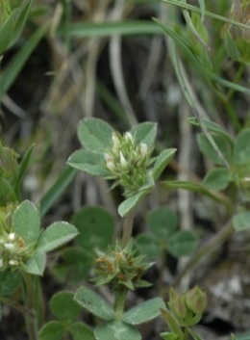
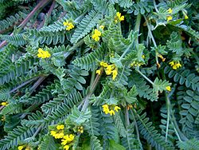
Ozone effects on biodiversity: annual Med pastures
O3 sensitive legume
Trifolium striatum
O3 tolerant legume
Ornithopus compressus
Overall decrease in aboveground biomass in both seasons
Change in the species composition (first season)
Sources: Calvete-Sogo et al, 2016

Slide 15
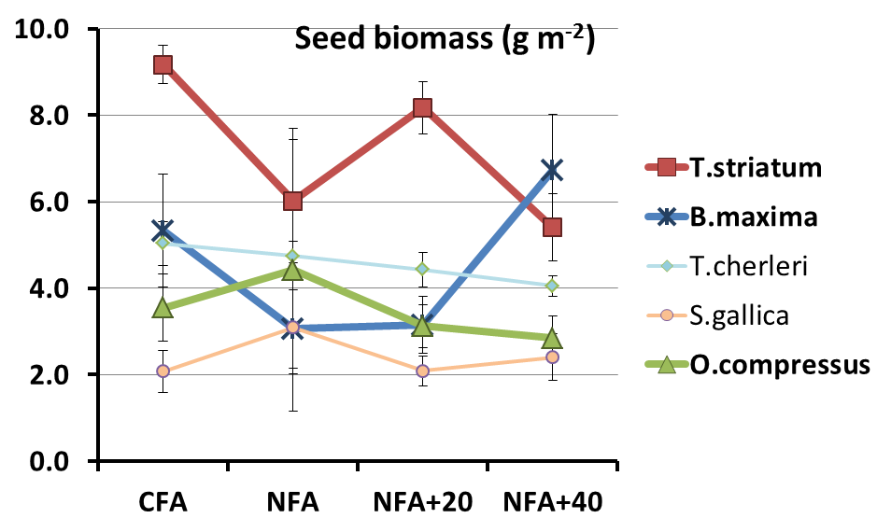
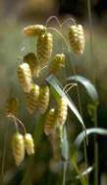
Ozone effects on biodiversity: annual Med pastures
O3 sensitive legume
Trifolium striatum
O3 tolerant grass
Briza maxima
Overall decrease in aboveground biomass in both seasons
Change in the species composition (first season)
Change in seed production on some species (first season)
Sources: Calvete-Sogo et al, in preparation

Slide 16
Ozone critical levels for plant biodiversity
Constraints
Scientific evidence on O3 effects focuses on growth or productivity, no direct relationship with biodiversity indices (just one study)
Difficult to extrapolate O3 effects from single species experiments or simple mixtures
Few experiments with intact communities: mixed results
Small number of species/ecosystems tested
Findings
Indirect evidence through biomass species composition, flower and seed production
Flower and seed production more relevant than biomass for O3 effects on biodiversity of annual Mediterranean pastures
O3 x N interaction on reproductive capacity of annual species

Slide 17
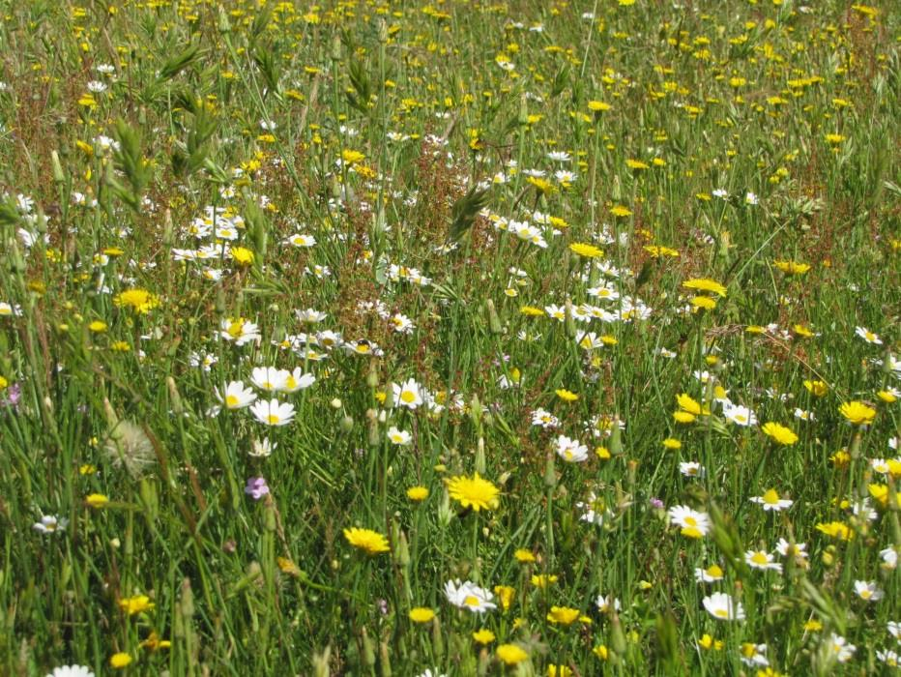
Ozone critical levels for plant biodiversity
Mediterranean annual pastures
Ozone critical levels set for effects on aboveground biomass may not protect from long term effect on biodiversity (mediated by effects on seed and flower biomass)

Slide 18
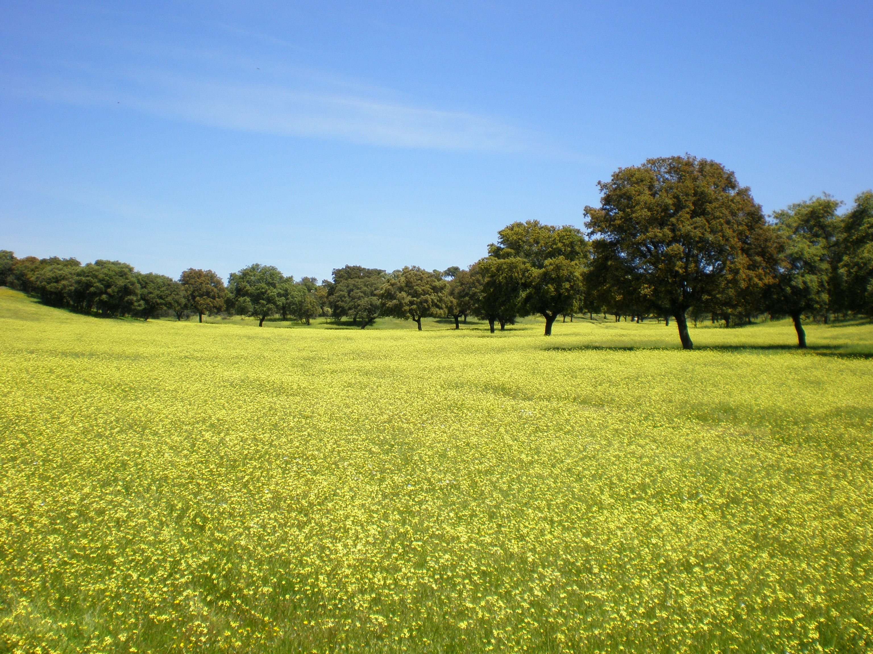




Thank you for your attention!
ignacio.gonzalez@ciemat.es
Funding:
ECLAIRE (EU-FP7-ENV-2011)
NEREA (AGL2012-37815-C05)
AgriSost (P2013/ABI-2717)
MAGRAMA
NEREA
AGL2012-37815-C05-03

