Slide 1

49th meeting of the PAC for Nuclear Physics
from Tuesday, 22 January 2019 to Wednesday, 23 January 2019
Concepts of new neutron sources at the Frank Laboratory of Neutron Physics and program of experiments
Egor Lychagin

Slide 2
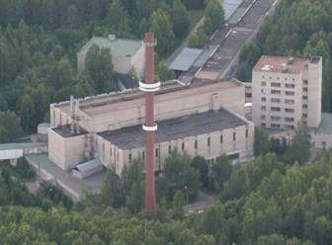
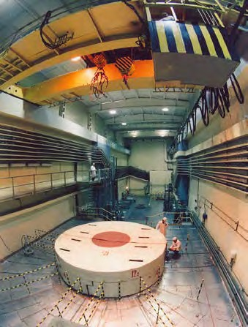
49th meeting of the PAC for Nuclear Physics
from Tuesday, 22 January 2019 to Wednesday, 23 January 2019
The service life of the IBR-2 facility, as well as the technological equipment complex is expected to expire in the mid 2030s (depending on operating conditions) and the lifetime of the building is estimated to end in 2042.
What should be next?
Taking into account:
FLNP experience in developing, exploitation and utilization of pulsed neutron sources
The analysis of the horizons of neutron studies and world trends at the sources construction
we conclude that we need a pulsed source with an average thermal neutron flux density
no less than 10¹⁴ n/(cm²⋅s).
In 2015-2018, in FLNP various variants of sources were considered.

Slide 3
49th meeting of the PAC for Nuclear Physics
from Tuesday, 22 January 2019 to Wednesday, 23 January 2019
Main parameters of the source
Average thermal neutron flux density Φ_{n} not less than 10¹⁴ n/(cm²⋅s)
Instantaneous flux in pulse Φ >10¹⁶ cm⁻²⋅s⁻¹
Pulse width 200 ÷ 300 μs and 20 ÷ 30 μs (the pulse width is limited from shortest side using target with multiplication)
Repetition rate 10-30 Hz
To determine parameters of the source two workgroups were formed
at the beginning of 2017:
Condensed Matter Physics
Kucerka N.
Kozlenko D.
Balagurov A.
Avdeev M.
Kuklin A.
Goremychkin E.
Scheffzuk C.
Khaydukov Yu.
Ioffe A.
Alekseev P.
Nuclear Physics
Lychagin E.
Kopatch Yu.
Sedyshev P.
Skoy V.
Shvetsov V.
Frank A.
Khriachkov V. (IPPE, Obninsk )
Scherbakov O. (PNPI Gatchina)

Slide 4
49th meeting of the PAC for Nuclear Physics
from Tuesday, 22 January 2019 to Wednesday, 23 January 2019
Two initial concepts of the source:
“Neptun”
“Pluton”
E.P. Shabalin, V.L. Aksenov, G.G. Komyshev, A.D. Rogov “Highly Intense Pulsed Neutron Source Based on Neptunium” JINR Preprint P13-2017-57 (in Russian)
http://flnph.jinr.ru/images/content/Books/Blok.pdf (in English)
Vinogradov A.V., Pepelyshev Yu.N., Rogov A.D., Sidorkin S.F. “High-flux pulsed neutron source driven by a proton accelerator for beam research” JINR Preprint Р-13-2018-40 (in Russian)
“Superbooster” is an accelerator driven multiplying neutron-producing target with periodic modulation of reactivity. Reactivity modulation allows working with a high neutron multiplication factor of a source.

Slide 5
49th meeting of the PAC for Nuclear Physics
from Tuesday, 22 January 2019 to Wednesday, 23 January 2019
“Superbooster” advantages/disadvantages:
+ accelerator could allow to change neutron pulse width;
+ subcritical system looks more safe;
+ multiplication target allows to have intense pulse with relatively small power at the
accelerator target;
+ accelerator allows to have several targets;
accelerator itself is a new critical system for safety at powerful ADS;
target with multiplication is a source of additional background;
minimal neutron pulse width is about 20s at target with multiplication.

Slide 6
49th meeting of the PAC for Nuclear Physics
from Tuesday, 22 January 2019 to Wednesday, 23 January 2019
Public discussions during 2015 – 2018:
Seminars at FLNP and NRC KI (Shabalin E., Pepelyshev Yu.)
Seminars at DNICM FLNP
Presentation at the 45th meeting of the PAC for Condensed Matter Physics
(A 15-year forward look at neutron facilities at JINR Aksenov V.)
Discussions during ISINN-25 (May 2017)
Presentation at the 46th meeting of the PAC for Condensed Matter Physics
(Work plan for the development of a concept for JINR's new neutron source Vinogradov A.
and User demands on the parameters of a future neutron source at JINR Kucerka N.)
Presentation at the 47th meeting of the PAC for Condensed Matter Physics
(Development of the scientific case for a new source of neutrons at JINR Kucerka N. and
a 20-year forward look at JINR's high-flux pulsed neutron source Aksenov V.)
Presentation at the 48th meeting of the PAC for Condensed Matter Physics
(Proton controlled high-flux pulsed neutron source for beam research Pepelyshev Yu. and
Nuclear physics at a new Dubna neutron source Lychagin E.)
Workshop “Advanced ideas and experiments for the new Dubna Neutron Source (DNS-IV).
Related moderators and infrastructure“ (December 2018)

Slide 7
49th meeting of the PAC for Nuclear Physics
from Tuesday, 22 January 2019 to Wednesday, 23 January 2019
Results of discussions concerning condensed matter research
From the presentation of A.Balagurov
Method | Instrument | Main issue | Neutron spectra
Diffraction | 1. Material science*) 2. High-resolution*) 3. High-intensity 4. High-pressure 5. Magnetic | Internal stresses Crystal structure In situ, real-time Micro samples Magnetic structure | Thermal Thermal/cold Cold Cold Cold
Inelastic | 6. Direct geometry - I**) 7. Direct geometry - II***) 8. Inverse geometry | General purpose General purpose Molecular systems | Cold Сold Cold
SANS | 9. High-resolution 10. High-intensity-I 11. High-intensity-II | General purpose In situ, real-time Micro samples | Cold Cold Cold
Reflect. | 12. Horizontal plane 13. Vertical plane | General purpose Liquid media | Cold Cold
NI | 14. “White” beam 15. Energy dispersive | General purpose Complex media | Cold Cold
*) Fourier chopper **) Fermi chopper ***) Set of choppers
Optimal neutron pulse width about 200 s

Slide 8
49th meeting of the PAC for Nuclear Physics
from Tuesday, 22 January 2019 to Wednesday, 23 January 2019
List of nuclear physics experiments/fields discussed by Local Nuclear Physics Work Group depending on the pulse width and intensity:
1-100 ns …
Need an additional target and other proton beam structure
100-400 ns …
Measurements of the inelastic neutron scattering and (n, xn) reactions cross sections at energy up to 30 MeV (nuclear data needed for next generation nuclear technology);
Measurement of (n, p), (n, α) reaction cross sections on stable targets (at neutrons’ energy about several MeV) (astrophysics, nuclear fuel cycle);
Investigation of fluctuations of the fragments’ total kinetic energy in binary fission , as well as yield of neutrons and gamma rays in fission neutron resonances (fission physics);
Study of P-even and P-odd angular correlations of fission fragments with polarized neutrons (detail understanding of TRI- and ROT-effects nature);
Measurements of fission fragments angular distributions in correlation with instantaneous neutrons and gamma quanta near fission barrier (investigation of fission barrier structure and dynamics of fissile system);
Precision measurements of neutron cross sections in neutron resonances (nuclear data);
Isotope analysis using resonance technique.

Slide 9
49th meeting of the PAC for Nuclear Physics
from Tuesday, 22 January 2019 to Wednesday, 23 January 2019
List of nuclear physics experiments/fields discussed by Local Nuclear Physics Work Group depending on the pulse width and intensity:
20 ÷ 30 μs
search for the new and investigations of known T-odd effects in neutron-nuclear resonances;
measurements of parity-violating effects in the lowest neutron resonances;
precise measurements of neutron cross sections in low-lying resonances;
200 ÷ 300 μs
measuring of neutron-neutron scattering cross section;
research using VCN;
UCN physics
Does not need
the pulse structure but could be realized at pulsed source
UCN physics at an intense source;
search for symmetry breaking in fission and reactions with light nuclei;
investigations of exotic neutron rich nuclei;
prompt (n,γ) analysis;
neutron activation analysis

Slide 10
49th meeting of the PAC for Nuclear Physics
from Tuesday, 22 January 2019 to Wednesday, 23 January 2019
VCN is the instrument to get new quality of measurements
extremely broad applications
in various domains: solid state, soft
matter, surface physics, magnetism, chemistry, biology, precision studies of the neutron decay and in studies of fundamental symmetries
UCN → VCN → CN
are widely used in precision
particle physics experiments
neutrons (v=8÷200 m/s) are very attractive for:
search for extra-short-range interactions at neutron scattering;
experiments with neutrons in a whispering gallery;
beam experiment to measure the neutron lifetime;
search for neutron-antineutron oscillations;
…
spin-echo technique;
reflectometry;
high-resolution inelastic scattering;
small angle scattering;
diffraction;
…

Slide 11
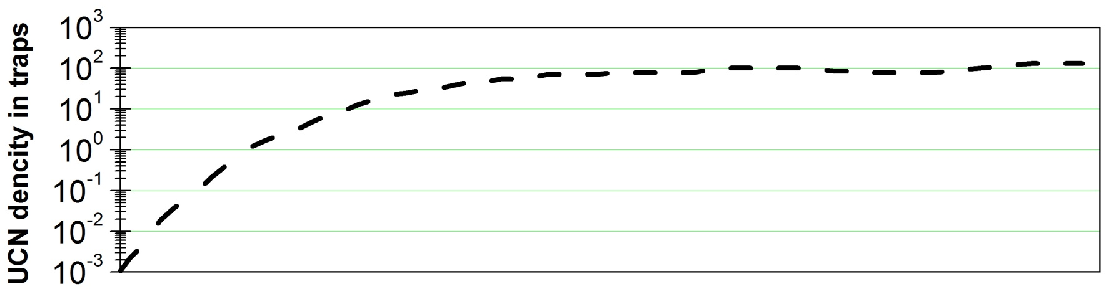
49th meeting of the PAC for Nuclear Physics
from Tuesday, 22 January 2019 to Wednesday, 23 January 2019
UCN physics
1970
1980
1990
2000
2010
2020
Development of experimental techniques, of UCN sources, UCN detectors and etc.
Search reasons of abnormal large losses of UCN from traps
Discovering hydrogen contamination of surfaces
903±13
978±0.8
Discovery of UCN “small heating and cooling”
Research with UCN energy levels in gravitational field
There is no UCN source in Russia

Slide 12
49th meeting of the PAC for Nuclear Physics
from Tuesday, 22 January 2019 to Wednesday, 23 January 2019
UCN physics
Neutron lifetime and neutron decay parameters (electroweak interaction theory)
Neutron EDM (T-invariance)
Experiments with UCN quantum states in a gravitational field (search for a new type of interaction)
Neutron wave properties (quantum mechanics, theory of relativity)
Surface investigations
…
We could get a world level UCN source at the neutron facility with average in time thermal neutron flux density about 10¹⁴ n/(cm²⋅s).
There is an idea to accumulate UCN density corresponding to the pulse neutron density (F.L.Shapiro, 1970). Its realization could allow to construct the most powerful in the world UCN source and essentially increase the UCN density in experimental set-ups.
But the idea neve have been realized yet because need to construct a devise for focusing in time of extracted UCN . The technology has not developed.

Slide 13
49th meeting of the PAC for Nuclear Physics
from Tuesday, 22 January 2019 to Wednesday, 23 January 2019
Nowadays situation:
Reactor “Neptun”
Superbooster “Pluton”
with
neptunium fuel
an average power of ~10 MW
modulation reactivity by void
sodium coolant
pulse width about 200 μs
+ does not need an accelerator
- there is no possibility to produce
“short” pulse (only cutting by choppers)
- needs developing a new type of fuel
with
plutonium fuel
proton linac at 100kW
an average power of ~10 MW
modulation reactivity by reflector
water coolant
pulse width about 50-200 μs
+ has an accelerator allowing to extend
the scientific program
+ allows to vary pulse width
- the accelerator looks as a “week link” at
the system
An agreement has been signed between JINR and the Chief Designer (NIKIET) for developing the two conceptual projects of the source during 2019.

Slide 14
49th meeting of the PAC for Nuclear Physics
from Tuesday, 22 January 2019 to Wednesday, 23 January 2019
Roadmap of the creation of a new neutron source
 | 2016 | 2017 | 2018 | 2019 | 2020 | 2021 | 2022 | 2023 | 2024 | 2025 | 2226 | 2027 | 2028 | 2029 | 2030 | 2031 | 2032 | 2033 | 2034 | 2035 | 2036
Conceptual research
Technical study
R&D
Engineering design
Construction
Commissioning

Slide 15
49th meeting of the PAC for Nuclear Physics
from Tuesday, 22 January 2019 to Wednesday, 23 January 2019
Workshop “Advanced ideas and experiments for the new Dubna Neutron Source (DNS-IV). Related moderators and infrastructure“ (December 2018) conclusions:
1. The vector (in 2π) neutron flux density in the range of (1÷2)⋅10¹⁴ n/cm²/s at 10÷15 MW is considered as the key parameter of DNS-IV.
2. In cooperation with the Chief Designer (NIKIET), work on the conceptual project of DNS-IV should be carried out in two directions:
а) the pulsed periodic reactor IBR-3;
b) the pulsed neutron source driven by a proton accelerator with a multiplying target.
3. The fast neutron pulse duration in the range of 150÷200 μs with 10 Hz repetition is considered to satisfy the majority of experimental research areas: diffraction, inelastic and small-angle scattering, reflectometry, tomography.
5. It is suggested that proposals for the creation of a factory of ultracold and very cold neutrons should be developed.
6. Nuclear-physics-oriented proposals are welcome.
7. The development of the concept of neutron moderators at DNS-IV for experiments on scattering and experiments with very cold neutrons should be considered as a top-priority task for 2019.
8. It is necessary to develop and provide a cost estimate of experimental stations including infrastructure and personnel costs.
9. For a proton-accelerator-driven source, it is necessary to investigate the effect of unscheduled interruptions in the operation of the accelerator on the safety and stability of operation of the multiplying target and, taking this into consideration, determine the parameters of the accelerator.
10. To justify the proton-accelerator-driven source, it is necessary to expand the scientific program to include the application of proton beams in other fields of physics, biophysics and medical applications.

Slide 16
49th meeting of the PAC for Nuclear Physics
from Tuesday, 22 January 2019 to Wednesday, 23 January 2019
Report conclusion:
The development of the new source has been started and the two conceptual designs of possible constructions are under investigation with the Chief Designer (NIKIET).
The scientific program for the new source is mainly focused on the solid state physics research.
The research in nuclear/fundamental/particle physics will be focused on the fields of ultracold, very cold neutrons and applied research.
It is desirable to find possibility of using pulse mode features for UCN production. Obtaining the most intense UCN source and a new level of research has been promised.
As IBR-2 has very similar parameters (pulse width, repetition rate) to the new source, it is the best place for developing new technology and technique for future scientific infrastructure.
For further development of the new source at FLNP needs to open a new theme and it will be discussed at the PAC for Condensed Matter Physics.

