Slide 1
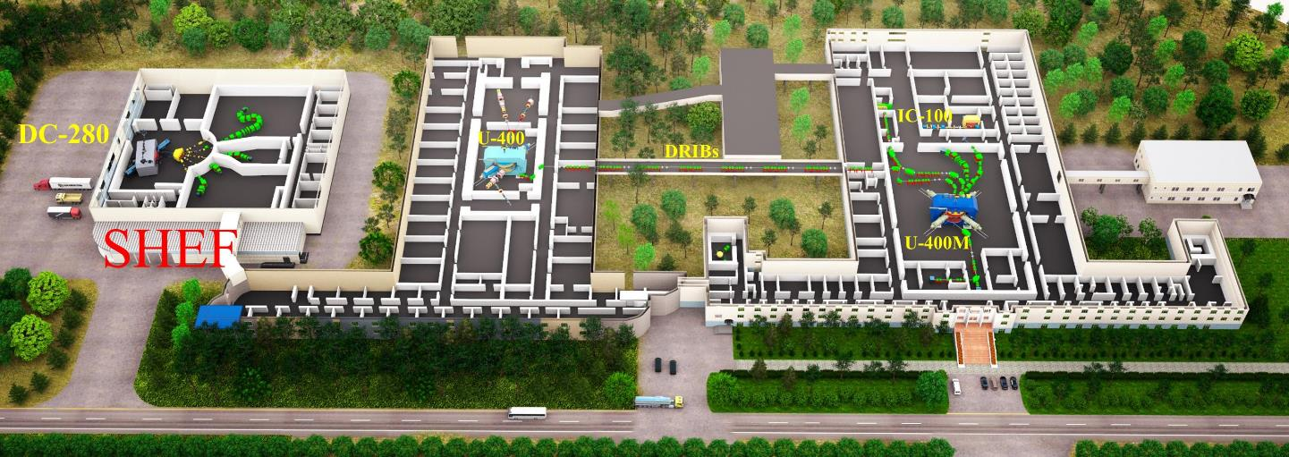
Status of the Factory of Super Heavy Elements DC-280 cyclotron
Igor Kalagin
FLEROV LABORATORY of NUCLEAR REACTIONS
JOINT INSTITUTE FOR NUCLEAR RESEARCH
Dubna 2019

Slide 2
Superheavy Elements (SHE) Factory – the Goals
Experiments at the extremely low (σ<100 fb) cross sections:
Synthesis of new SHE in reactions with ⁵⁰Ti, ⁵⁴Cr ...;
Synthesis of new isotopes of SHE;
Study of decay properties of SHE;
Experiments requiring high statistics:
Nuclear spectroscopy of SHE;
Study of chemical properties of SHE.

Slide 3
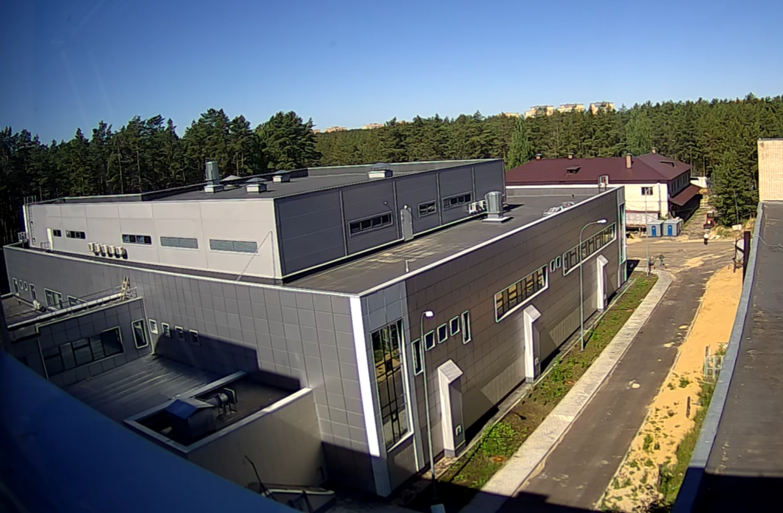
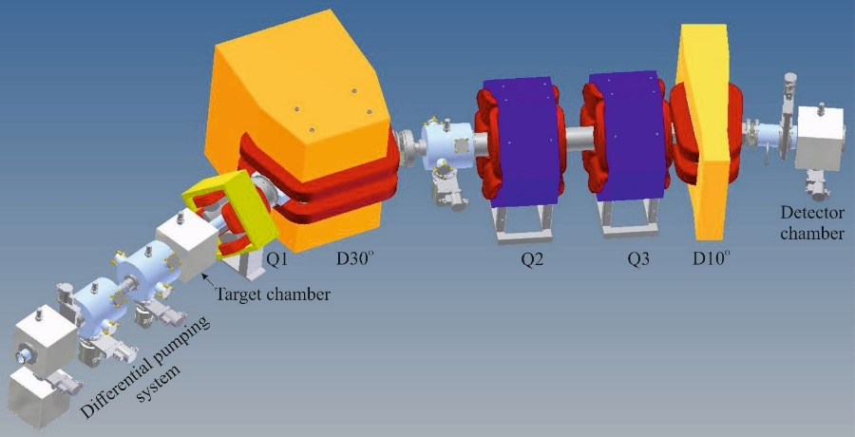
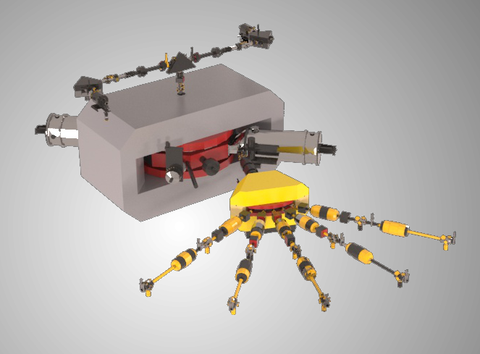
SHE Factory
SHE Factory Building
High-current cyclotron DC-280
New facilities:
New gas-filled separator
Preseparator
SHELS
Etc.
Notes:
The project of the SHE factory includes three principal components: i) high current accelerator, ii) new experimental hall and iii) a number of the next generation facilities.

Slide 4
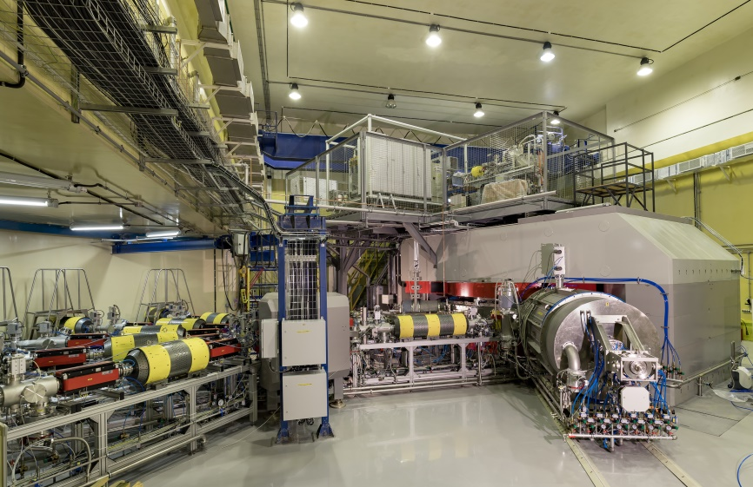
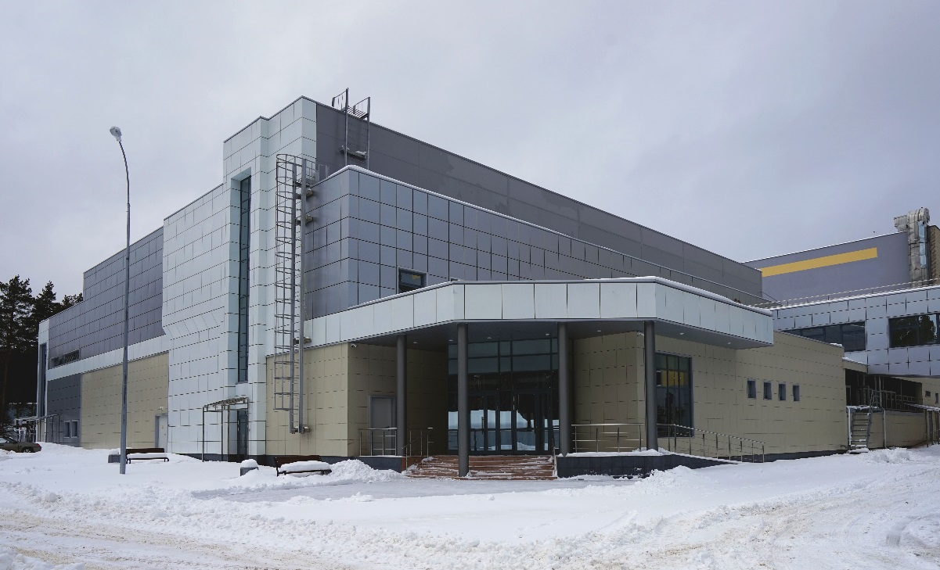
Stand-alone SHE factory with DC-280 cyclotron
DC280 (expected) E=4÷8 MeV/A
Ion | Ion energy [MeV/A] | Output intensity
⁷Li | 4 | 1×10¹⁴
¹⁸O | 8 | 1×10¹⁴
⁴⁰Ar | 6 | 6×10¹³
⁴⁸Ca | 6 | 6,2×10¹³
⁵⁰Ti | 6 | 3,1×10¹³
⁵⁴Cr | 6 | 2×10¹³
⁵⁸Fe | 5 | 1×10¹³
¹²⁴Sn | 5 | 2×10¹²
¹³⁶Xe | 5 | 1×10¹⁴
²³⁸U | 7 | 5×10¹⁰
SHE factory building 2018

Slide 5
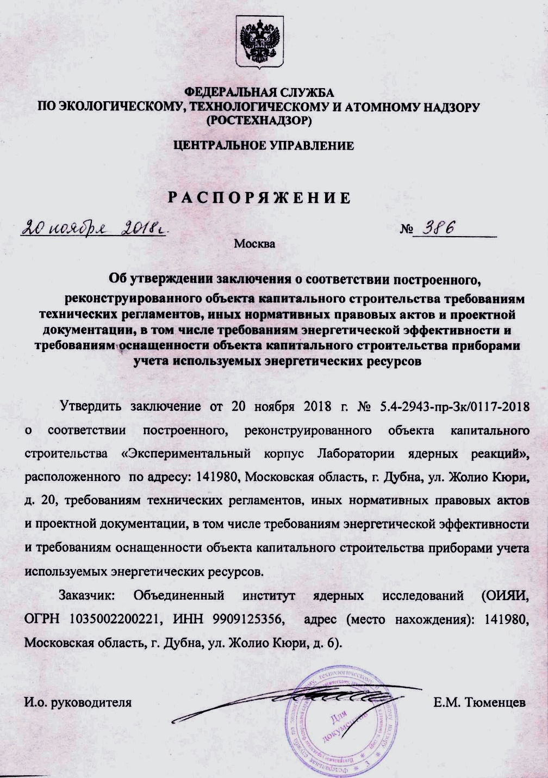
Approval of the Statement of Compliance
Federal Service
For Environmental, Industrial and Nuclear Supervision
(Rostechnadzor)
Central Department
ORDER
20 November 2018 No. 386
Moscow
On approval of the statement of compliance of the built and reconstructed unit of capital construction with engineering requirements, other regulations and design documentation, including energy efficiency requirements and the requirements for the electricity meter infrastructure at the unit of capital construction
The statement of compliance as of 20 November 2018 No. 5.4-2943-пр-Зк/0117-2018 of the build and reconstructed unit of capital construction “Experimental building of the Laboratory of Nuclear Reactions”, located in Moscow region, 141980 Dubna, Joliot-Curie Str. 20, with engineering requirements, other regulations and design documentation, including energy efficiency requirements and the requirements for the electricity meter infrastructure at the unit of capital construction to be approved.
Customer: The Joint Institute for Nuclear Research (JINR, Primary State Registration Number PSRN 1035002200221, Taxpayer ID 9909125356, address: 141980, Moscow region, Dubna, Joliot-Curie Str. 6.

Slide 6
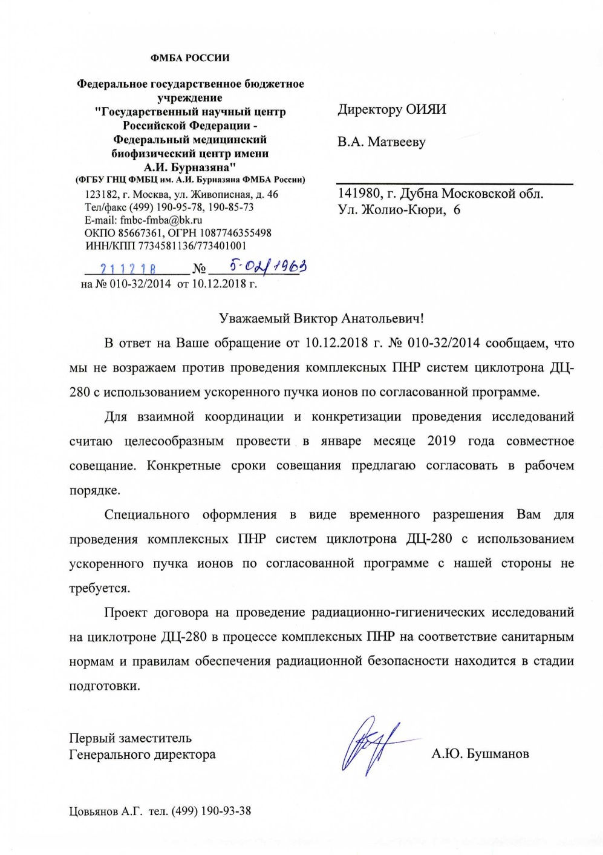
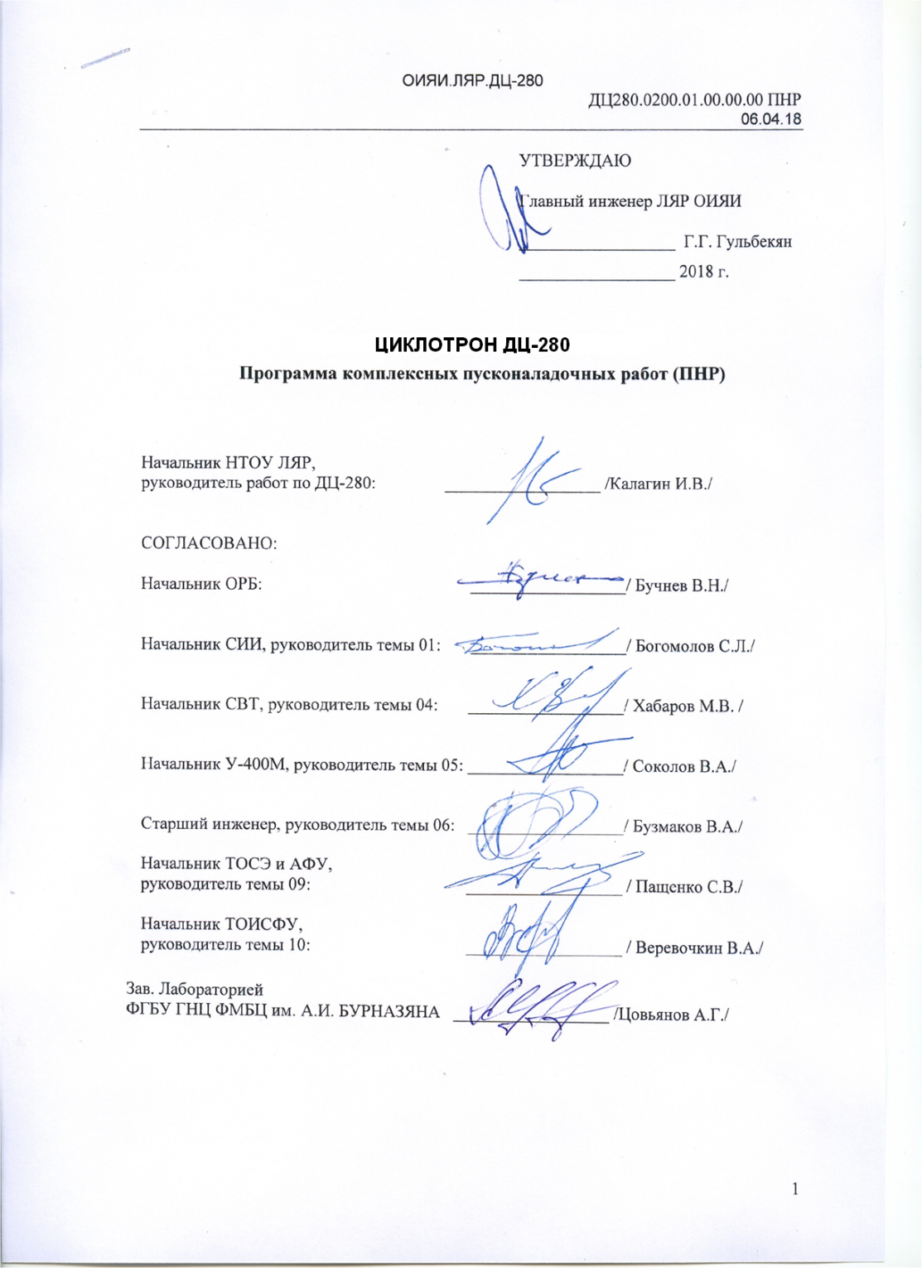
Program of Complex Launching and Tuning Works (LTW) with ion beams on DC-280 agreed with the Federal Medical and Biological Agency of Russia (FMBA)
FMBA letter to JINR Director about possibility to start the Complex LTW with ion beam on DC-280 according with the agreed program

Slide 7
DC-280
Main Parameters
Ion sources | Permanent magnet ECR DECRIS-PM - 14 GHz
Injection energy | Up to 80 keV/Z
A/Z range | 4÷7.5
Energy | 4÷8 MeV/n
Magnetic field level | 0.6÷1.3 T
K factor | 280
Magnet weight | 1000 t
Magnet power | 300 kW
Dee voltage | 2x130 kV
RF power consumption | 2x30 kW
Flat-top dee voltage | 2x14 kV
Deflector voltage | Up to 90 kV

Slide 8
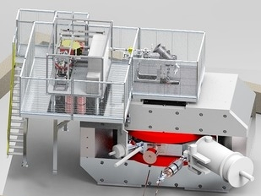
Configuration of the DC-280
Separating magnet
Accelerating tube
Electrostatic deflector
(Bender)
DECRIS-PM
ECR-source
(U_{max}=20 kV)
Magnet yoke
Magnet coils
HV platform N1
(U_{max}=70 kV)
Vacuum pump
Main RF-resonator
Flat –top resonator
Ion beam extraction

Slide 9
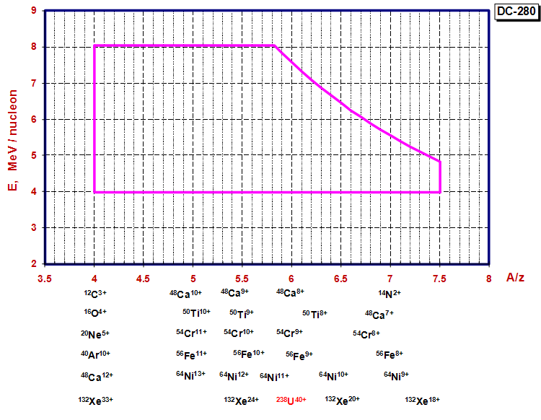
Working diagram of the DC-280
First experiments at SHE factory

Slide 10
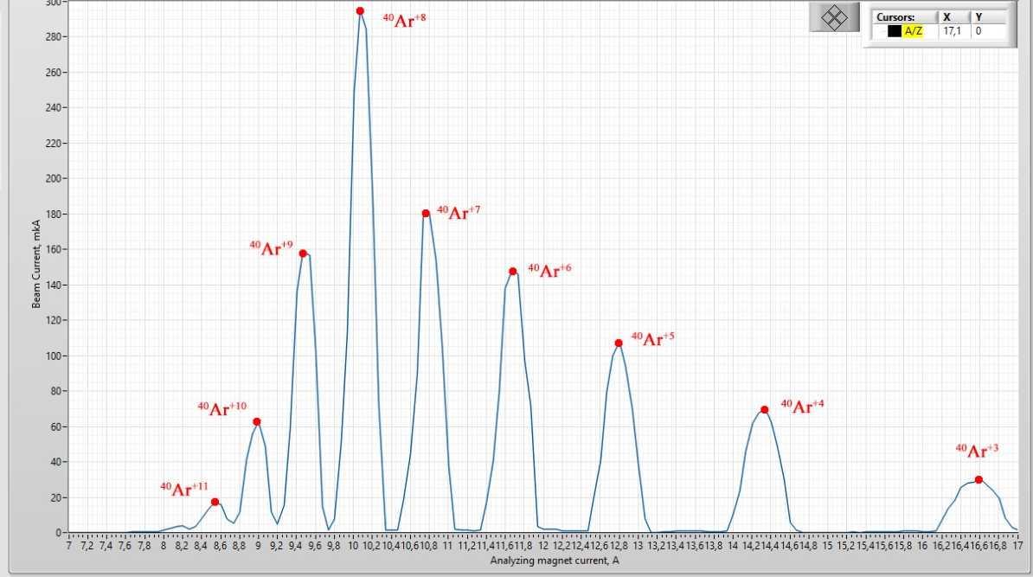
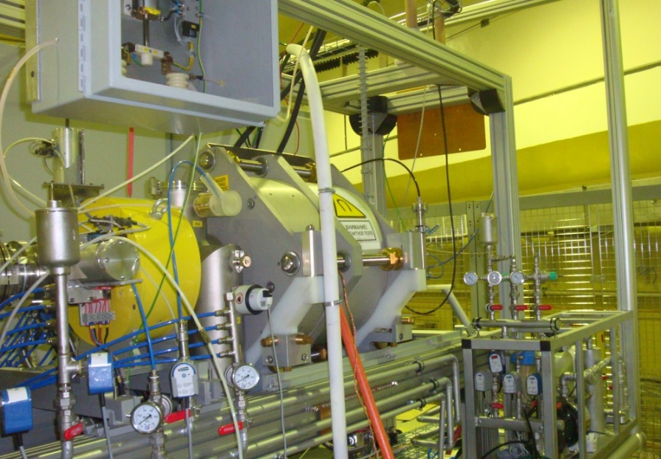
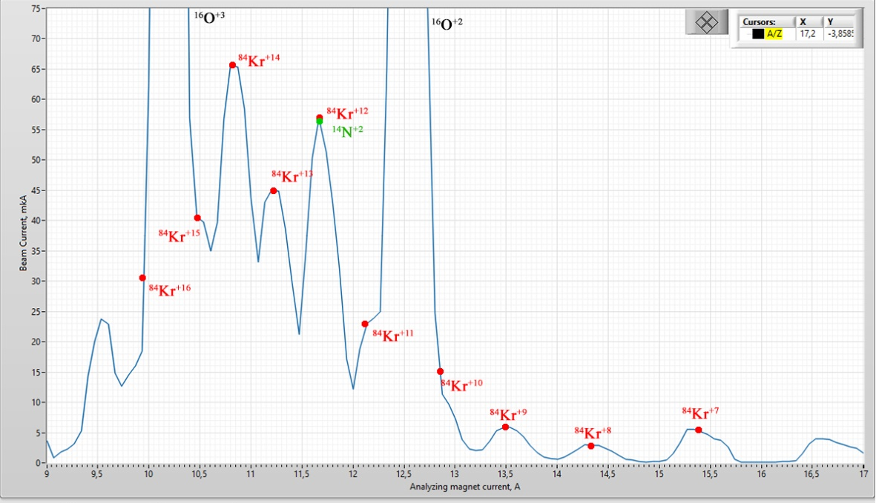
Tests of DECRIS-PM at the HV platform of DC-280
Ar
U_{ECR}=15 kV
Ions for DC-280 tests
₄₀Ar⁺⁷ , A/Z=5.71
I max=190 µA
Kr
₄₀Ar⁺⁸, A/Z=5
I max=290 µA
₈₄Kr⁺¹⁴ , A/Z=6
I max=65 µA
-The first beam

Slide 11
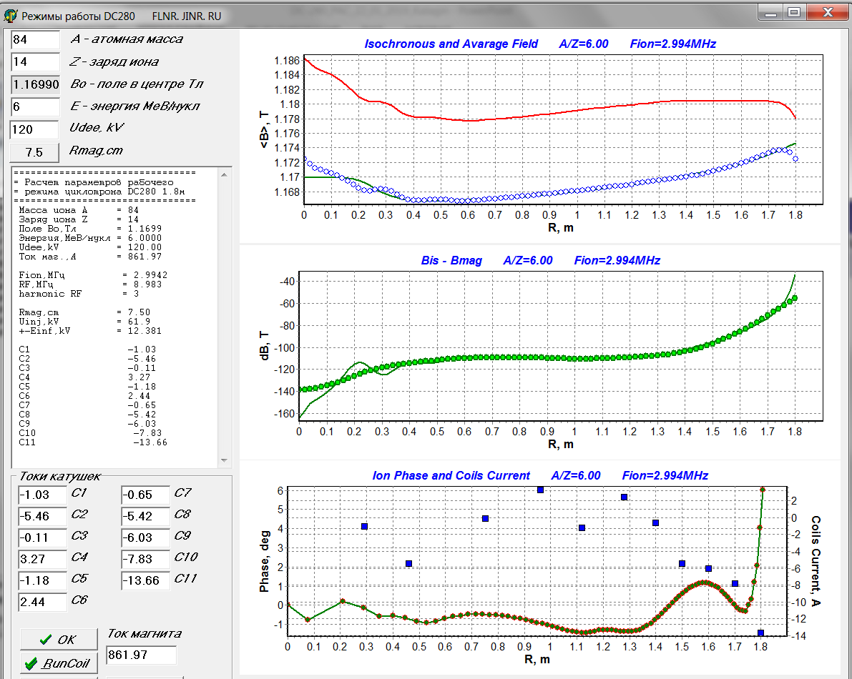
Calculated regime of ₈₄Kr⁺¹⁴ acceleration
ION | A/Z | R_{extr} | ΔR_{extr} _{120 kV} | F | HARM | В₀ | ΔВ at R_{extr} | I_{m} | U_{inj} | U_{bender} | U_{infl} | U_{defl} | E
 |  | m | mm | MHz |  | T | G | A | kV | ± kV | ± kV | kV | MeV/u
₄₈Ca⁸⁺, ₈₄Kr¹⁴⁺ | 6 | 1.76 | 12 | 9 | 3 | 1.1722 | 76.8 | 857 | 62.14 | 9.32 | 12.43 | 76 | 5.8
The first beam: ₈₄Kr⁺¹⁴
Lower activation of components at 6 Mev/u, good for materials outgazing, relatively low max ion current
Gs

Slide 12
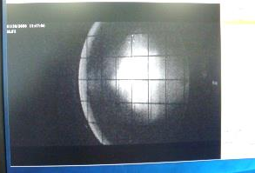
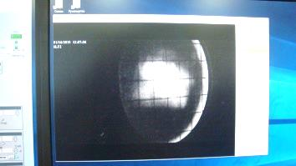
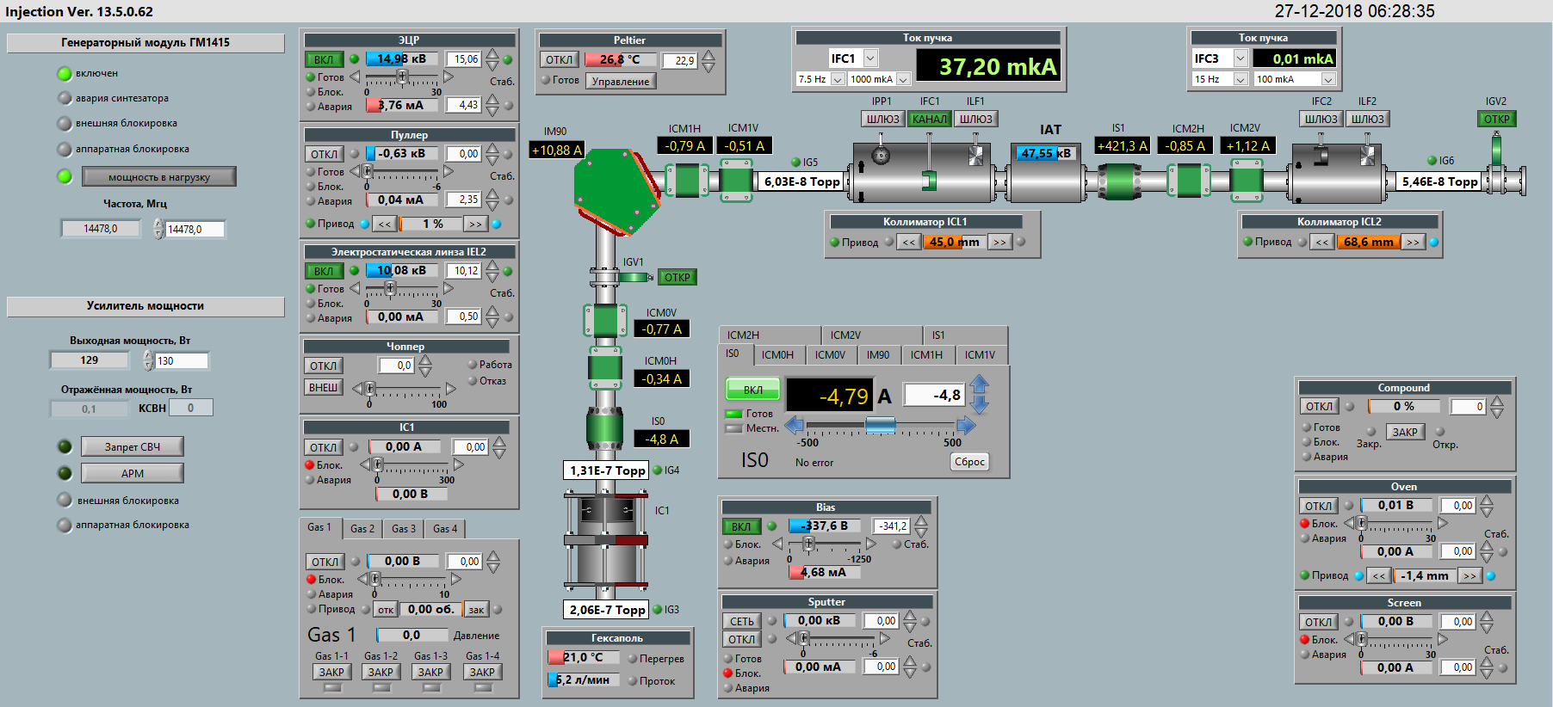
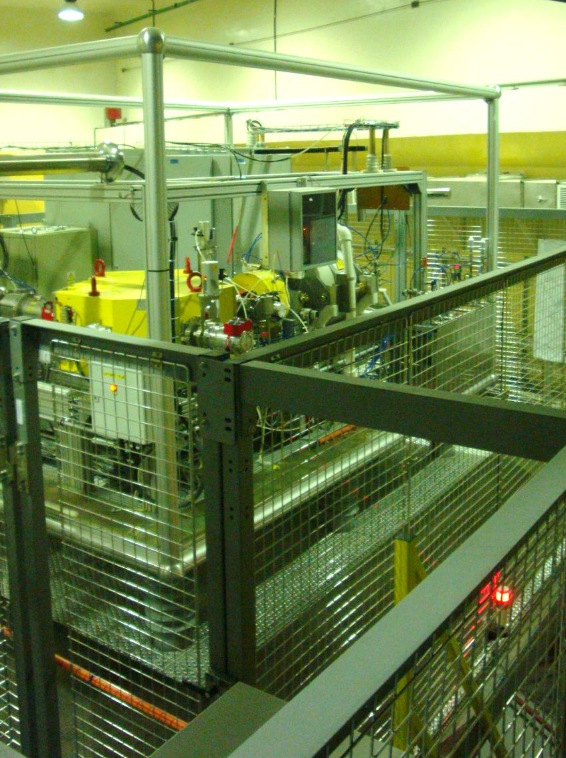
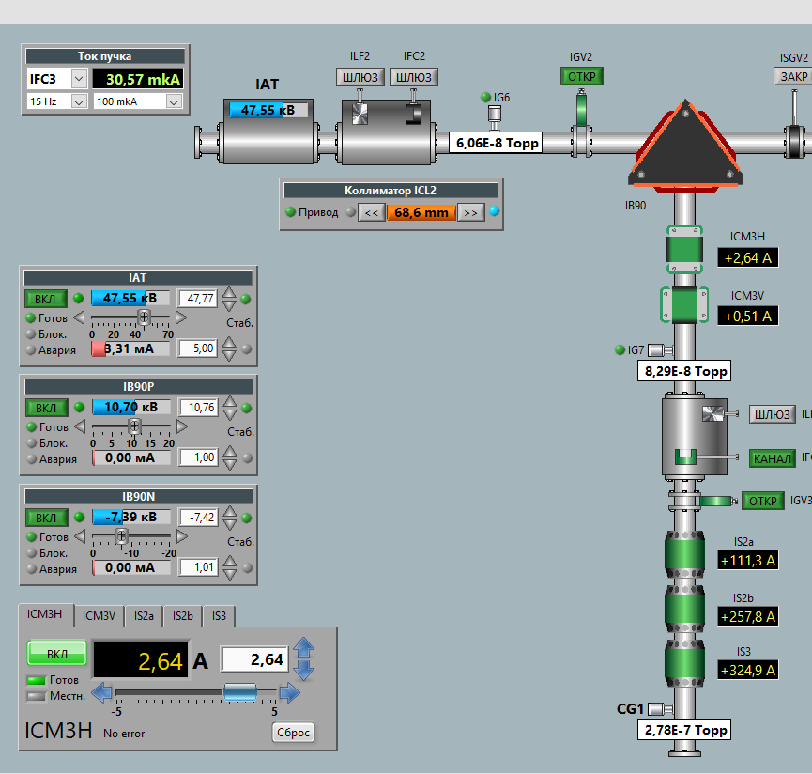
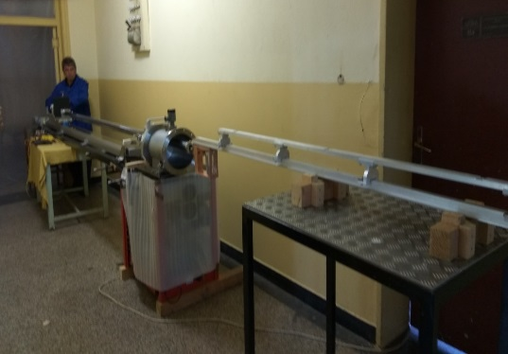
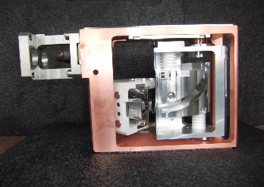
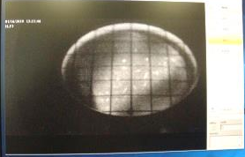
Beam injection system
ILF1
ILF2
HV
Ion beam: ₈₄Kr⁺¹⁴
Faraday cup | I (µA) | I (µA) | I (µA)
IFC1 | 40.7 | 30.1 | 18.1
IFC1 | 41 | 32.7 | 18.6
IFC1 | 40.8 | 30.8 | 17.7
ILF3
regular inflector
The HV platform (December 2018)
U_{DECRIS-PM}=15 kV
U_{HV} _{platform}=47.5 kV
We used commissioning variant of inflector

Slide 13

Transport of ₈₄Kr⁺¹⁴ beam through injection system
ILF1
ILF2
ILF3
~40
~30
~40
~40
75
Collimated
65 µA -> 41.8 µA

Slide 14
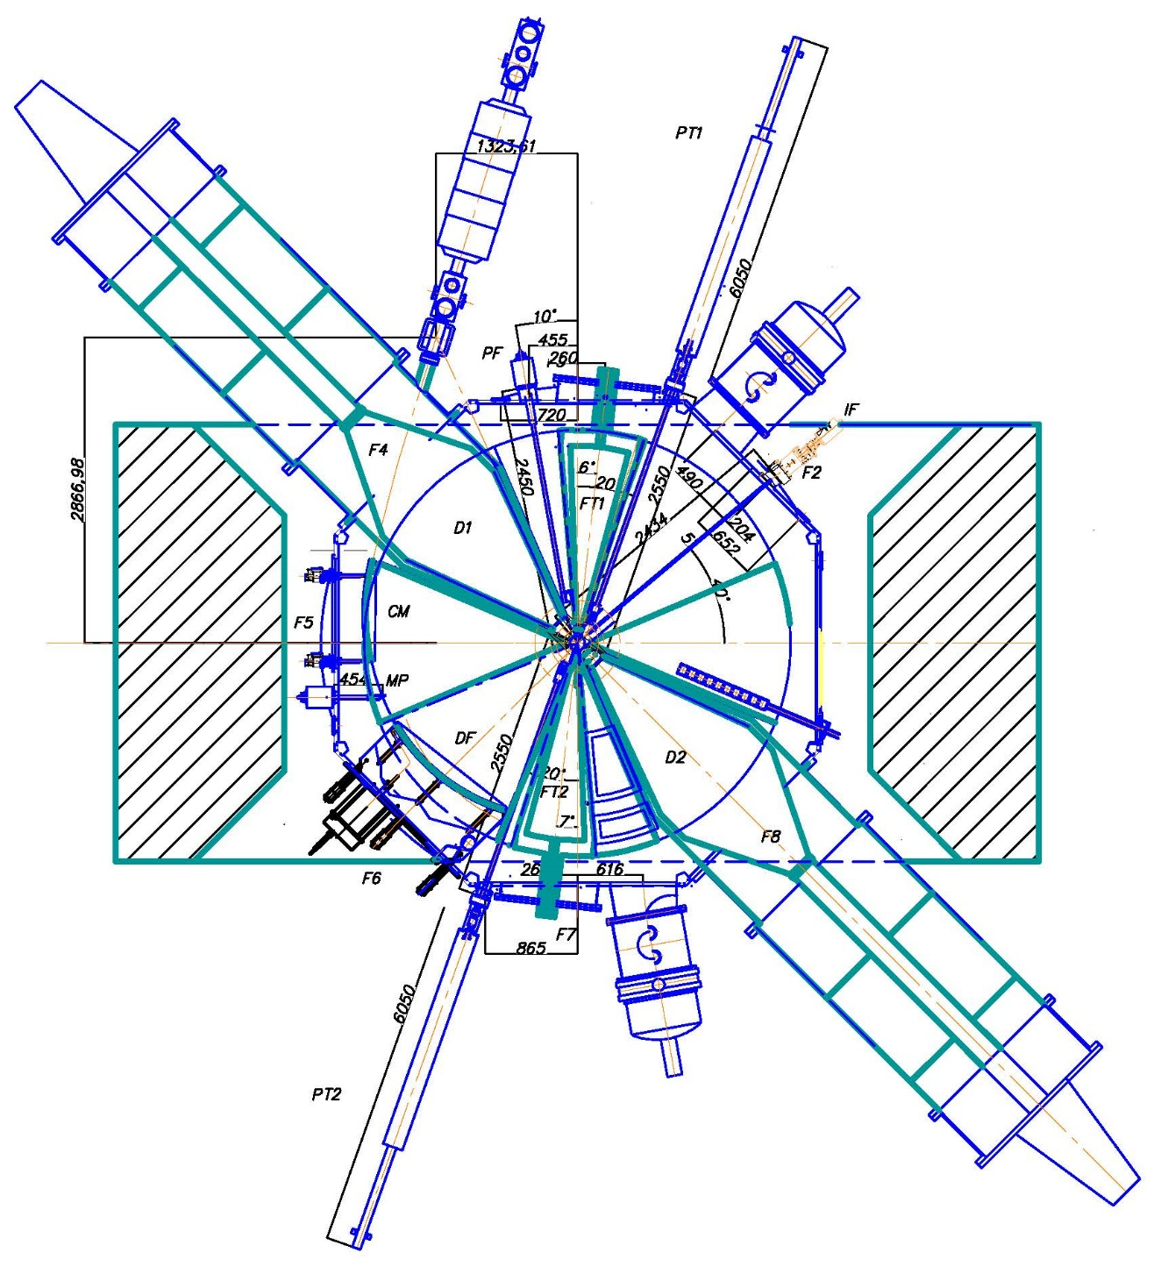
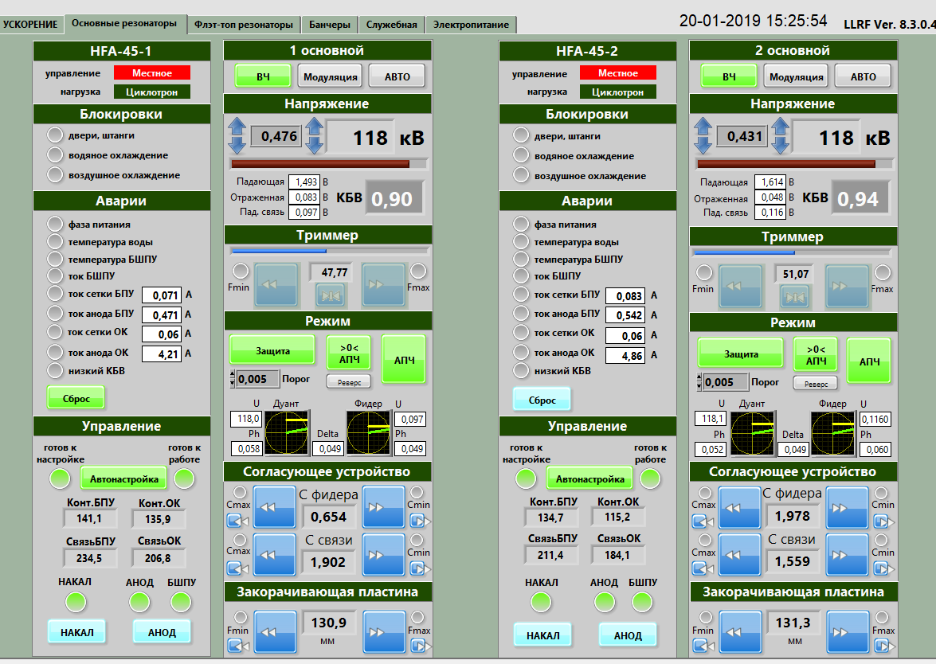
F_{rf}=7.32÷10.38 MHz
F_{ft}=21.96÷31.14 MHz
RF system
Spectrums of X-rays from dee N1 for different dee voltages measured by XR-100T-CdTe detector
3F_{rf}
F_{rf}
`
Dependence of maximal energy of X-rays on pick-up voltage

Slide 15
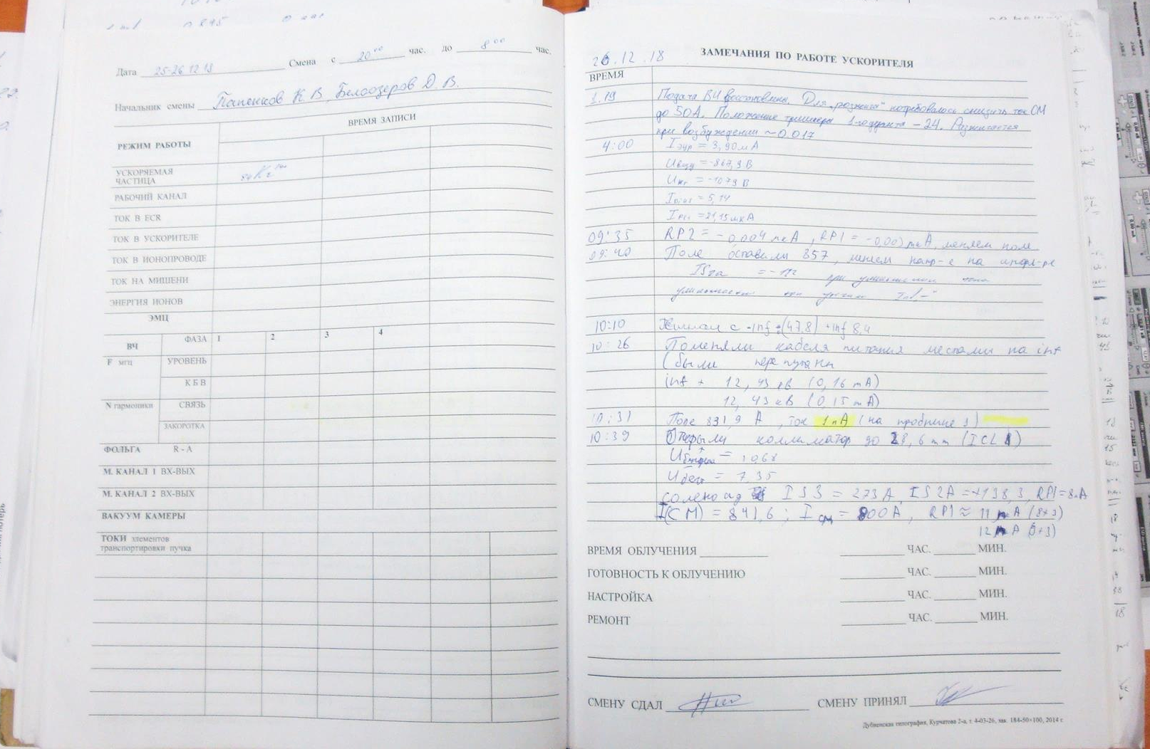
The first ion beam accelerated in DC-280
26.12.2018
The first accelerated beam
of ₈₄Kr⁺¹⁴ I_{RP1}=1nA
R probe 1=281 мм
Im=831.9 A 10:31 a.m.
`
Current at radius of 1700 mm was up to 4 µA at injection current of 31 µA
Beam was not extracted due to problems with deflector

Slide 16
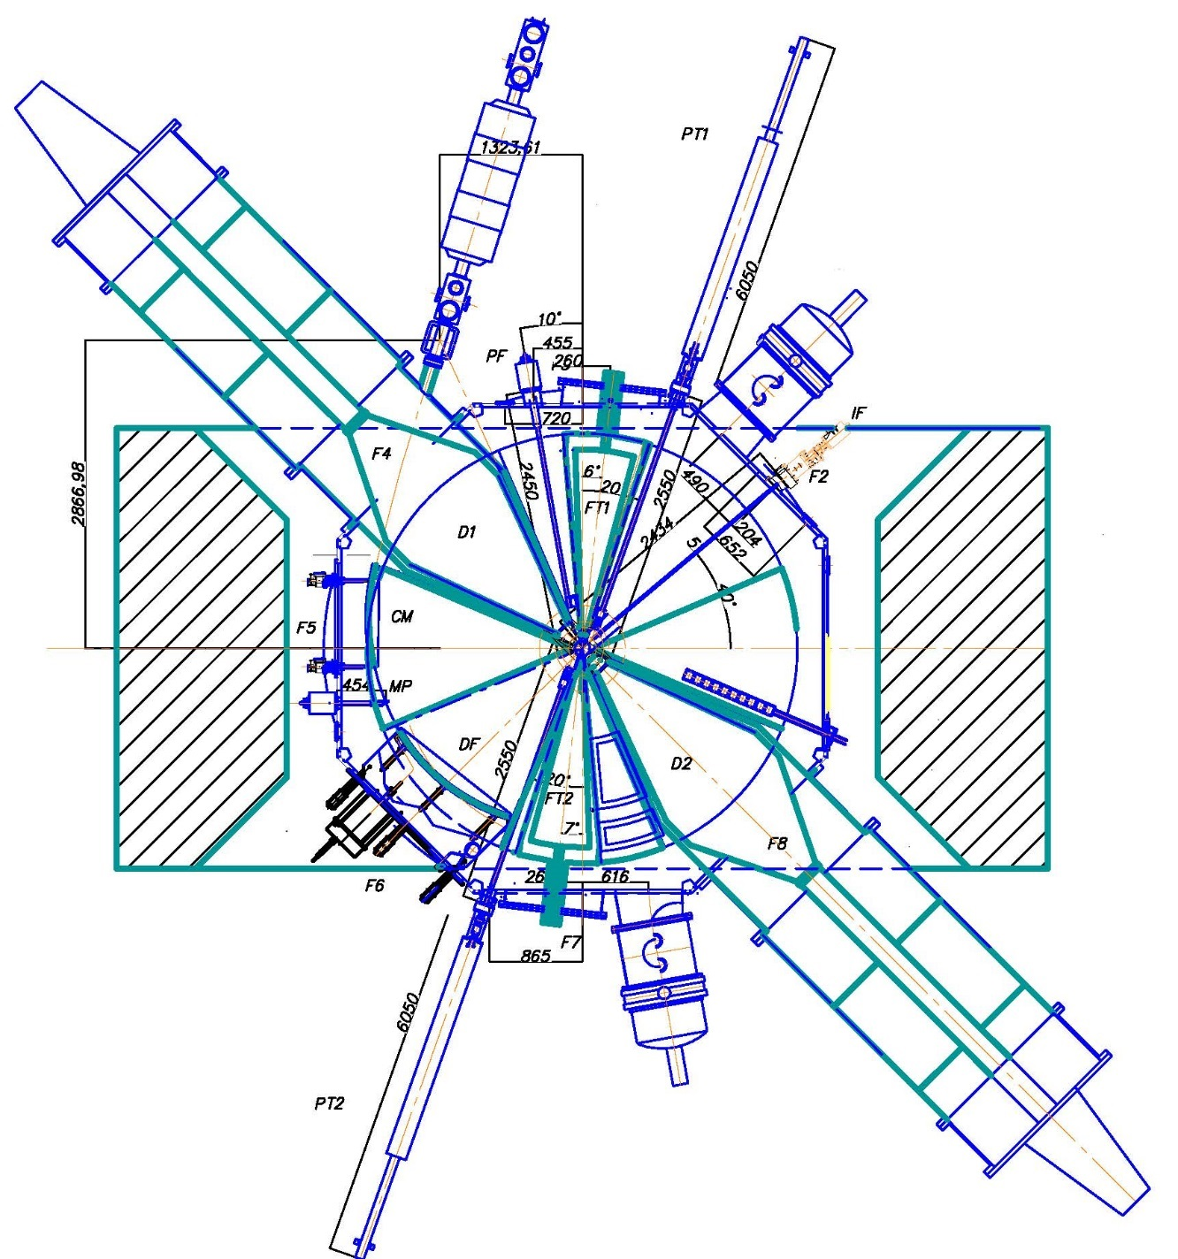
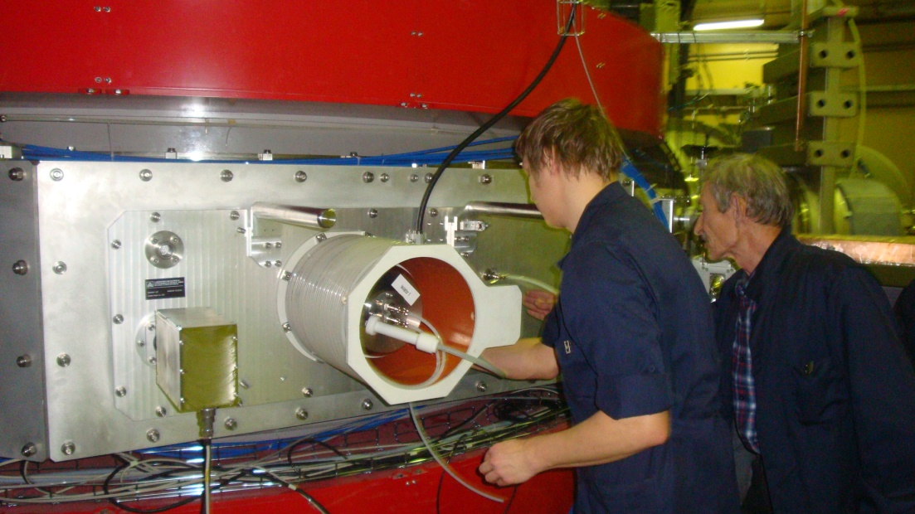
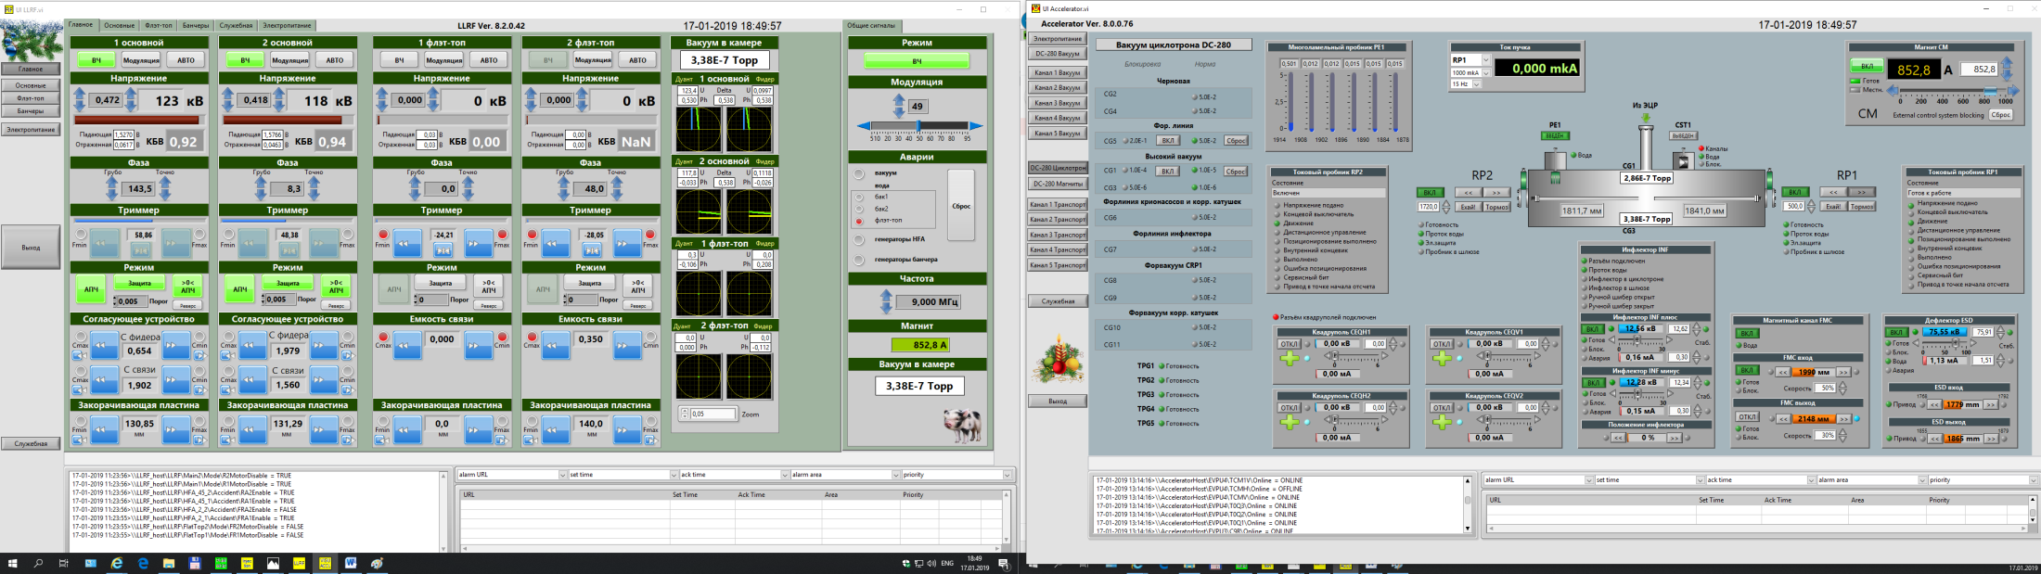
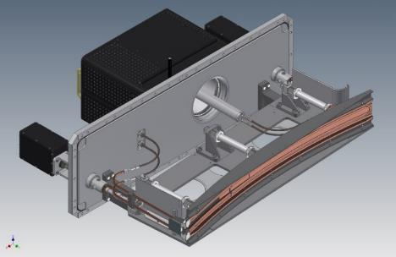
Beam extraction system
Extraction radius of R_{ext}=1.79 m
Deflector tuning
Focusing magnetic channel
`
Electrostatic deflector
Electrostatic deflector
L=1.3 m, Emax=90 кV/сm
Udefl=75.55 kV, Ileak=1.13 mA

Slide 17
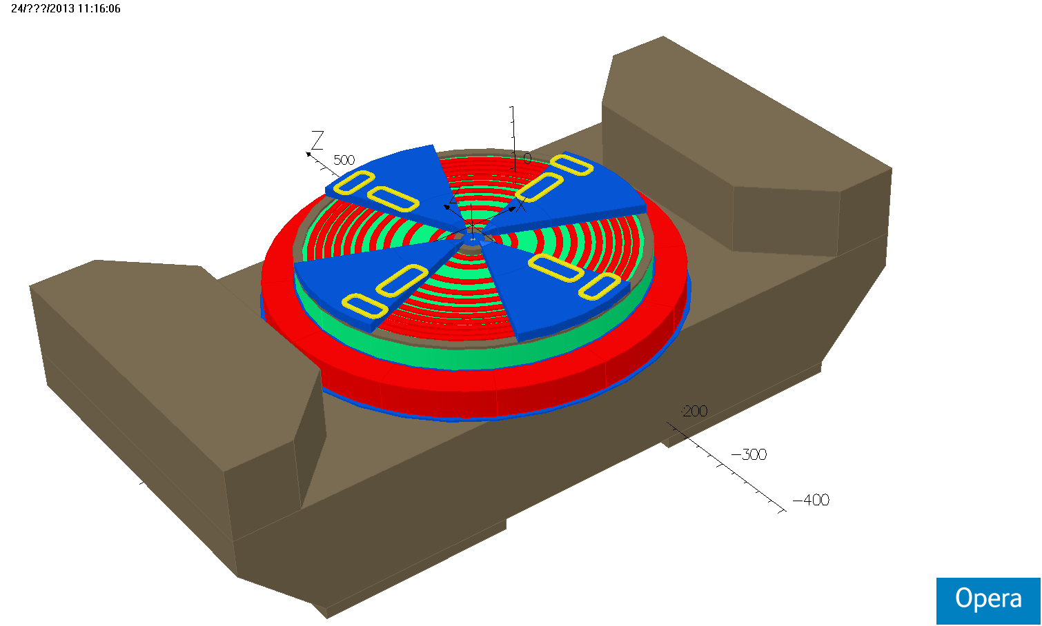
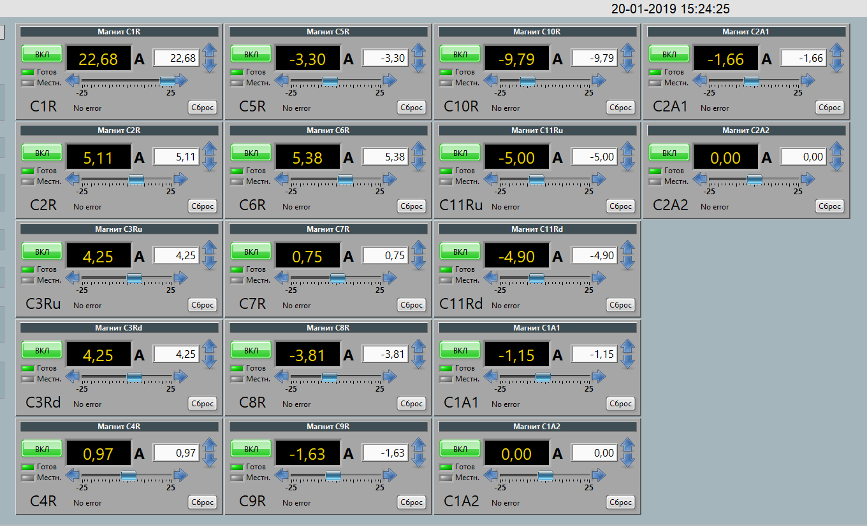
Magnet trimming coils
Radial trimming coils
Azimuthal trimming coils
Number of radial trimming coils | 11
Number of azimuthal trimming coils | 8

Slide 18
Resonance characteristics of ₈₄Kr⁺¹⁴ acceleration
(Garren-Smith method)
50 G
B (T)

Slide 19
Transmission of ₈₄Kr⁺¹⁴ at acceleration
Preliminary results
Capture: ~51%
Losses: ~20%
Capture: ~13%
Losses: ~40%
Without buncher
With 1-st harmonic of buncher
I _{FC1} | 18.1 | µA |  | Polyharmonic buncher
I _{FC2} | 18.6 | µA
I _{FC3} | 17.7 | µA
 | R, mm | I, µA | I/I _{FC1}
PR1 | 1400 | 2.8 | 16% | without buncher
PR1 | 1400 | 9.8 | 54% | with 1-st harmonic | 545 V
PR1 | 1400 | 10.3 | 57% | with 1-st and 2-nd harmonics | 900 V, 404 V

Slide 20
Dependence of ion current on dee voltage

Slide 21
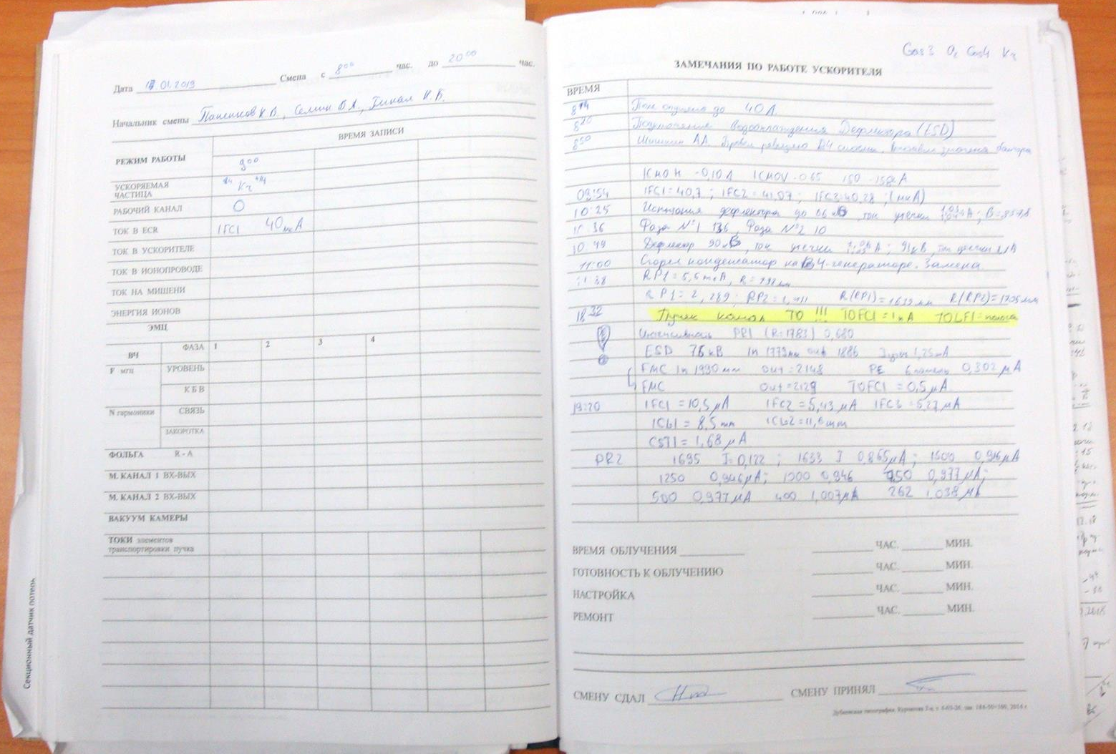
The first ion beam extracted from DC-280
without flat-top resonators
`
17.01.2019
The first extracted beam
of ₈₄Kr⁺¹⁴ I_{RP1}=1nA
18:32

Slide 22
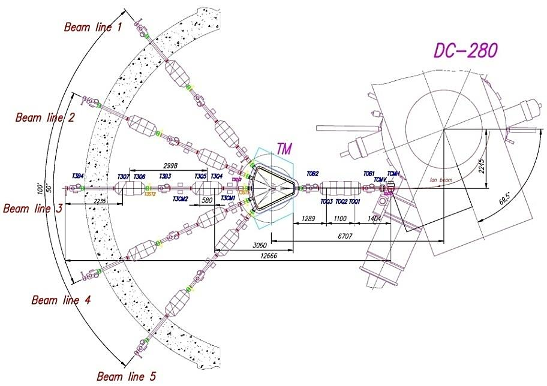
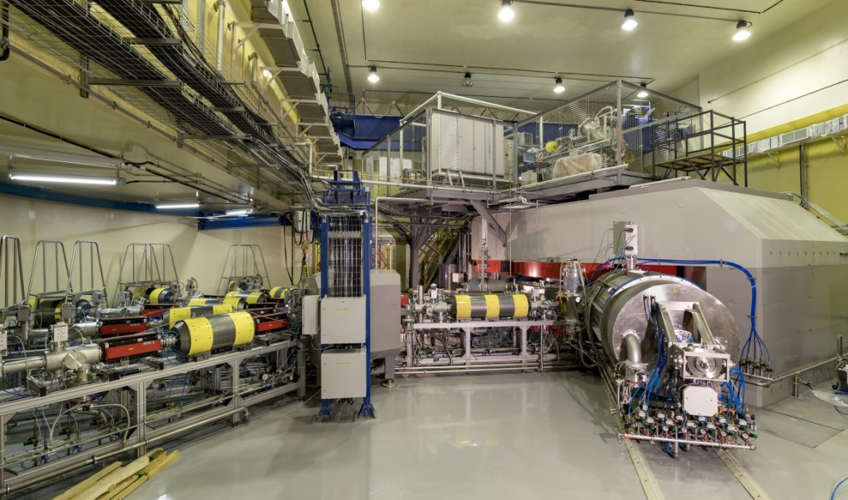
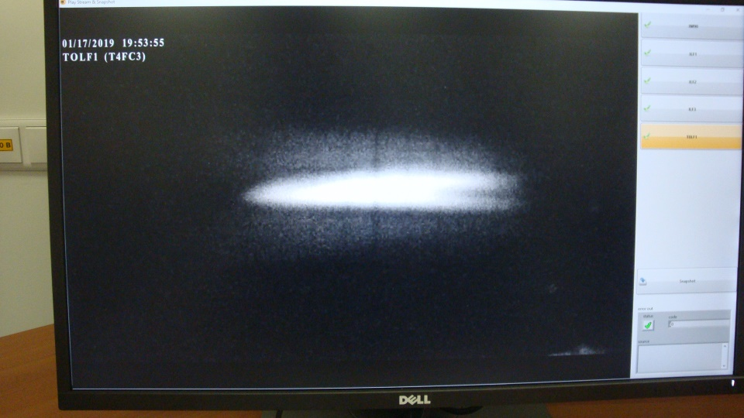
Extraction channels
Bending magnet ±50°
Quadrupole lenses
~10
~45
Beam of 100 nA on the TLF0 luminophor
T0LF1

Slide 23
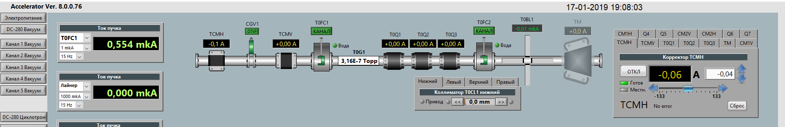
Vacuum conditions
`
Vacuum in the DC-280 chamber PCG1=2.86⋅10⁻⁷ Torr, PCG3=3.38⋅10⁻⁷ Torr
`
Vacuum in the extraction channel: PT0G1=3.16⋅10⁻⁷ Torr

Slide 24
Efficiency of ₈₄Kr⁺¹⁴ beam transportation
from ECR source to extraction channel
Extraction without flat-top resonators
Measuring point | Beam intensity μA | Transmission factor
ECR source, after separation | 10.6 | 17.6% |  |  | Total 6%
Cyclotron center | 1.87 |  | 48.7%
Extraction radius | 0. 91 |  |  | 70.3%
Extracted beam | 0.64
Preliminary results
Transmission without buncher
Measuring point | Beam intensity μA | Transmission factor
ECR source, after separation | 11 | 51.4% |  |  | Total 18.2%÷ 27.3%
Cyclotron center | 5.65 |  | 78.8%
Extraction radius | 4.45 |  |  | 45%÷ 67.4%
Extracted beam | 2÷3
Transmission with only the 1-st harmonic of buncher
Notes:
transmission factor.
Less than 20% of beam is lost in the process of acceleration
The overall efficiency is slightly less than 10 percent

Slide 25
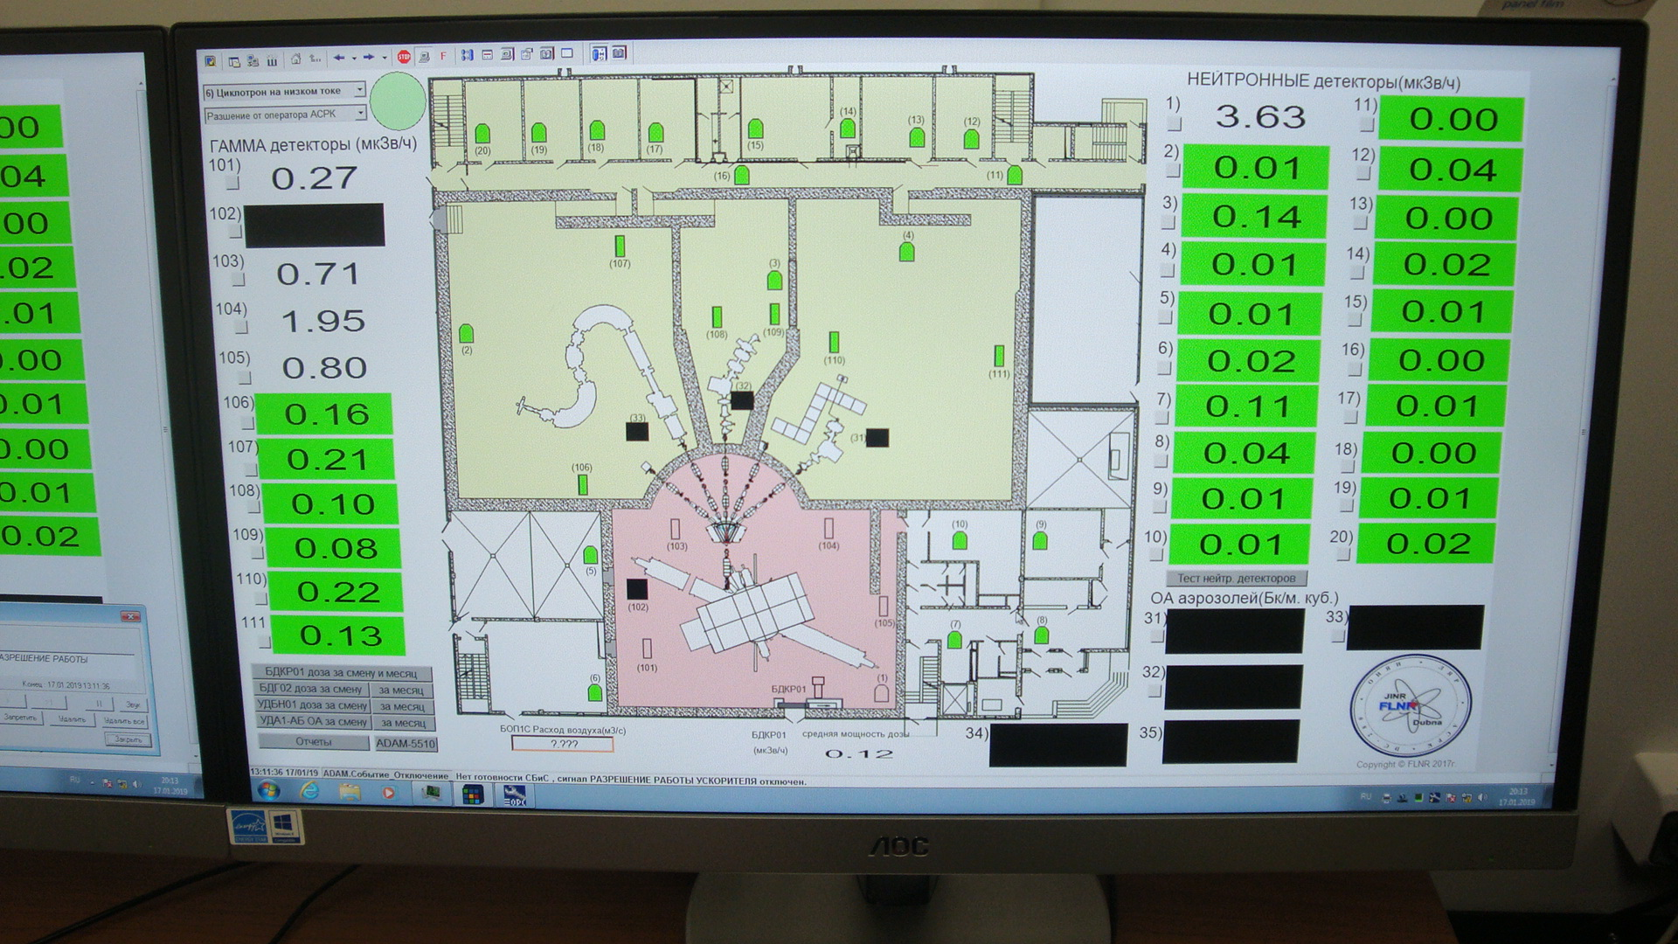
Radiation conditions
`
`
3.63 µZv/hour at 1 µA of extracted ₈₄Kr⁺¹⁴ beam

Slide 26
Future plans
Continuation of Complex LTW with acceleration of ₁₂C⁺², ₄₀Ar⁺⁷, ₄₈Ca^{+8,+9}, ₈₄Kr⁺¹⁴ ion beams. Carrying out radiation measurements with participation of FMBA representatives.
Installation of flat-top resonators, installation of regular inflector instead of commissioning variant, improving vacuum in the cyclotron chamber by searching hidden leak in the RF resonator N1.
Acceleration of ₄₈Ca^{+8,+9} ₅₀Ti^{+8,+9}. Increasing ion beam intensity to designed, transportation of ion beams to the GNS-2 experimental setup, measuring of beam transmission, measuring of beam parameters (energy, intensity distribution in cross-sections), preparation to first experiments.

Slide 27
Conclusion
The first beam of ₈₄Kr⁺¹⁴ ions was accelerated in the DC-280 cyclotron on 26.12.2018.
The first beam of ₈₄Kr⁺¹⁴ ions was extracted from the DC-280 cyclotron on 17.01.2019.
Complex LTW with acceleration of ₁₂C⁺², ₄₀Ar⁺⁷, ₄₈Ca^{+8,+9}, ₈₄Kr⁺¹⁴ ion beams will be carried out up to March 2019.
The DC-280 will be prepared to first experiments with acceleration of ₄₈Ca^{+8,+9} ₅₀Ti^{+8 ,+9} in March 2019.

Slide 28
S.Dmitriev, Yu.Oganessian, G.Gulbekian, I.Kalagin, B.Gikal, S.Bogomolov, A.Efremov, A.Lebedev, V.Semin, V.Buzmakov, N. Pchelkin, S. Prokhorov, V. Sokolov, V.Mironov, N.Kazarinov, I.Ivanenko, V.Kazacha, V. Melnikov, O.Borisov, A.Tikhomirov, K. Gikal, K.Papenkov, K.Verlamov, A. Issatov, S.Mitrofanov, Yu. Teterev, N.Osipov, G. Ivanov, V.Bekhterev, V.Zarubin, V.Galinsky, S.Pashenko, S.Gusarov, V.Aleinikov, V.Verevochkin

Slide 29
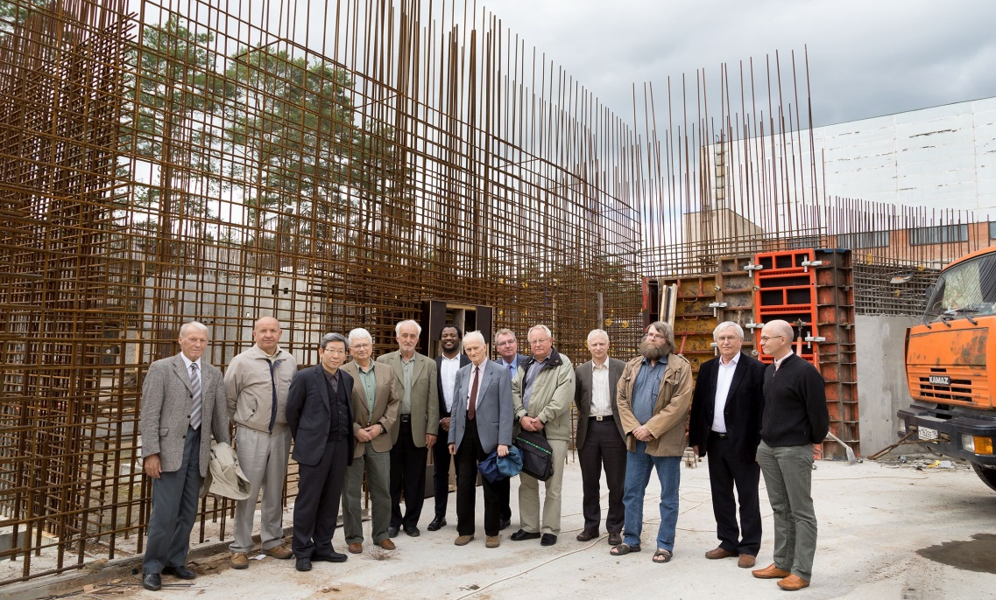
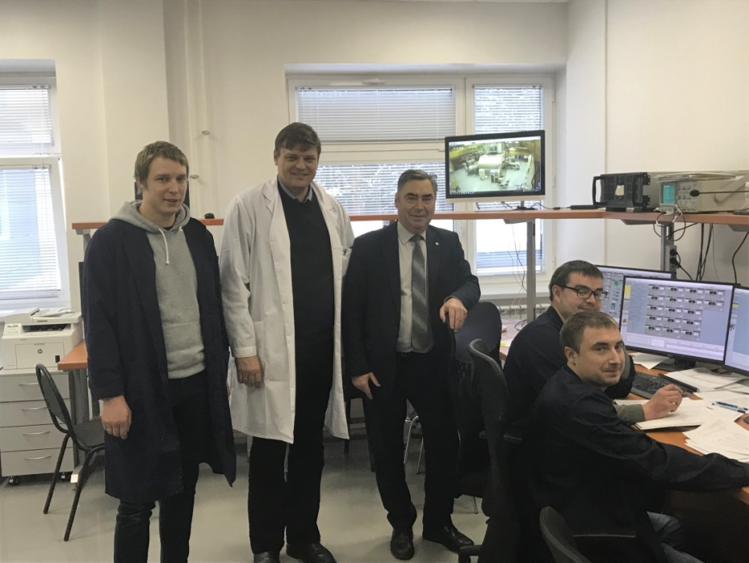
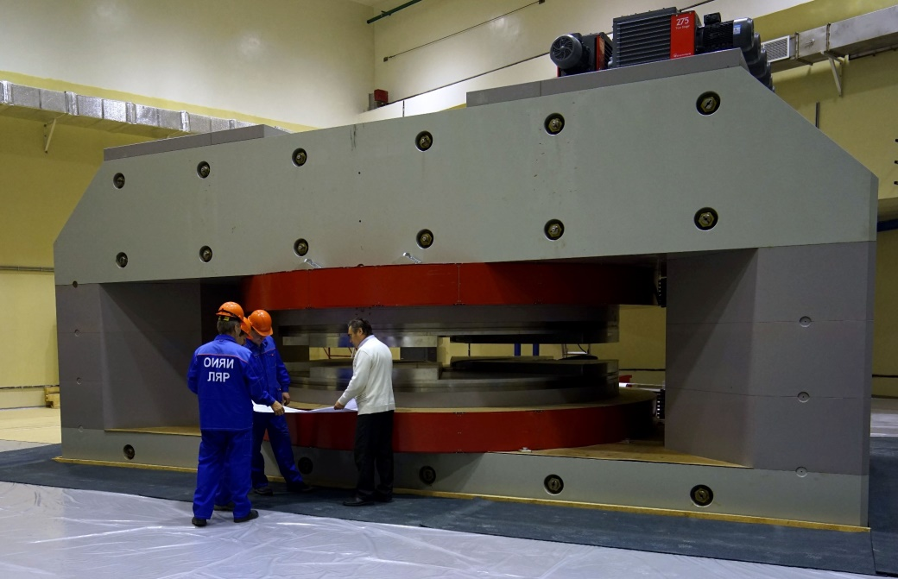
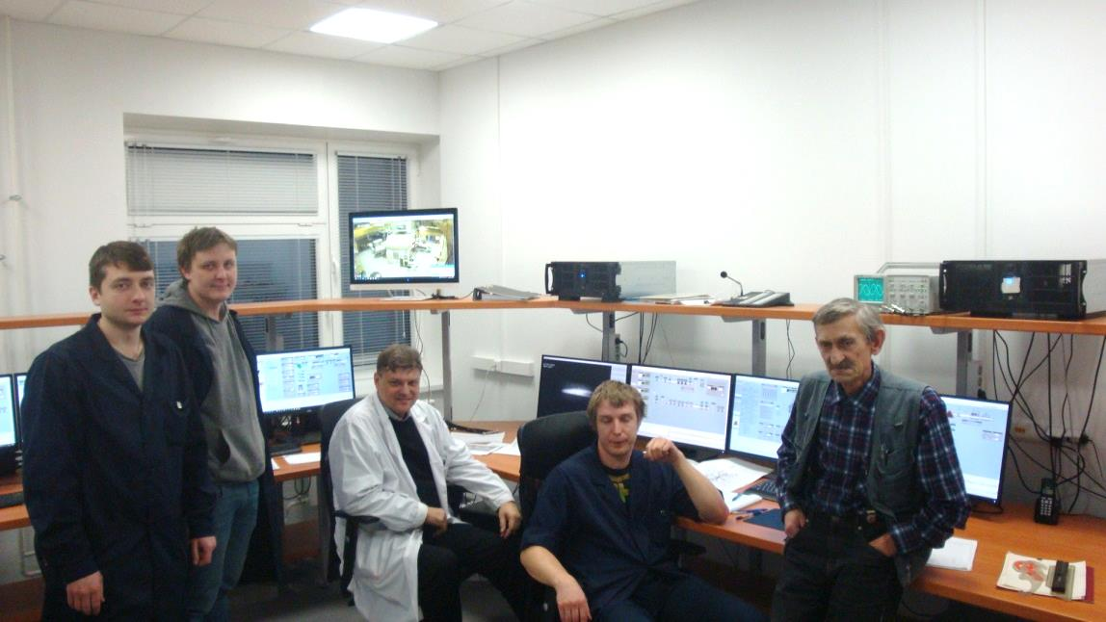
THANKS FOR YOUR ATTENTION!
DC280 accelerator hall, PAC-40 26.06.2014
The first accelerated beam 12.12.2018
Magnet of DC280 18.01.2017
The first extraсted beam 17.01.2019

