Slide 1
Status of TDRs of MPD subsystems
V.Golovatyuk
http://mpd.jinr.ru/doc/mpd-tdr/

Slide 2
# | TDR name | Comments | Date | Link
1 | TPC TDR | Version: 16 Jan. 2019 | 17.01.2019 | TpcTdr-v07 Chapter 8 on FEE was completely redesigned. A new front-end electronics is based on 32 channels ASIC SAMPA. Each FEC comprises two SAMPA chips. FEE, which was developed at the initial stage of TPC creating and based on ASIC ALTRO, is made in the form of an application "Addendum A1 to TPC/MPD TDR Rev.07." The changes have been made to the low-voltage power supply hardware on Slow Control (Chapter 13). The infrastructure information is added for the TPC gas supply system (Chapter 14). Some adjustments was entered in the TPC time schedule design and construction cost (Chapter 14). 3 new publications for 2017 - 18 have been added to the list of publications
1a | Addendum - TPC electronics | Version: 2018 | 17.01.2019 | TpcTdrv07-AddA1-FEE FEE based on PASA-ALTRO
2 | TOF | final version | 17.11.2018 | TDR_TOF_MPD_v3_0-08_11_2018

Slide 3
3 | FFD | final version | 14.01.2019 | FFD report_Jan-2019 The new version of FFD TDR were made the following changes: 1. Section 5.6 "Special stand for tests with cosmic muon" was added. 2. In Chapter 6 "The FFD electronics" the description of electronics was changed with new figures. 3. In Chapter 9 "Calibration system" information about test measurements was added. 4. The Time table (chapter 17) and Detector budget (chapter 18) were corrected
4 | FHCal | final version | 28.05.2018 | MPD_TDR_FHCal_28_05_2018
5 | ECal | Version: January 2019 | 16.01.2019 | TDR_ECAL_v3.6_2019.pdf Added chapters: 2.4 MC detector study with clustering algorithm 3.5 Power Structure of the Calorimeter Changes were made: 3.1 ECal module 5. Time table and cost estimation
6 | DAQ | version of 27 August 2018 | 27.08.2018 | MPD_DAQ_TDR-2018-8

Slide 4
7 | Computing |  | 18.12.2017 | NICA_computing_TDR_1.03 Budget_NICA_Computing_2016_2020
8 | Integration MPD | to be ready in May 2019 | 24.05.2017
9 | Solenoid and Magnet Yoke | final version | 26.05.2017 | TDR MAGNET
10 | ITS- Inner Tracking System | TDR of 1st stage version of ITS will be ready by April 2019
11
12

Slide 5
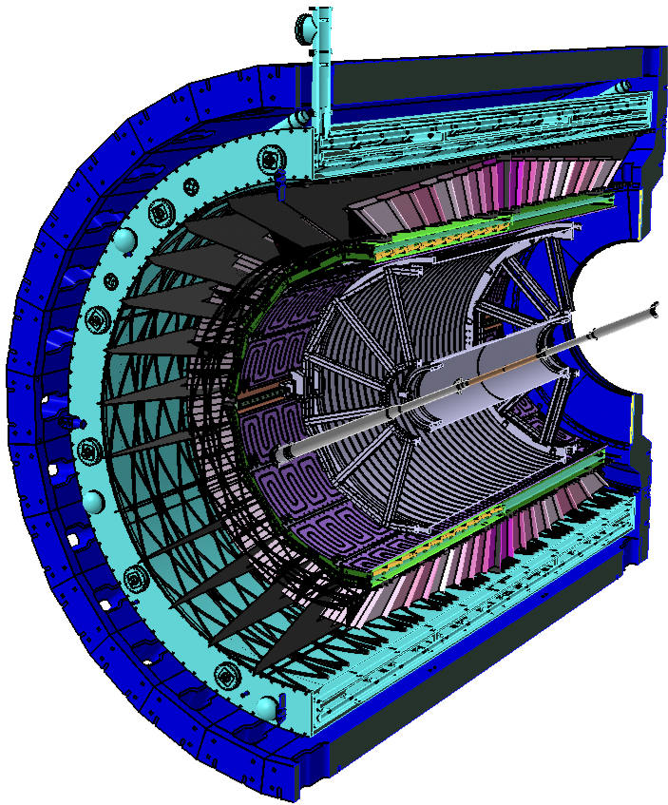
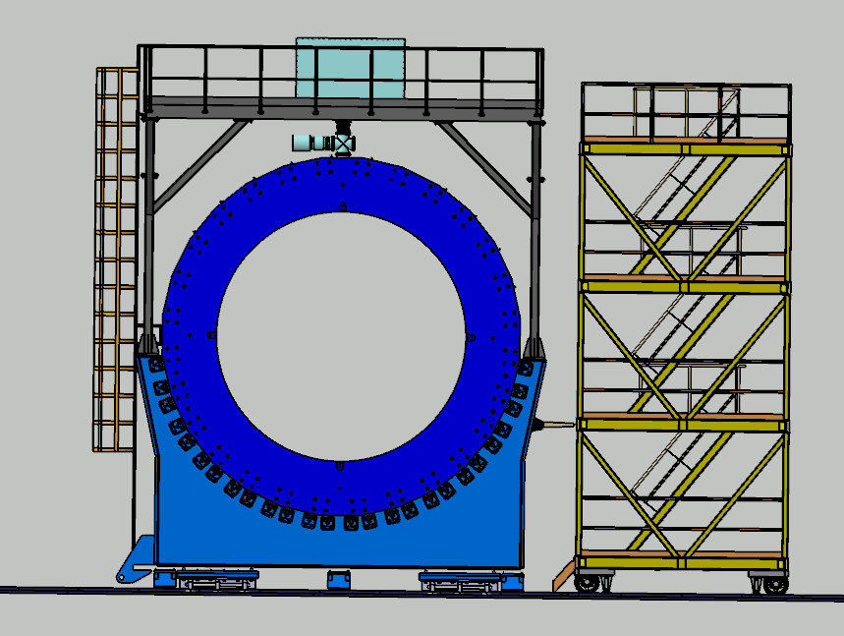
ITS, FFD and beam pipe integration

