Slide 1
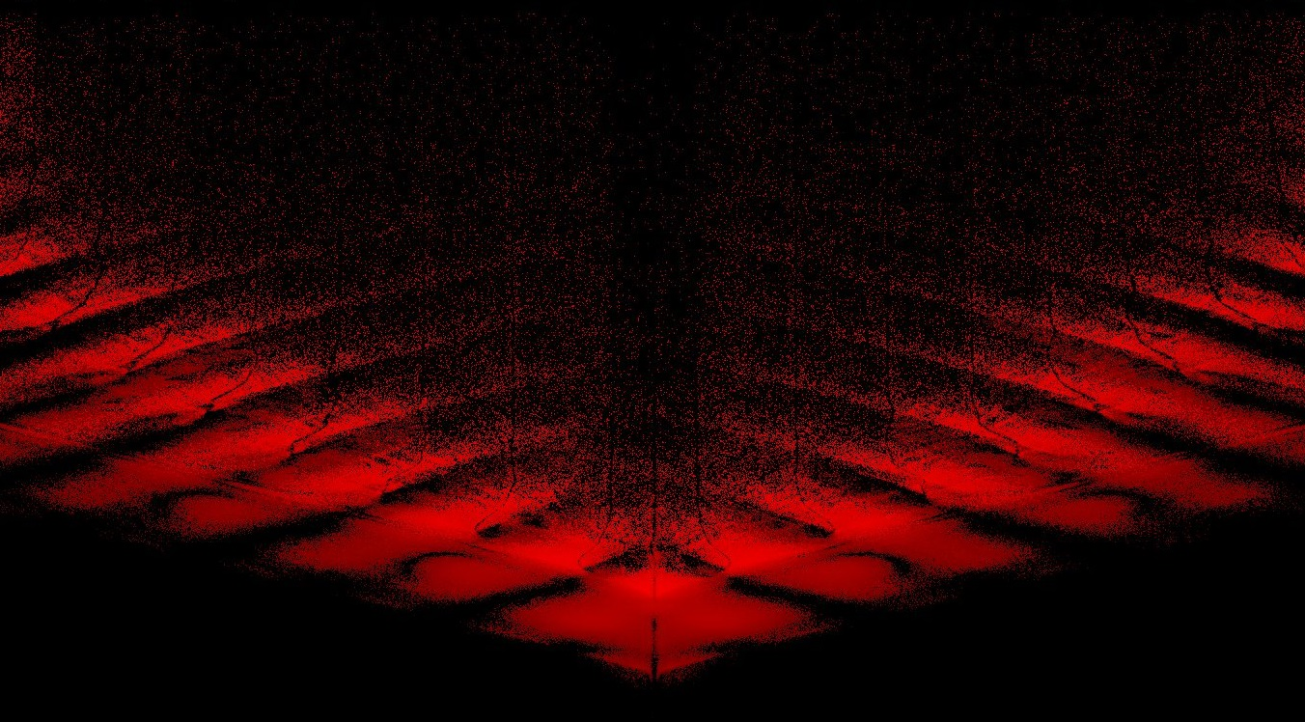
Exawatt Science
Alexander Sergeev
Russian Academy of Sciences
JINR, Dubna

Slide 2

Motivation
Today’s PW scale lasers provide maximum intensity 10²² W/cm²
Upcoming 10 PW facilities (ELI NP, Apollon, SIOM) will achieve 10²³ W/cm²
Exawatt scale lasers will provide operation at 10 ²⁴ W/cm² – 10 ²⁵ W/cm² where a new and very rich realm of e-e+ plasmas and gamma ray sources exists
New realm is featured by
Ultrarelativistic, ultradense e-e+ plasma
GeV Gamma-Ray sources with extreme brilliance
Giant magnetic fields and currents
Exawatt scale lasers enable approach to even higher intensities 10 ²⁶ W/cm² – 10 ²⁸W/cm² by efficient conversion
    from fs to as pulses

Slide 3
Intensity and field magnitude scales
10¹⁵ W
e A
Schwinger field
а=mc²/ħω≈500000
I (W/сm²)=
=10²²W/сm²
a =
10⁻⁷ сm²
mc²
a ≈ 0.1
I ≈ 3 10¹⁶ W/cm²
Corresponds to intraatomic field that holds electron at first orbit in Hydrogen atom
Ions become relativistic
а≈5000
Strong Nonlinear QED phenomena
а=2e²mc/3ħ²ω≈2000
Radiation reaction а=(3λ/4π r_{e})^{1/3}≈500
Electrons become relativistic а≈1
Intraatomic field а=eE_{at}/mcω≈0.1
10¹⁴
10¹⁶
10¹⁸
10²⁰
10²²
10²⁴
10²⁶
10²⁸
10³⁰
W/сm²
present
future

Slide 4
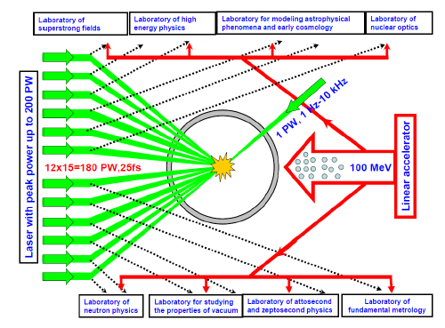
XCELS
XCELS- EXawatt Center for Extreme Light Studies
is based on a new laser facility comprising of 12 amplification channels,
each of them providing 400 J, 25 fs pulses, with the total pulse power of
almost 200 PW. A new research institute will be built around this laser facility.
12 channels
15 PW each
400 J, 25 fs, 910 nm
Quality: 3 divergence limits
Intensity 10²⁴-10²⁵ W/cm²

Slide 5
Laser or Parametric Amplification?
Pump
Pump wave
Laser
pulse
Signal
Laser medium
Nonlinear crystal
Laser amplification
Parametric amplification

Slide 6
Optical Parametric Chirped Pulse Amplification (OPCPA)
versus
Chirped Pulse Amplification (CPA)
Optical
Parametric
Amplifier
Stretcher
Ti:Sapphire
Compressor
100 fs
1 ns
amplifier
1 ns
100 fs
100 MHz
100 MHz
10 Hz
10 Hz
2 nJ
1 nJ
200 mJ
100 mJ
2
⋅
10
4
W
1 W
2 10
8
W
10
12
W
Optical
Parametric
Amplifier
Nd:glass
Compressor
amplifier
1 ns
400 fs
1KJ
660 J
10
12
W
1.5
⋅
10
15
W

Slide 7
Superbroadband synchronism e = o+o in DKDP crystal
ω₃ ,k₃ – narrow band pump (ns pulse) – frequency ω₃ = const
ω₁ ,k₁ and ω₂ ,k₂ – broadband signal and idler – variables, Δω₁=−Δω₂=Ω
Synchronism
Broadband
Synchronism
Superbroadband
Synchronism
At pumping with second harmonic of Nd:glass laser (λ₃ = 527 nm) in DKDP crystal with 85% deuterization, superbroadband synchronism takes place for :
λ₁ = 910 nm, λ₂ = 1250 nm, θ ₃=37,5⁰ , ϕ₁₃ = 0.7⁰
1/527=1/910+1/1250

Slide 8
Optical Parametric Chirped Pulse Amplification (OPCPA)
Nanosecond pump pulse
Chirped femtosecond signal

Slide 9
XCELS Layout
Key technologies for XCELS facility:
OPCPA technique
3 kJ, 1.5 ns Nd: glass pump lasers
30x30 cm² KD*P crystals
50x100 cm², broad band
(25 fs), 0.2 J/cm² damage threshold
gratings with 910 nm central
wavelength
5. Tight focusing optical system

Slide 10

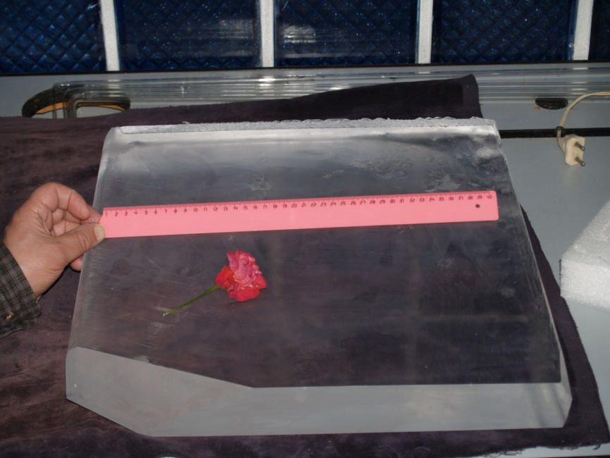
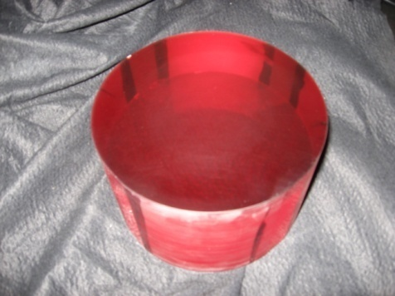
Laser or Parametric Amplification?
Crystal Systems, USA
RSA Le Rubis, France
IAP RAS
Cleveland Crystals, USA
Ti:Sa boule, diameter 192 mm,
height 122 mm.
Crystal KDP, 40х40 см²

Slide 11
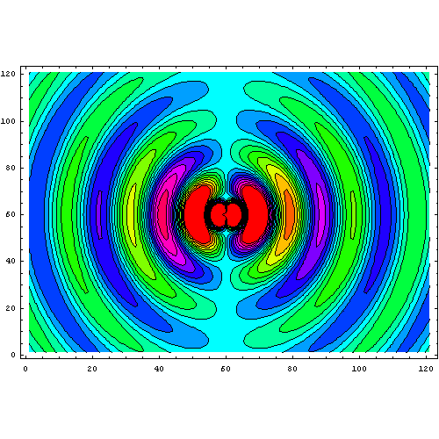
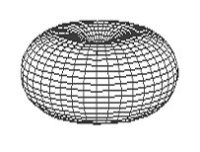
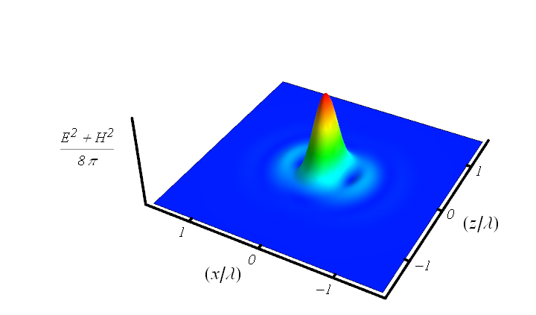


How to maximize field intensity at given power ?
Rule of thumb for coherent combining of several beams:
To maximize the electric field at focusing point,
radiation of several combining beams should reproduce
configuration of phase conjugated dipole radiation field
I. Gonoskov, A. Aiello, S. Heugel, and G. Leuchs, Phys. Rev. A (2012)
z
x
Minimum focusing volume:
Converging dipole wave as an exact solution of Maxwell equations:

Slide 12
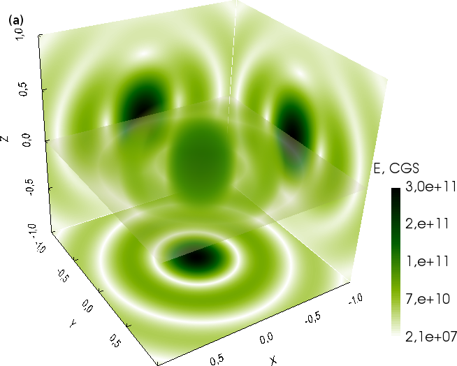
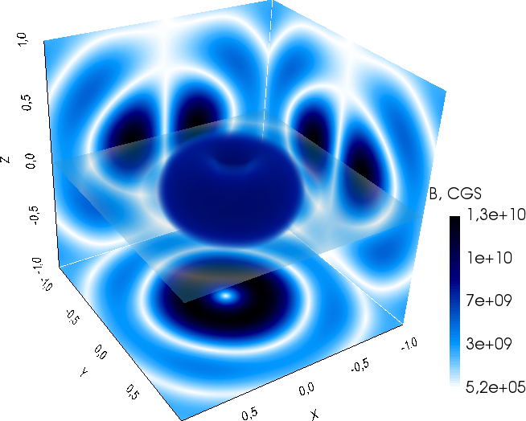
Dipole wave structure
Electric field Magnetic field
Minimum focusing volume:

Slide 13
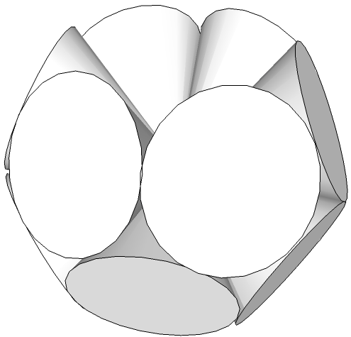
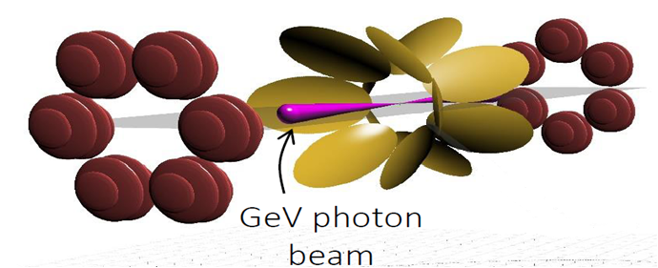
How to achieve intensity 10²³-10²⁵ W/cm²
Geometry | Power per channel | Intensity, ×10²⁵W/cm² | I/I(f=1.2) | Equivalent power (f=1.2)
Single beam (f=1.2) | P₀=10 PW | 0.06 | 1 | 10 PW
Single beam (f=1.2) | P₀=200 PW | 1.2 | 1 | 200 PW
Dipole-Wave | P₀=200 PW | 16.7 | 13.9 | 2800 PW
Double-Belt-12 12× (f=0.96) | P₀/12 | 13.4 | 11.2 | 2200 PW
Double-Belt-12
XCELS design: Coherent combining to mimic a converging dipole wave
A. Gonoskov, A. Bashinov, I. Gonoskov,C. Harvey, A. Ilderton, A. Kim, M. Marklund, G. Mourou, A. Sergeev, PRL (2014)

Slide 14
Amazing new physics of laser-particle-vacuum interaction at light intensity > 10²³ W/cm²
Radiation dominated regime:
Particles become efficient convertors of energy from optical to gamma range
Trajectories of particles
change dramatically;
no more relativistic Newton
mechanics
New sources of
gamma radiation:
controlled, brilliant,
collimated
New state of matter:
strongly coupled
optical fields, ultrarelativistic
electron-positron plasma and
gamma radiation
Advanced Instrument for Modeling: A.Gonoskov et al Phys. Rev. E92 (2015)

Slide 15
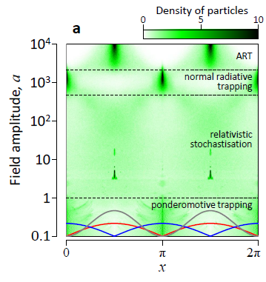
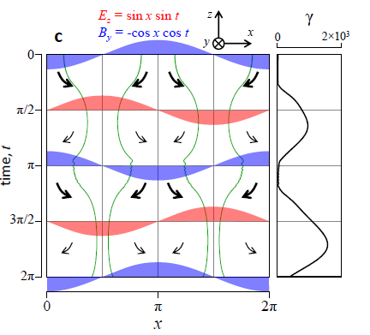
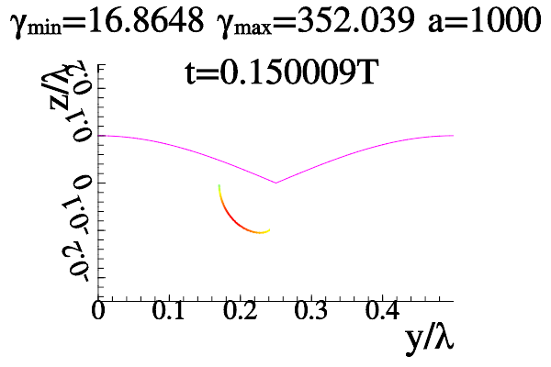
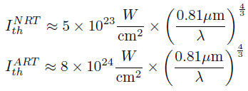
Electron Dynamics in Radiation Dominated Regime
Radiation force, i.e. recoil at radiating hard photons at ultrarelativistic
motion with acceleration, becomes of the order of the Lorentz force by
the laser field. Particle trajectories acquire unusual properties that in turn
results in new amazing gamma ray sources.
Phenomenon of radiative trapping:
Electrons condense to minima (NRT)or maxima (ART) of electric field
A.Bashinov et al. Quantum Electronics 43(4),291 (2013),
A.Gonoskov et al. Phys.Rev.Lett. 113 (2014)
A.Bashinov et al. Phys.Rev.E 92 (2015)

Slide 16
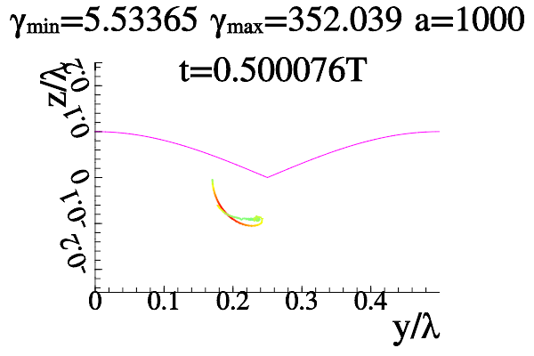
Electron Dynamics in Radiation Dominated Regime
Radiation force, i.e. recoil at radiating hard photons at ultrarelativistic
motion with acceleration, becomes of the order of the Lorentz force by
the laser field. Particle trajectories acquire unusual properties that in turn
results in new amazing gamma ray sources.
Phenomenon of radiative trapping:
Electrons condense to minima (NRT)or maxima (ART) of electric field
A.Bashinov et al. Quantum Electronics 43(4),291 (2013),
A.Gonoskov et al. Phys.Rev.Lett. 113 (2014)
A.Bashinov et al. Phys.Rev.E 92 (2015)

Slide 17
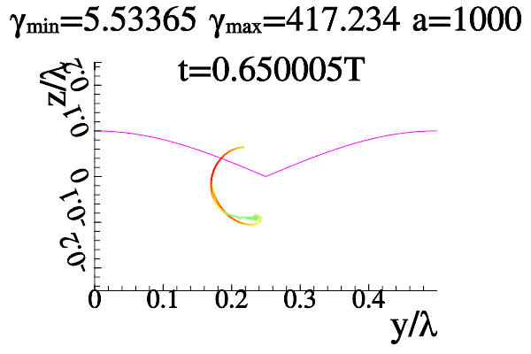
Electron Dynamics in Radiation Dominated Regime
Radiation force, i.e. recoil at radiating hard photons at ultrarelativistic
motion with acceleration, becomes of the order of the Lorentz force by
the laser field. Particle trajectories acquire unusual properties that in turn
results in new amazing gamma ray sources.
Phenomenon of radiative trapping:
Electrons condense to minima (NRT)or maxima (ART) of electric field
A.Bashinov et al. Quantum Electronics 43(4),291 (2013),
A.Gonoskov et al. Phys.Rev.Lett. 113 (2014)
A.Bashinov et al. Phys.Rev.E 92 (2015)

Slide 18
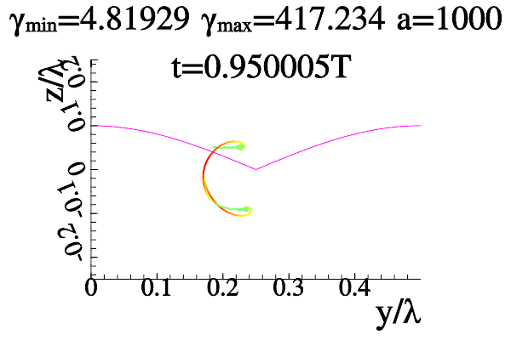
Electron Dynamics in Radiation Dominated Regime
Radiation force, i.e. recoil at radiating hard photons at ultrarelativistic
motion with acceleration, becomes of the order of the Lorentz force by
the laser field. Particle trajectories acquire unusual properties that in turn
results in new amazing gamma ray sources.
Phenomenon of radiative trapping:
Electrons condense to minima (NRT)or maxima (ART) of electric field
A.Bashinov et al. Quantum Electronics 43(4),291 (2013),
A.Gonoskov et al. Phys.Rev.Lett. 113 (2014)
A.Bashinov et al. Phys.Rev.E 92 (2015)

Slide 19
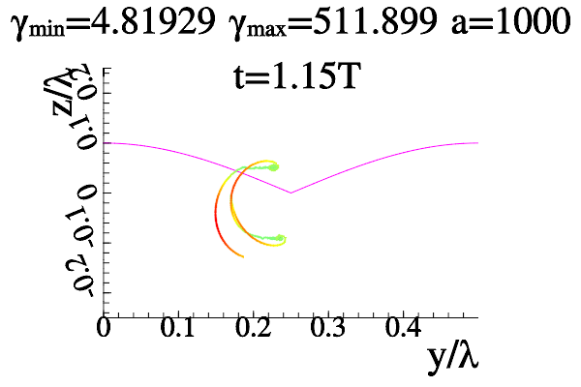
Electron Dynamics in Radiation Dominated Regime
Radiation force, i.e. recoil at radiating hard photons at ultrarelativistic
motion with acceleration, becomes of the order of the Lorentz force by
the laser field. Particle trajectories acquire unusual properties that in turn
results in new amazing gamma ray sources.
Phenomenon of radiative trapping:
Electrons condense to minima (NRT)or maxima (ART) of electric field
A.Bashinov et al. Quantum Electronics 43(4),291 (2013),
A.Gonoskov et al. Phys.Rev.Lett. 113 (2014)
A.Bashinov et al. Phys.Rev.E 92 (2015)

Slide 20
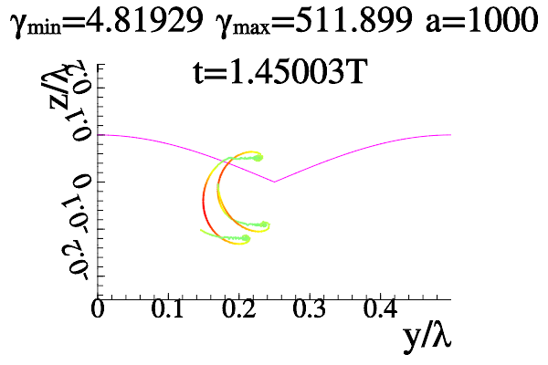
Electron Dynamics in Radiation Dominated Regime
Radiation force, i.e. recoil at radiating hard photons at ultrarelativistic
motion with acceleration, becomes of the order of the Lorentz force by
the laser field. Particle trajectories acquire unusual properties that in turn
results in new amazing gamma ray sources.
Phenomenon of radiative trapping:
Electrons condense to minima (NRT)or maxima (ART) of electric field
A.Bashinov et al. Quantum Electronics 43(4),291 (2013),
A.Gonoskov et al. Phys.Rev.Lett. 113 (2014)
A.Bashinov et al. Phys.Rev.E 92 (2015)

Slide 21
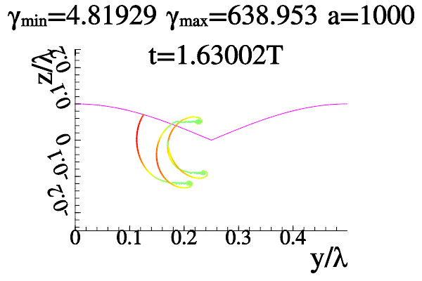
Electron Dynamics in Radiation Dominated Regime
Radiation force, i.e. recoil at radiating hard photons at ultrarelativistic
motion with acceleration, becomes of the order of the Lorentz force by
the laser field. Particle trajectories acquire unusual properties that in turn
results in new amazing gamma ray sources.
Phenomenon of radiative trapping:
Electrons condense to minima (NRT)or maxima (ART) of electric field
A.Bashinov et al. Quantum Electronics 43(4),291 (2013),
A.Gonoskov et al. Phys.Rev.Lett. 113 (2014)
A.Bashinov et al. Phys.Rev.E 92 (2015)

Slide 22
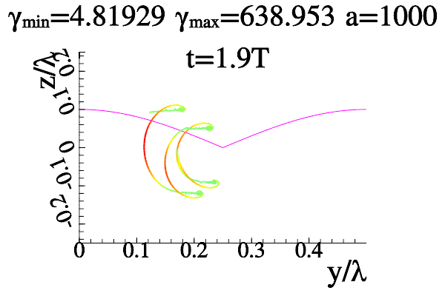
Electron Dynamics in Radiation Dominated Regime
Radiation force, i.e. recoil at radiating hard photons at ultrarelativistic
motion with acceleration, becomes of the order of the Lorentz force by
the laser field. Particle trajectories acquire unusual properties that in turn
results in new amazing gamma ray sources.
Phenomenon of radiative trapping:
Electrons condense to minima (NRT)or maxima (ART) of electric field
A.Bashinov et al. Quantum Electronics 43(4),291 (2013),
A.Gonoskov et al. Phys.Rev.Lett. 113 (2014)
A.Bashinov et al. Phys.Rev.E 92 (2015)

Slide 23
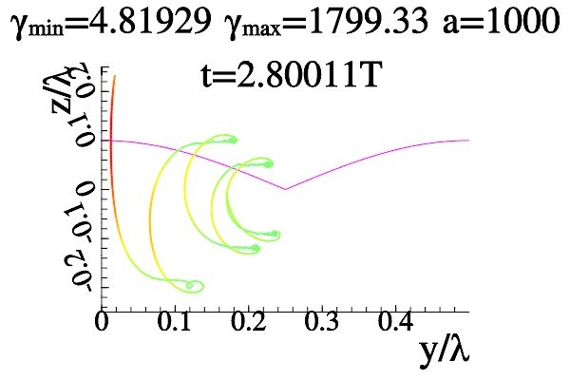
Electron Dynamics in Radiation Dominated Regime
Radiation force, i.e. recoil at radiating hard photons at ultrarelativistic
motion with acceleration, becomes of the order of the Lorentz force by
the laser field. Particle trajectories acquire unusual properties that in turn
results in new amazing gamma ray sources.
Attraction to maximum of
electric field in standing wave!
Phenomenon of radiative trapping:
Electrons condense to minima (NRT)or maxima (ART) of electric field
A.Bashinov et al. Quantum Electronics 43(4),291 (2013),
A.Gonoskov et al. Phys.Rev.Lett. 113 (2014)
A.Bashinov et al. Phys.Rev.E 92 (2015)

Slide 24
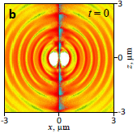
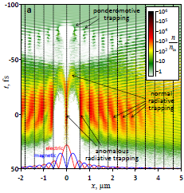
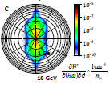
Electron Trapping and Directed Gamma Rays Excitation
at Converging Dipole Wave Laser Focusing
Density distribution at the instance of peak field
strength; photons with energy
exceeding 3 GeV are shown in cyan
Electron density versus time and radius
at 30 fs dipole wave laser pulse focusing with peak total power of 200 PW
Hard photon emission distribution as a function of angle and energy (radial coordinate, log scale). 0.1% of laser energy is converted to > 1 GeV photons
A.V.Bashinov et al. Quantum Electronics 43(4),291 (2013),
A.Gonoskov et al. Phys.Rev.Lett. 113 (2014)

Slide 25
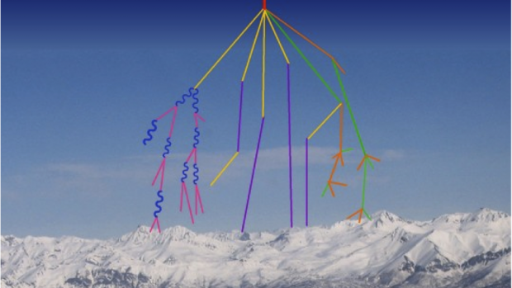
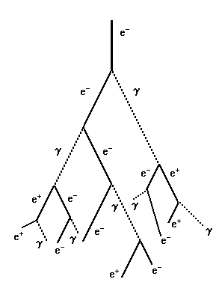
QED cascades
A.R. Bell and J. G. Kirk, Phys. Rev. Lett. (2008)
A.M. Fedotov, N. B. Narozhny, G. Mourou, G. Korn, Phys. Rev. Lett. (2010)
E. N. Nerush, I. Yu. Kostyukov, A. M. Fedotov, N. B. Narozhny, N. V. Elkina, and H. Ruhl,
Phys. Rev. Lett. (2011)
V.F.Bashmakov, E.N.Nerush, I.Yu.Kostyukov, A.M.Fedotov, N.B.Narozhny
Phys. Plasmas (2014)
Message: Vacuum behaves like a rather dense dielectric medium at ionization.
Cascades start at much lower fields (10²⁴-10²⁵ W/cm²) as compared to
Sauter-Schwinger limit (10²⁹ W/cm²)

Slide 26
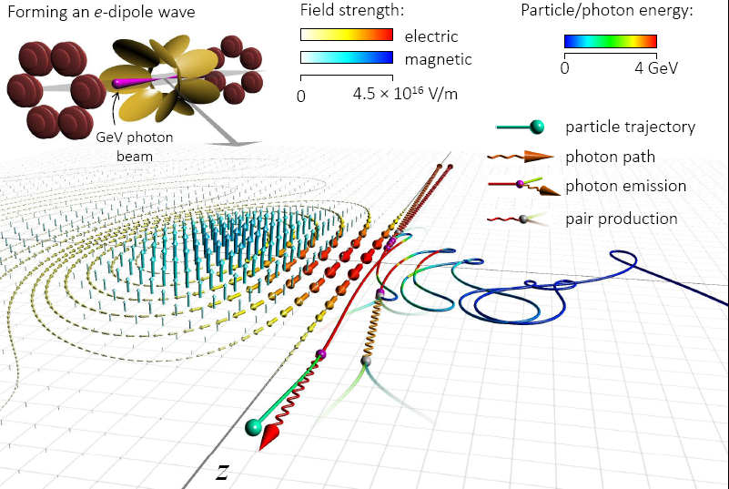
Anomalous radiation trapping and gamma ray emission
A. Gonoskov, A. Bashinov, I. Gonoskov,C. Harvey, A. Ilderton, A. Kim, M. Marklund, G. Mourou, A. Sergeev, PRL (2014)

Slide 27
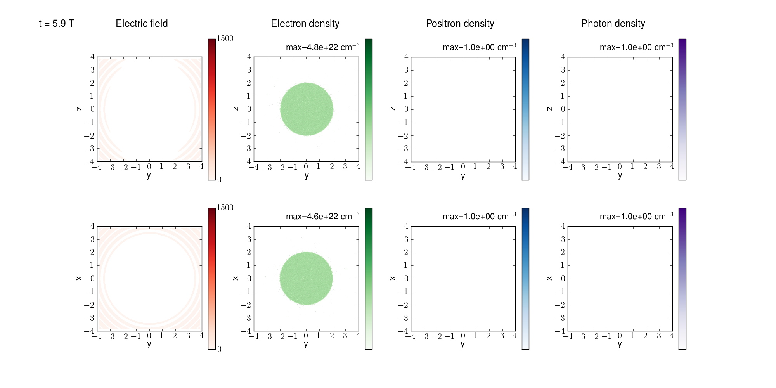
QED cascades in dipole wave
P=100 PW, t=5.9 T

Slide 28
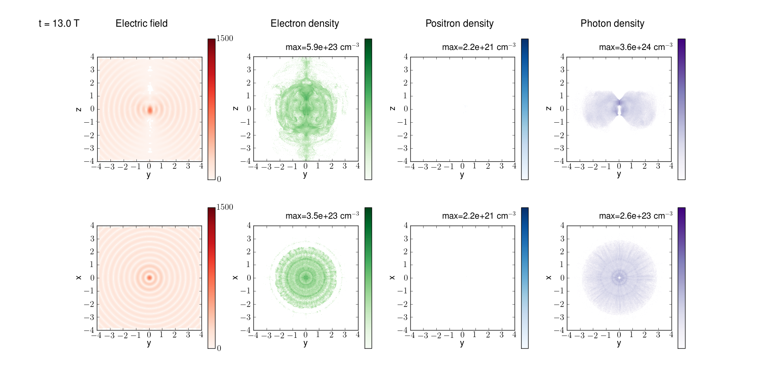
QED cascades in dipole wave
P=100 PW, t=13 T

Slide 29
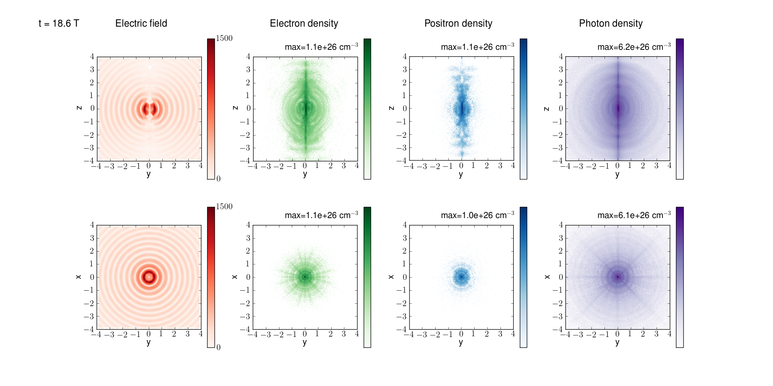
QED cascades in dipole wave
P=100 PW, t=18.6 T

Slide 30
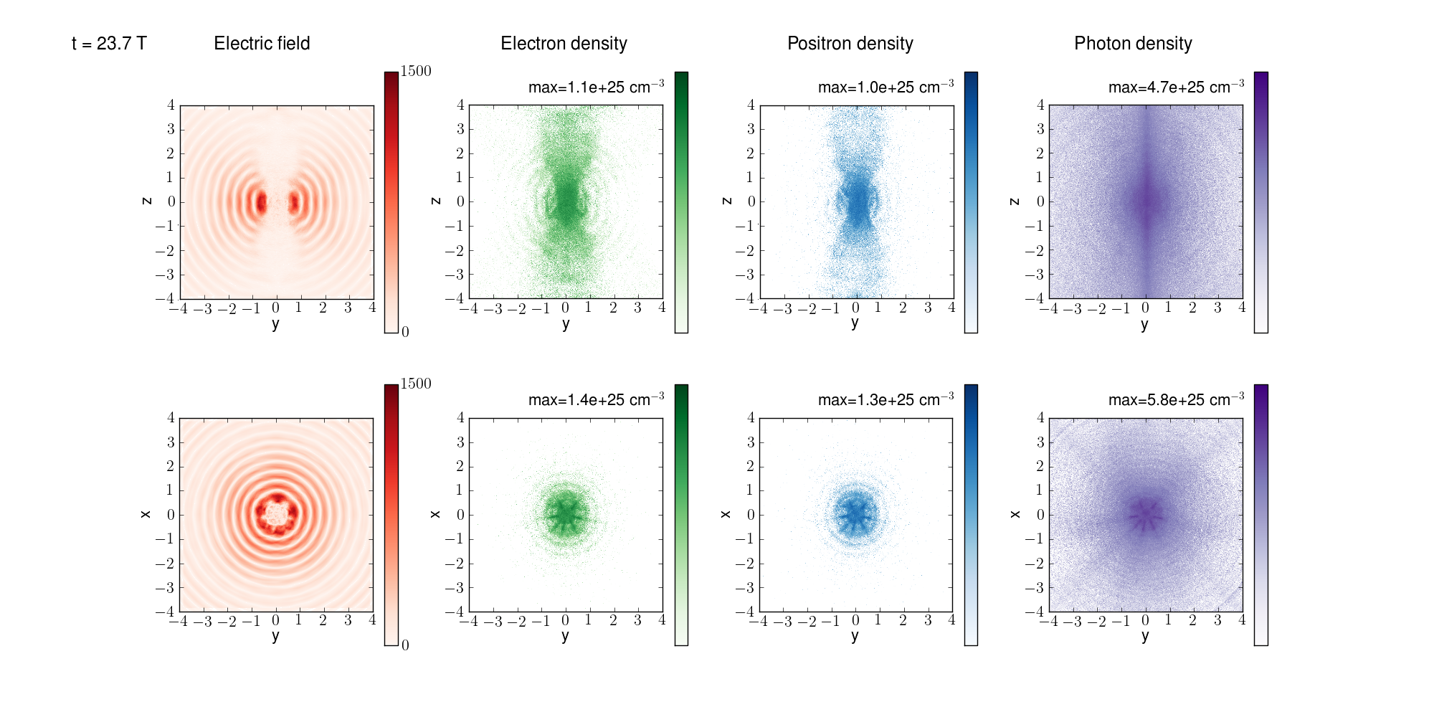
QED cascades in dipole wave
Max electron density > 10 ²⁶ cm⁻³,
Max photon density 6 10 ²⁶ cm⁻³,
10¹³ photon/pulse (E>100 MeV), 10¹⁰ photon/pulse (E>1 GeV)
Limitation by optical pulse refraction from plasma
How nuclei behave in this environment? Can we observe γ-γ collision effects? …………?

Slide 31
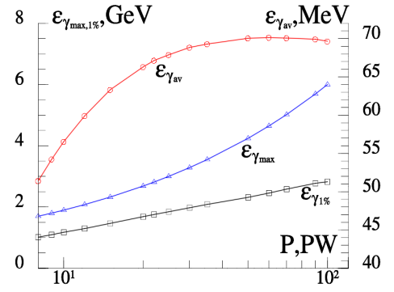
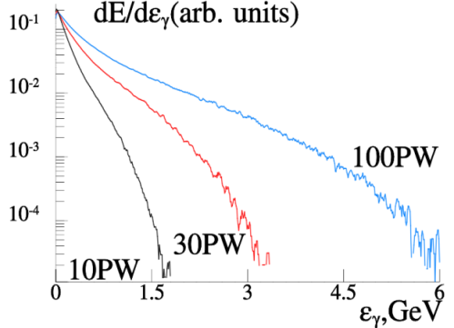
Gamma ray source characteristics
Left. Dependence of average (red line with circles), maximal (blue line with triangles) photon energy and energy at the level 1% (black line with squares) on incoming power P.
Right. Normalized spectra of electron-positron plasma radiation for 10, 30 and 100PW.

Slide 32
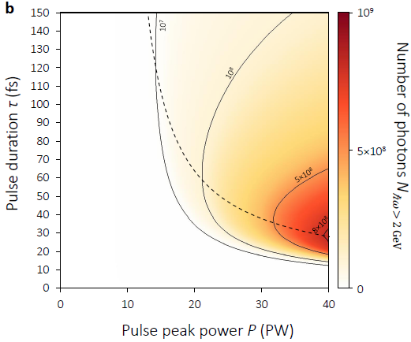
Optimization of GeV photon yield
Nonlinear stage begins at leading edge
Nonlinear stage begins at peak of pulse
There is no nonlinear stage, or nonlinear stage begins at rear front
Maximum photon number slightly vary for power P>40 PW

Slide 33
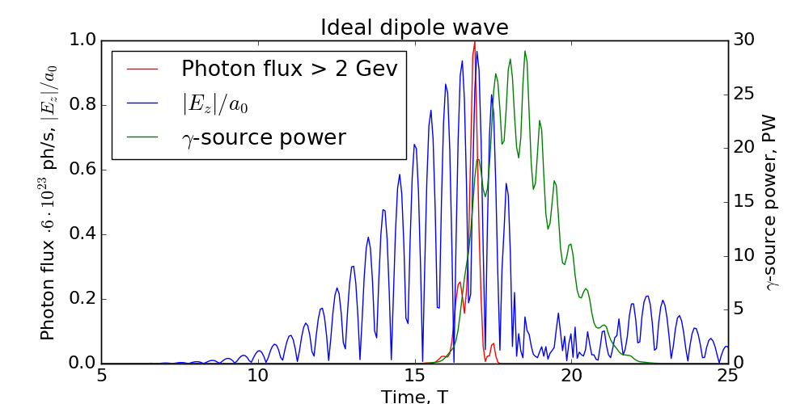
Gamma photon yield for ideal dipole wave
2 GeV photons are emitted only near the maximum of the laser pulse producing sub-period gamma burst
The rear part of the pulse is transformed to gamma quanta with the lower energies almost completely, resulting in overall 34% efficiency

Slide 34
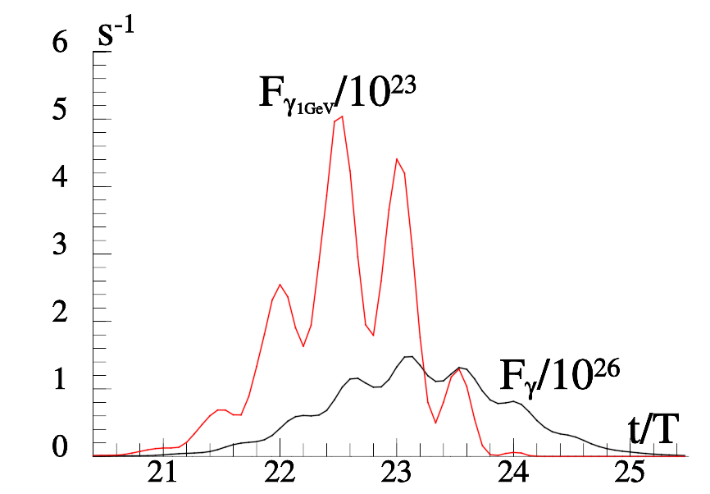
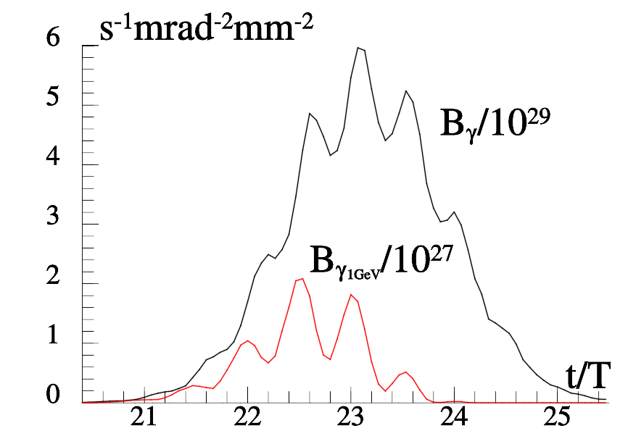
Optimization of GeV photon brilliance
How to make the most brilliant gamma source?
Do not allow degradation of optical wave structure (shorter pulse)
In the case of particular experiments for the Gaussian pulse with the peak power P = 40PW, the duration of τ = 15 fs and the density of the target 10¹⁶cm⁻³. The measured flux and brilliance are shown as a function of time. The duration of the generated gamma pulse is 4.5 fs, maximal brilliance is 610²⁹ s⁻¹mrad⁻²mm⁻² , the number of photons for energies >100MeV is 10¹¹. The photon flux for energies greater 1 GeV is 510²³s⁻¹, number of photons is 10⁹.The beam width for the gamma photons is 2 mrad.
A.Gonoskov, A.Bashinov, E.Efimenko et al., PRX, 2017

Slide 35
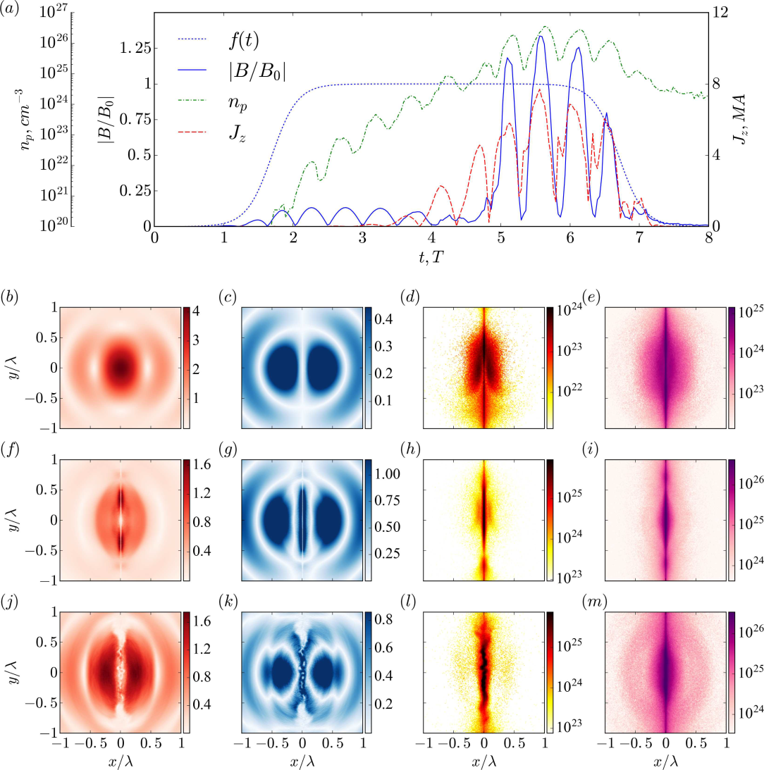
Plasma pinching in e-e+ cascade

Slide 36
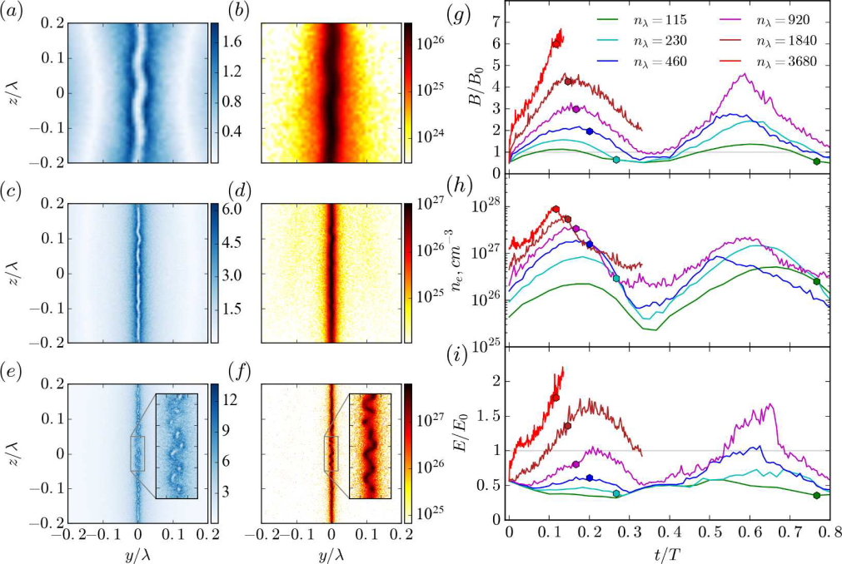
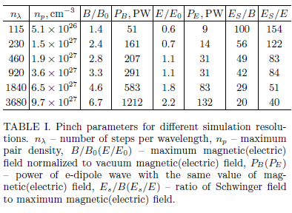
Plasma pinching in e-e+ cascade

Slide 37
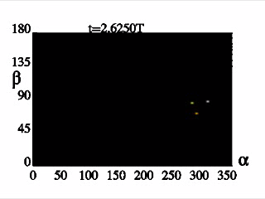
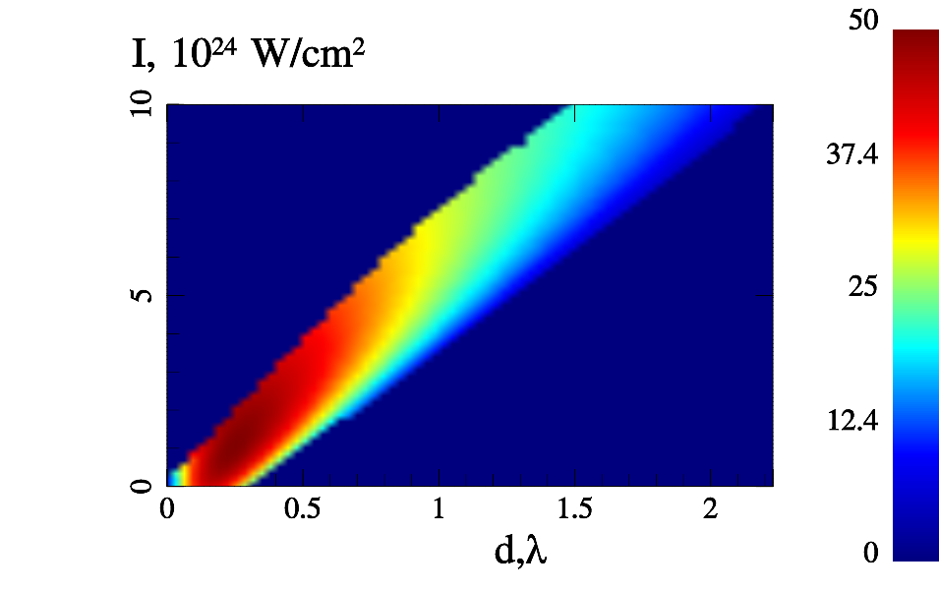
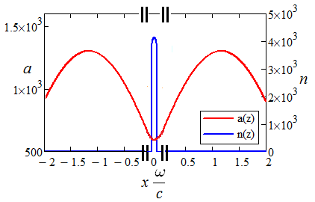
GAMMA LIHGT HOUSE SOURCE WITH
CIRCULARLY POLARIZED COLLIDING PULSES
γ
N_{e} ≈10²⁷cm⁻³
Δx≈λ/5000
e
d≈λ
laser
i
laser
γ
Efficiency η, %
A.Bashinov, A.Kim , Phys.Plasmas 2013

Slide 38
GAMMA LIHGT HOUSE SOURCE WITH
CIRCULARLY POLARIZED COLLIDING PULSES
γ
N_{e} ≈10²⁷cm⁻³
Δx≈λ/5000
e
d≈λ
laser
i
laser
γ
Efficiency η, %
A.Bashinov, A.Kim , Phys.Plasmas 2013

Slide 39
GAMMA LIHGT HOUSE SOURCE WITH
CIRCULARLY POLARIZED COLLIDING PULSES
γ
N_{e} ≈10²⁷cm⁻³
Δx≈λ/5000
e
d≈λ
laser
i
laser
γ
Efficiency η, %
A.Bashinov, A.Kim , Phys.Plasmas 2013

Slide 40

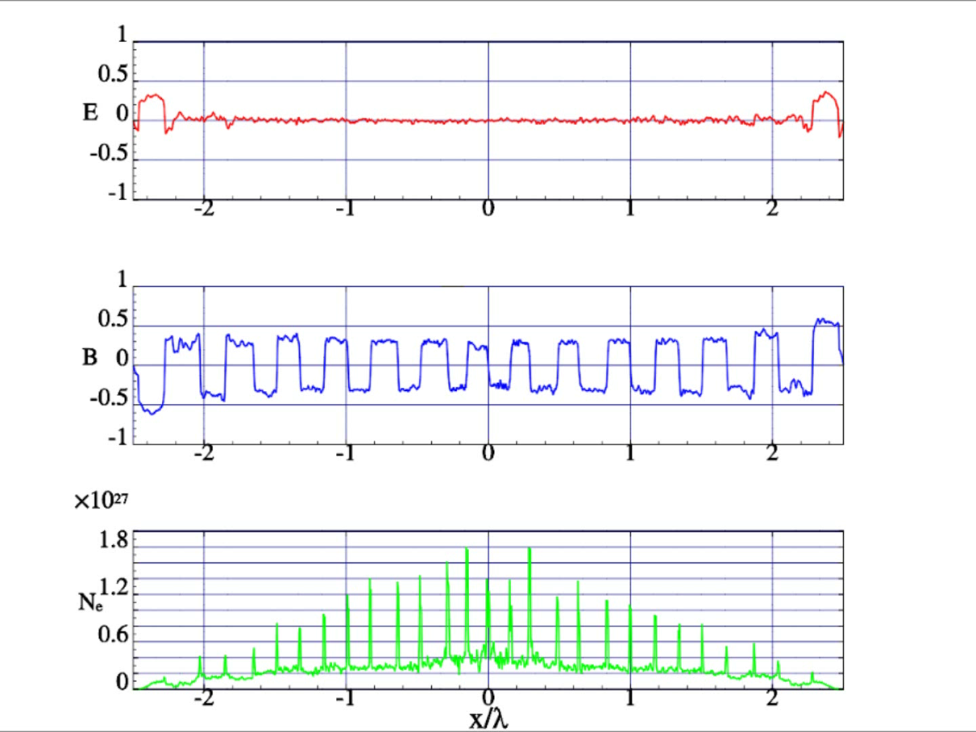

QED cascades in counter-propagating
linearly polarized laser pulses and generation of giant magnetic fields
A.Muraviov et al, ZhETP Lett 2015
Plasma density time-space map
e-e+ avalanche fine structure and dynamics at a=5000
(I=7.5 10²⁵ W/cm²)
Plasma density in current sheets exceeds 10²⁷ cm⁻³
Quasi-static magnetic field approaches 6 10¹¹ G

Slide 41
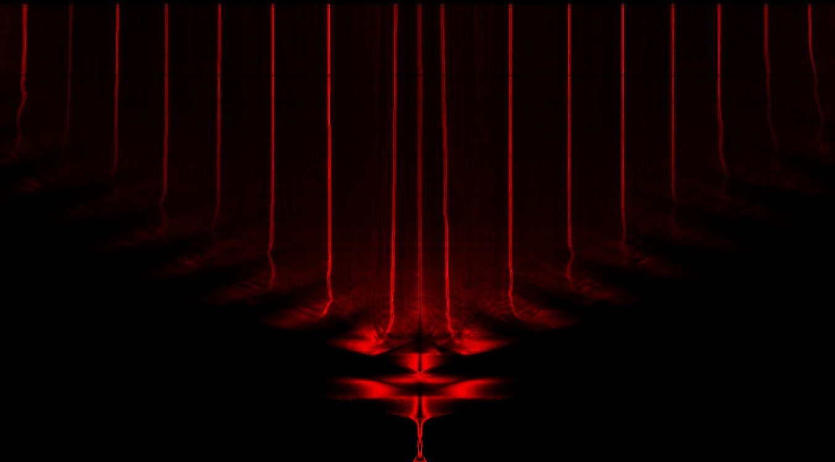

Gamma photon birth and death time-space map
Time
5.85T
Plasma density evolution
x
E_{z}, 10¹² cgs
B_{y}, TeraGauss
1.5
2.64λ
0
-1.5

Slide 42
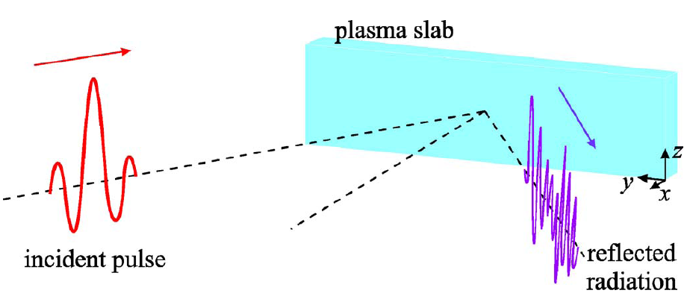
XCELS 10²⁶ W/cm²-and-Beyond Program
Overcritical plasma surface
Incident pulse 10¹⁸ -10²³ W/cm²
Re-emitted pulse
Oscillating Mirror Model (OMM)
S.V. Bulanov et al., Phys. Plasmas (1994)
S.R. Lichters et al., Phys. Plasmas (1996)
S. Gordienko et al, PRL (2004)
N. M. Naumova et al, PRL (2004)
T. Baeva et al., PRE (2006)
D. an der Brugge at al, Phys. Plasmas (2010)
Incident pulse >10²³ W/cm²
Relativistic Electronic Spring (RES) Model
A.Gonoskov et al, PRE (2011)
J.Fuchs et al, EJP (2014)

Slide 43
Effect of Relativistic Electronic Spring
Stages:
1) pushing of electrons and the formation of a thin current layer- nanoplasmonic structure, which results in energy transfer from the laser field to the plasma fields and particles;
2) backward motion of the electrons towards the incident wave with conversion of energy accumulated in the plasma and laser field energy into the kinetic energy of an ultrarelativistic electron bunch;
3) radiation of the attosecond pulse by an electron bunch due to conversion of the kinetic energy and laser field energy to the XUV and X- ray range.
Y
X
electrons
Z
ions

Slide 44

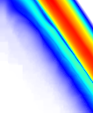
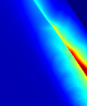
Optimal Conditions and Efficiency of
Giant Attosecond Pulse Generation
A.Gonoskov et al, Phys. Rev. E (2011)
J. Fuchs et al, EJP (2014)
Classifcation of Interaction Type:
OMM- oscillating mirror
RES - relativistic electronic spring
RIST - relativistically induced
solid target transparency
RIST
RIST
RES
RES
N_{e}, cm⁻³
N_{e}, cm⁻³
S=5
δ
S=5
OMM
OMM
I, W/cm²
I, W/cm²
δ = W_{acc} / W_{cycle} – coefficient of energy transformation
a_{g}/a_{in} – amplitude enhancement
M. Behmke et al, PRL (2011)
experiment

Slide 45

Groove Shape Target and Superluminal Focal Spot

Slide 46

Focusing of Giant Attosecond Pulses
PIC modeling demonstrated > 10²⁶ W/cm² in giant attosecond pulses at the focal point with 2 PW, 10²³ W/cm² of the incident pulse for a 2d grooved target

Slide 47


Pair Production from Vacuum with
Attosecond Superluminal Probe
For 200 PW and 10²³W/cm² at the groove target 0.5 mm wide
we have 10²⁸ W/cm² in the volume V~10nm³
Number of pairs N~10⁹
Cascades are strongly suppressed due superluminal motion of the focal area
10²⁸ W/cm²
10 nm
v_{f} = c/sinθ
0.5 mm

Slide 48







Experimental Prospects
Laser facilities
Vacuum breakdown
probing vacuum
XCELS 10²⁴-2 10²⁵
ELI I-III 10²³-2 10²⁴
Brilliant gamma ray sources
radiative losses
EM cascades
relativistic electrons
ionization
Notes:
48

Slide 49
In Conclusion
We are at the entrance to a new realm of physical phenomena
Exawatt-scale lasers will bring particle dynamics in the radiation dominated regime
QED cascades and radiation trapping of particles produce ultrarelativistic, ultradense e-e+ plasma that efficiently convert optical energy to gamma rays
Controllable directed gamma ray sources of GeV photons with extreme brilliance will be soon available as a new instrument to study nuclear matter and vacuum physics
Laboratory astrophysics will be provided with Gigagauss and Teragauss magnetc fields on the Earth
By energy conversion from femtosecond to attosecond pulses, the Schwinger field can be approached and time-space structure of vacuum can be studied

