Slide 1

PAC on Particle Physics
50th Meeting
Report to Scientific Council
JINR, January 21, 2019
Itzhak Tserruya

Slide 2
50th PAC-PP agenda January 21-22, 2019
Highlights of the 50th PAC-PP meeting:
Update reports on NICA, MPD and BM@N
Projects seeking continuation
Joint session of the PAC-PP and PAC-NP for joint evaluation of all JINR projects on neutrino physics and dark matter

Slide 3
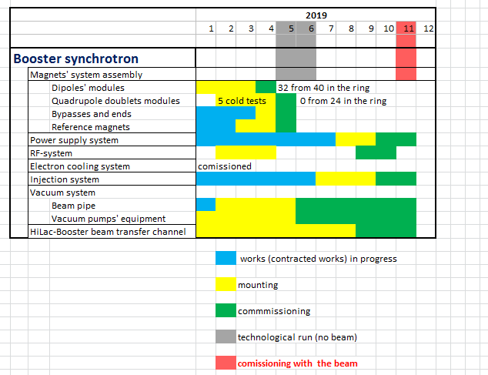
Report on the Nuclotron-NICA project
S. Kostromin
The PAC is concerned by the series of delays (mainly in the Booster installation and in civil construction), which affect the overall schedule of the NICA project. The PAC urges the NICA management to critically scrutinize the current schedule of the entire project to ensure that it stands on solid ground and that no further delays occur.
New Booster schedule
Booster (25 Tm)
up to 578 MeV/u
Apr-May 2019 – technical run
Oct-Nov 2019 - commissioning with beam

Slide 4
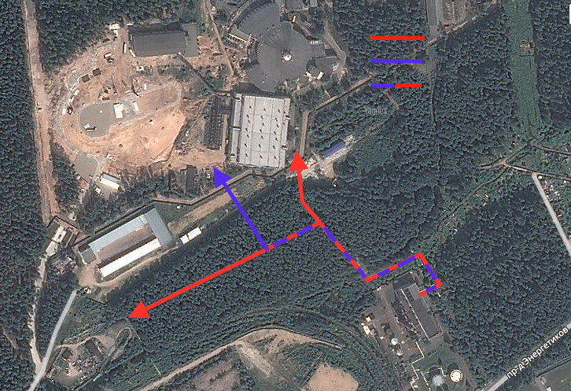
Infrastructure Developments
N. Agapov
The PAC is pleased to note the successful implementation of the plan for the renewal of heating, water and drainage networks. As of today, 12 km of networks have already been renewed (2 km since the previous PAC meeting), and this work is expected to be completed by the end of the year.
The PAC welcomes the efforts of the Laboratory’s management to eliminate the backlog from the plans to build a compressor station and wishes success in finding a new reliable contractor for this project.
Existing lines
New lines
Modernization needed
D500>D600mm
Main NICA infrastructure projects:
Upgrading of plants for liquid helium and nitrogen production
Modernization of electrical systems
Renovation of water pipelines and thermal grids
Construction of new buildings
A
Eastern Thermal Station

Slide 5
MPD
Adam Kisiel
The PAC notes the steady progress in constructing the main subsystems of the MPD facility: the superconducting magnet, TPC and ToF.
The PAC welcomes the award of a special-purpose joint grant of the Russian Federation and the People’s Republic of China for construction of the MPD ECal detector.
The PAC supports the plans for the formation of management and organizational structures of the collaboration.

Slide 6
BM@N
Mikhail Kapishin
The PAC heard preliminary results about the detector performance in the 55th run and urges the BM@N team to focus efforts on the physics analysis of the large data sets collected.
The PAC reiterates its request to see physics analysis reports at the next meeting.
The PAC supports the plans for the installation of the BM@N transport line and the vacuum beam pipe though the experimental set-up, which are necessary for operation with heavy-ion beams, and urges the BM@N team to coordinate these plans with the accelerator team.
Replace air intervals / foils with vacuum beam pipe along 160 m of BM@N transport line to get minimum dead material.
Install vacuum beam pipe through the BM@N set-up.
BM@N

Slide 7
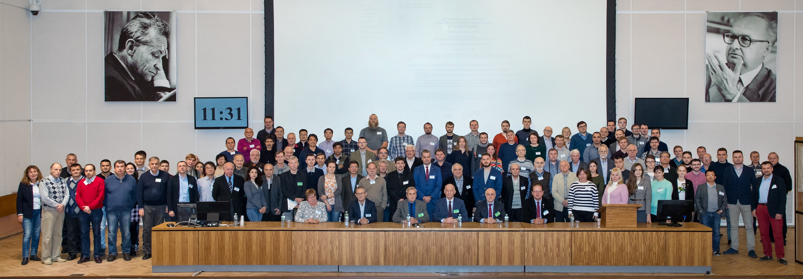
2nd Collaboration meeting of MPD and BM@N
V. Kekelidze
The 2nd Collaboration meeting of MPD and BM@N Collaborations took place at JINR on October 29-30.
The PAC welcomes the establishment of official international collaborations and the admission of new institutions to the collaborations.
The PAC congratulates the elected Spokespersons and IB Chairs, the appointed Project Managers and Deputy Spokespersons, and wishes them all very fruitful work at the NICA facility.
https://indico.jinr.ru/conferenceDisplay.py?confId=610

Slide 8
Highlights of the MPD and BM@N 2nd Collaboration meeting
Admission of 6 new institutions to the MPD Collaboration and 1 new institution to the BM@N Collaborations.
Election of Spokespersons:
MPD: Adam Kisiel (WUT) BM@N: Mikhail Kapishin (JINR)
Election of IB Chairs:
MPD: Fuqiang Wang (Huzhou U.) BM@N: Hans Rudolf Schmidt (Tubingen U.)
Appointment of Project Managers:
MPD: Slava Golovatyuk (JINR) BM@N: Anna Maksymchuk (JINR)
Appointment of Deputy spokespersons:
MPD: Victor Ryabov (PNPI) BM@N: Peter Senger (MEPhI, GSI)
Zebo Tang (Hefei U.)
Executive Council of BM@N just formed.
Executive council of MPD under formation.
Detector councils, physics working groups, software and analysis groups being formed.
BM@N and MPD should soon start to operate as international collaborations.

Slide 9
Recent Developments
The Russian Foundation for Basic Research (RFBR) launched on September 3, 2018 a grant program to support research at NICA. Grants of 3-6 MRubles per year for a duration of 3 years will be granted starting on Jan. 2019.
97 proposals were submitted of which 36 were approved for funding.
Complement the RFBR program with a similar JINR grant program to support non-Russian groups, from member states and non-member states, working at the NICA facility.

Slide 10
Proposal of a new project - SPD
Spin Physics Detector (SPD) – R. Tsenov
New project for the preparation of a Conceptual Design Report (CDR) for the Spin Physics Detector (SPD) at the NICA collider, followed after its acceptance by a Technical Design Report.
The current concept presented to the PAC does not look very convincing. The CDR must contain a full concept (allowing for optional technical solutions) with clear physics goals and simulations showing the physics performance targeted.
The concept should guarantee much better spin physics results than those that could be achieved with MPD at NICA in order to justify the needed important investment to realize SPD.
Once the CDR is presented within one year and approved by the PAC, the Technical Design Report is expected to be prepared within the following two years. Technical solutions should be of latest state-of-the-art and should not necessarily be based on in-house existing technologies.
The PAC encourages the full SPD Collaboration to be involved in the concept finding process. A dedicated core of people is needed in order to achieve the task.
The PAC recommends approval of the project of preparation of the CDR and TDR until the end of 2021 with first priority.

Slide 11
Recommendations on projects approved for completion in 2019 and proposed for continuation
BES-III - A. Zhemchugov. The BES-III experiment is focused on studies of charmonium physics, physics of charmed mesons, τ-leptons and light-hadron spectroscopy in the energy range of 2-4.6 GeV at the BEPCII e-e+collider at the Institute of High Energy Physics in Beijing (China). The PAC appreciates the many significant contributions in software development and data analysis and the results obtained by the JINR group in the BES-III experiment since 2005. The PAC notes that the experiment has reached most of the aimed at goals and considers that further studies could be conducted by the proponents with a commensurate lower effort. For these reasons the PAC recommends continuation of this activity until the end of 2022 with second priority.
PHOS - R&D for upgrade of Photon Spectrometer - A. Vodopyanov.
  The aims at improving the performance and reliability of the PHOS detector. A number of tests performed with electron beams at CERN with different SiPMs have shown that 500 ps time resolution is achievable at ambient temperatures. The pre-production prototype of 32-channel readout card (FEC-32) compatible with the ALICE DCS and DAQ systems will be developed and tested during 2019–2020, with complete documentation for the mass production. The PAC recommends continuation of JINR’s participation in the R&D project for the ALICE photon spectrometer upgrade until the end of 2020 with first priority.

Slide 12
Strategic long-range plans
N. Russakovich
The PAC heard with interest the report concerning the long-range plans for JINR’s development in the area of particle physics.
The PAC highly appreciates the JINR Directorate’s efforts towards defining strategic objectives and establishing priorities in the JINR scientific policies.
The PAC also supports JINR's plans to become integrated, with its projects and facilities, into the European Research Infrastructure and to further enforce partnership relations with CERN.

Slide 13
Presentations by young scientists
The PAC reviewed 22 poster presentations in particle physics by young scientists from DLNP and VBLHEP.
The Committee selected the poster “East-west asymmetry effect in atmospheric muon flux in the Far Detector of NOvA” presented by O. Petrova to be reported at this session of the Scientific Council

Slide 14
Next PAC-PP Meeting – June 19-20, 2019
The next meeting of the PAC-PP will be held on June 19-20, 2019
The following items are proposed to be included in the agenda of the next meeting:
  Follow-up on the to-do-list from this PAC meeting
  Consideration of new projects
  Reports and recommendations on the projects to be completed in 2019
  Status Report on the Nuclotron-NICA project
  Status Report on infrastructure issues including Nuclotron
  Report from the Coordinator of the Nuclotron experimental programme
  Status report on the MPD project including simulation results
  Status report on the BM@N project including simulation results and first beam test of the SRC programme
  Posters from young physicists

Slide 15
Thank you!

