Slide 1
Trigger and beam monitoring system of BM@N and SRC experiments .
D.N.Bogoslovsky, V.Yu.Rogov, S.V.Sergeev, V.I.Yurevich

Slide 2
BM@N trigger system components (I)
Target
HI beam
BC1
BC2
VC
BD
SiD
Scintillation Detector | Photodetector | Scintillator | Operation in magnetic field
BC1 | XP2020 | Plastic scintillator D150×3 mm | No
BC2(T0) | MCP-PMT PP2365E | Plastic scintillator D20x0.8 mm Angle 45º | Yes
VC | XP2020 | Plastic scintillator D100×10 mm hole D27 mm | Yes
BD | SiPMs (Sensl) 6 x 6 mm | BC-418 plast. scintillator 150×7×7 mm 40 units | Yes
SiD | 64 radial strips | Silicon D86x0.3 mm hole D32 mm | Yes

Slide 3
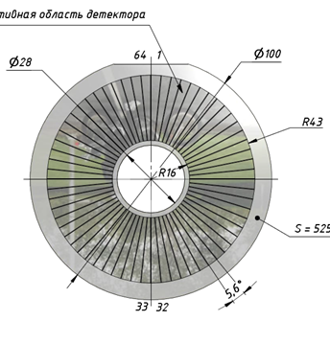
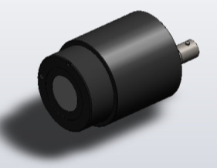
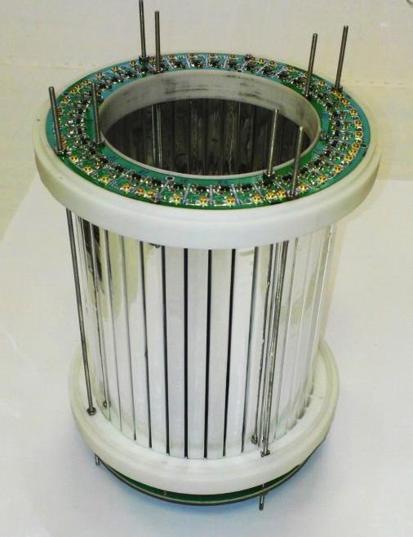
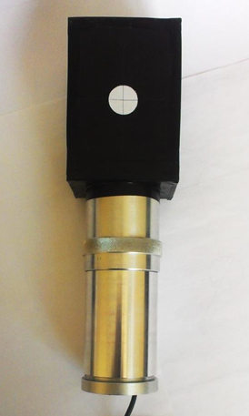
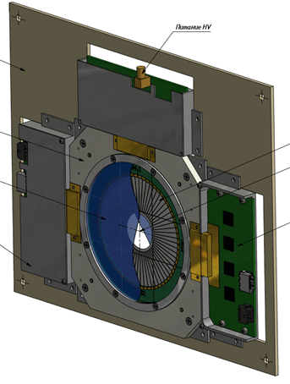
BM@N trigger system components(II)
T0 detector (BC2)
Barrel detector
Si detector
40 scintillation strips
with SiPM readout
64 radial strips
Photodetector
TYPE PP0365G
Active area
18mm MCP-PMT
BD

Slide 4
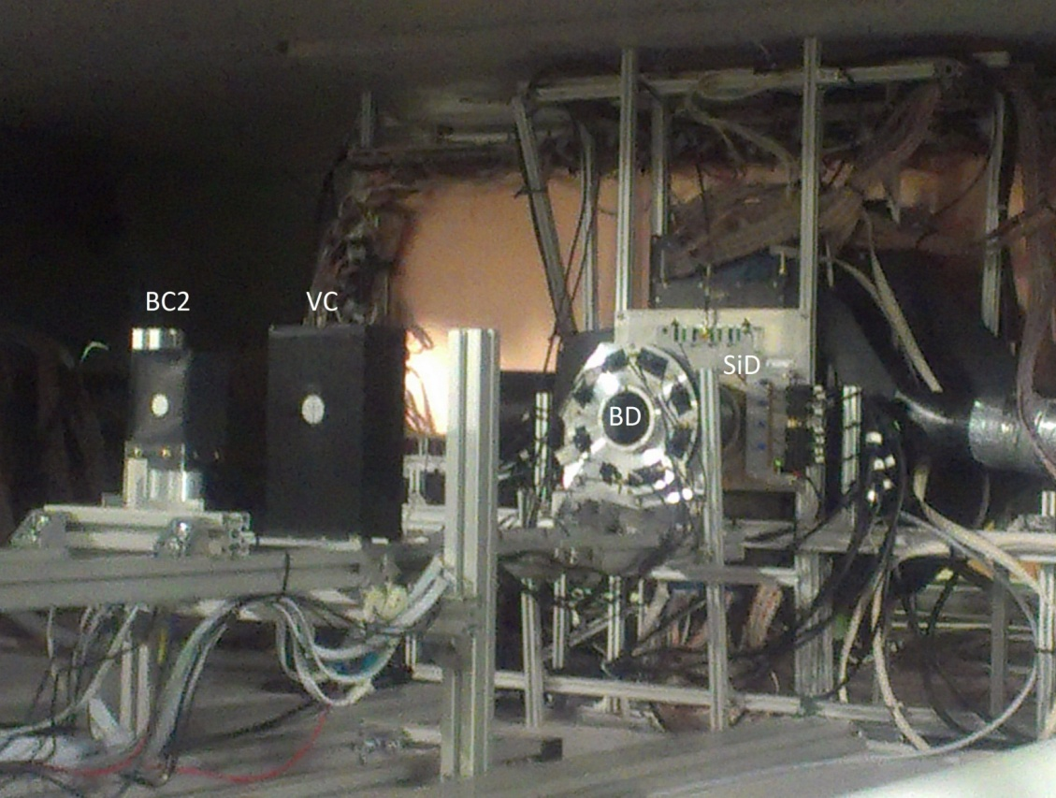
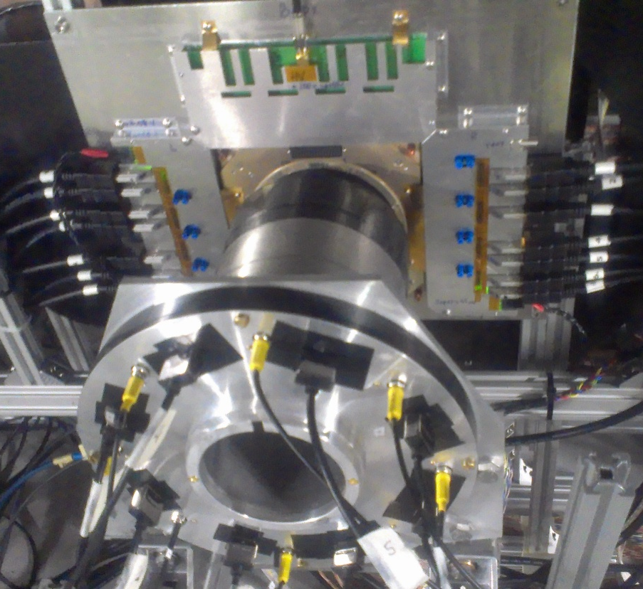
BM@N trigger system components(III)

Slide 5
Requirements to the trigger system
Good time resolution (requires short cables => trigger system should be located in the beam area => no direct human access to the trigger equipment)
Synchronization with accelerator
Beam gate signal generation
Physical trigger signal generation based on the beam line trigger and secondaries multiplicity and geometry in BD and SiD detectors
Readout start signal generation (DAQ Trigger)
Calorimeter calibration system support
GEM heating control (should be started outside of the beam gate)
“Flags word” generation for each DAQ trigger
Adjustment of discriminators, delays and shapers for all input signals
Beam monitoring with data recording to a local archive.
Publishing of all meaning information using web technologies and specialized programs
Data transfer to the experiment central DCS

Slide 6
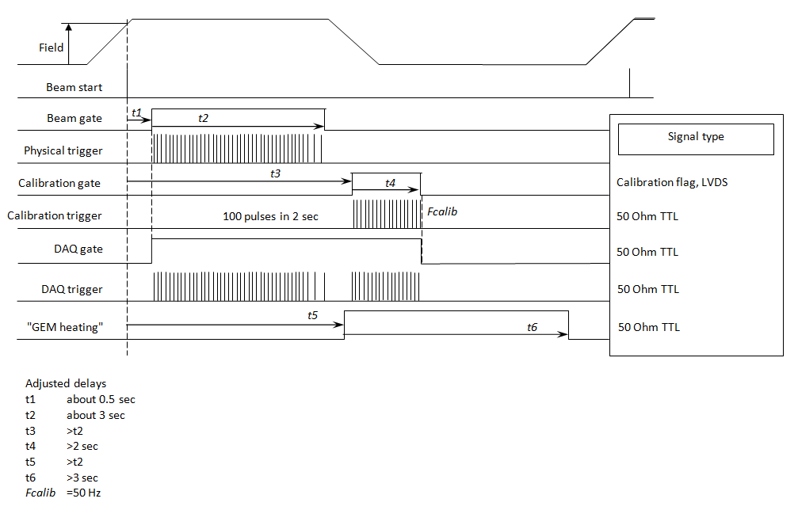
Timing signals

Slide 7
Trigger system block diagram
Acc.
BC1
BC2
VC
BC3
BD 40 channels
T0U
Real-time
counts
Control
To TDC (70 ch)
USB-RS
Trigger
Rack-mount PC
DAQ gate
Multiplicity > N
Calib
GEM Heater
DAQ busy
BC1
Control
USB-RS
To TDC (60 ch)
SiDU
SiD 64 channels

Slide 8
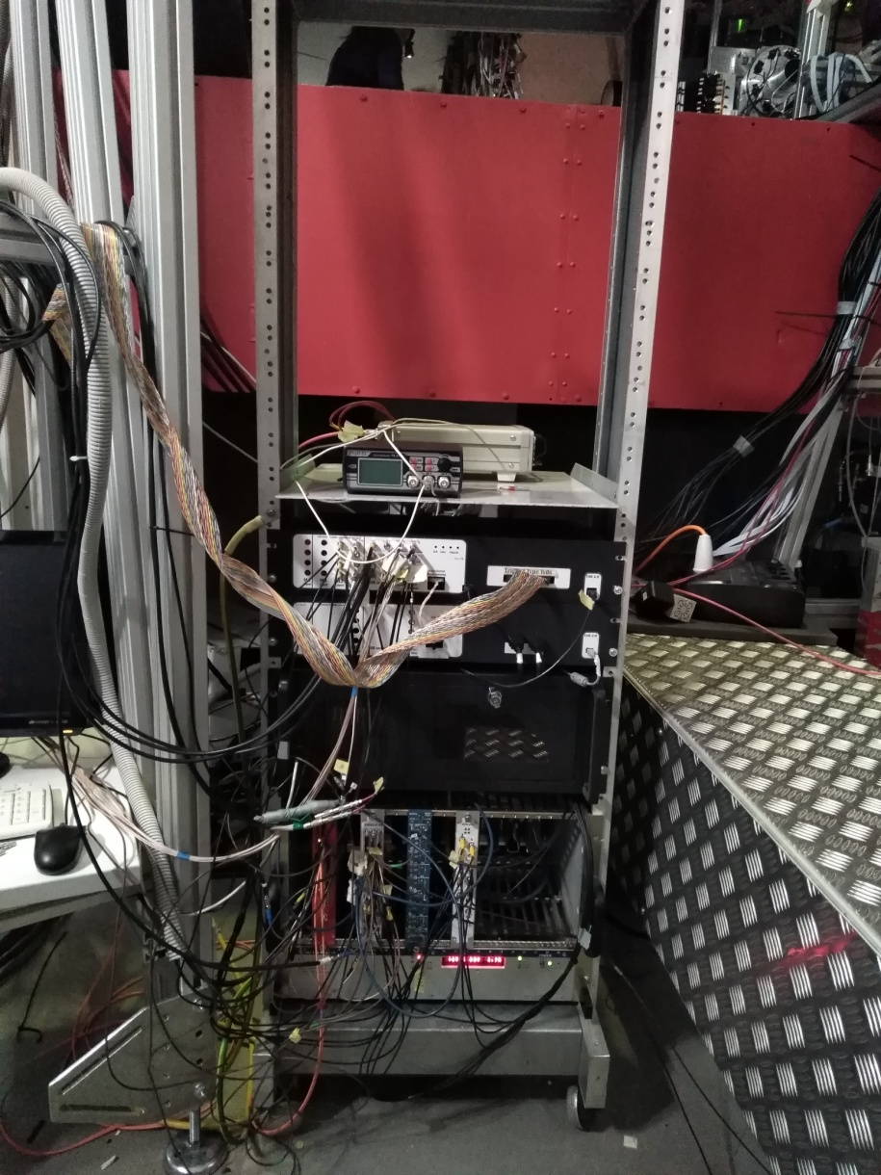
How it is done
Equipment rack is located close to the target
Magnetic field influence is not observed
Radiation influence (SEU) is not observed

Slide 9
T0U equipment (I)
Motherboard contains
FPGA Altera Cyclon V
Small jitter signal splitters
2 virtual USB-Com ports,
Ethernet and Optical link interfaces are foreseen
Daughter boards contain
4 analog input modules containing 4 channels each having discriminators with range -3V … +0.5V
4 NIM output modules having 4 channels each or
4 50-Ohm TTL output modules having 4 channels each
12 LV power supply units having
2 channels with range + 4V…+8V
Fixed channel -7.2V
Output LVDS buffer

Slide 10
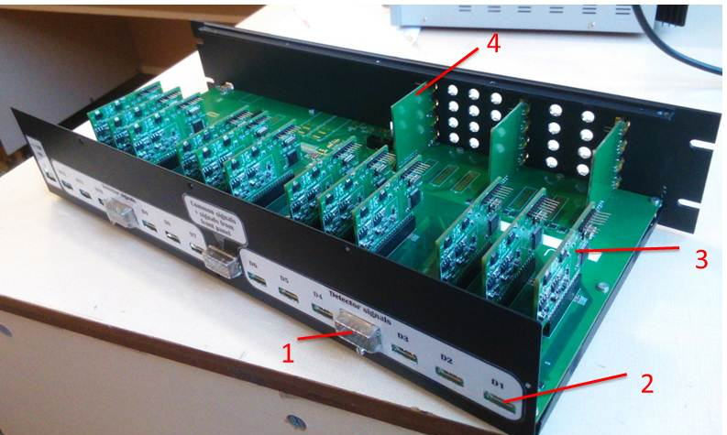
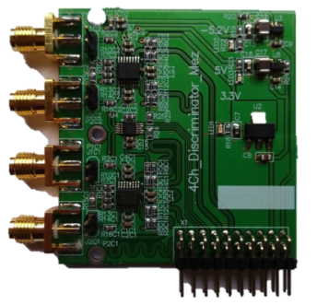
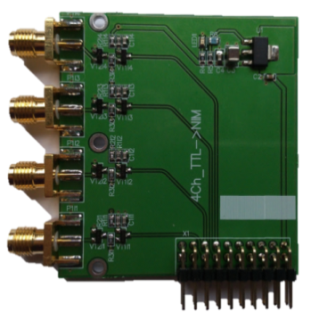
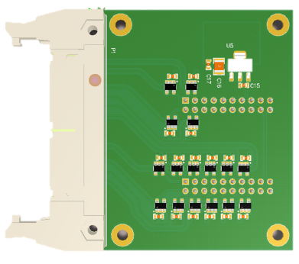
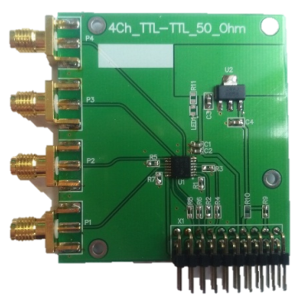
T0U equipment(II)
Input module
NIM output module
LVDS output buffer
50 Ohm TTL output module

Slide 11
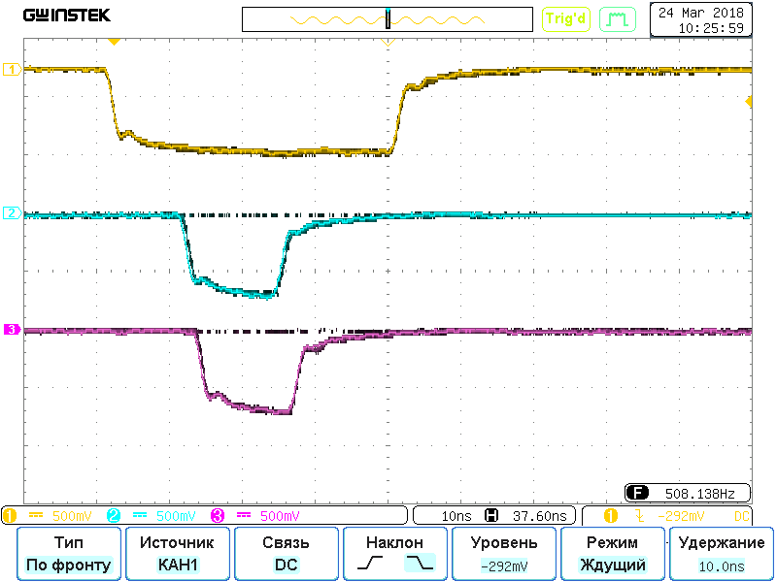
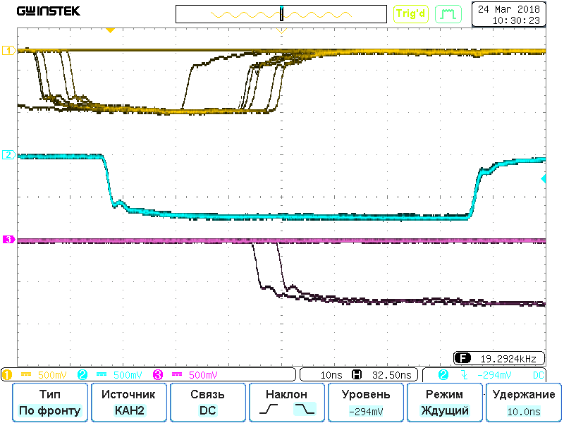
T0U main features
T0U contains
Up to 12 asynchronous channels containing
discriminator (-3V … +0.5V with 3.5 mV step)
delay line (10..85 ns with 0.75 ns step)
shaper (15..100 ns with 0.75 ns step)
5 Synchronous delay channels with 0.1 ms step and width up to 6.5 sec
4 multiplexers to access key signals inside the FPGA which
h allow to adjust trigger timing
BC1, BC2 and Beam_Trigger (BT)
BT, SiD and DAQ_Trigger

Slide 12
Software
To meet requirements the trigger system software includes:
T0U manager with GUI to adjust trigger delays, shapers and trigger logics and to monitor trigger performance. The spill summary information is recorded to the local archive and published
SiD manager with GUI to adjust and to monitor SiD performance.
Server + client applications to observe beam intensity curves in counters and DAQ performance in the real time mode with 100 Hz sampling frequency (built as TCP/IP server and client)
Web-server to publish spill summary after each spill
HV power supply server to control HV_Sys module. This server publishes actual state of HV channels
DCS server – an interface application collecting all relevant information and publishing it to connected clients (TCP/IP server). It was used to transfer spill data to the central DCS.
Spill summary archive browser
Debugging programs to adjust hardware

Slide 13
Application intercommunication
Detectors
SiU
T0U
SpillView
Clients
SiU_Mgr
T0U_Mgr
SpillView
Server
SpillView
Clients
SpillView
Clients
SpillView
Clients
Spill picture
Spill counts
Web-browser
Web_Server
Web-browser
Log-file
Web-browser
Web-browser
Log_View
Spill counts + LV state + trigger type
HV_Server
DCS_Server
To the central
DCS
HV state

Slide 14
T0U_Mgr (I)

Slide 15
T0U_Mgr (II)

Slide 16
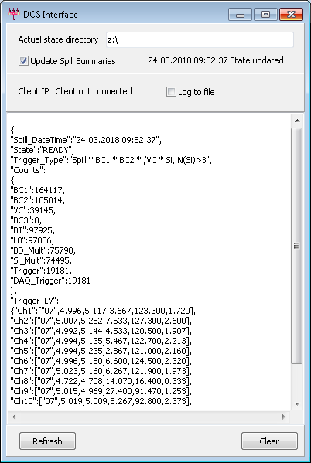
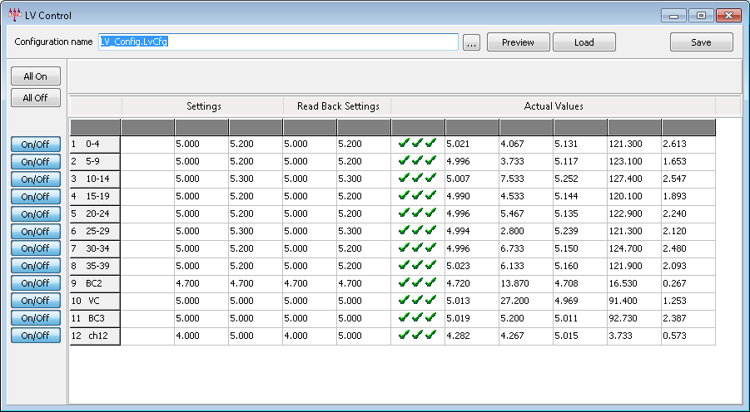
T0U_Mgr (III)

Slide 17
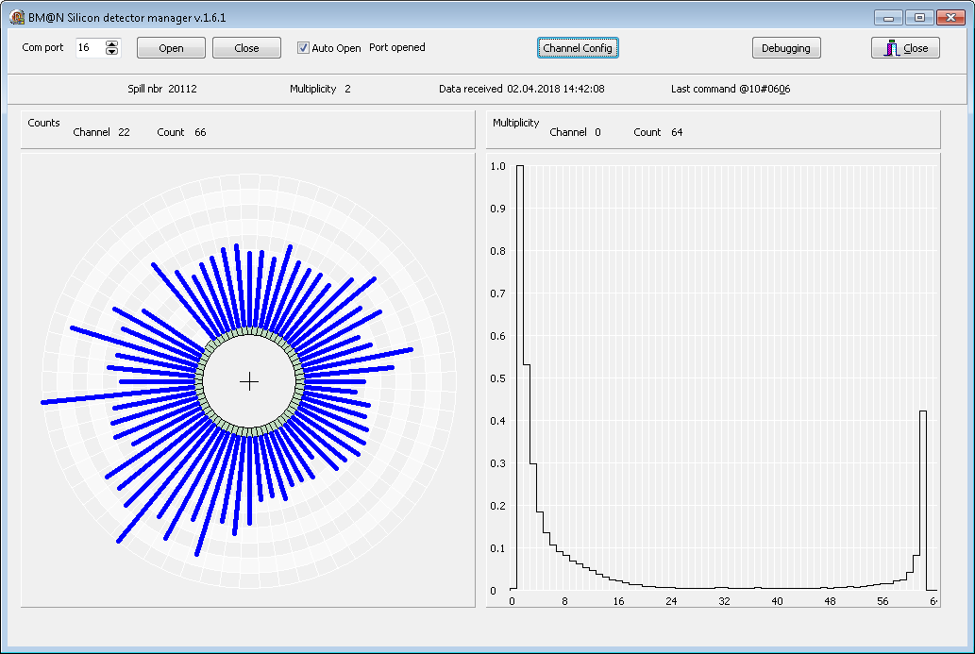
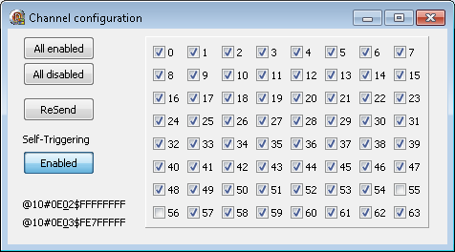
SiD_Mgr

Slide 18
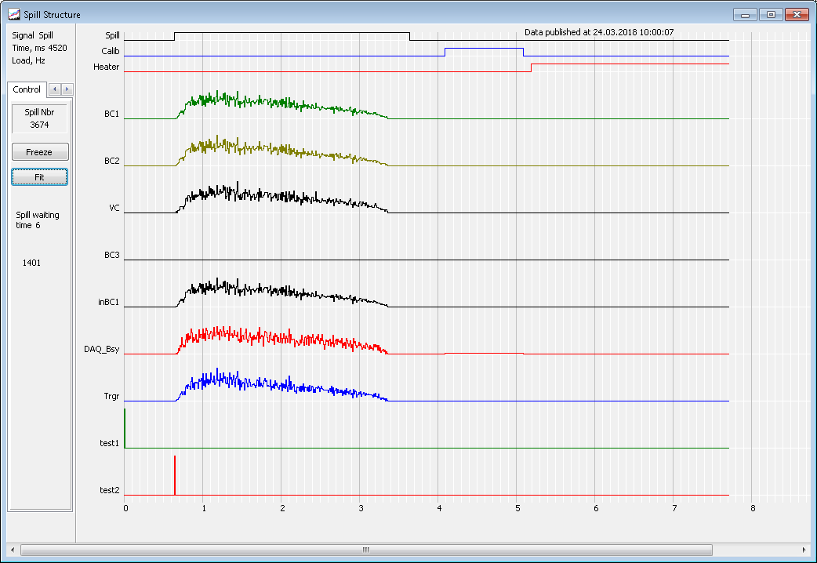
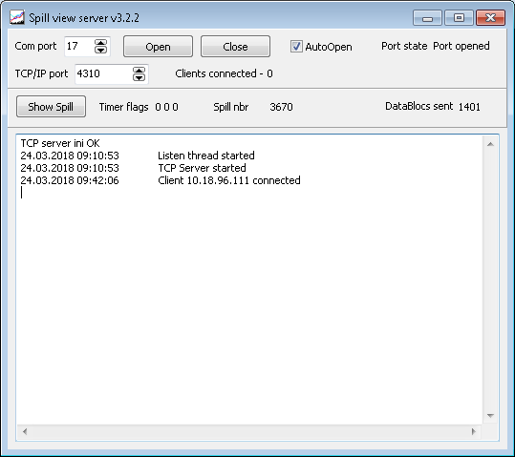
Spill_View server

Slide 19
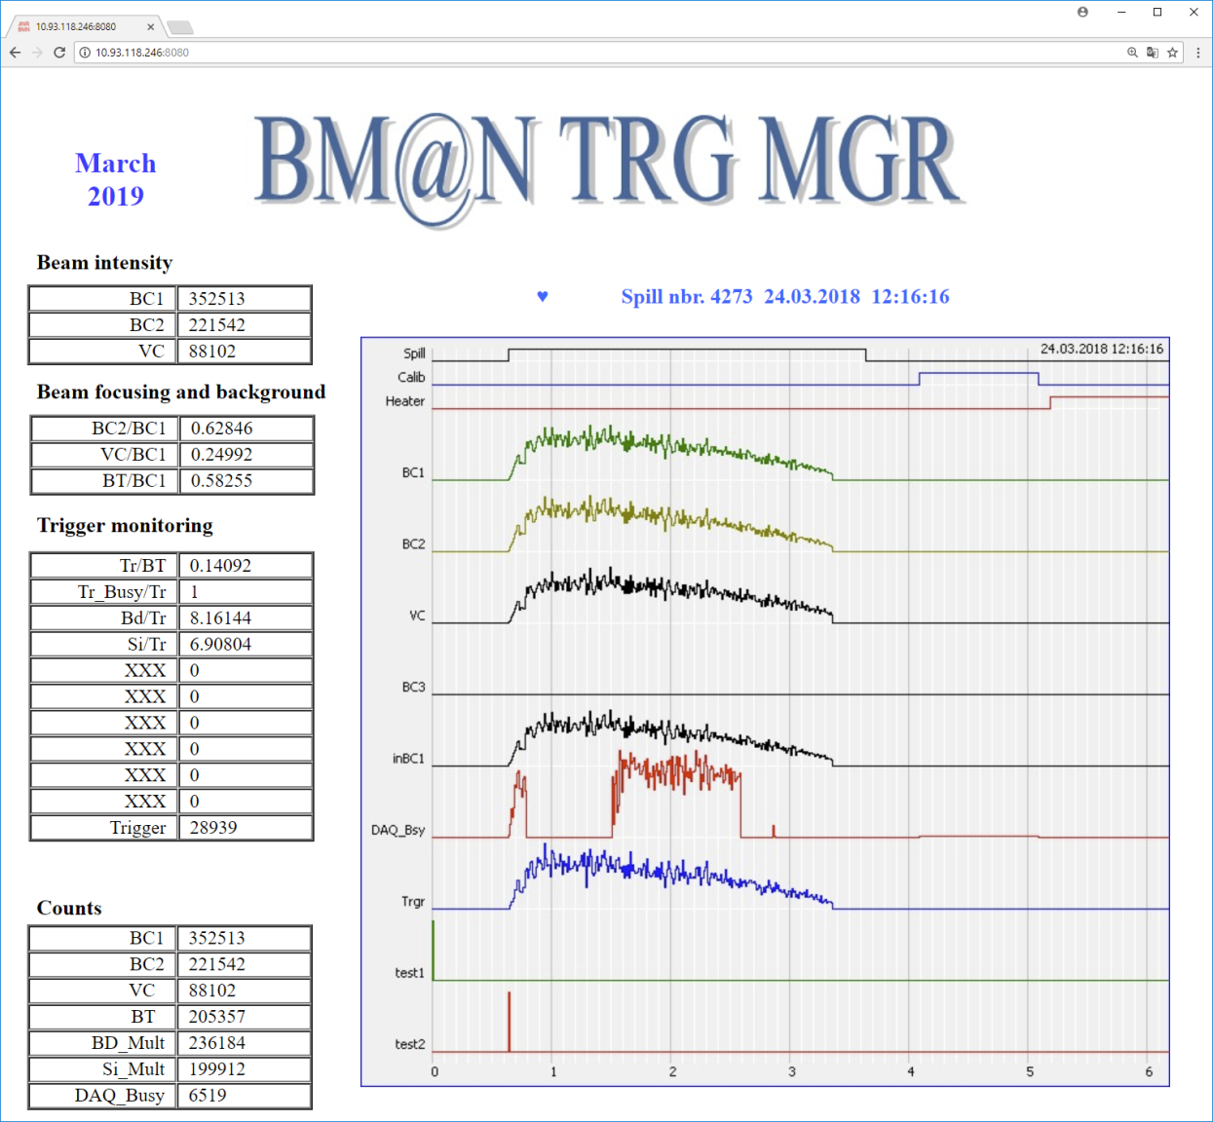
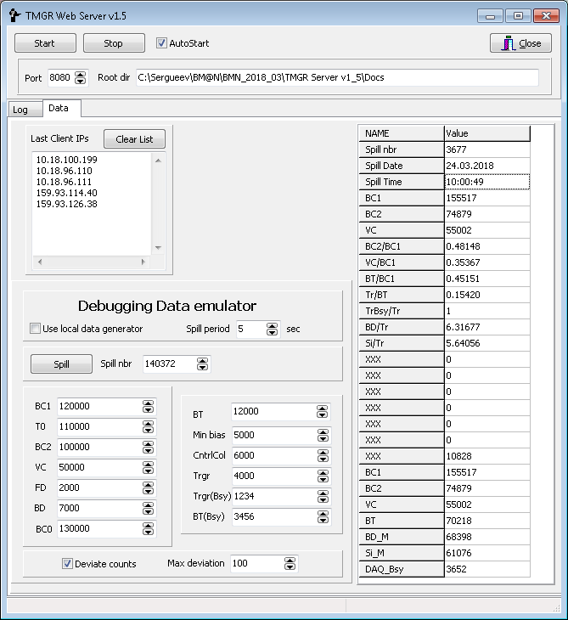
Web-Server + browser

Slide 20
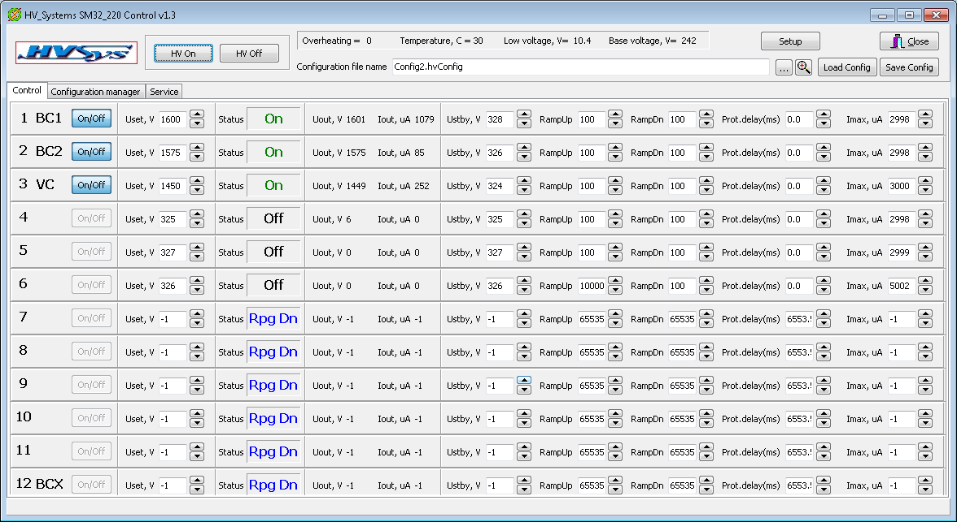
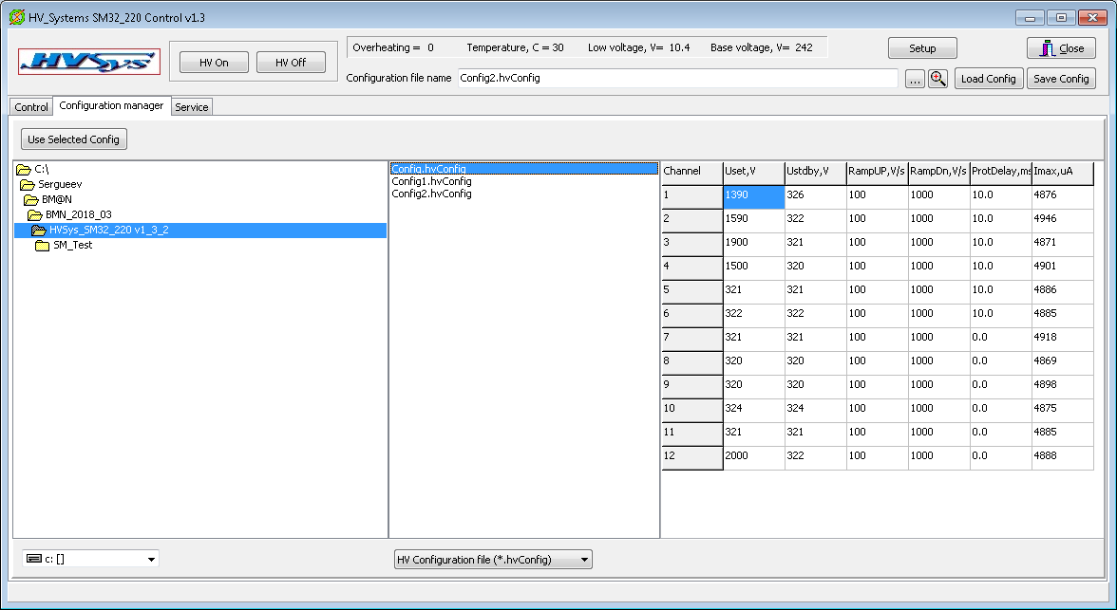
HV Server

Slide 21
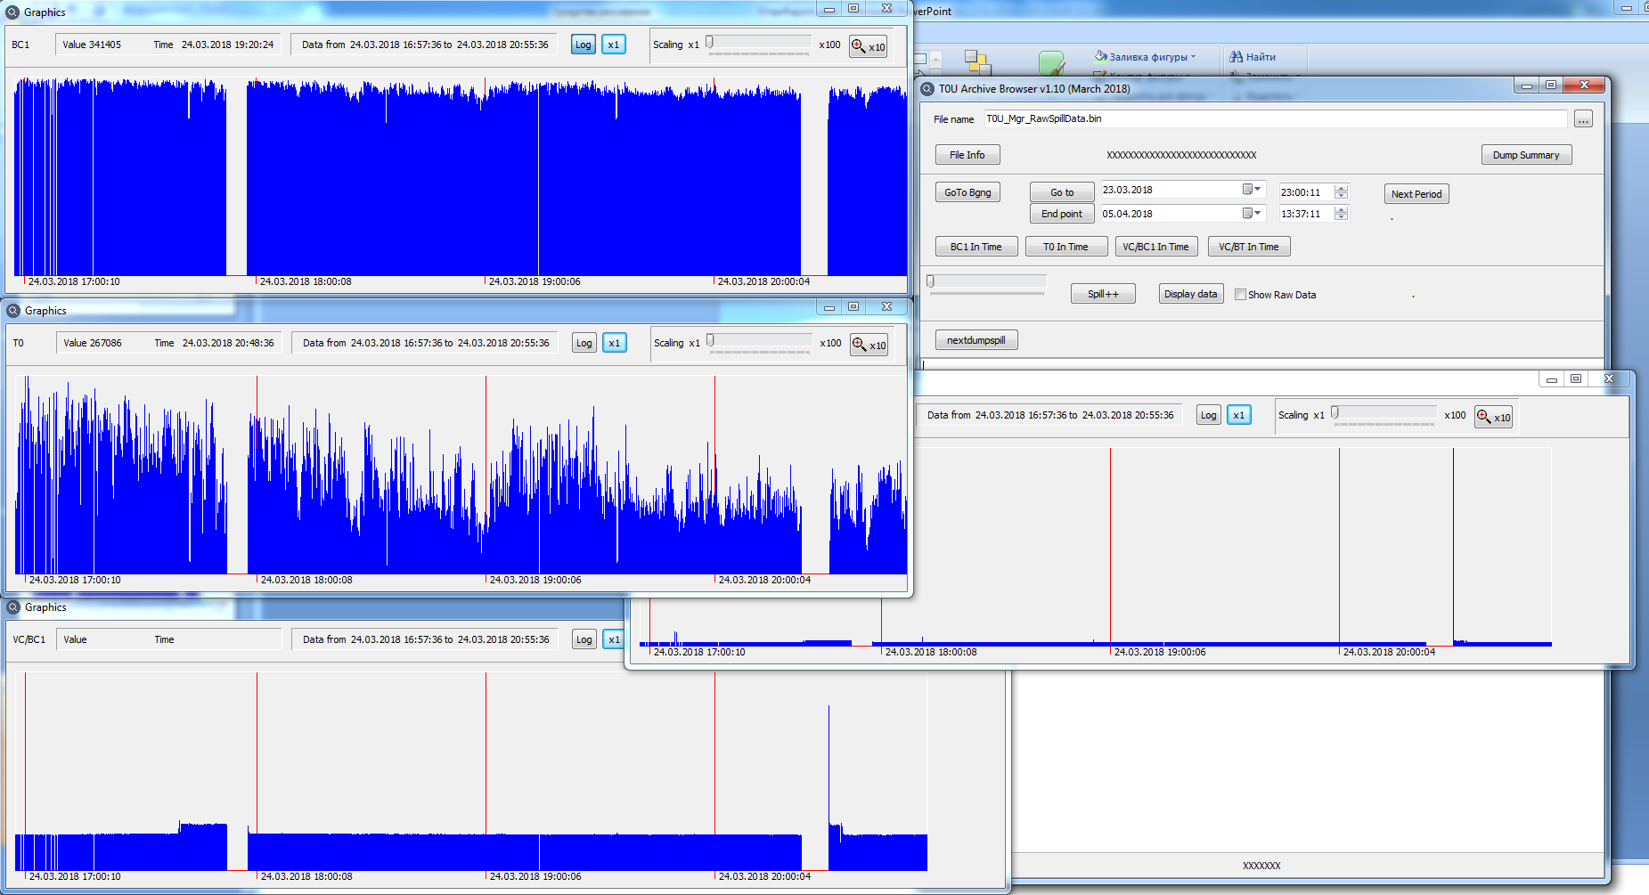
Log_Viewer

Slide 22
SRC vs BM@N
Difference between SRC and BM@N
SRC does not have multichannel detectors BD and SiD
SRC has additional scintillation detectors
Added 2-level discriminator
Trigger logics becomes more complicated
As a result the software was significantly modified but the software structure was almost the same

Slide 23
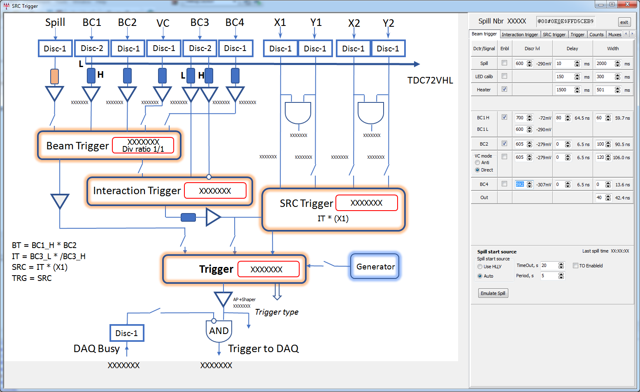
SRC_Mgr

Slide 24
Conclusion
The modular trigger system for fixed target experiments BM@N and SRC has been developed.
The system has only virtual controls and all trigger adjustment is done inside FPGA. No need to human access to the beam area to adjust trigger performance.
The set of applications to control and monitor trigger system performance has been developed
The system has been successfully used during 2016…2018 BM@N and SRC physics runs

