Slide 1
L. P. Kaptari
Bogoliubov Lab. Theor. Phys . JINR, Dubna

Slide 2
MOTIVATION
Dubna, July, 2019

Slide 3
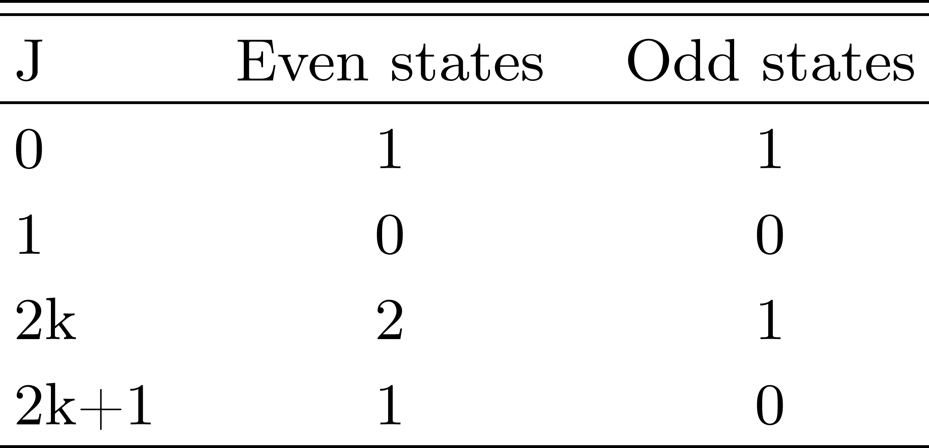
L.P. Kaptari
BSE:
Masses, wave functions, decay processes etc.
Dubna, July, 2019

Slide 4
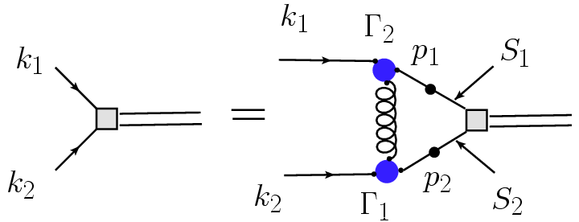
L.P. Kaptari
Dubna, July, 2019

Slide 5
L. P. Kaptari
Dubna, July, 2019

Slide 6
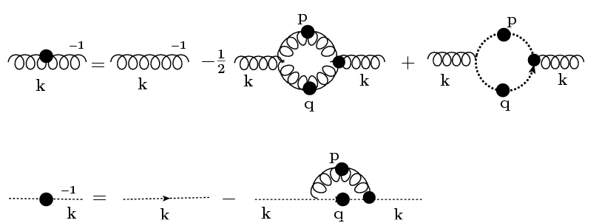
L.P. Kaptari
TRUNCATION:
Dubna, July, 2019

Slide 7
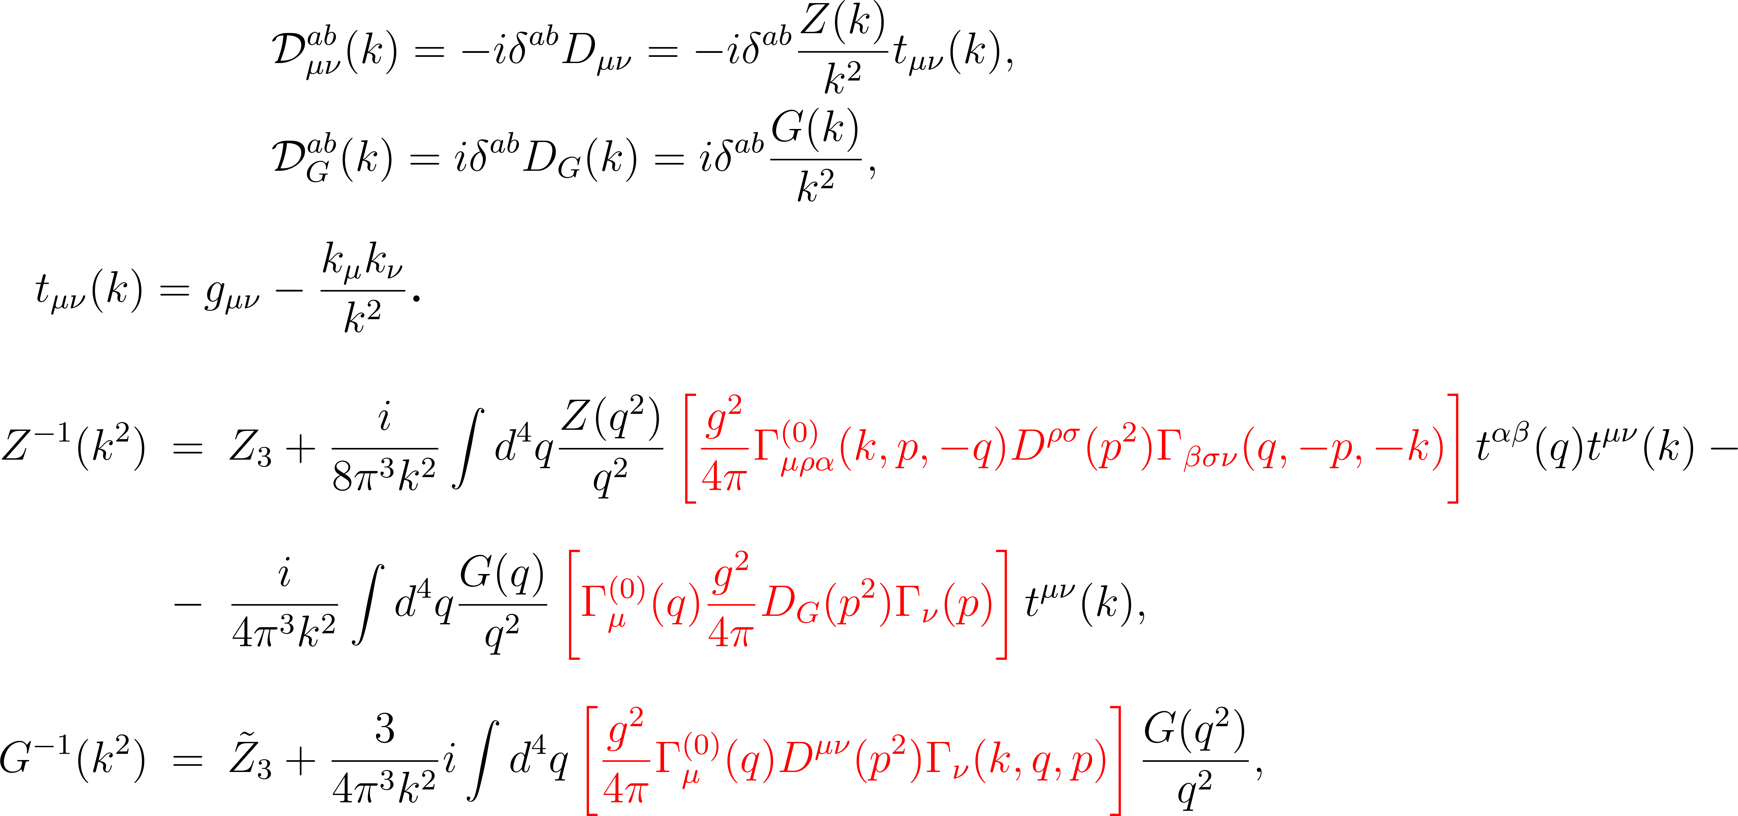
L.P. Kaptari
LANDAU gauge

Slide 8
L.P. Kaptari
Effective interaction: rainbow approximation:

Slide 9
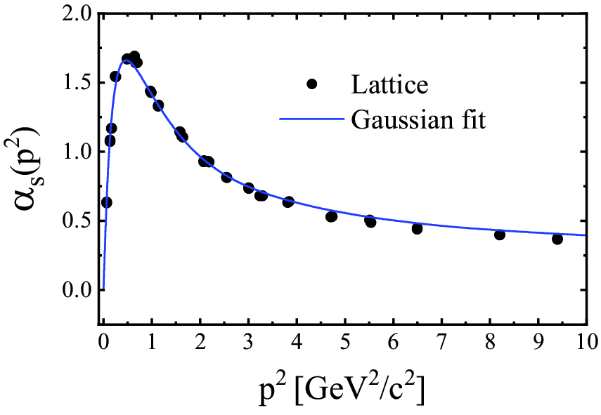
L.P. Kaptari
IR Gaussian fit
Euclidean space (only IR):
Dubna, July, 2019

Slide 10
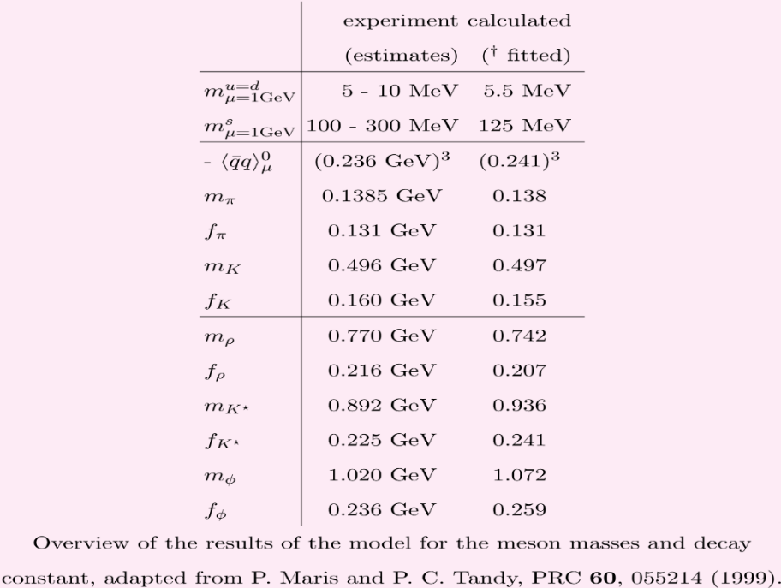
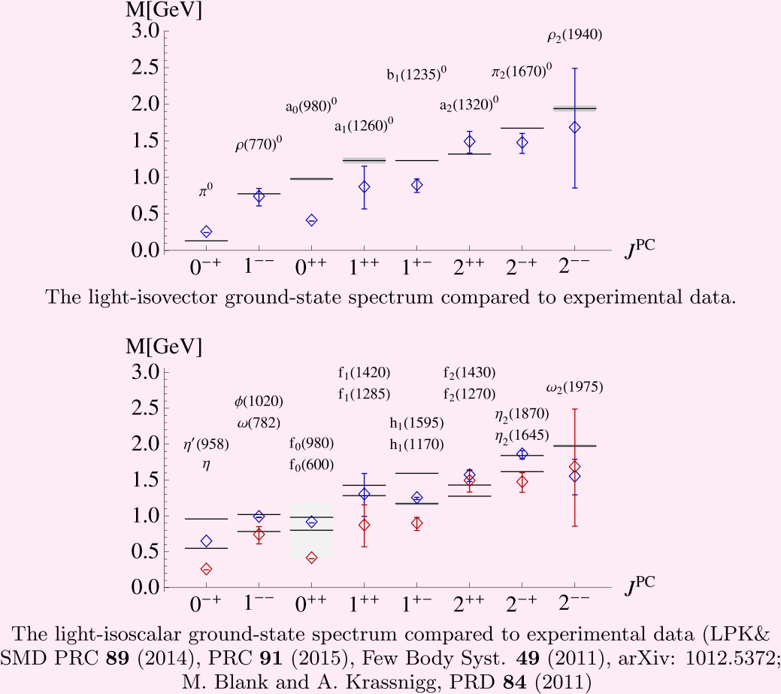
L.P. Kaptari
RESULTS
MESONS:
Information on gluon propagators is much more scarce
(even absent?) !!!
Dubna, July, 2019

Slide 11
L.P. Kaptari
Solving the gluon-ghost DSE
Dubna, July, 2019

Slide 12
L.P. Kaptari
Dubna, July, 2019

Slide 13
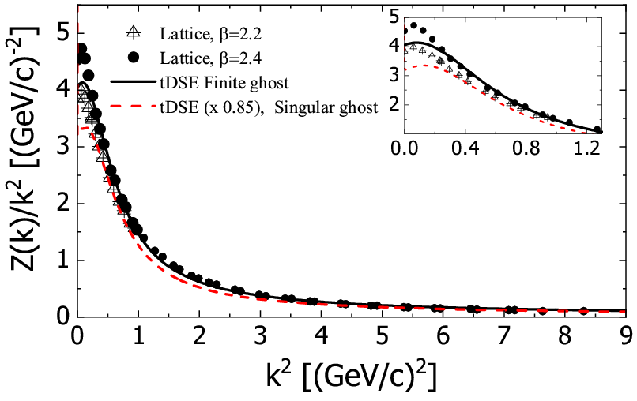
L.P. Kaptari
Dubna, July, 2019

Slide 14
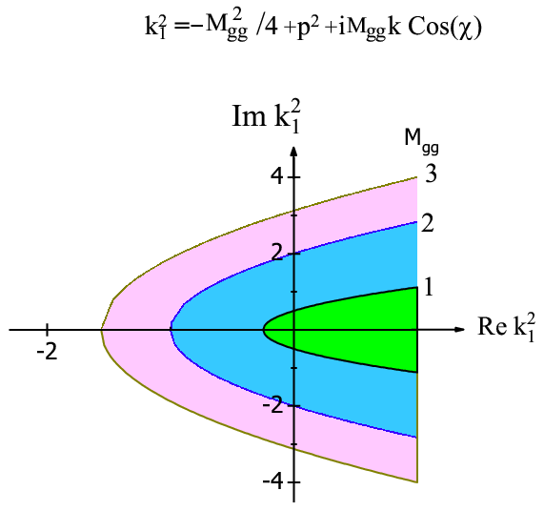
L.P. Kaptari
BSE domain
Dubna, July, 2019

Slide 15
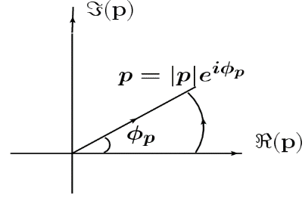
L.P. Kaptari
Complex Euclidean space (numerical)
i) rays along φ=const
ii) Laurent series
iii) DSE solution along real momenta q
and DSE at complex external momenta k

Slide 16
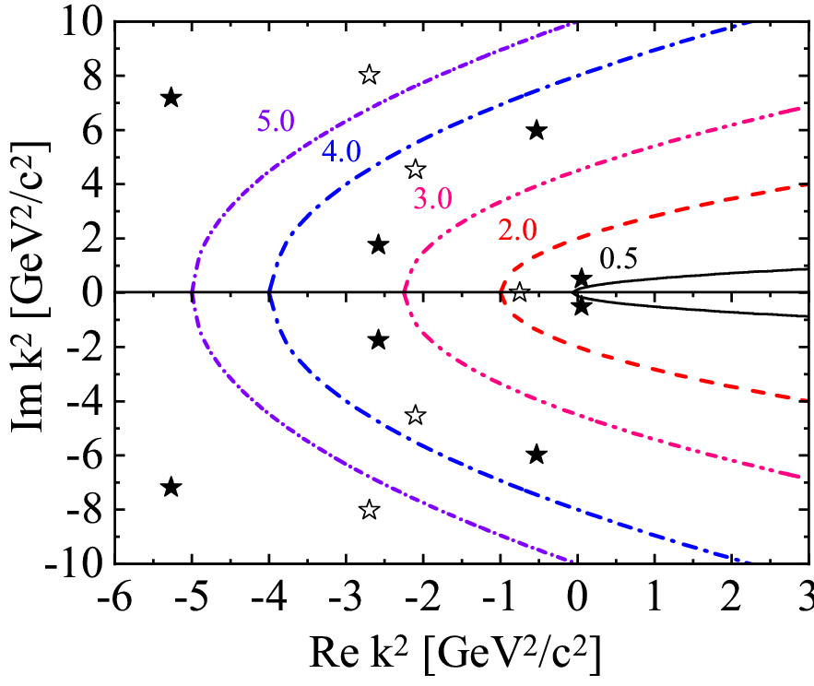
L.P. Kaptari
Analytical properties
Dubna, July, 2019

Slide 17
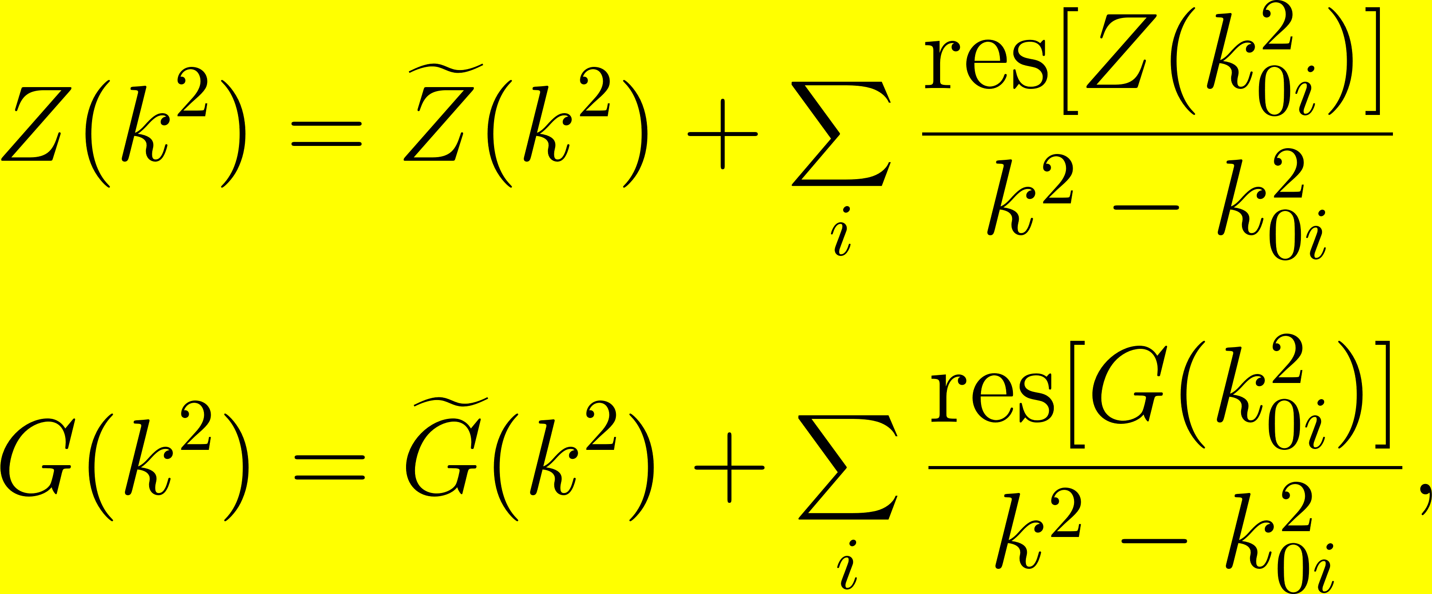
Numerical integration
Dubna, July, 2019

Slide 18
L.P. Kaptari
SUMMARY
The gluon and ghost propagators, in Landau gauge, have been analyzed by the Dyson-Schwinger equation within the ladder rainbow truncation. It has been found that, by a proper choice of the effective model parameters, the method provides reliable solutions for the model propagators in a good agreement with the available SU(2) and SU(3) lattice QCD calculations.
The obtained solutions have been generalized to complex Euclidean space in the domain where the Bethe-Salpeter equation for glueballs is defined.
It has been shown that the complex solutions od the tDSE are not analytical in complex Euclidean space and contain pole-like singularities, which can hamper the numerical procedure of solving the BSE for glueballs.
A method based on the Cauchy’s and Roushe’s theorems has been proposed to analyze the corresponding singularities. The position of the few first poles together with their residues are found with a good accuracy to be used in subsequent calculations based on the Bethe-Salpeter equation for glueballs.

Slide 19
THANK YOU !!!

