Slide 1

Phase transition between the isovector to isoscalar pair correlations in N = Z nuclei
Eun Ja Ha
Soongsil University, Seoul, Korea

Slide 2
Contents
Motivations
Formalism
Results
Summary
1. Motivation
2. Formalism : pairing scheme
3. The ratio of Isoscalar(IS) pairing and Isovector(IV) pairing in N=Z nuclei
4. Summary

Slide 3
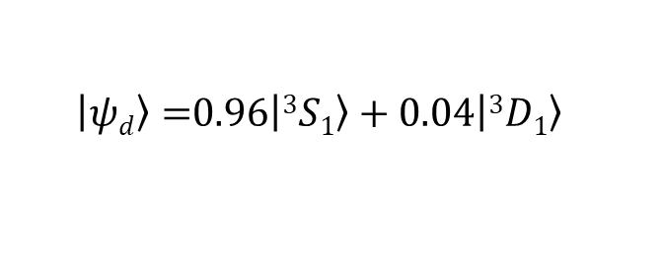
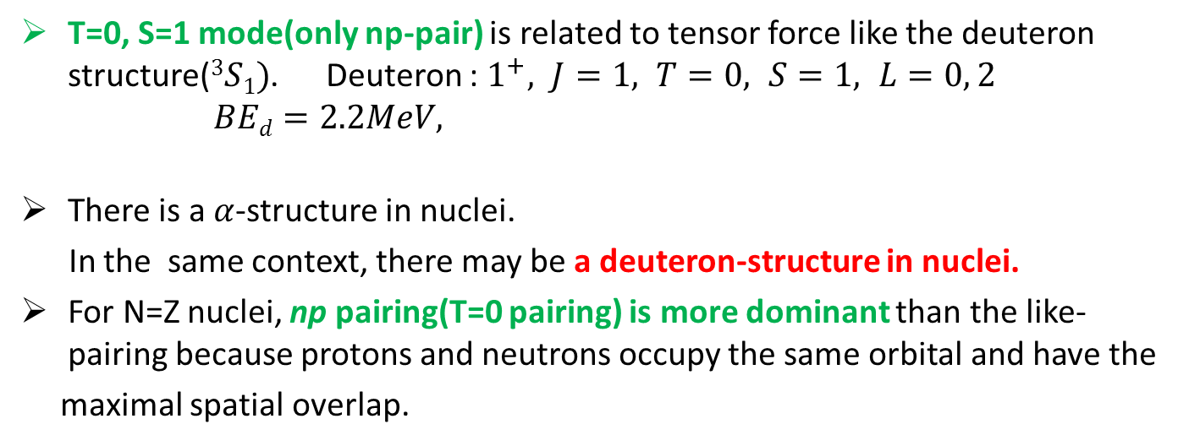
T=1, S=0 (Isovector(IV), spin- singlet)
Motivations
Formalism
Results
Summary
deuteron-like structures in N=Z nuclei ?
T=0, S=1 (Isoscalar(IS), spin- triplet)
T_{z} : +1 0 -1 S_{z} : +1 0 -1
p
p
n
p
n
p
n
n
n
p
n
p
n
p
n
p
T=0, S=1 mode(only np-pair) is related to tensor force like the deuteron structure($3S1)$. Deuteron : $1^{+}, J=1, T=0, S=1, L=0, 2$
$BEd=2.2MeV,$
There is a $α$-structure in nuclei.
In the same context, there may be a deuteron-structure in nuclei.
For N=Z nuclei, np pairing(T=0 pairing) is more dominant than the like-pairing because protons and neutrons occupy the same orbital and have the
maximal spatial overlap.
$\left|\left.ψd\right\rangle =\right.0.96\left|\left.3S1\right\rangle \right.+0.04\left|\left.3D1\right\rangle \right.$

Slide 4
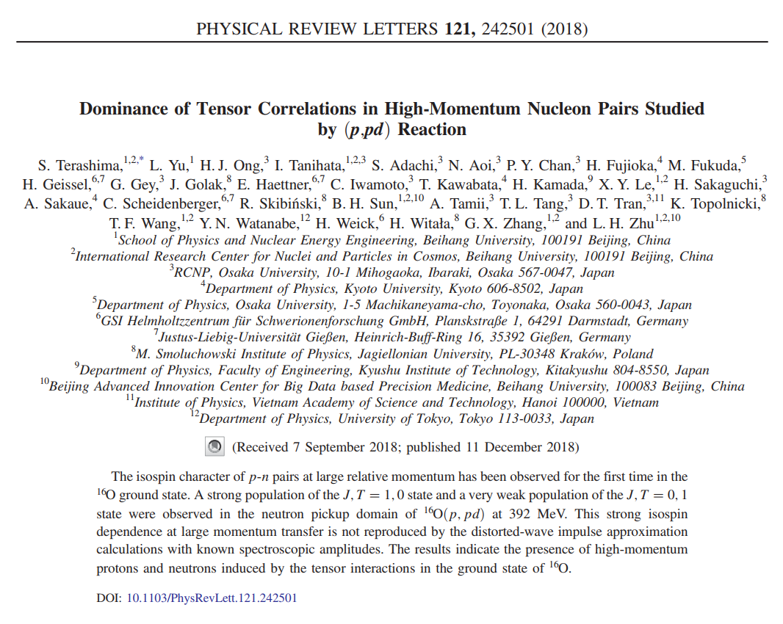
Motivations
Formalism
Results
Summary

Slide 5
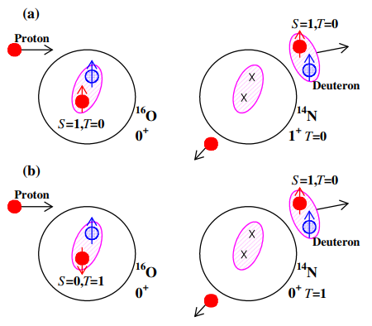

Motivations
Formalism
Results
Summary
$16O(p,pd)$
S.Terashima, et al. PRL 121 (2018)
S=1,T=0 channel in the cross section is dominant.
The unlike-pairing correlations coupled through a higher angular momentum,
L= 2, can be important to search the deuteron break-up reaction.
Notes:
Deuteron is emitted from target.

Slide 6
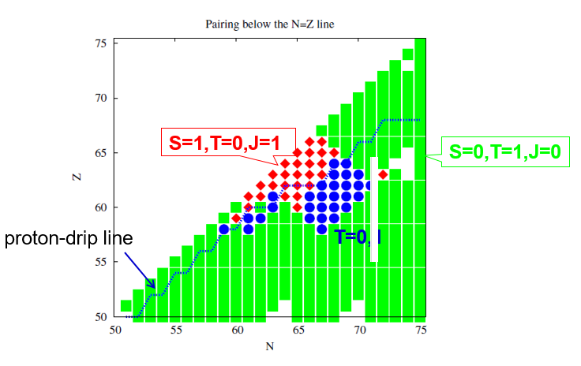
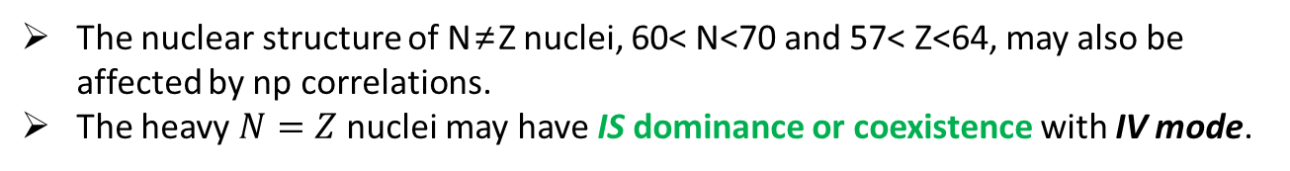
Motivations
Formalism
Results
Summary
Unlike-pairing correlations in $N\sim Z nuclei$
A. Gezerlis, et al. PRL 106, 252502(2011)
The nuclear structure of N≠Z nuclei, 60< N<70 and 57< Z<64, may also be affected by np correlations.
The heavy $N=Z$nuclei may have IS dominance or coexistence with IV mode.

Slide 7
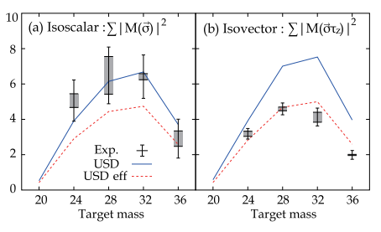
Motivations
Formalism
Results
Summary
M1 spin transition data shows the IV quenching for the N = Z sd-shell nuclei.
: IS T = 0 pairing by the tensor force well-known in deuteron structure may
become more significant even inside nuclei.
According to a study on the relationship between nuclear deformation and np-pairing correlation, the IV and IS pairing may have a large coexistence and the deformation can cause the quenching of the IV np-pairing.
H. Matsubara, et al. PRL 115 (2015)
Danilo Gambacurta, et al. PRC 91 (2015)

Slide 8
Motivations
Formalism
Results
Summary
In our early papers, the IV np-pairing was included in spherical formalism and IS np-pairing was taken into account by renormalizing the IV np-pairing implicitly. M.K. Cheoun et al. NPA 561(1993), NPA 564(1993)
In this work, the effects of deformation and IS np- pairing are taken into account explicitly within the deformed BCS approach.

Slide 9
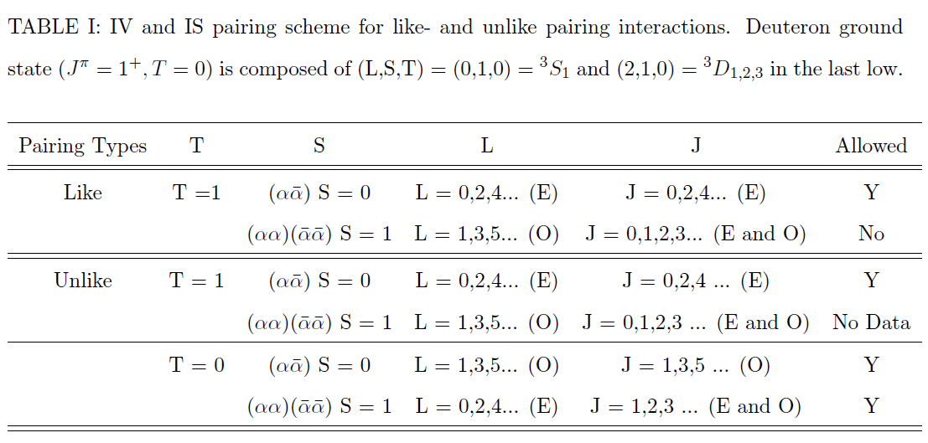
Motivations
Formalism
Results
Summary
Pairing scheme
High-momentum components in nuclei are important for understanding the roles of noncentral nuclear interactions, such as the tensor force, beyond the single particle motion.
In this work, higher angular momentum components in the pairing are included.

Slide 10
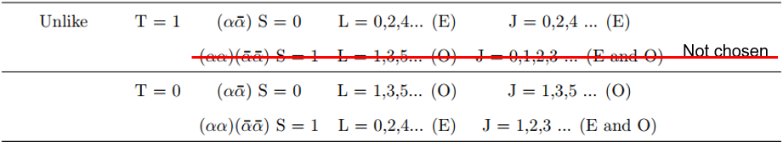
Motivations
Formalism
Results
Summary
In our formalism, we can not separate the relative orbital angular momentum L.
We consider the maximum of total angular momentum J, J_{max,} instead
of L to find the effect of high relative angular momentum L.

Slide 11

Motivations
Formalism
Results
Summary
Enhanced T=0 (T₀) pairing correlation for N=Z nuclei
T=0, S=1 (Isoscalar(IS), spin- triplet)
n
p
n
p
n
p
n
p
Enhanced T₀ = T₀ ⅹ1.5(due to IV quenching)ⅹ2
Enhanced T₀ = 3 T₀
Sagawa et al.
Ha et al. PRC97,024320(2018)

Slide 12

Motivations
Formalism
Results
Summary
How to include the deformation?
Ha et al. NPA934, 73(2015)
Deformed Woods-Saxon(WS) potential
(cylindrical WS, Damgaard et al 1969)
distance function
β₂ : quadrupole deformation parameter
β₄ : hexadecapole deformation parameter
We can determine these two parameters by taking values giving the minimum ground state energy.
To exploit G-matrix elements, which is calculated in the spherical basis, deformed bases are expanded in terms of the spherical bases.
Deformed SPS Sph. HO w. f.

Slide 13
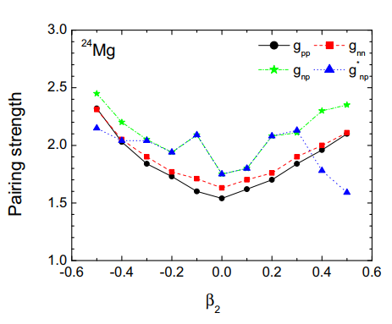
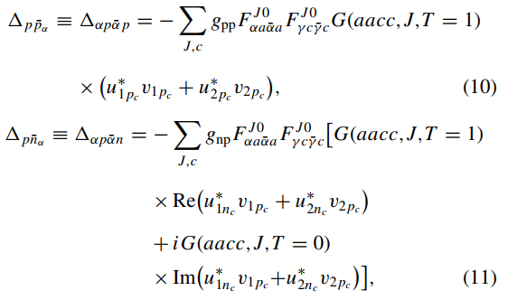
Motivations
Formalism
Results
Summary
Evolution of pairing strength of ²⁴Mg in sd-shell
Ha et al. PRC97,024320(2018)
enhanced T=0
T=0 (IS) condensation
Coexistence of T=0 and T=1 pairing
The smaller g_{np}* value in mean the larger pairing energy is obtained.
Notes:
Gnp is multiplied to G-mat to renormalize G-matrix

Slide 14
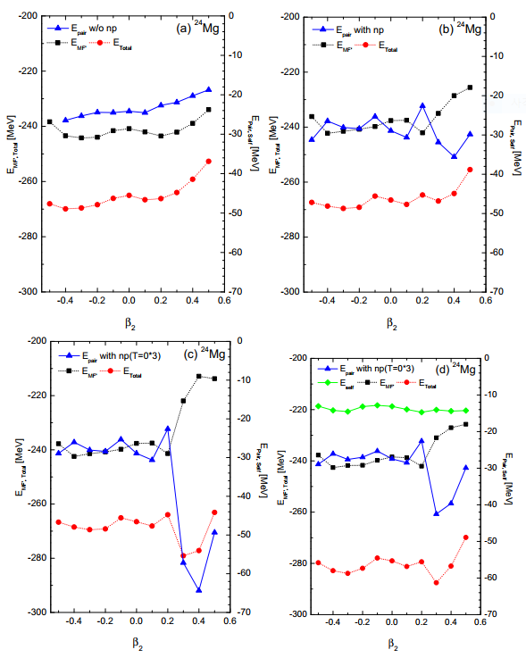

Motivations
Formalism
Results
Summary
Shell evolution of ²⁴Mg
(a) without np-pairing (like-pairing,T=1)
(b) with np-pairing
(c) with enhanced T=0
(d) with enhanced T=0 + self E
Enhanced IS np pairing correlations may be an indispensable ingredient to understand the prolate deformation.
Notes:
The pairing E is getting bigger with prolated deformation

Slide 15
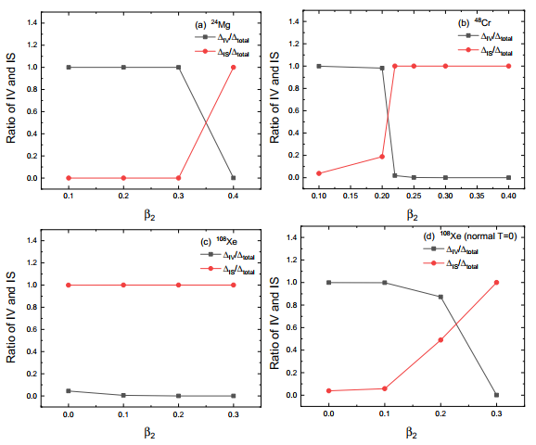
Motivations
Formalism
Results
Summary
Ratio of IV and IS np-pairing
Ha et al. PRC99,064304 (2019)
a)∼c): enhanced T=0
d): normal T=0
IS condensation by the enhanced T=0 np pairing may happen in deformed ²⁴Mg and ⁴⁸Cr.
Rapid phase transition from IV to IS component in the np pairing. But it may happen slower in heavy nuclei, which may mean the coexistence of IV and IS in some deformation region.
For heavy nuclei, ¹⁰⁸Xe, T=0 np pairing (IS) is dominant by the enhanced T=0 and the phase transition may happen more easily even with the normal T=0.

Slide 16
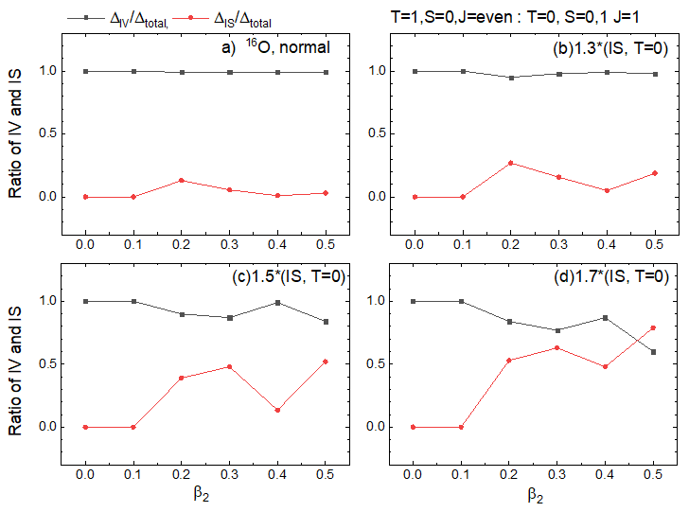
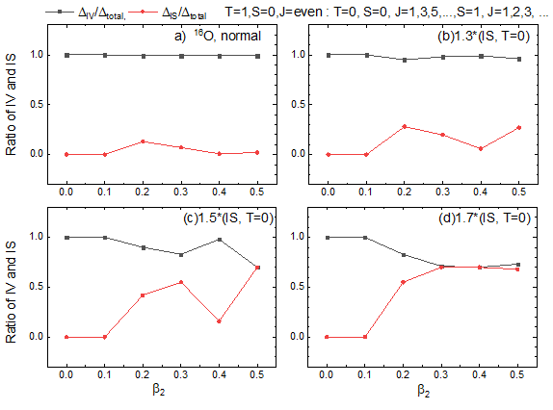
Motivations
Formalism
Results
Summary
Ratio of IV and IS pairing gap for ¹⁶O ; $β_{2}$
We investigate the contribution of high angular momentum couplings to the pairings.
For IS np-pairing we multiplied a weighting factor from 1.0 to 1.7.
Preliminary
IS contribution to the np-pairing increases with large deformation and large weighting factor.
IS np-paring in high angular momentum state is non-negligible.
Notes:
The pairing E is getting bigger with prolated deformation

Slide 17
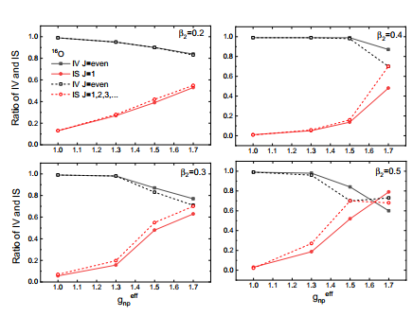
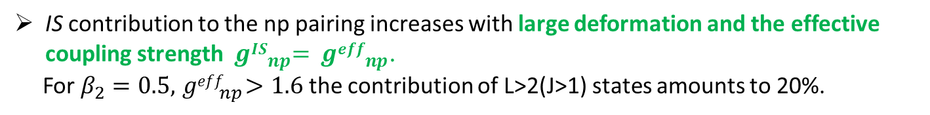
Motivations
Formalism
Results
Summary
Ratio of IV and IS pairing gap for ¹⁶O ; Enhanced T=0 pairing
Preliminary
IS contribution to the np pairing increases with large deformation and the effective coupling strength${ gIS}_{np}^{}={ geff}_{np}^{}$.
For $β_{2}=0.5,{ geff}_{np}^{}>1.6$ the contribution of L>2(J>1) states amounts to 20%.
Notes:
The pairing E is getting bigger with prolated deformation

Slide 18
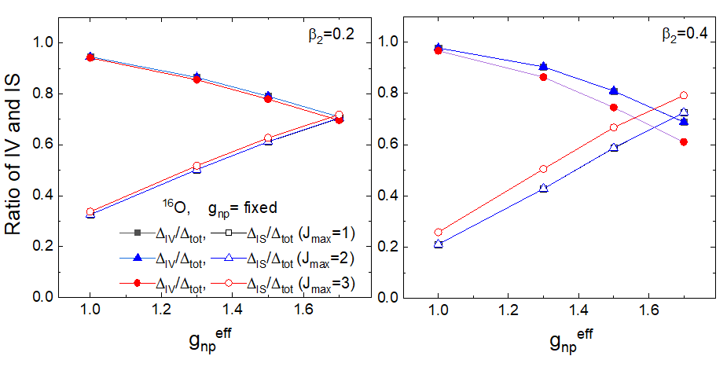
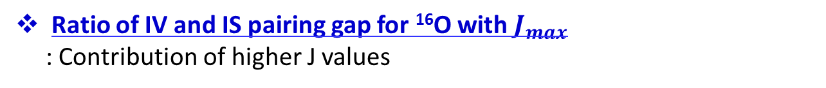
Motivations
Formalism
Results
Summary
Ratio of IV and IS pairing gap for ¹⁶O with $J_{max}$
: Contribution of higher J values
Preliminary
The tensor force contribution explicitly appears in the ratio, which increases with the deformation.
Notes:
The pairing E is getting bigger with prolated deformation

Slide 19
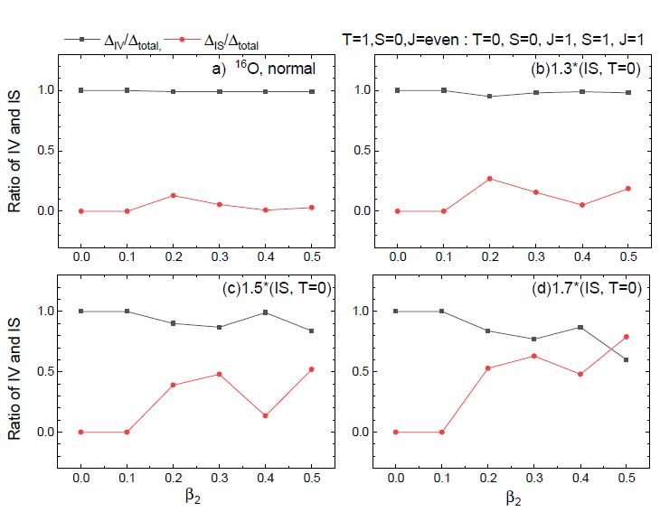
Motivations
Formalism
Results
Summary
Ratio of IV and IS pairing gap for ¹⁶O ; $β_{2}$
Notes:
The pairing E is getting bigger with prolated deformation

Slide 20
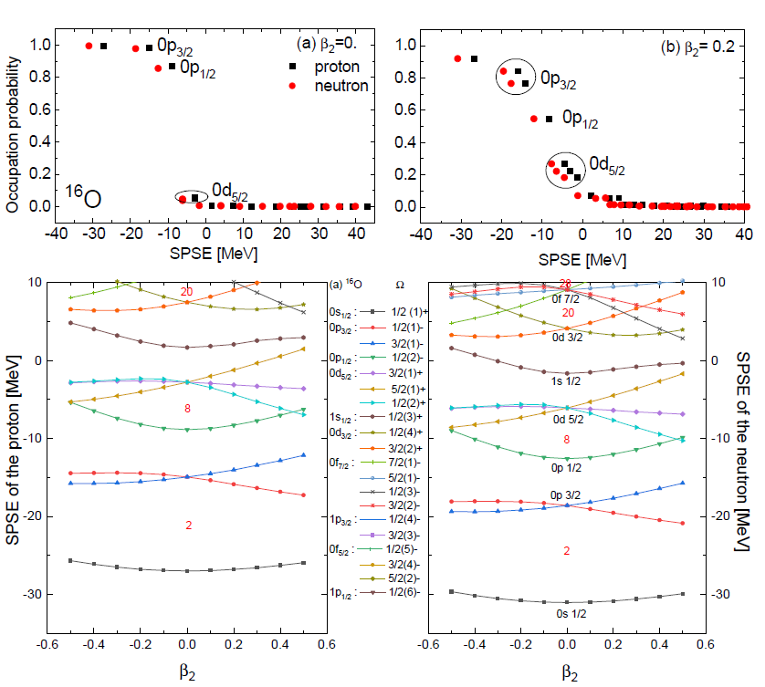
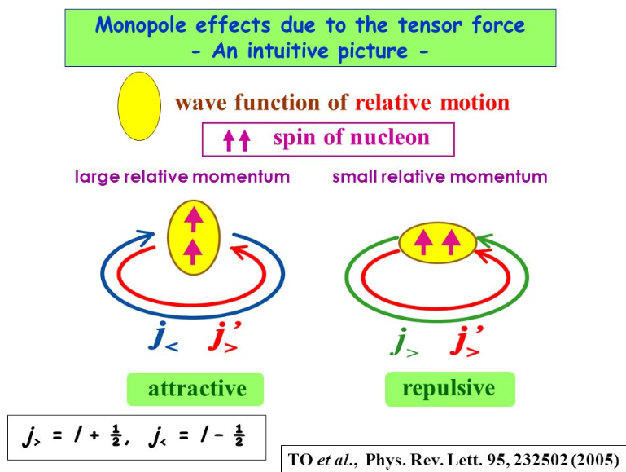


Motivations
Formalism
Results
Summary
Smearing of Fermi surface by DBCS & Single particle state E(SPSE) by DWS of ¹⁶O
Fermi smearing can be produced due to the tensor force .
$$0d3/2$$
$$0p3/2$$

Slide 21
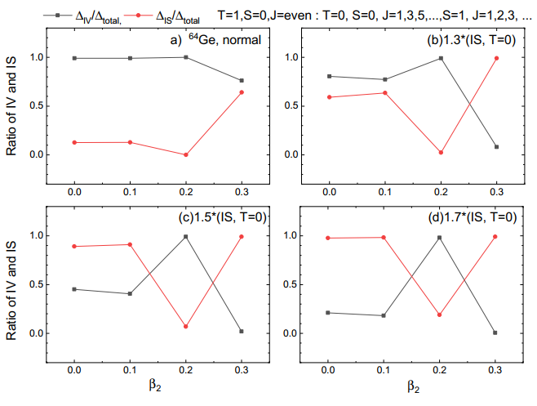
Motivations
Formalism
Results
Summary
Ratio of IV and IS pairing gap for ⁶⁴Ge ; $β_{2}$
Preliminary
IS contribution becomes larger with the deformation even in the normal strength.
Notes:
The pairing E is getting bigger with prolated deformation

Slide 22
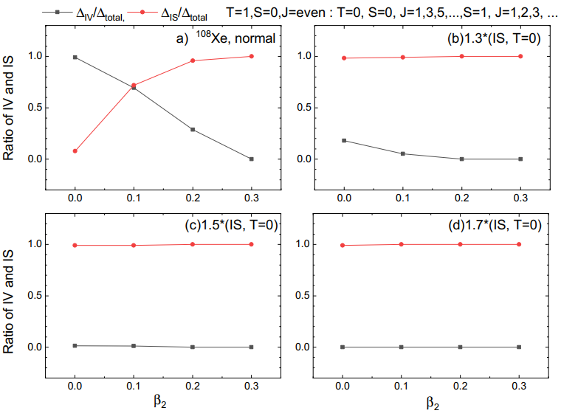
Motivations
Formalism
Results
Summary
Ratio of IV and IS pairing gap for ¹⁰⁸Xe ; $β_{2}$
Preliminary
Notes:
The pairing E is getting bigger with prolated deformation

Slide 23
Collaborator : Myung-Ki Cheoun¹ and Hiroyuki Sagawa²
Department of Physics and Origin of Matter and Evolution of Galaxy (OMEG) Institute,
Soongsil University, Seoul, Korea
2) RIKEN and University of Aizu, Japan
This talk was based on our recent papers.
1. Spin singlet and spin triplet pairing correlations on shape evolution in
sd-shell N=Z nuclei. Ha et al. PRC97, 024320(2018)
2. Neutron-proton pairing correlations and deformation for N = Z nuclei
in pf-shell by the deformed BCS and HFB approach. Ha et al. PRC97, 064322(2018)
3. Isoscalar condensation in N = Z nuclei.
Ha et al. Acta Physica Polonica B 50, 697(2019).
4. Effects of the Coulomb and the spin-orbit interaction in a deformed mean
field on the residual pairing correlations for N=Z nuclei.
Ha et al. PRC99, 064304 (2019)
5. Competition of deformation and neutron-proton pairing in Gamow-Teller
transitions for ^{56,58,60,62,64}Ni. Ha et al. JPG. (in press )

Slide 24
Summary
Motivations
Formalism
Results
Summary
IS pair condensation may occur in deformed N = Z nuclei, such as ²⁴Mg and ⁴⁸Cr, through an abrupt phase transition from IV to IS interaction due to the enhanced T = 0 np-pairing correlations.
2. For heavy nuclei such as ¹⁰⁸Xe, the transition may happen more smoothly
even with the normal T = 0 pairing interaction.
3. More detailed and systematic calculations regarding the IS pair condensation
and the coexistence of the IV and IS phase for heavy N= Z nuclei are in progress.

Slide 25
Thanks for your attention !!

Slide 26
Back-up files

Slide 27
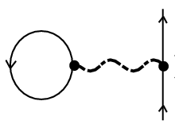
Motivations
Formalism
Results
Summary
Self energy in BCS
E_{mean} E_{self} E_{pair}
: self energy
: pairing gap
The self energy term was usually neglected in BCS eq. because it results from particle-hole correlations beyond the BCS and affects a renormalization of the single particle energy.
Notes:
The self E represents the contribution to the particles E due to interaction between the particle and its system.

Slide 28
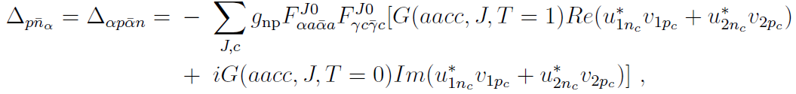
Motivations
Formalism
Results
Summary
Pairing correlation
deformed HFB deformed BCS
K=0
K=0
Ω
Ω -Ω
-Ω
BCS
HFB

Slide 29
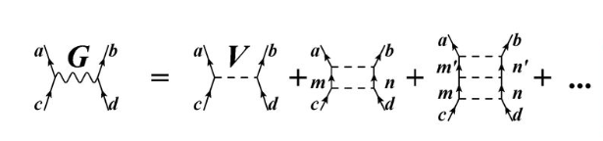
Brueckner G-matrix
Bethe-Goldstone equation
a,b,c,d : single particle state from a Woods-Saxon potential
w : starting energy
ε : single particle energy
Q : Pauli operator
V^{OBEP} : one boson exchange potential of the Bonn group

Slide 30
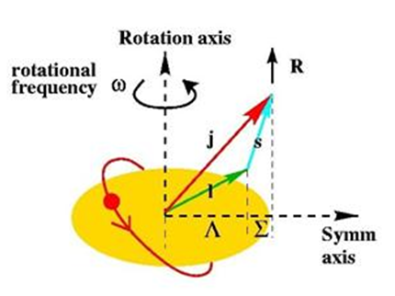
Motivations
Formalism
Results
Summary
Pairing correlation
BCS deformed BCS
J=0
T=1
K=0
Ω -Ω
(J=0,1, 2, 3 ∙∙∙)
T=0 J=1, 3, 5, ∙∙∙
T=1 J=0, 2, 4, ∙∙∙
Ω= ½
j ≥ Ω
j m j -m
(Coupled system)
J
Laboratory
frame
K
Intrinsic
frame
Since the deformed SPS are expanded in terms of the spherical SP bases the different total angular momenta of the SP basis states would be mixed.

Slide 31
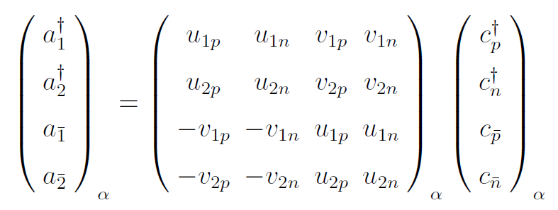

Slide 32
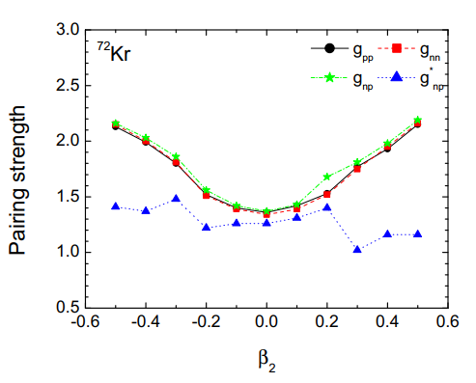
Motivations
Formalism
Results
Summary
Evolution of pairing strength of ⁷²Kr in pf-shell
Ha et al. PRC97, 064322(2018)
enhanced T=0
There is also the coexistence of T=0 and T=1 np-pairing at large deformation
similarly to sd-shell N=Z nuclei.

Slide 33
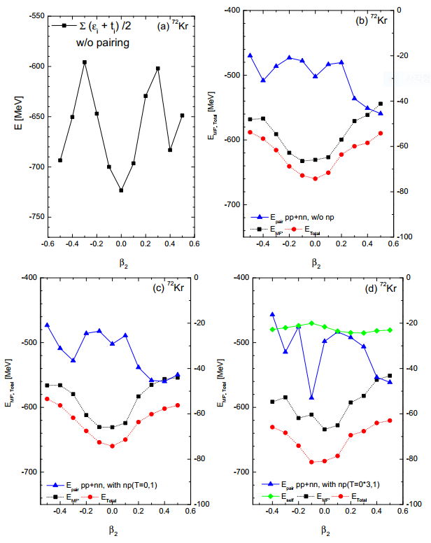
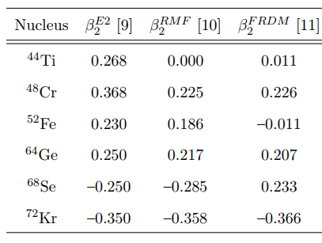
Motivations
Formalism
Results
Summary
Shell evolution of ⁷²Kr
Enhanced IS np pairing correlations may be an indispensable ingredient to understand the oblate deformation.

Slide 34
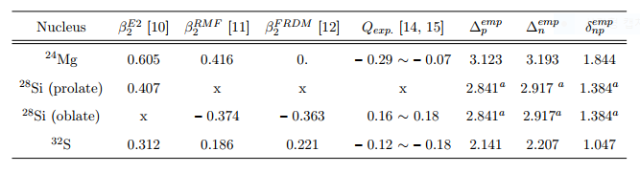
Motivations
Formalism
Results
Summary
In sd-shell N=Z nuclei , Q_{exp} of ²⁸Si is different from ²⁴Mg and ³²S
for 2⁺, Q₂₊ = -2/7 Q₀
Q₂₊ : experimental quadrupole moment
Q₀ : intrinsic quadrupole moment
²⁸Si is not heavy. Where does it come from ?

Slide 35
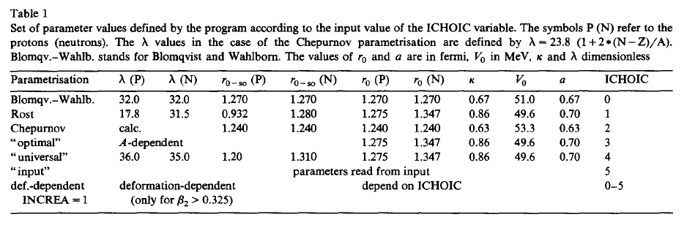
backup file
Parameter set of Deformed Woods-Saxon

Slide 36
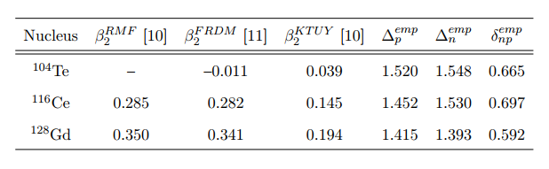
In gd-shell N=Z nuclei

Slide 37
Used parameters in this work.

Slide 38
Motivations
Formalism
Results
Summary
Tensor force

Slide 39
Motivations
Formalism
Results
Summary
Two-body interaction
Realistic two body interaction inside nuclei was taken by Brueckner g-matrix, which is a solution
of the Bethe-Salpeter Eq., derived from the Bonn-CD potential for nucleon-nucleon interaction in
free space.
a,b,c,d : single particle states from the Woods-Saxon potential.
V_{ab,cd} : phenomenological nucleon-nucleon potential in free space.
Notes:
Residual interaction contains two parts.
A particle-hole force are defined with positive sign, which is repulsive, and particle-particle force is negative sign which is attractive.

