Slide 1
13th APCTP - BLTP JINR Joint Workshop "Modern problems in nuclear and elementary particle physics"
The Isoscalar Mesons and Exotic States in (Supersymmetric)Light Front Holographic QCD
Liping Zou
Institute of Modern Physics, CAS
In collaboration with: H. G. Dosch, Stan Brodsky, Guy de Teramond, Pengming Zhang
Phys. Rev.D99.114024
Phys.Rev. D98 (2018) 034002
arXiv:1801.00607
Notes:
0

Slide 2
Supersymmetric Light Front Holographic QCD
Supersymmetry : Supersymmetric QM not supersymmetric QFT !! connects meson wave functions with baryon wave functions. No squarks and gluinos
Light Front: We work in a Light front system
Holographic: The Quantum Field Theory in our 4-dimensional World is a hologram of a classical field theory in 5 dimensions: AdS/CFT correspondence

Slide 3
Outline
1) Theoretical Background—AdS/CFT
2) Consequences for Ordinary Hadrons—An overview
3) The Isoscalar Mesons eta mesons open questions
4) Tetraquarks and candidates among the isoscalar bosonic states 5) Conclusion
Notes:
2

Slide 4
AdS/CFT
Maldacena conjecture
J. M. Maldacena, Int. J. Theor. Phys. 38, 1113 (1999)
Classical gravitational field theory in 5-dimensional Anti deSitter space (AdS₅)
conformal quantum field gauge theory with infinitely many colors in 4 dimensions
Superconformal Infinite number of colours
Unrealistic
QCD is not the scale invariant theory, one needs to break the conformal invariance.
A boundary condition in the extra dimension z in AdS_{d+1} breaks the conformal invariance and allows QCD mass scale and confinement.
Modify the Maldacena Lagrangian
Infinitely many colors, all hadrons are stable.
indicates errors typically
”bottom-up” approach
Modify the 5-d classical gravity theory to obtain realistic features of hadron physics that cannot be seen from QCD Lagrangian

Slide 5
HQCD
Scalar
By Fourier transformation and rescaling
we obtain the Schrodinger like equation from EoM
Solution for every value of M²
Bessel function of the first kind
No scale ! no bound states, no confinement…
Modifications

Slide 6
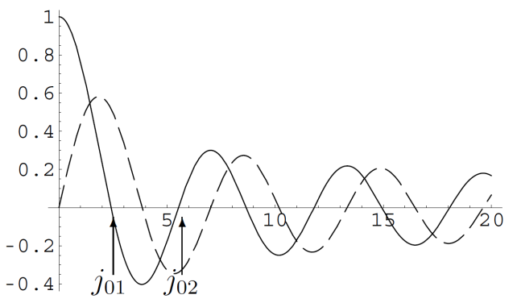
Hard wall model
Cutoff is set at
Duality only valid for
and demand
Zeros of the Bessel function
Yields discrete bound states, but no linear Regege trajectories.
Soft wall model
Modify the action by a for that purpose chosen, the Dilaton factor
Solve Schrodinger equation and obtain Linear Regge trajectories
meson
baryon
“Arbitrary” modification

Slide 7
Light Front Holographic QCD
S. J. Brodsky and G. F. de Teramond, Phys. Lett. B 582. 211(2004). Phys. Rev. Lett. 96(2006)201601
Introduce scales by adequate, but arbitrary, modify the Maldacena Lagrangian
Identify the equation of motion of the 5-d classical theory with the Hamiltonian of Light cone wave function
Particularly
5th variable of 5-d theory is identified as the boost invariant transverse separation of LF wave functions
“Dictionary” is fixed
Phenomenologically very successful
But
1. Modification of action “arbitrary”.
Theoretical remedy
---SuSyLFHQCD
2. completely different treatment of mesons and baryons, although structure very similar.

Slide 8
Discontent with arbitrariness of modifications (completely different for mesons and baryons) Supersymmetric Light Front Holographic QCD
H. G. Dosch, G. F. de Teramond and S. J. Brodsky, Phys. Rev. D 91 (2015), 085016; Phys. Rev. D 92 (2015), 074010;
Phys. Rev. D 95 (2017), 034016
L. Zou and H. G. Dosch, arXiv:1801.00607 [hep-ph].

Slide 9
Supersymmetric Light Front Holographic QCD
Superconformal Quatum Mechnics (Not supersymmetric quantum filed theory )
i) Does not led to new particles(super partners of existing particles)
ii) The “Supersymmetry” relates the LF bound-state wave functions of mesons to baryons
(or to tetraquarks), in Hilbert space.
Simplest superconformal algebra: “4 Supercharges ”
Hamiltonian
Generator of special conformal Transformation
Light front Hamiltonian of Meson and Baryon without interaction
H. G. Dosch et al. PRD 91,045040(2015), PRD 91,085016(2015), PLB 759,171(2016)

Slide 10
Superconformal QM
E. Witen, Nucl. Phys. B 188, 513(1981)
S. Fbini et al. Nucl. Phys. B 245,17(1984)
To construct a new and general Hamiltonian G inside the algebra
One introduces of scale
Meson
Baryon
The interaction U for the meson with L_{M} and the baryon with L_{B} = L_{M}-1
is exactly the one we had introduced before “arbitrarily”.
Supersymmetry indicates NO arbitrary choice!
same λ for mesons and baryons in one family !
Meson with L=0 has no fermionic super-partner

Slide 11
Exotic States ？-Tetraquarks
Completing the Supermultiplets.
Mesons: one wavefunction
Baryons: Two wavefunctions with different chirality
Up to now, we have doublet
completed by
completed supersymmetric multiplet

Slide 12
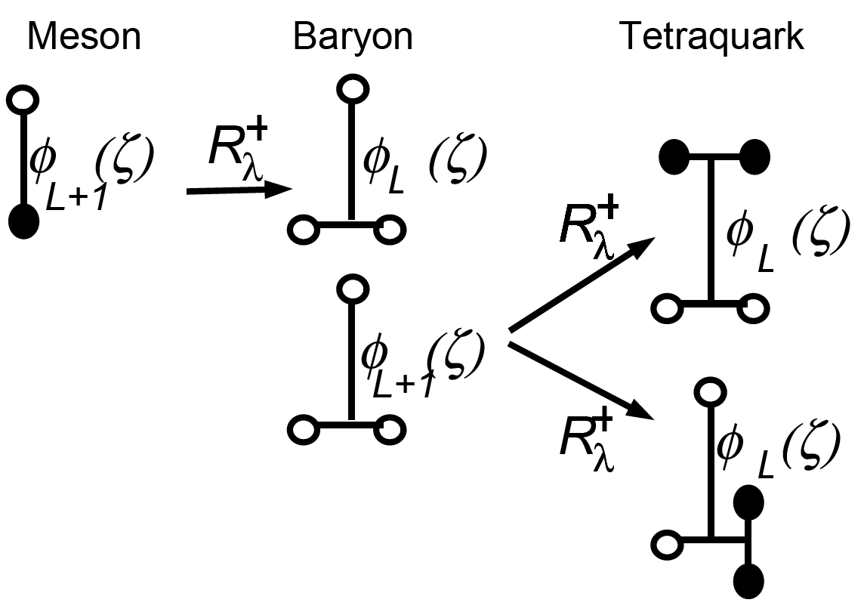
S. J. Brodsky, G. F. de Tramond, H. G. Dosch and C. Lorc, Phys. Lett. B 759 (2016) 171.
L. Zou and H. G. Dosch, arXiv:1801.00607 [hep-ph].
Interpretation in QCD
Meson
Spin contribution
Baryon
Quark masses correction
Tetraquarks
Notes:
11

Slide 13
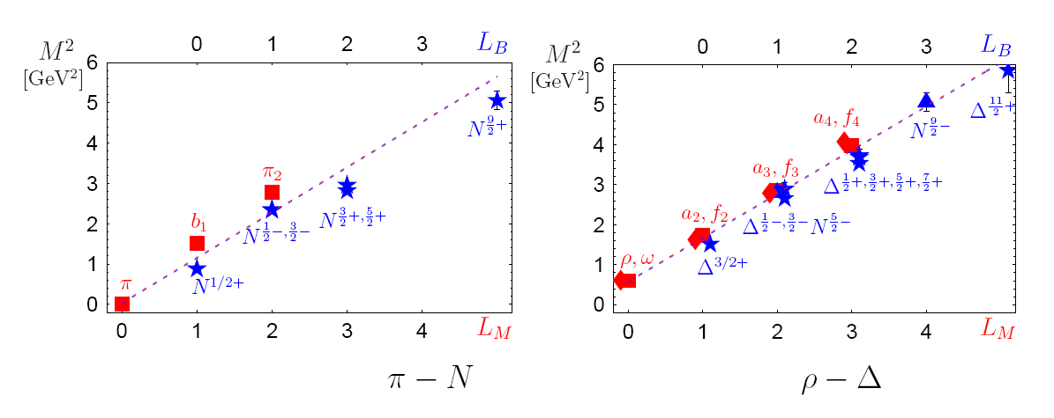
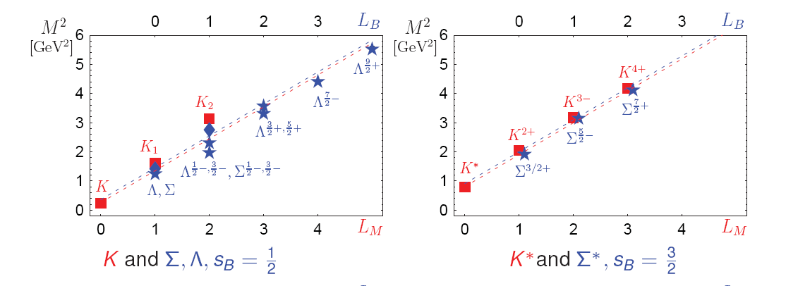
PRD 91,085016(2015)
Notes:
12

Slide 14
Inclusion of heavy quarks, c and b
Conformal symmetry is strongly broken, since the mass
Supersymmetry ?
Data not overwhelming
LFHQCD gives good prediction
H. G. Dosch etal, Phys. Rev. D 95, 034016 (2017)

Slide 15
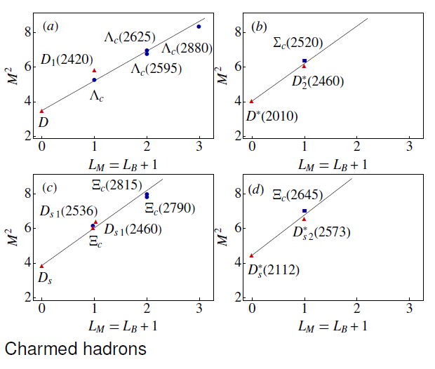

Slide 16
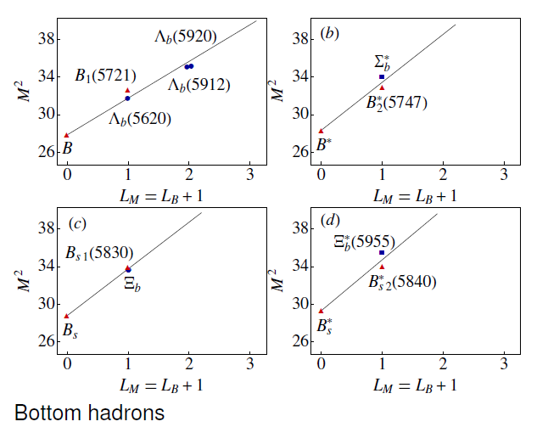

Slide 17
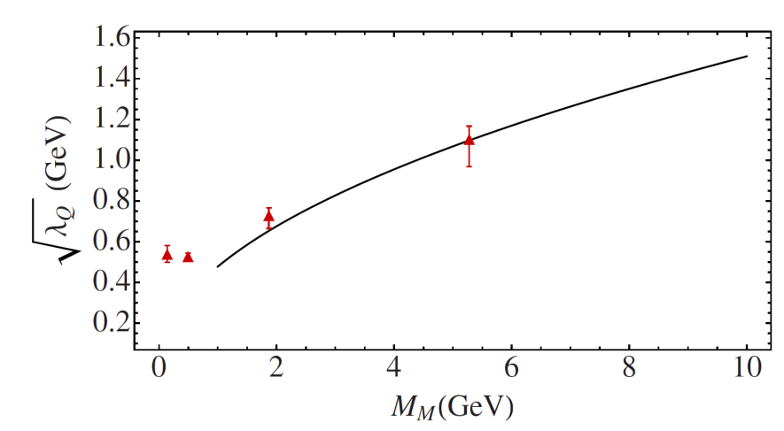
Data not overwhelming but compatible with our theory
Supersymmetry still valid
Straght trajectories (not consequence of the conformal symmetry)
In practical, it matches to the Heavy Quark Effective Theory

Slide 18
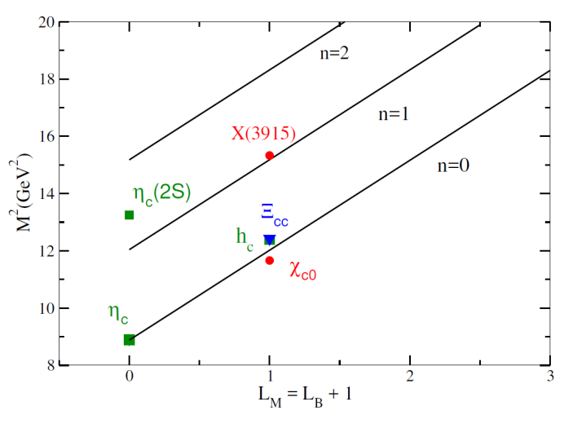
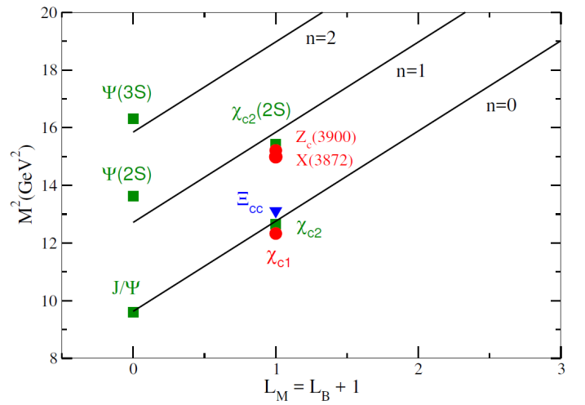
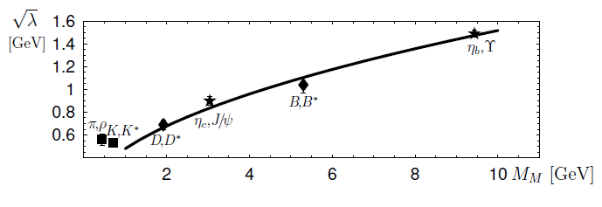
Double Heavies
Fewer data, but prediction is rather good,
To predict higher excitations for Charmonium and bottomonium?

Slide 19
Light Isoscalars have not been investigated carefully in AdS/QCD, LFHQCD
Especially, the η mesons
a systematic quantitative analysis of the (all confirmed) isoscalar states is performed
With only one parameter
spectroscopy of the η and h mesons can be well described if one additional mass parameter

Slide 20
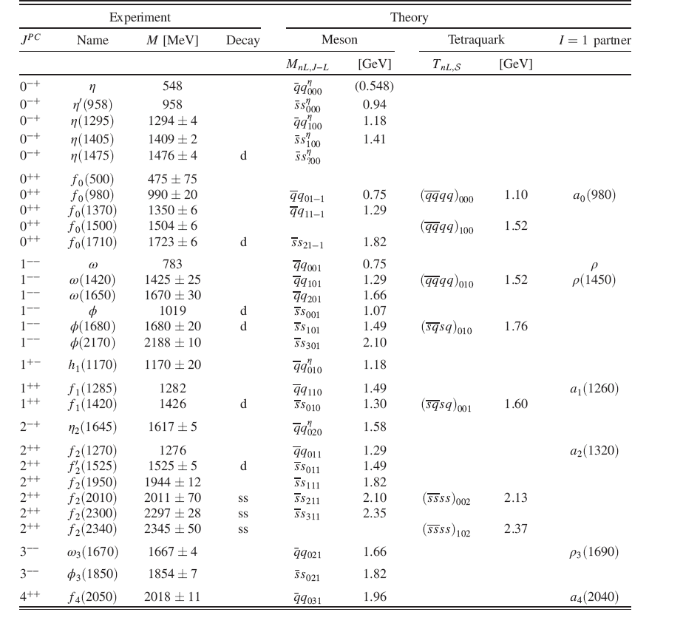
We leave out the
broad f₀(500)
The overall
fit from theory to experiment is satisfactory
The standard deviation
between theory and experiment is
~93 MeV
inside the
model uncertainty
~100 MeV

Slide 21
The assignment of f₀(500) and f₀(980) as tetraquarks was very plausible.
The lightest tetraquark consisting of nonstrange quarks,
has a mass of 1.10 GeV, compatible with the f₀(980)
The conventional meson in a (³P₀) state,
has the mass 0.75 GeV in LFHQCD, also in the mass range of f₀(980)
LFHQCD cannot quantitatively predict these two states.
The other f₀ states fit very well into the LFHQCD theoretical scheme.
The f₀(1500) is a very good candidate for a radially excited tetraquark
f₀ states

Slide 22
f₁ states
f₁(1282) is heavier than the ¹P₁ ground state (1.06 GeV) and lighter than its first radial excitation (1.49 GeV),
f₁(1420) could be a candidate of tetraquark states, within model uncertanty.

Slide 23
f₂ states
f2
f₂(1270) and the f₂’(1525) is compatible with a recent lattice result, lighter state couples predominantly to ππ and the heavier to KK¯ R. A. Briceno, etal, Phys. Rev. D 97, 054513 (2018).
profusion of f₂ states makes the occurrence of exotic states very plausible
two ϕ mesons in the decay channels of the heavier f₂ mesons
strongly suggests the admixture of a tetraquark consisting of two strange and two antistrange quarks
f₂(2010), f₂(2300), and f₂(2340) are mixtures of meson states and tetraquark states

Slide 24
eta mesons ?
The eta mesons were the problem in LFHQCD, data cannot be fitted to the theory prediction.
modification
one additional mass parameter—corresponds to the hard breaking of chiral U(1) symmetry in standard QCD
In standard QCD SU_R(2) ⊗ SU_L(2) is broken spontaneously and leads to an isovector of Goldstone particles, the π mesons. ---agrees well with LFHQCD.
Since the isoscalar pseudoscalar meson, the η-meson, is considerably heavier than the π-mesons, the remaining chiral U(1) symmetry is most probably broken directly, and presumably due to instantons
The direct breaking of U(1) is in standard QCD,
a direct breaking must also occur in our treatment,
since otherwise we have a massless eta in the limit of massless quarks.
similar to the treatment of 't Hooft in his classical PR: He also added an instanton induced term to an effective Lagrangian. He also needs at least one additional parameter, the instanton cutoff.
Plays the role of a direct chiral U(1) breaking term in effective
chiral representations of standard QCD

Slide 25
eta meson

Slide 26
Open questions
role of instanton in LF theory
LF vacuum is very different from QCD Vacuum
The new constant in the LF Hamiltonian could have a deep connection to the role of instanton phenomena and the LF QCD vacuum
how to understand chiral symmetry breaking in the LF formalism.
It is an intriguing question how the additional term, which breaks the supersymmetry of the spectra, plays the role of a direct chiral U(1) breaking term
The scale paprameter
Is this another way to define the LFHQCD scale λ ?
Can we relate this to the Regge slope for heavy hadrons?

Slide 27
Exotic states ?
Extra hadronic states appear to
be particularly abundant in the isoscalar channels
Look for possible tetraquarks in these channels-----is promising?
f₀(980)
f₀(1500)
Glueball ?
Eberhard Klempt Alexander Zaitsev, Phys. Rept.45(2007)1.

Slide 28
Conclusion
SuSyLFHQCD
i) Supersymmetric quantum mechanics
ii) Supersymmetry between light-front wave functions of mesons, baryons and tetraquarks.
ii) Conformal symmetry is strongly broken due to heavy quark masses, but the supersymmetry still holds.
The predicted Regge trajectories
agrees well with experimental data.
light quarks ---> heavy quarks, isosaclars
eta mesons and U(1) Chiral symmetry breaking—not yet understood well

Slide 29
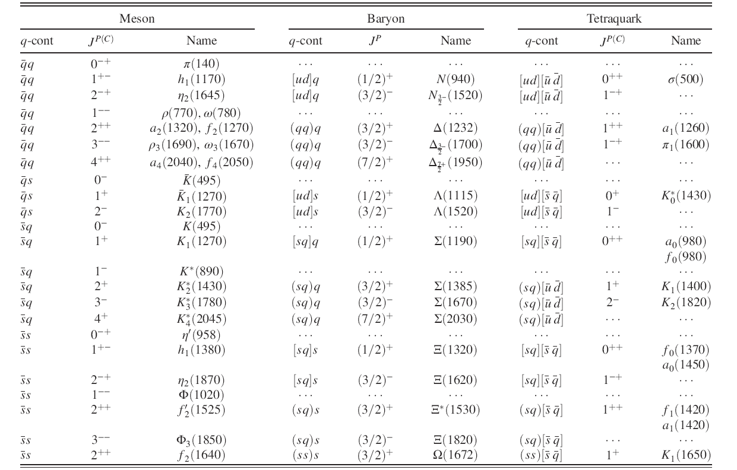
M. Nielsen and S. J. Brodsky, Phys. Rev. D 97 (2018)

Slide 30
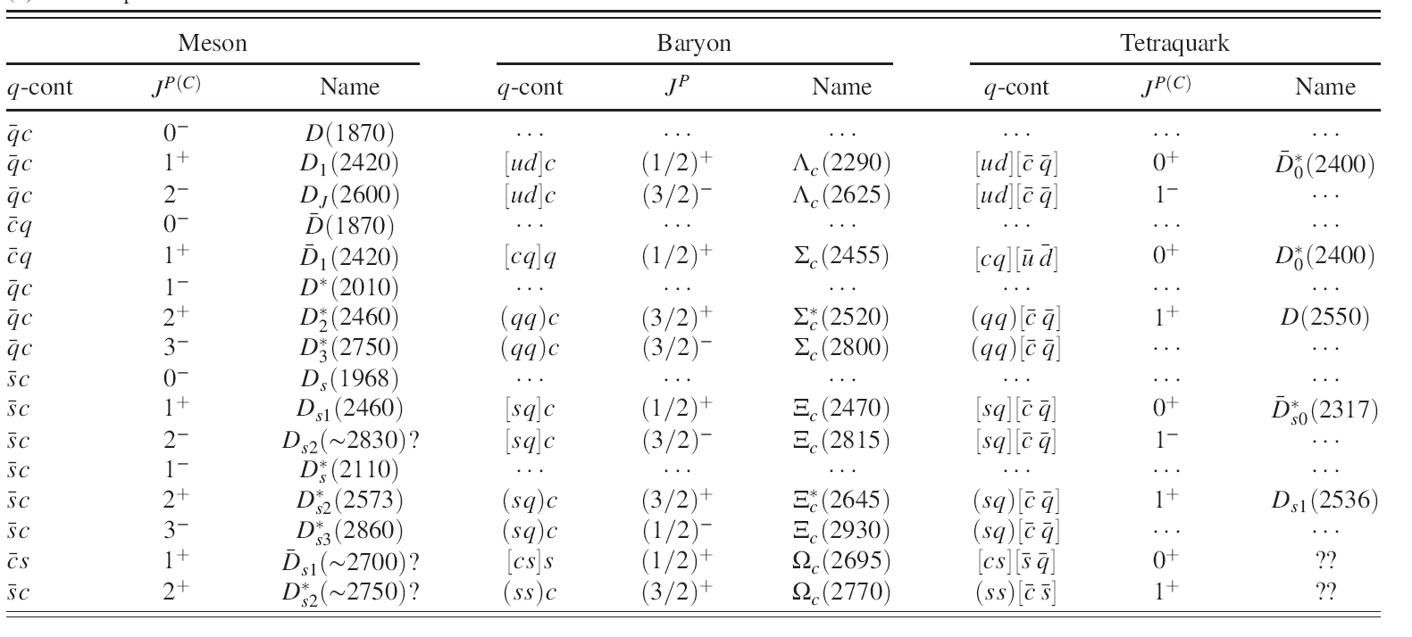
one charm quark
M. Nielsen and S. J. Brodsky, Phys. Rev. D 97 (2018)

Slide 31
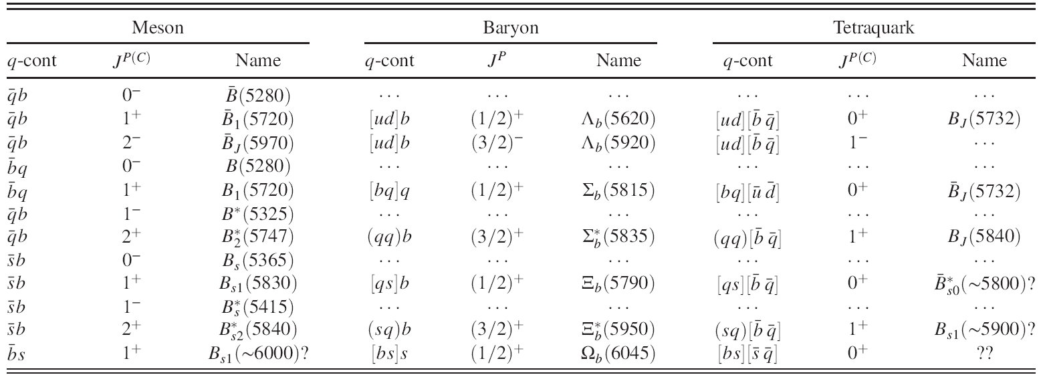
One bottom quark
M. Nielsen and S. J. Brodsky, Phys. Rev. D 97 (2018)

Slide 32
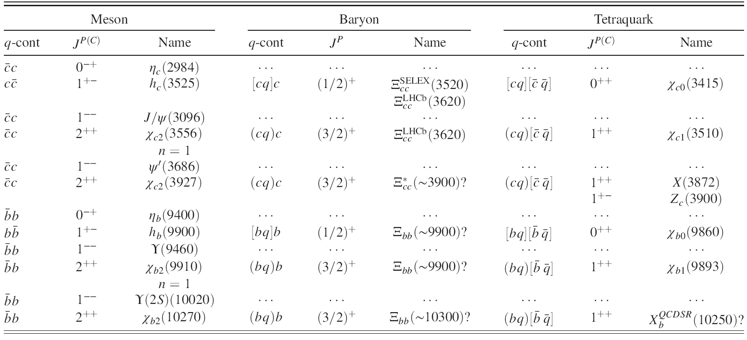
Two heavy quarks
M. Nielsen and S. J. Brodsky, Phys. Rev. D 97 (2018)

Slide 33
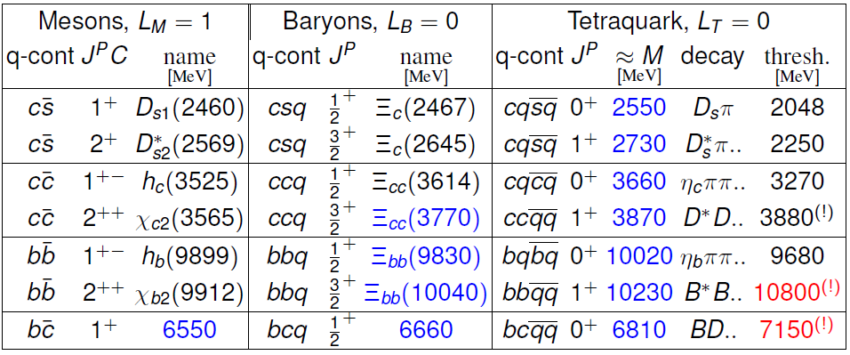
L. Zou and H. G. Dosch, arXiv:1801.00607 [hep-ph].
M. Karliner and J. L. Rosner, Phys. Rev. Lett. 119, 202001(2017)

