Slide 1

Triton binding energy and neutron-deuteron scattering up to next-to-leading order in chiral effective field theory
Young-Ho Song(RISP, Institute for Basic Science)
Collaboration with
R. Lazauskas( IPHC, IN2P3-CNRS)
U. van Kolck (Orsay, IPN & Arizona U.)
2019.07.17, APCTP-BLTP Joint workshop, Dubna, Russia

Slide 2

Introduction
Chiral Effective Field Theory
Modified power counting scheme
Results
Two-body case(deuteron, n-p scattering)
Three-body case( triton, n-d scattering)
Summary/Discussion
Y.-H. Song, R. Lazauskas, and U. van Kolck, PRC 96, 024002 (2017)
Erratum: Phys. Rev. C 100, 019901

Slide 3
Nucleon-Nucleon interaction
QCD at low energy scale requires either
  Non-perturbative calculation of QCD (Lattice QCD)
  Or effective formulation of strong interaction for hadrons.
Phenomenological NN interaction
  Av18, CD-Bonn etc.
  Fitting to phase shifts and deuteron binding energy
  Model dependence. (Meson exchange…)
  Theoretical Error estimation is difficult

Slide 4
Effective Field Theory
(Nuclear) Effective Field Theory
- Aims to construct model independent description of nuclear system
  Basic assumption: Low energy dynamics are not sensitive to the short distance detail and we only need to know finite number of LECs at desired accuracy.
  Only Use: Symmetry of the system, Effective degrees of freedom of the interested system
  → Infinite number of terms in Lagrangian
  → Need to sort terms by importance

Slide 5
Power counting
Separation of scale:
Typical scale of system : Q
High energy scale : M
Q << M
Power counting:
Expand observables in power of (Q/M)
Finite number of terms at each order
Theoretical error estimation
Systematic improvement scheme of accuracy

Slide 6
Chiral Effective Field Theory
Chiral effective field theory
  Low energy effective theory of QCD for nucleons, pions
  Same symmetry and symmetry breaking pattern of QCD : Chiral symmetry
  Infinite number of operators, diagrams
  Require truncation scheme or power counting:
  Expansion in power of Q/M_hi, Q/cutoff
  Require Renormalization Group invariance : cutoff independence
  → expect: inverse power of (residual) cutoff dependence
  In order to maintain predictive power of EFT, it is necessary to truncate the sum in such a way that the resulting cutoff dependence and truncation error can be decreased systematically as increasing order.

Slide 7
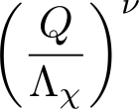

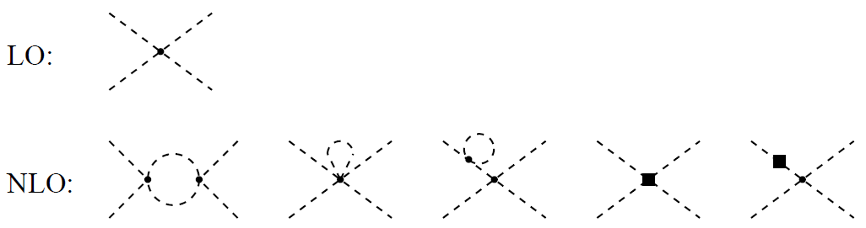
Chiral Perturbation Theory
Chiral Perturbation Theory(ChPT): EFT of pions
  Expansion in power of
All divergences(cutoff dependence) from loop diagrams can be absorbed by counter terms order by order.

Slide 8
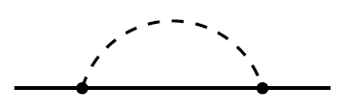



Heavy Baryon Chiral Perturbation Theory
ChPT+ nucleon: Relativistic theory requires subtle power counting scheme because of heavy nucleon mass scale.
Heavy Baryon Chiral Perturbation theory: expansion in inverse power of nucleon mass.
All divergences(cutoff dependence) from loop diagrams can be absorbed by counter terms order by order.

Slide 9
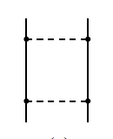
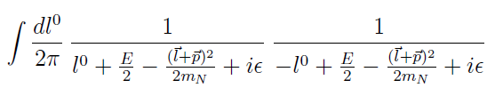
Weinberg power counting scheme
However, two nucleon system must be treated
non-perturbatively
  Existence of shallow deuteron bound state
  Large scattering length in S-wave scattering
  -> Sum of infinite number of diagrams
Infrared enhancement from pure nucleon intermediate state diagram (reducible diagrams)

Slide 10
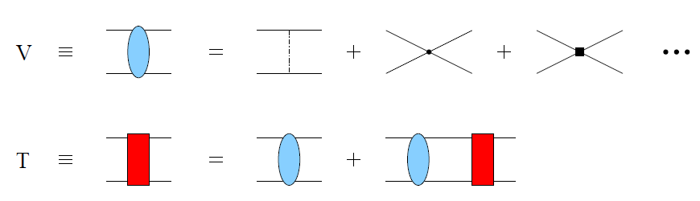


Weinberg power counting scheme
Weinberg’s suggestion:
  Compute potential from irreducible diagram
  Non-perturbative sum of reducible diagrams with kernel
Naive Dimensional Analysis of (Heavy Baryon) ChPT
-> perturbative Power counting for nuclear system
-> Explain the potential order 2B > 3B > 4B

Slide 11
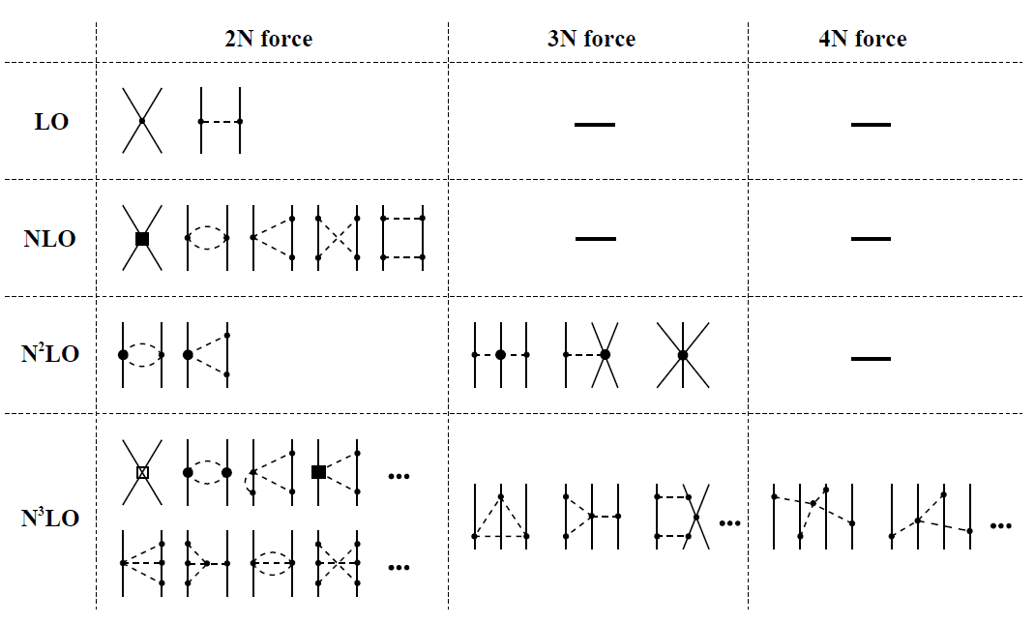
Weinberg power counting scheme

Slide 12
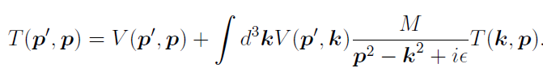

Chiral EFT potential
Perturbative Renormalization in kernel:
  Divergence(cutoff dependence) from loop diagrams can be absorbed by contact counter terms order by order.
Non-perturbative Renormalization of amplitude:
  LS equation is usually divergent and require regularization
  Cutoff dependence have to be removed by renormalization

Slide 13

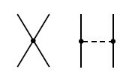
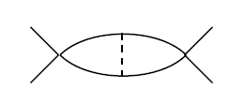

Problem in Weinberg power counting
Implicit assumption:
  counter terms in potential are also enough to absorb cutoff dependence from iteration of one-pion exchange diagrams.
  Wrong.
Example: D.B.Kaplan, M.J. Savage, M.B.Wise , NPB478,629(1996)
Divergence of
Leading order Diagram
Cannot be absorbed by
Leading order counter term

Slide 14
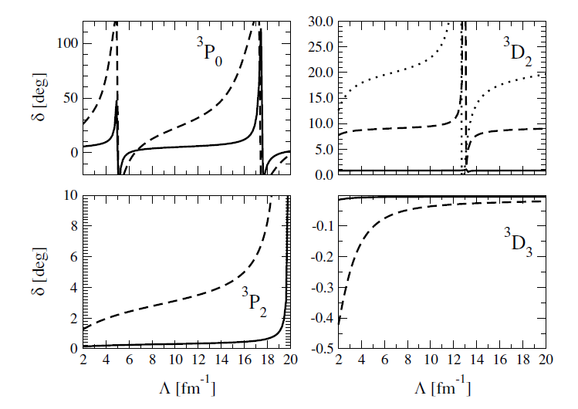
Problem in Weinberg power counting
Example: A. Nogga, R.G.E.Timmermans, U. van Kolck
PRC72,054006(2005)
  In addition to the 1S0, 3S1 counter terms at LO, counter terms for 3P0, 3P2,3D2 are required at LO to absorb cutoff dependence.

Slide 15
Modified power counting
Origin of problem: singular tensor force in OPE
Nogga, Timmerman, van Kolck (PRC72(2005)054006)
  Weinberg’s power counting is okay for singlet and repulsive tensor channel : leading order counter term can absorb cutoff dependence
  However, attractive tensor channels show limit cycle like cutoff dependence (3P0, 3P2, 3D2)
  Need to promote higher order counter terms to leading order

Slide 16

Modified power counting
LO potential
All LECs are fitted to PWA93 phase shifts
NLO potential
Long and Yang, PRC86, 024001(2012)

Slide 17
Regularization

Slide 18
Counter terms

Slide 19
Results : 2 body scattering at LO
Modified Weinberg Power Counting works well at LO for two-body

Slide 20
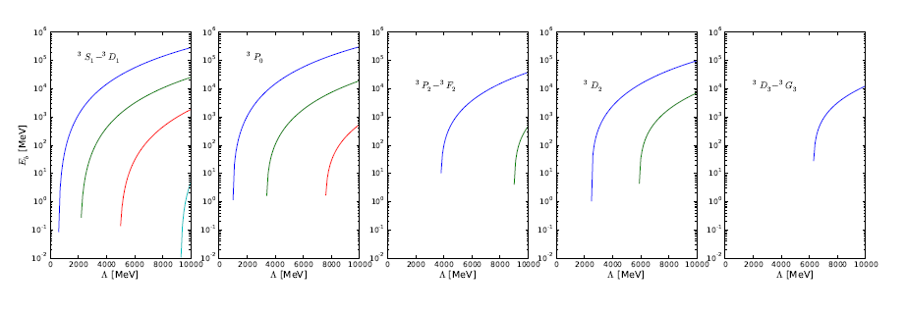
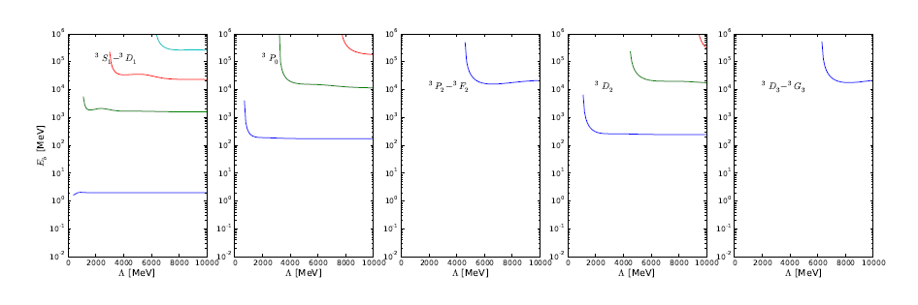
Results : 2 body bound state at LO
With Counter terms

Slide 21
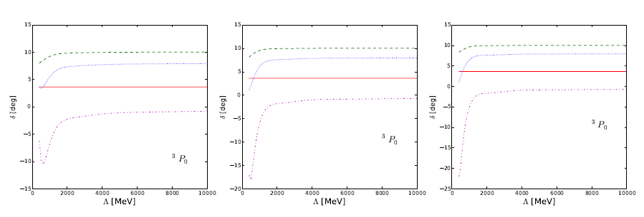


Results : 2 body scattering(regulator)
Regulator dependence

Slide 22
Results : 2 body scattering at NLO
DWBA

Slide 23
Three-body calculation
Possible Modification of power counting of 3-body interaction?
  - In Pionless EFT, 3-body interaction should be promoted to LO

Slide 24
Three-body calculation
Faddeev equation
(Remove spurious deep bound states)

Slide 25
Three-body wave function
We obtain 3-body wave function by solving Faddeev equation in configuration space
Fourier transform potential from momentum space to configuration space
Removed unphysical deep bound states in 3-body calculation.

Slide 26
Results : 3 body at LO

Slide 27
Results : 3 body at NLO
There were numerical error in published paper.
(Y.-H. Song, R. Lazauskas, and U. van Kolck,
Phys. Rev. C96, 024002 (2017), 1612.09090.)
Erratum is published.

Slide 28
Summary
Applied modified Weinberg power counting up to NLO for 2-body and 3-body
Modified Weinberg Power counting works well for 2-body up to NLO
Modified Weinberg Power counting can remove cutoff dependence of 3-body calculation up to NLO.
No need of promoting 3-body interaction up to NLO.
However, triton is under binding and doublet n-d scattering length is overestimated up to NLO.
Need NNLO of 2-body and 3-body interaction

