Slide 1

Drift Chambers reconstruction software status
Vladimir Palichik, Nikolay Voytishin
JINR, Dubna
BM@N Software Group Meeting
January 16 , 2019

Slide 2
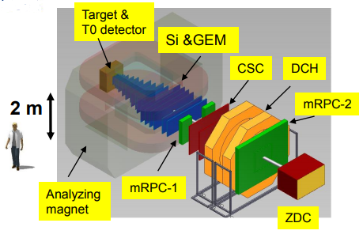
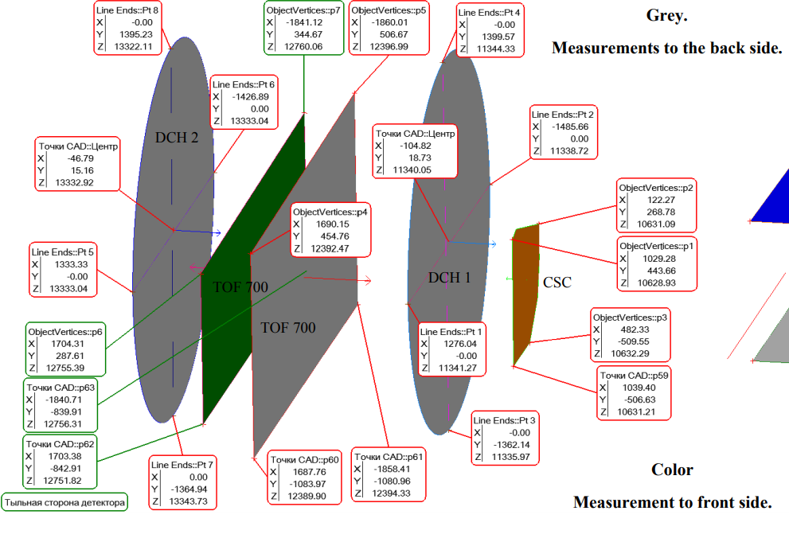
BM@N - 2018 experimental setup
Central tracker (GEM) - AA interactions reconstruction;
Outer tracker (DCH, CSC) - link central tracks to ToF;
ToF - hadrons and light nucleus identification;
ZDC calorimeter - centrality of AA collisions measurement;
Detectors to form T0, L1 centrality trigger and beam monitors;
Electromagnetic calorimeter - γ,e+e- detection;
MWPC – alignment and incoming beam trajectory positioning.
DC + CSC pic from kolesnikov

Slide 3
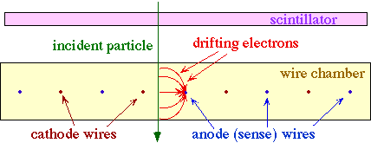
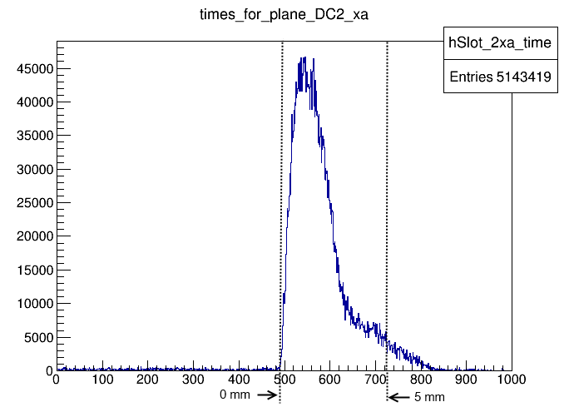
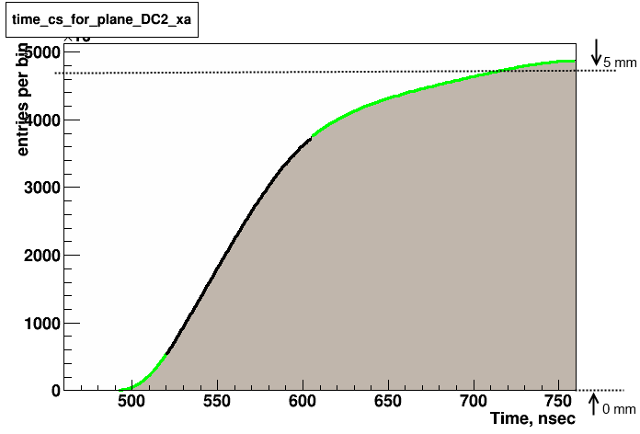
DCH coordinate reconstruction
Principle of working of a Drift Camber detector

Slide 4
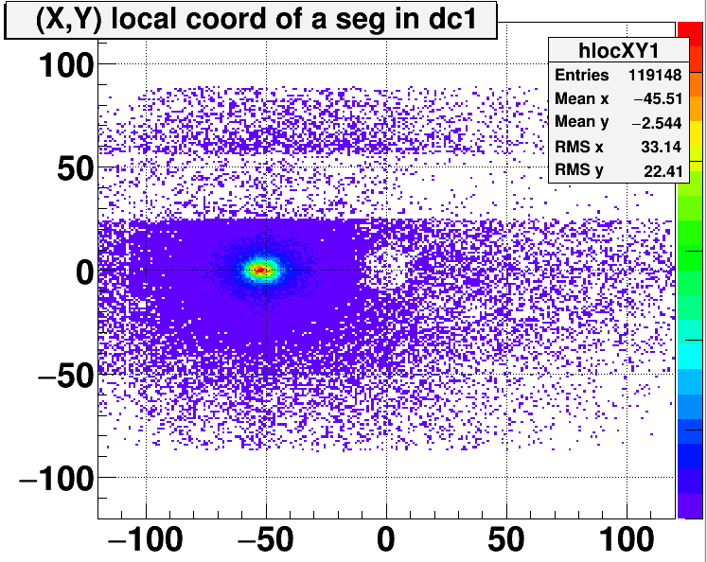
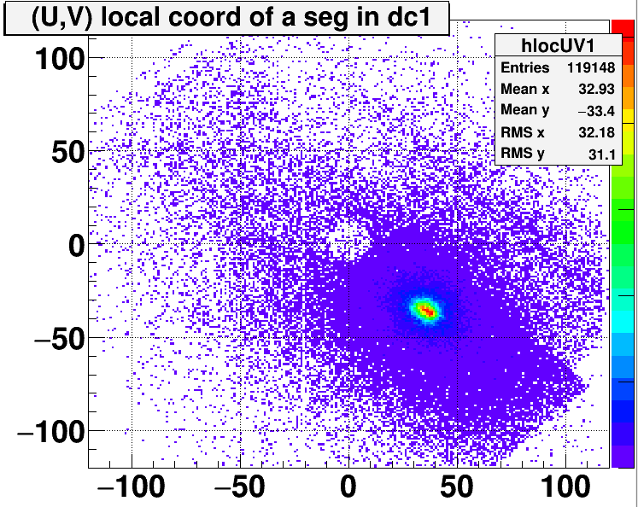
DCH local hits
Local (X, Y) hits
Local (U, V) hits
No reco objects written to the root tree

Slide 5
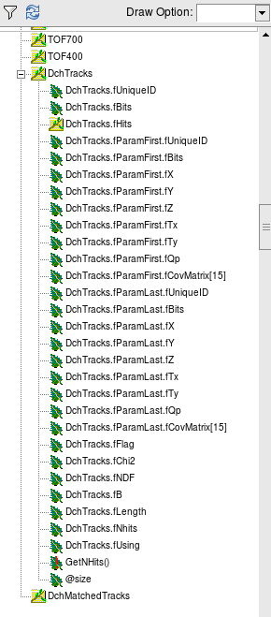
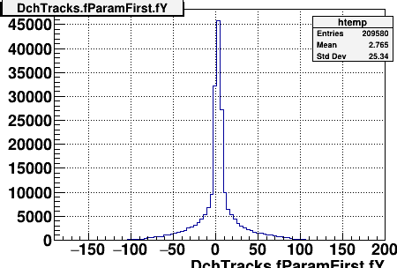
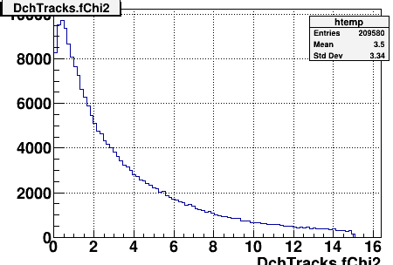
DCH local segments

Slide 6
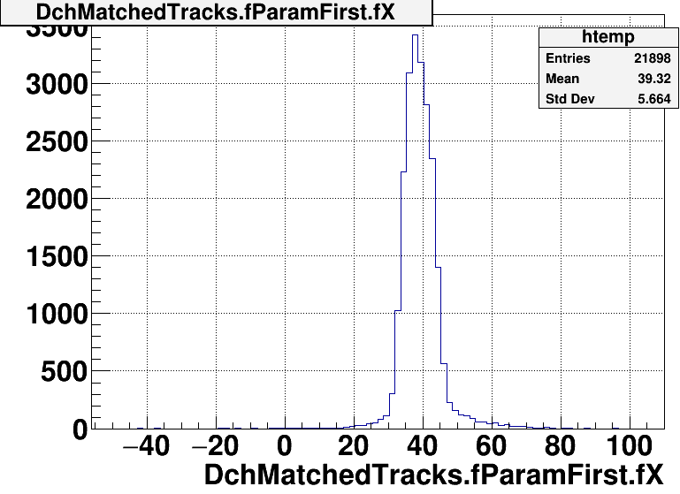
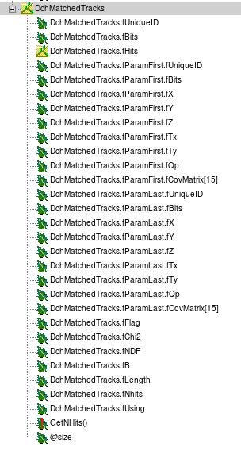
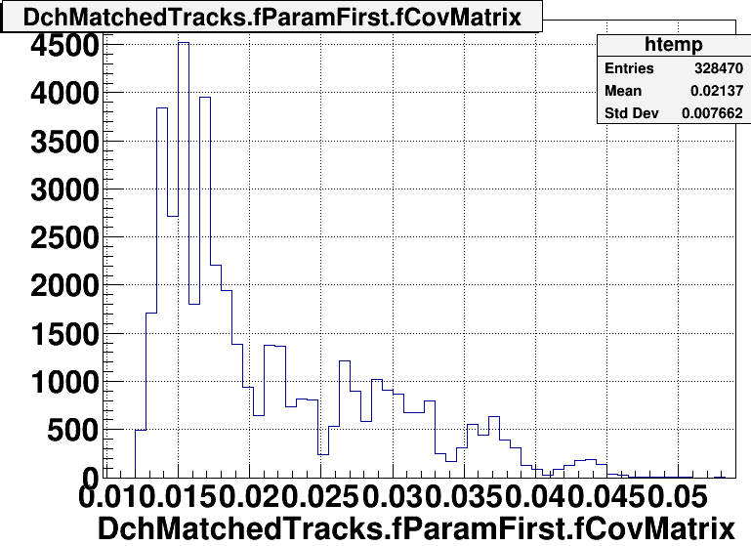
DCH global matched segments

Slide 7
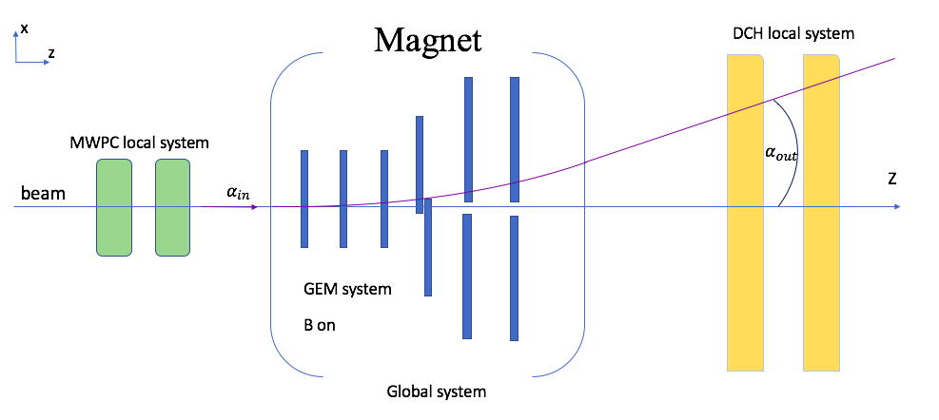
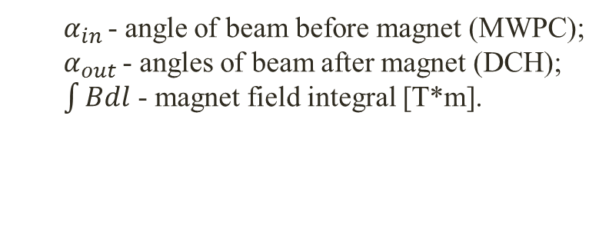
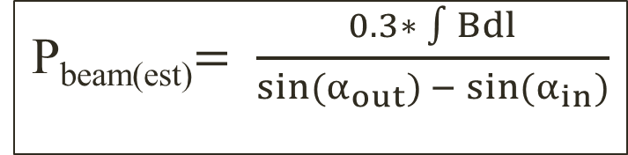
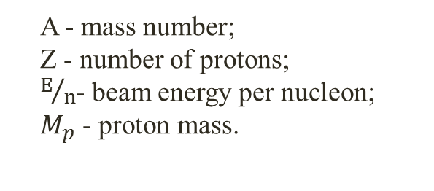
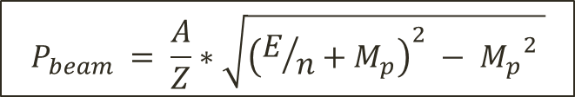
Beam momentum estimation procedure
P_{beam(est)}$= \frac{0.3∗ \int{Bdl}}{\sin{{(α}_{out}) {− sin(α}_{in})}}$
$α_{in }$- angle of beam before magnet (MWPC);
$α_{out }$- angles of beam after magnet (DCH);
$\int{Bdl}$ - magnet field integral [T*m].
A - mass number;
Z - number of protons;
$E/n$- beam energy per nucleon;
$M_{p}$ - proton mass.
$$P_{beam} = \frac{A}{Z}∗\sqrt{{\left(E/n+M_{p}\right)}^{2} − {M_{p}}^{2} }$$

Slide 8
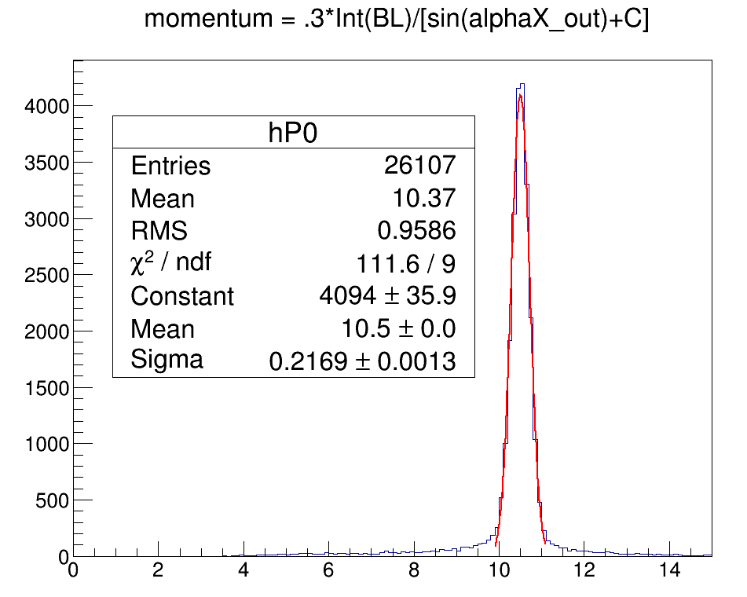
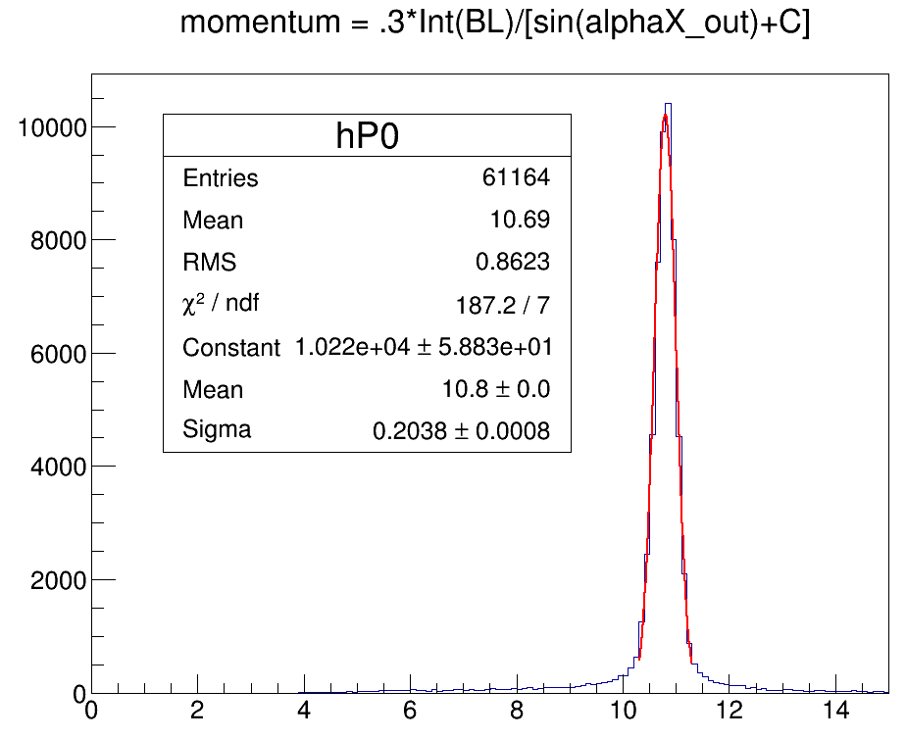
Momentum estimation for particular magnetic field values
1500A
1750A
Remark. Beam momentum value calculated correctly only for runs with B ON and Empty target.

Slide 9
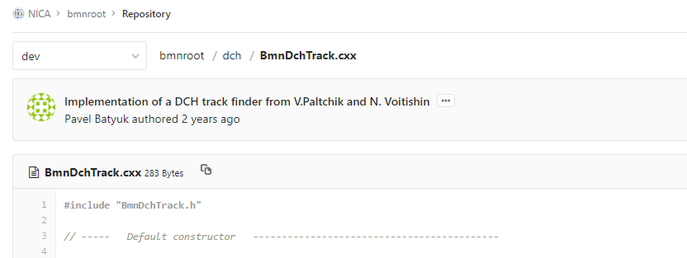
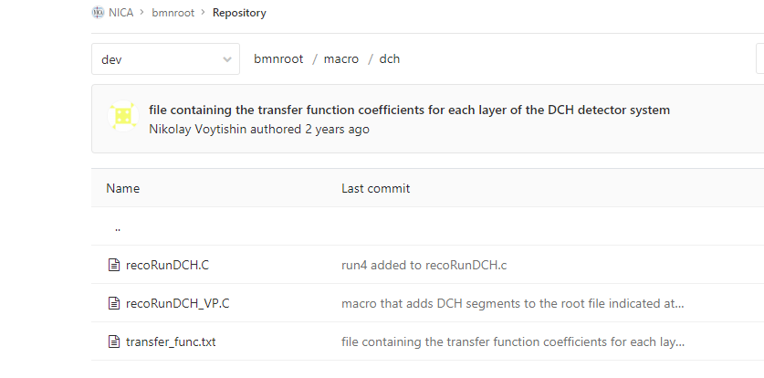
Current placement in the package and status
BMNROOT class implemented by Pavel
Reco macro by Nikolay

Slide 10
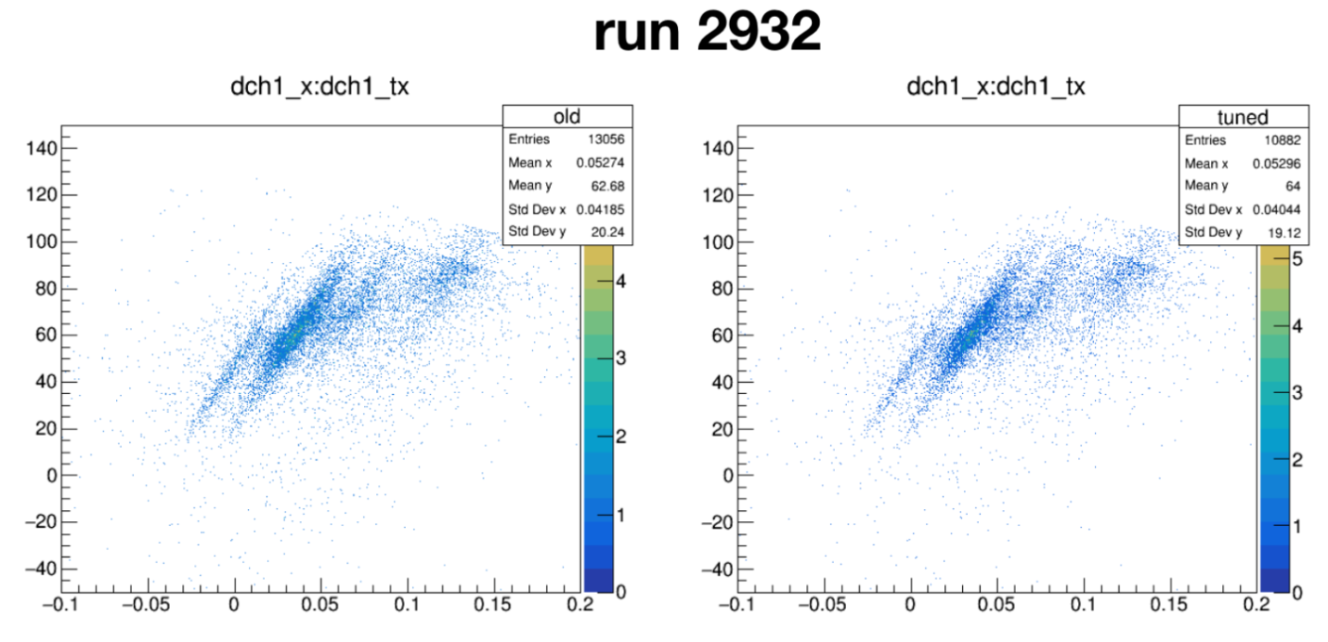
Run7 DCH reconstruction software status
Two similar macros for SRCSetup & BMNSetup;
Same input format files:
  Transfer function files (a big set accumulated already, to be placed in the bmnroot/input???);
  *digi.root files.
Same output;
SRC group provided with recoFiles by me(no complaints yet)

Slide 11
Development plans
Update the existing class with improvements/changes for Run7(SRCSetup??? and BMNSetup macros) (2 weeks);
Upload “tipical” transfer function into bmnroot/input dir;
Update the existing simulation for DCH (with Valerii Panin help) after previous tasks done.

Slide 12
Thank you for your attention!

Slide 13
Backup slides

Slide 14
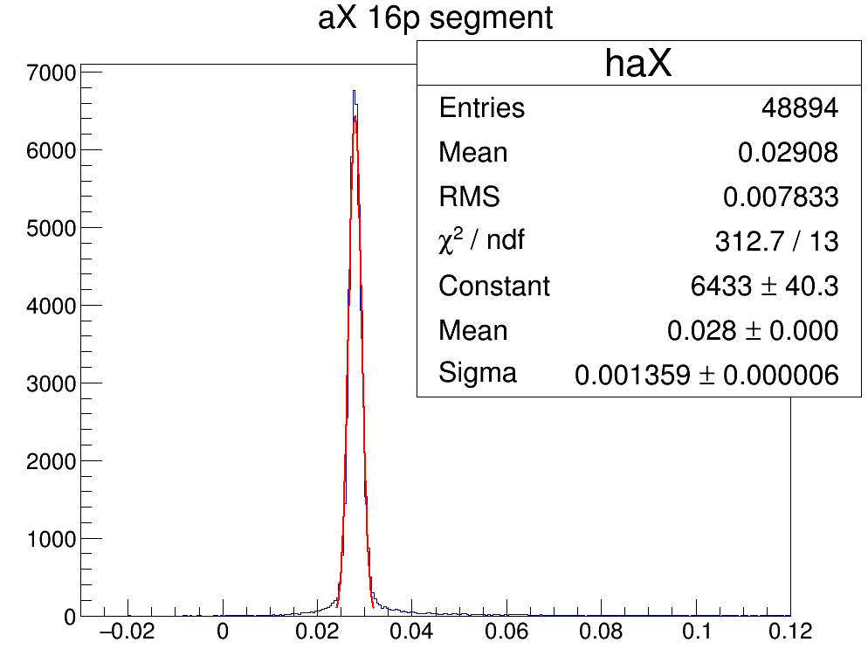
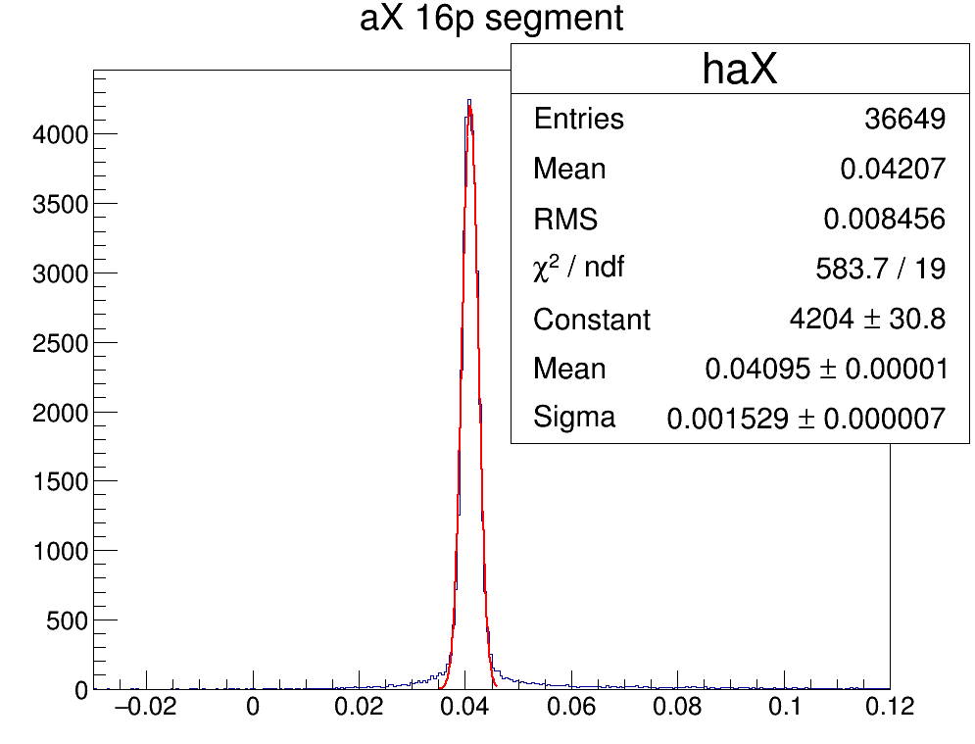
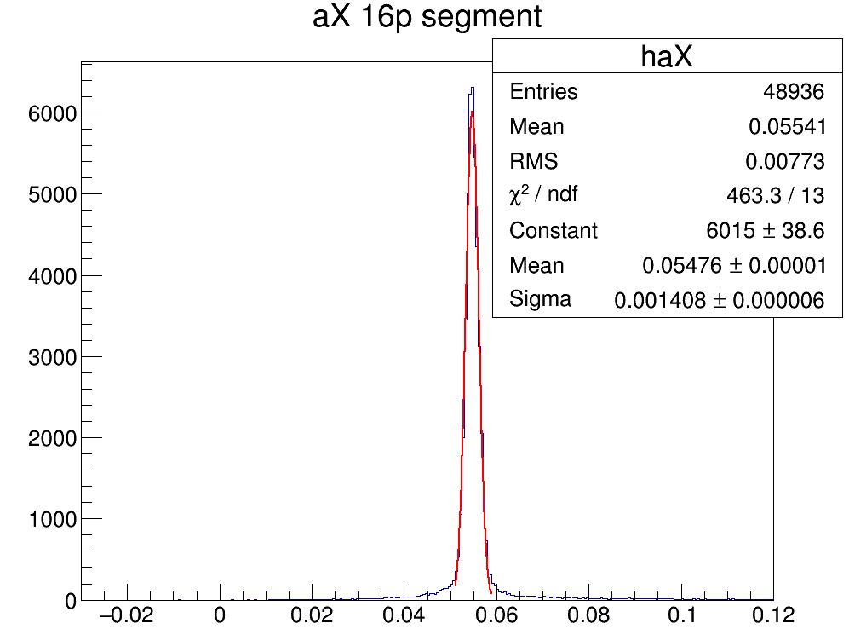
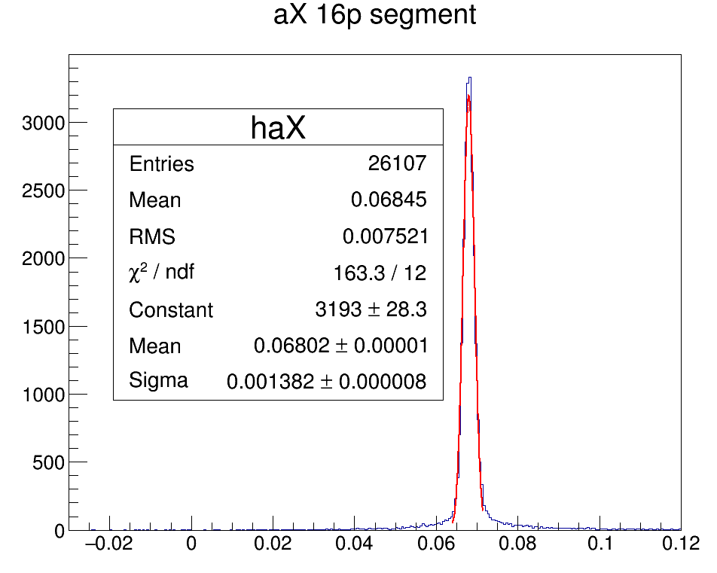
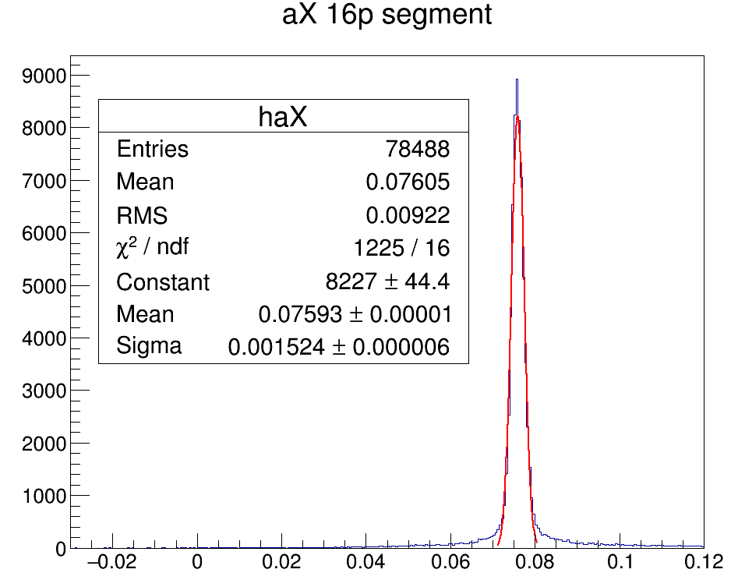
ax slope for beam – C 4.5 GeV/nucl
600A
900A
1200A
1750A
1500A

