Slide 1

SECONDARY BEAMS
AND MACHINE PROTECTION
Francesco Cerutti
Joint US-CERN-Japan-Russia
International Accelerator School
on Ion Colliders
Dubna October-November 2019

Slide 2
OUTLINE
which ones?
Beam Loss Monitor system
validation of collision debris simulation
impact on the machine and mitigation strategies
new challenges
input from beam tracking
acknowledging the contribution of several CERN colleagues

Slide 3
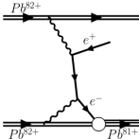
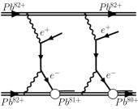

SECONDARY BEAMS
magnetic rigidity relative difference
Bound Free Pair Production
γ → e⁻ + e⁺
δ > 0
Z^{Z+} + Z^{Z+} → Z^{Z+} + Z^{(Z-1)+} + e⁺
Double
Bound Free Pair Production
2(γ → e⁻ + e⁺)
δ >> 0
Z^{Z+} + Z^{Z+} → Z^{Z+} + Z^{(Z-2)+} + 2e⁺
Electromagnetic Dissociation
γ → ^{A}Z*
δ < 0
^{A}Z^{Z+} + ^{A}Z^{Z+} → ^{A}Z^{Z+} + ^{(A-1)}Z^{Z+} + n
equivalent photon spectrum ~ Z²
ω_{max} = hcγ / (2πR_{A})
γ → ^{A}Z*
x = 2,…
δ << 0
^{A}Z^{Z+} + ^{A}Z^{Z+} → ^{A}Z^{Z+} + ^{(A-x)}Z^{Z+} + xn
virtual photon energy

Slide 4
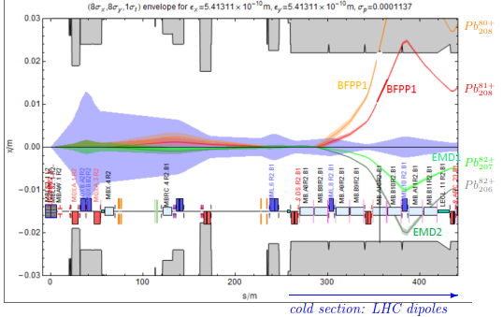
²⁰⁸Pb–²⁰⁸Pb
[J. Jowett]
δ = 0.01235
δ = -0.00481
EMD for ⁴⁰Ar–⁴⁰Ar @ FCC (45 A TeV CM): 2 b
for ⁸⁴Kr–⁸⁴Kr @ FCC (43 A TeV CM): 16 b
for ¹²⁹Xe–¹²⁹Xe @ FCC (42 A TeV CM): 60 b
power towards one side
LHC (6 10²⁷ cm⁻² s⁻¹) [kW] | FCC (3 10²⁹ cm⁻² s⁻¹) [kW]
0.15 | 70
0.055 | 25
0.9 | 260
one side cross section | LHC (5 A TeV CM) [b] | FCC (40 A TeV CM) [b]
BFPP | 280 | 345
DBFPP | 0.01–0.1
EMD | 215 | 280
EMD1 | 95 | 120
EMD2 | 30 | 35
Nuclear inelastic | 8 | 8
p–p | 0.08 | 0.11

Slide 5
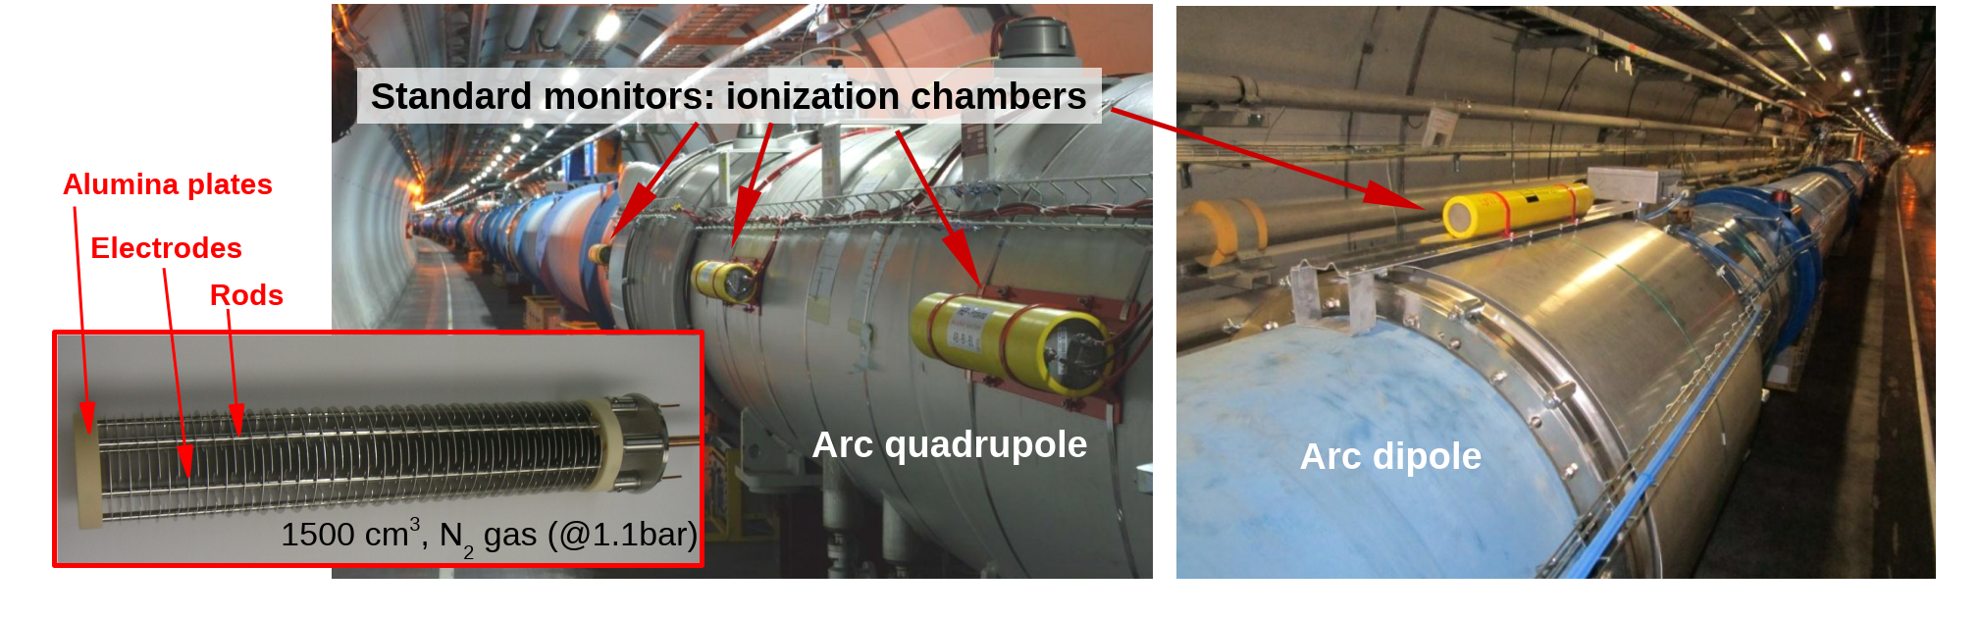
BEAM LOSS MONITORING
BLMs are used for diagnostics and machine protection (beam extraction in case of critical beam losses).
They are ionization chambers, pin diodes, diamond detectors, …
The LHC BLM system

Slide 6
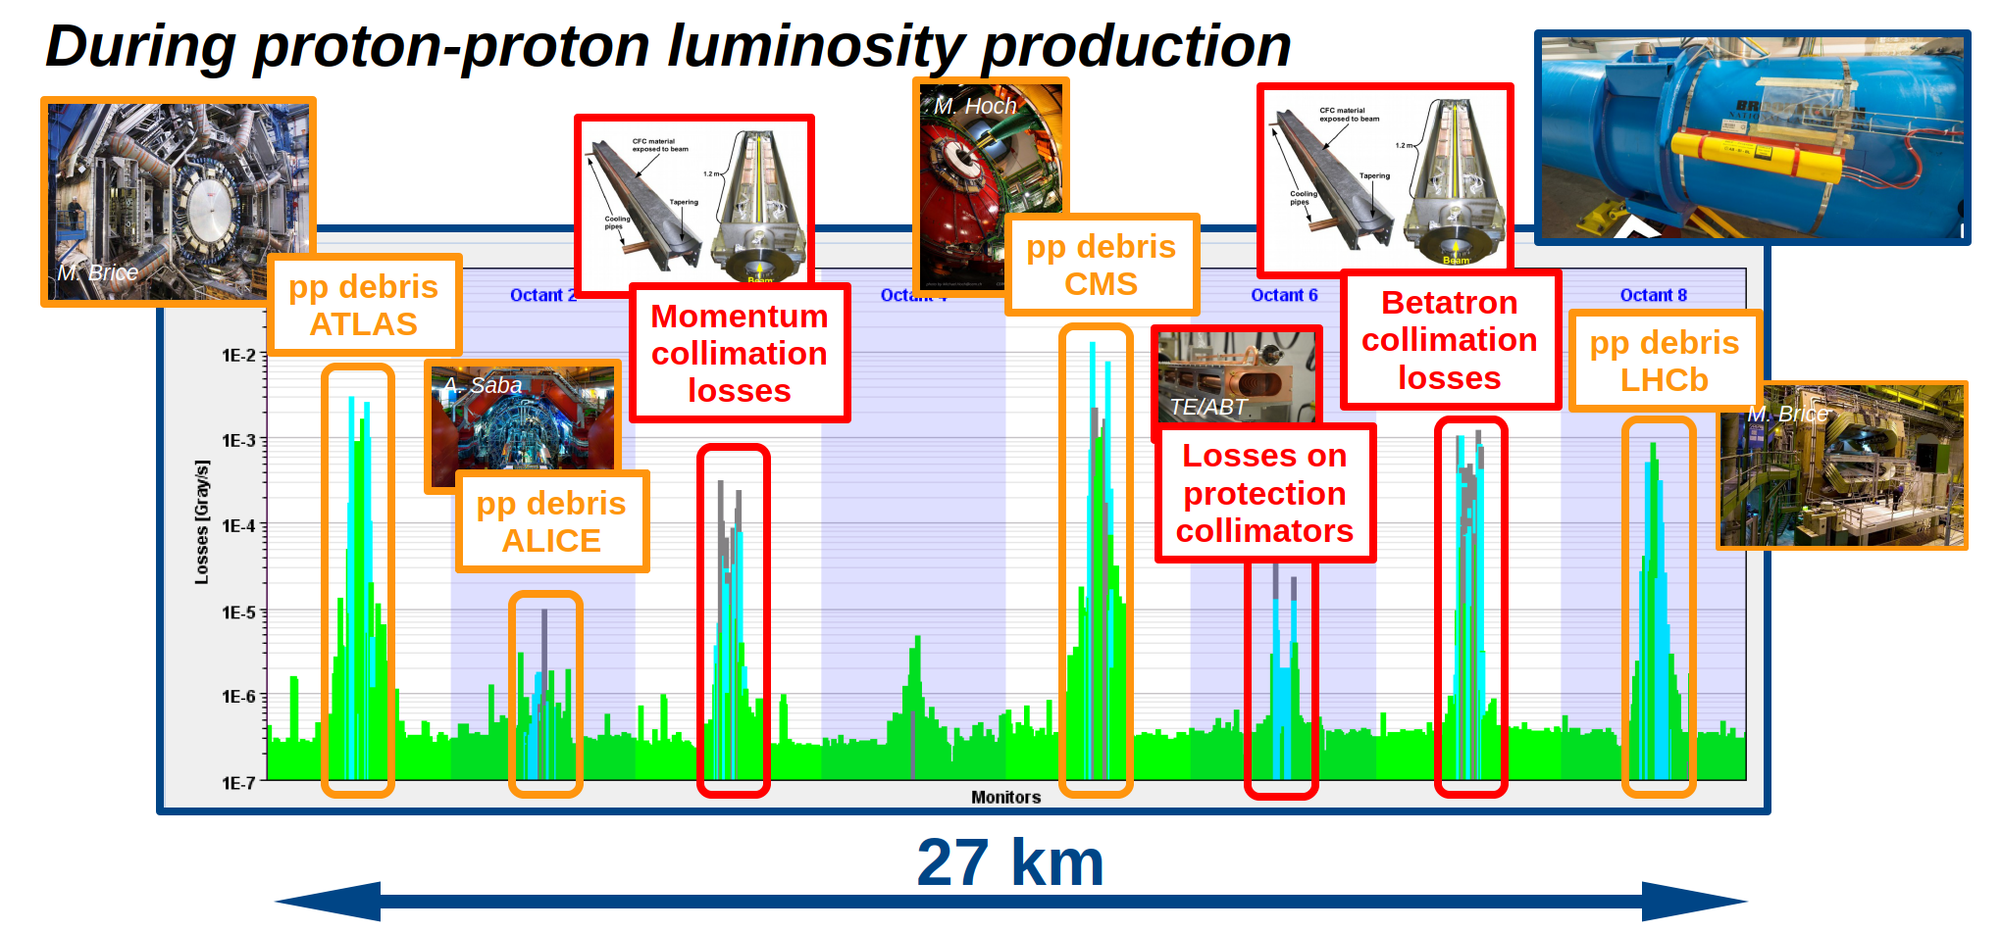
REGULAR PROTON LOSSES
noise
floor
~4000 BLMs

Slide 7
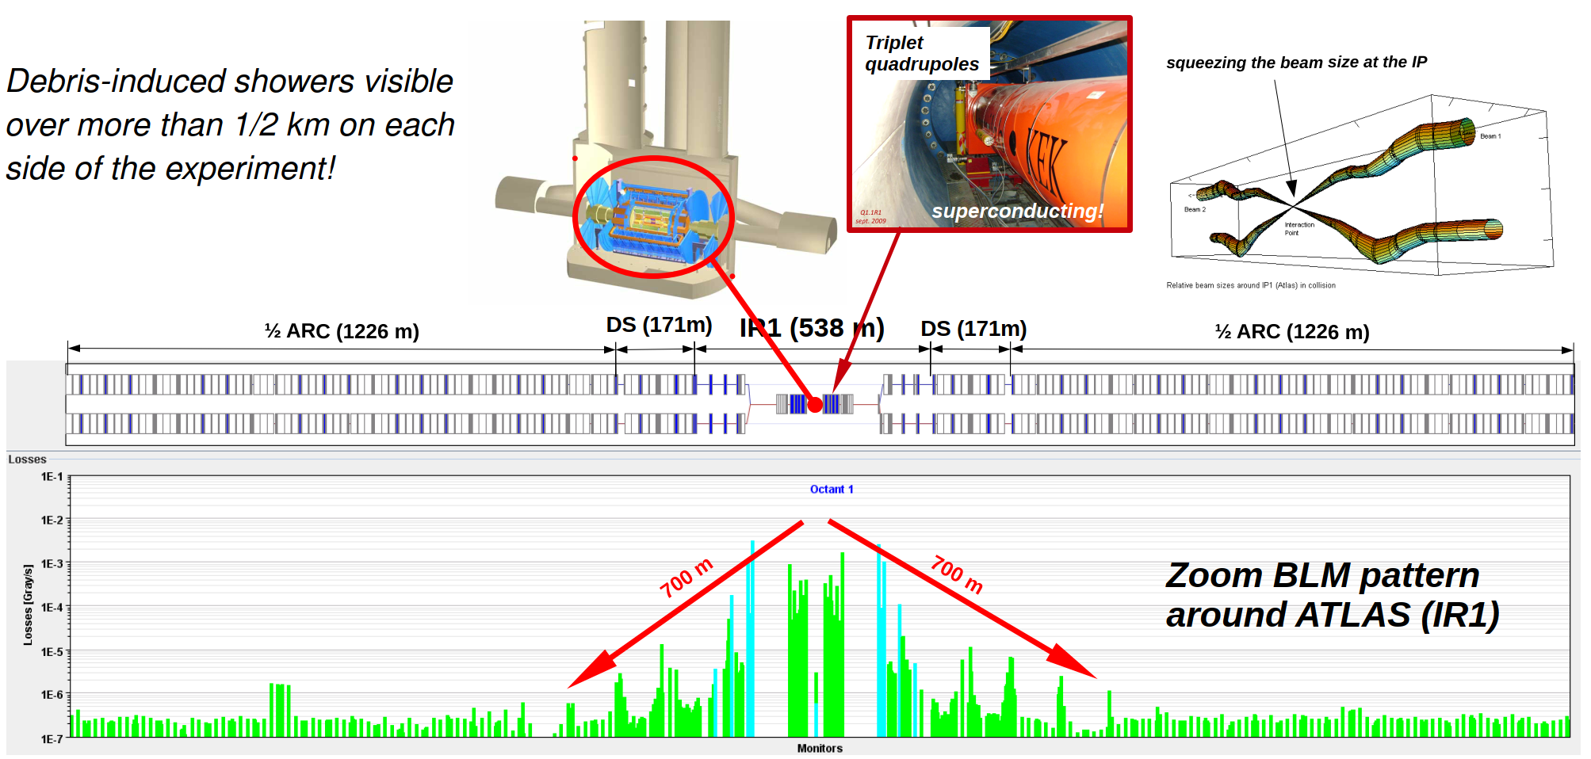
THE COLLISION DEBRIS

Slide 8
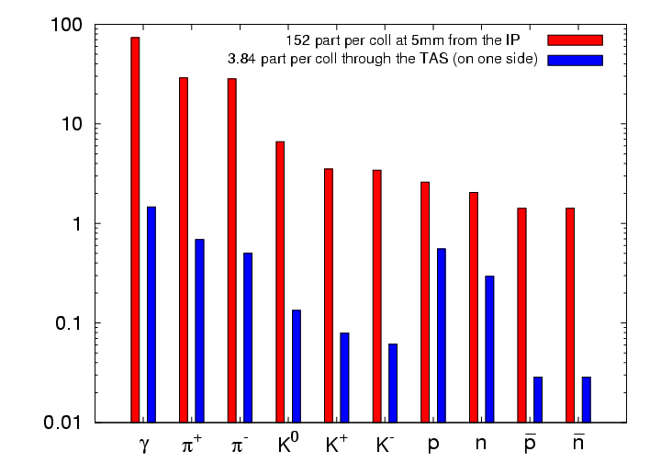

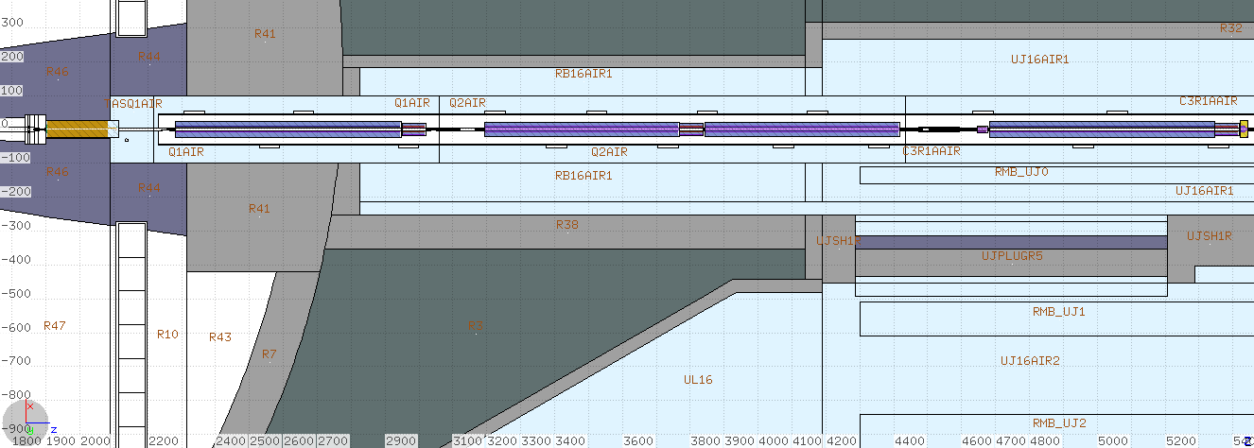
√s = 14 TeV p–p
Instantaneous luminosity: 10³⁴ cm⁻² s⁻¹
(i.e. 8.5 10⁸ inelastic collisions)
950 W towards each (L&R) side
right of ATLAS
150 W absorbed in the TAS absorber
650 W going through the TAS
of which
150 W absorbed in the triplet
cold magnets

Slide 9
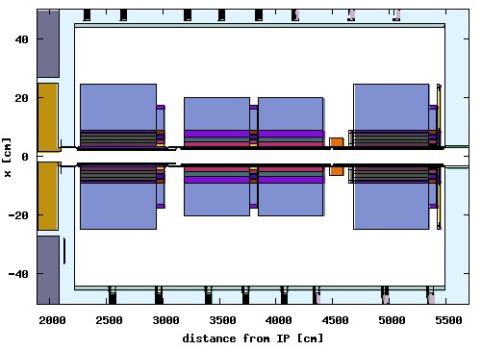
DEBRIS CAPTURE IN THE FINAL FOCUS “TRIPLET”
right of ATLAS
high energy spectra are depopulated by charge particle interception in the successive quadrupoles
due to magnetic field bending
lost in Q1
end of the
TAS shadow

Slide 10
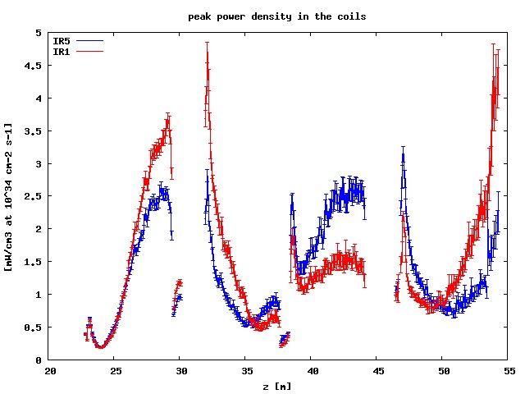
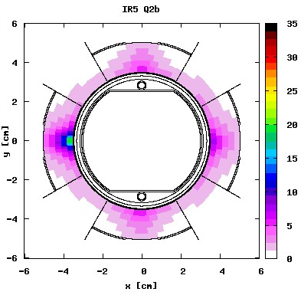
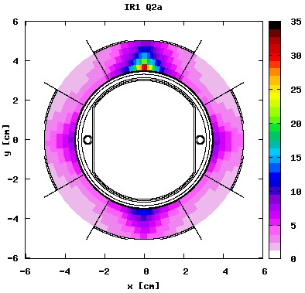
MARGIN TO QUENCH AND LIFETIME
round optics
142.5 μrad half crossing angle
x
peak dose [MGy] after 300 fb⁻¹, relevant for triplet (i.e. coil insulator) lifetime
V crossing in ATLAS (IR1)
H crossing in CMS (IR5)
x
different behavior reflecting the crossing plane variation for the same
magnetic configuration of the triplet (FDF in the horizontal plane for
positively charged particles coming from the IP)
- IR1 triplet (Q2a) reaches the design limit at nominal luminosity

Slide 11
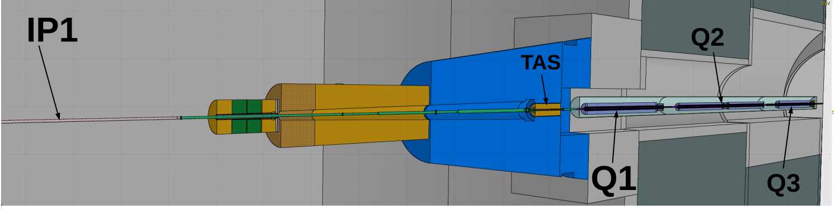
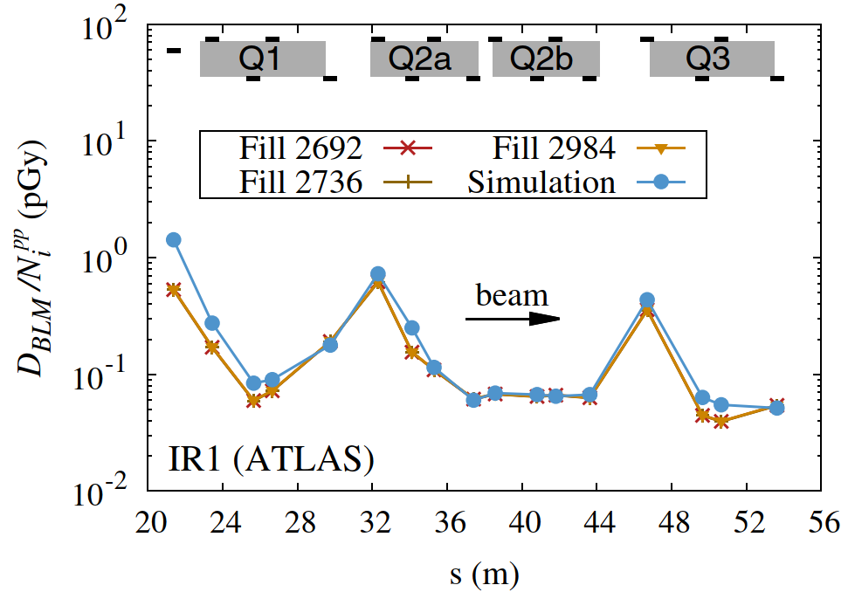
RUN 1 (√s = 8 TeV) BENCHMARK @ ATLAS
[A. Lechner et al, Phys. Rev. AB 22 (2019) 071003]

Slide 12
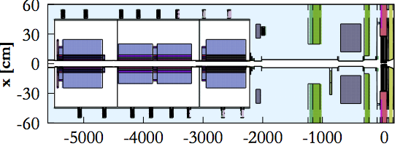
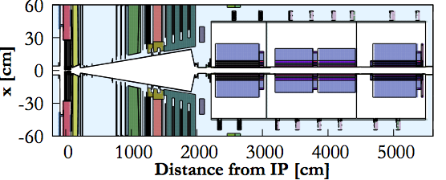
outside
the ring
LHCb
D
F
F
D
[on the horizontal plane for the outgoing beam]
compensator dipoles
LHCb spectrometer

Slide 13
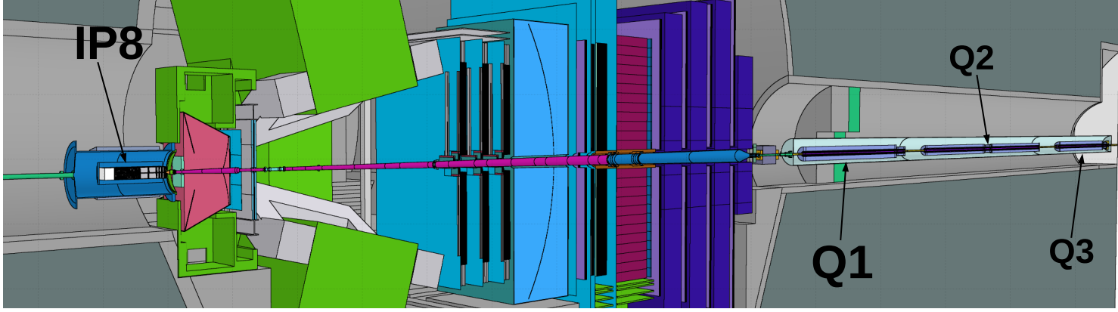
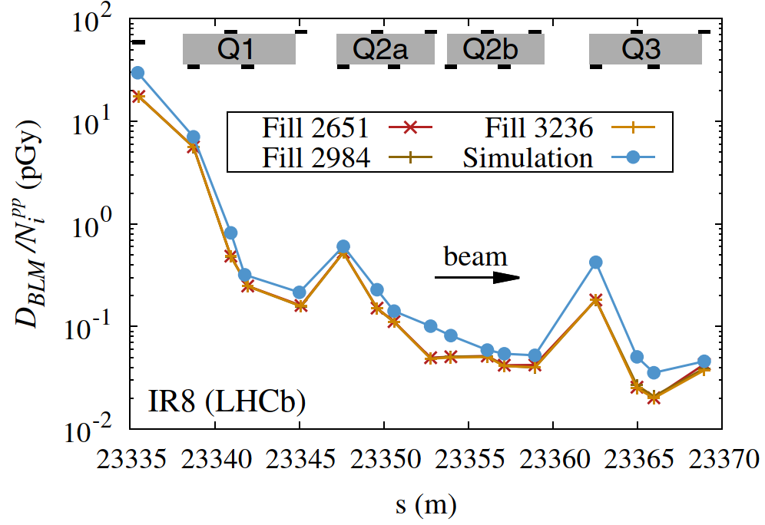
RUN 1 (√s = 8 TeV) BENCHMARK @ LHCb
[A. Lechner et al, Phys. Rev. AB 22 (2019) 071003]

Slide 14
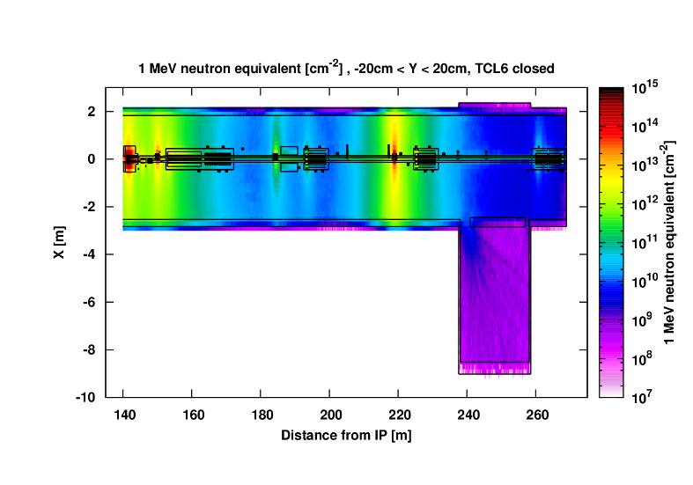
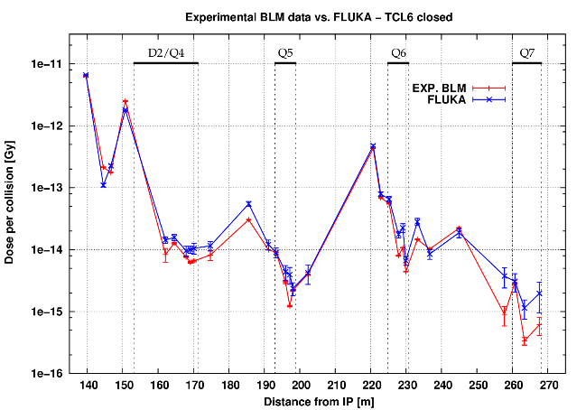
ATLAS MATCHING SECTION IN RUN 2 (√s = 13 TeV)
Fill #4919 (May 2016)
TCLs @ 15-35-20 sigma
absorbing 40 W
[A. Tsinganis]

Slide 15
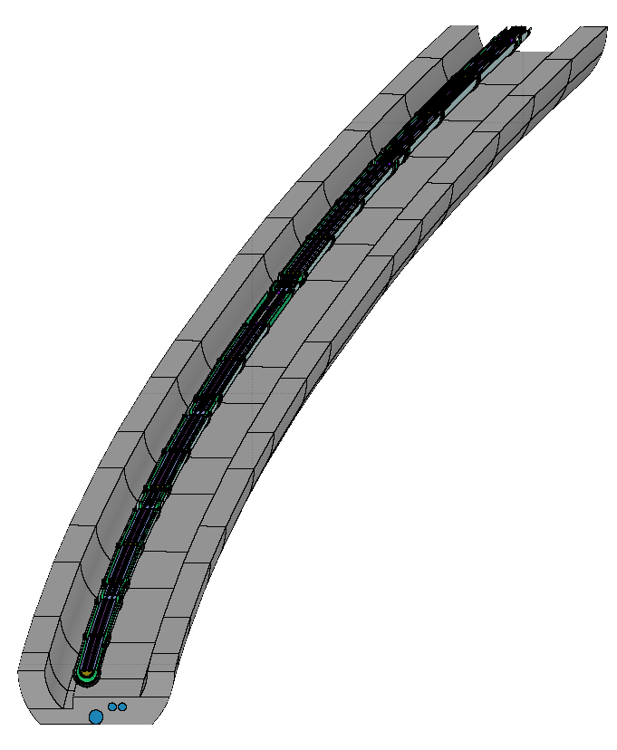
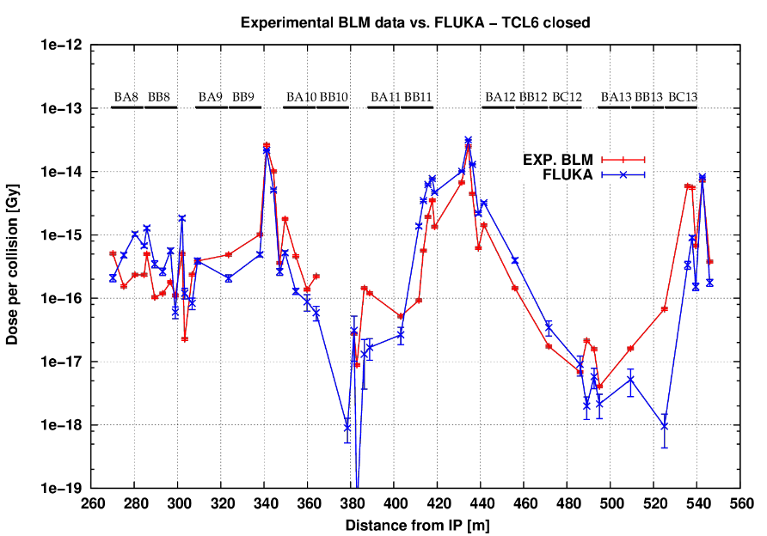
CMS DISPERSION SUPPR. IN RUN 2 (√s = 13 TeV)
Fill #5401 (October 2016)
TCLs @ 15-35-20 sigma
[A. Tsinganis]

Slide 16
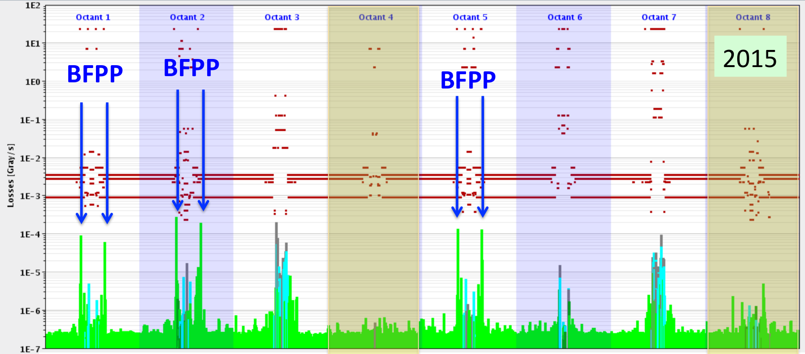
REGULAR ION LOSSES*
* see lecture of Michaela Schaumann this afternoon

Slide 17
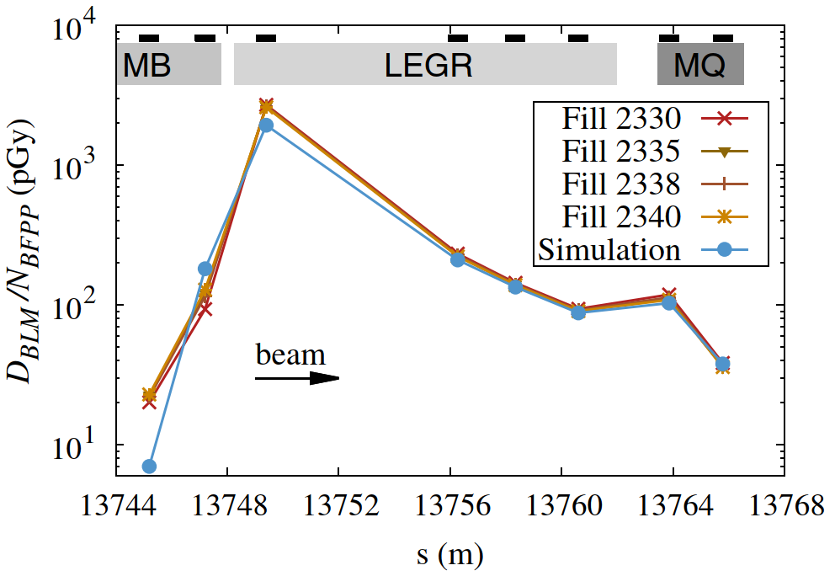
CMS DISPERSION SUPPR. IN RUN 1 (√s_{NN} = 2.76 TeV)
σ_{BFPP} = 250 b (one side),
L_{int} = 4.2–6.2 μb⁻¹ per fill, N_{BFPP} = 1–1.5 10⁹ per beam and fill
[A. Lechner et al, Phys. Rev. AB 22 (2019) 071003]

Slide 18
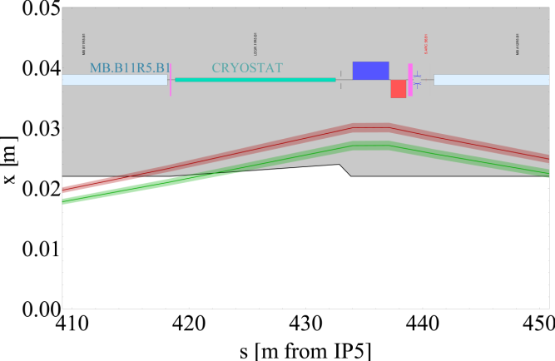
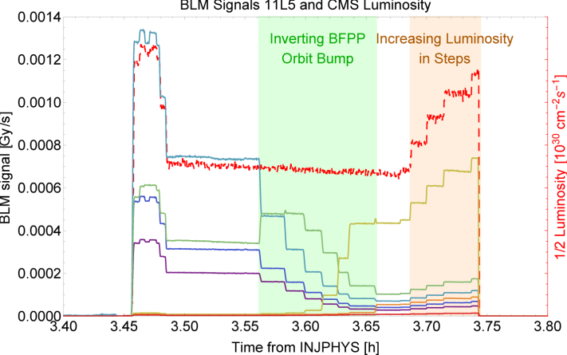
A SUCCESSFUL QUENCH TEST
on Dec 8th, 2015
with 6.37 Z TeV beams
from -3 mm to +0.5 mm
the MB.B11L5 main dipole quenched
at L=2.3 10²⁷ cm⁻² s⁻¹ in CMS
[J. Jowett et al, IPAC2016, TUPMW028]

Slide 19
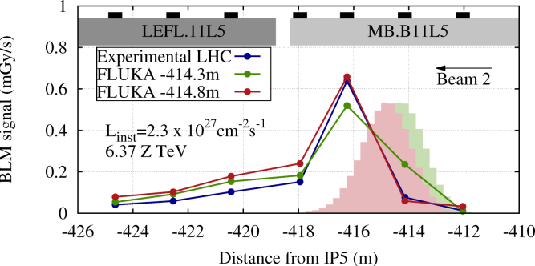
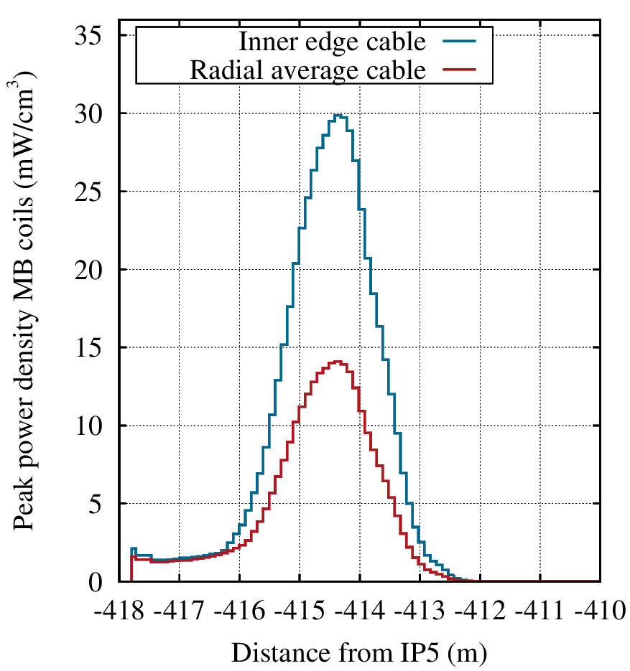
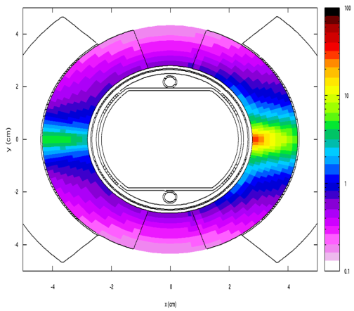
WHICH IMPACT ON THE MAGNET?
²⁰⁸Pb⁸¹⁺ distributions from MAD-X tracking
[C. Bahamonde Castro, A. Lechner]

Slide 20
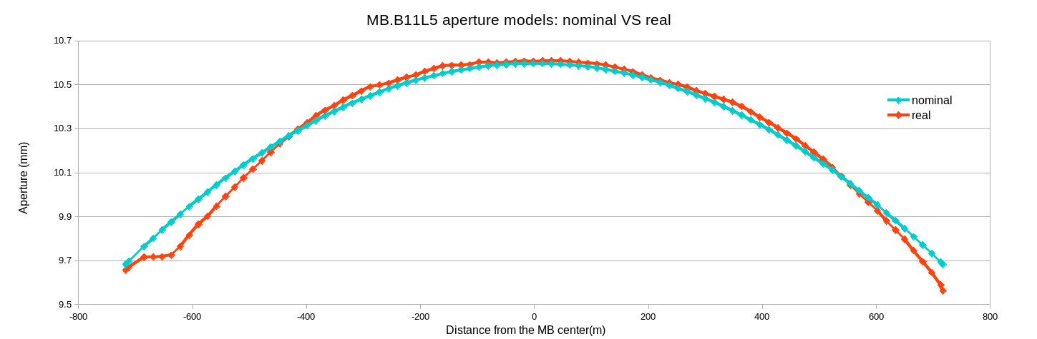
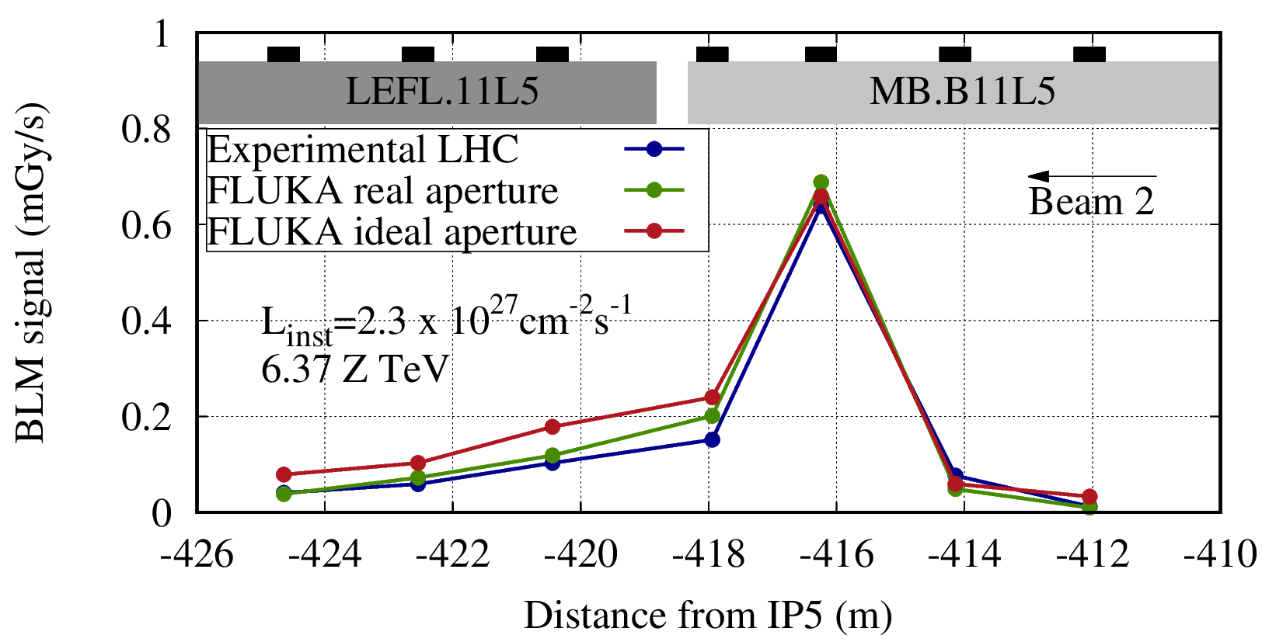
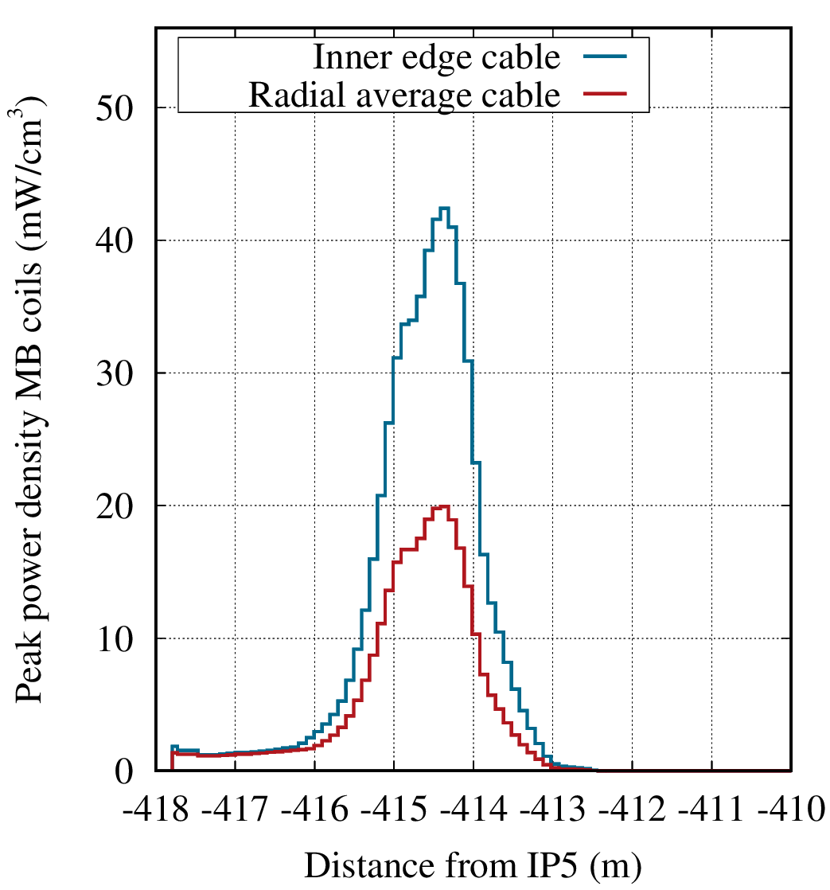
IMPERFECTION EFFECT
Δx = 2.21 mm
Δx = 1.5 mm
nominal aperture
real aperture
40% increase in peak power density
[C. Bahamonde Castro, A. Lechner]

Slide 21
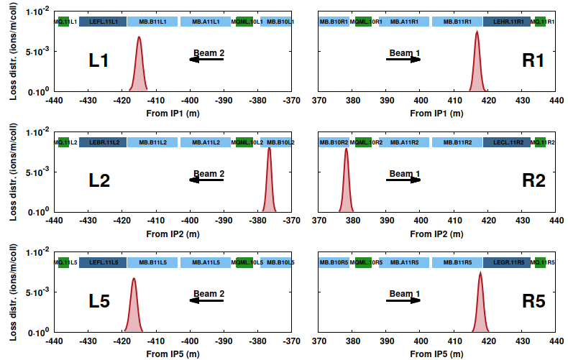
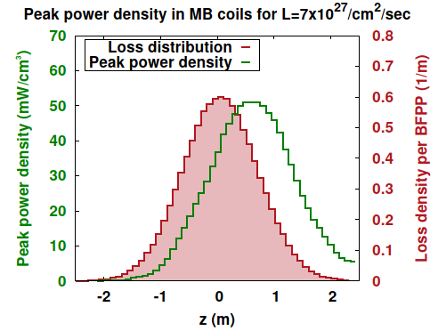
COPING WITH SECONDARY BEAMS
simulated in the absence of orbit bump
[A. Lechner]

Slide 22
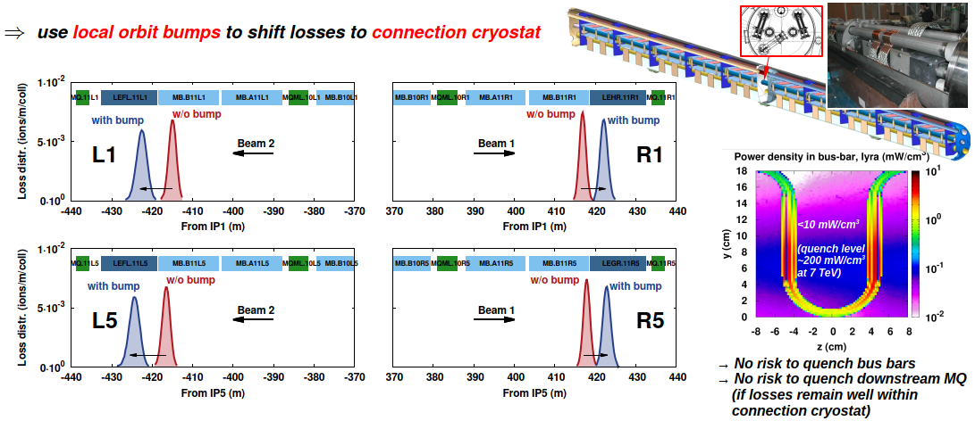
BY AN ORBIT BUMP
[A. Lechner]

Slide 23
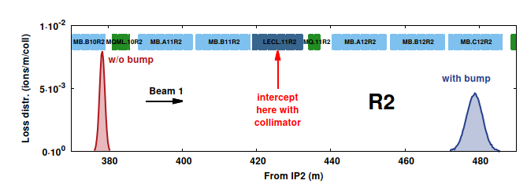
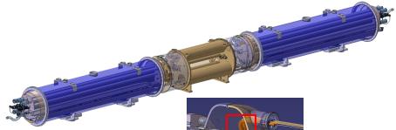
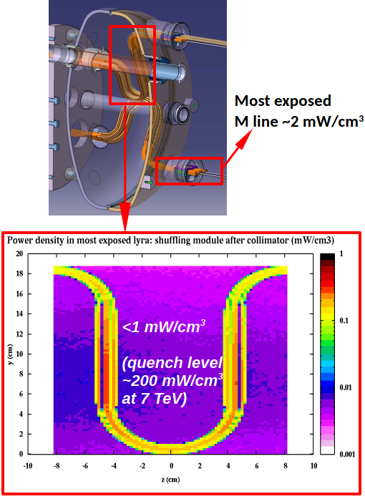
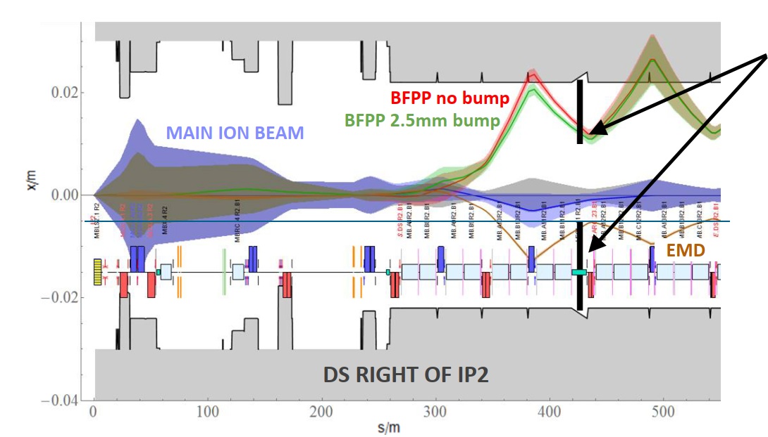
BY A COLLIMATOR
60 cm long W-alloy collimator
with a 30 sigma gap
[A. Lechner]

Slide 24
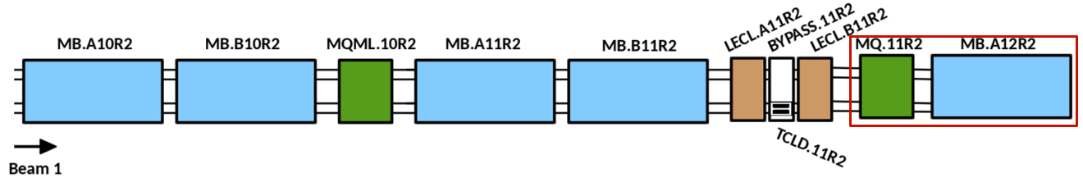
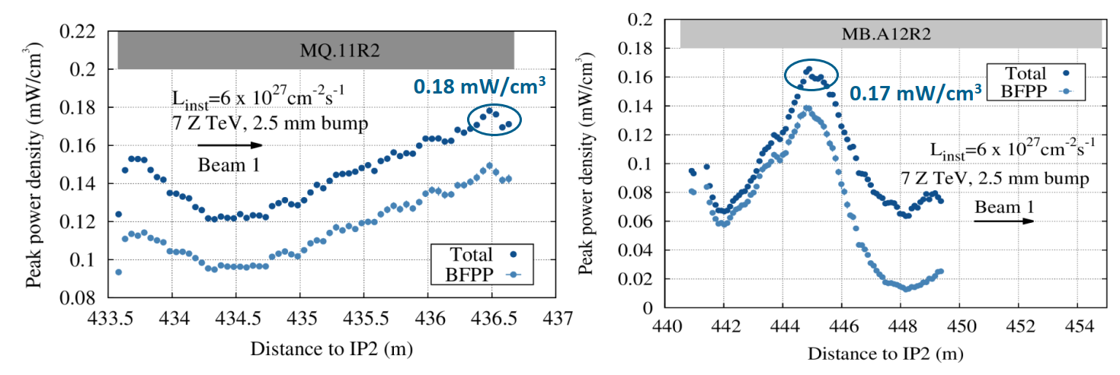
MAGNET PROTECTION
[C. Bahamonde Castro]

Slide 25
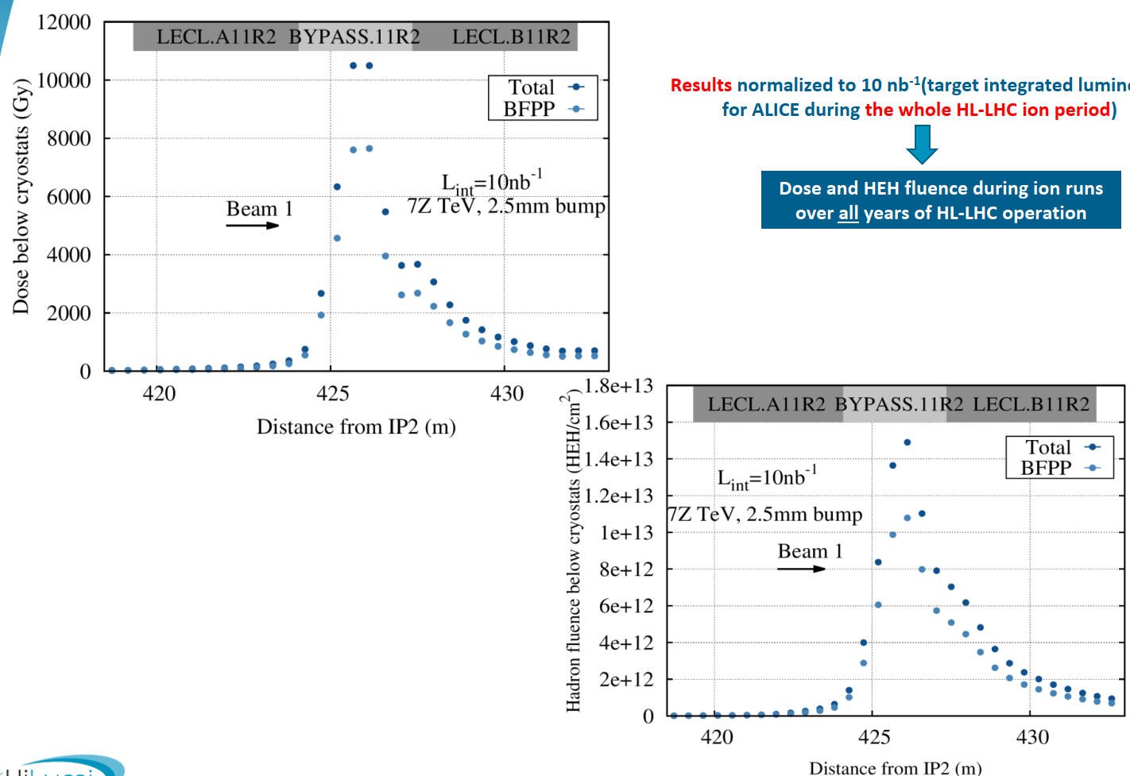
RADIATION TO ELECTRONICS
[C. Bahamonde Castro]

Slide 26
MAIN RADIATION EFFECTS ON ELECTRONICS
 |  |  | relevant physical quantity the effect is scaling with
Single Event effects (Random in time) | Single Event Upset (SEU) | Memory bit flip (soft error) Temporary functional failure | High energy hadron fluence [cm⁻²] (but also thermal neutrons!)
 | Single Event Latchup (SEL) | Abnormal high current state Permanent/destructive if not protected | High energy hadron fluence [cm⁻²]
Cumulative effects (Long term) | Total Ionizing Dose (TID) | Charge build-up in oxide Threshold shift & increased leakage current Ultimately destructive | Ionizing dose [Gy]
 | Displacement damage | Atomic displacements Degradation over time Ultimately destructive | Silicon 1 MeV-equivalent neutron fluence [cm⁻²] {NIEL -> DPA}

Slide 27
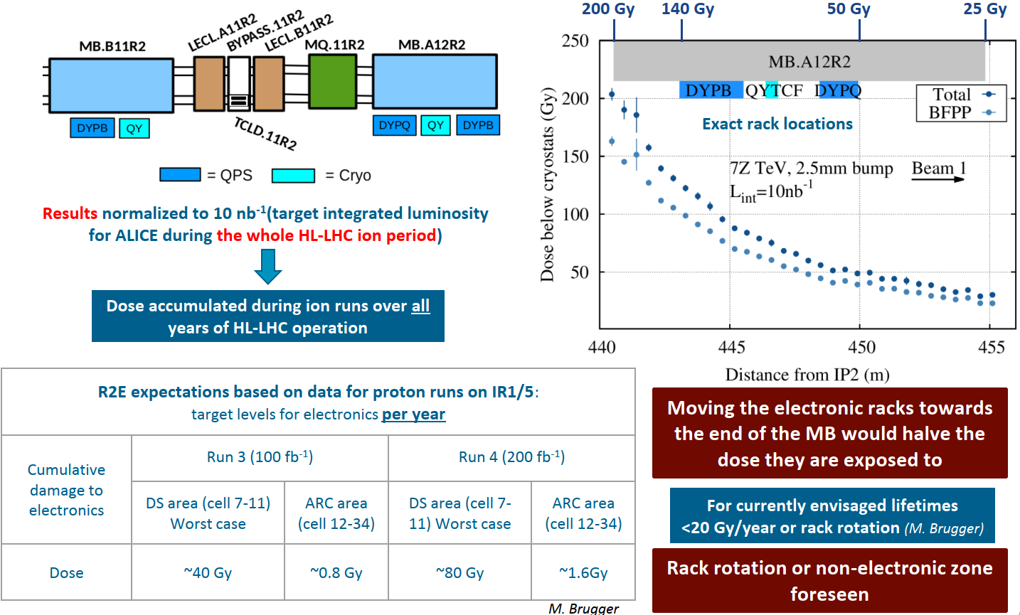
CUMULATIVE DAMAGE
[C. Bahamonde
Castro]

Slide 28
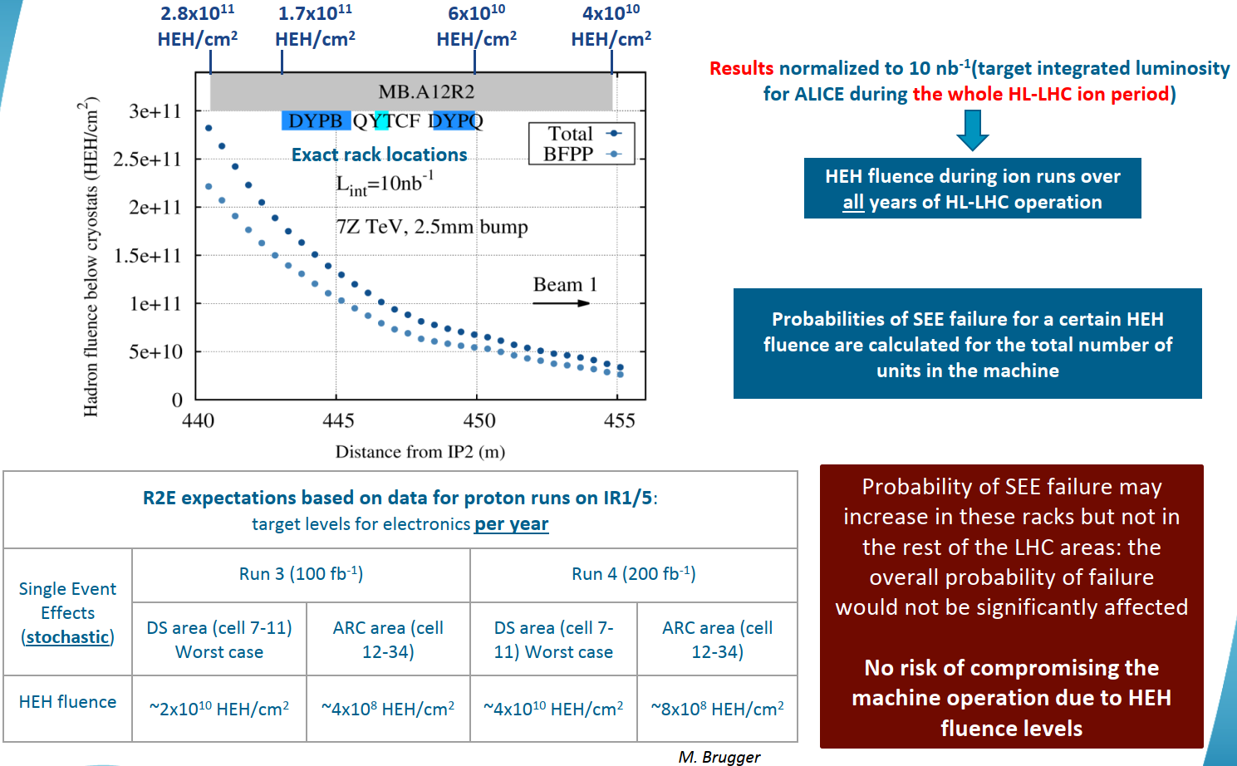
SINGLE EVENT EFFECTS
[C. Bahamonde Castro]

Slide 29
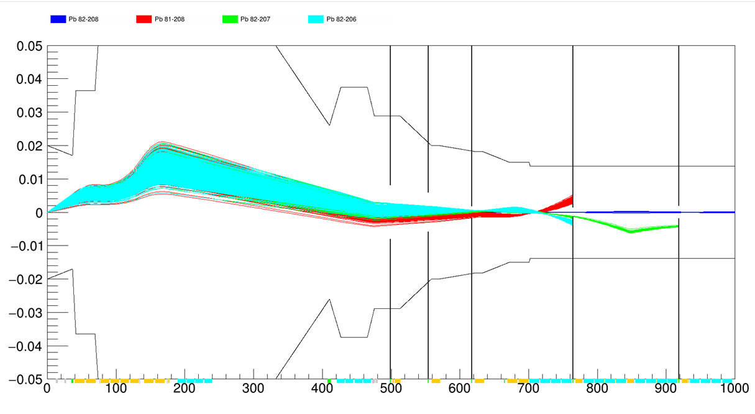
NEW CHALLENGES
[J. Molson]
one side cross section | FCC (√s_{NN} = 40 TeV) [b] | FCC (3 10²⁹ cm⁻² s⁻¹) [kW]
BFPP | 345 | 70
EMD1 | 120 | 25
EMD2 | 35 | 7

Slide 30
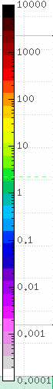
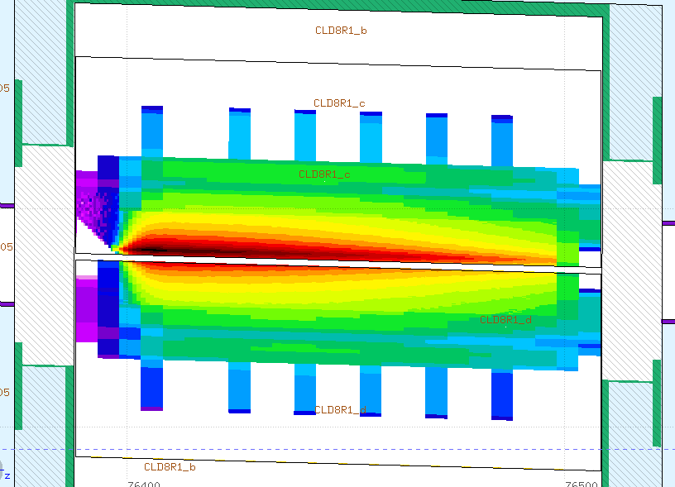
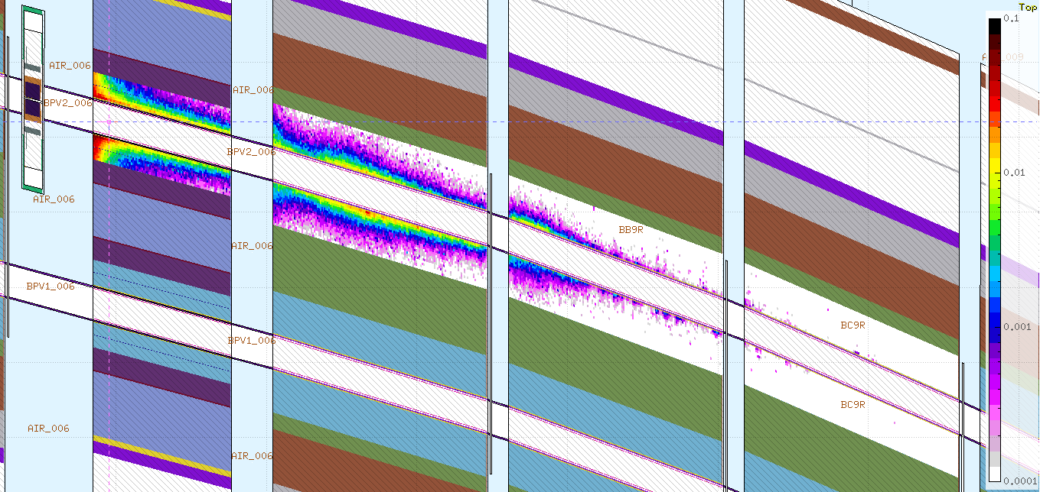
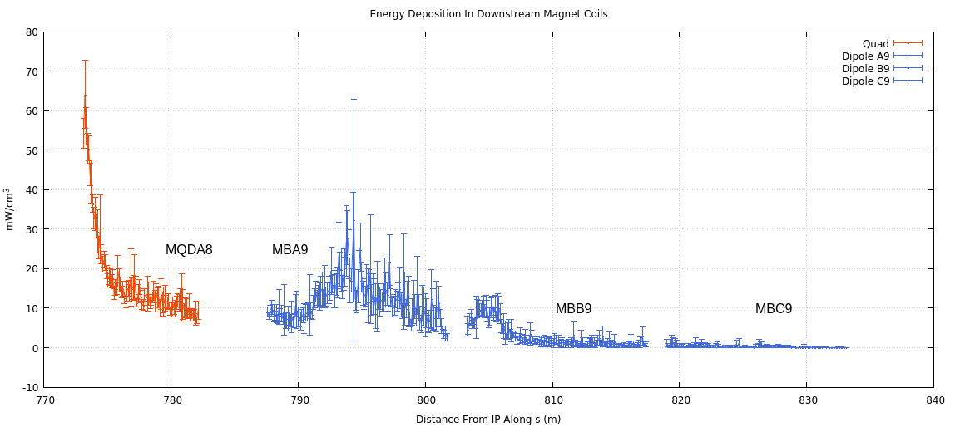
BFPP AT FCC (70 kW)
tungsten alloy collimator
W/cm³
W/cm³
would absorb 55 kW
peaking at 5 kW/cm³
severe, but
almost acceptable (if alone!)
1350 W
140 W
25 W
2 W
[J. Hunt]

Slide 31
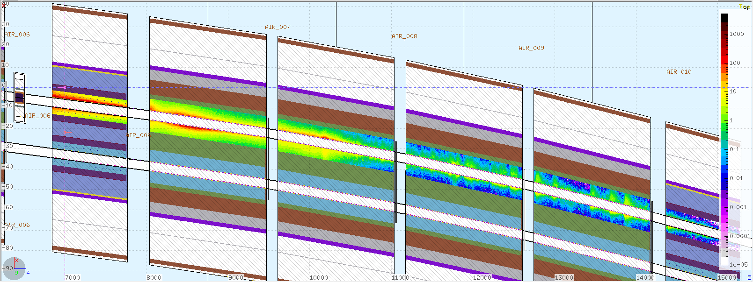


EMD1 AT FCC (25 kW)
mW/cm³
charged pions
15 kW more on the collimator
neutrons
heavier fragments
[J. Hunt,
J. Molson]
2450 W
leakage
due to distributed impacts
630 W
150 W
15 W

Slide 32

INPUT FROM BEAM (HALO) TRACKING
Machine protection calculations lie in a multi-disciplinary field, where particle dynamics in accelerators and radiation-matter interaction play together.
Energy deposition, particle fluence, monitor signals … are simulated by shower Monte Carlo codes but imply multi-turn tracking in accelerator rings which requires dedicated codes. On the other hand, the latter ones are faced with the problem of particle scattering in beam intercepting devices (like collimators).
The interface regularly goes through static loss files
giving the spatial distribution of non-elastic interactions
- which cannot be handled by tracking codes - inside the jaw material, together with the direction and energy of the beam particle being lost

Slide 33

COUPLING TOOLS
On-line coupling is becoming also available, allowing to avoid possibly critical simplifications (approximate interaction modules in tracking codes and vice versa).
Two codes running at the same time and talking to each other through a network port, by which particles are exchanged at run-time
[P.G. Ortega, P. Hermes et al., LHC Collimation Working Group, Oct 6, 2014]
MMBLB
MARS and MAD

Slide 34


SIMULATION CHAIN VALIDATION
LHC BETATRON CLEANING INSERTION
TCP
TCP B1
IP7
Q4
Q5
[E. Skordis]

