Slide 1
Heavy Ion collision at RHIC
Mei Bai
GSI GmbH and University Bonn

Slide 2
Relativistic Heavy Ion Collider
RHIC seen from space

Slide 3
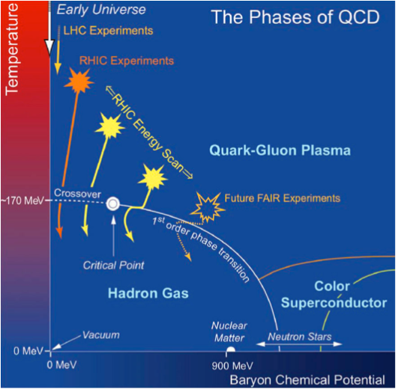
Recreate the early phase of universe
To heat up nuclear matter to very high temperature/high energy densities, greater than 10 normal nuclear density to liberate the quarks and gluons

Slide 4
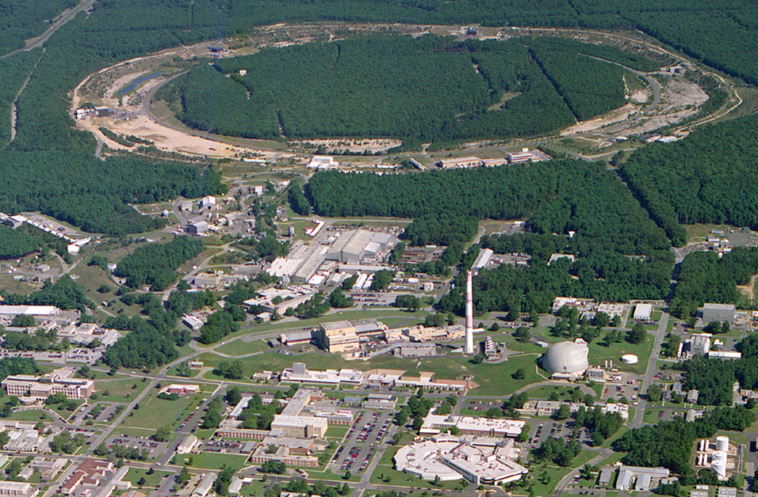
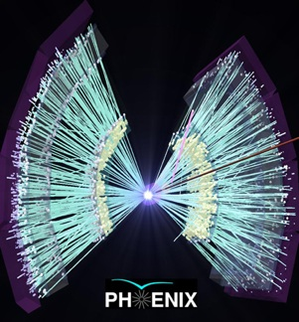
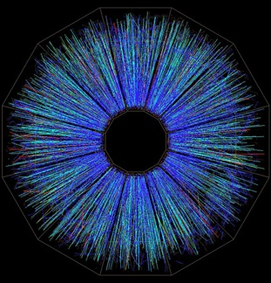
RHIC: A versatile collider
10:00 o’clock
Jet Target
12:00 o’clock
RHIC
(AnDY)
2:00 o’clock
PHENIX
8:00 o’clock
RF
4:00 o’clock
STAR
6:00 o’clock
LINAC
NSRL
EBIS
Booster
Operated modes (beam energies):
Au–Au 2.5/3.8/4.6/5.8/10/14/32/65/100 GeV/u
Cu–Cu 11/31/100 GeV/u
U – U 100 GeV/u
Ru – Ru 100 GeV/u
Zr – Zr 100 GeV/u
p↑–p↑ 11/31/100/250/255 GeV
He3 – Au* 100 GeV/u
d–Au* 100 GeV/u
p↑ – Au* 100 GeV/u
Cu – Au* 100 GeV/u
(*asymmetric rigidity)
AGS
Tandems
Achieved peak luminosities (100 GeV):
Au–Au 155×10²⁶ cm⁻² s ⁻¹
p↑–p↑ 245×10³⁰ cm⁻² s ⁻¹

Slide 5
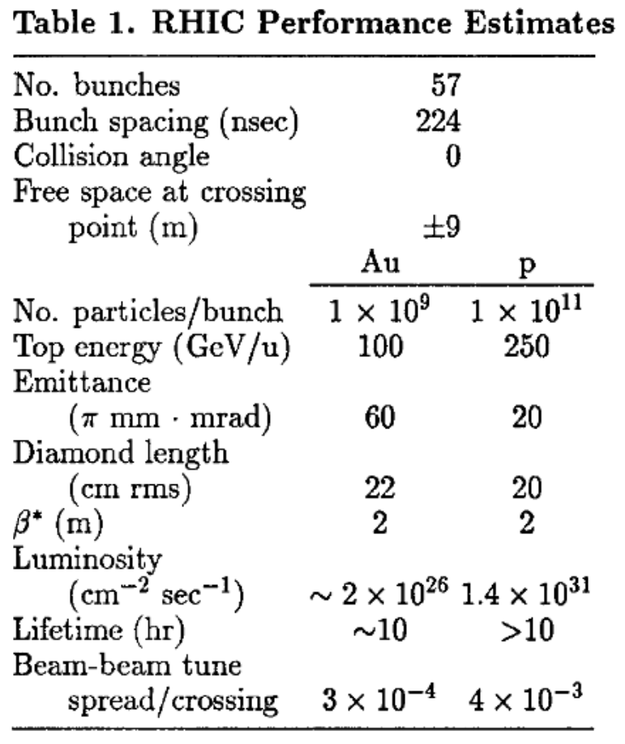
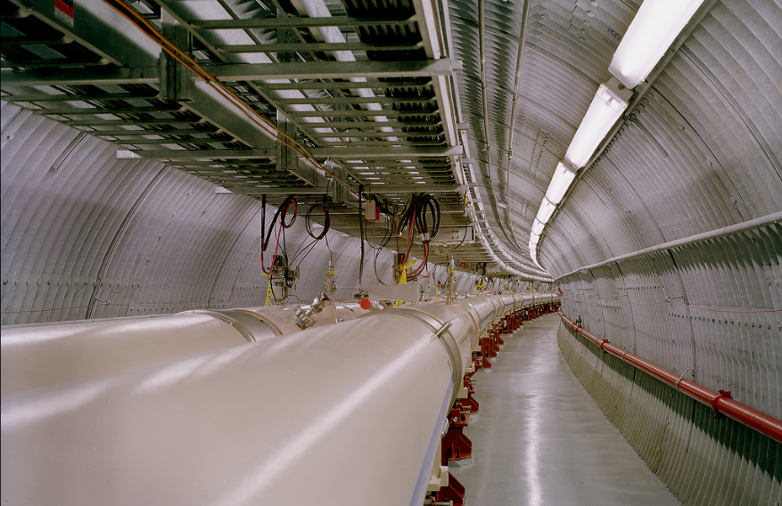
Facts about RHIC
Circumference
2.5 miles/3.8km
Accelerated species
Proton, Cu, Au, … Uranium
Energy Range
Protons: 23 GeV – 255 GeV
Ions: 10 GeV/u – 100 GeV/u
One of the few super-conducting collider in the world
Operating temperature: 4K or -452ºF
Collision temperature
Heavy ions: 4 trillion Celsius
Revolution time
~13$μ$s
RF system and harmonics
Injection and ramp: 28MHz, h=360
Store: 197MHz, h=2520
S. OZAKI, The Relativistic heavy ion collider at Brookhaven

Slide 6
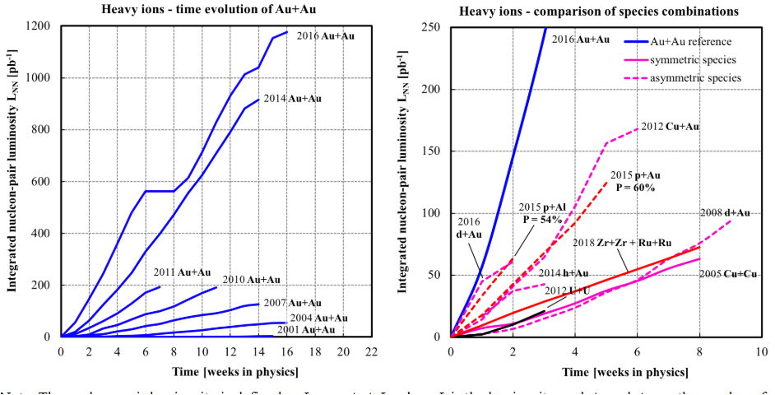
Delivered Integrated Luminosity and Polarization
Nucleon-pair luminosity: luminosity calculated with nucleons of nuclei treated independently; allows comparison of luminosities of different species; appropriate quantity for comparison runs.
W. Fischer, https://www.agsrhichome.bnl.gov/RHIC/Runs/
Notes:
updated

Slide 7
Brief History of RHIC
1989: RHIC design
1991: construction started
1996: AGStRHIC transfer line commission
1997: first sextant test
1999: Engineering test, first circulating Au beam
2000: first Au-Au collision at 100 GeV/u!
2003: d-Au collision
2005: Cu-Cu collision
2002: first polarized proton collision at 100 GeV
2009: first polarized proton collision at 250 GeV
2012: first ²³⁸U⁹²⁺ ~ ²³⁸U⁹²⁺ collision at 96.4 GeV/u
2013: first polarized proton collision at 255 GeV
2015: first polarized proton and Au collision at 100 GeV/u

Slide 8
RHIC Operation parameters & performance
 | Energies [GeV/u] | Bunch# | Bunch intensity | Beta* [m] | Store peak lum. [cm⁻²s⁻¹] | Store avg. lum [cm⁻²s⁻¹]
Au-Au | 100 | 111 | 2e9 | 0.7 | 155x10²⁶ | 87x10²⁶
U-U | 100 | 111 | 0.3e9 | 0.7 | 8.8x10²⁶ | 5.6x10²⁶
Cu-Cu | 100 | 37/35 | 4.5e9 | 1/0.9 | 2.0x10²⁸ | 0.8x10²⁸
Au - Au | 31.2-31.2 | 111 | 1.2e9 | 2.5 | 4.5x10²⁶ | 3.0x10²⁶
Zr-Zr | 100-100 | 111 | 1e9 | 0.7 | 48x10²⁶ | 22x10²⁶
Ru - Ru | 100-100 | 111 | 1e9 | 0.7 | 38x10²⁶ | 21x10²⁶
d - Au | 101.3-99.4 | 111 | 1.3e11/1.9e9 | 0.7 | 85x10²⁸ | 50x10²⁸
p-Au | 104-97.4 | 111 | 2.3e11/1.6e9 | 0.85/0.7 | 88x10²⁸ | 45x10²⁸
p-Al | 103.9-98.6 | 111 | 2.4e11/11e9 | 0.85/0.7 | 760x10²⁸ | 380x10²⁸
Cu-Au | 99.9-100 | 111 | 4e9/1.3e9 | 0.7 | 1.2x10²⁸ | 1.0x10²⁸
W. Fischer, https://www.agsrhichome.bnl.gov/RHIC/Runs/

Slide 9
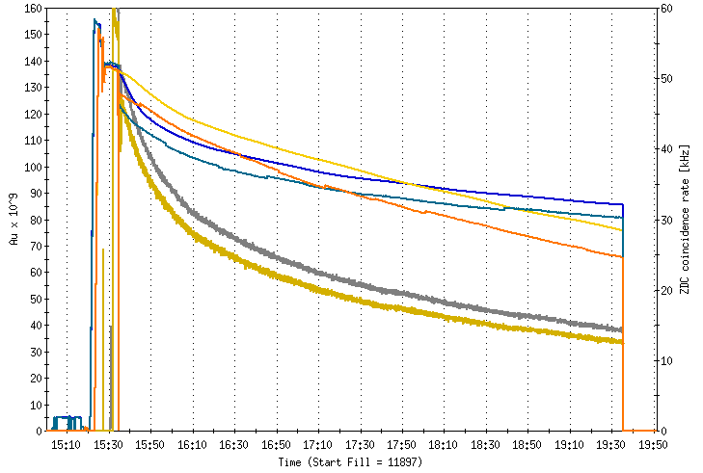
RHIC Operation: A Typical RHIC Store
Cogging, establish collision
Injection and Acceleration
Beam currents
STAR and PHENIX ZDC

Slide 10
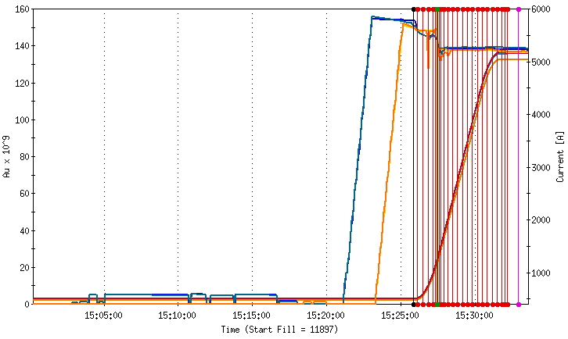
RHIC Operation: A Typical RHIC Store
Acceleration…
Filling Blue ring…
Filling Yellow ring…
Check injection:
bunch intensity
injection matching
…

Slide 11
A closer look at RHIC Complex
(PHOBOS)
10:00 o’clock
Jet Target
12:00 o’clock
RHIC
(BRAHMS)
2:00 o’clock
Linear Accelerator: accelerator proton beam up to 200MeV
PHENIX
8:00 o’clock
RF
4:00 o’clock
EBIS based pre-injector for heavy ions: 2MeV/u
STAR
6:00 o’clock
LINAC
NSRL
EBIS
Booster
Alternating Gradient Synchrotron: one of the first synchrotron based on strong focusing principle
AGS
Tandem van de Graff:
Two 15MV electrostatic accelerator. Each 24m long
able to develier 40 tpes of ions
world’s largest electrostatic accelerator
Tandems
Booster: a circular synchrotron

Slide 12
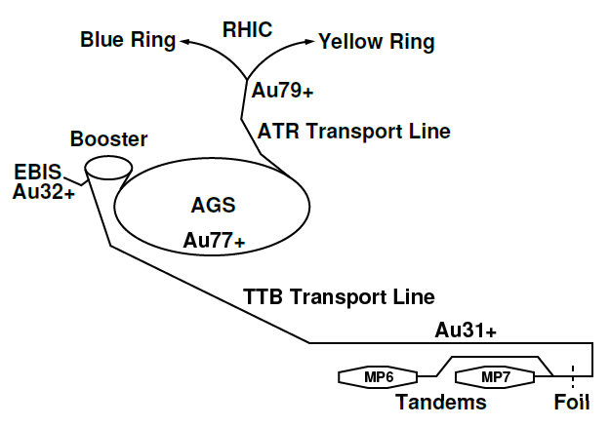
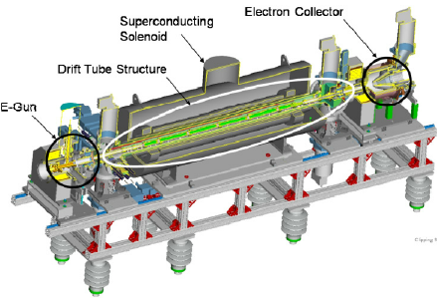
RHIC Injector Chain for Heavy ions
Simple, modern, low maintenance
Lower operating cost
Can produce any ions (noble gases, U, He³↑)
Higher Au injection energy into Booster
Fast switching between species, without constraints on beam rigidity
Short transfer line to Booster (30 m)
Few-turn injection (now about 50)
No stripping needed before the Booster,
resulting in more stable beams
in service until 2012
provide maximum 5e9 Au31+ ions per pulse
no Uranium
C. J. Gardner et al, IPAC2015 Proceeding, Richmond, VA, USA
J. Alessi, et al, Proceedings of IPAC11, New York, NY, USA

Slide 13
RHIC Injector Chain for Heavy ions
Ions | He-U
A/Q | <=6.25
Current | >1.5emA
Pulse length | 10-40us(< a few turn injection)
Rep. rate | 5Hz
EBIS output energy | 17 keV/u
RFQ output energy | 300 keV/u
Linac exit energy | 2MeV/u
Time2switch species | 1 sec
in service until 2012
C. J. Gardner et al, IPAC2015 Proceeding, Richmond, VA, USA
J. Alessi, et al, Proceedings of IPAC11, New York, NY, USA

Slide 14
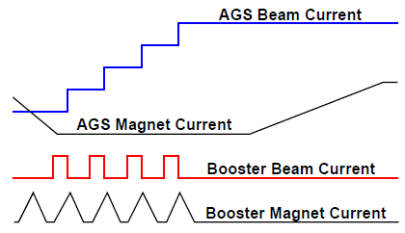
RHIC Injector Chain for Heavy ions
8 Booster loads per AGS cycle
RF gymnastics
Injection: h=16 $→$8 $→$4
adiabatic h=4$→$12
ramp h=12
Au77+
Au32+
Booster harmonic 4
cycle time: 200ms
RF capture: 8ms
RF merging: 20ms
harmonic 8 $→$4 $→$2
EBIS bunch
length: 10 ~ 40us
intensity: upto 1.62e9 Au32+
C. J. Gardner et al, IPAC2015 Conference Proceeding, Richmond, VA, USA

Slide 15
Performance limitation
Figure of measure for a collider
Peak luminosity:
# of collisions per unit area and per unit time
Integrated luminosity:
total number of collision events within the duration of a store

Slide 16
What is luminosity?
For fixed target
The event rate is given by
$$R=\frac{N}{A}ρ_{T}σ_{T}$$
where $σ_{T}$ is the cross section of interaction. And, $L=Nρ_{T}$ is defined as luminosity
Collision of two relativistic beams
The luminosity is
$$L=\int{\int{\int{\int_{−∞}^{∞}{ρ_{1}\left(x,y,s,−ct\right)}}}}$$
$$ρ_{2}\left(x,y,s,−ct\right)cdtdsdxdy$$
The event rate of the collider is $R=Lσ_{c}$ where $σ_{c}$ is the interaction cross section

Slide 17
Figure of Measure for a collider
Peak luminosity: # of collisions per unit area and per unit time
For the case of head-on collisions
$$L=f\frac{N_{1}N_{2}}{A}$$
Ways to increase the peak luminosity
Increase # of particles in each beam, i.e. bunch intensity
Increase # of bunches
Make each bunch more bright, i.e. shrink the size of the bunch at the collision point
# of particles from
Beam 1 in collisions
# of particles from
Beam 2 in collisions
Frequency of collision
Area of collisions, i.e. the product of beam size

Slide 18
Figure of Measure for a collider
Integrated luminosity is defined as total number of collision events within the duration of a store
$$L_{int}=\int_{0}^{T_{store}}{L\left(t\right)dt}$$
The unit of integrated luminosity is the inverse of cross-section unit, and typically expressed in inverse barn (10⁻²⁴cm⁻²). For instance, RHIC delivered about 540 pb⁻¹ of about 4 month polarized proton operation in 2013.
In additional to the direct burn-off rate of collisions, the integrated luminosity is directly affected by
how effective is the detector: vertex distribution, detector ramp-up time, etc
beam emittance growth during store due to various diffusion mechanisms such as intra-beam scattering, beam-beam effect, orbital resonance, etc.
overall percentage of time-in-store

Slide 19
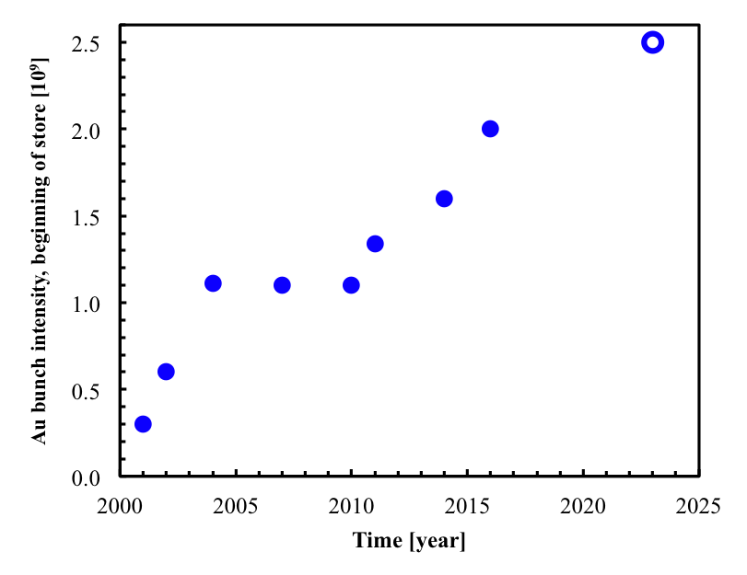
Performance limitation
Bunch intensity limit
ultimate goal (25% more)
AGS 12g6g2 merge
EBIS, Booster 4g2g1, AGS 8g4g2 merge
scrubbing with protons
111 bunches
43 bunches
γ_{t}-jump, octupoles at transition
Wolfram Fischer IPAC16-WEZA01

Slide 20
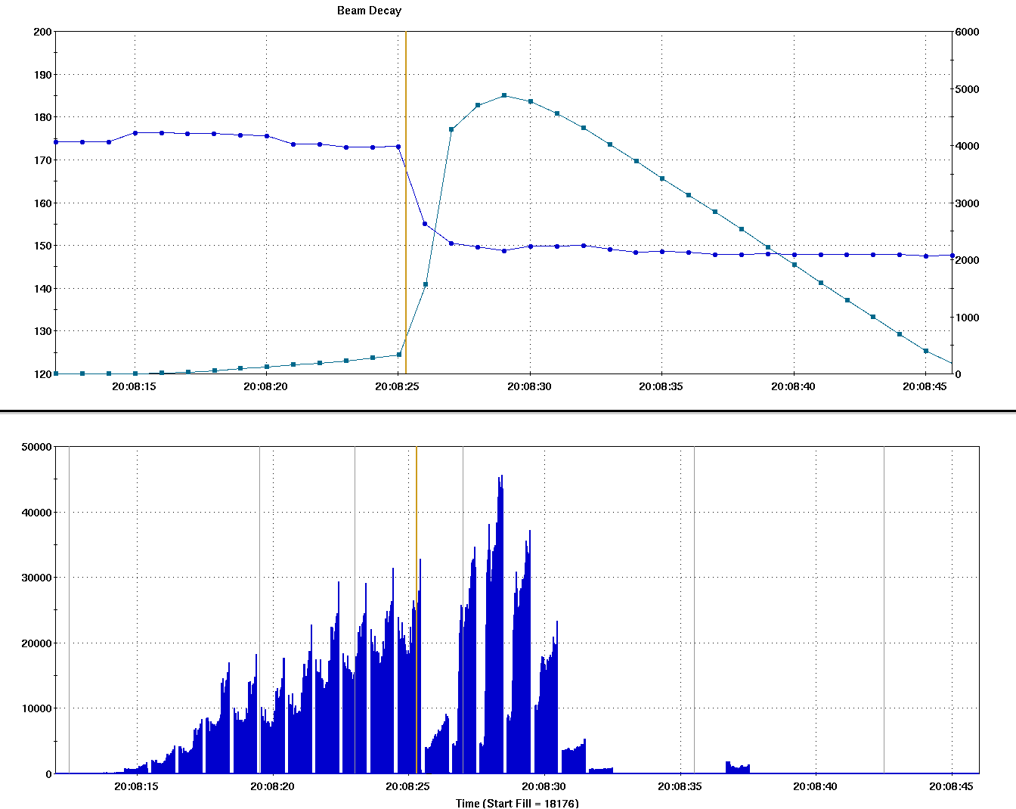
Performance limitation: transition crossing
Highly non-linear, and non-adaibatic beam dynamics near transition energy
RHIC is the 1st superconducting accelerator for transition crossing of all ions except proton
limited ramp rate: $\frac{dγ}{dt}=0.4$/s
$→$ long jump time, ~30 - 50ms instead of a few ms
Beam experiences longer non-adiabatic, chromatic non-linear effects, and is more vulnerable to beam loss, emittance growth etc
$$Δt_{jump}$$
energy jump
$γ_{T}$ jump
Beam decay
Beam intensity

Slide 21
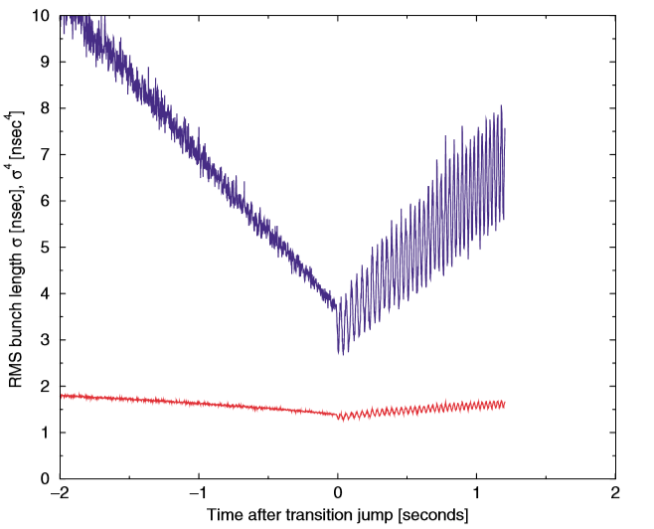
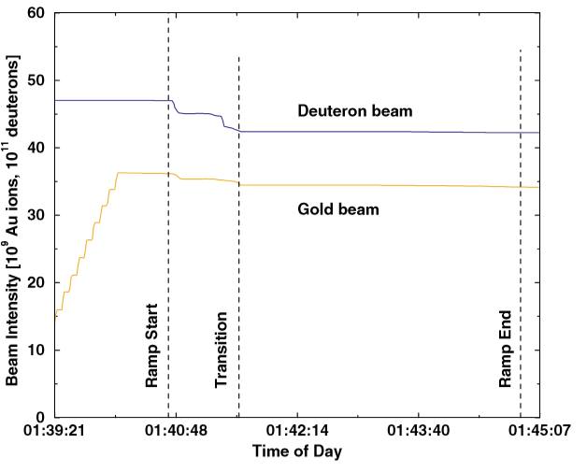
RHIC Transition Crossing
$γ_{T}$ jump: two dedicated families of quadrupoles in each of the six RHIC sextants
Size of the jump: $Δγ_{T}=±0.5$ in ~30 - 50 ms
1st order $γ_{T}$ jump successfully commissionined during the 2004 d-Au Run with 216ns bunch spacing[C. Montag, J. Kewisch, PRST-AB, Vol. 7, 011001, 2004]
]
$${\left\lfloor γ−γ_{T}\right\rfloor }^{4}\sim σ_{s}$$

Slide 22
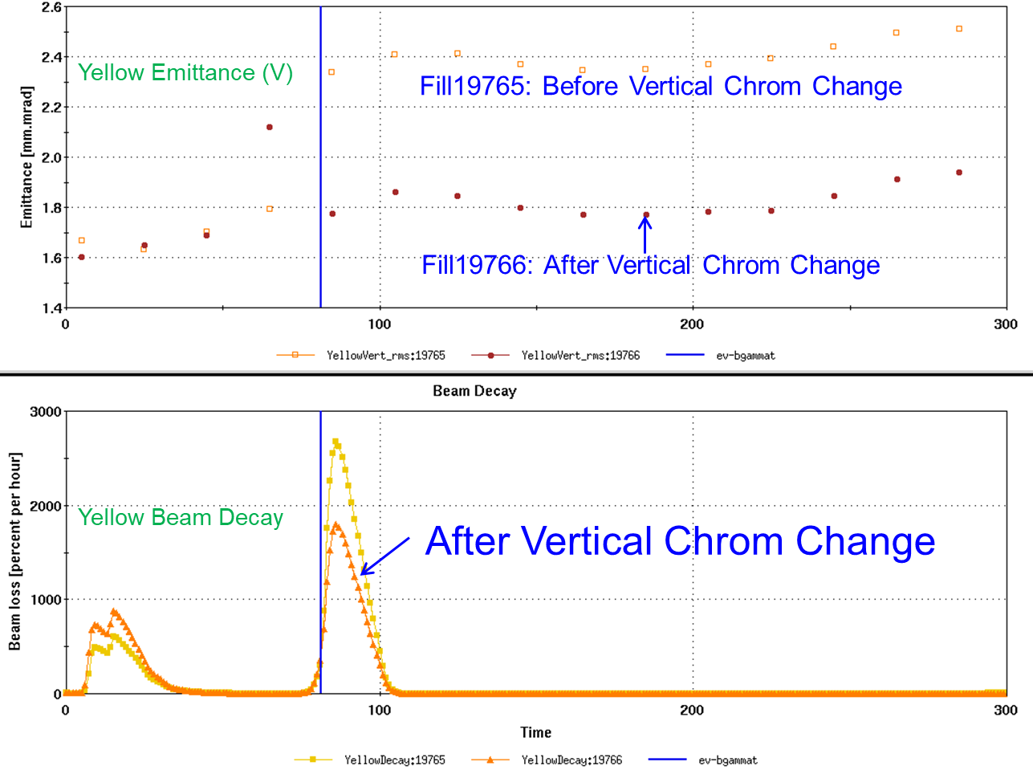
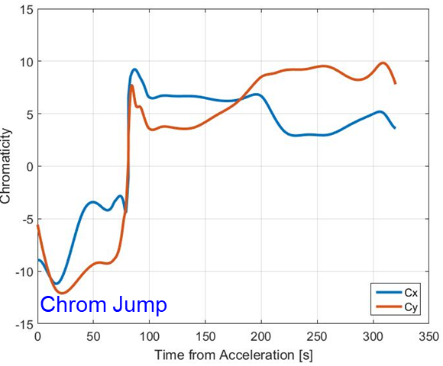
RHIC Transition Crossing
careful optics optimization is needed
Proper optics setup to minimize the optics distortion due to $γ_{T}$ jump
chromaticity adjustment during the transition
Chromaticity must flip sign before and after the transition to avoid microwave instability
X. Gu, ECLOUD, 2018
X. Gu, ECLOUD, 2018

Slide 23
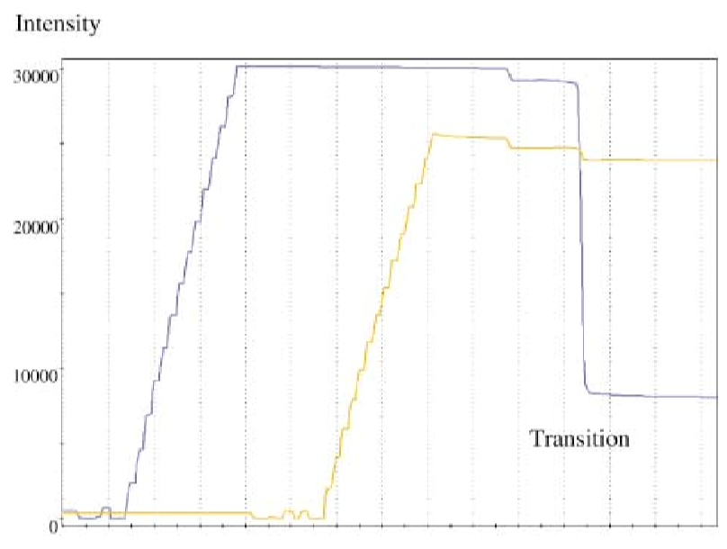
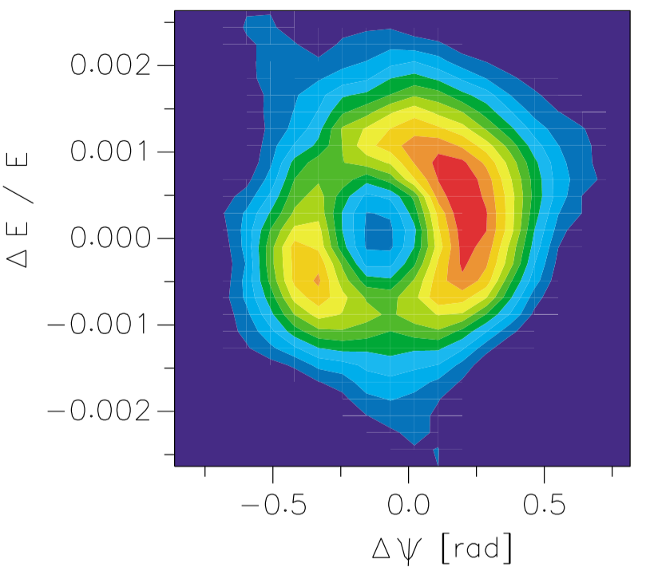
RHIC Transition Crossing
Nevertheless, significant beam loss due to fast instability is still experienced when beam intensity is pushed higher
Longitudinal Phase
Au intentisty [1e6]
Time during ramp [s]
Bunch #: 55
C. Montag, J. Kewisch, D. Trbojevic, PRST-AB, VOLUME 5, 084401 (2002)

Slide 24
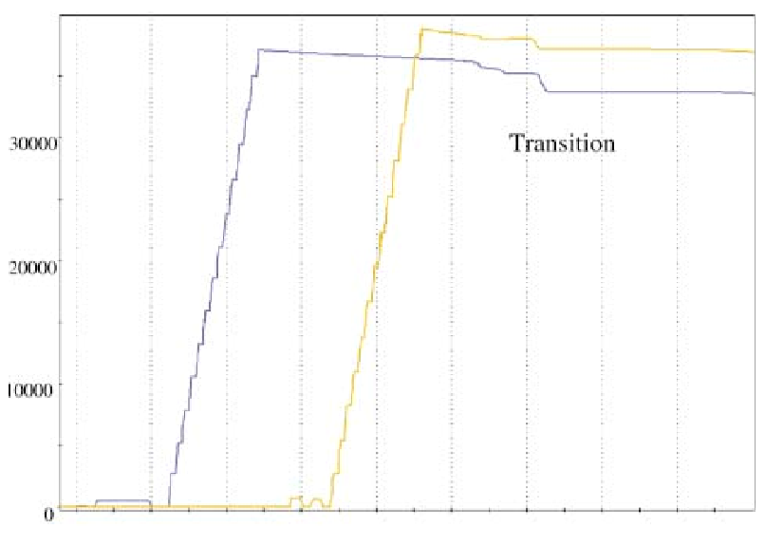
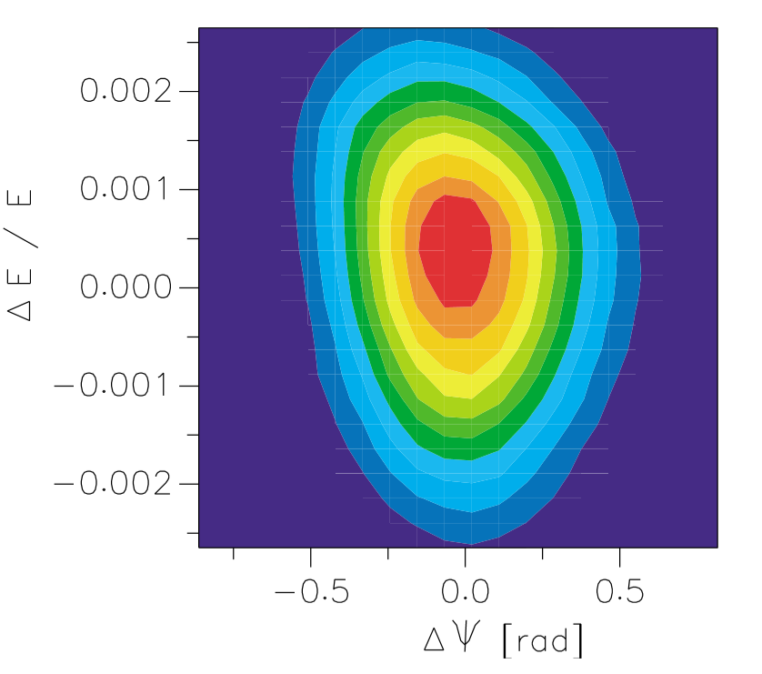
RHIC Transition Crossing
Nevertheless, significant beam loss due to fast instability is still experienced when beam intensity is pushed higher
When 4 arc octupoles were engaged to provide more Landau damping
Longitudinal Phase
Au intentisty [1e6]
Time during ramp [s]
Bunch #: 55
C. Montag, J. Kewisch, D. Trbojevic, PRST-AB, VOLUME 5, 084401 (2002)

Slide 25
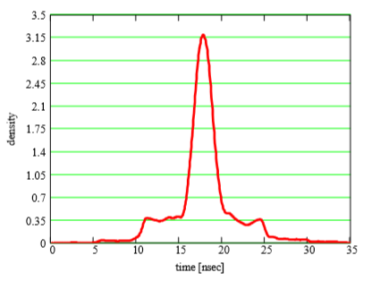
RHIC Transition Crossing
Longitudinal plane often suffers quadrupole oscillation after the transition
Longitudinal emittance growth, which subsequently cause trouble for the rebucketing at store with 197MHz (h=2520)
C. Montag, J. Kewisch, PRST-AB, Vol. 7, 011001, 2004
V. Ptitsyn et al, Proceedings of Hadron Beam 2008,Nashville,Tennessee,USA

Slide 26
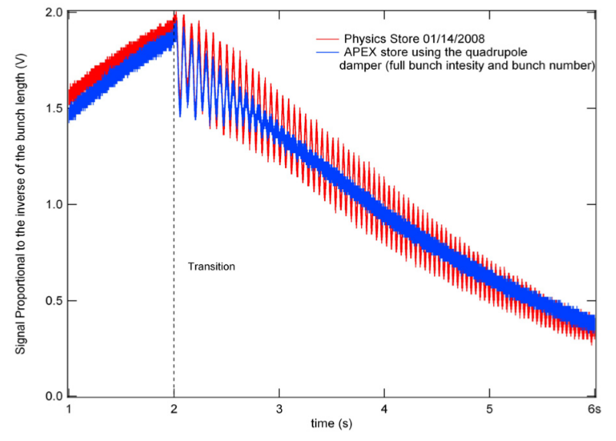
RHIC Transition Crossing
Longitudinal plane often suffers quadrupole oscillation after the transition
A dedicated RF feedback with was developed to damp the quadrupole oscillation and reserve longitudinal emittance
V. Ptitsyn et al, Proceedings of Hadron Beam 2008,Nashville,Tennessee,USA

Slide 27
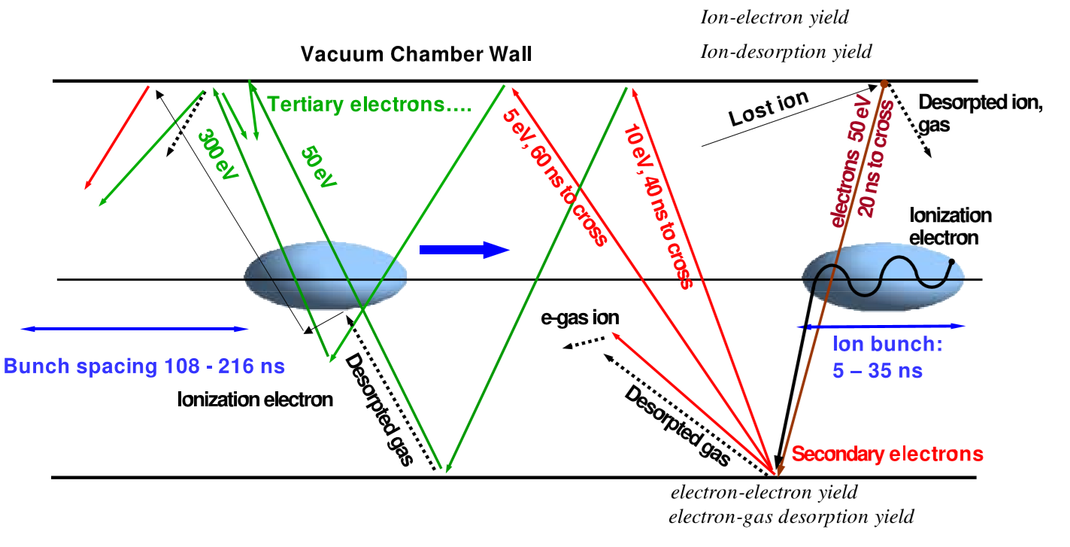
Performance limitation: e-cloud
Ion beam induced electron cloud was observed early on in RHIC operation
Vacuum presure rise at warm region
J. Wei et al, Proceedings of 2005 Particle Accelerator Conference, Knoxville, Tennessee
27

Slide 28
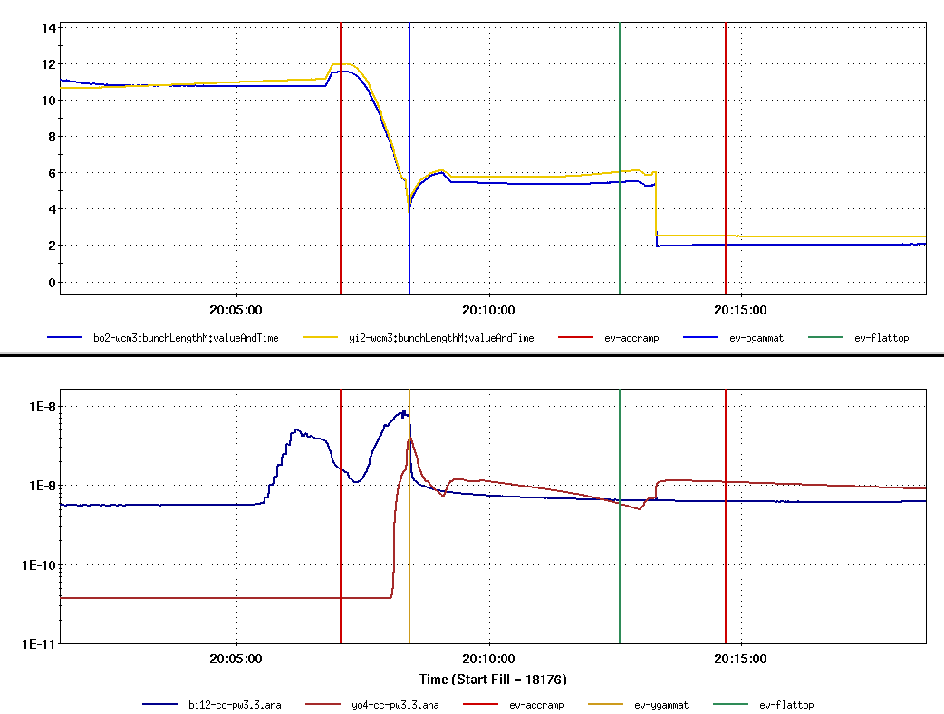
Performance limitation: e-cloud
It gets much worse during transition crossing,
Transition Crossing
Bunch Length
Vacuum pressure
X. Gu, ECLOUD, 2018

Slide 29
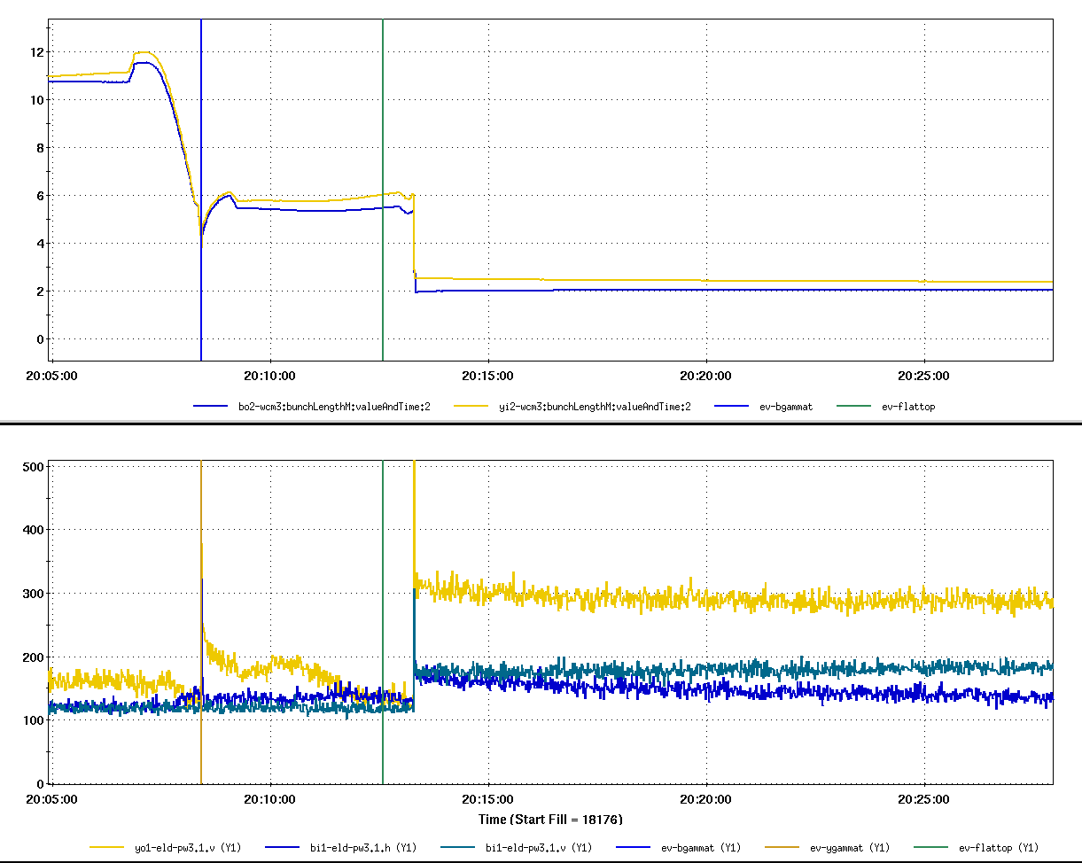
Performance limitation: e-cloud
It gets much worse during transition crossing,
Transition Crossing
Bunch Length
Re-bucketing
E-cloud
Yellow (V)
E-cloud Signal
Blue (H&V)
X. Gu, ECLOUD, 2018

Slide 30
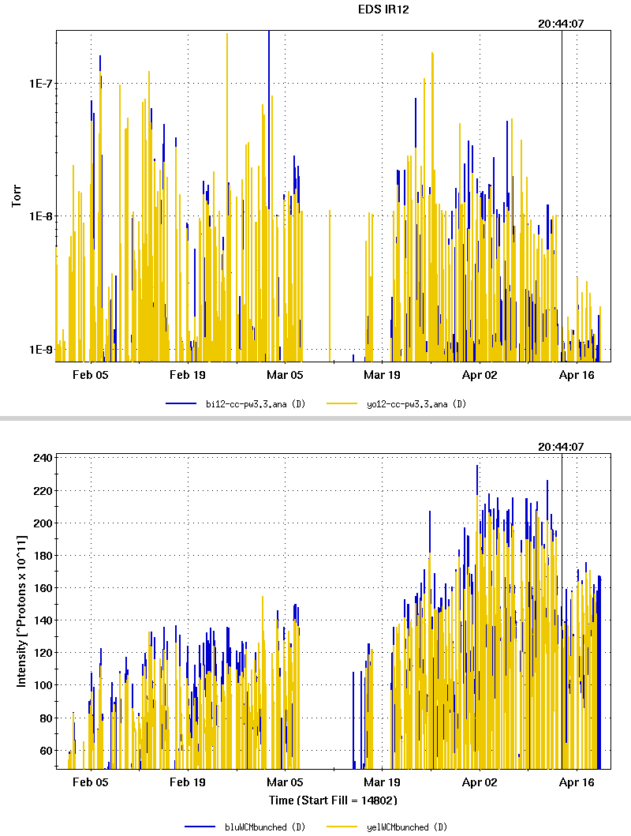
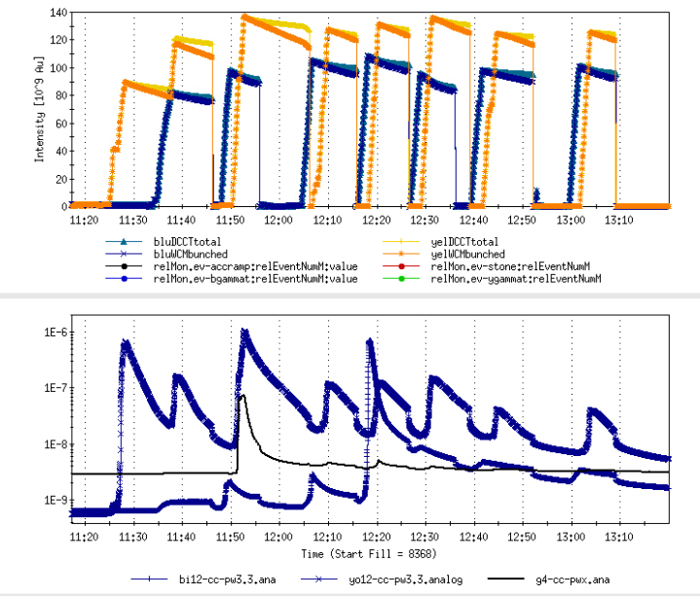
Mitigation of e-cloud: beam scrubbing
Scrubbing used in 2007 Au-Au operation:
2011 pp operation:
Vacuum
Intensity
7 high intensity fills in about 2 h, Reduced dynamic pressure in worst location by more than 1 order of magnitude
X. Gu, ECLOUD, 2018

Slide 31
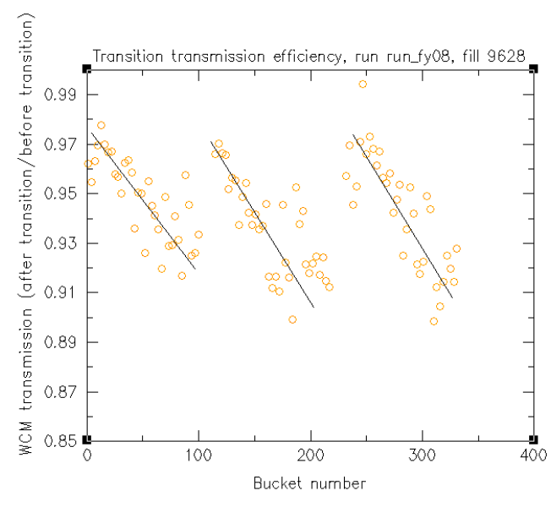
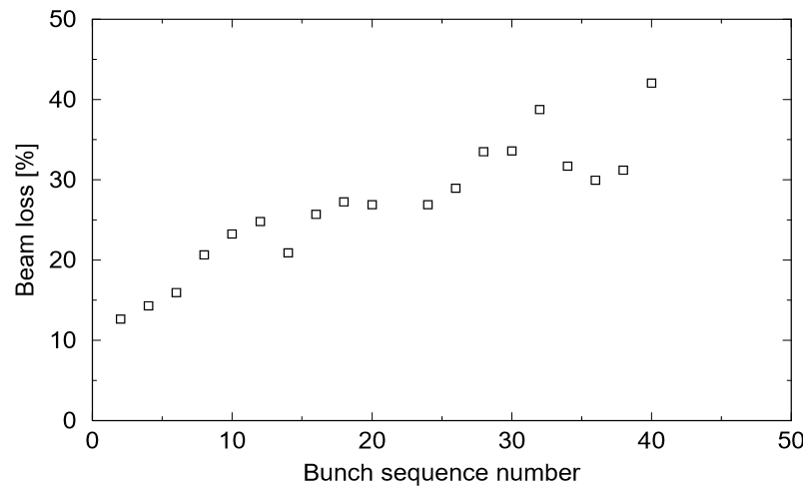
Performance limitation: e-cloud
which in turn triggers more profound impact on the beam dynamics in the neighborhood of transition crossing
Bunch-by-bunch beam loss was also observed during transition crossing
V. Ptitsyn et al, Proceedings of Hadron Beam 2008,Nashville,Tennessee,USA
J. Wei et al, Proceedings of 2005 Particle Accelerator Conference, Knoxville, Tennessee

Slide 32
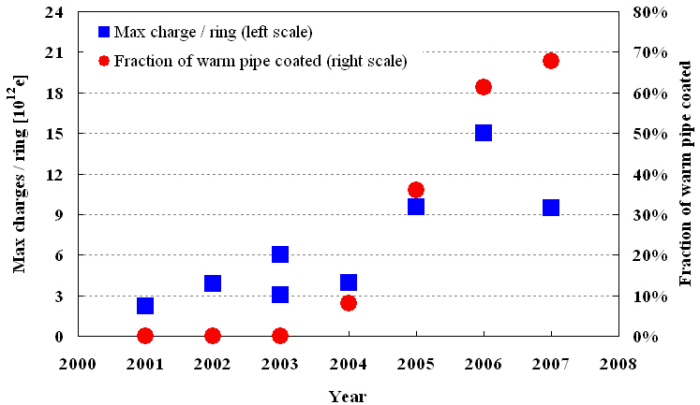
Mitigation of e-cloud: NEG coating
Starting from 2005, most of the warm areas were NEG coated, which significantly contributed to the increase of total beam intensity
p⁺
Au⁷⁹⁺
d⁺
Cu²⁹⁺
p⁺
Au⁷⁹⁺
Au⁷⁹⁺
Au⁷⁹⁺
X. Gu, ECLOUD, 2018

Slide 33
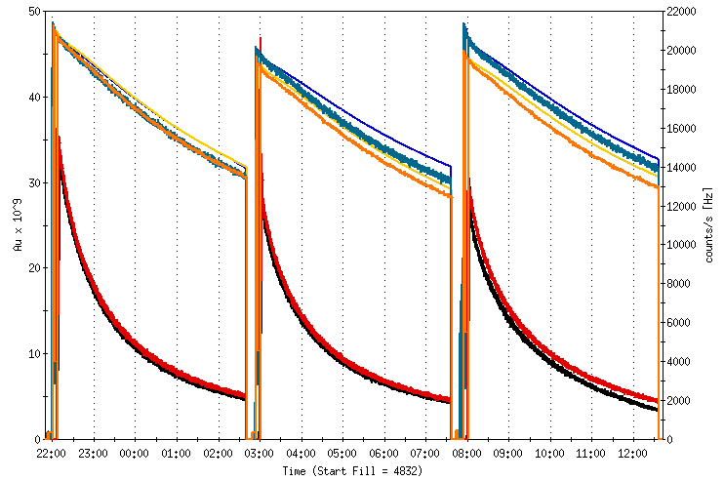
Performance limitation: IBS
Intra-beam scattering: IBS
Couloumb interaction between charged particles
Leads to debunching and transverse emittance growth, i.e. longer bunch length and larger transverse beam size
2004 no cooling
33

Slide 34
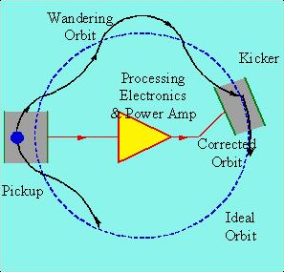
Stochastic Cooling: Mitigation of IBS
More details in Bunched Beam Stochastic Cooling, M. Steck, Nov. 6

Slide 35
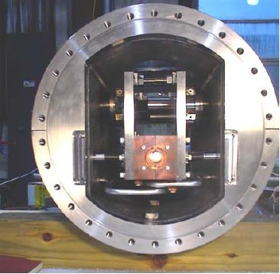
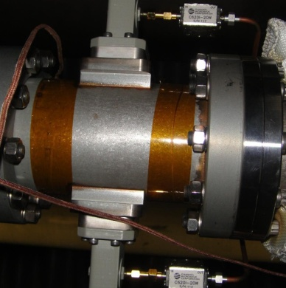
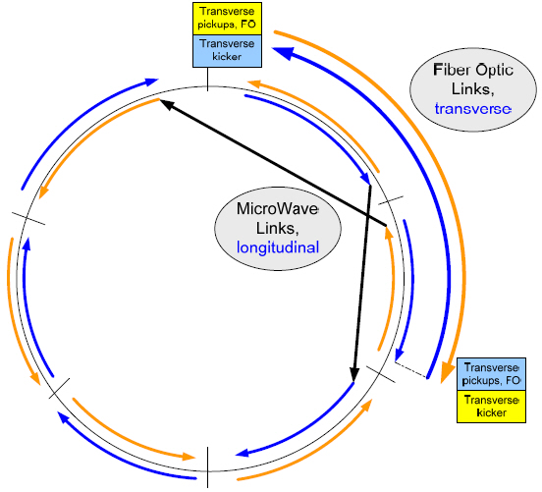
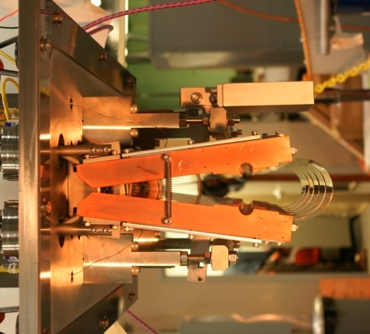
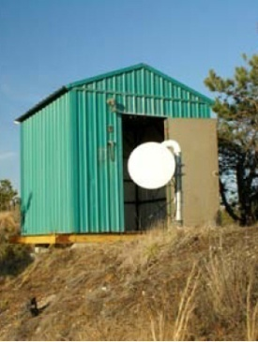
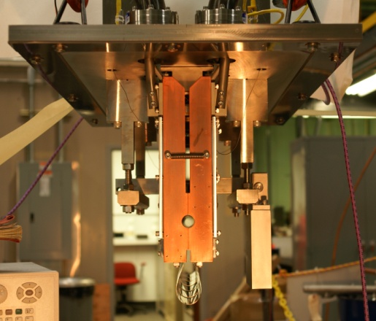
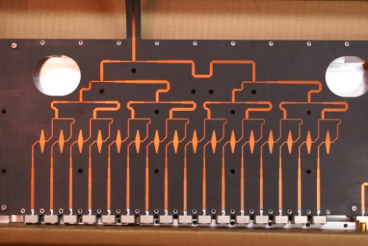
Full 3D Stochastic Cooling at RHIC
longitudinal pickup
longitudinal kicker (closed)
Y h+v pickups
B h+v kickers
horizontal kicker (open)
horizontal and vertical pickups
B h+v pickups
Y h+v kickers
vertical kicker (closed)
5-9 GHz, cooling times ~1 h

Slide 36
Status of Stochastic Cooling
Longitudinal stochastic cooling since 2007
Black: data
Magenta: simulation
First Stochatic Cooling of Bunched Beam!
M. Brennan, M. Blaskiewicz et al.

Slide 37
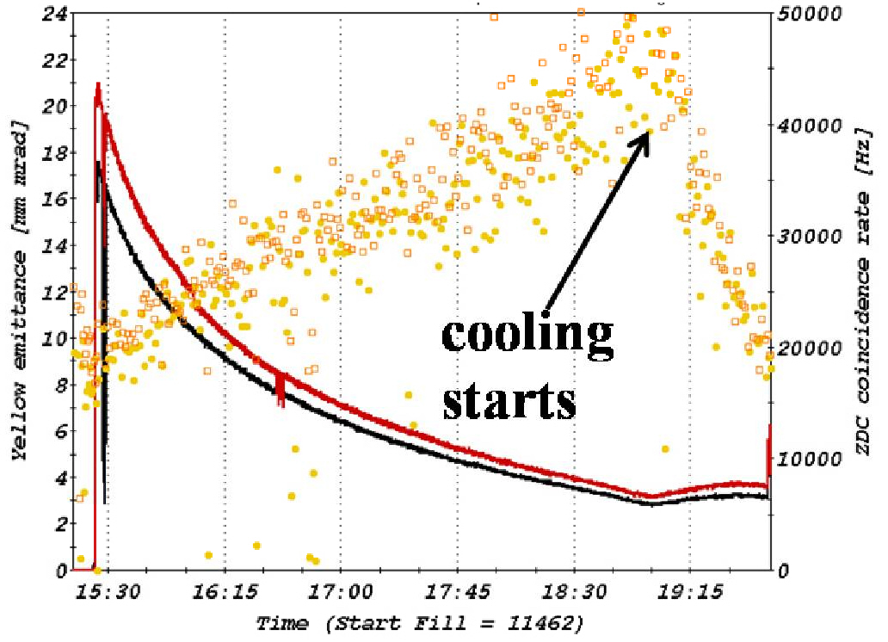
First Transverse(vertical) Stochastic Cooling!
14 Jan 2010
Beam size in vertical plane
So far stochastic cooling increased average store luminosity by factor 2
M. Brennan, M. Blaskiewicz et al.

Slide 38
56MHz SRF cavity: Mitigation of IBS
To obtain short bunch at store for collision, it is designed to accelerate the beam with 28MHz RF cavity and rebucket the beam with 197MHz at store
Nevertheless, the bunch length at store is ~10ns, while the bucket length of the197MHz cavity is only 5.1 sec
Rebucketing requires bunch rotation, which often results
Beam loss or mis-match
spills particles to the neighboring buckets
During store, longitudinal emittance growth due to IBS pushes particles to the neighboring buckets due to rather limited bucket size of 197MHz

Slide 39
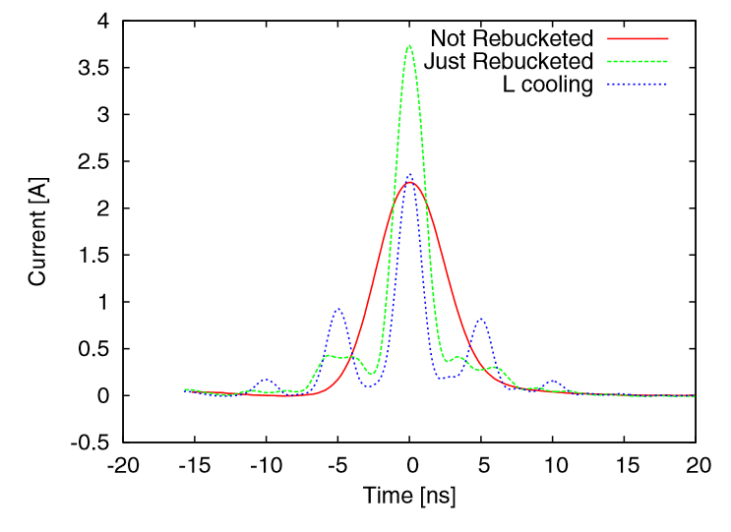
56MHz SRF cavity: Mitigation of IBS
Measured beam profile with 197MHz
Measured beam profile in 2011
Y. Luo et al, PRST AB 17, 081003, 2014

Slide 40
56MHz SRF cavity: Mitigation of IBS
Measured beam profile with 197MHz
6 hours into store
G. Robert-Demolaize, RHIC 2014 performance, RHIC retreat

Slide 41
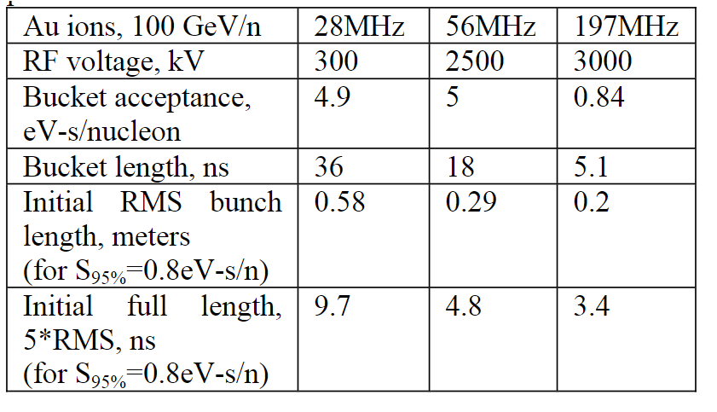
56MHz SRF cavity: Mitigation of IBS
A 56MHz SRF cavity to provide short bunch and avoid re-bucketing RF gymnatics
Cavity is designed to be a quarter-wave resonator, located at RHIC IP-4
A. V. Fedotov, I. Ben-Zvi, Proceedingsof PAC09,Vancouver,BC,Canada, 2009

Slide 42
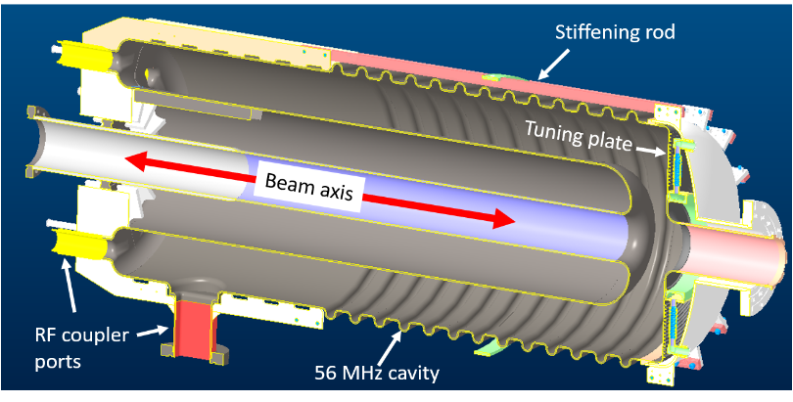
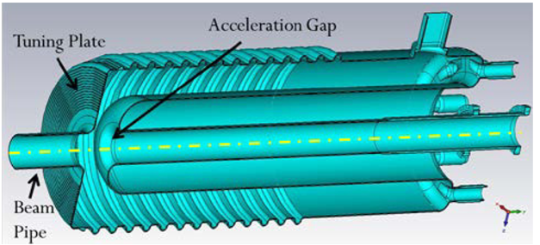
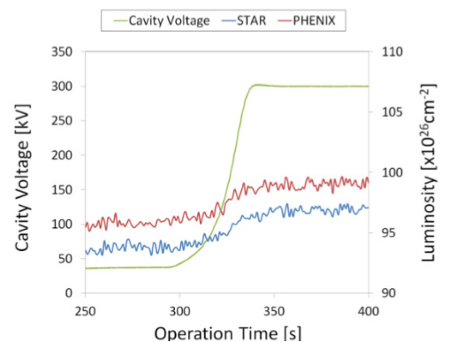
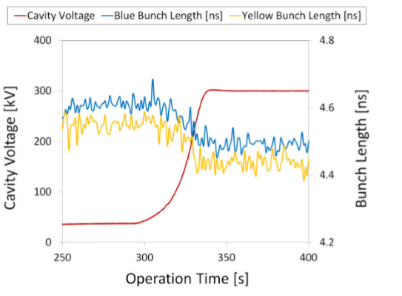
56MHz SRF cavity commissioning in 2014
Q. Wu, et al, Proceedings of SRF2015, Whistler, BC, Canada

Slide 43
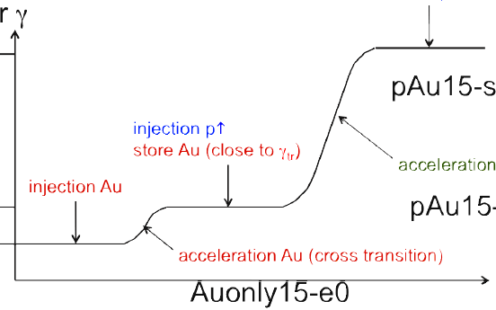
Asymmetric collision
RHIC started its asymmetric collision d-Au in 2003. Different from LHC, RHIC carries out asymmetric collision
The successful development of He3-Au in 2014 demonstrated the feasibility of local orbit path through D0. This set the path for the later-on p-Au operation with re-positioned D0 magnets
More to see lecture on Performance Highlights from the LHC, M. Schaumann, Nov. 5, afternoon
store
flattop porch
injection of d
store Au
ramp
Injection Au
Injection porch
mini- ramp Au just above $γ_{T}$

Slide 44
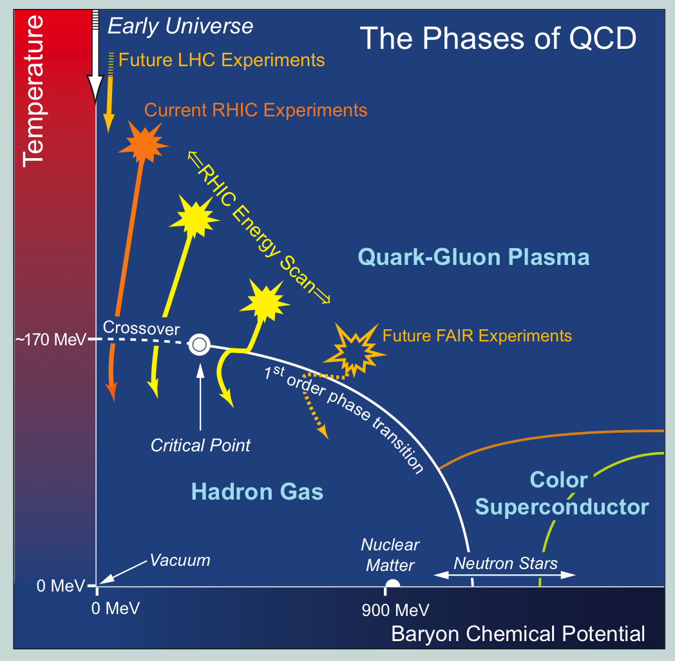
RHIC Low Energy Operation
Motivation: search critical point in QCD phase diagram
Energy scan extends below nominal injection energy
main challeng: magnetic errors at low fields

Slide 45
RHIC Low Energy Operation
Motivation: search critical point in QCD phase diagram
Energy scan extends below nominal injection energy
main challeng: magnetic errors at low fields
Desing RHIC injection

Slide 46
RHIC Low Energy Operation: √s=7.7GeV
short stores due to limited beam lifetime
luminosity is also limited by space charge effect as well as IBS
beam size blowup
2 minute turnaround
10 minute
store
Au Ions [e9]

Slide 47
E-cooling for Low Energy Operation
1st success cooling heavy ions with RF accelerator based electron bunches
A.V. Fedotov et al, FIRST ELECTRON COOLING OF HADRON BEAMS USING A BUNCHED ELECTRON BEAM, NAPAC 2019

Slide 48
E-cooling for Low Energy Operation
1st success cooling heavy ions with RF accelerator based electron bunches
A.V. Fedotov et al, FIRST ELECTRON COOLING OF HADRON BEAMS USING A BUNCHED ELECTRON BEAM, NAPAC 2019
Dmitry Kayran, et, al. Proceedings of NAPAC2019

Slide 49
Summary
As the first high energy heavy ion collider, RHIC delivered amazing physics
Re-recreated the conditions of the early universe
Early universe behaved like perfect liquid
Detected exotic anti matter and Jet quenching
The RHIC team has achieved an exceptional performance improvements with numerous techniques and upgrade measures
Peak luminosity exceeded design by a factor of 75!
NEG coating, e-cloud,
3-D Stochastic cooling
56 Mhz
variety of collisions also exceeded expectation, in particular the asymmetric collision options
EBIS, Improved the local orbit control and manipulation
Collision energy
Bunched electron cooling
Look forward to its next phase with electron beams for the electron ion collider!

