Slide 1

SIMULATIONS TOOLS:
INTERACTION WITH MATTER
Francesco Cerutti
Joint US-CERN-Japan-Russia
International Accelerator School
on Ion Colliders
Dubna October-November 2019

Slide 2
OUTLINE
interaction types and modeling
sources and effects
acknowledging the contribution of several CERN colleagues

Slide 3
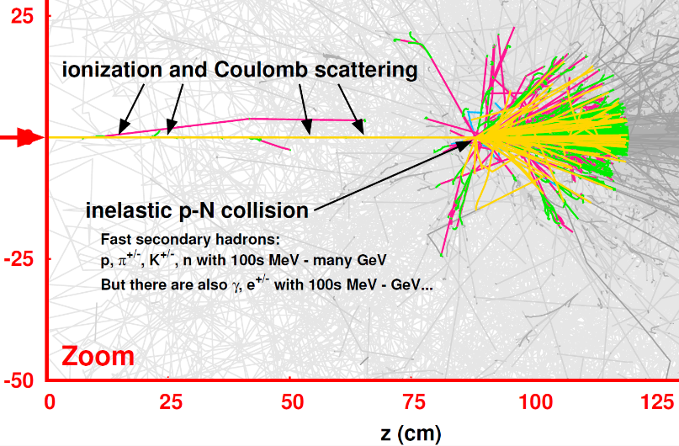
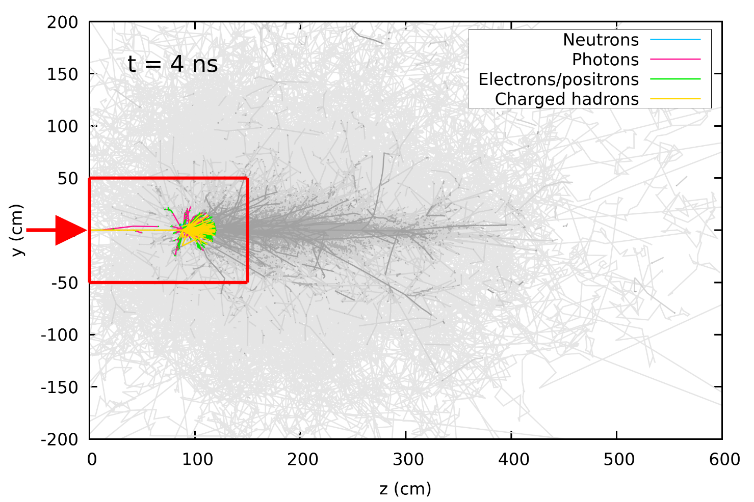
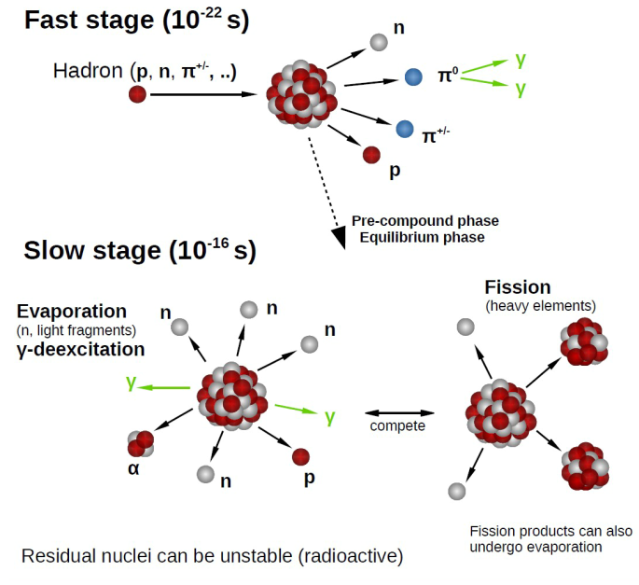
THE MICROSCOPIC VIEW [I]
one 450 GeV proton on aluminum
high energy nuclear reaction

Slide 4
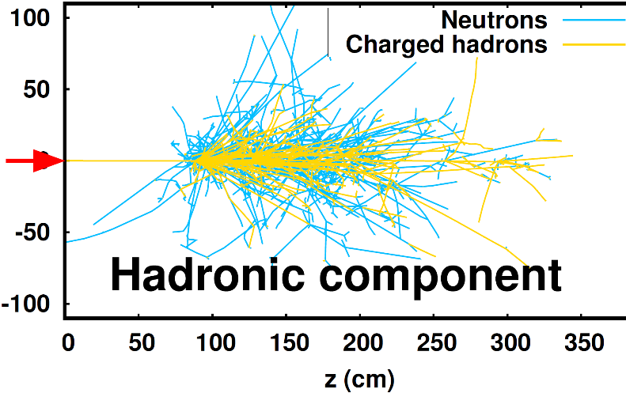
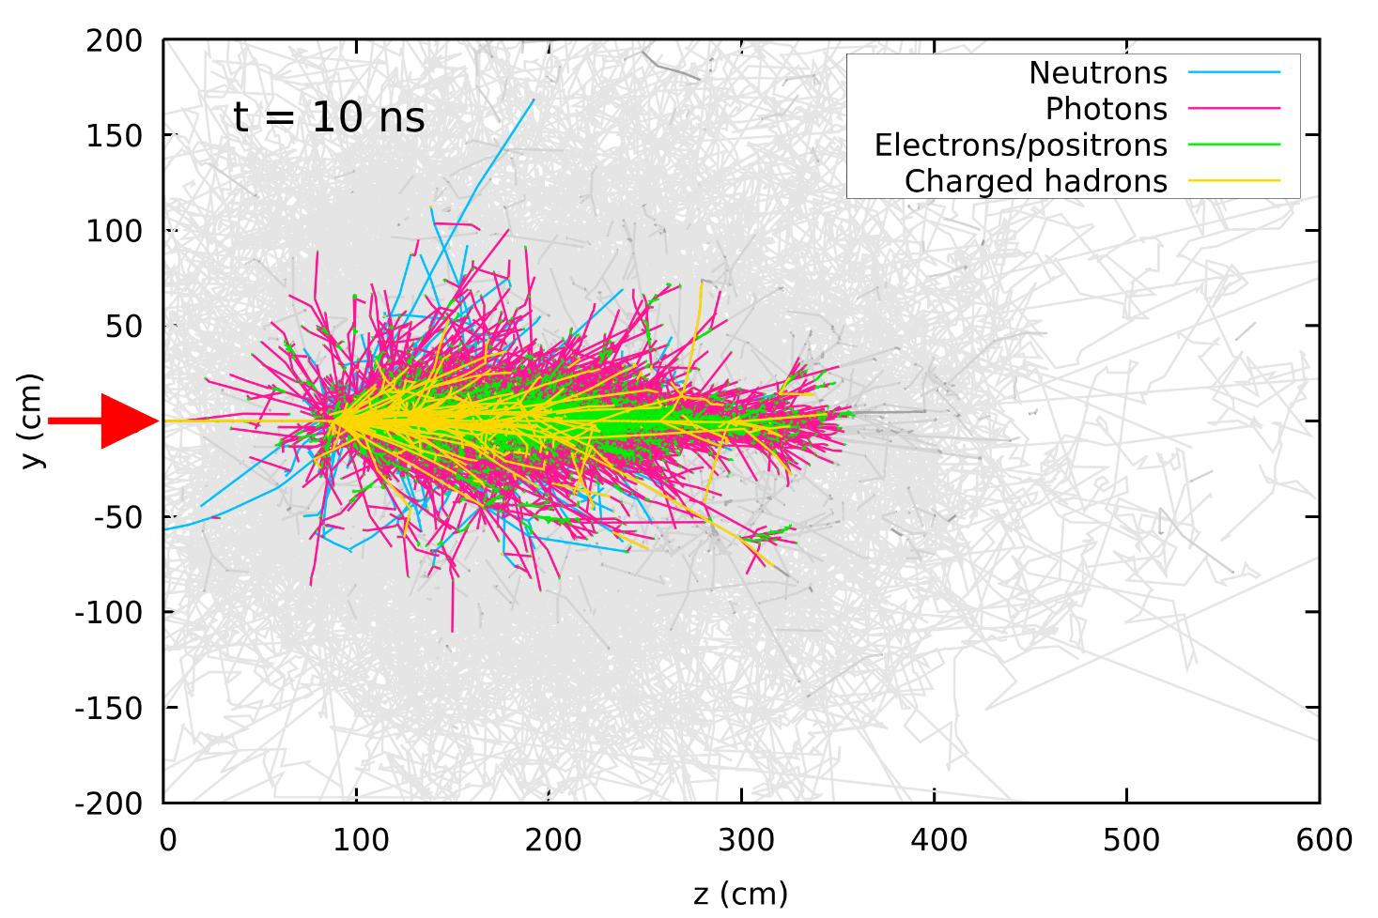
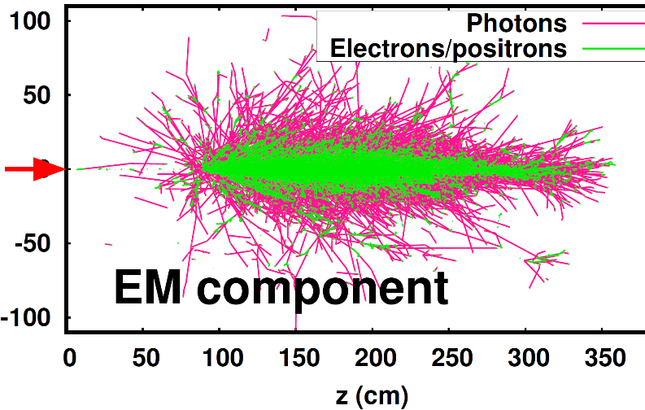
THE MICROSCOPIC VIEW [II]
one 450 GeV proton on aluminum
hadronic shower continues until particle energy falls below pion production threshold
non-negligible fraction of initial energy goes to mass by nuclear binding breaking

Slide 5
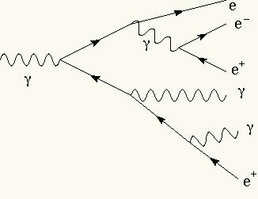
ELECTROMAGNETIC SHOWERS
development stops after t_{max} radiation lengths X₀ as energy per particle reaches the critical energy E_{c}
hence
shower depth increases logarithmically with initial energy E₀
90% of deposited energy within ~ 1 R_{M}

Slide 6
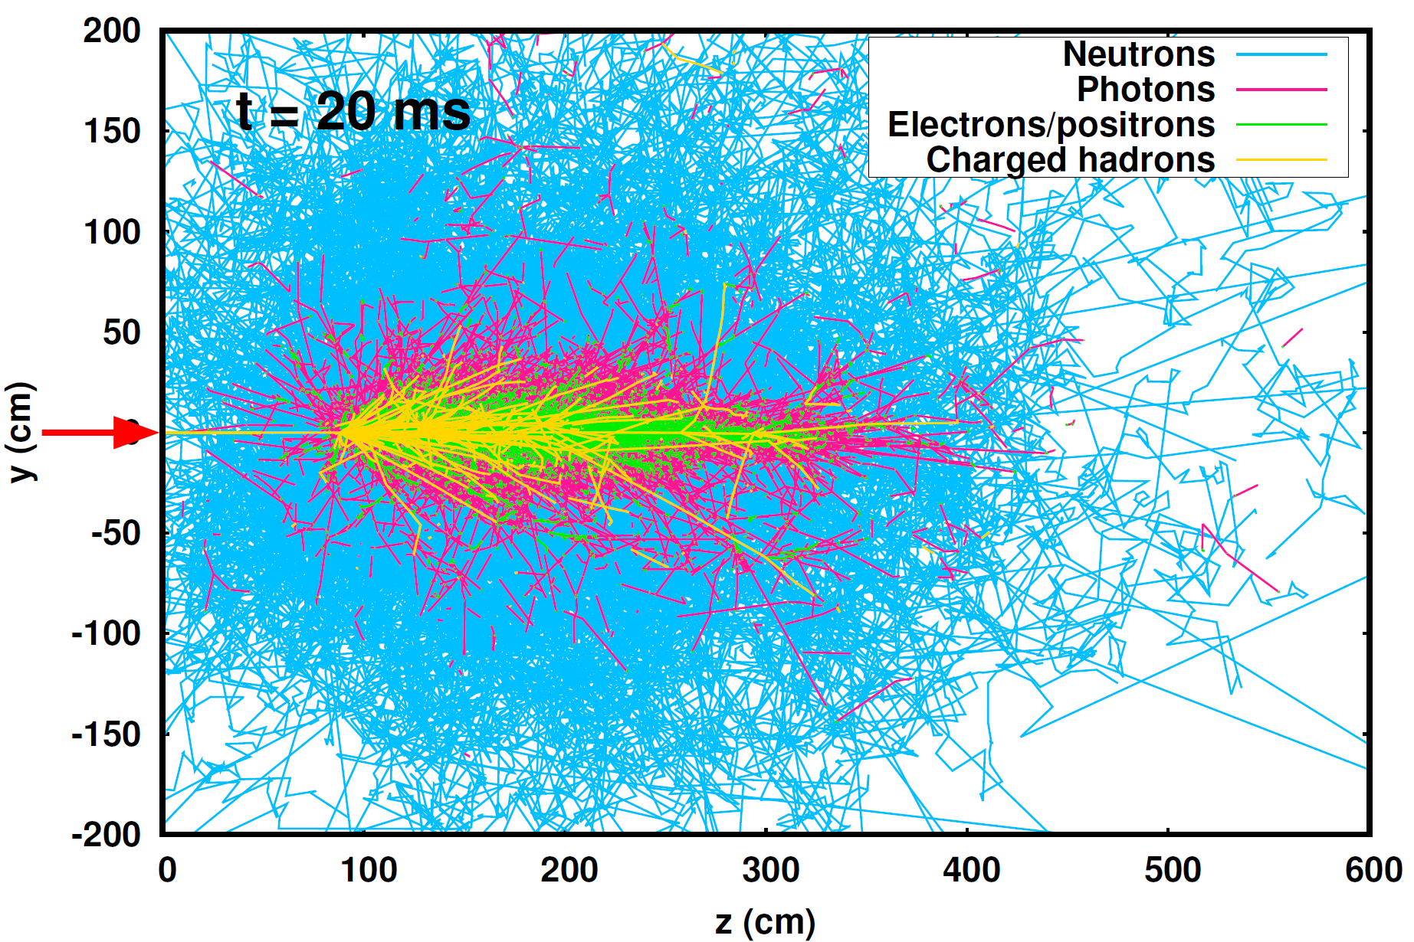
THE MICROSCOPIC VIEW [III]
one 450 GeV proton on aluminum

Slide 7
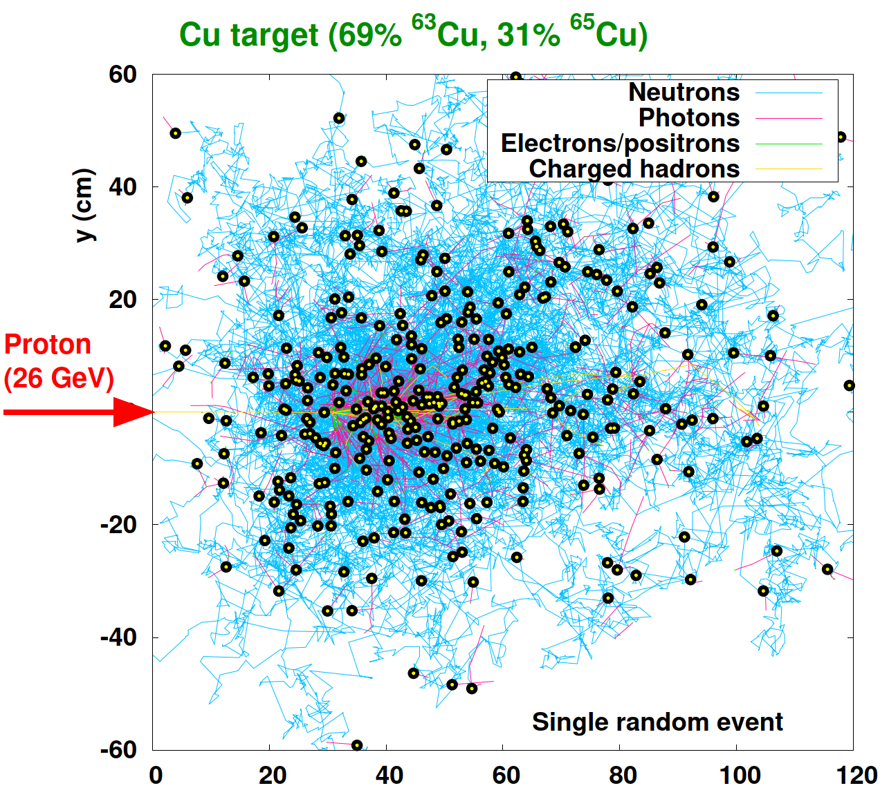
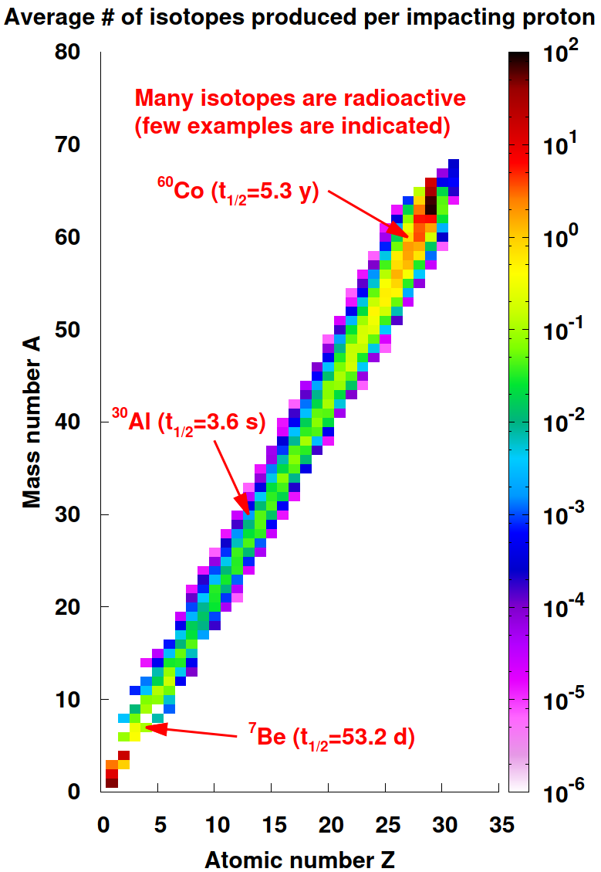
THE MICROSCOPIC VIEW [IV]
one 26 GeV proton on copper
THE MACROSCOPIC VIEW: ACTIVATION

Slide 8
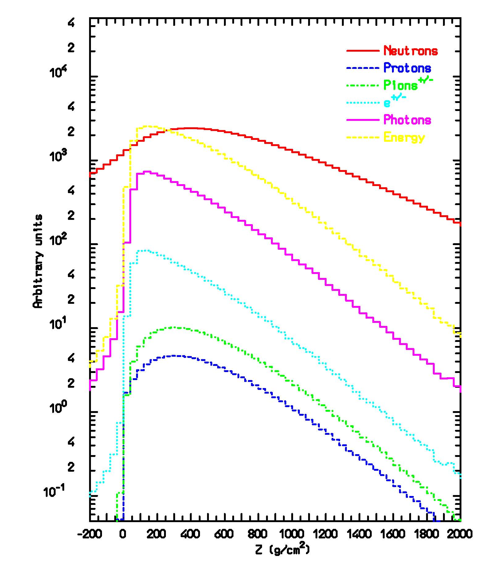
THE MACROSCOPIC VIEW OF
HIGH ENERGY SHOWERS
particle fluence and energy deposition profile
volume-averaged particle spectra
100 GeV protons on lead
100 GeV protons on iron

Slide 9
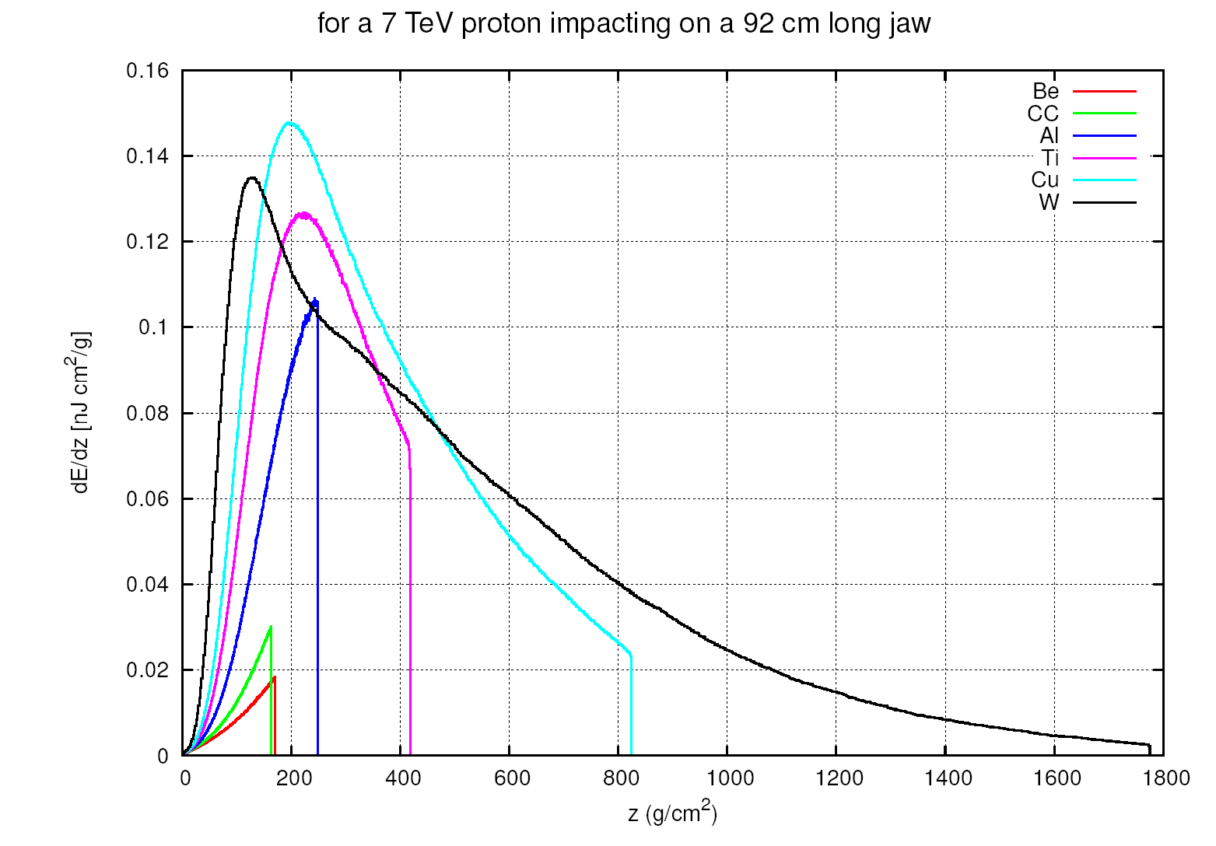
MATERIAL DEPENDENCE
for 7 TeV p
energy deposition transversally integrated
[different from peak density profile, which depends on beam size]
Fe 7.9 26 1.76 15.1

Slide 10
NUCLEAR REACTIONS
In general there are two kinds of nuclear reactions:
Elastic interactions are those that do not change the internal structure of the projectile/target and do not produce new particles. Their effect is to transfer part of the projectile energy to the target (lab system), or equivalently to deflect in opposite directions target and projectile in the Centre-of-Mass system with no change in their energy. There is no threshold for elastic interactions.
Non-elastic reactions are those where new particles are produced and/or the internal structure of the projectile/target is changed (e.g. the nucleus is excited). A specific non-elastic reaction has usually an energy threshold below which it cannot occur (the exception being neutron capture).

Slide 11
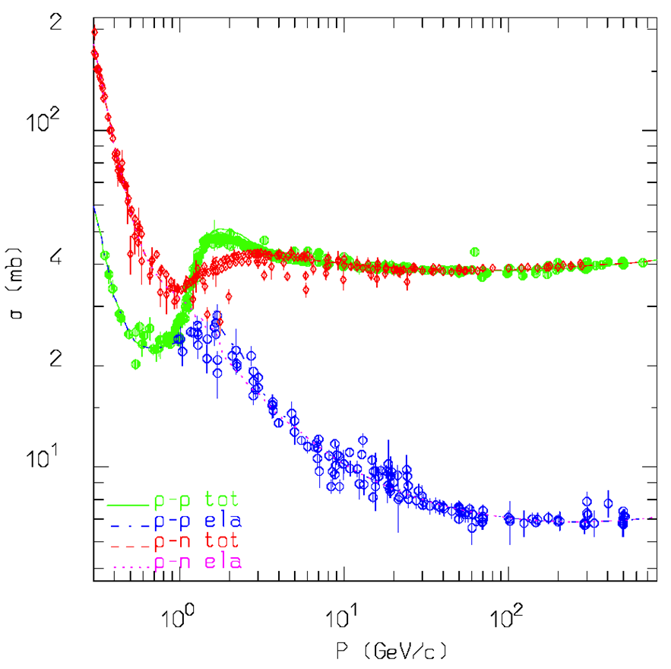
NON-ELASTIC HADRON-NUCLEON REACTIONS
In order to understand Hadron-Nucleus (hA) nuclear reactions, one has to understand first Hadron-Nucleon (hN) reactions, since nuclei are made up by protons and neutrons.
Intermediate Energies
All reactions proceed through an intermediate state containing at least one resonance (dominance of the Δ(1232) resonance and of the N* resonances)
N₁ + N₂ → N₁’ + N₂’ + π threshold around 290 MeV, important above 700 MeV
π + N → π’ + π” + N’ opens at 170 MeV
High Energies: Dual Parton Model/Quark Gluon String Model etc
Interacting strings (quarks held together by the gluon-gluon interaction into the form of a string). Each of the two hadrons splits into 2 colored partons → combination into 2 colorless chains → 2 back-to-back jets.
Each jet is then hadronized into physical hadrons.
momentum fraction

Slide 12
NON-ELASTIC HADRON-NUCLEUS REACTIONS [I]
Target nucleus description (density, Fermi motion, etc)
t (s)
10⁻²³
10⁻²²
10⁻²⁰
10⁻¹⁶
Glauber-Gribov cascade with formation zone
FLUKA PEANUT
Generalized IntraNuclear cascade
Preequilibrium stage
with current excitation energy and exciton configuration
(non-nucleons are emitted/decayed )
Evaporation/Fragmentation/Fission
γ de-excitation

Slide 13
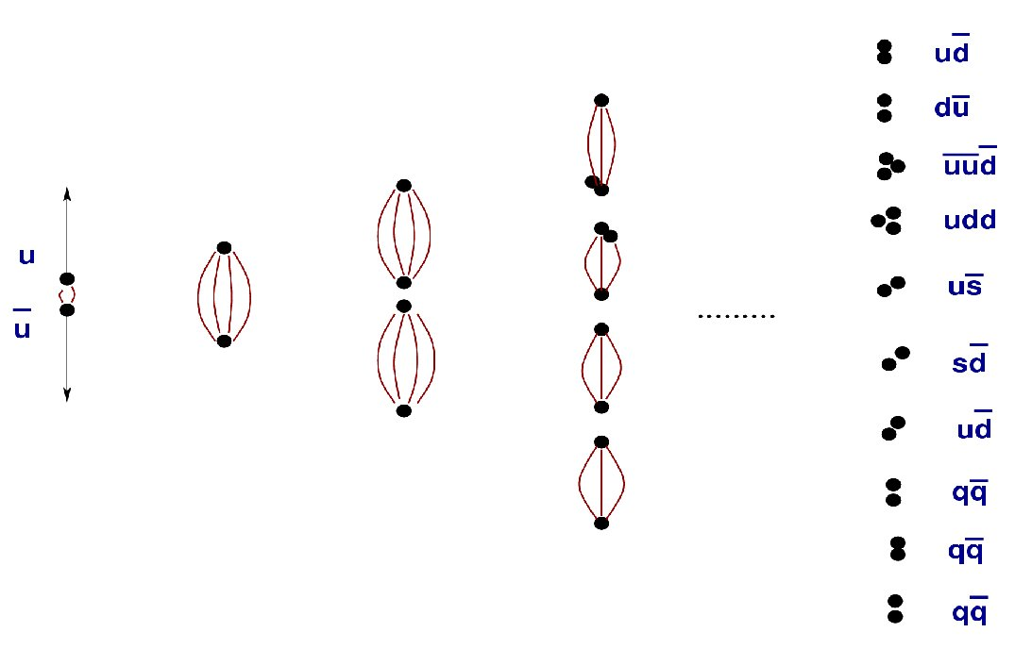
NON-ELASTIC HADRON-NUCLEUS REACTIONS [II]
i. two-chain diagram
ii. hadronization
q-q and qq-qq
pairs generation
iii. formation zone
Condition for possible re-interaction inside a nucleus:
reflecting the materialization time

Slide 14
A BENCHMARK GLIMPSE
PROTON ‒ C, PROTON
Pb ‒ PROTON
1 GeV/n ²⁰⁸Pb+p
Data
FLUKA
FLUKA after cascade
FLUKA after preeq
Inclusive fragment production
Points: exp. data (T. Enqvist, Nucl. Phys. A 686 (2001) 481)
Differential pion and kaon production
Points: exp. data (C. Alt et al., EPJC49 (2007) 897
and T. Anticic et al. (NA49) EPJC68 (2010) 1)
Histogram: FLUKA

Slide 15
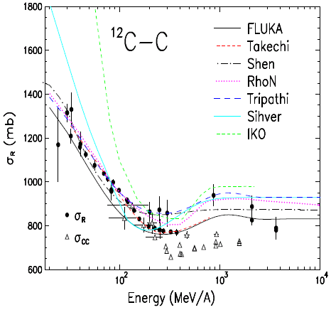
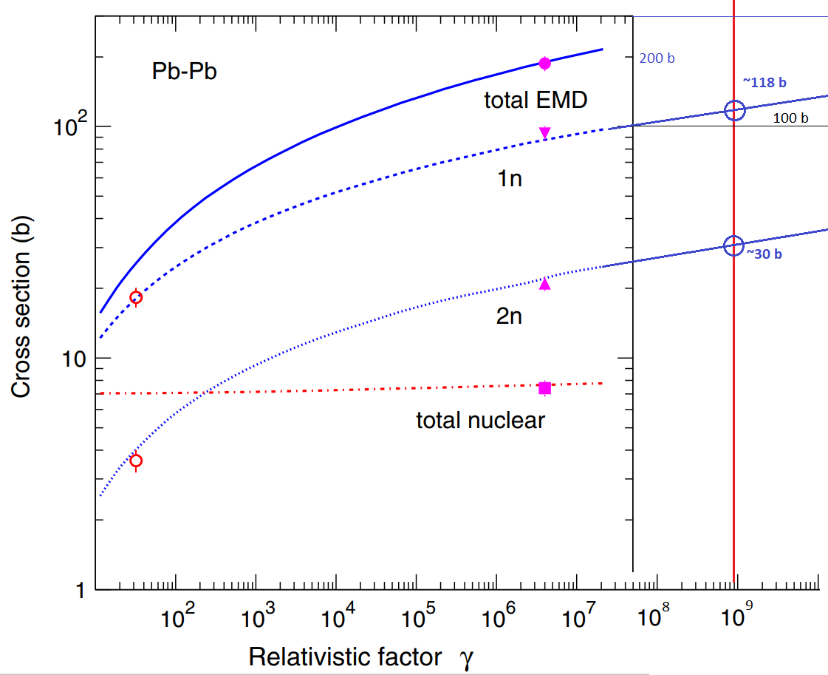
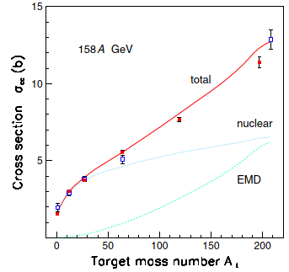
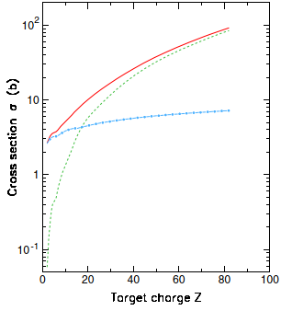
NON-ELASTIC NUCLEUS-NUCLEUS REACTIONS
nuclear reaction cross section
+ ElectroMagnetic Dissociation
by virtual photon absorption γ + A → A’ + X
[L. Sihver et al, Advances in Space Research 49 (2012) 812]
√s_{NN} = 39.4 TeV (FCC)
√s_{NN} = 2.76 TeV (LHC 2011)
²⁰⁸Pb
EMD
[H.H. Braun et al, Phys. Rev. ST AB 17 (2014) 021006]
nuclear
charge changing cross section
7 Z TeV ²⁰⁸Pb
[H.H. Braun et al, Phys. Rev. ST AB 17 (2014) 021006]

Slide 16
NUCLEUS-NUCLEUS PRODUCTS
158 GeV/n ²⁰⁸Pb on C, Al, Cu, Sn, Au, Pb
Inclusive fragment production
Red squares and blue circles: exp. data
Blue histograms: FLUKA EMD; Yellow histograms: FLUKA EMD+hadronic
(Phys. Rev. ST AB 17 (2014) 021006)

Slide 17
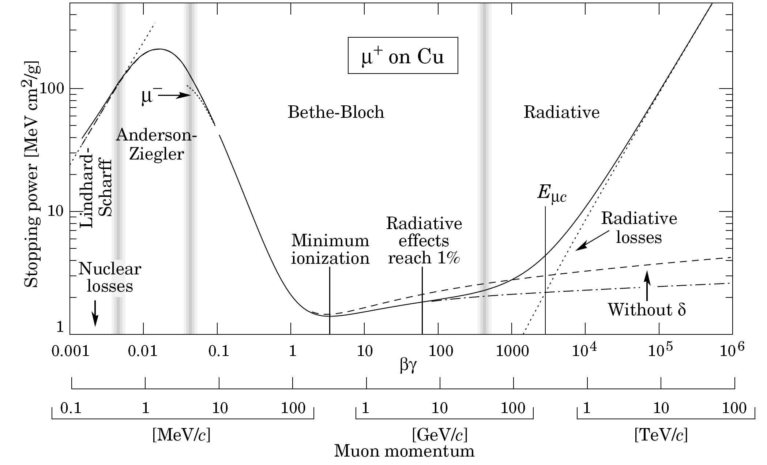
ENERGY LOSS
mean energy loss rate
C. Amsler et al.,
Phys. Lett. B667 (2008) 1
ionization
z²/β² dependence
bremsstrahlung
shell, Barkas, Mott corrections
20 MeV for e ⁻ on Cu
effective charge for low energy high z ions

Slide 18
NUCLEAR STOPPING POWER
¹⁰⁷Ag in Gold
¹⁶O in Silicon
total kinetic
partition function S_{n}/(S_{n}+S_{e}) decreases with energy and increases with charge

Slide 19
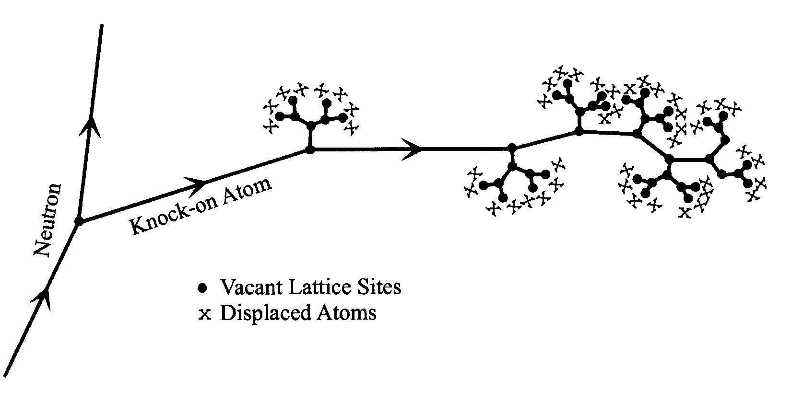
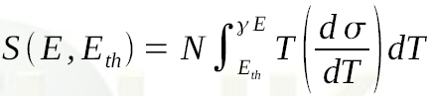
DISPLACEMENTS PER ATOM
It is a “measure” of the amount of radiation damage in inorganic materials
0.3 dpa means that on average 3 atoms out of 10 have been displaced once from their site within the structural lattice
Displacement damage can be induced by all particles
produced in the hadronic cascade, including high energy photons
(through photonuclear reactions).
It is directly related to energy transfers to atomic nuclei
i.e. (restricted) Non Ionizing Energy Losses
E particle energy E_{th} displacement threshold N atom density T energy transfer
As a result of the nuclear stopping power behavior,
NIEL and DPA are dominated by low energy heavy recoils

Slide 20
EFFECTS
Heating energy deposition (integral power)
Thermal shock energy deposition (power density)
Quenching energy deposition (power density)
Deterioration energy deposition (dose), particle fluence, DPA
Oxidation, radiolysis, ozone production energy deposition
Gas production residual nuclei production
Single event effects in electronic devices high energy hadron fluence [+ neutron fluence, energy deposition (dose)]
Shielding requirements particle fluence (prompt dose equivalent)
Access limitations, radioactive waste, air activation residual dose rate and activity
Beam Loss Monitors (BLM) energy deposition
Radiation Monitors (RadMon) thermal neutron and high energy hadron fluence
Tumor cell destruction energy deposition (dose, biological dose)
relevant macroscopic quantity

Slide 21

GENERAL-PURPOSE PARTICLE TRANSPORT
MONTE CARLO CODES

Slide 22
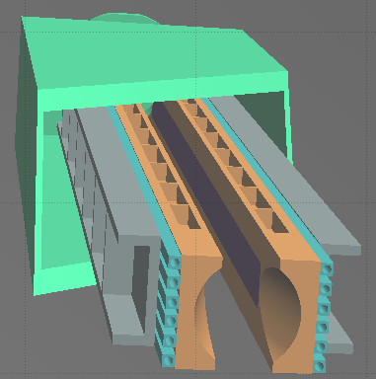
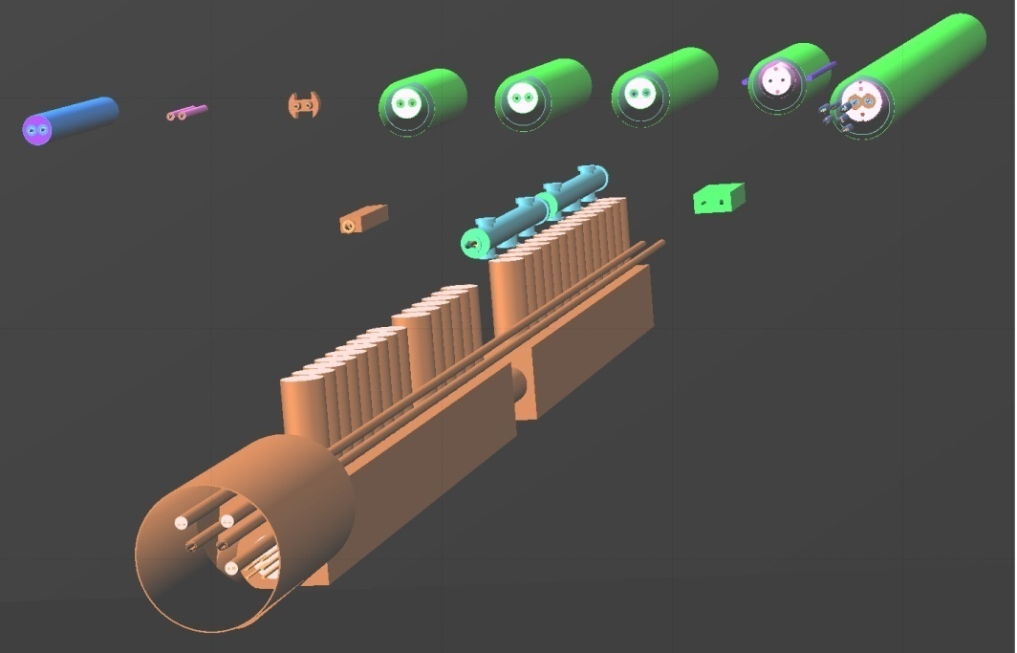
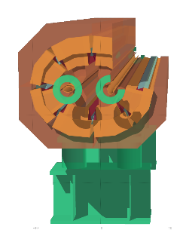
GEOMETRY MODELING
NEED FOR DETAILED MODELS OF ACCELERATOR COMPONENTS WITH ASSOCIATED SCORING
ELEMENT SEQUENCE AND RESPECTIVE MAGNETIC STRENGTHS
IN THE MACHINE OPTICS (TWISS) FILES

Slide 23
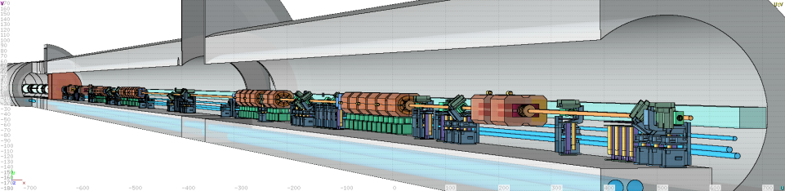
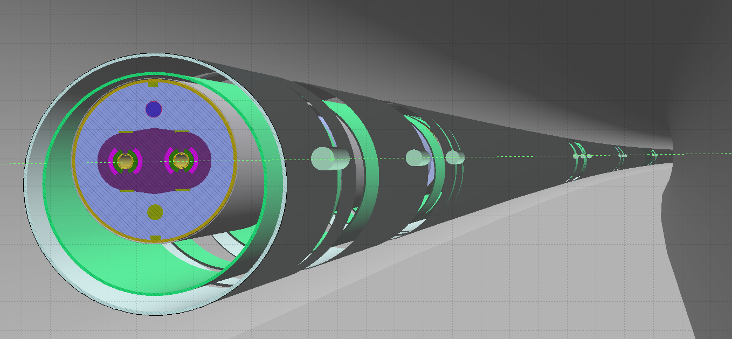
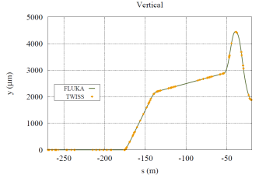
THE LINE BUILDER
Profiting from roto-translation directives and replication (lattice) capabilities,
the AUTOMATIC CONSTRUCTION OF COMPLEX BEAM LINES,
including collimator settings and element displacement (BLMs), is achievable
Beam orbit
[A. Mereghetti et al., IPAC2012, WEPPD071, 2687]

Slide 24
BEAM LOSSES
on beam intercepting devices (targets, collimators*, dumps, stoppers, stripping foils, … )
  regular
  accidental: smearing failures, injection mis-steering, asynchronous beam dump, top-off
diffused
  synchrotron radiation, beam-gas interaction, gas bremsstrahlung
debris from regular collisions at the interaction points
on unexpected obstacles (UFO, ULO, … )
* see lecture of Roderik Bruce later this morning

Slide 25
BEAM−GAS INTERACTION
nuclear reaction between the circulating hadron and an atomic nucleus of a gas molecule
σ [m²] I [s⁻¹] n [m⁻³] collision rate [m⁻¹s⁻¹] 1/(σ [m²] c [m/s] n [m⁻³]) beam lifetime [s]
LHC (FCChh): 7 (50) TeV proton energy σ = 77 (89) mb 0.58 (0.5) A = 3.6 (3.1) 10¹⁸ s⁻¹ 10¹⁵ m⁻³ H₂ eq. density
2.8 10⁴ m⁻¹s⁻¹ ≥ 100 h
LHC (FCChh): 574 (4100) TeV ²⁰⁸Pb energy σ = 1.9 (2.0) b 6.12 (43) mA = 4.7 (33) 10¹⁴ s⁻¹ 10¹⁵ m⁻³ H₂ eq. density
89 (660) m⁻¹s⁻¹ ≤ 5 h

Slide 26
GOING THROUGH THE EFFECT LIST

Slide 27
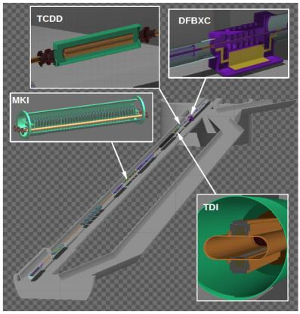
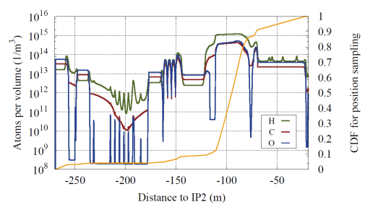
BACKGROUND: ALICE [I]
LHC IR2 Long Straight Section (Left)
Beam orbit
Residual Gas density
Fill 2736, Jun 16, 2012
[A. Lechner, G. Bregliozzi, E. Leogrande, A. Di Mauro
LHC Background Study Group Meeting, Jan 28th, 2013]

Slide 28
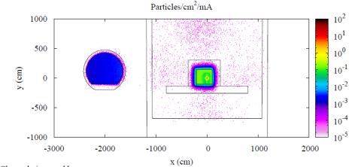
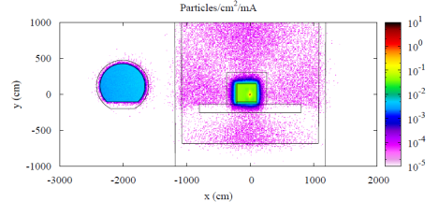
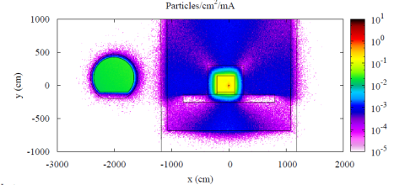
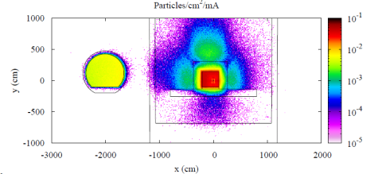
BACKGROUND: ALICE [II]
charged pions and kaons
protons
neutrons
muons
[R. Kwee
HL-LHC Annual Meeting 2013]

Slide 29
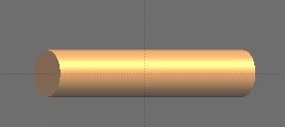
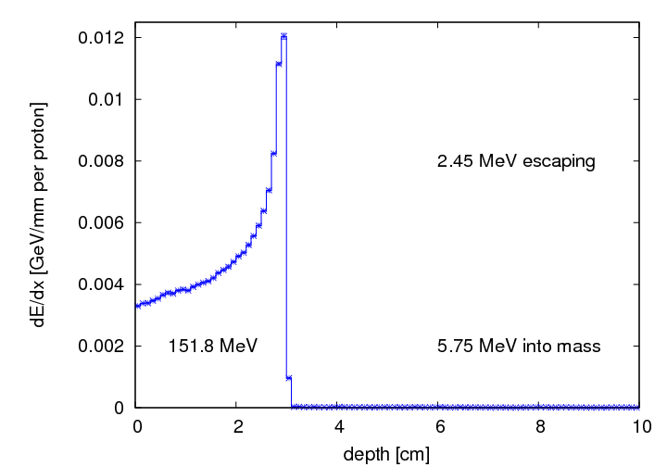
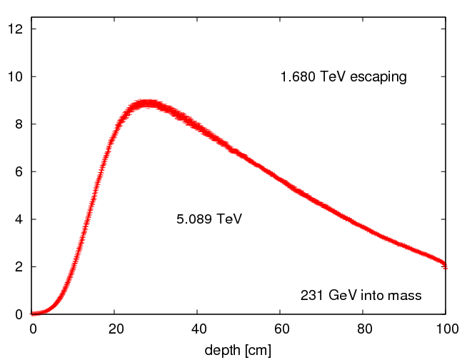
INTERACTION WITH ACCELERATOR MATERIAL:
the macroscopic view
LINAC4
and LHC
proton beam on a 1 m long and 10 cm radius copper rod
160 MeV
7 TeV
ionization
electromagnetic shower

Slide 30
3 MeV PROTON DUMP
Intensity: 65mA over 100μs
Beam size: 4.5mm σ_{x} = σ_{y}
tilting
orthogonal impact
beam
graphite
[C. Maglioni, V. Vlachoudis, EDMS 1182648]
85% gain!
z
y

Slide 31
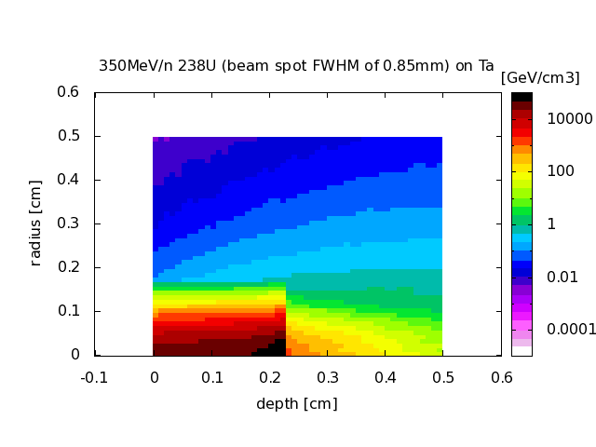
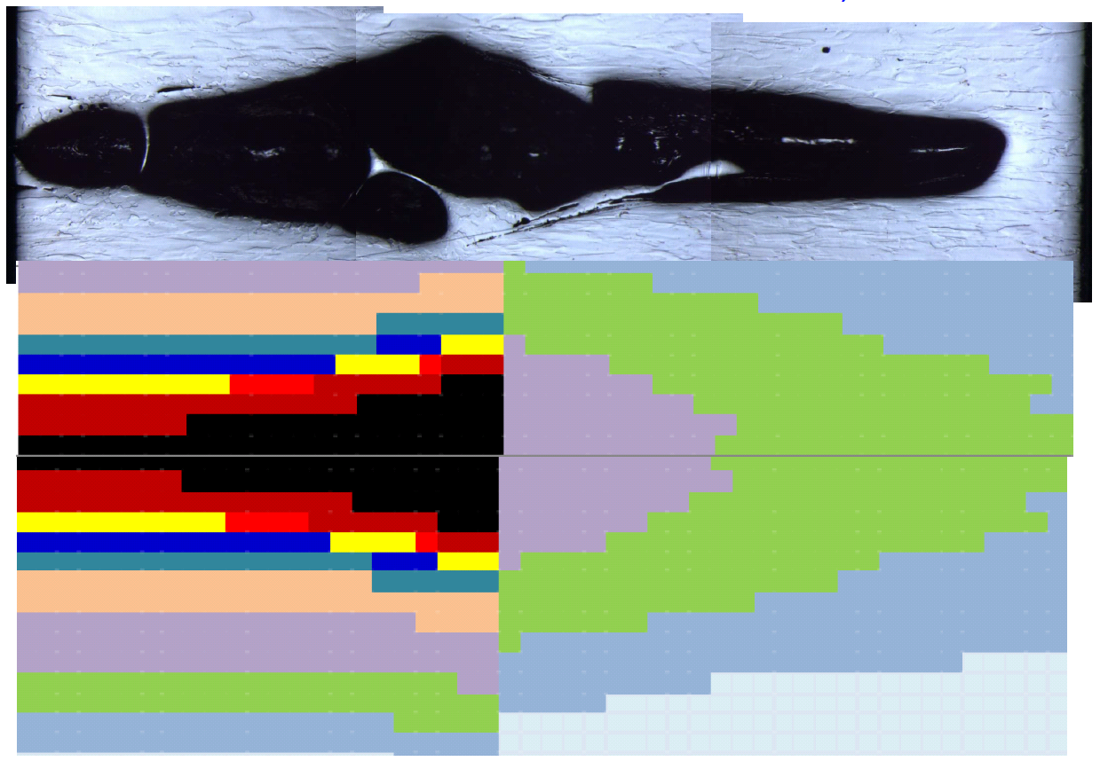
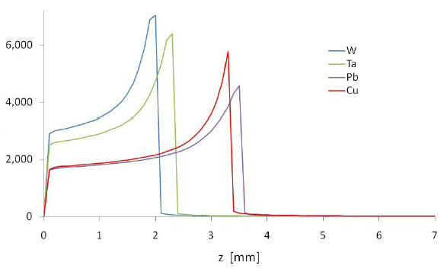
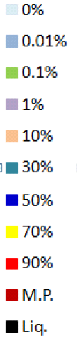
HIGH Z ION BEAMS
350 MeV/n ²³⁸U
Intensity: 2.4 10⁹ ions per pulse
Beam size: 0.85 mm FWHM
tantalum target
GSI S-334 experiment [courtesy of J. Lettry]
two pulses
per beam particle
dE/dz [10 MeV/mm]
one pulse
1 mm

Slide 32
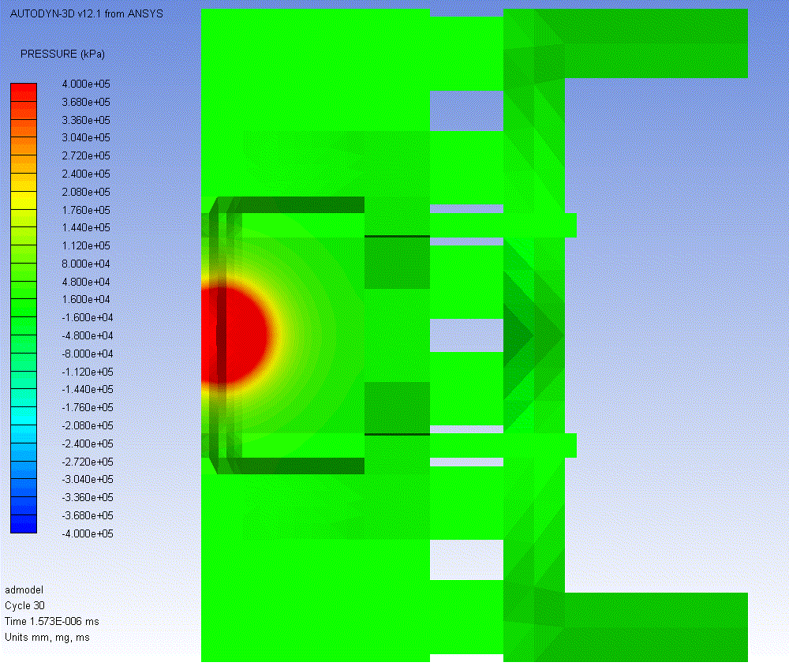
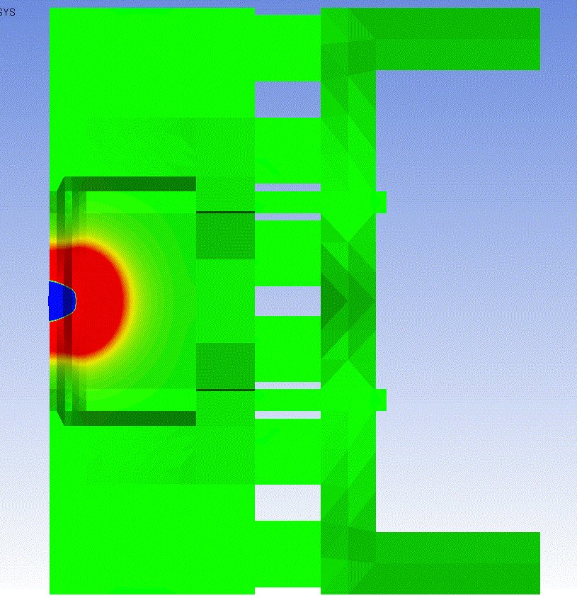
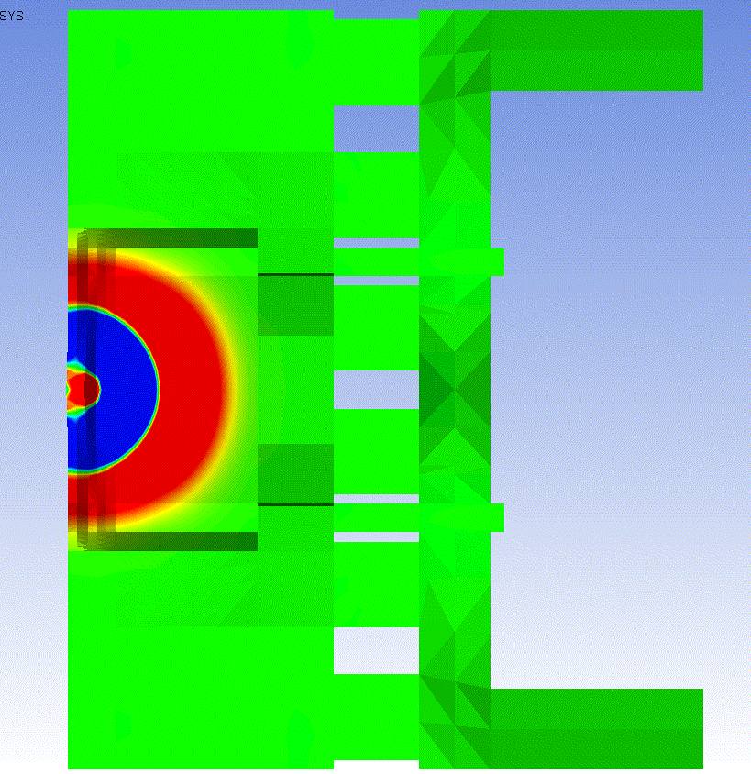
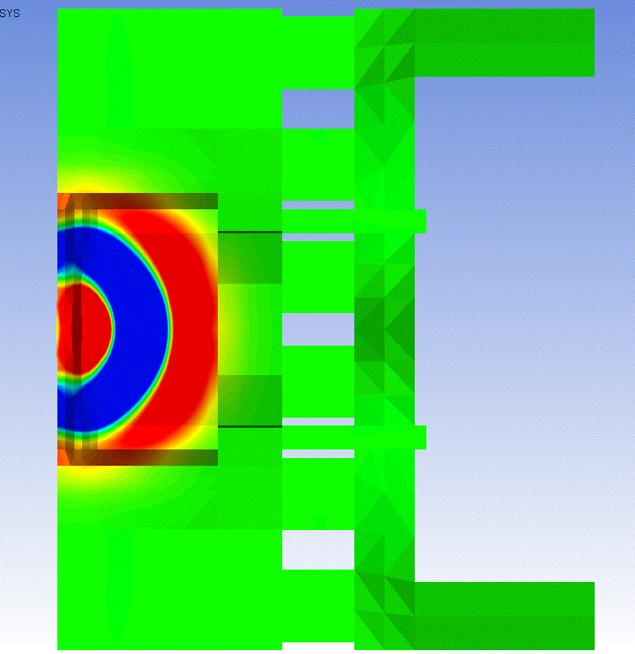
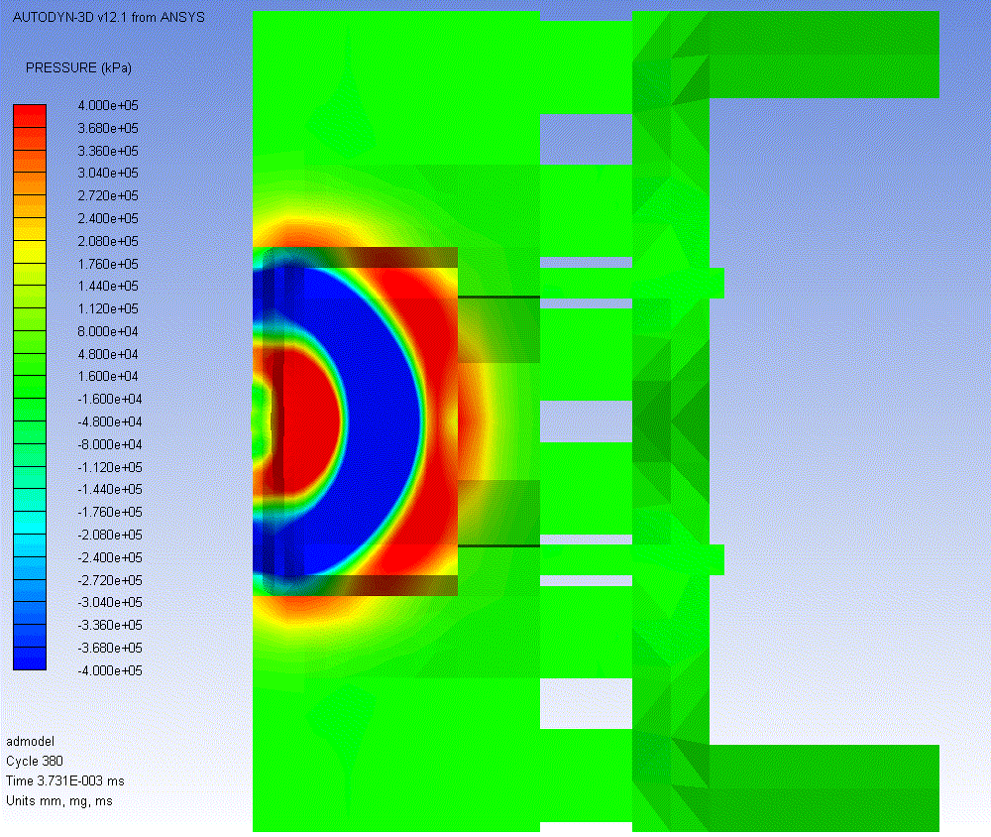
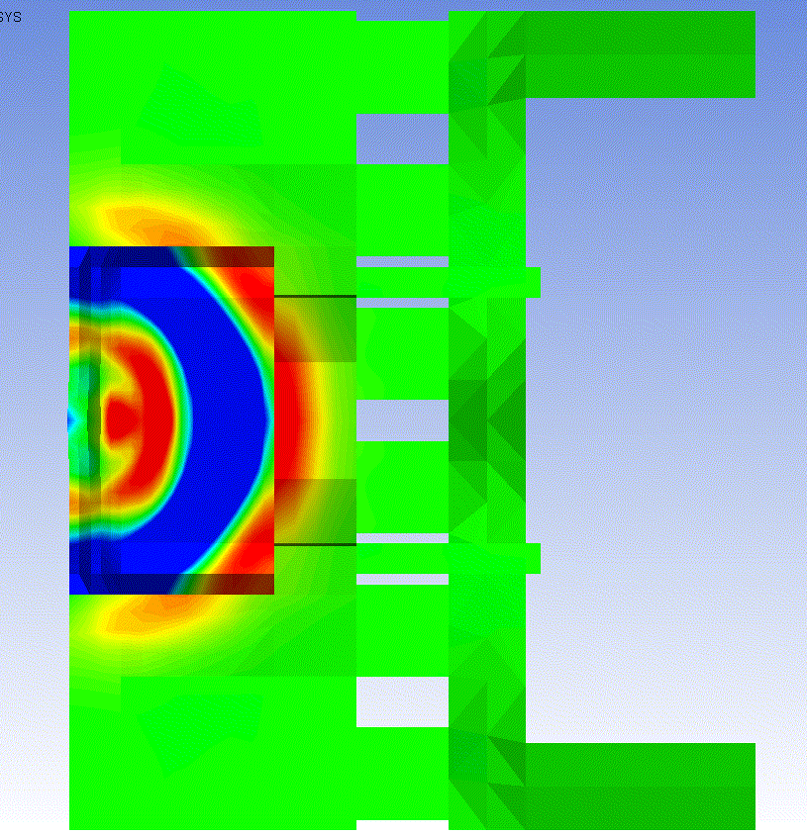
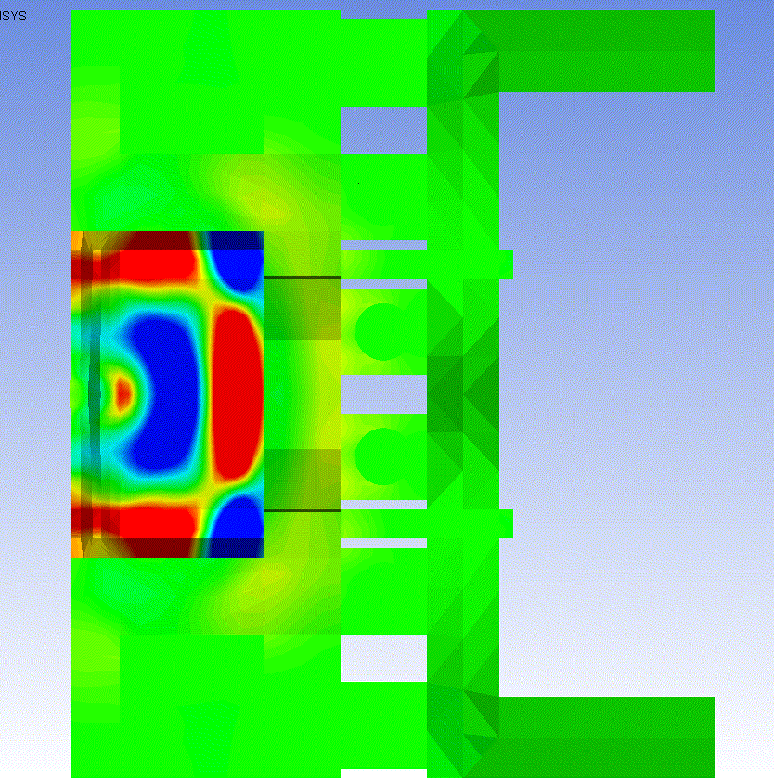
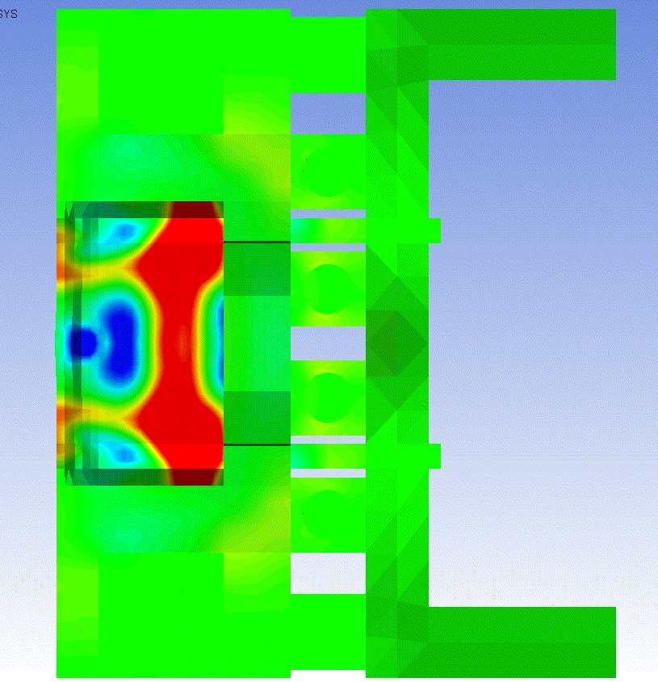
5 TeV PROTON BUNCH ON TERTIARY COLLIMATOR [I]
Intensity: 1.3 10¹¹ p
Beam size: 1.75 μm rad norm. emittance (0.3 mm σ_{x} and 0.19 mm σ_{y})
shock wave propagation
[courtesy of A. Bertarelli and his team]
t = 1 ns
t = 85 ns
t = 2.8 μs
t = 3.2 μs
P_{max}
2.2 GPa
P_{max}
30 GPa
Compression Wave (red)
+ Rarefaction Wave (blue)
Compression Wave
reaches W-Cu interface
t = 3.7 μs
t = 4.2 μs
t = 5.6 μs
t = 6.6 μs
P_{max}
160 MPa
P_{max}
500 MPa
Compression Wave
reaches Cu-Ni Pipes
Compression Wave bouncing back in W jaw

Slide 33
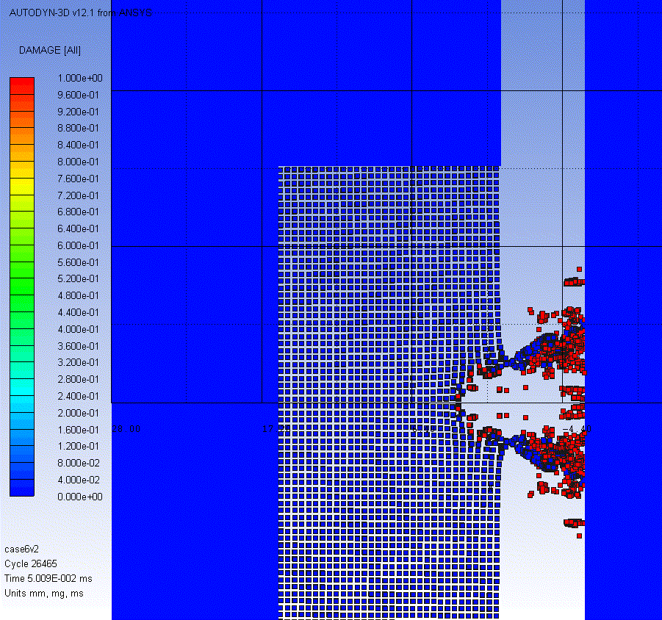
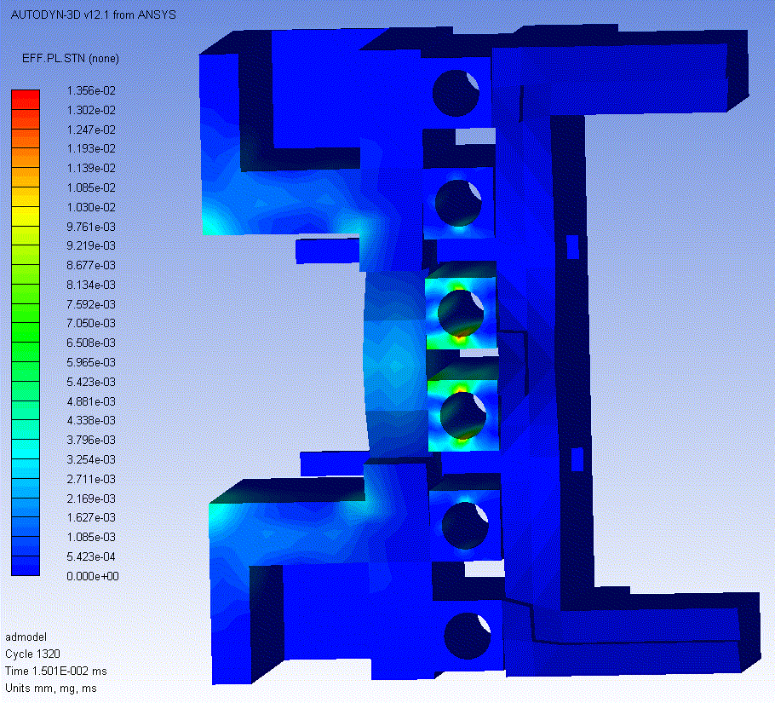
5 TeV PROTON BUNCH ON TERTIARY COLLIMATOR [II]
Intensity: 1.3 10¹¹ p
Beam size: 1.75 μm rad norm. emittance
(0.3 mm σ_{x} and 0.19 mm σ_{y})
[courtesy of A. Bertarelli and his team]
Plastic Strain
Max 1.4%
(on Water Pipes)
~8 mm
Particle spray on the opposite jaw Sticking droplets?

Slide 34
HYDROGEN AND HELIUM GAS PRODUCTION
Spallation reactions induced by protons, neutrons, pions, … produce a variety of particles including protons (¹H), deuterons (²H) , tritons (³H), ³He, and alphas (⁴He). The least energetic of these products (which are also the most abundant) can stop in the target assembly giving rise to a hydrogen and helium buildup.
These gases can lead to grain boundary embrittlement and accelerated swelling.
In the case of the CNGS target, for 1.4 10²⁰ protons on target one expects about 4 10²¹ H atoms.
Assuming that all H atoms are desorbed from the target solid structures, this corresponds to ∼150 ml of atomic H at atmospheric pressure (75 ml if we assume they combined into molecules).

Slide 35



REDOX
Ionising radiation creates radicals chemically active
Ball bearings exposed
to hadronic showers in air
energy deposition
PVC dehydrochlorination by X and γ-rays
Cl⁻ ions react with water droplets and create a very corrosive environment

Slide 36
OZONE PRODUCTION
conversion factor
deposited power
[NCRP Report 51, LEP Note 379]
under the assumption of no O₃ decomposition
(yielding in the τ expression a neglected term kP_{eV}/V with k decomposition constant
equal to 1.4 10⁻¹⁶ cm³/eV)

Slide 37
ELECTRONICS FAILURES [I]
CNGS 2007 physics run, 8 10¹⁷ protons on target delivered ( ≈2% of a nominal CNGS year )
Gy per 4.5 10¹⁹ p.o.t.
Predicted dose levels
[in agreement with measurements]
Electronics
Ventilation Units
CV,crane,
fire controls
[L. Sarchiapone, A. Ferrari]
Single event upsets in ventilation electronics caused ventilation control failure and interruption of communication

Slide 38

ELECTRONICS FAILURES [II]
collimator controls

Slide 39
MAIN RADIATION EFFECTS ON ELECTRONICS
 |  |  | relevant physical quantity the effect is scaling with
Single Event effects (Random in time) | Single Event Upset (SEU) | Memory bit flip (soft error) Temporary functional failure | High energy hadron fluence [cm⁻²] (but also thermal neutrons!)
 | Single Event Latchup (SEL) | Abnormal high current state Permanent/destructive if not protected | High energy hadron fluence [cm⁻²]
Cumulative effects (Long term) | Total Ionizing Dose (TID) | Charge build-up in oxide Threshold shift & increased leakage current Ultimately destructive | Ionizing dose [Gy]
 | Displacement damage | Atomic displacements Degradation over time Ultimately destructive | Silicon 1 MeV-equivalent neutron fluence [cm⁻²] {NIEL -> DPA}

Slide 40
HOW HIGH ENERGY HADRONS?
>20 MeV
plus
²⁸Si(n,xα) cross section
5 MeV

Slide 41


MITIGATION/PREVENTION STRATEGY
identify forbidden regions
relocate
design shielding
install radiation resistant equipment
2007
10⁷ ÷ 10⁹ heh/cm²
high energy hadron fluence
per nominal CNGS year
[L. Sarchiapone, A. Ferrari]
2008
< 10⁶ heh/cm²
CNGS radiation issues solved
during shutdown 2007-2008

Slide 42


FACILITY SHIELDING DESIGN
For radiation protection purposes, depending on the aspects to be considered,
particle fluence in a given location is transformed into effective dose or ambient dose equivalent (Sv)
through the use of respective sets of conversion coefficients, which are a function of particle type and energy.
Prompt dose equivalent outside a radiation facility, reflecting the relevant radiation level in a public space during normal or accidental operation of the facility, is the quantity to minimize below acceptable limits.
top view of the ISR tunnel on the side of the n_TOF EAR-2 vertical beam line
(for neutrons from 1.6 10¹² Hz 20 GeV/c protons on lead)
[I. Bergström, V. Vlachoudis, J. Vollaire]
0.5 μSv/h classification limit
with default* shielding
with improved† shielding
* 80 cm thick 2m high concrete block
† triple concrete volume + two iron plates

Slide 43

HADRON (NEUTRON) ATTENUATION
high energy
“disappearing” by non-elastic reactions
$$Σ∝ρ/A^{1/3}$$
through dense (and cheap) materials
iron
low energy neutrons
slowed down by elastic scattering
through hydrogen-rich materials
and once thermalized
absorbed by neutron capture (n,γ) or
borated polyethylene
tot
¹⁰B (n,α)
el

Slide 44




PHOTON ATTENUATION
Photoelectric dominated
Compton dominated
Pair dominated
Photoelectric dominated
Compton dominated
Pair dominated
$$Σ∝ρZ^{5}/A$$
$$Σ∝ρZ/A$$
$$Σ∝ρZ^{2}/A$$

Slide 45

DELAYED RADIATION FROM RADIOACTIVE DECAY
Bateman equations
$$\frac{dN_{n}}{dt}=P_{n}+{{(b}_{n−1,n}∙λ}_{n−1}∙N_{n−1})−λ_{n}∙N_{n}$$
production
rate
growth by parent decay
decay
which are solved for a given irradiation profile at different cooling times
…
I_{n}, (Δt)_{n}
I, Δt
0, Δt
1h
…
8h
1d
7d
etc.
yielding (specific) activities [Bq(/g)] – to be compared to legal exemption limits –
and residual dose rates [uSv/h] by the decay radiation (mainly electromagnetic)

Slide 46





ACTIVITY BENCHMARKING
500 MeV/n ²³⁸U beam on Cu
[E. Mustafin et al., EPAC 2006, TUPLS141, 1834]

Slide 47


RESIDUAL DOSE RATE EVOLUTION
A benchmarking experiment at CERF: Irradiation of samples of different materials in the stray particle field created by
the interaction of a 120 GeV positively charged hadron beam in a copper target
[M. Brugger et al.,
Radiat. Prot. Dosim. 116 (2005) 12-15]
current
instantaneous lumi
accumulated intensity
integrated lumi
t
short-lived isotopes (~ low Z)
long-lived isotopes (~ high Z)
t_{cool} < 2 hours :
¹¹C (β⁺, t_{1/2} = 20min)
2 hours < t_{cool} < 2 days :
²⁴Na (β⁻γ, t_{1/2} = 15h)

Slide 48




RESIDUAL DOSE RATE MAPS
HL-LHC final focus triplet around ATLAS and CMS 900fb⁻¹ between Long Shutdowns
@ 40 cm
SM
SM
[C. Adorisio and S. Roesler,
HL-LHC TC, Sep 30, 2014]

Slide 49
INTERVENTION PLAN
valve exchange in the TAS-Q1 region at 22m from the collision point
[work example by C. Garion]
4 months cooling time
[C. Adorisio and S. Roesler,
HL-LHC TC, Sep 30, 2014]
team | # person | action | distance from the beam pipe | duration (minutes)
T0 | 2 | Valve investigation | 400 mm | 60
A | 1 | Jacket and cabling removal | in contact | 30
B | 2 | Pneumatic system disconnection | 400 mm | 10
B | 2 | Flanges disconnection | in contact | 20
B | 2 | Valve removal | in contact | 30
B | 2 | Valve re-installation | in contact | 30
B | 2 | Flanges reconnection | in contact | 30
B | 2 | Pneumatic system reconnection | 400 mm | 10
A | 1 | Jacket and cabling installation | in contact | 45
dose per action (μSv) | individual dose (μSv)
290 | 145
103
48 | 427
138
206
206
206
48
155 | 258
Collective Dose 1.4 mSv
limit of 6 or 20 mSv/y depending on the worker category
with optimization threshold of 100 uSv/y and design criterion requiring not to surpass 2 mSv per intervention/year

Slide 50
OPTIMIZATION PRINCIPLES
Material choice
  Low activation properties to reduce residual doses and minimize radioactive waste
  Avoid materials for which no radioactive waste elimination pathway exists (e.g., highly flammable metallic activated waste)
  Radiation resistant
Optimized handling
  Easy access to components that need manual intervention (e.g., valves, electrical connectors) or complex manipulation (e.g., cables)
  Provisions for fast installation/maintenance/repair, in particular, around beam loss areas (e.g., plugin systems, quick-connect flanges, remote survey, remote bake-out)
  Foresee easy dismantling of components
Limitation of installed material
  Install only components that are absolutely necessary, in particular in beam loss areas
  Reduction of radioactive waste
[C. Adorisio and S. Roesler,
R2E and Availability Workshop, Oct 16, 2014]

Slide 51


AIR ACTIVATION
The activity of an air radioisotope (⁷Be, ¹¹C, ¹³N, ¹⁵O, ³⁸Cl, ³⁹Cl, etc.) in the irradiation area
at the end of the irradiation period T is
where $m_{on}$ is the relative air exchange rate during irradiation,
i.e. the fraction of the air volume renewed per unit time
and $A_{S}$ is the saturation activity
production cross section
irradiated air volume
differential fluence rate of (hadron) particles (P=p,n,π±)
air atom density (T=¹²C,¹⁴N,¹⁶O,⁴⁰Ar)
Amount of activity released into atmosphere all along the irradiation period
($t_{on}$ is the time taken by the air flux to reach the release point from the irradiated area)
Amount of activity released into atmosphere after the end of the irradiation
($m_{off}$ and $t_{off}$ as $m_{on}$ and $t_{on}$ but referring to the shutdown period)

