Slide 1


Recap of longitudinal beam dynamics.
RF gymnastics
Joint US-CERN-Japan-Russia School on Ion Colliders
28 October – 7 November 2019
Dubna, Russia
E. Shaposhnikova (CERN)
29 October 2019

Slide 2
Outline
Acceleration
Longitudinal beam dynamics
  Equations of motion
  Longitudinal phase space
RF gymnastics/manipulations
  CERN ion complex
  Bunch rotation, bunch shaping, controlled emittance blow-up, bunch splitting, momentum slip-stacking
Bibliography

Slide 3
Acceleration

Slide 4

Electromagnetic force
We characterize a particle by charge q = eZ and rest mass m₀
The Lorentz force acting on a particle with charge q
acceleration bending (steering)
+ focusing by
  quadrupole magnets in transverse planes
  the same electro-magnetic field in longitudinal plane
  * Exceptions exist, have you heard about an RFQ?

Slide 5
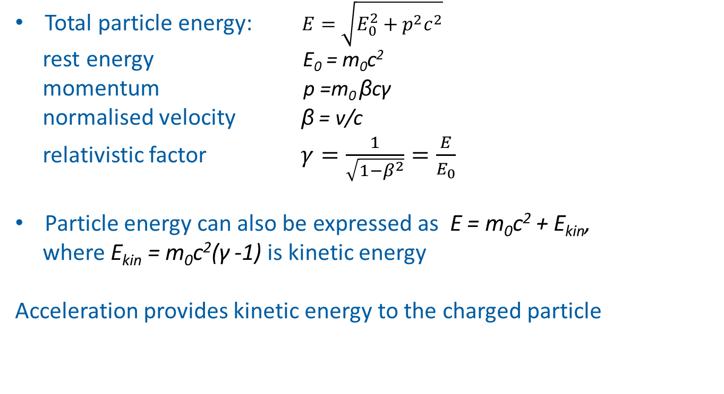
Relativistic kinematics.
Reminder
Total particle energy: $E=\sqrt{E_{0}^{2}+p^{2}c^{2}}$
rest energy E₀ = m₀c²
momentum p =m₀ βcγ
normalised velocity β = v/c
relativistic factor $γ=\frac{1}{\sqrt{1−β^{2}}}=\frac{E}{E_{0}}$
Particle energy can also be expressed as E = m₀c² + E_{kin},
where E_{kin} = m₀c²(γ -1) is kinetic energy
Acceleration provides kinetic energy to the charged particle

Slide 6
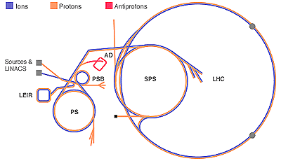

Acceleration
Energy gain of a particle from the electric field E_{z}
∆E = eZ$∫$E_{z} (r,z,t)dz = eZ V, V is a potential
→ Energy and particle mass are expressed in [eV]: it is the energy which electron or proton gains in a potential of 1 Volt. Particle momentum is measured in [eV/c]
Acceleration by DC devices is limited
to ~ 20 MeV (insulation, …)
→ Use varying/oscillating field!
Particle mass
electron m₀ = 0.511 MeV
proton m₀ = 938 MeV
ion m₀ = A m_{u}
m_{u} = 931 MeV for nucleon
(A - atomic number)
CERN proton accelerators (E_{kin})
Linac4 160 MeV (10⁶ eV)
PSB 2 GeV (10⁹ eV)
PS 25 GeV
SPS 450 GeV
LHC 6.5 TeV (10¹² eV)

Slide 7
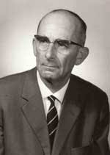
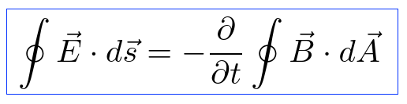
Acceleration: energy gain (1/2)
(1) Induction acceleration
This is the principle of betatron.
The first PhD project (R. Wideroe, 1927) for betatron
was rejected.
In 1928 achieved 50 keV acceleration of K⁺ ions with 25 kV
voltage at 1 MHz using alternating (rf) field.
The effect (called also “betatron voltage”) exists in other circular accelerators, but is small in comparison with external accelerating voltage
Rolf Wideroe (U. of Aachen)

Slide 8
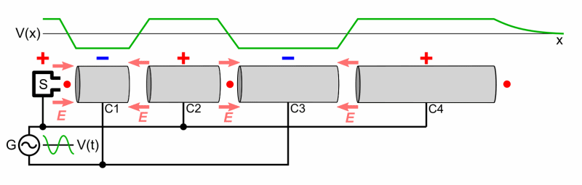
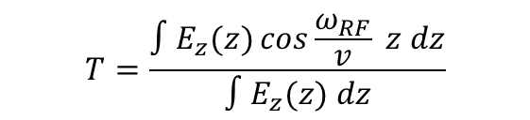
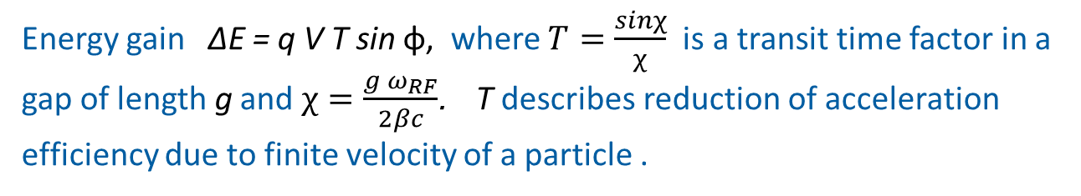
Acceleration: energy gain (2/2)
(2) Alternating electrical (rf) field E_{z} = E₀ sinω_{rf}t = E₀ sin φ(t)
Single beam passage → linear accelerator
Beam - RF field synchronism at low energy is achieved by varying the drift tube length
Multiple beam passages → circular accelerator!
  $$T=\frac{∫E_{z}(z)\cos{\frac{ω_{RF}}{v} z dz}}{∫E_{z}(z) dz}$$
Energy gain ∆E = q V T sin φ, where $T=\frac{sinχ}{χ}$ is a transit time factor in a gap of length g and $χ=\frac{{g ω}_{RF}}{2βc}$. T describes reduction of acceleration efficiency due to finite velocity of a particle .

Slide 9
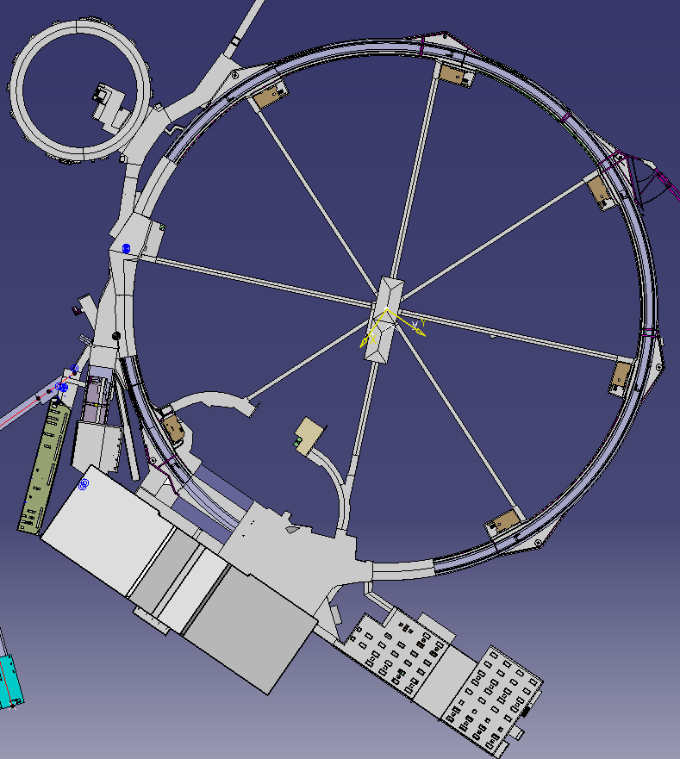

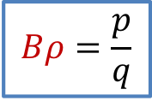
Circular accelerator
The bending magnetic field B compensates the centrifugal force F
Magnetic rigidity of a particle with momentum p = mv = m₀ cβγ is
$$F=\frac{mv^{2}}{ρ} =q v B$$
B - the total integrated dipole magnetic field
ρ - bending radius
$$Bρ=\frac{p}{q}$$
During acceleration (increase in momentum p)
one needs to change either
ρ → cyclotron or
B → synchrotron
There are other schemes: synchrocyclotron, microtron, …
CERN PS

Slide 10
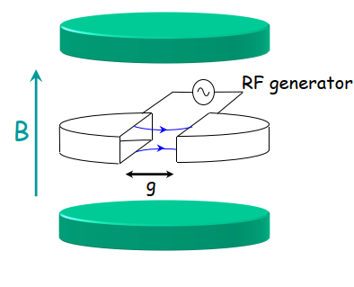
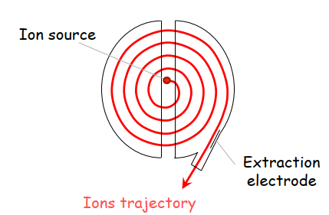
Cyclotron
Cyclotron:
Cyclotron frequency ω_{c} = β c/ρ = qB/(m₀ γ) decreases with energy
B and ω_{RF} are constant
→ Synchronism: ω_{c} = ω_{RF} works only for β <<1 (γ ~ 1)
Synchrocyclotron: ω_{RF} ~ 1/γ – decreases with energy (time)
Isochronous cyclotron: athimuthal varying B field
Limited to a few hundreds of MeV/u.

Slide 11
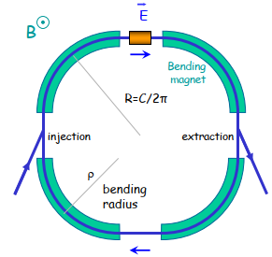



Synchrotron.
Synchronous particle
Constant orbit during acceleration → B and ω_{RF} increase synchronously.
Design momentum follows the magnetic field variation
Corresponding particle has revolution period
A particle synchronised with RF frequency ω_{RF} = h ω₀ is called synchronous particle, its energy gain per turn is
where φ_{s} is synchronous phase, h harmonic number.
The acceleration rate of synchronous particle
$\frac{ΔE}{T_{0}}= \frac{dE_{s}}{dt}=\frac{ω_{0}}{2π} q Vsinφ_{s}$
→ No acceleration, if φ_{s} = 0 or π.
p_{s} = q Bρ.
$$T_{0}=\frac{2πR}{β_{0}c}$$
(R – average machine radius)
and angular revolution frequency ω₀ = 2π f₀ = 2π/T₀
$$ΔE= qV sinφ_{s},$$
Longitudinal motion → synchrotron motion

Slide 12
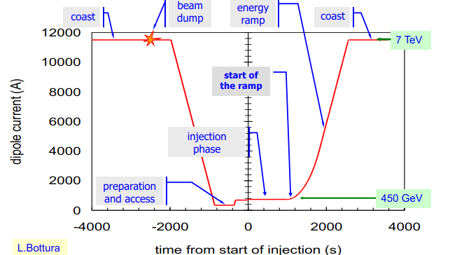
Synchrotron: LHC magnetic cycle
Magnetic field B(t) or momentum program
Design value 7 TeV
Operational 6.5 TeV

Slide 13
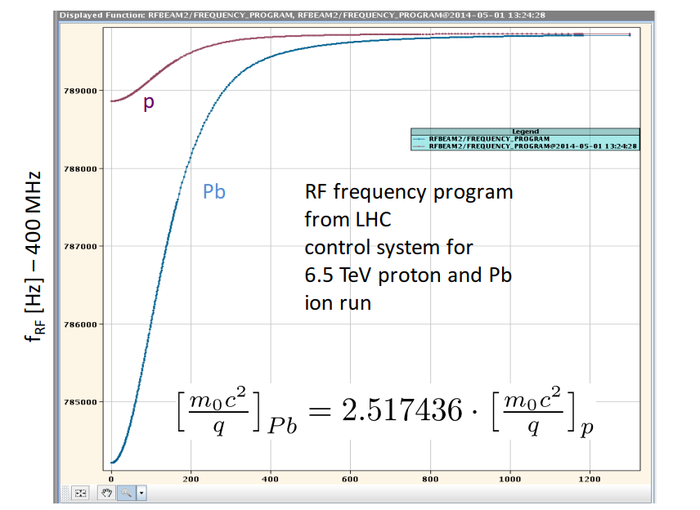
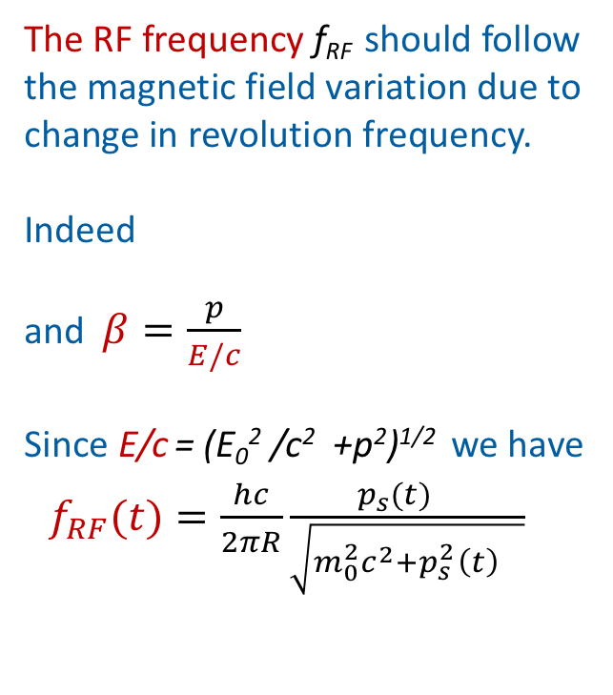
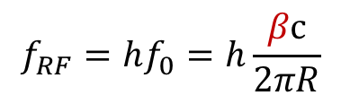
Synchrotron: RF frequency program
The RF frequency f_{RF} should follow the magnetic field variation due to change in revolution frequency.
Indeed
and $β=\frac{p}{E/c}$
Since E/c = (E₀² /c² +p²)^{1/2} we have
$f_{RF}(t)=\frac{hc}{2πR}\frac{{p_{s}(t)}^{}}{\sqrt{m_{0}^{2}c^{2}+p_{s }^{2}{\left(t\right)}^{}}}$
RF frequency programs in LHC
for proton and Pb ion beams
$$f_{RF}=hf_{0}=h\frac{βc}{2πR}$$
Here p_{s}(t) = q ρ B(t)
What about the corresponding RF voltage program V(t)?

Slide 14
Longitudinal beam dynamics

Slide 15
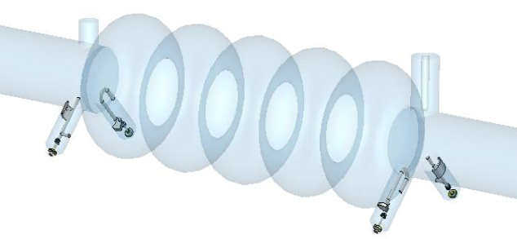
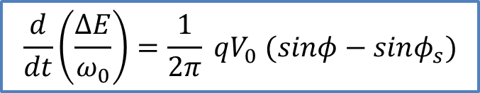
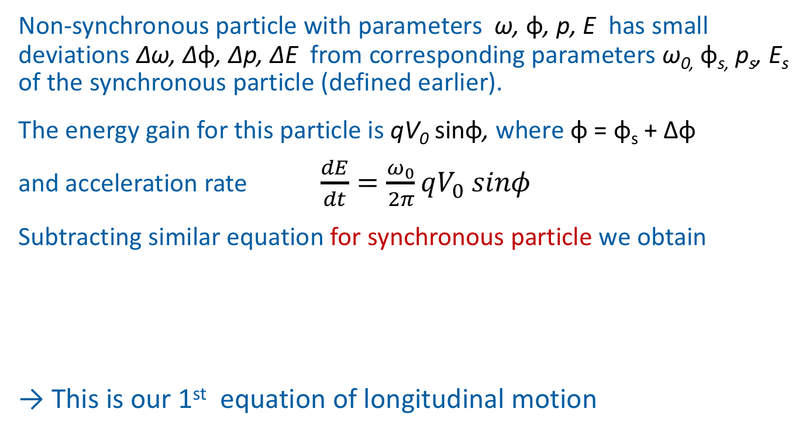
Non-synchronous particle.
First equation of longitudinal motion
Non-synchronous particle with parameters ω, φ, p, E has small deviations ∆ω, ∆φ, ∆p, ∆E from corresponding parameters ω_{0,} φ_{s,} p_{s}, E_{s} of the synchronous particle (defined earlier).
The energy gain for this particle is qV₀ sinφ, where φ = φ_{s} + ∆φ
and acceleration rate $\frac{dE}{dt}=\frac{ω_{0}}{2π}qV_{0} sinφ$
Subtracting similar equation for synchronous particle we obtain
→ This is our 1st equation of longitudinal motion
$$\frac{d}{dt}\left(\frac{ΔE}{ω_{0}}\right)=\frac{1}{2π} qV_{0} (sinφ−sinφ_{s})$$

Slide 16



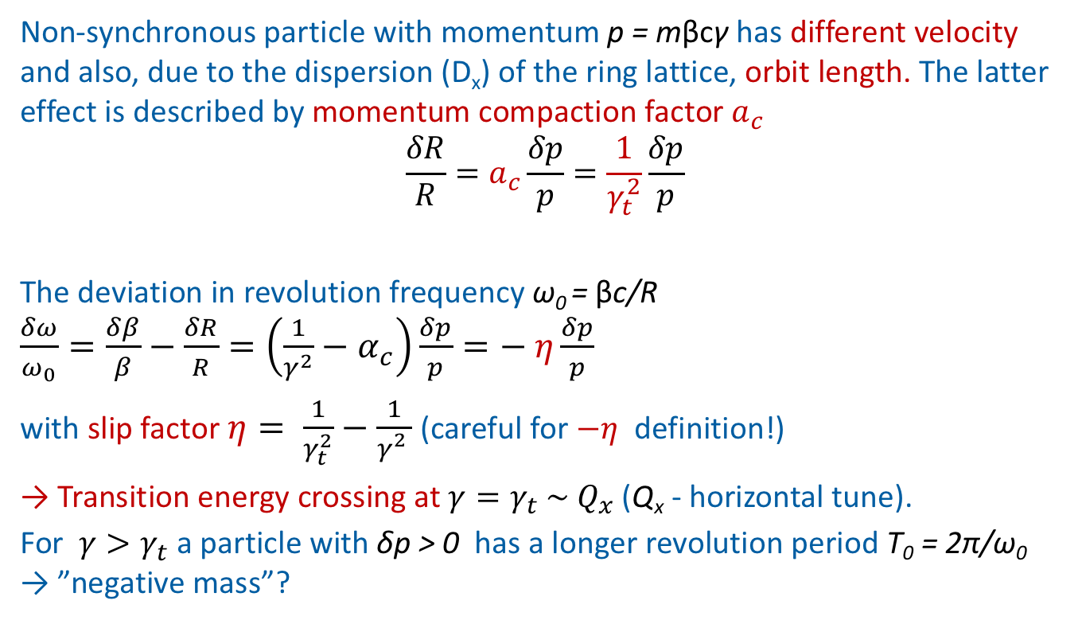



Non-synchronous particle.
Dispersion effects
Non-synchronous particle with momentum p = mβcγ has different velocity and also, due to the dispersion (D_{x}) of the ring lattice, orbit length. The latter effect is described by momentum compaction factor $a_{c}$
$$\frac{δR}{R}=a_{c}\frac{δp}{p}=\frac{1}{γ_{t}^{2}}\frac{δp}{p}$$
The deviation in revolution frequency ω₀ = βc/R $\frac{δω}{ω_{0}}=\frac{δβ}{β}−\frac{δR}{R}=\left(\frac{1}{γ^{2}}−α_{c}\right)\frac{δp}{p}=− η\frac{δp}{p}$
with slip factor $η= \frac{1}{γ_{t}^{2}}−\frac{1}{γ_{}^{2}}$ (careful for $−η$ definition!)
→ Transition energy crossing at $γ=γ_{t} \sim { Q}_{x}$(Q_{x} - horizontal tune).
For $γ>γ_{t}$ a particle with δp > 0 has a longer revolution period T₀ = 2π/ω₀ → ”negative mass”?
$$\frac{δβ}{β}= \frac{1}{γ^{2}}\frac{δp}{p}$$
(α_{c} = $\frac{1}{γ_{t}^{2}}$ = <D_{x}> /ρ)
$$p+δp$$
$$δR$$
$$p$$
$$R$$

Slide 17
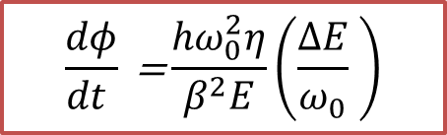
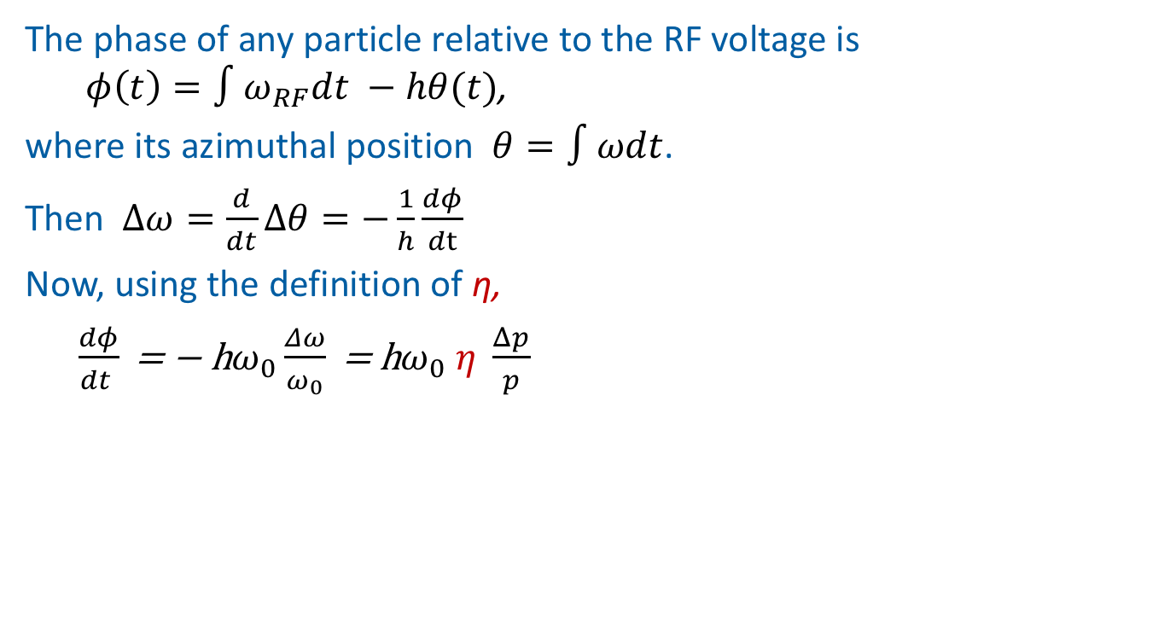
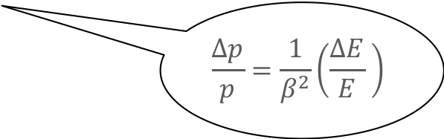
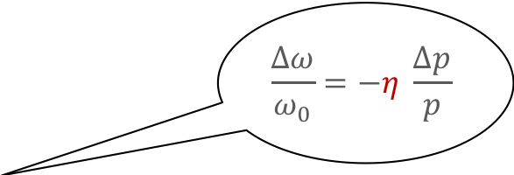
Second equation of particle motion
The phase of any particle relative to the RF voltage is $φ\left(t\right)=∫ω_{RF}dt −hθ(t)$,
where its azimuthal position $θ=∫ωdt$.
Then $Δω=\frac{d}{dt}Δθ=−\frac{1}{h}\frac{dφ}{dt}$
Now, using the definition of η,
$\frac{dφ}{dt }\text{ = − }\text{h}ω_{0}\frac{Δω}{ω_{0}}\text{ = }\text{h}ω_{0} η \frac{Δp}{p}$
$$\frac{Δω}{ω_{0}}=−η \frac{Δp}{p}$$
$$\frac{Δp}{p}=\frac{1}{β^{2}}\left(\frac{ΔE}{E} \right)$$
the 2nd equation of longitudinal motion is
$$\frac{dφ}{dt }\text{ =}\frac{{hω}_{0}^{2}η}{β^{2}E}\left(\frac{ΔE}{ω_{0}} \right)$$

Slide 18
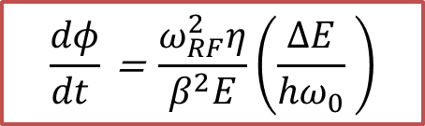
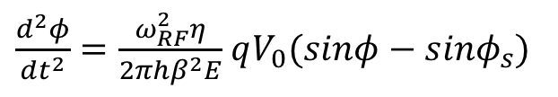

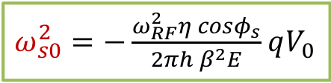
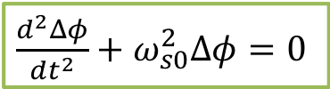
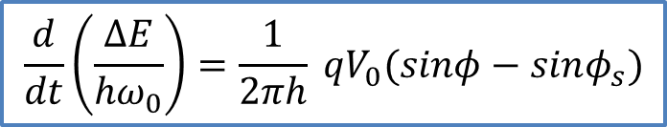
Phase equation.
Small amplitude oscillations
Combining two equations of motion in conjugate variables $\left(\frac{ΔE}{{hω}_{0}}, φ\right)$
and assuming slow time-variation of E, ω₀, η, we obtain phase equation:
For small amplitude particles with ∆φ = φ – φ_{s} < 1
(since $sinφ$ = $\sin\left(φ_{s}+Δφ\right)≃sinφ_{s}+Δφ cosφ_{s})$ →
$$\frac{d}{dt}\left(\frac{ΔE}{{hω}_{0}}\right)=\frac{1}{2πh} qV_{0}(sinφ−sinφ_{s})$$
$$\frac{dφ}{dt }\text{ = }\frac{ω_{RF}^{2}η}{β^{2}E}\left(\frac{ΔE}{{hω}_{0}} \right)$$
&
$\frac{d^{2}φ}{dt^{2}}=\frac{ω_{RF}^{2}η}{{2πhβ}^{2}E}$ $qV_{0}(sinφ−sinφ_{s})$
$\frac{d^{2}Δφ}{dt^{2}}+ω_{s0}^{2}Δφ=0$
With frequency of linear synchrotron oscillations
$ω_{s0}^{2}=−\frac{ω_{RF}^{2}η cosφ_{s}}{{2πh β}^{2}E}$ $qV_{0}$

Slide 19
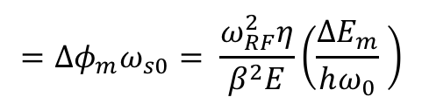



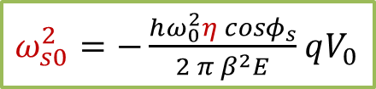
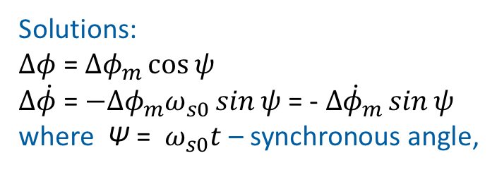
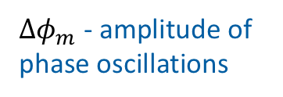


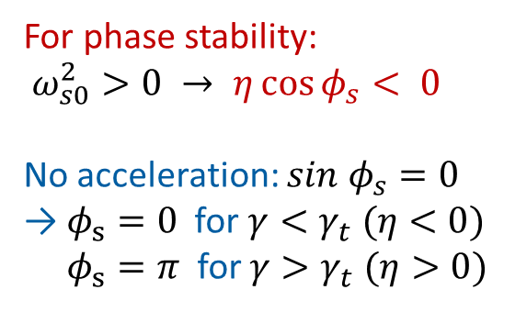

Small amplitude oscillations.
Phase stability
$\frac{d^{2}Δφ}{dt^{2}}+ω_{s0}^{2}Δφ=0$
→ Equation of a harmonic oscillator
$$η= \frac{1}{γ_{t}^{2}}−\frac{1}{γ_{}^{2}}$$
Solutions:
$Δφ$ = $Δφ_{m}\cos{ψ}$
$Δ\dot{φ}$ = ${−Δφ_{m}ω}_{s0}\sin{ψ}$ = - $Δ{\dot{φ}}_{m}\sin{ψ}$
where Ψ = $ω_{s0}t$ – synchronous angle,
$ω_{s0}^{2}=−\frac{hω_{0}^{2}η cosφ_{s}}{{2 π β}^{2}E}$ $qV_{0}$
$$={Δφ_{m}ω}_{s0}= \frac{ω_{RF}^{2}η}{β^{2}E}\left(\frac{ΔE_{m}}{hω_{0}} \right)$$
$$Δ\dot{φ}$$
$$Δ{\dot{φ}}_{m}$$
For phase stability:
$ω_{s0}^{2}>0 → η\cos{φ_{s}}< 0$
No acceleration: $sin{ φ}_{s}=0$
$\text{→}$ $φ_{s}=0$for $γ<γ_{t} (η<0)$
$φ_{s}=π$ for $γ>γ_{t}$ $(η>0)$
$Δφ$
$$ψ$$
$Δφ_{m}$ - amplitude of phase oscillations

Slide 20
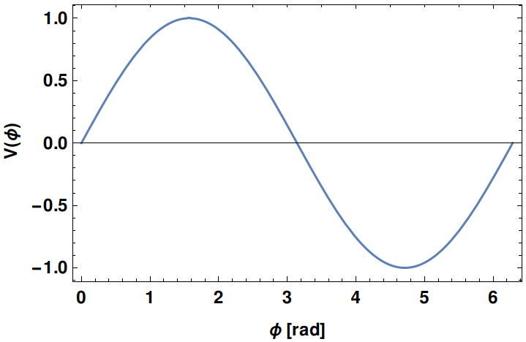
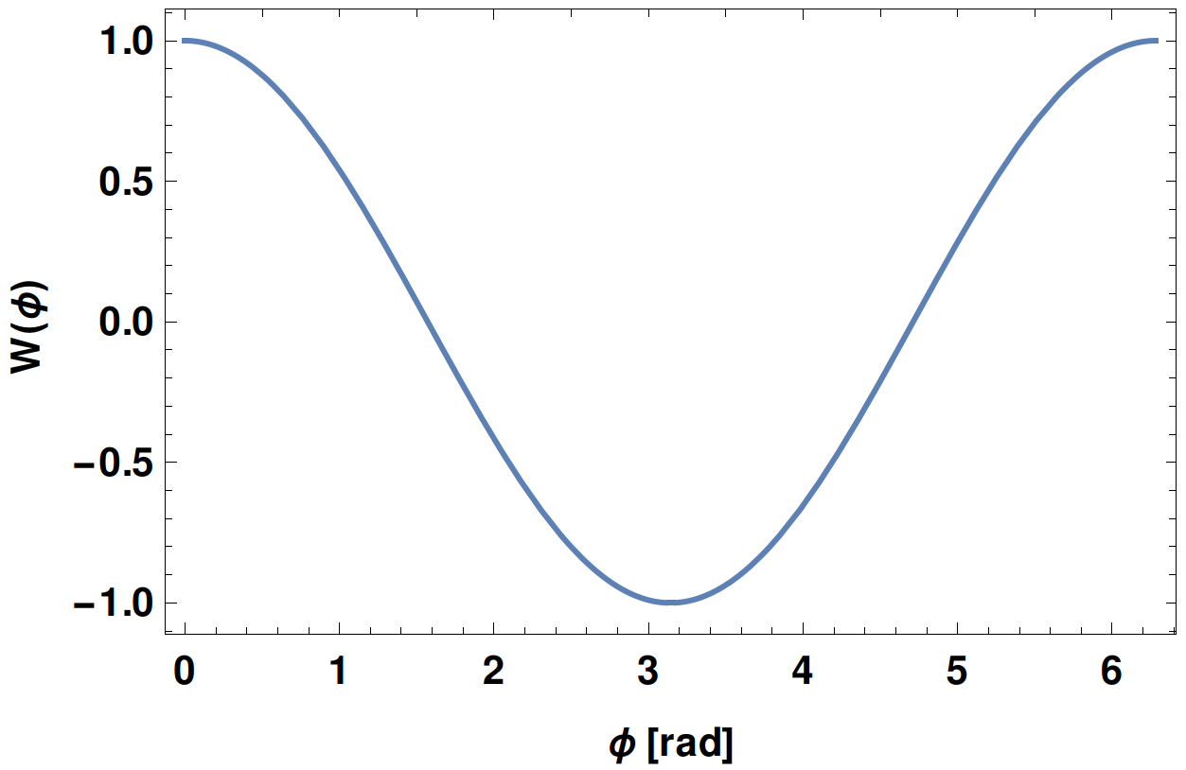
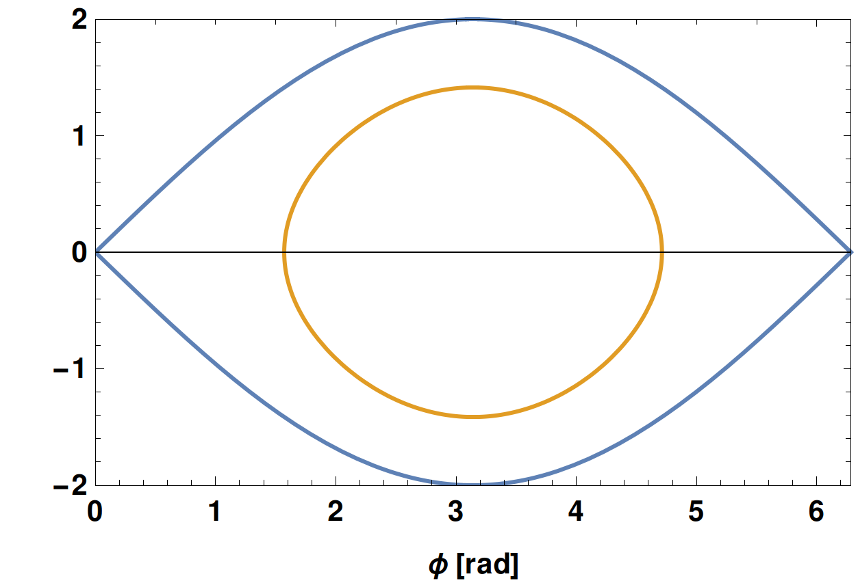

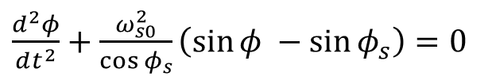
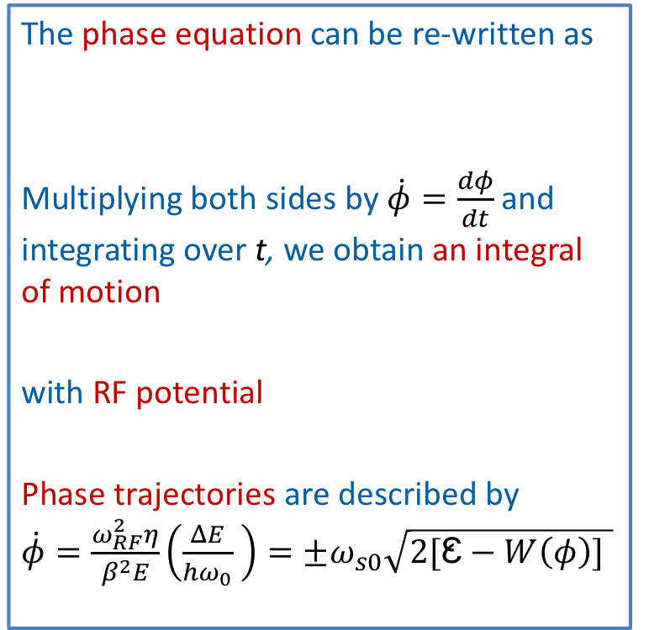

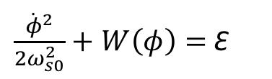

Phase equation.
Large amplitude oscillations
voltage
The phase equation can be re-written as
Multiplying both sides by $\dot{φ}=\frac{dφ}{dt}$ and integrating over t, we obtain an integral of motion
with RF potential
Phase trajectories are described by $\dot{φ}=\frac{ω_{RF}^{2}η}{β^{2}E}\left(\frac{ΔE}{{hω}_{0}} \right)=±ω_{s0}\sqrt{2[Ꜫ−W\left(φ\right)] }$
$\frac{d^{2}φ}{dt^{2}}+\frac{ω_{s0}^{2}}{\cos{φ_{s}}}\left(\sin{φ }−\sin{φ_{s}}\right)=0$
φ_{s} = π
$$γ>γ_{t}$$
potential
$\frac{ {\dot{φ}}^{2} }{2ω_{s0}^{2}}+W\left(φ\right)=$Ꜫ
φ_{s} = π
$$W\left(φ\right)=−(\cos{φ+φ\sin{φ_{s})/\cos{φ_{s}}}}$$
$$\frac{ {\dot{φ}}^{} }{ω_{s0}^{}}$$
φ_{s} = π
separatrix

Slide 21
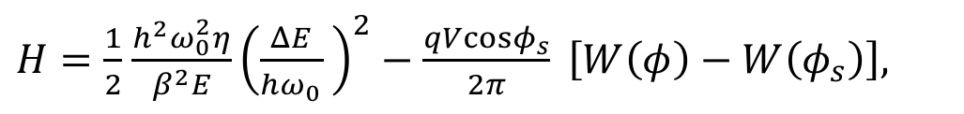


Hamiltonian of longitudinal motion
Using conjugate variables φ and ∆E/(hω₀), the equations of longitudinal motion can be also presented as
$\frac{∂H}{∂φ}=−\dot{\left(\frac{ΔE}{{hω}_{0}} \right)}$ and $\frac{∂H}{∂\left(\frac{ΔE}{{hω}_{0}} \right)}=\dot{φ}$,
with the Hamiltonian
where potential for a single RF system was defined as
It can be easily generalised for more RF systems (with different harmonic numbers h) and even induced voltage (collective effects).
$H=\frac{1}{2}$ $\frac{h^{2}ω_{0}^{2}η}{β^{2}E}{\left(\frac{ΔE}{{hω}_{0}} \right)}^{2}−\frac{qVcosφ_{s}}{2π} \left[W\left(φ\right)−W\left(φ_{s}\right)\right],$
$$W\left(φ\right)=−(\cos{φ+φ\sin{φ_{s})/\cos{φ_{s}}}}$$

Slide 22










Acceleration. Separatrix
deceleration
Example:
$$γ>γ_{t}$$
Potential well for
φ_{s} = π – π/18
$${\sin{φ_{s}}}_{ }<0$$
acceleration
$${\sin{φ_{s}}}_{ }>0$$
Phase stability
$$η cosφ_{s }< 0$$
φ₂ = π/18
φ_{m}
$$γ<γ_{t}$$
$$γ>γ_{t}$$
$$\frac{ {\dot{φ}}^{} }{ω_{s0}^{}}$$
$$W\left(φ\right)=−(\cos{φ+φ\sin{φ_{s})/\cos{φ_{s}}}}$$
Potential
∆E = 0 at extremes of potential: W’(φ) = V(φ) = 0
→ sinφ = sinφ_{s} has 2 solutions:
- φ₁ = φ_{s} + 2πk (k=0, 1,... h-1) - stable fixed point
- φ₂ = π – φ_{s} + 2πk – unstable fixed point
the 2nd turning point is φ_{m} defined by
W(φ_{m}) = W(φ₂) = W(π - φ_{s})
φ₂
φ_{s}
φ_{m}
The separatrix separates the bound oscillations from unbound

Slide 23










Acceleration. Transition crossing
Below transition:
$γ<γ_{t}, η<0$
Above transition:
$$γ>γ_{t}, η>0$$
Direction of particle motion.
Since
→ φ increases
($\dot{φ}>0)$for
∆E < 0 if η < 0
or
∆E > 0 if η > 0
Potential well
φ_{s} = π/18
Potential well
φ_{s} = π – π/18
$$\dot{φ}=\frac{ω_{RF}^{2}η}{β^{2}E}\left(\frac{ΔE}{{hω}_{0}} \right)$$
$ΔE$ [a.u]
$$ΔE$$
→ RF phase jump (π - 2φ_{s}) needed during transition crossing

Slide 24






Acceleration. RF bucket
The phase-space limited by the separatrix is the RF bucket:
Bucket area [eVs] (also longitudinal acceptance):
Bucket length [rad] is φ_{m} - (π - φ_{s})
Bucket height (energy acceptance)
with synchrotron tune
$$\dot{φ}=\frac{ω_{RF}^{2}η}{β^{2}E}\left(\frac{ΔE}{{hω}_{0}} \right)=±ω_{s0}\sqrt{2[W(π−φ_{s})−W\left(φ\right)]}$$
$$A=\frac{2}{hω_{0}}\int_{φ_{2}}^{φ_{m}}{Δ}E\left(φ\right)dφ$$
$$\frac{ {\dot{φ}}^{} }{ω_{s0}^{}}$$
separatrix
$$\frac{{ ΔE}_{max}}{E}=\frac{ν_{s0} β^{2}}{hη}\sqrt{2[W(π−φ_{s})−W\left(φ_{s}\right)]}$$
$$ν_{s0}=\frac{ω_{s0}}{ω_{0}}$$
φ₂ =
π – φ_{s}
φ_{s}
φ_{m}
$$γ>γ_{t}$$

Slide 25





Longitudinal phase space.
Longitudinal phase space.
Bucket area
$$\frac{ {\dot{φ}}^{} }{ω_{s0}^{}}$$
No energy gain → sinφ_{s} = 0 and
W(φ) = cosφ (for $γ>γ_{t}$). Then
$$\int_{0}^{2π}{\sqrt{2\left[W\left(π−φ_{s}\right)−W\left(φ\right)\right]} dφ} =2\int_{0}^{2π}{\sin{\frac{φ}{2}} \text{d}φ\text{ = 8} }$$
The bucket area
is reduced due to acceleration by a factor $Γ\left(φ_{s}\right),$which approximately is
$Γ(φ_{s}) ≃\frac{1−\sin{φ_{s}}}{1+\sin{φ_{s}}}$
Stationary case. No acceleration
$A=\frac{16β}{ω_{RF}} \sqrt{\frac{qV_{0}E}{2πh|η|}}Γ(φ_{s})$
uncaptured
particles
Bucket area $\sim \sqrt{V}$ should be sufficient to accommodate a given bunch
Note, that A = 0 for φ_{s} = π/2.

Slide 26




Longitudinal phase space.
Bunch emittance
$$\frac{ {\dot{φ}}^{} }{ω_{s0}^{}}$$
Particles usually fill some part of the bucket, a bunch
There can be up to h = ω_{RF}/ω₀ bunches in the ring
Longitudinal emittance [eVs] is the area inside the limiting phase trajectory
$ε =\frac{2}{hω_{0}}\int_{φ_{L}}^{φ_{R}}{Δ}E_{b}\left(φ\right)dφ$
Here W(φ_{L} ) = W(φ_{R}).
For ions units are [eVs/charge]
∆φ
bunch
$$φ_{L}$$
$$φ_{R}$$
Bunch length [rad] ∆φ = φ_{L} - φ_{R}
and in [s] τ = ∆φ/(hω₀)

Slide 27





Longitudinal bunch emittance
$ε_{b }$/$ε_{b }^{short}$
Phase trajectory (reminder)
For non-accelerating bucket: φ_{L} - φ_{R} = 2φ_{b}
and bunch emittance is
$$ε_{b}=\frac{4 E ω_{s0}}{ω_{RF}^{2}\left|η\right| } \int_{0}^{φ_{b}}{\sqrt{2(cosφ−cosφ_{b})}dφ}$$
Short-bunch approximation $\frac{πφ_{b}^{2}}{4}$
Ratio
(no acceleration)
φ_{b}
$$\frac{ω_{RF}^{2}|η|}{β^{2}E}\left(\frac{ΔE}{{hω}_{0}} \right)=ω_{s0}\sqrt{2[W(φ_{L})−W\left(φ\right)] }$$
→ Short-bunch approximation
$ε_{b}=πΔEb φ_{b}/h=πΔEbτ/2$
should be used with caution
for φ_{b} > 1

Slide 28


Adiabaticity: why it is important?
During beam acceleration, the Hamiltonian H of the system depends on time. If changes are slow enough (adiabatic), H is considered to be quasi-static.
The parameter λ changes adiabatically if $T\frac{dλ }{dt}≪λ,$ where T is a period.
Applying for the synchrotron motion $\frac{dT_{s} }{dt}≪1$
Adiabatic invariant of motion (action)
→ Longitudinal bunch emittance is an invariant of motion during acceleration and RF manipulations, if parameter change is adiabatic.
During acceleration, voltage program should be designed to keep a certain filling factor (< 90%) of the bucket area for a given bunch emittance
$$J=\frac{1}{2π} \int{\frac{ΔE\left(φ\right)}{{hω}_{0}} dφ=\frac{ε}{2π} }$$

Slide 29


Energy loss
Phase trajectories of lost particles on LHC flat top
Even without acceleration the average energy of particles may change due to synchrotron radiation, induced voltage, electron cloud…
Energy lost by a particle per turn ∆E = U₀ is compensated by the RF system
→ Bucket becomes accelerating with B = const.
→ Damping of synchrotron oscillations
Synchrotron radiation at LHC flat top:
U₀ = 7 keV for protons and for ²⁰⁸Pb⁸²⁺ ions it is
$\frac{U_{ion}}{U_{p}}≃\frac{Z^{6}}{A^{4}}≃162$ larger!
Damping time $\frac{τ_{ion}}{τ_{p}}≃\frac{A^{4}}{Z^{5}}≃0.5$ is also smaller!
→ 6.3 h for longitudinal emittance
U₀ = q V sinφ_{s}
V = 16 MV, 400 MHz

Slide 30






Synchrotron frequency
Due to non-linearity of RF voltage
all particles oscillate with different frequencies ω_{s} = 2π f_{s} , which depend on amplitude of oscillations.
Since
the period of synchrotron oscillations is
$$T_{s}=\oint{\frac{dφ}{\dot{φ}}}=\frac{2}{ω_{s0}} \int_{φ_{L}}^{φ_{R}}{\frac{dφ}{\sqrt{2[W(φ_{L})−W\left(φ\right)] }}}$$
For non-accelerating bucket
K(x) is the complete elliptical integral of the 1st kind
$\frac{d^{2}φ}{dt^{2}}+\frac{ω_{s0}^{2}}{cosφ_{s}}\left(\sin{φ}−\sin{φ_{s}}\right)=0$
$$\frac{ω_{s }}{ω_{s0}}= \frac{π}{2 K(\sin{\frac{φ_{b}}{2}})} ≃1−\frac{φ_{b}^{2}}{16}$$
$\frac{dφ}{dt}$ = ${\dot{φ}=ω}_{s0}\sqrt{2[W(φ_{L})−W\left(φ\right)] }$
$$1−\frac{φ_{b}^{2}}{16}$$
Ts → ∞
Oscillation amplitude φ_{b} [rad]

Slide 31



Discrete equations.
Mapping/particle simulations
Discrete equations of longitudinal particle motion in (∆t, ∆E) canonical coordinates at revolution turn (n+1) with general RF system and induced voltage
Index “0” refers to design values, including reference time $t_{0}^{n}=\sum_{i=1}^{n}{T_{0}^{(i)}.}$
These equations can be written in the form of the symplectic mapping from a point {∆t^{(n)}, ∆E^{(n)}} to {∆t^{(n+1)}, ∆E^{(n+1)}} preserving the phase space area.
Open-source simulation code BLonD developed in RF group at CERN (all types of particles, RF manipulations, RF loops and feedbacks): http://blond.web.cern.ch
$$ΔE^{(n+1)}={ΔE}^{(n+1)}+q\sum_{k=1}^{K}{V_{k}^{\left(n\right)}sin\left(ω_{rf}^{\left(n\right)}Δt^{(n)}+φ_{k}^{(n)}\right){− (E}_{0}^{(n+1)}−E_{0}^{\left(n\right)})+qV_{ind}{\begin{aligned} \\ \end{aligned}}}$$
$$Δt^{(n+1)}=Δt^{(n)}+\frac{T_{0}^{(n+1)}η_{0}^{(n+1)}}{{β_{0}^{2}}^{(n+1)}E_{0}^{(n+1)}} ΔE^{(n+1)}$$

Slide 32
Rf Manipulations

Slide 33

LHC ion beam at CERN
 | State of lead ion | Energy [GeV/u]
Linac3 | 27⁺ | 0.0042
LEIR | 54⁺ | 0.0722
PS | 54⁺ | 5.9
SPS | 82⁺ | 176.4
LHC | 82⁺ | 2759
Ions accelerated for the collider physics in LHC: Pb, Xe
More ions for the fixed-target physics in all CERN accelerators

Slide 34
LHC ion beam production scheme
LEIR
Multi-turn injection
Adiabatic RF capture
into 2 bunches
PS
Batch expansion
Bunch splitting
Batch expansion
SPS
Multiple injections with
150 ns batch spacing
Momentum slip stacking
at high energy (50 ns
bunch spacing → 100 ns)
LHC
bunches
2
2
4
28 + 28
56
1256
LEIR

Slide 35
Ion beam production at CERN
RF manipulations used for LHC ions in injector chain
  Rebunching - LEIR
  Bunch shaping (double RF operation) – LEIR
  Bunch splitting - PS
  Batch compression/expansion – PS
  Controlled emittance blow-up - PS
  Bunch rotation - SPS in future (2021)
  Fixed frequency acceleration - SPS
  Momentum slip-stacking - SPS (2021)
Even more for the proton beams…

Slide 36

RF gymnastics for Pb ion beam in CERN PS
Batch compression
(< 2015)
Batch expansion.
Bunch splitting
Batch compression
(2018)
2 bunches at 200 ns →
2 bunches at 100 ns
2 bunches at 200 ns → 4 bunches at 100 ns
3 bunches at 100 ns → 3 bunches at 75 ns
Voltage at the next harmonic h is adiabatically increased and then the initial one is decreased. For 2 bunches in the ring, it works without intermediate steps in h.

Slide 37
Controlled longitudinal emittance blow-up
  Some possible methods (used at CERN):
  Coloured (band-limited) phase noise (for protons during ramp in PSB, SPS and LHC, also for ions in LHC and planned in SPS)
  Deliberate bunch to bucket mismatch (in phase or energy) – the simplest but not always well controlled, used at injection and during transition crossing (SPS)
  Phase modulation of the main (in LHC during physics) or of the higher harmonic RF system (PS)

Slide 38


Controlled emittance blow-up by band-limited noise
Emittance blow-up in the CERN PSB.
Synchrotron frequency distribution
Noise-band frequencies
f_{up} -- to cover bunch centre
f_{down} – for target emittance
Similar technique is applied in SPS and also in LHC, with bunch-length feedback acting on strength of excitation.

Slide 39


Phase error/shift
PSB - PS bunch transfer.
90 deg injection error
Average bunch length of ion beam during acceleration in SPS
→ Large (intentional emittance blow-up at transition crossing
In hadron accelerators beam phase loop keeps bunch locked to the RF phase to avoid uncontrolled emittance blow-up

Slide 40



Voltage mismatch.
Bunch rotation
Bunch matched to bucket
Mismatched → rotation
Sharp increase of RF voltage → used for bunch compression (at T_{s0}/4)
Less voltage needed than with adiabatic voltage increase
(after bunch rotation $τ \sim \sqrt{V}$ instead of $τ\sim \sqrt[4]{V}$)

Slide 41


Bunch rotation.
Jump to unstable phase
(1) Jump to unstable phase (fixed point) to stretch the bunch
(2) Jump back to stable phase and continue the rotation

Slide 42

Fixed-frequency acceleration of ion beam in the SPS
During lead ion acceleration with constant harmonic number h, the RF frequency f_{rf} = h f₀ changes from 198.51 MHz to 200.39 MHz
The tuning range of the 200 MHz TW cavities is (199.5 - 200.4) MHz
The LHC ion beam occupies only a part of the ring (6.6 μs out of 23.1 μs)
Cavity-amplifier rise time ~ 1μs
Switch to the constant harmonic number acceleration, when f_{rf} is inside the cavity bandwidth
→ Use non-integer harmonic number (D. Boussard et al., 1989): pulse cavity at the centre cavity frequency during beam passage and switch it off in the beam gap to correct the RF phase for the next beam passage

Slide 43


Momentum slip-stacking of ion beam in the SPS
MSS is extensively used in Fermilab.
Usually performed at B₀ = const
$\frac{δω_{RF}}{ω_{RF}}=− η\frac{δp}{p_{0}}=− η γ_{tr}^{2}\frac{δR}{R_{0}}$
→ Change in phase or “drifting” per T₀
$$δφ=2πh\frac{δω_{RF}}{ω_{RF0}}$$
Slip-stacking parameter:
$$α=\frac{δω_{RF}}{ω_{s0}}=\frac{2 δE_{beams}}{δE_{bucket}}$$
At α = 4 the two separatrices touch.
→ Keep α > 4 to reduce perturbation.
ω_{RF1}(t)
ω_{RF2}(t)
Two independently controlled 200 MHz RF systems with large frequency bandwidth.
Radial displacement of two beams.

Slide 44


Particle simulations of ion beam in the SPS.
Momentum slip-stacking and bunch rotation
Should work in 2021 to obtain the design ion luminosity in HL-LHC!

Slide 45
Bibliography
G. Dome, Theory of RF acceleration, CAS 1985, CERN 87-03
S. Y. Lee, Accelerator physics, World Scientific, 1999
LHC Design Report, CERN-2004-003, 2004
Acknowledgements
T. Argyropoulos
H. Damerau
V. Kain
D. Quartullo
F. Tecker
Thank you for your attention!

Slide 46
Accelerators used for ions
Linear Accelerators (LINAC):
  Linac3 (CERN), ATLAS (ANL), FRIB (MSU), UNILAC (GSI),…
Cyclotrons: easy to operate and tune; used for isotope production, but limited to a few hundreds of MeV/u
  RIKEN RIBP, HRIBP (pd), TRIMF (pd), NSCL, GANIL; U400, U400M, IC100 and DC130, DC280 in JINR Dubna
  *pd – proton driver
Synchrotrons
  SIS18 @GSI; LEIR, PS, SPS, LHC @CERN; RHIC@BNL, NICA @ JINR

