Slide 1

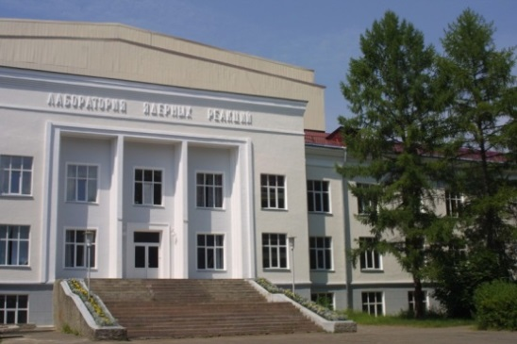
Towards nuclear physics in electron – radioactive ion collisions
Leonid Grigorenko
Flerov Laboratory of Nuclear Reactions, JINR, Dubna
Joint US-CERN-Japan-Russia International Accelerator School 2019, Ion Colliders Dubna,
28 October — 7 November 2019

Slide 2
RIB physics

Slide 3
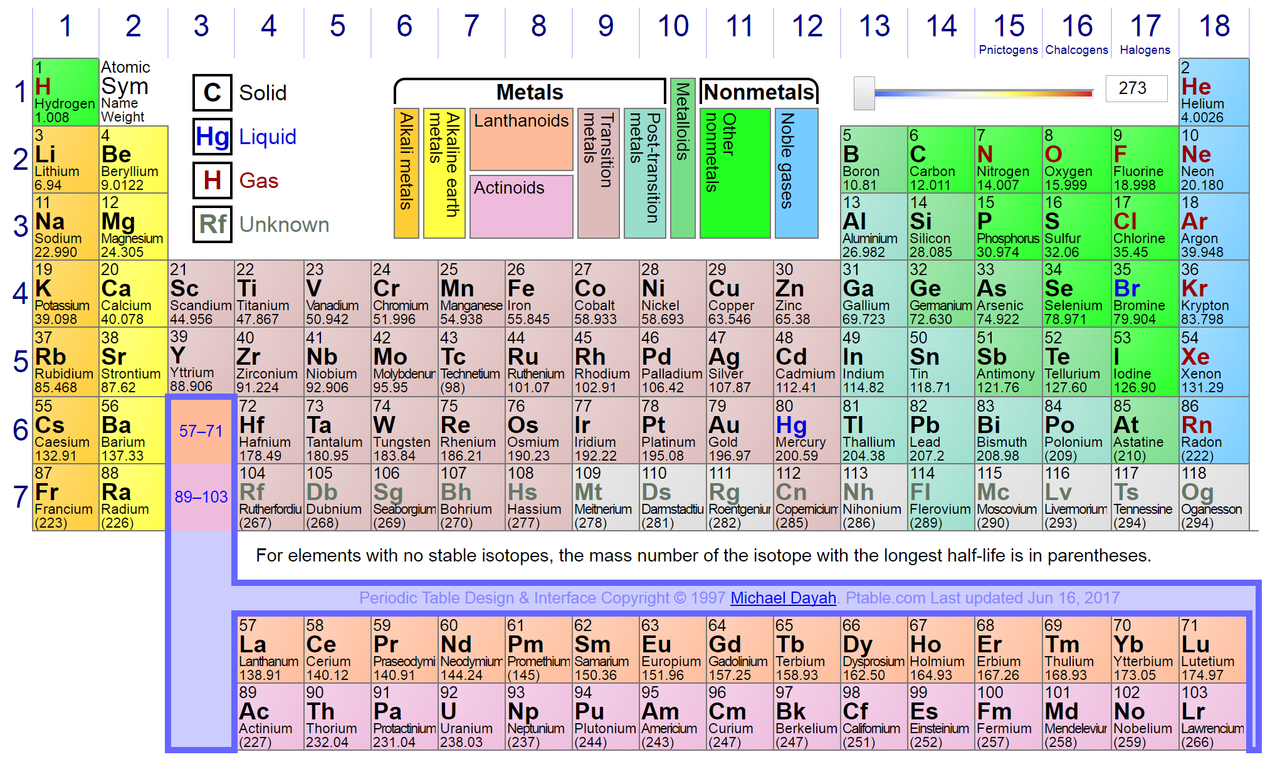
Mendeleev periodic table of elements
ptable.com
Periodic law is base for qualitative understanding of chemistry basic principles
Electron motion in the central Coulomb field of nucleus
Quantum mechanical systematics of shell population
Fight to complete Mendeleev Table: JINR vs. GSI vs. RIKEN. 118 discovered. 119? 120?

Slide 4
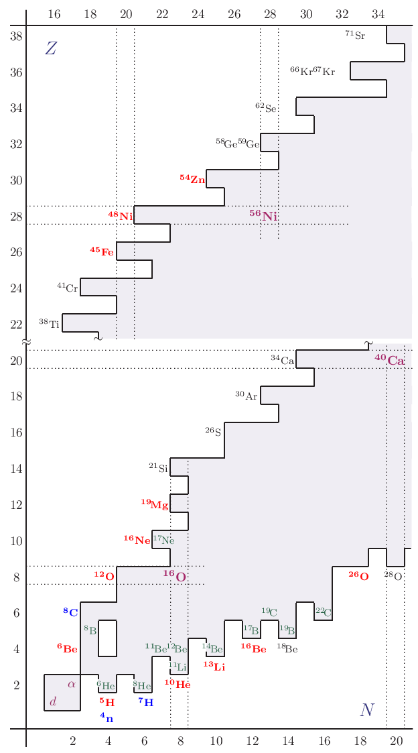
Shell structure in atoms and in nuclei
Qualitative difference: energy levels in Coulomb field vs. energy levels in oscillator potential
Atomic magic numbers: 2, 10, 28, 60, 110
Nuclear magic numbers: 2, 8, 20, 28, 50, 82, 126
Atomic potential is connected with interaction with “singular” strength center
In contrast nuclear potential has s mean field origin: there is nothing special sitting in the “center”
Origins of the nuclear shells
Nuclear chart of nuclides is two-dimensional!

Slide 5
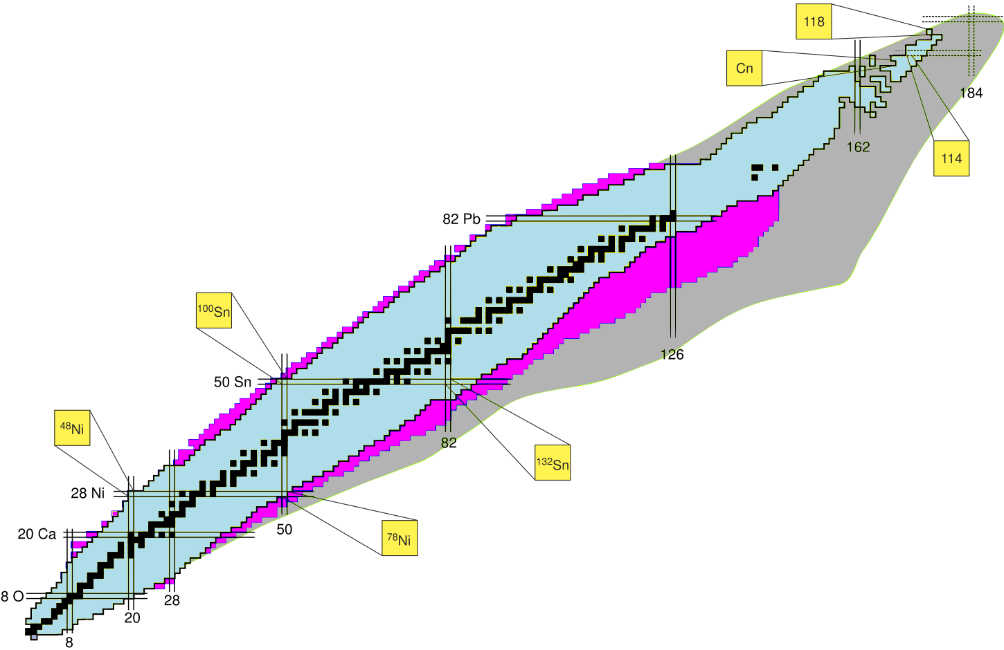
Chart of nuclides and Radioactive Ion Beam (RIB) physics
The map of nuclides
- 254 stable nuclides,
- 339 can be found in nature
- Around 3100 RI are known
- Around 2500 to be discovered
“Isle of stability” for superheavies:
We just “touched” a bit of its “shore”…
Proton dripline:
Achieved and studied for Z<32
Limits of nuclear structure existence:
Are known only for the lightest nuclei
Exotic structure of exotic nuclides:
- Neutron/proton halo
- Neutron skin
- “Soft” excitation modes
- Breakdown of shell structure
- New “magic numbers”
Neutron dripline:
Achieved and studied for N<20

Slide 6
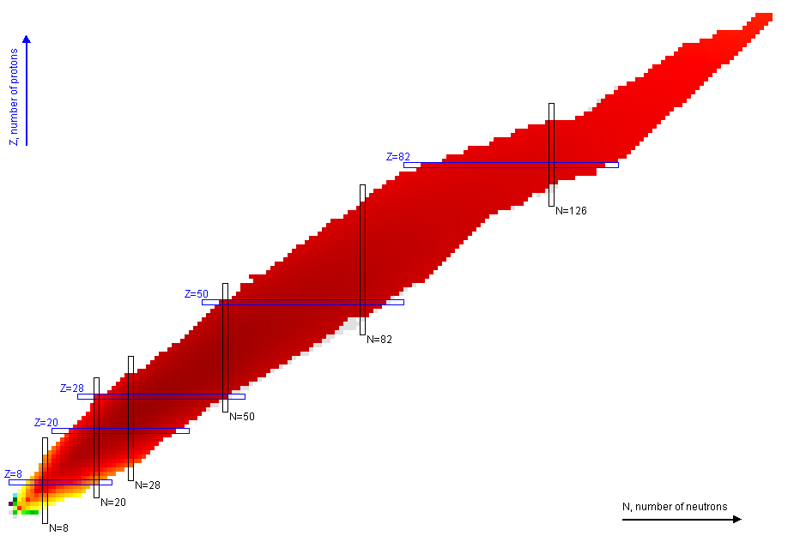
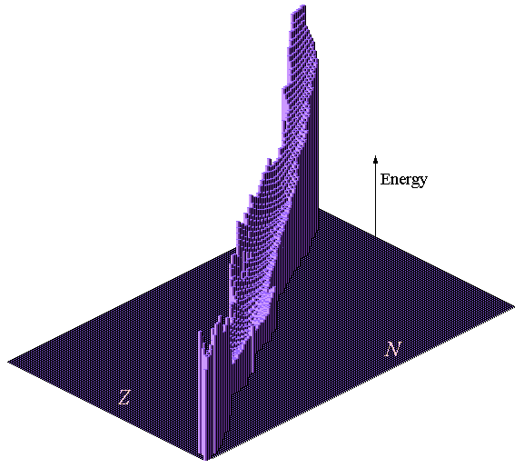
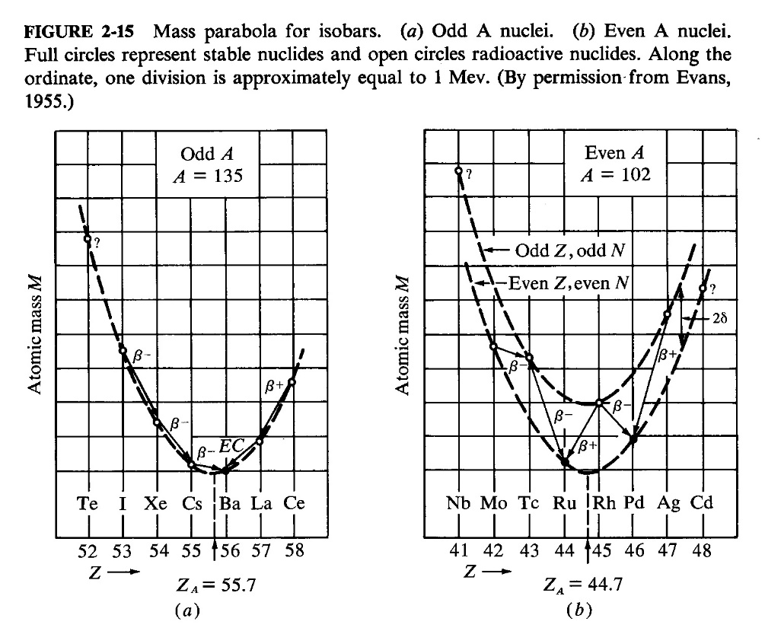
Nuclear stability valley

Slide 7
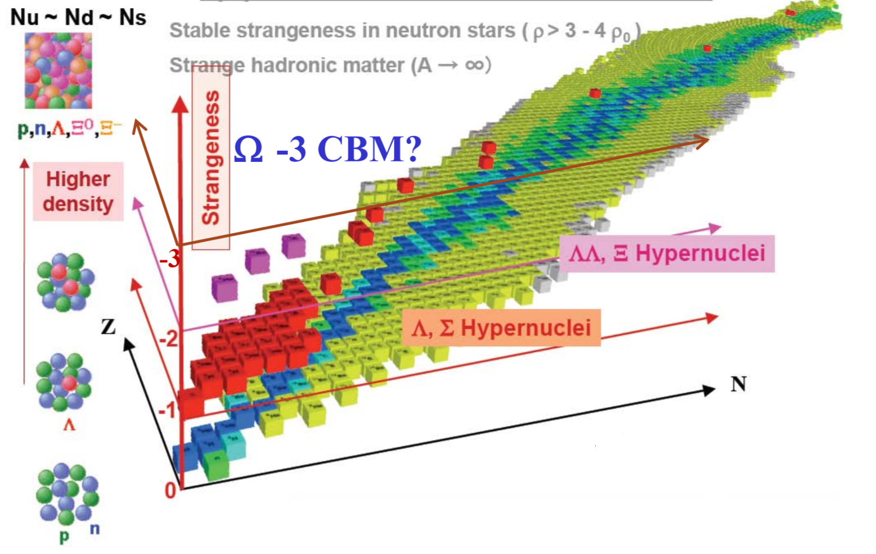
Strangeness – the third dimension in the chart of nuclides

Slide 8
RIB physics applications

Slide 9
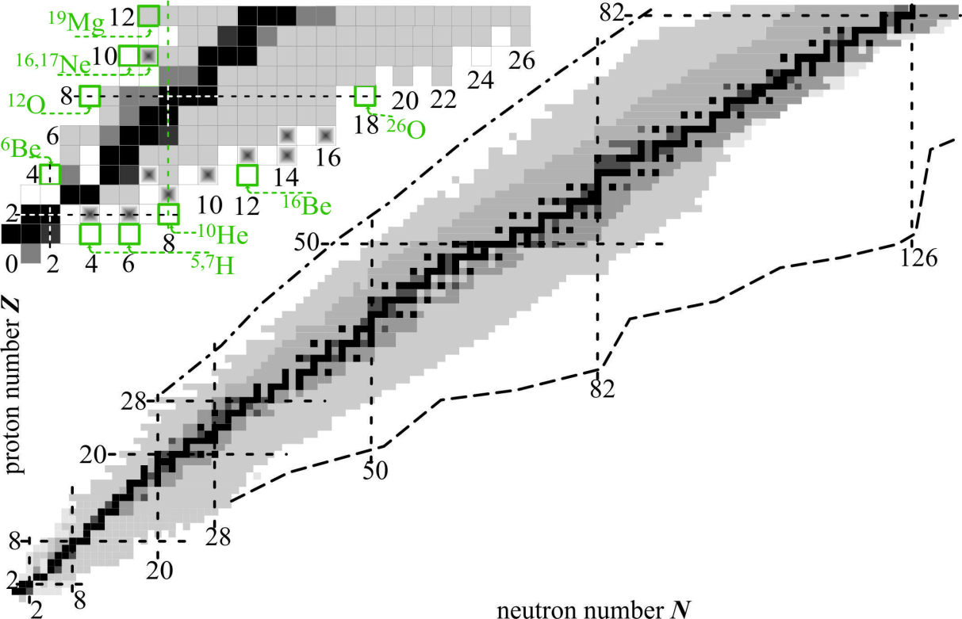
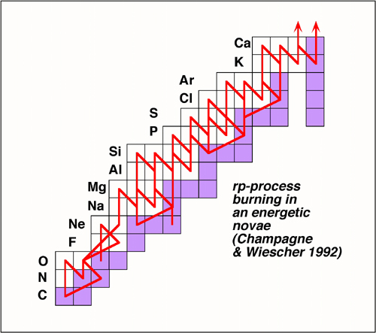
Motivation – Applications to nucleosynthesys
s-process
rp-process fragment
rp-process
r-process
Hydrostatic burning in stars – slow process
Explosive burning – rapid processes
Where does it take place?
Every day observed violent events in space are produced by rp-processes
Element abundance in space is connected with r-processes
No quantitative understanding until the driplines are studied in details

Slide 10
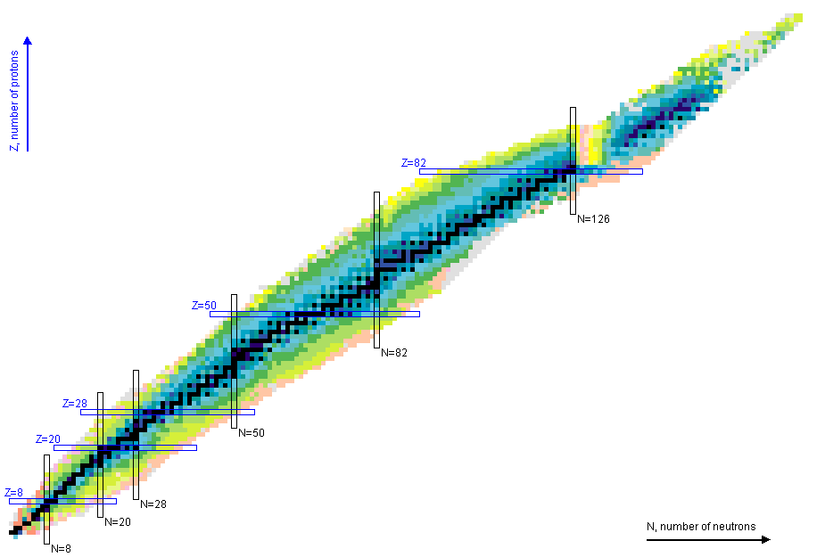
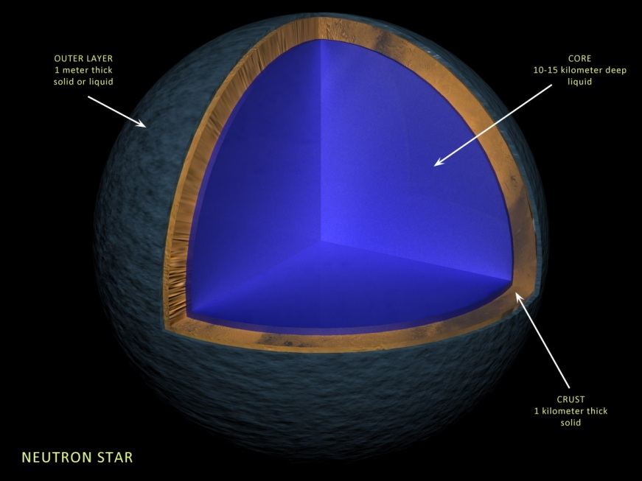
Motivation – Applications to neutron stars
All the heavy elements in the Universe are produced in explosive nucleosynthesys
PV = (m/μ) RT
Equation of state for ideal gas. What about nuclear matter?
Supernovae explosions. How we get from neutron star to Supernova?
Neutron star: very large nucleus with
absolutely asymmetric nuclear matter
Known nuclei: practically symmetric
nuclear matter
Moving towards the driplines we get experimental knowledge about more and more asymmetric nuclear matter

Slide 11
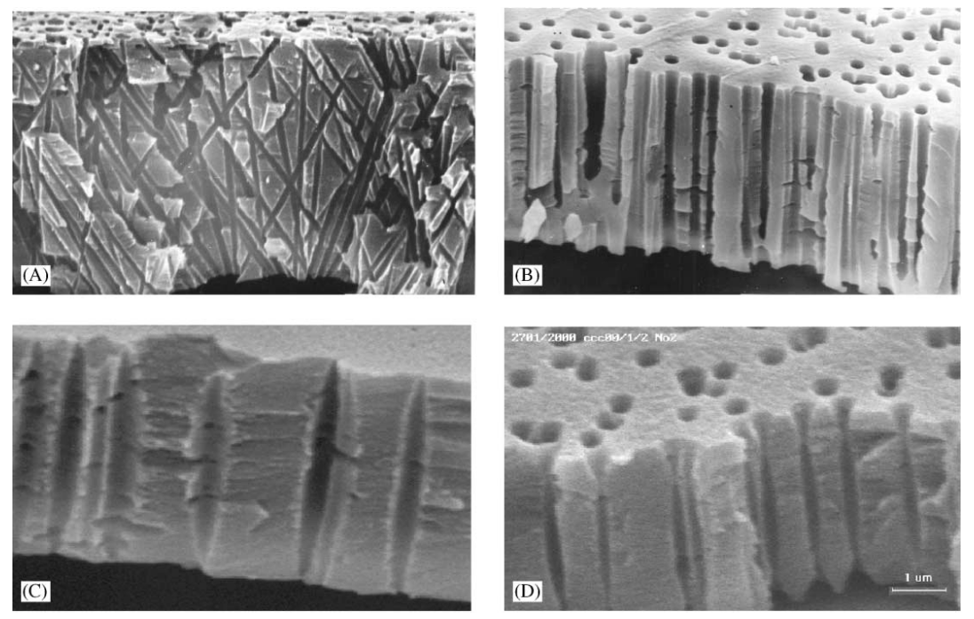
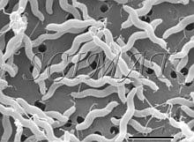
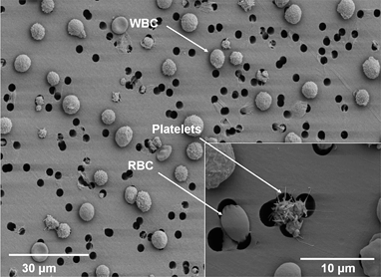
Motivation for nuclear technology. “Cold sterilization”
Mass production at Flerov Lab.
Sterilization without thermal processing, e.g. by gas, x-rays, UV light, electron beam
One type of CS is very special. The only applicable in faint applications like molecular microbiology, etc.: nuclearpore membrane sterilization
Pores from 10 to 0.01 μm
Even virus can not get through!
Production:
- Heavy ion irradiation
- Chemical “track etching”

Slide 12
Exotic things near the driplines

Slide 13
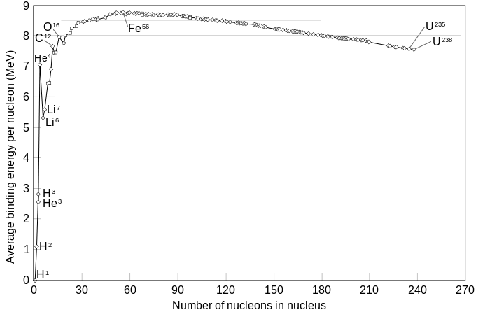
Ordinary things deep in the nuclear stability valley
Saturation of nuclear forces. Saturation of nuclear density
Trivial model of the “global distance-independent interactions”
In reality binding energy per nucleon saturates
Consequence of the short range nuclear force
Consequence of Pauli principle
1/2
Result: density also saturates. Like in liquid
3/3
6/4
Binding energy
per nucleon
Binding energy per
nucleon is
n!/n = (n-1)!

Slide 14
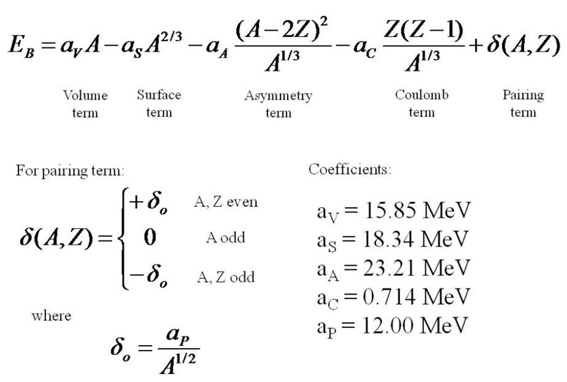
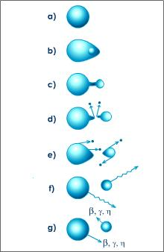
Ordinary things deep in the nuclear stability valley.
Liquid drop model of nucleus. Bethe–Weizsäcker formula.
Nucleus is a drop of “nuclear liquid” with r = r₀ A^{1/3}
Quantitative explanation of nuclear masses
Quantitative explanation of fission in heavy nuclei

Slide 15
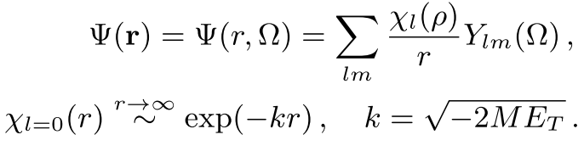
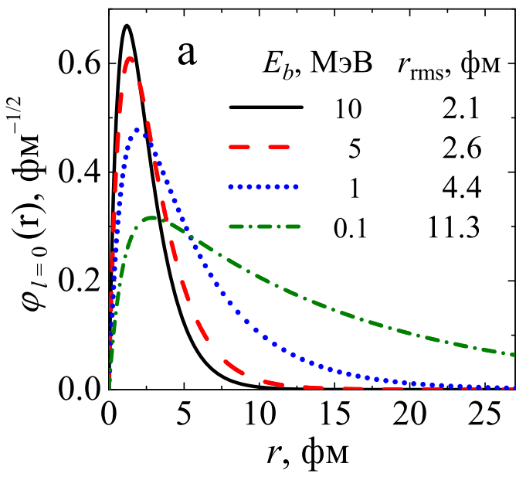
Nucleon halo. One-nucleon halo

Slide 16
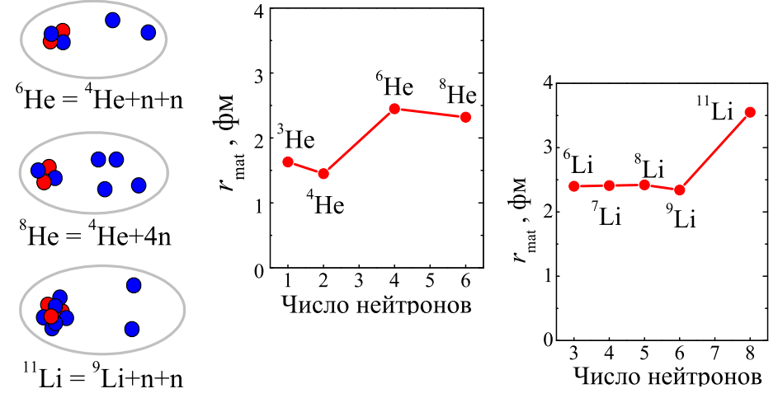
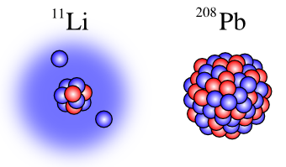
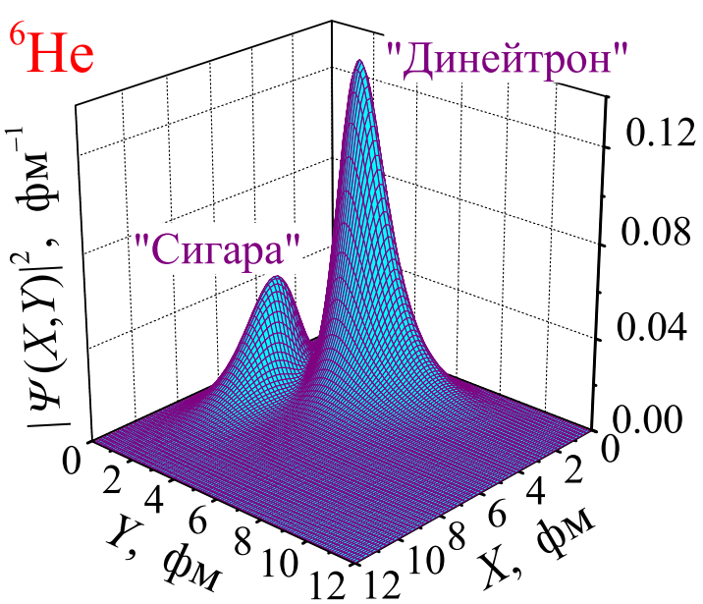
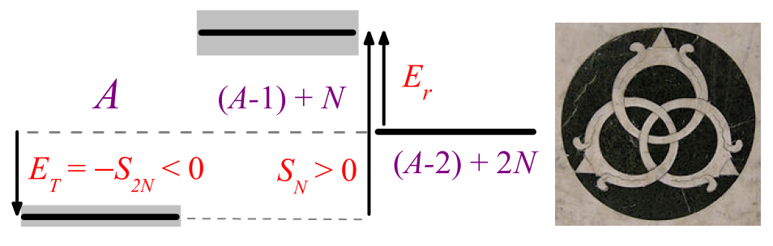
Borromean nuclei. Two-Nucleon halo.
Abnormal valence orbital size
Curious spatial correlations
Borromean property
G.N. Flerov, A.S. Ilyinov (1982)

Slide 17
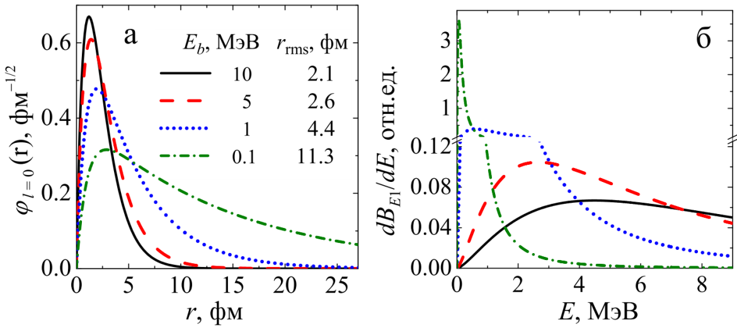
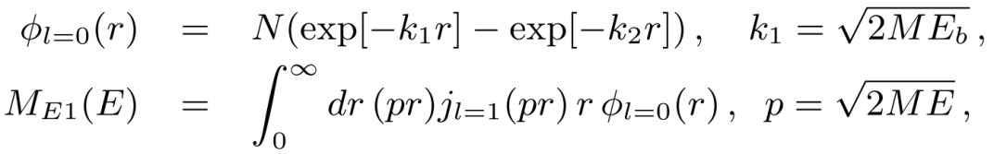
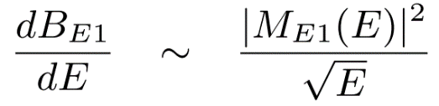
Soft dipole mode
Existence of soft dipole mode strongly influence the nonresonant radiative capture rate in astrophysics
G.N. Flerov, A.S. Ilyinov (1982)

Slide 18
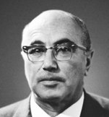
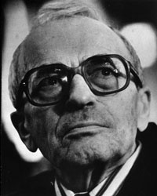
Two-proton radioactivity: a qualitative view
Goldansky and
Zeldovich, 1960
Pfutzner et al and
Giovinazzo et al, 2002
Classical case:
one particle emission is always possible
Quantum mechanical case:
it could be that both particles should
be emitted simultaneously
Exclusive Quantum-Mechanical phenomenon
No deeper bound orbitals.
The common orbital for two protons exists only when both are “inside”.
When one of them goes out, their common orbital do not exist any more and the second HAS to go out instantaneously

Slide 19
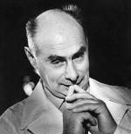
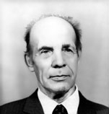
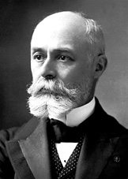
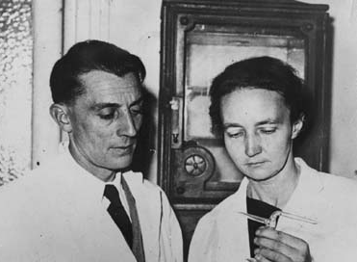
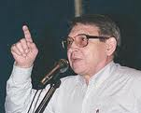
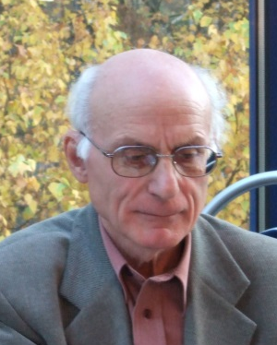
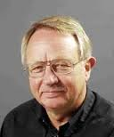
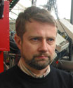
Radioactivity “hall of fame”
G.N. Flerov and K.A. Petrzhak
spontaneous fission
F. Jouliot and I. Curie:
β⁺
Henri Becquerel: three classes of radioactivity - negative, positive, and electrically neutral
?
?
V.A. Karnaukhov and G.M. Ter-Akopian
β-delayed p
S. Hofmann:
p
M. Pfutzner:
2p
???
2n radioactivity
???
4n radioactivity

Slide 20
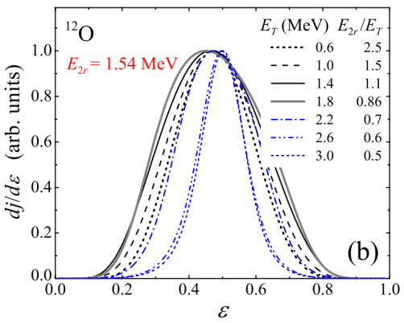
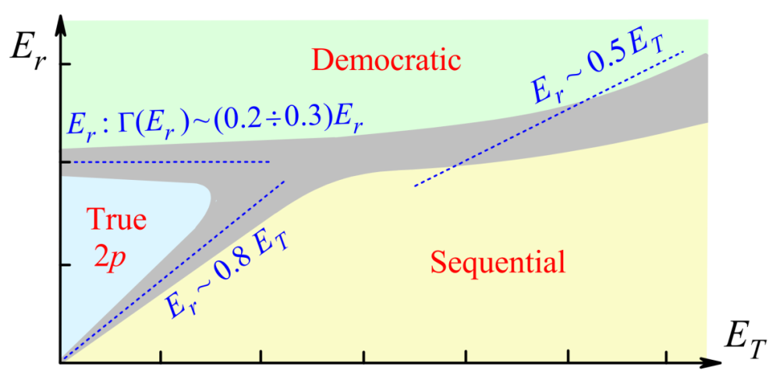
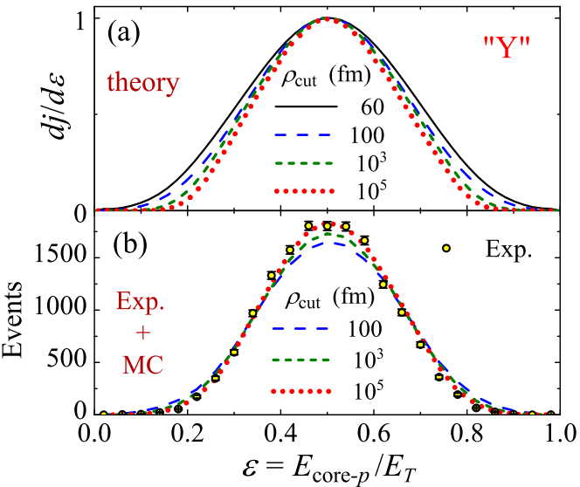
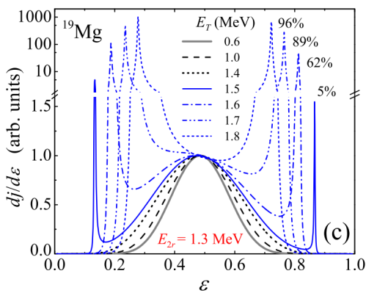
Few-body dynamics in continuum of clusterized exotic (dripline) nuclei
Transitional (phase-transition-like) dynamics in three-body decays
Long-range character of three-body Coulomb continuum problem by example of ¹⁶Ne
Democratic 2p <-> Sequential 2p
K. Brown et al., PRL 113 (2014) 232501
True 2p <-> Sequential 2p
T.A. Golubkova et al., PLB 762 (2016) 263

Slide 21
Last generation RIB factories in the world

Slide 22
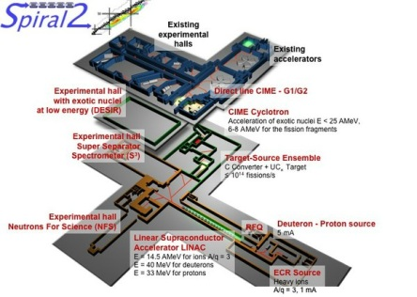
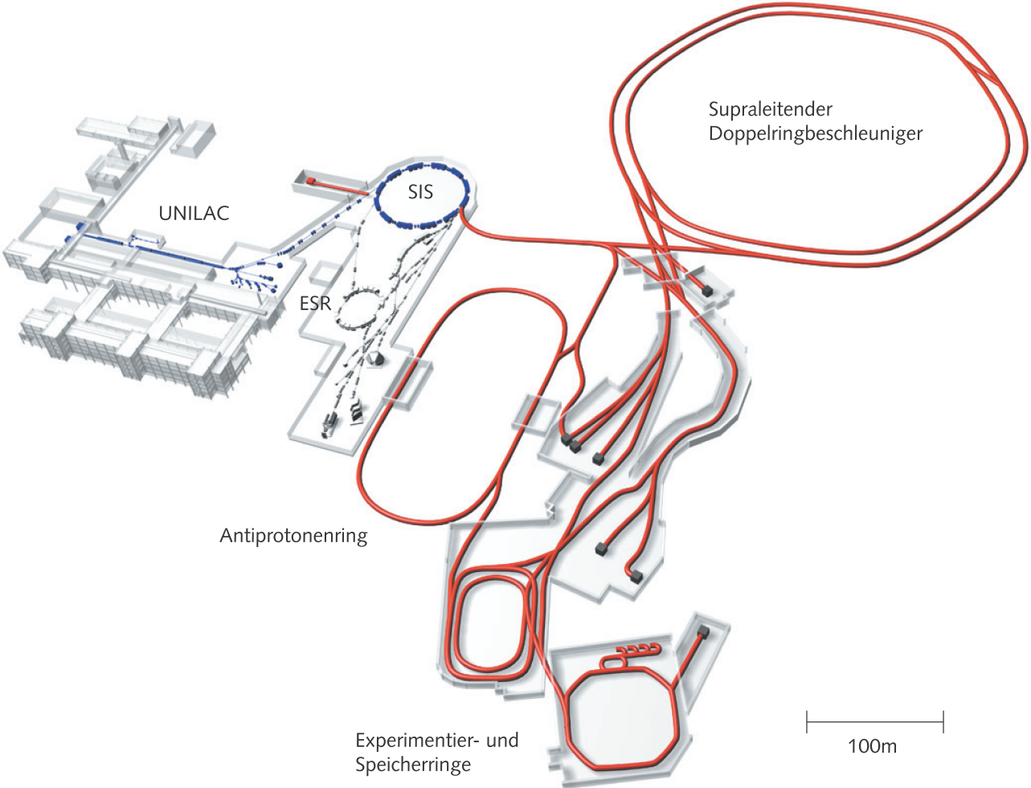
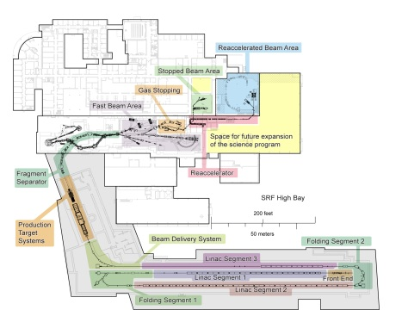

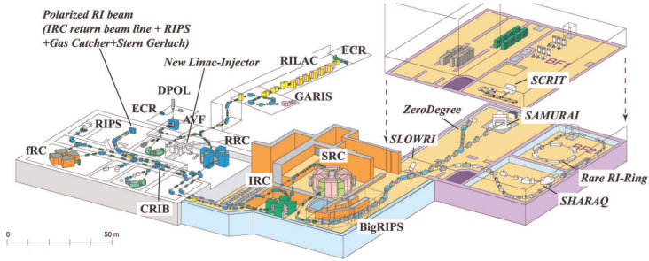
Big, bigger, the biggest
Huge increase in the scale of modern and prospective RIB facilities:
Price tag 1-2 G€
SPIRAL 2
FAIR
FRIB
U400M
hall
Is it possible to have world competitive RIB program with modest investment scale?
RIBF

Slide 23
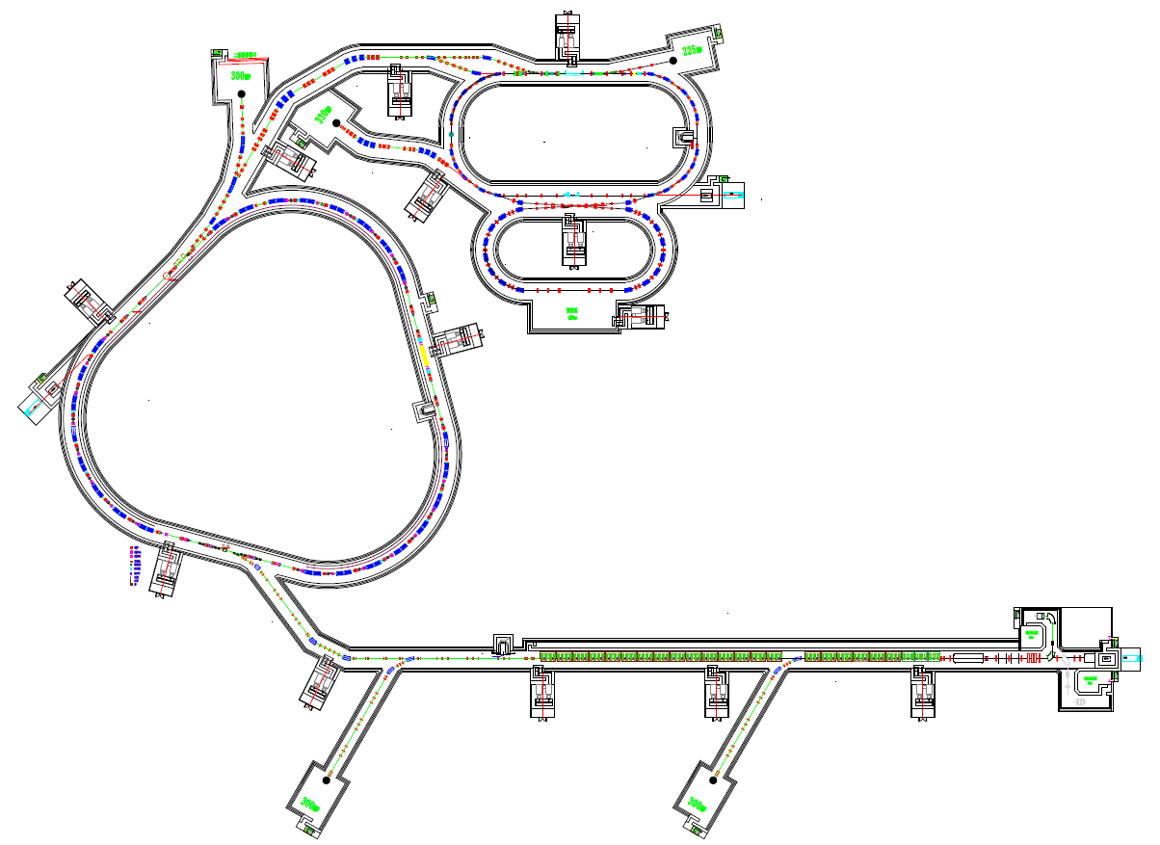
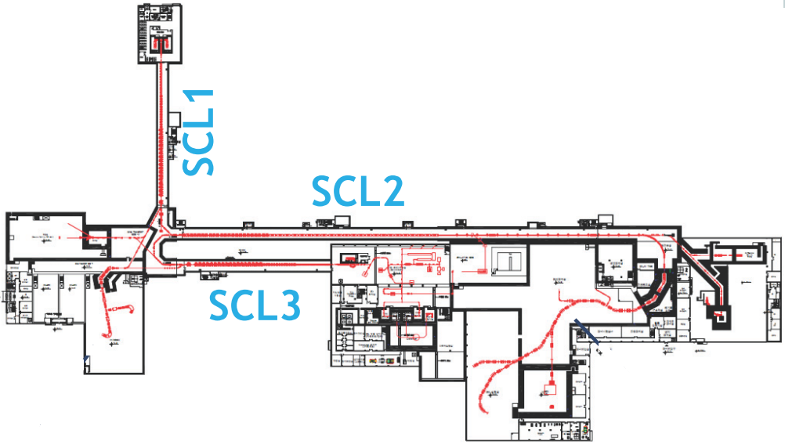
However, even bigger…
HIAF China
(see, FAIR)
Horizontal size of the slide ~1 km
RAON Korea
(see. FRIB)

Slide 24
Why to increase scale? – Increase energy!
10¹⁰ - 10¹² layers
~ 0.1 - 1m
How to make something exotic? Take something heavy (e.g. uranium), accelerate, crash it on the target nucleus, select exotic fragments
H r ~ 0.8 fm
O r ~ 3 fm
U r ~ 7.5 fm
Complicated to utilize much of the primary beam for nuclear reactions
~10⁵ fm
Beam energy loss by ionization
~10⁵ fm
Trend to energy increase at modern RIB facilities

Slide 25
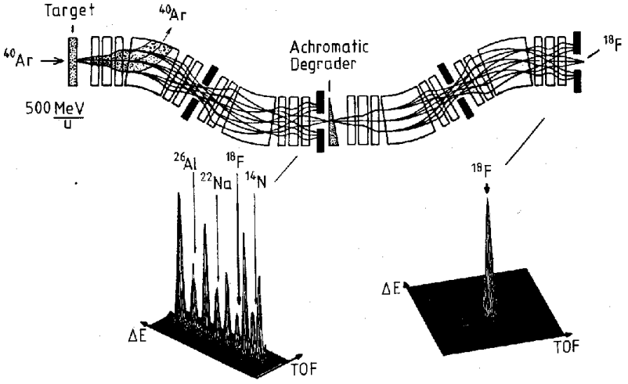
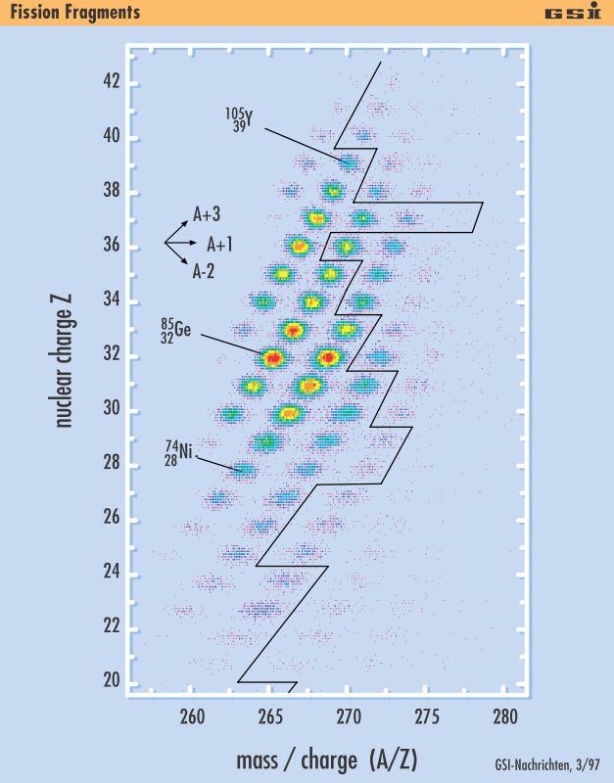
RIB production: In-Flight (Fragment Separators)
Typical FS design: 1-3 achromatic stages
TOF – Δ E particle identification
ε = E_{x} / E_{T} cos(q _{k}) = (k_{x},k_{y})/k_{x}k_{y}
FRS@GSI
Qualitatively:
Dipole = prism
Quadrupole = lens
Wedge degrader changes energy – no direct optical analogue
Fast RIB delivery –
t < 100-300 ns
Selectivity ~10⁻¹⁷ - 10⁻¹⁸

Slide 26
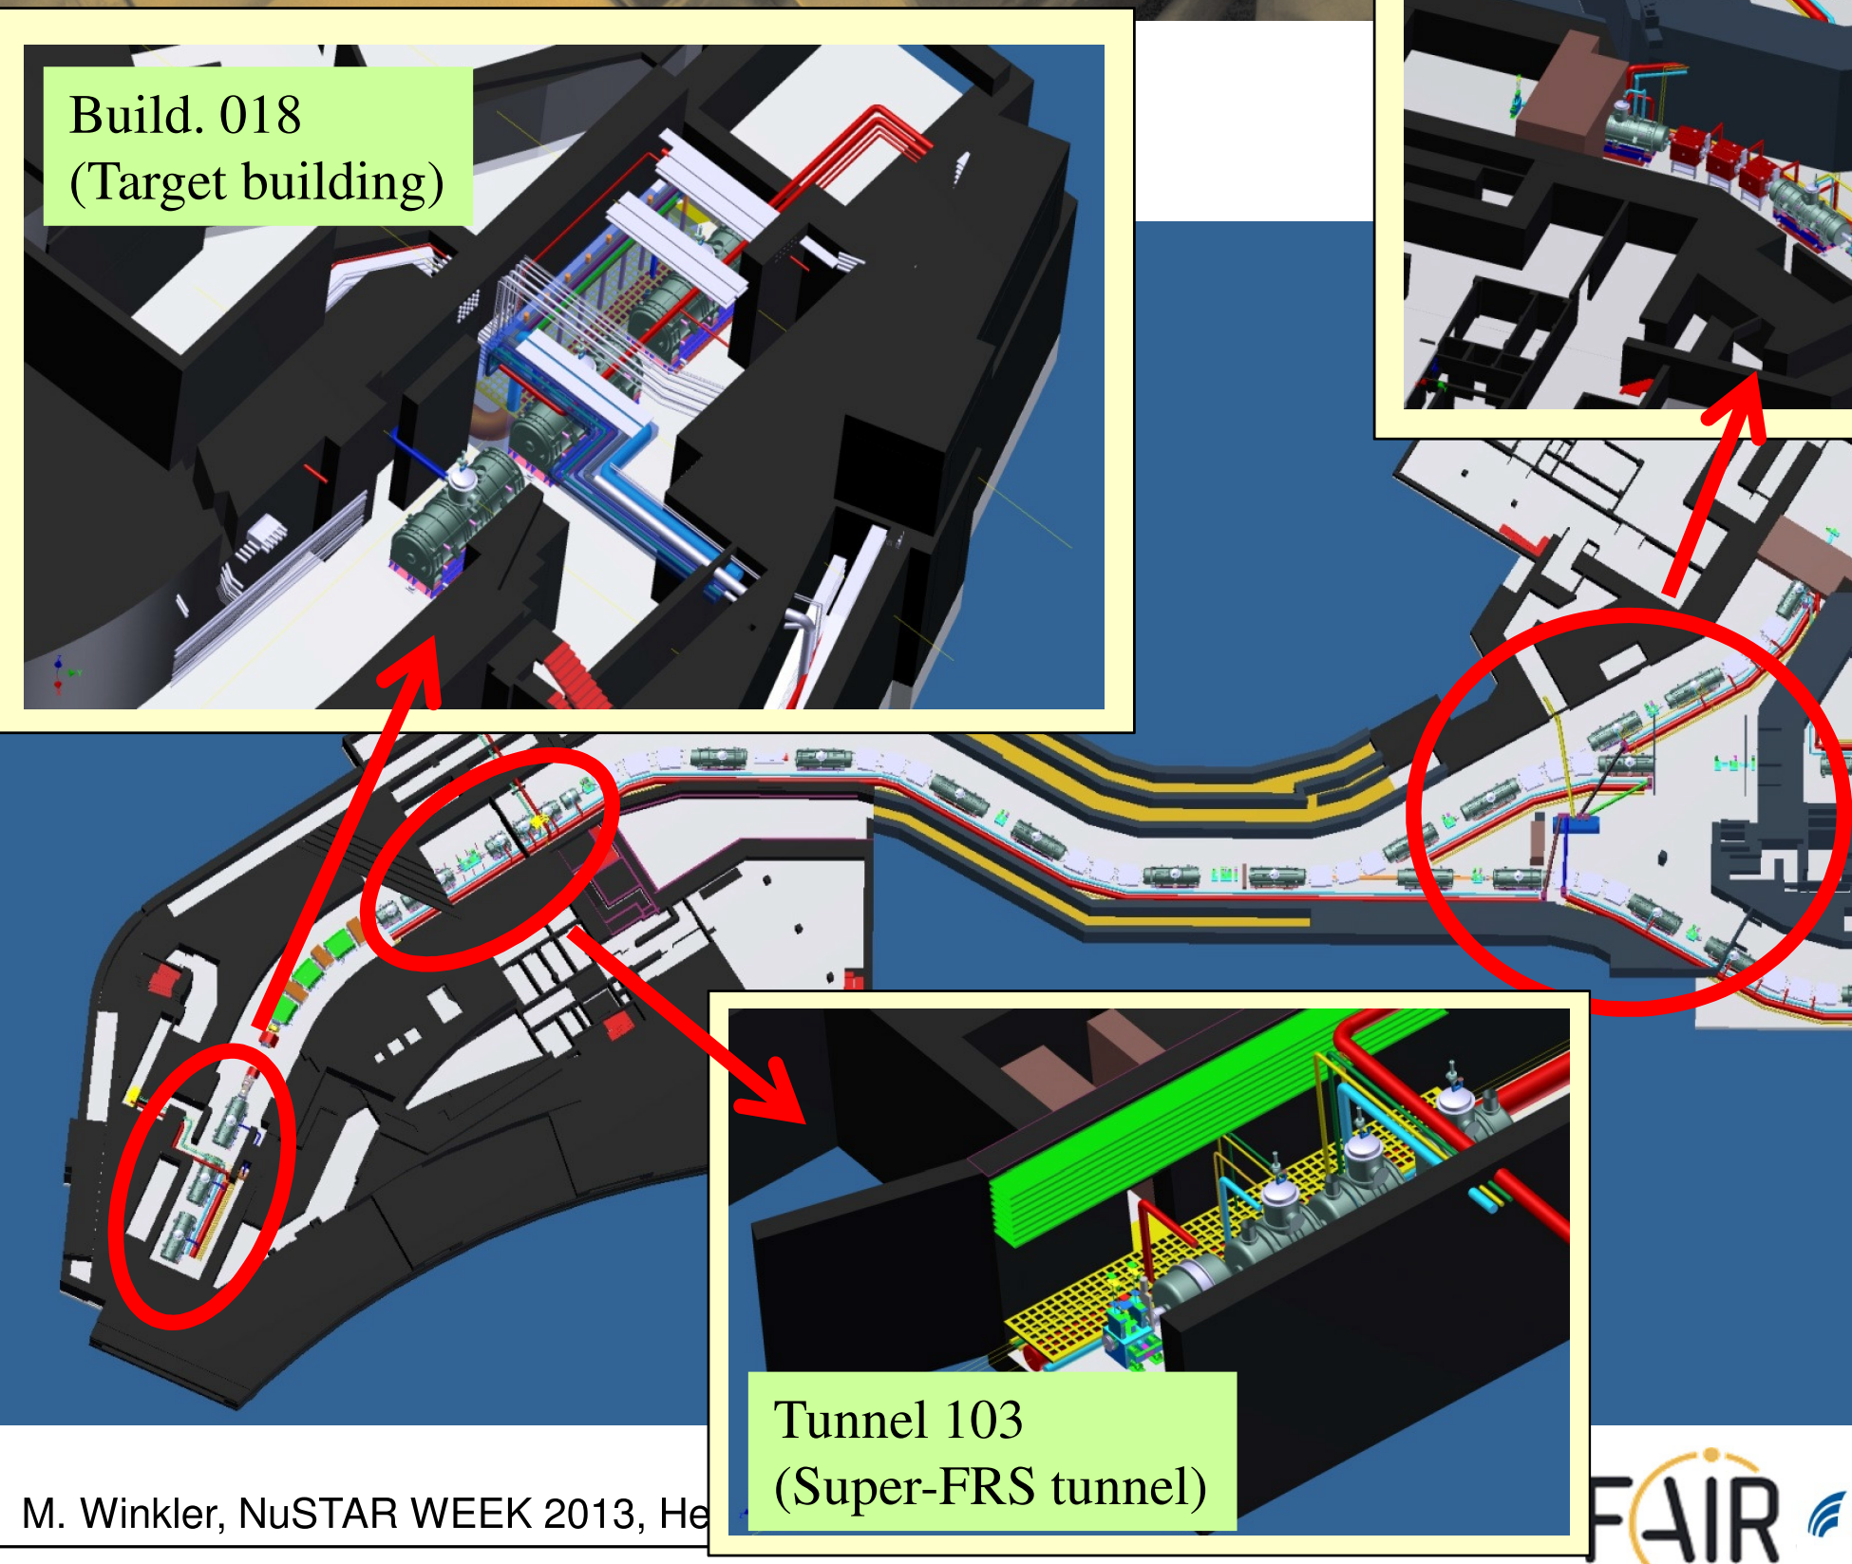


Challenge of modern fragment separators
FAIR, SuperFRS
U beam ~1500 AMeV
planned: ~1 pμA
achieved: ~200 pnA

Slide 27
Alternative approach to RIB production: ISOL (Isotope Separation On-Line)
Noble gas
flow
Possible ISOL layout (SPIRAL2)
Neutron converter
Uranium
foils
Deuteron beam
neutron beam
Kind of small reactor
Up to 10¹⁴ fissions/s
Selective laser ionization
RIB extraction
Problems:
Extraction selectivity
Extraction time (> 10 ms)

Slide 28
RIB physics at JINR

Slide 29
What we already have at Flerov lab
U-400 accelerator
Elements 102 - 108 and 113 - 118 were synthesized at FLNR JINR
Superheavy “isle of stability” discovered
New elements
¹¹⁴Fl Flerovium
¹¹⁶Lv Livermorium
¹¹³Nh Nihonium
¹¹⁵Mc Moscovium
¹¹⁷Ts Tennessine
¹¹⁸Og Oganesson recognized recently
Fragment-separator ACCULINNA:
Studies of the light RIBs
U-400М accelerator
The only facility for RIB studies in Russia, CIS, and Easten Europe

Slide 30






Flerov Lab: Superlights – fragment separator ACCULINNA
U-400M :
⁶Li @ 47 AMeV
I ~ 3×10⁷ 1/s
BS ~ 5 mm
C degrader
¹H(⁶Li,⁶Be)n
E(⁶Li)=33 A MeV
¹¹B @
34 AMeV
I ~ 2×10⁴ 1/s
BS ~ 15 mm
P ~ 90 %
no wedge
Δp/p=0.4%
Be 1.8 mm
Be 1.0 mm
Δp/p=3.6%
³H(⁸He,p)¹⁰He
E(⁸He)=22 A MeV
G.M. Ter-Akopian, A.M. Rodin, A.S. Fomichev, 1996-Now

Slide 31
Flerov Lab: Superlights – fragment separator ACCULINNA
A.A.Korsheninnikov, PRL 82 (1999) 3581.
A.A.Korsheninnikov, PRL 87 (2001) 092501.
S.V. Stepantsov et al., PLB 542 (2002) 35.
M.S. Golovkov et al., PLB 566 (2003) 70.
G.V. Rogachev et al. PRC 67 (2003) 041603(R).
M.S. Golovkov et al., PRL 93 (2004) 262501.
M.S. Golovkov et al., PLB 588 (2004) 163.
M.S. Golovkov et al., PRC 76 (2007) 021605(R).
M.S. Golovkov et al., PLB 672 (2009) 22.
L.V. Grigorenko et. al., PLB 677 (2009) 30.
S.I. Sidorchuk et al., PRL 108 (2012) 202502.
A.S. Fomichev et al., PLB 708 (2012) 6.
I.A. Egorova et al., PRL 109 (2012) 202502.
U-400M :
⁶Li @ 47 AMeV
Historically: injection line for K4-K10 facility
I ~ 3×10⁷ 1/s
BS ~ 5 mm
C degrader
¹H(⁶Li,⁶Be)n
E(⁶Li)=33 A MeV
¹¹B @
34 AMeV
I ~ 2×10⁴ 1/s
BS ~ 15 mm
P ~ 90 %
Transfer, charge-exchange and QFS reaction studies of ^{4,5}H, ^{5,6,8,9,10}He, ⁹Li, ⁶Be, ^{26,27}S, ¹⁷Ne
no wedge
Δp/p=0.4%
Be 1.8 mm
Be 1.0 mm
Δp/p=3.6%
³H(⁸He,p)¹⁰He
E(⁸He)=22 A MeV
G.M. Ter-Akopian, A.M. Rodin, A.S. Fomichev, 1996-Now

Slide 32



ACCULINNA instrumentation development
Already in production
New OTPC
Zero-angle spectrometer
Velocity filter (RF-kicker)
Stilbene neutron array
γ-array GADAST
“Expensive toys” shopping list
Tritium target system for ACC-2
High-resolution telescope array
U400M upgrade

Slide 33





Competitive light nuclei RIB program at FLNR.
Specific equipment development
HI
Warsaw OTPC (optical time-projection chamber)
p
M. Pfutzner, 2007
p
p
⁴⁵Fe
p
³¹Ar
p
MSU 2007: ⁴⁵Fe,
2p-radioactivity
ACCULINNA 2011: ⁸He, β-delayed α-t-n
GSI 2012: S388, ³¹Ar, β-delayed 3p
CCD 2/3’’
1000×1000 pix
12-bits
image ampl. (× 2000)
Truly unique item: cryogenic tritium gas system
Two units move to the neutron-rich region in (t,p) reaction
Background free experiments, easy variation of target thickness
Available only in military laboratories
Nice example of military technology conversion for fundamental science conversion

Slide 34




Example: ¹⁰He studied in the ⁸He(t,p)¹⁰He reaction
“Conundrum nucleis” second double magic in nuclide chart
Discovered by Korsheninnikov et al. in 1994 in RIKEN giving E_{T} =1.2 MeV
M.S. Golovkov et al., PLB 672 (2009) 22
S.I. Sidorchuk et al., PRL 108 (2012) 202502
Three-body correlations were studied in ⁵H basing on outstanding statistics. Can be something useful done with really exotic systems and limited statistics?
New ground state energy for ¹⁰He:
E_{T} =2.0-2.5 MeV
Shell structure breakdown in ¹⁰He

Slide 35



Publicity for ¹⁰He work

Slide 36
Today

Slide 37
Long-term prospects
“Factory of superheavy elements”
Status: running since 2019
Near future
Facility based on
ACCULINNA-2 fragment-separator
Status: running since 2018
Near future

Slide 38






Flerov Lab layout
SHE research:
DC-280
Since 2019
SHE research:
U-400
Since 1978
RIB research: ACCULINNA-2 Since 2018
SHE factory
U200
1500m²
2016
1000m²
IC100
NanoLab
DRIBs
2012
1500m²
U400R
MT25
U400M+DECRIS-SC
U400M
SHE experiments
Nuclear
Physics
Exotic Nuclei
E = 30 ÷ 60 MeV/n
A < 60
Reaction studies:
U-400
Since 1988

Slide 39


New facilities at FLNR: “factory of superheavies”
DC-280 cyclotron specifically adopted for superheavy elements synthesis
Building of “Factory of superheavy elements”

Slide 40


New facilities at FLNR: “superlights”
ACCULINNA-2 and zero-angle spectrometer delivered by “SigmaPhi” French ion optics solutions provider
ACCULINNA-2 fragment-separator
U-400M cyclotron
Zero-angle spectrometer in the low-background experimental hall

Slide 41


⁷H studied in the ²H(⁸He, ³He)⁷H -> t+4n reaction
⁸He beam 26 AMeV, 10⁵ pps
A.A. Korsheninnikov, 2003, ⁸He(p,2p)⁷H
There is something E<2
M.S. Golovkov, 2004,
No long living g.s.
Caamano, 2007,
⁷H g.s. at 0.57 MeV
Nikolskii, 2010,
There is something E<3
Excited state at 6.5 MeV
Indication of ground state at 2.1 MeV
May be something at 12 MeV

Slide 42
Tomorrow

Slide 43
Long-term prospects
“Factory of superheavy elements”
Status: running since 2019
Near future
???
Long-time prospects
Facility based on
ACCULINNA-2 fragment-separator
Staus: running since 2018
Near future

Slide 44
To limit universality
To go to “underdeveloped” fields
Huge increase in the scale of modern and prospective RIB facilities:
Starting price tag 1-2 G€
Scale increase – (i) RIB production increase via primary beam energy increase and (ii) universality of RIB facility
Is it possible to have world competitive RIB program with modest investment scale?

Slide 45
Empty “ecological niche”
Underdeveloped field: storage ring physics with RIBs
Empty field: studies of RIBs in electron-RIB collider
Studies of electromagnetic formfactors of exotic nuclei in e-RIB collider
Isochronous mass spectromentry
RIB storage ring
Precision reaction studies on internal gas jet target
electron storage ring
Atomic physics studies with striped ions
Etc….
Radioactivity studies with striped ions

Slide 46
Some philosophy.

Slide 47
What to study first…
Masses
Radial characteristics
The rest…
Nuclear masses measured in beginning 20-th century
Tanihata, 1988: radii in the lightest isotopic chains
Concept of nuclear power. Why the stars are shining…
Concept of nuclear halo

Slide 48






Electron scattering
Robert Hofstadter 1915-1990,
1961 Nobel Prize "for his pioneering studies of electron scattering in atomic nuclei and for his consequent discoveries concerning the structure of nucleons.."
After masses, the radial properties are the most important characteristics of nuclei
First Born approximation, fast electrons, relatively light nuclei
электроны, достаточно легкие ядра
Charge formfactor, charge radius
Electromagnetic probe is the most reliably studied
- Electron scattering
- Experiments in traps – “static” EM characteristics -> derivation of r_{ch}
- Electron scattering –
differenttial characteristics

Slide 49
Status of charge radii studies – broad field for exploration
900 measured for 3100 known nuclear-stable isotopes
Some isotopic chains are well studied – some not at all
Somewhere driplines is nearly achieved – somewhere very far
Systematics demonstrate complicated dynamical effects in the isotopic chains, especially near the driplines

Slide 50
e-RIB colliders. Prehistory.

Slide 51


e-RIB colliders: FLNR, К4-К10
Yu.Ts. Oganessian et. al.,
Z. Phys. A341 (1992) 217
Injection from U-400M
K4 ring (4 Tm)
- Storage
- Cooling
- Bunching
- Acceleration
К4
Separation channel
(fragment-separator)
K10 ring (10 Tm)
- Superhigh resolution spectrometer
- Reactions on internal target
К10
Electron-RIB collider

Slide 52




e-RIB colliders: Evolution of RIKEN
RI-Ring: isochronous mass spectroscopy for very rare events
- e-RIB collider MUSES
Planned
SCRIT: separate-standing ISOL facility for e-RIB collision studies in trap
Built

Slide 53

e-RIB colliders: Evolution of FAIR.
Planned
FAIR “Ring Branch”:
- Storage ring CR
- Experimental ring NESR
NESR@FAIR:
- e-RIB collider ELISE
- experiments on the internal
gas target EXL
Decision
postponed to 2026 (?)
Low-energy storage ring program CRYRING is relocated from Sweden

Slide 54
DERICA

Slide 55





Luminosity requirements for e-RIB collider studies
Realistic setup 10 days of measurements
Limiting cases of charge distributions
⁴⁰Ca and ⁴⁸Ca realistic 2 parameter density
1% precision charge radius
L = 10²⁶-10²⁷ cm⁻² s⁻¹
T = 10 days
L = 7x10²⁷ cm⁻² s⁻¹
2σ (95% confidence)

Slide 56


DERICA –
Dubna Electron-Radioactive
Isotope Collider fAcility
Project emphasis
Reaccelarated RIBs, storage ring physics including e-RIB collider
Basic facility
High-current superconducting HI cw-LINAC-100

Slide 57
DERICA стадия 2
Новые экспериментальные возможности на каждой стадии
LINAC-100 - упор на интенсивность первичного пучка, а не энергию
Прямые реакции с РИ при промежуточных энергиях (30-80 AMeV)
Хотим иметь рекордные первичные пучки для энергии ~ 100 АМеV
Рекордные интенсивности пучков РИ 30-80 AMeV
Ca – 3 pmA U – 1 pmA

Slide 58
DERICA стадия 3.1
Новые экспериментальные возможности на каждой стадии
Реакции с постускоренными РИ вблизи кулоновского барьера (5-7 AMeV) или при промежуточных энергиях (20-30 AMeV)
Низкоэнергетическое накопительное кольцо
Остановленные РИ – изучение распадов и эксперименты в ловушках

Slide 59
DERICA стадия 3.2
Новые экспериментальные возможности на каждой стадии
Синхротрон до 300-500 AMeV
Прямые реакции с постускоренными РИ до 300-500 AMeV

Slide 60
DERICA стадия 4.1
Новые экспериментальные возможности на каждой стадии
Эксперименты в высокоэнергетическом накопительном кольце

Slide 61
DERICA стадия 4.2
Новые экспериментальные возможности на каждой стадии
Эксперименты на e-РИ коллайдере

Slide 62
Advantages of the proposed facility
Unusual facility layout
Ordinary approach 1:
ISOL RIB production ->
problem to reaccelerate RIBs
Ordinary approach 2:
In-flight RIB production ->
Problem to stop/cool RIBs
DERICA approach:
In-flight RIB production + RIB “cooling” in gas cell + reaccelerated RIBs up to 500 AMeV
Staged development
- Continuity and flexibility of
the research program
- Low technological risks
- Highly upgradable facility
design
Unique opportunities
- World most intense RIBs with
intermediate energy (20-70 AMeV)
for reaction studies
- Reaccelerated RIBs up to 500 AMeV
- e-RIB collider experiment

Slide 63

LoI: Russian physical review journal Physics-Uspekhi (2019)
http://derica.jinr.ru/index.php
April 26, 2018. The is project is submitted to Russian Ministry of Education and Science on the call for «Proposals to build “megascience”-class facilities on the territory of Russian Federation» as joint JINR-BINP venture
In September 2018 evaluation by Russian Academy of Sciences positioned DERICA in the top of the proposals list.

Slide 64




LINAC-100
DERICA workshop February 7-8, JINR
Declaration of most urgent task
To start development of the “front end” for LINAC-100 immediately
Support by JINR directorate for 2019
- Resources allocated: 650 k$
New research project at JINR for 2020-2021
- Decision to be made by JINR PAC 24-25 June 2019
- Expected resources 2020: 1400 k$ - 2021: 1450 k$
Expected output by the end 2021
- TDR + prototypes for LINAC-100 - CDR for DERICA

Slide 65
DERICA
In certain sense it is not a project (with well defined start and finish). This is rather vision for possible integrated strategy of the low-energy nuclear physics development in Russia, JINR, and Member states for the 15-30 year period

