Slide 1
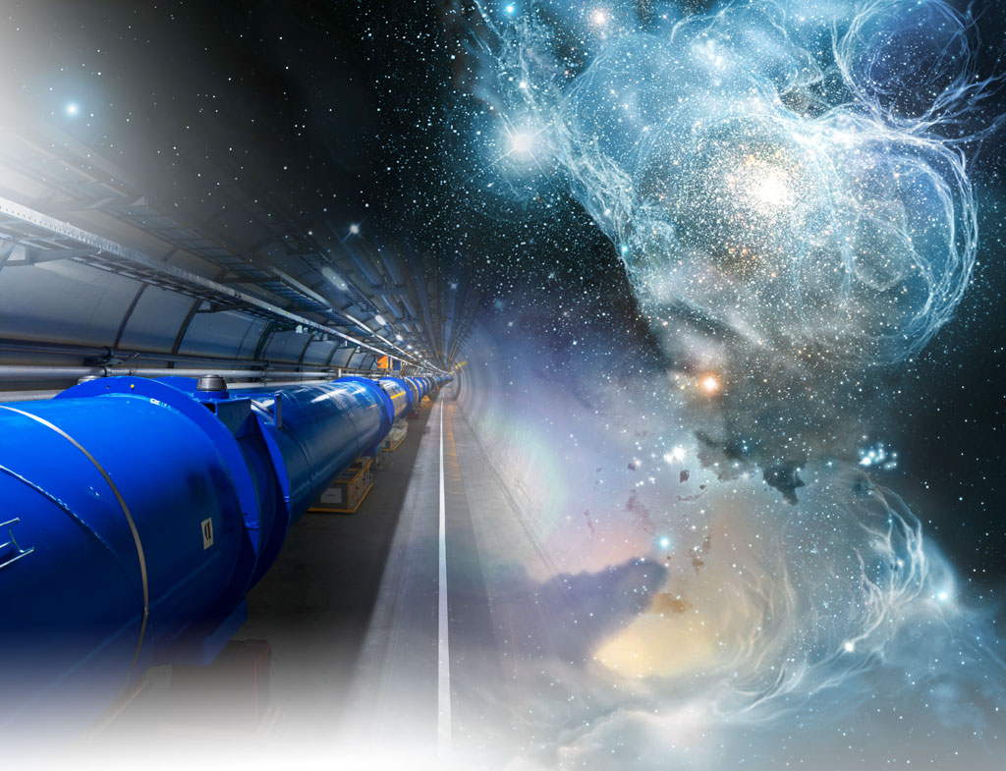
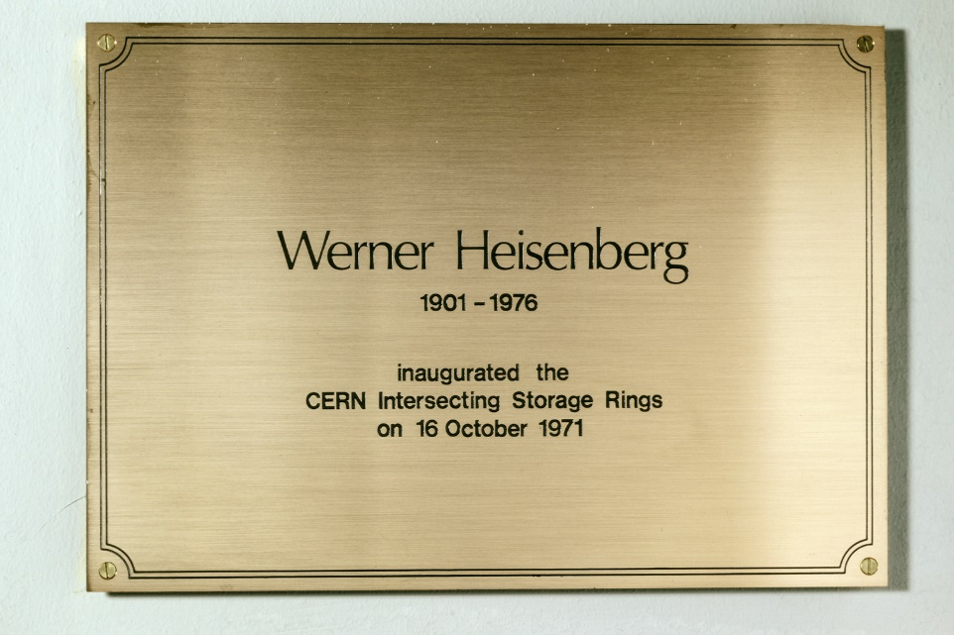
Highlights from the CERN Intersecting Storage Rings (ISR)
1971-1984
Strategies, performance, challenges & possible lessons learned
Fritz Caspers
(joined CERN 1982)
J.-P. Koutchouk
then ISR Operations group

Slide 2
Outline
The structure of the ISR collider; motivation, ideas, timeline
The ISR parameter list and its operational concepts
Challenges and solutions (magnets, vacuum, RF, Instr…)
Some reasons for the « explosion » in performance
The ion operation
Groundbreaking developments (e.g.first stoch cooling)
First signs of the electron cloud
Lessons learned and exploring new territories
The human and managerial factor
Some short comments on particle physics achievements
Acknowledgements/Conclusions
Further reading

Slide 3
1.1 ISR topology (structure)
2 interlaced rings:
8 crossings
  Detectors in I1, I2, I4, I6, I7, I8
  Beam dump in I3

Slide 4
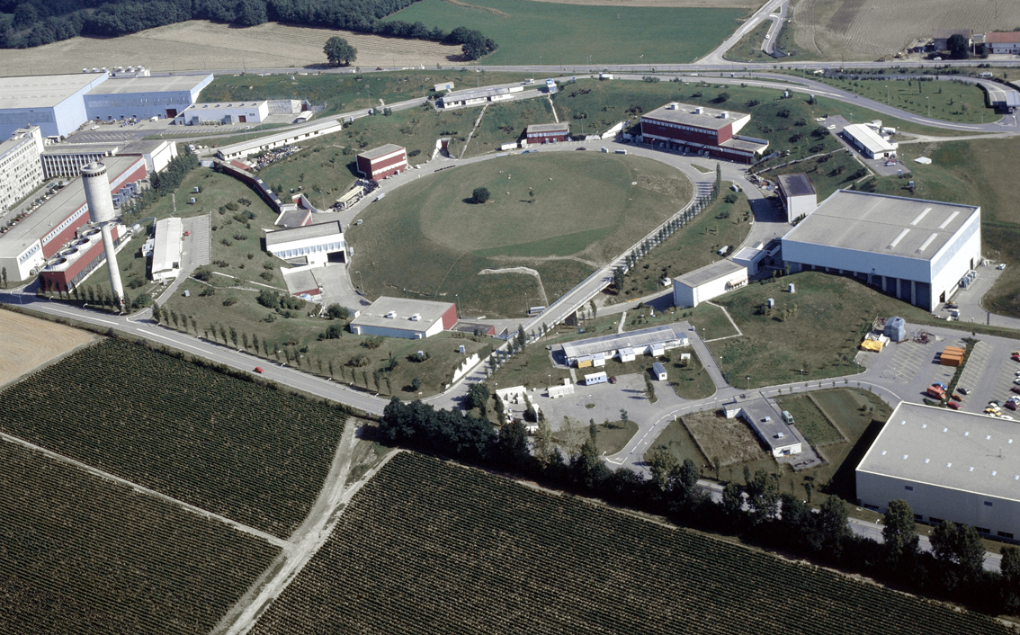
1.2 The general layout (aerial view)
7808537X (1978)

Slide 5
1.3 The Motivation
The most relevant point was, to boost the center of mass energy
For the same CM energy as achieved in the ISR a normal synchrotron would have required 1.5 TeV..not achieveable at that time (c.f K.Hübner: ISR for pedestrians)
Note, that the crossing angle was large in order to house the quads;
Despite this difficulty the Luminosity obtained after many years of improvments was un-challendged for a long time and may still be considered « high » these days.
And to have an excellent test bed for new accelerator technologies (vacuum, impedance, superconducting elements etc)

Slide 6
1.4 The timeline
Design from 1960
Approval by CERN Council in 1965
Construction started in 1965
  See: ISR Design Report 1964 https://cds.cern.ch/record/110073/files/CM-P00064209.pdf
First collisions in January 1971
12 years of highly efficient operation
Closed (in perfect fit) in 1983 in view of the LEP construction.

Slide 7
2. Main parameters (protons)
 | Nominal | Achieved | unit
Circumference | 942.637 (2πR) | =3/2 times PS | m
Beam momentum | 26 | 31 | GeV/c | Phase displacement acceleration
Beam current | 2 x 20 | 57 | A | Space charge control
Beam charge | 4 x 10¹⁴ | ≈10¹⁵ | ^{elementary charge of a proton}
Luminosity (p) | 4x10³⁰ cm⁻² s⁻¹ | 1.4 x 10³² In the superconducting low beta section | cm⁻² s⁻¹
Beam structure | coasting
In this parameter list one can nicely see the “explosion” in performance, related to several factors (discussed in the following slides); maybe this experience can help also for NICA,
as some numbers are not so far apart

Slide 8
3. Challenges and related solutions I
  The ISR was not easy to operate (with protons) compared to LEP (electrons)
    The beam was always close to the transverse stability limit for currents > 20A
    Beam losses during filling, acceleration and physics runs were not uncommon
    Thus there was a strong and proactive motivation to improve on stability
      Theory (B. Zotter)
      Transverse feedbacks by the Rf group (W. Schnell)
  At this time the concept of beam impedance was basically known (definition by V. Vaccaro 50 years ago from today) and got explored…
    But the practical work with this subject brought many surprises and required high specialised skills
    Very competent engineers in analog (RF) technology (led by W.Schnell)
    Specialized Instrumentation for transient beam phenomena (By RF and OP)
    Spike detectors in the PPM level for the power group
    Shift from empirical to systematic tuning of the machine
    Highest weight on novel observation techniques
    Observation of strong coasting beams by sweeping empty buckets to measure orbit and tune vs ΔP/P. ( it was 2 % compared to about 1 ‰ for bunched beams on all other machine then)

Slide 9
3. Challenges and related solutions II
Observation of Schottky signals
  Systematic use of longitudinal and transverse Schottky monitors (beam diagnostics); Schottky noise observation on a 20 A beam is really fun
    Learning to do BTF measurements (large RF group with J. Borer) and translation into a stability diagram
    Luminosity optimisation with “van der Meer” scans
    What is a van der Meer scan? http://cds.cern.ch/record/296752/files/196800064.pdf (ISR PO-68-31)
      One of the two colliding beams is displaced wrt the other one and one records the counting rate from the interaction region as a function of displacement
    Two beam stability evaluation (A. Hofmann and JPK)
      Here A Hofmann (theory group) was an outstanding driving force motivating many young people from OP, RF ..)

Slide 10
3. Challenges and related solutions III
The ISR was severely limited by betatron resonances
  Below Order of 8 they were killers
  Between order 8 and 10 they would impact background
  The extend of beam in transverse phase space was severely limited by nonlinear resonances; yet for transverse stability a sufficient chromaticity had to be respected. To satisfy these conflicting requirements the tunes of the machine had to be moved very close to integer values where the non-linear resonance web is less dense and offers more space for the stack at the expense of delicate and careful control.
  the stability of the stack was in danger when Landau damping by dQ/dp was not enough to counteract/compensate the transverse resistive wall instability
  In the process of approaching very closely the integer resonance, a blow up of the top of the stack was observed and explained by a newly defined “overlap knock out” resonance driven by a non-optical effect; This was considered related to the impact of the machine impedance coupling he longitudinal frequencies of the injected bunches with the transverse betatron frequencies at the top of the ISR stack (J. Gourber, S. Myers)

Slide 11
3. Challenges and related solutions IV
Vacuum
  The proper understanding of vacuum dynamics and their improvement was a key R&D issue (led by E. Fischer +VAC group)
    Glow discharge cleaning
    Already at this time: electron cloud
    Clearing electrodes (metallic, thus not “invisible” and acting as resonant PU)
    Electron-proton instabilities
  Each progress was investigated by a “vacuum run”
    There OP had the task to use all aspects of beam dynamics, beam operation etc
    Specially developed MD settings for this kind of run
    And try to exceed the last beam intensity records until finally vacuum collapses
    And this time gas desorption (when particles hit the beampipe and liberate gas) from certain surfaces treatments of the beampipe became a relevant issue (later followed up by E. Mahner)
    Of course sometimes the beam was lost before the last records were passed..leading to “friendly”comments by certain colleagues

Slide 12
4. Some reasons for the « explosion » in performance I
Improvements in the use of existing hardware
  Progress in the understanding of beam dynamics
  Refining all beam control processes to a high degree of accuracy
  Flexible and intelligent Controls (they would even today still be competitive , some experts say…)
    That’s why the ION operation was considered a “non challenge”
  This learning curve was not so much different from other machines, except this was the FIRST proton collider and everything had to learned…
  Many things learned on this proton-proton collider operation were later taken into consideration for the construction of the SPS, the AA, LEP and also the LHC

Slide 13
4. Some reasons for the « explosion » in performance II
Beam observation/diagnostics as key factor
  Continuously pushed for better accuracy and performance
  Ultimate use of the data content of Schottky signals and later beam transfer functions
    Single beam/single plane for observation of particle densities, tunes, resonances and the impact of the machine impedance.
    Single beam and coupling between horizontal and vertical plane for refined non-destructive betatron coupling measurement and minimisation, reducing thereby the background of the experiment.
    Two-beam transfer function for the stability of the colliding beam systems and as a novel observable, to measure and optimize luminosity by a “van der Meer scan”, immune to beam background experienced by physics detectors.
  Generation of sophisticated data (stability diagram in direct display) and thus acting directly to maximize transverse stability

Slide 14
4.Some reasons for the « explosion » in performance III
New concepts
  Steel based low beta insertion and its (incomplete) matching with the lattice
  This was the first kind of a low beta insertion in a proton collider
    Notice: The first low beta insertion bad been used in the by-pass of the Cambridge electron accelerator
  Here the absence of synchrotron damping (like in electron machines) would not wipe out the effect of (magnetic) nonlinearities;
  The superconducting low beta insertion (for the first time)
  Vacuum vessel processing (in situ high temp. bake-out and plasma discharge) leading to a huge improvement of vacuum quality; a prerequisite for the AA(antiproton accumulator)
    This vacuum improvement did amount to more than one order of magnitude, reaching well into the low 10E⁻¹² Torr (mbar) region
    Experiments complained about background when the beam lifetime fell below 4 months (!!!) despite collimation
  The evidence of Schottky signals opened the door to stochastic cooling

Slide 15
5.The ion operation (I)
After demonstration of the feasibility of deuteron acceleration in the CERN-PS, deuteron storage in the ISR was considered.
  Acceleration of deuterons standard momentum for ISR operation (26 GeV/c) and transfer to the ISR could be achieved with normal proton settings since all elements in the transfer lines etc are magnetic.
  In the ISR, for a fixed momentum the difference between proton shows up only in the relativistic parameters ß and γ as well as the slip factor η.
  Variations in those quantities will affect the revolution frequency and the stacking bucket area (which must be matched to the area of the bunches for optimizing stacking efficiency
  I addition the relation between measured beam frequencies and average radial position must be taken into account together with the betatron tune spread derived by Schottky scan techniques
  The other parameters such as beam trajectory , closed orbit, working lines, Q values in the stack, incoherent tune shift due to the stacked beam remain unchanged.
CERN-ISR-OP-77-14; CERN-PS-DL-77-14.- 1977- Published in : IEEE Trans. Nucl. Sci. 24 (1977) 1557-1560

Slide 16
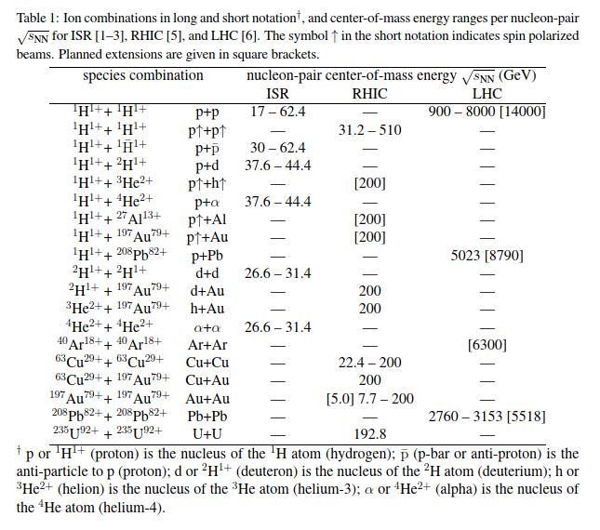
5.The ion operation (II)
The table at the left [W. Fischer , J. Jowett Ion Colliders; CERN –ACC-2015-0015] gives an idea and overview on the type of light ions used in the ISR and also shows a nice comparison of the respective center of mass energy
The light ion collider operation (from1977 onwards) was in addition to the well known p+p but also p+pbar operation.

Slide 17
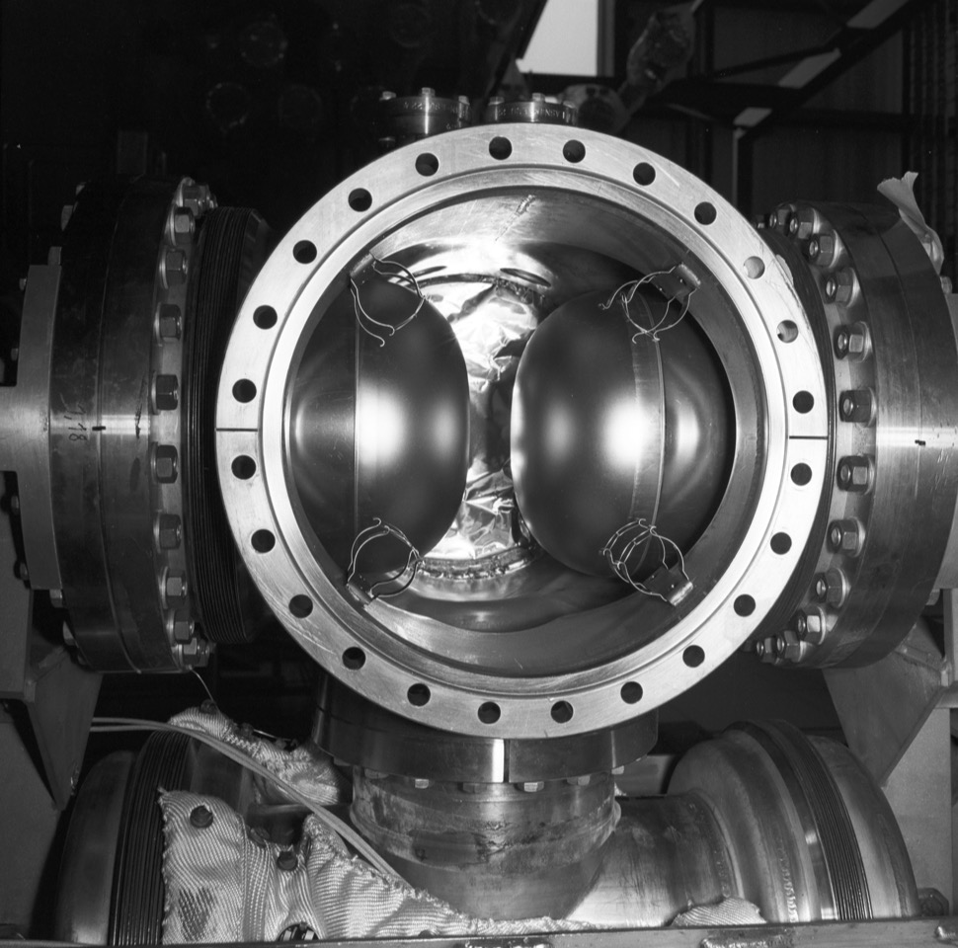
6.The « roman pots » in the ISR
"Roman pots" are stainless steel containers, which can be moved from outside the vacuum chamber towards the beam. They house detectors which are conveniently at atmospheric pressure and can still be brought close to the limit of the circulating beam, to detect particles emanating at very small angles from the intersection of two colliding beams. Eifionydd Jones was the inventor of this device, highly successful at the ISR and now used again at the TOTEM experiment at the LHC. This particular Roman Pot, with a thickness of 0.2 mm, was built in 1980 for experiment R210 in intersection I-2, in preparation for proton-antiproton collisions in 1981. See also 7501065.
8008139
8312596X

Slide 18
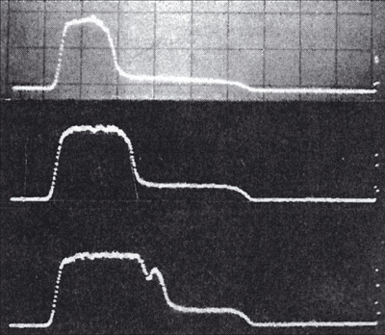
6.Schottky Signals and Stochastic Cooling (I)
  The first longitudinal Schottky scans were seen in 1972
First longitudinal Schottky scans
In 1972 Wolfgang Schnell looked for and found the longitudinal and transverse Schottky signals at the the ISR. This prompted Simon van der Meer to publish his work from 1968 about stochastic “damping” which became later changed to stochastic cooling.
The longitudinal Schottky signals permit to measure in a non-destructive manner the current density in the stack while the transverse signals provide information on how the density varies with the betatron frequency

Slide 19
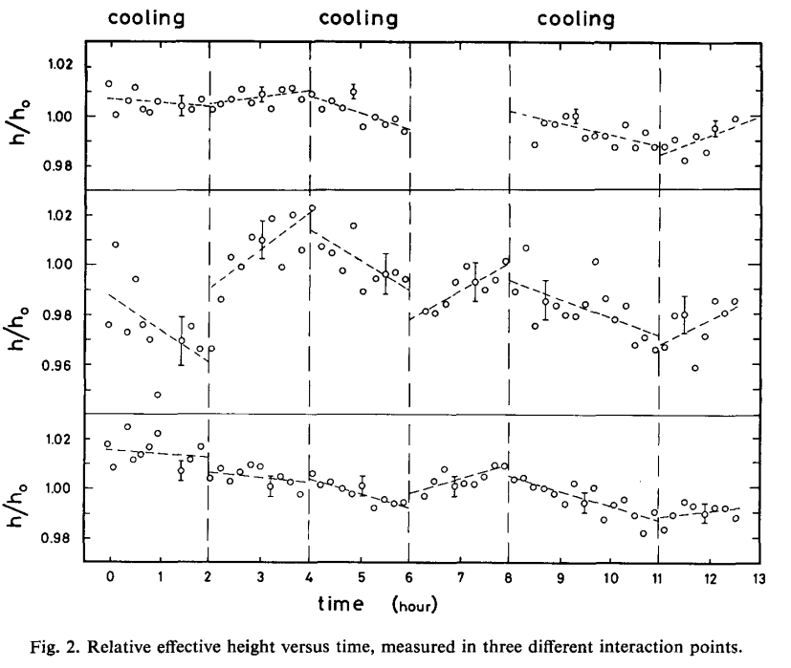
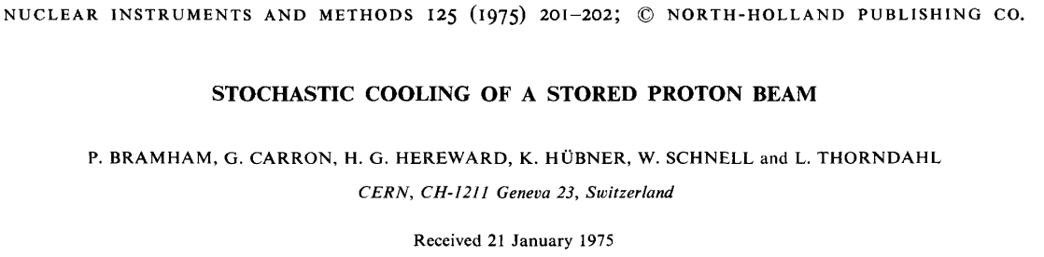
6.Schottky Signals and Stochastic Cooling (II)
  The first evidence of (betatron) stochastic cooling (1974)
  Here
Here we see clearly the effect of the transverse cooling system on the beam; note that the beam intensity has been monitored very carefully during this process. The output power was rather moderate (around 1 Watt) and there were 2 E13 particles in the machine at 26.6 GeV.
Experiments were done in 1974 and this paper became submitted early 1975. The measured cooling time constant were not far from predictions.
As for the budget...”tricky operations required”…W. Schnell managed to hide the cost for this under “feedback systems”.

Slide 20
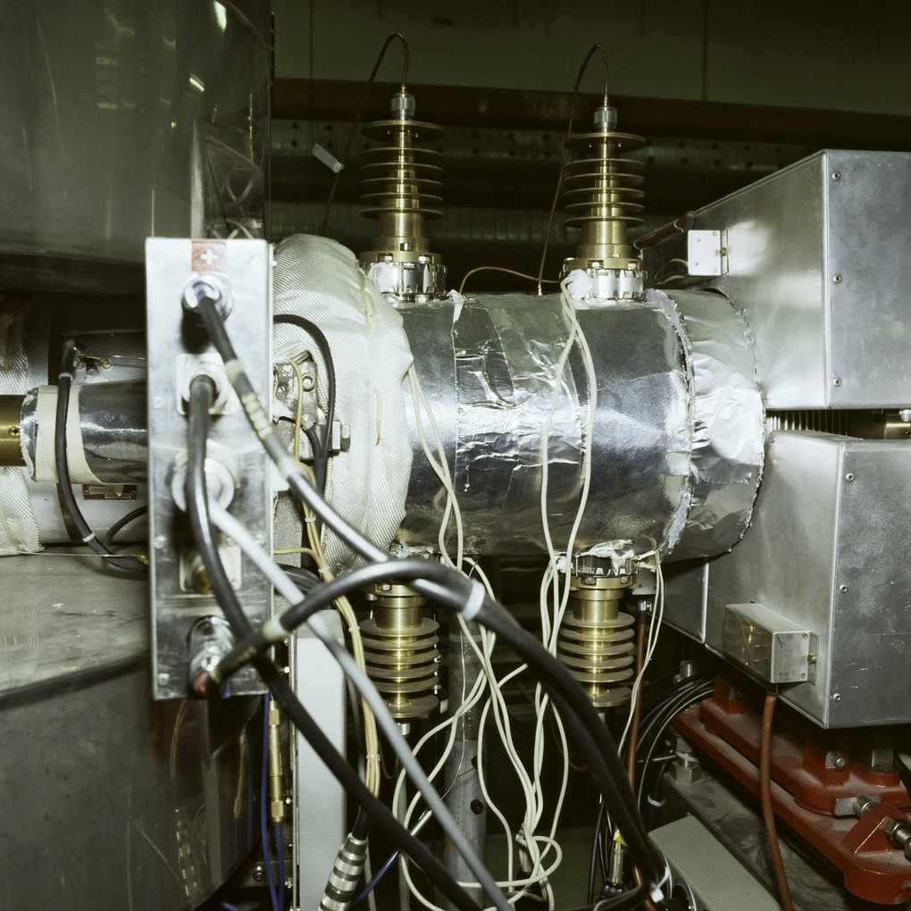
6.Stochastic cooling hardware in the the ISR
The photo shows (center) an experimental set-up for stochastic cooling of vertical betatron oscillations, used at the ISR in the years before the ICE ring (ICE= Initial cooling experiment) was built. Cooling times of about 30 min were obtained in the low intensity range (~0.3 A). To be noted: the four 50 Ohm brass input/output connections with cooling fins (important during bake-out), and the baking-out sheet around the cylinder. On the left one sees a clearing electrode box allowing the electrode current to be measured, and the pressure seen by the beam to be evaluated. A bit later the first plunging PU structures were applied using the ROMAN POT type mechanical displacement mechanism (private communication by L .Thorndahl)
83010785X

Slide 21
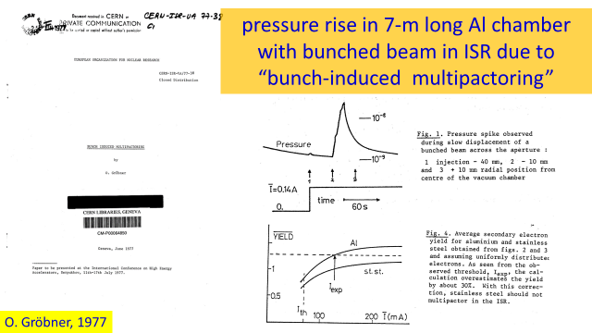
7. Electron cloud observation in the ISR (I)
This slide was kindly provided by F .Zimmermann

Slide 22
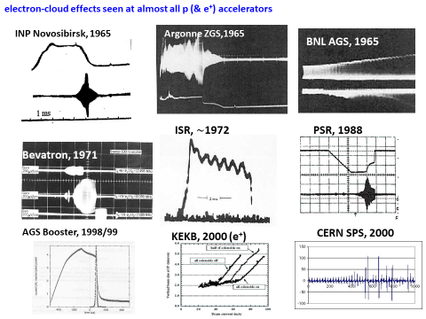
7. Electron cloud observation in the ISR (II)
This slide was kindly provided by F .Zimmermann

Slide 23
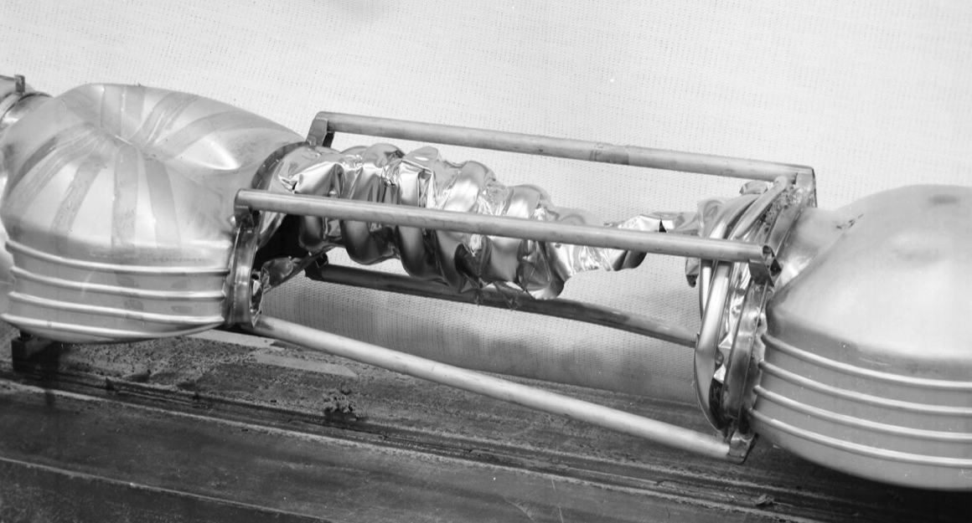
8.Lessons learned: An imploded vacuum chamber
Just one example..there were more
7701343
The vacuum chamber had to be as transparent as possible to let the collision products reach the detector. This test chamber with 0.6 mm titanium failed
In some cases hardware tests give the final truth and the ISR could be a bumpy road

Slide 24
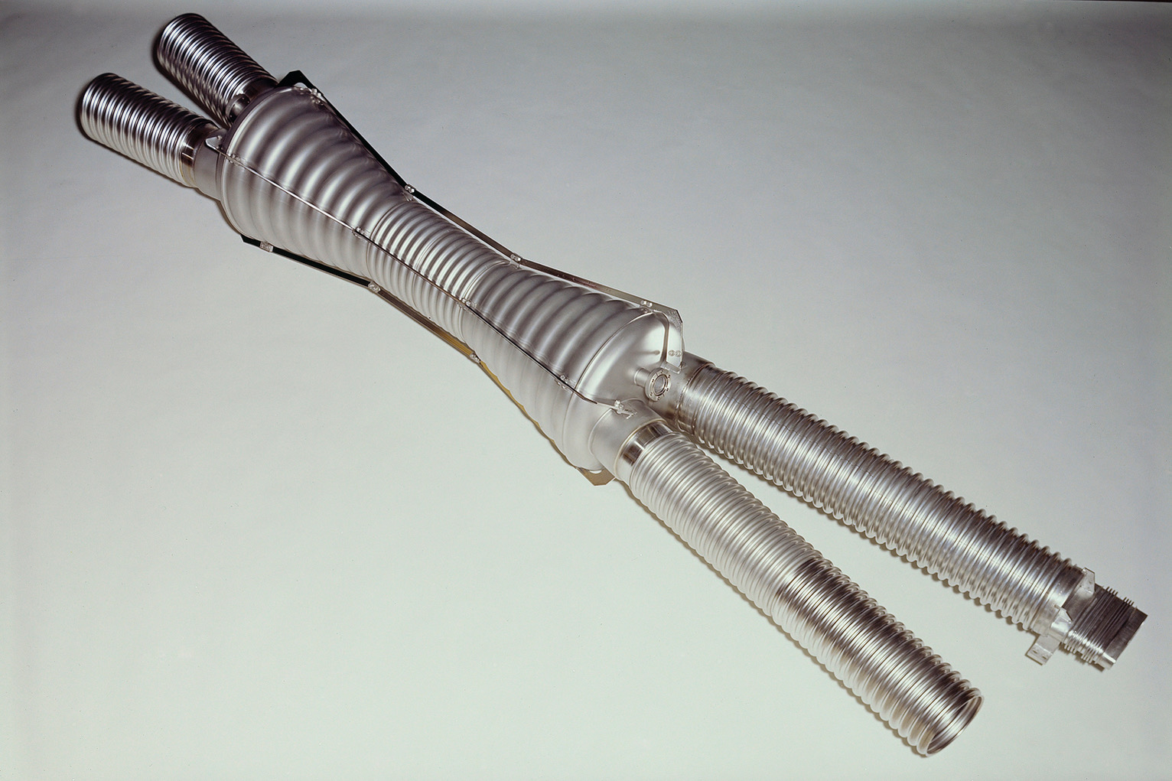
8. The « bicone » of the ISR
This chamber is now in the National Museum of History and Technology, Smithsonian Institution, Washington, DC, USA, where it was exposed in an exhibit on the History of High Energy Accelerators (1977).
7704618X

Slide 25
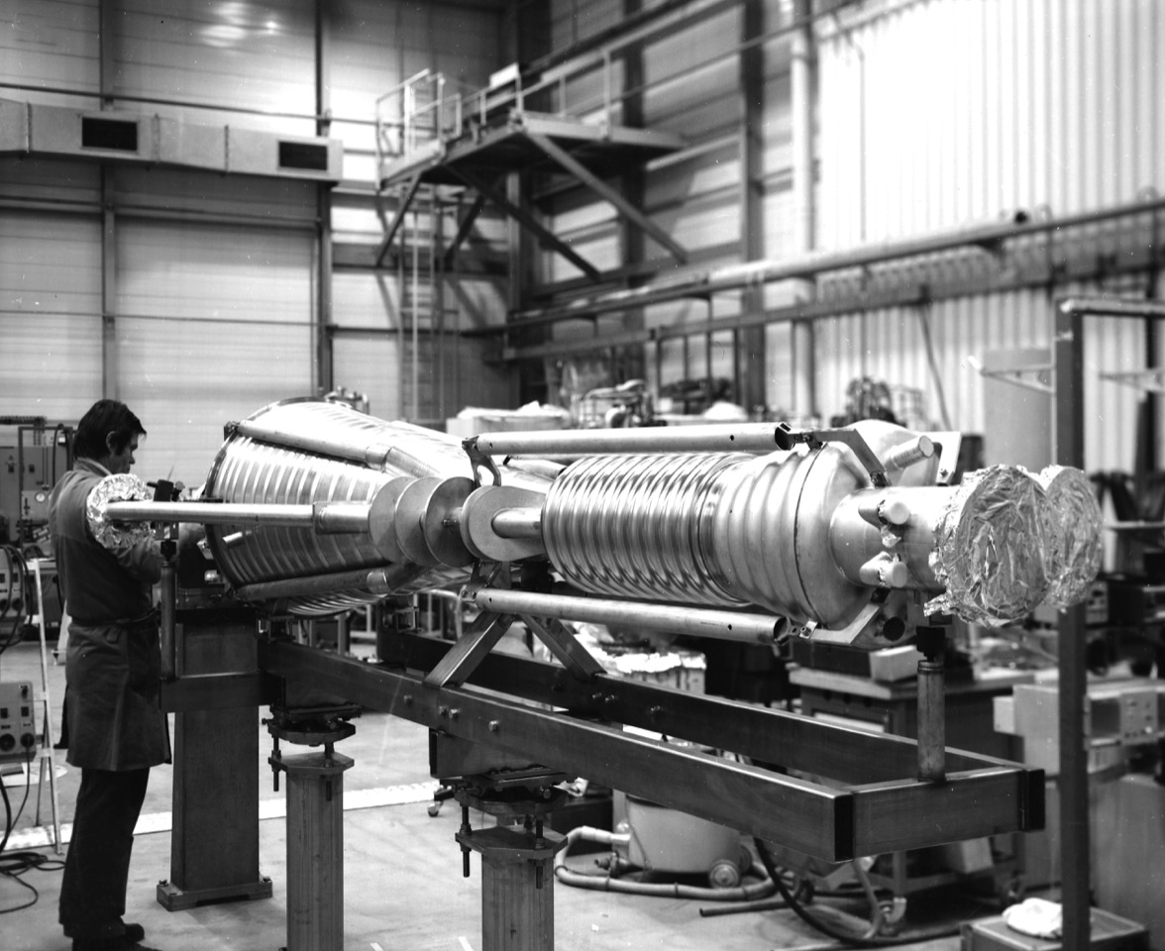
8. The « mega-bicone » of the ISR
Here we can nicely identify some of the external mechanical re-inforcements (some of them are removed later in situ) to prevent collapse of this delicate thin walled structure against collapse from ambient air pressure.
7911590

Slide 26
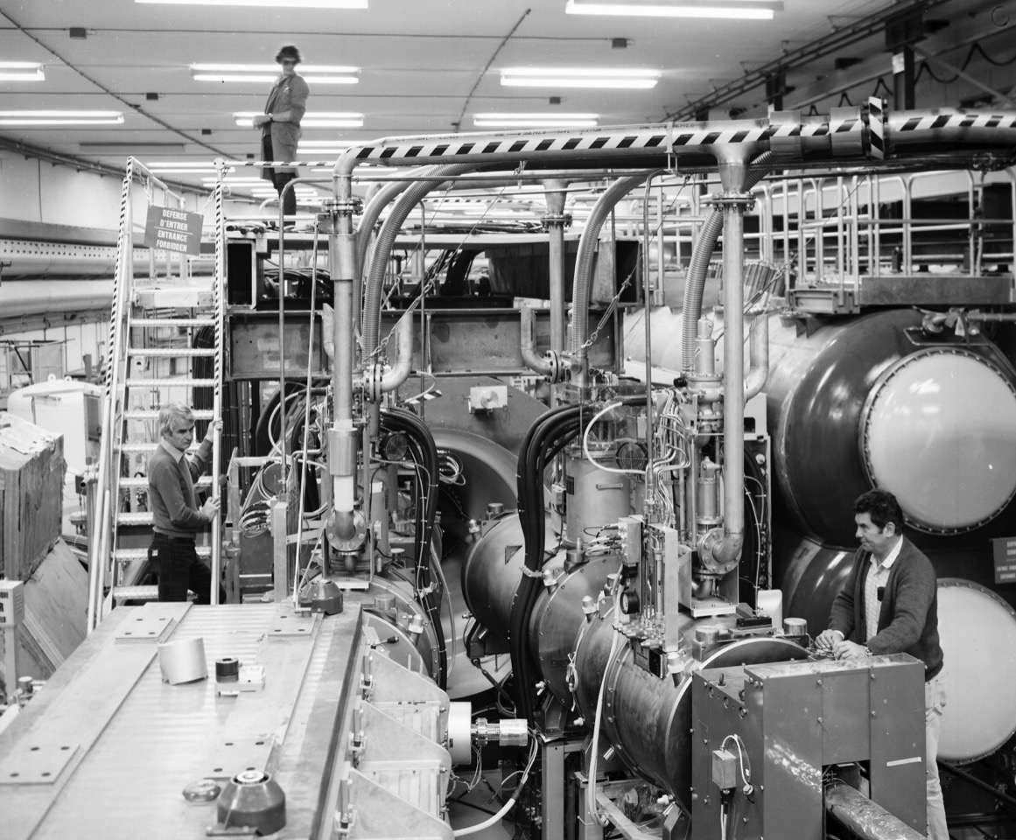
8.Superconducting quadrupoles in the ISR
Two of the eight superconducting quadrupoles are visible on the right. Stephan Pichler stands on the left (see photo 8010791X and Annual Report 1980 p. 101). On the background (center) one sees the entrance of the Open Axial Field Magnet. The twin cylindrical stucture at the very right is a high-pressure gas Cerenkov counter for R807.
S. Pichler
8010397

Slide 27
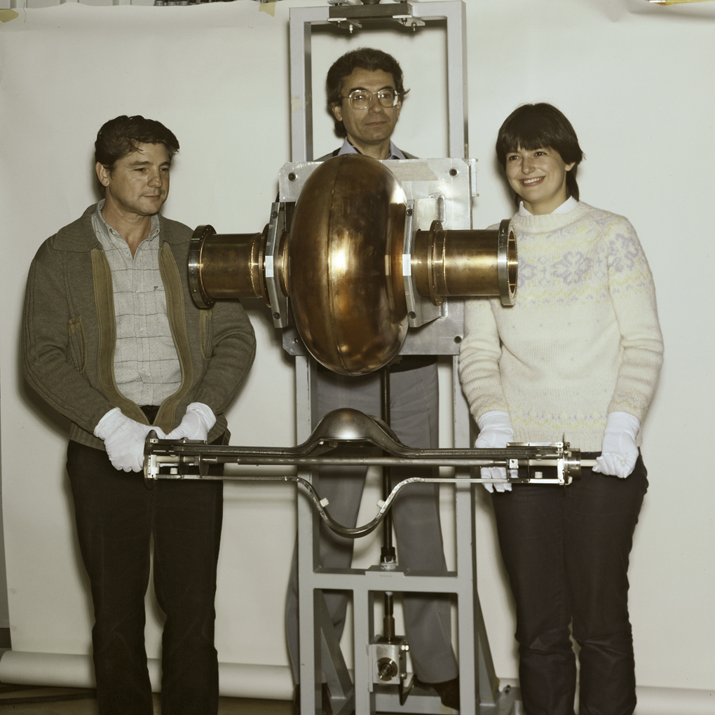
8.The first SC cavity for the ISR
This is the first RF superconducting cavity made of copper with a very thin layer of pure niobium deposited on the inner wall by sputtering. This new development led to a considerable increase of performance and stability of superconducting cavities and to non-negligible economy. The work was carried out in the ISR workshop. This technique was adopted for the LEP II accelerating cavities. At the center is Cristoforo Benvenuti, inventor of this important technology, with his assistants, Nadia Circelli (right) and Max Hauer(left), carrying the sputtering electrode. See also 8209255, 8312339.
8312596X

Slide 28
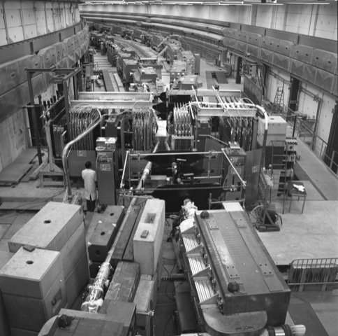
8.Experiment R105 in the ISR
The experimental apparatus used at intersection 1 by the CERN-Bologna Collaboration (experiment R105). It consists of two almost identical magnetic spectrometers centered at 90 degrees on opposite sides of the intersection region. In each spectrometer one can see(?) magnetostrictive wire spark chambers, a magnet, more chambers and various hodoscopes of scintillation counters. Gas Cerenkov counters (almost invisible in the picture) are located in the gap of each magnet. On the left hand side, a matrix of 119 lead glass Cerenkov counters is located behind some concrete and iron shielding.
74-6-293

Slide 29
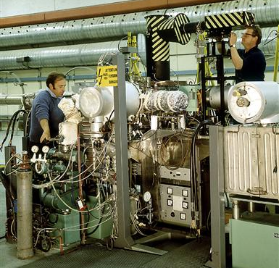
8. BPM with Sodium-Vapour in the ISR
Beam-profile monitor using a sodium-vapour curtain at 45 degrees to the ISR beam in Ring I (sodium generator is in white cylinder just left of centre). Electrons produced by ionization of the sodium vapour give an image of the beam on a fluorescent screen that is observed by a TV camera (at upper right).
This Monitor was also called Vositsi monitor, from his developer who was CERN staff from the former Yugoslavia, at a time when this country was a CERN member state
..to illustrate the “science for peace” dimension
7209170

Slide 30
8. Awareness of beam impedance issues (I)
(new territories)
The relevance of the beam coupling impedance
  Wolfgang Schnell provided resistively coated ceramic tubes to be placed inside cavity like elements of the machine (un-intended cavities) in order to de-Q them; those coated ceramic tubes (with a thin and nonmagnetic Ni-Cr layer of about 100..200 Ohm/unit square) were later re-used in the CERN AD…and are applied now for FAIR and NICA..with a slightly different coating (produced by Fraunhofer institute Freiburg/Germany [Tom Kroyer]).
  A lot of theoretical work related to beam coupling impedance issues started during this period (Keil, Zotter, Henke etc.)
  Heino Henke produced a very nice setup for bench type impedance measurements (coax wire method) building a fast pulse generator with an avalanche transistor and a step recovery diode (for testing components e.g. bellows of the LEP machine) which was around the corner in the early 80th…he was in competition then with F. Caspers who introduced the “synthetic pulse method” for the same purpose.

Slide 31
8. Awareness of beam impedance issues (II)
(new territories)
The ISR was the ideal machine for impedance and stability studies
  Amongst many related publications the now widely used KEIL-SCHNELL Criterion (longitudinal phase space) and the SCHNELL ZOTTER criterion for transverse phase space must be mentioned.
  Landau damping was also investigated in great detail.
  The “brick wall” instability (A coherent transverse instability related to the finite resistivity of the vacuum chamber walls); mitigation via tune spread to stabilize the beam; this effect showed up already for beam current of 3 Ampere. Many papers on coherent and incoherent space charge tune–shift effects were produce as well as for on axis and off axis beams
In addition to hardware type impedance issues also beam-beam interactions got a lot of attention (E. Keil)

Slide 32
9.The human and managerial factor
Working in and being member of the ISR division (now we call it department) was a big challenge and a great honour during that period.
The motivation for (nearly?) everyone was excellent and the was a very strong common sense and mutual understanding with a minimum of administrative burden. There were essentially three committees (machine operation, performance and vacuum) with mostly very coherent and harmonic interaction (vacuum was a bit reluctant for new ideas..they would have preferred a smooth vacuum chamber all the way).
Everyone knew that the work done on this unique machine was really at the cutting edge and the rewarding experience came in new and fundamental findings every few months.
Funding was often, but not always, rather easily available, sometimes just having a coffee with the person in charge..or supervisor..similar for hiring..new staff or inviting an interested and experienced college from overseas for a visit..or going there for a visit.
In the beginning of the ISR era it was the “Golden Age” from a todays point of view in particular wrt “financial impedance”.

Slide 33
10. Some particle physics aspects (I)
The ISR missed the J/ψ and later also the Y particle
Non observation of Quarks as well as magnetic monopoles
However the experience gained at the ISR often with respect to detector technology and the lessons learned helped a lot for the success of the SPS.
It opened up a range for experiments in a new and wide range of energies where fragmentary pieces of information where only available from cosmic ray research at that time
The main particle physics findings can be listed as follow:
  The rising pp total cross section
  The structure of the pp differential cross sections
  The main features of particle production, in particular short range order
  Large mass diffractive excitation
  Large transverse momentum phenomena
  Prompt lepton production

Slide 34
10. Some particle physics aspects (II)
Main advantages of the ISR were at that time (compared to fixed target machines)
  (i) higher c.m. energy,
  (ii) good duty cycle,
  (iii) the fact that one performs experiments effectively in the c.m. frame.
This last point offered the advantage that the secondary particles are well separated in angle and that they have relatively low momenta, which are thus easier to measure.
The main disadvantages of the ISR were:
  (i) Lack of variety in the types of reactions which can be studied.
  (ii) Lower luminosity, which is a serious limitation for low cross section reactions.
  (iii) Difficulties in reaching very low momentum transfers.
  (iv) Relatively poor momentum resolution in the two crossing beams.
  (v) Inaccessibility of the reaction vertex and spurious secondaries associated with the walls of the vacuum chamber.
  (vi) Covering large solid angles requires the use of large detectors.
These differences should be kept in mind when analysing the comparative merits of the ISR and
SPS.
For higher energy pp storage rings, and in particular at Isabelle, the main drawback of lower luminosity should be reduced and some of the other difficulties can in part be overcome with appropriate equipment.
Ref: Giacomelli, G. and Jacob, M.: Physics at the CERN ISR Phys. Rep. 55 (1979) 1-132

Slide 35
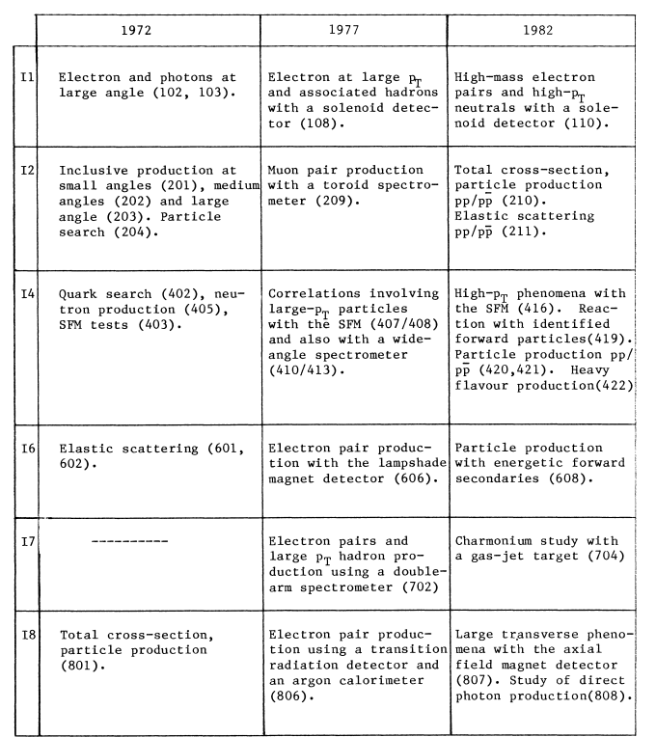
10. Some particle physics aspects (II)
A list of experiments
Some selected achievements:
The roman pot system permitted to measure elastic scattering at small angles
1) Evidence for large p_{T} production (I1 and I2)
2) Inclusive production with evidence for scaling (I1, I2, I4, I8)
3) Evidence for short –range order in particle production (I4 and I8)
4) Evidence for rising total cross-sections (I6 and I8)
5) Evidence for high mass diffraction (I2)
For further details: CERN 84-13(yellow report; Part II by M. Jacob

Slide 36
Conclusion
The ISR turned out to be an excellent test bed for advanced accelerator technology in many different fields.
The results obtained paved the way for the proper construction of the SPS which begun during the same period when the ISR was active.
Progress of understanding issues of beam dynamics, vacuum, magnets and superconducting elements and related technology were essential for SPS, LEP and also the LHC.
Stochastic cooling emerged from theoretical ideas to first practical implementation.
The ISR can be considers as the origin of Schottky noise diagnostics in particle accelerators.

Slide 37
Acknowlegements
The authors would like to express their deep appreciation in particular to K. Hübner who contributed a large number of very valuable hints and comments as well as references from the literature.
Also thanks and many other “old” CERN colleagues for valuable remarks on this masterpiece of accelerator engineering.
Frank Zimmermann provided slides on the electron cloud effect.
Thanks to CERN and the JAS/CAS for supporting this compilation of historical facts on the ISR.
Several colleagues were bitterly disappointed when the ISR became “sacrificed” for new machines in 1983 and I have seen comments saying “This is a crime”.

Slide 38
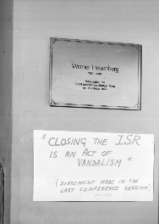

Slide 39
Some further reading ( many refs by K.Hübner) I
1. The history and emergence of the concept.
The most detailed article on this point except the book History of CERN, Vol.2, might be
The CERN intersecting storage rings (ISR), K.Hübner, Eur.Phys.J.H 36, 509-522 (2011)
https://link.springer.com › article › 10.1140 › epjh › e2011-20058-8
2. The design and construction of the ISR
  Design and construction of the ISR, K.Hübner, p.1,in Amaldi et al.
Proceedings, 40th Anniversary of the First Proton-Proton Collisions in the CERN Intersecting Storage Rings (ISR) : Geneva, Switzerland, January 18, 2011 40th Anniversary of the First Proton-Proton Collisions in the CERN Intersecting Storage Rings (ISR) - Colloquium
Yellow report CERN-2012-004 - Published in : 10.5170/CERN-2012-004

Slide 40
Some further reading ( many refs by K.Hübner) II
3. ISR Technology highlights
  P.Bryant, The impact of the ISR on accelerator physics and technology, p. 15 in 10.5170/CERN-2012-004 (CERN Yellow report)
  “Technology meets Research”, C.Fabjan et al.(eds), World Scientific 2017, ebook; open access
  4.2 Cryopumping, C.Benvenuti
  4.3 Pressure measurement in the low 10⁻¹² mbar range, C.Benvenuti
  4.4 Superconducting Magnets for a low-beta insertion, R.Perrin
  4.5 Cryogenics for these low-beta insertion quads, P.Lebrun
  4.6 Van der Meer Scan for absolute luminosity measurements, H.Burkhardt.
In addition the “ISR Performance report” should be mentioned which as key internal publications on ALL results of the ISR machine (successful or not) are now public.They are available via the CERN document server > collection “ISR performance report”

Slide 41
Some further reading (many refs by K.Hübner) III
Performance and beam physics
K.Johnsen, The ISR and Accelerator, Physics,Part.Acc, 18 167-182,1986.
Or earlier but nearly identical
K.Johnsen, Review of Accelerator and Particle Physics at the CERN ISR, Part I,
CERN-84-13 (1984) 10.5170/CERN-1984-013
S.Myers, The CERN Intersecting Storage Rings in
O.Brüning and S.Myers, Challenges and goals for accelerators in the XXI century, pp.135-151, World Scientific, 2016. Physics highlights !
Discovery of rising cross-section with energy
U.Amaldi, Small-angle physics at the intersecting storage rings forty years later, p33
Discovery of jets
P.Dariulat, Large-transverse-momentum processes: the ISR as a gluon collider, p. 63
In the yellow report cited under point 2.

