Slide 1
JAS’2019
Joint US-CERN-Japan-Russia International Accelerator School,
Asymmetric Colliders
Part II.
Space Charge and Luminosity Optimization
Igor Meshkov
JINR, Dubna
October 31

Slide 2
Outline
Introduction – space charge effects in cyclic accelerators
1. Laslett tune shift
2. Beam-beam parameter in colliders
3. Optimization of the Collider Luminosity
4. Examples of Optimization of the Cyclic Collider Luminosity
4.1. NICA Ion Collider in the Symmetric Mode
4.2. NICA Collider in the Asymmetric Mode
I. Meshkov Space Charge effects and Luminosity Optimization JAS’2019 31.10.19 JINR Dubna

Slide 3
Introduction: Space Charge Effects in Cyclic Accelerators
Space charge (SC) effects are an influence of electromagnetic field of a charged particle beam in an accelerator on charged particle motion in this accelerator.
One can divide the SC effects on longitudinal and transverse ones according to the component of the particle motion.
Both these kinds of effects can have linear or nonlinear character – see the lectures
- Recap of transverse particle dynamics, Dmitry Shwartz (BINP) 29.10
- Recap of longitudinal beam dynamics, RF-gymnastics, Elena Shaposhnikova (CERN) 29.10
- Nonlinear dynamics, Kazuhito Ohmi (KEK) 30.10
- Collective effects, Yoshihiro Shobuda (JAEA) 01.11
Related problems appear at interaction of beam electromagnetic field with environment, both natural (residual gas):
- Electron clouds, Alexandr Krasnov (BINP) 01.11
and artificial, like elements of accelerator structure (PU stations, kickers, RF cavities, etc):
- Collective effects, Yoshihiro Shobuda (JAEA) 01.11
Majority of these effects can be eliminated (suppressed) by a skilled design and
construction of the machine elements and/or by cooling application:
- Electron cooling, Vladimir Reva (BINP) 06.11
- Bunched beam stochastic cooling, Markus Steck (GSI) 06.11
However, there two strong effects, which don’t “obey” these methods and are intrinsic
restriction of charged particle beam intensity – Laslett and beam-beam effects.

Slide 4
1. Laslett tune shift
The charge density distribution of a Gaussian bunch of particles with charge Ze is described in the laboratory system by the formula
$ρ_{Z}\left(x, y, s\right)=Zeρ\left(x, y, s\right)$ (2.1)
Here ρ(x,y,s) is the bunch particle density distribution. In what follows, we consider long bunches $σ_{s}≫σ_{x}, σ_{y}$ , for which the electric field of the Gaussian bunch having an elliptical cross section with the semiaxes σ_{x} and σ_{y} in the region x << σ_{x} and y << σ_{y} is described by the formula
$E_{x,y}\left(s\right)=\frac{4ρ_{0}\left(s\right)}{σ_{x}+σ_{y}}×\left\{\begin{matrix}\frac{x}{σ_{x}}, & x −component, \\ \frac{y}{σ_{y}}, & y −component,\end{matrix}\right.$ $ρ_{0}\left(s\right)=\frac{ZeN}{\sqrt{2π}∙σ_{s}}∙e^{−{s^{2}}/{2σ_{s}^{2}}},$ (2.2)
$$\vec{B}=\frac{1}{c}\left[\vec{v},\vec{E}\right] .$$
$$\vec{E}$$
$$\vec{E}$$
$$\vec{B}$$
$$\vec{B}$$
$${\vec{v}}_{ion}$$
The Lorenz force can be written as follows:
$${\vec{F}}_{B}$$
$\vec{F}=Ze\left(\vec{E}+\frac{1}{c}\left[\vec{v}, \vec{B}\right]\right)=Ze\left(\vec{E}−β^{2}{\vec{E}}_{⊥}\right)$ , (2.3)
That gives us the equation of particle betatron oscillations:
$$γM\left[\frac{d^{2}x}{dt^{2}}+{Q_{x}^{2}ω}_{0}^{2}x\right]=\frac{ZeE_{x}}{γ^{2}}$$
. (2.4)
Here Q_{x} is the number of the particle betatron oscillations along the x coordinate for one particle turn in the ring (betatron number or “tune”), and ω₀ is the revolution frequency.

Slide 5
1. Laslett tune shift (End)
Let us introduce the betatron frequency shift Δq_{x}ω₀ that appears under the action of the force F_{x} by the following equality:
${{Q_{x}^{2}ω}_{0}^{2}−\frac{ZeE_{x}}{γ^{2}}=\left(Q_{x}+Δq_{x}\right)}^{2}ω_{0}^{2}$ .
Then we find for near near bunch center s << σ_{s} and at Δq_{x} << Q_{x}
$$∆q_{x}≈−\frac{ZeE_{x}}{{2Q_{x}γ}^{2}ω_{0}^{2}}= −\frac{2Z^{2}Nr_{p}}{γ^{3}A〈σ_{x}\left(σ_{x}+σ_{y}\right)〉}∙\frac{1}{Q_{x}ω_{0}^{2}\sqrt{2π}σ_{s}}.$$
Here we used the equalities $ω_{0}=\frac{2π}{T_{0}}=2π\frac{C_{Ring}}{βc}$ , N is the number of particles per bunch (or beam), r_{p} = e²/m_{p}c² = 1.535⋅10⁻¹⁶ cm^{*)} is the classical proton (nucleon) radius, m_{p} ≈ 938 MeV/c² is proton (nucleon) mass, and A is the particle mass in atomic mass units. We also used below equalities where ⟨B_{x}⟩ is the circumference-average x-beta function, and ε_{x} is the x-emittance of the beam:
$$∆q_{x}=−\frac{Z^{2}Nr_{p}k_{bunch}〈B_{x}〉}{πβ^{2}γ^{3}A〈σ_{x}\left(σ_{x}+σ_{y}\right)〉}=\frac{Z^{2}Nr_{p}}{πβ^{2}γ^{3}A}∙\frac{\sqrt{〈B_{x}〉}}{\sqrt{ε_{x}}∙\left(\sqrt{ε_{x}〈B_{x}〉}+\sqrt{ε_{y}〈B_{y}〉}\right)}∙k_{bunch};$$
$k_{bunch}≡\frac{C_{Ring}}{\sqrt{2π}σ_{s}}$ .
Δq_{y} can be found using the replacement $x⇄y.$
At B_{x} = B_{y} and ε_{x} = ε_{y} = ε we have the classical Laslett formula $∆q=−\frac{Z^{2}}{A}∙\frac{r_{p}N}{{2πβ}^{2}γ^{3}ε}∙k_{bunch}$.
For coasting beams, it is enough to put k_{bunch} = 1.
^{*)} The formula (2.6) is valid for electrons (positrons) at А = 1 with replacement of r_{p} by r_{e}, the classical electron radius.
(2.5)
(2.6)

Slide 6
2. Beam–Beam Parameter in Colliders
When particle 1 crosses counterpropagating particles bunch 2, it gets a momentum increase under the effect of the electromagnetic field of the bunch,
$∆{\vec{p}}_{12}=\int_{−∞}^{∞}{{\vec{F}}_{12}}(t)∙dt$ .
where (see (2.3)) ${\vec{F}}_{12}=Z_{1}e\left({\vec{E}}_{2}+\frac{1}{c^{2}}\left[{\vec{v}}_{1}\left[{ \vec{v}}_{2},{\vec{E}}_{2}\right]\right]\right)=Z_{1}e\left({\vec{E}}_{2}−\left({\vec{β}}_{1}{,\vec{β}}_{2}\right){\vec{E}}_{⊥2}\right).$
(2.7)
Here ${\vec{β}}_{1,2 }={\vec{v}}_{1,2}/c$, ${\vec{E}}_{2}$ is the vector of the electric field of bunch 2 in the laboratory system at the location of particle 1, and ${\vec{E}}_{⊥2}$ is its component transverse to the s axis.
The time dependence of the transverse coordinates of particle 1 in the laboratory system x_{α1}(t) is defined by beta-function, i.e by the invariant (х_{α1}(t))²/B_{α1}(s(t) (Part I, formula (2.11))
The longitudinal coordinate s(t) is defined in (1.7), and $B_{α1}^{∗}=B_{α1}\left(0\right).$ The coordinates of particle 1 with respect to the center of bunch 2 is found using Part. I, Fig., 1 and equalities (2.5) and (2.7) there:
$x_{α2}\left(t\right)=x_{α1}\left(t\right), η_{2}\left(η,s_{0}\right)=η+Vs_{0}$ . (2.9)
$x_{α1}\left(s(t\right))=x_{α1}\left(0\right)∙\sqrt{1+{\left(\frac{s(t)}{B_{α1}^{∗}}\right)}^{2}}$ . (2.8)

Slide 7
2. Beam–Beam Parameter in Colliders
The particle momentum increase in the (x, s) plane is defined by the x-component of the force (2.7)
${ F}_{x12}=Z_{1}e\left(1−\left({\vec{β}}_{1}{,\vec{β}}_{2}\right)\right)∙E_{x2}\left(t\right)$ ,
$E_{x2}\left(t\right)=\frac{4Z_{2}eN_{2}}{σ_{x2}(t)\left(σ_{x2}(t)+σ_{y2}(t)\right)\sqrt{2π}σ_{s2}}∙e^{−{η_{2}^{2}(t)}/{2σ_{s2}^{2}}}∙x_{1}\left(t\right)$.
Note that particles 2 and 1 are at the point s(t) at the time $t\left(s,η\right)=\frac{s−η}{v_{1}}$ , that allows time dependence of the parameters to be transformed to their s dependence.
In one collision, particle 1 receives a transverse momentum (average over many revolutions (!))
$∆p_{x12}(η)=\int_{−t_{1}}^{t_{2}}{F_{x12}\left(s(t)\right)}∙dt=\frac{{4Z}_{1}Z_{2}e^{2}N_{2}}{σ_{s2}}\frac{1−\left({\vec{β}}_{1}{,\vec{β}}_{2}\right)}{β_{1}c}∙Φ(η)$ ,
$Φ(η)=\frac{1}{\sqrt{2π}}\int_{−l_{D}}^{l_{D}}{\frac{x_{1}\left(s\right)}{σ_{x2}\left(χ\right)\left(σ_{x2}\left(s\right)+σ_{y2}\left(s\right)\right)}}exp\left\{−\frac{1}{2}∙{\left(\frac{η_{2}\left(η,s\right)}{σ_{s2}}\right)}^{2}\right\}ds$ .
Multiple crossing of bunch 2 by particle 1 results in
a betatron oscillation frequency shift
This is known as the parameter of the beam–beam effect (BB), or, briefly,
the beam–beam tune shift ξ₁₂ (conventional designation!).
The quantity ξ₁₂ can be found in the thin lens approximation. Finally we come to very lengthy formula – shown in the next slide (see details in: I.Meshkov, Phys. Part. Nucl. V.6 (2019), preprint is available at JAS Org. Com.).
(2.10)
(2.11)

Slide 8
2. Beam–Beam Parameter in Colliders
$_{x12}(η)=\frac{Z_{1}Z_{2}}{A_{1}}∙\frac{{r_{p}N}_{2}}{2πε_{x2}}∙\frac{1−\left({\vec{β}}_{1}{,\vec{β}}_{2}\right)}{β_{1}^{2}∙γ_{1}}∙\frac{B_{x1}^{∗}}{B_{x2}^{∗}}∙Φ_{x12}(η),$
$Φ_{x12}\left(η\right)==\sqrt{\frac{8}{π}}\int_{−l_{D}}^{l_{D}}{\frac{\sqrt{1+{\left(\frac{s}{B_{x1}^{∗}}\right)}^{2}} ∙Ψ(η,s)}{\sqrt{1+{\left(\frac{s}{B_{x2}^{∗}}\right)}^{2}}\left(\sqrt{1+{\left(\frac{s}{B_{x2}^{∗}}\right)}^{2}}+\sqrt{\frac{ε_{y2}B_{y2}^{∗}}{ε_{x2}B_{x2}^{∗}}}\sqrt{1+{\left(\frac{s}{B_{y2}^{∗}}\right)}^{2}}\right)}}∙\frac{ds}{σ_{s2}}$ ,
$Ψ(η,s)$ = $exp\left\{−\frac{1}{2}∙{\left(\frac{η_{2}\left(η,s\right)}{σ_{s2}}\right)}^{2}\right\} .$
The parameter Φ_{x12}(η), is an analogue of the known hourglass parameter in luminosity formulas (Part I, formula (2.16)) .
We underline that formula (2.12) describes the absolute value of the BB parameter.
The choice of its sign is discussed at the beginning of the next section.
(2.12)
For identical beams (see Part I, section (2.3)) we find from (2.12)
$_{x}\left(η\right)=ξ_{y}\left(η\right)=\frac{Z^{2}}{A}∙\frac{{r_{p}N}_{2}}{4πε}∙\frac{1+β^{2}}{β^{2}∙γ}∙λ_{0}∙Φ_{x}\left(η\right),$ (2.13)
$$Φ_{x, y12}\left(η=0\right)=\frac{1}{α}\sqrt{\frac{2}{π}}\int_{−l_{D}/B^{∗}}^{l_{D}/B^{∗}}{\frac{1}{\sqrt{1+χ^{2}}}}e^{−2{\left(χ/α\right)}^{2}}d = \sqrt{\frac{2}{π}}\int_{−l_{D}/σ_{s}}^{l_{D}/σ_{s}}{\frac{1}{\sqrt{1+{\left(αu\right)}^{2}}}}e^{−2u^{2}}du,$$
$$α=\frac{σ_{s}}{B^{∗}} , χ=\frac{s_{0}}{B^{∗} }, u=\frac{s_{0}}{σ_{s}} .$$

Slide 9
2. Beam–Beam Parameter in Colliders
Note, when σ_{s} → 0, we have α → 0 and accordingly obtain Φ_{x,y12} (η = 0)= 1.
As the emittance increases, the function Φ_{х,у12} monotonically decreases,
being 0.913 at α = 1 and 0.554 at α = 5.
Formulas (2.12), (2.13) differ from those could be found in the literature:
they do not have the parameter Φ_{x12} .
The beam–beam effect in the collision of a particle with a coasting beam is described
by expressions (2.12) and (2.13), in which the bunch length σ_{s} is taken to be equal to
the ring circumference C_{Ring} (see section 3.2).
Note that the betatron tune shifts Δq and ξ depend on the particle energy through
the Lorentz factors β and γ.
3. Optimization of the Collider Luminosity
Now we can start consideration of optimal parameter values choice. As it was said in
The Introduction, the most severe restrictions of beam intensity and, as consequence,
the collider luminosity, are Laslett and beam-beam effects. Therefore, our choice of
Parameter values will be based on these two criteria, i.e. Δq and ξ parameters.

Slide 10
3. Optimization of the Collider Luminosity
In ion colliders the betatron tune shifts, both Δq and ξ, have a negative value. This fact has a simple explanation: particles of both counterpropagating bunches have a positive charge (except for an exotic case of negatively charged ions of one of the beams). Therefore, the forces of the space charge of both the reference and the counterpropagating bunch are directed outward of the beam axis. This determines the signs of the betatron tune shifts (see formulas (2.5), (2.6)).
The effect is different in electron–ion, electron–positron, and proton–antiproton colliders: the force of the counterpropagating beam is attractive, and the ξ-parameter is positive.
Nevertheless, both effects influence independently on particle dynamics, and the process of beam instability development when the particle betatron frequency approaches the resonance value is rather complicated. Therefore, for simple estimates, the criterion of betatron oscillation stability can be the requirement that the sum of the moduli of the tune shifts does not exceed a certain maximum value
⎪Δq⎪ + ⎪ξ⎪ ≤ ΔQ_{max}. (3.1)
Further we use, for brevity, the symbols Δq ≡ ⎪Δq⎪ and ξ ≡ ⎪ξ⎪.
It is known from practice that an intense beam is stable (with all other conditions fulfilled) if ΔQ ≤ 0.05 (3.2)
It is the first optimization criterion.

Slide 11
3. Optimization of the Collider Luminosity
When choosing optimal parameters of collider beams, it is enough to ensure fulfillment of this condition for the largest of two pairs of parameters Δq_{x}, ξ_{x} and Δq_{y}, ξ_{y}. We will consider the х-parameters as having the largest values (when σ_{x} << σ_{y}).
Let us write the parameters of the first beam as
$Δq_{x1}= \frac{Z_{1}^{2}}{A_{1}}N_{1}a_{x1}$ , $ξ_{x12}=\frac{Z_{1}Z_{2}}{A_{1}}N_{2}b_{x1}$
$a_{x1}=\frac{r_{p}}{πβ_{1}^{2}γ_{1}^{3}}∙\frac{\sqrt{〈B_{x1}〉}∙k_{bunch1}}{\sqrt{ε_{x1}}∙\left(\sqrt{ε_{x1}〈B_{x1}〉}+\sqrt{ε_{y1}〈B_{y1}〉}\right)}$ , $b_{x1}=\frac{r_{p}}{4πε_{x2}}∙\frac{1−\left(β_{1}, β_{2}\right)}{β_{1}^{2}∙γ_{1}}∙\frac{B_{x1}^{∗}}{B_{x2}^{∗}}∙Φ_{x12}(η)$ , (3.3)
and do the same for the parameters of the second beam Δq₂ and ξ_{x21,} making the replacement $1⇄2$. Then we write two equations (3.1) for reference particles of both beams
$$∆q_{x1}+ξ_{x12}=ΔQ_{x1}$$
$$∆q_{x2}+ξ_{x21}=ΔQ_{x2}.$$
Substituting here ξ_{x12} and ξ_{x21} we obtain two equations for the unknowns N₁ and N₂ :
$\frac{Z_{1}^{2}}{A_{1}}a_{x1}N_{1}+\frac{Z_{1}Z_{2}}{A_{1}}b_{x1}N_{2}=ΔQ_{x1}$,
$\frac{Z_{2}^{2}}{A_{2}}a_{x2}N_{2}+\frac{Z_{1}Z_{2}}{A_{2}}b_{x2}N_{1}=ΔQ_{x2}$ .
(3.4)
(3.5)

Slide 12
3. Optimization of the Collider Luminosity
However – disappointment (!): an attempt to straightforwardly solve this system of equations reveals that at particular energies the determinant of the system is equal to zero, which means that there is no solution. Therefore, the beam parameters have to be optimized on the basis of physical and obvious mathematical considerations.
Therefore, we assume that both the collider rings and colliding beams 1 and 2 are tuned so that their Laslett shifts are equal (the second optimization condition):
$∆q_{x1}=∆q_{x2}≡∆q_{x}$. (3.6)
Then, substituting Δq_{1,2} from (3.3) in (3.5) we find
$\frac{N_{1}}{N_{2}}=\frac{A_{1}}{Z_{1}^{2}}∙\frac{Z_{2}^{2}}{A_{2}}∙\frac{a_{x2}}{a_{x1}}$ . (3.7)
Substituting N₁/N₂ (3.7) into the ratio of the parameters Δq/ξ, we obtain
$\frac{{∆q}_{x}}{ξ_{x12}}=λ_{0}∙\frac{a_{x2}}{b_{x1}}, \frac{{∆q}_{x}}{ξ_{x21}}=\frac{1}{λ_{0}}∙\frac{a_{x1}}{b_{x2}}$ . (3.8)
Here λ₀ is parameter introduced in Part I, formula (2.15).

Slide 13
3. Optimization of the Collider Luminosity
The relations (3.8) allow the parameters ξ_{x12} and ξ _{x21} to be eliminated from equations (2.21), and system of equations (3.4) involves only three unknowns, Δq_{x}, ΔQ_{x1}, and ΔQ_{x2}:
$Δq_{x}\left(1+\frac{b_{x1}}{λ_{0}a_{x2}}\right)=ΔQ_{x1}$ ,
$Δq_{x}\left(1+\frac{b_{x2}}{λ_{0}a_{x1}}\right)=ΔQ_{x2}$ .
It follows that the shifts ΔQ _{x1} and ΔQ_{x2} are not independent parameters. Choosing, for example, the value ΔQ_{x1}, we unambiguously determine the values Δq_{x} and ΔQ_{x2} :
$Δq_{x}=\frac{λ_{0}a_{x2}}{{λ_{0}a}_{x2}+b_{x1}}∙ΔQ_{x1}, ΔQ_{x2}=\frac{a_{x1}+λ_{0}b_{x2}}{{λ_{0}a}_{x2}+b_{x1}}∙\frac{λ_{0}a_{x2}}{a_{x1}}∙ΔQ_{x1 }$. (3.10)
Then we find ξ_{x12} and ξ _{x21} from (2.25) and N₁ and N₂ from (2.20).
Thus, all parameters needed for luminosity calculations are determined.
(3.9)
Some considerations:
1) Generally speaking, the first criterion can be violated so that the function ΔQ_{x2}(E_{ion}) grows above the limiting value (e.g., 0.05)^{*).} In this case, ΔQ_{x1} has to be decreased until ΔQ_{x2} drops below 0.05.
^{*)} e.g. = exempli gratia (Latin) => for instance (например)

Slide 14
3. Optimization of the Collider Luminosity
Some considerations (Contind) :
2) The presented method for optimization of collider parameters imposes limits on the intensity of the colliding beams and thus on the collider luminosity. But this does not mean that there is no way to increase luminosity. Indeed, the above optimization was performed for the chosen values of
- the focusing system parameters (В*),
- beam emittances (ε),
- longitudinal bunch sizes (σ_{s}) for bunched beams.
Actually, three sets of these parameters remain free. Their choice determines the luminosity after the optimization. And they have their own limits (see details in: Ibid^{*)}, page 22).
^{*)} Ibid = ibidem (Latin, shortened) => the same place (там же)

Slide 15
4. Examples of Optimization of the Cyclic Collider Luminosity
In this section we give two examples of choosing optimal parameters for different versions of cyclic ion colliders. The parameters of the collider and its beams are formulated in each example.
4.1. NICA Ion Collider in the Symmetric Mode
The symmetric mode of the ion phase of the NICA collider implies collision of two bunches of ¹⁹⁷Au⁷⁹⁺ nuclei at one IP (Table 1).
In this section the parameter λ is unity due to the symmetry of both the beams and the focusing system.
Table 1. Parameters of the NICA collider at the collision of gold nuclei
(symmetric mode)
Parameter | Rings 1 and 2
Ring circumference, m | 503,04
Ions | ¹⁹⁷Au⁷⁹⁺
Ion energy, GeV/u | 1.0 – 4.5
B*, cm | 60
Ion bunch emittance, π⋅mm⋅mrad | 1.1
Bunch length, cm | 60
Betatron tune, Q_{x} | 9.44

Slide 16
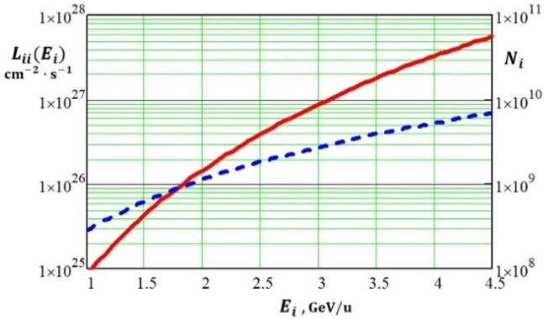
4. Examples of Optimization of the Cyclic Collider Luminosity
4.1. NICA Ion Collider in the Symmetric Mode
As the calculations show (Fig. 1a), the effect that defines the beam intensity and consequently the luminosity is the Laslett effect (Δq (2.5), (2.6)). The BB effect (ξ (2.12), (2.13)) becomes noticeable at an energy above 3 GeV/u. The sum of the betatron frequency shifts Δq and ξ remains constant, ΔQ₁ = ΔQ₂ = 0.05. The parameter Φ_{х12} (2.13) is 0.457.
a) b)
Fig. 1. Dependence of the parameters of the ion collider with the bunched ¹⁹⁷Au⁷⁹⁺ beams on the ion energy E_{i} (GeV/u); ΔQ = 0.05.
(a) Laslett parameter Δq (solid curve) and the BB parameter ξ (dotted curve);
(b) collider luminosity L (solid curve) and the number of particles per bunch N_{i} (dotted curve).

Slide 17
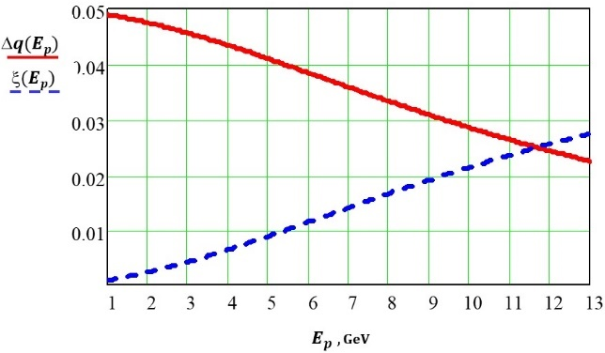
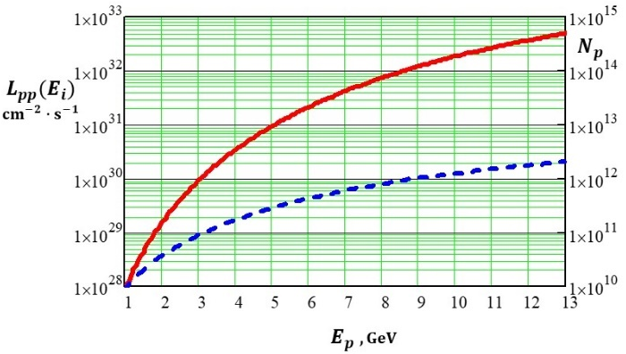
4. Examples of Optimization of the Cyclic Collider Luminosity
4.1. NICA Ion Collider in the Symmetric Mode
As the energy of colliding particles increases, the space charge effects reverse the roles: the parameter of the space charge effect is larger than the Laslett parameter. This is demonstrated in collisions of proton beams, which are planned in the NICA project, with polarized protons and deuterons (Fig. 2).
a) b)
Fig. 2. The parameters of the proton–proton collider vs the proton energy E_{р} (GeV); ΔQ = 0.05.
(a) Laslett parameter Δq (solid curve) and the BB parameter ξ (dashed curve);
(b) collider luminosity L_{рр} (solid curve) and the number of particles per bunch N_{р} (dashed curve).

Slide 18
4. Examples of Optimization of the Cyclic Collider Luminosity
4.2. NICA Collider in the Asymmetric Mode
As an example of an asymmetric collider, we consider the NICA collider with colliding proton and deuteron beams. This problem appears in the nucleon spin physics studies, when it is possible to discriminate between proton–proton and proton–neutron collisions. Of interest are both the cases of the resting center of mass (c.m) of two colliding nucleons (pp or pn) and the case of the c.m. of the proton–deuteron system. In the first case, the proton and deuteron velocities are equal, and in the second case the deuteron velocity is lower than the proton velocity
$β_{d}= \frac{β_{p}}{\sqrt{A_{μ}^{2}+β_{p}^{2}\left(1−A_{μ}^{2}\right)}}$ .
Here β_{d} and β_{p} are the velocities of the nucleus (deuteron) and the proton in units of the speed of light, A_{μ} = μA_{d} , μ is the ratio of the nuclear nucleon mass to the proton mass, and A_{d} is the atomic weight of the nucleus. This mode is of interest for studying difference between polarized pp and pn interactions (they differ by quark structure).
Luminosity in proton–nucleon collisions at the NICA collider calculated by formula (1.19) is presented in Fig. 3.. The beams have equal emittances of 1.1 π∙mm∙mrad. The particle energy in the collider is 1–6 GeV/nucleon, and √ s_{NN} = 3.87–13.87 GeV. The other parameters are the same as in Table 1.
The parameter λ is put equal to unity because the NICA collider is supposed to have a unique beam convergence system, where convergence magnets are placed closer to the IP than the final focus lenses, which allows their independent tuning.

Slide 19
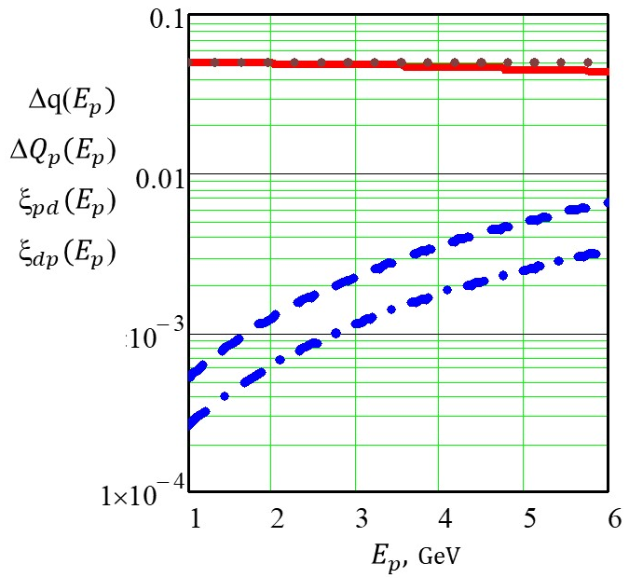
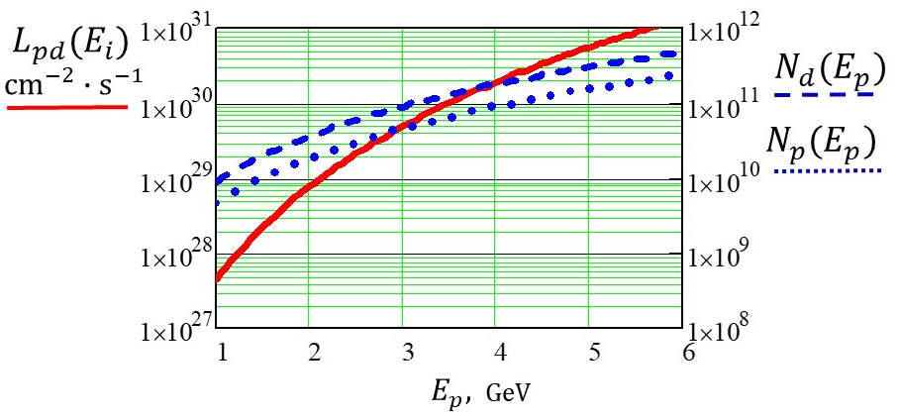
4. Examples of Optimization of the Cyclic Collider Luminosity
4.2. NICA Collider in the Asymmetric Mode
Dependence of the parameters of the ion collider with the bunched deuteron and proton beams on the proton energy E_{p} (GeV); B*= 3 m. (Fig. 7a, b).
Fig. 7a. Laslett parameter Δq (solid curve), the total betatron tune shift for protons ΔQ_{p} (dotted curve), and the BB parameter for protons on a deuteron bunch ξ_{pd} (dashed curve) and deuterons on a proton bunch ξ_{dp} (dot-dash curve);
Δq ΔQ_{p}
ξ_{pd}
ξ_{dp}
Fig. 7b. Collider luminosity L_{pd} (solid curve) and the number of particles in a deuteron bunch N_{d} (dashed curve) and a proton bunch N_{p} (dotted curve).

Slide 20
Thank you for your (patient) attention!
Спасибо за ваше (терпеливое) внимание!

