Slide 1
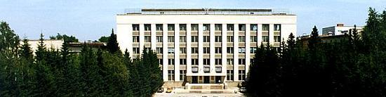
BINP
Electron Clouds
Alexander Krasnov
Budker Institute of Nuclear Physics (BINP), Novosibirsk, Russia
JAS 28 October – 7 November, 2019, Dubna, Russia
a.a.krasnov@inp.nsk.su

Slide 2

BINP
Contents
Historical review
Electron clouds (EC) sources
EC influence on an accelerator performance
EC formation
Key parameters and equations for EC simulation
LHC arc beam pipe
SuperKEKB, beam pipe in dipoles
Surface conditioning
EC investigations on SPS (CERN),
Photoelectron emission experiments at BINP
SEE in magnetic field, experiments at BINP and at JINR
References

Slide 3
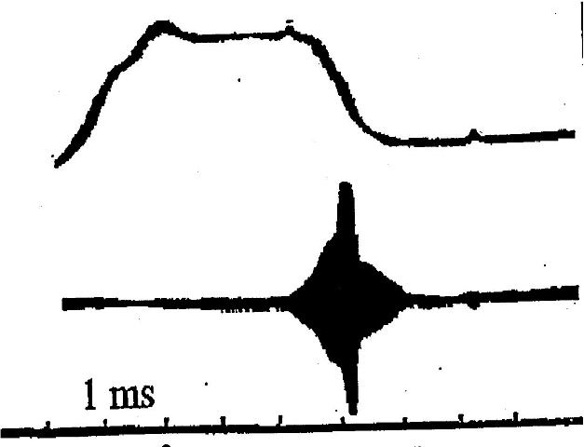
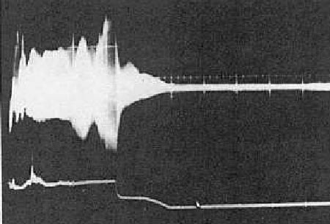
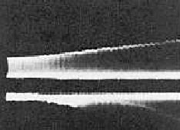
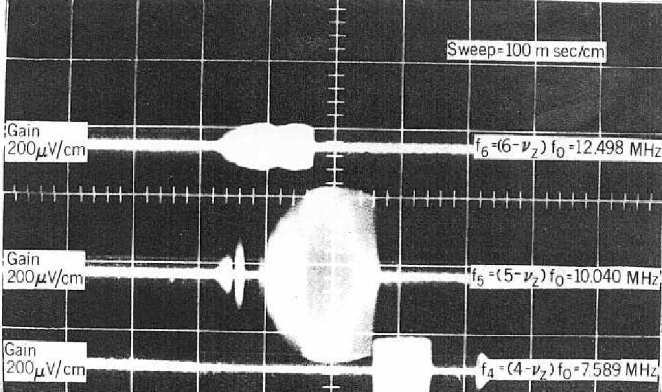
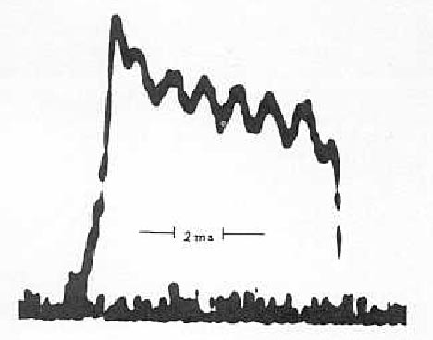
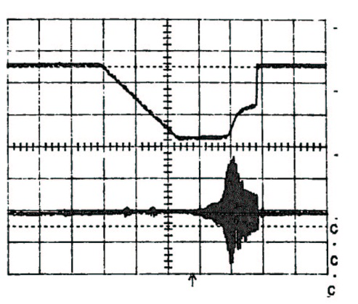
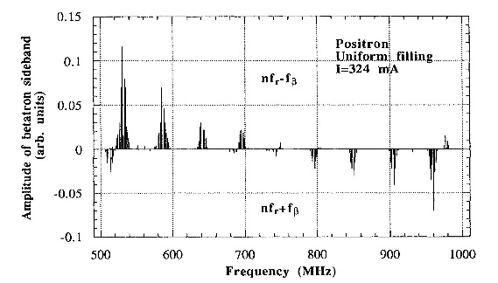
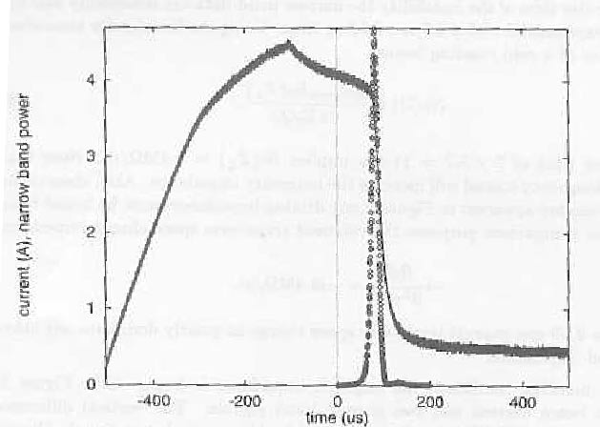
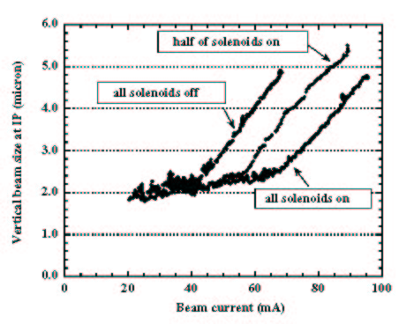
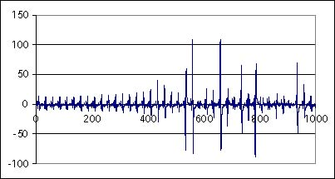
Slide from Frank Zimmermann
INP Novosibirsk, 1965
Argonne ZGS,1965
BNL AGS, 1965
E.C. Raka
G. Budker et al
J.H. Martin, F.E. Mills et al
Bevatron, 1971
ISR, ~1972
PSR, 1988
KEK PF, 1988
D. Neuffer,
R. Macek et al
H.A. Grunder,
G.R. Lambertson
E. Calder,
O. Gröbner et al
M. Izawa, Y. Sato,
T. Toyomasu
AGS Booster, 1998/99
KEKB, 2000
CERN SPS, 2000
PEP-II,
MI,
SNS,
CesrTA,
LHC,
…
M. Blaskiewicz
K. Cornelis,
G. Arduini et al
H. Fukuma et al

Slide 4
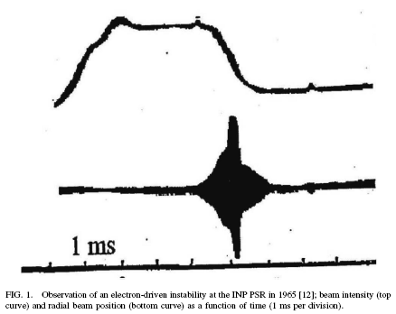
EC in PSR at INP. Novosibirsk
BINP
G. Budker, G. Dimov, V. Dudnikov, Experiments on production of intense proton beam by charge exchange injection method;
Proceedings of the International Symposium on Electron and Positron Storage Rings, Saclay, France, VIII, 6.1 (1966)
F. Zimmermann, “Review of single bunch instabilities driven by an electron cloud”, PHYSICAL REVIEW SPECIAL TOPICS - ACCELERATORS AND BEAMS, 7, 124801 (2004)
“Perhaps the first ever observation of an electron-cloud driven instability was made with a bunched beam at a small proton storage ring of the INP Novosibirsk around 1965. The ring circumference was only 2.5 m. Coherent betatron oscillations and beam losses occurred above a threshold proton intensity of 1–1.5 10¹⁰. Soon G. Budker and co-workers identified the instability as one due to electrons (secondary particles). It was cured by a transverse feedback system.
Two years later, another PSR at INP also suffered an electron-cloud instability, in this case with a coasting proton beam. The threshold here corresponded to 1.2 10¹¹ protons, which were distributed over a 6 m circumference. The coasting-beam instability was suppressed by increasing the beam current and the gas density. This compensation scheme allowed storing up to 1.8 10¹² protons, i.e., about 15 times the initial threshold value. As pointed out by V. Dudnikov, the fast accumulation of secondary plasma by gas ionization was essential for the stabilization. The existence of an ‘‘island of stability’’ above the threshold was consistent with a previous analysis by B. Chirikov (1965)”

Slide 5
EC influence on an accelerator performance
BINP
EC driven beam instability
The first numerical simulation of an electron-cloud formation was done by K. Ohmi in 1995. It served to explain coupled-bunch instabilities observed with positron beams at the KEK photon factory.
Coherent single bunch instability has been observed at KEK and SuperKEKB. Freq. signal corresponding head-tail motion has been observed (synchro-betatron oscillation).
For SuperKEKB : Estimated threshold of electron density ~ 2∙10⁵ cm⁻³
Different types of EC driven instability were observed in
ISR, PS, SPS, KEKB, PEP, TEVATRON, RHIC…
LHC: Up to now main limiting factor – heating of cold beam pipe by electron bombardment. Cooling capacity about 1.2 W/m, if each electron transmits average energy 350 eV, current must be less than 3 mA/m (or 2E16 e/m/s). Taking into account banch spacing 25ns and beam pipe cross-section (about 15 cm²) one can obtained density ~ 3∙10⁵ cm⁻³

Slide 6
EC influence on dynamic gas density
BINP
Surface
Metallic surface contains 10 ÷ 100 ML (1 ML ≈ 10¹⁵ cm⁻² ) of
Chemically bound: MxOy, Mx(OH)y, Mx(HCO₃)y, carbon clusters
Physically adsorbed: H₂O, organics
Example: Internal surface of a tube with D=5 cm contains 10⁸ ÷ 10⁹ times more molecules than ones inside the tube in gas phase at density 3∙10⁷ cm⁻³ (10⁻⁷ Pa – requirement for SuperKEKB)!
Electrons can provoke dissociation of the molecules which causes desorption of:
H₂ - most critical for cryogenic beam pipe (LHC) because H₂ can re-desorb on surface with very low binding energy
CO, CO₂ and saturated hydrocarbons CxHy (due to catalytic reactions on surface) - defines “vacuum” beam lifetime.
Exercise: Which pumping speed is sufficient to provide gas density at level 3∙10⁸ cm⁻³ in presence of electron stimulated desorption by electron current 1 mA and efficiency 0,01 molecule/electron?

Slide 7
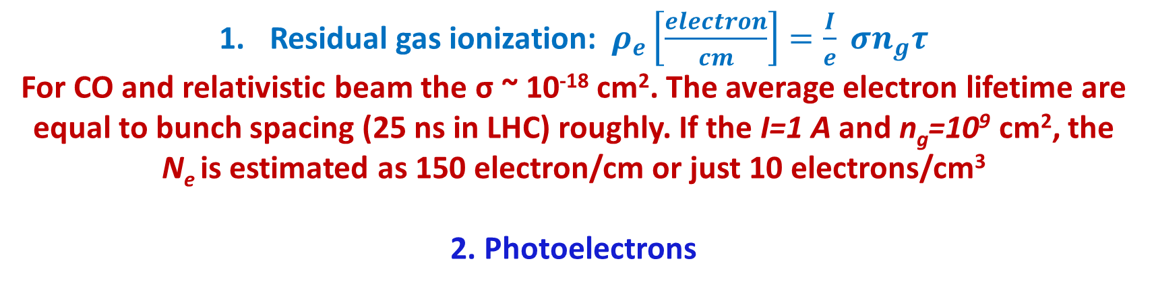
EC sources
BINP
Residual gas ionization: $ρ_{e}\left[\frac{electron}{cm}\right]=\frac{I}{e} σn_{g}τ$
For CO and relativistic beam the σ ~ 10⁻¹⁸ cm². The average electron lifetime are equal to bunch spacing (25 ns in LHC) roughly. If the I=1 A and n_{g}=10⁹ cm², the N_{e} is estimated as 150 electron/cm or just 10 electrons/cm³
2. Photoelectrons
For LHC SR photon flux ~1E17 ph/m/s and estimated photo-electron density ~ 1.5∙10⁵ cm⁻³
3. Multipacting

Slide 8
EC formation
Beam-Induced Multipacting
BINP

Slide 9
EC formation
Saturation
The electron-cloud density saturates when the electron losses balance the electron generation rate. This can happen when EC screens beam electric field in average or, at high bunch population, when the kinetic energy at emission is too low to penetrate into the space-charge field of the cloud:
BINP
e⁻
up to 10⁶ cm⁻³ for LHC
~3.6∙10⁶ cm⁻³ for LHC
where b denotes the chamber radius (for simplicity we consider a round chamber), E_{s} is the average energy of the emitted secondary electrons, r_{e} is the classical electron radius, N_{b} is bunch population. The transition occurs at a bunch population of about
~10¹⁰ for LHC
Note, if acceptable density several times less than saturated value, we can simulate EC neglecting space charge

Slide 10
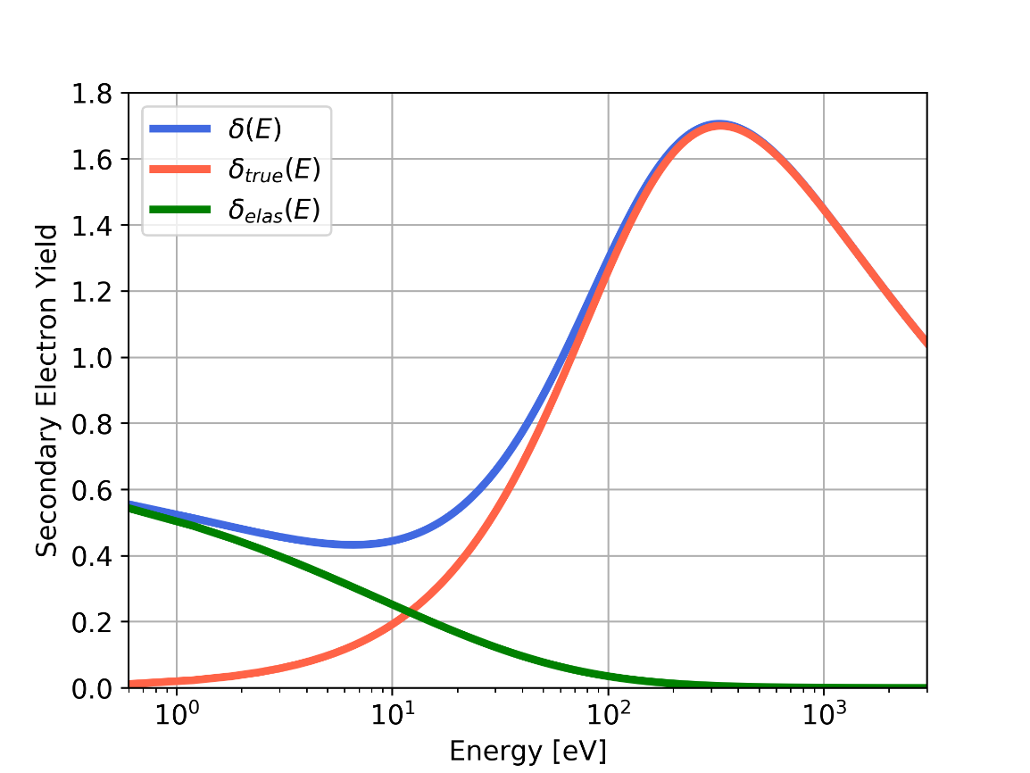
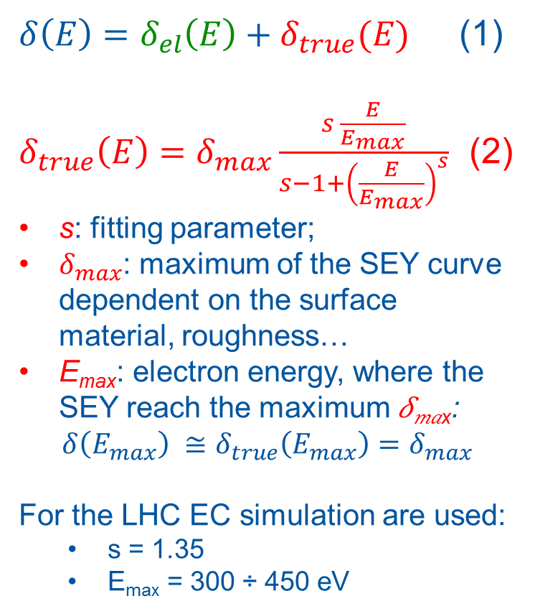

Key parameters for EC simulation
BINP
According to:
R. Cimino, I. R. Collins, M. A. Furman, M. Pivi, F. Ruggiero, G. Rumolo, and F. Zimmermann, “Can Low-Energy Electrons Affect High-Energy Physics Accelerators?,” Phys. Rev. Lett., vol. 93, p. 014801, Jun 2004.
$δ\left(E\right)=δ_{el}\left(E\right)+δ_{true}(E)$ (1)
$δ_{true}\left(E\right)=δ_{max}\frac{s \frac{E}{E_{max}}}{s−1+{\left(\frac{E}{E_{max}}\right)}^{s}}$ (2)
s: fitting parameter;
$δ_{max}$: maximum of the SEY curve dependent on the surface material, roughness…
E_{max}: electron energy, where the SEY reach the maximum 𝛿_{𝑚𝑎x}:
$$δ\left(E_{max}\right) ≅δ_{true}\left(E_{max}\right)=δ_{max}$$
For the LHC EC simulation are used:
  s = 1.35
  E_{max} = 300 ÷ 450 eV
𝛿_{𝑚𝑎x}
(1)
(2)
(3)
$$E_{max}$$

Slide 11
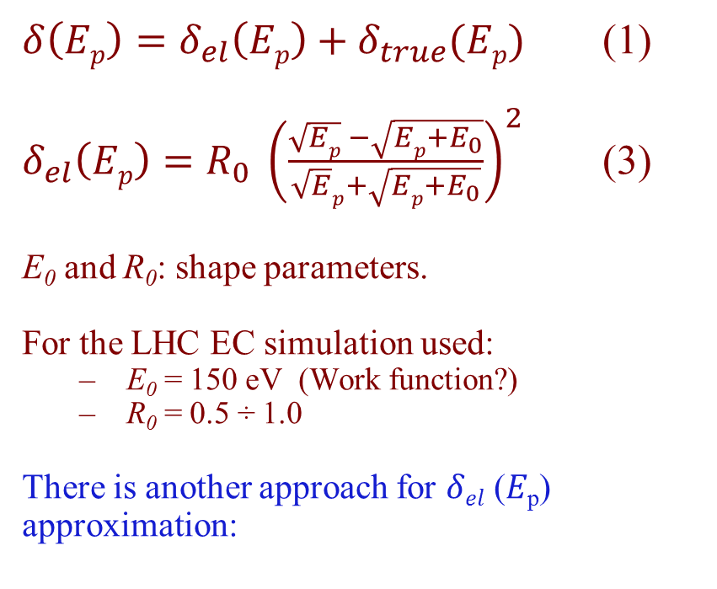
BINP
Key parameters for EC simulation
According to:
R. Cimino, I. R. Collins, M. A. Furman, M. Pivi, F. Ruggiero, G. Rumolo, and F. Zimmermann, “Can Low-Energy Electrons Affect High-Energy Physics Accelerators?,” Phys. Rev. Lett., vol. 93, p. 014801, Jun 2004.
$δ\left(Ep\right)=δ_{el}\left(Ep\right)+δ_{true}(Ep)$ (1)
$δ_{el}\left(Ep\right)=R_{0} {\left(\frac{\sqrt{Ep} −\sqrt{Ep+E_{0}}}{\sqrt{E}p+\sqrt{Ep+E_{0}}}\right)}^{2}$ (3)
E₀ and R₀: shape parameters.
For the LHC EC simulation used:
  E₀ = 150 eV (Work function?)
  R₀ = 0.5 ÷ 1.0
There is another approach for 𝛿_{𝑒𝑙} (𝐸_{p}) approximation:
𝛿_{𝑚𝑎x}
(1)
(2)
(3)
$$E_{max}$$
$$\text{δ}\text{el}\text{ (}\text{E}\text{p}\text{)}=f∙δ_{max}, ln{f=}1.59+3.75\ln{E_{p}−1.37 {(lnE_{p})}^{2}}+0.12 {(lnE_{p})}^{3}$$
E_{p}∈[0,100eV]
Empirical, from data on different materials:
Scholtz, J.J., D. Dijkkamp, and R.W.A. Schmitz, Philips Journal of Research, 1996. 50(3-4), 375

Slide 12
BINP
Key parameters for EC simulation
Secondary energy spectrum
E_{s.max} ≈ 1.8 eV, ∆E_{s} ≈ 1 eV
Dependencies on primarily electrons angle incidence (relatively to surface normal vector):

Slide 13
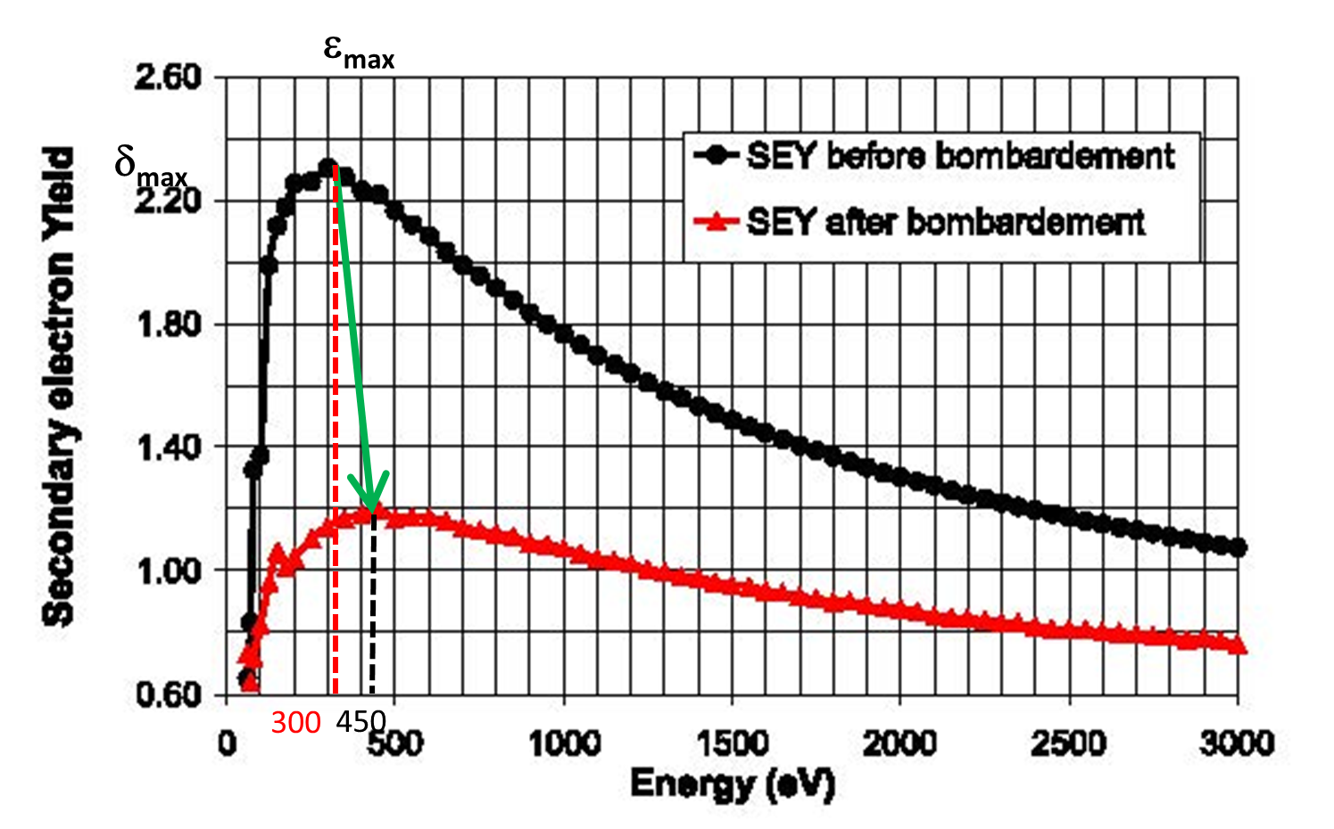
Electron cloud formation
at <1
BINP
Phenomenologically, neglecting space charge, electron density can be estimated as:
The problem is solved if s <0,02,
and < 0,95 for example
How to reach it:
amorphous carbon coating
High quality NEG (TiZrV)
Laser tritment
Or just Ti but deposited in-situ (!)
Geometrical solutions with low “s”
< 2E5 cm⁻³
SEY of OFE Copper

Slide 14
EC formation
EC numerical simulation made at CERN
BINP
a.a.krasnov@inp.nsk.su
EC linear density in LHC dipole chamber
R – elastic scattering is taking into account
NR - elastic scattering is NOT taking into account

Slide 15
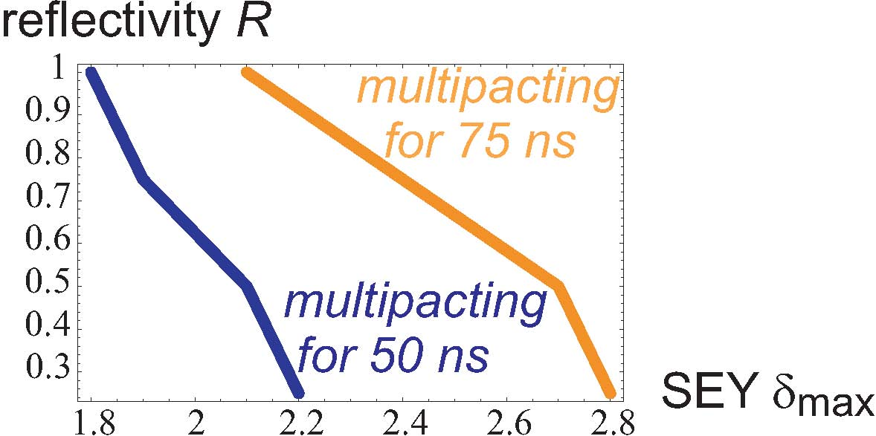
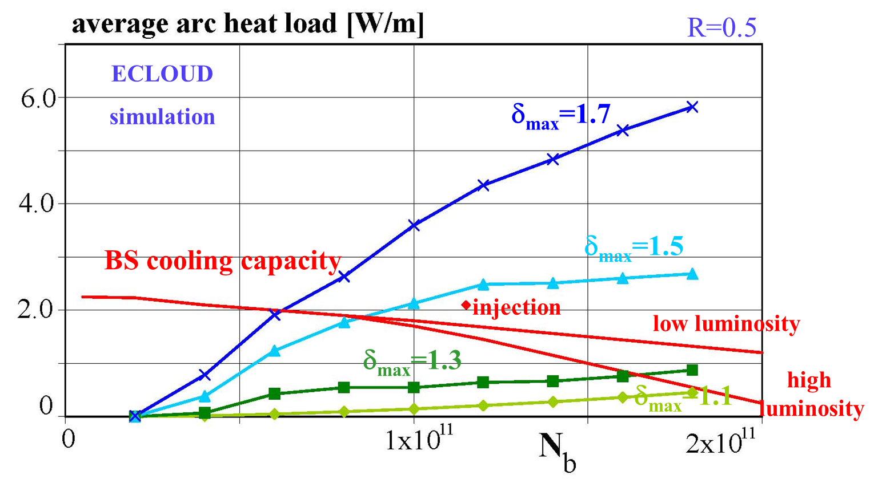
EC formation
EC numerical simulation made at CERN
BINP
a.a.krasnov@inp.nsk.su
Multipacting threshold at long bunch spacing
EC head load at nominal munch spacing 25 ns

Slide 16
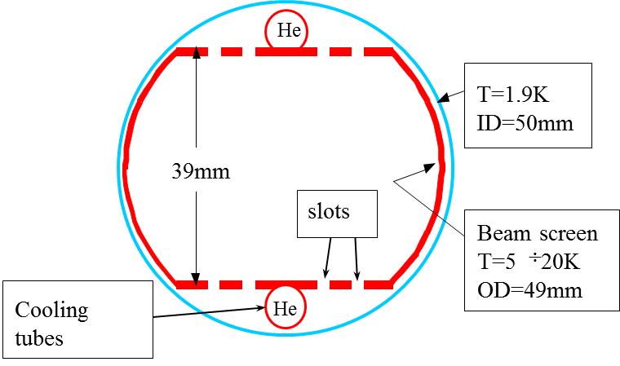
LHC, Phenomena in cold beam pipe
BINP
Cross-section of arc LHC beam pipe in superconducting dipoles
Cooling capacity at 1.9K is 10s mW/m
Cooling capacity of BS about 2 W/m
Old design
Molecular physisorption
onto cryogenic surfaces
(weak binding energy)
Screens against e⁻
B
CB T=1.9K
Electron Cloud
e⁻
γ
p⁺
ID=50mm
γ_{d}
Saw tooth!
γ_{d}
e⁻
e⁻_{ph}
BS T=5 ÷ 20K
OD=49mm
Cooling tubes
Slots
Position of EC strips is defined by maximum of:

Slide 17
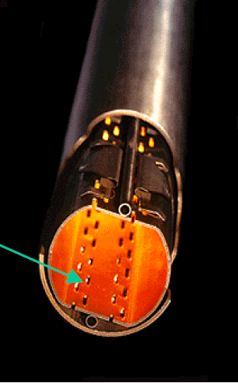
BINP
LH beam pipe
Important solutions made for LHC arc beam pipe
Beam screen: screening of CB against SR and EC, power absorption
Copper co-lamination: high electrical conductivity at cryogenic temperature
SR
Saw tooth!
0.02÷0.03
0.5
Slots
Decreasing number of diffusely scattered photons
decreasing number of photo-electrons (3 ÷ 5 times!) and increasing of conditioning effectiveness

Slide 18
BINP
SuperKEKB dipole chamber
a.a.krasnov@inp.nsk.su
SR

Slide 19
Surface conditioning (SEY must be less 1.3 for LHC arcs)
SEY measurements at CERN for copper samples:
BINP
a.a.krasnov@inp.nsk.su
Pure copper: δ = 1.35
Surface conditioning (SEY must be less 1.3 for LHC arcs)
SEY measurements at CERN for copper samples

Slide 20
a.a.krasnov@inp.nsk.su
BINP
Relation between SEY and ESD during conditioning!
B.Henrist, N.Hilleret, C.Scheuerlein, M.Taborelli, G.Vorlaufer. The variation of the secondary electron yield and of the desorption yield of copper under electron bombardment: origin and impact on the conditioning of the LHC. Proceedings of EPAC 2002, pp. 2553-2555, Paris, France.

Slide 21
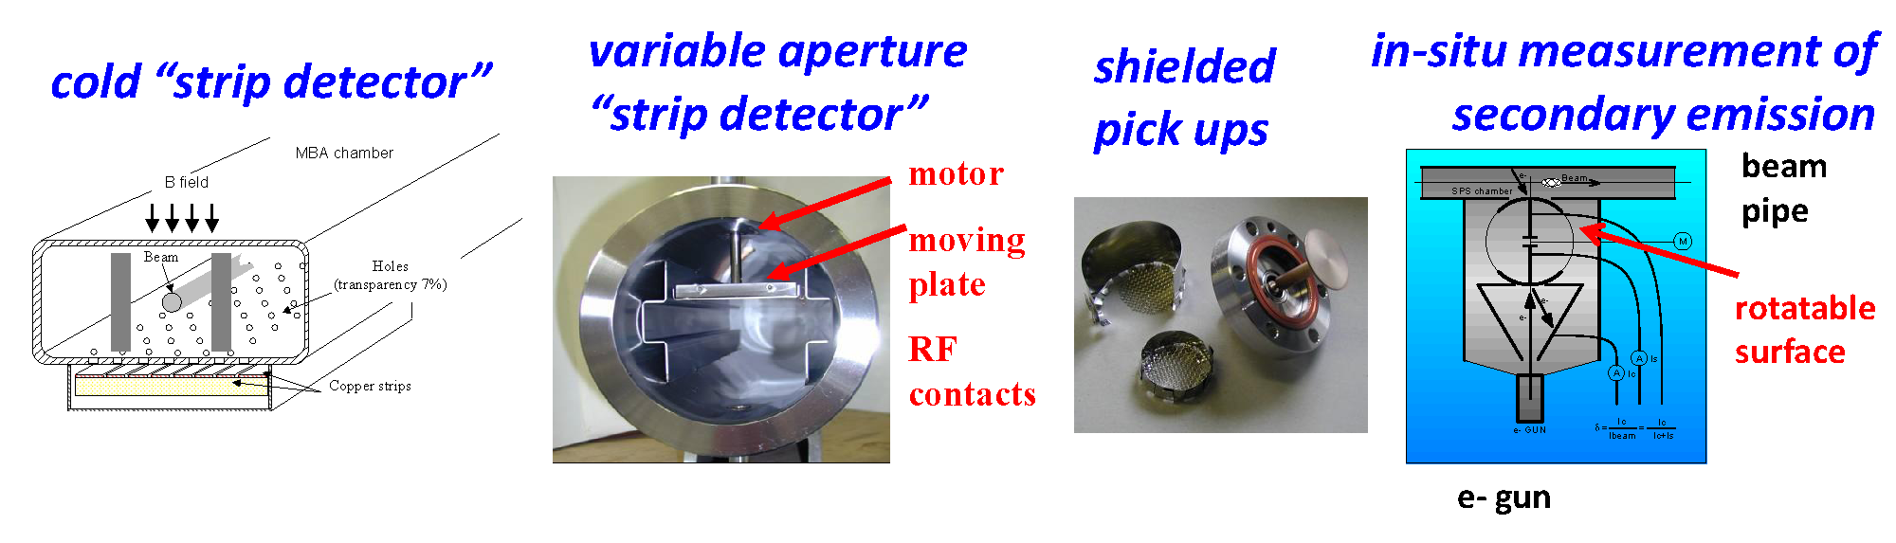
BINP
EC investigations on SPS (CERN)
a.a.krasnov@inp.nsk.su
EC detection with the use microwave phase shift
Details ask Fritz Caspers

Slide 22
BINP
EC investigations on SPS (CERN)

Slide 23
EC investigations on SPS (CERN)
BINP
a.a.krasnov@inp.nsk.su

Slide 24
EC investigations on SPS (CERN)
BINP

Slide 25
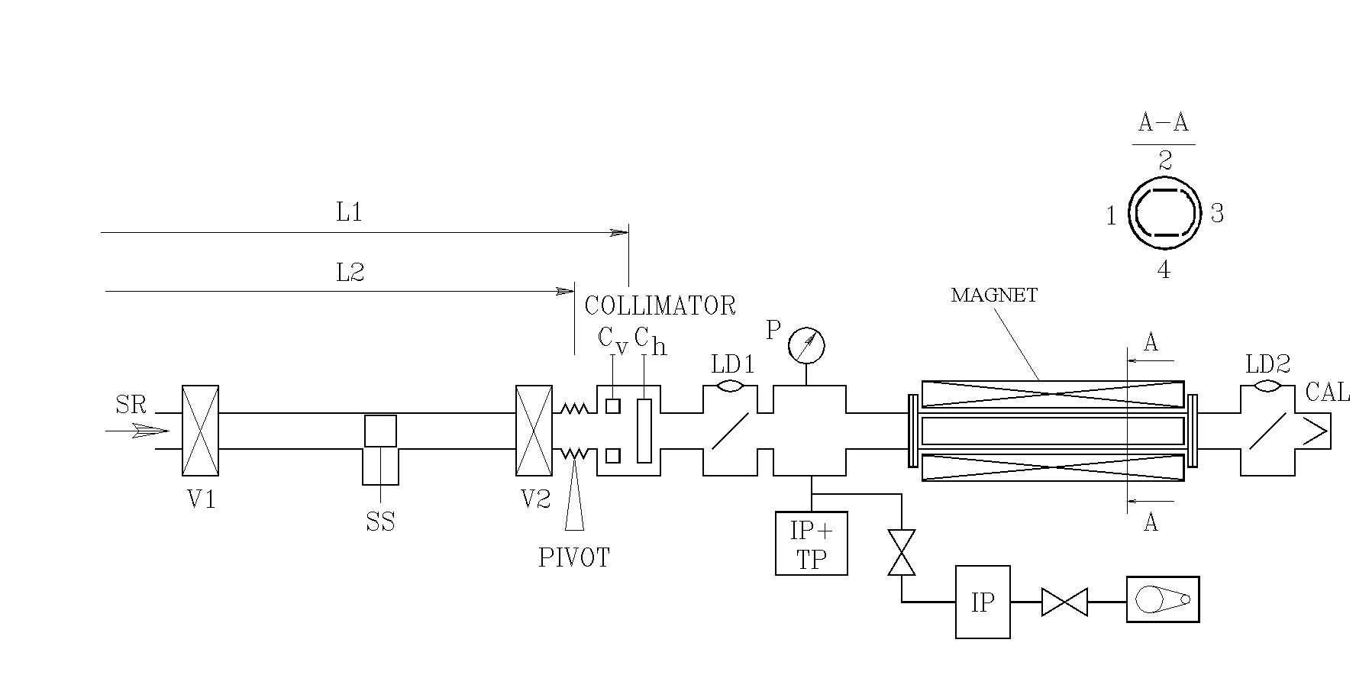
Photoelectron azimuthal distribution
Experiments at BINP (Novosibirsk)
BINP
a.a.krasnov@inp.nsk.su
Sample | E_{c} [eV] | Specular scattering [%] |  | Quantum yield | Normalized photocurrent [%]
 |  | R_{e} current | R_{W} power |  | R₁ | R₃ | R₂+R₄
Smooth | 49 | 80 | — | 0.047 | 16 | 2.2 | 1.8
Saw tooth N1 | 49 | 3.5 | — | 0.05 | 74 | 18.5 | 4
 | 246 | 2.5 | 3 | 0.06 | 79 | 15 | 3.5
Saw tooth N2 | 98 | 13 | 10±5 | 0.055 | 67 | 16 | 4

Slide 26

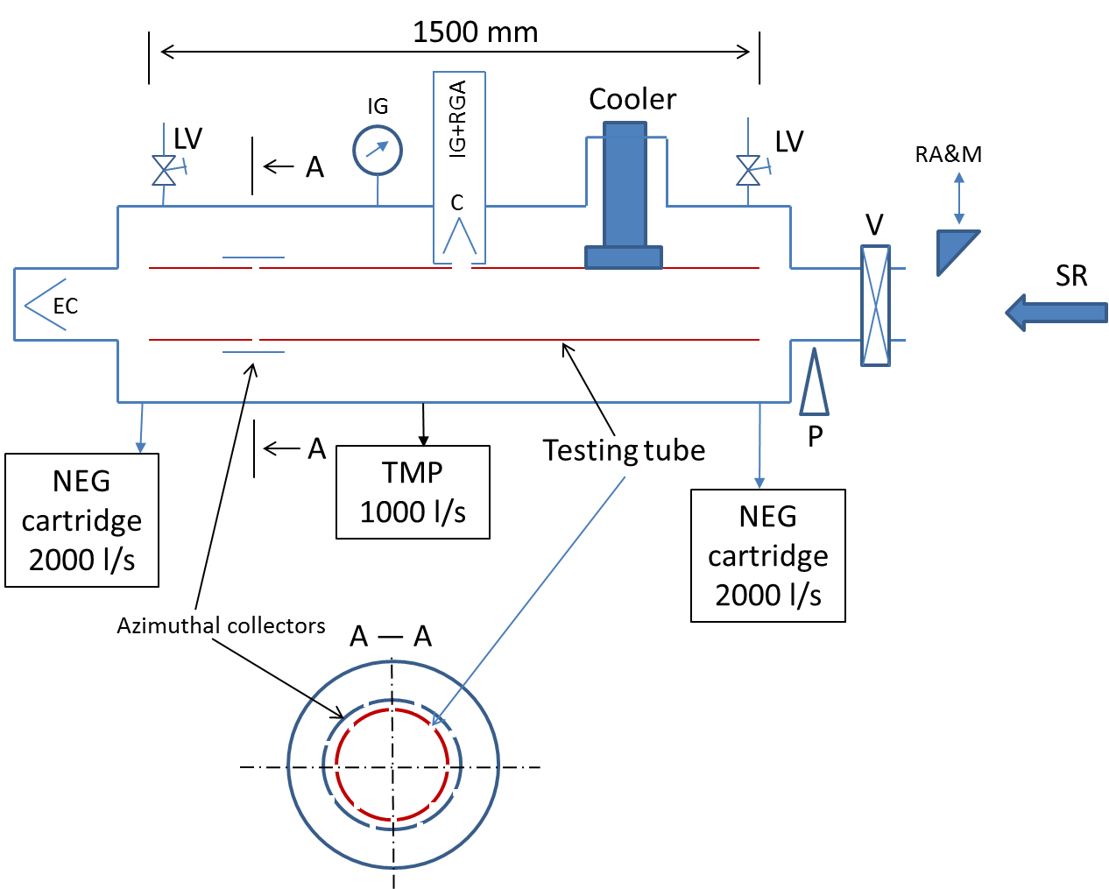
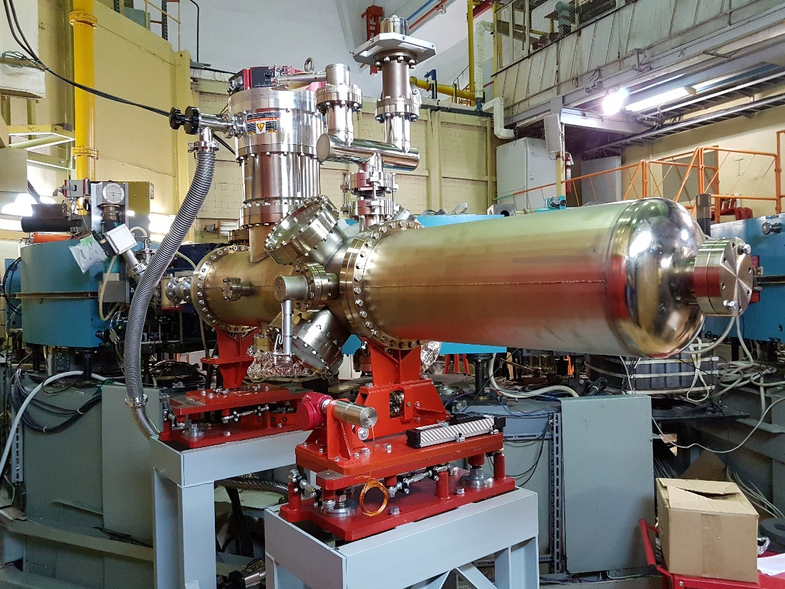
Collaboration R&D CERN – BINP (Addendum P110/A2)
BINP
In the framework of the HL-LHC project, the vacuum performance of new surface material needs to be studied in details. In particular, amorphous carbon (a-C) coating is proposed as an anti-multipactor surface with the objective to minimize the heat load deposed on the shielded beam screen and the background to the experiment due to proton scattering onto the residual gas. Since the protons in the HL-LHC Inner Triplets generates SR with ~ 10 eV critical energy and ~ 10¹⁶ ph/m/s flux, it is therefore of great importance to study the impact of such photons on a-C coating held at room and cryogenic temperature and compare the results against present LHC material.
The experimental set-up
on BEP SR beam line at BINP

Slide 27
Forward reflectivity
BINP
BEP: Ie up to 650 mA, Ee=193….900 MeV, Ec=12,5… 1250 eV
Ec eV | α-C R forward | Cu1 R forward
12,5 | 0,013 | >0,75
25 | - | >0,75
50 | - | >0,7
100 | 0,027 | 0,6…0,75
200 | 0,018 | -
400 | 0,028 | -
800 | 0,021 | -
1250 | 0,015 | -
* Calibration and more experiments are needed to check the result

Slide 28
Azimuthal photon distribution
BINP
_
SR
0
+
Alpha/2
Alpha/2

Slide 29
Azimuthal photo-electrons distribution
BINP
_
SR
0
+
Alpha/2
Alpha/2

Slide 30

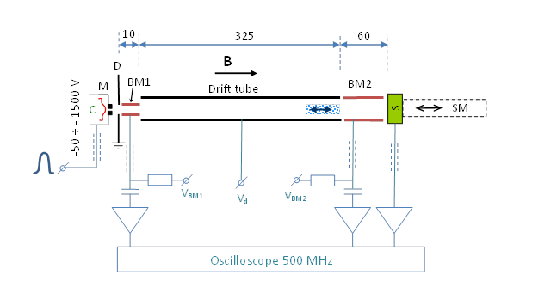
SEE in magnetic field
BINP
“C” – thermo-cathode
“M” – modulator
“D” – diaphragm
“BM1, BM2” – beam monitors
“S” – sample
“SM” – sample manipulator
Parameters
-Energy of primarily electrons: 50 ÷ 1500 eV
-Primarily beam pulse current: up to 200 µA
-Primarily electron beam pulse duration: 1 ÷ 10 ns.
-Beam diameter: ~ 1.5 mm
-Maximum magnetic field: 0.05 T
-BM1, Drift tube, BM2 bias: -600 ÷ +600 V
Element (from left to right) | ID [mm] | Length [mm] | Gap with right element [mm]
C | - | - | 0.25
M | 0.5 | 2 | 3
D | 4.5 | 1 | 1
BM1 | 4 | 10 | 0
Drift tube | 7 | 325 | 1
BM2 | 7 | 59 | 2 ÷ 3 (to sample)

Slide 31
First experimental results
BINP
BM2
S
BM1
Primary
Secondary
Secondary - Primary

Slide 32
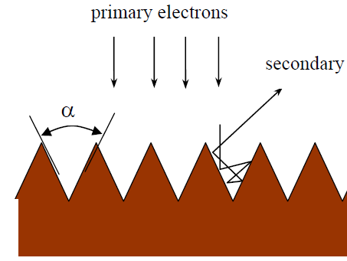
10
325
60
B
BINP
D
M
BM1
Drift tube
BM2
C
S
Flat

Slide 33
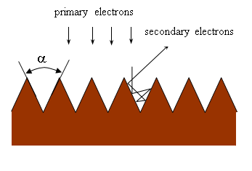
SEY vs extracting bias Ubm2
BINP
10
325
60
D
B
M
BM1
Drift tube
BM2
C
S

Slide 34
Energy distribution
BINP
10
325
60
D
B
M
BM1
Drift tube
BM2
C
S
z
0
where E_{z}=E_{sz}+U_{bm2} and delay t’ is defined as:
$$If I\left(t=0, z=0\right)=Q∙δ\left(0\right)$$
Ubm1=Udrift=Ubm2=5V

Slide 35
Energy distribution
BINP
10
325
60
D
B
M
BM1
Drift tube
BM2
C
S

Slide 36


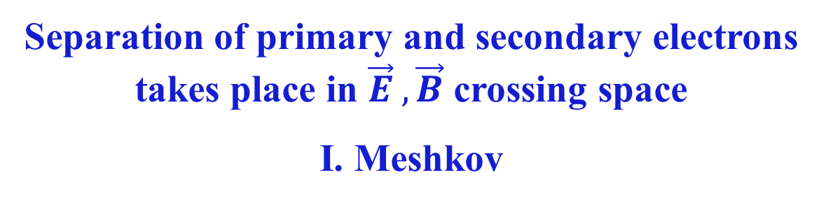
SEE in magnetic field (JINR)
How to separate primary and secondary electrons in DC mode?
BINP
$\vec{B}$everywhere
e - gun
Sample
$$\vec{E}$$
Collector
Separation of primary and secondary electrons takes place in $\vec{E} , \vec{B}$ crossing space
I. Meshkov

Slide 37
References
BINP
[1] G. Budker, G. Dimov, and V. Dudnikov, in Proceedings of the International Symposium on Electron and Positron Storage Rings, Saclay, France, 1966 (Saclay, Paris, 1966), Article No. VIII-6-1.
[2] G. Budker, G. Dimov, and V. Dudnikov, Sov. Atomic. Energy 22, 384 (1967).
[3] V. Dudnikov, in Proceedings of the Particle Accelerator Conference, Chicago, 2001 (IEEE, Piscataway, NJ, 2001).
[4] G. Budker, G. Dimov, V. Dudnikov, and V. Shamovsky, in Proceedings of the International Conference on High Energy Accelerators, ambridge, MA, 1967 (CEA, Cambridge, MA, 1967).
[5] Yu. I. Belchenko, G. Budker, G. E. Derevyankin, G. Dimov, V. Dudnikov, G.V. Roslyakov, V. E. Chupriyanov, and V. G. Shamovsky, in roceedings of the Xth International Conference on Particle Accelerators, Protvino, 1977 (Protvino Institute of High Energy Physics, Serpukhovy, 1977), Vol. 2, p. 287.
[6] B.V. Chirikov, Sov. At. Energy 19, 1149 (1965).
[7] J. H. Martin, R. A. Winje, R. H. Hilden, and F. E. Mills, in Proceedings of the 5th International Conference on High Energy Accelerators, Frascati, 1965 (CNEN, Rome, 1966), p. 47.
[8] J. H. Martin, R. A. Winje, and R. C. Trendler, in Proceedings of the International Conference on High Energy Accelerators, Cambridge, MA, 1967 (Ref. [15]), p. 356. [9] E. C. Raka, in Proceedings of the International Conference on High Energy Accelerators, Cambridge, MA, 1967 (Ref. [15]), p. 428.
[10] K. Ohmi, Phys. Rev. Lett. 75, 1526 (1995).
[11] M. A. Furman and G. R. Lambertson, in Proceedings of the International Workshop on Multibunch Instabilities in Future Electron and Positron Accelerators (MBI’97), Tsukuba, edited by Y.H.
Chin, KEK Proceedings Vol. 97–17 (KEK, Tsukuba, 1997).
[9] K. Ohmi, in Proceedings of the International Workshop on Multibunch Instabilities in Future Electron and Positron Accelerators (MBI’97), Tsukuba (Ref. [8]).
[10] S. S. Win, H. Fukuma, K. Ohmi, and S.-I. Kurokawa, in Proceedings of ECLOUD’02, Geneva (Ref. [6]).
[11] D. Schulte, in Proceedings of ECLOUD’04, Napa, CA (Ref. [1])
[12] F. Zimmermann, “Review of single bunch instabilities driven by an electron cloud”, PHYSICAL REVIEW SPECIAL TOPICS - ACCELERATORS AND BEAMS, 7, 124801 (2004)
[13] K.Ohmi and F.Zimmermann. Head-Tail Instability Caused by Electron Clouds in Positron Storage Rings. Phys. Rev. Lett. 85, 3821, 2000.
[13] B.Henrist, N.Hilleret, C.Scheuerlein, M.Taborelli, G.Vorlaufer. The variation of the secondary electron yield and of the desorption yield of copper under electron bombardment: origin and impact on the conditioning of the LHC. Proceedings of EPAC 2002, pp. 2553-2555, Paris, France.
[14] R.Cimino, I.R.Collins, M.A.Furman, M.Pivi, F.Ruggiero, G.Rumolo, and F.Zimmermann. Can Low-Energy Electrons Affect High-Energy Physics Accelerators? Phys. Rev. Lett. 93, 014801, 2004.
[15] B.Henrist, N.Hilleret, M.Jimenez, C.Scheuerlein, M.Taborelli, G.Vorlaufer. Secondary electron emission data for the simulation of electron cloud. Proc. Mini Workshop on Electron Cloud Simulations for Proton and Positron Beams (ECLOUD'02), Geneva, 15-18 April 2002, pp. 75-78, CERN Report: CERN-2002-001, 2002.
[15] J.M.Jimenez, G.Arduini, P.Collier, G.Ferioli, B.Henrist, N.Hilleret, L.Jensen, K.Weiss, F.Zimmermann. Electron cloud with LHC-type beams in the SPS: A review of three years of measurements. Proc. Mini Workshop on Electron Cloud Simulations for Proton and Positron Beams (ECLOUD'02), Geneva, Switzerland, 15-18 Apr 2002, pp. 17-18, CERN Yellow Report: CERN-2002-001, 2002.
[16] R.Cimino, I.R.Collins, V.Baglin. VUV photoemission studies of candidate Large Hadron Collider vacuum chamber materials. Phisical rewiew special topics – accelerator and beams, v.2, 063201 (1999).
[17].V.V.Anashin, I.R.Collins, R.V.Dostovalov, N.V.Fedorov, O.Gröbner, A.A.Krasnov, O.B.Malyshev and E.E.Pyata. Magnetic and electric field effects on the photoelectron emission from LHC beam screen material. Vacuum, ISSN 0042207X, p. 255-260, vol. 60, N 1-2, January-February 2001.
[18] A.A.Krasnov. Molecular pumping properties of the LHC arc beam pipe and effective secondary electron emission from Cu surface with artificial roughness. Vacuum, vol. 73, pp. 195-199 (2004).
[19] A. Kulikov et al, “The Electron-Cloud Instability at PEP-II,” Proc. 2001 Particle Accelerator Conference (2001), p. 1903S.
[20] S. Heifets, “Electron Cloud at High Beam Currents,” Proc. ECLOUD02 Geneva (2002)
[21] F. Zimmermann, LHC Project Report 95 (1997).
[22] R. Valizadeh, A. Hannah, O.B. Malyshev, T. Sian, J. Mutch, N Sykes, Y. Dan, J.S. Colligon, V. Dhanak, MULTIPACTOR SUPPRESSION BY LASER ABLATION SURFACE ENGINEERING FOR SPACE APPLICATIONS, IPAC2019, Melbourne, Australia, ISBN: 978-3-95450-208-0, JACoW Publishing, doi:10.18429/JACoW-IPAC2019-TUPMP051
[23] E. Belli,* P. Costa Pinto, G. Rumolo, A. Sapountzis, T. Sinkovits, M. Taborelli, B. Spataro, M. Zobov, G. Castorina and M. Migliorati. Electron cloud buildup and impedance effects on beam dynamics in the Future Circular e + e − Collider and experimental characterization of thin TiZrV vacuum chamber coatings, PHYSICAL REVIEW ACCELERATORS AND BEAMS 21, 111002 (2018)
[24] P. Costa Pinto, A. Bellunato, T. Basso, Paul Edwards, M.Mensi, A. Sublet, M. Taborelli, IMPLEMENTATION OF CARBON THIN FILM COATINGS IN THE SUPER PROTON SYNCHROTRON (SPS) FOR ELECTRON CLOUD MITIGATION, Proceedings of IPAC2014, Dresden, Germany, WEPRI043.
[25] ECLOUD’12, https://agenda.infn.it/event/4303/timetable/?view=standard
[26] ECLOUD’18, https://agenda.infn.it/event/13351/timetable/#20180603
[27] ICFA mini-Workshop on "Mitigation of Coherent Beam Instabilities in particle accelerators" MCBI 2019, https://indico.cern.ch/event/775147/timetable/#20190923.detailed
[28] О. Орлов, И.Н. Мешков и др. Стенд по измерению вторичной электрон-электронной эмиссии, XIII Международный научный семинар памяти профессора В. П. Саранцева «Проблемы коллайдеров и ускорителей заряженных частиц» 3-8 сентября 2019 г.

Slide 38
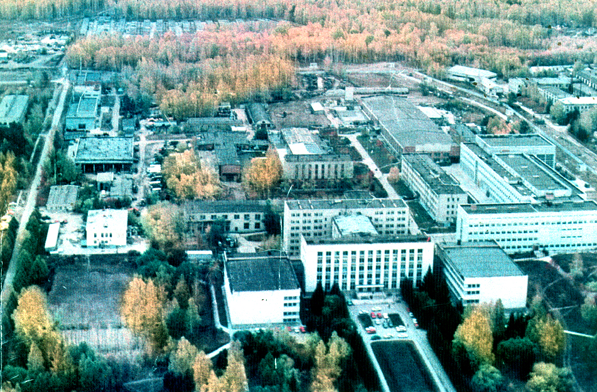
Thanks for your attention

Slide 39

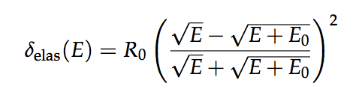
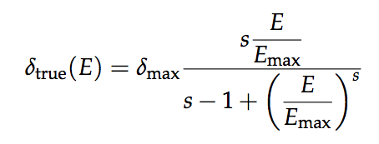




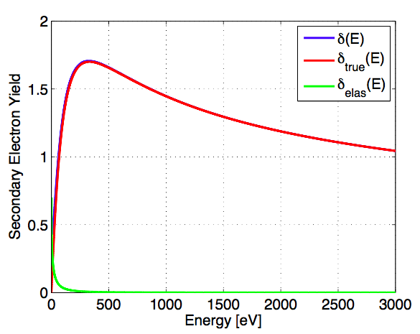
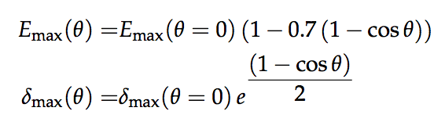
SEY model
The predictions from e-cloud simulations rely on confidence in the SEY curves used
Cimino-Collins SEY model, parameterising measured SEY curves of the LHC beam screens:
Dependence on incidence angle:
with:
with:
R. Cimino et al., Phys. Rev. Lett. 93, 014801

Slide 40
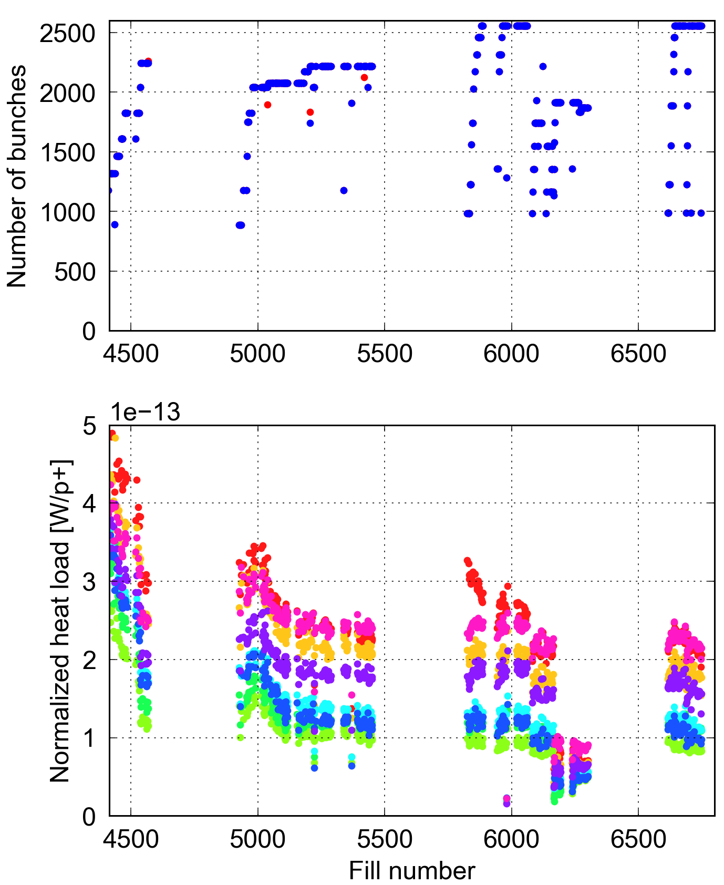
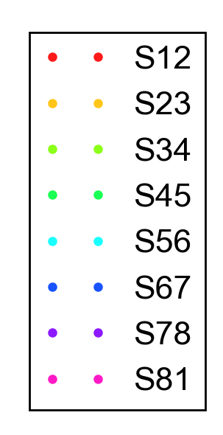
Electron cloud in the LHC
To fill LHC with 25 ns beams in presence of electron cloud it has been necessary to run with high chromaticity and octupole currents throughout the cycle
More scrubbing has been accumulated while running for physics with 25 ns beams during 2015, 2016 and 2017
2015
2016
2017
2018
Notes:
In ‘stable’ beam conditions, scrubbing can be directly seen through the decrease of the normalised heat load in the LHC arcs

Slide 41
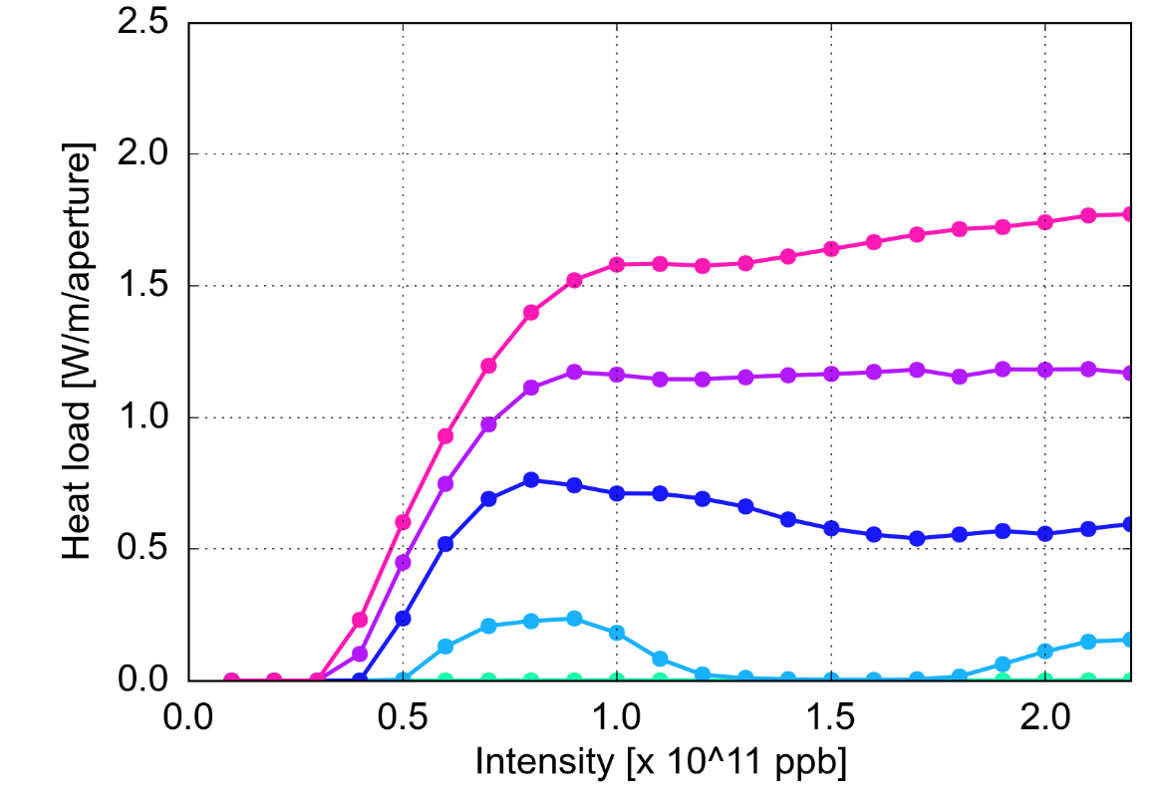
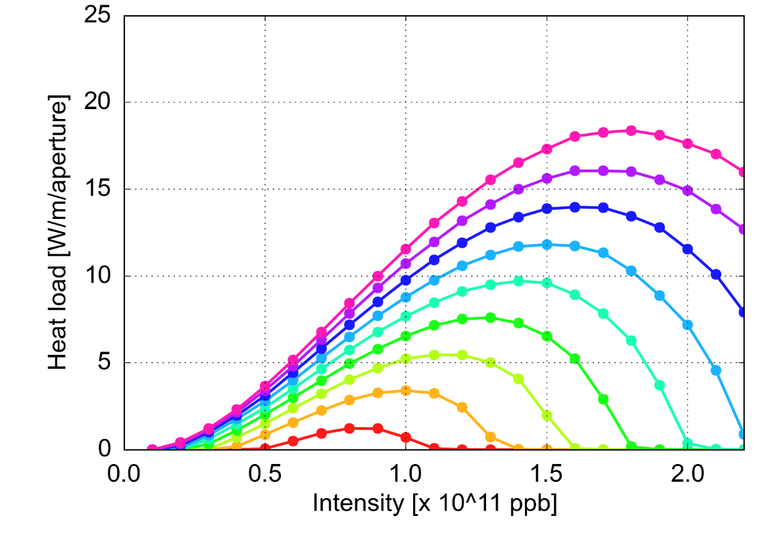
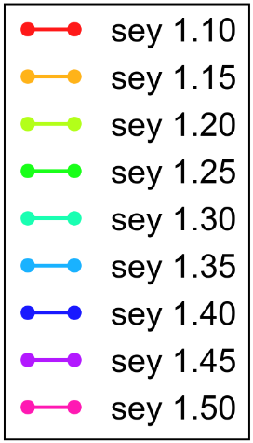
Electron cloud in the LHC: the future
In the High Luminosity (HL) era, LHC will also run with double intensity and brightness
Dependence on bunch intensity seems to be favorable in both dipoles and quadrupoles for low enough SEY values (pending experimental verification)
Future value
Future value
Arc dipoles
Arc quadrupoles
Current value
Current value

Slide 42
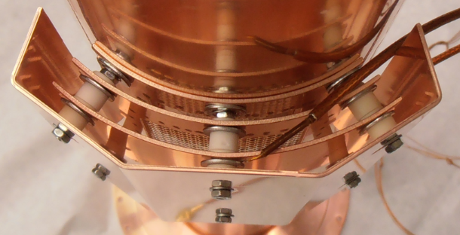
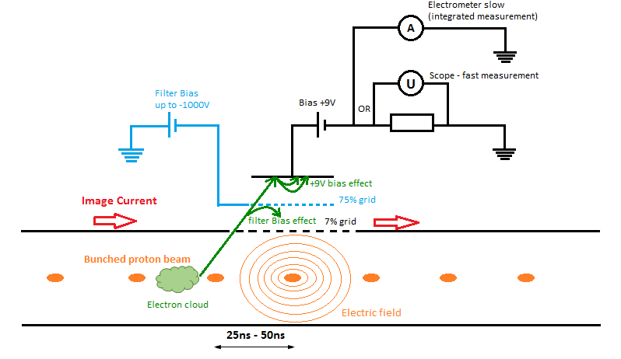
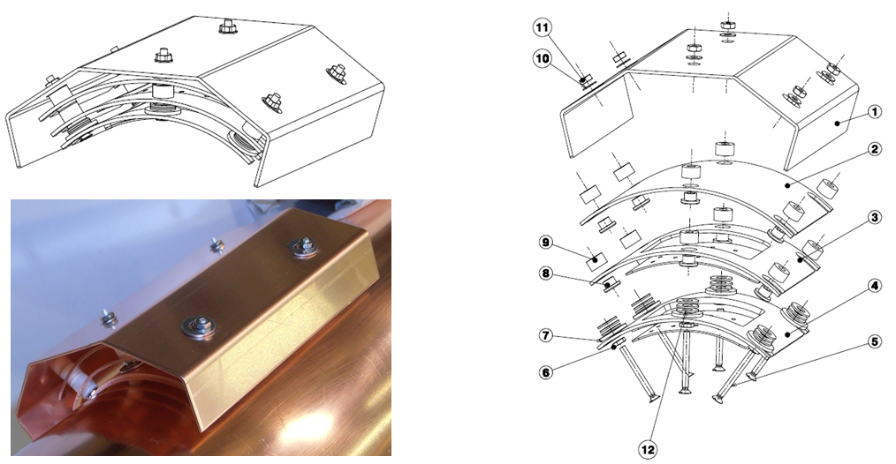
Energy spectrum
- Electron kicker detector:
Analyser of the energy spectrum of the electrons
Elena Buratin

Slide 43
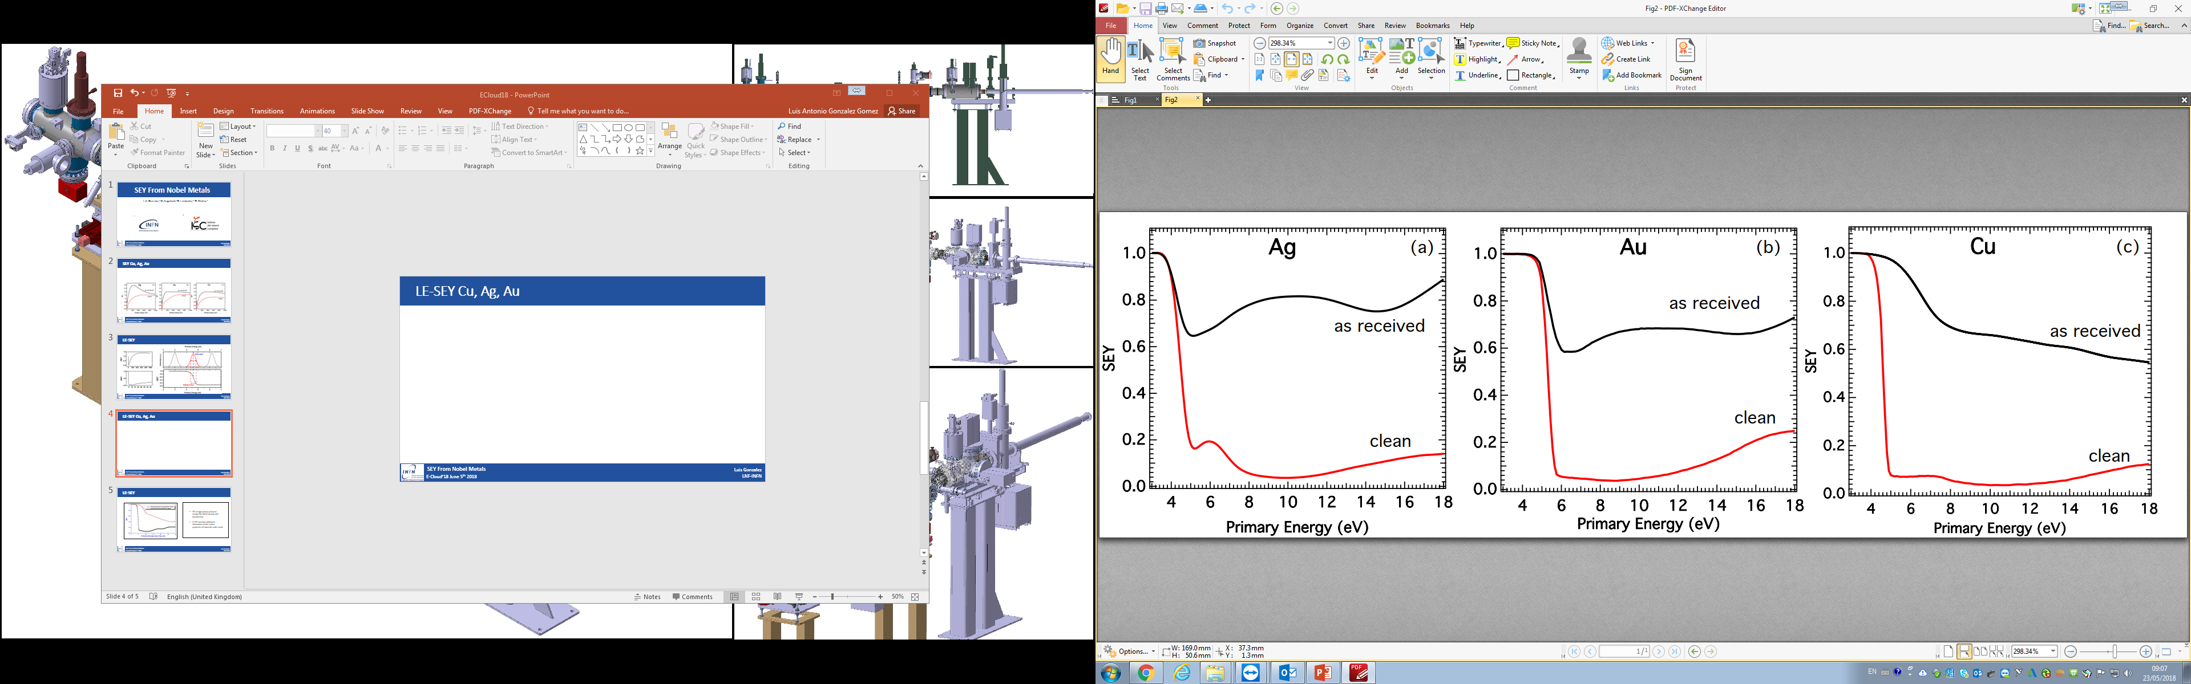

LE-SEY Cu, Ag, Au
CLEAN SURFACES
-SEY drastically decreases at impinging energies close to zero.
-Different work functions were measured for each clean surface, in good agreement with literature results*
“AS RECEIVED” SURFACES
-LE-SEY remain above 0.5 for all “as received” surfaces.
-Similar behaviour of Ag and Au – Including WF does not change with respect CLEAN.
-Cu shows a different trend and an increase in the WF
ΔWF
WF = 4.4
WF = 5.3
WF = 4.6
Ag
Au
Cu
*
A. Kawano, Progr. Surf. Sci. 83, 1-165 (2008).
SEY From Noble Metals
3
Luis Gonzalez
LNF-INFN
E-Cloud’18 June 5th 2018

