Slide 1
RF systems
Dr. Michael Lalayan
National Research Nuclear University - MEPhI
Joint US-CERN-Japan-Russia
International Accelerator School
Dubna
1 November 2019
1/29
Notes:
https://uspas.fnal.gov/materials/19Knoxville/Knoxville-Electromagnetism.shtml

Slide 2
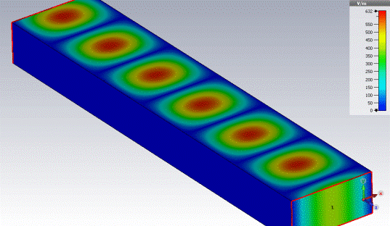
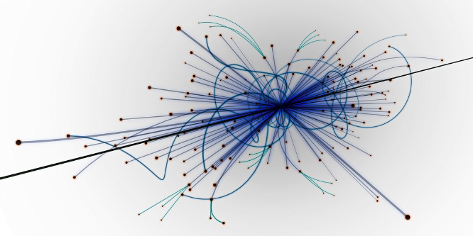
Cause
Electromagnetic (RF) field is the most convenient medium to transfer the power from net to the beam
General power flow chart in accelerator
Electric Grid
(wall power)
Electromagnetic fields
Accelerated beam
2/29

Slide 3
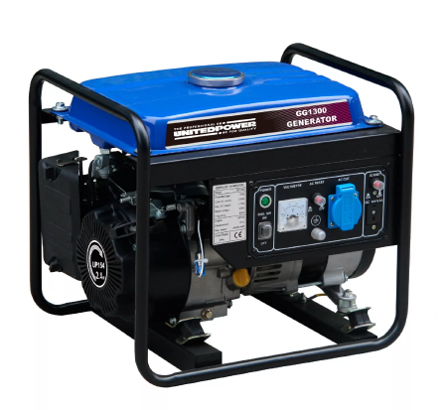
Topics to be discussed
RF power generation
RF power control
RF power transmittion
RF power use
3/29

Slide 4
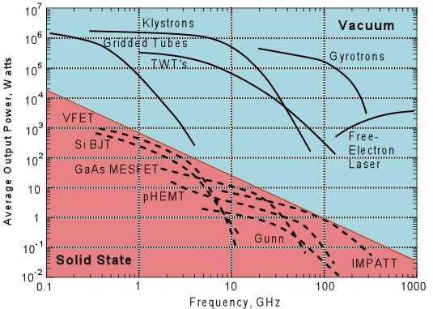
RF power generation
Klystron (amp)
Magnetron (gen)
Inductive Output Tube (amp)
Grid tubes (amp)
Solid State (amp)
4/29

Slide 5
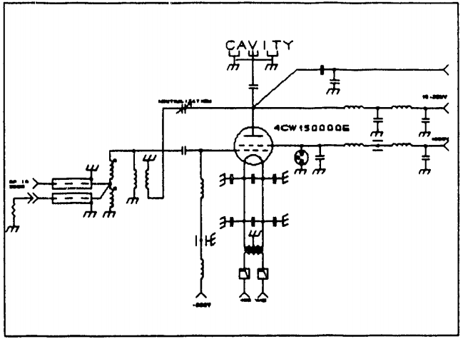
Vacuum grid tubes – decades of experience
 Compact, rugged tube (up to 15K hours lifetime)
 Low frequency , low gain
Schematics of
tetrode-based power amp for RHIC
26.7 MHz, 100kW
year 1995
5/29

Slide 6
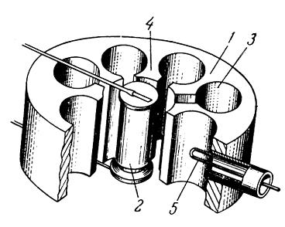
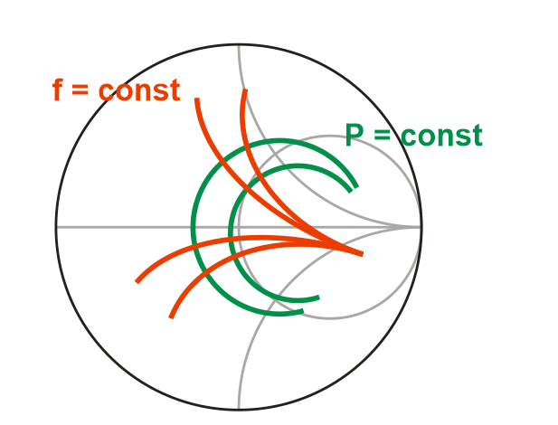
Magnetron
Features
Ultra-efficient
Cost-effective
Needs lower HV than klystron / IOT
... but ...
unstable
1-anode; 2-cathode w/heater;
3-RF cavities; 4-segments;
5-dower output coupler.
Widely used for industrial accelerators but not for "science".
P=P(Z) ; f=f(Z)
{Z – load impedance}
6/29

Slide 7
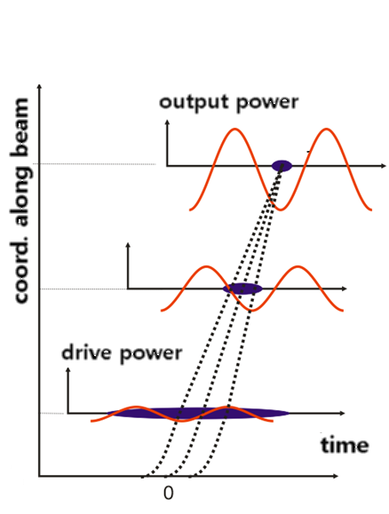
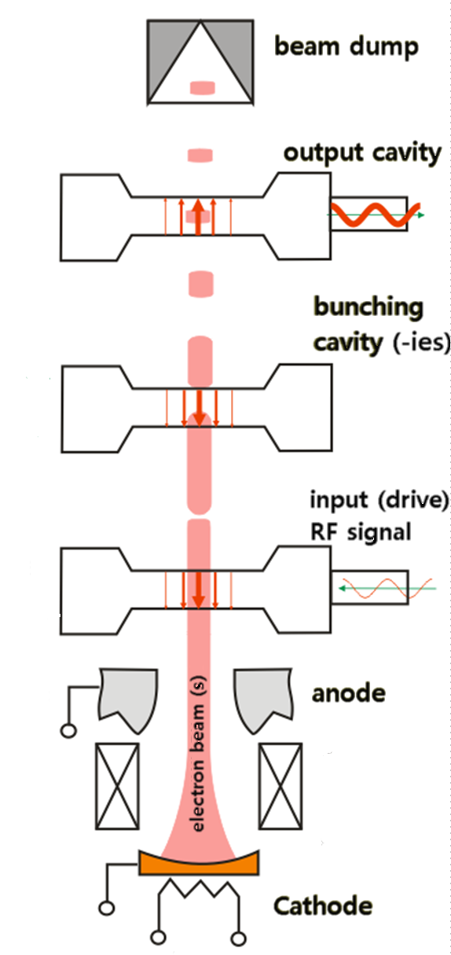
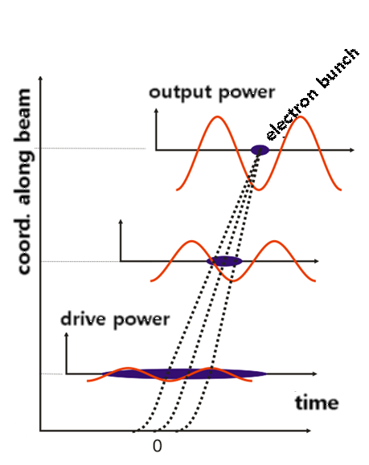
Klystron – operation basics
Thermionic cathode emits continuous beam.
1st cavity modulates particles speed by drive RF signal;
drift space converts it into density modulation;
bunch kinetic energy converts into RF power.
7/29

Slide 8
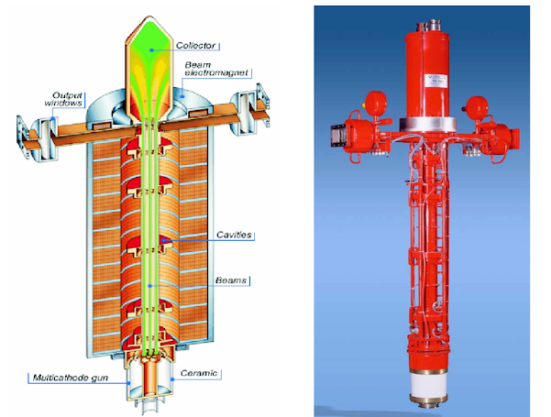
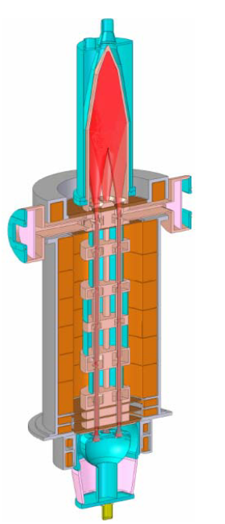
Klystron – design
Toshiba E3736
8/29

Slide 9
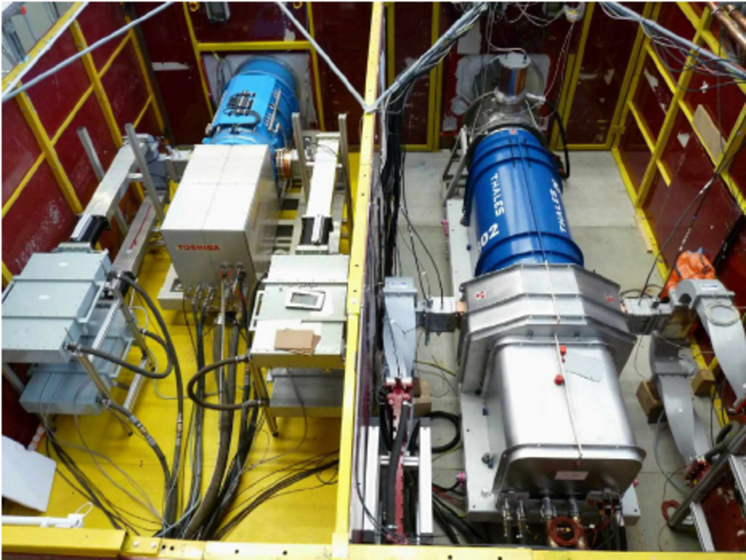
Klystron – modulator
Klystron needs HV modulator to operate (converts wall plug power to HV ~ 50 ... 350 kV)
at about 85...90% conversion efficiency (losses + raise/fall transients)
high HV is to be avoided : cost / radiation from beam dump / efficiency
RF efficiency η (%) = 90 − 20×P(μperv.)
beam perveance P = I/V^{3/2}
[R.S. Symons, “Scaling laws and power limits for klystrons”, IEDM, 1986]
test stand at DESY
klystron
pulse transformer tank
9/29

Slide 10
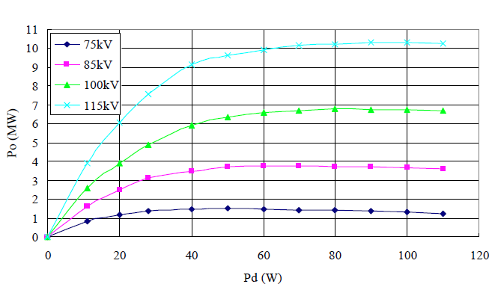
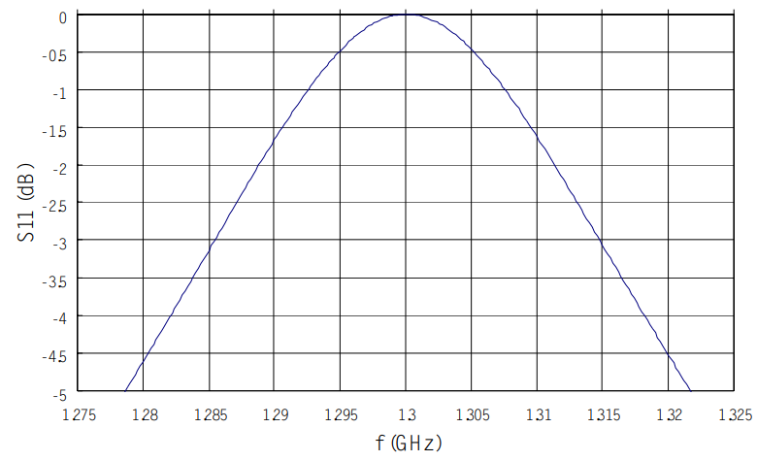
Klystron – RF control
TOSHIBA E3736 Multi(6)-beam klystron:
output power vs. RF drive power at 1300 MHz.
output frequency response
10/29

Slide 11
Klystron – summary
Features
 High stability (power, freq)
 High gain ~25...55dB
 Different ways for RF control
Low frequency tuning range ~0.5 ... 5% typ.
Average reliability, lifetime ~10K hours
 Expensive
 Needs HV modulator (bulky, expensive)
11/29

Slide 12
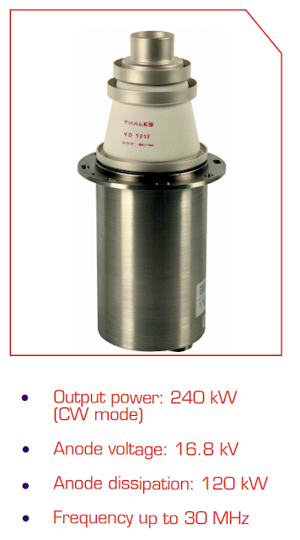
IOT – inductive output tube
The inductive output tube (IOT) is the latest generation of amplifying device. Could be more efficient replacement for the klystron (efficiency drop at UHF)
Sometimes unstable and unreliable in operation. (ALBA experience)
Operation: combines various aspects of tetrode and klystron technology: the RF input signal is applied between the cathode and a grid.
The electron beam is density modulated within the gun region itself.
Power is extracted via a conventional klystron output system.
12/29
Notes:
https://tech.ebu.ch/docs/techreview/trev_273-heppinstall.pdf

Slide 13
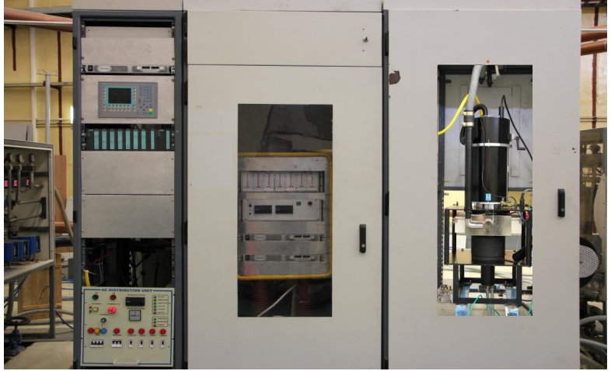
IOT – inductive output tube
Setup is very similar to one used for klystron
(power requirements, schematics, design, space...)
INDUS-2 :
IOT : 80 kW , 505.8 ± 1,8 MHz, 23 dB gain
power supply :36 kV
13/29

Slide 14
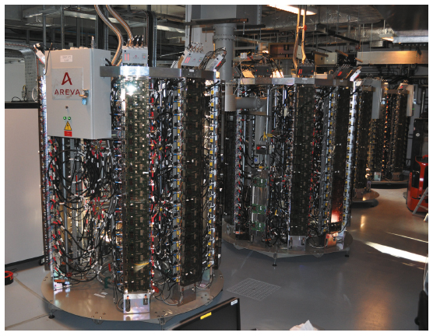
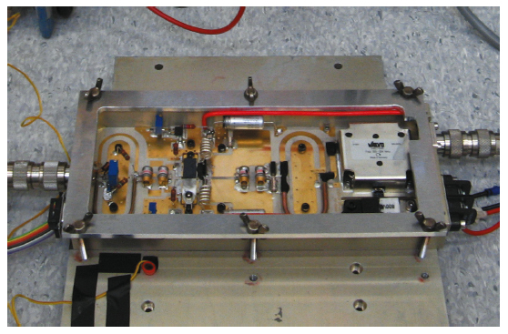
Solid State Power Amplifiers
Single Solid state amplifier yields some P_{rf}≤ 1kW
Hundreds of units are to be combined -> redundancy and reliability of entire system.
Power saving tech (ESRF: AC power 1.2MW for klystron-powered -> 0.4MW for SSPA).
Today SSPA technology is a qualified alternative to klystrons.
ESRF system:
one tower : Ф1.5m*h=2m;
128 modules*650W; 352 MHz
14/29

Slide 15
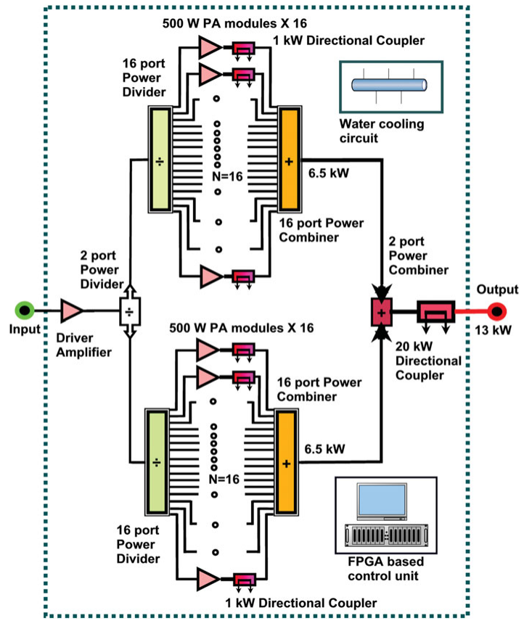
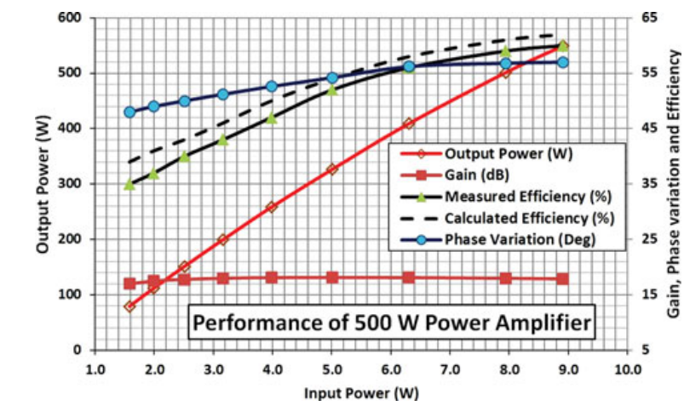
Solid State Power Amplifiers
SSPA for INDUS-2
developer:
Raja Ramanna Centre for Advanced Technology (RRCAT)
50 kW, 18dB gain, 505.8 ± 5 MHz
Design and characterization of 50 kW solid-state RF amplifier. Akhilesh Jain et al. International Journal of Microwave and Wireless Technologies, 2012, 4(6), 595–603.
15/29

Slide 16
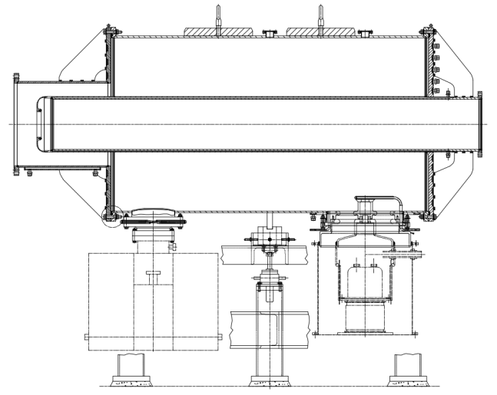
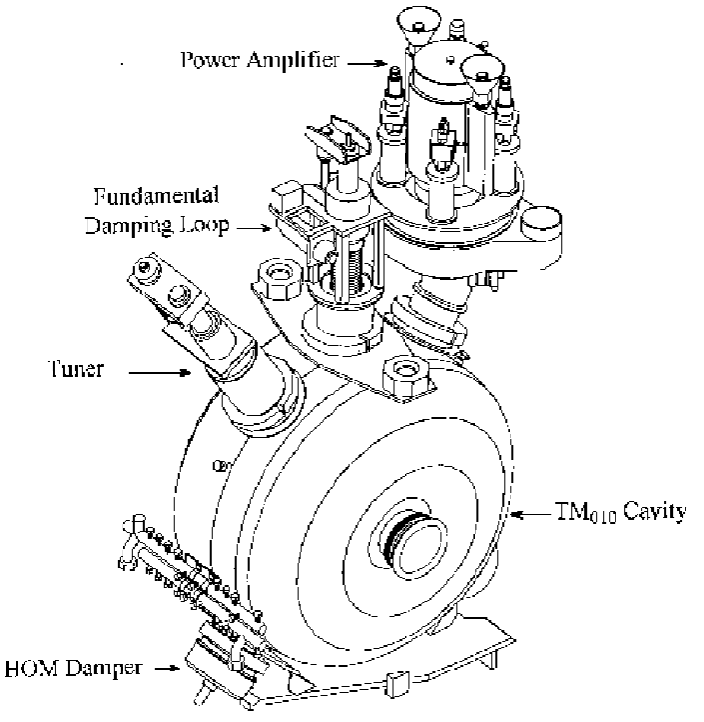
RF power transfer
two cavities per ring
f = 27 MHz
Vacc = 300 kV
In some cases:
no power transfer necessary –
Direct-driven cavity
(RHIC @ Brookhaven)
tetrode amp
seven cavities per beam
f = 196 MHz
Vacc = 1MV
/surplus from SPS/
https://www.researchgate.net/publication/3634776_RF_systems_for_RHIC
16/29
Notes:
https://www.researchgate.net/publication/3634776_RF_systems_for_RHIC

Slide 17
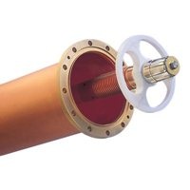
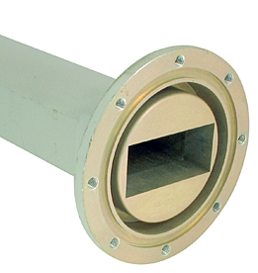
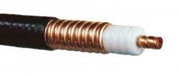
RF power transfer
Waveguides : link distributed system components, tens of meters per cavity
Coaxial
Rectangular waveguide
rigid
semi-rigid
and
flexible
17/29

Slide 18
RF power transfer – summary
Type | advantages | drawbacks | usage
Rectangular | power handling; low losses; mechanical rigidity. | bulky (esp. on low freq.) rigid, heavy/ | high power applications @ mid to high frequency range
Circular |  | undefined wave polarization plane ; limited range of devices (circulators, directional couplers etc.). | limited usage in particle accelerators
Coax | space-saving ; widely used, cheap; easy to handle; vast range of connectors. | poor electric strength and power handling; high losses; | low frequencies; LLRF.
18/29

Slide 19
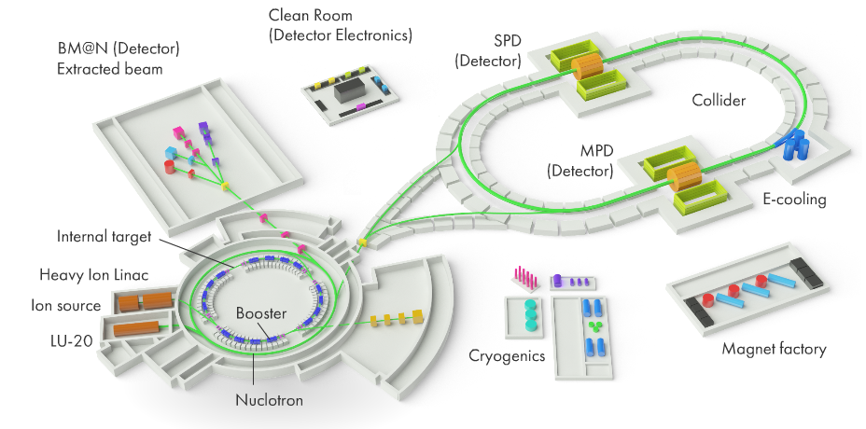
Accelerating cavities
NICA facility
accelerating
cavities for
rings
accelerating
cavities for
linacs/particle sources
http://nica.jinr.ru/ru/complex.php
19/29

Slide 20
Accelerating cavities
Accelerating cavities: a holes in a chunk of metal, capable to store RF energy
Low-β
(0.001 … 0.5)
 RFQ
 Coaxial resonator
 H-type resonator
 split-ring
 spoke resonator
etc.
High-β
(0.5 … 1.0)
 Multicell cavities
(ancessor: Disk-Loaded Waveguide)
Certain configurations, such as travelling wave accelerators, are needed for highly relativistic electrons, but it is not the case for much more massive ions.
20/29

Slide 21
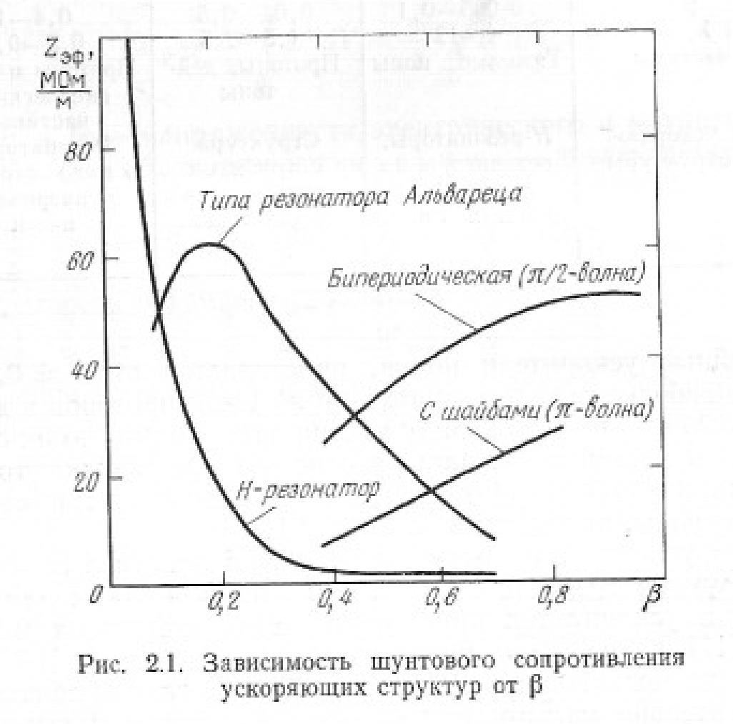
Accelerating cavities – Low-β
Low-β resonators basic requirements
To be efficient at low-β implies:
short gap length → High peak fields, low energy gain
low rf frequency → Large resonators, many complicated designs
small bore radius → Low transverse acceptance
There is no “one fits all” cavity design for Low-β:
Structure | “Best” β | f, MHz
RFQ | 0.005 ≤ β ≤ 0.03 | 4-rod: 10 ≤ f ≤ 200 4-vane: 100 ≤ f ≤ 425
IH | 0.01 ≤ β ≤ 0.10 | 30 ≤ f ≤ 250
CH | 0.10 ≤ β ≤ 0.40 | 150 ≤ f ≤ 800
DTL | best 0.1 ≤ β ≤ 0.4 (use 0.04 ≤ β ≤ 0.43) | βλ/2 : 20 ≤ f ≤ 10 βλ : 100 ≤ f ≤ 500
λ/4 | β ≤ 0.15 | f ≤ 160
Shunt impedance
21/29

Slide 22
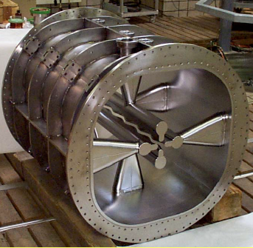
Low-β Cavity design – RFQ
 RFQ
 Compact
 CW operation
 High efficiency
 Down to very low beta
 Large acceptance
 Mechanical stability
 Not easy to build
 Strong Multipactor and Field emission
Technology: copper-plated steel.
PIAVE (injector for ALPI linac) SRFQ – the only superconducting RFQ @ Laboratori Nazionali di Legnaro INFN, 2004
2 sections operate at 80 MHz
22/29

Slide 23
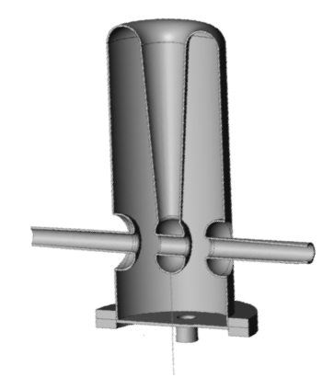
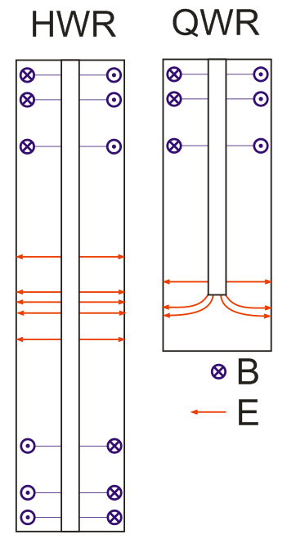
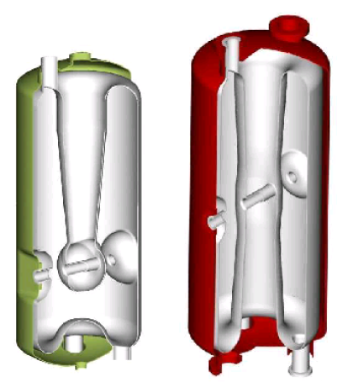
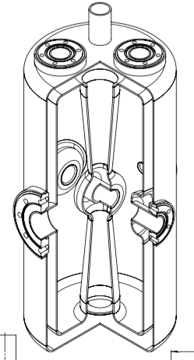
Low-β Cavity design – Coaxial
 Half-wave and quarter-wave coaxial resonators
β ~ 0.1, f ~ 50…150 MHz, π- mode operated
Design:
Concept:
QWR HWR
23/29

Slide 24
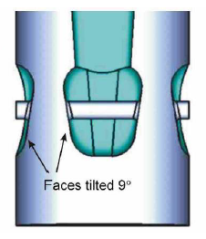
Low-β Cavity design – Coaxial
 Due to low frequency – bulky (∅~20…30 cm, L ~ 50…100 cm)
QWRs:
 ~2 times shorter,
 Have Ey ≠0 and Bx ≠0 on beam line due to structure vertical unsymmetry
→ Global steering effect to beam and emittance growth
HWRs:
 No dipole steering
 Peak surface fields ~ 0.5 of QWR
 The same Eacc achieved by ×2 RF power
 Lower shunt impedance
 Not easy access inside
steering can be compensated by beam line offset or sophisticated shaping
24/29

Slide 25
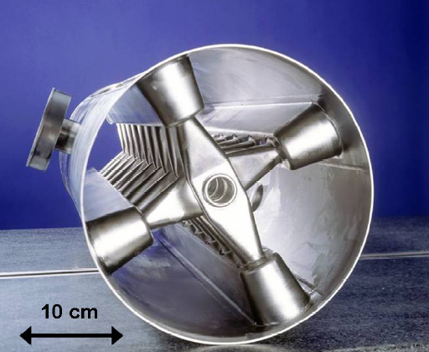
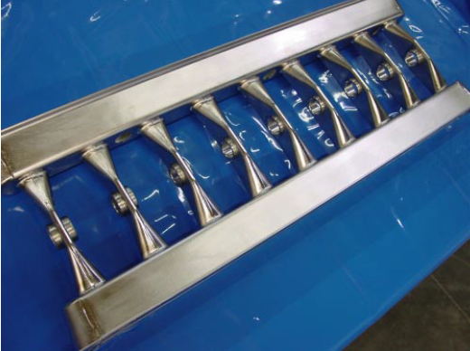
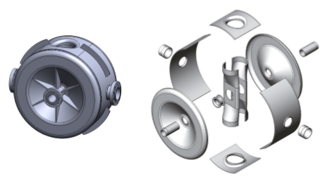
Mid-β Cavity design – H-type
 H-type (CH) Drift Tube Linac
150≤f≤800 MHz, 0.2 ≤β≤0.6
←
Single-SPOKE resonators
 All virtues of coaxial HWRs
 Higher Rsh than HWRs
 larger aperture than HWRs
 Larger size than HWRs, too large below ~350 MHz
 More expensive than HWRs
25/29

Slide 26
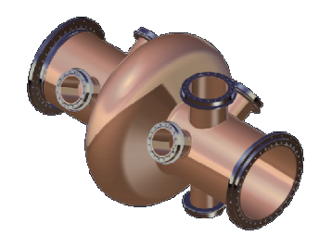
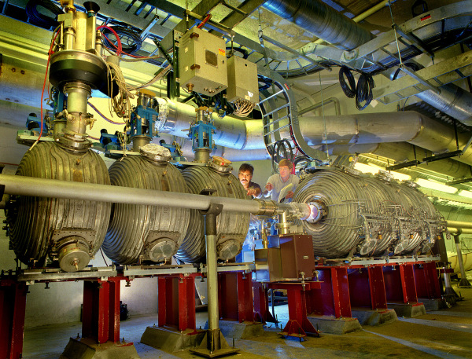
Accelerating cavities for ring
 independent cavities (LHC – 8 cavities per ring, all installed in one location)
CW operation , high-power (100s of kW)
Low gradient is typical (1...10 MV/m)
Large aperture
LHC : 8 SC cavities (Vacc = 2MeV) (Eacc=5MV/m) per beam
f=400MHz.
Klystron-driven (300 kW in CW), 1 Kly per cavity
Cavity @ BNL
26/29
Notes:
https://en.wikipedia.org/wiki/Relativistic_Heavy_Ion_Collider

Slide 27
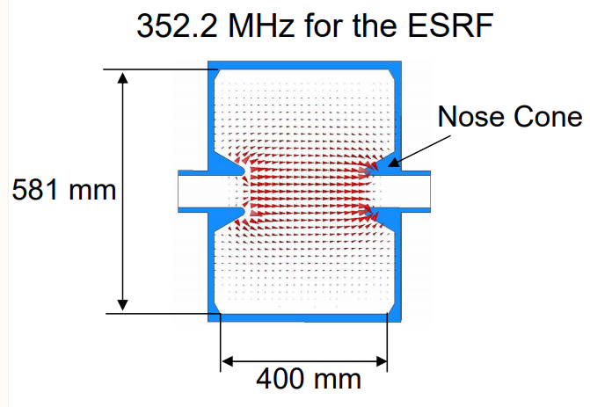
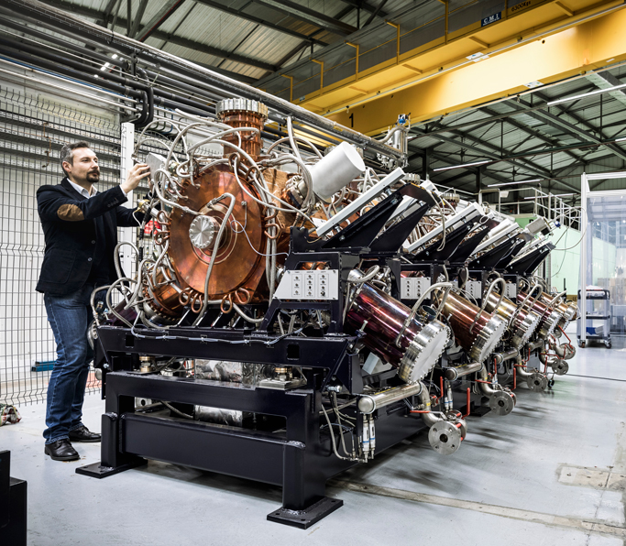
Accelerating cavities for ring
Сavities : simple shapes, complicated design
Many aspects to be kept in mind
aligning, control, cooling...
Vacuum: 10⁻¹¹ mbar
sophisticated instrumentation
broadband HOM damping
27/29

Slide 28
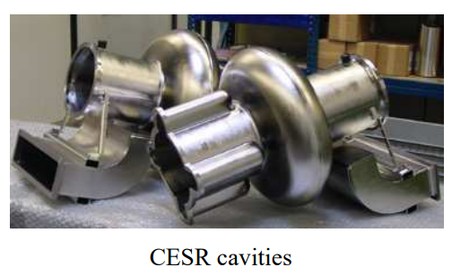
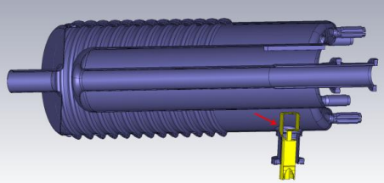
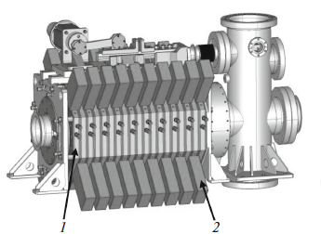
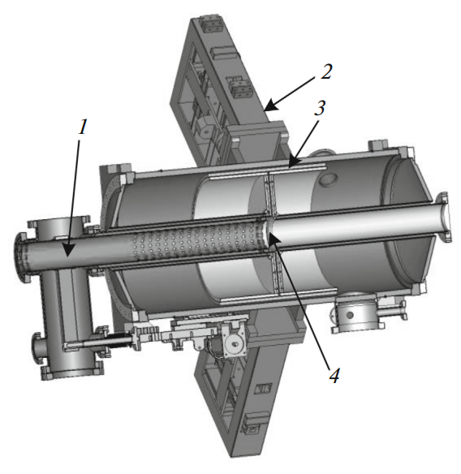
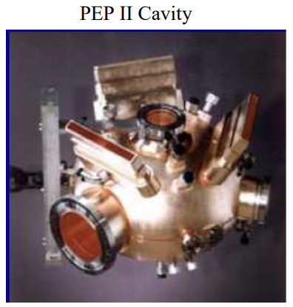
Accelerating cavities for ring
operate on ultra-low frequency
RHIC cavity (coaxial)
28 MHz,
Ф100mm aperture, 2m long
NICA RF-1
~0.5 MHz
accumulation and
acceleration
RF-2 station
~12 MHz
bunch formation
induction accelerator
coaxial cavity
RHIC 28 MHZ ACCELERATING CAVITY SYSTEM.
J. Rose and J.M. Brennan. BNL publication 68473. June 2001
RF System for the NICA Collider. E. A. Rotov et al.
Phys.of Particles and Nuclei Lett., 2018, Vol. 15, No. 7, pp. 919–922
28/29

Slide 29
our revels now are endeth
thank you

