Slide 1
Super-conducting magnets
for ring accelerators

Slide 2
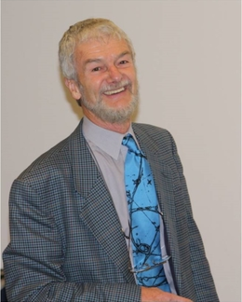
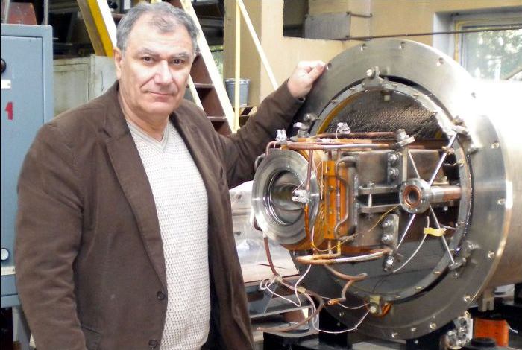
Dr. Hamlet Khodzhibagiyan
Dr. Martin N. Wilson

Slide 3
Modern accelerators:
the synchrotron
the cyclotron
…for high energy physics…and for something else…
beam energy record-holder (LHC)
beam power record-holder (PSI cyclotron)
ring cyclic accelerators: synchrotrons
RF cavity
RF generator
B
Constant orbit during acceleration
B increase with time
ω and ω_{RF} increase with energy
E
Bending
magnet
R=C/2π
injection
extraction
r
bending radius

Slide 4
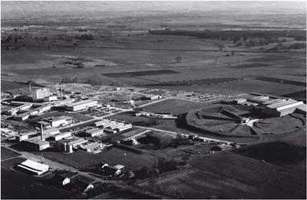
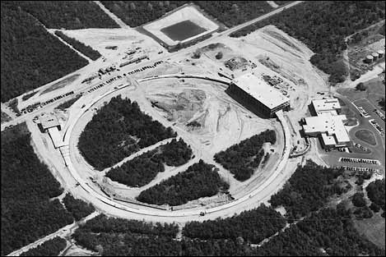
Synchrotrons
„Living legendes“: PS and AGS
PS @ CERN 28 GeV p, 1959
AGS @ Brookhaven 33 GeV p, 1960
CERN 1959, PS
Alternating Gradient Synchrotron under construction, c. 1957
Both are still operational today

Slide 5
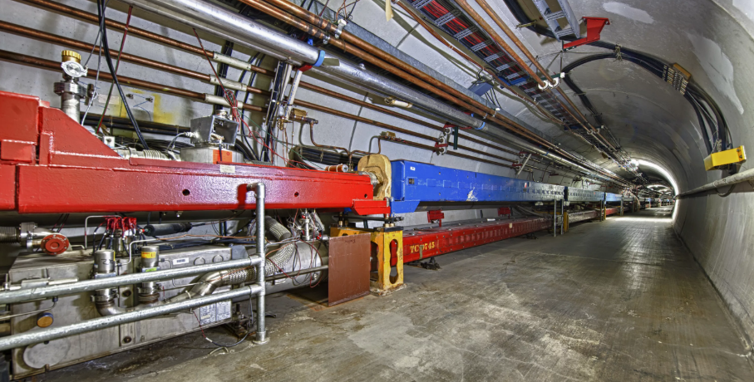
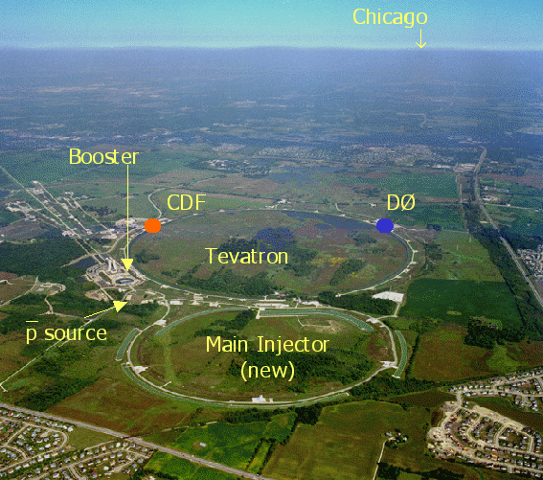
Colliders
Tevatron, Batavia, Illinois, USA
1983-2011
pp-bar
Energy: 1 TeV
Circumference 6.3 km
Average beam current: 0.02-0.06 A
Magnetic dipole field max 4.4 T

Slide 6
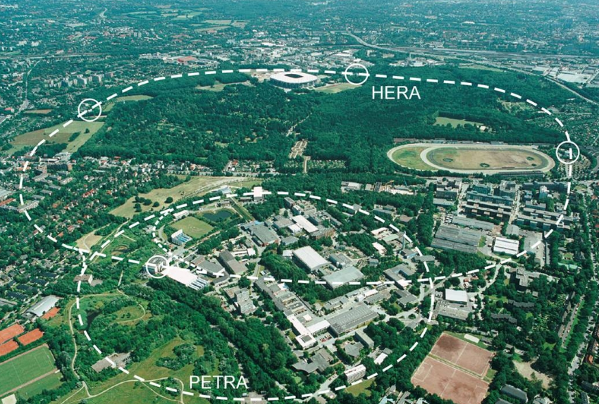
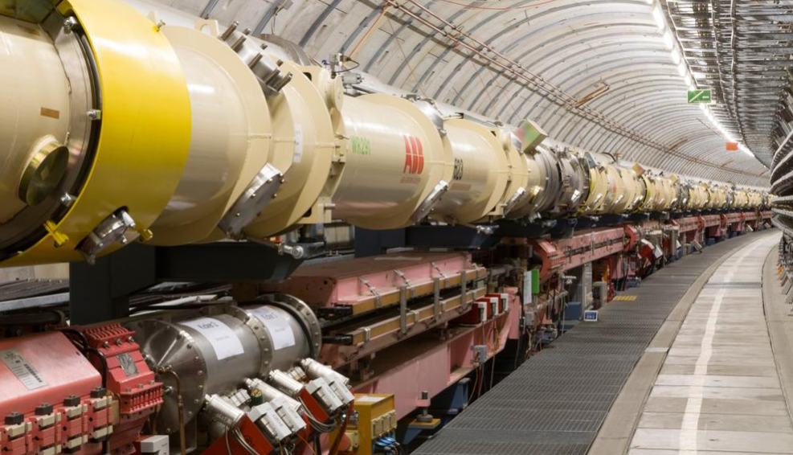
Colliders
HERA, Hamburg, Germany
Lepton-proton
collider
1992-2007
e p
Energy: 0.03 TeV (e), 0.92 TeV (p)
Circumference 6.3 km
Average beam current: 0.04-0.09 A
Magnetic dipole field max 5 T

Slide 7
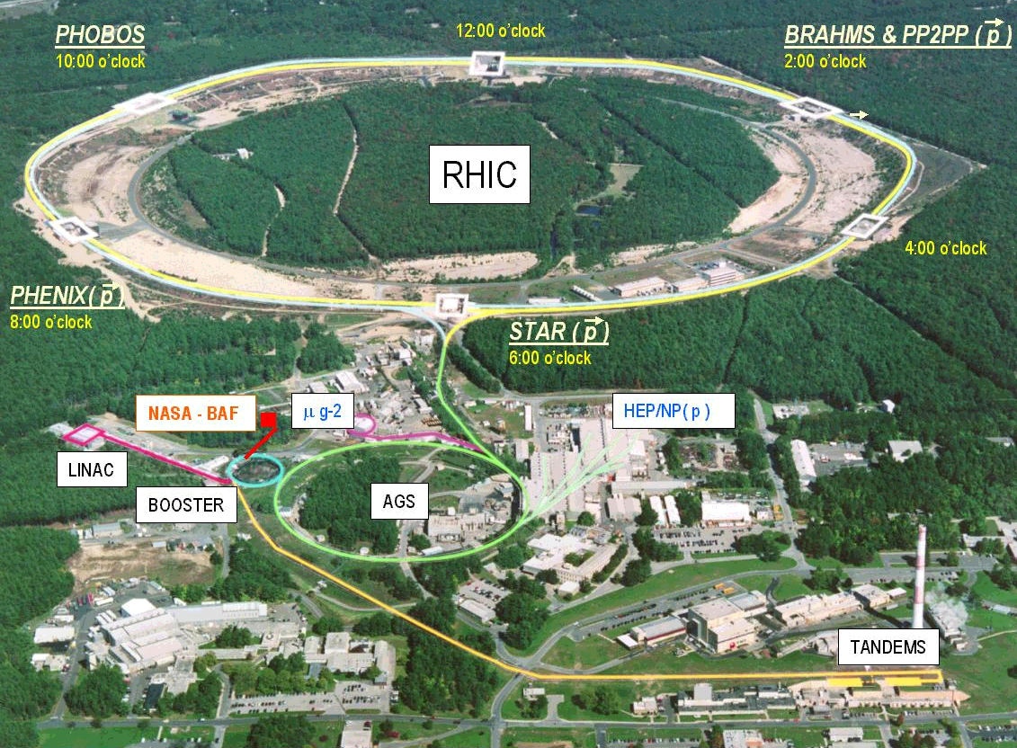
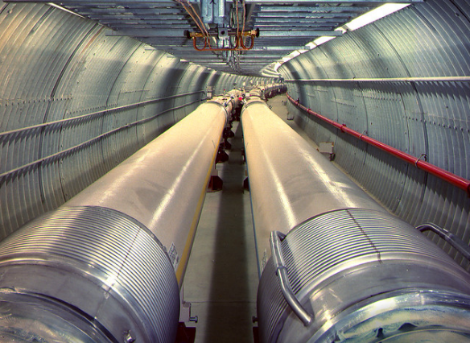
Colliders
Brookhaven Nat’l Labs, Long Island, USA
2001--
RHIC:
Relativistic
Heavy Ion
Collider
pp, Au Au, Cu Cu, d Au
Energy: 0.1TeV/n
Circumference 3.8 km
Average beam current: 0.05-0.1 A
Magnetic dipole field max 3.5 T

Slide 8
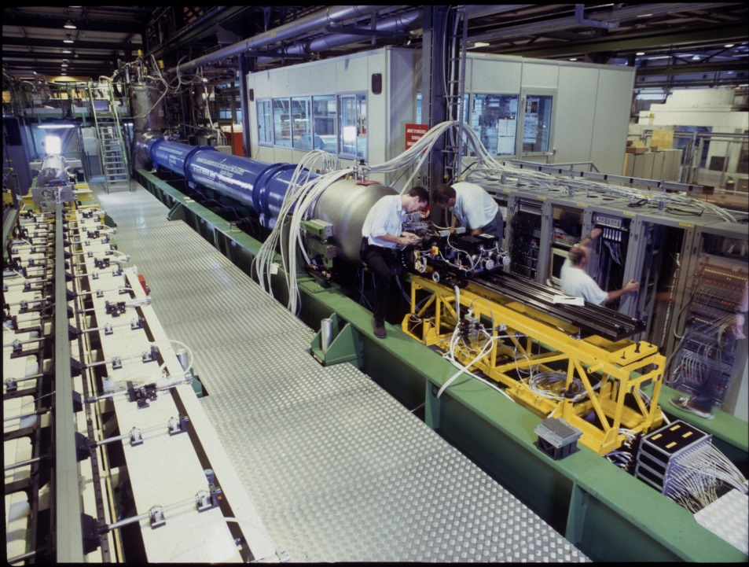
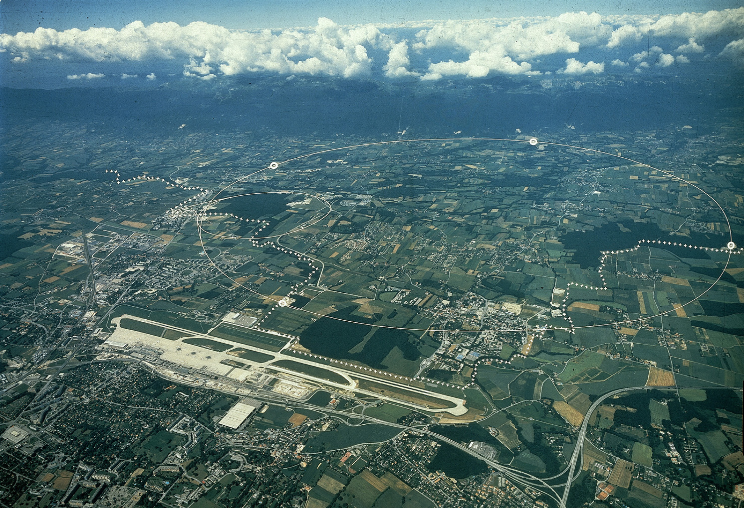
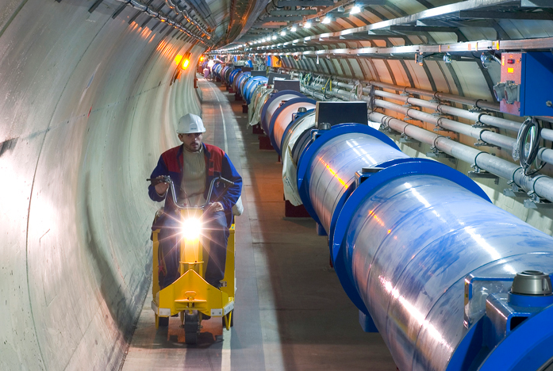
Colliders
CERN Large Hadron Collider (LHC)
pp, Pb Pb
Energy: 7 / 2.76 TeV/n
Circumference 26.7 km
Average beam current: 0.6 / 0.06 A
Magnetic dipole field max 8.3 T
2007--

Slide 9
the base of accelerators’ business
equation of particle motion in the electro-magnetic field of accelerator/collider
Stability of the particles’ motion
(bring all the injected particles to the target)

Slide 10
(bring all the injected particles to the target)
Collider
Ring accelerator
B
E
Bending
magnet
R=C/2π
injection
extraction
Stability of the particles’ motion
r
bending radius
Take
particles from ion source (injector)
Accelerate, store,
collide
Extract
to target
Bend in a circle
Focus around ideal orbit
Accelerate, group
Quadrupole
magnets
Main
accelerator systems
Dipole
magnets
RF-stations

Slide 11
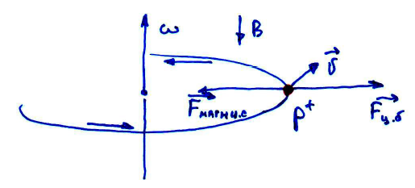
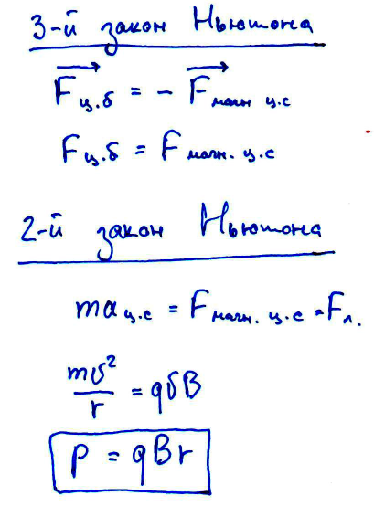
Magnetic field strength
??
3rd -Newton law
2nd-Newton law
Bρ-magnetic rigidity – ability to keep the particle with P on the circular orbit…

Slide 12
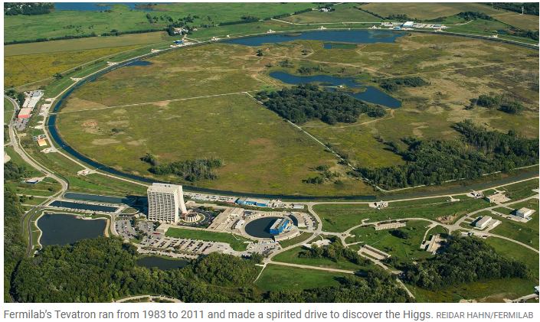
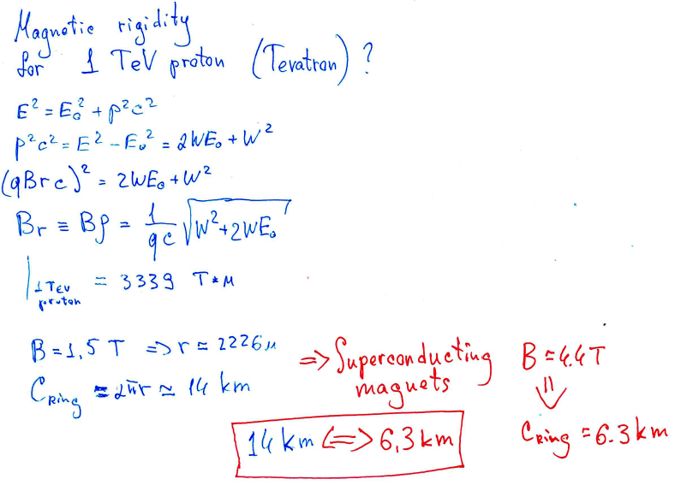
Why use superconducting magnets
??

Slide 13
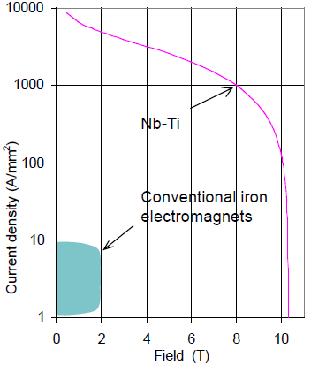
Superconductivity
Superconductivity is the set of physical properties observed in certain materials, wherein electrical resistance vanishes and from which magnetic flux fields are expelled.
high current density =>
higher magnetic fields (than in “warm” magnets)
need no power for the magnets, only for its cooling)
smaller, lighter, cheaper magnets
smaller, lighter, cheaper accelerators
smaller running costs

Slide 14
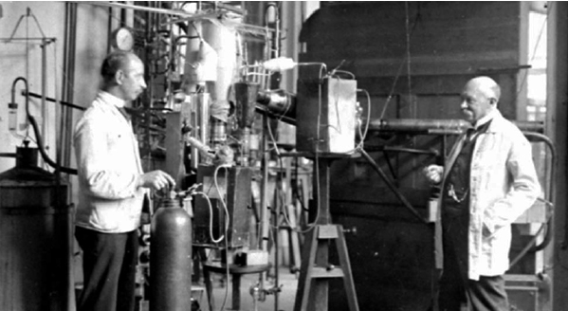
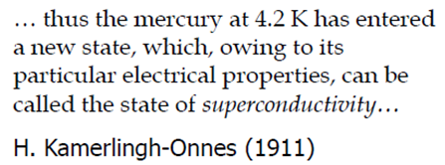
Superconductivity – brief history
H. Kamerlingh-Onnes (right) and his assistant Gerrit Flim (left) in their lab. 1911.
4.2 K ≈ - 269°C

Slide 15
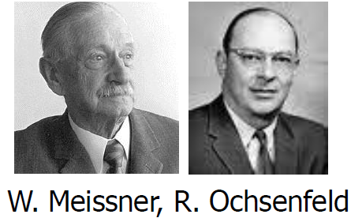
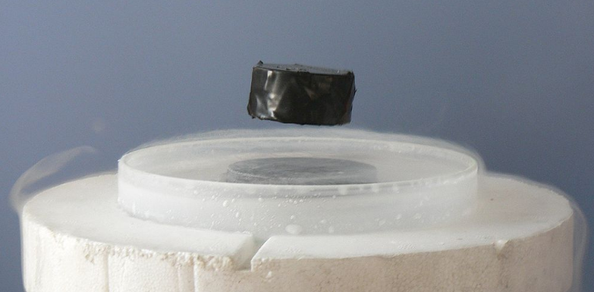
Superconductivity – brief history
1933 – Deutsch physicists Walther Meissner and Robert Ochsenfeld discover that not strong magnetic field does not penetrate into the body of the superconductors – diamagnetic property of superconductors
(T<Tc – the currents flux occur in thin surface layer of the superconductor. Its magnetic field compensate external magnetic field)
1935 – first theoretical works on SC by Heinz and Frits London
(suggest to consider superconductivity as macroscopic quantum effect )
1950 Ginsburg and Landau proposed a macroscopic theory for SC
Meissner effect
Magnetic levitation

Slide 16
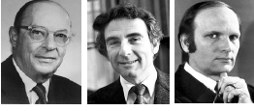
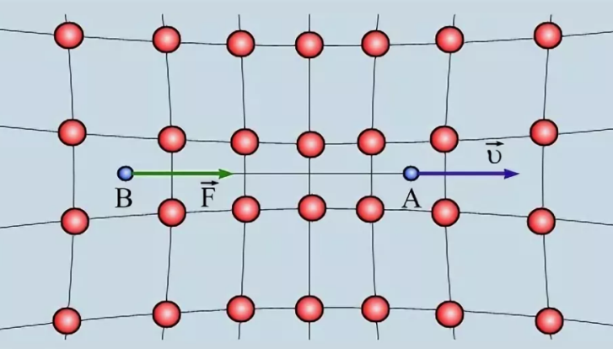
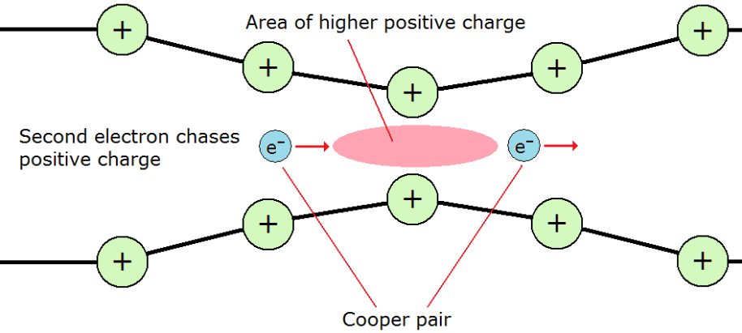
Superconductivity – brief history
1957 – BCS - theory
Pairs can drift through the crystal lattice without energy loss on interactions with atoms
John Bardeen
Leon N Cooper
John Robert Schrieffer
- works only at LOW temperature !

Slide 17
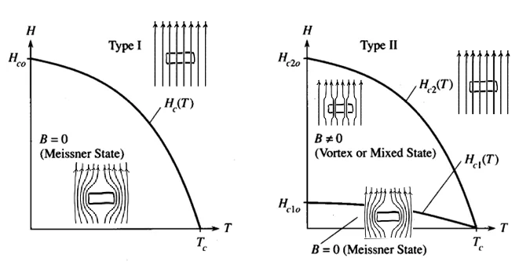
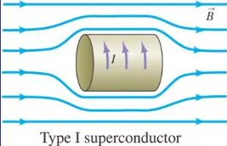
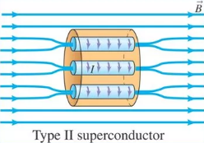
Superconductivity – Two types of conductors
more than 20 pure metals
(mercury, lead, titanium)
usually they have not good
conductivity @ room temperature
Bc ~ 10^-3 – 10^-2 T
not useful for sc-magnets
several hundreds materials:
(alloys, intermetallic, ceramic)
Bc ~ 10 – 10^2 T
NbTi Tc=9.8 K Bc=10 T
Nb3Sn Tc=18 K Bc=25
OK for sc-magnets
Type-1 superconductor completely expels magnetic field from its interior by acting as a perfect diamagnetic
Type-2 superconductor: the magnetic field is confined to filamentary structure

Slide 18
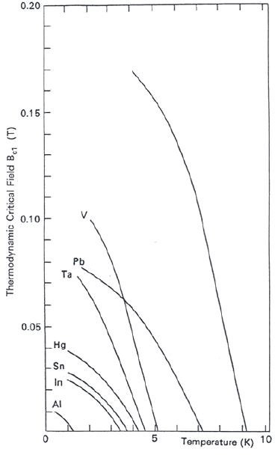
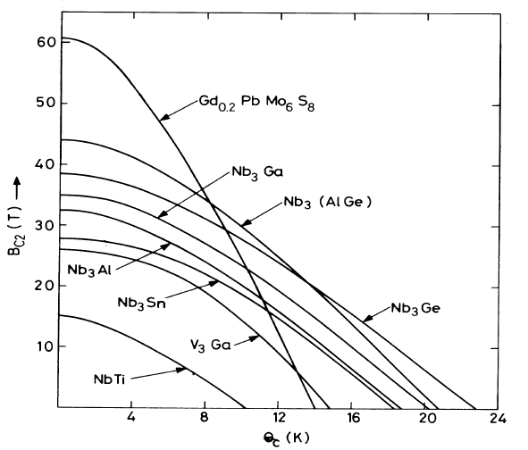
Superconductivity - Critical field
Type-1
Type-2

Slide 19
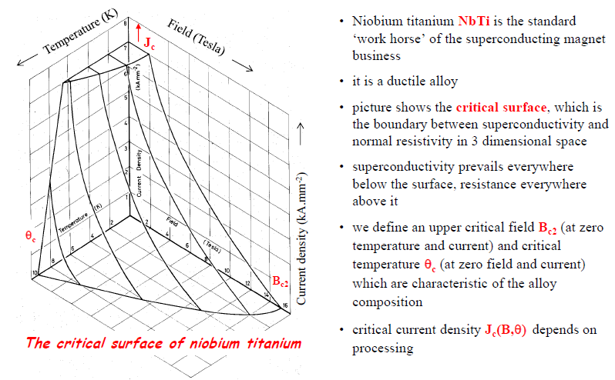
Superconductivity – critical surface
Martin Wilson lecture

Slide 20
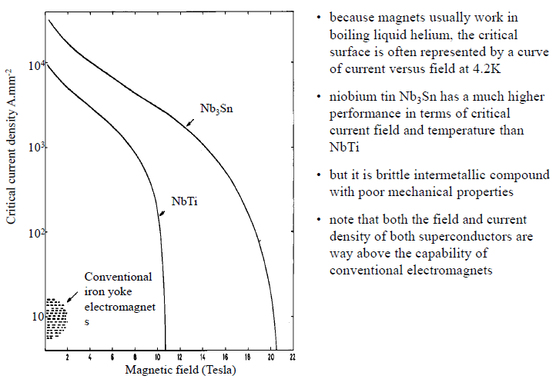
Superconductivity – critical line for 4.2 K

Slide 21
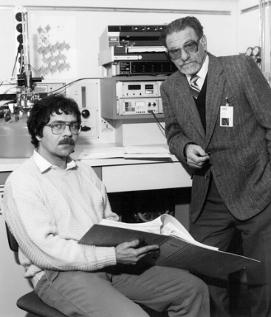
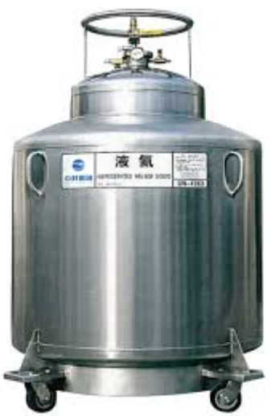
Superconductivity – high temperature superconductors
High-temperature superconductors (abbreviated high-T_{c} or HTS) are materials that behave as superconductors at unusually high temperatures.
The first high-T_{c} superconductor was discovered in 1986 by IBM researchers Georg Bednorz and K. Alex Müller, who were awarded the 1987 Nobel Prize in Physics .
Whereas "ordinary" or metallic superconductors usually have transition temperatures (temperatures below which they are superconductive) below 30 K (−243.2 °C) and must be cooled using liquid helium in order to achieve superconductivity, HTS have been observed with transition temperatures as high as 138 K (−135 °C), and can be cooled to superconductivity using liquid nitrogen.
LHe
LNi

Slide 22
Superconductivity – high temperature superconductors
certain compounds of copper and oxygen (so-called "cuprates") were known to have HTS properties, and the term high-temperature superconductor was used interchangeably with cuprate superconductor for compounds such as bismuth strontium calcium copper oxide (BSCCO) and yttrium barium copper oxide (YBCO).
Yttrium barium copper oxide (YBCO) is a family of crystalline chemical compounds.
Many YBCO compounds have the general formula YBa₂Cu₃O_{7−x} (also known as Y123), although materials with other Y:Ba:Cu ratios exist, such as YBa₂Cu₄O_{y} (Y124) or Y₂Ba₄Cu₇O_{y} (Y247).

Slide 23
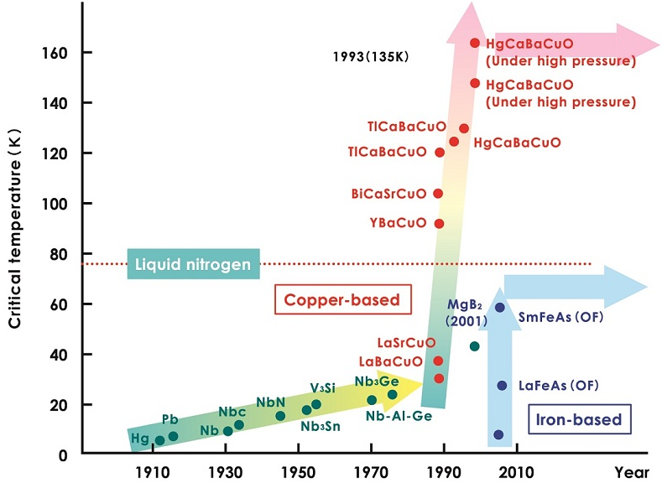
Superconductivity – Two types of conductors
chart is not completed…

Slide 24
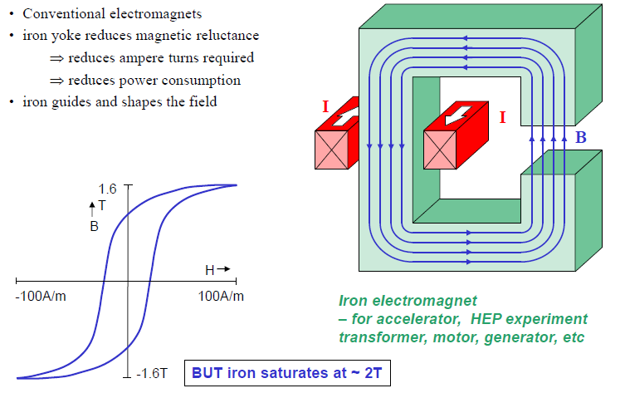
Magnetic field: ways to create and form them – (1) - iron
Martin Wilson lecture

Slide 25
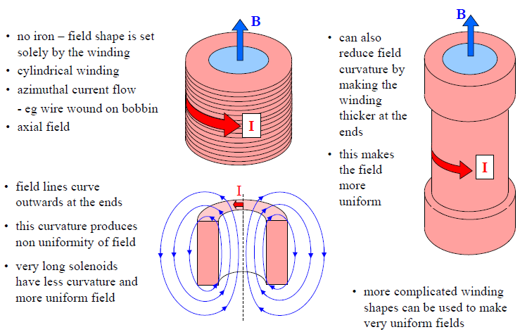
Magnetic field: ways to create and form them – (2) - solenoids
Martin Wilson lecture

Slide 26
Magnetic field:
dipoles
quadrupoles

Slide 27
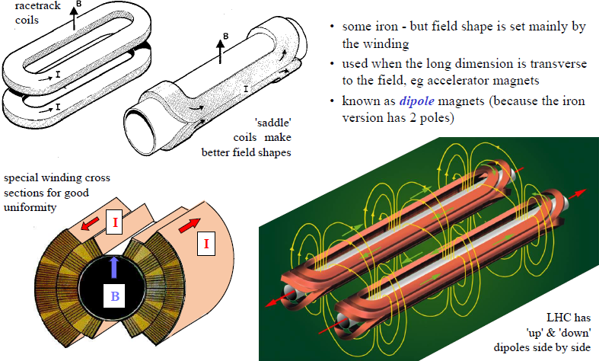
Magnetic field: ways to create and form them – (3) – transverse uniform
fields
Martin Wilson lecture

Slide 28
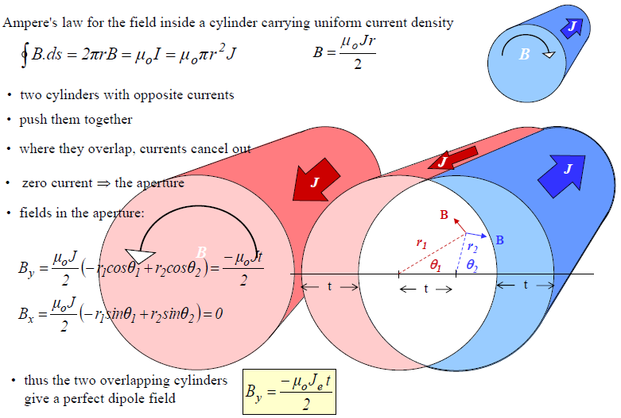
Magnetic field: ways to create and form them – dipole field from overlapping cylinders with current => Cosine theta magnets
Martin Wilson lecture

Slide 29
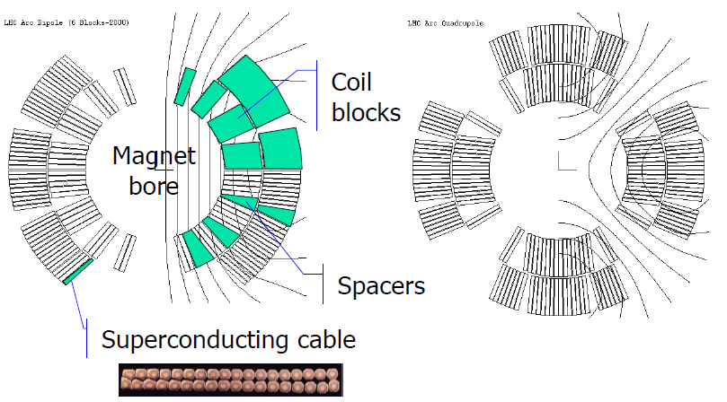
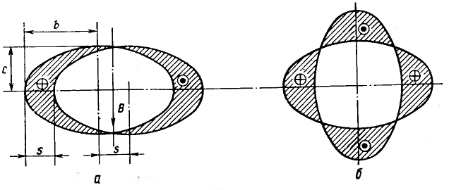
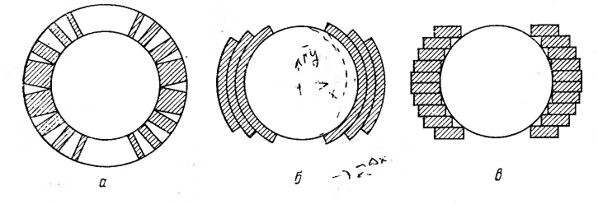
Magnetic field: ways to create and form them – dipole field from overlapping cylinders with current => Cosine theta magnets
ideal shape of current area = cross-section of ellipses
real cross-section of «cos θ» coils

Slide 30
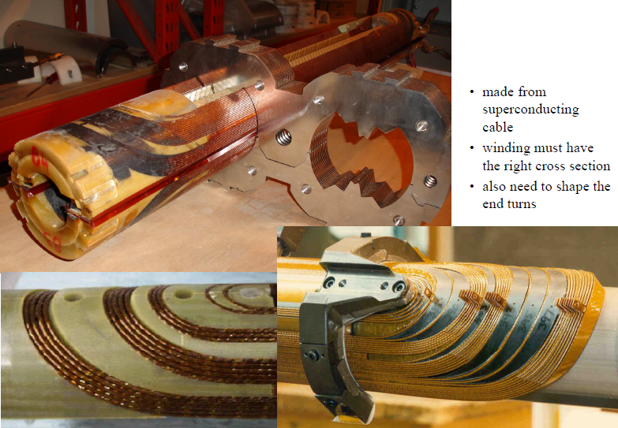
Magnetic field: ways to create and form them –cosine theta magnets
Martin Wilson lecture

Slide 31
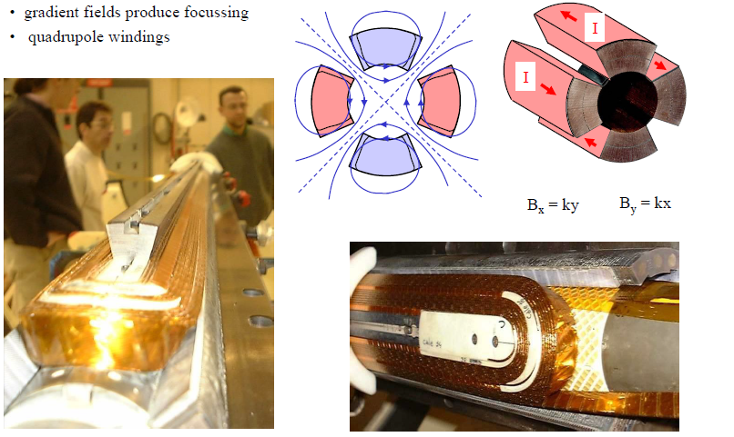
Magnetic field: ways to create and form them – (4) – transverse gradient
fields
Martin Wilson lecture

Slide 32
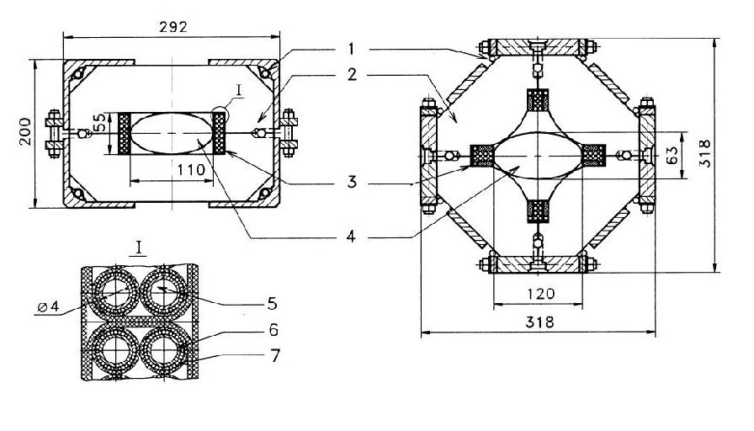
Magnetic field: ways to create and form them – (5) – super ferric magnets: sc-coil + iron for the field forming
uniform (dipole) field
gradient (quadrupole) field
Nuclotron - magnets

Slide 33
Magnetic field: ways to create and form them – engineering current density
Martin Wilson lecture

Slide 34
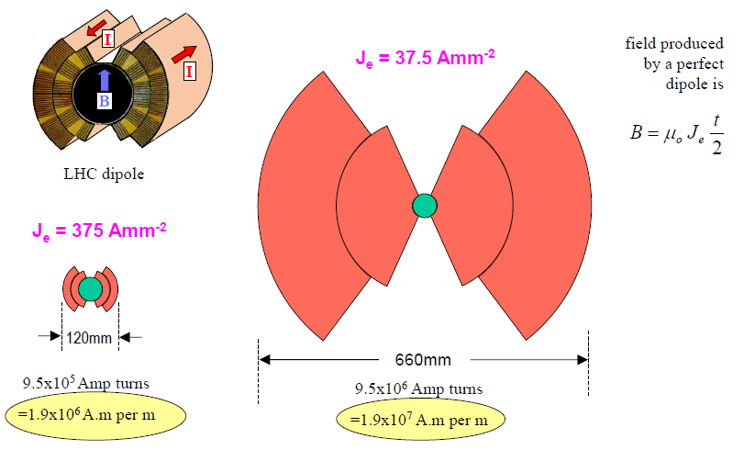
Magnetic field: ways to create and form them – engineering current density
Martin Wilson lecture

Slide 35
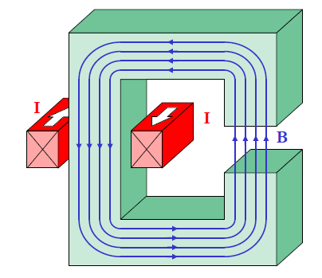
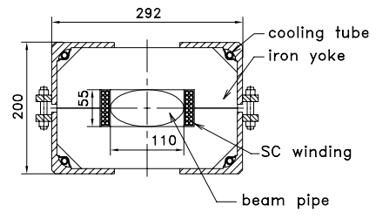
Magnetic field: ways to create and form them – engineering current density
Normal conductors
Je ≈ 150 A/mm^2

Slide 36
Superconductivity – the last slide
3 kinds of superconductors
- type 1 – useless for sc-magnets production
- type 2 – OK for sc-magnets
- HTS – good for high field and temperature but current density still is a problem in high magnetic field
type 2 and HTS – used for sc-magnets production
all existing sc-accelerators up to date use NbTi
engineering current density is a crucial factor in the magnet design and economy

Slide 37
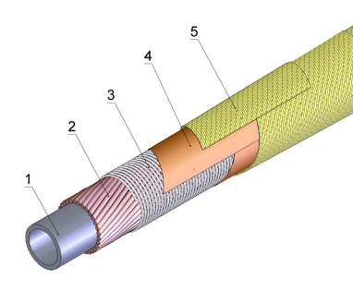
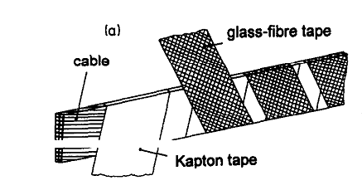
SC-magnets production
Superconducting
Materials
high current wires
high current tapes
high current cables
Superconducting
Magnets

Slide 39
SC-magnets production
“Nuclotron” - cable

Slide 40
SC-magnets production
LHC-sc-wires (for Rutherford cable)

Slide 41
SC-magnets production
NbTi----SC-wires production technology
1 Cu lid
2 NbTi billet
3 Cu extrusion can
4 evacuate and seal
5 heat treatment
6 extrude
7 single core rod
8 hexagonal rod
9 stack
10 evacuate and seal
11 pre-heat and extrude
12 multi-core rod
13 cold draw
14 multi-core wire
15 heat treatment
16 twist
17 anneal
18 insulate
19 test
20 dispatch
multifilament wires have good current carrying capability 100-1000A
accelerators sc-magnets require ability to operate with 10kA-100kA currents
Je≈500 A/mm^2

Slide 42
Magnets
Rutherford cable
Nuclotron cable
1 – CuNi tube
2 –SC-wire
3 – NICr-wire
4 – Isolation
5- Isolation

Slide 43
SC-magnets production
production of Rutherford cable
Rutherford cable

Slide 44
SC-magnets production
Rutherford cable machine @ CERN

Slide 45
SC-magnets production
winding of LHC dipole

Slide 47
SC-magnets production
adding the iron

Slide 48
SC-magnets production
Nuclotron- cable machine @ JINR

Slide 49
SC-magnets production
cs-coils production for Nuclotron- magnets

Slide 50
SC-magnets production
super ferric Nuclotron- magnets assembly

Slide 51
SC-magnets’ physics
quench -
sudden, unexpected and unrecoverable transition of superconductor in the device (magnet, bus bar, current lead…) to the normal state.
enforce the convention of the stored energy into heat (mostly)
this can lead to the damage of the device
use magnet quench protection system !!!
quench protection – the art of preventing of any damages of sc-magnet concerned with the phenomena or its serving after the quench occurs

Slide 52
SC-magnets’ physics
Critical surface and magnet load line
- relates magnet field to its current

Slide 53
SC-magnets’ physics
why do magnets quench ?
Internal to the magnet:
wire movement, resin cracking, shearing on coil windings
accidents, helium leaks in cooling tubes, leaks in vacuum parts
External to the magnet:
radiation, damaged cryo-supply-lines, sensors, valves, flow meters, earth-quake
Specific heat of the all substances falls with temperature
(~2000 times less @ 4.5 K than @ room temperature)
smallest energy release can rise superconductor temperature above the critical surface
conductors of the magnets are stressed by magnetic forces – sometimes they move suddenly under this force – and mechanical stress come out
this movement => frictional heating
for NbTi 10μm motion can raise local temp. to 7.5 K

Slide 54
Amount of energy released

Slide 55
SC-magnets’ physics
Degraded performance and “training” of the magnets

Slide 57
Magnet stability and quench
External perturbation:
flux jump
conductor motions
insulation cracks
AC loss
heat leaks
nuclear
…
Stable operating condition
Approach Jc(T, B, …)
Heat balance
Transition to normal state and Joule heat generation in current sharing
Perturbation spectrum
heat generation >
heat removal
no
yes
stability analysis
and design
Stable operating condition
Quench

Slide 58
Perturbation overview

Slide 59
SC-magnets
choose of operation parameters
typical NbTi
J
operating plane
J_{c}
Margin in critical current
J_{c}
B_{max}
J_{op}
Margin along the loadline
3000 A/mm²
B_{op}
B_{c}
B
5 T
4.2 K
J
9 K
14.5 T
Margin in temperature
T
B
T_{cs}
J_{op}
J_{op}/J_{C} ≈ 0.5
B_{op}/B_{max} ≈ 0.8
T_{cs}-T_{op} ≈ 1…2 K
T_{op}
T_{c}
T

Slide 60
SC-magnets
examples

Slide 61
SC-magnets
examples
RHIC
3.45 T
NbTi Rutherford cable
a single-layer coil
cold iron as both yoke and collar.
forced-flow helium @ 4.6K
The arc dipoles have 8cm aperture and 9.7m length

Slide 62
SC-cable
Developed at 1980-th…
“Nuclotron”-cable
SC-magnets for synchrotrons
“Nuclotron”- magnets

Slide 63
Nuclotron technology
Thermal shield
Iron Yoke
Beam Pipe
Current:
~10 000 А
Vacuum shell
SC coil
Support
4.2 K
Cooled by LHe

Slide 64
First Superconducting heavy ion accelerator
Nuclotron – Superconducting Synchrotron
operation since 1993
Thank you

Slide 69
Case Study___task_1

Slide 70
Case Study___task_2
What is the engineering current density Je of the NICA collider dipole magnet ?
Exclude not necessary data…

Slide 71
Case Study___task_3
What altitude must take hovering in place flying-cow (500kg) to have the same energy as stored in NICA collider magnet with magnetic field 1.8 T ?
aperture height = 70mm
N-coil-turns = 10
magnet inductance = 450 μH

Slide 72
Сверхпроводящие провода и кабели, технология их изготовления
Ic/I0 в зависимости от dB/dt для двух типов кабелей, применяемых в обмотках магнитов для синхротронов.

Slide 73
Engineering critical current density versus magnetic field for low temperature superconductor wires, high temperature superconductor wires and tapes and MgB 2 wires.

Slide 74
Superconductivity – critical surface
Luca Bottura lecture

Slide 77
Superconducting magnets
1980’s
1990’s
2000’s
2010’s
2020’s ?
Tev,76 mm
4.5T,4.2K
Maximum energy and 70% of price are determined by the magnets

Slide 78
SC-magnets
examples

