Slide 1
Injection and extraction
Introductory slides:
  Kickers, septa and normalised phase-space
Injection methods
  Single-turn hadron injection
  Injection errors, filamentation and blow-up
  Multi-turn hadron injection
  Charge-exchange H- injection
  Lepton injection
Extraction methods
  Single-turn (fast) extraction
  Non-resonant and resonant multi-turn (fast) extraction
  Resonant multi-turn (slow) extraction
Verena Kain, CERN (BE-OP-SPS)
based on lectures by B. Goddard and M. Fraser

Slide 2
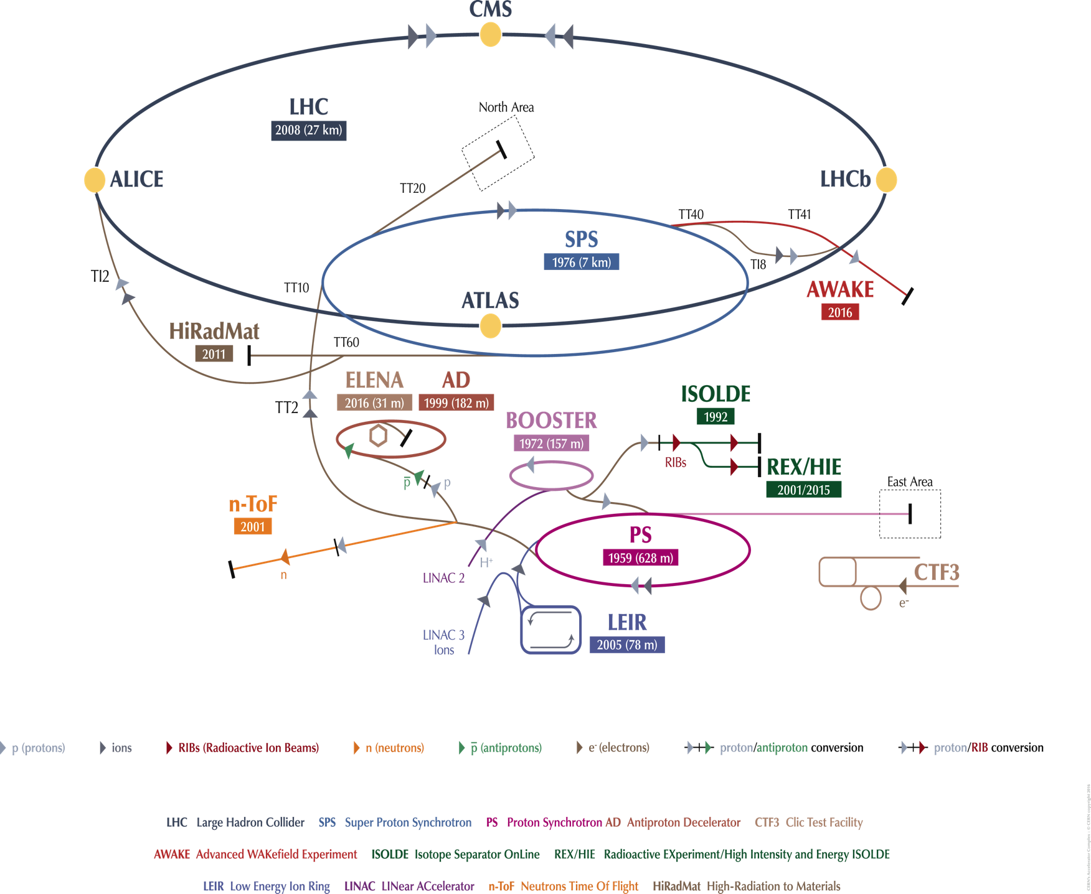
Injection and extraction
CERN Accelerator Complex
An accelerator has limited dynamic range
Chain of stages needed to reach high energy
Periodic re-filling of storage rings, like LHC
External facilities and experiments:
  e.g. ISOLDE, HIRADMAT, AWAKE…
Beam transfer (into, out of, and between machines) is necessary.
ABT Introductory Lectures – JAS, Dubna, Russia, 2019

Slide 3
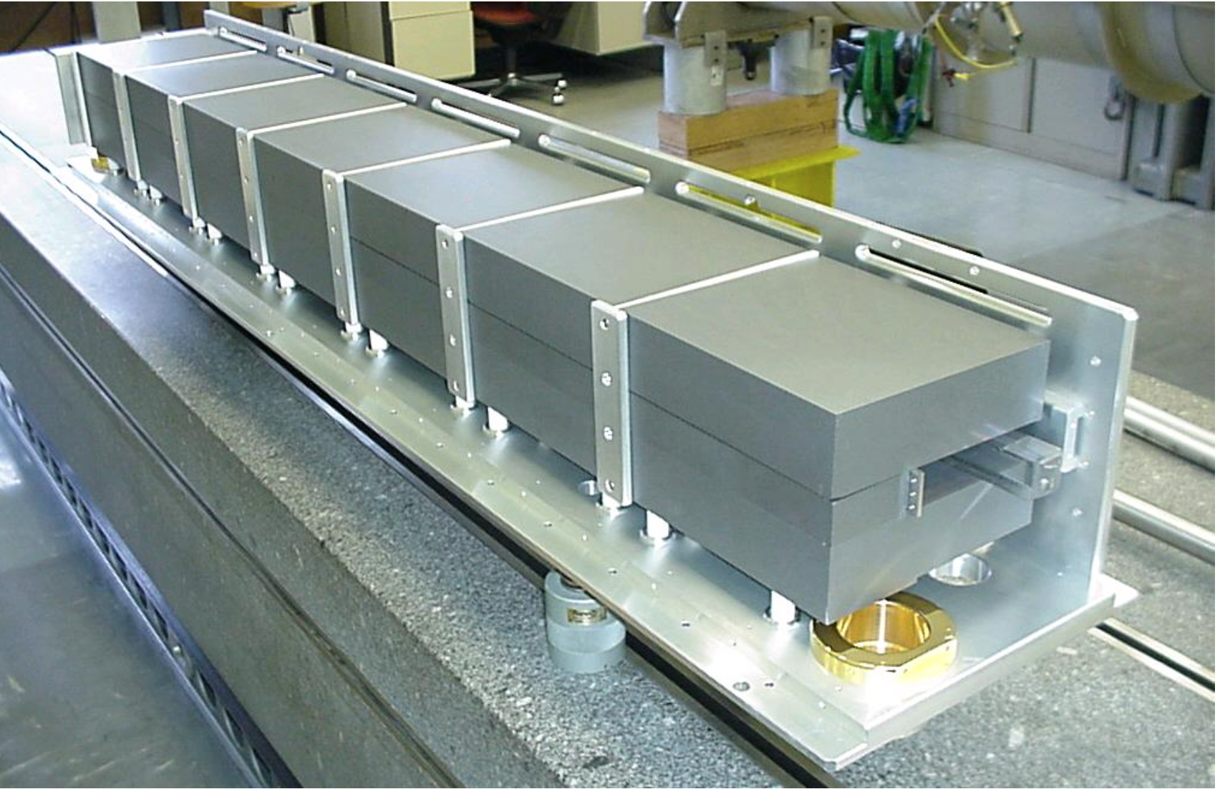
Kicker magnet
w
Pulsed magnet with very fast rise time
(100 ns – few μs)
Ferrite
g
B
Ferrite
Conductors
I
B = μ₀I / g
L [per unit length] = μ₀w / g
dI/dt = V / L
Typically 3 kA in 1 μs rise time
ABT Introductory Lectures – JAS, Dubna, Russia, 2019

Slide 4
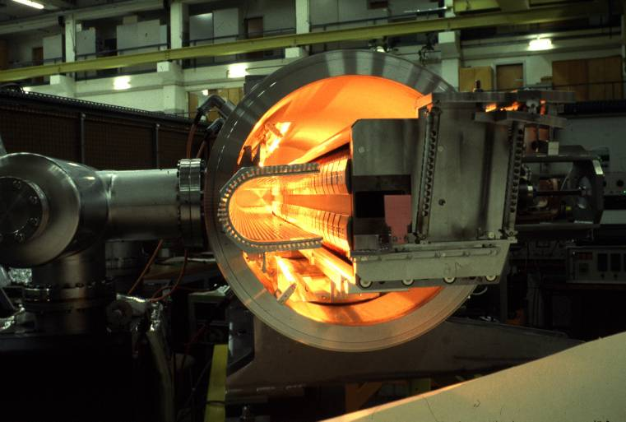
Magnetic septum
Pulsed or DC magnet with thin (2 – 20 mm)
septum between zero field and high field region
Typically ~10x more deflection given by magnetic septa, compared to kickers
Septum coil
I
B_{o} = μ₀I / g
Typically I 5 - 25 kA
Yoke
ABT Introductory Lectures – JAS, Dubna, Russia, 2019

Slide 5
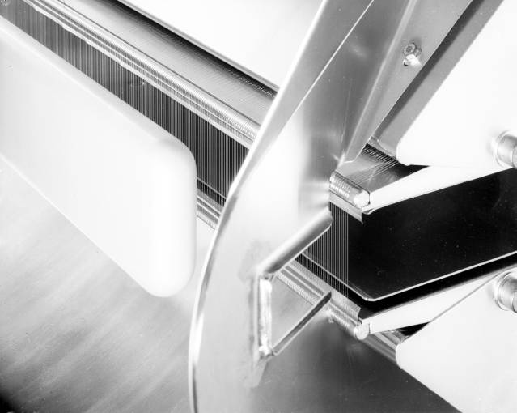
Electrostatic septum
DC electrostatic device with very thin septum between zero field and high field region
High voltage
electrode
Hollow earth
electrode
Hollow earth
electrode
g
Septum wires
E₀
E=0
Thin wire or
foil (~0.1 mm)
E = V / g
Typically V = 200 kV
E = 100 kV/cm
High voltage
electrode
ABT Introductory Lectures – JAS, Dubna, Russia, 2019

Slide 6
Normalised phase space
Real phase space
Normalised phase space
x’(s)
⇒
x(s)
Area = πε
Area = πε
ABT Introductory Lectures – JAS, Dubna, Russia, 2019

Slide 7
Single-turn injection – same plane
Injected beam
‘boxcar’ stacking
intensity
injected
beam
Septum magnet
kicker field
t
Circulating beam
Kicker magnet
F-quad
D-quad
Septum deflects the beam onto the closed orbit at the centre of the kicker
Kicker compensates for the remaining angle
Septum and kicker either side of D quad to minimise kicker strength
ABT Introductory Lectures – JAS, Dubna, Russia, 2019

Slide 8
Single-turn injection
Normalised phase space at centre of idealised septum
ABT Introductory Lectures – JAS, Dubna, Russia, 2019

Slide 9
Single-turn injection
Normalised phase space at centre of idealised septum
θseptum
ABT Introductory Lectures – JAS, Dubna, Russia, 2019

Slide 10
Single-turn injection
Normalised phase space at centre of idealised septum
ABT Introductory Lectures – JAS, Dubna, Russia, 2019

Slide 11
Single-turn injection
μ/2 phase advance to kicker location
ABT Introductory Lectures – JAS, Dubna, Russia, 2019

Slide 12
Single-turn injection
Normalised phase space at centre of idealised kicker
Kicker deflection places beam on central orbit:
θ_{kicker}
ABT Introductory Lectures – JAS, Dubna, Russia, 2019

Slide 13
Injection oscillations
For imperfect injection the beam oscillates around the central orbit,
e.g. kick error, Δ:
θ_{kicker} - Δ
ABT Introductory Lectures – JAS, Dubna, Russia, 2019

Slide 14
Injection oscillations
For imperfect injection the beam oscillates around the central orbit,
e.g. kick error, Δ:
After 1 turn…
ABT Introductory Lectures – JAS, Dubna, Russia, 2019

Slide 15
Injection oscillations
For imperfect injection the beam oscillates around the central orbit,
e.g. kick error, Δ:
After 2 turns…
ABT Introductory Lectures – JAS, Dubna, Russia, 2019

Slide 16
Injection oscillations
For imperfect injection the beam oscillates around the central orbit,
e.g. kick error, Δ:
After 3 turns etc…
ABT Introductory Lectures – JAS, Dubna, Russia, 2019

Slide 17
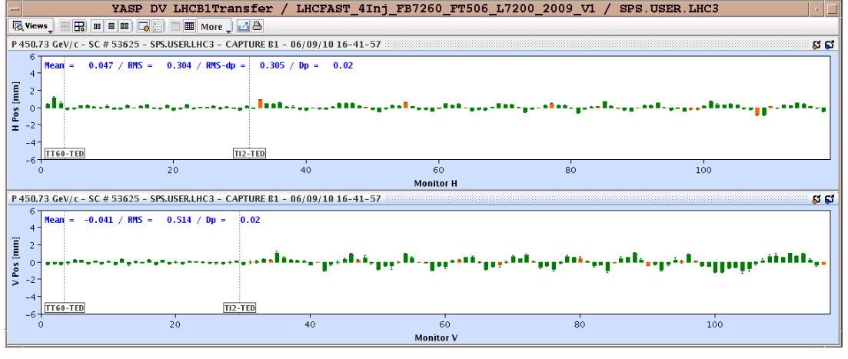
Injection oscillations
Betatron oscillations with respect to the Closed Orbit:
Horizontal
Vertical
Transfer line
LHC (first turn)
ABT Introductory Lectures – JAS, Dubna, Russia, 2019

Slide 18
Filamentation
Non-linear effects (e.g. higher-order field components) introduce amplitude-dependent effects into particle motion
Over many turns, a phase-space oscillation is transformed into an emittance increase
So any residual transverse oscillation will lead to an emittance blow-up through filamentation
  Chromaticity coupled with a non-zero momentum spread at injection can also cause filmentation, often termed chromatic decoherence
  “Transverse damper” systems are used to damp injection oscillations - bunch position measured by a pick-up, which is linked to a kicker
ABT Introductory Lectures – JAS, Dubna, Russia, 2019

Slide 19
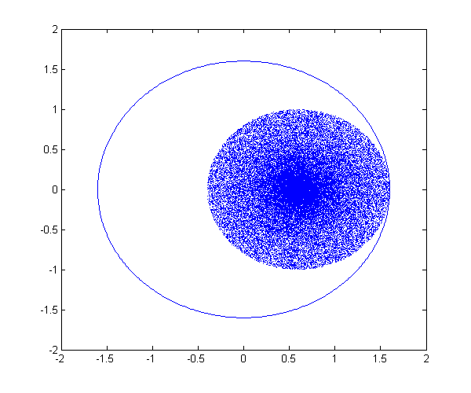
Filamentation
ABT Introductory Lectures – JAS, Dubna, Russia, 2019

Slide 20
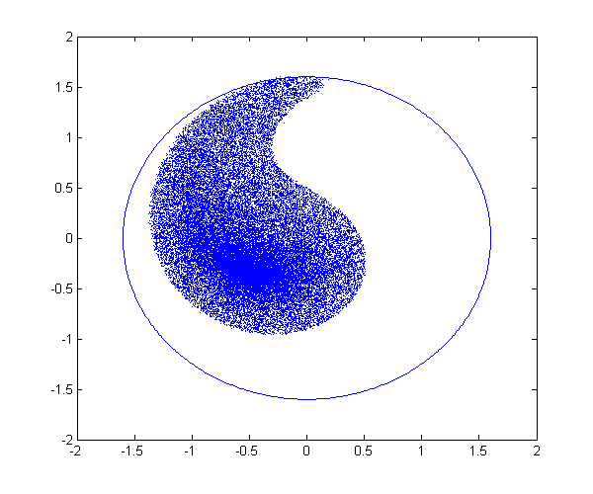
Filamentation
ABT Introductory Lectures – JAS, Dubna, Russia, 2019

Slide 21
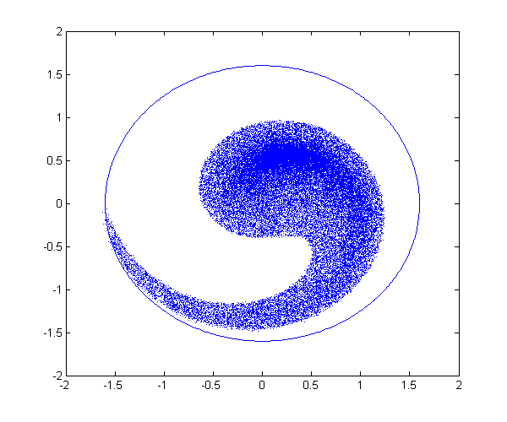
Filamentation
ABT Introductory Lectures – JAS, Dubna, Russia, 2019

Slide 22
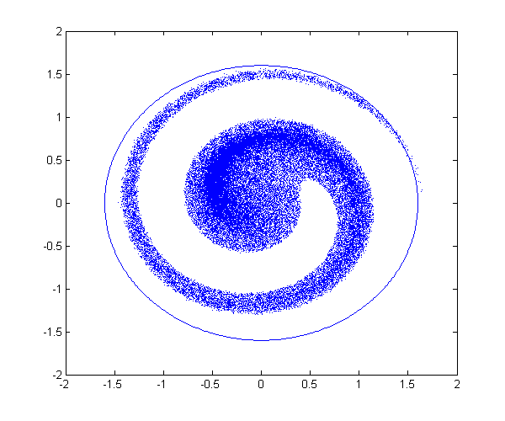
Filamentation
ABT Introductory Lectures – JAS, Dubna, Russia, 2019

Slide 23
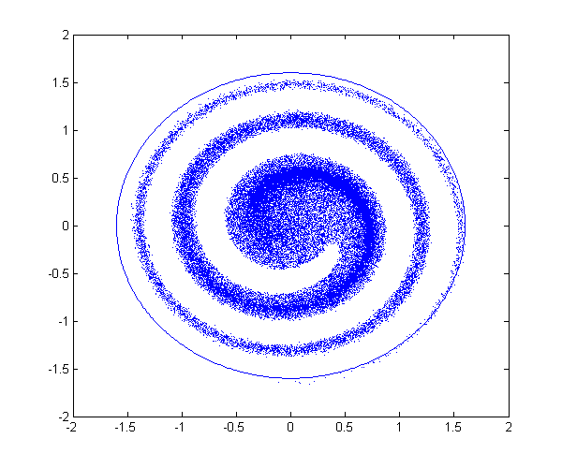
Filamentation
ABT Introductory Lectures – JAS, Dubna, Russia, 2019

Slide 24
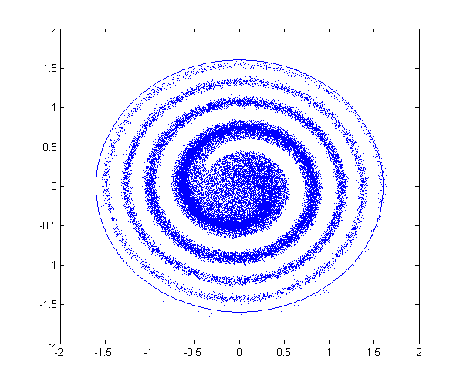
Filamentation
ABT Introductory Lectures – JAS, Dubna, Russia, 2019

Slide 25
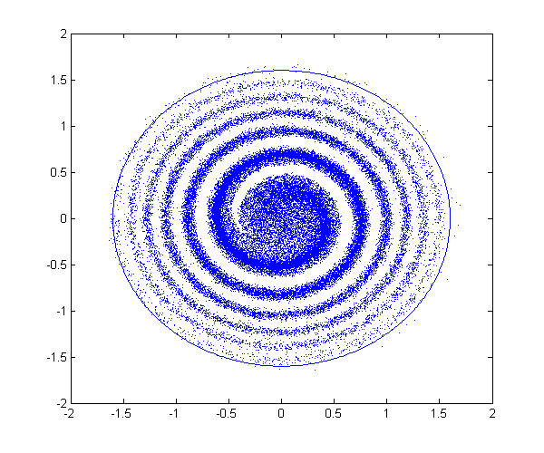
Filamentation
ABT Introductory Lectures – JAS, Dubna, Russia, 2019

Slide 26
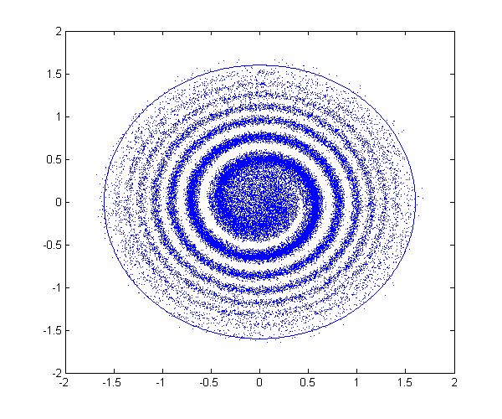
Filamentation
ABT Introductory Lectures – JAS, Dubna, Russia, 2019

Slide 27
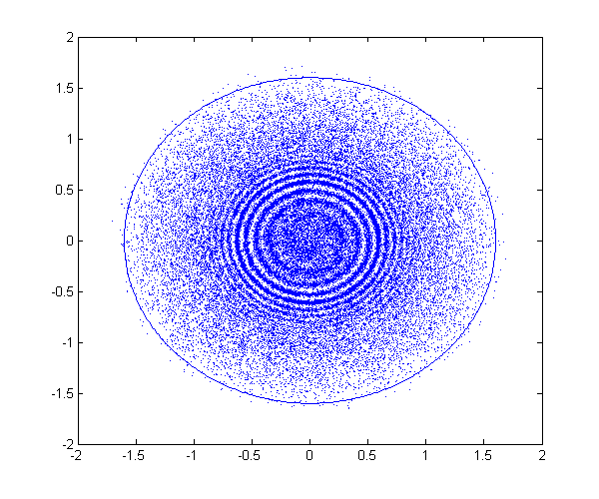
Filamentation
ABT Introductory Lectures – JAS, Dubna, Russia, 2019

Slide 28
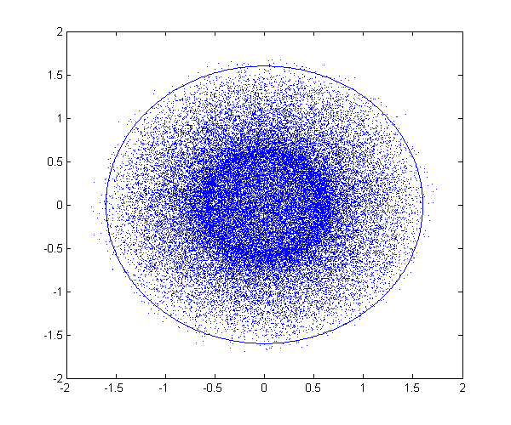
Filamentation
ABT Introductory Lectures – CERN Accelerator School, Constanta, Romania, 2018

Slide 29
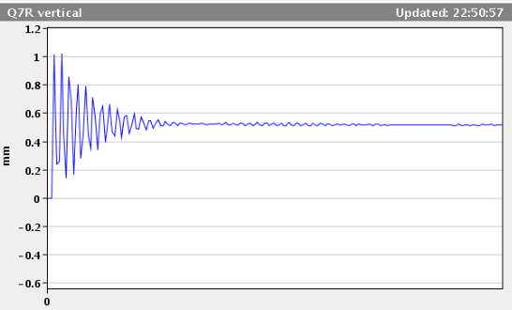
Filamentation
Residual transverse oscillations lead to an effective emittance blow-up through filamentation:
Injection oscillation
Reference closed orbit
ABT Introductory Lectures – JAS, Dubna, Russia, 2019

Slide 30
Multi-turn injection
For hadrons the beam density at injection can be limited either by space charge effects or by the injector capacity
If we cannot increase charge density, we can sometimes fill the horizontal phase space to increase overall injected intensity.
  If the acceptance of the receiving machine is larger than the delivered beam emittance we can accumulate intensity
ABT Introductory Lectures – JAS, Dubna, Russia, 2019

Slide 31
Multi-turn injection for hadrons
Injected beam
(usually from a linac)
Septum magnet
Circulating beam
Varying amplitude bump
Programmable closed orbit bump
No kicker but fast programmable bumpers
Bump amplitude decreases and a new batch injected turn-by-turn
Phase-space “painting”
ABT Introductory Lectures – JAS, Dubna, Russia, 2019

Slide 32
Multi-turn injection for hadrons
Example: CERN PSB injection, high intensity beams, fractional tune Q_{h} ≈ 0.25 Beam rotates π/2 per turn in phase space
Turn 1
On each turn inject a new batch and reduce the bump amplitude
Septum
ABT Introductory Lectures – JAS, Dubna, Russia, 2019

Slide 33
Multi-turn injection for hadrons
Example: CERN PSB injection, high intensity beams, fractional tune Q_{h} ≈ 0.25 Beam rotates π/2 per turn in phase space
Turn 2
Septum
ABT Introductory Lectures – JAS, Dubna, Russia, 2019

Slide 34
Multi-turn injection for hadrons
Example: CERN PSB injection, high intensity beams, fractional tune Q_{h} ≈ 0.25 Beam rotates π/2 per turn in phase space
Turn 3
Septum
ABT Introductory Lectures – JAS, Dubna, Russia, 2019

Slide 35
Multi-turn injection for hadrons
Example: CERN PSB injection, high intensity beams, fractional tune Q_{h} ≈ 0.25 Beam rotates π/2 per turn in phase space
Turn 4
Septum
ABT Introductory Lectures – JAS, Dubna, Russia, 2019

Slide 36
Multi-turn injection for hadrons
Example: CERN PSB injection, high intensity beams, fractional tune Q_{h} ≈ 0.25 Beam rotates π/2 per turn in phase space
Turn 5
Septum
ABT Introductory Lectures – JAS, Dubna, Russia, 2019

Slide 37
Multi-turn injection for hadrons
Example: CERN PSB injection, high intensity beams, fractional tune Q_{h} ≈ 0.25 Beam rotates π/2 per turn in phase space
Turn 6
Septum
ABT Introductory Lectures – JAS, Dubna, Russia, 2019

Slide 38
Multi-turn injection for hadrons
Example: CERN PSB injection, high intensity beams, fractional tune Q_{h} ≈ 0.25 Beam rotates π/2 per turn in phase space
Turn 7
Septum
ABT Introductory Lectures – JAS, Dubna, Russia, 2019

Slide 39
Multi-turn injection for hadrons
Example: CERN PSB injection, high intensity beams, fractional tune Q_{h} ≈ 0.25 Beam rotates π/2 per turn in phase space
Turn 8
Septum
ABT Introductory Lectures – JAS, Dubna, Russia, 2019

Slide 40
Multi-turn injection for hadrons
Example: CERN PSB injection, high intensity beams, fractional tune Q_{h} ≈ 0.25 Beam rotates π/2 per turn in phase space
Turn 9
Septum
ABT Introductory Lectures – JAS, Dubna, Russia, 2019

Slide 41
Multi-turn injection for hadrons
Example: CERN PSB injection, high intensity beams, fractional tune Q_{h} ≈ 0.25 Beam rotates π/2 per turn in phase space
Turn 10
Septum
ABT Introductory Lectures – JAS, Dubna, Russia, 2019

Slide 42
Multi-turn injection for hadrons
Example: CERN PSB injection, high intensity beams, fractional tune Q_{h} ≈ 0.25 Beam rotates π/2 per turn in phase space
Turn 11
Septum
ABT Introductory Lectures – JAS, Dubna, Russia, 2019

Slide 43
Multi-turn injection for hadrons
Example: CERN PSB injection, high intensity beams, fractional tune Q_{h} ≈ 0.25 Beam rotates π/2 per turn in phase space
Turn 12
Septum
ABT Introductory Lectures – JAS, Dubna, Russia, 2019

Slide 44
Multi-turn injection for hadrons
Example: CERN PSB injection, high intensity beams, fractional tune Q_{h} ≈ 0.25 Beam rotates π/2 per turn in phase space
Turn 13
Septum
ABT Introductory Lectures – JAS, Dubna, Russia, 2019

Slide 45
Multi-turn injection for hadrons
Example: CERN PSB injection, high intensity beams, fractional tune Q_{h} ≈ 0.25 Beam rotates π/2 per turn in phase space
Turn 14
Septum
ABT Introductory Lectures – JAS, Dubna, Russia, 2019

Slide 46
Multi-turn injection for hadrons
Phase space has been “painted”
Turn 15
In reality, filamentation (often space-charge driven) occurs to produce a quasi-uniform beam
ABT Introductory Lectures – JAS, Dubna, Russia, 2019

Slide 47
Charge exchange H- injection
Multi-turn injection is essential to accumulate high intensity
Disadvantages inherent in using an injection septum:
  Width of several mm reduces aperture
  Beam losses from circulating beam hitting septum:
    typically 30 – 40 % for the CERN PSB injection at 50 MeV
  Limits number of injected turns to 10 - 20
Charge-exchange injection provides elegant alternative
  Possible to “cheat” Liouville’s theorem, which says that emittance is conserved….
  Convert H⁻ to p⁺ using a thin stripping foil, allowing injection into the same phase space area
ABT Introductory Lectures – JAS, Dubna, Russia, 2019

Slide 48
Charge exchange H- injection
Start of injection process
H⁻ beam
Stripping foil
H⁻
H₀
p⁺
Circulating p⁺
Circulating p⁺
Injection chicane dipoles
ABT Introductory Lectures – JAS, Dubna, Russia, 2019

Slide 49
Charge exchange H- injection
End of injection process with painting
H⁻ beam
Stripping foil
H⁻
H₀
p⁺
Circulating p⁺
Circulating p⁺
Displace orbit
Injection chicane dipoles
ABT Introductory Lectures – JAS, Dubna, Russia, 2019

Slide 50
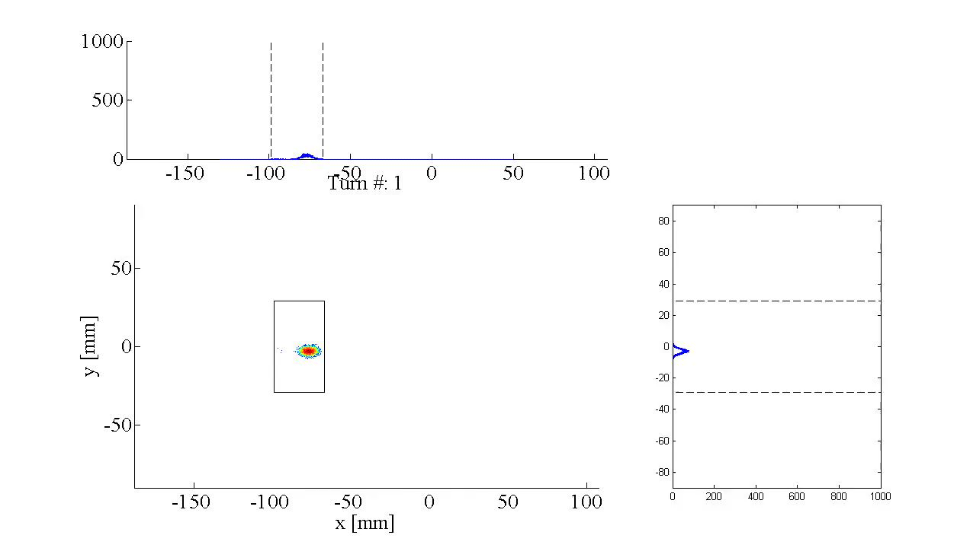
Accumulation process on foil
Linac4 connection to the PS booster at 160 MeV:
  H⁻ stripped to p⁺ with an estimated efficiency ≈98 % with C foil 200 μg.cm⁻²
V. Forte, Performance of the CERN PSB at 160 MeV with H- charge exchange injection, PhD thesis – CERN and Université Blaise Pascal
ABT Introductory Lectures – JAS, Dubna, Russia, 2019

Slide 51
Charge exchange H- injection
Paint uniform transverse phase space density by modifying closed orbit bump and steering injected beam
Foil thickness calculated to double-strip most ions (≈99%)
  50 MeV – 50 μg.cm⁻²
  800 MeV – 200 μg.cm⁻² (≈ 1 μm of C!)
Carbon foils generally used – very fragile
Injection chicane reduced or switched off after injection, to avoid excessive foil heating and beam blow-up
Longitudinal phase space can also be painted turn-by-turn:
  Variation of the injected beam energy turn-by-turn (linac voltage scaled)
  Chopper system in linac to match length of injected batch to bucket
ABT Introductory Lectures – JAS, Dubna, Russia, 2019

Slide 52
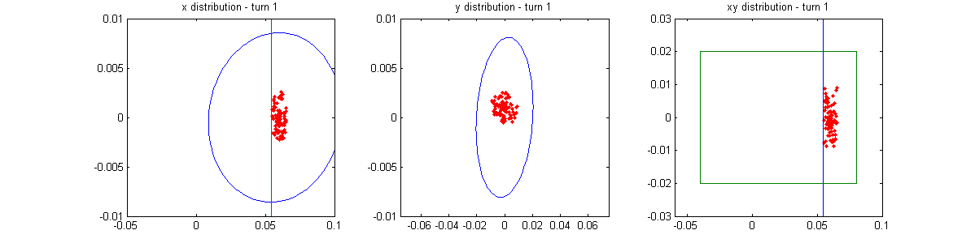
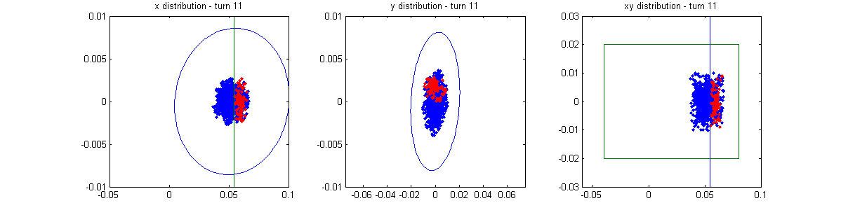
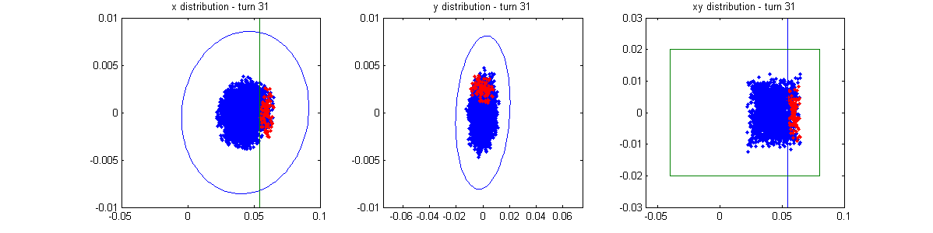
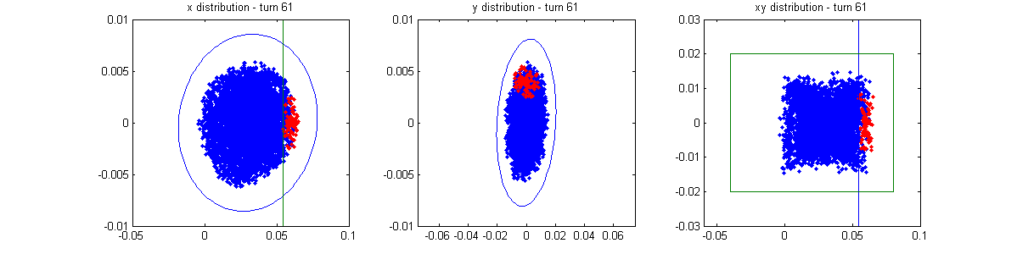
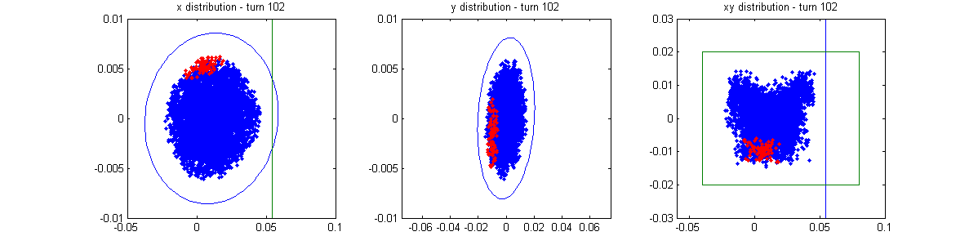
H- injection - painting
x’ vs x
y’ vs y
y vs x
Time
Note injection into same phase space area as circulating beam
≈100 turns
ABT Introductory Lectures – JAS, Dubna, Russia, 2019

Slide 53
Lepton injection
Single-turn injection can be used as for hadrons; however, lepton motion is strongly damped (different with respect to proton or ion injection).
  Synchrotron radiation
    see Electron Beam Dynamics lectures by L. Rivkin
Can use transverse or longitudinal damping:
  Transverse - Betatron accumulation
  Longitudinal - Synchrotron accumulation
ABT Introductory Lectures – JAS, Dubna, Russia, 2019

Slide 54
Betatron lepton injection
Injected beam
Septum magnet
Circulating
beam
Closed orbit bumpers or kickers
Beam is injected with an angle with respect to the closed orbit
Injected beam performs damped betatron oscillations about the closed orbit
ABT Introductory Lectures – JAS, Dubna, Russia, 2019

Slide 55
Betatron lepton injection
Injected bunch performs damped betatron oscillations
In LEP at 20 GeV, the damping time was about 6’000 turns (0.6 seconds)
ABT Introductory Lectures – JAS, Dubna, Russia, 2019

Slide 56
Synchrotron lepton injection
Inject an off-momentum beam
Injected beam
p = p₀ + Δp
Septum magnet
p = p₀
x_{s}
Bumped circulating beam
x_{s} = D_{x ·} Δp/p₀
Closed orbit bumpers or kickers
Beam injected parallel to circulating beam, onto dispersion orbit of a particle having the same momentum offset Δp/p
Injected beam makes damped synchrotron oscillations at Q_{s} but does not perform betatron oscillations
ABT Introductory Lectures – JAS, Dubna, Russia, 2019

Slide 57
Synchrotron lepton injection
Double batch injection possible….
RF bucket
Injection 2 (turn N + Q_{s}/2)
Stored beam
Injection 1 (turn N)
E
Φ
Longitudinal damping time in LEP was ~3’000 turns (2x faster than transverse)
ABT Introductory Lectures – JAS, Dubna, Russia, 2019

Slide 58
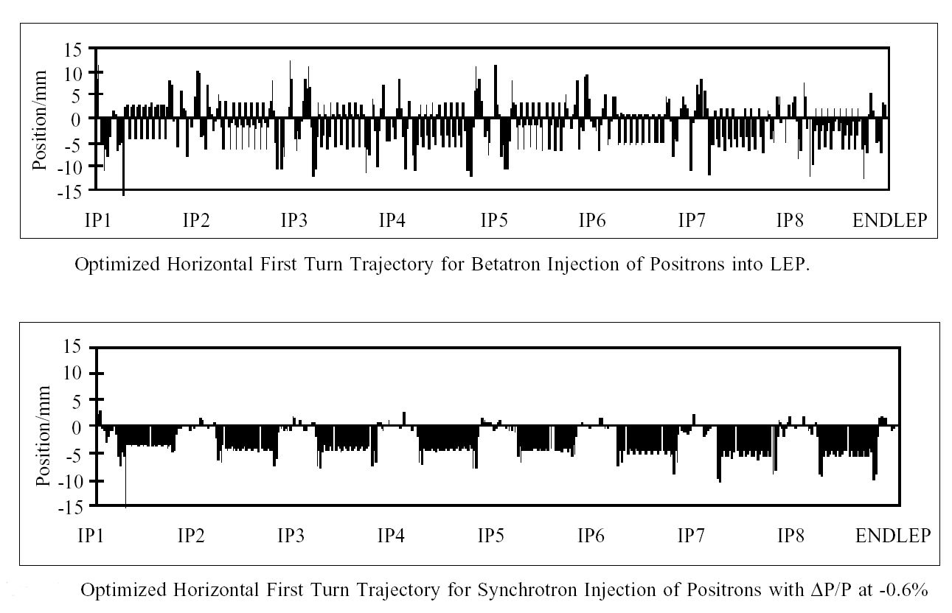
Synchrotron lepton injection in LEP
Synchrotron injection in LEP gave improved background for LEP experiments due to small orbit offsets in zero dispersion straight sections
ABT Introductory Lectures – JAS, Dubna, Russia, 2019

Slide 59
Injection - summary
Several different techniques using kickers, septa and bumpers:
  Single-turn injection for hadrons
    Boxcar stacking: transfer between machines in accelerator chain
    Angle / position errors ⇒ injection oscillations
    Uncorrected errors ⇒ filamentation ⇒ emittance increase
  Multi-turn injection for hadrons
    Phase space painting to increase intensity
    H- injection allows injection into same phase space area
  Lepton injection: take advantage of damping
    Less concerned about injection precision and matching
ABT Introductory Lectures – JAS, Dubna, Russia, 2019

Slide 60
Extraction
Different extraction techniques exist, depending on requirements
  Fast extraction: ≤1 turn
  Non-resonant (fast) multi-turn extraction: few turns
  Resonant low-loss (fast) multi-turn extraction: few turns
  Resonant multi-turn extraction: many thousands of turns
Usually higher energy than injection ⇒ stronger elements (∫B.dl)
  At high energies many kicker and septum modules may be required
  To reduce kicker and septum strength, beam can be moved near to septum by closed orbit bump
ABT Introductory Lectures – JAS, Dubna, Russia, 2019

Slide 61
Fast single turn extraction
    Entire beam kicked into septum gap and extracted over a single turn
Extracted beam
intensity
Septum magnet
kicker field
t
Circulating
beam
Kicker magnet
Closed orbit bumpers
F-quad
D-quad
Bumpers move circulating beam close to septum to reduce kicker strength
Kicker deflects the entire beam into the septum in a single turn
Most efficient (lowest deflection angles required) for π/2 phase advance between kicker and septum
ABT Introductory Lectures – JAS, Dubna, Russia, 2019

Slide 62
Fast single turn extraction
For transfer of beams between accelerators in an injector chain
For secondary particle production
  e.g. neutrinos, radioactive beams
Losses from transverse scraping or from particles in extraction gap:
  Fast extraction from SPS to CNGS:
Particles in SPS extraction kicker rise- and fall-time gaps
ABT Introductory Lectures – JAS, Dubna, Russia, 2019

Slide 63
Multi-turn extraction
Some filling schemes require a beam to be injected in several turns to a larger machine…
And very commonly Fixed Target physics experiments and medical accelerators often need a quasi-continuous flux of particles…
Multi-turn extraction…
  Fast: Non-resonant and resonant multi-turn ejection (few turns) for filling
    e.g. PS to SPS at CERN for high intensity proton beams (>2.5 10¹³ protons)
  Slow: Resonant extraction (ms to hours) for experiments
ABT Introductory Lectures – JAS, Dubna, Russia, 2019

Slide 64
Non-resonant multi-turn extraction
    Beam bumped to septum; part of beam ‘shaved’ off each turn
Extracted beam
Magnetic
septum
Electrostatic septum
Bumped circulating beam
Fast closed orbit bumpers
Fast bumper deflects the whole beam onto the septum
Beam extracted in a few turns, with the machine tune rotating the beam
Intrinsically a high-loss process: thin septum essential
Often combine thin electrostatic septa with magnetic septa
ABT Introductory Lectures – JAS, Dubna, Russia, 2019

Slide 65
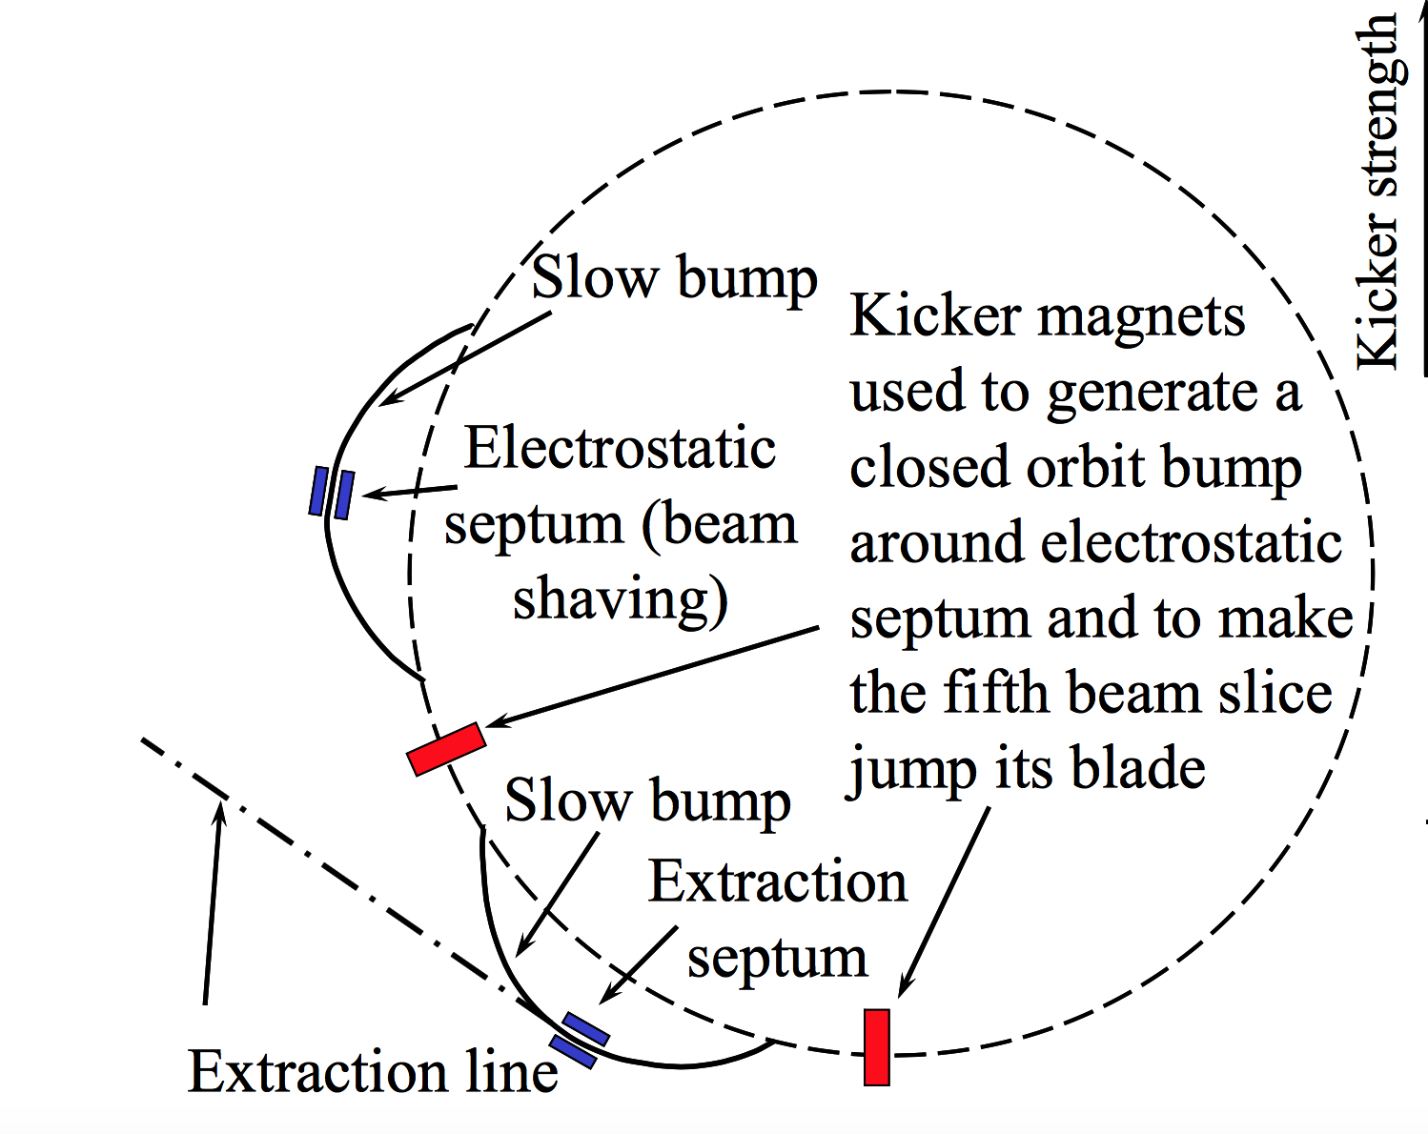
Non-resonant multi-turn extraction
Example system: CERN PS to SPS Fixed-Target ‘continuous transfer’.
  Accelerate beam in PS to 14 GeV/c
  Empty PS machine (2.1 μs long) in 5 turns into SPS
  Fill SPS machine (23 μs long)
  Quasi-continuous beam in SPS (2 x 1 μs gaps)
  Total intensity per PS extraction ≈ 3 × 10¹³ p+
  Total intensity in SPS ≈ 5 × 10¹³ p+
beam
To the SPS
Extracted beam
ABT Introductory Lectures – JAS, Dubna, Russia, 2019
The PS

Slide 66
Non-resonant multi-turn extraction
CERN PS to SPS: 5-turn continuous transfer – 1st turn
Q_{h} = 0.25
septum
2
5
1
3
4
Bump vs. turn
1 2 3 4 5
ABT Introductory Lectures – JAS, Dubna, Russia, 2019

Slide 67
Non-resonant multi-turn extraction
CERN PS to SPS: 5-turn continuous transfer – 2nd turn
Q_{h} = 0.25
septum
2
5
1
3
4
Bump vs. turn
1 2 3 4 5
ABT Introductory Lectures – JAS, Dubna, Russia, 2019

Slide 68
Non-resonant multi-turn extraction
CERN PS to SPS: 5-turn continuous transfer – 3rd turn
Q_{h} = 0.25
septum
2
5
1
3
4
Bump vs. turn
1 2 3 4 5
ABT Introductory Lectures – JAS, Dubna, Russia, 2019

Slide 69
Non-resonant multi-turn extraction
CERN PS to SPS: 5-turn continuous transfer – 4th turn
Q_{h} = 0.25
septum
2
5
1
3
4
Bump vs. turn
1 2 3 4 5
ABT Introductory Lectures – JAS, Dubna, Russia, 2019

Slide 70
Non-resonant multi-turn extraction
CERN PS to SPS: 5-turn continuous transfer – 5th turn
Q_{h} = 0.25
5
Bump vs. turn
1 2 3 4 5
ABT Introductory Lectures – JAS, Dubna, Russia, 2019

Slide 71
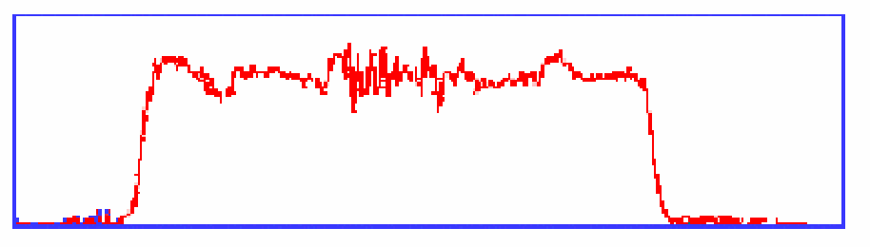
Non-resonant multi-turn extraction
CERN PS to SPS: 5-turn continuous transfer
  Losses impose thin (ES) septum…
  …a second magnetic septum is needed
  Still about 15 % of beam lost in PS-SPS CT
  Difficult to get equal intensities per turn
  Different trajectories for each turn
  Different emittances for each turn
I
1
2
3
4
5
1
2
3
4
5
ABT Introductory Lectures – JAS, Dubna, Russia, 2019

Slide 72
Resonant multi-turn (fast) extraction
Adiabatic capture of beam in stable “islands”
  Use non-linear fields (sextupoles and octupoles) to create islands of stability in phase space
  A slow (adiabatic) tune variation to cross a resonance and to drive particles into the islands (capture) with the help of transverse excitation (using damper)
  Variation of field strengths to separate the islands in phase space
Several big advantages:
  Losses reduced significantly (no particles at the septum in transverse plane)
  Phase space matching improved with respect to existing non-resonant multi-turn extraction - ‘beamlets’ have similar emittance and optical parameters
ABT Introductory Lectures – JAS, Dubna, Russia, 2019

Slide 73
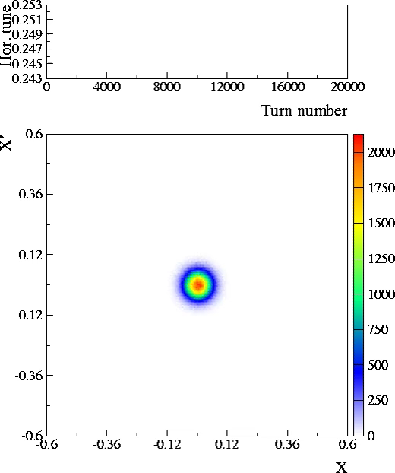
Resonant multi-turn (fast) extraction
Unperturbed beam
Increasing non-linear fields
Beam captured in stable islands
Islands separated and beam bumped across septum – extracted in 5 turns
(see Non-Linear Beam Dynamics lectures by Y. Papaphilippou)
Courtesy M. Giovannozzi: MTE Design Report, CERN-2006-011, 2006
ABT Introductory Lectures – JAS, Dubna, Russia, 2019

Slide 74
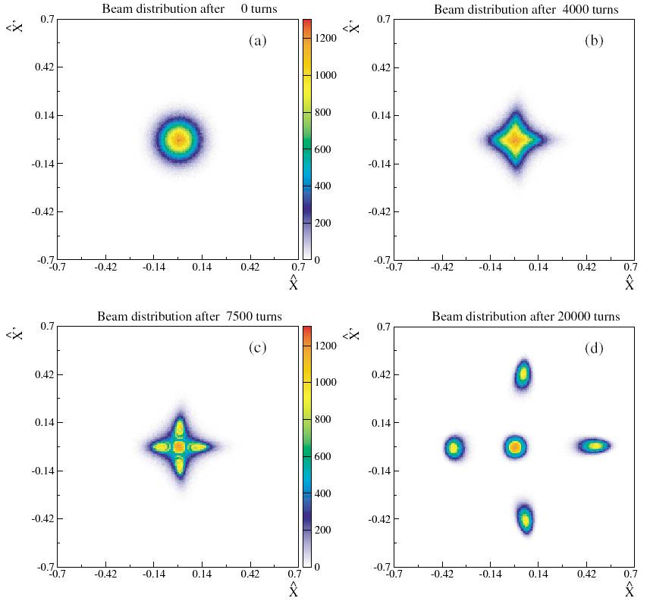
Resonant multi-turn (fast) extraction
Unperturbed beam
Increasing non-linear fields
Beam captured in stable islands
Islands separated and beam bumped across septum – extracted in 5 turns
Q_{h} = 0.25
Bump vs. turn
1 2 3 4 5
Septum wire
Courtesy M. Giovannozzi: MTE Design Report, CERN-2006-011, 2006
ABT Introductory Lectures – JAS, Dubna, Russia, 2019

Slide 75
Resonant multi-turn (slow) extraction
    Non-linear fields excite resonances that drive the beam slowly across the septum
Extracted beam
Magnetic
septum
Electrostatic septum
Bumped circulating beam -
particles moved across
septum by resonance
Closed orbit bumpers
Slow bumpers move the beam near the septum
Tune adjusted close to n^{th} order betatron resonance
Multipole magnets excited to define stable area in phase space, size depends on ΔQ = Q - Q_{r}
ABT Introductory Lectures – JAS, Dubna, Russia, 2019

Slide 76
Resonant multi-turn (slow) extraction
3rd order resonances – see lectures by Y. Papaphilippou
  Sextupole fields distort the circular normalised phase space particle trajectories.
  Stable area defined, delimited by unstable Fixed Points.
  Sextupole magnets arranged to produce suitable phase space orientation of the stable triangle at thin electrostatic septum
  Stable area can be reduced by…
    Increasing the sextupole strength, or…
    Fixing the sextupole strength and scanning the machine tune Q_{h} (and therefore the resonance) through the tune spread of the beam
    Large tune spread created with RF gymnastics (large momentum spread) and large chromaticity
R_{fp}
ABT Introductory Lectures – JAS, Dubna, Russia, 2019

Slide 77
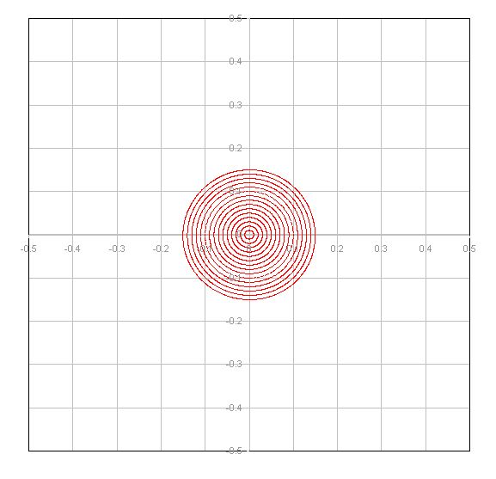
Third-order resonant extraction
Septum wire
Particles distributed on emittance contours
ΔQ large – no phase space distortion
ABT Introductory Lectures – JAS, Dubna, Russia, 2019

Slide 78
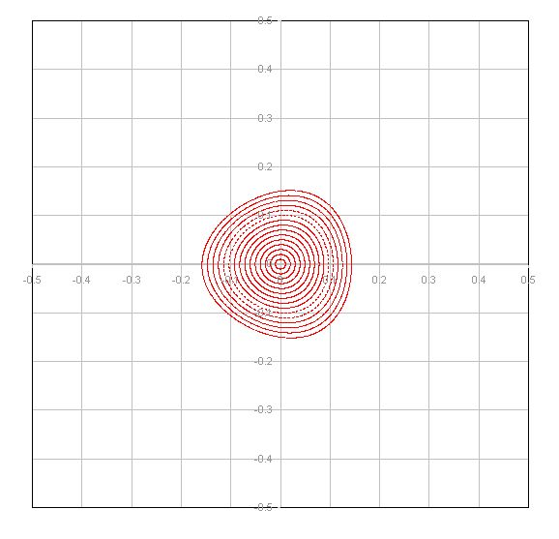
Third-order resonant extraction
Septum wire
Sextupole magnets produce a triangular stable area in phase space
ΔQ decreasing – phase space distortion for largest amplitudes
ABT Introductory Lectures – JAS, Dubna, Russia, 2019

Slide 79
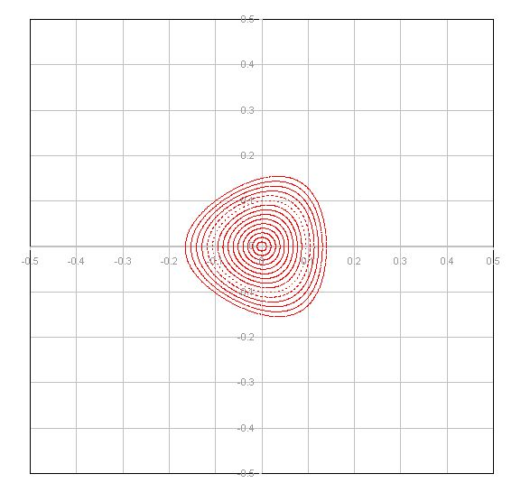
Third-order resonant extraction
Septum wire
Sextupole magnets produce a triangular stable area in phase space
ΔQ decreasing – phase space distortion for largest amplitudes
ABT Introductory Lectures – JAS, Dubna, Russia, 2019

Slide 80
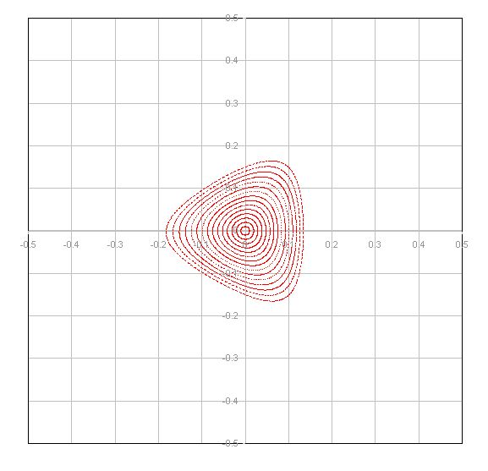
Third-order resonant extraction
Septum wire
Sextupole magnets produce a triangular stable area in phase space
ΔQ decreasing – phase space distortion for largest amplitudes
ABT Introductory Lectures – JAS, Dubna, Russia, 2019

Slide 81
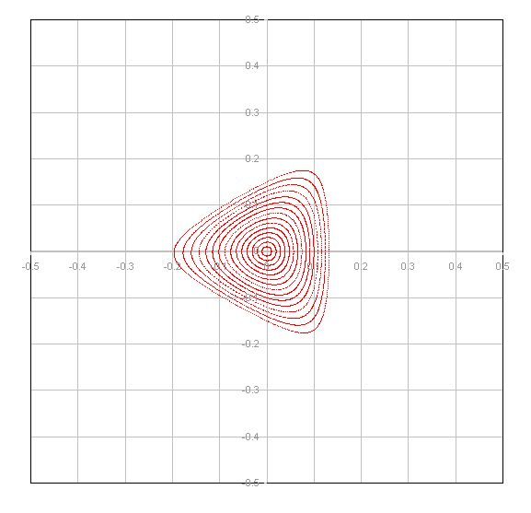
Third-order resonant extraction
Septum wire
Sextupole magnets produce a triangular stable area in phase space
ΔQ decreasing – phase space distortion for largest amplitudes
ABT Introductory Lectures – JAS, Dubna, Russia, 2019

Slide 82
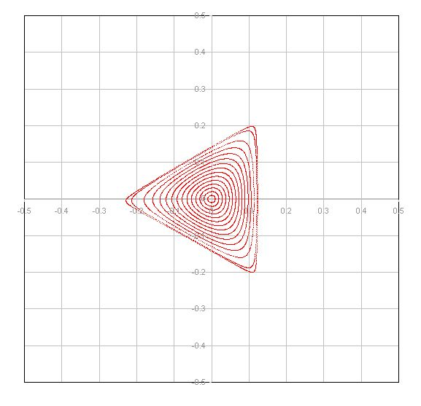
Third-order resonant extraction
Septum wire
Largest amplitude particle trajectories are significantly distorted
Locations of fixed points discernable at extremities of phase space triangle
ABT Introductory Lectures – JAS, Dubna, Russia, 2019

Slide 83
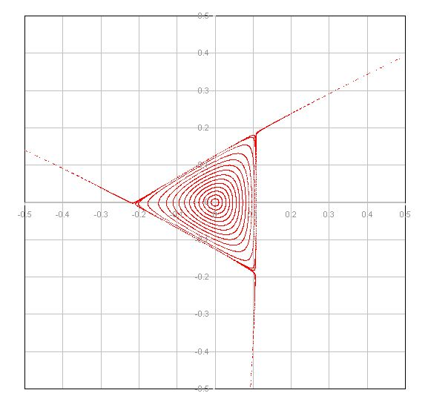
Third-order resonant extraction
Septum wire
ΔQ small enough that largest amplitude particle trajectories are unstable
Unstable particles follow separatrix branches as they increase in amplitude
ABT Introductory Lectures – JAS, Dubna, Russia, 2019

Slide 84
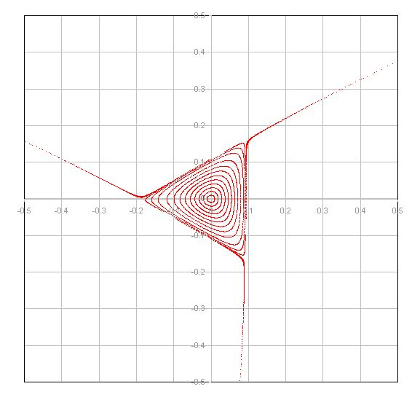
Third-order resonant extraction
Septum wire
Stable area shrinks as ΔQ becomes smaller
ABT Introductory Lectures – JAS, Dubna, Russia, 2019

Slide 85
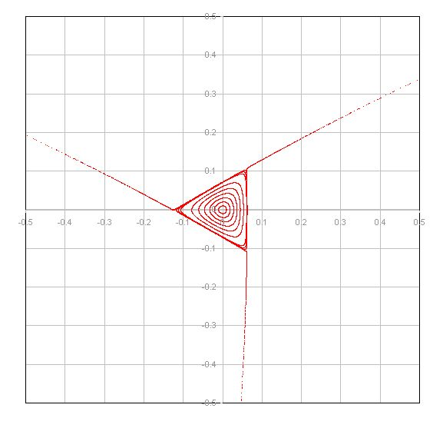
Third-order resonant extraction
Septum wire
Separatrix position in phase space shifts as the stable area shrinks
ABT Introductory Lectures – JAS, Dubna, Russia, 2019

Slide 86
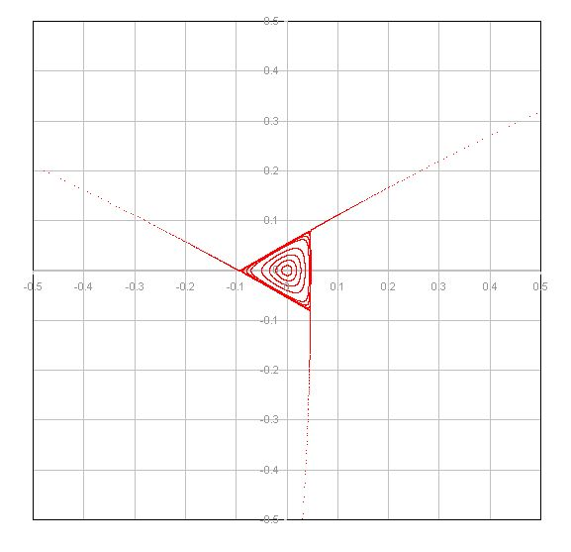
Third-order resonant extraction
Septum wire
As the stable area shrinks, the circulating beam intensity drops since particles are being continuously extracted
ABT Introductory Lectures – JAS, Dubna, Russia, 2019

Slide 87
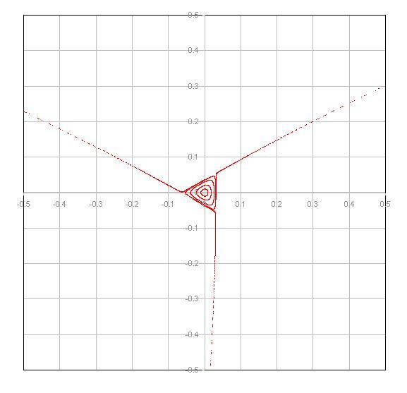
Third-order resonant extraction
Septum wire
As the stable area shrinks, the circulating beam intensity drops since particles are being continuously extracted
ABT Introductory Lectures – JAS, Dubna, Russia, 2019

Slide 88
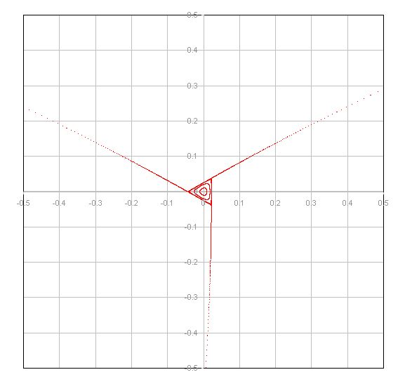
Third-order resonant extraction
Septum wire
As the stable area shrinks, the circulating beam intensity drops since particles are being continuously extracted
ABT Introductory Lectures – JAS, Dubna, Russia, 2019

Slide 89
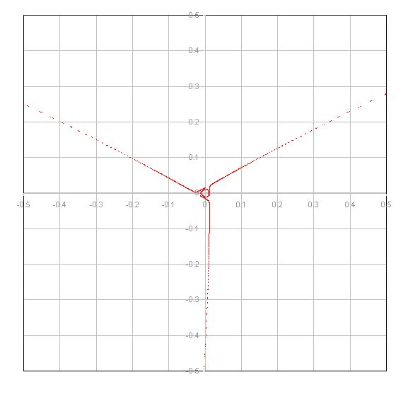
Third-order resonant extraction
Septum wire
As the stable area shrinks, the circulating beam intensity drops since particles are being continuously extracted
ABT Introductory Lectures – JAS, Dubna, Russia, 2019

Slide 90
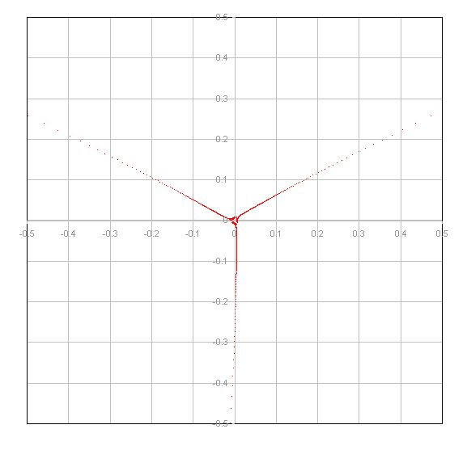
Third-order resonant extraction
Septum wire
As ΔQ approaches zero, the particles with very small amplitude are extracted
ABT Introductory Lectures – JAS, Dubna, Russia, 2019

Slide 91
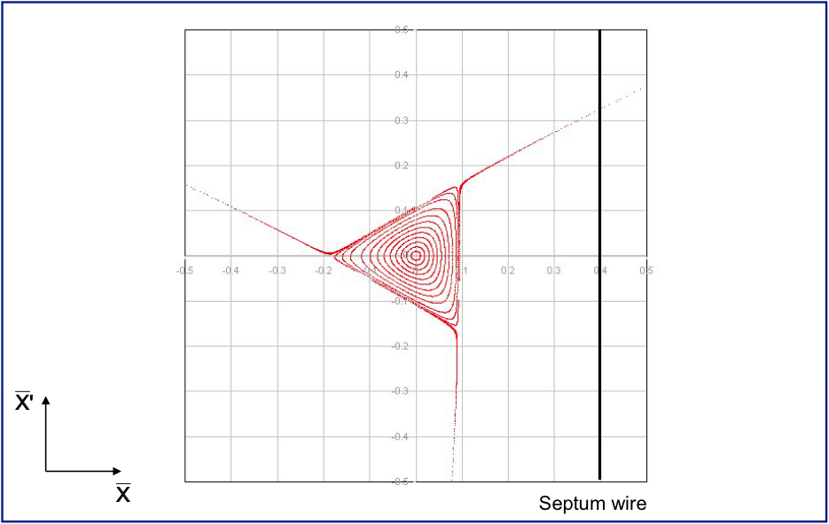
Third-order resonant extraction
On resonance, sextupole kicks add-up driving particles over septum
Particle at turn 0
ABT Introductory Lectures – JAS, Dubna, Russia, 2019

Slide 92
Third-order resonant extraction
On resonance, sextupole kicks add-up driving particles over septum
Particle at turn 1
ABT Introductory Lectures – JAS, Dubna, Russia, 2019

Slide 93
Third-order resonant extraction
On resonance, sextupole kicks add-up driving particles over septum
Particle at turn 2
ABT Introductory Lectures – JAS, Dubna, Russia, 2019

Slide 94
Third-order resonant extraction
On resonance, sextupole kicks add-up driving particles over septum
Particle at turn 3
ABT Introductory Lectures – JAS, Dubna, Russia, 2019

Slide 95
Third-order resonant extraction
On resonance, sextupole kicks add-up driving particles over septum
  Distance travelled in these final three turns is termed the “spiral step,” ΔX_{ES}
  Extraction bump trimmed in the machine to adjust the spiral step
Extracted beam
θ
ABT Introductory Lectures – JAS, Dubna, Russia, 2019

Slide 96
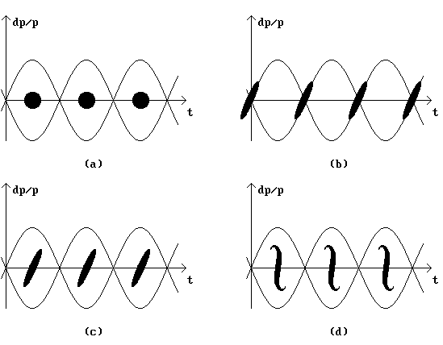
Third-order resonant extraction
On resonance, sextupole kicks add-up driving particles over septum
  Distance travelled in these final three turns is termed the “spiral step,” ΔX_{ES}
  Extraction bump trimmed in the machine to adjust the spiral step
RF gymnastics before extraction:
Extracted beam
θ
momentum spread, tune
RF gymn.
  Spill = 4.8 s
small Δp
Δϕ = π
RF off
time
Δϕ = -π
rotation: large Δp
Schottky measurement during spill, courtesy of T. Bohl
ABT Introductory Lectures – JAS, Dubna, Russia, 2019

Slide 97
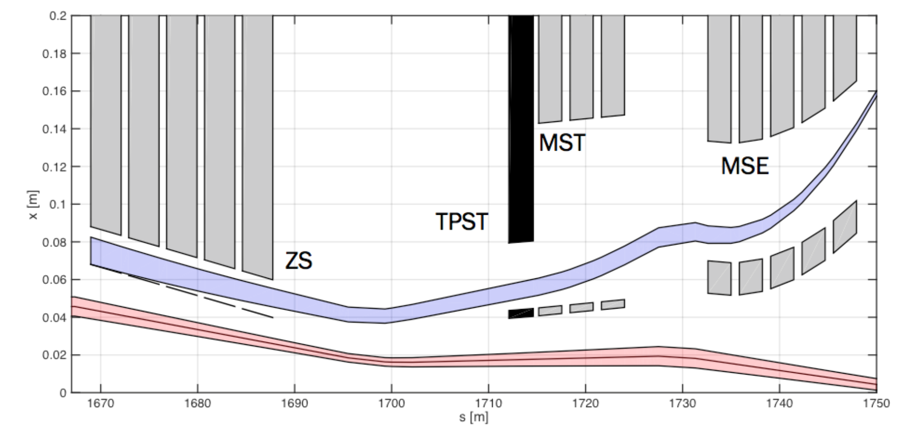
Slow extraction channel: SPS
extraction
bumper
TPST
mask
magnetic
septum (MST)
To TT20
and NA
QFA
electrostatic septum (ES)
QDA
QFA
magnetic septum (MSE)
ES
extracted beam
circulating beam
ABT Introductory Lectures – JAS, Dubna, Russia, 2019

Slide 98
Slow extracted spill quality
  The slow-extraction is a resonant process and it amplifies the smallest imperfections in the machine:
    e.g. spill intensity variations can be explained by ripples in the current of the quads (mains: n x 50 Hz) at the level of a few ppm!
    Injection of n x 50 Hz signals in counter-phase on dedicated quads can be used to compensate
  Reducing ΔQ with main machine quadrupoles can be augmented with a ‘servo’ quadrupole, which can modulate ΔQ in a servo loop, acting on a measurement of the spill intensity
10 Hz
50 Hz
  A recent example of a spill at SPS to the North Area with large n x 50 Hz components and another noise source at 10 Hz
ABT Introductory Lectures – JAS, Dubna, Russia, 2019

Slide 99
Second-order resonant extraction
An extraction can also be made over a few hundred turns
2nd and 4th order resonances
  Octupole fields distort the regular phase space particle trajectories
  Stable area defined, delimited by two unstable Fixed Points
  Beam tune brought across a 2nd order resonance (Q → 0.5)
  Particle amplitudes quickly grow and beam is extracted in a few hundred turns
ABT Introductory Lectures – JAS, Dubna, Russia, 2019

Slide 100
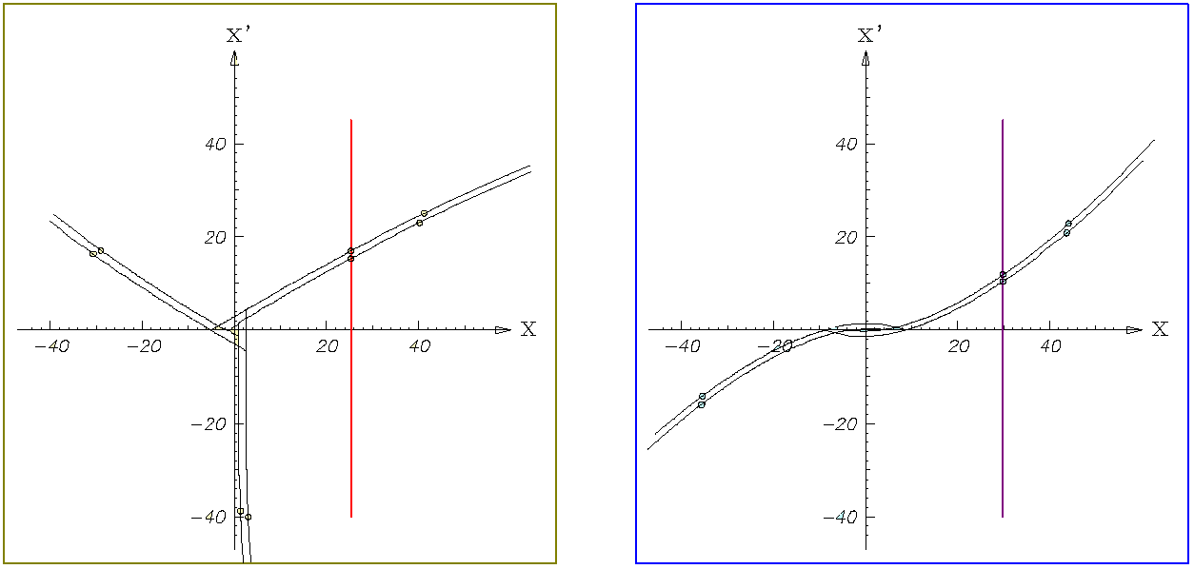
Resonant extraction separatrices
3rd order resonant extraction
2nd order resonant extraction
Amplitude growth for 2nd order resonance much faster than 3rd – shorter spills (≈milliseconds vs. seconds)
Used where intense pulses are required on target – e.g. neutrino production
ABT Introductory Lectures – JAS, Dubna, Russia, 2019

Slide 101
Extraction - summary
Several different techniques:
  Single-turn fast extraction:
    for transfer between machines in accelerator chain, beam abort, etc.
  Non-resonant (fast) multi-turn extraction
    slice beam into equal parts for transfer between machine over a few turns.
  Resonant low-loss (fast) multi-turn extraction
    create stable islands in phase space: slice off over a few turns.
  Resonant (slow) multi-turn extraction
    create stable area in phase space ⇒ slowly drive particles into resonance ⇒ long spill over many thousand turns.
Thank you for your attention
ABT Introductory Lectures – JAS, Dubna, Russia, 2019

Slide 102
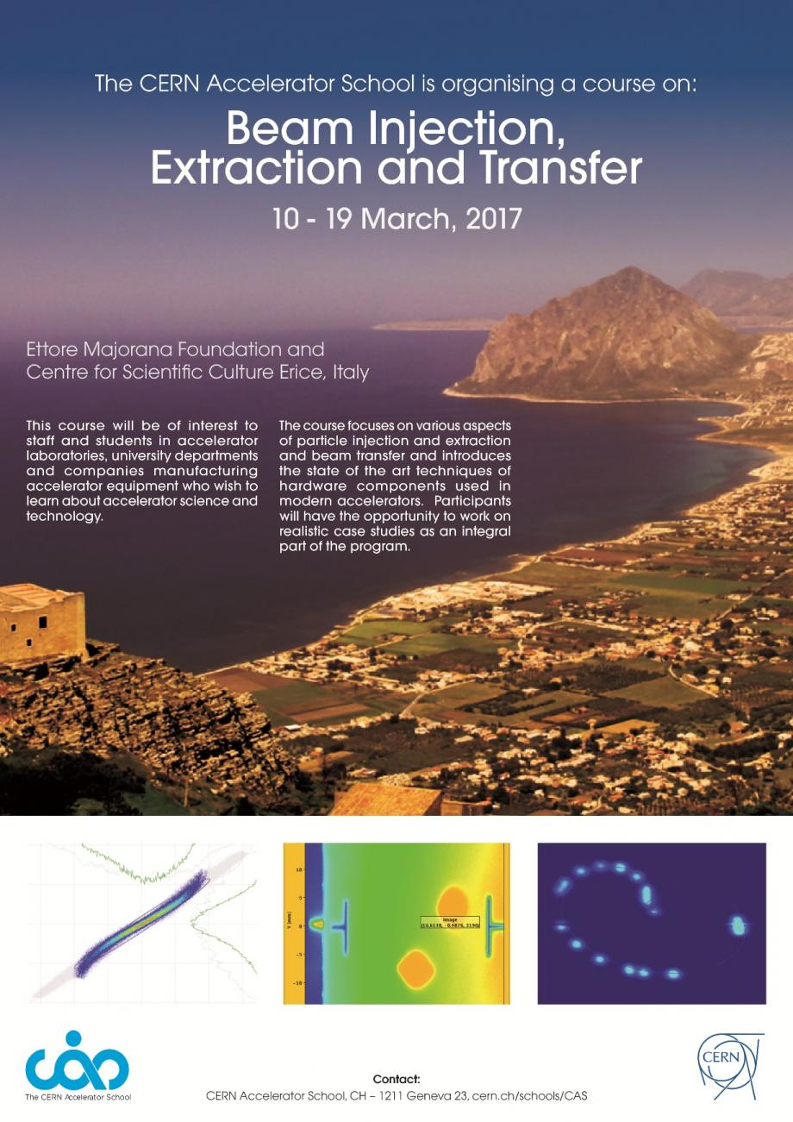
Further reading and references
Lot’s of resources presented at the recent CAS Specialised School:
Beam Injection, Extraction and Transfer, 10-19 March 2017, Erice, Italy
https://cas.web.cern.ch/schools/erice-2017
ABT Introductory Lectures – JAS, Dubna, Russia, 2019

