Slide 1

JAS 2019 – Ion Colliders
Heavy-Ions in the LHC
by
Michaela Schaumann
CERN, Beams Department, Operations Group
With big acknowledgements to John Jowett
05.11.2019

Slide 2
Outline
Introduction
History and Notations
Effects on Luminosity
Pb-Pb Collisions
Secondary Beams
Getting the beams into LHC
Beam and Luminosity Evolution
Performance Summary
Other Operational Modes
p-Pb collisions
Other unforeseen, but successful operational modes

Slide 3
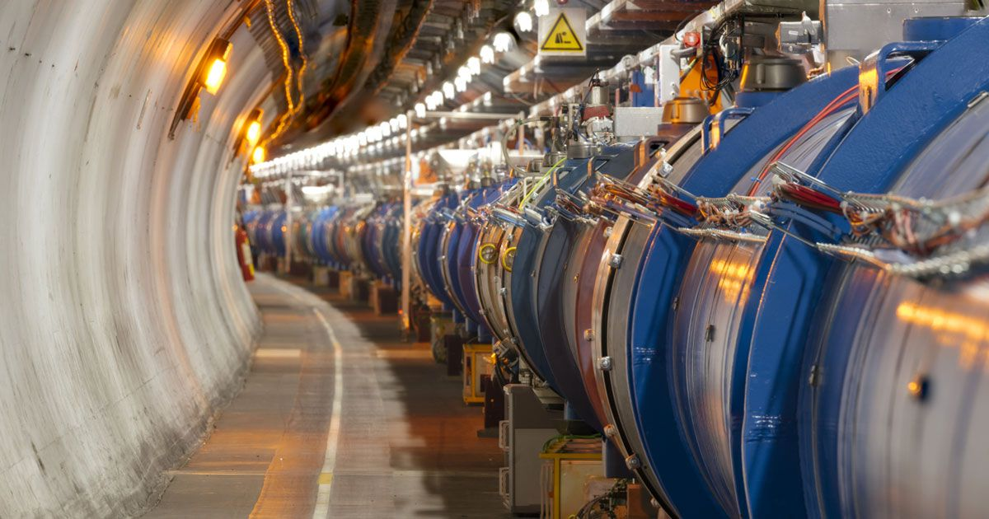
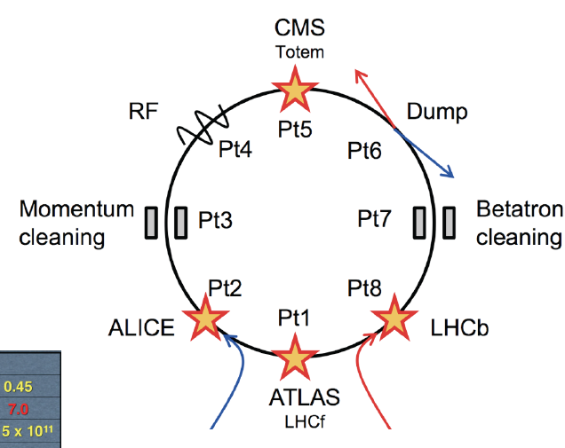
Introduction to LHC
The largest machine in the world: The Large Hadron Collider (LHC)
27 km circumference
100m underground
Accelerates protons and heavy-ions
to E = 6.5 Z TeV (2018).
Collides 2 counter-rotating beams
in 4 physics experiments.

Slide 4
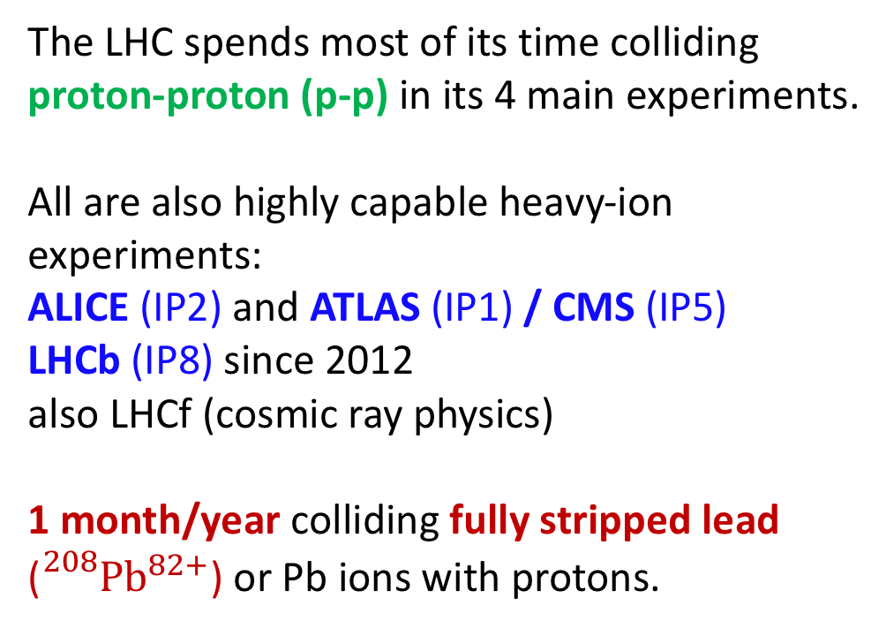
Collision Modes in LHC
p-p
Pb-Pb
p-Pb
The LHC spends most of its time colliding proton-proton (p-p) in its 4 main experiments.
All are also highly capable heavy-ion experiments:
ALICE (IP2) and ATLAS (IP1) / CMS (IP5)
LHCb (IP8) since 2012
also LHCf (cosmic ray physics)
1 month/year colliding fully stripped lead (${}_{}^{208}{{Pb}^{82+}}$) or Pb ions with protons.

Slide 5
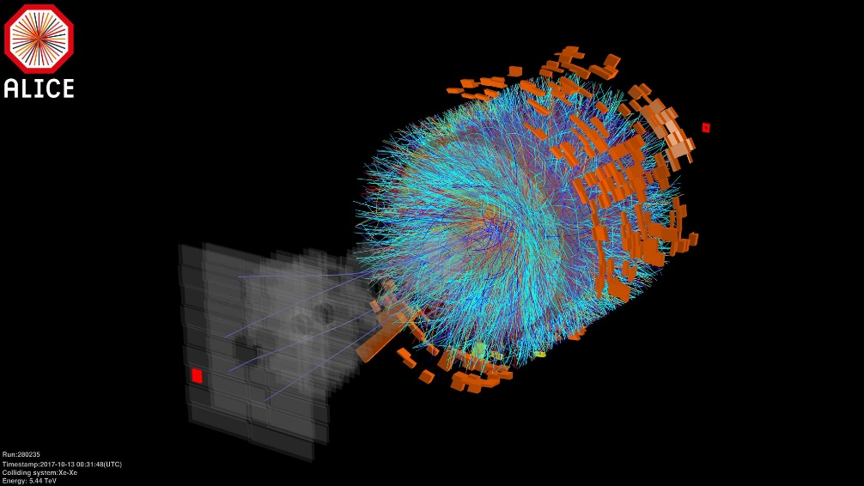
A short History and Future …
2010
2011
2012
2013
2014
2015
2016
2017
2018
2019
2020
2021
2022
2023
2024
2025
2026
2027
2028
2029
2030
12 one-month heavy-ion runs between 2010 and 2030. 6/12 done.
1st p-Pb
high luminosity run
@ 4 Z TeV
LS2 Hardware Upgrades:
ALICE detector upgrade to 7 x design luminosity
Dispersion Suppressor collimators for BFPP losses.
SPS RF (smaller bunch spacing)
Upgrade: new collision mode
16h p-Pb
pilot run
p-Pb
@ 4 Z TeV
@ 6.5 Z TeV
Run 1
Run 2
Run 3
Run 4
LS4
LS1
LS2
LS3
TODAY
Pb-Pb @ 6.37 Z TeV
6.1 x design luminosity
HL-LHC
Pb-Pb @ 6.37 Z TeV
3.5 x design luminosity
Run 5
2031
2032
2033
2034
2035
2036
2037
Run 6
Pb-Pb @ 3.5 Z TeV
0.5 x design luminosity
”Upgrade”: new species
12h Pb81+ operation
LS5
Currently no heavy-ion runs foreseen in Run 5 & 6, but a revised schedule is under discussion.
1st Pb-Pb collisions
@ 3.5 Z TeV
”Upgrade”: new species
16h Xe-Xe operation
HL-LHC

Slide 6
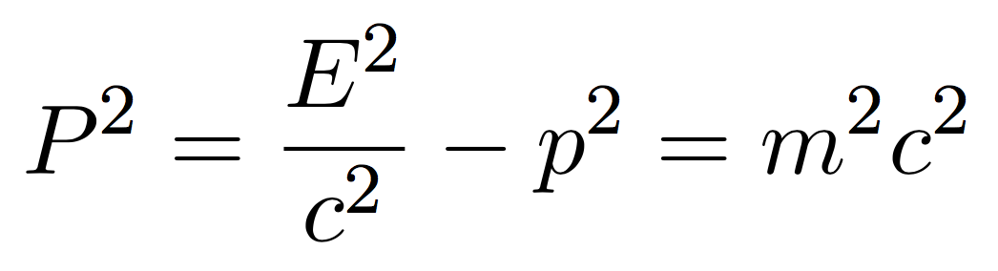


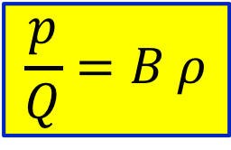
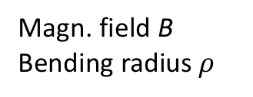
Energy of ions/nuclei and nucleons
The ideal circular orbit
Energy and momentum are related via the square of the 4-momentum vector, P = (E / c , p):
Lorentz Force
$$F_{L}=Q v B$$
Centrifugal Force
Operate at same beam rigidity for different species → equivalent beam energy:
E_{ion} = E_{p} Z
Keep similar magnetic cycles for proton and heavy-ion operation.
$$F_{L}= F_{centr}$$
At high energy
E >> mc²
Magn. field B
Bending radius $ρ$
$$\frac{p}{Q}=B ρ$$
Beam rigidity
Energy per charge,
relation to proton energy
Energy per nucleon
Energy of the particle

Slide 7
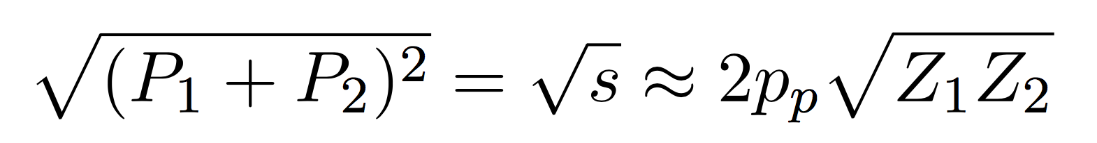

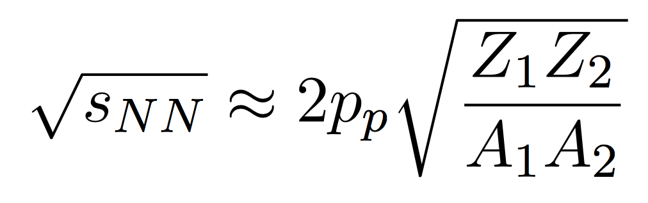
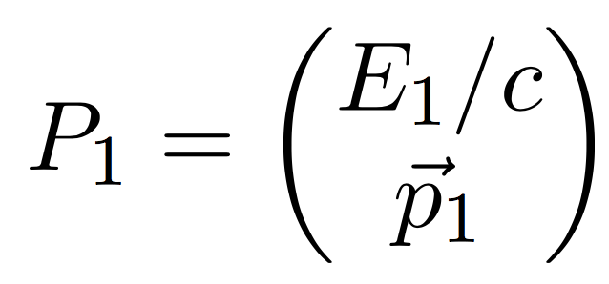
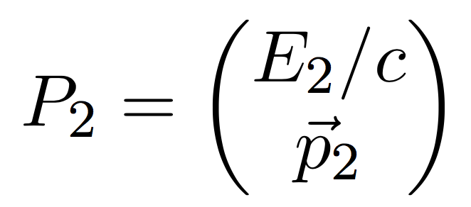
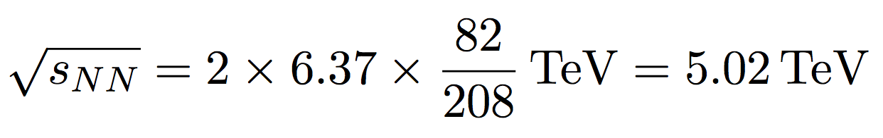
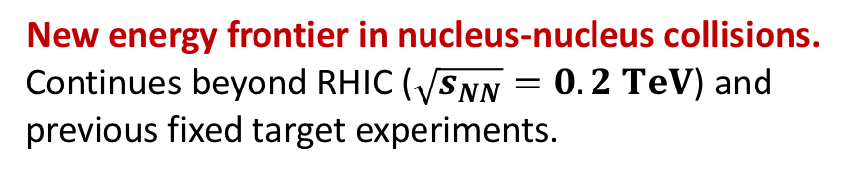
Centre-of-Mass Energy
From the sum of the 4-momentum vectors the centre-of-mass energy in collision of two different species
can be calculated:
Centre-of-Mass (CMS) energy is available for the production of new particles.
Centre-of-mass energy
per colliding nucleon pair:
proton momentum
LHC Pb-Pb run in 2015/18:
New energy frontier in nucleus-nucleus collisions.
Continues beyond RHIC ($\sqrt{s_{NN}}=0.2 TeV$) and previous fixed target experiments.

Slide 8
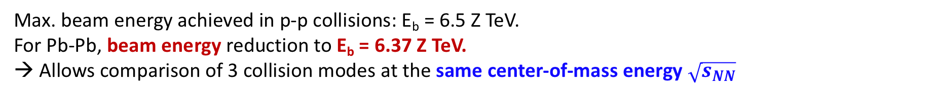
Choice of Beam Energy
particle charge
Max. beam energy achieved in p-p collisions: E_{b} = 6.5 Z TeV.
For Pb-Pb, beam energy reduction to E_{b} = 6.37 Z TeV.
→ Allows comparison of 3 collision modes at the same center-of-mass energy $\sqrt{s_{NN}}$
√s_{NN} = 5.02 TeV
p-p
p-Pb
Pb-Pb
E_{b} = 2.51 TeV
(2013, 2015)
E_{b} = 4 Z TeV
(2013, part 2016)
E_{b} = 6.37 Z TeV
(2015, 2018)
p-p reference data
Special p-p runs at this energy; different to general p-p programme

Slide 9
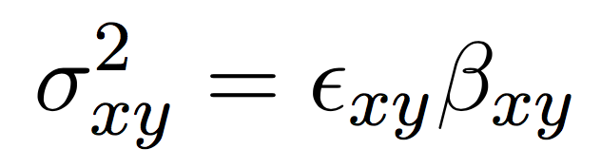
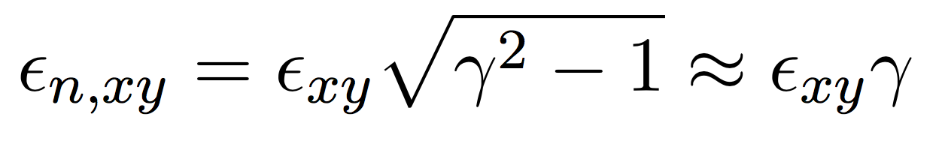
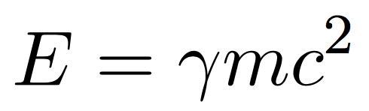
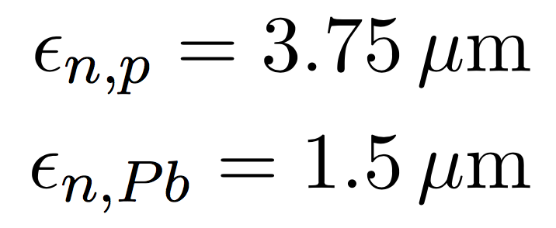
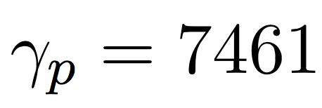
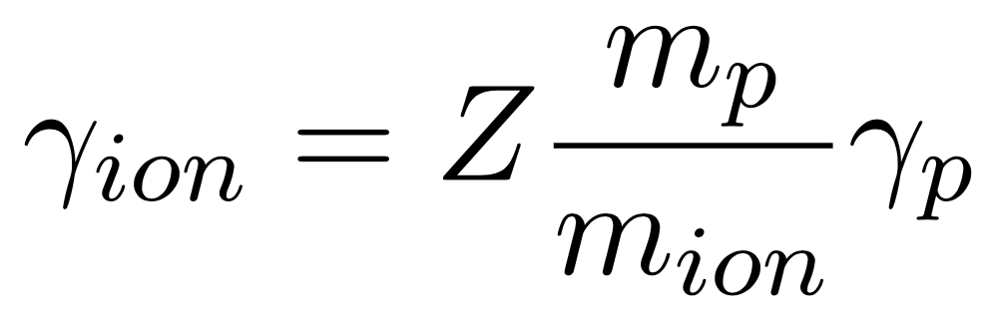

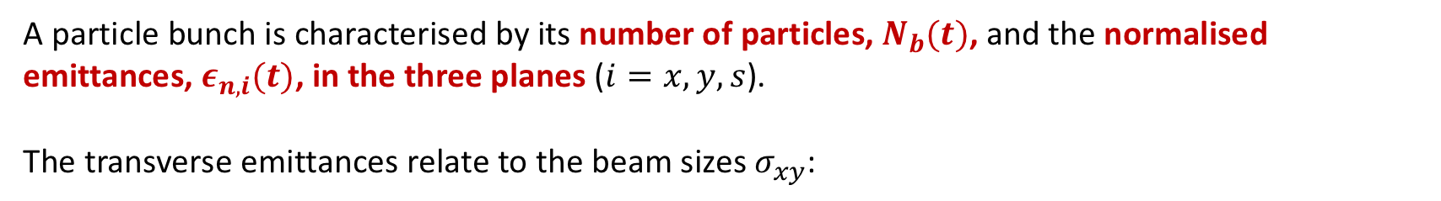
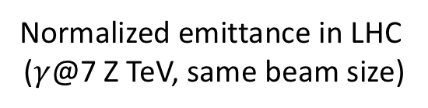
Beam Parameters
A particle bunch is characterised by its number of particles, $N_{b}(t)$, and the normalised emittances, $ε_{n,i}(t)$, in the three planes ($i=x,y,s$).
The transverse emittances relate to the beam sizes $σ_{xy}$:
The beam size shrinks during acceleration by adiabatic damping. Therefore we define the so-called normalised emittance $ε_{n}$, which is constant with energy:
Normalized emittance in LHC
($γ$@7 Z TeV, same beam size)
The rel. Lorentz factor is related to the energy as
Thus, for particles in the same magnetic field

Slide 10
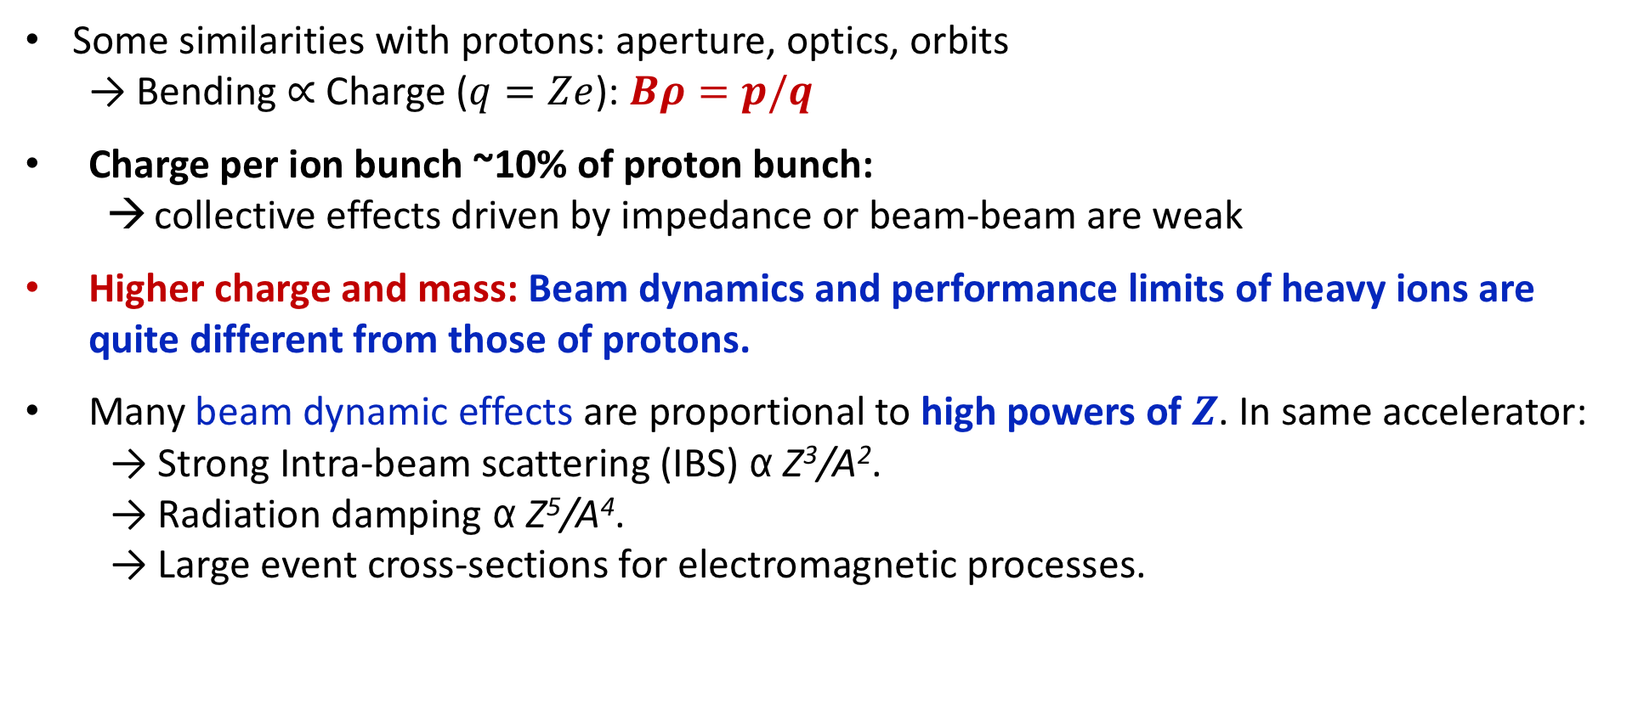
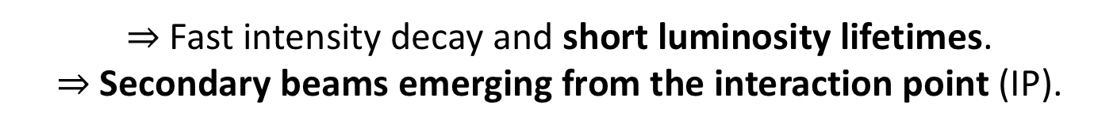
Heavy-Ion vs. Proton Operation
Some similarities with protons: aperture, optics, orbits
  Bending $∝$ Charge ($q=Ze$): $Bρ=p/q$
Charge per ion bunch ~10% of proton bunch:
  collective effects driven by impedance or beam-beam are weak
Higher charge and mass: Beam dynamics and performance limits of heavy ions are quite different from those of protons.
Many beam dynamic effects are proportional to high powers of $Z$. In same accelerator:
  → Strong Intra-beam scattering (IBS) α Z³/A².
  → Radiation damping α Z⁵/A⁴.
  → Large event cross-sections for electromagnetic processes.
$⇒$ Fast intensity decay and short luminosity lifetimes.
$⇒$Secondary beams emerging from the interaction point (IP).

Slide 11
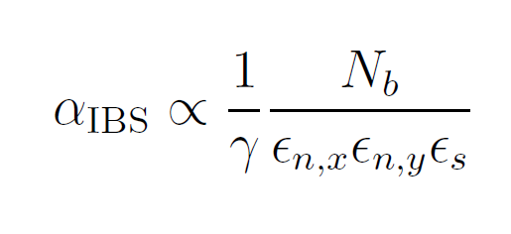
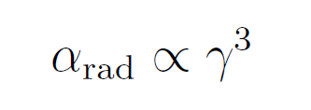
Dominant Effects on Emittance
See lecture by V. Kain
Intra-Beam Scattering (IBS)
Radiation Damping
Multiple small-angle Coulomb scattering among charged particles inside their bunch.
Energy loss due to synchrotron radiation emitted by charged particles bent on a circular orbit.
Emittance Growth and Particle Losses
Emittance Shrinkage
Growth rate dynamically changing with beam properties:
Damping rate is constant for a given beam energy:
Dominating effect in the LHC.
Tends to reduce luminosity.
Starts to become noticeable at LHC energies (and above).
Tends to increase luminosity
IBS and radiation damping both depend on particle type.

Slide 12
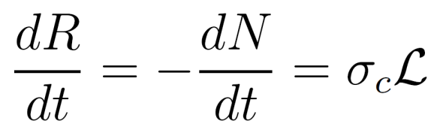
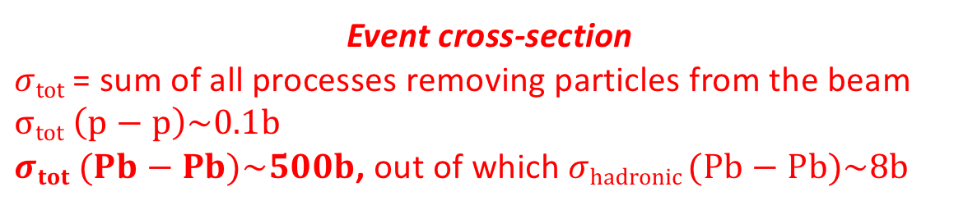
Luminosity
Luminosity is a measure of the ability of a particle accelerator to produce the required number of interactions:
Luminosity
Event/Collision rate:
Reduction of beam particles with time.
Event cross-section
$σtot$ = sum of all processes removing particles from the beam
$σtot \left(p−p\right)\sim 0.1b$
$σtot (Pb−Pb)\sim 500b$, out of which $σhadronic (Pb−Pb)\sim 8b$

Slide 13
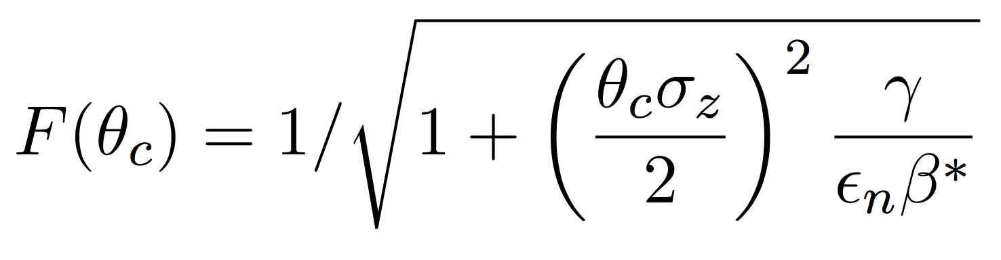
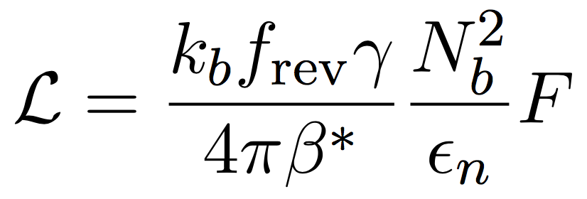
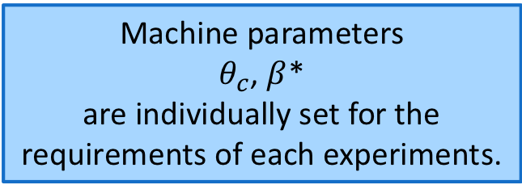
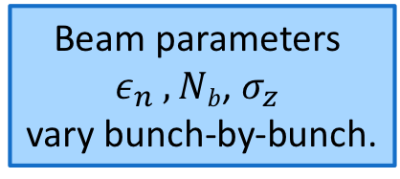
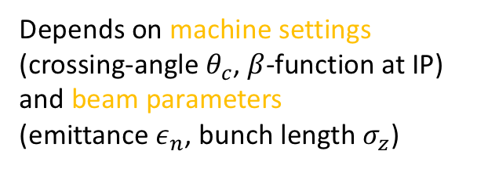
Luminosity
See lecture by I. Meshkov
For k_{b} colliding bunches, which are equal and round:
Constant during collisions
Change during fill
Depends on machine settings (crossing-angle $θ_{c}$, $β$-function at IP) and beam parameters
(emittance $ε_{n}$, bunch length $σ_{z}$)
Geometric reduction factor
Beam parameters
$ε_{n} , Nb$, $σ_{z}$
vary bunch-by-bunch.
Machine parameters
$θ_{c}$, $β$*
are individually set for the requirements of each experiments.
Number of colliding bunches k_{b} per IP depends on filling pattern.
LHC Heavy-Ion runs are complicated!
4 experiments with sometimes very different requests and conditions, luminosity sharing, …

Slide 14
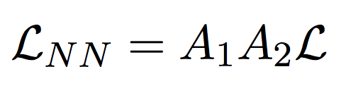
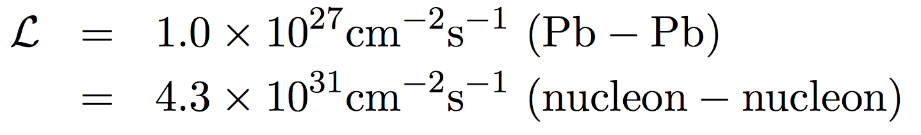
Nucleon-Nucleon Luminosity
See lecture by I. Meshkov
The nucleus-nucleus luminosities for collisions of different species or asymmetric collisions (e.g. p-Pb) are very different and may seem low compared to p-p.
In order to make a meaningful comparison one has to look at the nucleon-nucleon luminosity:
Pb-Pb
p-Pb
Example LHC Pb-Pb design luminosity:
p-p
A₁-A₂

Slide 15
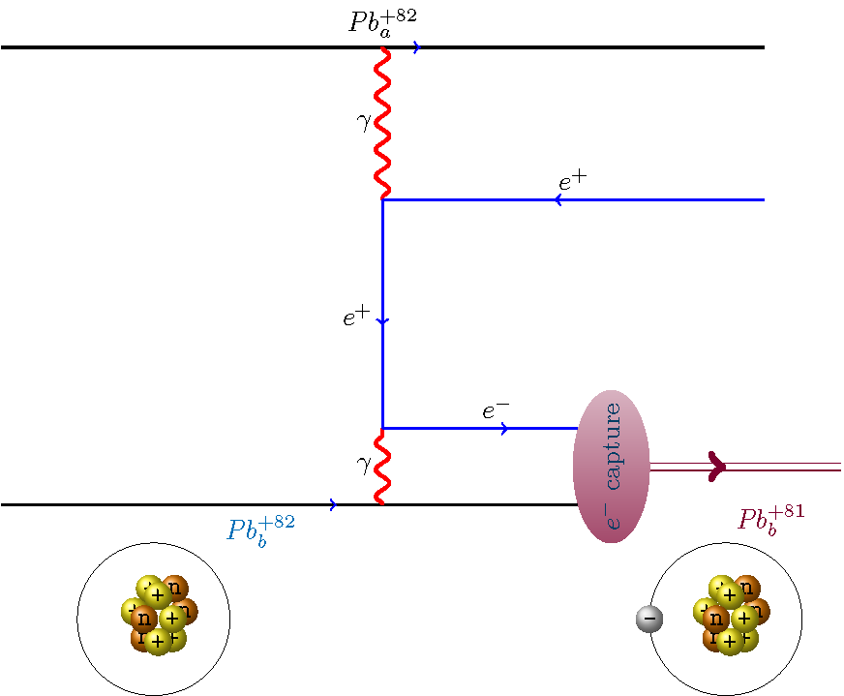
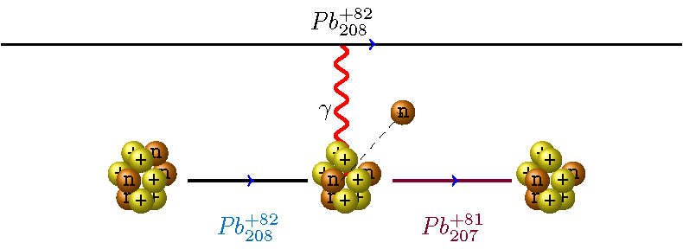
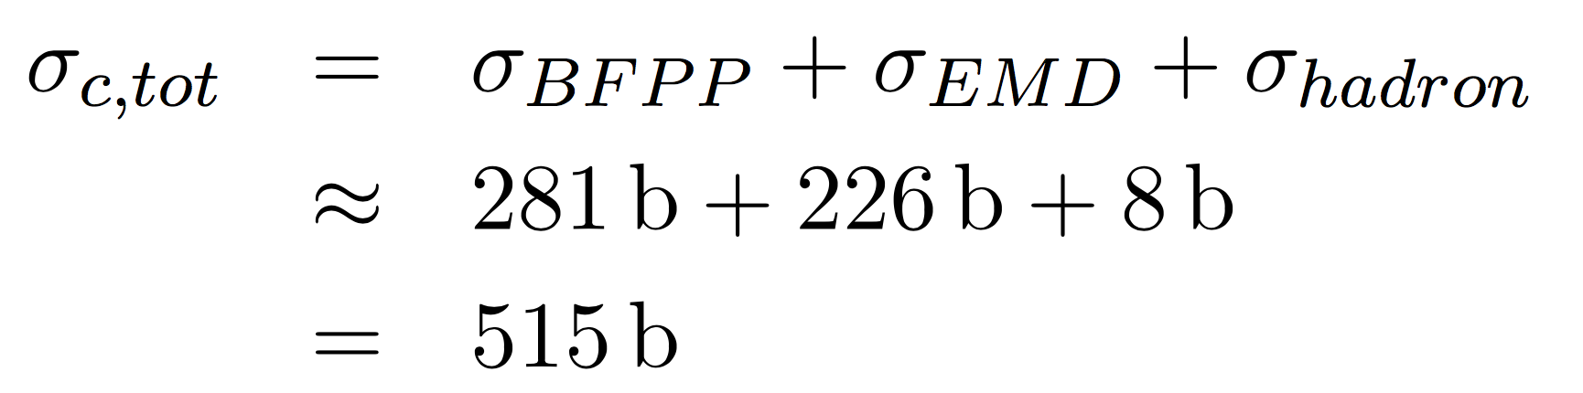
Interaction Cross-sections
Event rate:
Bound-free pair production (BFPP)
Electromagnetic dissociation (EMD)
…and higher orders
These ultraperipheral interactions have large interaction cross-sections in Pb-Pb collisions and are the main contribution to fast luminosity burn-off and short beam lifetime:
@ 7 Z TeV

Slide 16
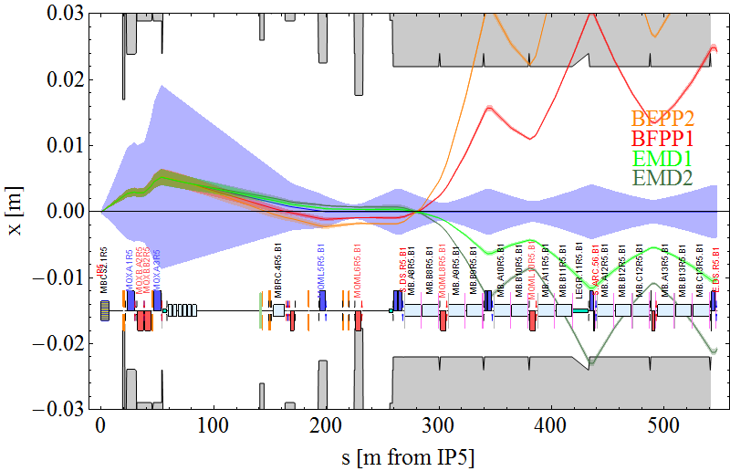
Secondary Beams
Performance Limitation

Slide 17
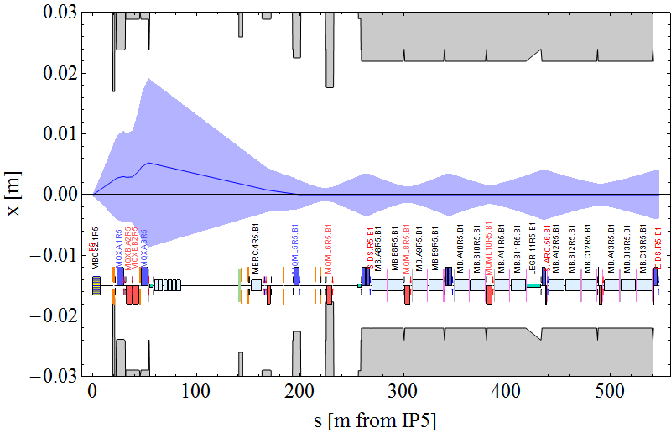
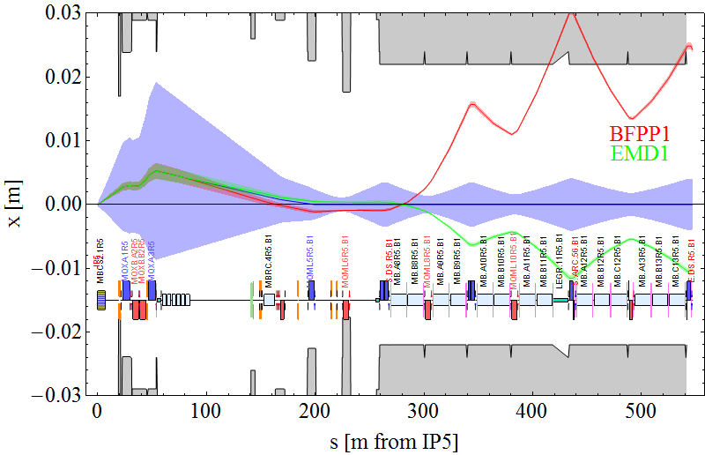
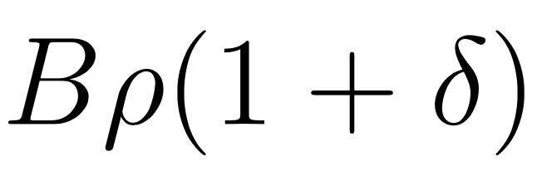
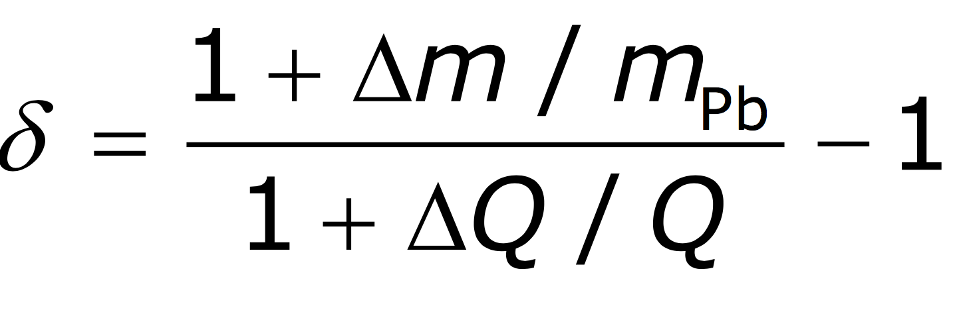
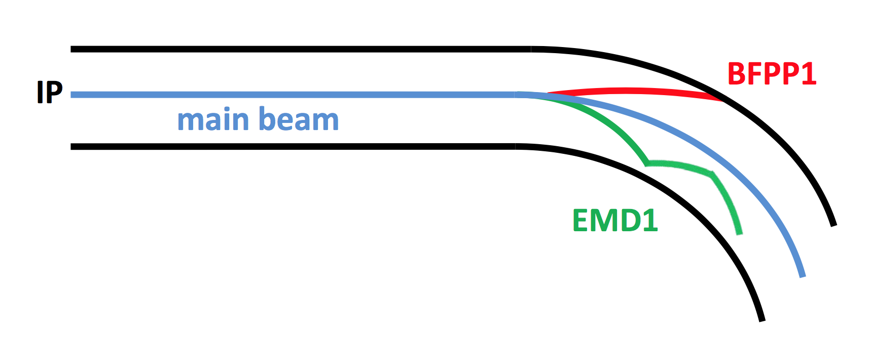

Secondary Beams Created in the Collision
These reactions change the charge-to-mass ratio of the ions, which changes bending in (main) dipoles: $Bρ=p/q$
Secondary Beam Paths right of IP5
Secondary beams with
rigidity change
where
Main: 208-Pb-82+
BFPP: 208-Pb-81+
EMD: 207-Pb-82+
Intense secondary beams are produced that impact in a superconducting magnet downstream from the IP.
Luminosity limit,
if deposited power exceeds quench limit.

Slide 18
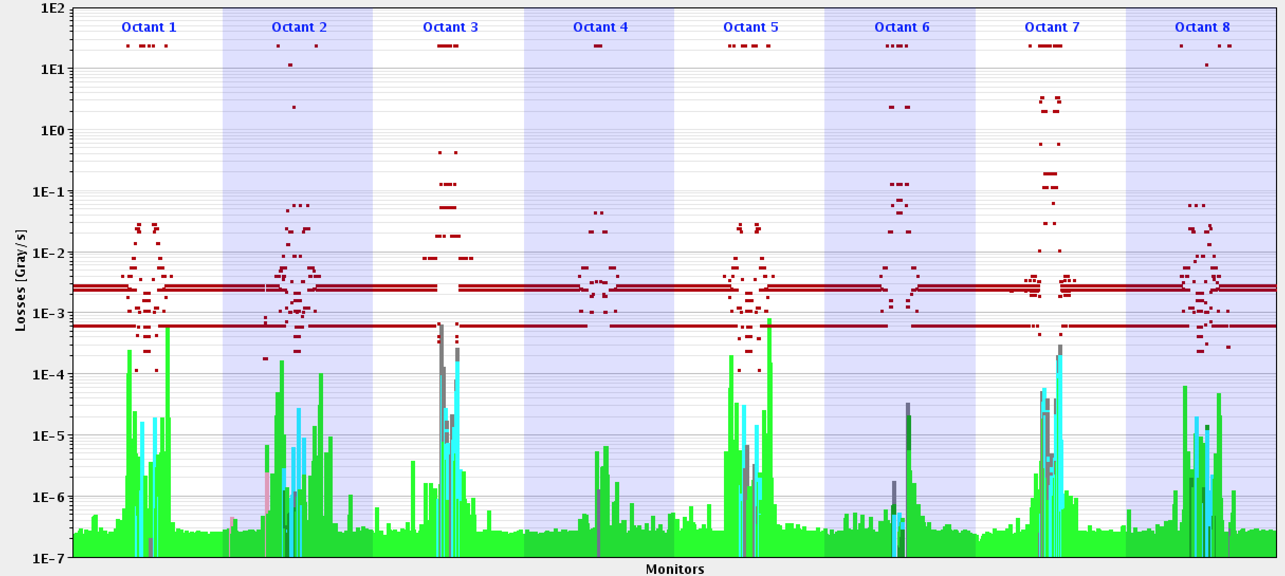
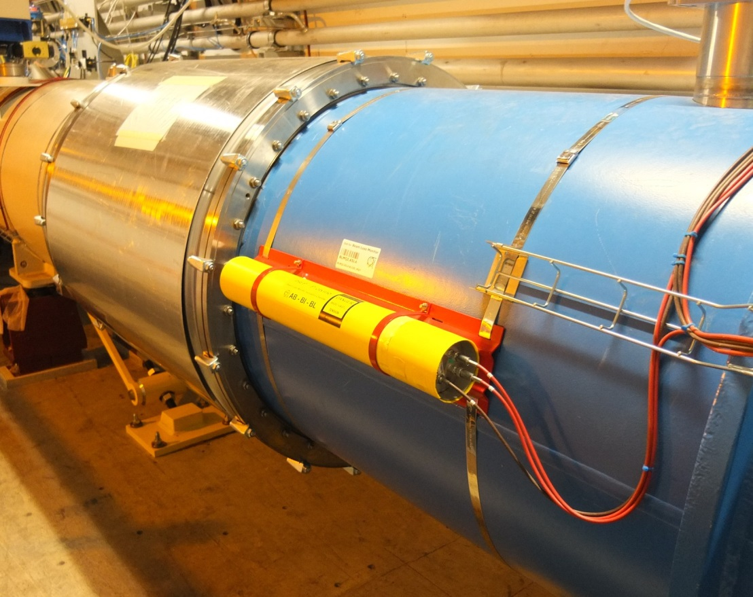
Loss Pattern around the Ring
Direct limit of luminosity
Beam loss spikes around all IPs where ions collide …
Deposit power >140W → exceeds quench limit of the superconducting magnets.
Luminosity limit found at L≈2.3 x 10²⁷cm⁻² s⁻¹ (≅50W into magnet)
BFPP
BFPP
BFPP
BFPP
Collimation
Collimation
ATLAS
ALICE
CMS
LHCb
Heavy-Ion collimation discussed in detail in lecture by R.Bruce
Beam Loss Monitors all around LHC circumference

Slide 19
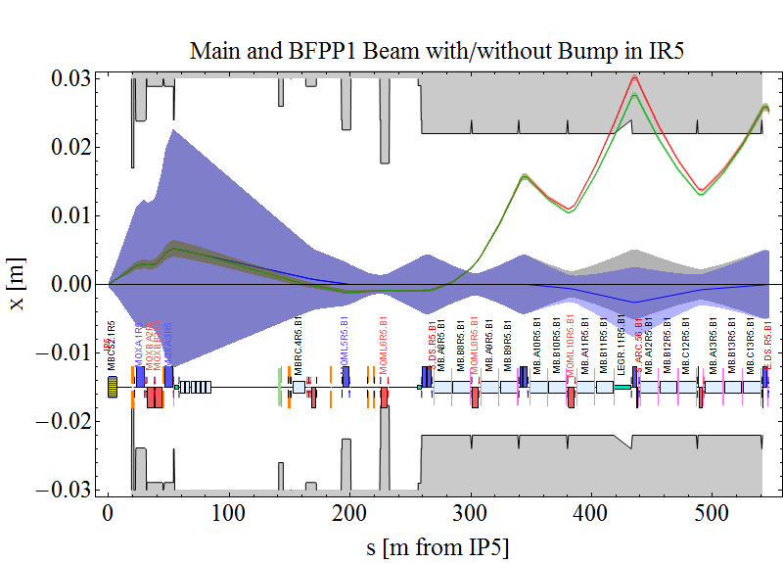
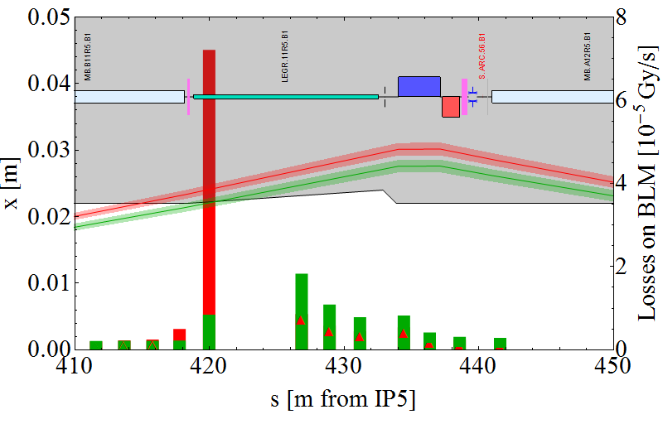
Quench Risk Mitigation with Orbit Bumps
Orbit bumps are used to move the secondary beam losses to a less vulnerable location in order to reduce risk of quench.
“missing dipole” cryostat
dipole
quadrupole
w/o bump
with bump
Particle losses
Careful setup of bumps in beginning of the run to achieve desired loss displacement.
Technique operationally used in ATLAS/CMS since 2015.
Allowed record luminosity of L > 6 x 10²⁷ cm⁻² s⁻¹ in 2018.

Slide 20
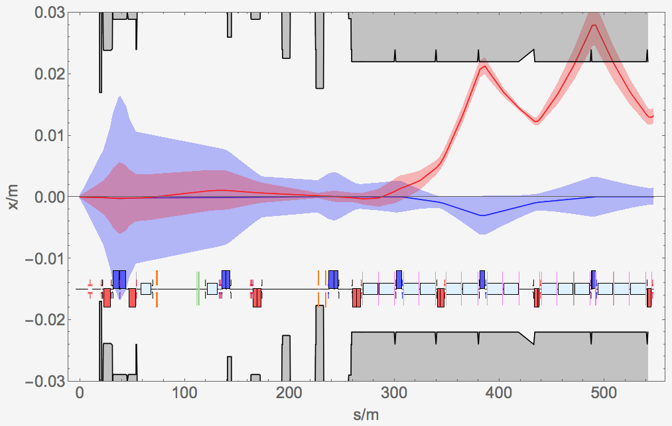
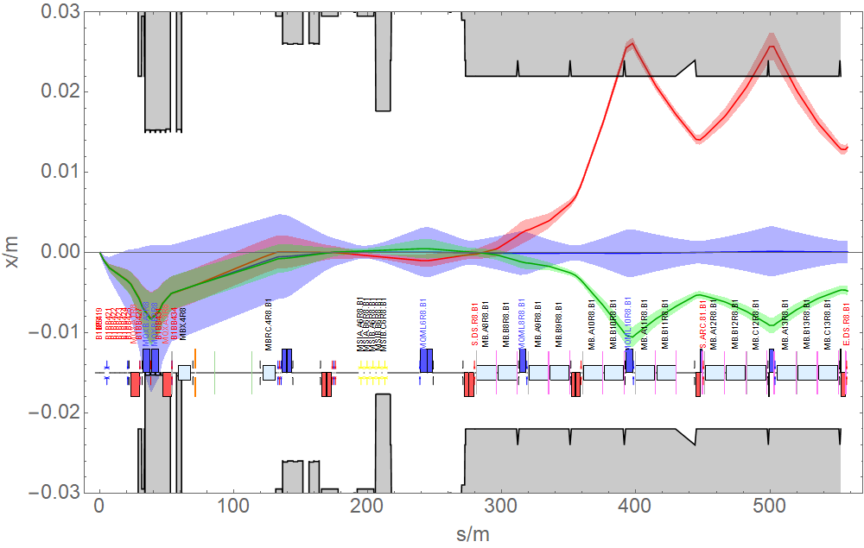
BFPP Mitigation around ALICE & LHCb
Due to different optics around ALICE and LHCb, bump technique does not work.
ALICE
Peak luminosity limited by detector saturation to 1 x 10²⁷cm⁻²s⁻¹.
Bump to distribute losses over two cells.
LHCb
No mitigation implemented.
75ns bunch scheme provides many more collisions in LHCb.
Peak luminosity levelled 1 x 10²⁷cm⁻²s⁻¹
ALICE (IP2)
LHCb (IP8)
Empty cryostat
Empty cryostat

Slide 21
BFPP Mitigation around ALICE & LHCb – LS2 Upgrade
Due to different optics around ALICE and LHCb, bump technique does not work.
ALICE
Currently implementing upgrade
Will allow to go to ~7 x 10²⁷cm⁻²s⁻¹
Installation of collimator in the empty cryostat location + orbit bump.
LHCb
No mitigation foreseen.
75ns bunch scheme provides many more collisions in LHCb.
Peak luminosity levelled 1 x 10²⁷cm⁻²s⁻¹
ALICE (IP2)
LHCb (IP8)
Empty cryostat
Collimator
More about secondary beams & their treatment discussed in lecture by F. Cerutti

Slide 22
Getting Ions into the LHC
LHC
Beam 2
Beam 1
SPS
Importance of the Injector Chain
PS
LEIR

Slide 23







How Ions get into the LHC
D. Küchler holding the source of Pb
LINAC 3
Low Energy Ion Ring (LEIR)
Beam 2
Beam 1
Proton Synchrotron (PS)
LEIR electron cooler built in Russia, at BINP
Super Proton Synchrotron (SPS)
LHC

Slide 24

Accelerator Cycle (Fill)
Beam Energy
Top (max) Energy:
Store & Collide (LHC)
Low energy injection plateau:
Accumulation of beam
Acceleration
Injector cycles (e.g. PS or SPS) are analogous except: collisions → extraction

Slide 25
Filling Pattern: Production of Beam in the Injectors
100ns train structure (2015)
Train
Bunch
PS-Batch
100ns
100ns
150ns
150ns
450ns
LEIR-batch
LHC
Filling scheme: How bunches are placed in the LHC defines which bunches collide where.
Due to symmetry and detector position not all bunches collide in each experiment.
Play with:
Number of PS-batches per SPS-train
Position of SPS-trains in LHC
(Separation levelling)
to get fair luminosity sharing.
accumulates m SPS-trains
Beam 2
Beam 1
SPS
accumulate n PS-batches
Split into 4 b
define bunch spacing
PS
2 bunches
LEIR

Slide 26
Filling Pattern: design → 100ns → 75ns
Reduction of PS-batch spacing by 30% (!)
Thanks to improvement of SPS injection kicker rise time
Design train structure
Bunch
PS-Batch
100ns
100ns
225ns
225ns
525ns
Bunch intensity >3x design
Improvement of performance throughout injector chain
100ns train structure (2015)
Bunch
PS-Batch
100ns
100ns
150ns
150ns
New 3-bunch scheme with reduced bunch spacing out of LEIR and no splitting in PS.
450ns
75ns train structure (2018)
Batch
75ns
Bunch
150ns
150ns
more bunches
Higher bunch intensity
300ns

Slide 27

LHC Pb-Pb Bunch Intensities
min. 1.8E8 Pb-Ions
mean 2.2E8 Pb-Ions
max. 3E8 Pb-Ions
Design (7E7 Pb-Ions)
Injectors provided intensities far above the design.
Typical structure:
Along bunch train, due to losses at the SPS injection plateau.
Along the beam, similar losses in the LHC.
Max. total number of bunches per beam: 733
Design
Screenshot from 2018 operation: bunch intensities at top energy just before collisions

Slide 28
Beam and Luminosity Evolution
Performance Details

Slide 29



Intensity and Emittance Evolution
Beam intensity decay dominated by burn-off (losses from production of collisions)
Beam Intensity
Horizontal
IBS counteracts radiation damping in horizontal plane
Vertical
In vertical, IBS is negligible
→ rad. damping leads to shrinkage
Emittance
Bunch length similar behavior to horizontal emittance
Bunch Length

Slide 30




Typical Luminosity Evolution in 2018
Each experiment has individual requirements: max. Luminosity, $β^{∗}$, crossing-angle, …
→ Separated machine setup per IP, luminosity levelling, luminosity sharing
ATLAS & CMS:
$β^{∗}$= 0.5m, $θ_{c}=170μ$rad
Short levelling period
Record: 6.1 x 10²⁷cm⁻²s⁻¹ peak luminosity
ALICE:
$β^{∗}$= 0.5m, $θ_{c}=60μ$rad
Levelled to design saturation level most of the time in physics.
Upgrade to ~7 x 10²⁷cm⁻²s⁻¹ in LS2.
Design
LHCb:
$β^{∗}$= 1.5m, $θ_{c}=250μ$rad
Also levelled to design value
LHC Pb-Pb design luminosity was chosen to be the detector saturation value of the ALICE experiment.

Slide 31


A (typical) LHC Ion Run
51% Stable Beams
35% Operation
Overview of the 2018 Pb-Pb run
Availability
87%
1% Pre-Cycle
13% Fault
30 days
Ion source fault
no ions available
Intensity ramp-up 100ns beams
New Record Peak luminosity in every fill up to 6.1 x 10²⁷cm⁻²s⁻¹
1st Pb-Pb
Stable Beams
ALICE polarity switch
1st source refill
2nd source refill

Slide 32

Status LHC → HL-LHC
Most of HL-LHC performance demonstrated!
 | Pb-Pb (Design) | Pb-Pb (2018 achieved)
Energy [TeV] | 7 Z | 6.37 Z
$β$* at IP (1/2/5,8) [m] | (0.5, - ) | (0.5, 1.5)
Emittance [$μ$m] | 1.5 | ~2
Bunch Intensity [10⁸ ions] | 0.7 | 2.2
No. Bunches | 592 | 733
Bunch Spacing | 100ns | 100ns → 75ns
Peak Luminosity at IP1/2/5/8 [10²⁷cm⁻²s⁻¹] | - / 1 / 1 / - | 6.1 / 1 / 6.1 / 1
”HL-LHC” Pb-Pb (after LS2) | Upgrade Status
7 Z |  | Magnet training
(0.5, 1.5)
1.65
1.8
1232 |  | SPS RF Upgrade (slip-stacking)
50ns
7 / 7 / 7 / ? |  | Lumi levelling
Green values reached & exceeded LHC design
Some collisions in LHCb (not considered in detail yet)

Slide 33


Delivered Luminosity: Pb-Pb
LHC design goal of 1nb⁻¹ in Pb-Pb luminosity already exceeded.
J.M. Jowett
1nb⁻¹
Future performance estimate from 2021:
  3 nb⁻¹/run → 12 nb⁻¹ in 4 more Pb-Pb runs
Weeks of luminosity production
Weeks of luminosity production

Slide 34
COLLISION Mode Upgrades
LHC has operated in 5 different modes, but was designed only for 2:
  Design: p-p, Pb-Pb
  Upgrade: p-Pb, Xe-Xe (pilot run), Pb81+ (MD in July)
Few hours runs with new particle types showed that the LHC is highly flexible and well under control.
Demonstrating Flexibility

Slide 35
Proton-lead
p-Pb

Slide 36













Storing and Colliding Different Species
Revolution time and RF frequency depend on particle’s mass m, charge Q=Ze:
where harmonic number h_{RF} = 35640 in LHC
Relation between momenta is fixed by two-in-one magnet design: → →
But in order for bunches to meet repeatedly and create collisions we need: →
Use length of closed orbit C to compensate for speed difference.
Done by adjusting RF frequency → moving to (slightly) off-momentum orbit
  Pb is slower, need smaller orbit length → move inward, $δ<0$
  Protons are faster, need longer orbit length → move outward, $δ>0$
  Horizontal offset given by dispersion:
momentum of offset orbit
Fractional momentum difference
Phase-slip factor,
$γ_{T}=55.8$ for LHC optics

Slide 37





Momentum Offset required through Ramp
Minimize needed aperture → take average $f_{RF}$ of both beams and share required momentum offset:
2% - would move beam by 35 mm in QF!!
  Horizontal offset given by dispersion:
$D_{x}$ (Quadrupole) $≈$ 2m
Limit with pilot beams
Limit in normal operation
(1 mm in arc QD)
~ 38 mm
~500$μ$m offset from central orbit at 6.5 Z TeV
~ 47 mm
Revolution frequencies must be equal for collisions at top energy.
Lower limit on beam energy for p-Pb collisions, E=2.7 Z TeV.
RF frequencies must be unequal for injection, ramp!

Slide 38

Un-equal Frequency Injection and Ramp
Both beams circulate on the central orbit, but with un-equal frequencies.
Arrive at different times in the IP – missing synchronization for collisions in every turn.
At injection and during energy ramp beams are always kept separated to avoid collisions anyway.
When being accelerated, the speeds of the two species approach each other.
RF frequency program during p-Pb energy ramp
protons
35 Hz
4655 Hz
At injection the proton beam makes 8 more revolutions per minute than the Pb beam
Pb
0.45 TeV
6.5 TeV

Slide 39

Top Energy: Cogging and Collisions
At top energy (min. 2.7 Z TeV):
Equalize revolution frequencies for collisions → move beams to off-momentum orbit.
Cogging: RF re-phasing to re-establish synchronization of bunch arrival times in IP (see video).
Squeeze and Collide
Real-time clock
RF cogging by Philippe Baudrenghien
Video shows the difference in arrival time of the bunches at IP1, taking Beam 1 (blue) as reference.
Timing data from BPTX beam position monitor during first cogging exercise in LHC (now its done faster), video by Thilo Pauly (ATLAS)

Slide 40

History and Performance of p-Pb Collisions at LHC
Long considered desirable by experiments but never included in LHC baseline design.
2005: First estimates
2011: Preparation of LHC + feasibility test
2012: Physics case document + Pilot-run (one night)
2013: 1st full physics runs
2016: 2nd run with multiple collision conditions
J.M. Jowett
“design”
 | ATLAS/CMS | ALICE | LHCb
2016 | 190 nb⁻¹ | 40 nb⁻¹ | 30 nb⁻¹
Total | 222 nb⁻¹ | 72 nb⁻¹ | 35 nb⁻¹
Future performance estimate:
  ~700 nb⁻¹/run (ATLAS/CMS)
  ~350 nb⁻¹/run (ALICE levelled)
Weeks of luminosity production
Weeks of luminosity production

Slide 41
Unforeseen Operational Modes

Slide 42


Xe-Xe Collisions
Lighter ions are not part of the present HL-LHC baseline.
  Potential for higher nucleon-nucleon luminosities
  (smaller el.mag. cross-sections)
17h of low-intensity running with Xe beams in 2017.
  Demonstrated the feasibility to operate with other species.
  Great physics outcome fed the interest in lighter ions for HL-LHC era
Beam Intensity
Magnetic Cycle
Xe-Xe Event in ALICE detector
Total period of LHC
Xe-Xe Operations
18 hours

Slide 43


Partially Stripped Ions
Physics Beyond Colliders
The Gamma Factory initiative proposes to use partially stripped ion (PSI) beams as drivers of a new type, high intensity photon source.
Initial beam tests with PSI beams have been executed in the SPS in 2017/18.
In 2018 the LHC injected, accelerated and stored lead ions with one remaining electron (208Pb81+) for the first time.
-
²⁰⁸Pb⁸¹⁺

Slide 44



Partially Stripped Ions
Synchrotron Light Monitor
A few Pb81+ bunches circulated at 6.5 Z TeV with beam lifetimes of ~40 hours.
Losses at FT
Loss maps
4%
Worst collimation cleaning efficiency ever observed. Introduces dominant limit of the beam intensity.
2h
N. Fuster Martinez
Electrons are stripped off at first interaction with collimators leading to a change of rigidity outside acceptance:
→ Pb82+ lost in cell 11R7.

Slide 45
Take home message …
The LHC is highly flexible: has
operated in 5 modes but was designed for 2
Design: p-p, Pb-Pb
Upgrade: p-Pb, Xe-Xe, Pb⁸¹⁺
extraordinary injector performance
optimizations between & during runs
Rapid switching between modes
The LHC Heavy-Ion performance is much higher than originally foreseen.
Control of heavy-ion beam losses, like collimation & BFPP, is critical, complicated and may surprise.
“first 10-year” Pb-Pb luminosity goal of 1nb⁻¹ has been exceeded
demonstrated
“HL-LHC” peak luminosity performance
Heavy ions will come back to the LHC end of 2021 after the injector and LHC hardware upgrades with the “HL-LHC” configuration.

Slide 46

Everything clear! Hmm ….

Slide 47
Mass of ions/nuclei
In general an ion is described by
charge Qe
(Lorenz-Invariant or rest) mass m
nucleon number ("mass number") A.
Mainly collide fully-stripped ions, bare nuclei → Q = Z (charge or proton number)
in LHC we use ²⁰⁸Pb⁸²⁺ with
Z = 82
A = 208
m_{208-Pb-82+} = 207.976652071u - 82m_{e}
= (193.729 - 82 x 0.000511) GeV / c²
= 193.687 GeV / c²
N.B. 208m_{p} = 195.161 GeV / c² is a poor approximation!
For this species the binding energy of the 82 electrons < 1 MeV.
1u = 931.49410242(28) MeV

Slide 48


Critical difference between RHIC and LHC
RHIC: Independent bending field for the two beams – they abandoned equal-rigidity and switched to equal-frequency d-Au.
LHC: Identical bending field in both apertures of
two-in-one dipole – no choice

Slide 49

The Idea of a Gamma Factory
LASER photon
1.) Resonant absorption of the laser photons by the Partially Stripped Ion (PSI) beam.
e-
Nucleus
2.) Followed by a spontaneous atomic-transition emissions of secondary photons.
Secondary photon
LASER photon strongly boosted by (2$γrel$)² → For LHC energy, photon energy exceeds those reachable for FEL at high light intensity.

Slide 50

Slip-Stacking
Technique to obtain effective 50/50ns bunch spacing within Pb trains. Builds together with LEIR intensity upgrade the new LIU baseline option.
The SPS is filled with 2 ”super-batches” of 6 x 4-bunch-PS-batches with a bunch spacing of 100ns.
The 2 super-batches are captured by two independently controlled 200MHz cavity systems.
Decelerate first super-batch, accelerate second super-batch.
Batches are allowed to slip until they interleave.
Bring back to same energy.
Recapture at an average RF frequency.

Slide 51
Collisions in LHCb
LHCb interaction point is displaced by 15 buckets (=37.5ns) with respect to symmetry point.
In order to have a collision in LHCb a long-range (LR) beam-beam encounter is required at a distance of 37.5ns or 11.25m away from the symmetry point.
Long-range beam-beam encounters occur at s = n x ½ bunch spacing:
25ns bunch spacing → LR @ 12.5ns, 25ns, 37.5ns … → collisions in LHCb
50ns bunch spacing → LR @ 25ns, 50ns … → need to displace a train of bunches to create collisions
75ns bunch spacing → LR @ 37.5ns, 75ns … → collisions in LHCb
100ns bunch spacing→ LR @ 50ns, 100ns … → need to displace a train of bunches to create collisions
IP8
Symmetry point
37.5 ns
75ns

Slide 52
BLM-System
The Beam Loss Monitor (BLM) System measures secondary particles from beam losses all around LHC circumference.
LHC dipole
Ionisation chamber

Slide 53


Particle Losses around the Ring
Before collisions
IP1, IP2, IP5
colliding

Slide 54

Notations – Energy of ions/nuclei and nucleons
Energy and momentum are related via the square of the 4-momentum vector,
P = (E / c , p),
where m is the Lorentz-invariant mass (rest mass) of the nucleus.
Nucleus of
charge Ze
(rest) mass m
nucleon number A
Traditionally, in low-energy ion accelerators, the kinetic energy per nucleon is quoted in parameter lists:
but this quantity does not appear in any equation of motion!
at high energy
At LHC (highly relativistic case) we use:
Energy per charge,
relation to proton energy
Energy per nucleon
Energy of the particle

Slide 55



Derive Center-of-Mass Equations for Collisions of two Species
Center-of-Mass Energy
Center-of-Mass Energy per nucleon

Slide 56

Luminosity Bunch-by-Bunch
The total luminosity in 1 experiment
is the sum over all colliding individual bunches of the 2 beams:

Slide 57
Integrated Luminosity Prediction per Pb-Pb run
For a 24-day run, with 3 experiments at β*=0.5 m, assuming (pessimistically) an operational efficiency of 50% and average luminosity of 3E27 cm⁻² s⁻¹, the total luminosity is
L_{int,annual} = (50%)(3.0 × 10²⁷ cm⁻²s⁻¹ )(24 day) ≈ 3.1 nb⁻¹
(c.f. target of 2.85 nb⁻¹)
→ 12 nb⁻¹ in the 4 Pb-Pb runs
foreseen after LS2

Slide 58
Integrated Luminosity Prediction per p-Pb run
Assuming
  a turnaround time of 2.5 h (optimistic!)
  operational efficiency of 50%,
  and optimal fill length of 6.1 h,
The total luminosity in 1 month of p-Pb running is estimated to
  714 nb⁻¹ for ATLAS/CMS
  346 nb⁻¹ for ALICE

Slide 59
Getting protons into the LHC
Protons on the way to LHC
Beam 2
Beam 1
Year Top energy Length
[GeV] [ m ]
Linac 1979 0.05 30
PSB 1972 1.4 157
PS 1959 26.0 628
SPS 1976 450.0 6’911
LHC 2008 7000.0 26’657

Slide 60


Luminosity Production
Steady increase of luminosity/fill
ALICE Polarity switch
ALICE Polarity switch
No. of bunches & bunch intensities
Levelling targets (ATLAS/CMS/LHCb)
Levelling time (after solving ALICE beam size problem)
Increasing
Source: http://lpc.web.cern.ch/

Slide 61
Levelling “a la carte”
Under certain conditions and depending on the experiments request, it is desirable to adapt the luminosity dynamically with beams in collision – luminosity levelling
Levelling by beam offset
Levelling by crossing angle
Levelling by β* (= beam size at IP)
Complexity

Slide 62


Slide 63





Intra-Beam Scattering
See lecture by V. Kain
Intra-Beam Scattering Growth Rates
A. Piwinski’s formalism
Complicated Integral, to be evaluated numerically at each element of lattice
Dynamic change with beam parameters
Dependency on lattice and beam parameters

Slide 64






Radiation Damping
See lecture by V. Kain
The average energy loss into synchrotron radiation in a circular accelerator leads to damping of the transverse and longitudinal emittances like
Emittance radiation damping rates
For an isomagnetic ring with separate function magnets and D_{y}=0:
Note:
1.) Independ of beam parameters.
2.) Depend on Energy³, machine size and particle type.
3.) In this approximation, longitudinal damping is twice as fast as transverse:
4.) Rad. damping for Pb 2x faster than for protons: $α_{rad,xy}=12h$
5.) Fast enough to overcome IBS at full energy and intensity

Slide 65
Xe-Xe Collisions
Data used to estimate future running.
Lighter ions have potential for significantly higher nucleon-nucleon luminosity:
  Expect higher bunch charge in the injector chain
  Lower cross sections for ultraperipheral collisions
    → σ_{BFPP} ~ Z⁷, σ_{EMD} ~ Z⁴
  → Slower burn-off and longer fills, more ions left for usable luminosity
Number of neutrons
Number of protons
Beam Intensity
Magnetic Cycle
physics data taking
6 hours
Total period of LHC
Xe-Xe Operations
18 hours

Slide 66

Beam Evolution
A particle bunch is characterised by its number of particles, $N_{b}(t)$, and the emittances, $ε_{n,i}(t)$, in the three planes ($i=x,y,s$).
Intra-beam scattering (IBS)
Radiation Damping
Scattering during the collision
The bunch’s evolution with time is defined by a system of
4 coupled differential equations:
Many other, less important, effects.
Luminosity burn-off
(incl. secondary beams)
Losses from IBS
Collimation
$α$ are growth rates or inverse lifetimes, describing how fast the corresponding process changes a quantity.
The bunch’s evolution is usually obtained by (numerically) solving those differential equations, or by tracking simulations.

