Slide 1
Joint Experimental Laboratory Located at York
JELLY

Slide 2
„
“
Science knows no country, because knowledge belongs to humanity, and is the torch which illuminates the world.
Louis Pasteur
International Facility with Partners all around the globe

Slide 3
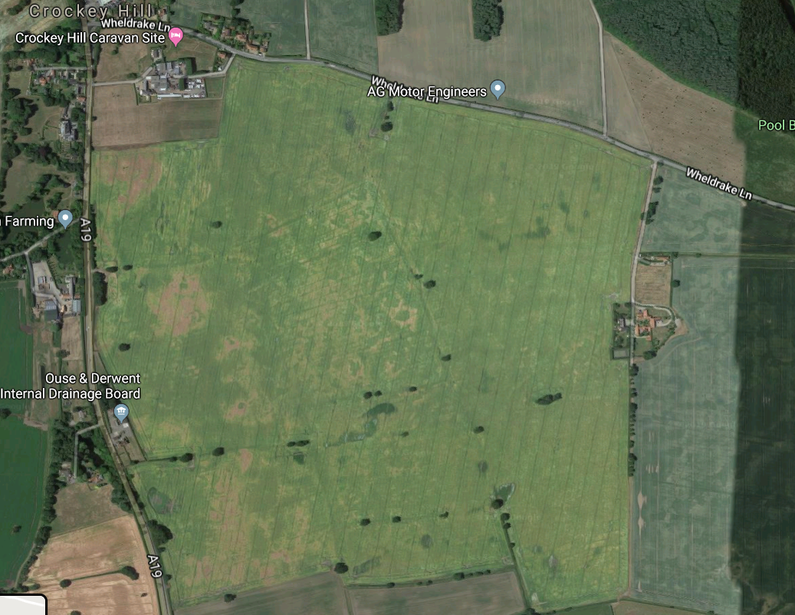
England will be the home for the first projekt of the JELLY.
The Proton-Deutoron - Ion Collider
p
d - I

Slide 4
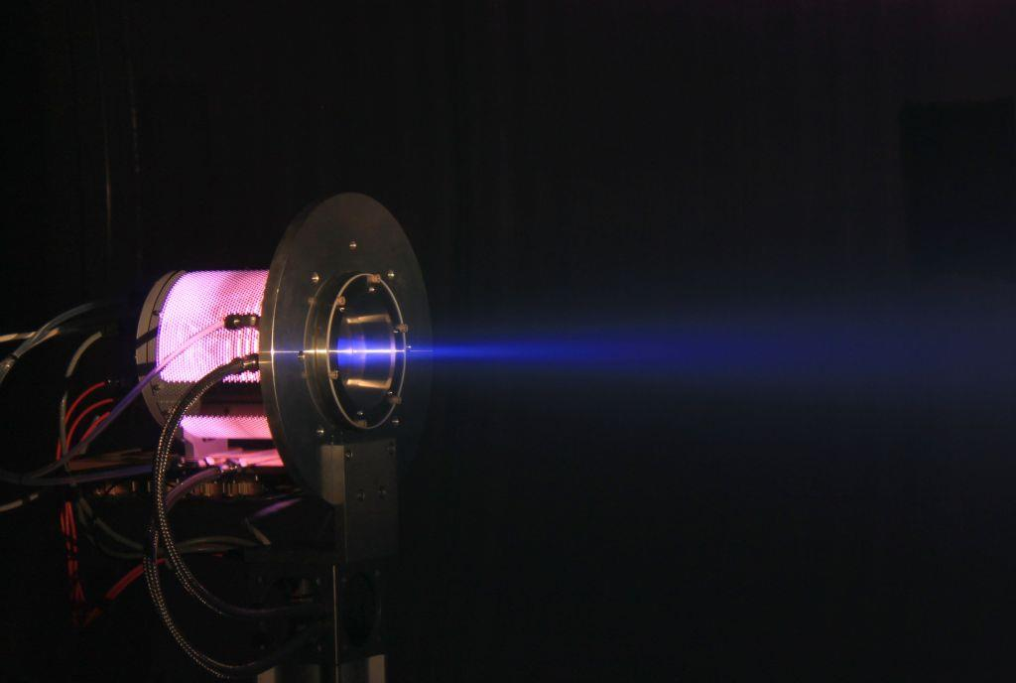
Ion Source

Slide 5
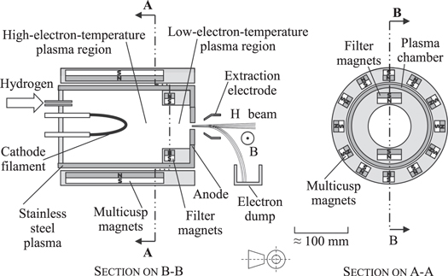
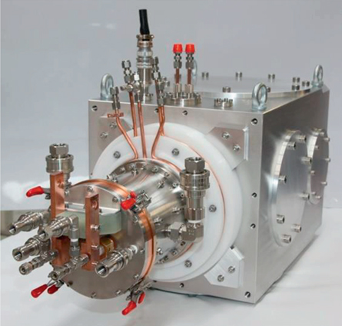
Ion Source
H⁻ D⁻ Volume Ion Source
N_{Pulse} = 1.5 ∙ 10¹¹
Energy 95 keV
Duty Cycle 4 Hz
(easier Injection with Stripper)
H₂ + e⁻ (fast) → H₂* + e⁻ (slow)
H₂* + e⁻ (slow) → H⁻ + H⁰

Slide 6
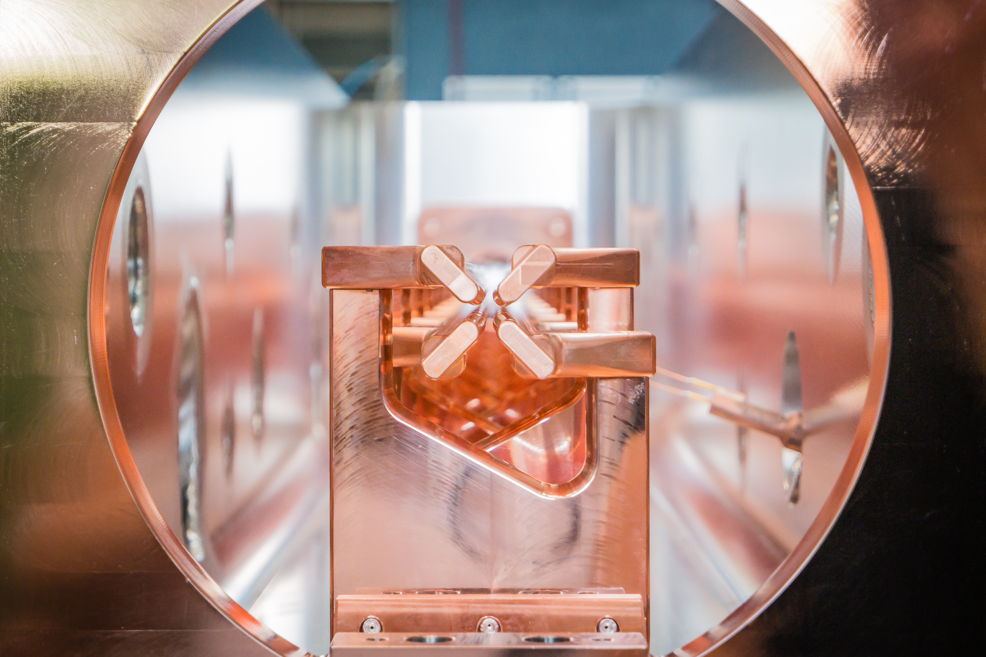
Linac

Slide 7
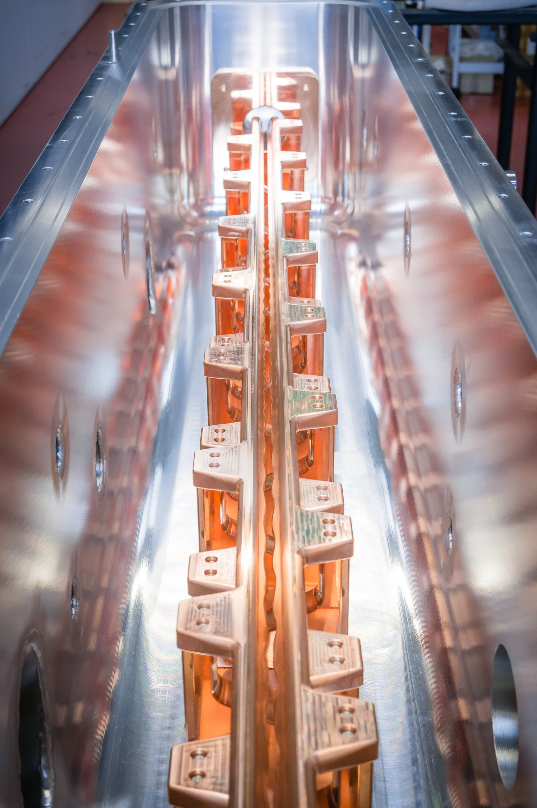
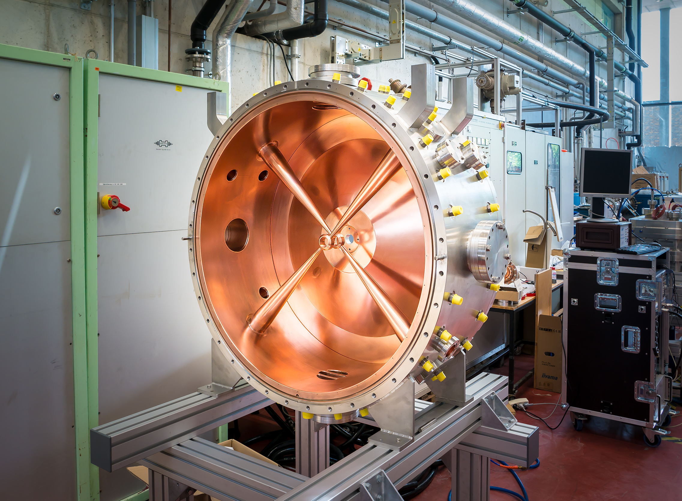
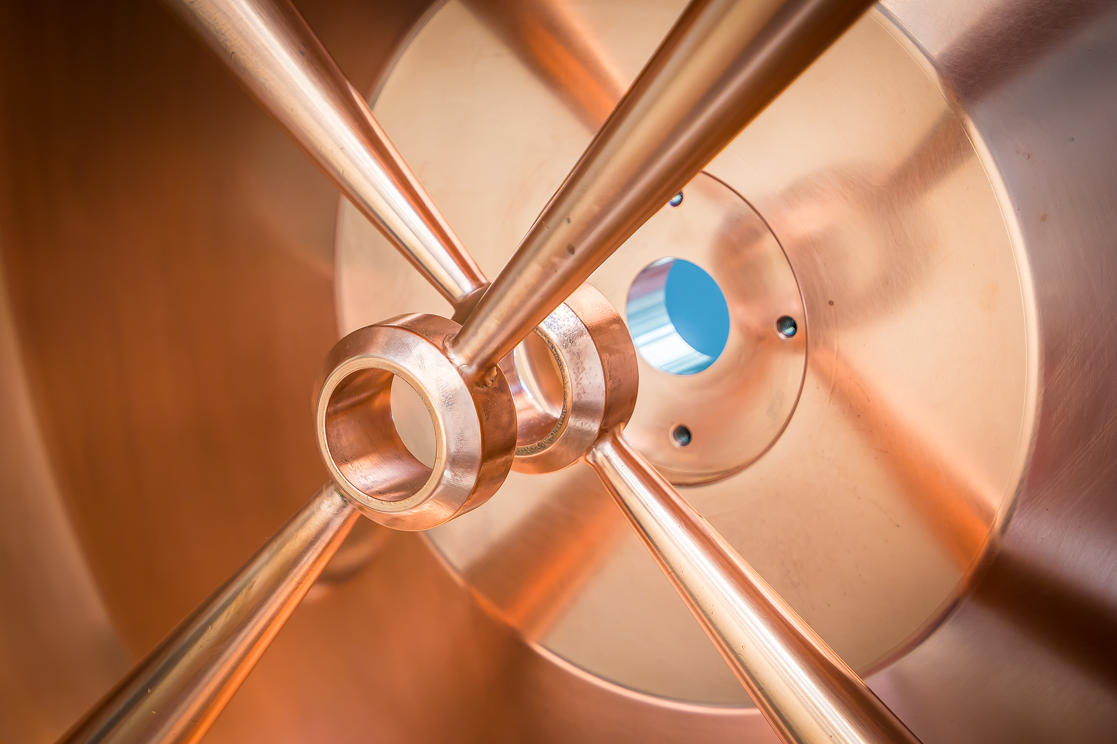
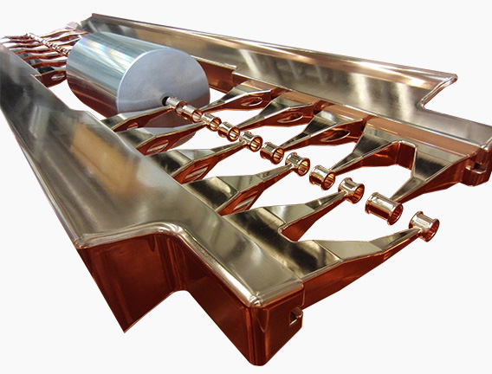
Linac
f = 200 MHz β_{in} = 0.01
L_{total} = 320 m β_{out} = 0.7
N_{Bunch} = 1.25 ∙ 10¹⁰
320 m
4 m
Consists of 2 Parts
Normalconducting Injector
Normalconducting Linac
Used Technology
4-Rod RFQ
NC IH-Cavities
NC CH-Cavities
40 m
276 m
4-Rod RFQ
IH-Cavities
CH-Cavities
0.095 MeV/u
1.5 MeV/u
10 MeV/u
400 MeV/u

Slide 8
Linac - Injection
H⁻ beam
Stripping foil
H⁻
H₀
p⁺
Circulating p⁺
Circulating p⁺
450 mT
Injection chicane dipoles
ABT Introductory Lectures, Verena Kain, JAS Dubna, Russia, 2019

Slide 9
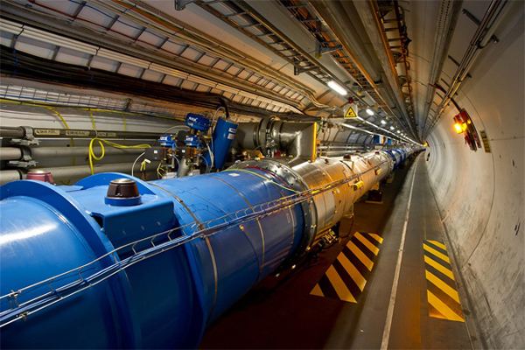
Ring - Parameter

Slide 10
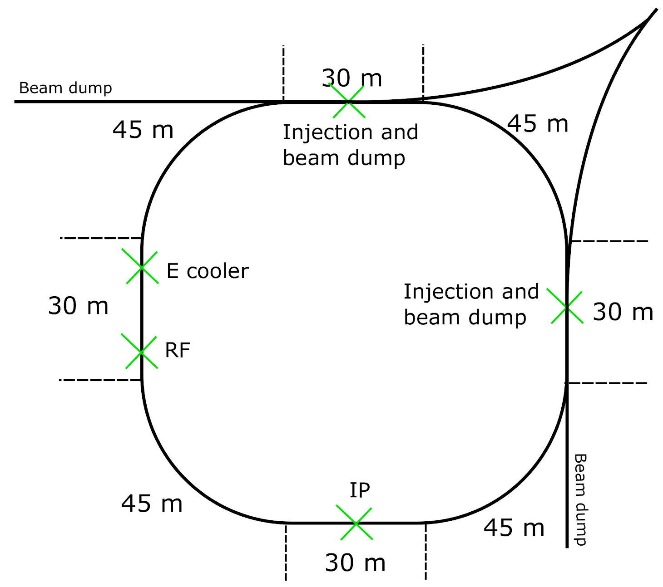
Ring - Parameter
Linac
2 Rings
Circumfrences both 300 m
Superconducting Dipoles
1 IP
Injection at 90°

Slide 11
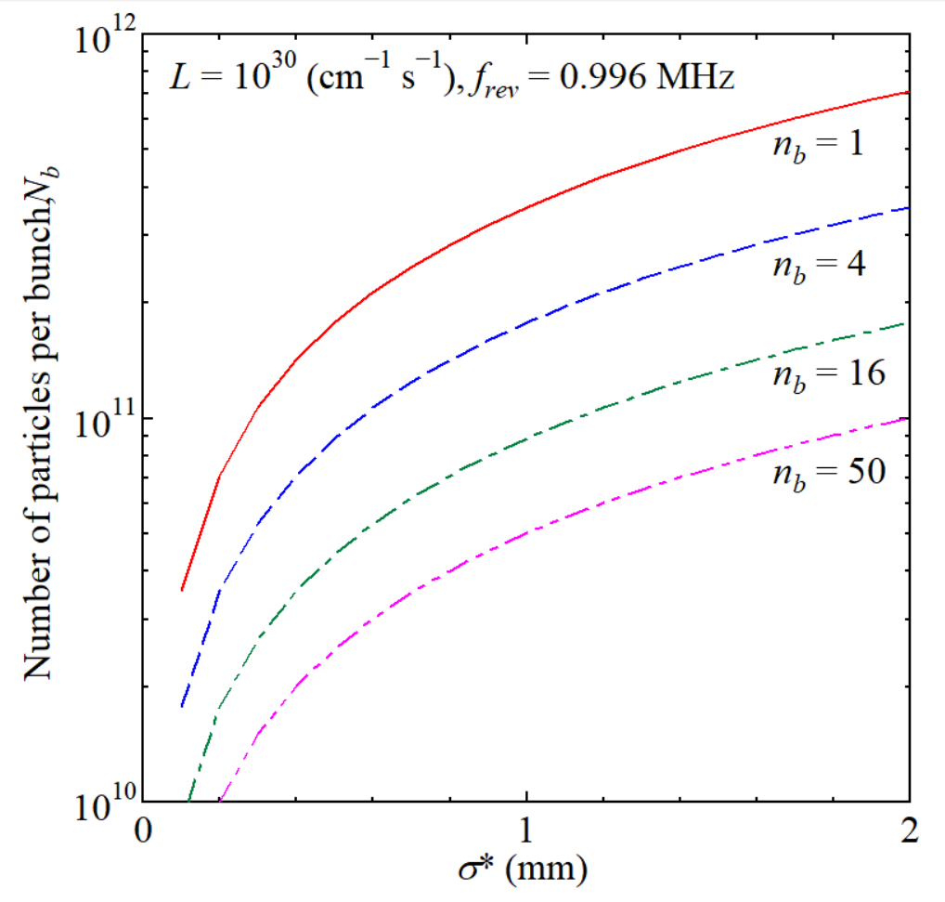
Ring - Parameter
N_{Bunch} = 50
n_{Proton} = n_{Deutoron} = 5 ∙ 10¹⁰ pB
ε_{x}(1σ) = ε_{y}(1σ) = 0.5 π mm mrad
β_{x}* = 2 m ; β_{y}* = 2 m
σ_{x,y} = 1 mm

Slide 12
Linac
F O D O - Lattice
Dipole length calculated from Bρ
3 FODO Cells per arc
3.2 m of Drift space for e.g. Diagnostics, Sextupoles, etc.

Slide 13
F O D O - Lattice
3 T/m

Slide 14
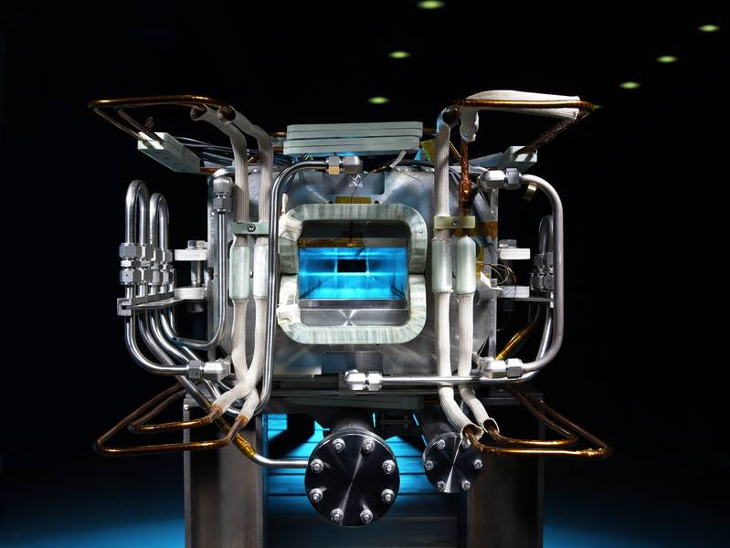
Superconducting Magnets

Slide 15
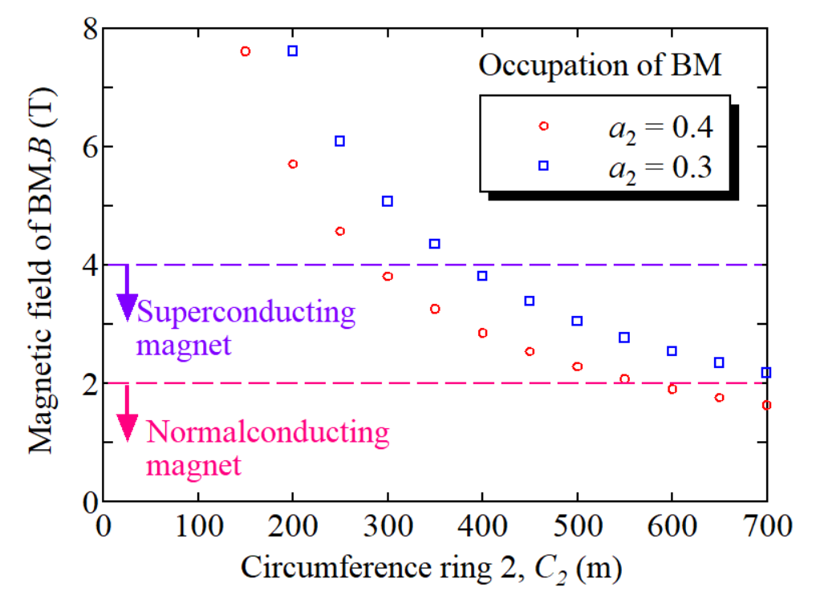
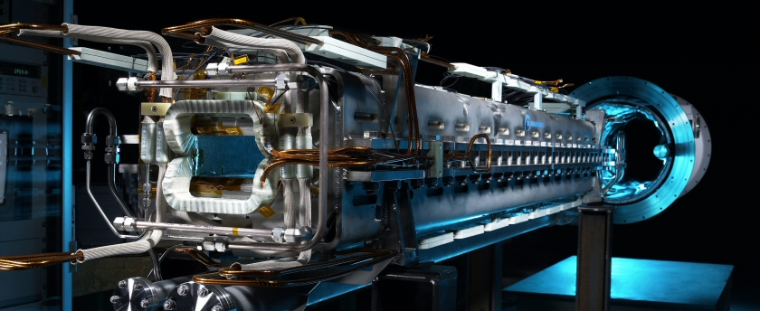
Superconducting Magnets
48 Dipols planned
L_{Magnet} = 4.75 m
2 T fo the P-ring
4 T for the D-ring
38% of the rings length
(24 each ring)

Slide 16
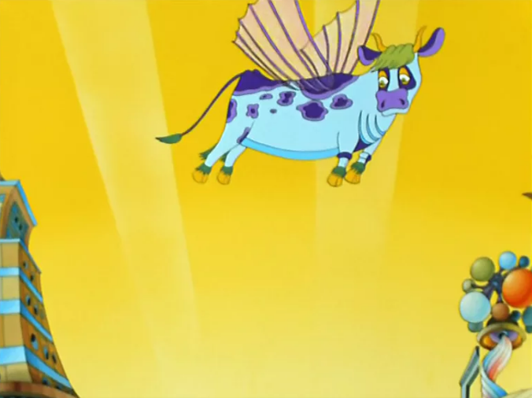
Superconducting Magnets
With the parameters
from the case study
but B = 4 T:
Cow flies now 23m high
23 m
(6 m for 2 T)

Slide 17
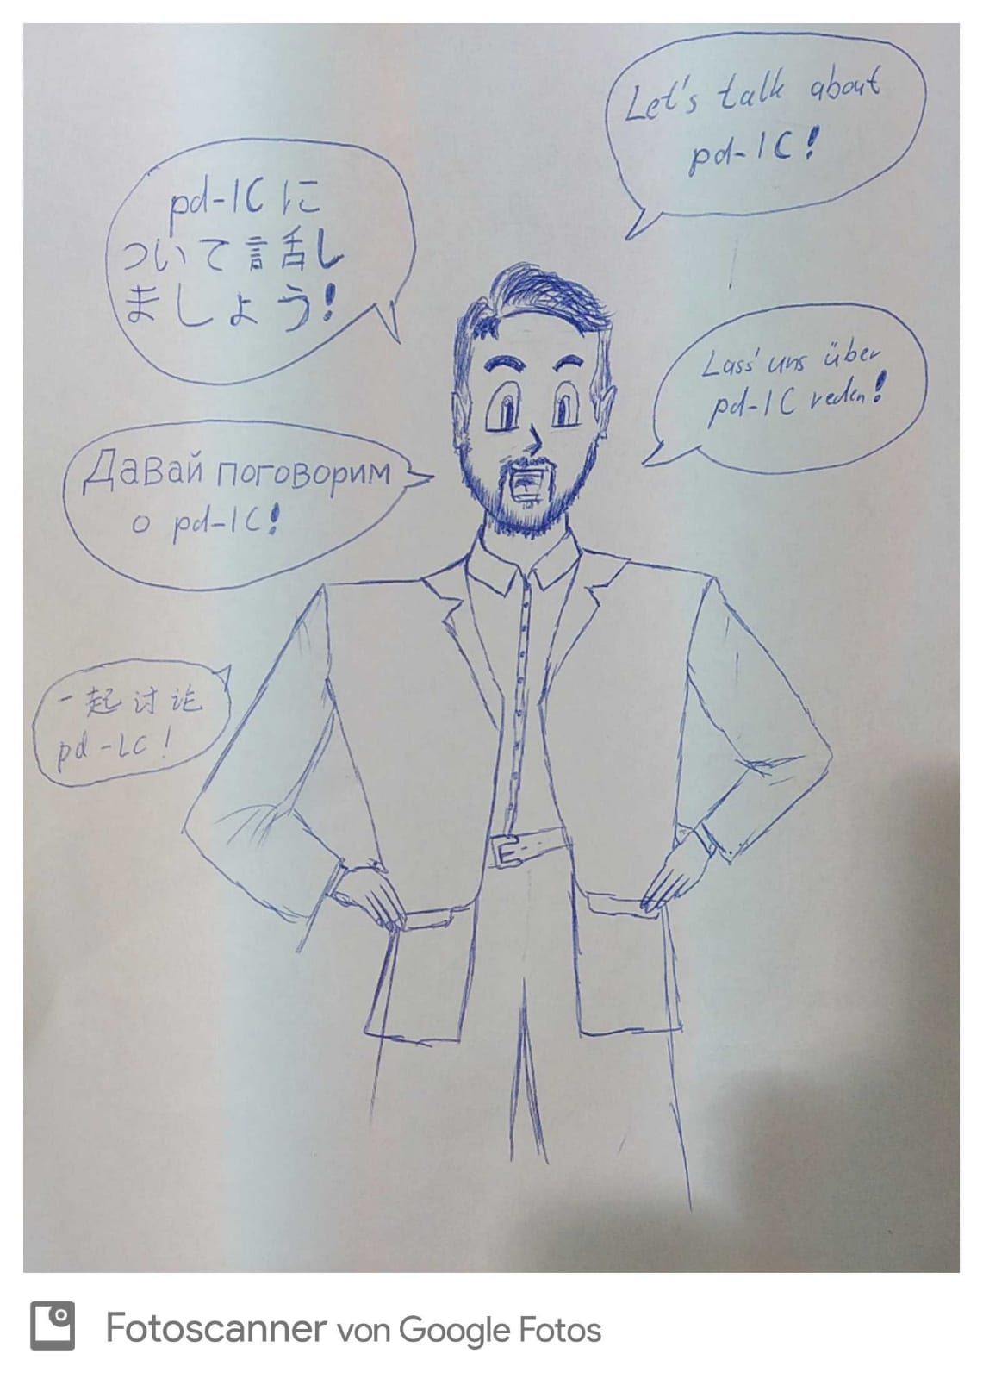
Thanks to all of You
Special Thanks to …
Mingxuan Chan
Thorsten Conrad
Georgy Filatov
James Hunt
Simon Lauber
Julian List
Fu Ma
Tsukasa Miyajima
Yana Samofalova
Michaela Schaumann
Aleksei Trifonov
Ippei Yamada
Takaaki Yasui

Slide 18
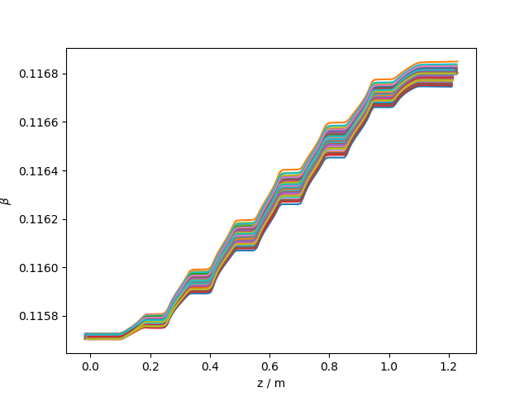
Back up

