Slide 1
Set parameters
Parameter | Value
$$C_{1}$$ | 800 m
$$C_{2}$$ | 800 m
Particle | $${Au}_{197}^{79+}$$
Luminosity | ${10}^{27}$ $\frac{1}{{cm}^{2}∙c}$
$$ε_{kin}^{lab}$$ | 1.0-5.0 $\frac{GeV}{u}$

Slide 2
$$m_{1},β_{1},γ_{1}$$
$$θ=−π$$
$${m_{2}=m}_{1},{β_{2}=β}_{1},γ_{2}=γ_{1}$$
$$A_{i}≡A=197$$
Head-on collision:
$$γ_{i}≡γ=2,066−6,33$$
CMS energy:
$$β_{i}≡β=0,875−0,987$$
$$⇒\sqrt{s}=\sqrt{2A^{2}m_{p}^{2}+2γ^{2}A^{2}m_{p}^{2}\left(1+β^{2}\cos{θ}\right)}c^{2}=\sqrt{1+γ^{2}\left(1+β^{2}\right)}\sqrt{2}Am_{p}c^{2}=2γAm_{p}c^{2}=3,876−11,876 GeV/u$$
Magnetic rigidity:
$$B_{ρ}=\frac{γβmc^{2}}{300}=48,7 kGs∙cm=48,7 T∙m$$

Slide 3
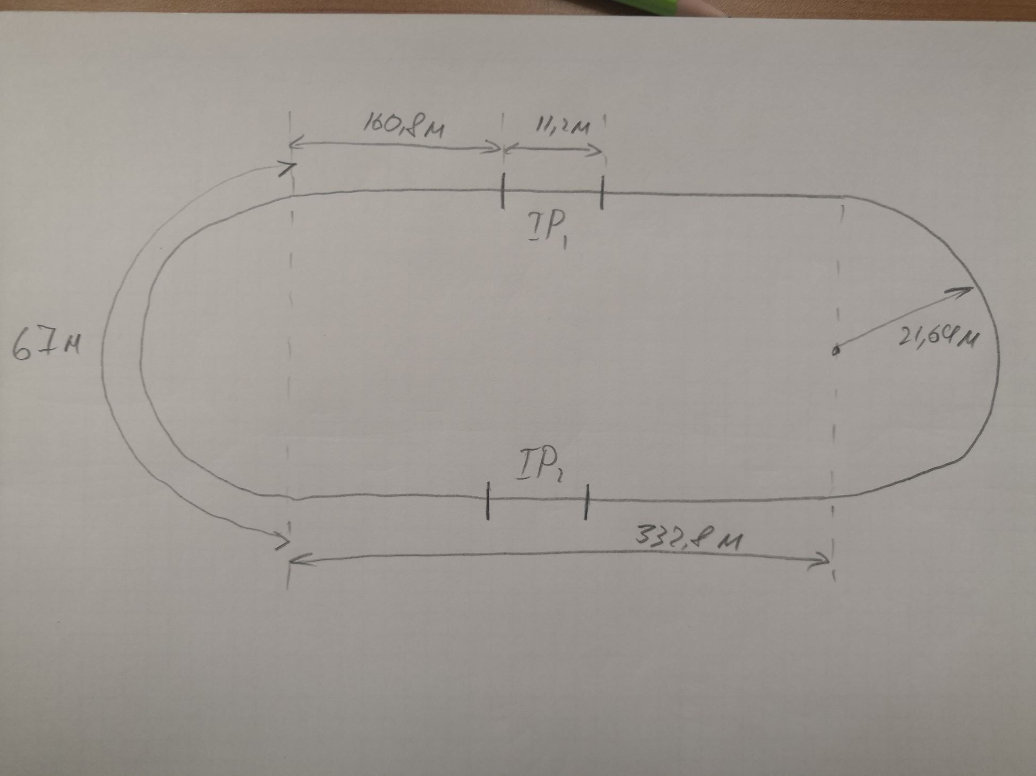
General scheme:

Slide 4
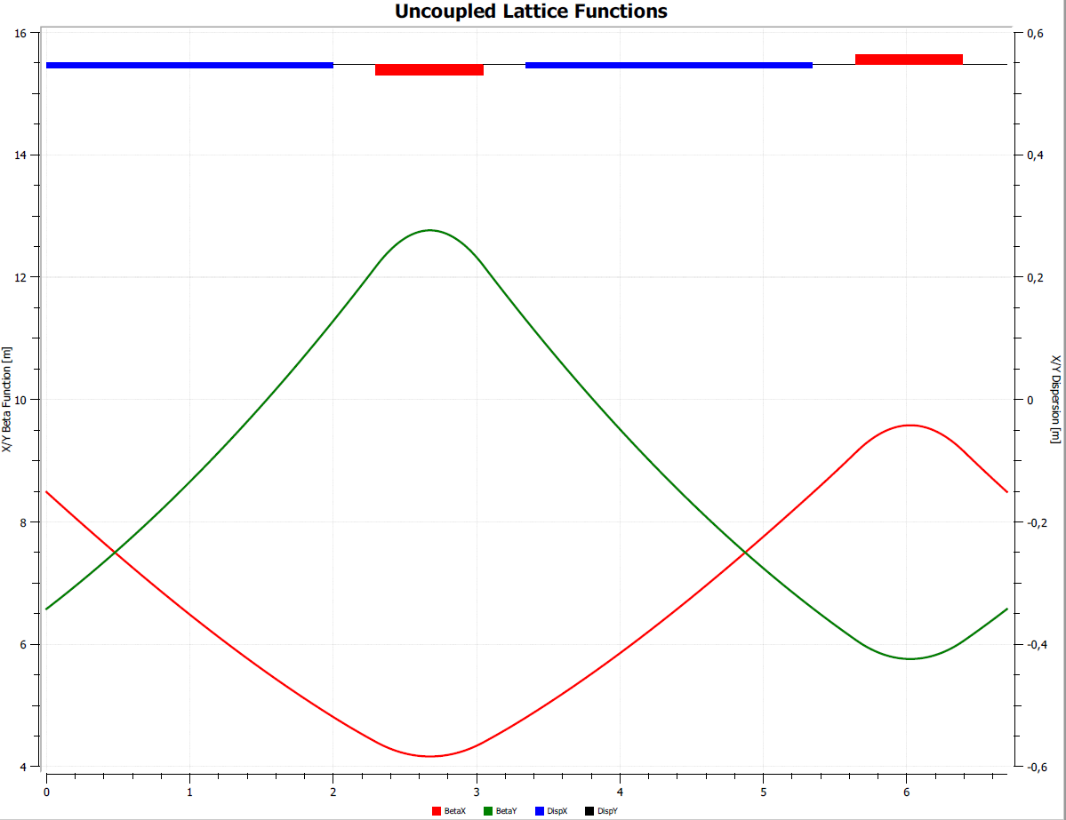
ARC beta-functions
Element | L, cm | B, T | G, T/m | N
Dipole magnet | 200 | 2,28 | - | 2
Quadrupole magnet | 75 | 2,7 | 0,657 | 2
Drift space | 30 | - | - | 4

Slide 5
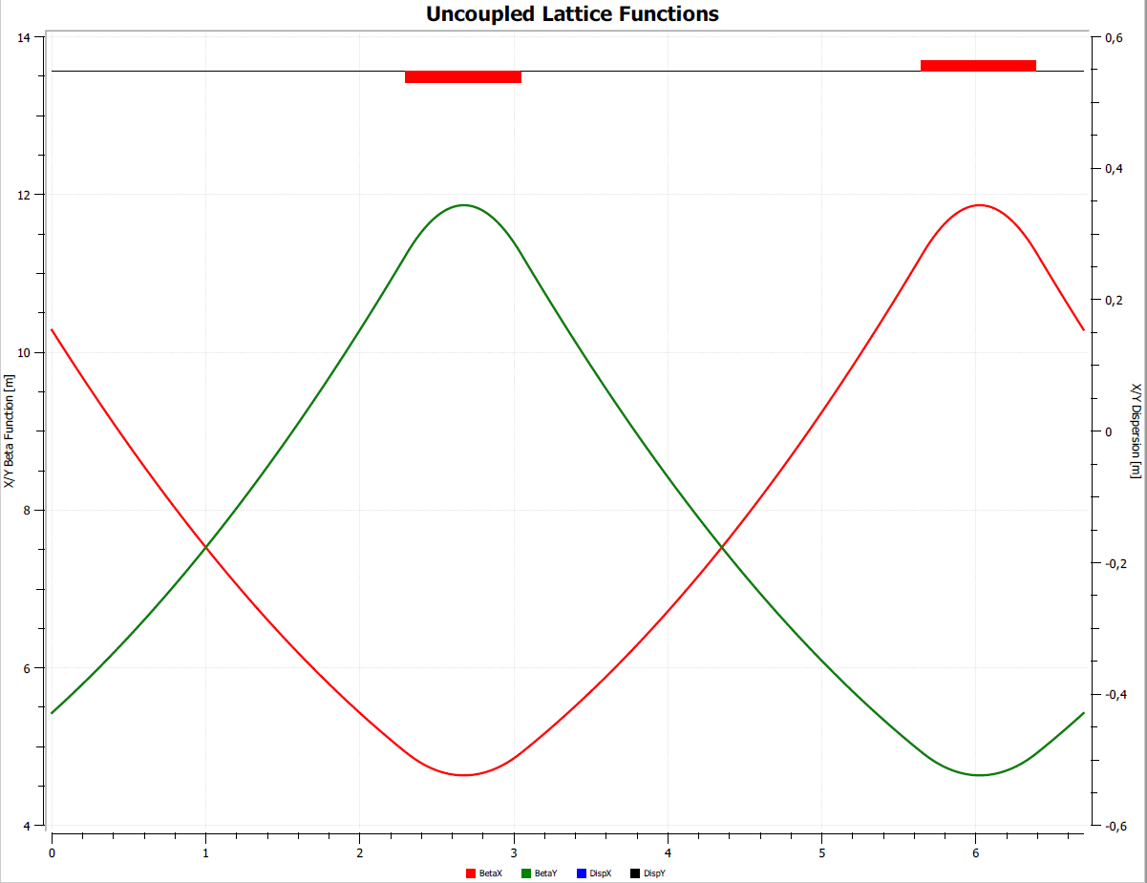
Straight section beta-function
Element | L, cm | B, T | G, T/m | N
Quadrupole magnet | 75 | - | 0,657 | 2
Drift space | 260 | - | - | 2
Drift space | 30 | - | - | 1

Slide 6
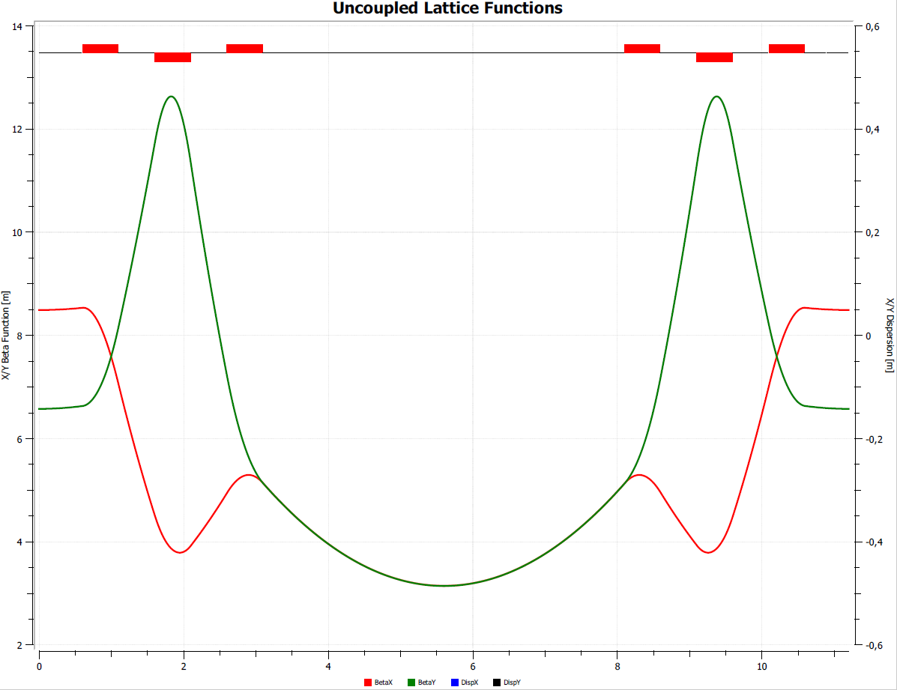
IP beta-functions
Element | L, cm | G, T/m | N
Focusing quadrupole magnet | 50 | 1,322 | 2
Defocusing quadrupole magnet | 50 | 2,4 | 4
Detector | 500
Drift space | 50 | - | 6
$$β_{x}^{∗}=β_{y}^{∗}=3,4 m$$

Slide 7
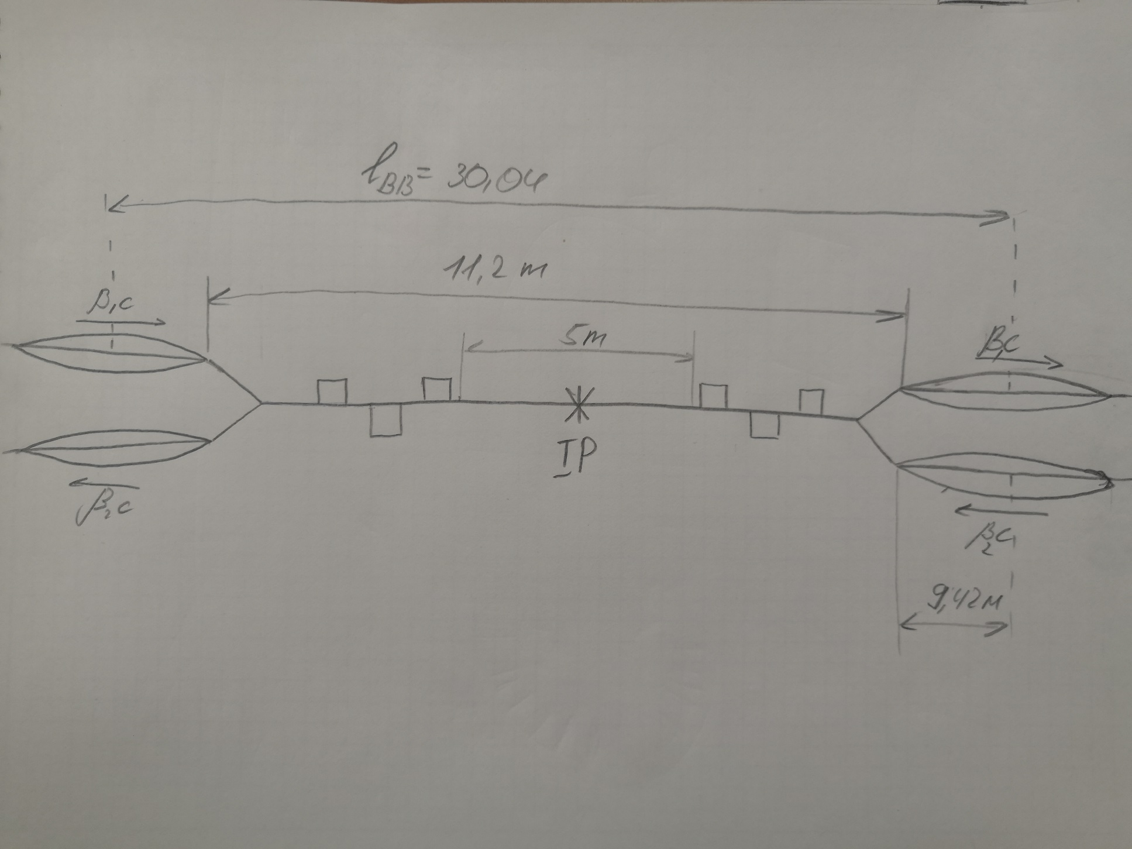
Collision scheme:
$$l_{BB}=30,04 m ⟹n_{b}=26$$

Slide 8
 | Cell length, m | Number of cells per section | Number of sections | Total length, m
Straight section | 6,7 | 24 | 4 | 643,2
Arc section | 6,7 | 10 | 2 | 134
IP section | 11,2 | - | 2 | 22,4
$$C_{ring}$$ |  |  |  | 799,6

Slide 9
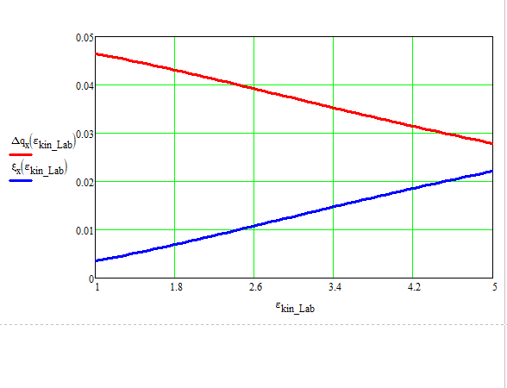
Laslett and beam-beam effect:
For $σ_{s}=3β^{∗}$

Slide 10
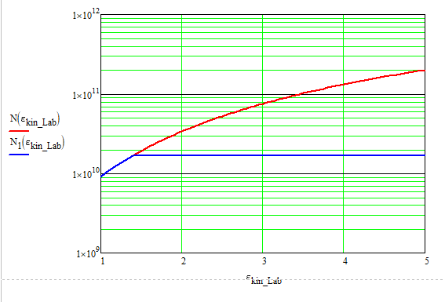
Number of particles depending on energy:

Slide 11
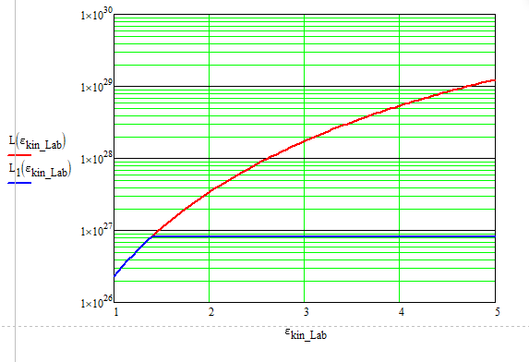
Luminocity on energy:

Slide 12
Parametr | Value
Emittance | $$3,8∙{10}^{−4} cm∙rad$$
Beta-function in IP | 3,14 m
Number of bunches | 26
$$σ_{s}$$ | 9,42 m
Luminosity | $${10}^{27} \frac{1}{{cm}^{2}c}$$
$$C_{ring}$$ | 799,6 m

