Slide 1
Super-conducting magnets
for ring accelerators

Slide 2
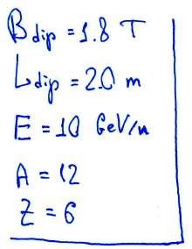
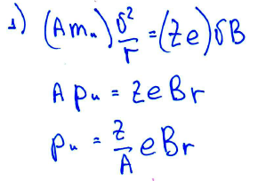
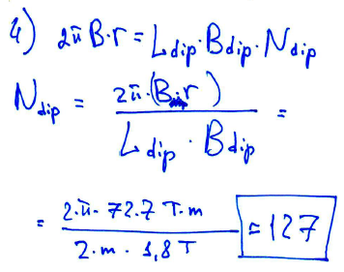
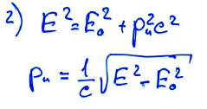
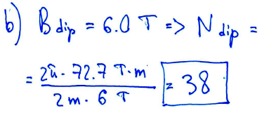
Case Study___task_1

Slide 3
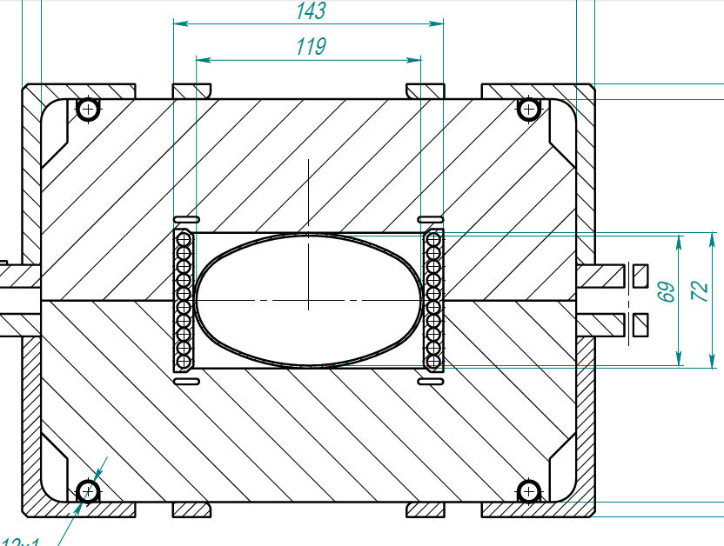
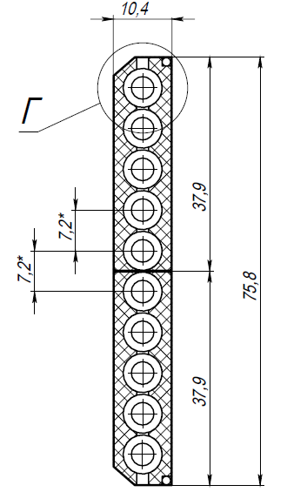
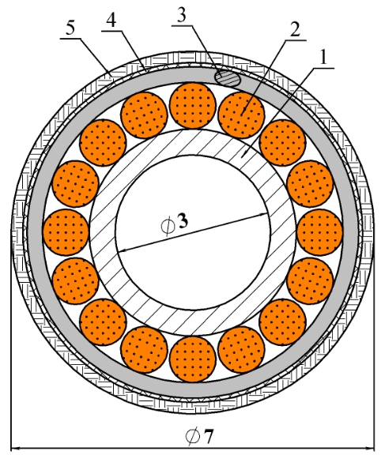
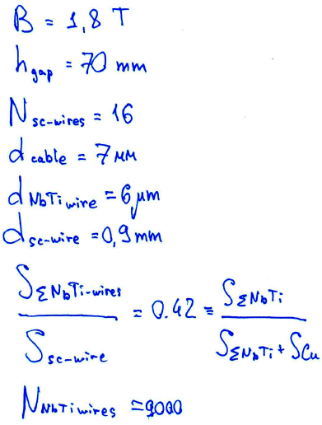
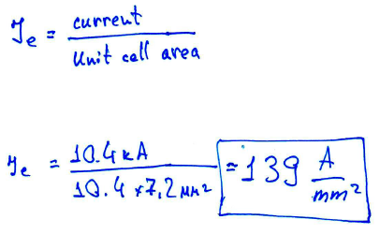
Case Study___task_2
What is the engineering current density Je of the NICA collider dipole magnet ?
Exclude not necessary data…

Slide 4
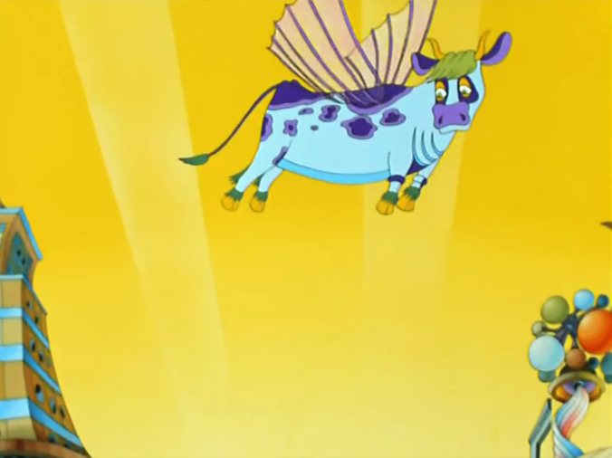
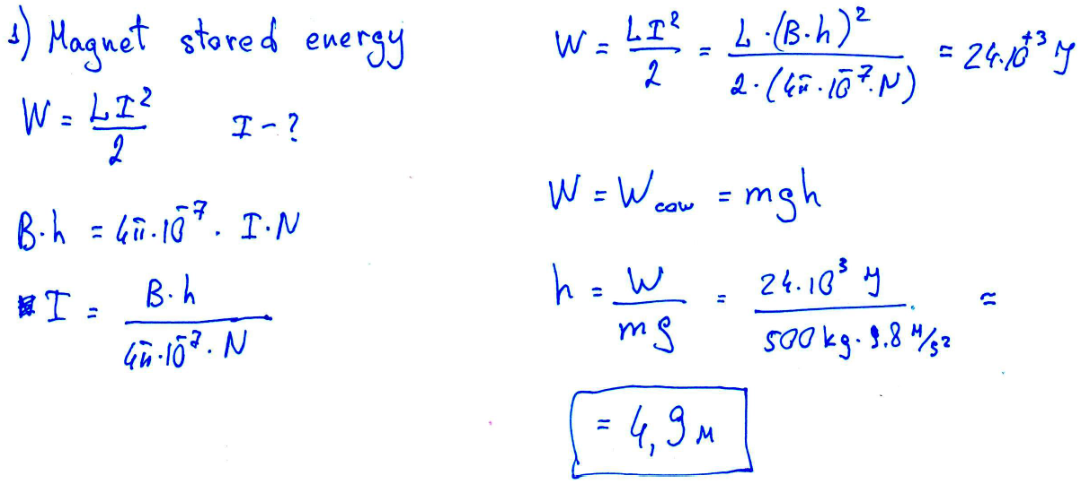
Case Study___task_3
What altitude must take hovering in place flying-cow (500kg) to have the same energy as stored in NICA collider magnet with magnetic field 1.8 T ?
aperture height = 70mm
N-coil-turns = 10
magnet inductance = 450 μH

