Slide 1
COMMON MISTAKES IN SCIENTIFIC WRITING 2.0
Anna Bogomolova
JINR, VBLHEP

Slide 2
Scientific Writing
• Papers / Articles / Abstracts / Posters / Reviews
• Seminar / Lecture Slides
• Letters / Emails (requests, recommendations, complaints, invitations)
Same grammar applies to all

Slide 3
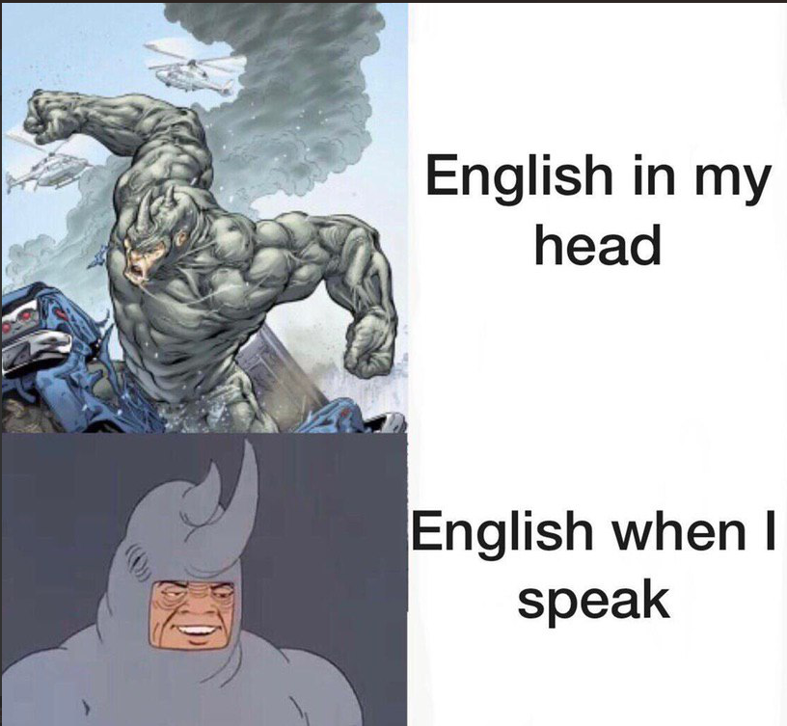
“YOU ARE SCIENTISTS AND SCHOLARS, YOU ARE PROFESSIONALS – YOU SHOULD FOR SURE GET IT RIGHT! TO REMAIN COMPETETIVE AT THE WORLD MARKET, ONE MUST LEARN TO OBEY THE RULES OF THE GAME”

Slide 4
Distorted language obstructs the road to success even for eminent scholars having well-known results. Language may mutilate or even nullify the significance of results (“attractor involves the set”)

Slide 5
Do not expect the referee to tolerate unreadable English, even though your result may be outstanding. Often the English (and, consequently, the result) becomes just meaningless!
No one is obliged to endure bad English

Slide 6
From persuasive papers to resumes, grammatical errors immediately take away the intended strength necessary to acquire an ally on an issue or an invitation for a job interview. In both situations, grammatical inconsistencies make influential words less poignant.

Slide 7
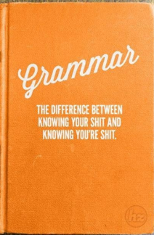
Why grammar matters?
People associate grammar with errors and correctness. But knowing about grammar also helps us understand what makes sentences and paragraphs clear and interesting and precise. Grammar can be part of literature discussions, when we and our students closely read the sentences in poetry and stories. And knowing about grammar means finding out that all languages and all dialects follow grammatical patterns.
(Brock Haussamen, "Guideline on Some Questions and Answers About Grammar", 2002)

Slide 8
My current list of common mistakes
Russian word order
Improper plurals
Noun+verb agreement
Verb tenses shifts
Improper use of resembling words (affect / effect, its / it’s, advice / advise, etc.)
Grammar inaccuracy (which / that, numerals, abbreviations, etc.)
Punctuation mistakes
Misuse of tenses
Misuse of prepositions or their omission

Slide 9
Why grammar matters?
"Grammar is the study of how sentences mean. And that is why it helps. If we want to understand the meaning conveyed by sentences, and to develop our ability to express and respond to this meaning, then the more we know about grammar, the better we will be able to carry out these tasks... "Grammar is the structural foundation of our ability to express ourselves. The more we are aware of how it works, the more we can monitor the meaning and effectiveness of the way we and others use language. It can help foster precision, detect ambiguity, and exploit the richness of expression available in English. And it can help everyone—not only teachers of English, but teachers of anything, for all teaching is ultimately a matter of getting to grips with meaning."
(David Crystal, Making Sense of Grammar. Longman, 2004)

Slide 10
WHY GRAMMAR MATTERS?
People do make judgments about you based on your grammar. Most of us do; it’s involuntary.
It’s hard to take someone seriously when they leave you a note saying, “Your ugly.” My ugly what? The idiot didn’t even know the difference between your and you’re. — Cara Lynn Shultz, Author of ‘Spellcaster’
Anything great is error-free. Period

Slide 11
prepositions
Collocational (with verbs, nouns, adjectives)
Of place
Of time

Slide 12
Misuse of prepositions
Aim against at
Arrive to at
Composed from of
Consist from of
Covered by with
Depend from on/upon
Different than from
Divide in into
Exception of to
Full from/with of
Opposite from to
Similar with to

Slide 13
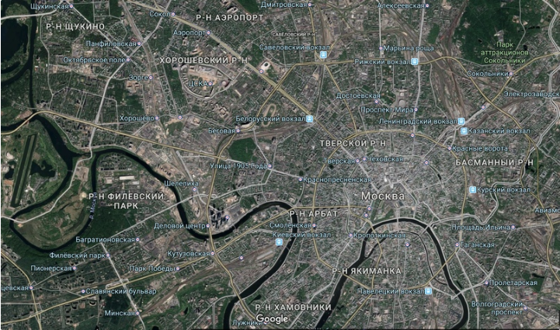
Prepositions of place
You use IN as continents, countries and cities are not so precise, aren’t they?

Slide 14
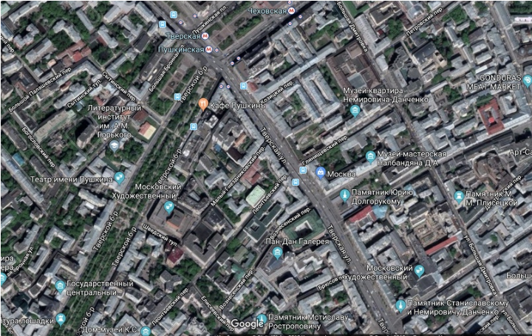
You use ON as streets and avenues are a bit more accurate than the size of the country, but not quite yet.

Slide 15
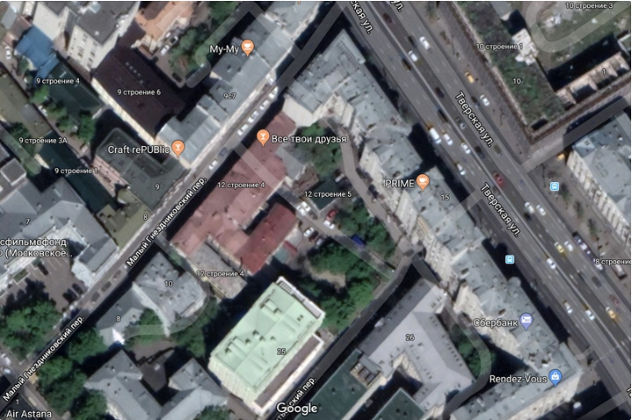
Use AT when you talk about the exact location.

Slide 16
Same rules apply to prepositions of time
In the 19th century, in 1991, in May (так себе подробно)
on 15th of September, on Monday, on Christmas Eve (не прям уж совсем, но немножко уже да)
at 12 o'clock, at midnight, at the last minute (точно)

Slide 17
exceptions
праздники, фестивали или тусы, которые длятся больше одного дня — тоже используется at: at Easter, at Christmas (все каникулы, а не один день, как в примере выше), at Nashestvie, at Kazantip
Непонятно почему, но все-таки in the morning, in the evening
At the weekend и on the weekend оба варианта правильные: первый это UK английский, а второй US

Slide 18
картинка

Slide 19
Please, stop
You should not use prepositions IN, ON, AT with LAST, NEXT, EVERY and THIS
I was depressed last May (in last May)
I’m planning to rob a bank next Monday (on next Monday)
I eat donuts every Christmas (at every Christmas)
I will take a walk naked this evening (in this evening)

Slide 20
Omission of prepositions
Ask for sth (ask sth) – She came and ask for my advice.
Listen to sb (listen sb) – They were not listening to my report.
Say to sb (say sb) – The accountant said to me, ‘Come tomorrow.’
Search for sth (search sth) – They are searching for dark matter.
Wait for sb/sth (wait sb/sth) – I’ll wait for you at the canteen.

Slide 21
Word order
Positive sentences
Подлежащее +сказуемое + косвенное дополнение + прямое дополнение + место + время
They………………will give……..you………………………………..a terrible beating…….at school…tomorrow.
I…………………….wish…………...you………………………………..the best.
Questions
Вопрос. слово + вспом. глагол + подлежащее + сказуемое + косв. дополнение + прямое дополн. + место + время
Why……………......did………………….you………………..send………….him…………………..anonymous letters…to his office…every day?
Where ……………were……………….you………………..–……………..... –………………........... –…………………………–……the night of the murder?
Negative sentences
Подлежащее +сказуемое + косвенное дополнение + прямое дополнение + место + время
She………………didn’t tell…….him………………………………...the truth…………………..at the pub…yesterday.
He…………………won’t trust…her…………………………………..-……………………………--………..............anymore.

Slide 22
Use of the wrong tense/tense form
Past simple: Did you went go to work yesterday?
Third person singular: Does the gardener waters water the flowers?
Modals with 3rd person singular: Ian can speaks speak English very well.
Wrong sequence of tenses: Rachel asked me what I am was doing.
Using past simple after to+infinitive: He tried to kicked kick the ball.
Misuse of past simple and present perfect: I have seen saw a good film last night. / I saw have seen the Parthenon of Athens.
Future in the if-clause: If he will ask asks me, I will stay.
Mixing up the tenses: They asked him to be their boss but he refuses refused.

Slide 23
Confusion of gender
The door is open, please shut her.
In English, only names of people and animals have gender.
Inanimate things are neutral and take the pronoun IT in the singular.

Slide 24
Using the possessive ‘s with inanimate objects
Her room’s window is open.
With inanimate objects we usually use the of-structure.
With the names of places and organizations we can use either:
Italy’s climate / The climate of Italy

Slide 25
Overuse of that
“The results showed that many people like vegetables.”
“The results showed many people like vegetables.”
The results that were found in this study showed many people like vegetables.
Some words you should not use “that” after:
Suggest / suggested
Observed
Found / was found
Show / shown
Is important
Highlight

Slide 26
Sentences beginning with it is
Weak English: It is important to highlight the most recent works that…”
Strong English: “The most recent works that (…) are important to highlight.”
Weak English: “There is little attention given to the event.”
Strong English: “Little attention is given to the event.”

Slide 27
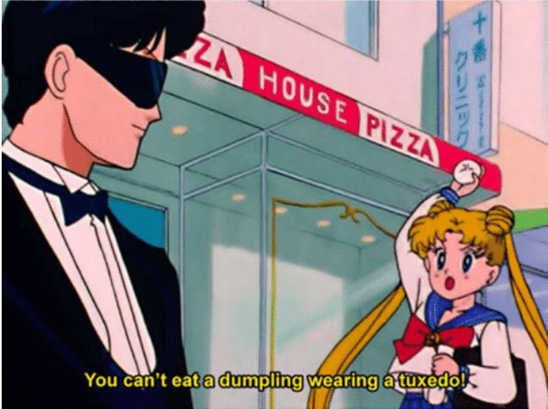
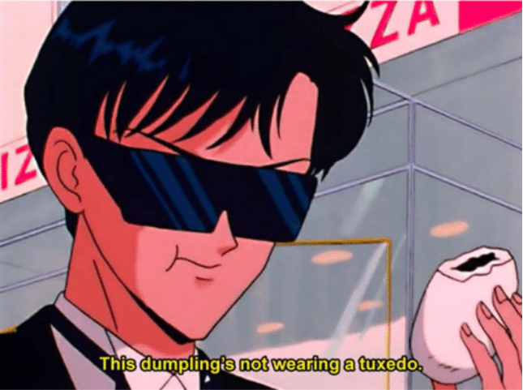
The use of gerund
The cells were grown in ABC medium containing glycine.
The cells were grown in ABC medium, which contained glycine.

Slide 28
Improper numerals
Data
Data shows…
Data show…
Separate hypotheses are proposed for each specific aim.
A separate hypothesis is proposed for each specific aim.
Hypothesis

Slide 29
Singular | Plural
Criterion | Criteria
Phenomenon | Phenomena
Equilibrium | Equilibria
Medium | Media
Datum | Data
Hypothesis | Hypotheses
Thesis | Theses
Axis | Axes
Nucleus | Nuclei
Optimum | Optima
Most graphs have two axes – one x-axis and one y-axis.

Slide 30
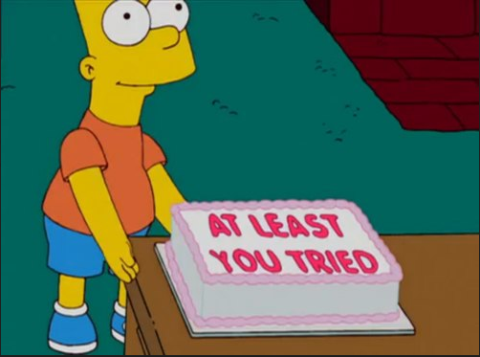
Few effective ways to learn & improve English grammar:
Write more in English
Listen more to English
Practise more
Keep it simple
Read good articles in English;
Read articles and books and absorb relevant vocabulary from them;
A native speaker can do a good job at getting rid of grammatical mistakes;
Try online courses like Coursera or EdX;
Experience is the most important part in scientific writing!
GOOD LUCK!

Slide 31
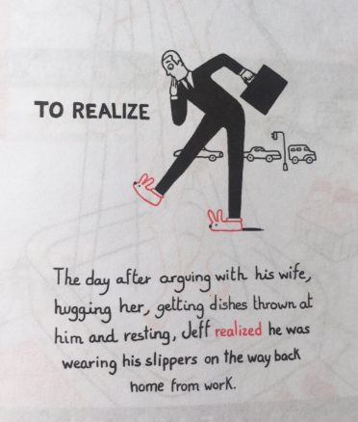
BONUS!
To realize!

