Slide 1
Decay $B_{s}→K^{∗0}μ^{+}μ^{−}$ in covariant confined quark model
Aidos Issadykov, Mikhail A. Ivanov

Slide 2
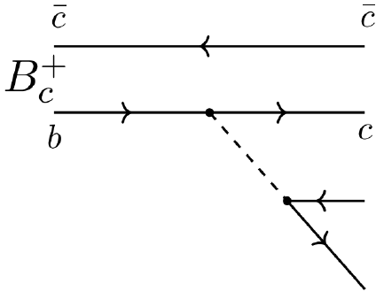
Semileptonic decays of B_{c} meson
*R. Aaij et al. Phys.Rev.Lett. 120 (2018) 121801

Slide 3
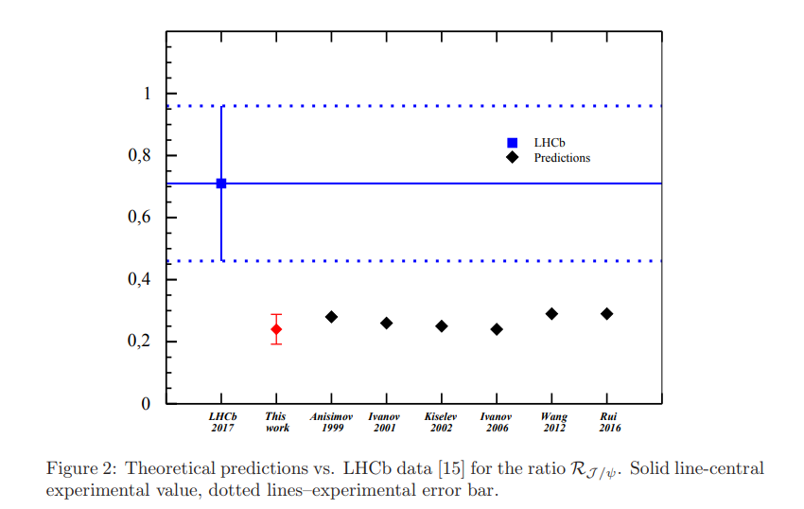
Branching ratios of semileptonic $B_{c}$ decays
*A. Issadykov, Mikhail A. Ivanov, Phys.Lett. B783 (2018) 178-182

Slide 4
Nonleptonic decays of B_{c} meson
LHCb collaboration(nonleptonic):
*R. Aaij et al. [LHCb Collaboration], JHEP 1309 (2013) 075
*R. Aaij et al. [LHCb Collaboration], JHEP 1609 (2016) 153

Slide 5
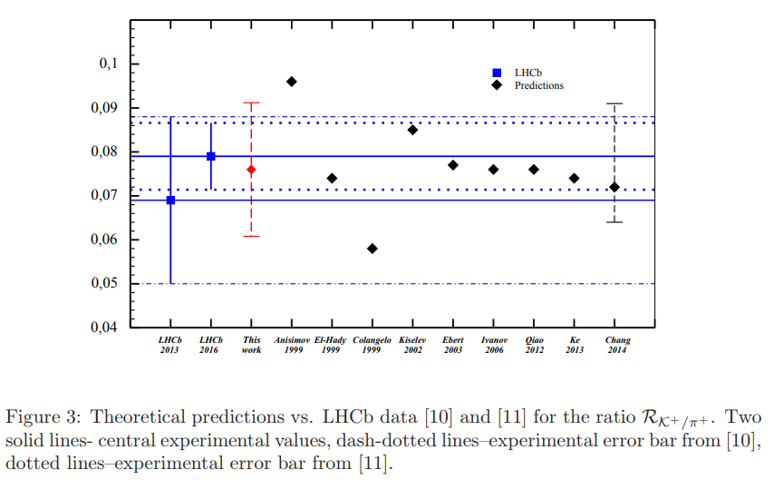
Ratios of branching fractions
*A. Issadykov, Mikhail A. Ivanov, Phys.Lett. B783 (2018) 178-182

Slide 6
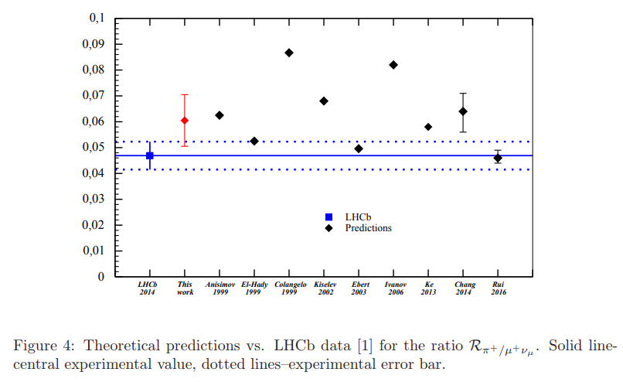
Ratios of branching fractions
*A. Issadykov, Mikhail A. Ivanov, Phys.Lett. B783 (2018) 178-182

Slide 7
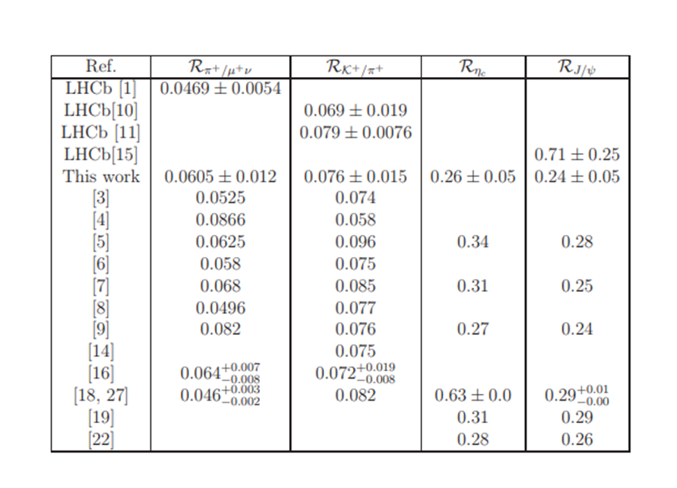
New physics in B_{c} meson decays?

Slide 8
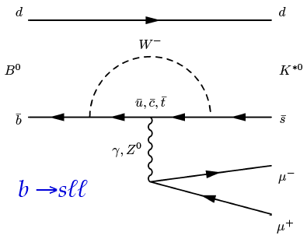
Rare decays of B meson
Loop-level decays b → sℓ⁺ℓ⁻:
forbidden at tree-level in SM
sensitive to NP contributions in loops

Slide 9
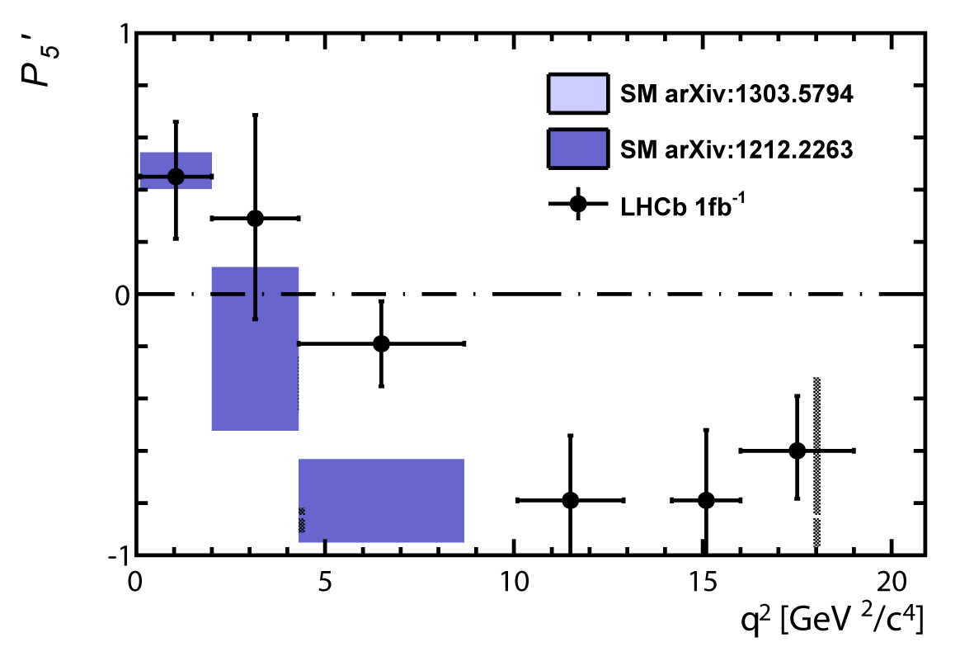
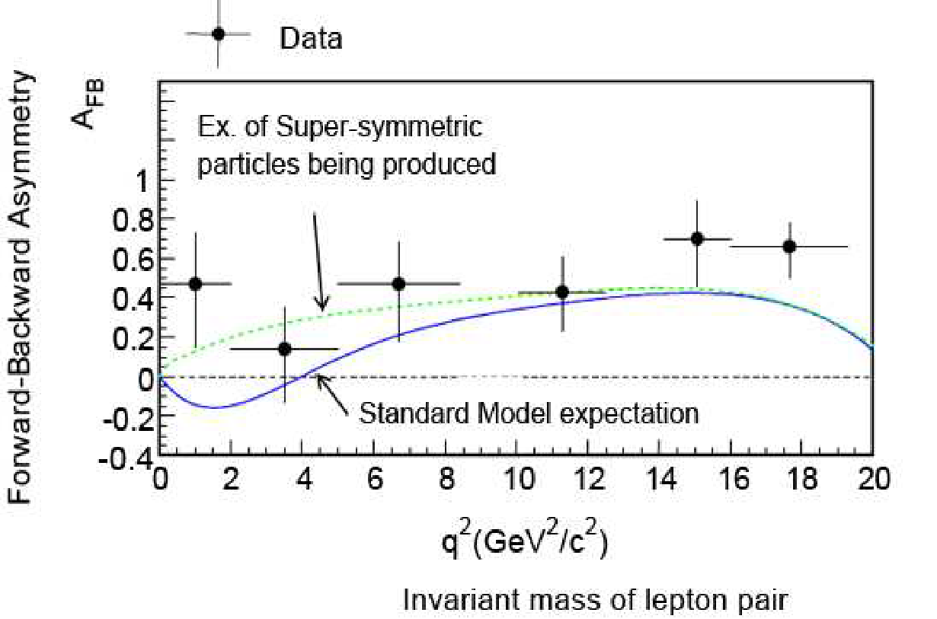
Rare decays of B meson
3.4 σ
~ 3 σ
*Phys.Rev.Lett. 111 (2013) 191801

Slide 10
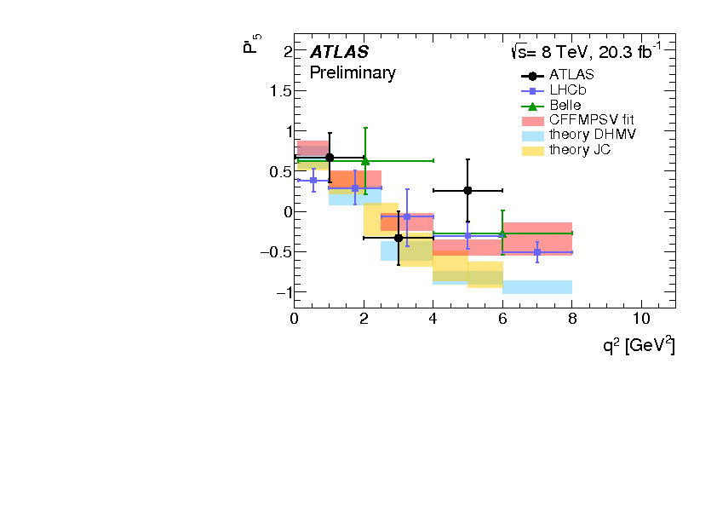
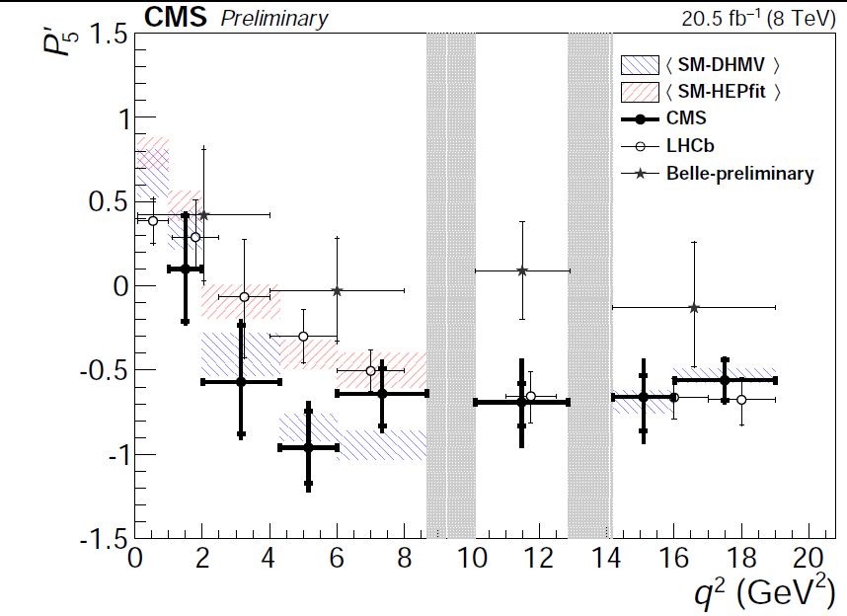
Angular observables
ATLAS measurement differs by 2.7σ from the SM prediction.
CMS results are consistent with SM prediction and other measurements

Slide 11
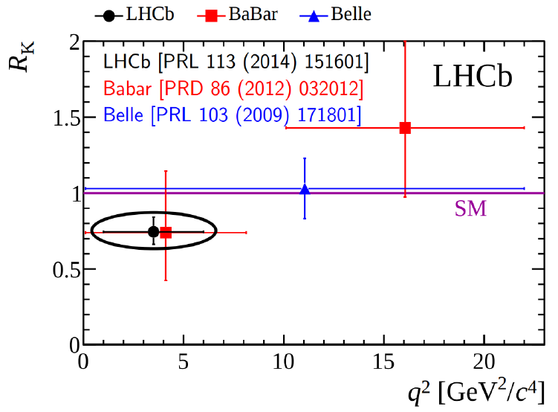
$$R_{K^{}}$$

Slide 12
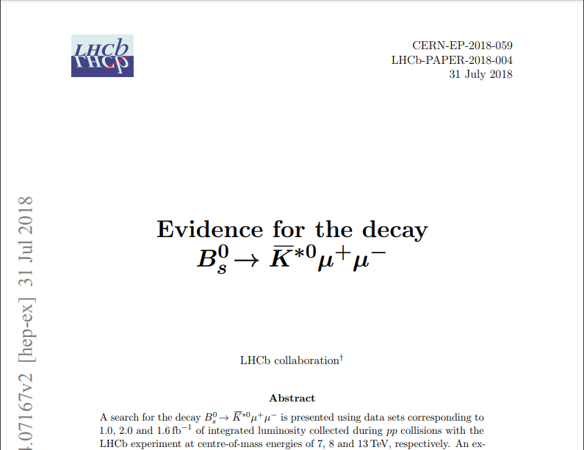
b-d transition

Slide 13
Effective Hamiltonian
$\text{b}\text{ → }\text{s} \text{transition}$ :
$\text{b}\text{ → }\text{d} \text{transition}$ :

Slide 14
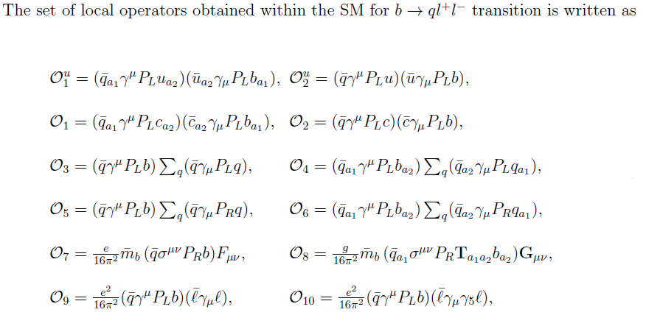
Effective Hamiltonian

Slide 15
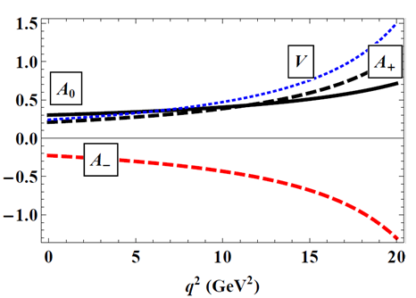
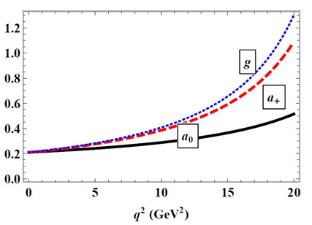
Form factors of B_{s} → K*⁰ decay
*Aidos Issadykov, EPJ Web Conf. 204 (2019) 08003

Slide 16
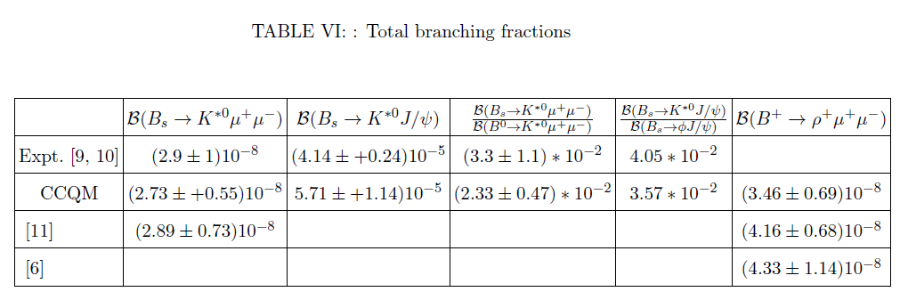
Branching ratios

Slide 17
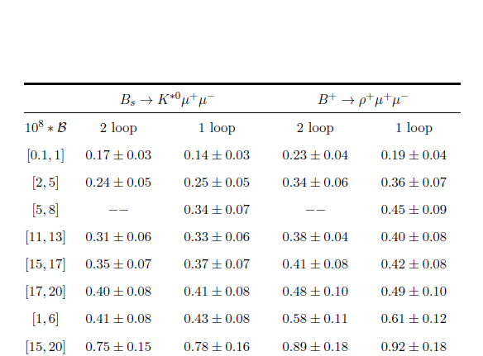
Binned branching ratios

Slide 18
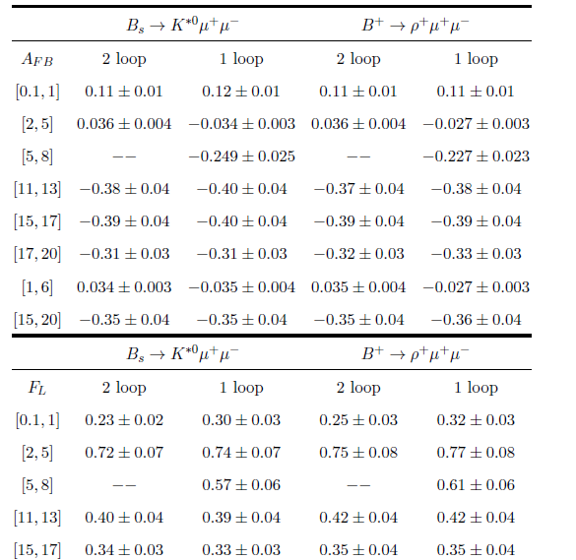
Binned angular observables

Slide 19
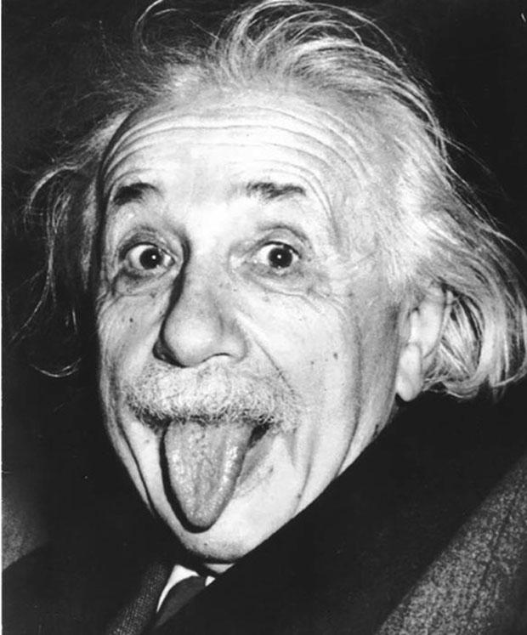
Thank you for your attention

Slide 20
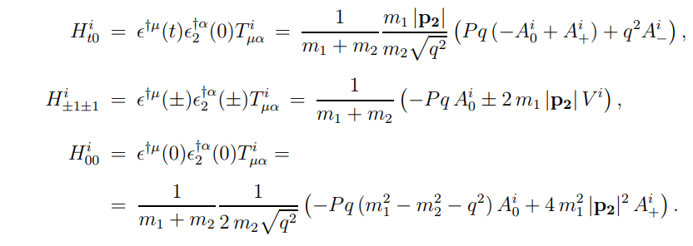

Slide 21
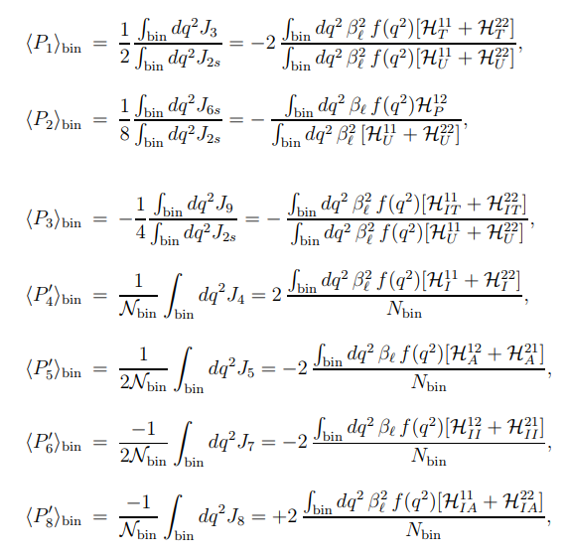

Slide 22
