Slide 1
Testing modules of Forward Hadron Calorimeter(FHCal) for MPD/NICA
A. Strijak
Moscow Institute of Physics and Technology, Moscow
Institute for Nuclear Research of the RAS, Moscow
1/14

Slide 2
Presentation plan
- Goals of experiment MPD/NICA
- Location and structure of FHCal for MPD/NICA
- Goal of FHCal
- Determination of event plane
- Determination of centrality
- Absolute calibration of FHCal modules
- Energy calibration of FHCal modules via cosmic muons
2/14

Slide 3
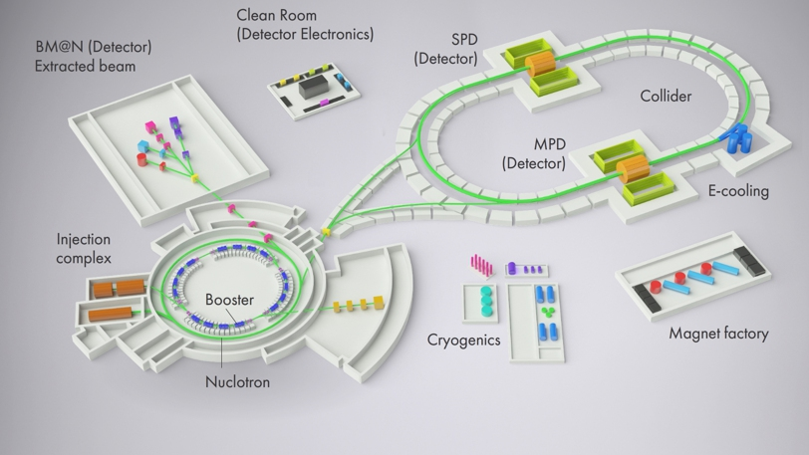
Goals of MPD/NICA
- research of phase transition
- research of mixed phase
- search for a critical point
- help in deriving equation of state
Phase diagram of QCD
3/14

Slide 4
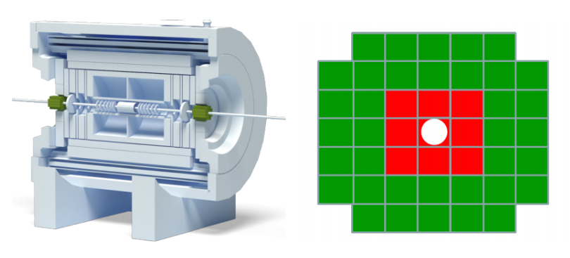
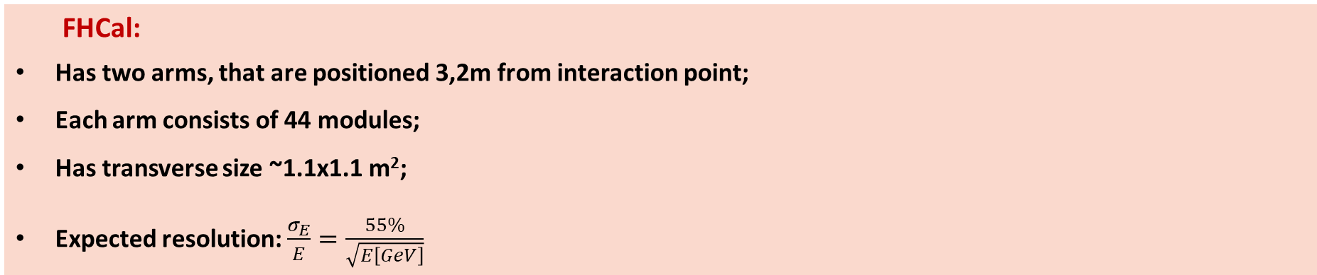
Location and structure of MPD/NICA
FHCal
Position of FHCal in MPD(green in left picture), structure of FHCal arm(right picture)
FHCal module for NICA
FHCal:
Has two arms, that are positioned 3,2m from interaction point;
Each arm consists of 44 modules;
Has transverse size ~1.1x1.1 m²;
Expected resolution: $\frac{σ_{E}}{E}=\frac{55\%}{\sqrt{E\left[GeV\right]}}$
4/14

Slide 5
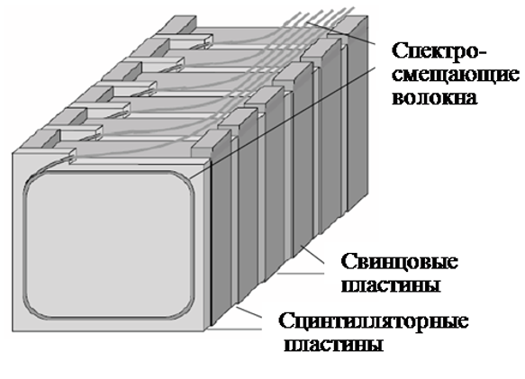
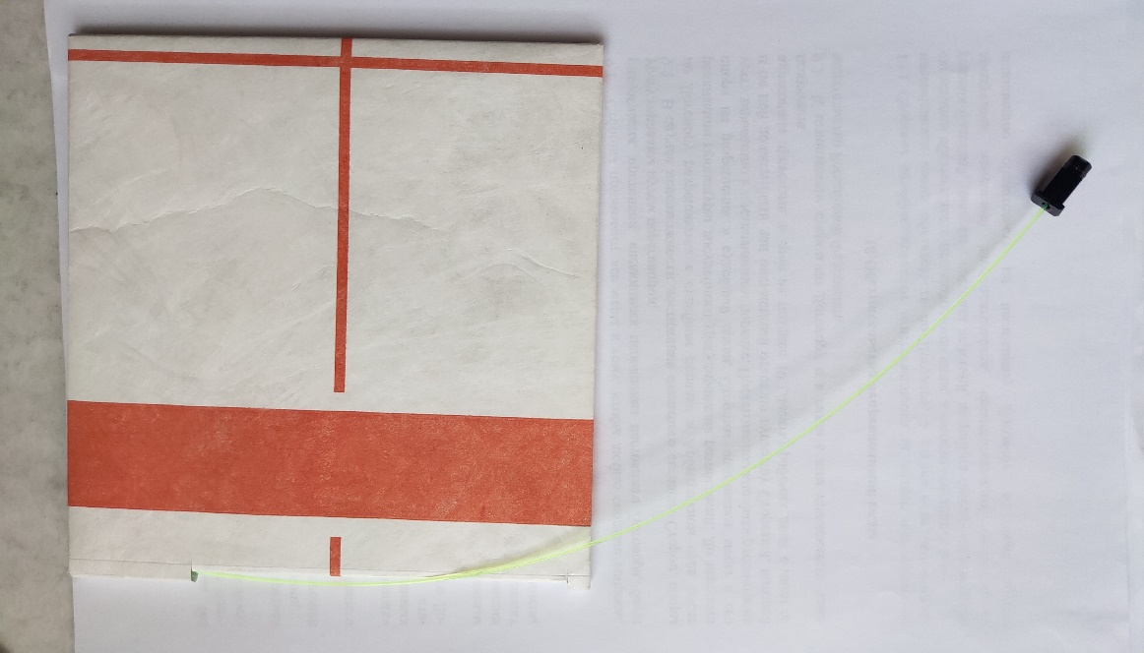
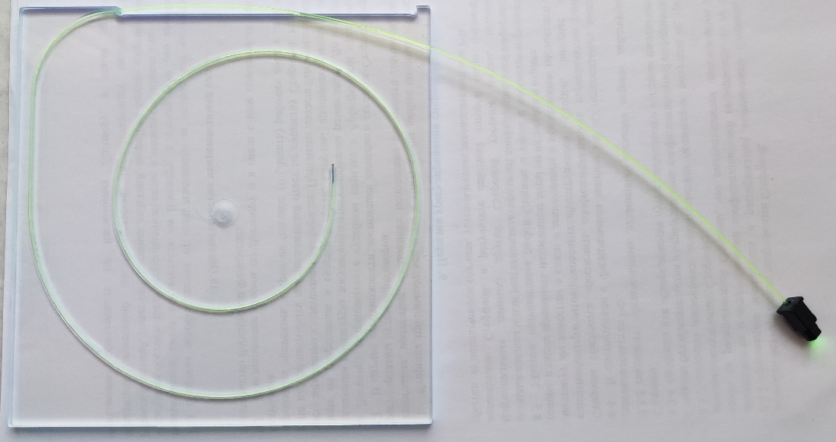
Structure of FHCal module
WLS fiber
Lead plates
Scintillator plates
Each module:
42 pairs of lead-scintillator plates(16mm:4mm) with transversal size - 15x15cm² ;
Module length~ 4 λ_{int};
Each module consists of 7 equal sections, connected to SiPMs;
Scintillator plates (the higher one is wrapped in TEIVIK)
5/14

Slide 6
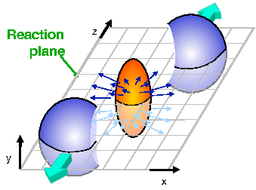
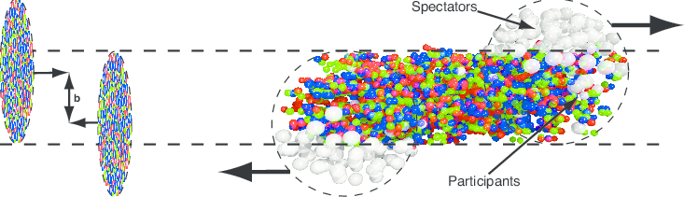
Goal of FHCal
Centrality is shown as b in the left picture;
Reaction plane is defined by vector of impact parameter and vector of nuclei motion direction
6/14

Slide 7
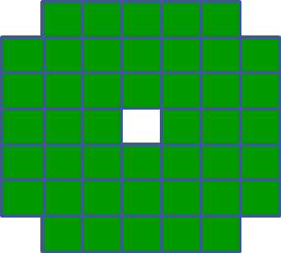
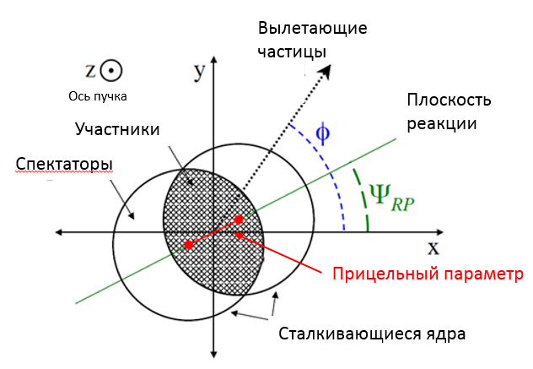
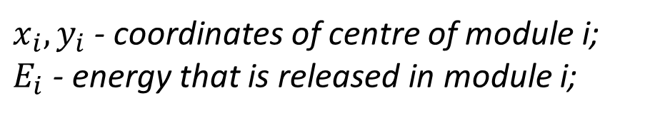
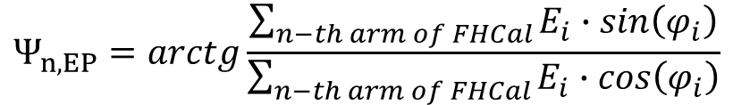
Determination of event plane
$x_{i},y_{i}$ - coordinates of centre of module i;
$E_{i}$ - energy that is released in module i;
i
$Ψ_{1,EP}$ - Event plane at one of the calorimeter arms
$Ψ_{2,EP}$ - Event plane at the other calorimeter arm
ejected particles
$$Ψ_{n,EP}=arctg\frac{\sum_{n−th arm of FHCal}{E_{i}∙sin\left(φ_{i}\right)}}{\sum_{n−th arm of FHCal}{E_{i}∙cos\left(φ_{i}\right)}}$$
, где n – arm of calorimeter, which is used to calculate event plane
Beam line
Reaction Plane
Partisipants
Spectators
Full event plane
Impact parameter
colliding nuclei
7/14

Slide 8
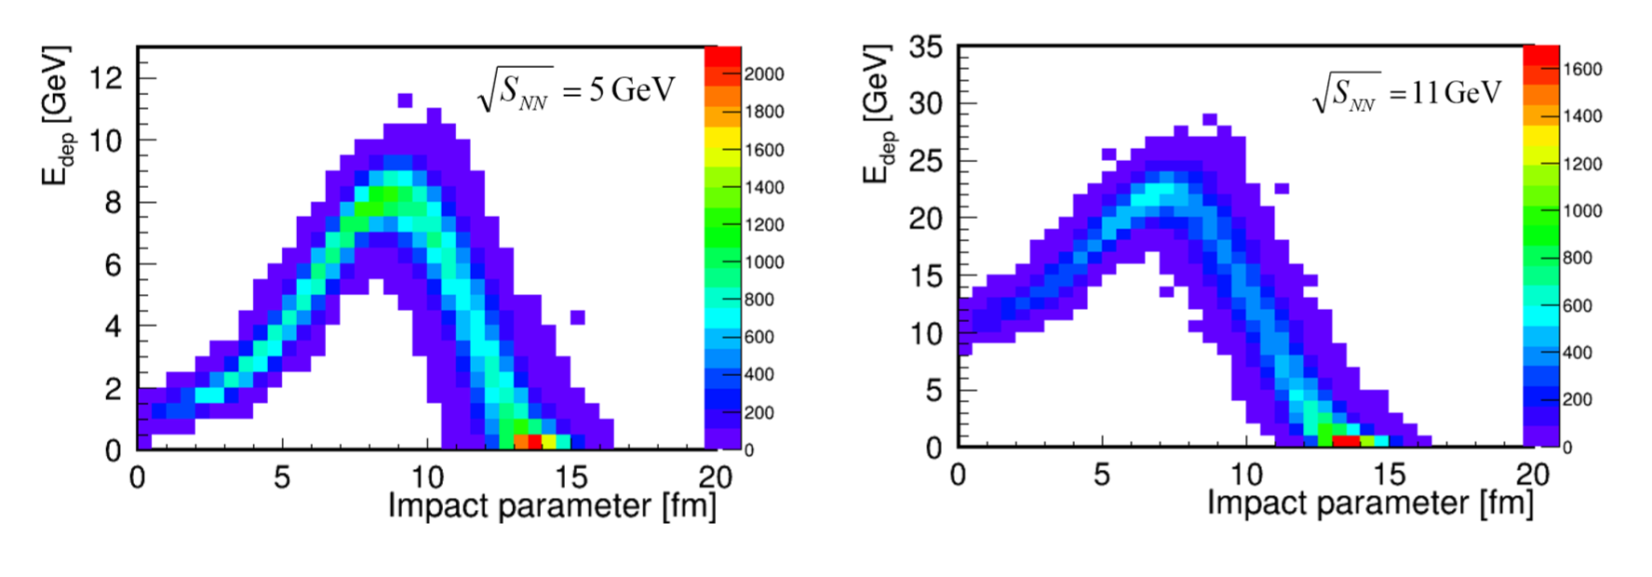
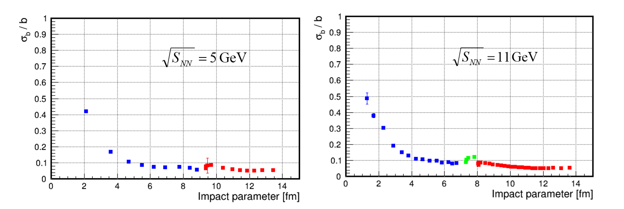
Determination of centrality
D$etermination of average impact parameter usind deposited in calorimeter enerfies for \sqrt{s_{NN}}=5, 11 GeV$
Error in centrality determination for$\sqrt{s_{NN}}=5, 11 GeV$
8/14

Slide 9
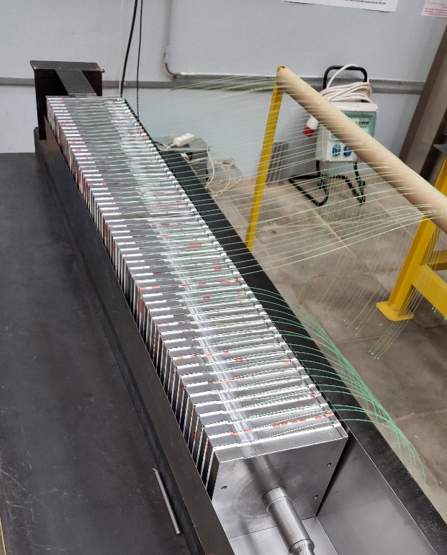
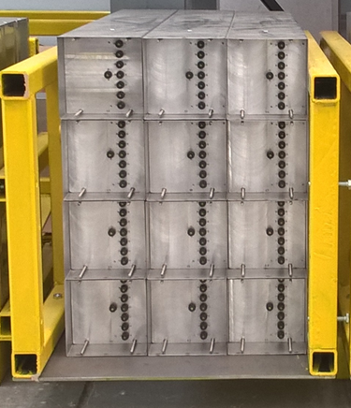
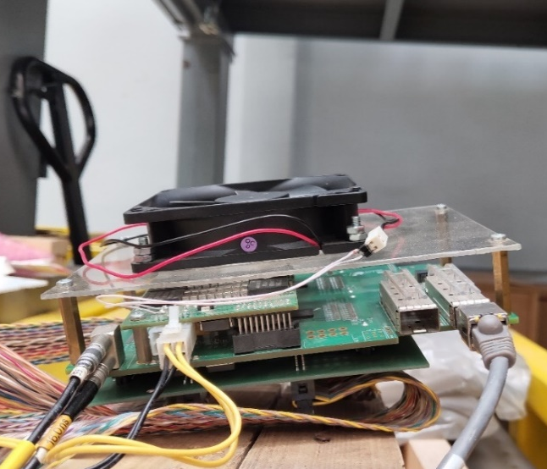
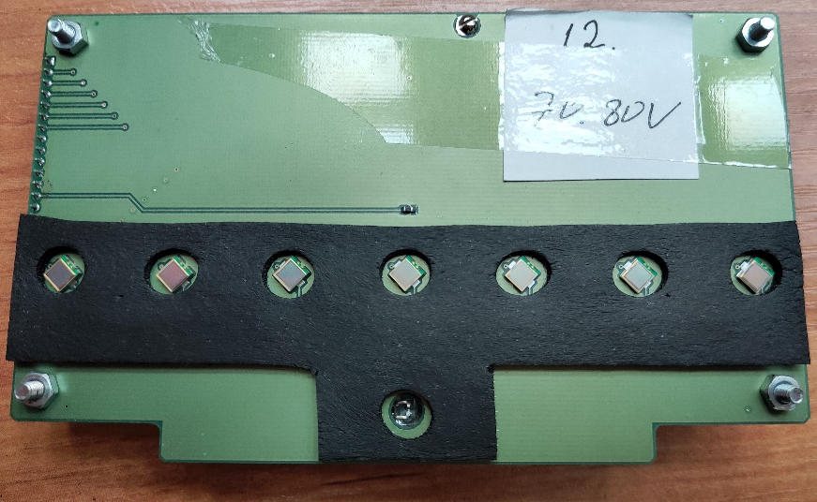
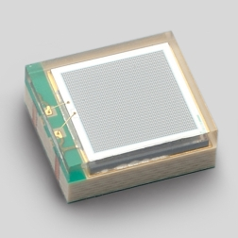
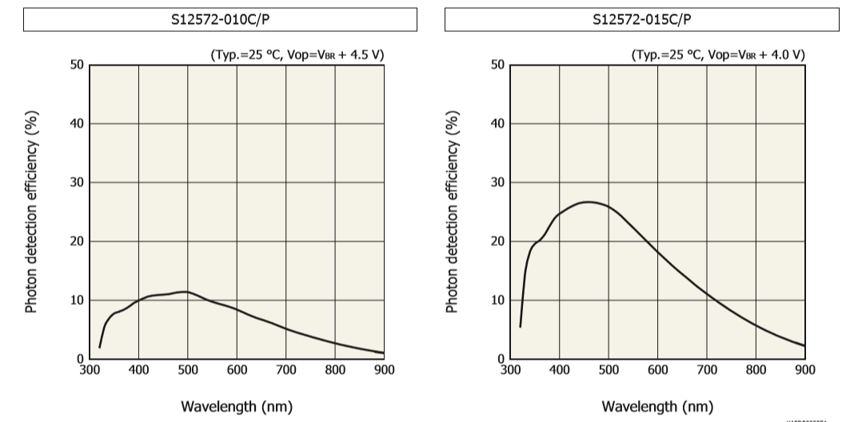
Experimental setup
ADC64
Module of FHCal
Test stand of 12 modules
+ wide dynamic range
+ relatively low noise
+ short relaxation time
+ high count rate
- low photon detection efficiency
LED
Signal reading board (bottom view)
SiPM
9/14

Slide 10
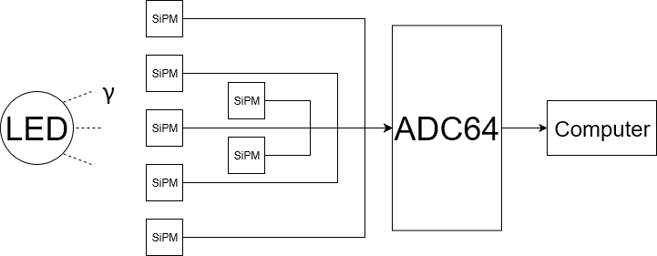
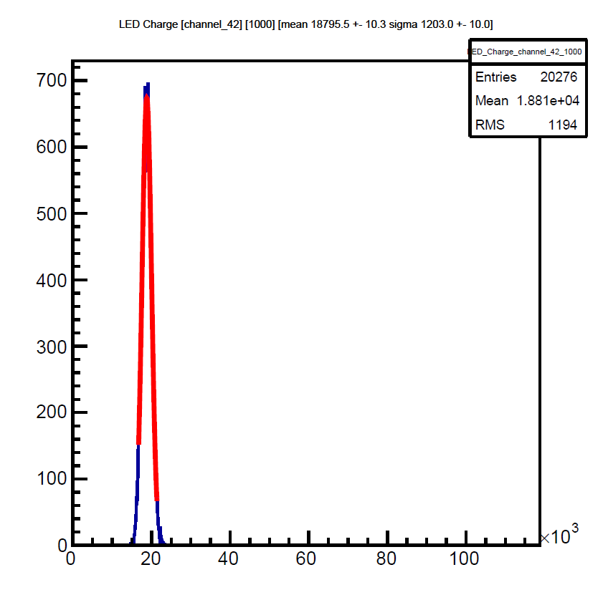
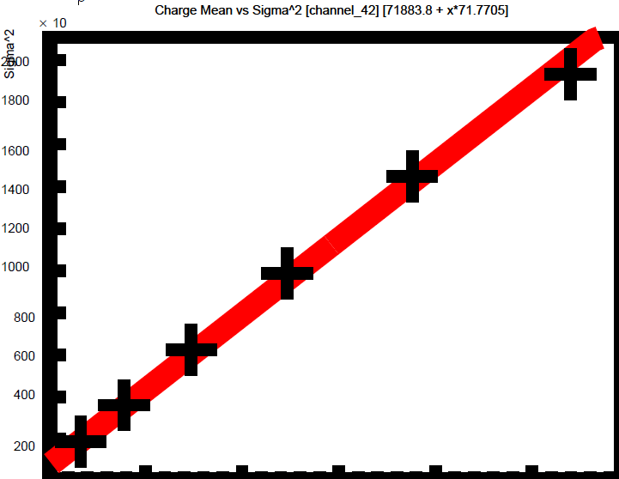
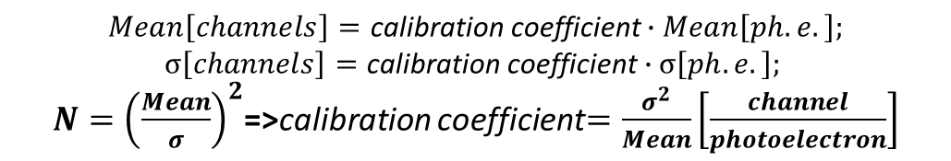

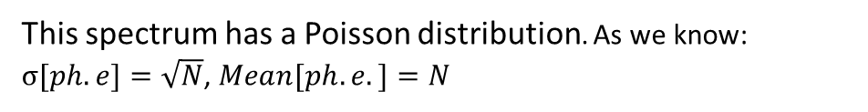
Absolute calibration of modules
Experimental setup scheme
$$σ^{2}$$
Charge[channels]
Example of amplitude spectrum
This spectrum has a Poisson distribution. As we know: $σ[ph.e]=\sqrt{N}$, $Mean[ph.e.]=N$
$$Mean\left[channels\right]=\text{calibration} \text{coefficient}∙Mean\left[ph.e.\right];$$
$$σ\left[channels\right]=\text{calibration} \text{coefficient}∙σ\left[ph.e.\right];$$
$N={\left(\frac{Mean}{σ}\right)}^{2}$=>calibration coefficient$=\frac{σ^{2}}{Mean}\left[\frac{channel}{photoelectron}\right]$
5000 10000 15000 20000 25000 Mean
10/14

Slide 11
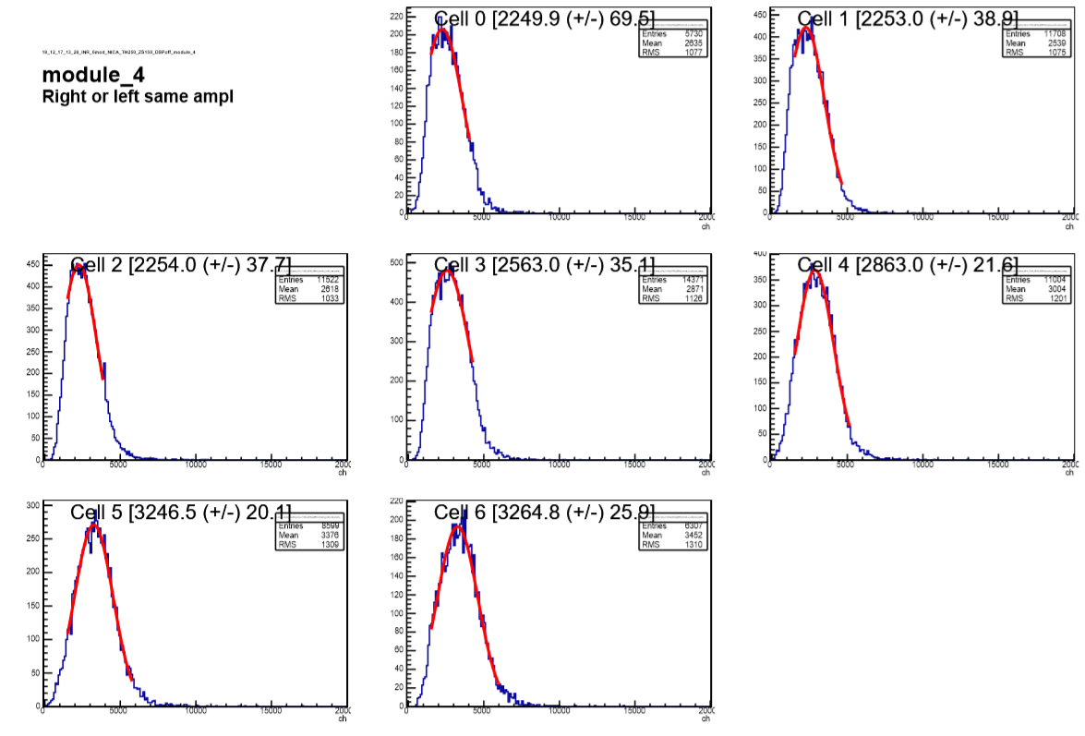
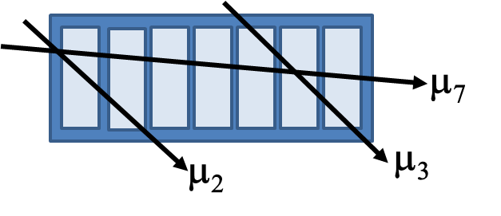
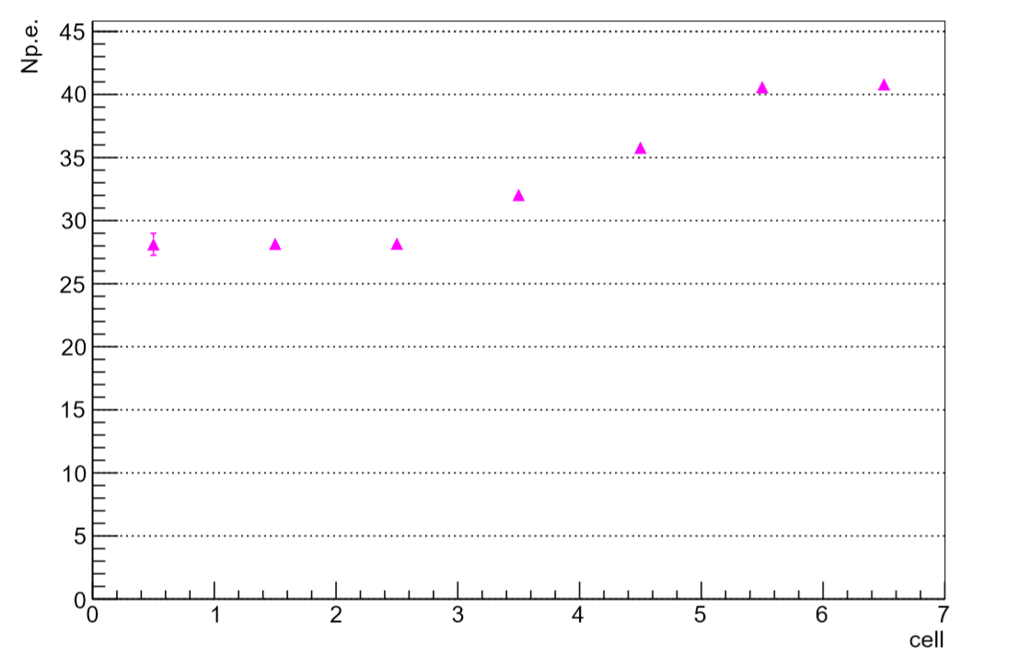
Energy calibration with cosmic muons
Structure of sections in one module
Spectra of charges for one of the modules, which correspond to responses to cosmic muons.
Following cases of comparison of signals in different sections took place:
- two neighbor cells
- three neighbor cells
- all cells
The light output of the module sections for the same module
(using the Poisson distribution fitting)
11/14

Slide 12
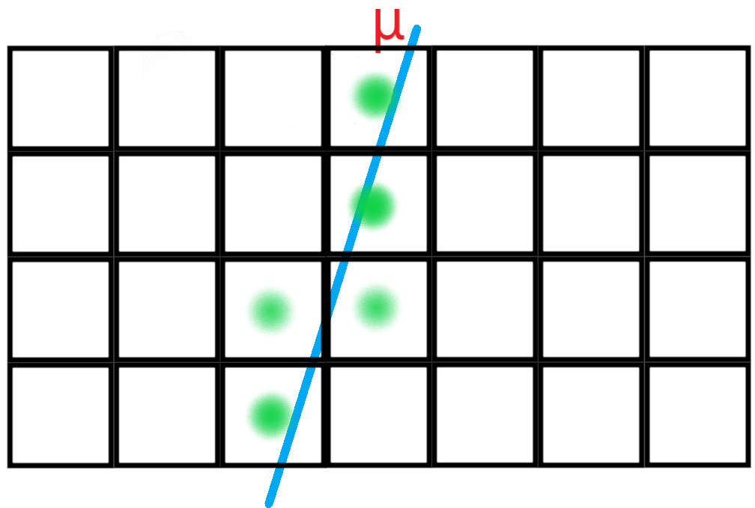
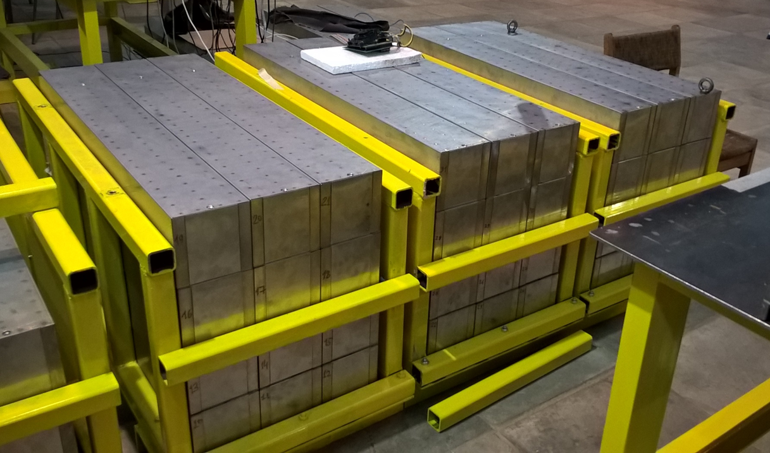
Calibration with cosmic muons
At present a method of simultaneous calibration of all modules is being created
The advantages of this method over the one above:
- more statistics
- greater signal / noise ratio
- possibility of simultaneous calibration of all modules
Longitudinal cut of the test stand
12/14

Slide 13
Conclusion
- A test stand for the study of energy calibration of modules with cosmic muons was created.
- There was developed a technique of absolute calibration of channels with light pulses.
- There were developed methods of muon calibration of FHCal modules using different geometry of muon tracks.
- A comparison of different calibrations was made with the help of cosmic muons.
- At present a method of simultaneous calibration of all modules, that will help to decrease time needed for calibration and decrease errors, is being created.
13/14

Slide 14
Thank you for your attention
14/14

