Slide 1
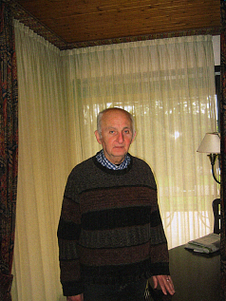
Pion degrees of freedom in equilibrium and non-equilibrium nuclear systems
D.N. Voskresensky NRNU MEPhI, Moscow, JINR Dubna
Dedicated to the memory of my friend E.E. Saperstein

Slide 2
Plan
A historical review.
Pion cond. and abnormal nuclei and phase transition in NS.
A general description of pions in baryon matter.
Pion softening effects in HIC.
Pion softening effects in problem of neutrino radiation of NSs, and in problem of damping of r-modes.

Slide 3
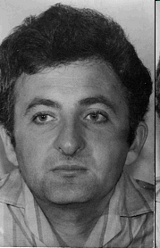
work under the guidance of A.B. Migdal on theory of finite Fermi systems. Pion degree of freedom was not treated explicitly that time.

Slide 4
Pion degree of freedom in hadron matter – history in Moscow time, in brief:
1971-1978 I period.
1971 A.B. Migdal ZhETF : pion cond. in strong fields, with ideas of pi-cond. in dense nuclear matter, and possibility of superdense pi-cond. nuclei.
1972 Migdal: P-wave pion cond. in dense nuclear matter. Are middle-heavy and heavy nuclei similar to liquid crystals or crystals? Pi-cond. in NS. 1974 Migdal, Markin, Mishustin JETP: Pion mode in cold dense nuclear matter.
1975-1978 Saperstein, Troitsky, Fayans, Tolokonnikov : no pion cond. in at. nuclei. But pion excitation mode is soften in nuclei.
1976 Migdal, Popov, D.V., 1977 Chernoutsan,Sorokin, D.V.: Relativistic semicl. approx. for Dirac eq., suggested nuclei-stars glued by π⁻-cond. and e⁻ .
1978 Migdal Rev.Mod.Phys., book (in Rus.) `Fermions and bosons in strong fields.`

Slide 5
Pion degree of freedom in hadron matter – history in Moscow time, in brief:
1978-1983 II period.
1978-1983 Saperstein, Troitsky, Fayans, Tolokonnikov, Borzov et al. recalc. Landau-Migdal param. at inclusion of pi-mode in support of idea of pion softening in nuclei.
1978 Migdal, Chernoutsan, Mishustin I-order pi-cond. phase tr. in NS, blowing off a matter.
1978 Mishustin, D.V. Pion degree of freedom in nucl. matter at T≠0. 1982,1983 Dyugaev : liquid (fl.) and solid phases of pi-cond. for T≠0.
1980 Anisimov, D.V. JETP, pi⁻ -cond. superconductivity in NS, Layer str. in mag. fields.
1982 Saperstein and Khodel Phys.Rep.: Self-consistent theory of finite Fermi systems.
Migdal 1983: II ed. book `Theory of finite Fermi systems. .. (in Rus. ) Saperstein and Khodel helped him a lot.

Slide 6
Pion degree of freedom in hadron matter - history in Moscow time, in brief:
1983-1990 III period.
1981 Nagamiya PRC: Results of HIC exp. on Bevalac. - Ideal gas models.
1984 Schulz, D.V. In-medium effects in pion production in HIC.
1984 Koldaev, Troitsky, Khodel. Localized states of pions and kaons in nuclei.
1986 Senatorov,D.V. Pion in-medium effects in problem of cooling of NS. 1987 Senatorov, D.V.,Kämpfer, Haubold: second neutrino burst as result of pi-cond. tr. during supernova explosion.
1989 D.V.: liquid phase of π-cond. & pion softening in HIC below 2GeV A energies.
1990 Migdal, Saperstein, Troitsky, D.V. 3-volums Phys.Rep. , 1991 book in Rus. `Pion degrees of freedom in nuclear matter`.
1990 Migdal: Program: QCD-deformed nucleon string with pion tail. in vac. and in hadron medium (worked on that with Saperstein and me, not finished, not publ.)

Slide 7
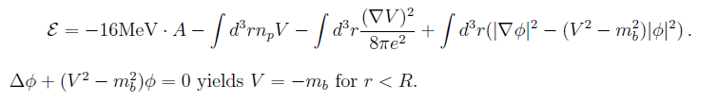

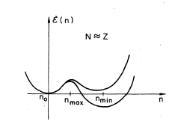
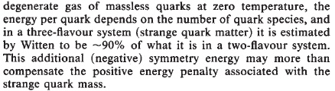

Pion condensation, superheavy nuclei and nuclei-stars
Superdense and supercharged nuclei, nuclearites, compact stars with pi-cond. Migdal ,ZhETF1971,1974, Migdal, Popov, D.V. JETP Lett.1976, Chernoutsan, Sorokin, D.V. 1977.
D.V.1977 in PhD thesis: if there were -charged light bosons with mass m _{b}
→ nuclei-stars with n~n ₀
For |V| ≥m_{b}, n→ p+b⁻,
charge-neutral interior
for A~Z>>1/e³ , and surf.
layer with field strength
E~10² E_{el} ~10¹⁸v/cm.
instead of Coulomb
charged boson
In realistic πN interaction problem m→ m* (k_{m} (n))
1979 Troitsky, Chekunaev, Δ and hyperon enreached superdense nuclei with π-cond.
Quark strange nuggets, strange stars
1984 Witten, Farhi, Jaffe,De Rujula, Glashow
1988 Bethe,Brown, Cooperstein, hybrid stars
1984 Glashow charged DM champs
2005 Glashow, U tera-quarks and O-{UUU} (e=-2) baryons, 2006 Khlopov, m_{O} ~1TeV, OHe DM
2019 Gani, Khlopov, DV, DM O-nuclearites,

Slide 8

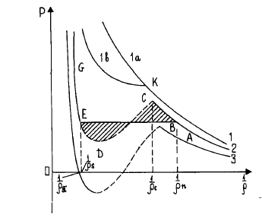
Compact stars with pion condensate
Superconductivity of π⁻ condensate in NS [D.V., Anisimov, Sov.Phys.JETP 51 (1980) 13] vortices are not threads but slabs (k~p_{Fn}, H-plane) in magnetic field, H_{c2} ~ p_{Fn}²/e ~ 10 ¹⁹ G
Estimate of H in peripheral HIC at ~GeV/A as ~ 10 ¹⁷ -10 ¹⁸ G :
supported by detailed calcul. by Skokov, Illarionov,Toneev 2009
Magnetars: observed 1998: have at surface H~ 10 ¹⁵ G, with dynamo mech. in interior H up to ~10 ¹⁸ G, so π⁻-cond. survives.
Sheet-mixed-state in rotating NS.
Possibility of the van-der-Waals EOS due to pi-cond.:
consequences for supernova explosions: blowing off part of matter, Migdal, Chernoutsan, Mishustin, Phys. Lett. B83 (1979)
t_{tr}~10⁻³ sec. Question of D.Pines: check that NS M _{max} >1.4M_{sol}, (Max NS mass constraint now M>1.97M_{sol} ) → Weaker tr.: strong glitches, strong NS kicks [Haensel, Proszynski, Phys. Lett. B96 (1980)] Similar consequences for Q-tr. In hybrid stars.
2-nd neutrino burst if tr. occurred during supernova explosion [Haubold, Kämpfer, Senatorov, D.V., 1987 t_{tr}~10 sec.– h.

Slide 9

Dynamics of I order phase transition near critical point
(nuclear liquid-gas, quark-hadron (?), π-condensate tr. )
From Navier-Stokes and continuity equations
neglecting u² terms:
Viscosity is driving force of ph. tr.
δ F / δ ρ
shear
bulk
+dΔ³δρ
D.V. Phys.Scripta 47 (1993) 333
cf. Ginzburg-Landau
ρ=mn
For liquid-gas tr. c>0, for pion cond. tr. c<0, d>0.
F-expansion near critical point but in mean field approximation
Slow tr.process: T ∂s/ ∂ t = κ Δ T,
s - is entropy density
initially spherical pi-cond.seed deforms: stick-like structures observed in A-smectics
Similar subjects - chiral nonuniform phases in quark matter: Tatsumi, Nakano 2004,
Nickel 2009, quarkyonic matter McLerran, Pisarski 2007.

Slide 10
In NS an overcritical drop reaches size R~0.1 km for t~10⁻³ sec. by growing of density mode, then it reaches R~(1-10) km for t~10 sec. – h.
(rather than collapse time 10⁻³ sec for R~10 km.) owing to neutrino heat transport to the surface (effect of thermal conductivity) for T~ 10 MeV.
D.V., Senatorov, Kämpfer, Astroph. Space Sci. (1988),
Migdal, Saperstein, Troitsky, D.V. Phys. Rep. (1990)

Slide 11
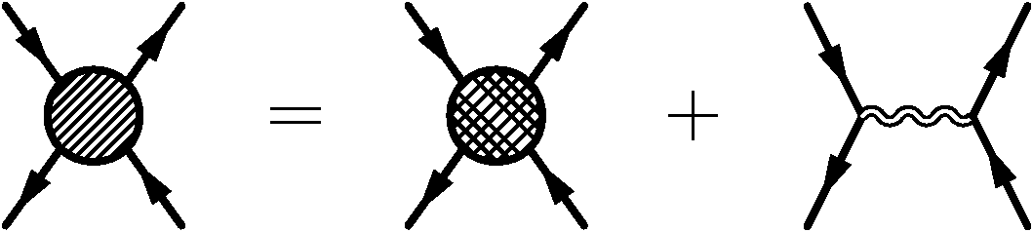
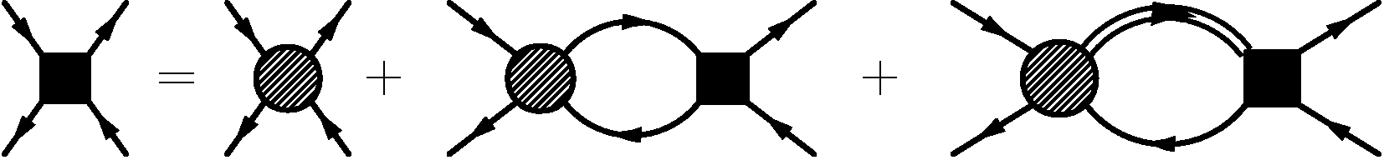
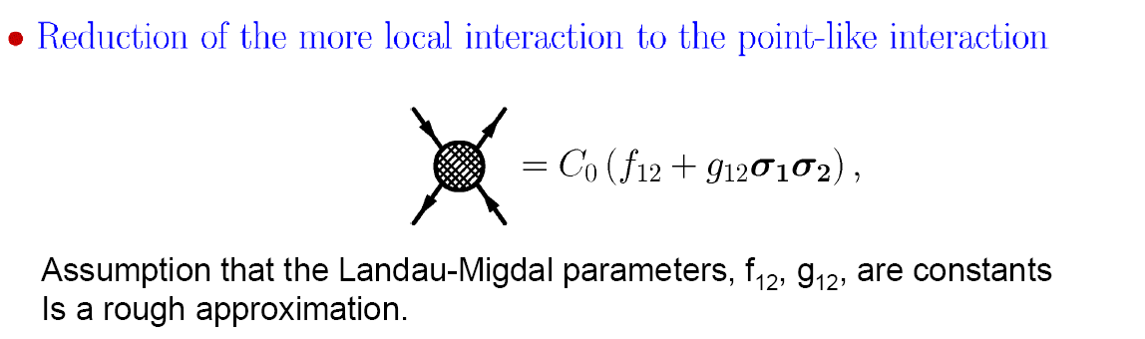
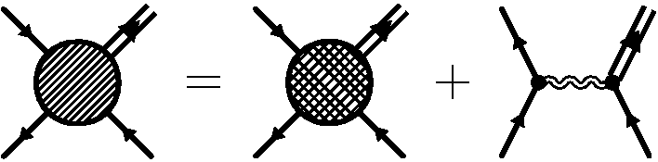
Fermi liquid approach: separation of soft and hard modes
pion with residual (irreducible in NN⁻¹ and Δ N⁻¹) s-wave π N interaction and ππ scattering``
explicit nucleon-nucleon hole and Delta-nucleon hole degrees of freedom
Part of the interaction involving Δ isobar is analogously constructed:
small

Slide 12
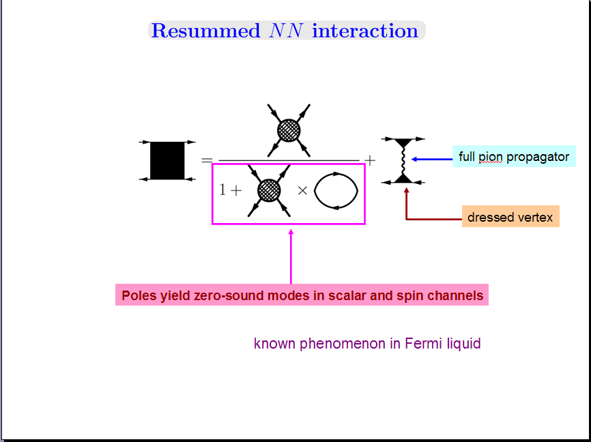

Low energy excitations in nuclear Fermi liquid (Migdal approach)
based on a separation of long and short scales
Info. on short-range interact. is extracted from analysis of atomic nuclei exp.
Migdal Rev.Mod.Phys. 50, 1978, Migdal,Saperstein,Troitsky,D.V. Phys.Rep.190 (1990).

Slide 13



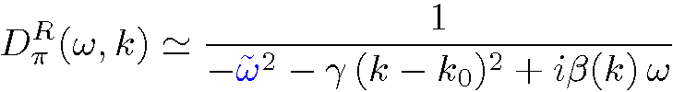
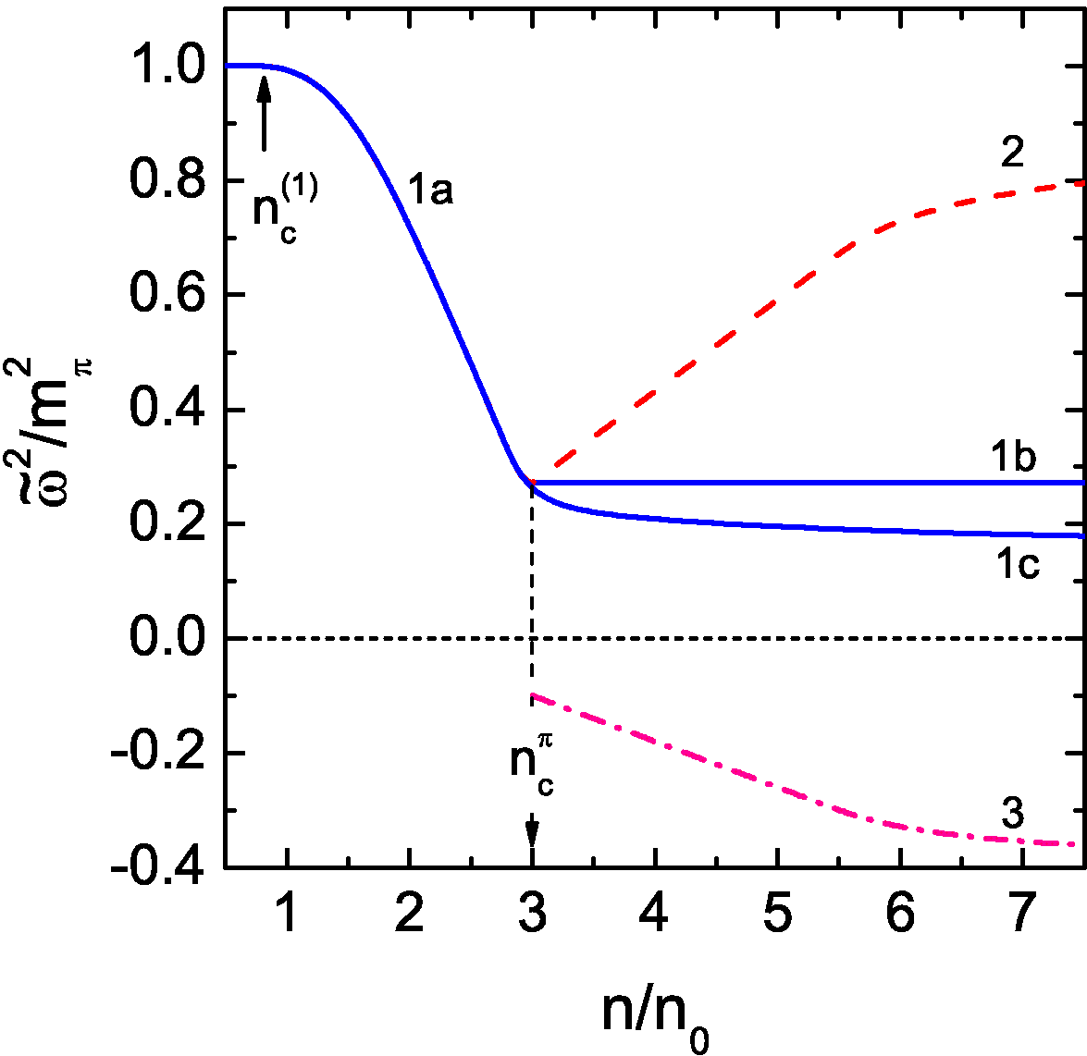

Neutral pion propagator for
n _{c}^{π} >n> n _{c1}~0.5 n₀
n _{c} ^{π}>n> n _{c1} ~0.5 n₀ nuclear glass, or liquid phase
of pion cond., cf. D.V. 1989, Nucl. Phys.A555 (1993)
Effective pion gap squared
reconstruction of pion spectrum
on top of the pion condensate
If LM parameters increase with density
-- saturation of pion softening and
no pion condensate
amplitude of the pion condensate
(liquid-crystal or m.b. solid) , e.g.

Slide 14
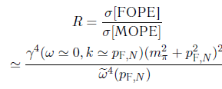





Where are virtual pions in nuclei (at n~n ₀ ) ?
G. Brown, Buballa, Li, Wambach NPA 1995: no excess pions in nuclei
Our arguments:
<1 for n≈n₀
Soft pions yield only small contribution to the sum-rule
for ω < k v _{F}
But from description of π-atoms
for ω~m_{π} , k<<m_{π}
→
for n ≈ n ₀
Pions at ω<<m_{π} are soft in sense that
at n ≈ n₀
Pions are there but their contribution depends on the frequency and momentum.
Virtual pions significantly contribute for T≠ 0 :
Strong effect for n>n_{c1} of fl. with k₀~p_{FN}→ liquid phase, large bulk-viscosity-pion glass

Slide 15
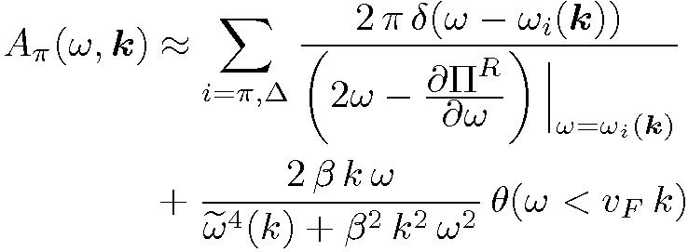
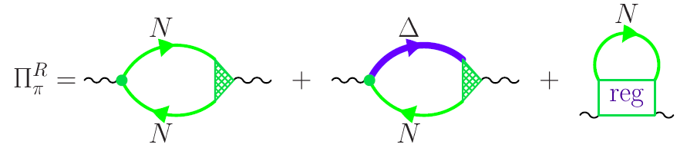
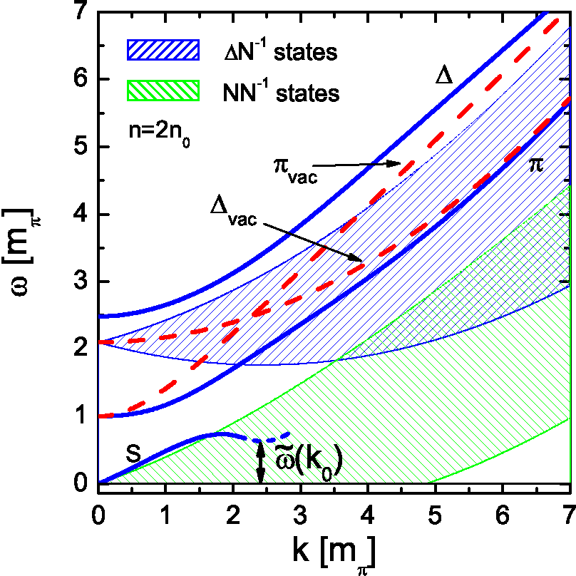

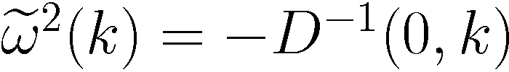
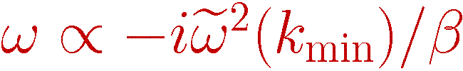
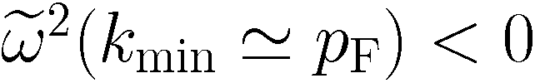
Pion spectrum in iso-symmetric nuclear matter
Migdal,Saperstein,Troitsky,D.V.Phys.Rept.192 (1990)
pion propagator has a complex pole
if
(for n>n _{c}~ (1.5-3) n₀)
“pion gap”
instability
pion condensation

Slide 16
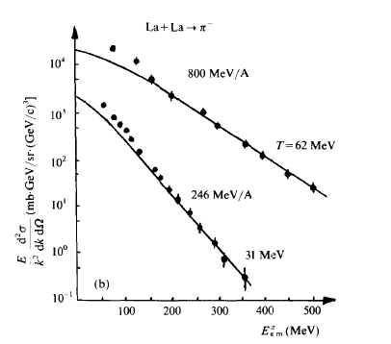
Pion production in La+La collisions
From D.V. Nucl. Phys. A555 (1993)
In-medium effects included, pions with k<(150-200) MeV have short mean-free path and
radiate from thermal freeze-out, n≈0.6 n ₀, more soft pions radiate from an earlier stage.

Slide 17
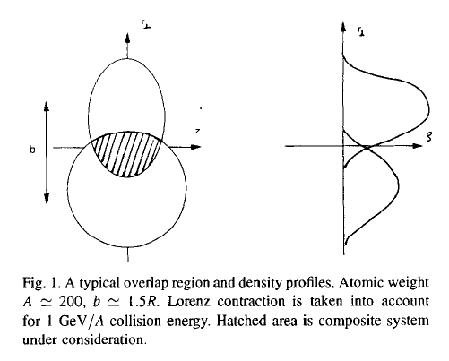



Is π-condensation possible in peripheral HIC?
interpenetrating nuclei
condition
is safely satisfied
Pion self-energy for 2 Fermi spheres
~ - 2p _{F} (n)
2p _{F} ~ (8n) ^{1/3}
effective attraction as at 8 n
(for n=n₀/2 in each nucleus → ef. density is 4n₀)
pion condensation might be

Slide 18
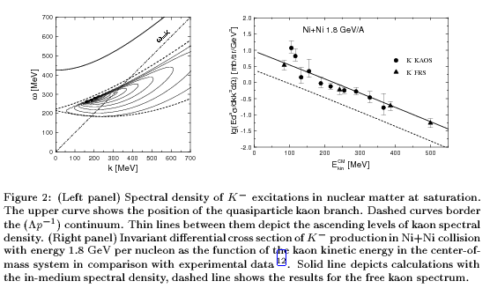
Antikaon spectra in nuclear matter
Description is rather similar to that for pions but with strange baryons included
N=Z n= n₀
dressed K⁻
free K
K- have short mean free path and radiate from freeze out
  Possibility of S and/or P wave antikaon condensation in dense NS interiors
Kolomeitsev, D.V.,Kampfer, Int.J.Mod.Phys. E5 (1996), Kolomeitsev, D.V. PRC68 (2003)

Slide 19

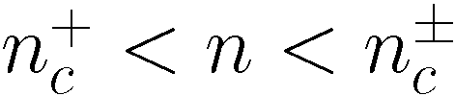
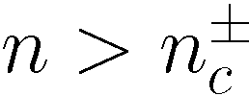
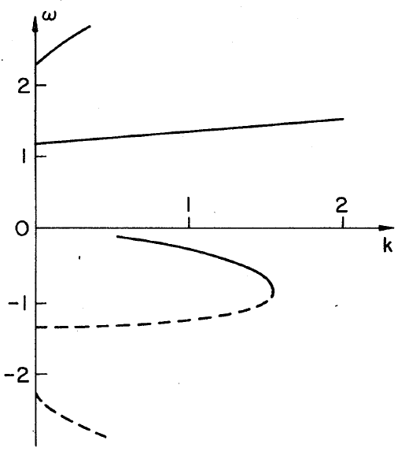






Charged pion spectra in neutron matter and pion condensation
[Migdal,Markin,Mishustin, JETP (1974)]
In variational EoS [Akmal, Pandharipande, Ravenhall, PRC58 (1998)]:
Takatsuka,Tamagaki 1997
π± condensate:
n_{c} ≈ (1.5-2)n₀ N>> Z
neutral pion condensate:

Slide 20

Cooling of neutron stars
After passing a minute after formation, during 10⁵ years a neutron star cools down by neutrino emission, then by photon emission from the surface
White-body radiation problem (at low T<T ~1-few MeV) -- direct reactions
D.V., Senatorov, JETP 1986, Yad. Fiz. 1987
opac
Neutrinos bring information straight from the dense interior
similar to di-leptons from HIC

Slide 21



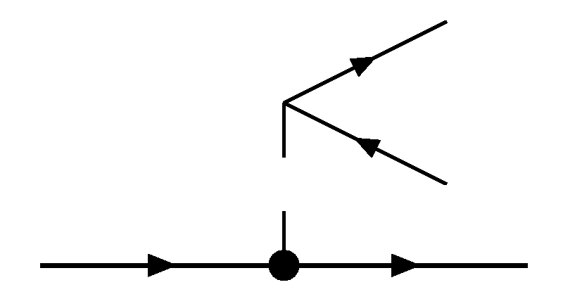




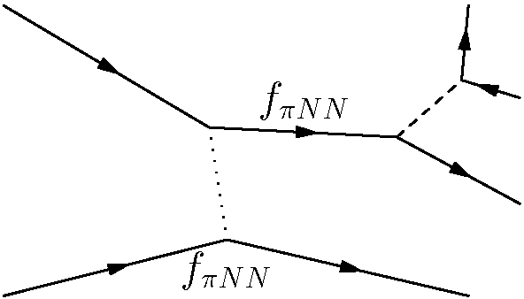
Main reactions in minimal cooling scenario (MCS)-most popular till now
1965 Tsuruta, Cameron and Bahcall, Wolf-standard scenario (SC), D. Page 2004 MCS
Similar scenario by Yakovlev et al.
Cooling: crust is light, interior is massive most important are reactions in dense interior
(where baryon density
n₀ is the nuclear saturation density)
Phase-space separation
G.Gamov
one-nucleon reactions:
direct Urca (DU)
needs 2p_{Fp} >p_{Fn}
not allowed in SC/MCS
Not allowed at least in most of NSs, otherwise too rapid cooling
unpaired nucleon
PBF processes are allowed in presence of pairing
paired nucleon
not included in SC, included in MCS
two-nucleon reactions:
modified Urca (MU)
Main process in SC and MCS, computed with FOPE model of NN interaction
nucleon bremsstrahlung (NB)
(less important)

Slide 22
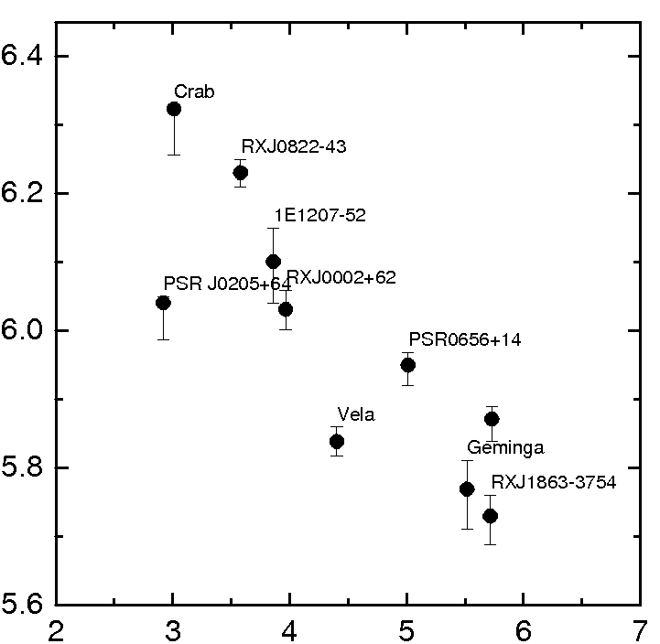



Neutron star cooling
3 groups+Cas A:
∞
>10³ in emissivity
slow cooling
XMMU-J17328
CaS A
intermediate cooling
rapid cooling
Difficult to describe all data in MCS.
With pion softening effect included data are described within one cooling scenario.

Slide 23

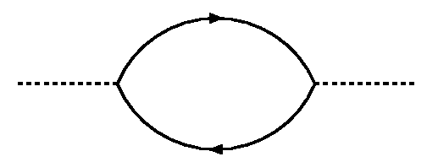
The only diagram in FOPE model which contributes to the MU and NB is
Free one-pion exchange
For consistency one needs !!! to calculate corrections of the second-order in f_{π NN} in all values. Otherwise -- problems with unitarity.
Real part of pion self-energy at order f_{π NN}² :
no fitting parameters
is so attractive that pion condensation would appear already at n>0.3 n₀
But exp. data show that there is no pion condensation in atomic nuclei

Slide 24

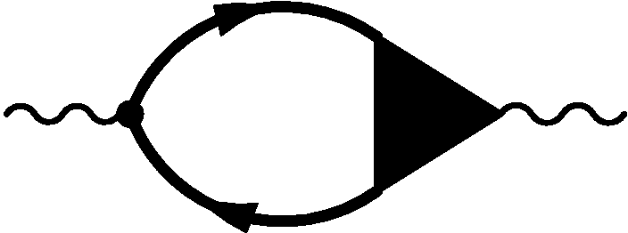
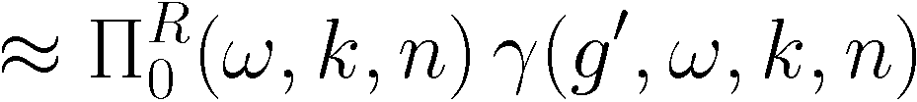
One should replace FOPE by the full NN interaction,
essential part of which is due to MOPE
with vertices corrected by NN correlations.
NN⁻¹ part of the pion self-energy
In isospin-symmetric matter
but pion softening with increase of n

Slide 25
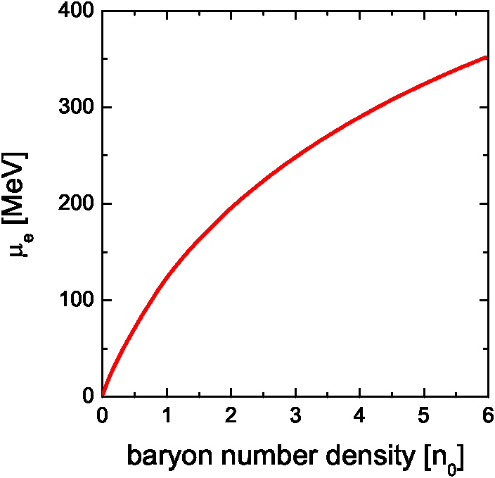


Weak reactions start
In SC and MCS one silently ignores BEC of pions! But within their concept it must be included! If included for n< (1.5-2) n₀, it would result in a too rapid cooling for all NS
(with M>(0.5-1) M_{sol} ).
→ Bose-Einstein π-cond. at k=0

Slide 26
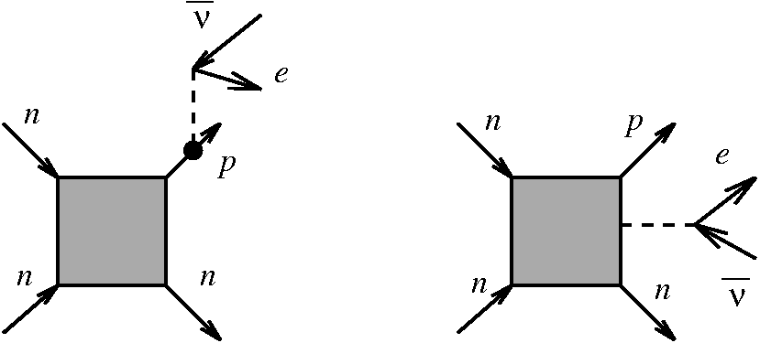

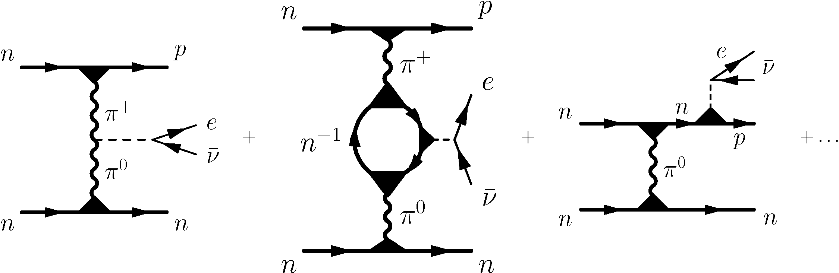
Key proc. in “Minimal cooling scenario” Page,Yakovlev et al.
D.V., Senatorov JETP (1986), A.B.Migdal,E.Saperstein,M.Troitsky,D.V. Phys.Rep.190 (1990)
MMU
Straight generalization of MU
emissivity:
larger
smaller
Very important !
F_{MMU}=
Very strong density
dependence
enhancement factor ~10³ -- 10⁵ for n~(1.5-4) n ₀
MMU-key proc. in “Nuclear medium cooling scenario” Blaschke, Grigorian, D.V. 2004

Slide 27
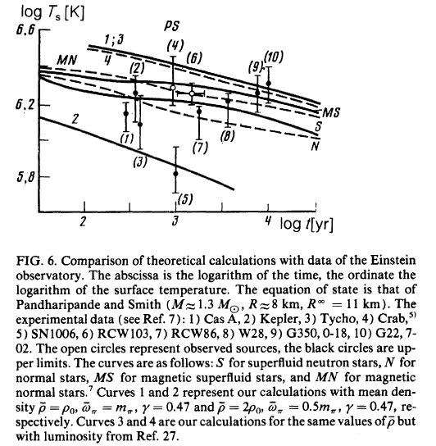

D.V., Senatorov JETP 1986 all the data (only upper limits on T_{s}!) were explained by medium-modified Urca (MMU) process assuming different masses
(different average densities) of NS
Following Brown, Bethe it was thought that
all NSs have masses M≈1.4 M _{sol} ,
With standard scenario
Now it is exp. known that
NS masses are different
Pulsar J0348-04232
M = (2.01± 0.04 ) M_{sol}
PSR J1807-2500B:
M=(1.2064+-0.0020) М_{sol}
1M _{sol}
our
2M _{sol}
Max.
was thought that no
source in Cas A ,
20 years of measure-
ments of T_{s} in Cas A,
~20 other data points.

Slide 28

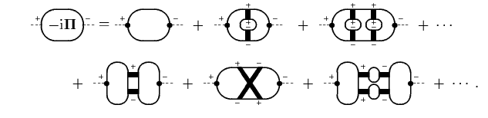
white body radiation problem in non-eq. closed diagram tech.
Most general consideration: Knoll, D.V. Ann. Phys. 249 (1996)
Direct reactions from piece of matter (v in NS, e+e-, γ, K⁺ in HIC)
expansion in full non-equilibrium G ⁻ ⁺
Only for low T<<ε_{F}, quasiparticle approximation is valid
(each G ⁻ ⁺ yields T², allows to cut diagrams over G ⁻⁺ )
For soft radiation: semiiclassics (all graphs in first line are of the same order):LPM effect

Slide 29
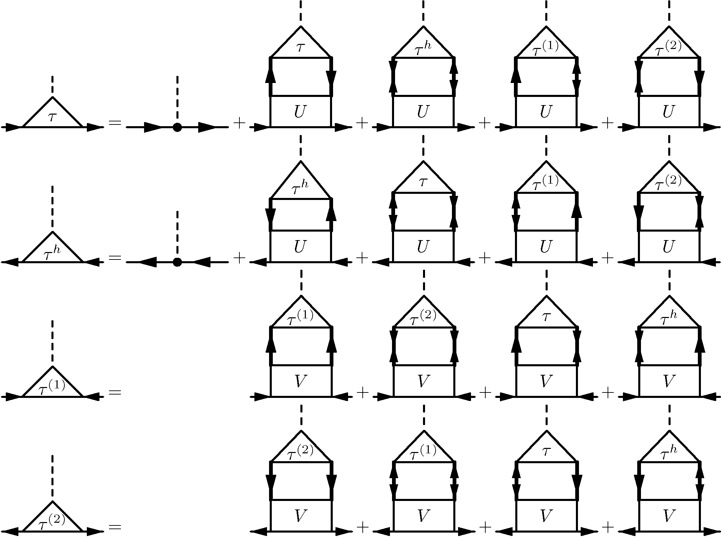
In presence of pairing:Larkin-Migdal equations
Larkin, Migdal 1963
Neutrino processes in presence of Cooper pairing of nucleons: Kolomeitsev, D.V. 2008
taken into account by Senatorov,D.V.1987
in PBF emissivity
Cannot be written in matrix form in Nambu-Gor’kov space since U ≠ V in p-h
and p-p channels. In non-eq. diagr. tech.: Kolomeitsev, D.V. 2011

Slide 30
Constraints on hadron EoS
EoS of the cold hadronic matter should:
(cf. Klähn et al. 2006, Kolomeitsev, Maslov, DV 2015-2018):
satisfy empirical constraints on global characteristics of atomic nuclei
constraints on the pressure of the nuclear mater from the description of particle transverse and elliptic flows and K⁺ production in HIC (flow constraint);
allow for the heaviest known compact stars with mass
allow for adequate description of the NS cooling, most probably without DU neutrino processes in the majority of the known pulsars with M<(1.4-1.5) M _{sol}.
(DU constraint)
yield a mass-radius relation comparable with the empirical constraints (gravitational wave constraint)
solve hyperon and Delta puzzles
being extended to T≠0, appropriately describe supernova explosions and proto-neutron stars, and heavy-ion collision data till T~T _{CEP} , etc

Slide 31
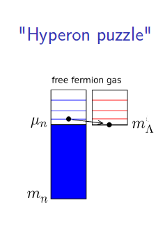
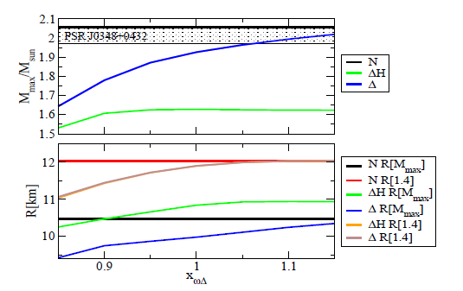
Hyperon and Delta puzzles
a non-linear Walecka RMF model
Filling of new Fermi seas leads to decrease of NS maximum mass

Slide 32
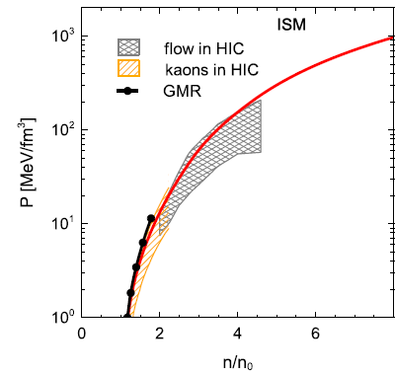
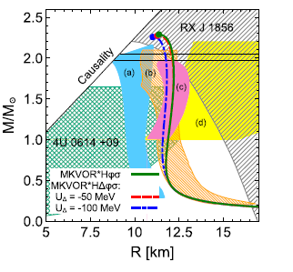
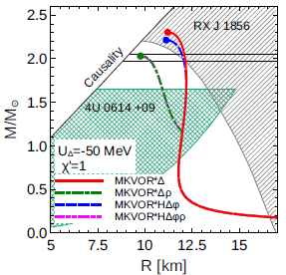
EoS with scaled masses-couplings with included hyperons and Deltas
satisfies main known constraints
M _{max} >1.97 M _{sol} constraint
Our EoS with a cut in ρ sector:
Kolomeitsev, Maslov,
D.V. NPA 2017
Flow constraint
Charged ρ condensation: D.V. Phys.Lett. (1997)
EoS with included charged ρ⁻ condensate also
fulfills constraints
Kolomeitsev, Maslov,D.V. NPA 2018

Slide 33
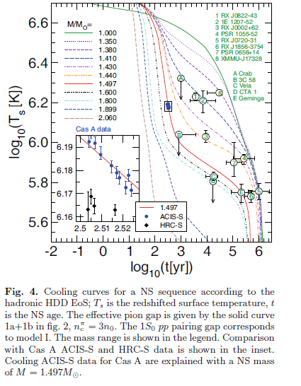
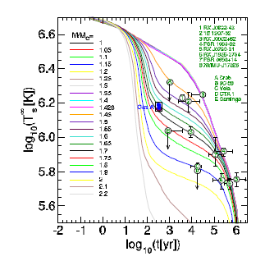
Nuclear medium cooling scenario with stiff EoSs without/with hyperons included
Blaschke, Grigorian, D.V. PRC 2013,
EPJA 2016, HDD EoS without hyperons
Grigorian, Maslov, D.V. 2018: Example of cooling calcul. with stiff MKVOR EoS with hyperons
DU is allowed in our EoSs only for most
massive NSs
MMU-main processes: low mass objects-slow coolers, more massive objects –more rapid coolers. Data are explained with EoSs, as with hyperons, as without

Slide 34
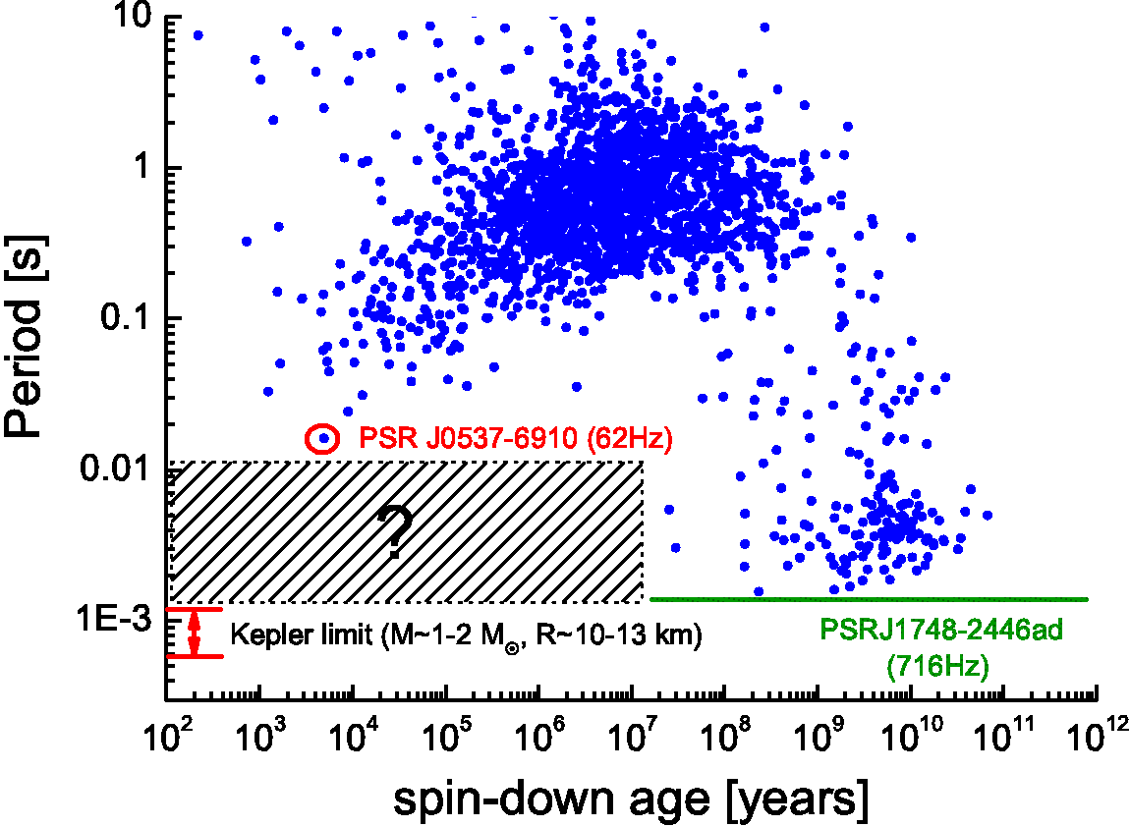

Age-period diagram for pulsars
The ATNF pulsar catalogue
recycled
pulsars
stability of
old pulsars?
Young pulsars periods
are much larger
than the Kepler limit (why ?)

Slide 35
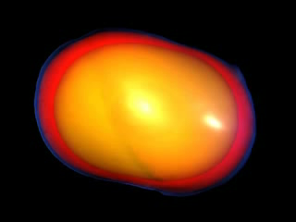
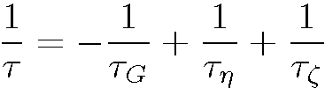
Viscosity effects:
r-mode instability of rotating neutron star and viscosity
In a dense system like a NS the Rossby waves are sources of r-mode instability
1998 Andersson, Friedman and Morsnik
r-modes can either destroy the star
or the star stops rotating
r-mode is stable if
>0
In presence of “soft-mode” bulk viscosity
increases
Viscosity of the dense nuclear matter can damp r-modes and save the rotating star

Slide 36
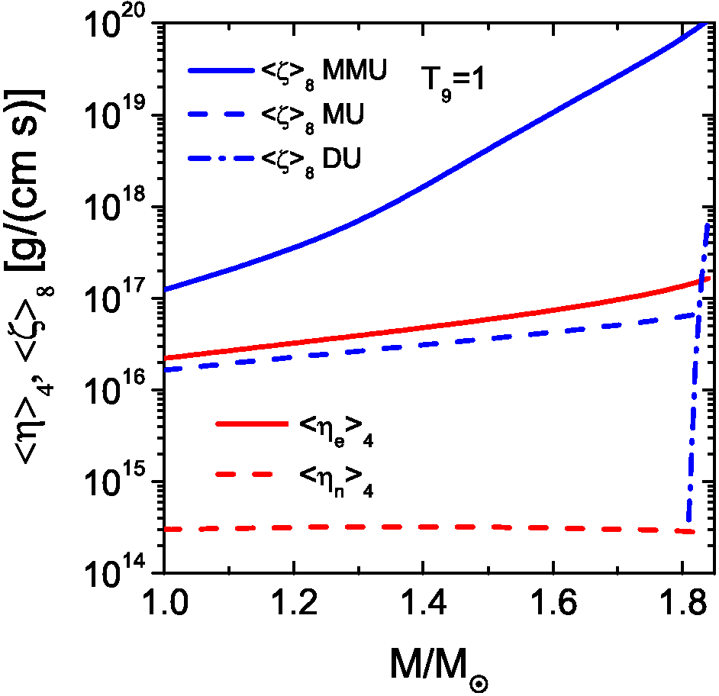


M_{DU} =1.90 M_{sol}
Main term is from MMU
again pion softening
Kolomeitsev,D.V. EPJA (2014), PRC (2015)

Slide 37


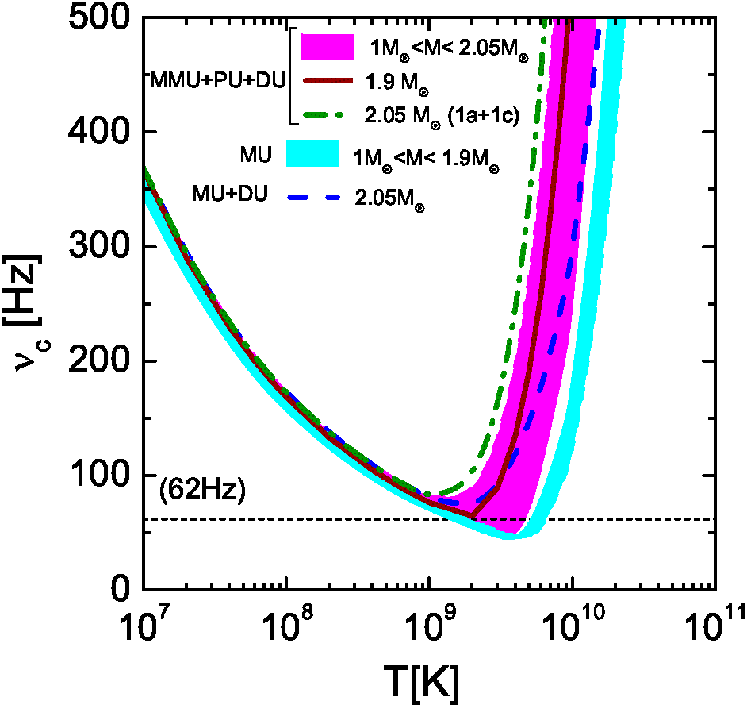

R-mode stability window
+DU
M _{DU} =1.90 M _{sol}
Region of
data on
recycled
pulsars
stable region
shear
bulk
Kolomeitsev,D.V. EPJA (2014), PRC (2015)
62 Hz threshold is reached with MMU for
M>M_{c}^{MMU}=1.84 M _{sol}

Slide 38
Key message – pion is soften in nuclear medium –simultaneous analysis is needed of the relevant phenomena in different domains of nuclear physics: low-density domain, atomic nuclei, neutron stars, supernovas, heavy-ion collisions

