Slide 1

E.E. Saperstein

Slide 2



IAEA Reference Database
for Beta-Delayed Neutron Emission EVALUATION
I.N.Borzov
National Research Centre “Kurchatov Institute”, Moscow, Russia
Bogolubov Laboratory of Theoretical Physics
Joint Institute of Nuclear Research, Dubna, Russia
The Fayans functional :
Fully self-consistent description
of the isospin excitations.
Beta decays.
Global calculations in very neutron-rich nuclei.
INFINUM, BLTP JINR, Dubna 20 – 22 MARCH 2019

Slide 3
    OUTLINE
    Theory
Fayans EDF
Fully self-consistent description of
isospin excitations in neutron-rich nuclei.
(g.s) and (exc. s.) from one and the same EDF
Spin-isospin excitations.
Fayans EDF (g.s) / Approximation: δ(LM) + π+ ρ (exc. s)
    Applications
Isobaric Analog Resonances in long isotopic chains.
Global calculations of beta decay half-lives T1/2.
Gamow-Teller (GT) and first-forbidden (FF) decays.
Notes:
The otiline is as follows/ The theory background. T
First, FULLY-SELFCONSISTENT approach to ISOSPIN exc/ both g/s end exc states from one and the same the Fayans-EDF/ Seconnd – SPIN-ISOSPIN states – g.s from F-s EDF/exc/states with LM-amplitude+pi+rho exch/

Slide 4

Three main families of phenomenological EDF
DF3… -a, -b, -f ,…FANDF⁰
Fayans and collaborators, KI ,Moscow
™since ~1995
BCPM - Barcelona–Catania–Paris–Madrid
( originating from an early work by Baldo et al. )
SeaLL - Seattle–Livermore .
directly parametrize the nuclear EoS by series of powers of the density ;
add corrective terms to account for finite-size and quantum effects and
Coulomb potential and pairing corrections.
Fayans and SeaLL functionals : the Kohn-Sham type EDF
independent-particle kinetic energy , m*=1
2017 - Recently estabilished “ new “ Fayans functional Fy ∆(r)
Notes:
What they have in common ISTHAT they…….
…..///IMPORTANTLY…..
An attempt to marrie the SK EDF with this family. Sucsessful in general…

Slide 5

Self-Consistent Ground State. Fayans EDF.
ρ – dependent denominator of
Fayans EDF
Skyrme EDF
      1. E(ρ) mimics ρ-dependence of Hq in qp-L theory;
      V. Khodel, E. Saperstein Phys. Reports 92 183 (1982)
      It implicitly accounts for energy dependence of qp-L;
      2. Kohn-Sham type of EDF → m=m*.
      Recent development DF3a + deformed HFBTHO :
S.V. Tolokonnikov, I.N. Borzov, M. Kortelainen, Yu.S. Lutostansky, E.E.Saperstein
J. Phys.G 35, 291, 2014.

Slide 6



Volume and surface energy densities:
Pade approximants
ε_{s}(r) – similar Pade-like structure + finite range + density gradient terms accounting for many-body interaction and correlations effects)
Such complicated dependence of interaction energy on real density
E int [ ρ( r ) ]
could hardly appear as an anzats.
It had been founded in the qp-Lagrangian theory
V. Khodel, E. Saperstein Phys. Reports 92 183 (1982)
Notes:
Pairing part the contains the rho dependent term and the term depending on grad(pho)

Slide 7



Pairing energy density
“Making the surface and pairing terms dependent on density gradients, the Fayans functional offers the superb simultaneous description of odd-even staggering effects in energies and charge radii.”
P.-G. Reinhard, W. Nazarewicz Phys.Rev. C95 (2017)
Volume and surface energy densities
“Recently estabilished new Fayans functional” Fy ∆(r)
Notes:
After nearly 20 years of usage of this ansatz by KI group,
Now it is a lot of excitement in the community
about its application to nuclear radii problem

Slide 8





IAS.
Fully self-consistent calculation.
GT and FF.
Self-consistent g.s.calculation
GT and FF.
Effective NN-interaction.
Neglecting the spin-isospin dependent components in E₀ causes
~ 100 KeV error in masses
J. Maurgeron (EP J 2010)
U: Particle-hole channel:
δ-interaction
with Landau-Migdal constant g’
+ π-meson + ρ-meson exchange
1 ≡ (r1, s1, t1).
V: Particle-particle channel:
T=0, δ-interaction
with one parameter: g’ _{pp}
Notes:
Fully self-consistent description in case of IAS/ Approximation for spin-dependent excitations and beta-decay/
Next slide /

Slide 9
Continuum pnQRPA. Full ph-basis, SO(8) symmetry
SO(8)
Self-consistent pnQRPA
B.L. Birbrair Nucl. Phys. A108, 449 (1968)
SO(4)
Standard beta decay Tables
P. Moeller et al., Phys. Rev. (1996, 2003, 2012)

Slide 10
IAR. Fully self-consistent approach.
H.Liang, Nguen Van Giai, J. Meng Phys.Rev.Lett. 101 (2008).
E_{IAR} and E_{A-IAS} are related to “neutron skin” ΔRnp
X. Roca-Maza et al., Phys.Rev. C 94 (2018)
The IAR is calculated based on the same EDF
as the one used for masses, charge radii etc.
N.I. Pyatov, S.A. Fayans PEPAN 14(4), 953 (1983).
V.A. Rodin, M.G. Urin., Phys.Atomic Nuclei 66, 2128 (2003).
G.V. Kolomiytsev, M.L. Gorelik, M.G. Urin, Eur. Phys. J. 54, 228 (2018).

Slide 11
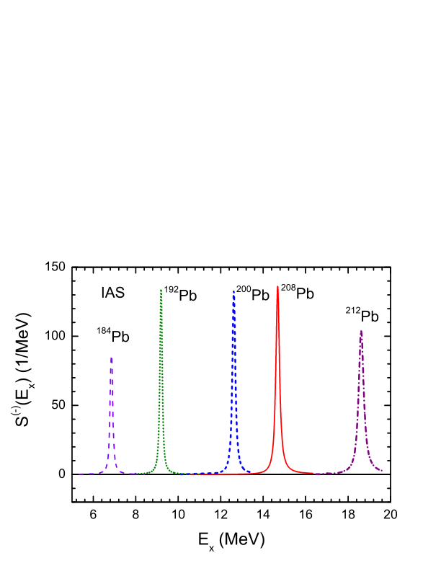
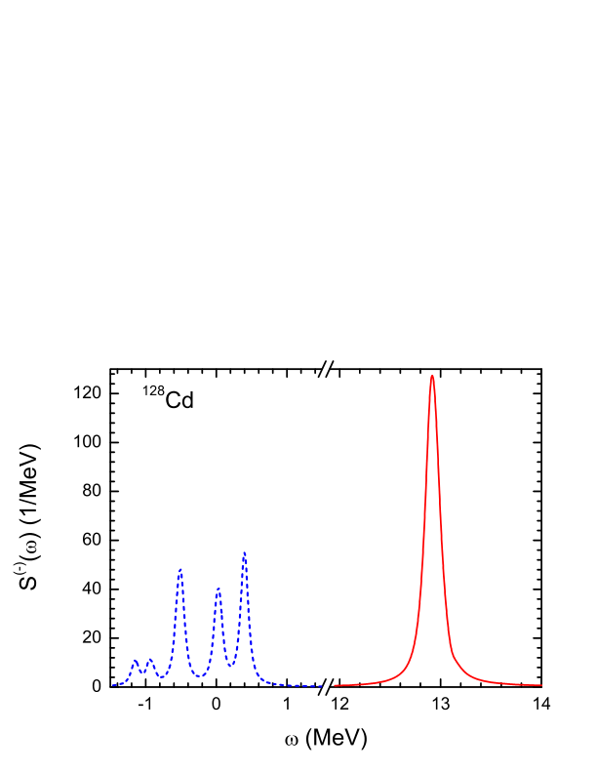
IAR check of self-consistentcy.
IAS degeneracy is broken on the mean field (HF+BCS) level.
It should be restored in self-consistent DF+QRPA.
CVC – small width (in nuclear scale)
Including the S=0, T=1 g.s. and dynamical pairing is crucial for full consistency. In this case the strengths has been fairly collected in a single peak .
(Artificial width is included … just for convenience…)
“ Doubly -non-magic “ Cd and semi-magic Pb isotopes .
I.N.B., S.V. Tolokonnikov, Phys. At. Nucl. (in print, 2019)

Slide 12
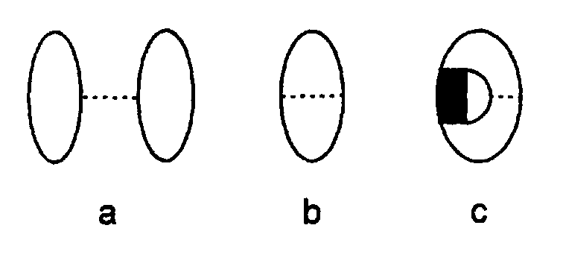
DF3-f 1. self-consistent RMF-like 2-body spin-orbit;
2. screening of Coulomb exchange term
Exchange Coulomb screening.
If one sets Vc exc=0
it removes the Nolen-Shiffer anomaly
h _{Coul}
σ
A. Bulgac, V.R. Shaginyan, Nucl.Phys.A601, 103 (1996).
DF3-f : IAS description in 208Pb and binding energy difference in mirror nuclei
demands from ~ 50~% to ~ 80% reduction of Vc_exch

Slide 13
IAR energies in reference Ca, Sn,Pb isochains.
DF3-f functional
Without V_Coul_exch :
Overall deviation:
|Eth | is ~ 200KeV
ΔEth/Eexp ~ < 1 %
cf. SAMi
Underestimate of E(IAR)
ΔE= - 200 – 900 KeV
ΔEth/Eexp ~ < 5%
Up to ~ 10 times larger
DF3-f I.N.B., S.V. Tolokonnikov Phys. At. Nucl . (2019).
SAMi : X.Roca-Maza et.al. PRC 94 (2018).

Slide 14
IAR energy in the reference 208 Pb nucleus. V_exch =0
E(IAS) exp =18.862 (0.2) MeV
DF3-f
E_theor – E exp= minus 82 KeV
Delta E/Eexp= minus 0.4 %
cf. SAMi => minus 1 % – 4.8 %
Rch_exp=5.5010(9)fm
DF3-f
Rch_theor=5.5040 fm
|Delta Rch/Rexp|=0.05 %
cf. SAMi => 0.2 %
DF3-f I.N.B., S.V. Tolokonnikov, Phys. At. Nucl. (in print, 2019)
S.A. Fayans JETP. Lett 68, 169 (1998); Nucl.Phys. A676, 49 (2000)
SAMi X.Roca-Maza et.al. PRL 102 (2018) - ISB, PRC 94 (2018) Coulomb exch.

Slide 15

IAEA Reference Database
for Beta-Delayed Neutron Emission EVALUATION
Nuclear Data sheets (2019, in press)
Comparison of self-consistent global approaches
DF + Continuum QRPA (2003)
DF3 - spherical , full basis, GT+FF
quasi-spherical nuclei;
I.N.Borzov, PRC 67 (2003)
Relativistic HB + QRPA (2016)
D3C* - spherical , GT+FF →
all nuclei;
T. Marketin et al. PRC 93 (2016)
Finite Amplitude Method (2015),
Sk(yrme) O’ - deformed, GT+FF →
all nuclei.
J. Engel et al. PRC 93 (2015 )
DF3
DF : Quality of the ground state description:
quasi-particle energies and Q_{β} , S_{xn} values.
Account for g.s. spin inversion: correct J/π g.s.
RHB
QRPA : Reliability of β–strength functions.
Two main beta decay channels :
Gamow-Teller (GT) and first-forbidden (FF).
NB! Balance of the GT and FF decays
% of FF vs. % GT !
FAM
Notes:
Global – based on s-c g/s, for Large-scale calc/ parameters are kept the same for all A

Slide 16
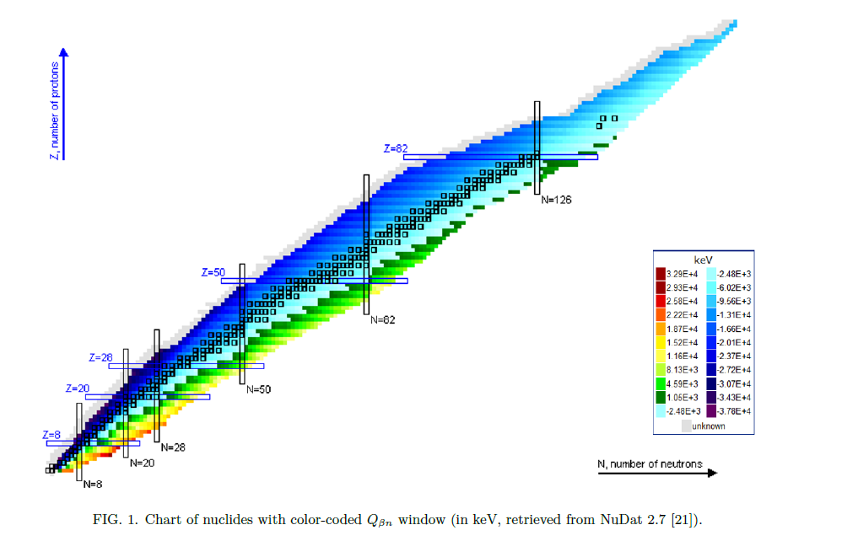
Beta decay energy release
Transition energies ω are correlated with Q_{β} : ω ≤ Q_{β}

Slide 17
Ground state properties of the reference Ni, Sn isotopes.
Q_{β ,} S_{xn} and ɛ (q-p) are treated on the same footing .
FAM > 1MeV underestimate of exp. and eval. data
DF3a : |ΔQ_{β}| ~ 500 – 700 KeV.
Underestimate of the Q _{β ,} Sxn as well as
deviation of the single-particle energies from the experimenal ones
may distort the β-decay half-lives, Pn values…
I.N.B. Phys.Rev. C 67 025802 (2003); Phys. At. Nucl. 79 (6) 921 (2016).

Slide 18
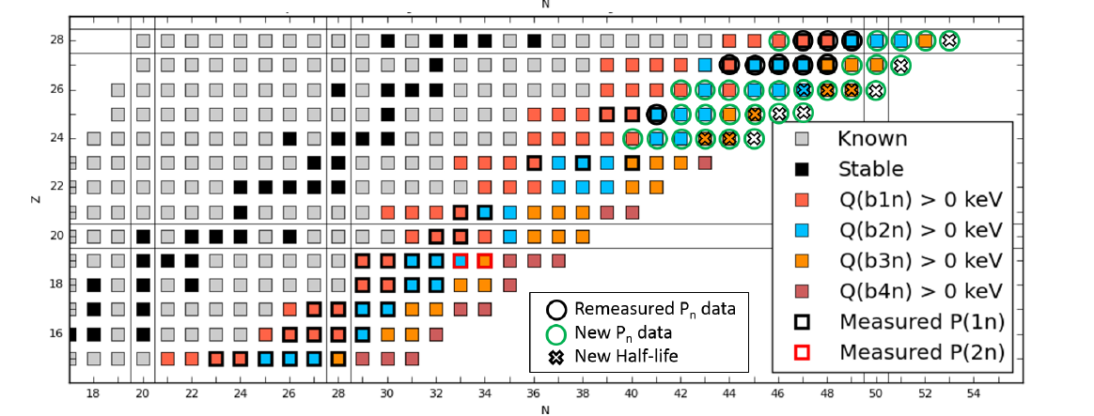
Very neutron rich isotopes in Ni region
Notes:
DN emission/
Shown are the known nuclides, possible DN emmiters up to 4n and measured ones/
Measured Co, Cu Ni isotopes/
A challenge is – 78Ni and beyond/

Slide 19
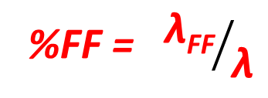
Z~ 28, N ~ 50 REGION: T1/2 in DF3, RHB,FAM
DF3+ CQRPA
good at N<50 , 30% higher for N>50
FRDM
spurious staggering (S=1 T=0 paring)
RHB, FAM :
T1/2 too long at N<50, a kink at N =50,
… but in agreement with the RIKEN data for N>50
%FF = ${\text{λ}\text{FF}}/{\text{λ}}$
DF3 predicts: negligible %FF at N<50
DF3 and FAM: moderate %FF at N>50
Balance of the GT and FF strengths
is what counts!
Notes:
Typical example / A comparison of the performance of the QRPA based on
the Fayans functional R-DD-ME-1/ SkO’ – within FAM/
Also a micro-macro standard FRDM is shown/
Balance of the GT and FF strengths is what counts !

Slide 20

N ~ 50 REGION: low GT strength in Qb-window and excessive FF strength.
Z ~ 28, N ~ 50 REGION: Comparison of T1/2 in DF3, RHB, FAM
N≤ 50
Main GT
n0f5/2→p1f 5/2
vs.
Unique FF
(rank 2, Δ J=2)
n0g9/2→p1f 5/2
N=50
GT
Z=28
N > 50
Non-unique FF
(rank1, Δ J=0,1)
n1d5/2→p0f 5/2…
Non-unique FF
Balance of the GT and FF strengths
Is crucial .
It should comply with
FF decays reduction factors !
%FF = $\text{λ}\text{FF}\text{ / }\text{λ}$

Slide 21
Global calculations (T1/2, Pn)
FRDM+RPA
DF3+CQRPA
RHB+RQRPA

Slide 22
Isotopes around 78Ni and 132Sn
Z =27 -35
Ni isotopes
β2=0.0 - 0.03
⁸³⁻⁸⁶Ga
β2=−0.104 to +0.183
Z =44 -52
β2= 0.0 - 0.03
¹²²⁻¹²⁴ Ag
β2=−0.124

Slide 23
Isotopes around 78Ni and 132Sn
Z =27 – 35, β2 = 0.00 – 0.05
Z>28 and N>50, 0.1< | β₂| < 0.2
Z = 45 – 52, β2 = 0.00 – 0.03
¹²²⁻¹²⁴ Ag β2=−0.124
FRDM 2012

Slide 24
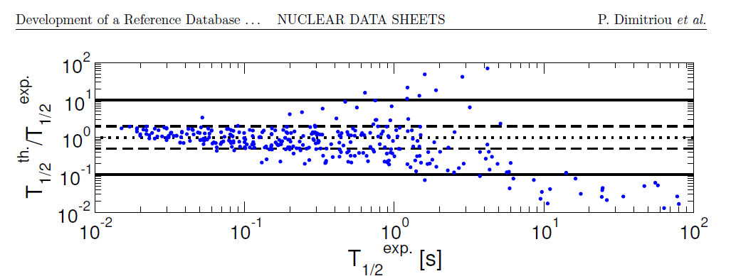
RHB+pnQRPA
Spherical RHB. No selection on the β₂ .

Slide 25
For the g.s properties:
Fully self-consistent model based on Fayans density functionals reached an accuracy of the micro-macro model FRDM
For IAR :
Fully self-consistent calculations of the IAR in in long isochains are performed including “doubly-non-magic nuclei”.
For beta-decay: with the GT and FF decays incl. the EDF based calculations have a higher accuracy then FRDM.
% FF to %GT - indicator has to be under control.
It should be consistent with the FF reduction factors and available decay schemes!
The applications of the Fayans pairing functional become very popular nowadays … R-charge
Self-consistent IAR and beta-decay model
based on the Fayans EDF

Slide 26


Acknowlegments
E.O. Sushenok, N.A. Arsenyev, A.P. Severyukhin, V .V. Voronov
BLTP, JINR, Dubna
S.V. Tolokonnikov
NRC “Kurchatov Institute”, Moscow
N. Van Giai, D. Verney, D. Testov IPN, Orsay
Supported by the Russian Scientific Foundation grant 16-12- 10161
The IAEA support of participation in the CRP
«Development of a Reference Database for Beta-Delayed Neutron Emission»
during the RCM-2 and RCM-3 Meetings is gratefully acknowledged.

Slide 27
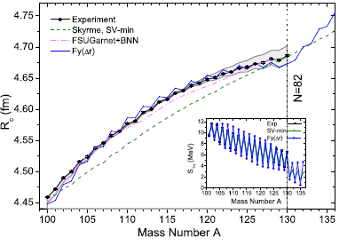
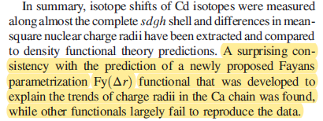
“Making the surface and pairing terms dependent on density gradients, the Fayans functional offers the superb simultaneous description of odd-even staggering effects in energies and charge radii.”
P.-G. Reinhard, W. Nazarewicz Phys.Rev. C95
“Recently estabilished new Fayans functional” Fy ∆(r)
PHYSICAL REVIEW LETTERS 121, 102501 (2018)

Slide 28
IAEA CRP Development of a Reference Database for Beta-Delayed Neutron Emission Nucl. Data Sheets (2019)
Very neutron rich isotopes in heavy Ca region

Slide 29
s-o interaction.
( important for full consistency)
E_{sl} corresponds to 2-body spin-orbit interaction
DF3 f : the isovector spin-orbit is small cf. to the isoscalar s-o,
as in RMF k’ = k^{nn} – k^{pp} =0, k=0.19.
Velocity and spin dependent interaction (LM 1st harmonic)
S.A. Fayans JETP. Lett 68, 169 (1998); Nucl.Phys. A676, 49 (2000)

Slide 30
Volume and surface energy densities:
Pade approximants
ε_{s}(r) – similar Pade structure + finite range + density gradient terms
( accounting for many-body interaction and correlations effects)
Notes:
Pairing part the contains the rho dependent term and the term depending on grad(pho)

Slide 31
IAR. Self-consistent calculation
DF3-f +200кэВ
DDME-1 - 200кэВ
PKO-1 < - 900кэВ
DF3-f : I. N .Borzov, S. V. Tolokonnikov, Phys. At. Nucl. (2019).
DD-ME1: N. Paar, T. Niksic, D. Vretenar and P. Ring, Physical Review C 69, 054303 (2004).
PKO-1 : Z. M. Niu , H. Z. Liang, W. H. Long and J. Meng , Phys.Rev. C 95, 044301 (2017)
p,n) data : R. Pham et.al., Physical Review C 51, 526 (1995)

Slide 32
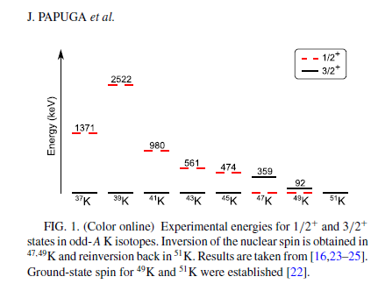
Potassium isotopes. Q_{β} - Sn = Q_{βn} values.
Only 6 mass units beyond N=28
Q_{βn} increases by a factor of 15
1n – 4n emission possible!
Spin inversion @ N= 28 , 30
Followed by re-inversion @ N=32
Phys.Rev.C90 , 034321 (2014)
How theory describes the exp. data on Q_{βn} , T1/2 and Pn tot in the inversion region and at N=32, 34 shell-closures?
How the Pn tot is distributed between 1n - 4n phase-subspaces

Slide 33
Half-lives and Pn tot. ₁₉ K isotopes
1. Stabilization of the T1/2
@ N=32 where
g.s. spin re-inversion 1/2 +→ 3/2 + occurs.
Q(A=50) ∞ Q(A=51) and GT dominance.
2. Acceleration of β-decay
@ N=34+1
35th-neutron opens up a strong GT transition
Deviation of the Pn tot
of DF3+CQRPA and RQRPA
@ N=32 +1
Pn tot @ A ≥ 34 are close
in DF3+CQRPA and RQRPA

Slide 34
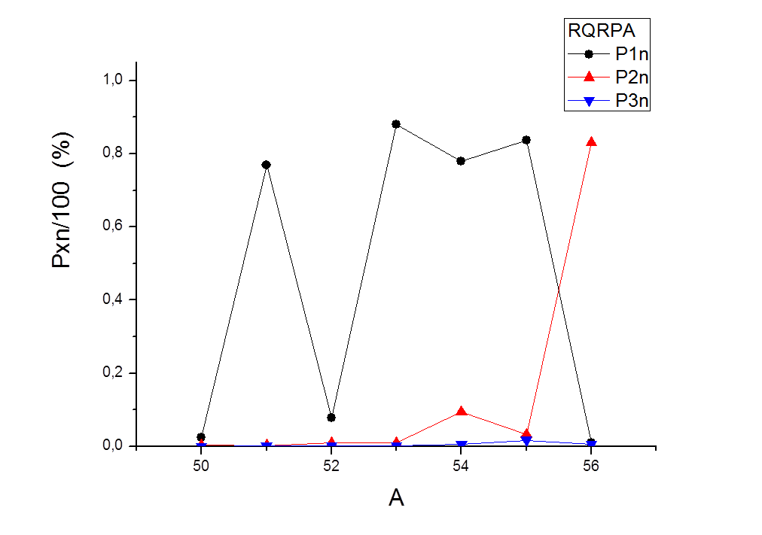
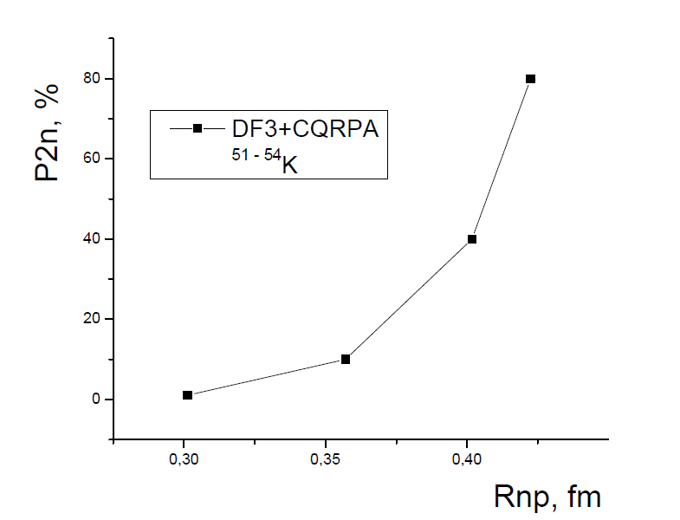
DF3 vs RHB: DF3 predicts giant P_{2n} values in ⁵³⁻⁵⁶K isotopes.
DF3+CQRPA I.N.B. Phys.At. Nucl. 81, 1-15 (2018)
A=52 P _{1n} = 41.6% , P_{2n} =11 % , P tot=52.6%
stands for Pn tot exp = 73%
RQRPA T. Marketin et al. PRC 93 (2016)
Correlation of P2n with ΔRnp!
A=52 Ptot=8.9% << P exp=73%

Slide 35
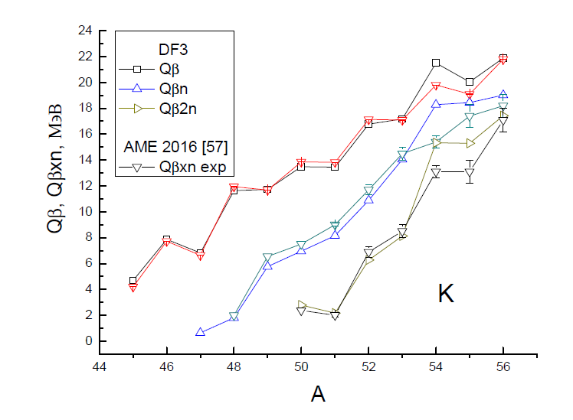
Q_{β ,} S_{xn} in Ca region.
|ΔQ_{β} | th-exp for A=49-51 ~ 258 KeV ,
|ΔQ_{βxn}| eval – exp for A=54 ~ 400 – 1000 KeV.

Slide 36
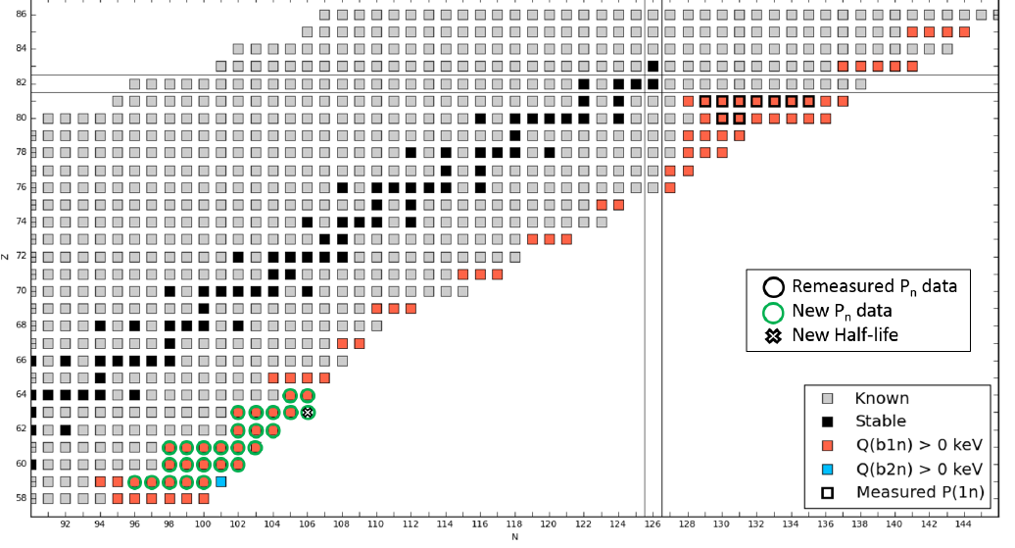
N ~ 126 isotopes west of 208Pb

Slide 37
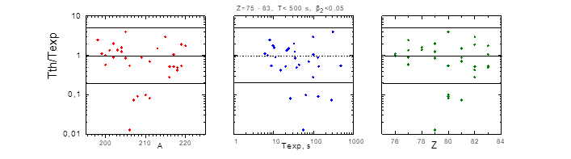
The most heavy nuclei for which
T1/2 and Pn have been measured:
Z=76 – 83 (Os – Bi)
DF3: T_{1/2} th / T_{1/2} exp ~ 5 vs. 10 - 10(2) RHB+QRPA

