Slide 1

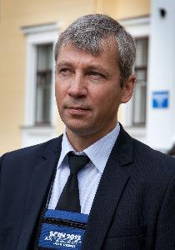
STATUS OF THE NICA PROJECT
07.10.2016
D. Peshekhonov, LHEP-JINR

Slide 2

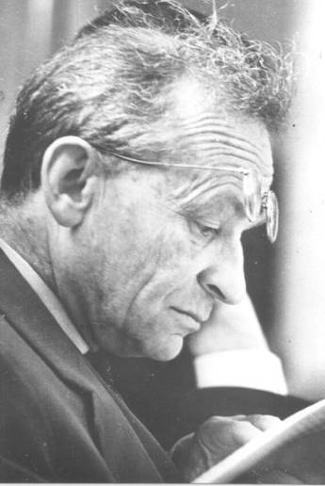

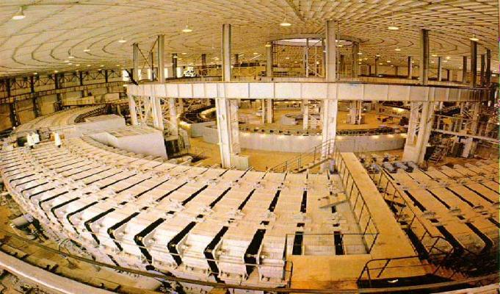
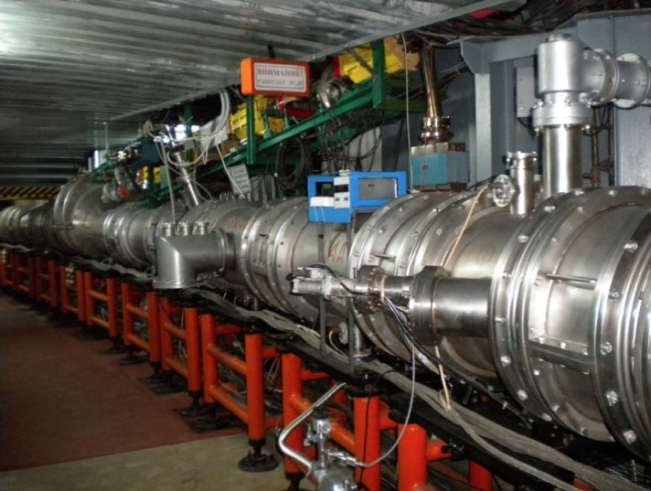
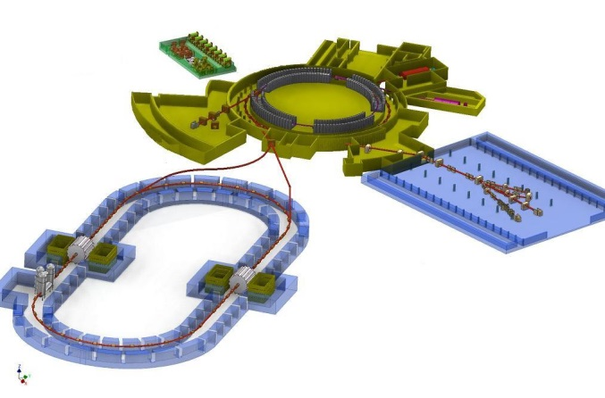
NICA – the flagship JINR project in HEP
1957
Synchrophasotron
1993
Nuclotron
2019
NICA
10 GeV proton
synchrotron –
leader in energy
The beginning
of high
energy physics
The first SC
Accelerator
of heavy
ions
SC collider of
heavy ions
Investigation of nuclear matter at extreme densities
V.I. Veksler
A.M. Baldin

Slide 3
SCIENTIFIC PROGRAM
Main targets of the NICA complex:
- study of hot and dense baryonic matter at the energy
range of max baryonic density
- investigation of nucleon spin structure &
polarization phenomena
Requirements:
- design and construction of accelerator facility providing
intensive beams of relativistic ions from p to Au,
polarized protons and deuterons
with energy up to
√S_{NN}= 11 GeV (Au⁷⁹⁺) and =27 GeV (p)
- development of a modern experimental complex

Slide 4
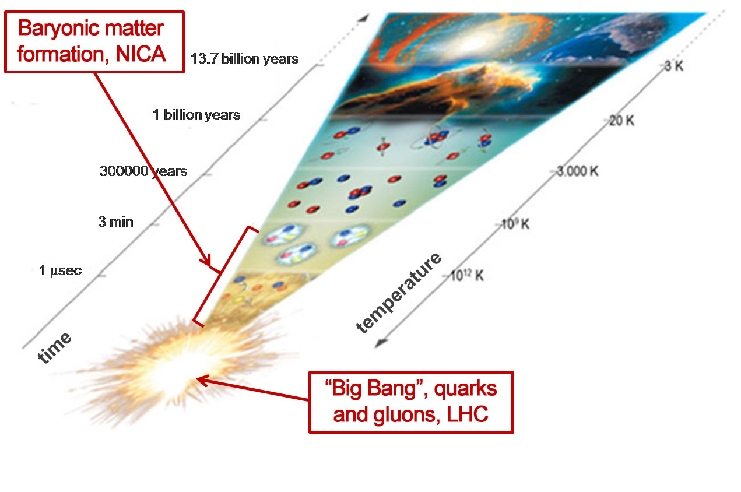
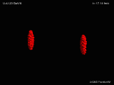
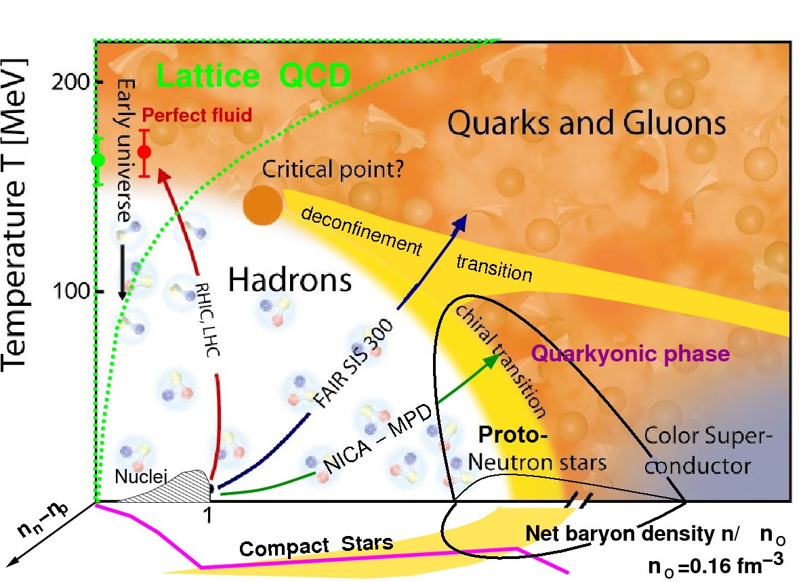
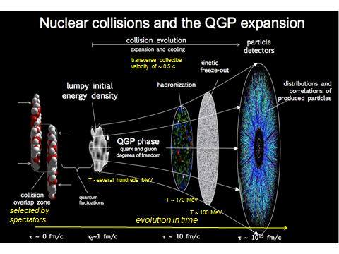
STUDY OF HOT & DENSE
BARYONIC MATTER
The most intriguing and unexplored
region of the QCD phase diagram:
Highest net baryon density
Onset of deconfinement
phase transition
Strong discovery potential:
a) Critical End Point (CEP)
b) Chiral Symmetry Restoration
Complementary to the RHIC/BES,
CERN and FAIR experimental
programs

Slide 5
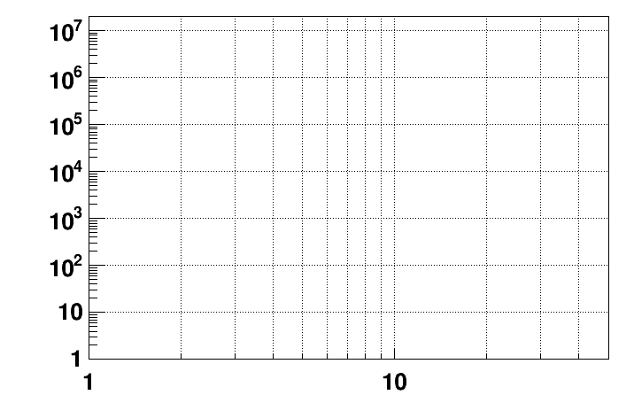
EXPERIMENTAL STATUS
CBM
energy region of max.
baryonic density
SIS-100 SIS-300
NICA/BM@N II
NICA/BM@N I
HADES
NICA/MPD
Interaction rate [Hz]
STAR F.T.
STAR BES II
NA-61/SHINE
Collision energy √S [GeV]
NN

Slide 6
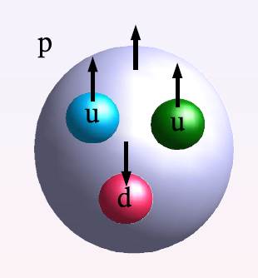
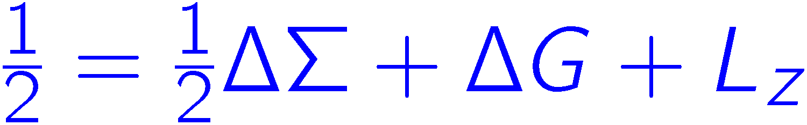
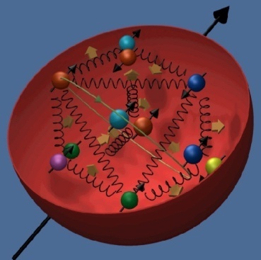
PHYSICS OBJECTIVES
IN SPIN PHYSICS
Spin is an intrinsic property of quantum objects.
Constituent QM: up and down quarks carry the nucleon spin.
EMC (CERN): Quarks spins contribute little (1987) SPIN CRISIS
= 0.12
quarks gluons orbital
~0.3
0±0.5
unknown

Slide 7
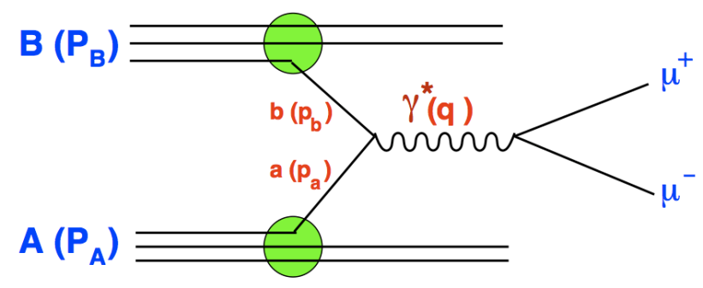
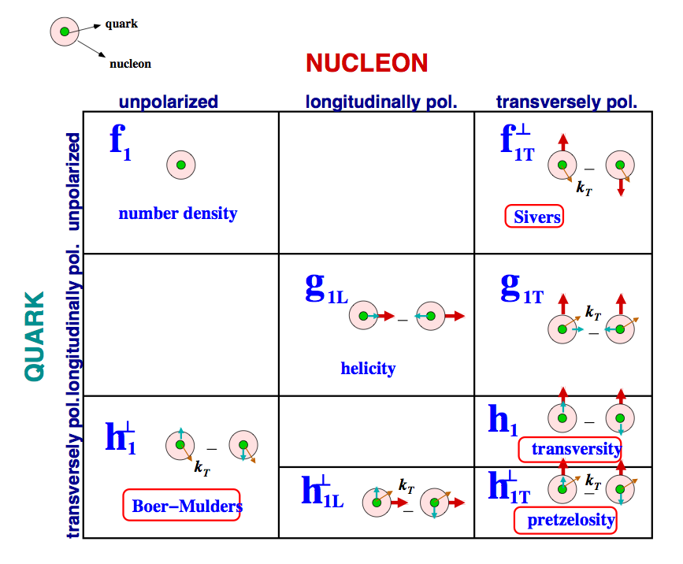
PHYSICS OBJECTIVES AT NICA
Drell-Yan process
No fragmentation functions !

Slide 8
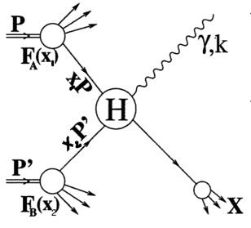


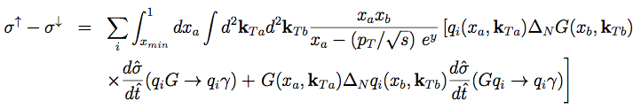
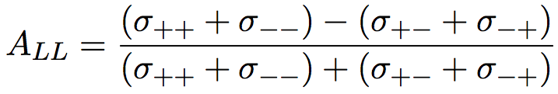
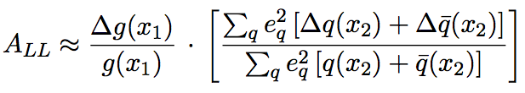

PHYSICS OBJECTIVES AT NICA
DIRECT PHOTONS
Hard processes:
q g→q γ 85%
q qbar→g γ 15%
single transverse spin asymmetry provides
access to the Sivers function of gluons
double longitudinal spin asymmetry gives
access to gluon polarization

Slide 9


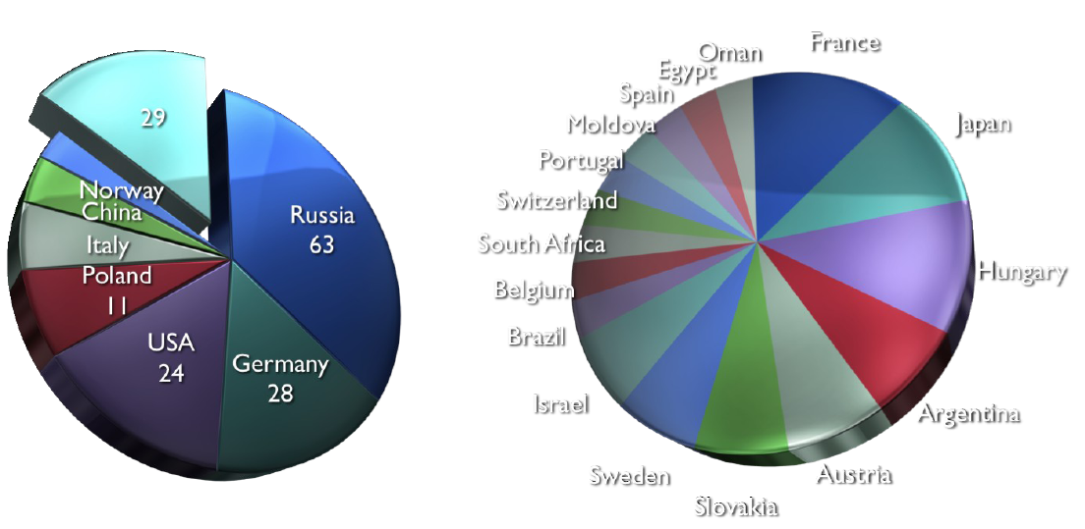
NICA White Paper – a truly international effort
T.D. Lee: “The NICA heavy ion collider will be a very major step towards the formation of a new phase of quark-gluon matter.”
Statistics of White Paper Contributions:
111 contributions,
188 authors from 70 centers in 24 countries
Notes:
9

Slide 10
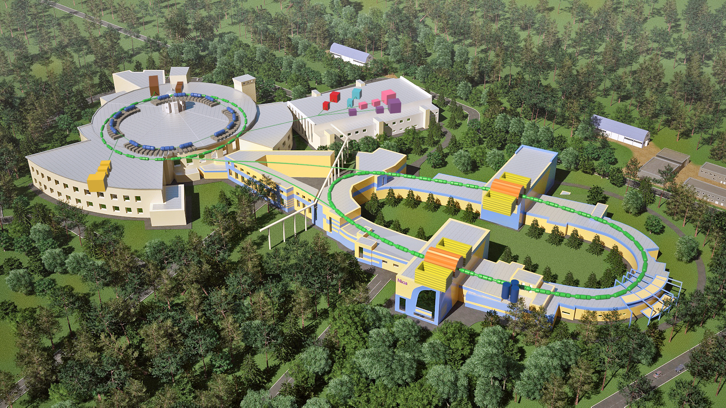

Slide 11
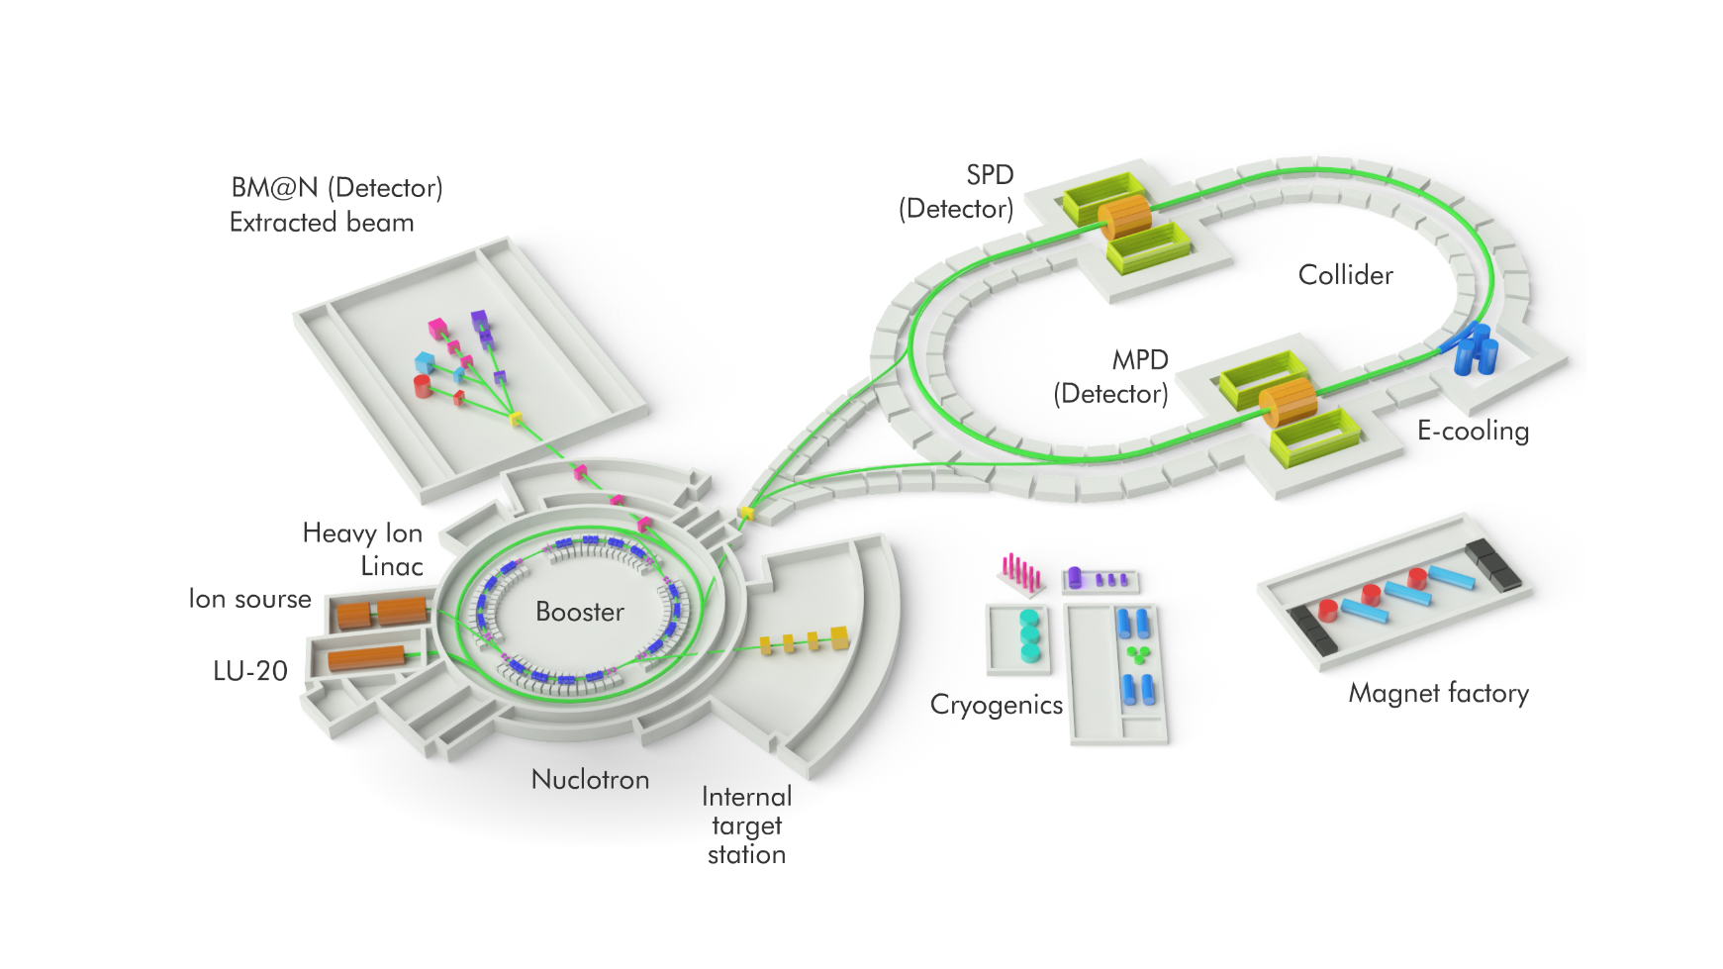
MAJOR BLOCK OF THE NICA
Injection Complex , Booster, Nuclotron, Collider
Infrastructure, Magnet production line, Cryogenic Complex, Computing
Detectors: BM@N , MPD, SPD

Slide 12
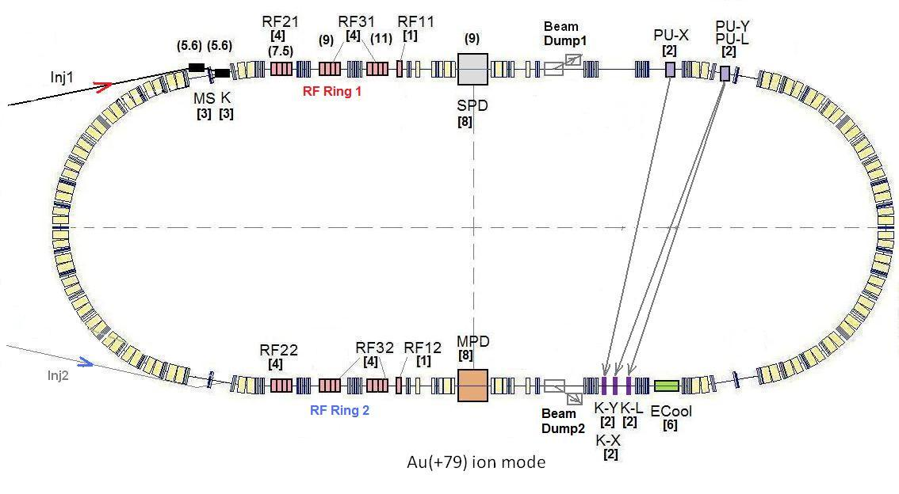
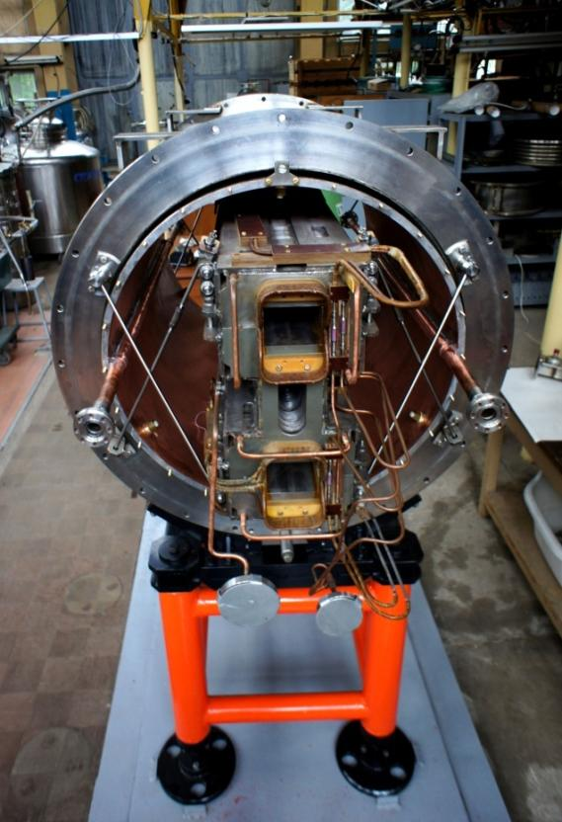
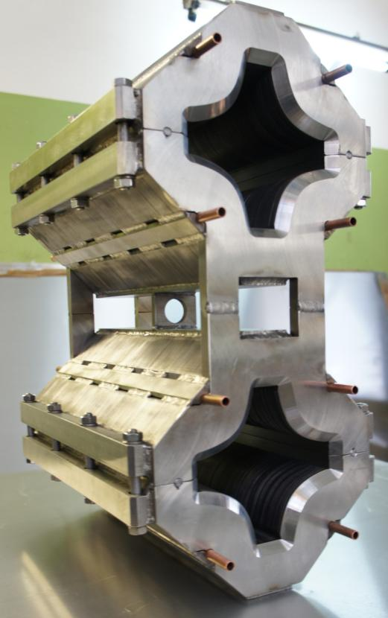
Collider basic parameters:√s_{NN} = 4-11 GeV;
beams: from p to Au; L~10²⁷ cm⁻² c⁻¹ (Au), ~10³² cm⁻² c⁻¹ (p)
SPD
Ring circumference, m | 503,04
Number of bunches | 22
r.m.s. bunch length, m | 0,6
β, m | 0,35
max. int. Energy, Gev/u | 11,0
r.m.s. Δp/p, 10⁻³ | 1,6
IBS growth time, s | 1800
Luminosity, cm⁻² s⁻¹ | 1x10²⁷
MPD
Double aperture magnets:
dipole & quadrupole
prototypes

Slide 13
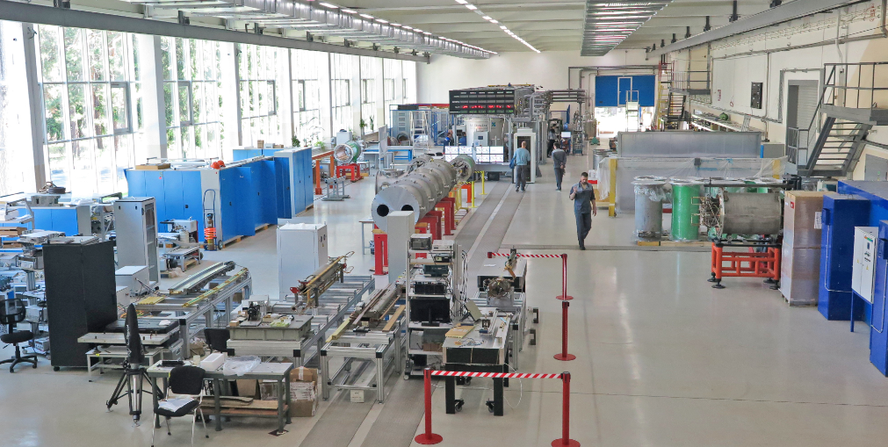
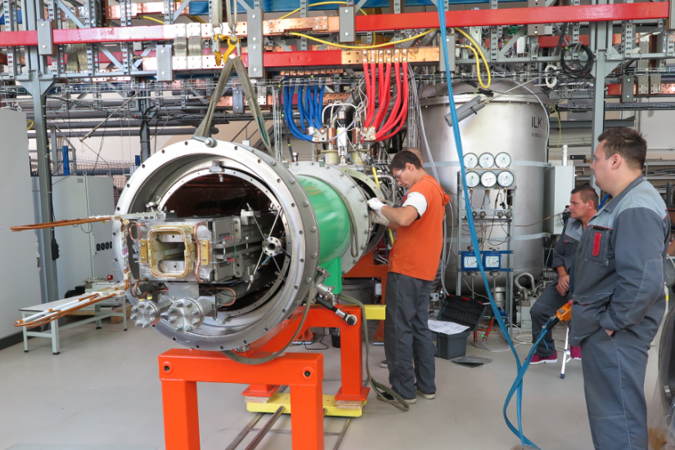
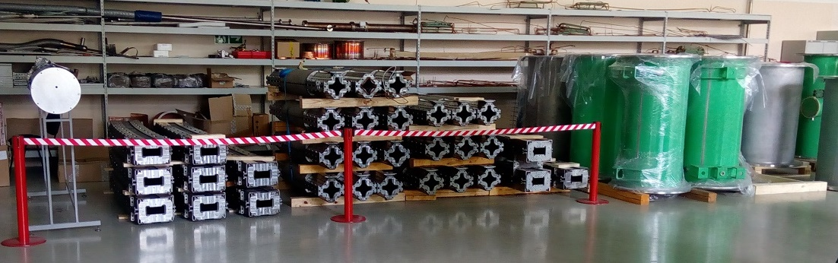
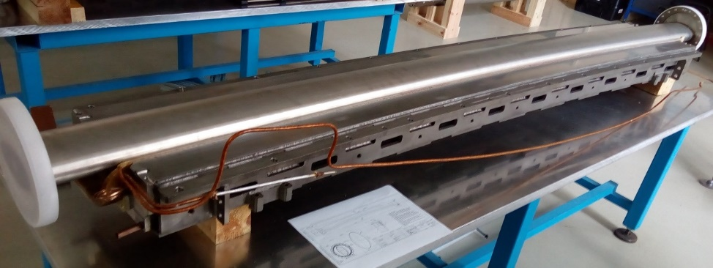
SC Magnets for Booster, Collider & SIS-100/FAIR
workshop at VBLHEP JINR (bld. 217)
procurement of magnet systems is in progress
Serial tests of Booster magnets has started

Slide 14
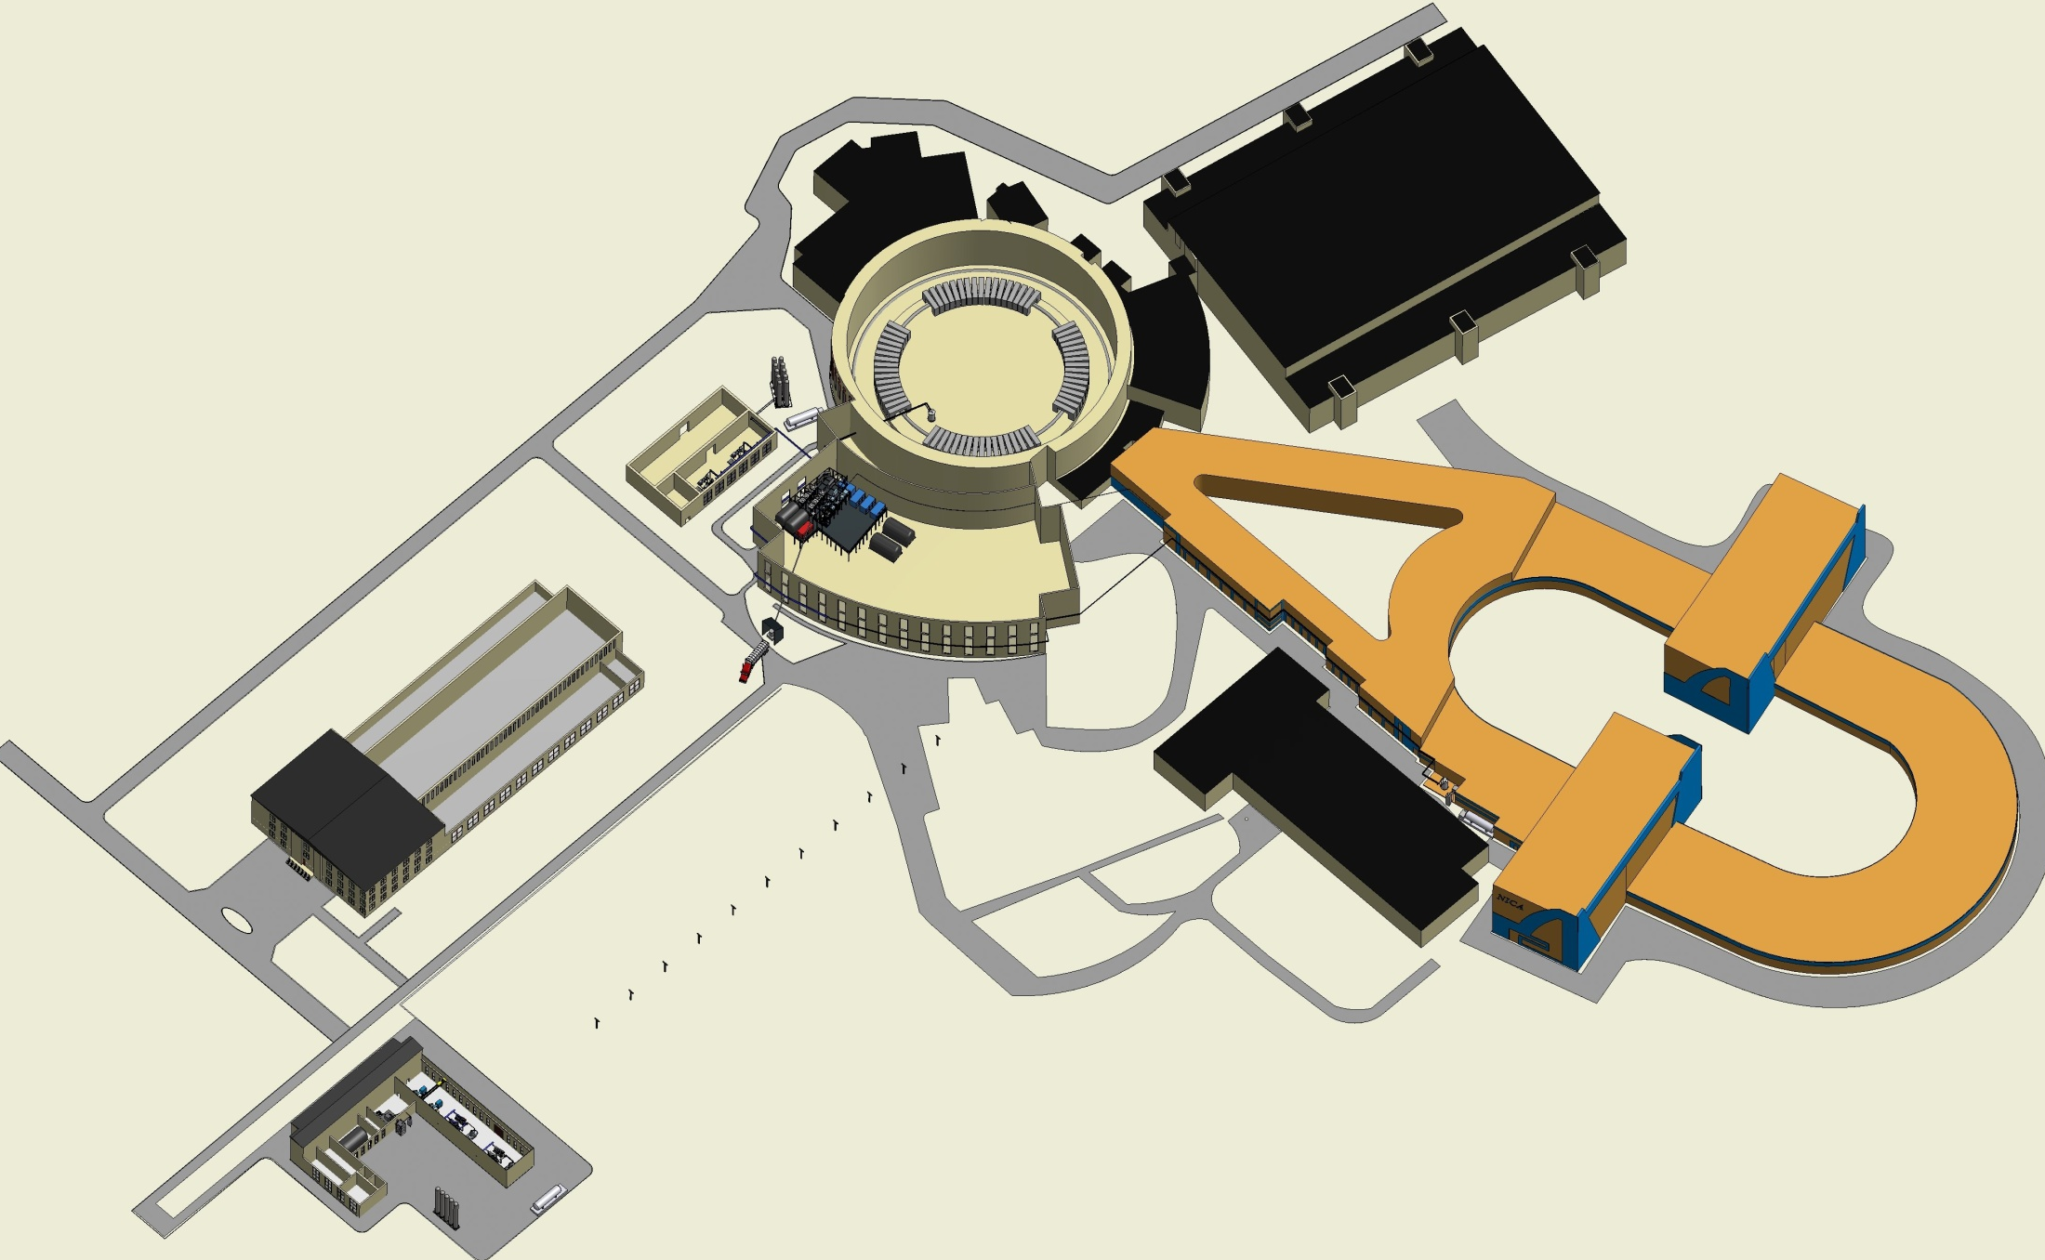
Development of the NICA Cryogenics
LHe Liquefier OG-1000
(the final stage of commissioning):
(2010-2016)
Gaseous He purification system:
25% completed
(2016-2017)
He satellite refrigerators for Collider & MPD magnet:
5% completed
(2014-2018)
Helium satellite refrigerator of Booster and Collider:
5% completed
(2016-2017)
LN2 Re-condensation
(liquefier + 2 compressors)
50% completed
(2012-2018)
Two He screw
compressors
(delivered):
95% completed
(2011-2016)
LHe 40m3 reservoir:
20% completed
(2016-2017)
The cooling power
should be doubled
from 4 kW to 8 kW @ 4.5K
Construction of the new compressor station:
(2015-2017)of 8 kWat 4.5 K

Slide 15

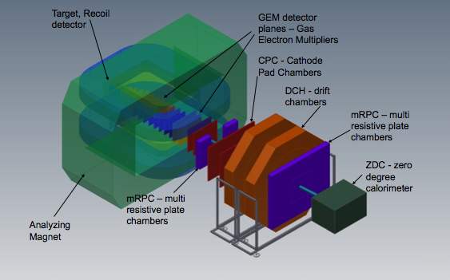
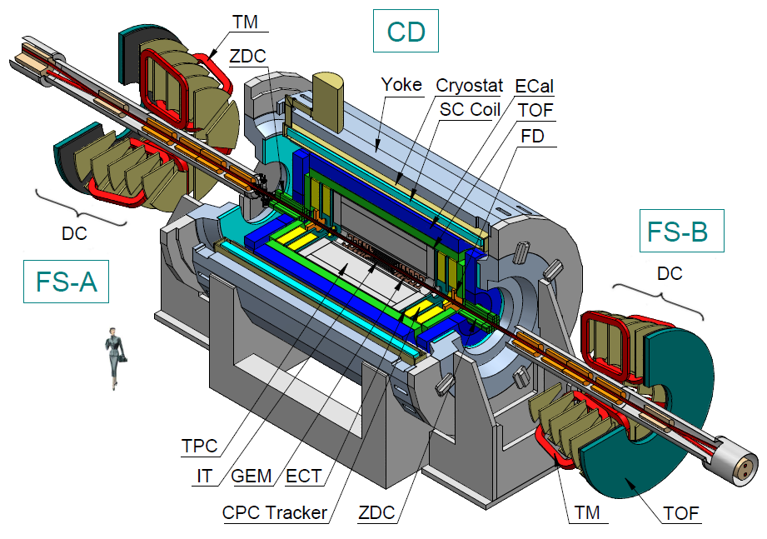
NICA DETECTORS
Baryonic Matter at Nuclotron (BM@N)
the fixed target experiment
at the Nuclotron
start of Stage I - 2017
MultiPurpose Detector (MPD)
at the Collider
start of Stage I - 2019
Spin Physics Detector (SPD) start of Stage I - 2023
project is under preparation

Slide 16

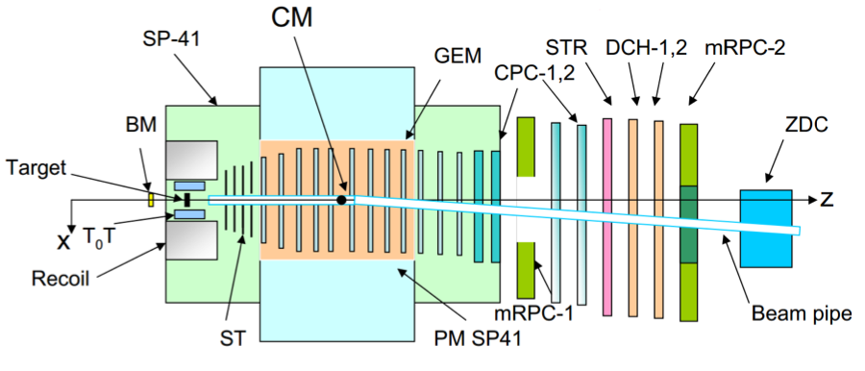
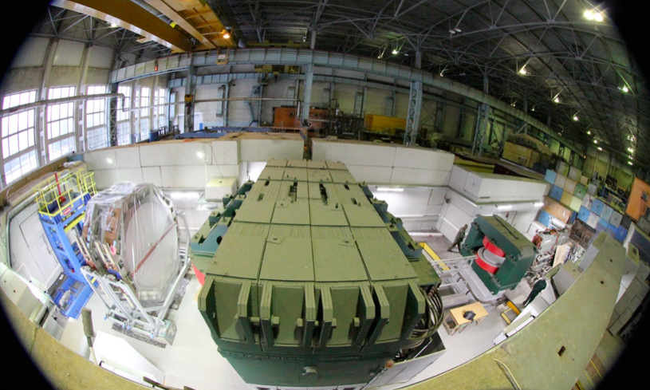
BM@N STUDY OF DENSE
BARYONIC MATTER AT < 6 GeV/u
BM@N configuration
DAQ GEM (CERN) ST TOF Outer tracker
2016, IV: basic 6 half 1 small half DCH
        config. planes plane config.
2017, III: complete 10 h/pl. 2 s/pl. basic DCH
2019, I: -”- 8-10 full pl. 2 s.,2 large pl. complete Straw+DCH
Fixed target experiment up to Au+Au
BM@N program:
hyperon & hypernuclei production
hadron femtoscopy
in-medium effects for strange
& vector mesons
electromagnetic probes (optional)
area prepared
for detector installation

Slide 17
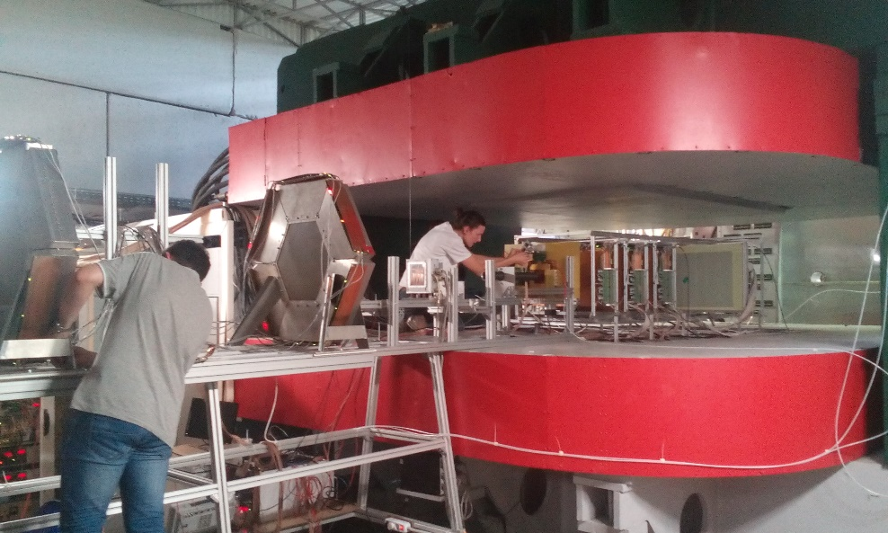
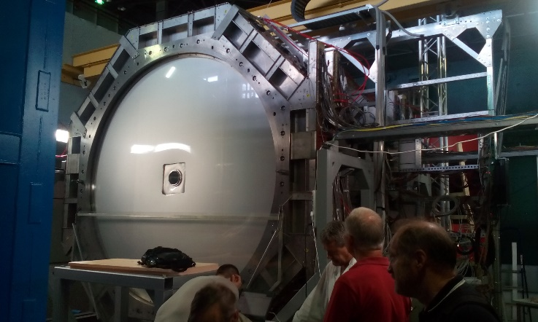
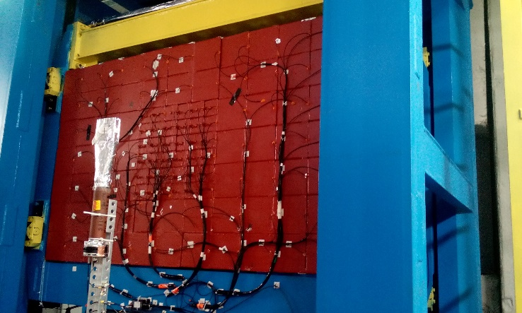
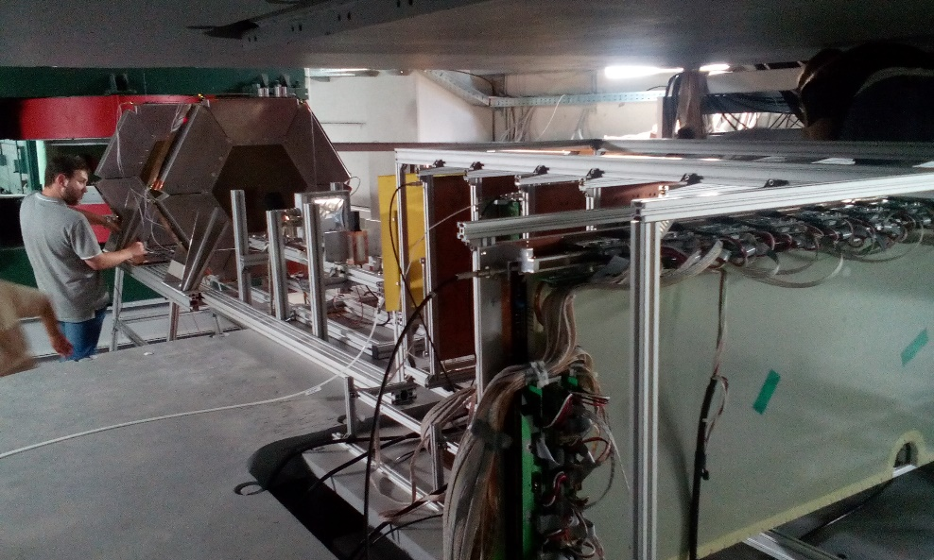
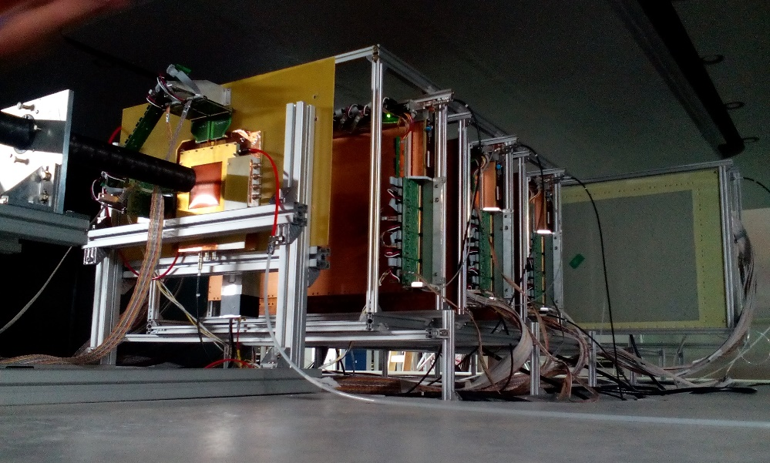
BM@N Run 52 (June 2016): tests & commissioning
of GEM CT located inside analyzing magnet
5 GEM detectors 66 x 41cm² + 1 detector 163 x 45 cm²

Slide 18

MPD DETECTOR
9 m length, 6 m in diameter
SC solenoid : 0.66 T (~900 tons)
Tracking: TPC, IT, ECT
Particle ID: TOF, ECAL, TPC
T0, Triggering: FFD
Centrality, Event plane: ZDC
S1: TPC, barrel (TOF, ECAL), ZDC, FFD
S2: Endcaps (tracker, TOF, ECAL) + IT
FFD
- hermetic & homogenous acceptance (2π in azimuth),
- low material budget,
- good tracking performance and powerful PID (nuclei, hadrons, e, γ),
- high event rate capability and reliable event separation

Slide 19
MPD STATUS
Magnet – fabrication stage
TOF, ECAL, ZDC – TDR are ready
FFD – fabrication stage
TPC
  assembly area in preparations
  fabrication of basic elements
  readout chambers – production + R&D (alternative)
  FEE (ALTRO-based FE card prototype)
MPD first stage program (central rapidity range):
- search for phase transitions (observables – particle yields and spectra) including partial restoration of chiral symmetry (observables – yields of di- leptons);
- search for the critical end-point (observables – event by event fluctuations, particle correlations)

Slide 20
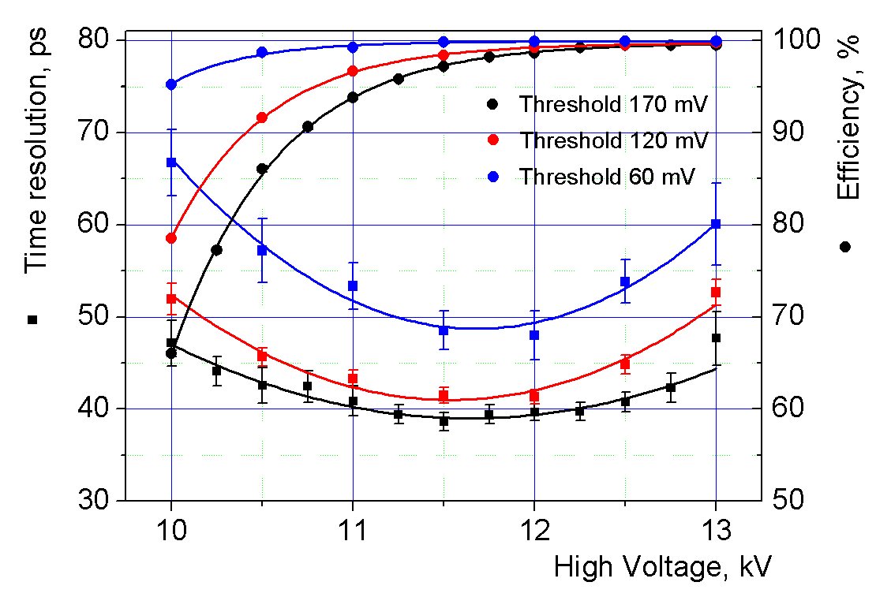
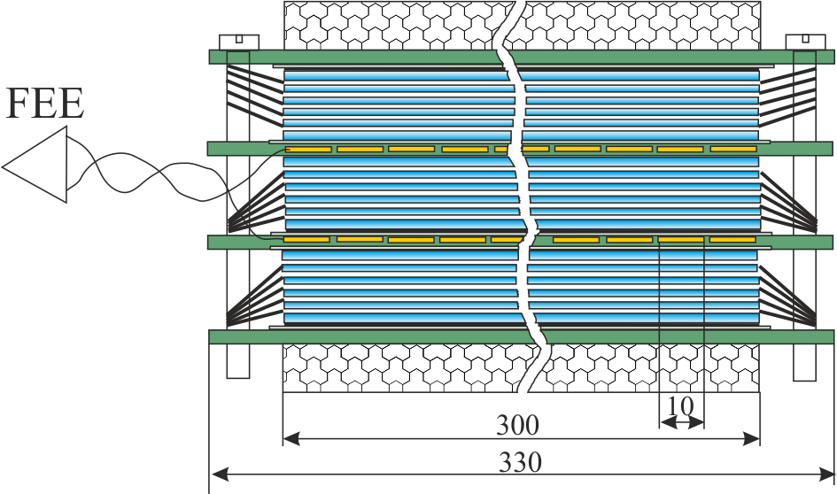
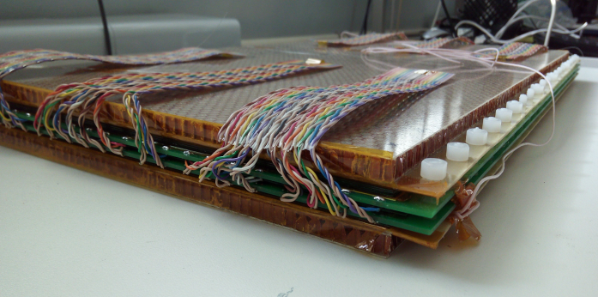
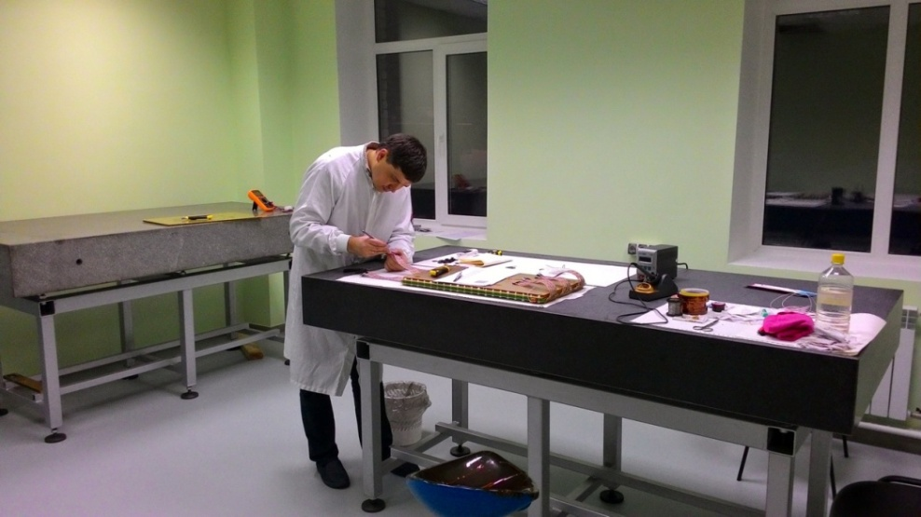
TIME OF FLIGHT
- the detector assembly (mass production) will start in Feb. 2017
- will be fully completed in December 2018
Active area of TOF barrel ~56 m²
Number of channels 13 824
detector assembly bench
Full scale prototype

Slide 21
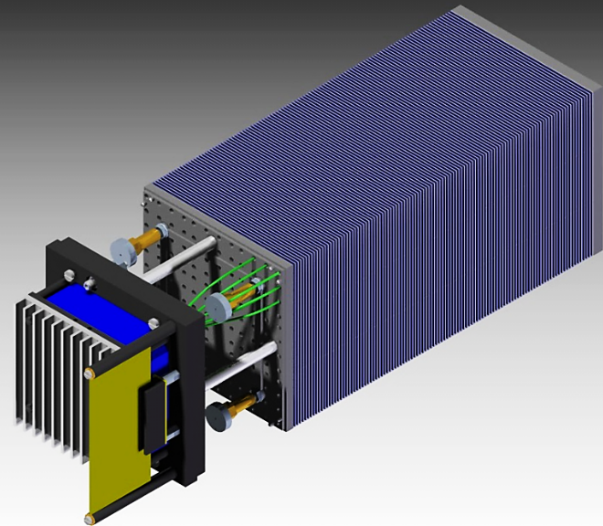
ECal
ECAL – shashlyk type
TDR - in preparation
L ~35 cm (~ 14 X₀), Pb+Scint. (4x4 cm²)
read-out: WLS fibers + MAPD
the design of integration with the MPD
- is completed
Agreement between JINR and Tsinghua University has been signed on:
-participation of Tsinghua physics group in the MPD experiment;
- preparation of workshop for mass production of Ecal modules in China;
- Production of first 10 test modules
.

Slide 22
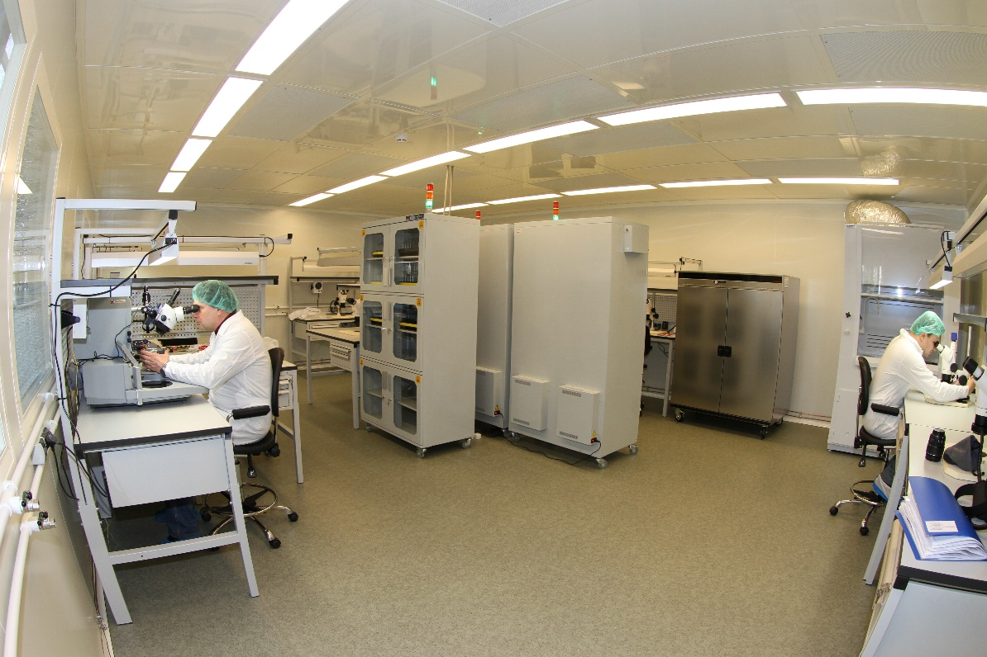
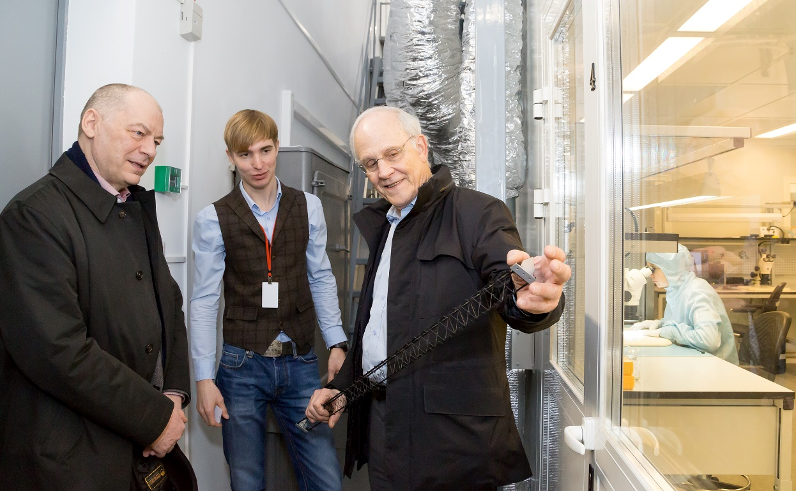
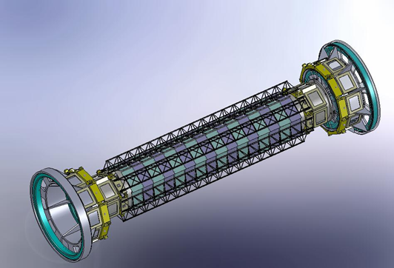
Workshop for microstrip detector
assembly & tests
project is supported by the CREMLIN grant
(in the framework of HORIZON-2020)
clean room for Silicon Vertex
Detector assembly is ready;
CERN & JINR signed MoU for Collaboration in manufacturing of the carbon fiber spaceframes for the (SiTS) for BM@N & MPD at NICA & CBM at FAIR

Slide 23
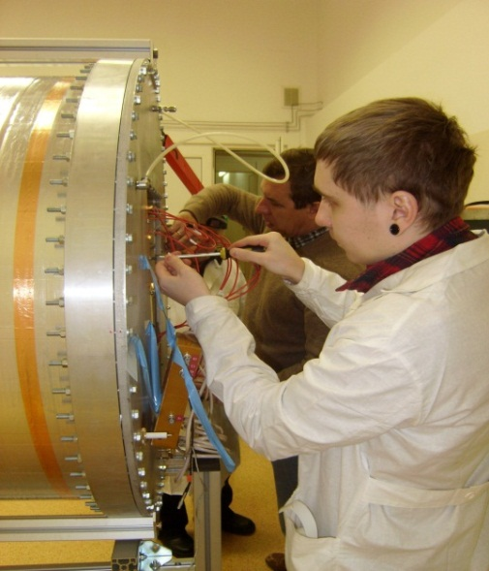
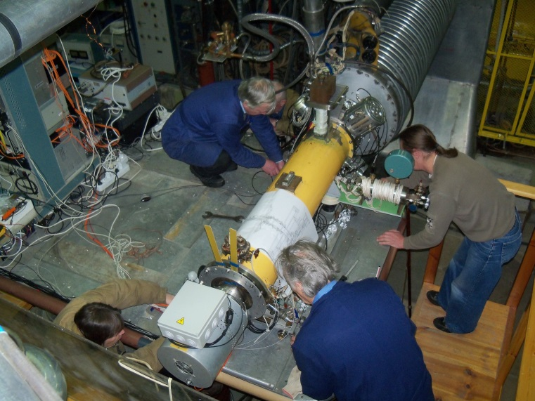
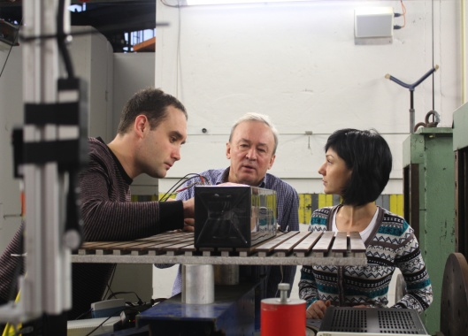



Engineers & Ph.D. students are welcome!
ТРС prototype assembling
of RoC electronics
Ion source at LU20
ECAL module
Straw wheel prototype
Work on mRPC
ZDC test at CERN

Slide 24

Civil Construction of NICA Complex
General Contract (duration 43 months) - signed!, Sept. 2015
STRABAG – General contractor; КометА – designer
The piling work is in progress by a subcontractor (~ 800 MRBL)
The whole Complex comprises of several Objects to be commissioned:
Bld.#1 reconstruction,
I q., 2019
SPD Hall, II q., 2019
East semi-ring,
IV q., 2018
Beam transport ch.,
I q., 2019
West semi-ring,
III q., 2018
MPD Hall, I q., 2018

Slide 25



Slide 26
NICA SCHEDULE
  The decommissioning is foreseen after 2045.

Slide 27

NICA COLLABORATION
ARE

Slide 28


Extension of the Cooperation
NICA & FAIR became the part (Work Package 3) of CREMLIN project (Connecting Russian & European Measures for Large-scale Research Infrastructures) in the framework of HORIZON 2020
NICA project was submitted to ESFRI Roadmap. Special letter of Commitment prepared and Letter of support for the submission of the NICA project.
Authorities of Bulgaria, Czech Republic, Romania and Slovakia kindly considered favorably the support to this submission.
MegaProject NICA
Germany (BMBF, GSI) –SC magnets
& Si tracker
China (ASIPP) – HTSC current leads,
SC magnets, vacuum systems
USA (FNAL) – collider stochastic and
electron cooling systems
CERN – BM@N and MPD elements
(drift chambers, MM systems…)
Rep. of South Africa – cryostats,
diagnostics for SC ion
source, cryogenics
08 Aug’13: Representatives of 13 countries, 6 signed
to join the mega-science project NICA

Slide 29

Main Research Infrastructure in Particle and Nuclear Physics
NICA – Complementary Project

Slide 30




A Quadripartite Protocol signed in China
At the 20th Regular Meeting of Prime Ministers of Russia and China
December 17, 2015, Beijing
On behalf of JINR G.V.Trubnikov, JINR Vice-Director,
signed a Quadripartite Protocol between
the Ministry of Education and Science of Russia ,
the Ministry of Science and Technology of China,
the Chinese Academy of Sciences and JINR
on the prospects of cooperation in the
frames of the complex of superconducting rings
with colliding beams of heavy ions NICA.
The protocol was signed with the aim of uniting the efforts of the parties in the frames of cooperation for establishment and use of the NICA complex. China considers joining the project and notes a wide interest of Chinese research organizations to participate in the project.

Slide 31
Additional funds from the Russian Federation become available by recent RF government decree.

Slide 32

Agreement
between
the RF Government
and
the Joint Institute for
Nuclear Research
has been signed.

Slide 33
Instead of conclusion…
NICA complex has great potential for competitive research in dense baryonic matter and spin physics.
The construction of accelerator complex and both BM@N and MPD detectors is going close to the schedule.
A number of steps are done towards making NICA a really international research project that will lead to establishing a research infrastructure of global importance.
In medium-term prospect the NICA complex will be the only facility in Europe providing unique high intensity ion beams (from p to Au) in the energy range from 2 – 27 GeV (c.m.s.), which could be used for both fundamental and applied research

Slide 34




Thanks for your attention!
Thank you

