Slide 1

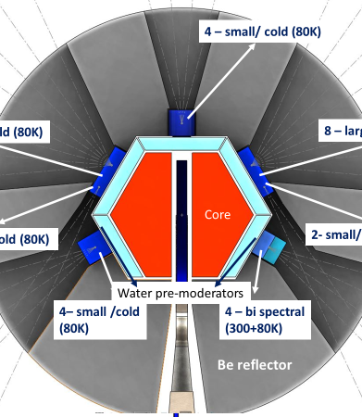
Proposal for the opening of a new theme «Development of the Conceptual Design of a New Advanced Neutron Source at JINR»
V. Shvetsov
50th meeting of the PAC for Condensed Matter Physics
June 17-18, 2019, JINR, Dubna, Russia

Slide 2
Content
Historical introduction;
Research in the field of condensed matter physics in Dubna;
The IBR-2 pulsed reactor, status and prospects;
World trends in the development of the neutron sources;
Current status of the development of conceptual design of a new neutron source at JINR;
Resource requirements;
Conclusion;

Slide 3
Historical introduction

Slide 4
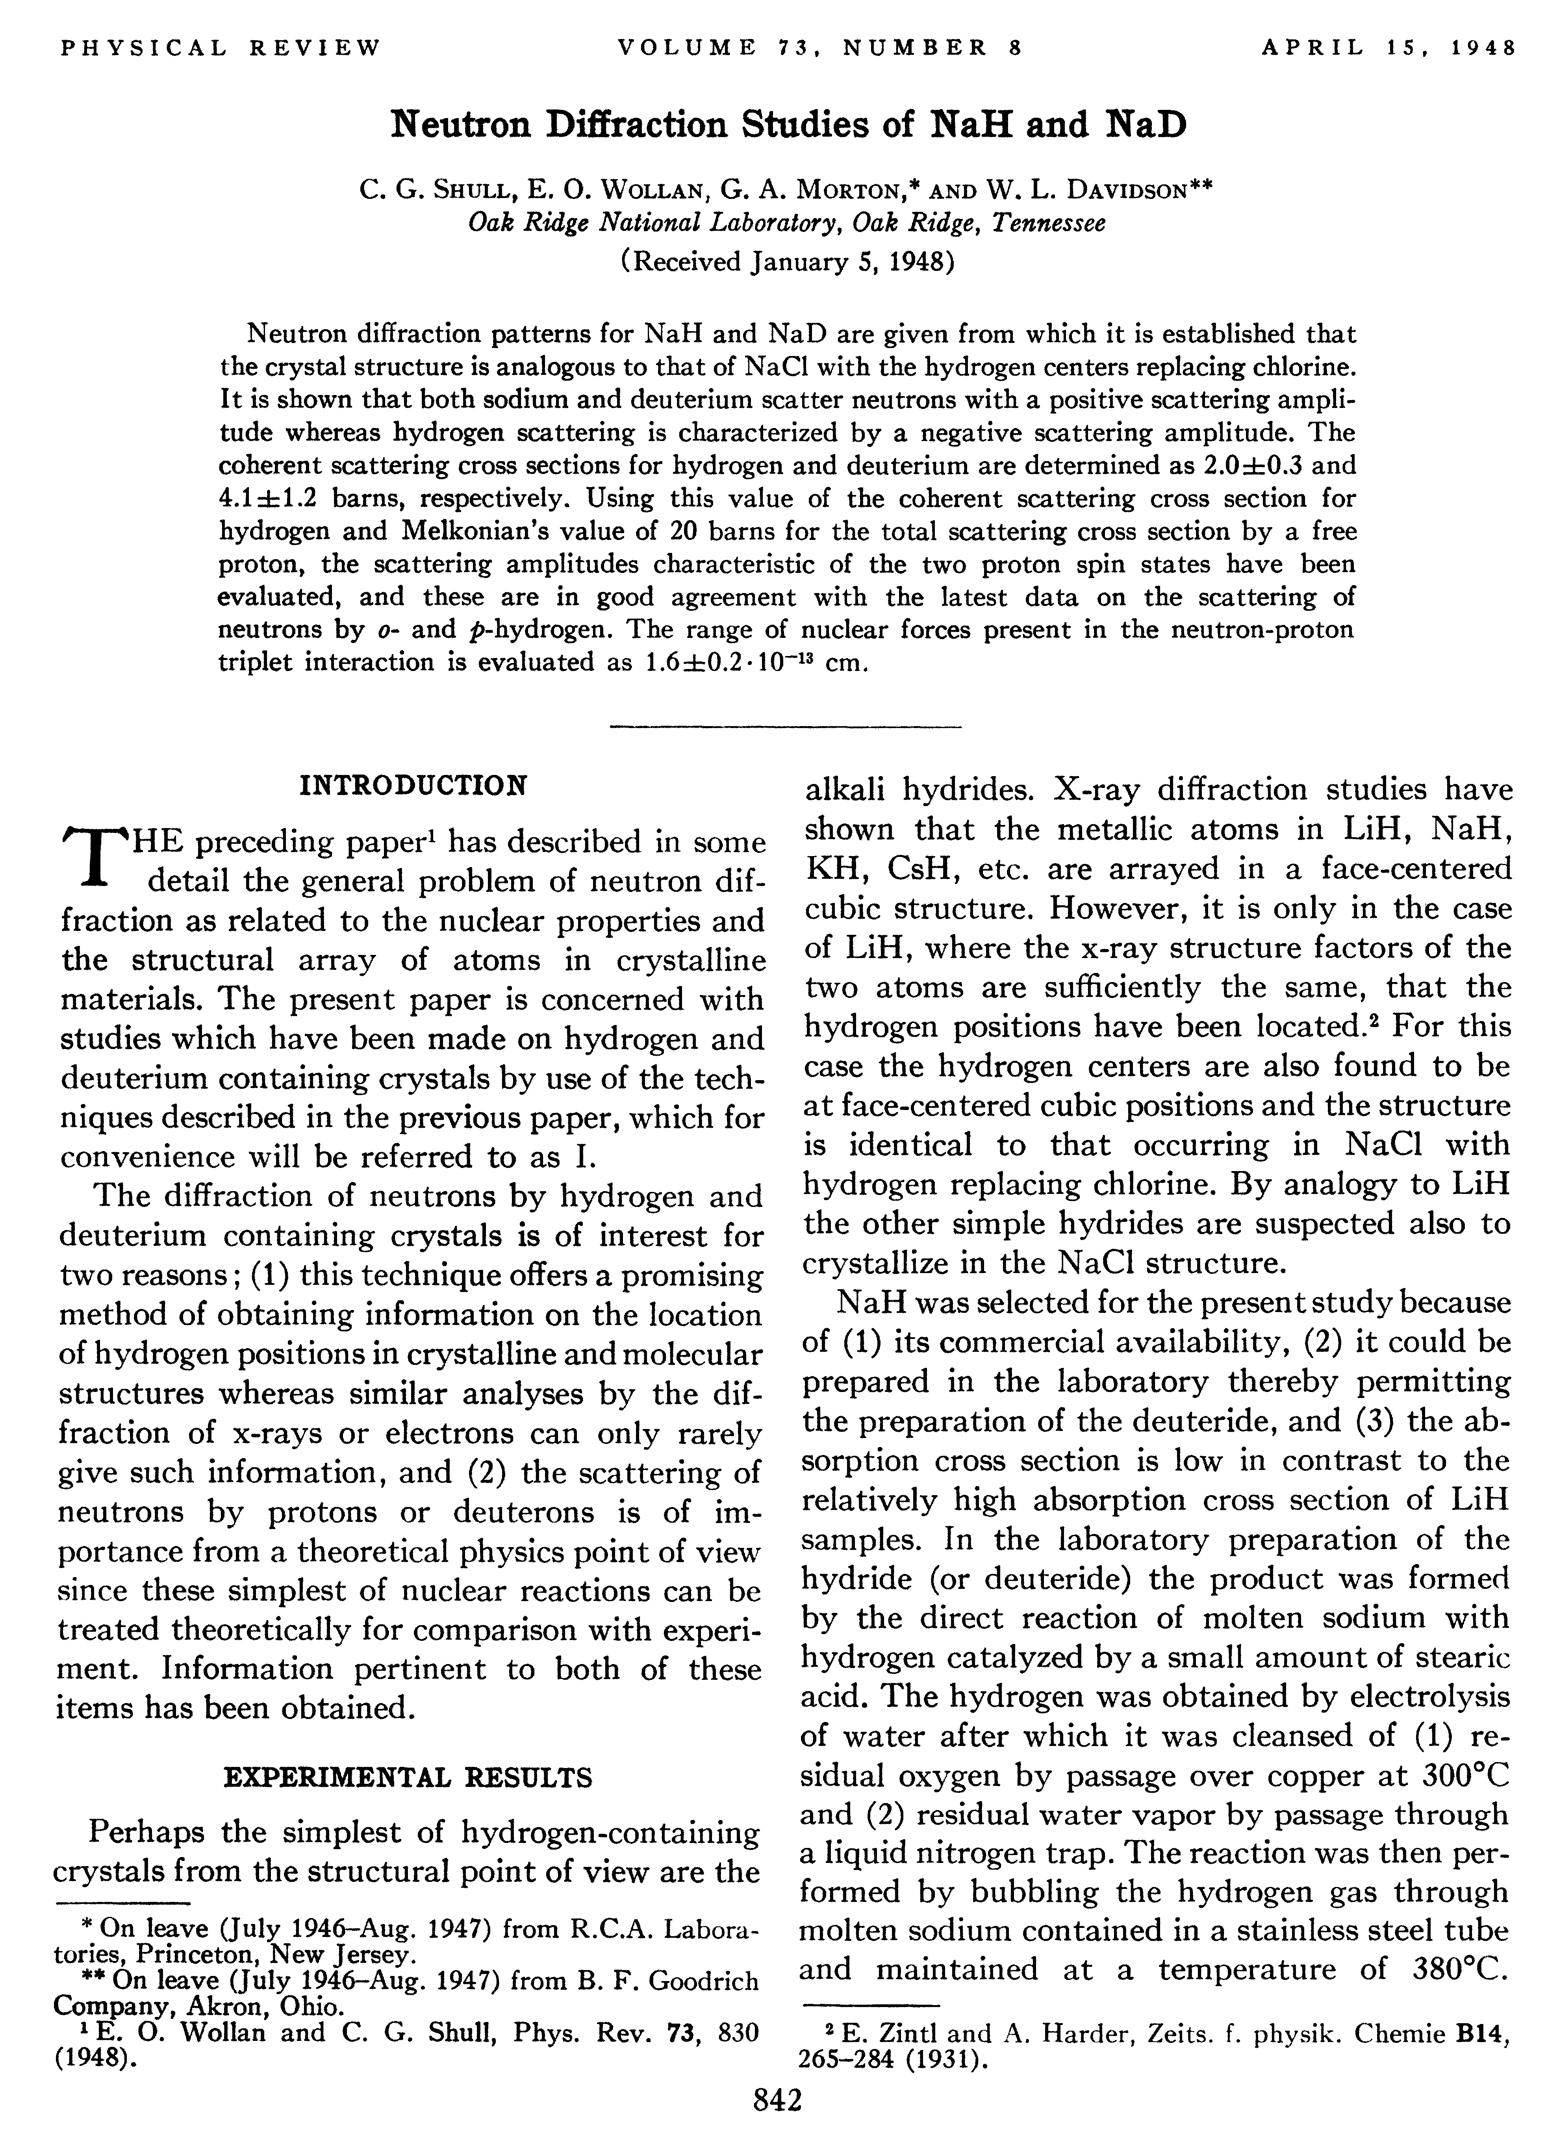
Historical introduction

Slide 5
IBR, IBR-30, IBR-2
IBR reactor – one of the worlds first dedicated for experiments on extracted beams;
Condensed matter physics – one of the three scientific “pillars” of the Joint Institute;
First experiments on CMP at the Laboratory of Neutron Physics of JINR started in early 60-th by initiative of F.Shapiro, J.Janik and B.Buras;
Effective development of the neutron instrumentation in parallel with construction of the new neutron sources;

Slide 6
Research in the field of condensed matter physics in Dubna

Slide 7
Research directions and instrumentation development
High temperature superconductors;
Soft matter, gels, polymers;
Chemistry, real time experiments;
Biology, ribosome and proteins structure;
Materials science, engineering analysis, mechanical stresses;
Neutron diffraction at extreme conditions;
Small angle scattering;
Inelastic scattering spectrometers;
TOF Fourier diffractometry;
Reflectometry of polarized neutrons;
Pulsed action on the sample, synchronized with the neutron pulse;

Slide 8

2018 results
203 papers in referred magazines;
208 reports at the international conferences;
3 patents;
40 students participated in the research;

Slide 9
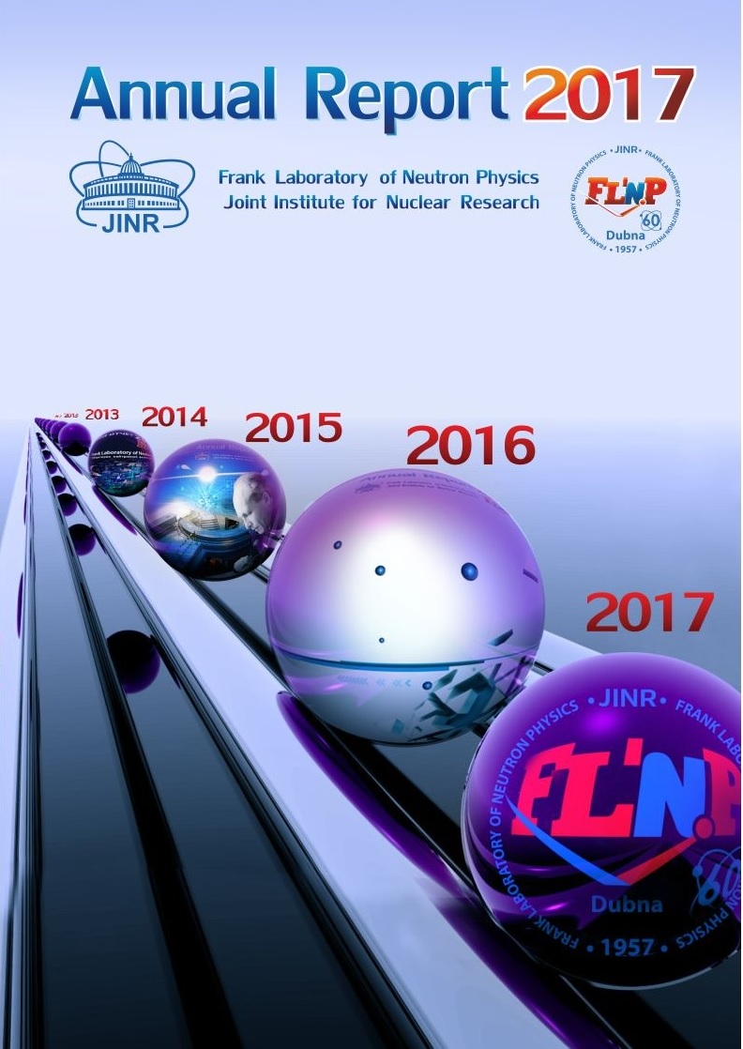
Comparison of the effectiveness of the IBR-2 instruments with the instruments at European sources
We have about 160 neutron instruments at 13 European neutron sources, generating almost 30000 instrument ⋅ days, resulting 1900 scientific papers each year;
16 instrument ⋅ days/paper in Europe
17 instrument ⋅ days/paper at IBR-2
At IBR-2 we have 15 instruments, operating about 2500 hours per year, that generates about 1563 instrument ⋅ days, resulting about 90 scientific papers each year;

Slide 10
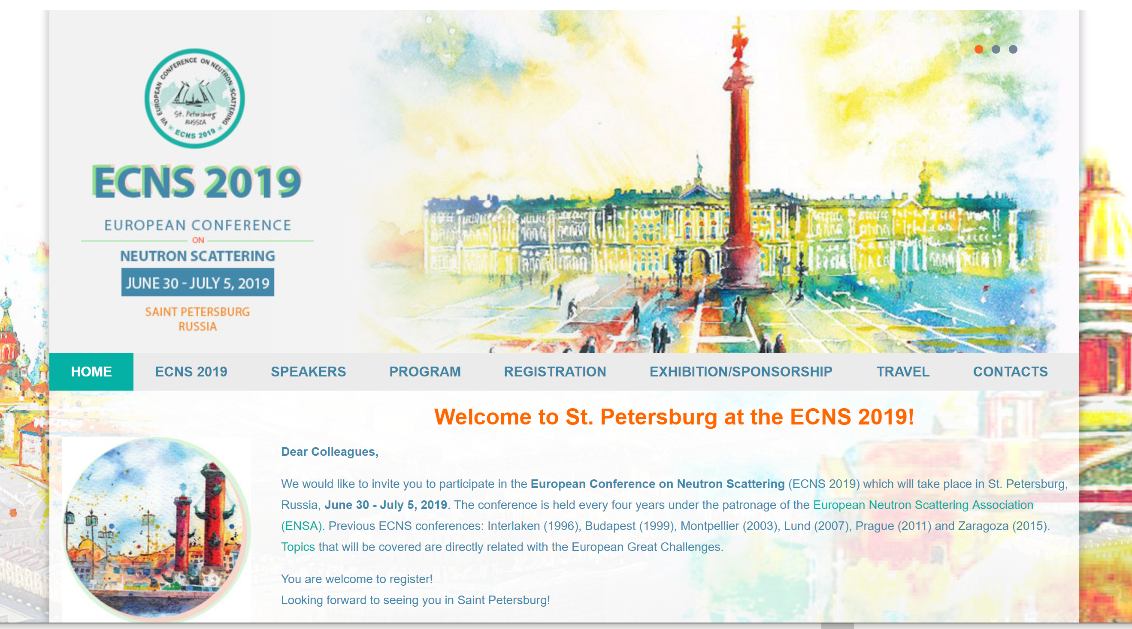
FLNP JINR:
2 plenary lectures
8 invited talks
20 oral presentations
31 poster

Slide 11
The IBR-2 pulsed reactor, status and prospects

Slide 12

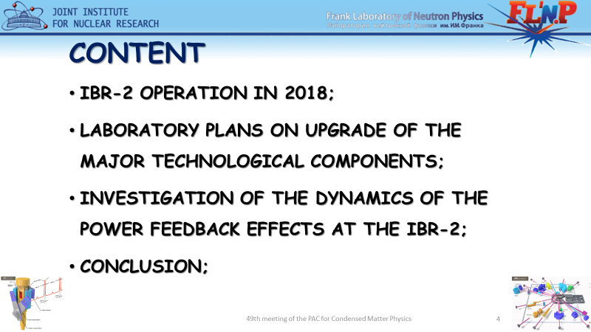
Topic was reported at the 49-th PAC meeting

Slide 13
World trends in the development of the neutron sources

Slide 14
Why do we need new source?
In order to preserve condensed matter physics as one of the three scientific pillars of JINR, we need a new world-class source that will replace the IBR-2 reactor after the end of its service life;
The period of ageing of the modern scientific facilities is increasing;
All developed countries are planning construction of the new neutron sources with extracted beams for neutron scattering and nuclear physics;
Thermal neutron flux density on the moderator surface (2π equivalent): average not less than 10¹⁴ n/cm²/s, peak not less than 10¹⁷ n/cm²/s

Slide 15
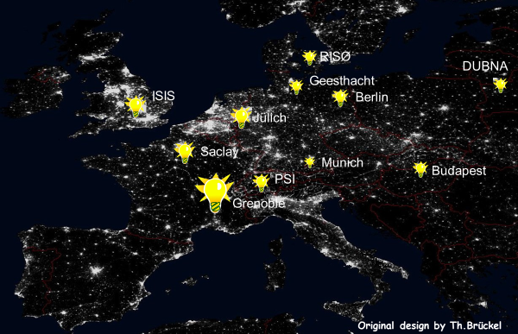
2015

Slide 16
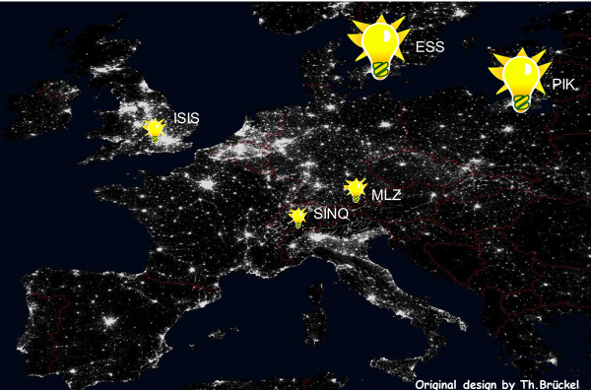
2032 ?

Slide 18
1. Investigations performed at neutron sources are essential components of R&D in numerous areas of science and engineering.
2. Neutron scattering is often an essential part of a broader experimental study that uses a complementary suite of tools (e.g., light sources, high-performance computers). Thus, neutron sources play a key role in overall U.S. innovation capacity.
3. The United States has lost important capability in neutron R&D in the last two decades and is no longer the world leader. The United States cannot afford to lose its remaining capacity and capability without significant detriment to the quality and quantity of science, engineering, and even medical and manufacturing processes that rely on neutron sources.
4. Reactor fuels containing HEU represent a risk for proliferation, which should be considered when planning for the future infrastructure for neutron R&D.
5. Current HEU-fueled research reactors provide unique R&D capabilities relative to other neutron sources available today. Eliminating them without developing and deploying alternative methods of producing neutrons with the same properties
(e.g., from high-density LEU-fueled reactors and/or a new generation of spallation sources) would compromise U.S. innovation capacity.
6. World-class neutron science and engineering require the comprehensive benefits of spallation facilities, research reactors, and high-performance instrumentation. While there is some overlap in the capabilities provided by spallation and reactor sources, each provides certain capabilities that cannot now be duplicated by the other type of source.

Slide 19
Current status of the development of conceptual design of a new neutron source at JINR

Slide 20
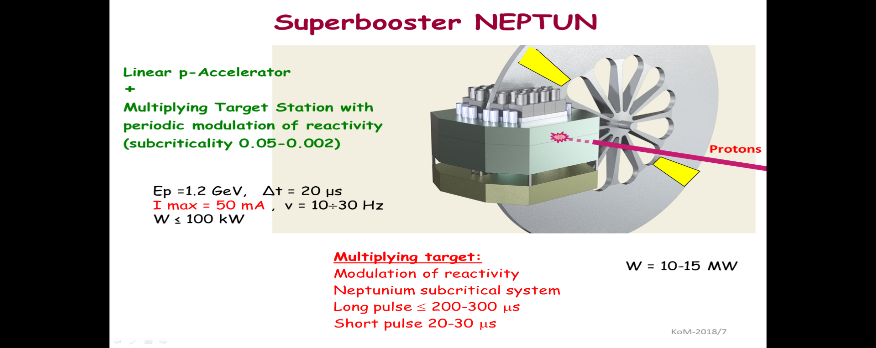
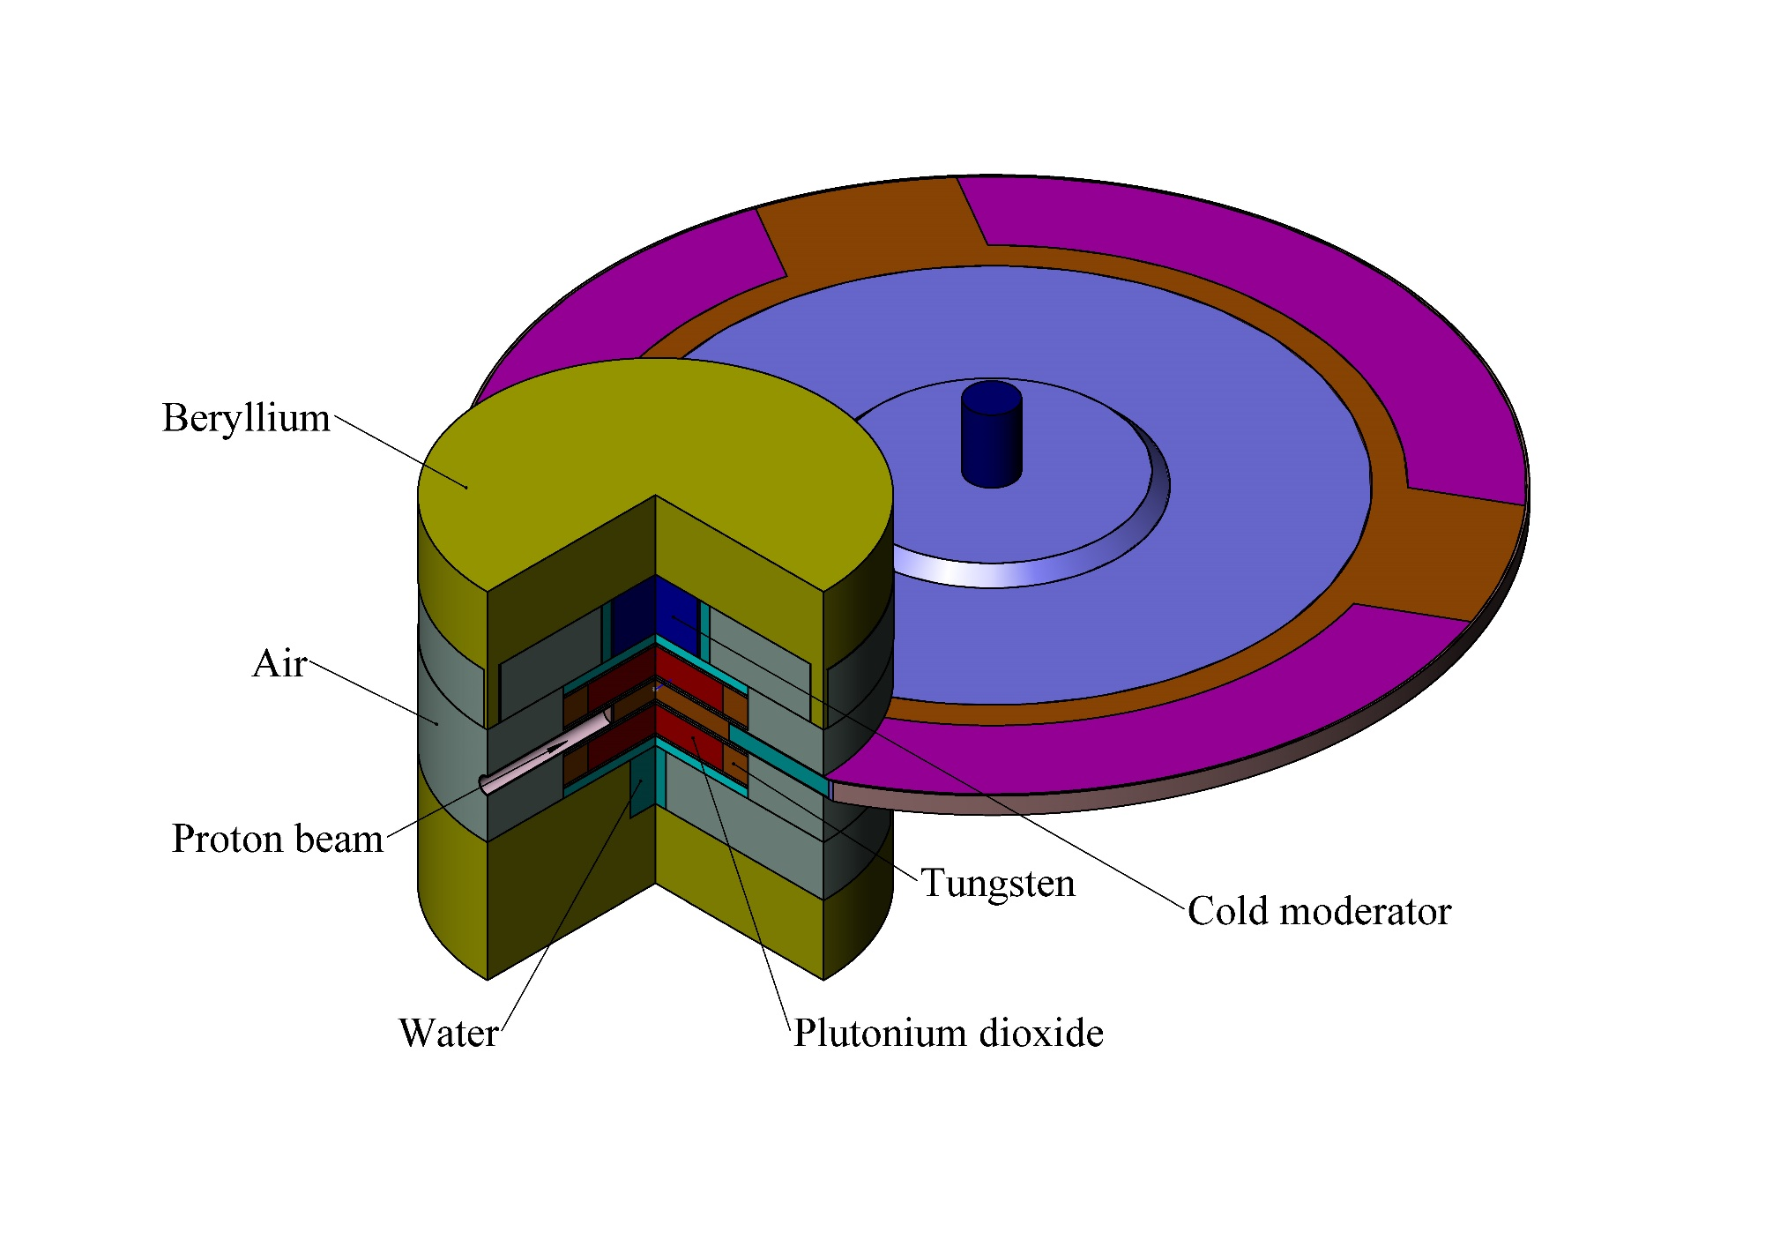
Dubna Neutron Source of the Fourth Generation two options
PuO₂ based superbooster
Progress outline:
A superbooster (multiplying target of proton linear accelerator with periodic reactivity modulation) is being considered for the new neutron source
Feasibility study of 2 concepts (neptunium and plutonium based) has been started
Time schedule road map has been developed that establishes 6 major stages and proposes the finalization in 2035 – replacing the present source IBR-2M smoothly
N. Kučerka & E.V. Lychagin: Development of the scientific case for a new source of neutrons at JINR
E. Shabalin & Yu.N. Pepelyshev: Concepts of JINR’s high-flux pulsed neutron source
V.N. Shvetsov & V.L. Aksenov: Milestones and time schedule proposal to the strategy plan of JINR
Notes:
In accordance to the 7-year plan and long-term strategic planning of JINR, the Frank Laboratory of Neutron Physics has initiated project for the realization of new JINR source of neutrons. In addition to developing the case for scientific justification, discussions are carried out regarding the type of this new source. A superbooster (multiplying target of proton linear accelerator with periodic reactivity modulation) has been concluded to be able to provide record parameters desired by physicists. Recently, the feasibility study of 2 most appealing concepts has been ordered at NIKIET, and time schedule road map has been developed that will allow a timely and smooth replacement of the present source IBR-2M.

Slide 21
At present we have contract with NIKIET on feasibility study of the:
Pulsed reactor with mechanical modulation of reactivity, based on Np fuel;
ADS with mechanical modulation of reactivity (super booster), based on PuO₂ fuel;

Slide 22
PROJECT ROADMAP (preliminary)
Stage | 18 | 19 | 20 | 21 | 22 | 23 | 24 | 25 | 26 | 27 | 28 | 29 | 30 | 31 | 32 | 33 | 34 | 35 | 36 | 37
Concept development
Conceptual design
Investment justification
R&D
Technical design
Construction
Commissioning

Slide 23
Basic parameters of the reactor
Parameter | Value
1 Average thermal power, MW | 15
2 Operational mode | pulsed
3 Repetition rate, Hz | 10
4 Fuel | NpN
5 Coolant | Na
6 Inlet temperature of the coolant, ⁰С | 290
7 Outlet temperature of the coolant, ⁰С | 391
8 Coolant flow through ½ of the core, kg/s | 58
9 Pressure drop across the core, Pa | 0,33·10⁵
10 Fast neutrons flux density on the reactor vessel, 10¹⁴ n/cm²·s¹ | 5,7
11 Fluence on the reactor vessel for 20 000 hours, n/cm² | 4,1·10²²

Slide 24
General view of the reactor in the bulk concrete
IC
Shutter
Stationary reflector
Ø 2m
Reactivity modulator
Ø 6m

Slide 25
Control
CR-2 (Ni)
EP-2 (Ni)
CR-1 (Ni)
AR-2 (Ni)
EP-1 (Ni)
CR-3 (TiH2)
CR-4 (TiH2)
AR-1 (Ni)

Slide 26
Spectrometers – Moderators: Optimization task
The basic set of spectrometers can include 15 the most called-for instruments, with ~10 additional ones as the second stage
Spectrometers at moderators for the first stage: 2 (80-90K+300 K) – small/bi-spectral, 4 (80-90 K)– large/cold, 9 (<30K) – small/very cold
Moderator size: 8 – small (~10 x 10 cm or d=10 cm), 7 – large (~20 x 20 cm)
The optimal “Moderator – NG” distance is around L = (2 ÷ 3) m
Instruments can be grouped to take a full advantage of moderators
*) from report of A. Balagurov

Slide 27
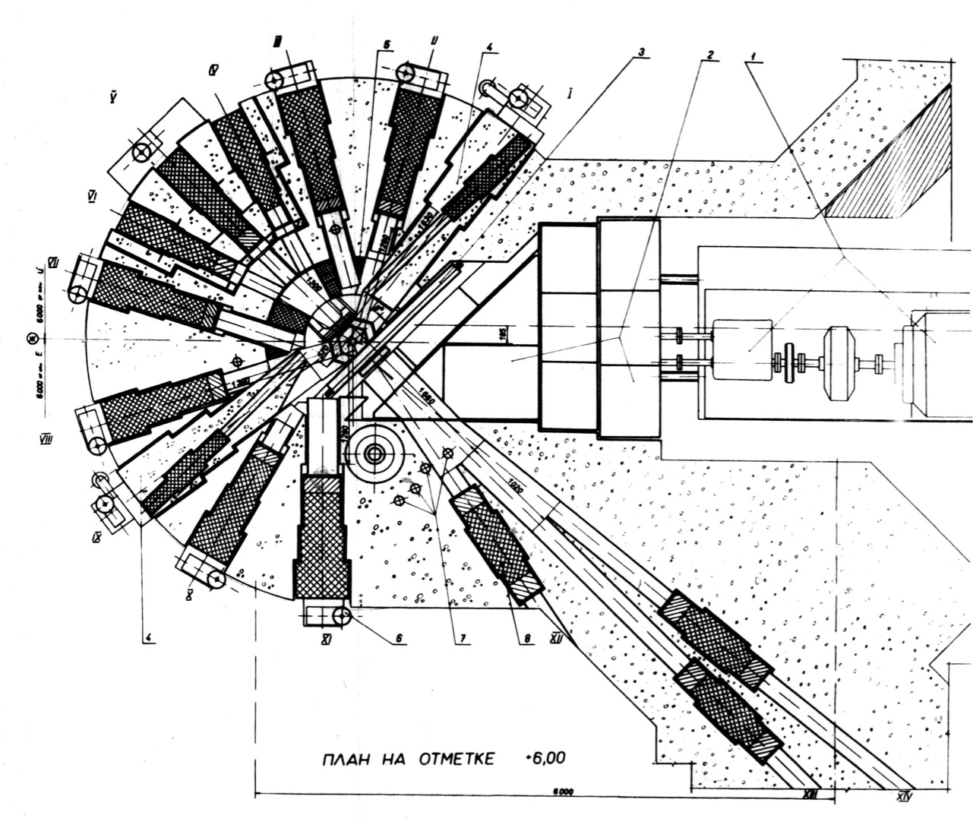
Beam ports arrangement at the IBR-2 reactor
18 ⁰
14 beamports
36 ⁰
30 ⁰

Slide 28
Beams arrangements of ESS
42 beamports with ~6° separation
*) from report of L. Zanini

Slide 29
Neutron fluxes at ”Neptun” neutron source
arb. units: 2.25E-08 (Energy range: 0 - 0.5 eV)
Water moderators
(ambient temperature, size d120 mm, h=60 mm )
arb. units: 2.89E-08 (Energy range: 0 - 0.5 eV)
~ 10¹⁴ n/cm^2/sec
Be
reflector
Core
arb. units: 2.86E-08 (Energy range: 0 - 0.5 eV)
The wheel of modulator

Slide 30
The basic set of 15 neutron TOF instruments (the first stage)
Moderator
Instrument Main issue T, K Size, cm
1. Material science*⁾ Internal stresses 300 / 80 K 10x10
2. High-resolution*⁾ Crystal structure 300 / 80 K 10x10
3. High-intensity In situ, real-time 80 K 20x20
High-pressure Micro samples 80 K 20x20
Direct geometry-I**⁾ General purpose 80 K 20x20
Inverse geometry Molecular systems 80 K 20x20
2
4
7. Magnetic Magnetic structure 30 K 20x20
8. Direct geometry-II***) General purpose 30 K 20x20
9. Energy dispersive Complex media 30 K 20x20
3
10. High-resolution General purpose 30 K 10x10
11. High-intensity-I In situ, real-time 30 K 10x10
12. High-intensity-II Micro samples 30 K 10x10
13. Horizontal plane General purpose 30 K 10x10
14. Vertical plane Liquid media 30 K 10x10
15. “White” beam General purpose 30 K 10x10
6
*⁾ Fourier chopper **⁾ Fermi chopper ***⁾ Set of choppers
*)from report of A. Balagurov

Slide 31
Beams – Moderators
Moderator | Amount of beams (first stage) | Temperature, K | Size, mm | Possible material
bi-spectral | 2 | Cold 80-90 K + warm 300 K (one above the other) | 100x100 + 100x100 | (Liquid methane/ethane/ pelletized mesitylene)+water
cold | 4 | 80-90K | 200 x 200 | Liquid methane/ethane/ pelletized mesitylene
very cold | 3 | <30K | 200 x 200 | Pelletized solid methane/parahydrogen/pelletized mesitylene
very cold | 6 | <30K | 100 x 100 | Pelletized solid methane/parahydrogen/pelletized mesitylene

Slide 32
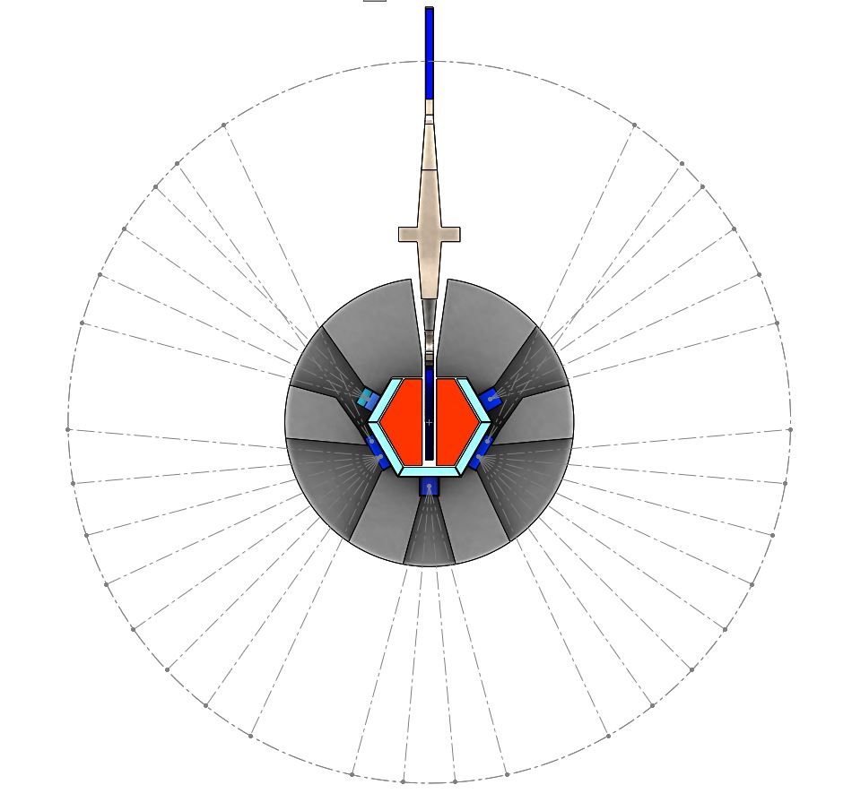
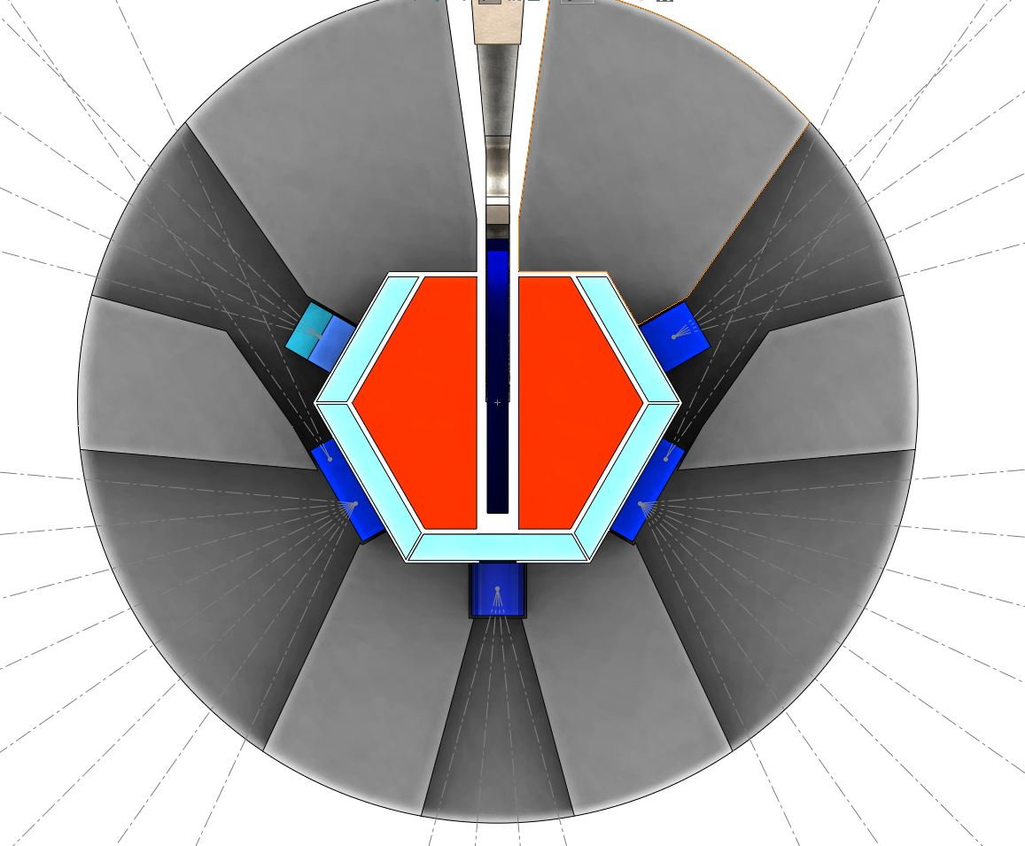
4 – small/ cold (80K)
8 – large cold (80K)
8 – large/ very cold (<30K)
Core
2- small/tangential/cold (80K)
2- small/ tangential/ very cold (<30K)
32 beamports with
10° separation:
For instruments:
4 – bi spectral
8 – large cold
8 – large very cold
8 – small cold
4- small tangential cold
Water pre-moderators
4– small /cold
(80K)
4 – bi spectral
(300+80K)
Be reflector

Slide 33
The basic set of 15 neutron TOF instruments for the first stage +
~ 10 instruments for the second stage
Moderator
Instrument Main issue T, K Size, cm
1. Material science*⁾ Internal stresses 300 / 80 K 10x10
2. High-resolution*⁾ Crystal structure 300 / 80 K 10x10
3. High-intensity In situ, real-time 80 K 20x20
High-pressure Micro samples 80 K 20x20
Direct geometry-I**⁾ General purpose 80 K 20x20
Inverse geometry Molecular systems 80 K 20x20
2
4
4
8
7. Magnetic Magnetic structure 30 K 20x20
8. Direct geometry-II***) General purpose 30 K 20x20
9. Energy dispersive Complex media 30 K 20x20
3
8
10. High-resolution General purpose 30 K 10x10
11. High-intensity-I In situ, real-time 30 K 10x10
12. High-intensity-II Micro samples 30 K 10x10
13. Horizontal plane General purpose 30 K 10x10
14. Vertical plane Liquid media 30 K 10x10
15. “White” beam General purpose 30 K 10x10
6
10+2
*⁾ Fourier chopper **⁾ Fermi chopper ***⁾ Set of choppers
*) report A. Balagurov

Slide 34
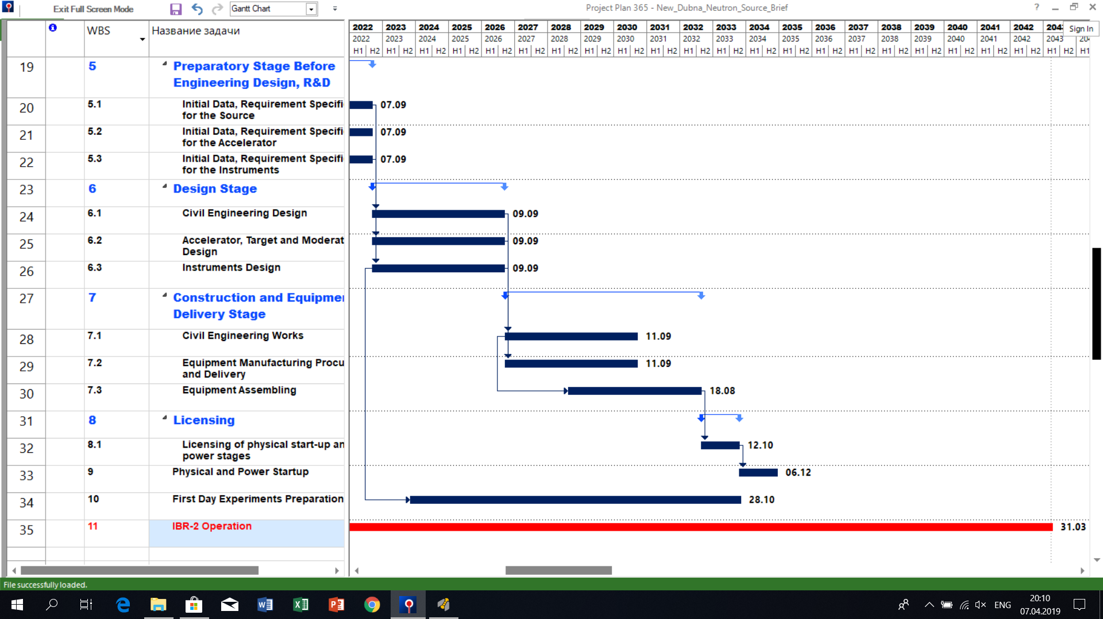

Slide 35
Resource requirements

Slide 37
Conclusion

Slide 38


Slide 39
Thanks a lot for your attention!

