Slide 1
Development of the SOLCRYS structural research laboratory at SOLARIS synchrotron
Norbert Kučerka
Frank Laboratory of Neutron Physics
at Joint Institute for Nuclear Research in Dubna
50th meeting of the PAC for CMP at JINR
Dubna: June 17, 2019

Slide 2
Outline
Condensed Matter Research with Nuclear Methods
SOLARIS machine and beamlines
SOLCRYS laboratory for Condensed Matter Research
Theme main activities
Theme results expected

Slide 3
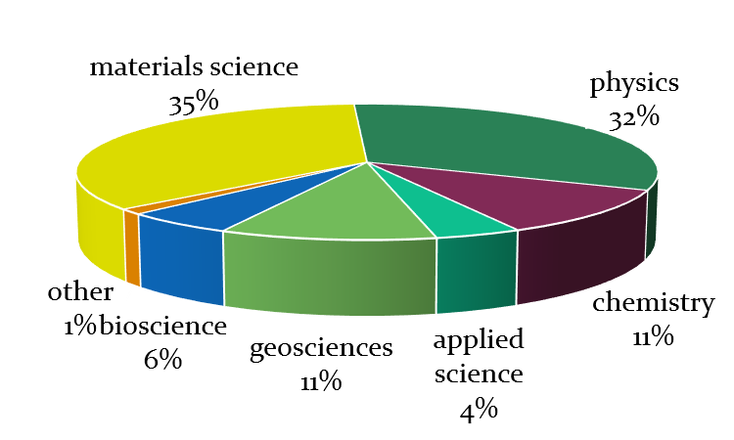
Condensed Matter Research Fields at JINR
solid and liquid states of matter
novel functional materials & materials under extreme conditions
nanomaterials
surfaces and interfaces
polymers and soft matter
solutions and chemical reactions
engineering structures
source: FLNP

Slide 4
Neutrons vs. X-rays
neutrons: ==> deep penetration into matter
            ==> sensitivity to magnetism, light elements and isotope exchange
X-rays: ==> high flux
==> high resolution

Slide 5
X-rays in the Condensed Matter Research of JINR
Crystal and magnetic structures of Cr₂O₃
- one of the first discovered magnetoelectric materials with ferroelectric polarization induced by external magnetic field
X-rays Neutrons
Sapphire anvils
Diamond anvils
Crystal and Magnetic Structures of Novel Materials.
J. of Alloys and Compounds (2017).

Slide 6
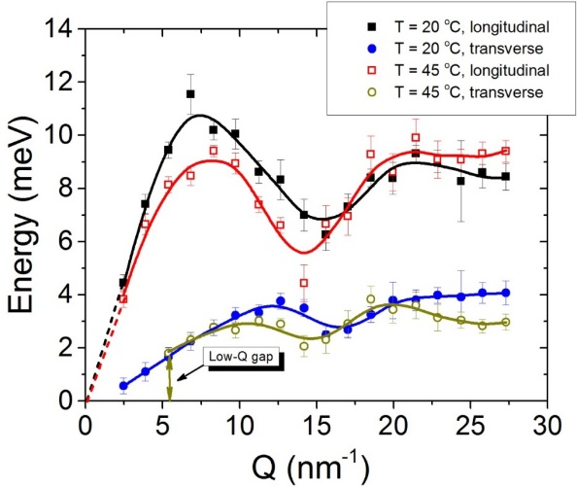
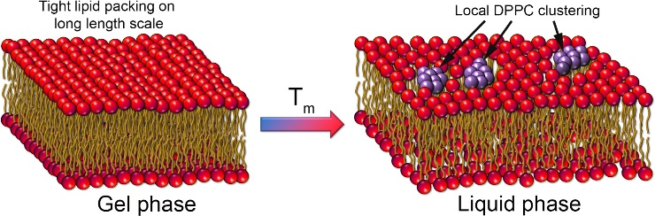
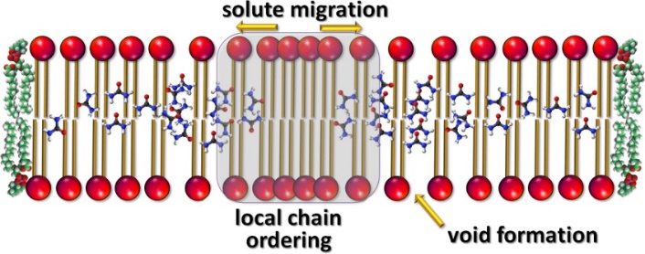
X-rays in the Condensed Matter Research of JINR
X-rays reveal:
nm-scaled short-lived molecular clusters → local chain ordering, or density fluctuations
Increased disorder beyond the cluster size → indication of the transient voids formation
Dynamics and the Mechanism of Passive Transport in Lipid Bilayers.
Nature Communications, 7 (2016) 1-9.

Slide 7
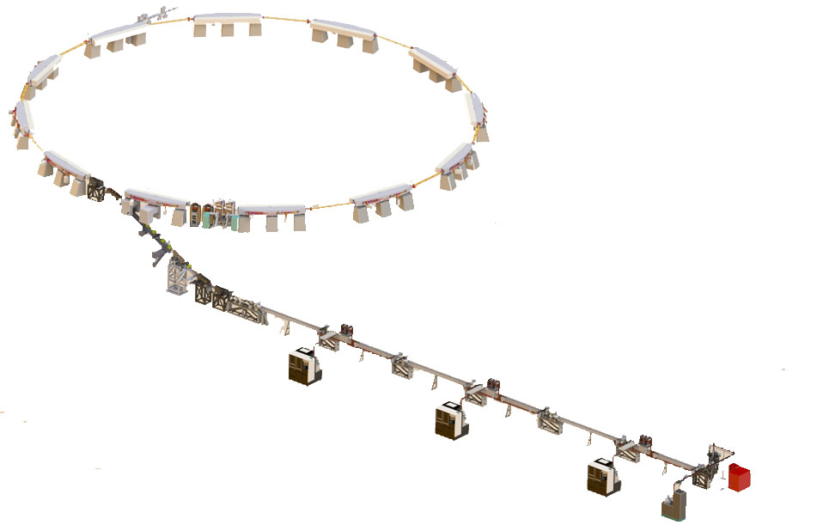
SOLARIS machine
Polish National Project, executed by Jagiellonian University
1.5GeV Storage ring
12 DBA Cells – 96 m circ.
Space for ID’s (10 sections) ~ 3.5 m
10 straight sections for Ids
100 MHz RF system
300 MHz Landau Cavities
Current: 500mA
Emmitance (bare Lattice): 6nmrad
Timetable
Conceptual design 2009
Project approved 2010 (started in April)
Project completed: December 2015
Budget
50 M€ - European Union Regional Development Fund,
Innovative Economy Operational Program
Deliverables
Building
Machine (linac + synchrotron)
2 experimental beamlines
M. Stankiewicz
p.7

Slide 8
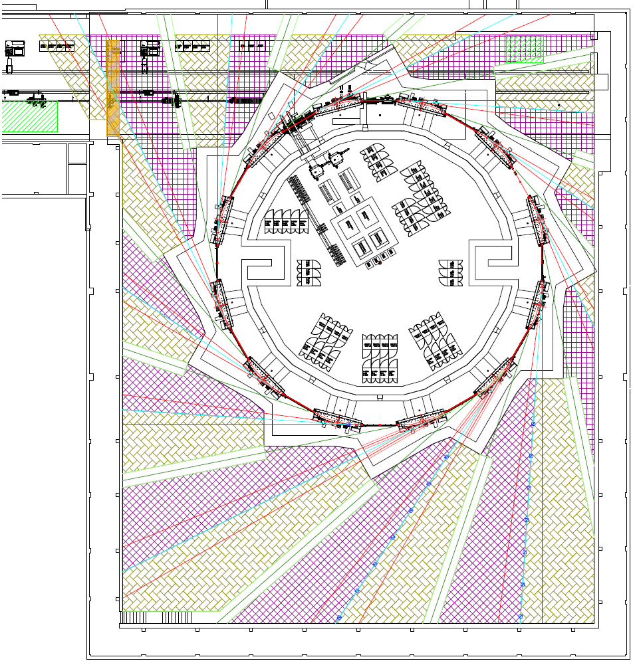
SOLARIS beam lines
Beamlines at the delivery:
Ultra Angle-Resolved Photoelectron Spectroscopy
Photoemission Electron Microscopy
X-ray Absorption Spectroscopy
Beamlines under construction:
angle integrated photoelectron spectroscopy
X-ray Magnetic Circular Dichroism
PHELIX
UARPES
PEEM/XAS
XMCD
p.8

Slide 9
Beam line proposals
Name | Techinques | source | energy range [eV]
SX | X-ray absorption spectroscopy XANES (X-ray Near Edge Absorption Spectroscopy) EXAFS (Extended X-ray Absorption Fine Structure Spectroscopy) XES (X-ray emission spectroscopy) | BM | 2.4 - 10000
FTIR | Absorption microspectroscopy Imaging | BM | 0.05 - 0.5
STXM (XMCD branch) | Scanning Trensmission X-ray Microscopy | EPU | 100 - 2000
MIDAMAX | X-ray absorption, micro imaging diffraction, magnetic dichroism | BM | 1000 - 15000
XAS/XES | Resonant X-ray Emission Spectroscopy (RXES) HR X-ray Absorption Spectroscopy (HR-XAS) High Energy Resolution Off-Resonanat Spectroscopy (HEROS) X-ray Emission Spectroscopy (XES) | IN VAC UND | 2000 - 10000
POLYX | X-ray microimaging, Microtomography X-ray fluorescsence, Fluorescsence tompography Diffraction/topography | BM | 5000 - 16000
NAPXPS (PHELIX branch) | near ambient pressure X-ray photoelectron spectroscopy | EPU | 50 - 1500
XRF/XAS | XAS: transmission, fluorescence, electron yield | BM | 1300 - 12000
p.9

Slide 10
Beam line proposal for JINR
Name | Techinques | source | energy range [eV]
MX-BioSAXS-PD | MX – Macromolecular Crystallography diffraction of single crystals SAXS - Small Angle X-ray Scattering PD - Powder Diffraction in wide range of temperatures and pressures X-ray absorption spectroscopy | SC Wiggler | 6000-25000
Materials science
structure of crystalline materials, semiconductors and new electronic materials, alloys and nanocomposites, polymers and fibers
Chemistry
catalysis, porous materials
Pharmacy
drug polymorphism, drug carriers, gels, lotions, creams
Structural biology
proteins and nucleic acids, biomacromolecular solutions
p.10

Slide 11
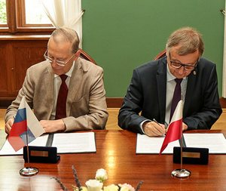
June 2018
p.11

Slide 12
Financial Commitment

Slide 13
A New Theme Within The Topical Plan of JINR

Slide 14
Main activities
years
2020 2021 2022 2023 2024 2025
Design of extended experimental hall, construction works
Insertion device
(SCW)
Beamline construction works
Equipment for end stations and additional facilities, commissioning
Utilization, user program

Slide 15
SOLCRYS laboratory
SOLCRYS
p.15

Slide 16
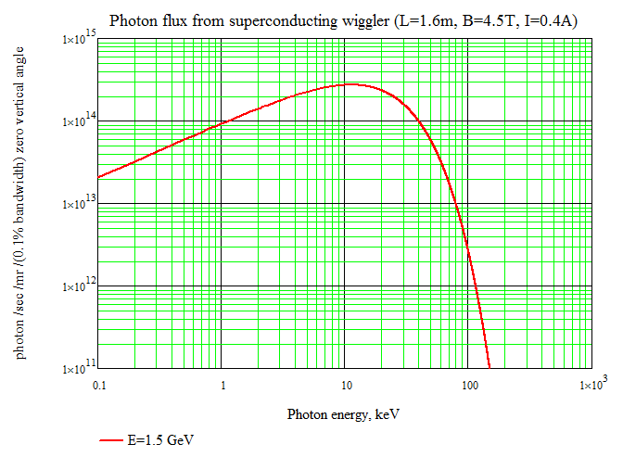
Super-Conducting Wiggler for energy 5-20 keV
B = 4.5T
Period = 51.4mm
Flux = (2-3)*10¹⁴ ph/s/mrad/0.1%

Slide 17
Main results
Technical infrastructure for the SOLCRYS laboratory.
Superconducting wiggler as a radiation source.
X-ray beamline for diffraction studies.
X-ray beamline for small-angle and wide-angle X-ray scattering studies.
Facilities for sample preparation.
Access to the constructed SOLCRYS laboratory for JINR scientists (including all the member states).

Slide 18
Small-Angle X-ray Scattering beamline
Wavelength range: 0.75 – 2.0 Å (16.5 – 6 keV)
Energy resolution ~ 1-2 ^{x} 10⁻⁴
Expected beam size ~100-150 μm
Main components:
Toroidal Collimating Mirror (Si and Rh)
Water-cooled or Cryogenically-cooled (preferred) Double Crystal Monochromator (DCM) (~0.75 –2.0 Å <> 16.5-6 keV)
Detectors (for SAXS/WAXS) – Pilatus 3S 2M or EigerX 4M
Studies at this station will include wide range of research on:
new materials
biological objects
nanoparticles and nanocomposites (in solution or in solid state)

Slide 19
Macromolecular Crystallography beamline
Wavelength range: 0.6 – 3.0 Å (20 – 4 keV)
Energy resolution ~ 1 ^{x} 10⁻⁴
Expected beam size ~50 μm
Main components:
Vertically Collimating Mirror (Si and Rh)
Cryogenically-cooled Double Crystal Monochromator operating at 4-20 keV (~0.6 –3.0 Å)
Toroidal Focusing Mirror
Detectors – Pilatus 3X 6M or EigerX 9M (Dectris)
Studies at this station will include wide range of research on:
new materials
biological objects
cryo-crystallography
diffraction from samples at extreme conditions

Slide 20
Sample preparation facility
cryo-cooling system
robotic autosampler for remote access
high pressure cell (mini hp cell)
temperature attachments
diamond anvil cell preparation laboratory (DAC holder, ultrasonic cleaner, driller, gas loading system)

Slide 21
Interest of users from JINR member states

Slide 22

SOLCRYS laboratory for JINR scientists
Short ID
SOLCRYS
p.22

Slide 23
Summary
The joint JINR-JU interests on the construction of SOLCRYS structural laboratory at SOLARIS has been established
FLNP directorate appeals to the PAC on Condensed Matter Physics looking for support in our decision to open the new theme within JINR topical plan “Development of the SOLCRYS structural research laboratory at the SOLARIS National Synchrotron Centre“ for the period of 5 years

Slide 24


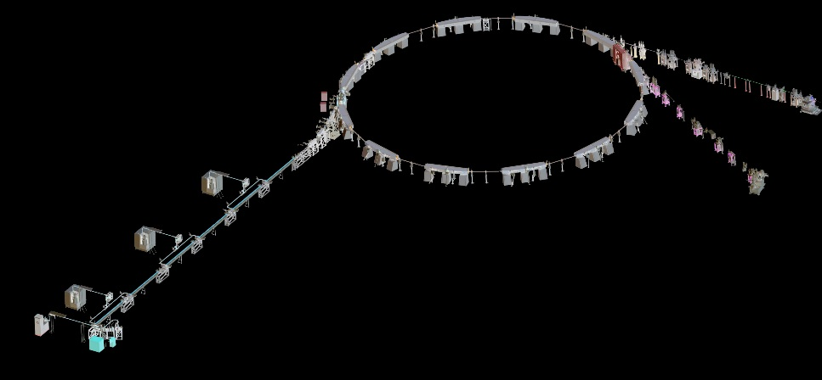
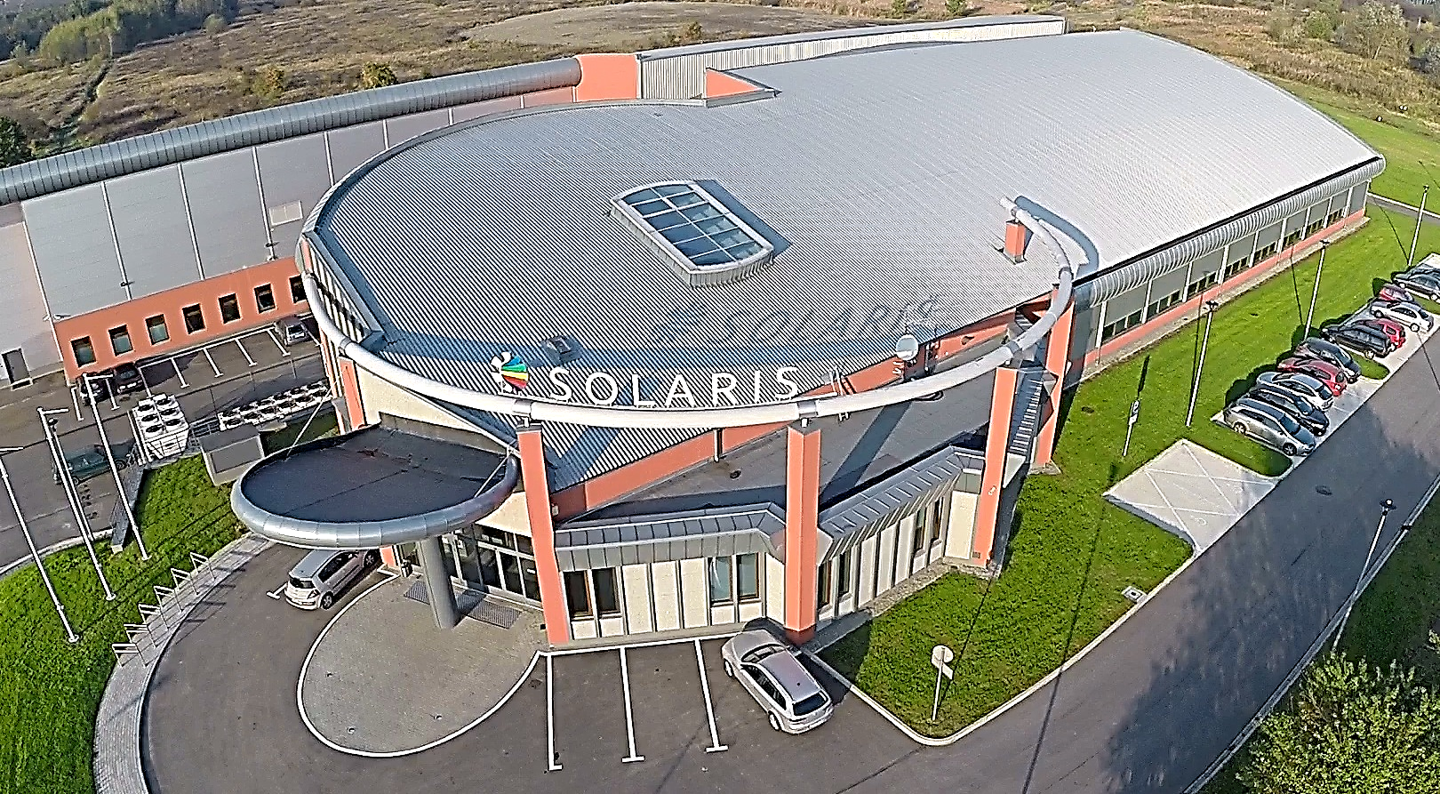
Thank You for Your Attention!

