Slide 1
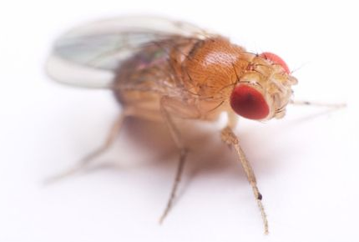
JOINT INSTITUTE FOR NUCLEAR RESEARCH
Dzhelepov Laboratory of Nuclear Problems
Molecular and radiation genetic group
The molecular genetics of radiation-induced changes at the gene, genome and transcriptome level in Drosophila melanogaster
Project RADIOGENE
Project Head I.D. Alexandrov
Project Head Deputy K.P. Afanasyeva
Dubna, 2019

Slide 2
Topic | 1132
Laboratory | Dzhelepov Laboratory of Nuclear Problems
Area | Condensed Matter Physics, Radiation and Radiobiological Research
"RADIOGENE Project: Experimental justification of radiation genetic risk estimation according to the frequency of heritable DNA changes in human and animal structural genes“ 2017-2019
Authors:
JINR, (Dubna) | I.D. Alexandrov, M.V. Alexandrova, K.P. Afanasyeva, S.V. Korablinova, L.N. Korovina, E.V. Kravchenko, A.N. Rusakovich
vigg, RAS, (Moscow) | I.A. Zakharov-Gezekhus
Southern Federal University, (Rostov-on-Don) | V.A. Chistyakov

Slide 3
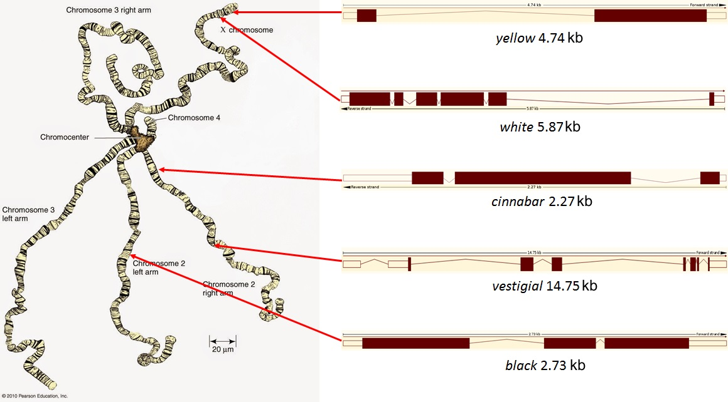
Tasks
To study the spectrum and frequency of the inherited DNA changes induced by γ- rays and neutrons at five genes using PCR method
To study the quality and the frequency of DNA micro-changes using the sequencing
To assess the frequency of the inherited DNA base substitution induction using the 1Gy per 1 nucleotide approach.
Taking into account this discovered induced frequency and spontaneous rate of this changes to determine the doubling dose as the basic criteria of the genetic risk of ionizing radiation on the molecular level for animals and humans.

Slide 5
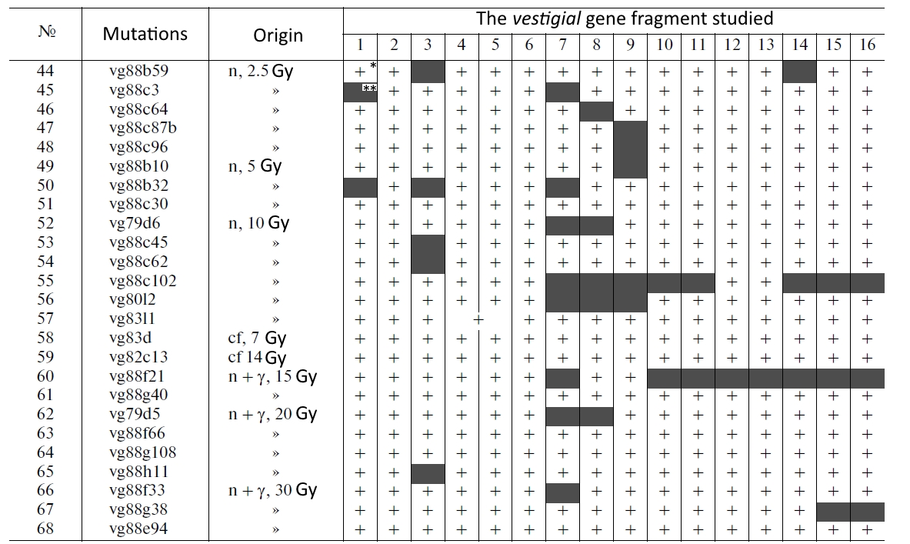

Slide 6
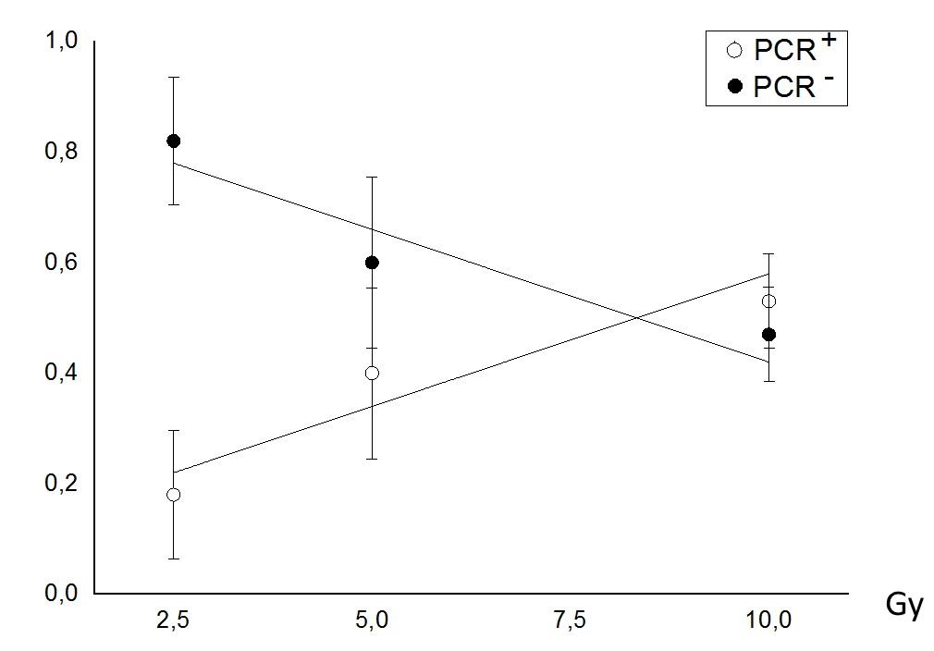
The dose-effect dependence of PCR⁺ and PCR⁻ mutants for five Drosophila melanogaster gene studied after action of ⁶⁰ Co γ- irradiation
The dose-effect dependence of PCR⁺ and PCR⁻ mutants for five Drosophila melanogaster gene studied after action of neutron-irradiation

Slide 7
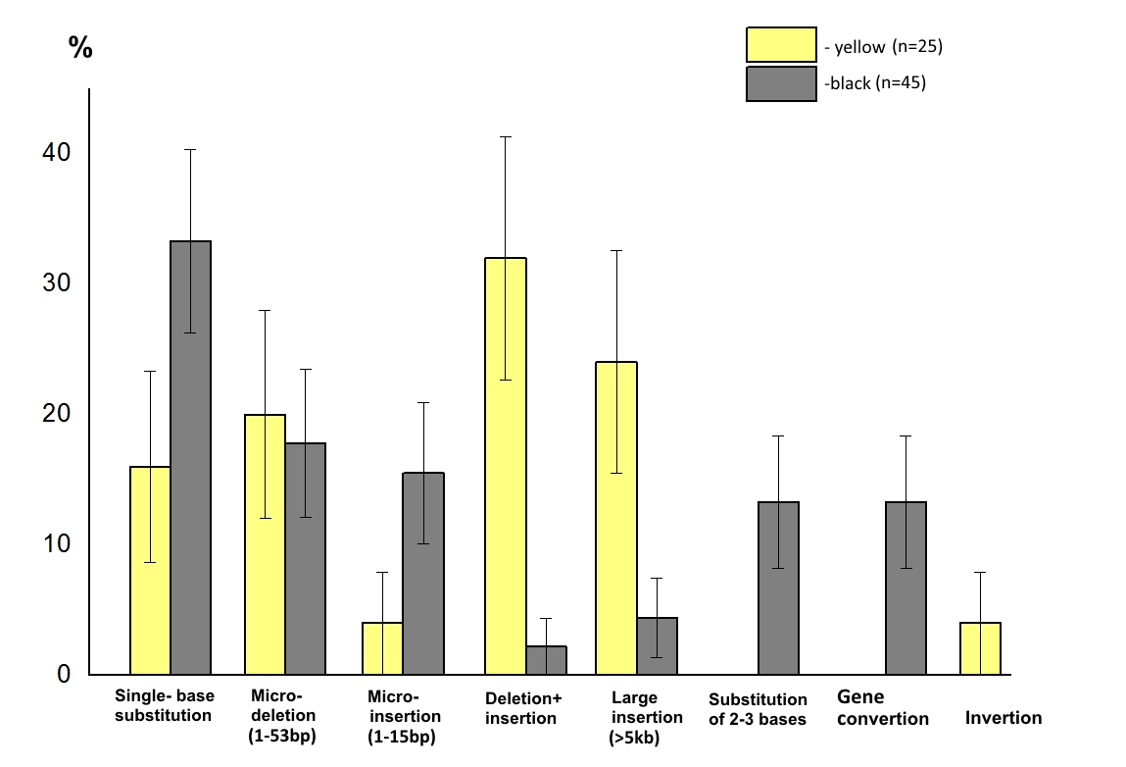
Spectra of γ-ray-induced DNA changes at the yellow and black genes of Drosophila melanogaster

Slide 8
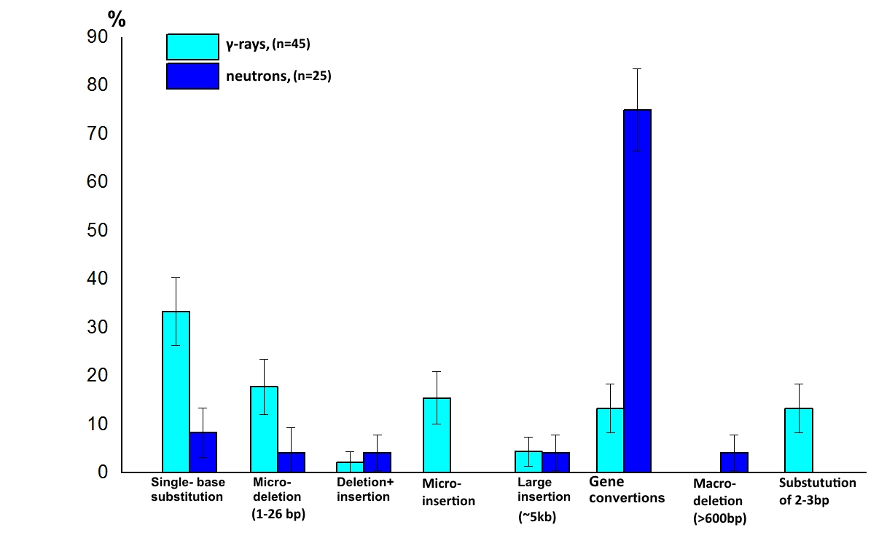
The relative frequency of different DNA changes induced by γ-rays and neutrons at the black gene of in Drosophila melanogaster

Slide 9
Doubling dose
frequency of base substitutions
(on the per 1 Gy per 1 nucleotide approach)
S – number of base substitutions
N - number of bases analyzed
D – dose
Doubling dose
Fs - spontaneous frequency
Fγ – γ-induced frequency

Slide 10
List of journal publications (2016-2019)
1. E.V. Kravchenko, A.N. Rusokovich et al. Radiation biology of structurally different genes of Drosophila melanogaster. Message 8. White gene: general characteristics of radio-mutability and PCR analysis of “point” mutations // Rad. biology. Radioecology, 2019 (in print)
2. E.V. Kravchenko, S.V. Dubovik et al., Message 7: gene yellow. General characteristics of mutability and PCR analysis of “point” mutations // Rad. biology. Radioecology, 2018, t. 58, No. 4, p. 341-351
3. I.D.Alexandrov, M.V. Alexandrova Radiation biology of structurally different genes of Drosophila melanogaster. Message 6: The cinnabar gene: sequencing of γ- and neutron-induced "point" mutations // Rad. biology. Radioecology, 2018, t. 58, No. 1, p.15-25
4. Afanasyeva KP, Alexandrova MV, Alexandrov I.D. Molecular genetic studies of the radiation genetics of Drosophila at JINR, Ecological Bulletin, 2016, No. 3 (37) p. 75-79.
List of presentations at conferences
1. I.D. Alexandrov, M.V. Alexandrova, K.P. Afanasyeva, et al. Radiation biology of Drosophila melanogaster structural genes / Abstracts of the All-Russian Conference "Drosophila in Genetics and Medicine", p.8, Gatchina, October, 2017.
2. Afanasyeva KP, Alexandrova MV, Alexandrov I.D. Molecular genetic analysis of γ- and neutron-induced "point" and structural mutations of the vestigial D. melanogaster gene / theses of the All-Russian conference "Drosophila in genetics and medicine", p.11, Gatchina, October, 2017.
3. Afanasyeva K.P., I.D. Alexandrov, M.V. Alexandrova Comparative characteristics of the damaging effects of γ-quanta, fission neutrons and 12C ions at different levels of the genome of D. melanogaster generative cells. Abstracts on the materials of the First All-Russian Scientific Conference "Toxicology and Radiobiology of the XXI Century", St. Petersburg, May, 2017
4. Afanasyeva KP, Alexandrova MV, Alexandrov I.D. Molecular genetic studies on radiation genetics of Drosophila at JINR // abstracts in the Materials of the 16th International Scientific Conference Sakharov Readings 2016: Ecological problems of the XXI century, Minsk, May 2016. s.200-201.

Slide 11
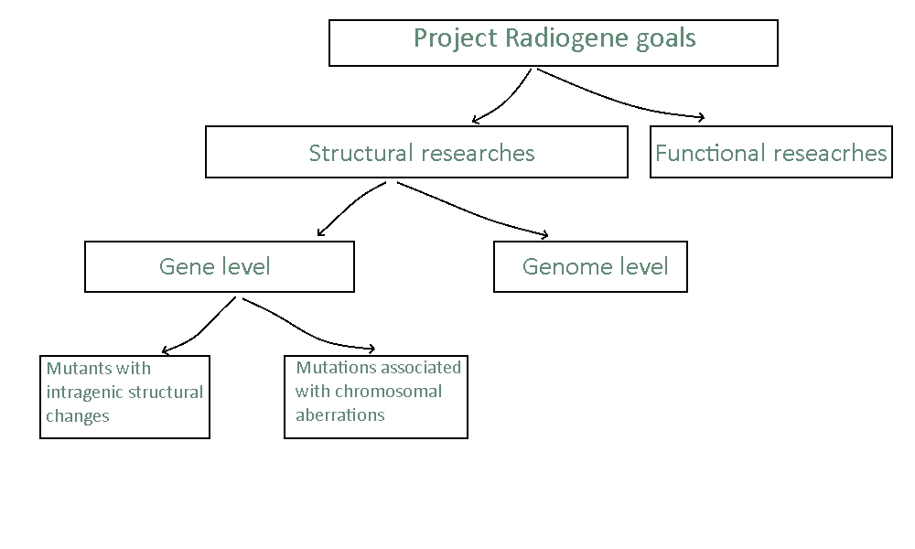
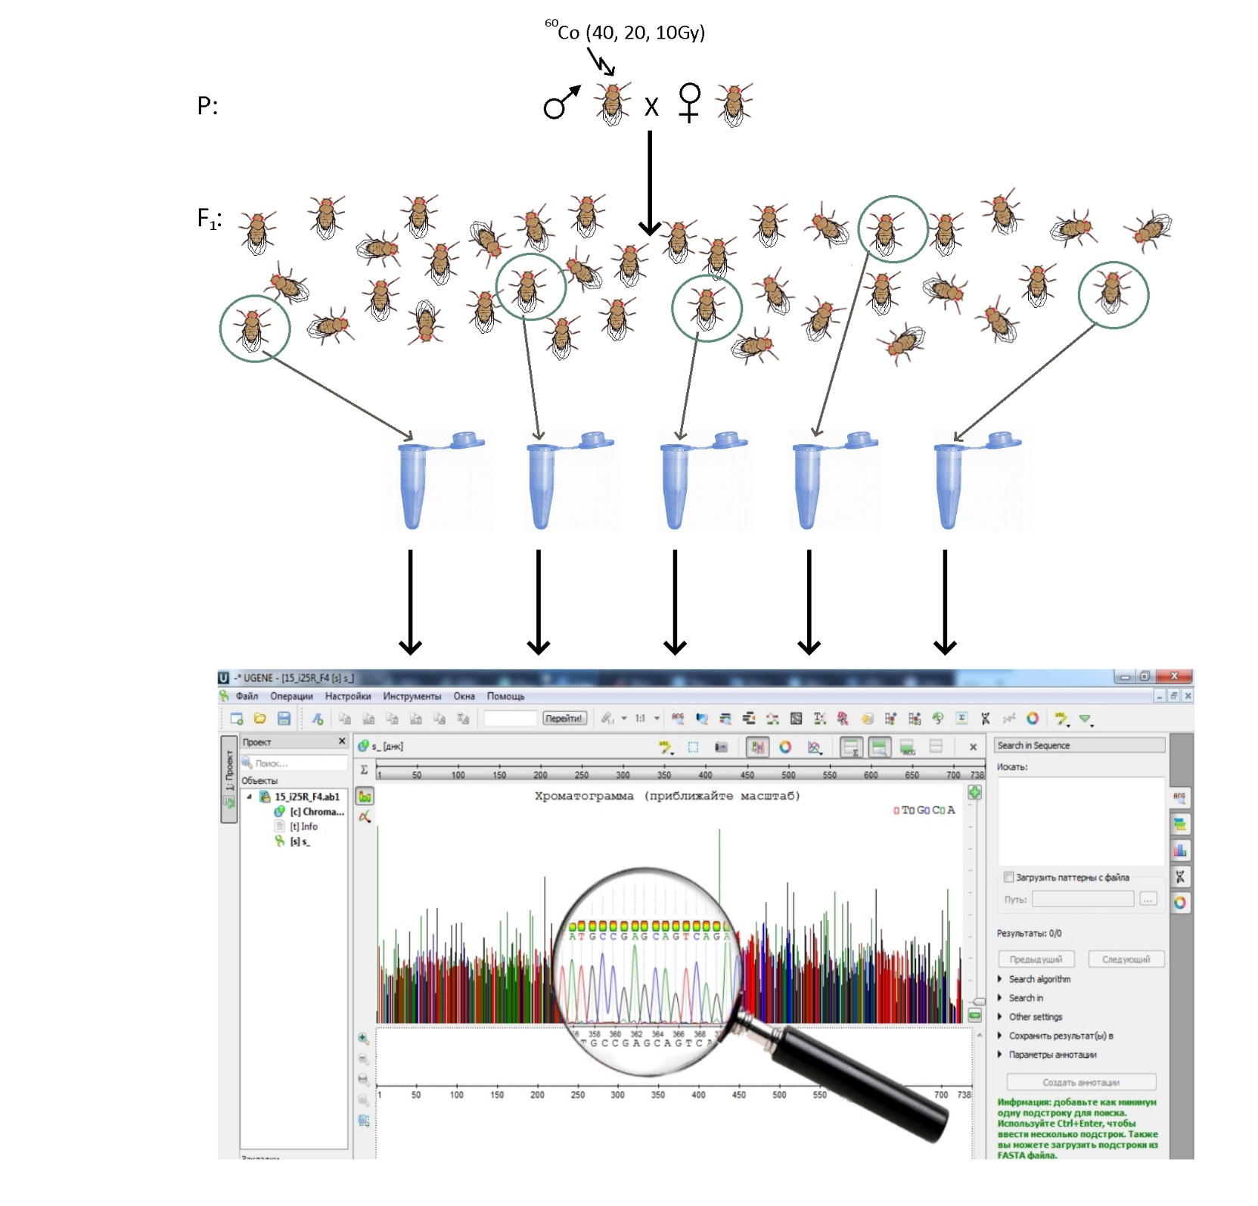
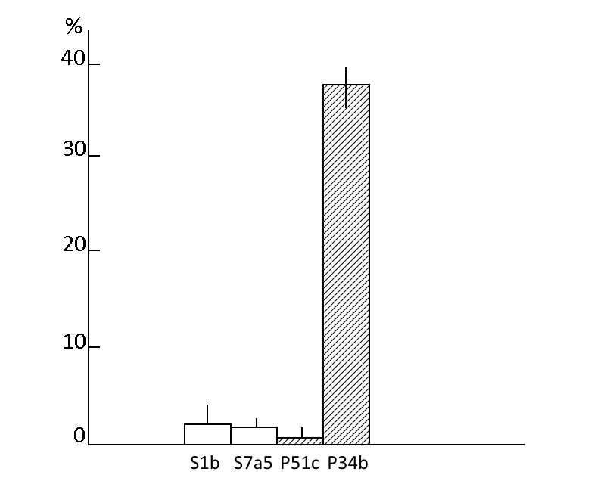
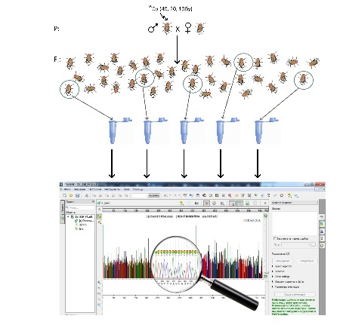
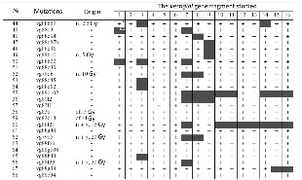

Slide 12
Expected results
The nature of structural gene changes in point and chromosomal mutations induced by γ-rays and neutrons
The results of genome-wide sequencing of offspring from irradiated males will be obtained for the first time ever
The estimating the genetic consequences of parental germline cells irradiation for the progeny
The transcriptome analysis will allow to identify the gene sets responsible for radiosensitivity in Drosophila genome

Slide 13
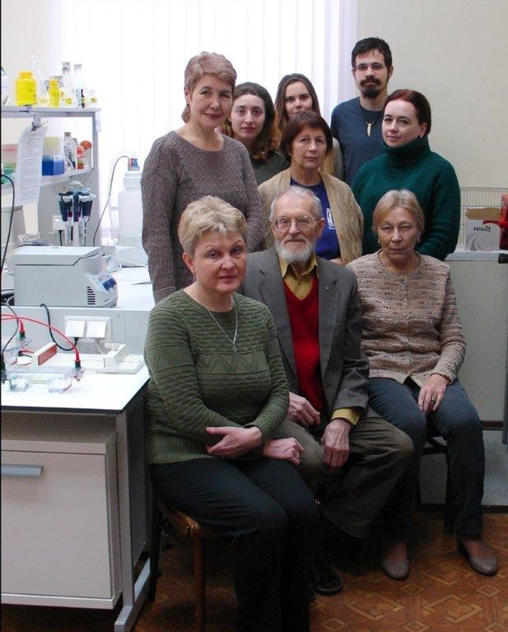
Project strengths are:
Long-term experience of the main implementers of the project in the field of general, radiation and molecular genetics
The unique collection of radiation-induced mutations of five different D. melanogaster genes
Great experience in the first project Radiogene
The combination of advanced scientific ideas with the most up-to-date DNA technology
Scientific support of uncoming research by a member of the Russian Academy of Sciences

Slide 14
Timetable on Project
Stages | Content | Institute
2020 г. | To perform works on PCR analysis of structural intragenic changes in γ- and neutron-induced mutants for five genes studied. To obtain isogenic lines for genomic analysis of mutations inherited in the offspring. To conduct preliminary work on the assessment of the radiosensitivity of the D. melanogaster lines from the LNP genetic collection. To work out the method of in situ FISH hybridization on Drosophila polytene chromosomes Perform sample work at Afimetrix | JINR
2021г. | Sequencing of the intragenic deletion ends of γ-ray- and neutron-induced mutations of the genes studied Sequencing of the genomic DNA of the offspring from isogenic males irradiated by 20-40 Gy γ rays ⁶⁰Co. To conduct a comparative computer analysis of the obtained sequencing results using the program from the resource EMBL-EBI. To begin work on in situ hybridization using mutants with chromosomal changes. To test the transcriptome analysis technique on Drosophila control lines using the Afimetrix. | JINR
2022 г. | To complete work on in situ FISH hybridization and sequencing of introgenic structural changes for γ- and neutron-indused mutants Conduct a comparative statistical analysis of the results obtained. To carry out the sequencing of the offstring genome from the males irradiated by 10 Gy γ rays To assess the nature of the dose dependence for inherited DNA micro changes. Compare these results with data available in the literature in mice. To carry out a comparative analysis of transcriptomes from Drosophila lines with different radiosensitivity. To identify the gene sets which are responsible for different radiation response. | JINR vigg, RAS, (Moscow) SFU Rostov-on – Don

Slide 15
The proposed timetable and resources needed for the Project
Required equipment, funding sources |  | Cost (ths.$) | The 1st year 2020 | The 2nd year 2021 | The 3rd year 2022
Equipment | 1. Microcentrifuge 2. PH meter 3. Autoclave | 5 0.6 | 5 0.6 | 5.6
Sources funding | The costs from the budget | 11.2 | 5.6 | 5.6

Slide 16
Estimated Project Cost
Name of cost items | full cost | 2020 year | 2021 year | 2022 year
Direct project costs
Materials (ths. $) | 117,8 | 39 | 39,8 | 39,0
Equipment (ths.$) | 11,2 | 5,6 | 5,6 | -
Travel expenses (ths. $) | 15.0 | 5.0 | 5.0 | 5.0
Total direct costs: | 144 | 49,6 | 50,4 | 44,0
Including from the LNP budget | 144 | 49,6 | 50,4 | 44,0

Slide 17
Thank you for your attention!

Slide 18
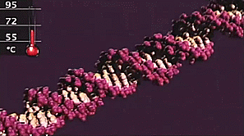
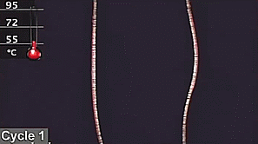
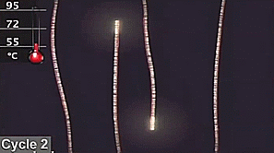
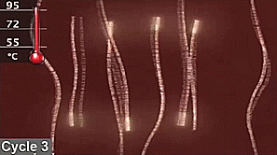
Our molecular methods: polymerase chain reaction (PCR)
http://gifsoup.com
https://www.youtube.com/watch?v=2KoLnIwoZKU
PCR permits to generate sufficient amount of copies of the DNA fragment of the gene under study. This DNA is than visualized and analyzed with agarose gel electrophoresis.

Slide 19
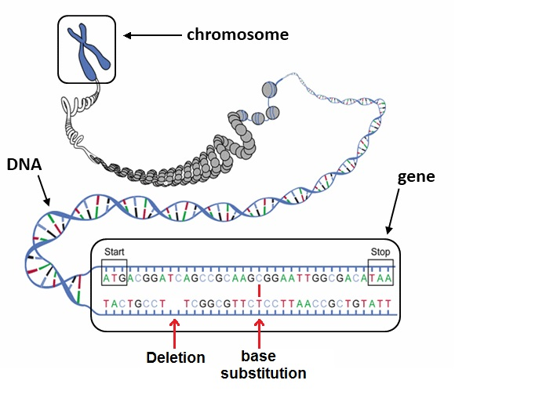
Our molecular methods: DNA sequencing
https://www.engrade.com
DNA sequencing is the process of determining the precise order of nucleotides within a DNA molecule

