Slide 1
Theme 04-4-1121-2015/2020
Project
A system for neutron operando monitoring and diagnostics of materials and interfaces for electrochemical energy storage devices at the IBR-2 reactor
ELCHEM_NS
M.V. Avdeev, I.A. Bobrikov, I.V. Gapon, A.I. Ivankov, V.I. Petrenko,
D.V. Soloviev, S.V. Sumnikov, A.V. Tomchuk (FLNP JINR)
D.M. Itkis (MSU)
F.S. Napolsky (Dubna University)
Leader: Mikhail V. Avdeev
Leader’s assistants: Ivan A. Bobrikov, Viktor I. Petrenko
2018-2020
Current state: June 2019

Slide 2
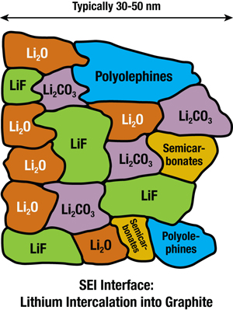
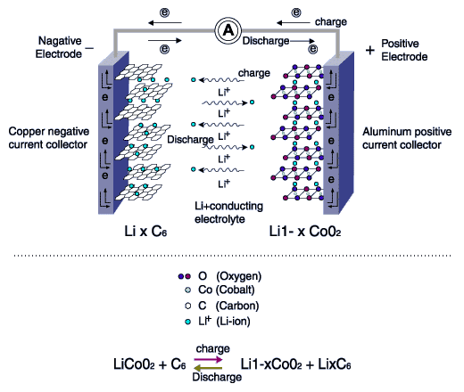
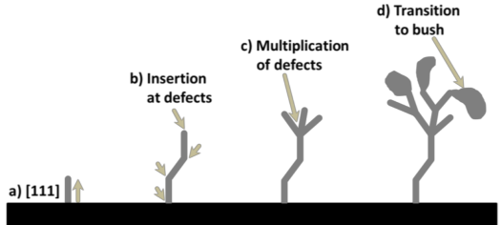
Structural Research of Electrochemical Accumulators
Interface evolution
Formation of solid electrolyte interphase (SEI)
Electrode structure evolution
Negative
Electrode
Growth of dendrites
Lithium intercalation
Main objective
Study of operating electrodes and interfaces (operando mode)

Slide 3
Project objectives
Development of common approaches to the effective use of neutron scattering methods (diffraction, reflectometry, small-angle scattering) in the analysis of the structural evolution of various types of electrodes and interfaces for electrochemical energy storage devices during operation (operando mode).
Design and development of specialized electrochemical cells and sample environment systems for operando research in neutron scattering experiments.

Slide 4
ELCHEM_NS Project
Small-angle
scattering
Diffraction
Reflectometry
Сu/Ni/Ti
Electrolyte
Сu/Ni/Ti
Electrolyte
Electrolyte
Si
Si_{1-y}M_{y}
Si
Si_{1-y}M_{y}
Si
Сu/Ni/Ti
Si_{1-y}M_{y}
n
n
n

Slide 5

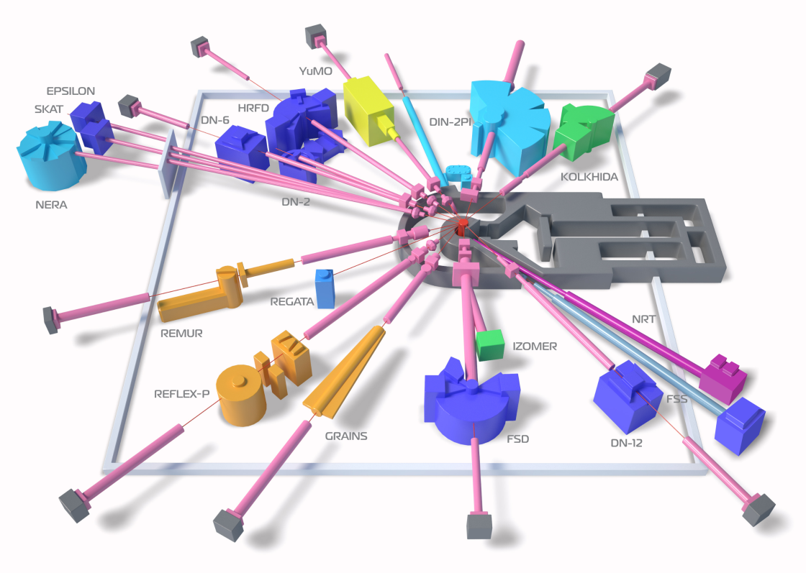
ELCHEM_NS Project
Instruments involved
HRFD, RTD (ND)
YuMO (SANS)
IBR-2 pulsed reactor, FLNP JINR
Neutron Difftraction (ND):
HRFD, RTD
Neutron Reflectometry (NR):
GRAINS
Small-Angle Neutron Scattering (SANS):
YuMO
GRAINS (NR)

Slide 6
ELCHEM_NS Project
Collaboration
FLNP JINR
Manufacturing:
Electrochemical cells for neutron scattering experiments;
Sample environment systems for in situ neutron scattering experiments.
Organization and support of R&D line for deposition and polishing of crystalline substrates;
Preparation and conduct of neutron scattering experiments at IBR-2;
Diagnostics and special treatment of samples after neutron scattering experiments.
MSU
Design and draft projects:
Electrochemical cells for neutron scattering experiments;
Sample environment systems for in situ neutron scattering experiments.
Scientific support.
Dubna University/
Engineering Center
Test assembly and electrochemical measurements of the cells and sample environment systems for neutron scattering experiments;
Electrochemical support of neutron scattering experiments.

Slide 7
Schedule
 |  | 2018 | 2019 | 2019
ND | Specialized Li-ion cells for multiple charge/discharge
 | Sample environment system for operando experiments
 | Multichannel cell charge/discharge line
NR | Specialized Li-ion cells with heterogeneous electrodes
 | Sample environment system for operando experiments
 | System for post experiment sample diagnostics, storage and treatment
SANS | Specialized Li-air cells for multiple charge/discharge
 | Sample environment system for ex-situ experiments
 | Sample environment system for operando experiments

Slide 8
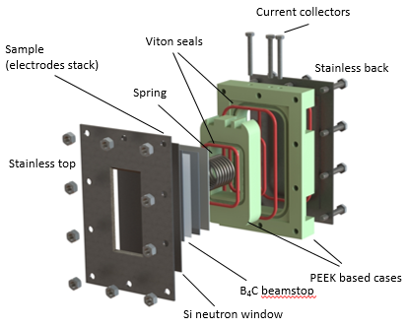
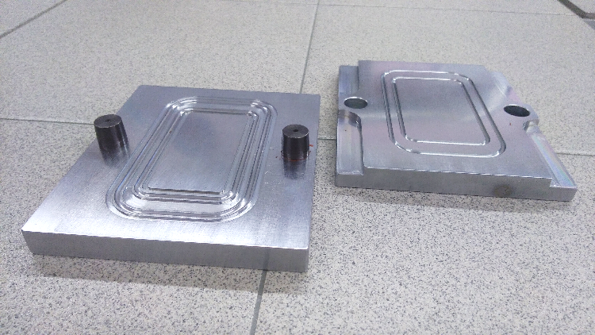
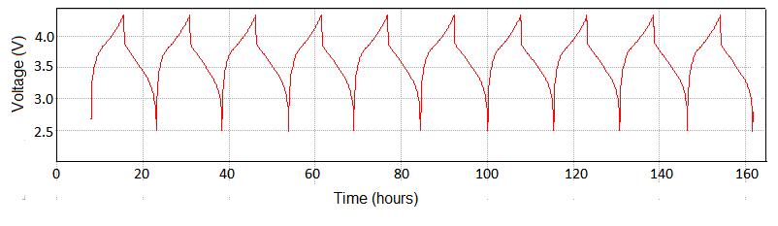
Neutron diffraction cell development
Cell upgrade:
Old type PTFE case was replaced with the PEEK type case.
Inner case construction was modified.
Beam attenuator (BN plate) was replaced with B₄С.
To make seals fitted to the PEEK cases the press forms were constructed and were used for producing numerical seals.
Results:
less active materials are used, cells are more chemically stable and easier to assembly.
tests and real experiments with electrode and solid electrolyte materials have been done.
NCA/C pack loses 30% capacity after 700 Cycles,
Current leakage ~1μA per an hour for 500 mAh cell
Practical cathode material LiNi_{0.8}Co_{0.15}Al_{0.05}O₂ (NCA)
Bobrikov et al, 2019

Slide 9
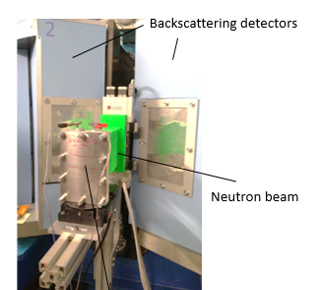
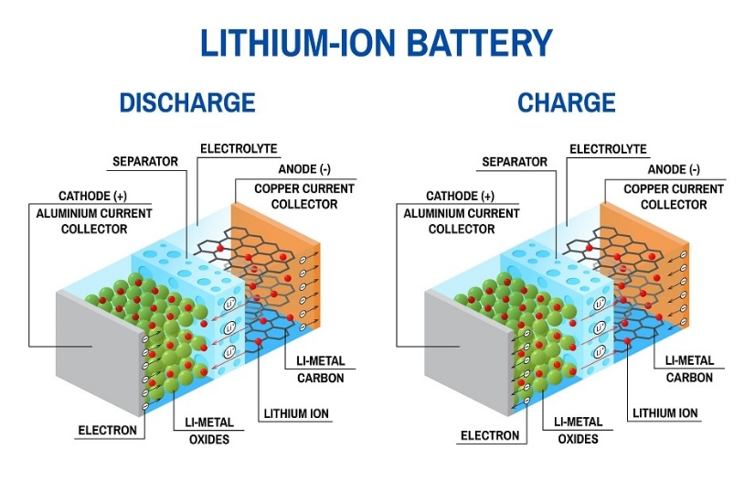
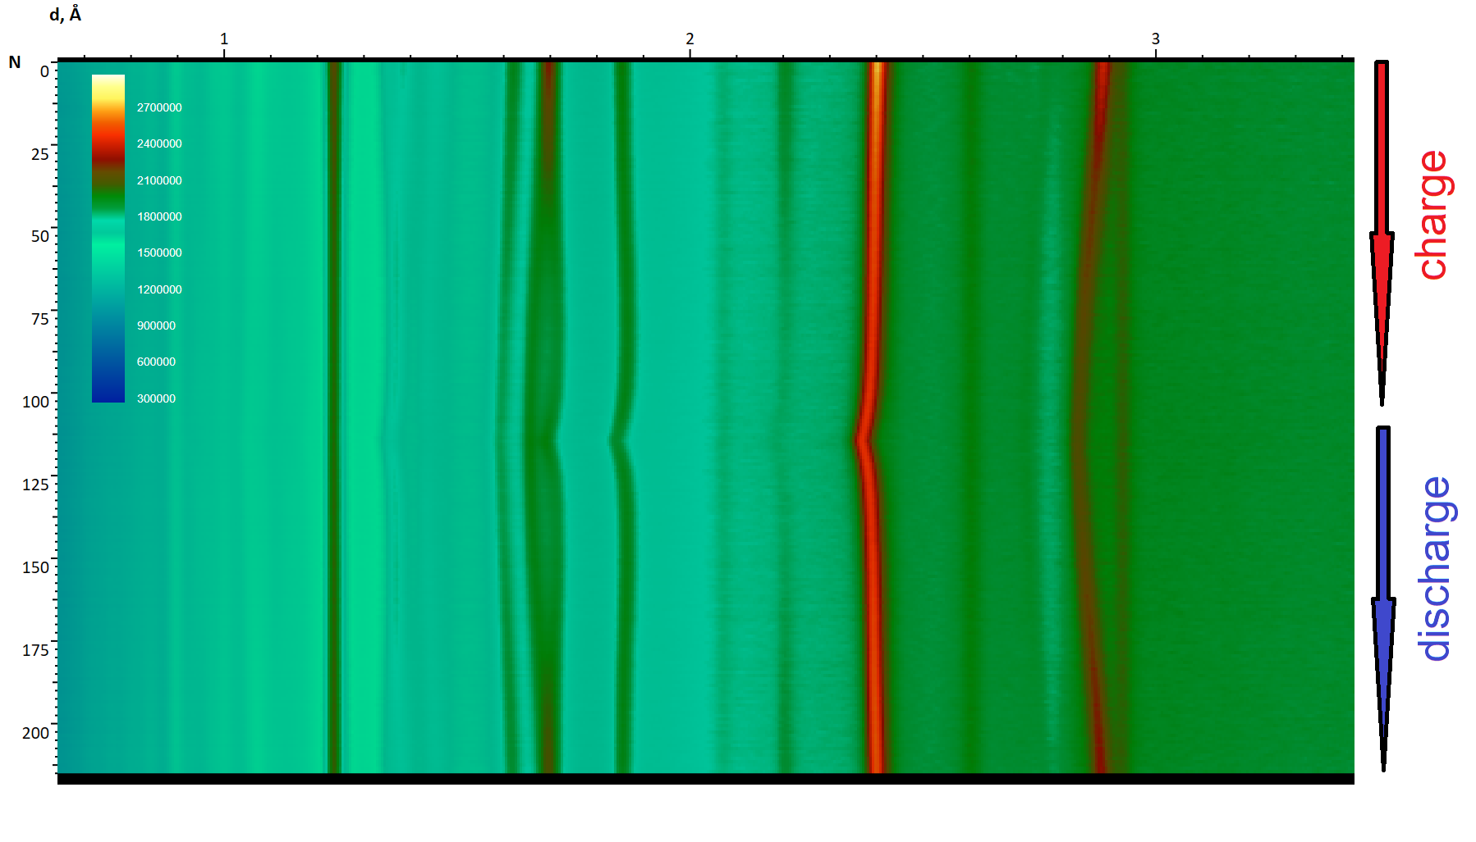
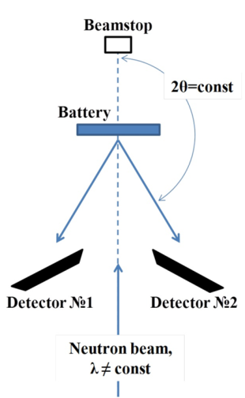
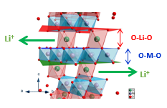
Neutron diffraction cell development
Maximum Capacity ~400 Wh/kg
ND cell
Bobrikov I.A., Samoylova N.Y., Ivanshina O.Y., Vasin R.N., Sumnikov S.V.,
Kornieieva K.A., Balagurov A.M. Electrochimica Acta. 2018. Т. 265. С. 726-735

Slide 10
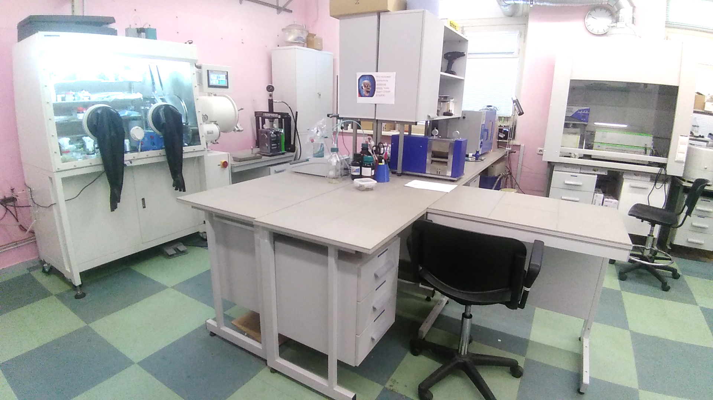
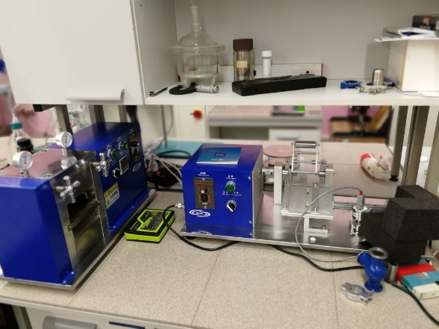
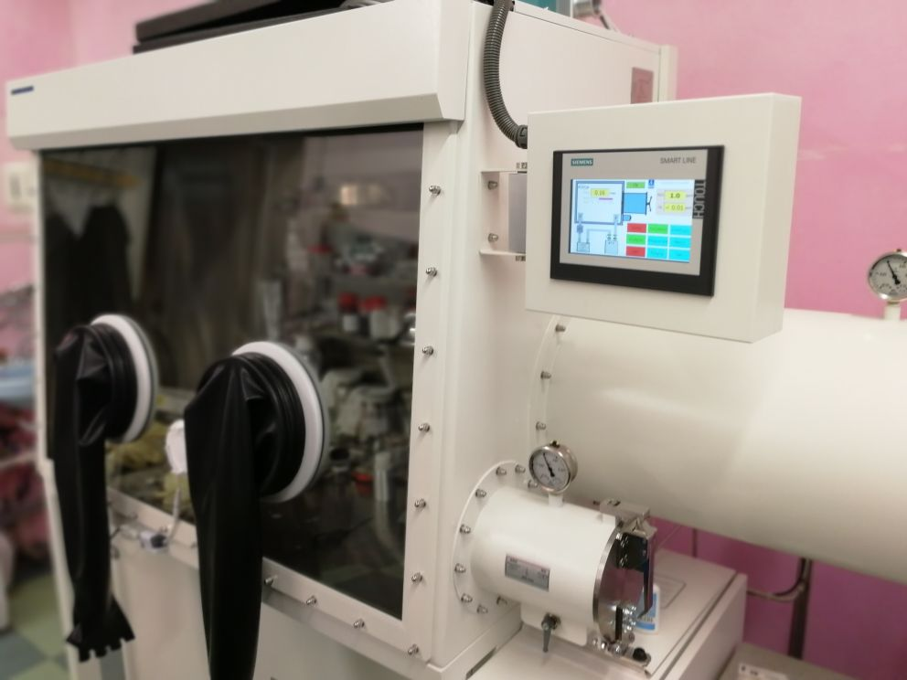
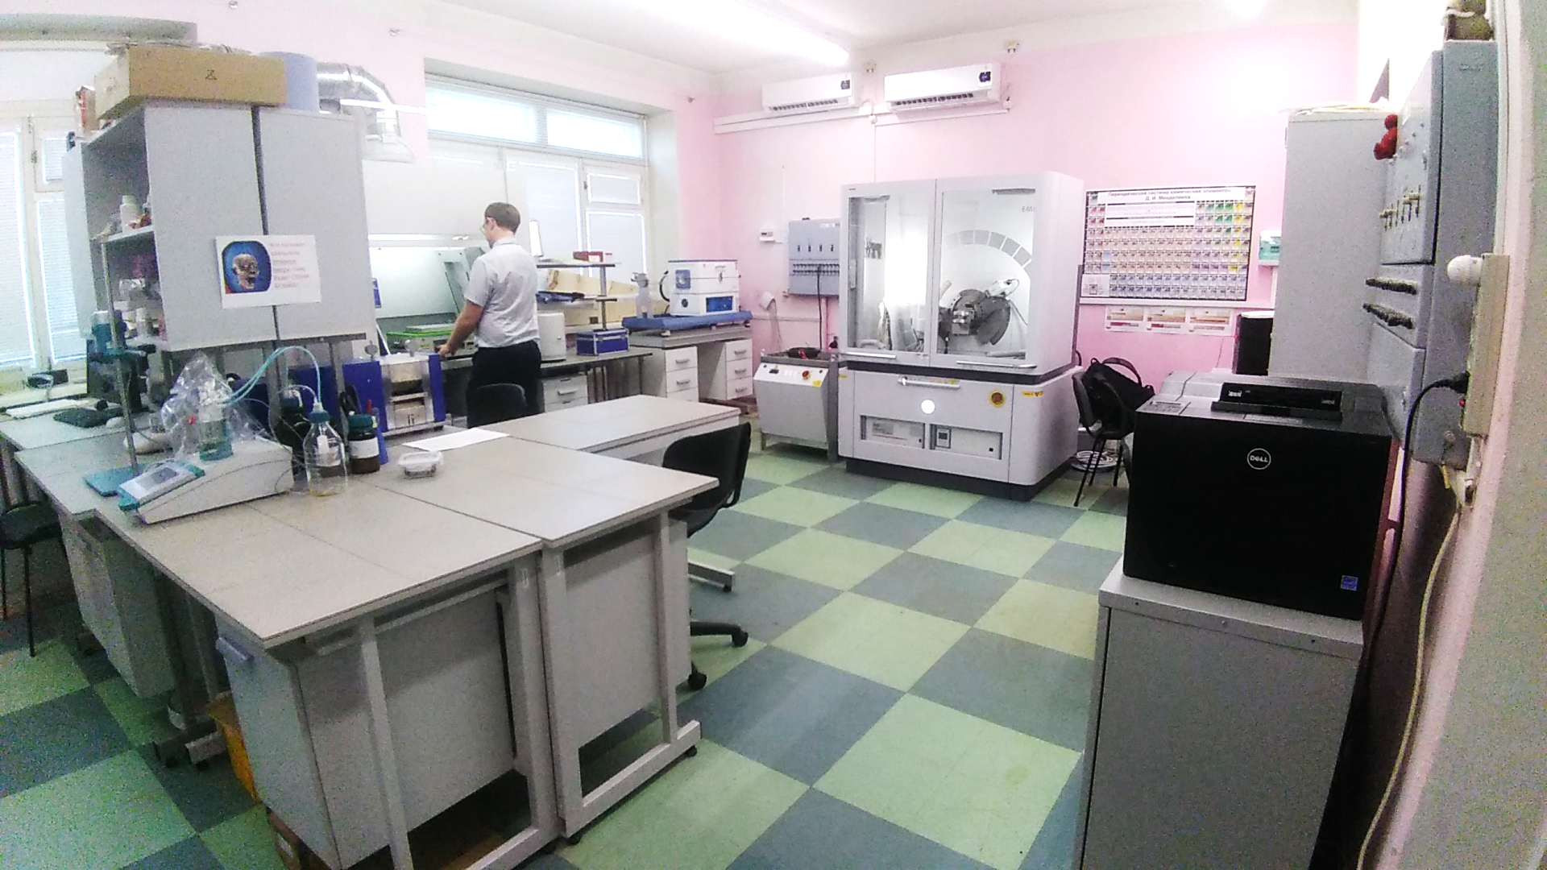
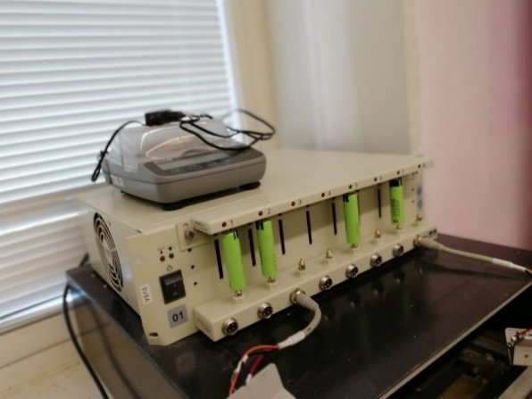
Electrochemical laboratory development
New Equipment:
Metrohm Fischer titrator 917
Despergator up to 25000 rpm
Potentiostat BIOLOGIC SP-300
High temperature inert gas furnace up to 1200˚ C
Storage of d-electrolytes for neutron scattering experiments (DMC, PC, EC)
3-axes for non-standard samples and electrochemical cells at X-ray diffractometer
Bobrikov et al, 2019

Slide 11
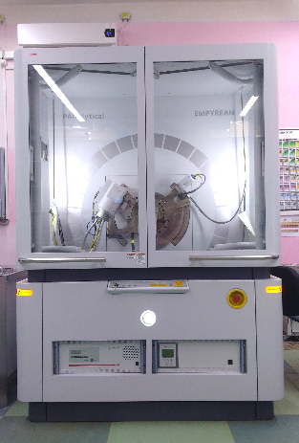
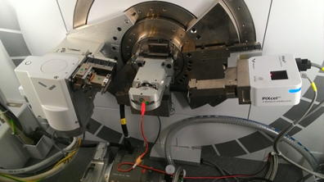
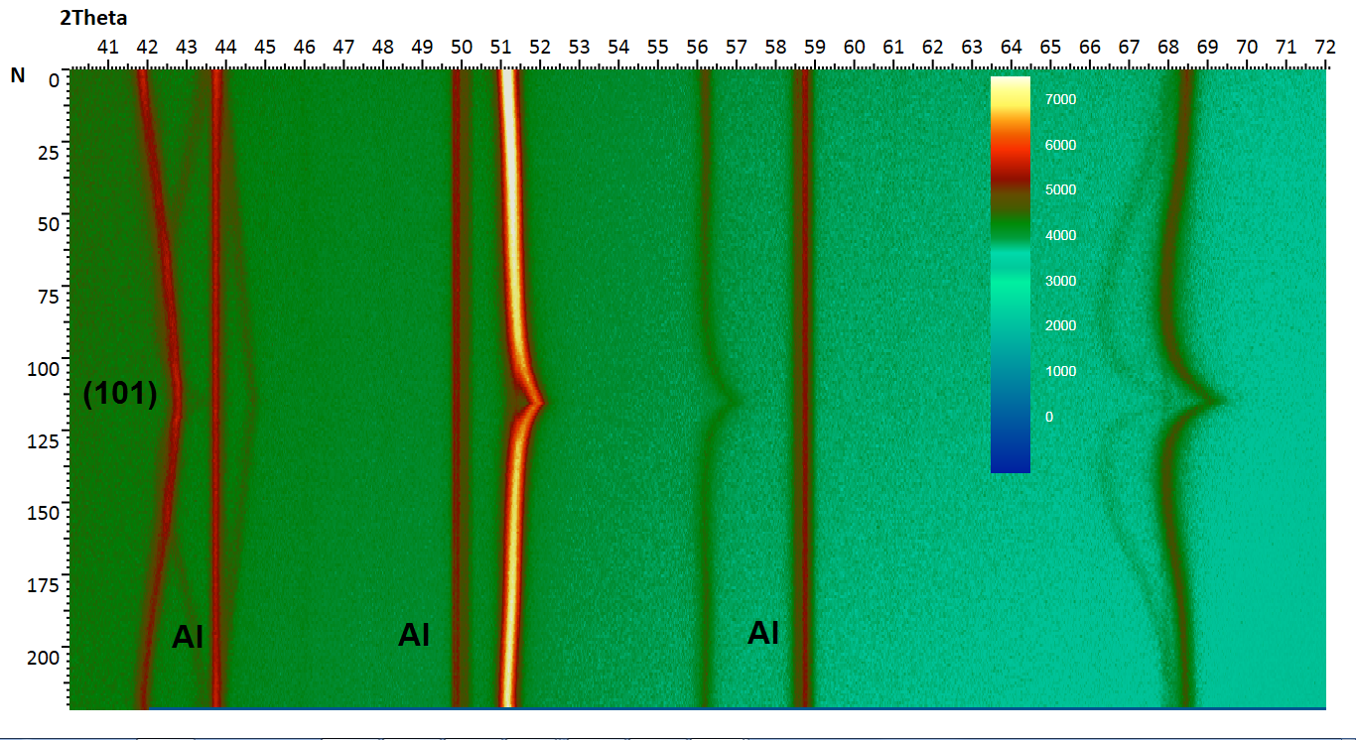
X-ray diffractometer
Malvern PANalytical Emyrean
XRD experiments
X-Ray operando diffraction scan of electrochemical cell
Diffraction pattern evolution
Bobrikov et al, 2019

Slide 12
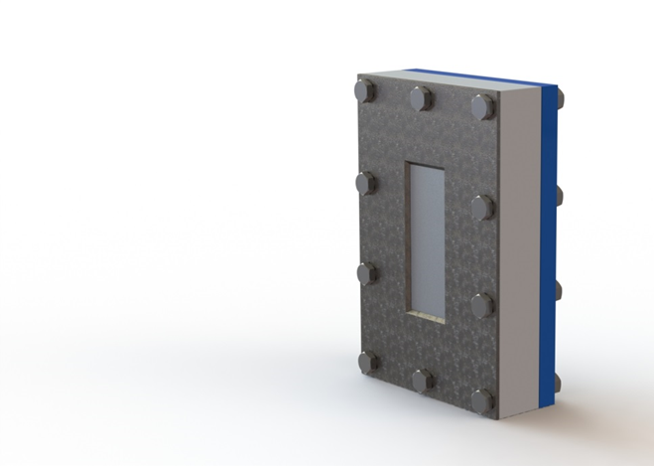
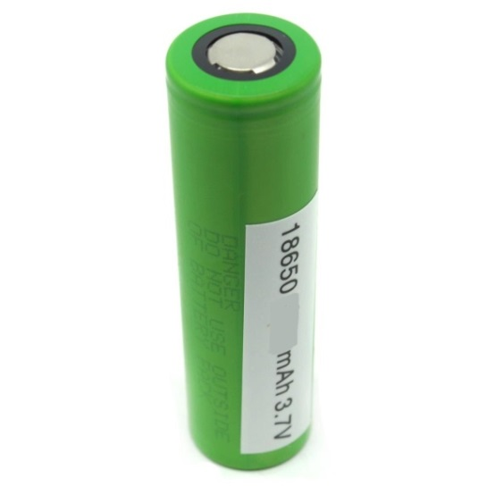
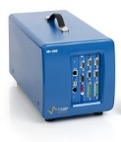
From model to real systems
NCA (+) opposite to Li (-)
NCA (+) opposite to graphite (-)
+
+
Phase stability during first cycle.
Trace of structural changes in cathode
Phase stability during operation.
Trace of structural changes in electrodes
-
-
Notes:
For that reason we have studied two systems: 1) real commercial battery based on NCA cathode for third and consequent cycles. We could not study the first cycle in commercial battery because first cycle is a procedure which is always done at a factory. 2) special designed electrochemical cell to check the same but at first cycle after cell assembling

Slide 13
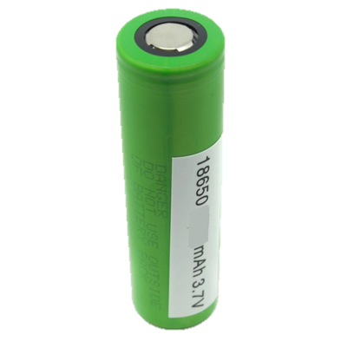
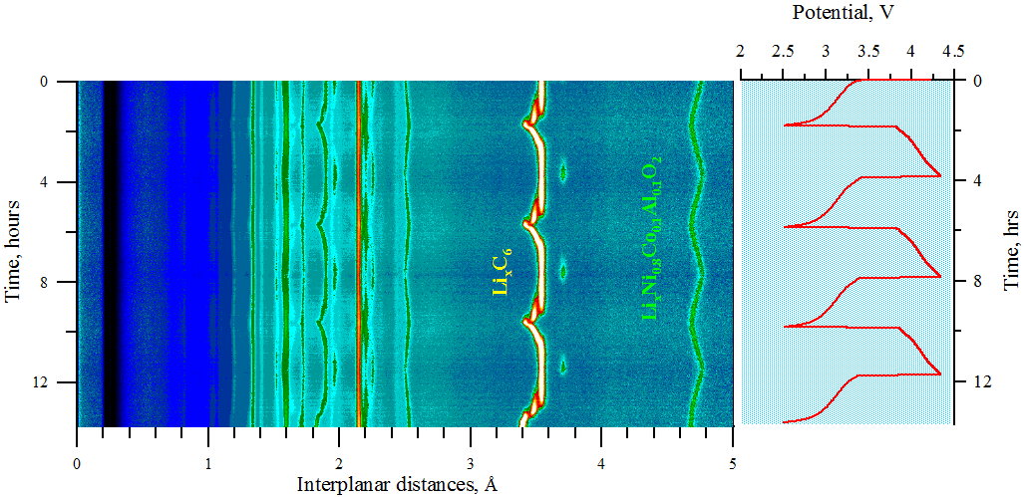
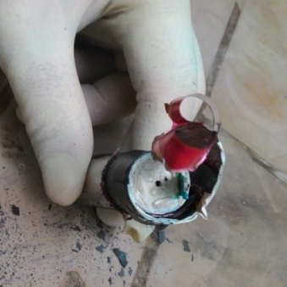
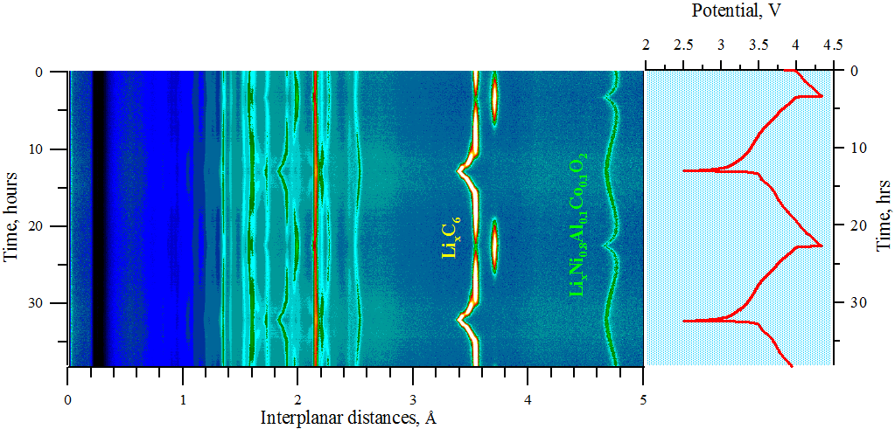
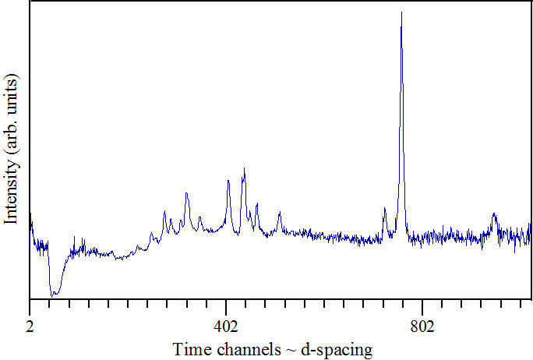
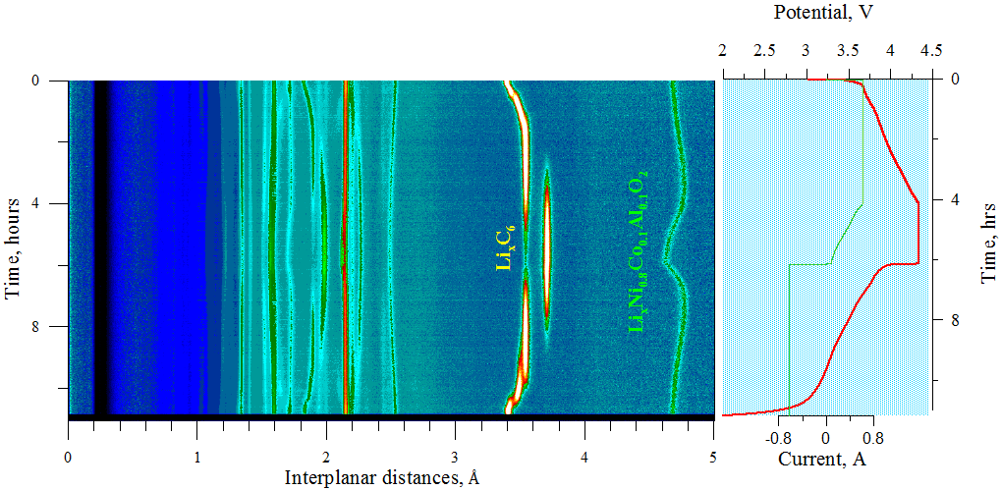
Operando Neutron Diffraction study of industrial batteries
1 (101)
2 1 (003)
U=2.5-4.33 V
C=3100mAh
Δt = 1.5-5 min
C=1852 mAh
Cт=278.9 mAh/g
m_{cathode}=14.6 g
LiC₆
C=2990 mAh
NCA
Li_{x}Ni_{0.8}Co_{0.15}Al_{0.05}O₂
C=3105 mAh
Notes:
Commercial battery 18650 type as it is with capacity 3100 mAh has been measured at different C-rate. Exposition time was from 1.5 up to 5 minutes for every diffraction pattern in high intensity. On these color picture you see diffraction pattern evolution in dependence on time or state of charge. Red color charge-discharge curve. Here I would like to mark so call cathode window where only cathode’s peaks are visualized and the same for anode window. One can see that without dependence on C-rate (speed of charge-discharge) there are significant changes of cathode and anode crystal structures. Тайпикал.

Slide 14
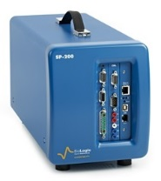
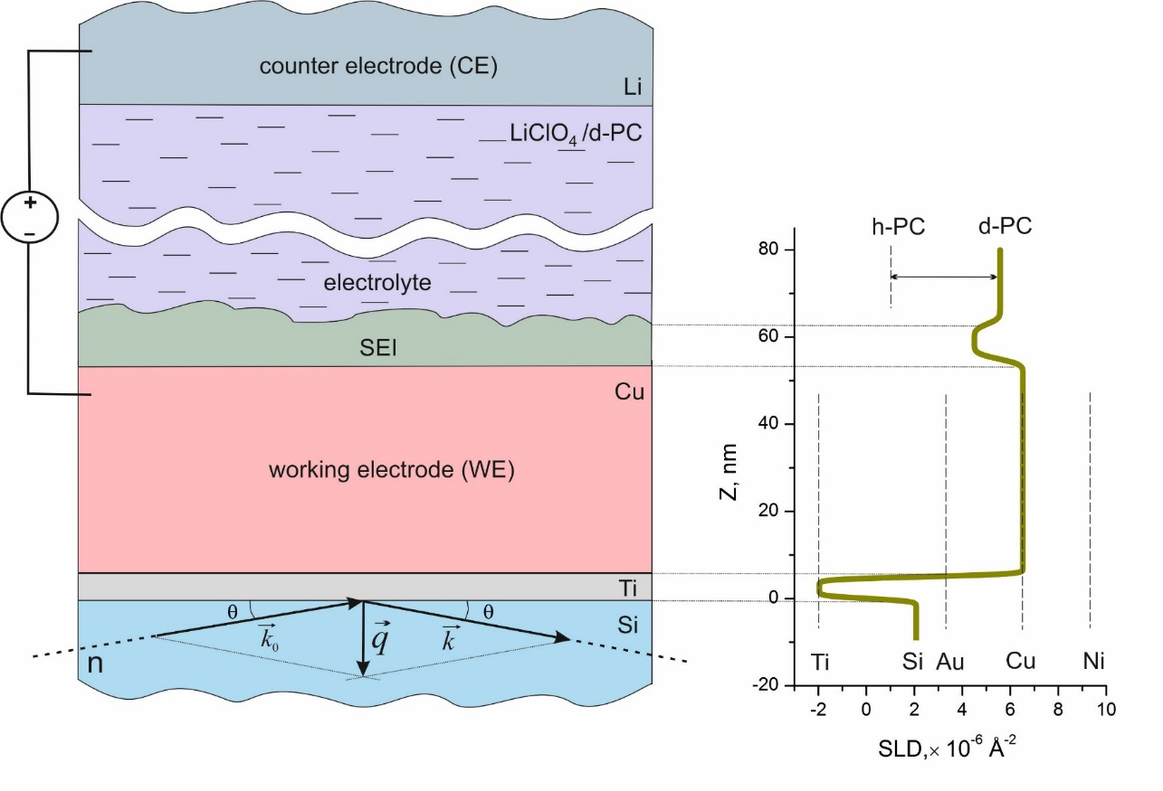
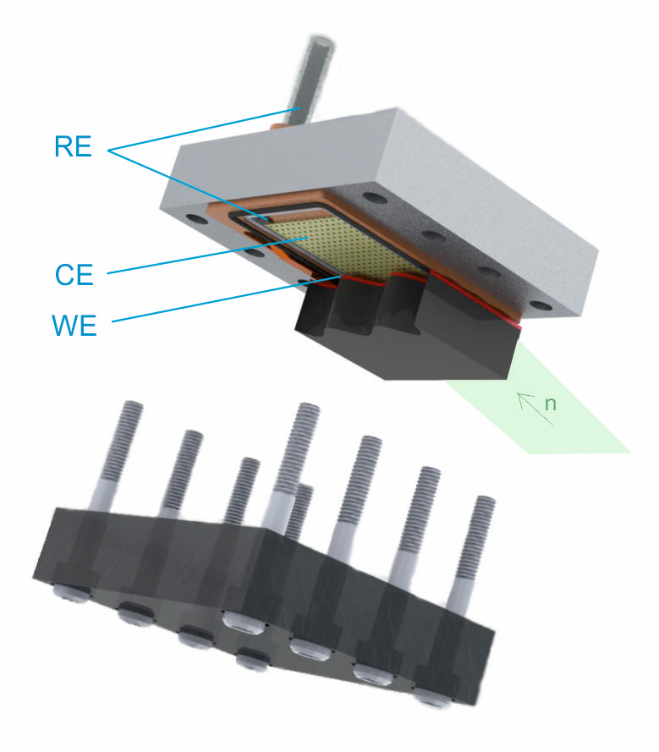
Neutron Reflectometry
Li-ion batteries with metal anodes and liquid electrolytes
Remote
control
Principal scheme
of experiment
Optimization of reflectometry cells and sample environment system
Synthesis of complex heterogeneous film electrodes
Complimentary diagnostics of electrode surfaces after neutron scattering experiments
Processing of crystalline substrates after neutron scattering experiments

Slide 15
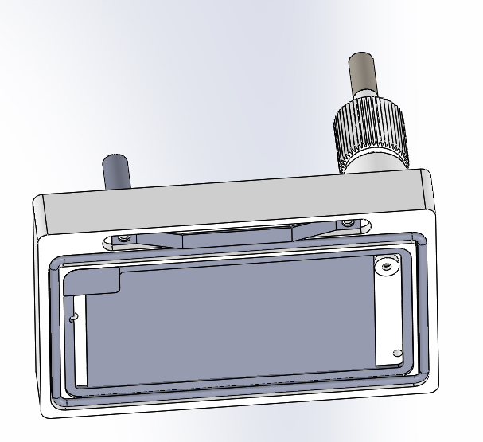
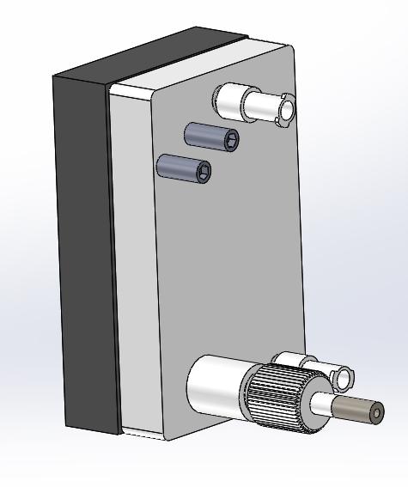
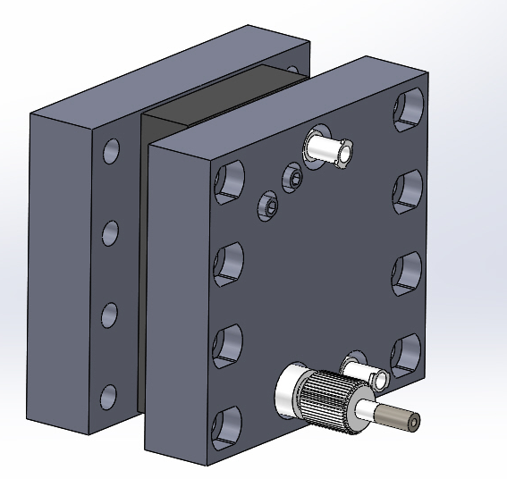
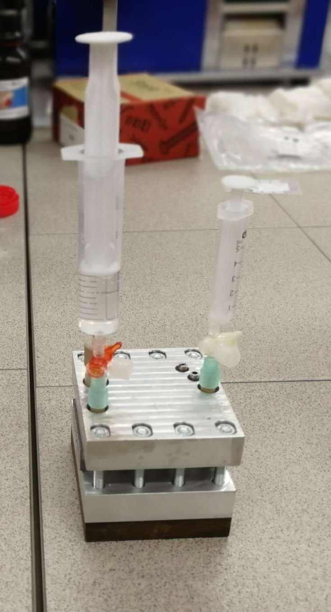
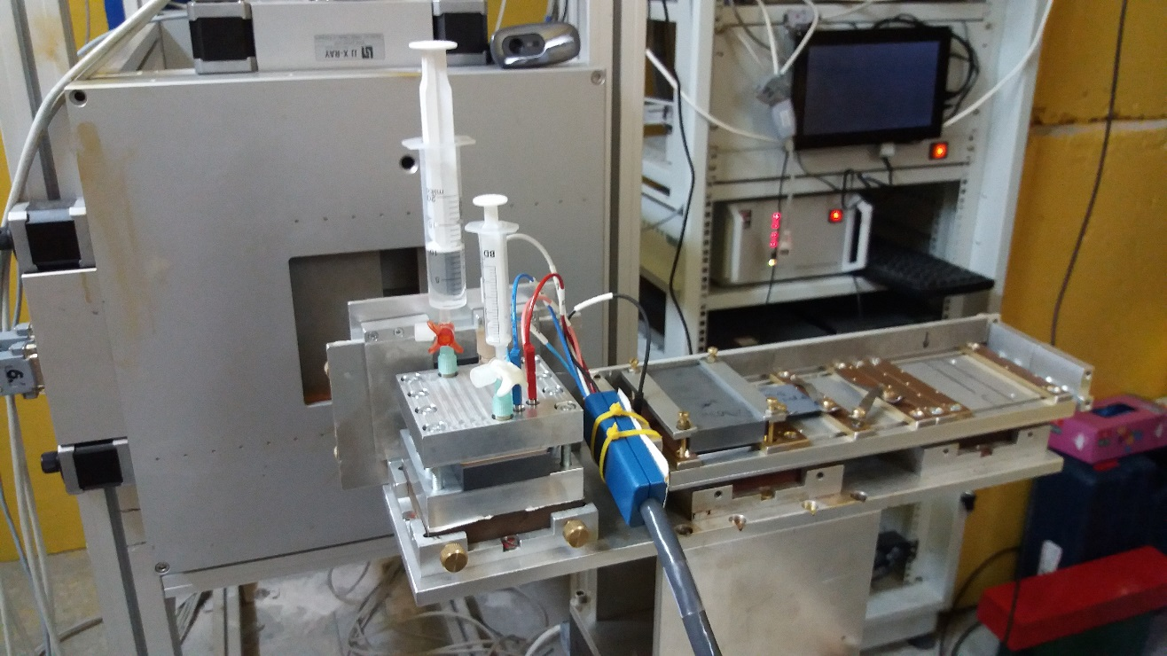
Neutron Reflectometry Cell
Electrolyte filling
WE/CE connectors
RE connector
PEEK case
Seal groove
Single crystal block Si
Counter electrode
Pressing plates (Al)

Slide 16
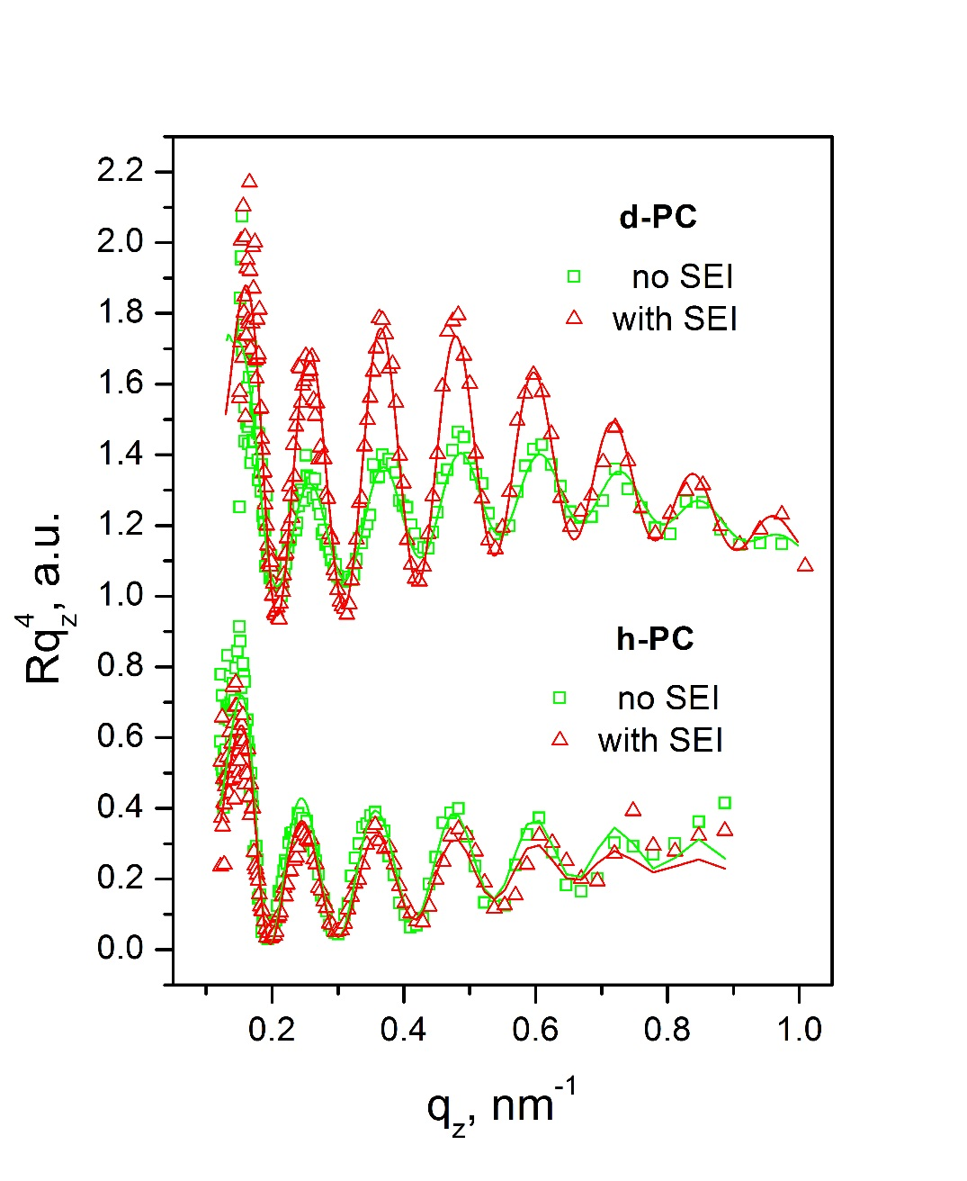
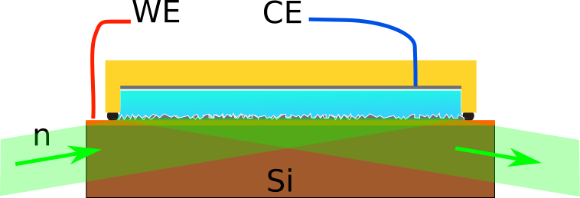
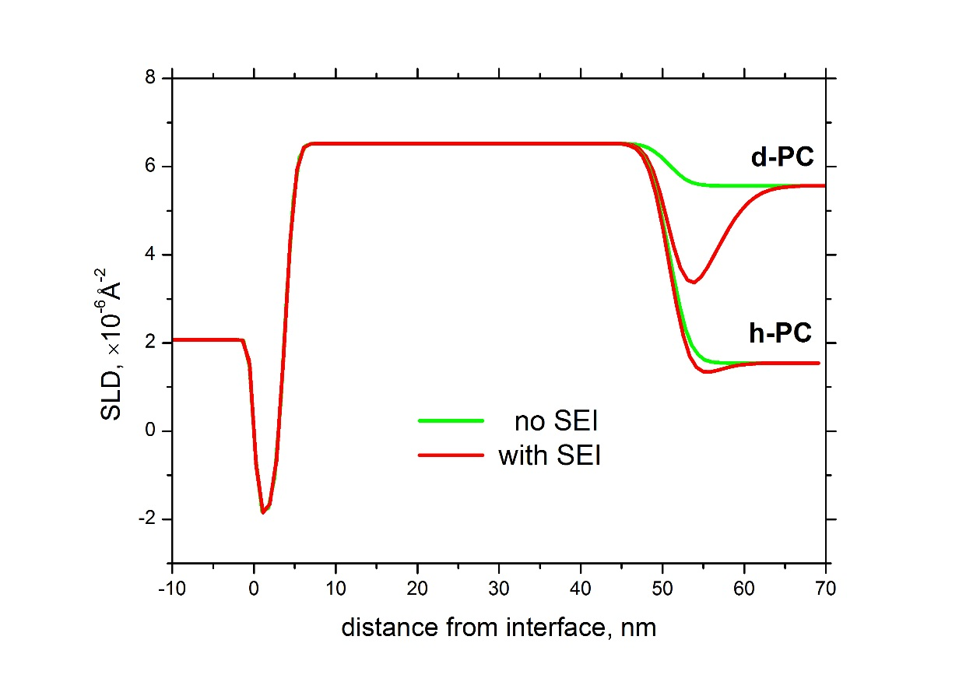
Neutron Reflectometry
z
Formation of Solid Electrolyte Interphase (SEI)
on plane metal anodes
Cu
Si
Ti
M.V. Avdeev, A.A. Rulev, E.E. Ushakova, Ye.N. Kosiachkin, V.I. Petrenko, I.V. Gapon, E.Yu. Kataev, V.A. Matveev,
L.V. Yashina, D.M. Itkis, Appl. Surf. Sci. 486 (2019) 287-291

Slide 17
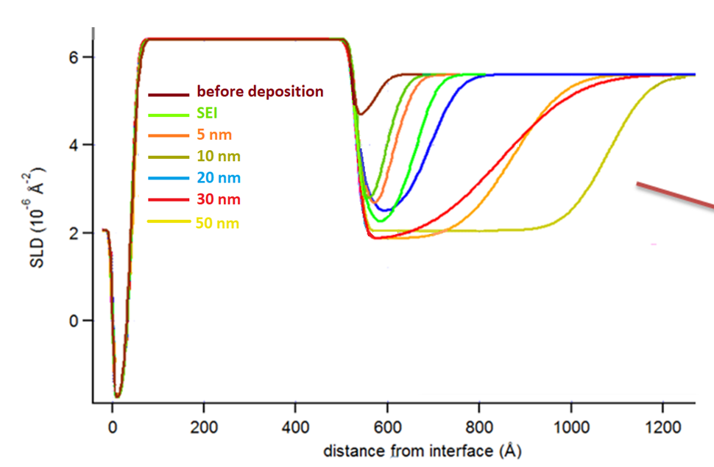
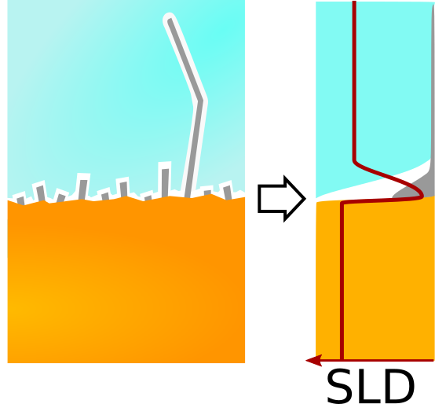
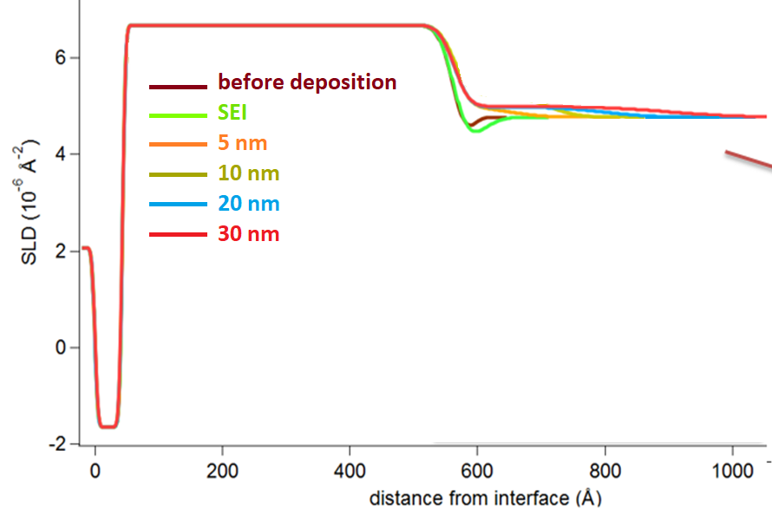
Neutron Reflectometry
Effect of concentrating electrolyte
on interface structure
0.1M LiClO₄/d-PC
Visual control at micron-size scale is required!
Solution under consideration –
cell with transparent window
(control of dendrite growth and
subsidiary gas bubble formation)
5M LiTFSI/d-PC

Slide 18
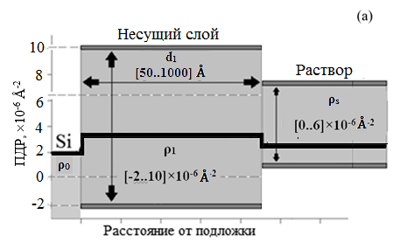
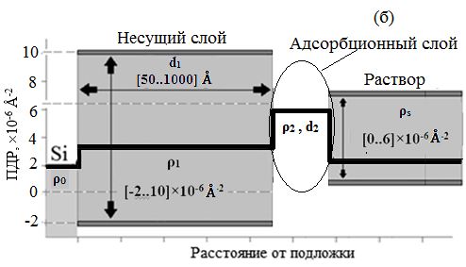

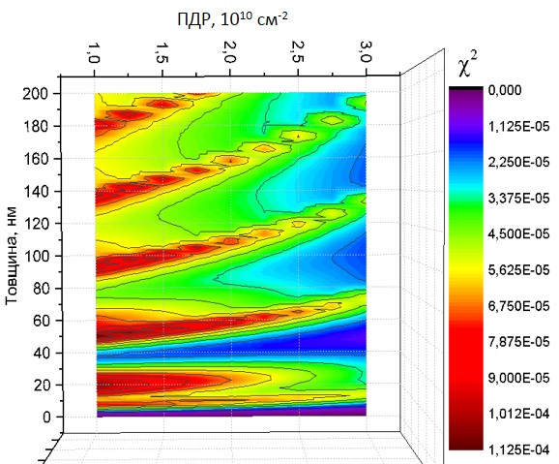
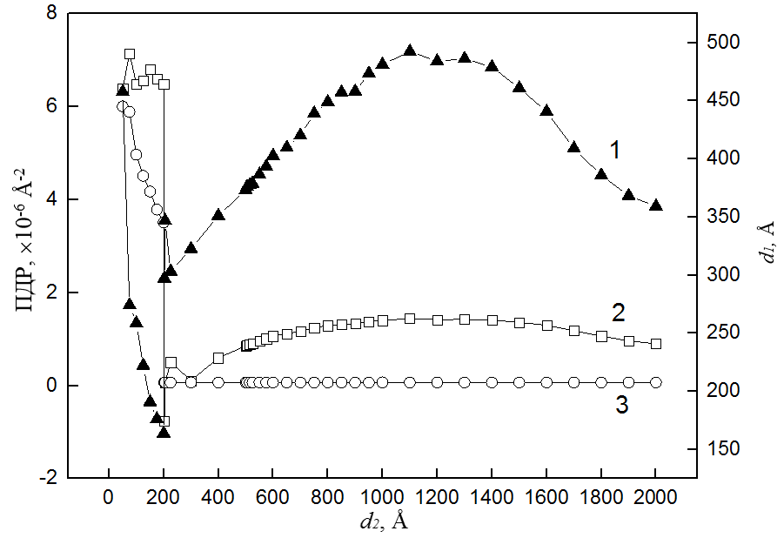
Neutron Reflectometry
Optimization of electrode structure
Electrode
Electrode
Adsorption layer
Electrolyte
Electrolyte
SLD, ×10⁻⁶ Å⁻²
SLD, ×10⁻⁶ Å⁻²
Interface depth
Interface depth
χ² map
(electrode Cu, 50 nm, best choice!)
Maximization of
Optimal value
ρ₂, ×10⁻⁶ Å⁻²
d₁
SLD, ×10⁻⁶ Å⁻²
ρ₁
d₂, nm
ρ_{s}
V. I. Petrenko, Ye. N. Kosiachkin, L. A. Bulavin, M. V. Avdeev, J. Surf. Investigation (2019) in press

Slide 19
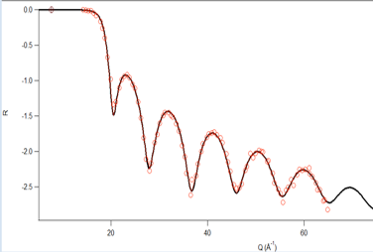
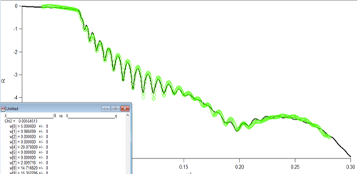
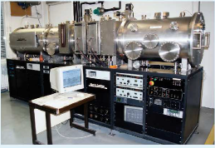




Neutron Reflectometry
Optimization of electrode structure: minimizing Ti-lyer
NR
GINA, BNC, Budapest
XRR
Malvern PANalytical,
FLNP JINR, Dubna
Si(crystal)/
/Ti [0-10 nm ]Cu[10-50 nm]
Ti [5 nm]
Magnetron Sputtering Facility,
MIRROTRON Ltd.,
Budapest, Hungary
Ti [1 nm]
Uniform deposition of Ti
down to thickness of 1 nm
Good adhesion Cu on Si
without Ti; low stability in time
Best choice − Cu electrode,
50 nm thick
Ti [0 nm]

Slide 20



Neutron Reflectometry
Optimization of electrode structure:
quasi-homogeneous electrode
Homogeneous approximation
Si (crystal)/[Ti 0.5 nm/NiMo 1.0 nm]₂₀
NR
GINA, BNC, Budapest
Si (crystal)/[Ti 0.5 nm/NiMo 1.0 nm]₂₀
Si (crystal)/[Ti 0.7 nm/NiMo 0.7 nm]₂₀
d₁ = 32.7 (30) nm
ρ₁ = 6.47 (6.49) × 10⁻⁶ Å⁻²
Malvern PANalytical,
FLNP JINR, Dubna
XRR
d₁ = 31.3 (30) nm
ρ₁ = 51.7 (54.9) × 10⁻⁶ Å⁻²
Deposition by MIRROTRON Ltd.,
Budapest
Uniform deposition at thickness 0.5 nm
Homogeneous approximation works well
(systematic errors < 10%)

Slide 21

Small-Angle Neutron Scattering
Li-O batteries
(Maximum Theoretical Capacity ~900 Wh/kg)
Parasitic effect −
passivation of porous carbon electrode by Li₂O₂

Slide 22


Small-Angle Neutron Scattering
Ex-situ studies
Laboratory Electrochemical Cell
Samples for SANS
Background
(quartz cell)
Dry electrode
Soaked electrode
1 cm
1 cm
Engineering Center, State University ‘Dubna’;
Chemical Department, Moscow State University

Slide 23
Small-Angle Neutron Scattering
Ex-situ studies
YuMO, IBR-2 (Dubna)
T.K. Zakharchenko, M.V. Avdeev, A.V. Sergeev, A.V. Chertovich, O.I. Ivankov, V.I. Petrenko,
Y. Shao-Horn, L.V. Yashina, D.M. Itkis, Nanoscale 11 (2019) 6838-6845

Slide 24

Small-angle Neutron Scattering
Choice of materials
YuMO, IBR-2 (Dubna)
In situ cell
O₂
Electrolyte
Separator
Carbon electrode
Lithium
n
O₂
-
+
low coherent scattering from separators;
sufficiently thick carbon electrode;
sufficiently thin separator, electrolyte region and lithium electrode;
low incoherent background from all components;
air-tight construction;
Requirements to SANS cell

Slide 25




Small-angle Neutron Scattering
Beam window
(∅ 13 mm)
In situ cell
Sealing (Torr Seal glue)
Sapphire (0.8 mm)
Mounting rods
Holes for
flange rods
Spring for WE
Neutron beam
Assembled chamber
Sapphire (0.8 mm)
Cu ring for CE
Insulating collar
Spring for CE
Cathode : SIGRACET Carbon paper (0.32 mm)
Separator: Dupont polyimide (0.02 mm)
Anode: Li foil (0.2 mm) on Al support (0.5 mm)
Windows: Sapphire (0.8 mm)

Slide 26





Small-angle Neutron Scattering
In situ cell
O₂
Planned Tests –
October 2019

Slide 27
Small-angle Neutron Scattering
Model real-time experiments
YuMO, IBR-2 (Dubna)
Minimal time step ~10 min
Evaporation of electrolyte (1 M LiTFSI in MeCN) from carbon electrode

Slide 28
Practical activities
Cooperation Agreement with Engineering Incubator Ltd. (Dubna, Moscow Reg.)
“Studies of the influence of the microstructure of electrodes of chemical current sources on their functional characteristics”
Cooperation Agreement with LITION Ltd. (Dubna, Moscow Reg.)
“Influence of evolution of electrode structures on functional characteristics of chemical current sources”
Visit of LG Technology Center Moscow (LGTCM) delegation to JINR,
Dubna, October 1, 2018

Slide 29
Participants
FLNP JINR
M.V. Avdeev, V.I. Petrenko, A.V. Tomchuk, I.V. Gapon, Y.N. Kosiachkin,
I.A. Bobrykov, S.V. Sumnikov, A.M. Balagurov, O.Yu. Ivanshina, N.Yu. Samoylova,
D.V. Soloviev, A.I. Ivankov
MSU, Moscow
D.M. Itkis, A.A. Rulev, T.K. Zakharchenko, L.V. Yashina
Dubna University, Dubna
F.S. Napolsky, E.E. Ushakova, M. Erdauletov, V.A. Krivchenko

Slide 30
Conclusions
Project implementation is in accordance with plan:
ND
Specialized Li-ion cells for multiple charge/discharge
Sample environment system for operando experiments
NR
Specialized Li-ion cells with heterogeneous electrodes/liquid electrolytes
SANS
Prototype of specialized Li-air cells for multiple charge/discharge
Sample environment system for ex-situ experiments

