Slide 1
Methods, Algorithms and Software for Modeling Physical Systems, Mathematical Processing and Analysis of Experimental Data
(Theme 05-6-1119-2014/2019)
Report on 2017 – 2019, proposal for extension 2020 – 2023
Gh. Adam, On behalf Theme Leaders
Programme Advisory Committee for Condensed Matter Physics
50-th Meeting, 17-18 June 2019
Notes:
1

Slide 2
Part I:
Proposal for Extension of the Theme 1119 on 2020-2023
Notes:
2

Slide 3
Theme 05-6-1119-2014/2023 at a glance
Research direction: Networking, Computing, Computational Physics (05)
Title of the theme: 05-6-1119-2014/2023, “Methods, Algorithms and Software for Modeling Physical Systems, Mathematical Processing and Analysis of Experimental Data”
Leaders: Gheorghe Adam, Petr V. Zrelov
Deputies: Ján Buša, Ochbadrakh Chuluunbaatar
Participating JINR Laboratories: LIT, VBLHEP, BLTP, FLNR, FLNP, DLNP, LRB, UC
Participating Countries, Institutes and International Organizations:
Armenia, Belarus, Belgium, Brazil, Bulgaria, Canada, CERN, China, Czech Republic, France, Georgia, Germany, Greece, Israel, Italy, Japan, Kazakhstan, Moldova, Mongolia, Poland, Romania, Russia, Slovakia, South Africa, Switzerland, Tajikistan, USA, Vietnam
Notes:
3

Slide 4
Main Activities
(1) Mathematical and computation methods for simulation of complex physical systems. Leaders: Gh. Adam, J. Buša, I.V. Puzynin
(2) Software complexes and mathematical methods for processing and analysis of experimental data. Leaders: P.V. Zrelov, V.V. Ivanov
(3) Numerical methods, algorithms and software for multicore and hybrid architectures and Big Data analytics.
A. Developments for Multicore and Hybrid Architectures. Leaders: Gh. Adam, O. Chuluunbaatar, O.I. Streltsova
B. Big Data Analytics. Leaders: V.V. Korenkov, P.V. Zrelov
(4) Methods, algorithms and software of computer algebra and quantum computing. Leader: V.P. Gerdt
Notes:
4

Slide 5
Essentials of the proposal
• Purpose: advanced research in computational mathematics and physics, directed to the creation of new mathematical methods, algorithms, and software for the numerical or symbolic-numerical solution of topics in experimental and theoretical physics studies.
• Subject area: within the seven year plan 2017–2023 approved for completion in JINR, there is a wide spectrum of investigations in high energy physics, nuclear physics, physics of condensed matter and of nanostructures, biophysics, information technologies, the solution of which is inseparable from the use of computing. Such subject matters of the outmost importance in JINR are the NICA project, the neutrino program, the superheavy and exotic nuclei physics, the neutron based investigations.
• MICC role: The bulk of the numerical or symbolic-numerical computations will be done on the Multifunctional Information and Computing Complex (MICC), primarily on the HybriLIT heterogeneous computing platform (the training and testing cluster and the “GOVORUN” supercomputer) and the emerging Big Data distributed infrastructure.
• The research teams: include both experienced scientists with outstanding scientific achievements and enthusiastic young scientists and engineers.
• The requested financing: will cover salaries, participations in scientific conferences, scientific visits and the acquisition of a minimal number of personal computers and licenses, within the approved resources for LIT-JINR.
• A distinctive feature of this research: is the close cooperation of the Laboratory of Information Technologies (LIT) with research groups from all JINR laboratories and from Member State institutions.
Notes:
5

Slide 6
02-0-1081-2009/2019 [1]
Leader: V.A. Bednyakov
Deputies: E.V. Khramov, A.P. Cheplakov
02-2-1099-2010/2023 [1]
Leaders: D.V. Naumov, A.G. Olshevskiy
02-2-1125-2015/2020 [2]
Leader:L.G. Tkatchev, Deputies:V.M. Grebenyuk,
A.V. Borodin
02-0-1108-2011/2019 [1]
Leader: G.D. Alexee; Deputy: A.N. Skachkova
02-2-1124-2015/2017 [1]
Leader: V.V. Glagolev, Deputy: A.I. Davydov;
Scientific leader: J.A. Budagov
03-2-1102-2010/2019 [2]
Leaders: G.A. Karamysheva, S.L. Yakovenko,
Scientific leader: L.M. Onischenko
02-2-1123-2015/2019 [2]
Leader: A.S. Zhemchugov; Deputy: A.V. Guskov
02-2-1134-2018/2019 [1]
Leader: Z. Tsamalaidze
LIT involvement in JINR research: 53 projects of 28 JINR topics of
the 2019 Topical Plan of JINR
04-4-1122-2015/2020 [1]
Leaders: S.A. Kulikov, V.I. Prikhodko,
V.I. Bodnarchuk
04-4-1121-2015/2020 [3]
Leaders: D.P. Kozlenko, V.L. Aksenov , A.M. Balagurov
FLNP
Information Technologies
DLNP
Theoretical
Physics
Experimental
Physics
04-5-1131-2017/2021 [1]
Leaders: S.N. Dmitriev, P.Yu. Apel
03-0-1129-2017/2021 [2]
Leaders: G.G. Gulbekyan, S.N. Dmitriev, M.G. Itkis
Scientific leader: Yu.Ts. Oganessian
03-5-1130-2017/2021 [2]
Leaders: M.G. Itkis
Scientific leader: Yu.Ts. Oganessian
FLNR
Computational
Physics
BLTP
VBLHEP
LIT
01-3-1135-2019/2023 [2]
Leaders: D.I. Kazakov, O.V. Teryaev,
01-3-1136-2019/2023 [3]
Leaders:N.V. Antonenko, S.N. Ershov,
A.A. Dzhioev
01-3-1137-2019/2023 [2]
Leaders: V.A. Osipov, A.M. Povolotskii
01-3-1138-2019/2023 [1]
Leaders: A.P. Isaev, A.S. Sorin,
S.O. Krivonos
Scientific leader: A.T. Filippov
01-3-1117-2014/2023 [1]
Leaders: V.V. Voronov, A.S. Sorin
Scientific leader: A.T. Filippov
02-0-1065-2007/2019 [5]
Leaders: V.D. Kekelidze, A.S. Sorin
Deputies A.D. Kovalenko, I.N. Meshkov
02-0-1066-2007/2020 [4]
Leaders: R. Lednicky, Yu.A. Panebratsev
02-0-1083-2009/2019 [5]
Leader: A. Zarubin, Scientific leader: I.A. Golutvin
02-0-1085-2009/2019 [1]
Leader: A.P. Nagaytsev, Deputy:A.V. Guskov
02-1-1088-2009/2019 [2]
Leader: A.S. Vodopyanov
02-1-1097-2010/2021 [2]
Leader: A.D. Kovalenko; Deputies: N.M. Piskunov, V.P.Ladygin, M.Finger (Jr.), R.A. Shindin
02-1-1106-2011/2019 [2]
Leaders: V.P. Ladygin, V. Ivanov; Deputy: O. Yu.Derenovskaya
05-6-1118-2014/2019 [1] Information and Computing Infrastructure of JINR
05-6-1119-2014/2019
Methods, Algorithms and Software for Modeling Physical Systems, Mathematical Processing and Analysis of Experimental Data
05-8-1037-2001/2019 [1]
Leader: A.S. Sorin
06-0-1120-2014/2023 [2]
Leaders: V.A. Matveev , S.Z. Pakuliak
Notes:
6

Slide 7
A characteristic which singles out the theme 1119
The overwhelming feature: work done in cooperation, mainly with research groups from other JINR Laboratories.
This assumes the use of LIT expertise for the solution of challenging problems which ask for elaborated mathematical modeling, development of algorithms and their implementation into packages to be run on the top computing facilities acquired, developed, customized, and maintained in the LIT within the Multifunctional Information and Computing Complex (MICC) project.
The viability of the model assumes on behalf the LIT staff: initiative in establishing personal contacts outside the Laboratory; submission for validation by the LIT leadership of the decisions concerning particular collaboration topics; firm compliance with the assumed obligations as the principal form of respect of partners.
Doubling the human qualities by a deep and extensive professional expertise along four critical directions: thinking as computer scientist with several computing paradigms; expert knowledge of the mathematical problems backing the topic of the collaboration; in depth grasp of the numerical analysis topics enabling both reduced complexity and full reliability of the developed algorithms; deep knowledge of the physics side of the problem at hand as a precondition of performing significant mathematical modeling undertakings.
A must for the large scale projects: working groups the complementarity of the knowledge of the members of which will secure the coverage of all the four mentioned expertise areas.
This cooperation model emerged from the JINR culture was gradually refined over time and has got support of the JINR Directorate and the Program Advisory Committees, the key factors for the approval of the JINR research topics.
Notes:
7

Slide 8
Exceptional role of “GOVORUN” supercomputer
• The new heterogeneous computing platform involves the HybriLIT cluster (now a learning and testing polygon) and the “GOVORUN” supercomputer.
• “GOVORUN” supercomputer, inauguration in 2018, substantial upgrade planned (2019)
• Its threefold heterogeneous structure offers: (i) Multicore CPU (Intel Gold) for high performance computing (HPC) with distributed memory; (ii) Many core CPU (Intel Phi) for HPC with shared memory; (iii) NVIDIA Volta for HPC with GPU acceleration.
• Only educated users can grasp this complex hardware. Therefrom, two central tasks in theme 1119:
• 1. Design, development, implementation, and maintenance on “GOVORUN” of an environment at user disposal. This is a fundamental in-house development with benefits for the JINR community at large (all JINR Laboratories and JINR Member State institutions collaborating with JINR).
• 2. An articulated and permanent educational system. Practical education consists of: lectures, tutorials, schools, etc. Tutors: Prominent specialists from JINR and from partner institutions in Russia and abroad. Places: HybriLIT; associated satellite Students’ Schools of the periodical international conferences (like the “Mathematical Modeling and Computational Physics” series), organized by LIT in partnership with cooperating institutions from JINR Member States.
Notes:
8

Slide 9
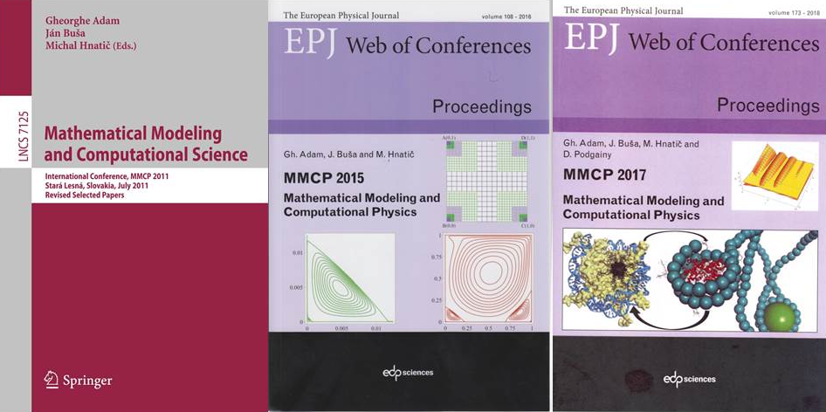
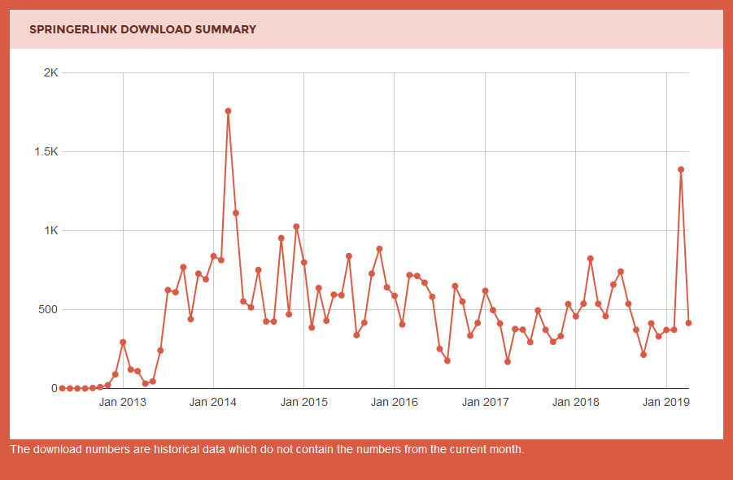
MMCP Conferences, 2011, 2015, 2017
Left: With over 40,800 downloads of the 41 papers, at a pace of over 500 monthly, the LNCS 7125 volume was annually quoted by Springer in 2013-2018 as one of its top 50% most downloaded eBooks in this collection:
http://www.bookmetrix.com/detail_full/book/8717d9eb-2653-4a3c-a8d9-adf82bdcd1d5#downloads
Centre: EPJ-WoC, Vol.108, with 58 accepted papers:
http://www.epj-conferences.org/articles/epjconf/abs/2016/03/contents/contents.html
Right: EPJ-WoC, Vol.173, with 100 accepted papers:
https://www.epj-conferences.org/articles/epjconf/abs/2018/08/contents/contents.html
Notes:
9

Slide 10
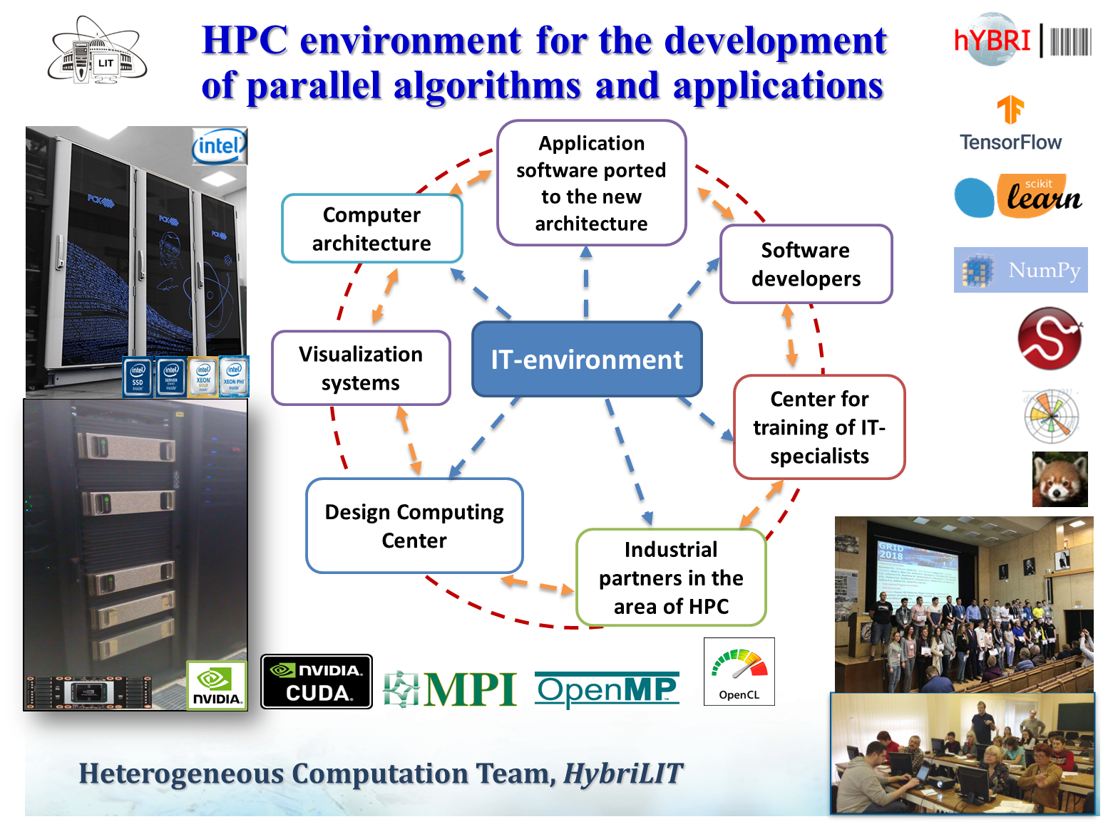
Exceptional role of “GOVORUN” supercomputer
Notes:
10

Slide 11
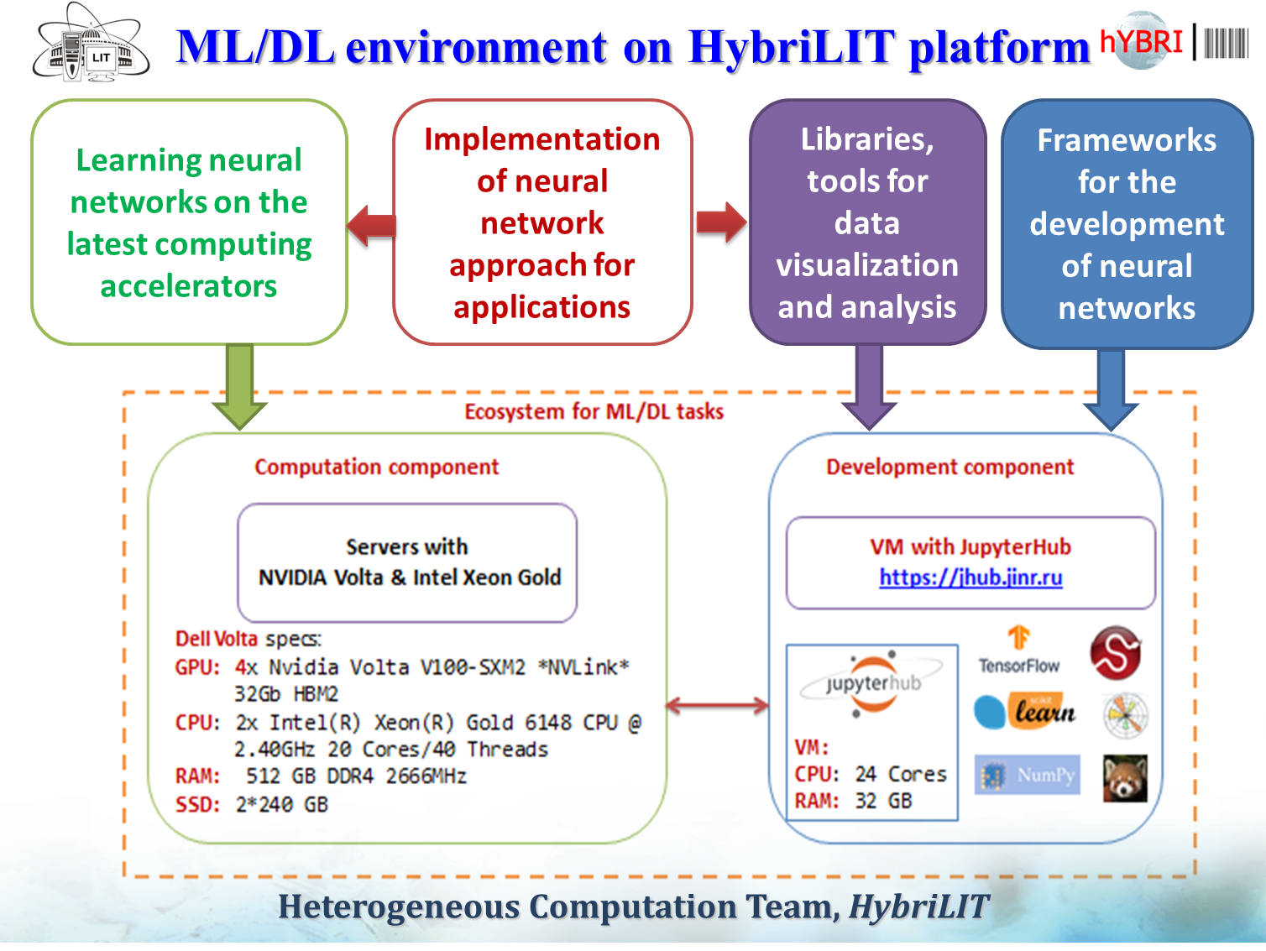
Exceptional role of “GOVORUN” supercomputer
Notes:
11

Slide 12
Big Data analytics and quantum computing (1)
Role of Big Data analytics and quantum computing: Search for breakthroughs in large scale projects – with the aim to alleviate the huge pressure on the costs coming from the need of resources for offline data storage, processing and analysis.
For 2020–2023: Data accumulation during the future Run 3 of the HL-LHC megaprojects done with the active JINR participation (ATLAS, ALICE, CMS);
Start of the NICA accelerator and the MPD/NICA project in the JINR;
Start of BAIKAL GVD.
Big Data analytics in LIT-JINR: Conceptual developments and their step-by-step implementation within the Big Data approach for solving tasks in large scale JINR projects. Are done based on the classical principle of the computing, “divide and conquer”. Tasks are divided in two groups. First group attributed to the theme 1118 and its MICC project. Second group, concerning data processing and analysis, attributed to the theme 1119. All the possible doors of communication in both senses are wide open.
Intensive training through the dedicated educational program “Big Data Analytics” within the framework of the “International IT - School on Big Data”.
Notes:
12

Slide 13
Big Data analytics and quantum computing (2)
Quantum computing developments are to be done in the computer algebra group, where there is the largest expertise based on previous achievements.
Features which deserve to be mentioned: the very high technicality and the counter-intuitive character of this research.
The crazy hopes connected to the quantum computing come from the perspective to get simultaneously computed solutions to as many tasks as fitting the quantum multiplicity of the quantum computer.
The orders of magnitude accelerations obtained in this way is a huge incentive for this very risky line of research which is vigorously pursued in several dozens of top research centers in the world.
Notes:
13

Slide 14
Budget estimation (k$)
• The requested financing: will cover salaries, participations in scientific conferences, scientific visits, acquisition of a minimal number of personal computers and licenses, within the approved resources for LIT-JINR.
 | Chapters of the JINR budget | Previsions | Yearly distribution (k$)
 |  | 2020–2023 | 2020 | 2021 | 2022 | 2023
1 | 2 | 3 | 4 | 5 | 6 | 7
1 | Salaries | 8761.8 | 1887.9 | 2076.7 | 2284.4 | 2512.8
2 | Unified social tax | 2646.1 | 570.1 | 627.2 | 689.9 | 758.9
3 | Social national fund | 569.5 | 122.7 | 135.0 | 148.5 | 163.3
4 | International cooperation expenses | 238.8 | 59.7 | 59.7 | 59.7 | 59.7
 | a) business trips to Member States | 60.8 | 15.2 | 15.2 | 15.2 | 15.2
 | b) business trips to Non-Member States | 72.0 | 18.0 | 18.0 | 18.0 | 18.0
 | c) business trips in Russia | 28.0 | 7.0 | 7.0 | 7.0 | 7.0
 | d) arrivals to JINR | 50.0 | 12.5 | 12.5 | 12.5 | 12.5
 | e) Conferences, protocol expenses | 28.0 | 7.0 | 7.0 | 7.0 | 7.0
5 | Materials | 104.0 | 20.0 | 24.0 | 28.0 | 32.0
6 | Equipment | 365.0 | 80.0 | 90.0 | 95.0 | 100.0
7 | Electro energy costs | − | − | − | − | −
8 | Heating and water supply costs | − | − | − | − | −
9 | Payment of commissioning and adjustment works | − | − | − | − | −
10 | Service payments to scientific-research organizations | − | − | − | − | −
11 | Scientific and information support | − | − | − | − | −
15 | Payment of communication services | − | − | − | − | −
 | TOTALS | 12685.2 | 2740.4 | 3012.6 | 3305.5 | 3626.7
Notes:
14

Slide 15
Part II:
Achievements during
2017-2019:
Selected results
Notes:
15

Slide 16
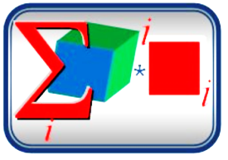
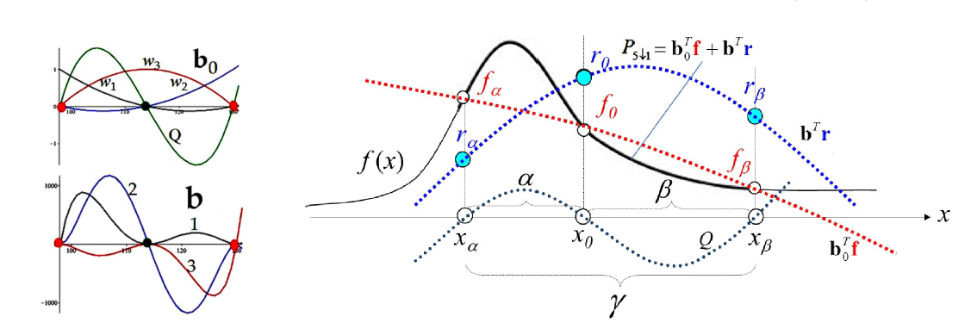
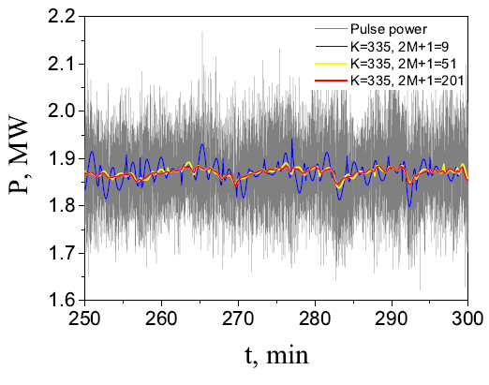
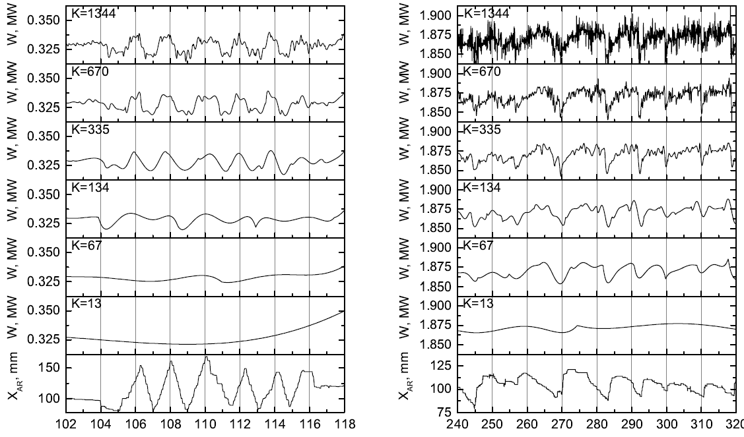
Neutron Noise Analysis Using the Basic Elements Method
(The algorithm to disentangle neutron noise from the slow power-changes)
Highlights
• Algorithm for disentangling neutron noise from reactor-operations’ power changes.
• Algorithm tested on both static and dynamic states of the reactor.
• Algorithm optimized for the best separation between neutron noise and power changes.
• Algorithm speed adequate for real-time monitoring.
The basis functions and geometrical interpretation of BEM-polynomial
Conclusions
BEM-polynomials applied to a batch of data from the IBR-2M reactor revealed their usefulness in the analysis of slow trends. This is very important, as degradation in systems is a slow-trend process.
We intend to continue this analysis with checking the separation baseline – noise and quantifying both for various periods in the functioning of the reactor. In particular we are interested in the degradation of the noise spectra in relation to hardware (of the movable reflectors) wear-out.
Different approximating curves and positions
of the automatic regulator (bottom)
Approximating curve as function of parameters M and K
Neutron Noise Analysis Using the Basic Elements Method, N.V. Korepanova, N.D. Dikusar, Y.N. Pepelyshev, M. Dima, E13-2018-22, Annals of Nuclear Energy, Volume 131, Sept. 2019, pp. 475-482

Slide 17
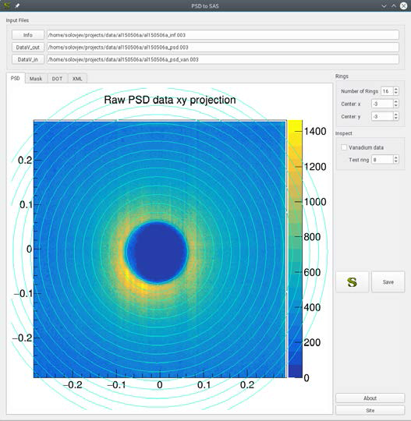
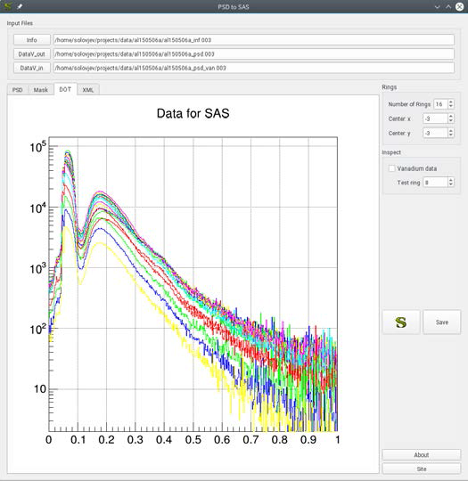
Online Data Processing for the new YUMO: PSD2SAS
Conversion of position-sensitive detector (PSD) data of small-angle neutron scattering spectrometer in isotropic pattern scattering case for automated SAS processing
PSD2SAS: - Data converter for position-sensitive detector of small-angle neutron scattering spectrometer in isotropic pattern scattering case Authors: A.G.Soloviev, S.A.Kutuzov, O.I.Ivankov, A.I.Kuklin
Time spectra for left rings shown,
ready for processing in SAS
PSD rings pattern
A.G. SOLOVIEV, S.A. KUTUZOV, O.I. IVANKOV, A.I. KUKLIN, EPJ Web of Conferences, Vol. 173, paper 050151 – 05015-4 (2018)
Notes:
17

Slide 18
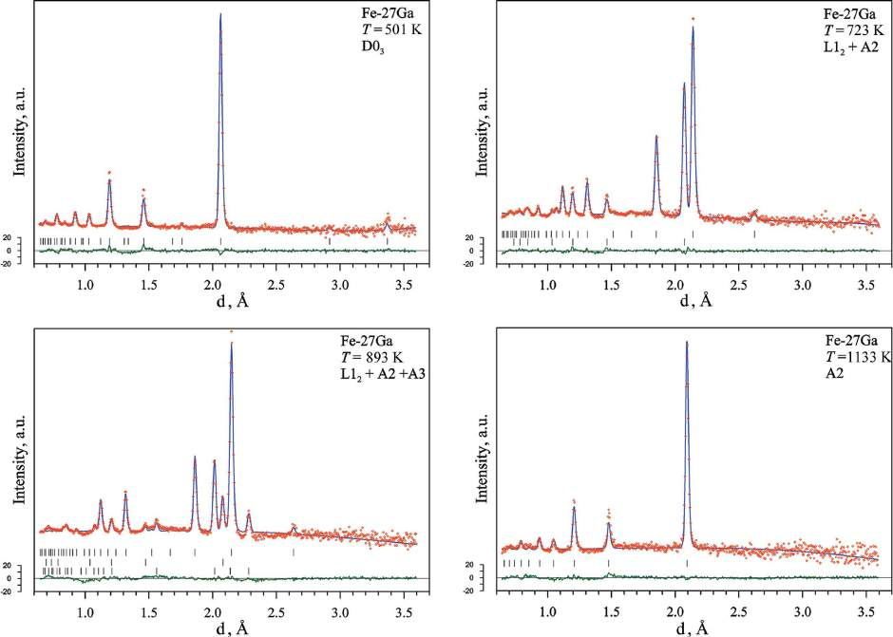
Development of batch processing of neutron diffraction spectra measured in real-time in situ mode (HRFD at IBR-2, FLNP)
The data: real time HRFD data for irreversible transient processes (solid-phase chemical reactions, structural phase transitions in metastable states, hydration of lipid membranes, etc.). During such processes, changes in external parameters (temperature, humidity, etc.) cause rearrangements of the atomic structure of the substance, which, in turn, lead to changes in diffraction spectra.
Mathematical problem: Analysis of spectra (based on the Rietveld method) allows us to trace the restructuring of the atomic structure and associate it with changes in the external parameter. Task: Secure correct mathematical extraction of structural information contained in the geometric characteristics of the diffraction peaks, i.e., in their intensities, positions and widths.
Diffraction patterns of SP sample measured upon heating for several temperatures, processed by the Rietveld method (MRIA, FullProof, SPEVA). Experimental points, calculated lines and difference lines are shown. Vertical bars indicate peak positions of the resolved phases.
A.M. Balagurov, I.S. Golovin, I.A. Bobrikov, V.V. Palacheva, S.V. Sumnikov, V.B. Zlokazov (LIT), Comparative study of structural phase transitions in bulk and powdered Fe–27Ga alloy by real-time neutron thermodiffractometry, J. Appl. Cryst. (2017) 50, 198–210
Notes:
18

Slide 19
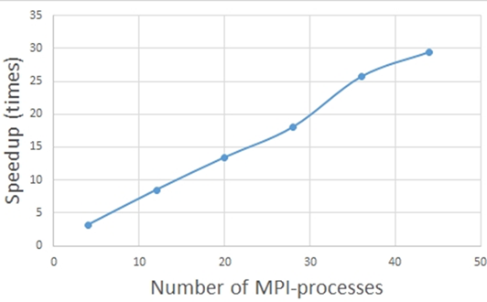
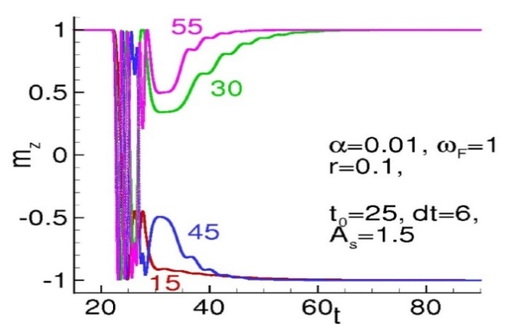
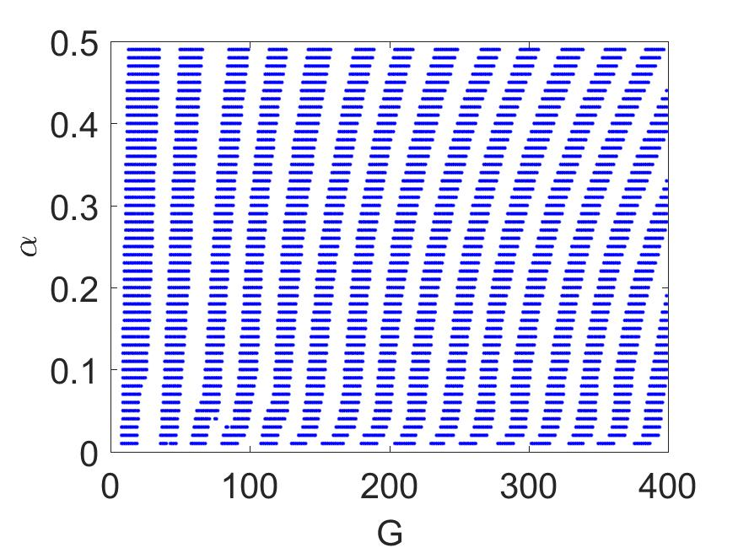
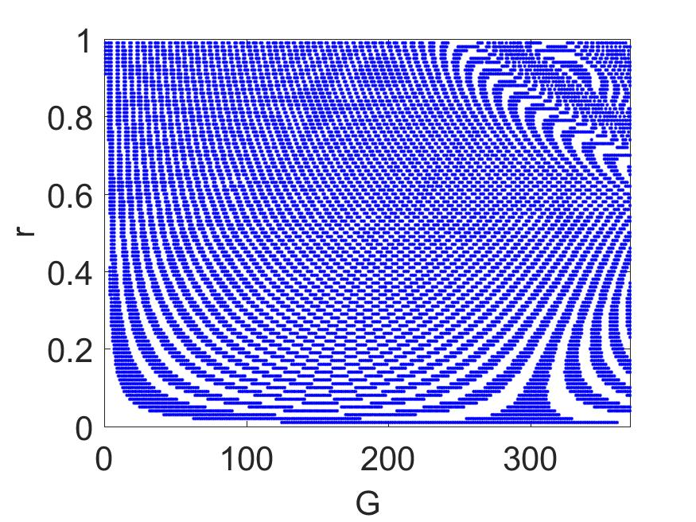
Parallel simulation of the magnetization reversal in φ₀-Josephson junction
Topic: superconducting spintronics (interaction of superconducting current with magnetic moments in Josephson superconductor-ferromagnet structures) enables the control of magnetism by superconductivity [of interest in quantum and nano-electronic technologies].
Method: implicit two-stage Gauss-Legendre numerical solution of ODE system.
Results: detailed pictures of intervals of the damping parameter α, relation of Josephson to magnetic energy G and spin-orbit coupling parameter r where the full magnetization reversal occurs.
Parallel implementation: significantly accelerates simulations in the wide range of parameters of model.
Acceleration of computations in terms of the MPI processes
Time dependence of m_{z}–component.
α=0.01, G=15, G=30, G=45, G=55. Magnetization reversal occurs for
G=15 and G=45
Intervals of complete magnetization reversal in (α,G)-plane (left)
and (r,G)-plane (right). The results are obtained with G-stepsize ΔG=1,
α-stepsize Δα=0.01 at A_{s} = 1.5; r = 0.1; t₀ =25; Δt = 6; ω_{F} = 1; h = 0.01.
M.V. Bashashin, E.V. Zemlyanaya, Yu.M. Shukrinov, I.R. Rahmonov, P.Kh. Atanasova, S.A. Panayotova, Procs. of International Conference ITTMM-2019, 367-371, 2019
Notes:
19

Slide 20
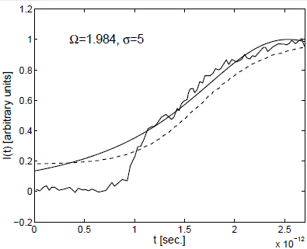
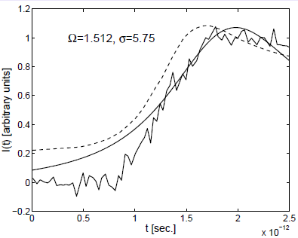
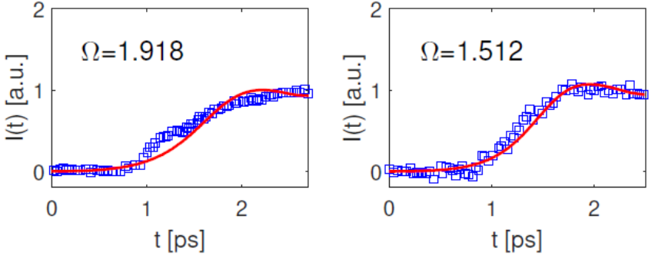
Progress in numerical simulation of the polaron
General frame: The boundary value problem of the polaron model was formulated and solved using our MPI/C++ code in 2015 (up [1]) and 2018 (down [2]).
Improvement of agreement with data was twofold:
- Optimization of the computational scheme, including parallel implementations
- Improvement of the polaron model by taking into account the time dependence of the width of the absorption band.
Discussion: The dynamics of the electron photoemission in water under the laser radiation in the ultra-violet range, which was qualitative (up) has become quantitative (down) after the inclusion of the two improvements.
1. В.Д.Лахно, А.В.Волохова, Е.В.Земляная, И.В.Амирханов, И.В.Пузынин, Т.П.Пузынина. Поверхность, 1, 82-87, 2015
2. A. Volokhova, E.Zemlyanaya, V. Lakhno, I. Amirkhanov, M.Bashashin, I. Puzynin, T. Puzynina, EPJ – WoC, Vol. 173 (2018), 06013 (1-4)
Notes:
20

Slide 21
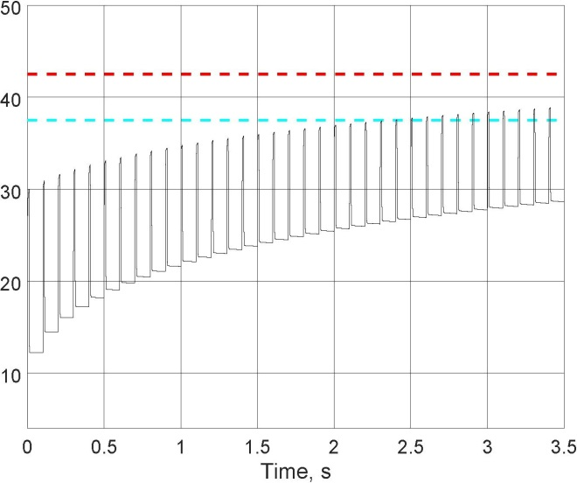
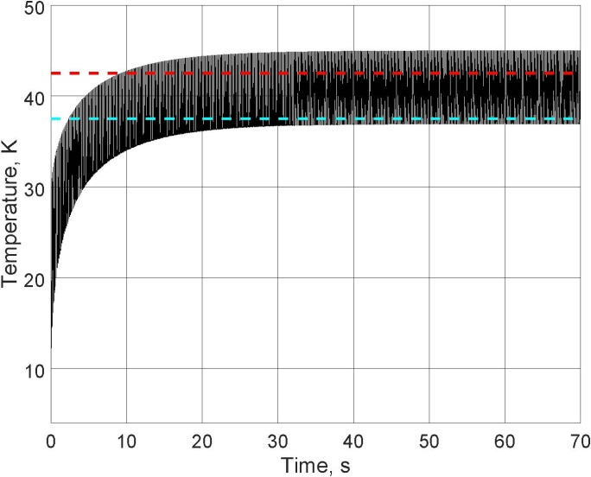
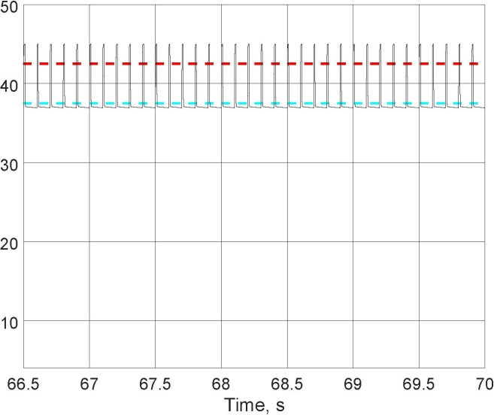
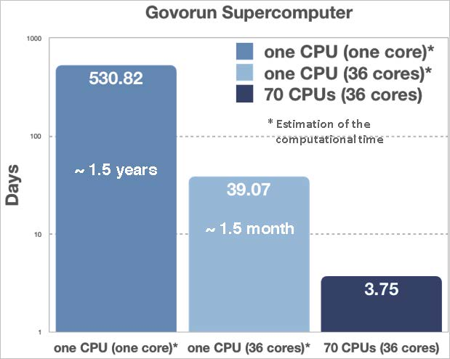
Optimization solution for the heat equation problem towards an improvement of the “thermal shutter” source characteristics
Computing time decrease: from 1.5 years to 3.75 days !
Problem: optimization of the characteristics of the thermal source of a cryogenic cell, i.e. a multilayer cylindrical sandwich-type configuration designed for a pulsed dosed injection of the working substance into the ionization chamber of the source of multiply charged ions.
Brute force numerical solution: an MPI+OpenMP hybrid parallel algorithm was developed to get the maximum of the integral of proportionality to the volume of gas evaporated from the cell surface.
Numerical solution predicts oscillatory behaviour of surface temperature which stabilizes through a transient period (top): start (left), stabilization (center), stationary regime (right).
Solution on the GOVORUN supercomputer has demonstrated a hundred fold acceleration of the calculations (bottom right)
A. Ayriyan and J. Busa Jr., RUDN Journ. Math., Information Sciences and Physics (accepted)
A. Ayriyan, J. Busa Jr., H. Grigorian, E. E. Donets, PEPAN Letters, vol. 16, No. 3, pp. 300-309 (2019), doi: 10.1134/S1547477119030026; Russian version Vol. 16, 3(222), 277-290 (2019)
Notes:
21

Slide 22
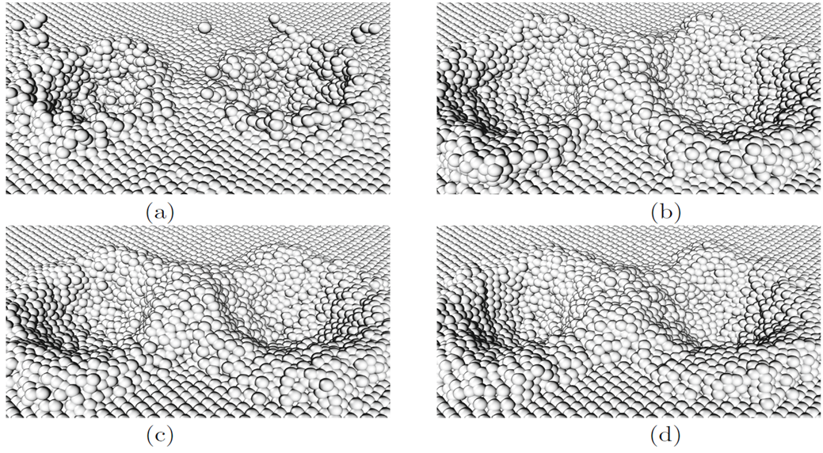
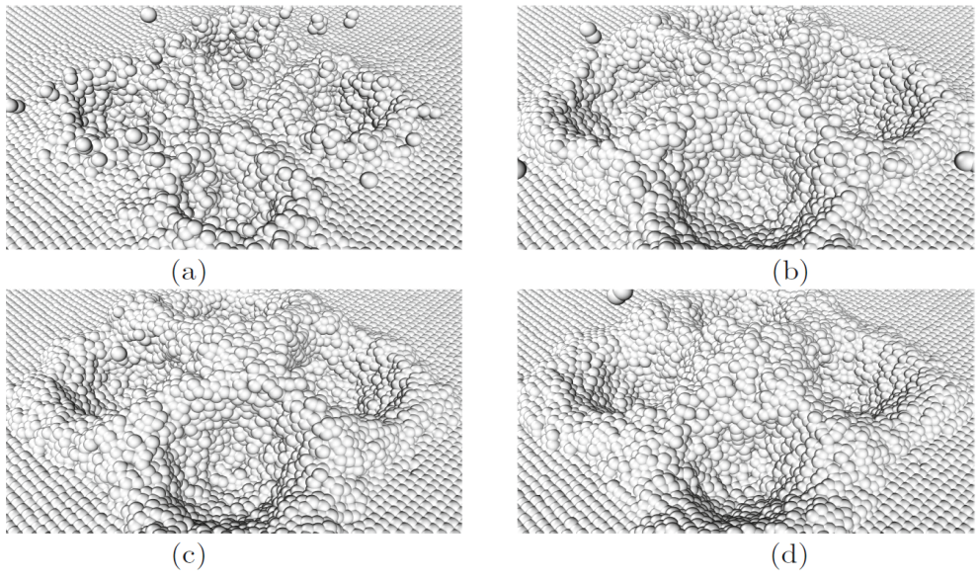
Molecular Dynamic Modeling of Long-Range Effects in Metals Exposed to Nanoclusters
Structural changes of the copper target and formation of craters at its surface under irradiation with two copper nanoclusters (left) and four copper nanoclusters (right).
Nanocluster energy: 50 eV/atom. The distance between clusters is 6 nm.
Left and right – time instants: 1 ps (a), 4 ps (b), 7 ps (c), and 10 ps (d).
Long range effect simulation: Under simultaneous irradiation by several nanoclusters, long-range effects arise at depths of the irradiated target which exceed the penetration depth of the particles. These consist in the fusion of high temperature moving regions at temperatures exceeding the melting temperature of the target, with subsequent structural changes in the crystal lattice.
B. Batgerel, I.V. Puzynin, T.P. Puzynina, I.G. Hristov, R.D. Hristova, Z.K. Tukhliev, Z.A. Sharipov,
Springer Nature Switzerland AG 2019, G. Nikolov et al. (Eds.): NMA 2018, LNCS 11189, pp. 318–325, 2019
Notes:
22

Slide 23
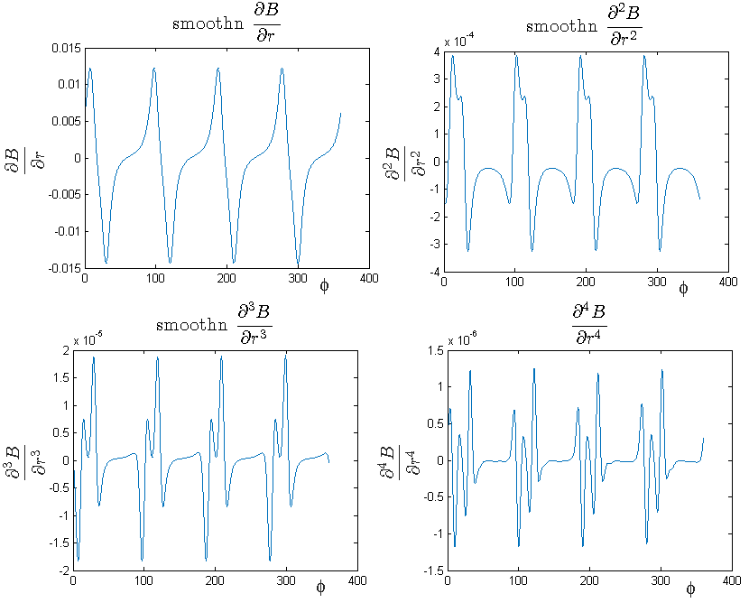
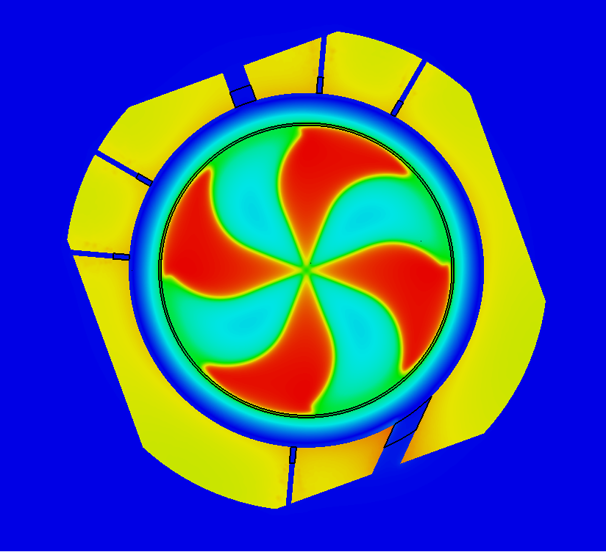
Magnetic field calculations for the
SC202 cyclotron for proton therapy
Derivatives of the magnetic field in the median plane adjusted with smoothing algorithms.
Such results were obtained by combining fitting of the field map by spline surface together with smoothing algorithms.
Magnetic field calculated by means of the CST Studio package
Techniques and algorithms for accurate analysis of the electromagnetic field were developed for the R&D of the SC202 cyclotron for proton therapy, which is under production by collaboration between DLNP JINR (Dubna, Russia) and ASIPP (Hefei, China).
T. Karamysheva, I. Amirkhanov (LIT), in collaboration with DLNP group
Notes:
23

Slide 24
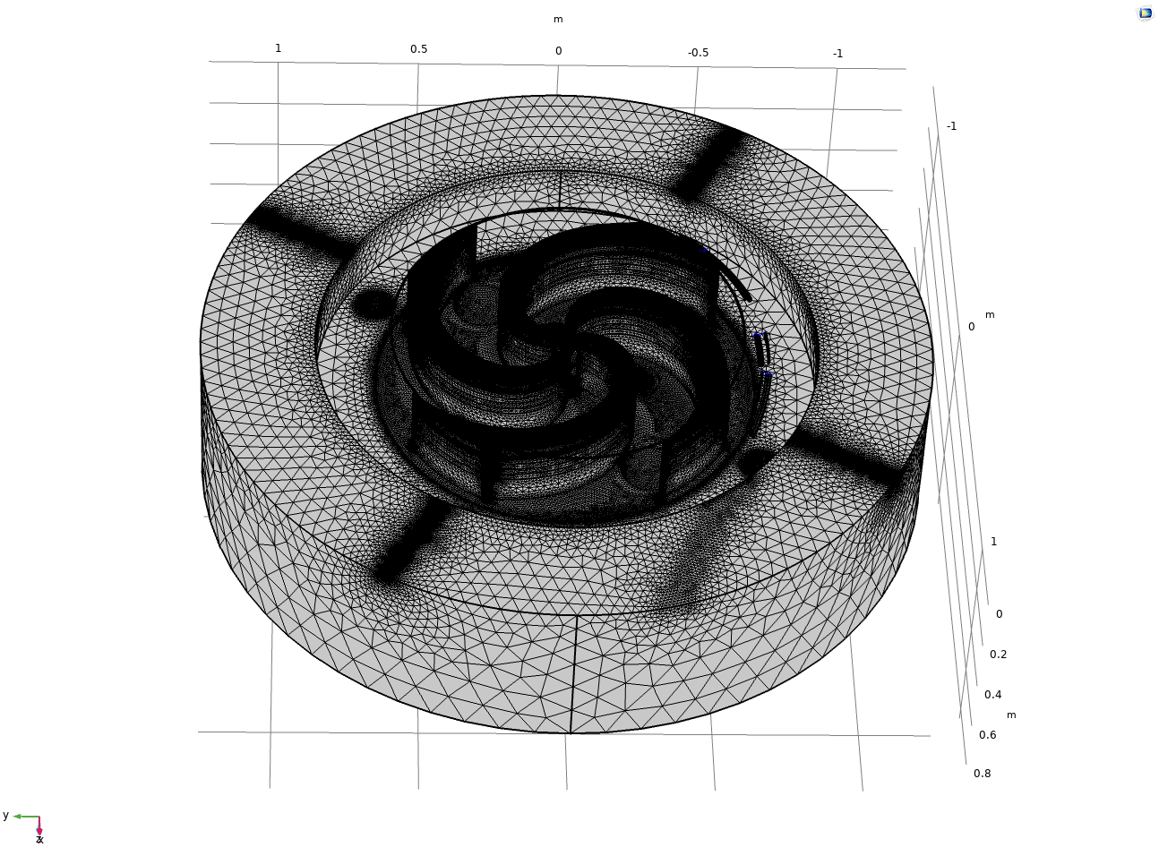
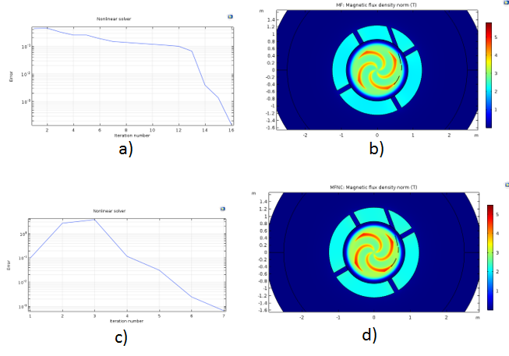
COMSOL Multiphysics 3D Simulation of the magnetic field distribution in the superconducting cyclotron SC202
3D mesh
Field map in the median plane & Convergence
The new formulation of the magnetostatics problem
reduced the solution time from 18 hours to 19 minutes for the MPI parallel runs
To achieve the required accuracy of calculations (1 Gs), it was necessary to generate a finite element grid consisting of 18 445 665 finite elements of seven kinds (Tetrahedra, Pyramids, Prisms, Triangles, Quads, Edge and Vertex elements).
Computations were done on the HybriLIT platform.
Comparison of the results of the magnetic field map calculation in the median plane made in the COMSOL Multiphysics based on the A- formulation (a, b) and V- formulation (c, d) of the magnetostatic equations: (а, b): Degrees of freedom (DOF) − 21 801 942, Solution time − 18h17m16s, Physical memory − 94.48GB; (c, d): Degrees of freedom (DOF) – 3 237 238, Solution time − 19m51s, Physical memory − 28.33 GB
A. Chervyakov (JINR, Dubna) and S. Yankin (COMSOL, Russia), Optimization of the magnetostatics simulations with COMSOL, submitted to J. Physics
Notes:
24

Slide 25
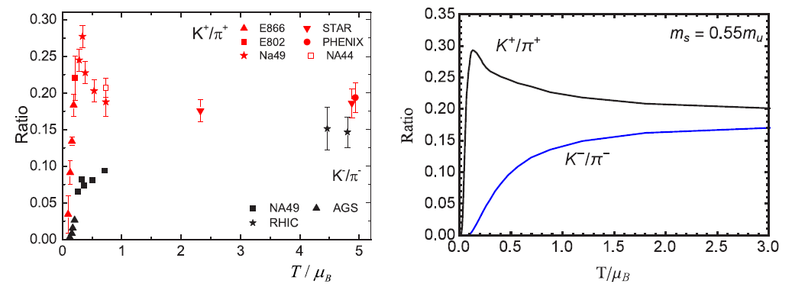
Strange matter and kaon to pion ratio in the SU(3)
Polyakov–Nambu–Jona-Lasinio (PNJL) model
The appearance of a peak in the ratio of the number of strange mesons to nonstrange mesons (at energies 8–10 GeV), known as a “horn”, was investigated.
By using the PNJL model, it was shown that the behaviour of the kaons in the dense nuclear matter depends on their charge. This allowed the explanation of the difference in the K⁺/π⁺ and the K⁻/π⁻ ratios at low energies.
When the temperature and the baryon chemical potential are chosen along the phase diagram line, the system is in the chiral phase-transition region and it is essential which order is this phase transition. At low temperatures and high densities (or baryonic chemical potential), there is a first order phase transition and the deconfinement is absent. Under temperature increase and density decrease, there is a crossover phase transition.
It is also shown that the increase in the ratio K+/π+ appears near the critical endpoint and can be considered as a critical region signal.
Dependence of the ratios K⁺/π⁺ and K⁻/π⁻ on T/μ_{B}:
- experimental data (left)
- simulation results (right)
A. V. Friesen, Yu. L. Kalinovsky, and V. D. Toneev, VBLHEP Seminar 30.11.2018, arXiv:1808.04179, Communication at CPOD-2018, PHYSICAL REVIEW C99, 045201 (February2019) DOI: 10.1103/PhysRevC.99.045201
Notes:
25

Slide 26
Mimicking the Hadron-Quark Mixed Phase in Compact Stars
A simple thermodynamically consistent interpolation method gives possibility of a systematic study of
mixed phase effects on the mass-radius diagram for compact stars.
The three points of the interpolation function (left)
The impact of the mixed phase in the mass-radius diagram of compact stars.
At least one companion of the GW170817 could belong to the third family and both of them could have mixed phase in their interior (right)
This result was included in the “BRIEF REVIEW OF THE TOPMOST SCIENTIFIC RESULTS
OBTAINED IN 2018 AT THE JINR”, JINR Publishing Department, 2019-1, p. 26.
Comparison of the interpolation method with the microscopic approach (so-called “pasta” phase)
Relationship between the free parameters of the two approaches to mixed phase description. Upper bound: ΔP/P_{C} ≈ 6%
1. Ayriyan and Grigorian. EPJ WoC (2018), vol. 173, 03003 2. Ayriyan, Bastian, Blaschke et al. Phys. Rev. C97 (2018), 045802
3. Abgaryan, Alvarez-Castillo, Ayriyan et al. Universe 4(9) (2018), 94 4. Maslov, Yasutake, Ayriyan et al. Submitted to PRC, arXiv:1812.11889
Notes:
26

Slide 27
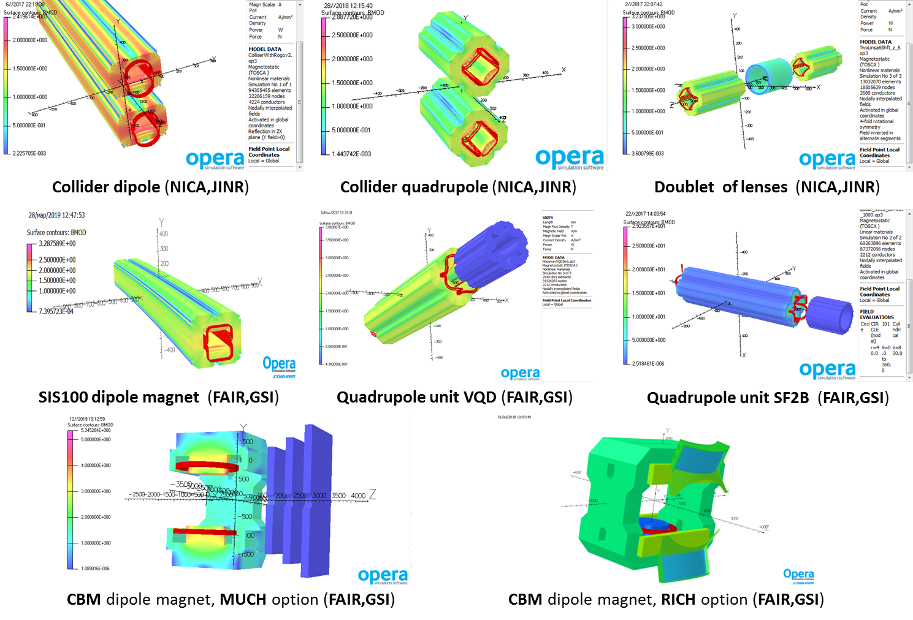
3D modeling of magnetic systems
P.G. Akishin, for NICA and FAIR collaborations
Notes:
27

Slide 28
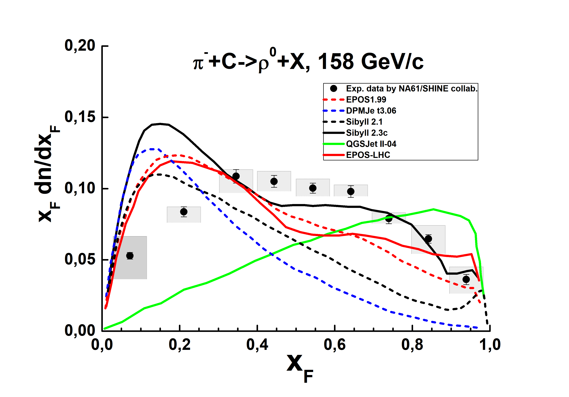
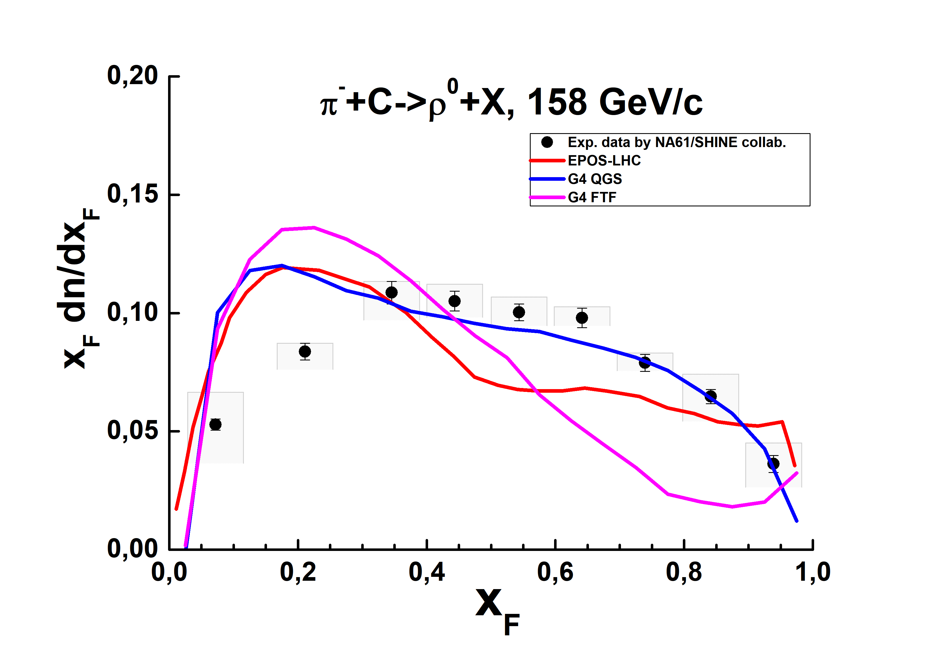
ρ⁰ production in π⁻ C interactions at 158 and 350 GeV/c
Measurement of Meson Resonance Production in Pi- C Interactions at SPS Energies, The NA61/SHINE Collaboration, Eur. Phys. J. C77 (2017) 626
Geant4 QGS (Quark Gluon String) and FTF (Fritiof) models used by all LHC Collaborations
There is NO model describing the ρ⁰ production!
Good results are reached in Geant4 QGS model!
The spectra are connected with quark and diquark fragmentation functions. The functions are solutions of the equations:
It is proposed to use
the kernel functions in the form:
Details in V. Uzhinsky (LIT) and A. Galoyan (VBLHEP), arXiv:1806.01534 [hep-ph]
Notes:
28

Slide 29
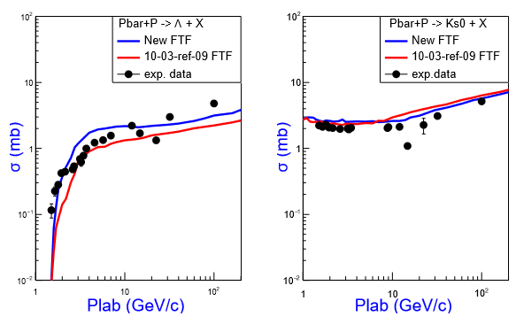
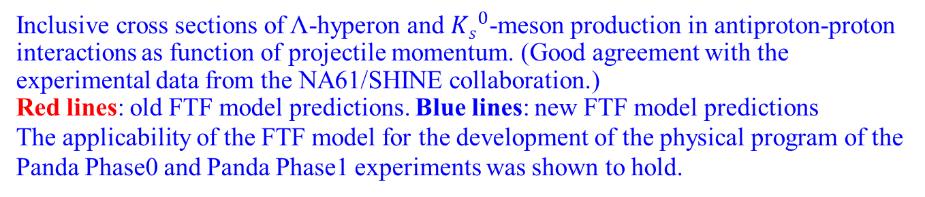
Simulation of the birth of strange quark-antiquark and diquark-antiquark pairs within the FTF model of the Geant4 package
Inclusive cross sections of Λ-hyperon and ${Ks}_{}^{0}$-meson production in antiproton-proton interactions as function of projectile momentum. (Good agreement with the experimental data from the NA61/SHINE collaboration.)
Red lines: old FTF model predictions. Blue lines: new FTF model predictions
The applicability of the FTF model for the development of the physical program of the Panda Phase0 and Panda Phase1 experiments was shown to hold.
A. Galoyan, A. Ribon, V. Uzhinsky, Nuclear Theory, Vol. 37 (2018) eds. M. Gaidarov, N. Minkov, Heron Press, Sofia, 98–108,
arXiv:1810.09973 [hep-ph]
Notes:
29

Slide 30
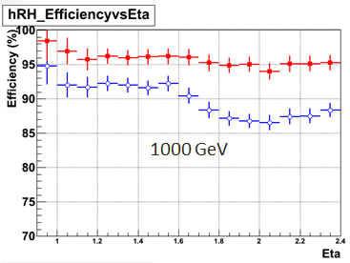
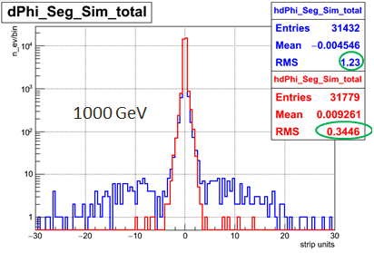
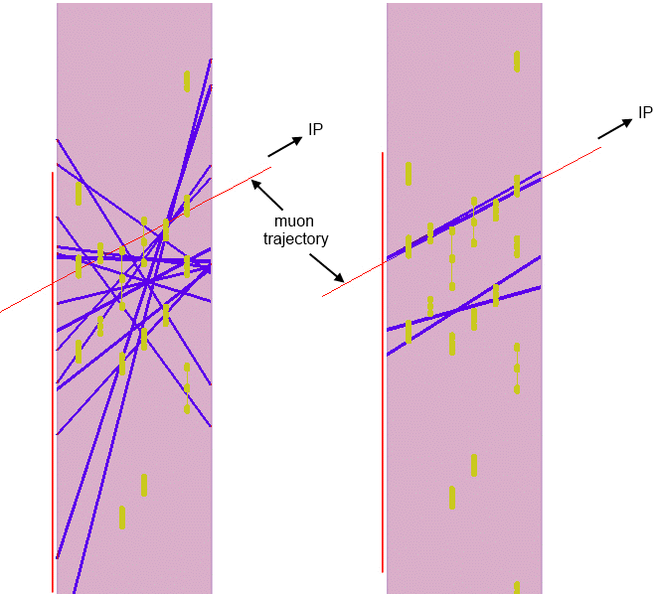
New segment building algorithm for the Cathode Strip Chamber (CSC) of the CMS facility
Purpose: to improve the reconstruction for high hit rate and big backgrounds due to luminosity increase
The new algorithm was implemented in the official CMS software package in July, 2016, extensive testing period until end of January 2017. It proved to be effective, stable and robust.
Perspectives: Further reconstruction procedure refinements, its use as reconstruction algorithm for the new GEM detectors that will be included in the experimental setup for the next major upgrade.
Standard alg. [blue]
New alg. [red]
Reconstruction efficiency vs. pseudorapidity
(new alg. efficiency is high and almost
constant, standard alg. eff. decreases
with the increase of the pseudorapidity)
Distance in strip units between the reconstructed and the simulated segment
(3.5 times signal improvement)
Example of a high hit multiplicity event reconstruction (standard alg. – left, new alg. – right) [# of fake segments: is considerably reduced]
V. Palichik, N. Voytishin, Phys. Part. Nuclei (2017) Vol. 48, Issue 5, 786–788.
https://doi.org/10.1134/S106377961705032X
https://link.springer.com/content/pdf/10.1134%2FS106377961705032X.pdf
Notes:
30

Slide 31
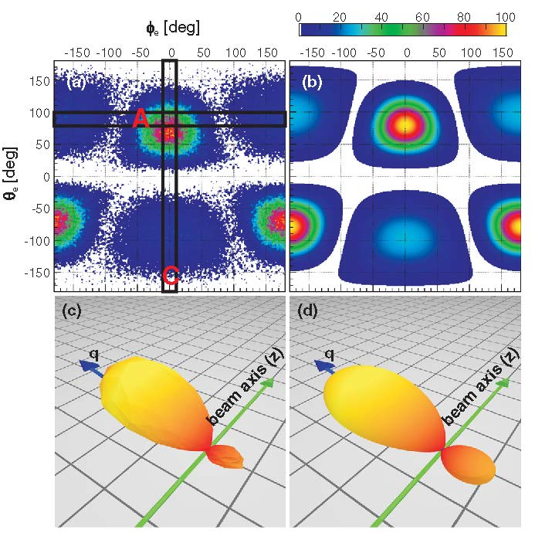
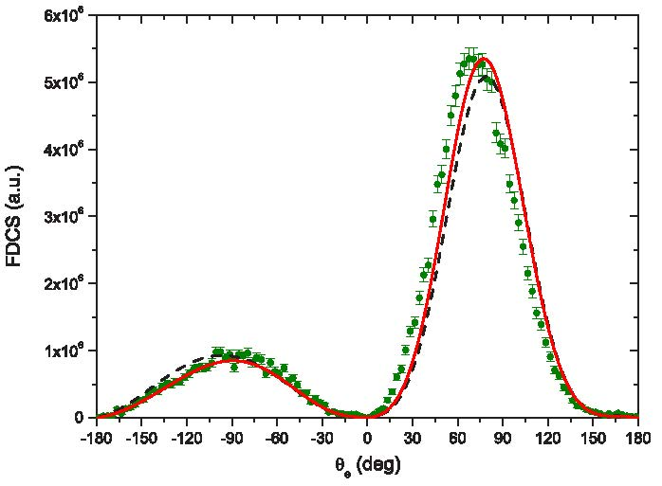
Fully differential cross sections for singly ionizing 1-MeV p+He collisions at small momentum transfer:
Beyond the first Born approximation
Fully differential cross sections in coplanar geometry using the plane wave first Born approximation (black dashed line) and 3C model (red solid line) with the correlated ground state function of the He atom. Experimental values are represented by points (green)
High resolution experimental results within the cold target recoil ion momentum spectroscopy obtained at the University of Frankfurt define the angular distribution of the escaped electrons in the atomic reaction p + He → p + He⁺ + e.
(a) Experimental result and (b) Theoretical distribution based on the First Born Approximation (FBA) calculations. The areas marked as A and C correspond to the so-called azimuthal plane and the coplanar geometry. (c) and (d) depict 3D representations of the contour plots (a) and (b).
Main result: A good agreement between theory and experiment is found in the case of the 3C (BBK) final state and a strongly correlated helium wave function.
O. Chuluunbaatar et al, Phys. Rev. A96, 042716 (2017)
Experimental results published: H. Gassert, O. Chuluunbaatar et al, Phys. Rev. Lett. 116, 073201 (2016)
Notes:
31

Slide 32
Reliable statistical inferences under low statistics and incomplete observation
Relation between measured α-particle energies E_{α} (with error bars) and decay times of isotopes assigned to ²⁹³Ts(a), ²⁸⁹Mc (b), ²⁸⁵Nh (c), ²⁸¹Rg (d), and ²⁷⁷Mt(e). Results from the DGFRS experiments observed in the reactions ²⁴⁹Bk+⁴⁸Ca [8–10] (16 chains, the α decays of ²⁹³Ts, ²⁸⁹Mc, and ²⁸⁵Nh were missed in 1, 4, and 2 cases, respectively) and ²⁴³Am+⁴⁸Ca [2] (4 chains) are shown by black diamonds and red squares, respectively. Data from the ²⁴³Am+⁴⁸Ca experiments carried out at TASCA [1] (7 chains) and BGS [3] (3~chains) are shown by blue circles and green triangles, respectively. Observed α-decay and SF events are shown by open and closed symbols, respectively. Time intervals for events following a missing α decay were measured from preceding registered events and are shown by arrows (upper limits).
Decay times for events with partially measured E_{α} values (full energy was not registered) or SF events are shown on dashed lines with E_{α}=9.9 MeV for ²⁸⁹Mc[1], E_{α}≈ 9.2 MeV for ²⁸⁵Nh [1, 3], and E_{α}≈9.0MeV [8–10], E_{α}≈ 8.9 MeV [2], E_{α}≈ 8.8 MeV [1], and E_{α}= 8.7 MeV [3] for ²⁸¹Rg. For spontaneously fissioning ²⁷⁷Mt only decay times are shown. [Quotations from references below]
LIT contribution to the recognizance of the FLNR priorities in discovery of new superheavy elements
V.B. Zlokazov, V.K. Utyonkov, J. Phys. G: Nucl. and Particle Phys., 44, 075107, 13, 2017
V. Zlokazov, V. Utyonkov, EPJ Web of Conferences 173, 04014 (2018)
Notes:
32

Slide 33
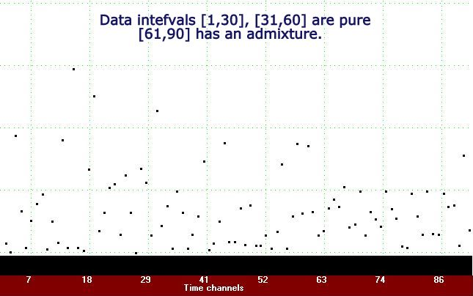
Nonparametric tests for checking data purity at low statistics
• Check of data purity: is a necessary condition for the effectiveness of their analysis.
• Preliminary data testing for purity is to be fast, reliable, and easy to perform.
• Reliability features: absence of a priori information about parameters of the data distributions; insensitivity to their statistics.
• The ratio of the sample median to the sample mean shows significantly different distribution functions on pure data and on mixtures.
• The confidence intervals for the functions of the ratio distributions have non-intersecting parts for clean data and mixtures. They can serve as a basis for the evaluation of the plausibility of hypotheses about the degree of data purity (see figure).
• Other advantages: building estimates of the parameters of data distributions and their accuracy, noise filtration from data and optimum planning of the experiment.
Data intervals [1,30] and [31,60] are pure
[61,90] has an admixture
V.B. Zlokazov, Nonparametric method for testing the exponential small volume data for purity, Physics of Particles and Nuclei Letters, 2018, Vol. 15, No.6, pp. 674-677, Pleiades Publishing, Ltd., 2018, Journal Physics of Particles and Nuclei Letters, 15(6), 685688
Notes:
33

Slide 34
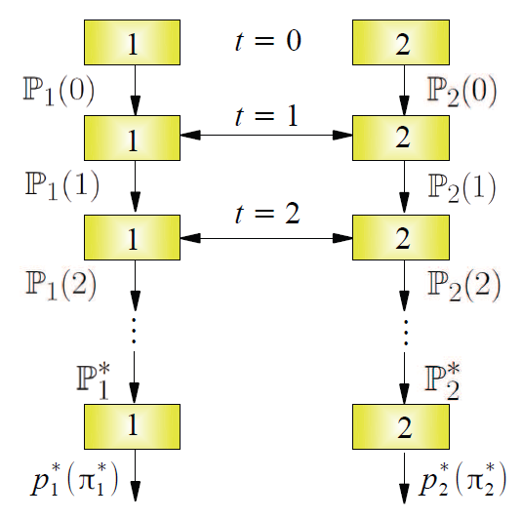
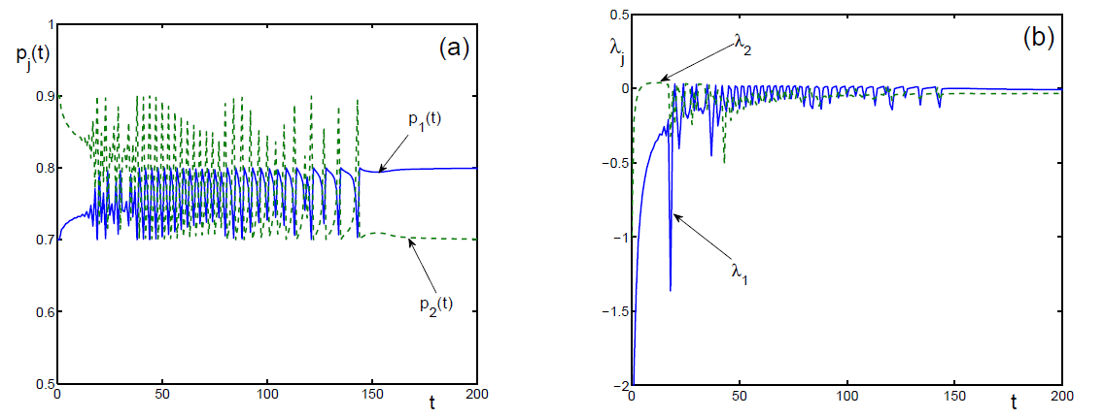
Information Processing by Networks of Quantum Decision Makers
A new model describing the artificial intelligence processing presents an intelligence network of decision makers exchanging information and forming their judgment, with collective decisions developed in time as a result of information exchange.
Such networks can describe dynamical processes occurring in artificial quantum intelligence composed of several parts or clusters of quantum computers.
Two-partner reconstructive memory under conﬂict.
Dynamics of the probabilities (a) and local Lyapunov exponents (b)
Dynamics of multistep decision
making governed by information exchange between two agents
V.I. Yukalov, E.P. Yukalova, and D. Sornette, Physica A 492 (2018) 747-766
Notes:
34

Slide 35
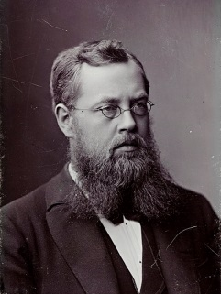
Computer Linearization of Differential Equations
Solving nonlinear ordinary differential equations is one of the fundamental and practically important research challenges in mathematics. However, the problem of linearizability for the equation
set up in “Sophus Lie. Vorlesungen über kontinuierliche Gruppen mit geometrischen und
anderen Anwendungen. Teubner, Leipzig, 1883“ so far remained algorithmically unsolved.
The algorithmic solution of this problem, i.e. the verification of the existence of linearizable transformation and its construction, if such transformation exists, together with implementation in the computer algebra system Maple, was given in the paper
V.P.Gerdt (LIT JINR), D.A. Lyakhov, D.L. Michels (both KAUST, Thuwal, Saudi Arabia), Proceedings of ISSAC 2017, ACM Press, 2017, pp.285--292. arXiv:1702.03829[math.CA]
ISSAC Distinguished Paper Award by ACM SIGSAM ( http://www.issac-conference.org/2017/awards.php ) for n ≥ 2 and for any rational function f.
Sophus Lie
1842-1899
Distinguished Paper Award by Association of Computing Machinery (ACM)
at the International Symposium on Symbolic and Algebraic Computation (ISSAC) 2017
( http://www.issac-conference.org/2017/awards.php )
Example: Tremblay-Turbiner-Winternitz equation (G.Gubbiotti, M.C.Nucci. J.Math.Phys. 58, 2017, 012902)
V.P.Gerdt (LIT JINR), D.A. Lyakhov, D.L. Michels, Proceedings of ISSAC 2017, ACM Press, 2017, pp. 285 – 292
Notes:
35

Slide 36
Conclusions
Following the worldwide trend, the computing and software are overwhelming
All the basic JINR research tasks are looking for novel computing models; the LIT expertise greatly facilitates their development
The development of numerical methods and algorithms for parallel and hybrid calculations in scientific research are pervasive
The heterogeneous hybrid platform HybriLIT (involving the learning and testing cluster and the “GOVORUN” supercomputer) is the key to the high performance computing in JINR. Its further extension and upgrade, as an indelible part of the Multifunctional Information and Computing Complex – basic JINR facility allowing to face up the future scientific research challenges in the JINR and the JINR Member States, is a fundamental contribution to the solution of the computer intensive tasks
We ask the Programme Advisory Committee for Condensed Matter Physics to approve the activity done during 2017-2019 and to agree with the continuation of the research within the theme: “Methods, Algorithms and Software for Modeling Physical Systems, Mathematical Processing and Analysis of Experimental Data” during 2020-2023
Notes:
36

Slide 37
Thank you for your attention !

Slide 38
Backup Slides
Notes:
38

Slide 39
Contents of the Proposal for Theme 1119 Extension
Introduction
State-of-the-art of the research field within the theme 1119
Description of the proposed research
Personnel
Budget estimation
Concise SWOT analysis
International Collaboration
Notes:
39

Slide 40
(1) Mathematical and computation methods for simulation of complex physical systems
General objectives
- Development of mathematical and computing methods for modeling new experimental facilities, accelerating complexes and their elements, nuclear-physical processes, complex physical systems;
- Compliance of the newly developed mathematical methods with the main features of the physical processes and mathematical models: non-linearity, multi-parametric behavior, the existence of critical modes and phase transitions;
- The main computational tools: parallel algorithms implemented in software packages tuned up to the latest hardware architectures, primarily the HybriLIT heterogeneous computing platform.
Main subject matters
• Calculations of magnetic fields for different facilities;
• The investigation of mathematical models of complex physical processes in the frame of quantum-field and molecular-dynamics approaches;
• Development of new mathematical methods with the aim to take into account specific features of the physical processes;
• Information-computing support aimed at improving the working regimes of several experimental facilities;
• Development of reliable scale-adapted algorithms of reduced computational complexity.
Notes:
40

Slide 41
Mathematical and computation methods for simulation of complex physical systems
Main subject matters
• Calculations of magnetic fields for different facilities:
- Three-dimensional computer simulation of magnetic systems in the framework of the NICA (JINR) and FAIR (GSI) projects. Calculation of the required characteristics of the magnetic field in the working areas of the magnets.
- Developing fast FEM algorithms for 3D simulation of the magnetic field distributions in COMSOL Multiphysics software.
- Development of methods and algorithms for efficient highly accurate three-dimensional modeling of magnets and computations targeted to the creation of superconducting cyclotrons for proton therapy, in collaboration with DLNP.
- Optimization of beam dynamics programs in cyclotrons aimed at increasing speed, efficiency, and accuracy of calculations.
• The investigation of mathematical models of complex physical processes will be pursued in the frame of quantum-field and molecular-dynamics approaches:
- Development of effective QCD-motivated models for describing properties of nuclear matter at NICA energies
- Development of new molecular dynamics algorithms aimed at increasing accuracy and significantly reducing the computing time.
- Development of models of interaction of ion beams with targets in order to explain various effects: long-range and description of structural changes of materials under heavy ion and nanocluster irradiation, finding threshold values of energy loss in irradiated materials, leading to structural changes and through tracks in thin targets.
- Development of mathematical models, algorithms and programs for the study of processes of local nonequilibrium created by the impact of ultrashort laser pulses on materials. Formulation and solution of systems of the heat conduction equations for the study of laser ablation, carrying out numerical experiments in the framework of molecular dynamics. Validation of theoretical models by comparing the obtained numerical results with experimental data.
Notes:
41

Slide 42
Mathematical and computation methods for simulation of complex physical systems
Main subject matters
• Development of new mathematical methods with the aim to take into account specific features of the physical processes:
-Development of numerical methods for describing equilibrium and nonequilibrium properties of mesoscopic systems of trapped atoms
- Numerical investigation of optical and self-assembled atomic lattices, with emphasis on the control of their properties by external fields. The extension of optimized perturbation theory and self-similar approximation theory for these systems.
- Investigation of nonlinear multiparameter processes in complex physical systems under external fields, including models of superconducting structures, localized states in condensed media, simulation of gas-hydrodynamic processes in porous media.
- Numerical investigation of nuclear-physical processes based on a hybrid model of microscopic potential, including reactions with light exotic nuclei.
- Development of methods for modeling the reflection of neutrons from layered nanostructures. Studies of magnetic films as structures consisting of vector micro-objects.
- Studies of black hole and wormhole models, both in astrophysics and in cosmology, are aimed at understanding the results of new experiments.
• LIT information-computing support aimed at improving the working regimes of several experimental facilities:
- Group of small-angle neutron scattering, FLNP (YuMO spectrometer at the IBR-2 reactor): (a) Maintenance of the SAS primary processing program for the YuMO spectrometer; (b) Development of a program for working with position sensitive detectors for isotropic and anisotropic scattering samples and for ring detectors; (c) Development and maintenance of a parallel version of the Fitter program.
- For the BAIKAL project, DLNP: step-by-step creation of an alert system.
- Modeling of electromagnetic cascade showers in the field of ultrahigh energies and numerical study of their characteristics in experimental data obtained in such astrophysical projects as IceCube, Antares, Baikal
• Development of reliable scale-adapted algorithms of reduced computational complexity:
- Development of an extrapolation method of the sixth order with the aim at improving the algorithm efficiency for the numerical solution of a wide range of tasks.
- Development of methods and algorithms for processing and analysis of the neutron noise of the IBR-2M reactor.
- Multistage multiscale approach to the Bayesian automatic adaptive quadrature.
- Development of algorithms for the numerical simulation of the evolution of a liquid crystal in a pulsed electric field, as well as under the influence of an orienting structured surface.
- Simulation of peculiarities of the absorption-emission and photon density of states of a cholesterol liquid crystal with isotropic defect inside.
- Quantum-chemical cluster approach to electronic systems with strong spin-orbit interactions.
- Carrying out calculations of electromagnetic and thermal quantities characterizing physical processes in MgB₂ superconductors.
Notes:
42

Slide 43
(2) Software complexes and mathematical methods for processing and analysis of experimental data
General objectives
- Derivation of new mathematical methods for the extraction of the useful information from the raw data obtained in experiments done in JINR or with the JINR participation;
- Development of algorithms and implementation of program packages for the solution of problems arising in the high energy physics – including the data got at the accelerator facilities LHC, NICA, FAIR as well as at the experimental facilities of the JINR neutrino program, the nuclear physics, the condensed matter physics and the physics of radiation biology.
- Deep learning neural networks are to become a significant part of this activity.
Main subject matters
• Development of mathematical methods, algorithms and software for reliable simulation and interpretation of the experimental data;
• Development of deep learning neural network algorithms;
• Software-information support of JINR projects;
• Software information support of large scale outer experiments done with JINR participation.
Notes:
43

Slide 44
(2) Software complexes and mathematical methods for processing and analysis of experimental data
Main subject matters
There are four classes of JINR undertakings covered with LIT participation:
• Development of mathematical methods, algorithms and software for reliable simulation and interpretation of the experimental data:
- Within the Geant4 package: simulation of the generation of charmed particles and their transport in matter; improvement of the algorithm for calculation of excitation energies of nuclear residuals and improvement of the description of nuclear fragment formation; improvement of FTF and QGSM models and their application for modeling the conditions of various experiments (PANDA, NICA/MPD, NICA/SPD).
- Development of software support, processing and analysis of data collected at the NUCLEON and COMBAS experiments.
- Investigation of the structure and properties of vesicular systems of phospholipids and medical drugs based on the phospholipid transport nanosystem by means of analysis of the neutron and X-ray small-angle scattering data, depending on external factors and chemical composition.
• Development of deep learning neural network algorithms:
- Development of a framework for the analysis and management of biological monitoring data for controlling and forecasting the status of the environment.
- Development of mathematical methods for the determination of fine structures in the distribution of nuclear reaction products by mass and energy.
- Development of software for the reconstruction of elementary particle tracks based on deep learning methods in the processing of experimental information from modern high-energy physics track detectors.
Notes:
44

Slide 45
(2) Software complexes and mathematical methods for processing and analysis of experimental data
Main subject matters
• Software-information support of JINR projects:
- Improvement of information systems for online and offline data processing of experimental facilities of the NICA complex: Database developments for the tasks of experiments BM@N and MPD.
- Software support for the BM@N experiment: Development and implementation of algorithms for modeling, processing and analysis of data for the BM@N track system consisting of gas and semiconductor detectors with microstrip information acquisition (GEM, SILICON, CSC) and their subsequent integration into the BMNRoot.
- Development and refinement of the DQGSM model by comparison with experimental data of the BM@N.
- The BM@N experiment: (a) trajectory reconstruction of charged particles in outer tracking detectors: MWPC, Si, CSC, DCH, GEM; (b) Particle identification in the TOF700 time-of-flight detector; (c) Search for strange hyperons on data from the Nuclotron.
- The MPD experiment: Participation in the realization of a laser calibration system for detector alignment, monitoring drift velocity and for taking electric field distortion into account inside the Time-Projection Chamber (TPC) of the MPD central barrel.
- Further development of statistical methods for the analysis of experimental data under small statistics and incomplete observation of the studied processes: testing the likelihood of hypotheses, estimates of the half-life of the nucleus and of the reaction cross section and of their accuracy, noise filtering and buildup of the optimal experimental design.
- Development of batch processing of neutron diffraction spectra measured in real-time in situ mode (HRFD at IBR-2, FLNP).
• Software information support of large scale outer experiments done with JINR participation:
- Software support of ATLAS experiment: (a) Development and maintenance of configuration and management of ATLAS TDAQ; (b) Development and support of modules of the EventIndex project; (c) Development of modules of Project ATLAS Condition DB (in preparation for RUN3).
- Software support of CMS experiment: (a) Development, testing and implementation into the official CMS release of algorithms for the separation of overlapping signals and for building track segments in cathode strip chambers (CSC); (b) Evaluation of the CSC spatial resolution and effectiveness on experimental data with LHC; (с) Study of the effects of CSC ageing on muon beam tests with radiation source (CERN Gamma Irradiation Facility (GIF++)); (d) Background rates estimation in CSCs with LHC data.
- Software support of CBM experiment: (a) Development of methods for the selection of rare processes: models, methods, algorithms and software; (b) Development and maintenance of the complex of databases.
Notes:
45

Slide 46
(3) Numerical methods, algorithms and software for multicore and hybrid architectures and Big Data analytics
A. Developments for Multicore and Hybrid Architectures
General objectives
- Development and maintenance on the heterogeneous “GOVORUN” supercomputer of an environment for the solution of massively parallel, resource-intensive problems of theoretical and experimental physics (data analysis and ML/DL tasks);
- Development of problem adapted numerical methods, algorithms and software packages using the possibilities of the HybriLIT platform: shared memory (OpenMP), distributed memory (MPI), and graphics accelerators (CUDA/OpenCL);
- Contributions to the development of the JINRLIB library .
Main subject matters
• Development of ML/DL based algorithms within the emerging new environment;
• Large scale numerical experiments for different projects;
• Support to the solution of applied engineering and physics problems on the HybriLIT platform using software packages adapted for parallel computations;
• Development of new parallel implementations of software packages for solving specific tasks;
• Implementation in the JINRLIB library of the most important developed parallel program packages.
Notes:
46

Slide 47
(3) Numerical methods, algorithms and software for multicore and hybrid architectures and Big Data analytics
A. Developments for Multicore and Hybrid Architectures
Main subject matters
• Development of ML/DL based algorithms based on the emerging ecosystem:
- using recurrent and convolutional neural networks with deep learning for solving problems of fast recognition of multiple tracks in particle physics experiments, including the NICA megaproject and the neutrino program;
- using the neural network approach for tasks of analyzing and classifying medical and biological data.
• Large scale numerical experiments for different projects (such as ELI-NP);
• Support to the solution of applied engineering and physics problems on the HybriLIT platform using software packages adapted for parallel computations;
• Development of new parallel implementations of software packages for solving specific tasks, namely:
- parallelization of the most time-expensive functions using tools such as OpenMP, MPI, CUDA/OpenCL, in the event modeling and reconstruction in NICA experiments;
- calculations on heterogeneous computing platforms for the study of long Josephson junctions;
- the numerical study of multidimensional models based on evolutionary equations;
- solving equations of motion of the molecular dynamics and equations of continuous media;
- calculations of multiple integrals arising from theoretical studies related to the NICA megaproject and entering the study of various physical processes;
- solution of multi-physical problems in accelerator design, dosimetry and radiation safety;
- study of the possibility of increasing the performance of data analysis in ROOT through the use of graphics processors, the comparative analysis of parallelization using PROOF and OpenCL (for the application of the obtained results in the work on the NICA project);
- diagonalization of large matrices in the theory of random matrices for the description of the decay properties of giant multipole resonances of heavy and medium nuclei;
- computations of non-standard problems of the magnetostatics;
- solving optimization problems aimed at getting the best parameters of superdense nuclear matter models in the simulation of heavy ion collisions and in astrophysical applications;
- development of LDPC-like efficient decoding algorithms based on a genetic approach;
- development of finite element method based computational schemes for the description of the quadrupole oscillations of the collective model of the nucleus;
- development of computational schemes for the triangular three-center Coulomb problem and application to the H3+ molecule ion and H₂O molecule;
- modeling processes of single and multiple ionization/photoionization of biomolecules by the method of separable potentials;
- study of single ionization of atoms and molecules by fast proton impact in different kinematic regimes.
• Implementation in the JINRLIB library of the most important developed parallel program packages.
Notes:
47

Slide 48
(3) Numerical methods, algorithms and software for multicore and hybrid architectures and Big Data analytics
B. Big Data Analytics
General objective
- Conceptual developments and their step-by-step implementation within the Big Data approach for solving tasks within large scale JINR projects (cooperation with theme 5-6-1118-2014/2023);
Main subject matters
• Development of a multipurpose scalable software-analytical platform for NICA and neutrino physics projects;
• Development of methods and software for effective use of Big Data analytics for resource-intensive computations;
• Development of techniques for event reconstruction and intellectual monitoring of detectors;
• Development of time series analysis methods and Big Data applications.
Notes:
48

Slide 49
(3) Numerical methods, algorithms and software for multicore and hybrid architectures and Big Data analytics
B. Big Data Analytics
General objectives and Main subject matters
• Development of the concept and step-by-step implementation within the Big Data approach of a scalable software-analytical platform for the collection, storage, processing, analysis, retrieval of relevant information and visualization of results for the MPD, SPD and BM@N experiments at the NICA accelerator complex and for experiments within the JINR neutrino program.
• Development of methods and software for effective use of Big Data analytics for resource-intensive computations on coprocessors and graphics processors for modeling, reconstruction and processing of experimental data (installations at the NICA accelerator complex, JINR neutrino program experiments, LHC experiments).
• Development of techniques for event reconstruction and intellectual monitoring of detectors using methods and technologies of Big Data and machine learning. The use of powerful high-level Big Data libraries, including the Spark MLlib machine learning library, the GraphX operations library for performing graphs and parallel operations with them, the Spark Streaming library for processing real-time streaming data, and the SparkSQL library. Use of new mathematical methods such as DQC (Dynamic Quantum Clustering), Complex Networks, etc.
• Development of time series analysis methods using Big Data technologies for intelligent monitoring of distributed computing systems. Application of machine learning and artificial intelligence to the optimization of the functionality of the distributed computing for physical experiments.
Notes:
49

Slide 50
(4) Methods, algorithms and software of computer algebra and quantum computing
General objectives
- Development of methods of computer algebra and quantum computing for simulation of quantum information processes;
- Creation of algorithms and programs for symbolic-numerical solution of problems arising in experimental and theoretical studies, using the latest computational hardware resources, including the heterogeneous platform HybriLIT.
Main subject matters
• Advances in computer algebra methods for modeling quantum systems and quantum information processes;
• Development of computer algebra methods with application to symbolic-numerical solution of differential equations;
• Development of algorithms requested by special topics, including quantum computing;
• Development and implementation of special computational tools.
Notes:
50

Slide 51
(4) Methods, algorithms and software of computer algebra and quantum computing
Main subject matters
• Advances in computer algebra methods for modeling quantum systems and quantum information processes:
- Development of methods of quantum information processing by means of dipolar and spinor atomic systems, derivation of optimal methods for spintronics.
- Modeling of intelligent networks performing operations based on quantum decision theory. Numerical analysis of artificial intelligence models.
- Investigation of methods and algorithms for quantum computing and quantum informatics focused on machine learning (quantum machine learning) in order to adapt them to the task of track reconstruction and data processing for the NICA collider.
- Comparison and analysis of the computational efficiency of the adiabatic and "universal" quantum computing on real equipment available through the cloud.
- Development of constructive algorithmic methods based on the computational theory of finite groups for studying the entanglement of many-particle quantum systems.
- Development of quantum algorithms for the study of phase transitions in lattice QCD models at finite density in the framework of tensor network methods.
• Development of computer algebra methods with application to symbolic-numerical solution of differential equations.
- Improvement of algorithms and programs for the study and solution of systems of nonlinear algebraic and differential equations arising in the simulation of quantum computing and other physical processes, based on the capabilities of the heterogeneous HybriLIT cluster and the “GOVORUN” supercomputer.
• Development of of algorithms requested by special topics
- Development of a new computational scheme for constructing a quasi-probability Wigner distribution for composite systems.
- Development of a relativistic version of the Lindblad equation for open systems based on the Bogolyubov equations for the state vector in relativistic quantum field theory.
- Application of the proposed versions of the quasi-probabilistic Wigner distributions and the relativistic Lindblad equations to the study of composite systems interacting with an intense laser field.
- Development of algebraic methods for the computation of radiation corrections, depending on many kinematic variables and masses, based on functional equations and recurrence relations.
• Development and implementation of special computational tools
- Embedding into the system of computer algebra of the Axiom module of field-theoretical calculations in high-energy physics, which is part of the FORM system – the most efficient among the computer algebra systems in terms of the speed of calculations of this type.
Notes:
51

Slide 52
MMCP Conferences, 2011, 2015, 2017
Left: With over 40,800 downloads of the 41 papers, at a pace of over 500 monthly, the LNCS 7125 volume was annually quoted by Springer in 2013-2018 as one of its top 50% most downloaded eBooks in this collection:
http://www.bookmetrix.com/detail_full/book/8717d9eb-2653-4a3c-a8d9-adf82bdcd1d5#downloads
Centre: EPJ-WoC, Vol.108, with 58 accepted papers:
http://www.epj-conferences.org/articles/epjconf/abs/2016/03/contents/contents.html
Right: EPJ-WoC, Vol.173, with 100 accepted papers:
https://www.epj-conferences.org/articles/epjconf/abs/2018/08/contents/contents.html
Notes:
52

Slide 53
SpringerLink Download Summary of LNCS 7125 (12.06.2019)
Notes:
53

Slide 54
Numerical simulation of the formation of hydrated electron states
Numerical simulation of the photoexcited electron states formation in water under ultraviolet range laser irradiation is carried out within the polaron model with a time-dependent calculation of the hydrated electron absorption band width.
This framework is shown to reproduce well the experimental data on the light absorption by the hydrated electron in polarized water.
Effectiveness of parallel implementation is tested on the HybriLIT cluster (Figs. 1, 2)
Fig.1. Numerical simulation of light absorption by a hydrated electron for experimental data derived at light frequencies of the scanning laser Ω = 1.918 eV (left) and Ω = 1.512 eV (right)
Fig.2. Same as Fig.1 for data at ­Ω = 1.378 eV (left) and ­ Ω = 1.305 eV (right)
A. Volokhova, E.Zemlyanaya, V. Lakhno, I. Amirkhanov, M.Bashashin, I. Puzynin, T. Puzynina, EPJ – WoC, Vol. 173 (2018), 06013 (1-4)
Notes:
54

Slide 55
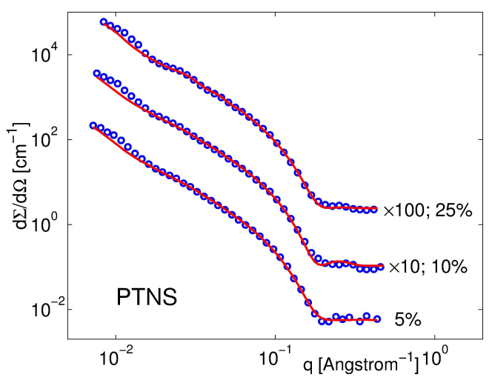
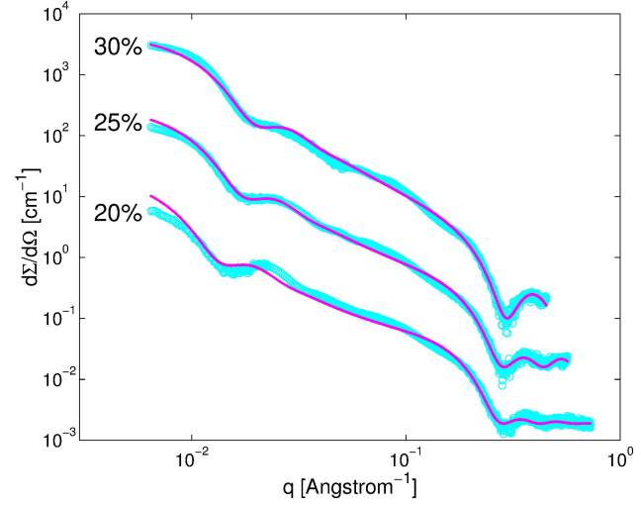
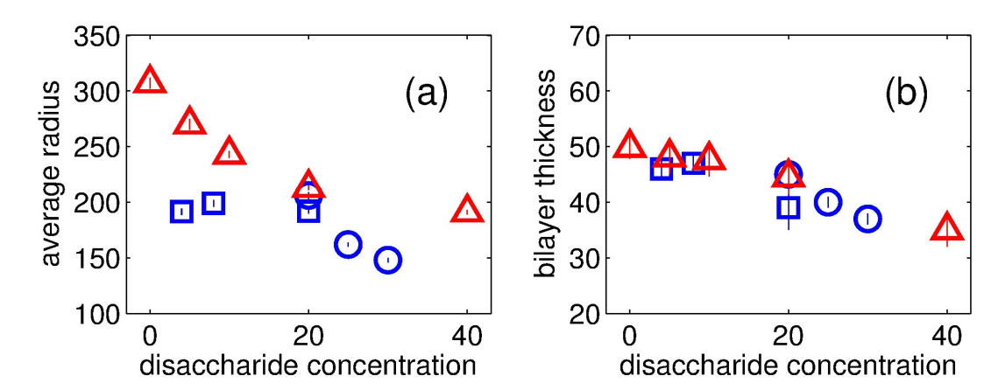
ADE-SFF Data Analysis for Vesicular Systems
SANS
SAXS
PTNS
Phospholipid unilamellar vesicles (ULVs, liposomes) are important in medicine.
Data collected by SAXS and SANS methods on ULVs are analyzed within the Separated form factors model (SFF), using Alternating Direction Explicit (ADE) minimization & parallel MPI programming
Online interface was developed http://sff-sans.jinr.ru/
Blue: PTNS
Red: DMPC
Blue: PTNS
Red: DMPC
Basic parameters of the Phospholipid transport nanosystem (PTNS) in water solutions of maltose were estimated from joint analysis of SANS and SAXS data in terms of the maltose concentration.
М.Кiselev, Е.Zemlyanaya, А.Gruzinov, Е.Zhabitskaya, О.Ipatova, V.Аksenov, Crystallography Reports. 2017. Т. 62. № 5. С. 763-767
E.Zemlyanaya, M.Kiselev, K.Lukyanov, I.Popov, K.Turapbay. Method. Journal of System Analysis in science and education, 2017, No.4
M.Bashashin, E.Zemlyanaya, E.Zhabitskaya, M.Kiselev, T.Sapozhnikova, EPJ – WoC, Vol. 173 (2018), 05003 (1-4)
E.Zemlyanaya, M.Kiselev, E.Zhabitskaya, V.Aksenov, O.Ipatova, O.Ivankov. J. Phys. Conf. Series, vol. 1023, 012017, 2018
Notes:
55

Slide 56
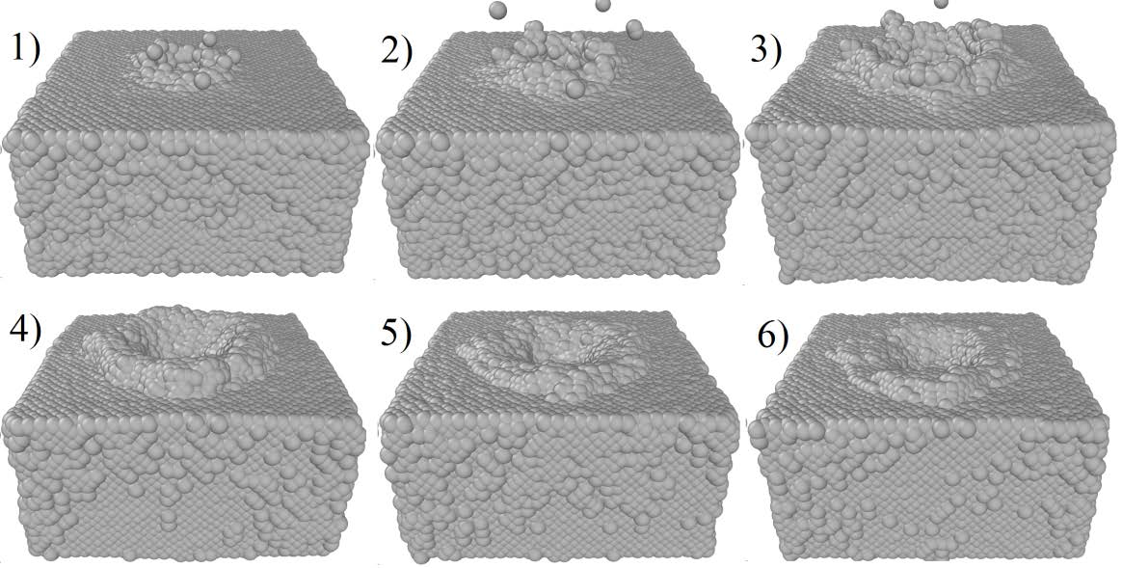
Modeling Structural Changes in Metals Irradiated by Copper Nanoclusters
Dynamics of crater formation in a target under irradiation with a 50-eV/atom nanoclusters at instants of time: 1) 0.5ps; 2)1ps; 3) 2ps; 4) 5ps; 5)10ps; 6) 20ps.
B. Batgerel, S.N.Dimova, T.N.Kupenova, I.V. Puzynin, T.P. Puzynina, I.G.Hristov, R.D.Hristova, Z.K. Tukhliev, Z.A.Sharipov, EPJ WoC, 173, 06001 (2018), pp. 1-4
Notes:
56

Slide 57
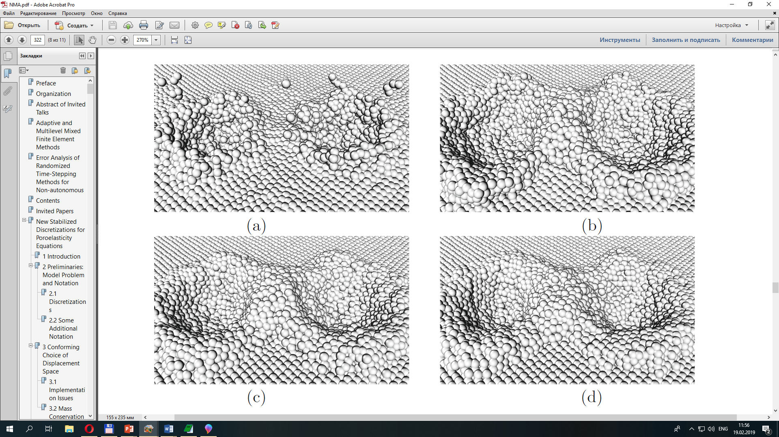
Molecular Dynamic Modeling of Long-Range Effects in Metals Exposed to Nanoclusters
B. Batgerel³, I.V. Puzynin¹, T.P. Puzynina¹, I.G. Hristov², R.D. Hristova²,
Z.K. Tukhliev^{1*}, Z.A. Sharipov¹
¹Joint Institute for Nuclear Research, 141980, Dubna, Russia *E-mail: zafar@jinr.ru
²Sofia University “ St. Kliment Ohridski”, Sofia, Bulgaria
³Mongolian State University of Science and Technology, Ulaanbaatar, Mongolia
Figure 1. Structural changes of the target and formation of craters at the surface of the target when irradiated with two nanoclusters of energy 50 eV/atom at instants of time 1 ps (a), 4 ps (b), 7 ps (c), and 10 ps (d). The distance between clusters is 6 nm.
Notes:
57

Slide 58
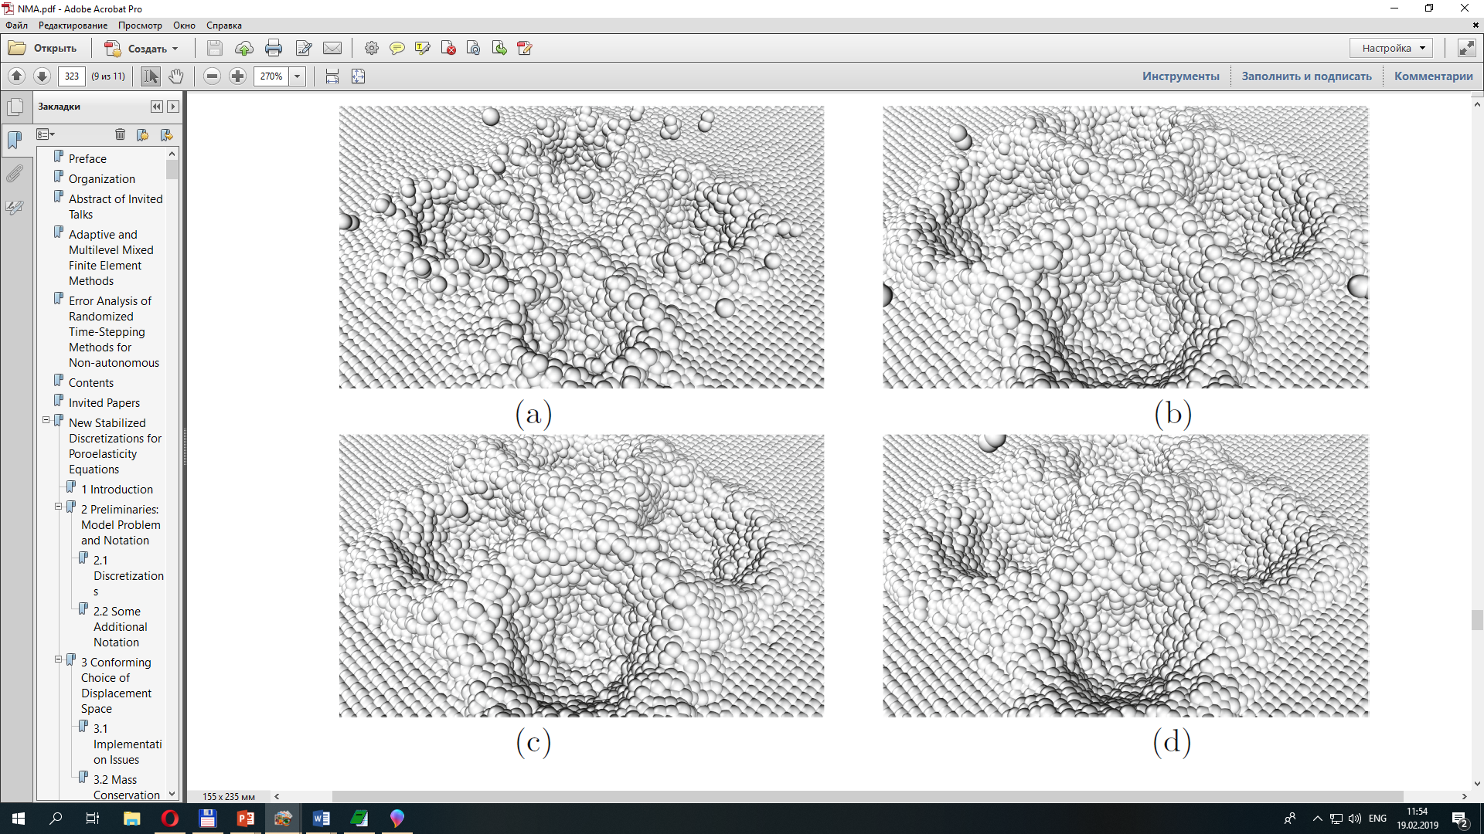
Molecular Dynamic Modeling of Long-Range Effects in Metals Exposed to Nanoclusters
Figure 2. Structural changes of the target and formation of craters at the surface of the target when irradiated with four nanoclusters of energy 50 eV/atom at instants of time 1 ps (a), 4 ps (b), 7 ps (c), and 10 ps (d).
Springer Nature Switzerland AG 2019 G. Nikolov et al. (Eds.): NMA 2018, LNCS 11189, pp. 318–325, 2019.
Notes:
58

Slide 59
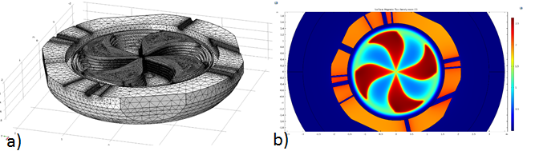

Simulation of the magnetostriction caused by the magnetic field distribution in the superconducting cyclotron for proton therapy in Dubna
The newly designed superconducting cyclotron for proton therapy in Dubna (a) and the trapping magnetic field induced by the superconducting coil (b).
The resulting stress (a) and strain (b), both caused by the induced magnetic field shown in the upper figure.
A. Chervyakov (LIT), Simulation of the magnetostriction caused by the magnetic field distribution in the superconducting cyclotron for proton therapy in Dubna (Leader G.D. Shirkov), March 30, 2019 (in collaboration with DLNP, JINR).
Notes:
59

Slide 60




3D modeling of magnetic systems [1]
Quadrupole unit VQD (FAIR,GSI)
Quadrupole unit SF2B (FAIR,GSI)
Doublet of lenses (NICA,JINR)
Collider dipole (NICA,JINR)
P.G. Akishin, for NICA and FAIR collaborations
Notes:
60

Slide 61




3D modeling of magnetic systems [2]
SIS100 dipole magnet (FAIR,GSI)
Collider quadrupole (NICA,JINR)
CBM dipole magnet, MUCH option (FAIR,GSI)
CBM dipole magnet, RICH option (FAIR,GSI)
P.G. Akishin, for NICA, FAIR & CBM collaborations
Notes:
61

Slide 62
3D modeling of magnetic systems P.G. Akishin, for NICA and FAIR collaborations
Collider dipole (NICA,JINR)
Collider quadrupole (NICA,JINR)
Doublet of lenses (NICA,JINR)
SIS100 dipole magnet (FAIR,GSI)
Quadrupole unit VQD (FAIR,GSI)
Quadrupole unit SF2B (FAIR,GSI)
CBM dipole magnet, MUCH option (FAIR,GSI)
CBM dipole magnet, RICH option (FAIR,GSI)
Notes:
62

Slide 63

Nuclotron beam momentum estimation in the BM@N experiment
А complex reconstruction algorithm for the Drift Chambers (DC) of the BM@N experiment was developed. Values of the correction factors for the drift time of DC were calculated and implemented into the official software as global constants.
The spatial resolution achieved by using the experimental data varies from 180 to 300 µm for different planes of the detector. The efficiency is above 90% for all planes.
Beam momentum was estimated using data got in the recent physical runs of the Nuclotron. All the estimated values and their errors satisfy the expected results, and the desired resolution of 2% was achieved for the working values of the magnetic field integral.
A special macro was developed for the chain used for particle identification in BM@N experiment. The reconstructed trajectories from tracking detectors combined with the information from Time-Of-Flight detectors allow identifying a large spectrum of particles with high precision. Results were reported on BM@N collaboration meetings.
C beam energy 4.5 GeV/nucleon momentum estimation.
The dashed line is the nominal beam momentum value.
The points are the beam momentum values estimated from the experimental data.
M. Kapishin, V. Palichik, N. Voytishin, ”Reconstruction algorithms for CMS and BM@N experiments”, Procs. RO-LCG-2017 Conf., p.56, ISBN 978-973-0-25620-8, 2017;
M. Kapishin, V. Lenivenko, V. Palichik, N. Voytishin, Nuclotron Beam Momentum Estimation Using Multiwire Proportional Chambers and
Drift Chambers in the BM@N Experiment, EPJ Web of Conferences, 173, 04008, 2018
Notes:
63

Slide 64

GEM detector performance assessment in the BM@N experiment
During the analysis of the obtained experimental data, the Nuclotron momentum was restored with high accuracy (~3–4%) for various types of beams and their energies, using only the data obtained in the drift chambers (DC).
This fully satisfies the expected accuracy of the detector system (see figure).
The parameters of the profiles of various types of beams in DC for the subsequent development and construction of the bundle-pipe were determined.
Momentum reconstruction of the Nuclotron beam based on the obtained data in the drift chambers of the BM@N experiment with the field operating value
M. Kapishin, V. Karjavin, E.Kulish, V. Lenivenko, A. Makankin, A. Maksymchuk, V. Palichik, S. Vasiliev,
GEM detector performance assessment in the BM@N experiment, EPJ Web of Conferences 173, 04007 (2018)
Notes:
64

Slide 65



3D calculations of the SPD detector magnetic system for the NICA project
Fig. 1. Set of coils
Fig. 2. “Toroidal” configuration
Fig. 3. “Hybrid” configuration
The 3D calculations for the SPD detector magnetic system of the NICA project need accurate solution of the magnetic field configurations at corners domains.
Three basic configurations of the NICA SPD magnetic systems are considered (Fig. 1-3): set of coils, “toroidal”, and “hybrid”.
The model parameters are presented, the maps of magnetic fields are obtained, and the maps of integrals by trajectories are constructed. The “hybrid” configuration is chosen as basic in further work.
(Collaboration VBLHEP, MSU, LIT)
E. Perepelkin, R. Polyakova, A. Tarelkin, A. Kovalenko, P. Sysoev, M. Sadovnikova, I. Yudin, EPJ Web of Conferences, vol. 173, 2018, 03018
E. Perepelkin, A. Tarelkin, R. Polyakova, A. Kovalenko, P. Sysoev, M. Sadovnikova, B. Sadovnikov, N. Inozemtseva, PEPAN Letters, Vol. 16, № 2, pp. 140-152, 2019
E. Perepelkin, A. Tarelkin, R. Polyakova, A. Kovalenko, P. Sysoev, M. Sadovnikova, N. Inozemtseva, PEPAN, Vol. 3, № 50, 2019
Notes:
65

Slide 66



Adiabatic Representation for Atomic Dimers and Trimers in Collinear Configuration
The profiles of 2D potential functions and the relative arrangement of particles (and barrier) :
(a) Be₃ trimer in Jacobi coordinates in the center-of-mass plane,
(b) Be₂ dimer with barrier.
The isolines of the absolute values |Ψ^{g,u}(ϕ, ρ)| of the ungerade and gerade solutions and their linear combination in sector 1 of (y, x) plane that corresponding to the minimum of the transmission coefficient
|S_{γβ}|² = 10⁻⁷ at E₁ = −189.676 A⁻².
The isolines of the absolute values |Ψ(ϕ, ρ)| of the solution for the trimer Be₃ in 1g metastable state with complex energy E₁^{M}=−188.94 −0.04 A⁻².
A. A. Gusev, S. I. Vinitsky, O. Chuluunbaatar et al,
Physics of Atomic Nuclei, 2018, Vol. 81, No. 6, pp. 911–936; [Russian], pp.945-970 [Eng.]
Notes:
66

Slide 67


Bayesian Inference from Chebyshev Expansion Coefficients
(e)
(c)
(d)
(a) (b)
Singular integrand
Singular derivative
(a) far outer singularity: fast convergence
(a) – (b) Outer singularity: fast convergence
(b) nearby outer singularity: moderate convergence
Endpoint singularity – monotonic behavior:
(c) larger intervals – smaller range of variation,
(d) smaller intervals – larger range of variation
(c) – (d) inner singularity, various range lengths:
– irregular behavior
(e) Inner singularity – irregular behavior
Gh. Adam, S. Adam, Disentangling complexity in Bayesian automatic adaptive quadrature,
MMCP 2017 Conference, LIT-JINR, July 3-7, 2017, EPJ-WoC Vol.173, paper 01001, p1-p8 (2018)
Notes:
67

Slide 68


Machine learning: new methods for predicting air pollution with heavy metals
(Collaboration with FLNP, which is coordinator of the UNECE International Cooperative Program Vegetation in the framework of the United Nations Convention on Long-Range Transboundary Air Pollution)
Analysis results: evidenced the existence of connections between heavy metal concentrations and data gathered from images provided by satellite projects. The available data have been used to train different statistical models and deep neural networks.
Successful instances: prediction of Sb in Norway [•], Mn in Serbia and U in Romania.
The figure illustrates one case study.
Mn pollution in Serbia. Left – real data. Right – model prediction
[•] A.V. Uzhinskiy, G.A. Ososkov, P.V. Goncharov, M.V. Frontasyeva, Computer Research and Modeling, 2018, vol. 10, no. 4, 535–544
Notes:
68

Slide 69


Bose-Einstein condensation temperature of weakly interacting atoms
The method of self-similar factor approximants developed by the authors is used for defining the phase transition temperature of Bose-Einstein condensation for different systems (homogenous Bose gas, trapped Bose atoms, and bosons in optical lattices). The results are shown to be in excellent agreement with the Monte Carlo calculations.
Coefficient c₁ of the critical temperature found using self-similar factor approximants at different values N of the components, and comparison with the available Monte Carlo simulations
Relative critical temperature as a function of the gas parameter for a homogeneous system with N=2. Solid line corresponds to the asymptotic expression; dots are Monte Carlo results.
V.I. Yukalov and E.P. Yukalova, Laser Phys. Lett. 14 (2017) 073001
Notes:
69

Slide 70


Description of N-level quantum systems in terms of quasiprobability distributions
Connections between the quantum and classical representations of the observables are established through the Weyl-Wigner map from the operators of an N-dimensional quantum system and the Wigner quasiprobability distributions on the corresponding phase space.
The classification of the Wigner quasiprobability distributions on the phase space, realized in the form of a symplectic flag manifold, was studied. The Wigner quasiprobability distribution is constructed in the form of a dual convolution of the density matrix and the Stratonovich-Weyl kernels.
It was shown that the moduli space of the Stratonovich-Weyl kernel is given by the intersection of the coadjoint orbit space of the connected action of the SU(N) group with a unit (N–2)-dimensional sphere.
The general approach is illustrated by a detailed description of the module space of 2-, 3-, and 4-dimensional systems. Examples are shown in the figures.
Left: Mapping of the tiling of S2(1) sphere by the Moebius triangles (2,3,3) onto a subset of the plane (υ1, υ2).
The dashed lines represent the degeneracies of the spectrum.
Right: Quatrit (N=4) moduli space represented by the Moebius spherical triangle (2, 3, 3) on a unit sphere
A. Khvedelidze and V. Abgaryan, On the Family of Wigner Functions for N-level Quantum System, arXiv: https://arxiv.org/abs/1708.05981, 2018
V. Abgaryan, A. Khvedelidze and A. Torosyan, On moduli space of the Wigner quasiprobability distributions for N-dimensional quantum systems,
Zap. Nauchn. Sem. POMI, 468, 177-201, 2018
Notes:
70

Slide 71




Simulation program SyMSim*
1.
A grid and cloud services simulation system
was developed in the LIT.
This system is focused on predicting evolution of work quality indicators of the grid-cloud systems. Simulation results are used to choose an optimal grid-cloud configuration of several distributed computing centers.
The certificate of state registration №2017618100 (21.07.2017)
Usage examples in 2017
Simulation of distributed data processing system for BM@N experiment of T0-T1 NICA project
Simulation of interprocessor interactions for MPI-applications in the cloud infrastructure
Simulation approach for improving the computing network topology and performance of the China IHEP Data Center
2.
Comparison of simulation and analytical models with test results
3.
*Synthesis of Monitoring and Simulation
Notes:
71

Slide 72





Dependence of software support on detector configuration
Конфигурация GEM детектора для BM@N RUN-6 (2017)
Конфигурация GEM детектора для BM@N RUN-7 (2018)
вершинный SI-детектор
8-модульный SI-детектор
Конфигурация SI детектора для BM@N RUN-7
Конфигурация CSC детектора для BM@N RUN-7
Были разработаны алгоритмы моделирования, обработки и анализа данных для детекторов трековой системы эксперимента BM@N, включающий газовые и полупроводниковые детекторы с микростриповым съемом информации (GEM, SILICON, CSC), для актуальных конфигураций в 2017-2019 годах.
D.A. Baranov
(LIT)
Notes:
72

Slide 73
Comparison of Parallel CPU Govorun Solutions of Compact Star Configurations for Sequence of Dense Nuclear Matter Models
An MPI algorithm was developed for the simulation of neutron star configurations described by equation of state models of dense nuclear matter. The performance of the parallel algorithm has been investigated for testing set of EoS models on two different types of computational nodes: 1xXeon Phi (KNL) 7250 and 2xXeon E5-2695v3, the presented computations have been obtained with use of Advanced Vector Extensions SIMD: AVX512 and AVX2 correspondingly.
A. Ayriyan, J. Busa Jr., H. Grigorian, and G. Poghosyan. Parallel Algorithm for Solving TOV Equations for Sequence of Cold and Dense Nuclear Matter Models // European Physics Journal WoC, vol. 177, 07001 (2018)
Notes:
73

Slide 74
Моделирование столкновений тяжелых ионов при энергиях Ферми в транспортном подходе и применение данного подхода для анализа экспериментальных данных полученных на установке Комбас
Т.И. Михайлова¹, Б. Эрдэмчимэг^{1,2}, А.Г. Артюх¹, Ю.М. Середа¹, М. Ди Торо³, Х.Х. Вольтер⁴
¹ ОИЯИ, ² МНУ, Улан-Батор, Монголия,³ ЛНС-ИНФН,Катания, Италия, ⁴ Университет Мюнхена, Германия
EPJ Web of Conferences, Vol. 173, 04010-1 – 04010-4 (2018)
Рис. 1 Изотопные распределения в реакциях различных налетающих ионов на мишени ¹⁸¹Ta. Налетающий ион и его энергия указаны внизу каждой панели. Для каждой реакции дается распределение одного конкретного элемента, указанного в верхнем левом углу панели. Кривые представляют: транспортная модель BNV (синие кружки), BNV с последующим статистическим распадом (использован код SMM ) (черные квадраты) и эксперимент (малиновые треугольники)

Slide 75
Рис. 2 Скоростные распределения для тех же элементов в тех же реакциях, что и на Рис. 1,
как функция приведенной скорости, v/v_{proj} (усредненные по выходам изотопов).
Реакции столкновения тяжелых ионов, приводящие к фрагментации, были систематически исследованы с использованием микроскопического транспортного подхода Больцмановского типа, дополненного программой статистического распада для описания девозбуждения первичных горячих фрагментов. Этот подход достаточно хорошо описывает изотопные распределения фрагментов. Скоростные распределения указывают на более тонкие детали механизма ядерных реакций.
Показано, что в экспериментальных данных присутствует компонента прямых реакций недостаточно хорошо описываемая в транспортном подходе. Подсчитанные скоростные распределения оказываются слишком узкими ввиду недоучета флуктуаций. Данный подход применим для оценки выходов изотопов в столкновениях тяжелых ионов.

Slide 76



Corrections to the higher moments of the relativistic ion energy-loss distributions beyond the Born approximation
Voskresenskaya O.O. (LIT)
arXiv:1711.11572 v1 [hep-ph] 30 Nov 2017
Based on the representation of the Mott corrections to the Bethe-Bloch formula in the form of rapidly convergent series of quantities bilinear in the Mott partial amplitudes, an algorithm is proposed for computing the most important parameters of the average energy-loss distributions of relativistic ions in the Mott approximation.
Using its implementation, the parameters of the energy-loss distributions were calculated for incident charged particles of charge number Z from 5 to 95 and relative velocity β from 0.05 to 0.95.
The relative Mott corrections ${ δ}_{n}$ to the Born values of the central moments and normalized central moments of the particle average energy-loss rates in the irradiated material were also computed.
It is shown that the relative Mott corrections ${ δ}_{n}$ to the Born central moments $μ_{n,B }$(n = $\overline{2, 4}$) of the distributions can reach several hundred percent for heavy relativistic ions.
Figure: Relative Mott’s corrections ${ δ}_{n}$to the Born central moments $μ_{n,B}$ (n = $\overline{2, 4}$) of the energy-loss distribution of incident charged particles: Z dependence of ${ δ}_{n}(μ)$for β = 0.75 (left) and β dependence of ${ δ}_{n}(μ)$for Z = 92 (right).
Notes:
Corrections to the higher moments of the relativistic ion energy-loss distributions beyond the Born approximation. Voskresenskaya O. (LIT). arXiv:1711.11572 v1 [hep-ph] 30 Nov 2017.
Using the Mott exact cross section for moderate relativistic energies $(γ≡{(1−β)}^{−1/2}≪200 Z^{−2/3}$), we obtained the corrections to the first-order Born higher moments of the energy-loss distribution in the irradiated material for incident charged of charge number Z from 5 to 95 and relative velocity β from 0.05 to 0.95.
С использованием точного моттовского сечения рассеяния для умеренно-релятивистских энергий $(γ≡{(1−β)}^{−1/2}≪200 Z^{−2/3}$) получены поправки к борновским высшим моментам распределений средних потерь энергии в облучаемом материале пучками заряженных частиц с зарядовым номером 5 ≤ Z ≤ 95 и относительной скоростью 0.05 ≤ β ≤ 0.95.

Slide 77
Заключительное замечание
Концентрация усилий - это хорошо. Но если существует команда из нескольких человек, которые не требуют никаких капитальных затрат и при этом выдают хорошую научную продукцию, участвуя в какой-то из коллабораций, лучше их не трогать - пусть работают.
Газета «Дубна: наука, содружество, прогресс», №5, 7 февраля 2019г.
Итоги 49-й сессии программно-консультативного комитета ОИЯИ по ядерной физике прокомментировал вице-директор Института профессор Михаил ИТКИС

