Slide 1


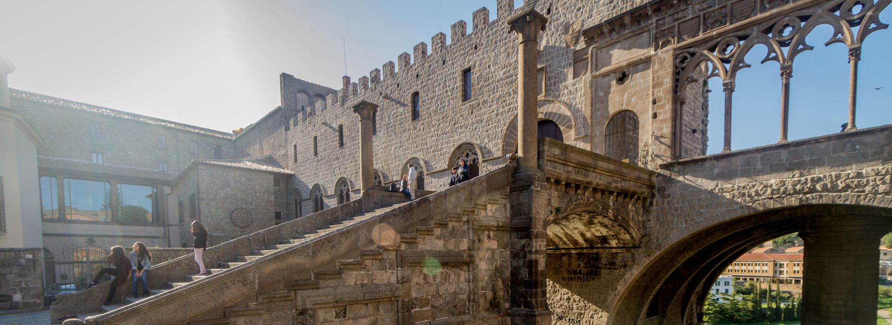
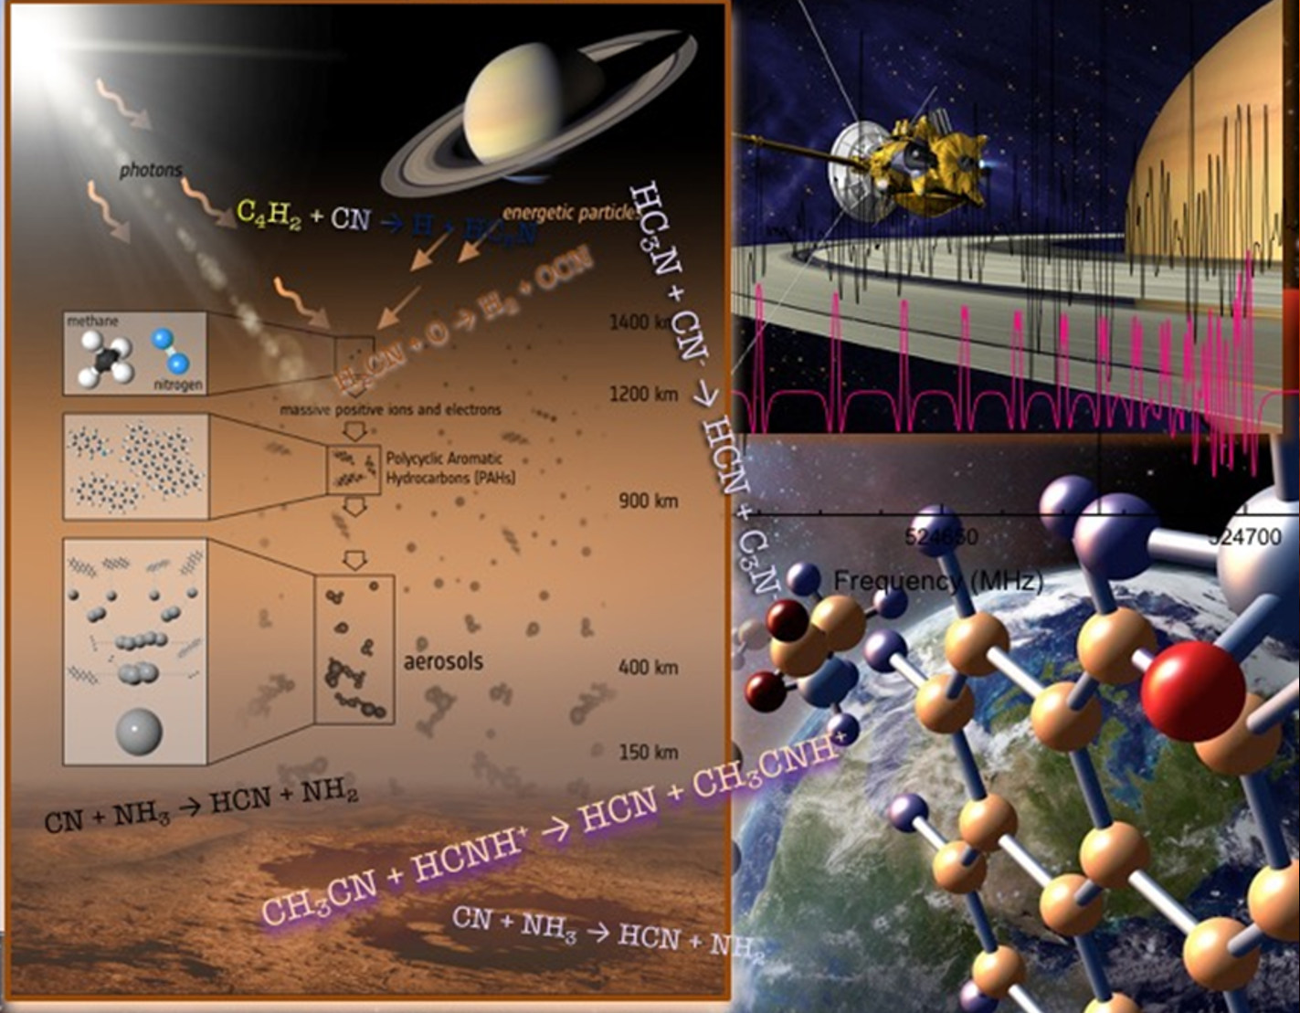
Emergence of life in formamide-based origin scenario
Raffaele Saladino

Slide 2


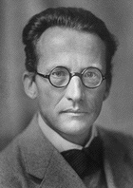
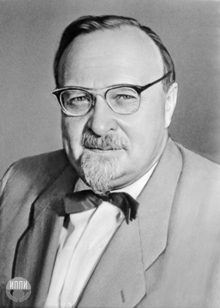
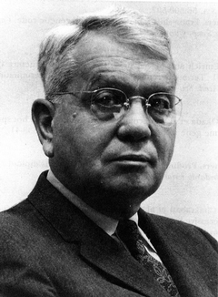
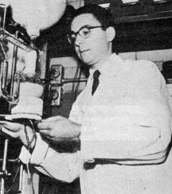

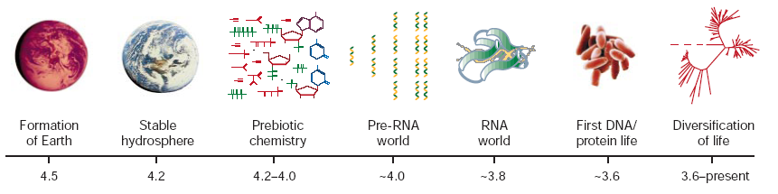
Prebiotic Chemistry
The Chemistry of Life
Joyce, G.F. (2002) Nature 418, 214-221
Notes:
2

Slide 3

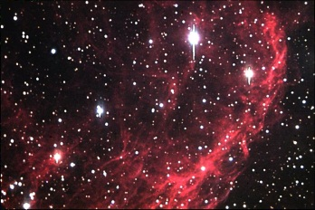
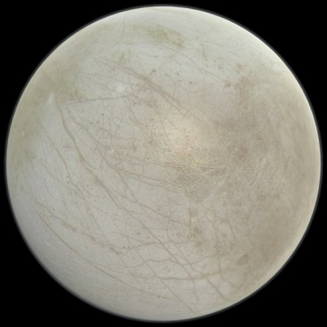
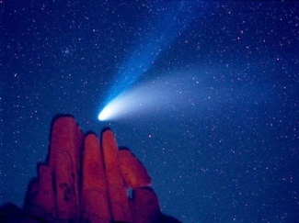
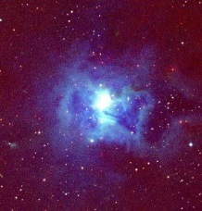
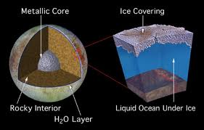
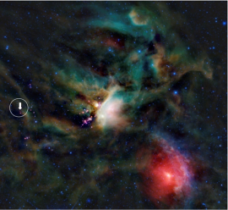
Formamide as Prebiotic Probe
“Simulations based on Density Functional Theory show that
formamide is the most stable species with molecular formula “CHON”
Pauzat, F. et al. 6th EANA 2006
Jupiter's satellite Europa
“This one-carbon molecule was detected in the
gas phase of interstellar medium” Crovisier,
J. Astrobiology: Future Perspectives,
Kluwer Eds, 2004 Chapter 8, p. 179-203.
“in the long period comet Hale-Bopp“
Bockelee-Morvan,
D. et al. Astr. Astrophys. 2000
“in the solid phase on grains
around the young stellar object W33A “
W.A. Schutte et al. Astr. Astrophys. 1999
«in the gas surrounding IRAS 16293-2422, a sun-like
forming star in the Rho Ophiuci nebula».
Astrophysical Journal Letter (ApJ 763, L38), 2013

Slide 4


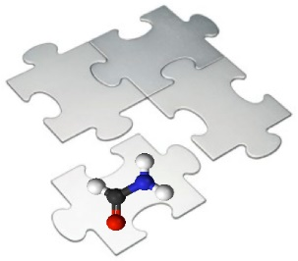
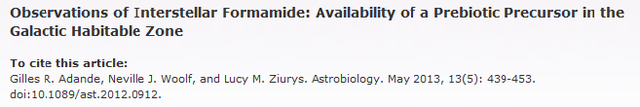


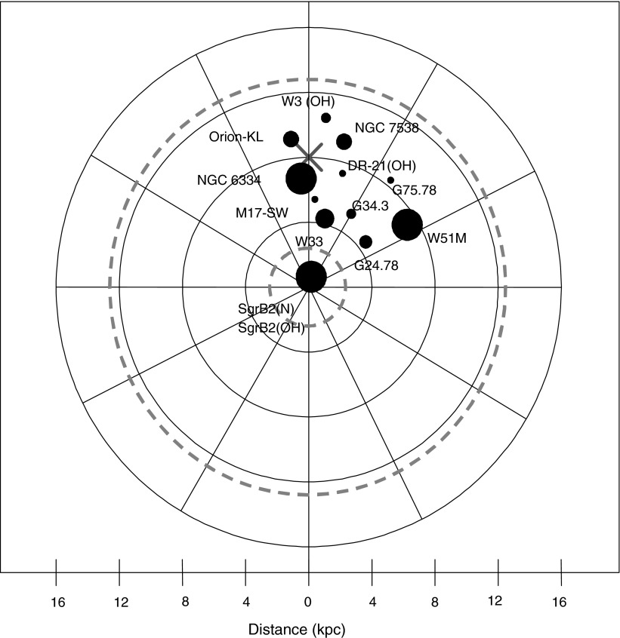
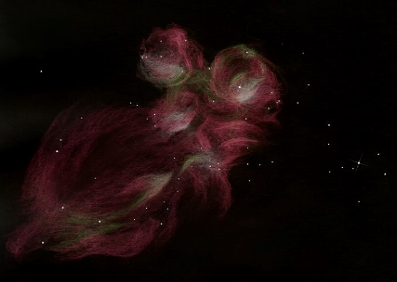
SgrB2(N)
kpc (1 kpc ∼ 3259 light-years)
NGC 6334
Schematic representation of the Milky Way Galaxy. The Sun is indicated by the cross.
The galactic habitable zone is indicated by the dashed, gray circles, based on work
of Gowanlock et al. (2011). The approximate galactic positions of the molecular clouds
where formamide has been detected are indicated by filled circles. The circle size indicates
the relative amount of formamide. The figure summarizes the current work and past
observations.

Slide 5
Elemental Formamide Chemistry
Formamide is easily produced by both space and planetary processes starting from mixtures of simple compounds. Once formed it can directly polymerize to biomolecules or it can in part degraded to other low molecular weight derivatives useful intermediates for the synthesis of biomolecules.
Notes:
5

Slide 6
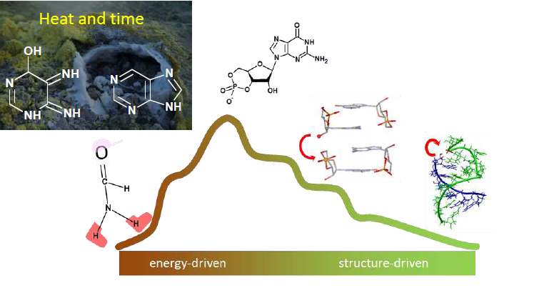

Slide 7
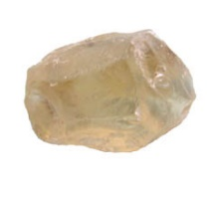
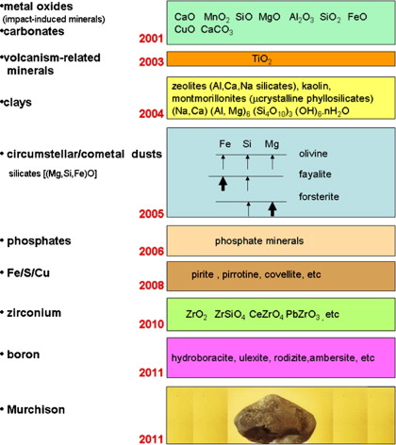
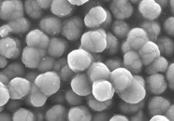
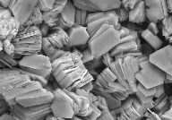
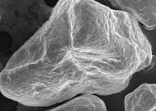
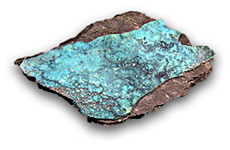
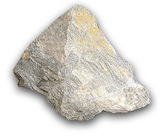
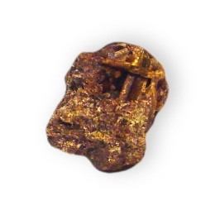
Formamide and minerals

Slide 8
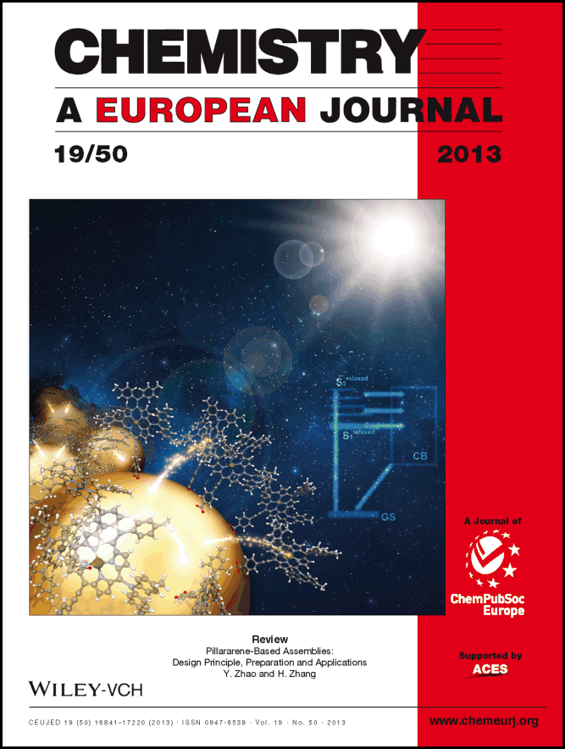
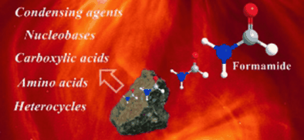
Prof. Raffaele Saladino^{1,*},
Dr. Giorgia Botta¹,
Dr. Michela Delfino¹ and
Prof. Ernesto Di Mauro²
Chemistry - A European Journal
Volume 19, Issue 50,
pages 16916–16922, December 9,
2013

Slide 9
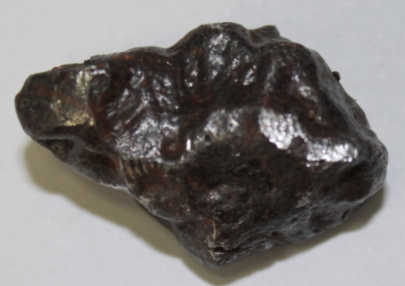
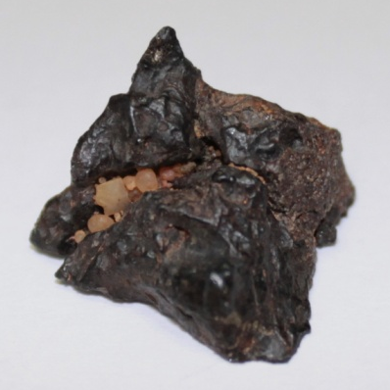
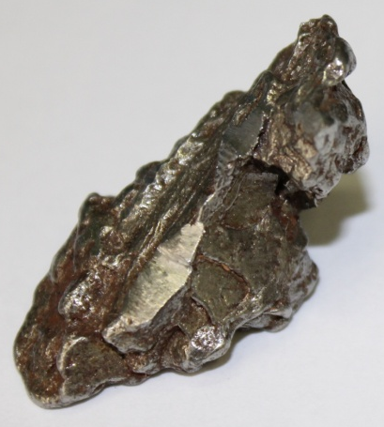
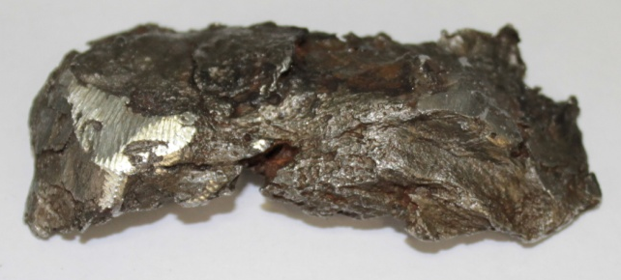
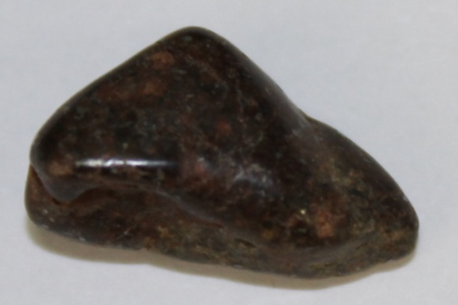
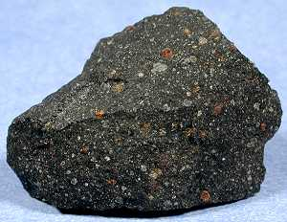
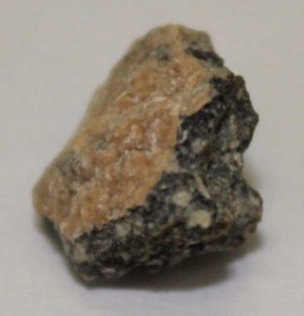
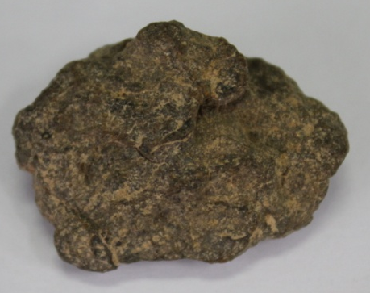
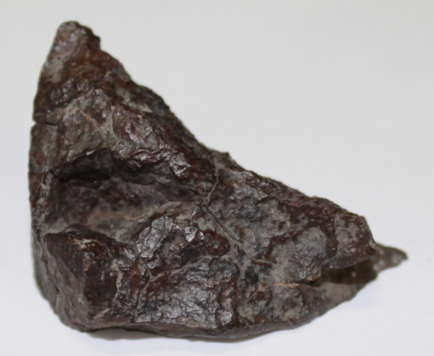
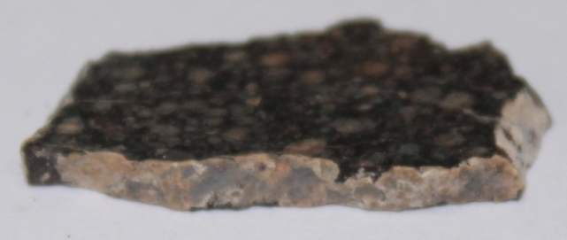
Iron meteorites
Stony Iron meteorites
Canyon
Diablo
Campo
del Cielo
NWA 4482
Sikhote Alin
Chondrites meteorites
Gold Basin
Achondrites meteorites
Murchison
Dhofar 959
Al Haggounia
NWA 1465
NWA 5357

Slide 10
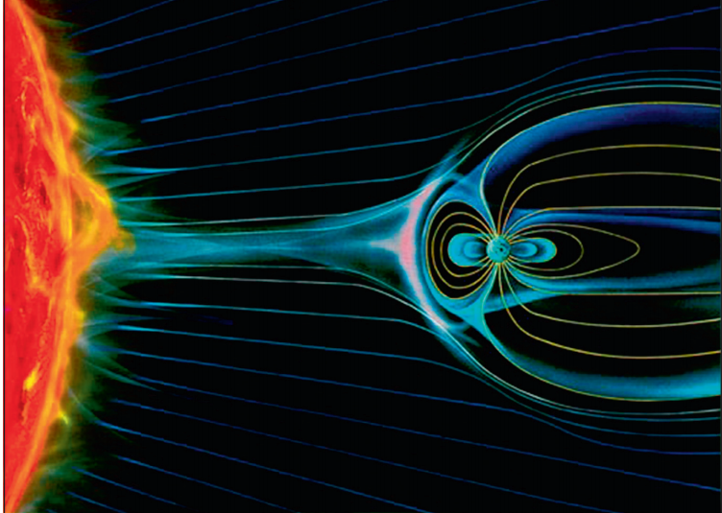
Is there an alternative to obtain nucleosides by a simple «one-pot» procedure?
Is the formamide chemistry in high energy conditions an alternative?

Slide 11
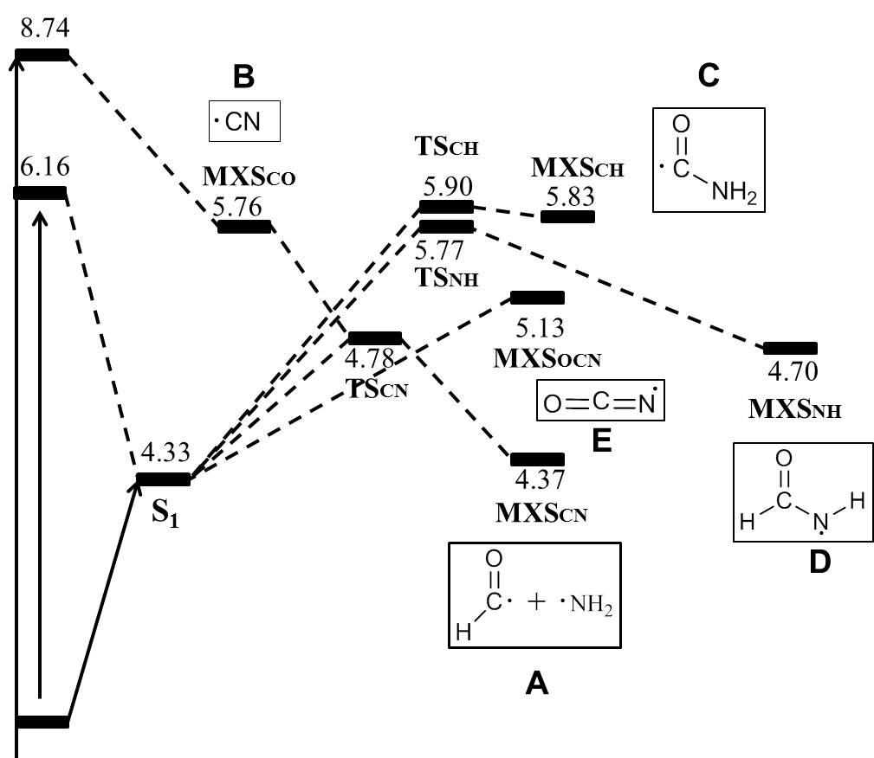
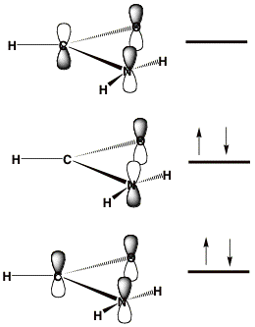
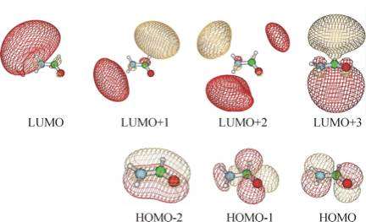
MO-π electronic stuctures and excited states profiles
After the interaction with radiation, formamide can be excited to high energy levels from which the molecule can be dissociated
yielding radical species, mainly centered at the N or C atoms. In figure we describes the energy profile for these processes. This is the core of the reactivity of formamide.
Notes:
11

Slide 12
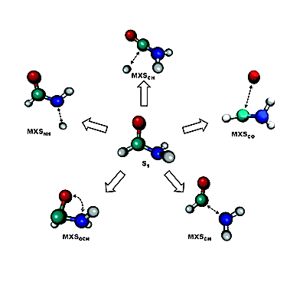
Formamide dissociation process
COMPLEX ORGANIC STRUCTURES
Radical Species
HNCO + H₂
C
D
B
HCN + H₂O
E
Core level
A
HNCO
CO + NH₃
First level of reactivity
Second level of reactivity
If radicals are quenched inside the first coordination sphere, as for example by hydrogen atom abstraction processes, they will produce simple compounds such as carbon monoxide (CO), hydrogen cyanide (HCN) and ammonia (NH₃) which are not directly involved in the life of the cell. We can call this phenomena as the first level of reactivity of formamide.

Slide 13
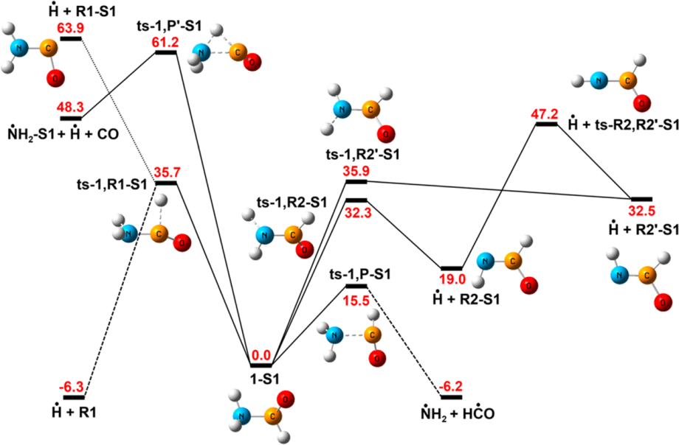
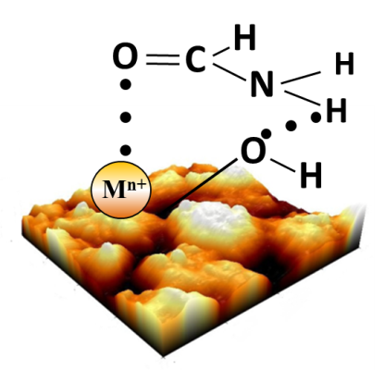
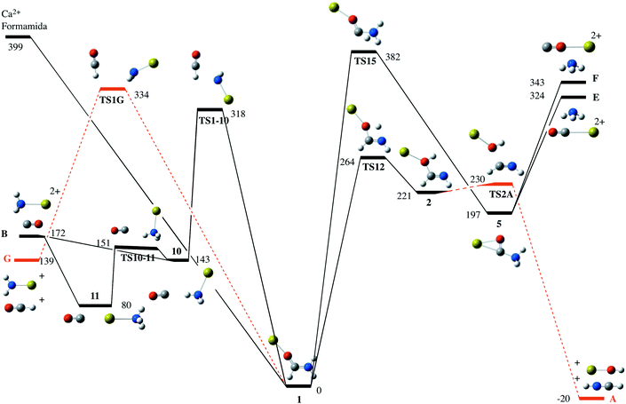
Effect of minerals on energy profiles
E
E
In this context it is worth to note that minerals can change the energy profiles for the formamide dissociation thus tuning the reactivity and the selectivity of the transformations. This is the third level of reactivity for formamide, the most useful for the formation of biomolecules.

Slide 14
Formamide dissociation processes
BIOMOLECULES
MINERALS
COMPLEX ORGANIC STRUCTURES
HNCO + H₂
C
R.
R.
D
B
HCN + H₂O
AB
RAB
ABR
E
Core level
A
SELECTIVITY
HNCO
CO + NH₃
First level of reactivity
Second level of reactivity
Third level of reactivity
Antol I. et al. QM/MM non-adiabatic decay dynamics of formamide in polar and non-polar solvents. Phys. Chem. Chem. Phys., 2012,14, 13262-13272

Slide 15

Energy source: solar wind
Solar Wind-LUNA 1 1959
Rate of impact- 400 Km/s

Slide 16


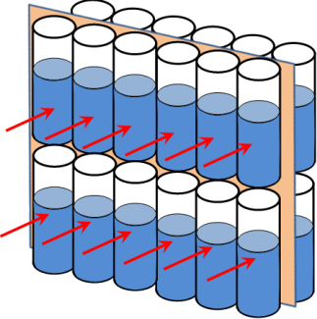
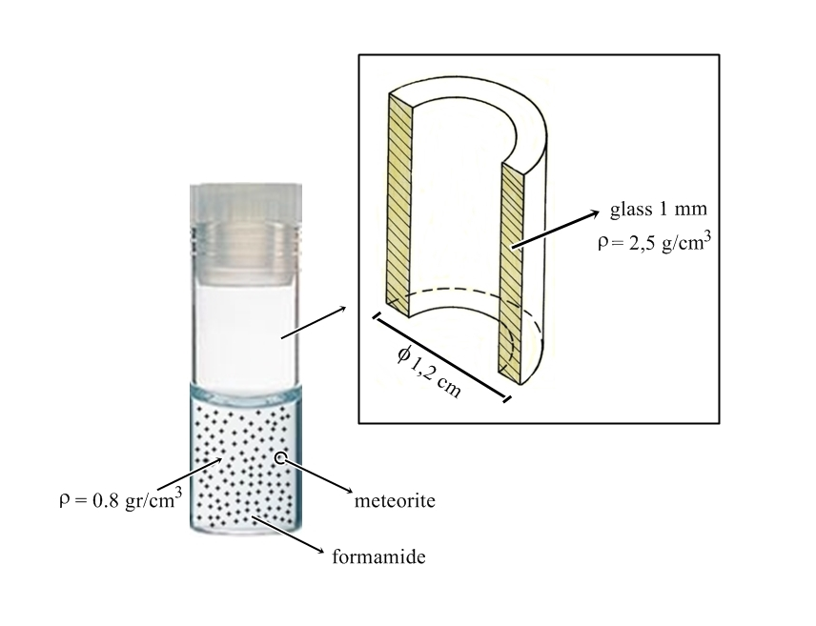

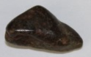


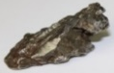




vol. 112 no. 21, E2746–E2755
Meteorite-catalyzed syntheses of nucleosides and of other prebiotic compounds from
formamide under proton irradiation
ªRaffaele Saladino, ªEleonora Carota, ªGiorgia Botta,^{b}Michail Kapralov, ^{b}Gennady N. Timoshenko,
^{b}Alexei Rozanov, ^{b}Eugene Krasavin, ^{c,1} Ernesto Di Mauro.
In each tube:
 | Name^{[a]} | Class | Type
1 2 | Canyon Diablo Campo del Cielo | Iron Iron | IA Hexaoctahedrite normal IAB Hexaoctahedrite coarse
3 | NWA4482 | Stony iron | Pallasite Anomalous
4 5 6 7 | NWA2828 Gold basin Orgueil NWA1465 | Chondrite Chondrite Chondrite Chondrite | Enstatite Ordinary Carbonaceoous LV3 Anomalous
8 9 | NWA5357 Al Haggounia | Achondrites Achondrites | Diogenite Aubrite
P
170 MeV
LET= 0,57 keV/μm
t= 3min
T= 25°C
Iron meteorites
Stony iron meteorites
Chondrites
NWA 4482
Gold Basin
NWA 1465
Canyon Diablo
Campo del Cielo
Achondrites
NWA 5357
Al Haggounia
Orgueil
NWA 2828

Slide 17




Nucleobases, nucleoside, heterocycles and sugars
Carboxylic acids
Meteorite
+
Amino acids
p+

Slide 18
Nucleobases
Nucleosides
Nucleotides
Oligonucleotides
Structural Complexity
RNA and DNA
Regioselectivity
N-9
N-1
β
β
C-1’
Stereoselectivity
C-1’

Slide 19

Scientific Reports
Volume 7, Issue 1,
1 December 2017
?
Entry | Conditions | Conversion(%) | Product (%)
 |  |  | α-dfA (3) | β-dfA (4) | α-dpA (5) | β-dpA (6) | df(p)A (7a) | poly-df(p)A (7b)
1 | Dry State (Solid Film) | 49 | 9.2 | 3.1 | 19.5 | 5.4 | 6.3 | 0.6
2 | FA | 80 | 16.3 | 8.1 | 32.8 | 9.9 | 9.8 | 1.4
3 | FA + meteorite (NWA1465) | >99 | 21.3 | 30.2 | 25.1 | 6.8 | 15.2 | 1.4

Slide 20
MALDI TOF/TOF analysis of the reaction between adenine (1) and 2-D-deoxyribose (2) in
NH₂CHO in the presence of NWA 1465. M/z = 252, 2′-deoxy adenosine. M/z = 368 df(p)A (7a–b). M/z = 484, 600, 716 and 832 products corresponding to addition of three, four, five and six sugar moieties, respectively.

Slide 21


Slide 22

Sugars synthetic pathway. The formose reaction. Butlerov 1861.
Single headed arrows represent aldol
condensations. Double-headed arrows
represent enolizations. Aldotreose can
undergo a reverse aldol condensation

Slide 23

Regioselectivity: the enamonium intermediate
Herak & Behrens Naturforsch 1986
Zhang et al. J. Phys. Chem. A 2006

Slide 24


Stereoselectivity: the effect of the mineral surface
β-face
α-face
β-isomer
α-isomer

Slide 25


Formamide irradiation at U400M cyclotron
In each tube:
JINR-Cyclotron
Meteorites: Dohfar 959
Gold Basin
NWA1465
Chelyabinsk
NWA 4482

Slide 26
And about Nucleotides ?
v
?
v
Nucleobases
Nucleosides
Nucleotides
Oligonucleotides
Structural Complexity
RNA and DNA
M. B. Simakov, E. A. Kuzicheva, A. E. Antropov, N. Y. Dodonova, Adv. Sp. Res. 2002, 30, 1489–1494.

Slide 27


Meteorite assisted phosphorylation of adenosine under proton irradiation conditions
In each tube:
P
170 MeV
LET= 0,57 keV/μm
t= 3min
T= 25°C
Yield of adenosine nucleotides and conversion of the substrate during the irradiation of adenosine and NaH₂PO₄ with a high energy proton beam (170 MeV) under different experimental conditions.
Entry | Reaction | Conversion (%) | Ade | 5’-AMP | 3’-AMP | 2’-AMP | 2’,3’-cAMP | 3’,5’-cAMP | 5’-ADP | Total yield (%)
1 | A | 72.3 | 39.8^{b} | 1.5 | 1.1 | 1.3 | 2.1 | - | - | 6.0
2 | B | 59.8 | 25.0 | 5.7 | 4.9 | 10.3 | 6.2 | - | 7.7 | 34.8
3 | C | 76.7 | 40.8 | 8.3 | 7.4 | 12.0 | 5.9 | - | - | 33.6
4 | D | 81.1 | 29.1 | 11.2 | 7.9 | 14 | 6.7 | 6.5 | 4.8 | 51.1
5 | E | 49 | 16.1 | 2.40 | 1.4 | 1.4 | 2.2 | < 0.1 | - | 7.4

Slide 28

Adenosine nucleotide polyphosphates (ApNs) and inorganic polyphosphates (PN) detected during the irradiation of adenosine and NaH₂PO₄ by the MALDI-TOF analysis.ª
MALDI-TOF profile of the irradiation of adenosine and NaH₂PO₄ with a high energy proton beam (170 MeV) in the presence of NH₂CHO and NWA 2828 (Reaction D). The signals crucial for the ApNs assignment are indicated with the corresponding formula.
Reaction^{b} | Ap3 (m/z)^{c} | Ap5 (m/z) | Ap7 (m/z) | Ap9 (m/z) | Ap11 (m/z) | Ap13 (m/z) | P3 (m/z) | P4 (m/z) | P5 (m/z) | P6 (m/z) | P10 (m/z) | P12 (m/z) | P14 (m/z)
A | +^{d} | + | + | - | - | - | - | - | - | - | - | - | -
B | + | + | + | + | + | + | + | + | + | + | + | + | +
C | + | + | + | + | - | - | - | + | - | - | + | + | -
D | + | + | + | + | + | + | + | - | - | - | + | + | -
^{b}A: dry-film conditions. B: dry-film conditions in the presence of NWA 2828. C: NH₂CHO solution. D: NH₂CHO in the presence of NWA 2828. ^{c}Characteristic molecular ions of adenosine nucleotide polyphosphates (ApNs) and inorganic polyphosphates (PN) detected in the MALDI-TOF analysis: Ap3 (m/z 507), Ap5 (m/z 667), Ap7 (m/z 827), Ap9 (m/z 987), Ap11(m/z 1147), Ap13 (m/z 1307), P3 (m/z 257), P4 (m/z 337), P5(m/z 417), P6(m/z 497), P10(m/z 817), P12 (m/z 977), P14 (m/z 1137), where N represents the repetitive number of phosphate units. ^{d}The symbol indicates the presence (+) or the absence (-) of the expected value of the molecular ion.

Slide 29


Slide 30
And about Nucleotides ?
v
v
v
?
Nucleobases
Nucleosides
Nucleotides
Oligonucleotides
Structural Complexity
RNA and DNA

Slide 31


Slide 32


Slide 33


Slide 34


Slide 35


Slide 36
Costanzo et al. ChemBioChem 2012
- PAGE
- MALDI ToF MS
⁻ ³¹P NMR chemical shifts
- enzymes
stacking
- inhibition
base
catalysis
polymerization

Slide 37

The translation to a more specific geochemical scenario: The Hadean Era

Slide 38


Serpentinization reaction- The geochemical origins
Olivine: Fayalite + Forsterite
Fayalite
Magnetite
Forsterite
Serpentine
Forsterite
Serpentine
Brucite
Serpentine
In the presence of CO₂
Olivine
Magnetite
C) Alkaline saturated silicate solutions (SSS)
obtained straightforward when water from serpentinization environments flow through
rock containing silica-rich minerals
formed directly from serpentinization when the rate of olivine dissolution is faster than
the rate of clay precipitation

Slide 39





Werner Kunz, Juan Manuel Garcia-Ruiz 2012

Slide 40




Formamide
%W/W
10
20
30
40

Slide 41


Slide 42

Silica gardens and formamide- Outside the membrane
SSS pH 12
80 °C
MSH
MSH: metal silicate hydrated membrane (ZnCl₂, FeCl₂•4H₂O, CuCl₂•2H₂O,
Fe₂(SO₄)₃•9H₂O, and MgSO₄).

Slide 43

Silica gardens and formamide- Inside the membrane
H₂O pH 7
80 °C
MSH
MSH: metal silicate hydrated membrane (ZnCl₂, FeCl₂•4H₂O, CuCl₂•2H₂O,
Fe₂(SO₄)₃•9H₂O, and MgSO₄).

Slide 44

MSH membranes catalyze the polycondensation
of formamide yielding compounds required for the
emergence of LUCA. We show that the catalysis is
selective so that different faces of the membrane
yield different compounds.
Noticeably, these membranes may form hollow
structures from nano to micro scale where the forming
organic products can be confined and protected from
ultraviolet radiation.
The condensation reactions take place in a
geochemical environment known to produce simple
abiotic compounds, and that was rather general and
well widespread during Hadean and Archean times,
but that were not privative of the Earth.

Slide 45




Slide 46


Slide 47


Slide 48

P
170 MeV
LET= 0,57 keV/μm
t= 3min
T= 25°C

Slide 49

University of Tuscia, Viterbo, Italy
R. Saladino, E. Di Mauro ChemSocRev 2012
Notes:
49

Slide 50





Aknowledgement
E Carota
R Saladino
E Di Mauro
E A Krasavin
G N Timoshenko
A Rozanov
M I Kapralov
E Solovoval

