Slide 1

51st PAC on Particle Physics
JINR, June 19, 2019
Implementation of recommendations and work towards optimisation
of the research programme
Itzhak Tserruya

Slide 2
Outline
Highlights of the Recommendations from the 50th PAC – PP
125th Scientific Council meeting (February 21-22, 2019)
Recent developments
Agenda

Slide 3
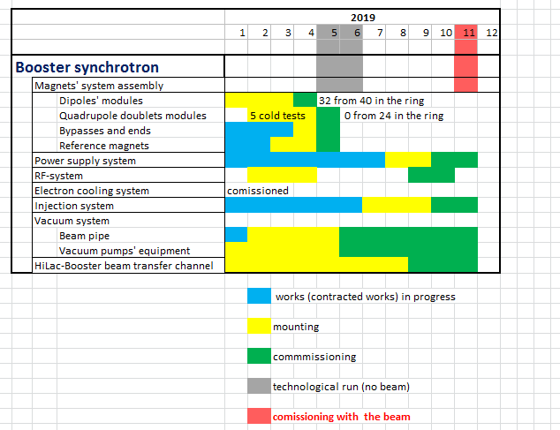
50th PAC-PP highlights: NICA
The PAC is concerned by the series of delays (mainly in the Booster installation and in civil construction), which affect the overall schedule of the NICA project. The PAC urges the NICA management to critically scrutinize the current schedule of the entire project to ensure that it stands on solid ground and that no further delays occur.
New Booster schedule
Booster (25 Tm)
up to 578 MeV/u
Apr-May 2019 – technical run
Oct-Nov 2019 - commissioning with beam

Slide 4
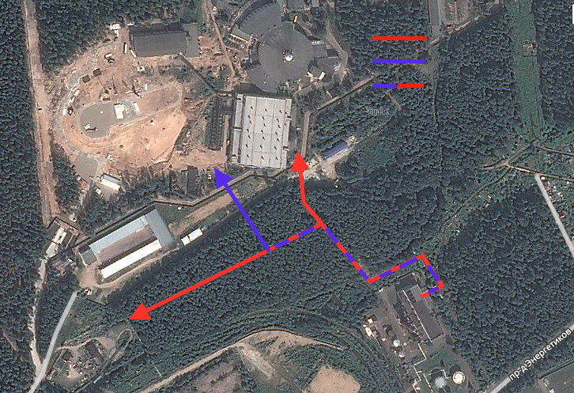
Infrastructure Developments
The PAC is pleased to note the successful implementation of the plan for the renewal of heating, water and drainage networks. As of today, 12 km of networks have already been renewed (2 km since the previous PAC meeting), and this work is expected to be completed by the end of the year.
The PAC welcomes the efforts of the Laboratory’s management to eliminate the backlog from the plans to build a compressor station and wishes success in finding a new reliable contractor for this project.
Existing lines
New lines
Modernization needed
D500>D600mm
Main NICA infrastructure projects:
Upgrading of plants for liquid helium and nitrogen production
Modernization of electrical systems
Renovation of water pipelines and thermal grids
Construction of new buildings
A
Eastern Thermal Station

Slide 5
50th PAC-PP highlights: BM@N & MPD
The 2nd Collaboration meeting of MPD and BM@N Collaborations took place at JINR on October 29-30. https://indico.jinr.ru/conferenceDisplay.py?confId=610
Highlights of the meeting:
Admission of new institutions: 6 to the MPD Collaboration and 1 new institution to the BM@N Collaborations.
Election of Spokespersons:
MPD: Adam Kisiel (WUT) BM@N: Mikhail Kapishin (JINR)
Election of IB Chairs:
MPD: Fuqiang Wang (Huzhou U.) BM@N: Hans Rudolf Schmidt (Tubingen U.)
Appointment of Project Managers:
MPD: Slava Golovatyuk (JINR) BM@N: Anna Maksymchuk (JINR)
Appointment of Deputy spokespersons:
MPD: Victor Ryabov (PNPI) BM@N: Peter Senger (MEPhI, GSI)
Zebo Tang (Hefei U.)
Executive Council of BM@N just formed.
Executive council of MPD under formation.
Detector councils, physics working groups, software and analysis groups being formed.

Slide 6
50th PAC-PP highlights: MPD
The PAC notes the steady progress in constructing the main subsystems of the MPD facility: the superconducting magnet, TPC and ToF.
The PAC welcomes the award of a special-purpose joint grant of the Russian Federation and the People’s Republic of China for construction of the MPD ECal detector.
The PAC supports the plans for the formation of management and organizational structures of the collaboration.

Slide 7
50th PAC-PP highlights: BM@N
The PAC heard preliminary results about the detector performance in the 55th run and urges the BM@N team to focus efforts on physics analysis of the large data sets collected.
The PAC reiterates its request to see physics analysis report at the next meeting.
The PAC supports the plans for the installation of the BM@N transport line and the vacuum beam pipe through the experimental set-up, which are necessary for operation with heavy-ion beams, and urges the BM@N team to coordinate these plans with the accelerator team.
Replace air intervals / foils with vacuum beam pipe along 160 m of BM@N transport line to get minimum dead material.
Install vacuum beam pipe through the BM@N set-up.
BM@N

Slide 8
Scientific Council (I)
Excerpts from the Resolutions of the 125th session of the Scientific Council held on February 21-22, 2019:
General considerations relevant to the PAC-PP:
The Scientific Council appreciates the milestones achieved in the development of JINR’s flagship programmes, in particular:
The establishment of the MPD and BM@N international collaborations, the holding of two collaboration meetings of the MPD and BM@N experiments and of a targeted NICA grant program of the Russian Foundation for Basic Research, which are significant steps towards attracting a wide international community, including Russian institutions, to the realization of the NICA megascience project;
The implementation of priorities between all ongoing neutrino experiments aimed at improving the coordination of the JINR Neutrino Physics Programme, and the continuing development of the Baikal-GVD detector;

Slide 9
Scientific Council (II)
Recommendations in connection with the PAC-PP:
The Scientific Council shares the PAC’s concern about the series of delays (mainly in civil construction), which affect the overall schedule of the NICA project, and urges the NICA management to critically scrutinize the current schedule of the entire project to ensure that no further delays occur. The Scientific Council notes with satisfaction the successful implementation of the plan for the renewal of heating, water and drainage networks (12 km of networks have already been renewed) and welcomes the efforts of the Laboratory’s management to eliminate the backlog from the plans to build a compressor station.
The Scientific Council is pleased to note the official establishment of the international experimental collaborations MPD and BM@N after their 2nd Collaboration meetings. The Scientific Council welcomes the admission of new institutions to the collaborations and congratulates the elected Spokespersons and Institutional Board Chairpersons, the appointed Project Managers and Deputy Spokespersons, and wishes them all very fruitful work at the NICA facility. The Scientific Council supports the plans for the formation of organizational structures of the Collaboration.
The Scientific Council notes the steady progress in constructing the main subsystems of the MPD detector: the superconducting magnet, TPC and ToF. It supports the plans for the installation of the BM@N transport line and the vacuum beam pipe through the experimental set-up, which are necessary for operation with heavy-ion beams. The Scientific Council concurs with the PAC’s reiterated recommendations for the BM@N team to focus efforts on the physics analysis of the large data sets collected both in the BM@N research programme and in the study of short-range correlations.

Slide 10
Scientific Council (III)
Recommendations in connection with the PAC-PP (new projects):
The SC supports the PAC’s recommendations on the approval of new projects and the continuation of ongoing projects in particle physics. In particular, it endorses the PAC’s recommendations to start the preparation of a Conceptual Design Report (CDR) for the Spin Physics Detector (SPD) at the NICA collider, followed after its acceptance by a Technical Design Report... The Scientific Council supports the PAC’s recommendations to approve the project until the end of 2021 with first priority.
The SC endorses the PAC’s recommendations for the continuation of the JINR’s participation in the BES-III project until the end of 2022 with second priority. The JINR group has made many significant contributions in the BES-III experiment since 2005, and the SC agrees with the PAC that the experiment has reached most of the aimed at goals and further studies could be conducted with a commensurate lower effort.
The SC considers JINR’s participation in the R&D project for the PHOS detector as an important contribution to the upgrade of the ALICE photon spectrometer and supports the PAC’s recommendation for continuation of JINR’s participation in the R&D project until the end of 2020 with first priority.
The SC recognizes the important results achieved by the JINR groups in the LHC experiments, ALICE, ATLAS and CMS.

Slide 11
Scientific Council (IV)
Recommendations in connection with neutrino physics:
The Scientific Council congratulates the PAC for Particle Physics and the PAC for Nuclear Physics for the careful evaluation, in a joint session of the two PACs on 22 January 2019, of all projects and research themes carried out at JINR in the areas of neutrino physics, astrophysics and dark matter… In order to achieve “a better coordination of the neutrino physics programme therefore allowing implementation of priorities in a more concerted and efficient manner”, all 13 projects have been jointly evaluated by both PACs with the ultimate goal to classify them into three categories A, B or C, based on the scientific merit of the project and the performance of the JINR group involved.
The project leaders were requested to answer a common questionnaire… Each project was reviewed by one referee from PAC-PP and one from PAC-NP. The final assignment of each project into category A, B or C was done taking into account the opinions of two referees and the subsequent discussion of the project at the joint session of both committees.
The evaluation resulted in specific recommendations for each one of the 13 projects, emphasizing their strengths and weaknesses, and in the following classification of the projects:
Category A: BAIKAL-GVD, DANSS, Daya Bay/JUNO, NOvA;
Category B: COMET, EDELWEISS-LT, GEMMA-III, GERDA, NA64, SuperNEMO, TAIGA;
Category C: BOREXINO, Mu2e/g-2.
The SC endorses the recommendations of the PACs and considers that the recommendations and the classification will be useful for the DLNP and the JINR Directorates in their efforts towards concentration of resources in selected directions and strengthening the research programme.

Slide 12
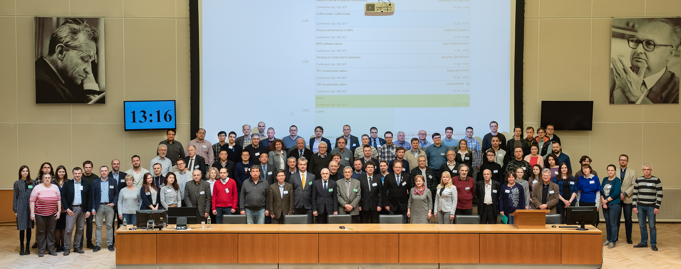
Recent Developments
3rd Collaboration meeting of MPD and BM@N at JINR on April 16-17, 2019
https://indico.jinr.ru/event/805/
JINR’s strategic Long Range Plan:
The working groups in the area of particle physics convened by N. Russakovich and in the area of relativistic heavy-ion and spin physics convened by R. Tsenov, submitted their draft report to Vice-Director Boris Sharkov.

Slide 13
51st PAC-PP agenda June 19-20, 2019
Highlights of today's meeting:
Update reports on NICA, MPD and BM@N
Projects seeking continuation:
ALICE, ATLAS and CMS
SCAN-3, NA64 and MICC
New project: FASA

Slide 14
Thank you !

