Slide 1


Transverse momentum distributions of hadrons in the Tsallis nonextensive statistics
A.S. Parvan
BLTP, JINR, Dubna, Russia
DFT, IFIN-HH, Bucharest, Romania

Slide 2
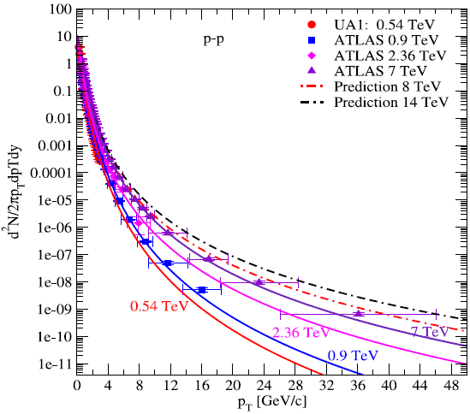
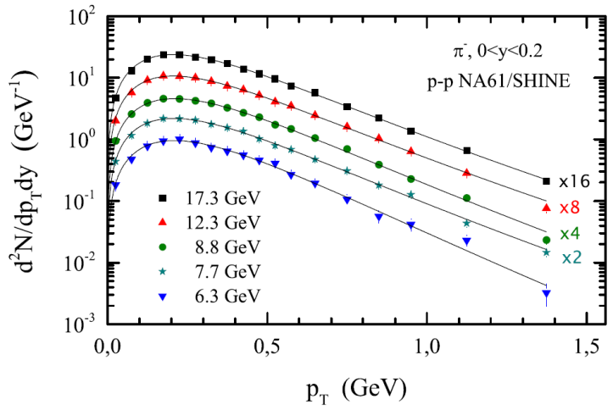
Phenomenological Tsallis distribution: Proton-Proton and Heavy-Ion Collisions
Proton-Proton Collisions
Central Pb-Pb collisions at 2.76 TeV
Charged hadron yields:
Exp.: ALICE, Phys. Rev. C 88 (2013) 044910
J.Cleymans, G.I.Lykasov, A.S.P., A.S.Sorin, O.V.Teryaev,
D.Worku, Phys. Lett. B 723 (2013) 351
The data of at 2.76 TeV are not described by the phenomenological Tsallis distributions at low pT momenta
Phenomenological Tsallis distribution:
Identified hadrons:
J. Cleymans, D. Worku, Eur. Phys. J. A 48 (2012) 160
It corresponds to Maxwell-Boltzmann Ideal Gas in volume V at temperature T and chemical potential μ
Distributions of Boltzmann-Gibbs statistics:
A.S.P., O.V.Teryaev, J.Cleymans,
Eur. Phys. J. A 53 (2017) 102

Slide 3
Generalized Statistical Mechanics
Fundamental statistical ensemble
Statistical ensemble
A.S.P., in Recent Advances in Thermo and
Fluid Dynamics, ed. Mod Gorji-Bandpy,
InTech, Chapter 11, 2015, pp.303-331
Legendre transform for the thermodynamic potential:
Statistical averages for the fluctuating quantities:
-Boltzmann-Gibbs entropy
-Tsallis entropy

Slide 4
Generalized Statistical Mechanics: Probability Distribution of Microstates
Principle of the maximum entropy from the second law of thermodynamics (constrained local extrema of the thermodynamic potential in the method of Lagrange multipliers) :
Probabilities of microstates and norm function:
Thermodynamic quantities are partial derivatives of thermodynamic potential :
A.S.P., in Recent Advances in Thermo and
Fluid Dynamics, ed. Mod Gorji-Bandpy,
InTech, Chapter 11, 2015, pp.303-331

Slide 5
Tsallis Generalized Statistical Mechanics
Boltzmann-Gibbs
Statistics
Tsallis-1
Statistics
Tsallis-2
Statistics
Tsallis-3
Statistics
-probability of
i-th microstate of system
Expectation values of Tsallis-2 statistics are unnormalized
Standard expectation values
Generalized expectation values
C. Tsallis, J. Stat. Phys. 52 (1988) 479
C. Tsallis, R.S. Mendes, A.R. Plastino, Physica A 261 (1998) 534

Slide 6
Tsallis Generalized Statistical Mechanics: Isolated Systems
Variables of state:
C. Tsallis, J. Stat. Phys. 52 (1988) 479
C. Tsallis, R.S. Mendes, A.R. Plastino,
Physica A 261 (1998) 534
A.S.P., Phys. Lett. A 350 (2006) 331
Fluctuating variables:
Second law of thermodynamics (constrained local extrema of thermodynamic potential):
Boltzmann-Gibbs Statistics
Tsallis-1 Statistics
Tsallis-2 Statistics
Thermodynamic
potential:
Probability
distribution:
Statistical
weight:

Slide 7
Tsallis Generalized Statistical Mechanics: Closed Systems
Variables of state:
C. Tsallis, J. Stat. Phys. 52 (1988) 479
C. Tsallis, R.S. Mendes, A.R. Plastino,
Physica A 261 (1998) 534
A.S.P., Phys. Lett. A 360 (2006) 26
Fluctuating variables:
Second law of thermodynamics (constrained local extrema of thermodynamic potential):
Boltzmann-Gibbs Statistics
Tsallis-1 Statistics
Tsallis-2 Statistics
Thermodynamic
potential:
Probability
distribution:
Norm function:
Expectation
values:
Expectation values of Tsallis-2 statistics are unnormalized

Slide 8
Tsallis Generalized Statistical Mechanics: Open Systems
Variables of state:
A.S.P., Eur. Phys. J. A 51 (2015) 108;
Eur. Phys. J. A 53 (2017) 53
Fluctuating variables:
Second law of thermodynamics (constrained local extrema of thermodynamic potential):
Boltzmann-Gibbs Statistics
Tsallis-1 Statistics
Tsallis-2 Statistics
Thermodynamic
potential:
Probability
distribution:
Norm function:
Expectation
values:
Expectation values of Tsallis-2 statistics are unnormalized

Slide 9
Ultrarelativistic Transverse Momentum Distribution: Tsallis-2 Statistics
Ultrarelativistic Maxwell-Boltzmann Ideal Gas in the Grand Canonical Ensemble
Mean occupation numbers:
Norm function:
A.S.P., Eur. Phys. J. A 53 (2017) 53
where
Expectation values of Tsallis-2 statistics are unnormalized
is a cut-off parameter
Terms with in Tsallis-2 statistics increase and became divergent for q>1

Slide 10
Ultrarelativistic Transverse Momentum Distribution: Tsallis-2 Statistics (continuation)
Ultrarelativistic transverse momentum distribution:
A.S.P., Eur. Phys. J. A 53 (2017) 53
Exact Solution:
Zeroth term approximation
The ultrarelativistic transverse momentum distribution of Tsallis-2 statistics in the zeroth term approximation exactly coincides with the phenomenological Tsallis distribution introduced in [J. Cleymans, D. Worku, Eur. Phys. J. A 48 (2012) 160] and largely used in high-enrgy physics .
Thus the well-known phenomenological Tsallis distribution corresponds to the Tsallis unnormalized (Tsallis-2) statistics for which the statistical averages are badly normalized.
Phenomenological Tsallis distribution:

Slide 11
Ultrarelativistic Transverse Momentum Distribution: Tsallis-1 Statistics
Ultrarelativistic Maxwell-Boltzmann Ideal Gas in the Grand Canonical Ensemble
Mean occupation numbers:
Norm function:
A.S.P., Eur. Phys. J. A 53 (2017) 53;
Eur. Phys. J. A 52 (2016) 355
where
Expectation values of Tsallis-1 statistics are well normalized
is a cut-off parameter
Terms with increase and became divergent for q<1

Slide 12
Ultrarelativistic Transverse Momentum Distribution: Tsallis-1 Statistics (continuation)
Ultrarelativistic transverse momentum distribution (Exact Solution):
A.S.P., Eur. Phys. J. A 53 (2017) 53;
Eur. Phys. J. A 52 (2016) 355
Zeroth term approximation
The ultrarelativistic transverse momentum
distribution of the Tsallis-1 statistics in the zeroth
term approximation exactly recovers the
ultrarelativistic transverse momentum distribution
of the Tsallis-2 statistics in the zeroth term
approximation under the transformation
Thus the ultrarelativistic phenomenological Tsallis
distribution is obtained from the zeroth term
approximation of the Tsallis-1 statistics by
transformation
Phenomenological Tsallis distribution:

Slide 13
The cut-off parameter of the Tsallis-2 statistics: Ultrarelativistic case
A.S.P., Eur. Phys. J. Web Conf. 138 (2017) 03008
Model A (from the minimum):
Tsallis-2 statistics:
Model B (from the inflection point):
Boltzmann-Gibbs statistics:

Slide 14
The cut-off parameter of the Tsallis-1 statistics : Ultrarelativistic case
A.S.P., Eur. Phys. J. Web Conf. 138 (2017) 03008
Model A (from the minimum):
Tsallis-1 statistics:
Model B (from the inflection point):
Boltzmann-Gibbs statistics:

Slide 15
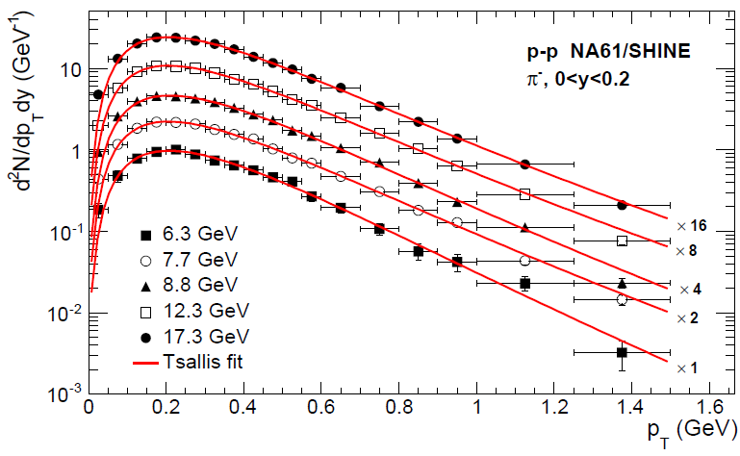
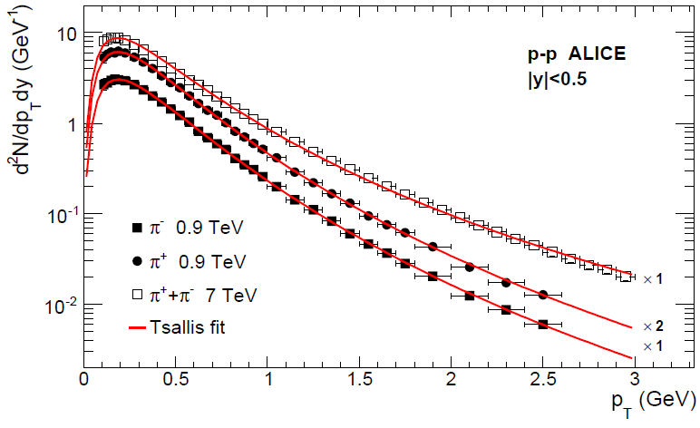
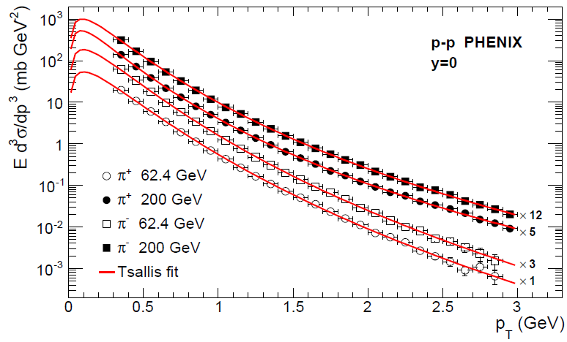
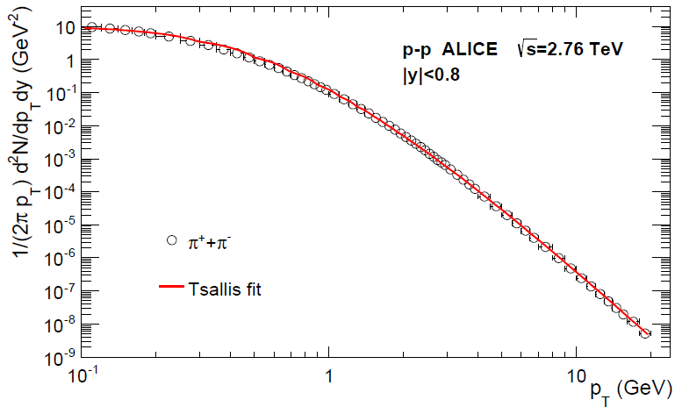
Model B of Tsallis-1 statistics and phenomenological Tsallis distribution: Ultrarelativistic case
Charged pions in pp collisions:
A.S.P., Eur. Phys. J. A 52 (2016) 355
Transverse momentum distributions of charged pions produced in pp collisions at SPS, RHIC and LHC energies
The yields were integrated in the experimental rapidity interval
The solid curves are the fits of the experimental data to
the ultrarelativistic (m=0)
transverse momentum
distributions of
1.) Tsallis-1 statistics
2.) Tsallis-2 statistics
3.) Phenomenological Tsallis
distribution
The curves are the same for all statistics but only the parameters are different.
Experimental Data:
NA61/SHINE, EPJC 74 (2014) 2794; PHENIX, PRC 83 (2011) 064903
ALICE, EPJC 71 (2011) 1655; ALICE, EPJC 75 (2015) 226;
ALICE, PLB 736 (2014) 196

Slide 16
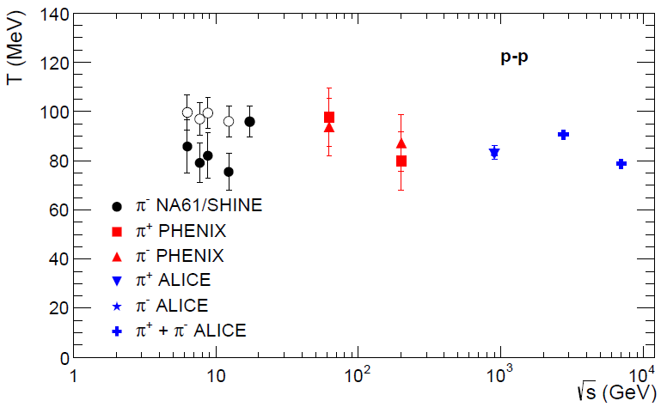
Temperature for Model B of Tsallis-1 statistics and phenomenological Tsallis distribution: Ultrarelativistic case
Charged pions in pp collisions:
A.S.P., Eur. Phys. J. A 52 (2016) 355
Solid points are the results of the fit by Model B of Tsallis statistics
Open symbols are the results of the fit by the phenomenological Tsallis distribution

Slide 17
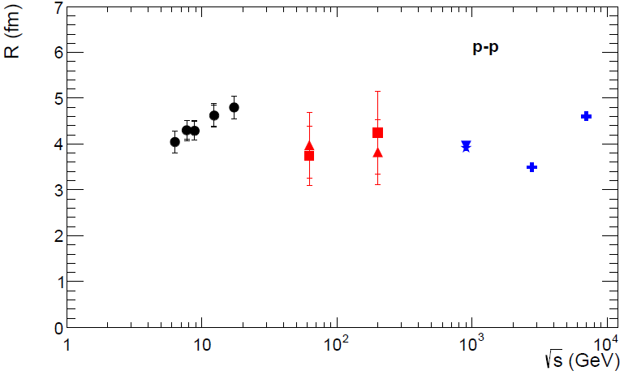
Radius for Model B of Tsallis-1 statistics and phenomenological Tsallis distribution: Ultrarelativistic case
Charged pions in pp collisions:
A.S.P., Eur. Phys. J. A 52 (2016) 355
Solid points are the results of the fit by Model B of Tsallis statistics
Open symbols are the results of the fit by the phenomenological Tsallis distribution

Slide 18
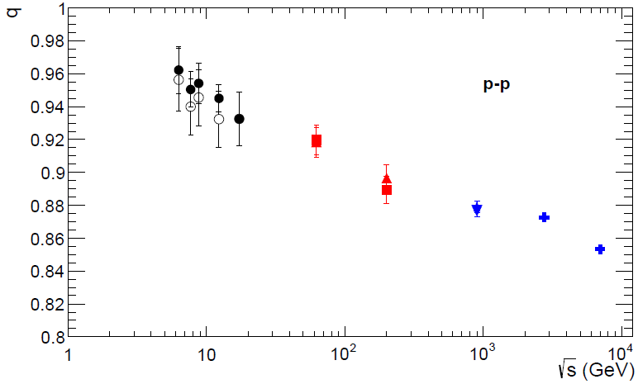
Entropic parameter for Model B of Tsallis-1 statistics and phenomenological Tsallis distribution: Ultrarelativistic case
Charged pions in pp collisions:
A.S.P., Eur. Phys. J. A 52 (2016) 355
Solid points are the results of the fit by Model B of Tsallis statistics
Open symbols are the results of the fit by the phenomenological Tsallis distribution

Slide 19
Transverse Momentum Distribution: Tsallis-1 Statistics (Massive Particles)
Transverse momentum distribution (exact results):
A.S.P., T. Bhattacharyya, arXiv:1903.06118 [nucl-th]
where
Norm function Λ:
Λ
where

Slide 20
Maxwell-Boltzmann Transverse Momentum Distribution: Tsallis-1 Statistics
(Massive Particles)
Transverse momentum distribution (exact results):
A.S.P., T. Bhattacharyya, arXiv:1903.06118 [nucl-th]
where
Zeroth term approximation :
Phenomenological Tsallis distribution
corresponds to the transverse momentum distribution in the zeroth term approximation of the Tsallis-1 statistics under the transformation
Phenomenological Tsallis distribution:

Slide 21
Transverse Momentum Distribution: Tsallis-2 Statistics (Massive Particles)
Transverse momentum distribution (exact results):
A.S.P., T. Bhattacharyya, arXiv:1903.06118 [nucl-th]
where
Norm function Ζ:
Ζ
where

Slide 22
Maxwell-Boltzmann Transverse Momentum Distribution: Tsallis-2 Statistics
(Massive Particles)
Transverse momentum distribution (exact results):
A.S.P., T. Bhattacharyya, arXiv:1903.06118 [nucl-th]
where
Zeroth term approximation :
Phenomenological Tsallis distribution
is equivalent to the transverse
momentum distribution in the zeroth
term approximation of the Tsallis
unnormalized (Tsallis-2) statistics.
Zeroth term approximation of the Tsallis-1 statistics corresponds to zeroth term approximation of the Tsallis-2 statistics under the transformation
Phenomenological Tsallis distribution:

Slide 23
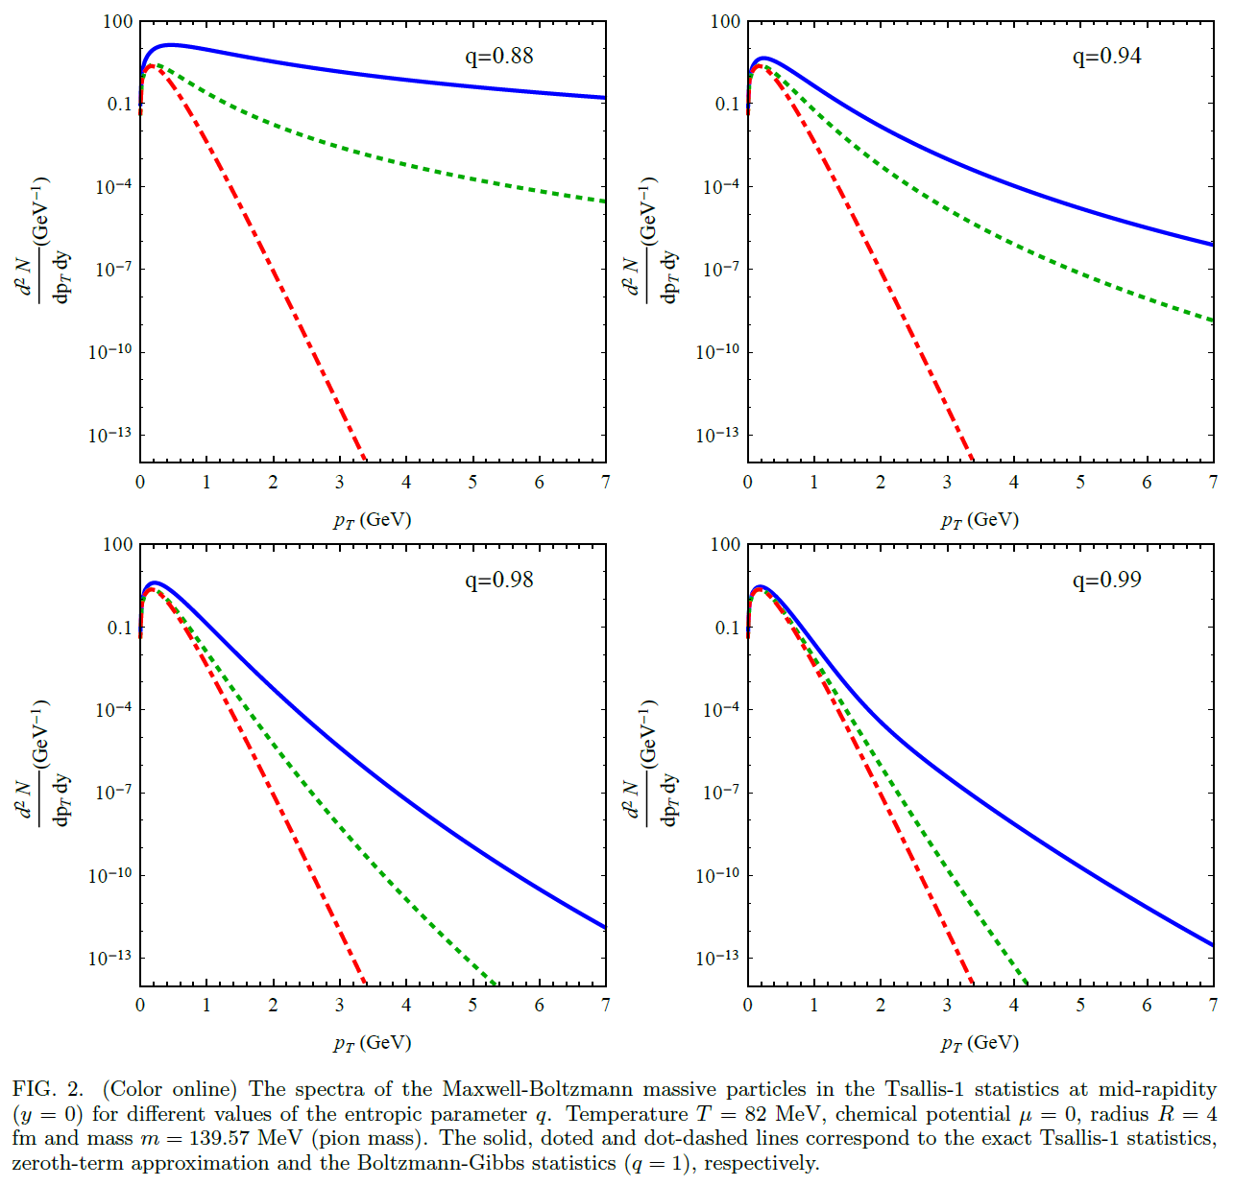
Maxwell-Boltzmann Transverse Momentum Distribution: Model A of Tsallis-1 Statistics (Massive Particles)
A.S.P., T. Bhattacharyya,
arXiv:1903.06118 [nucl-th]

Slide 24
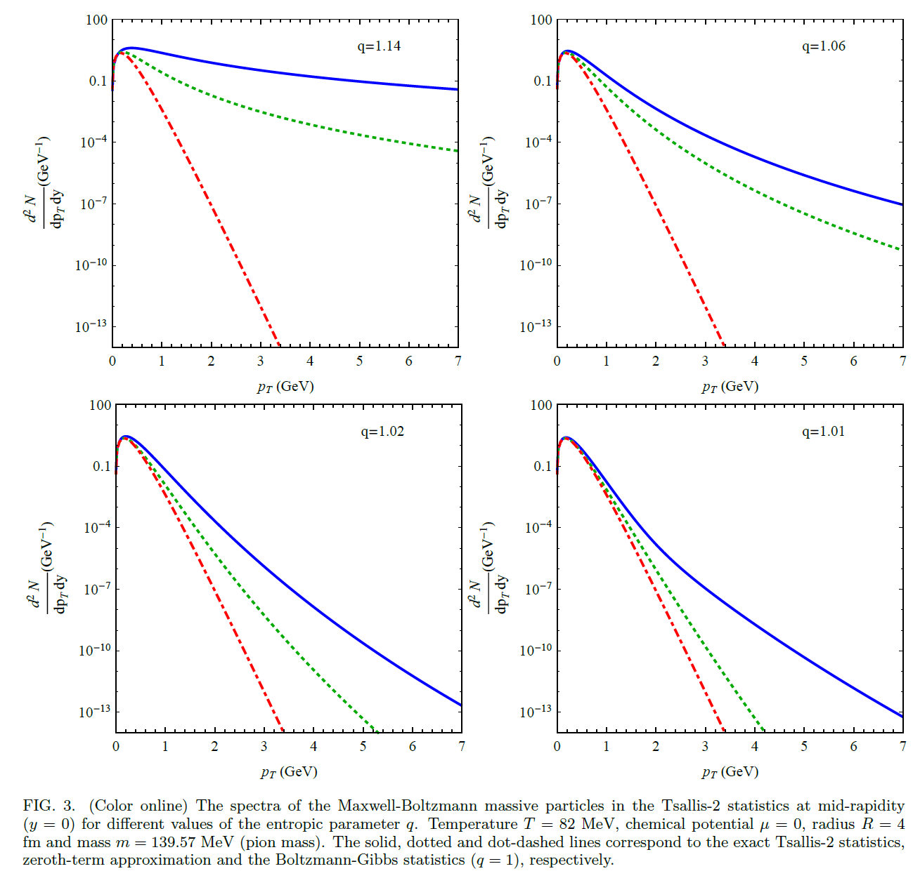
Maxwell-Boltzmann Transverse Momentum Distribution: Model A of Tsallis-2 Statistics (Massive Particles)
A.S.P., T. Bhattacharyya,
arXiv:1903.06118 [nucl-th]

Slide 25
Conclusions
We have obtained that the Tsallis statistics (Tsallis-1 statistics at q<1 and Tsallis-2 statistics at q>1) is divergent.
It is convergent only in the case of q=1 which corresponds to the standard Boltzmann-Gibbs statistics.
However, we have found that a few terms in a series expansion of quantities in the Tsallis statistics at are convergent and they describe very well the experimental data on the transverse momentum distributions (TMD) of hadrons in the pp collisions at high energies (the standard Boltzmann-Gibbs statistics fails to describe these experimental data).
The analytical exact expressions for the TMD (ultrarelativistic and massive) of the Tsallis-1 and Tsallis-2 statistics were obtained.
We have demonstrated that the phenomenological Tsallis distribution is equivalent to the TMD of the Tsallis unnormalized (Tsallis-2) statistics in the zeroth term approximation (the statistical averages of the Tsallis-2 statistics are not consistent with norm equation of probabilities).
We have demonstrated that the phenomenological Tsallis distribution recovers the TMD of the Tsallis-1 statistics in the zeroth term approximation under the transformation of the parameter q to 1/q.
We have found that the TMD of the Model B of the Tsallis statistics (the cut-off from the inflection point) differs from the phenomenological Tsallis distribution only at low energies of NICA and NA61/SHINE.
We have shown that the TMD of the Model A of the Tsallis statistics (the cut-off from the minimum point) differs essentially from the phenomenological Tsallis distribution.

Slide 26
Thank you for your attention!

