Slide 1
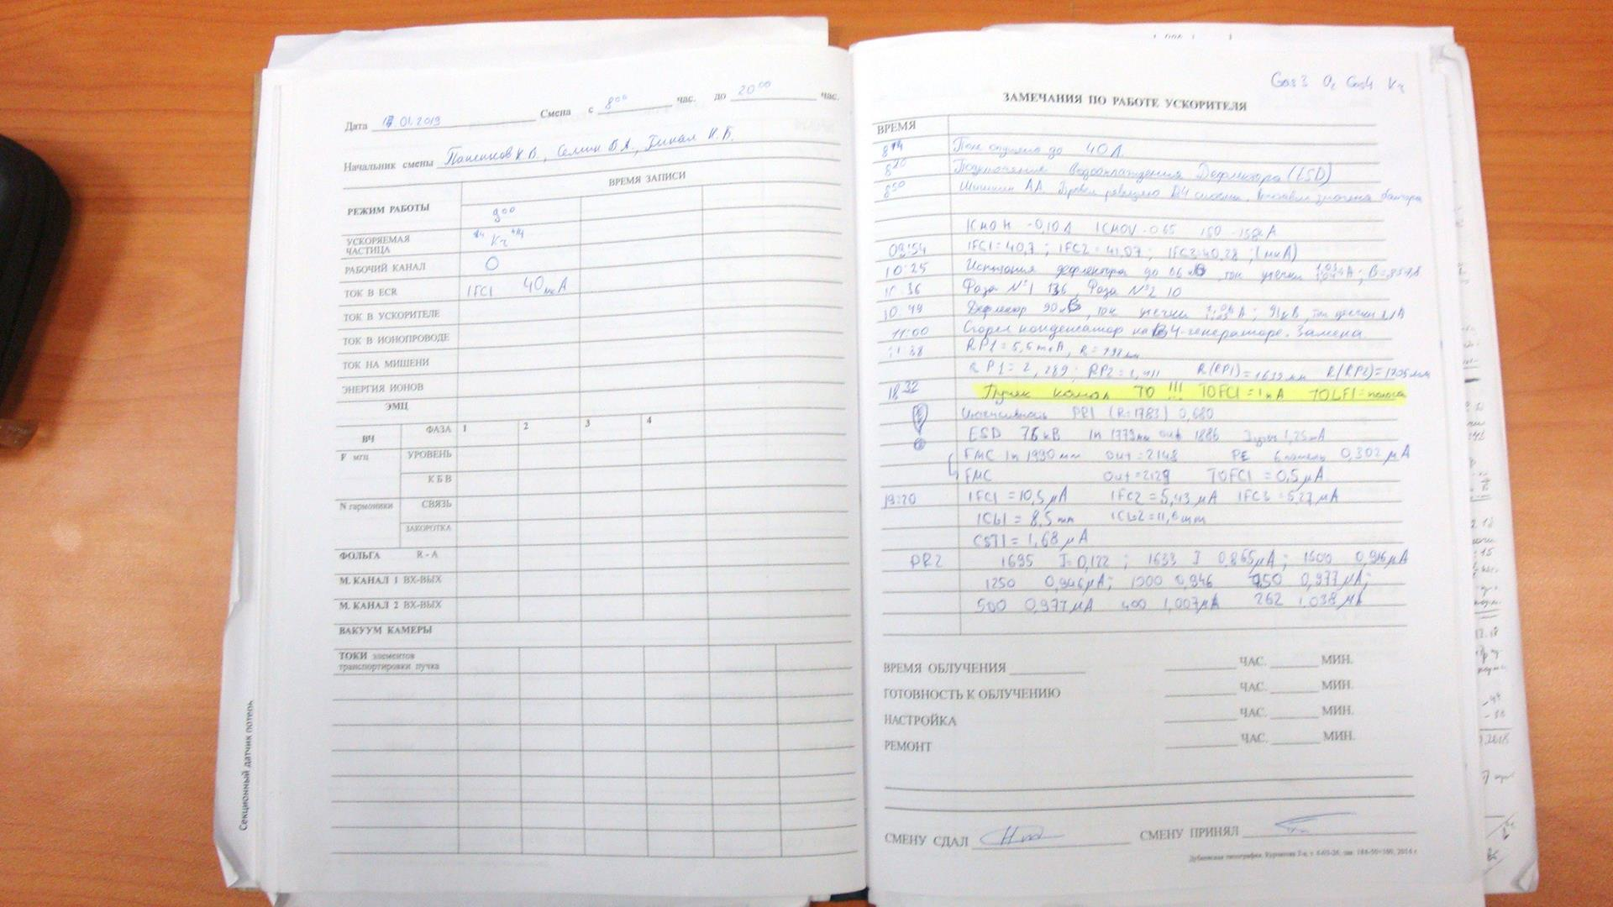
The first ion beam extracted from DC-280
without flat-top resonators
`
17.01.2019
The first extracted beam
of ₈₄Kr⁺¹⁴ I_{RP1}=1nA
18:32

Slide 2
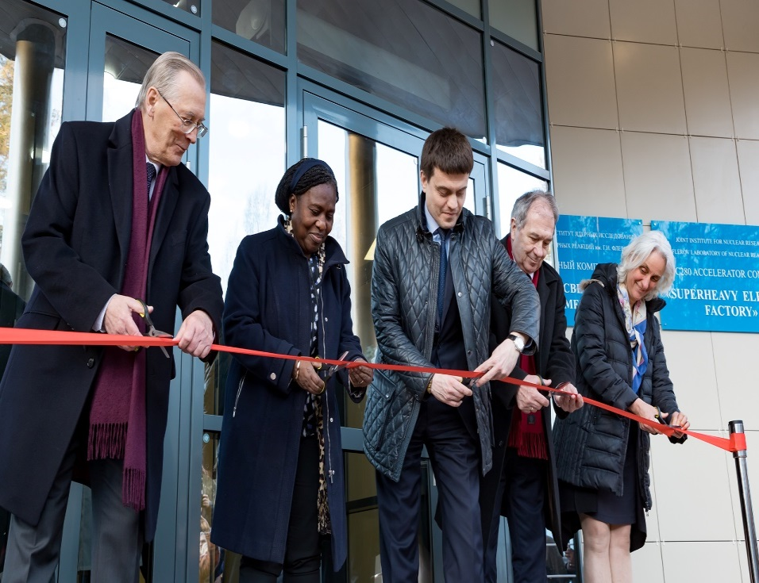
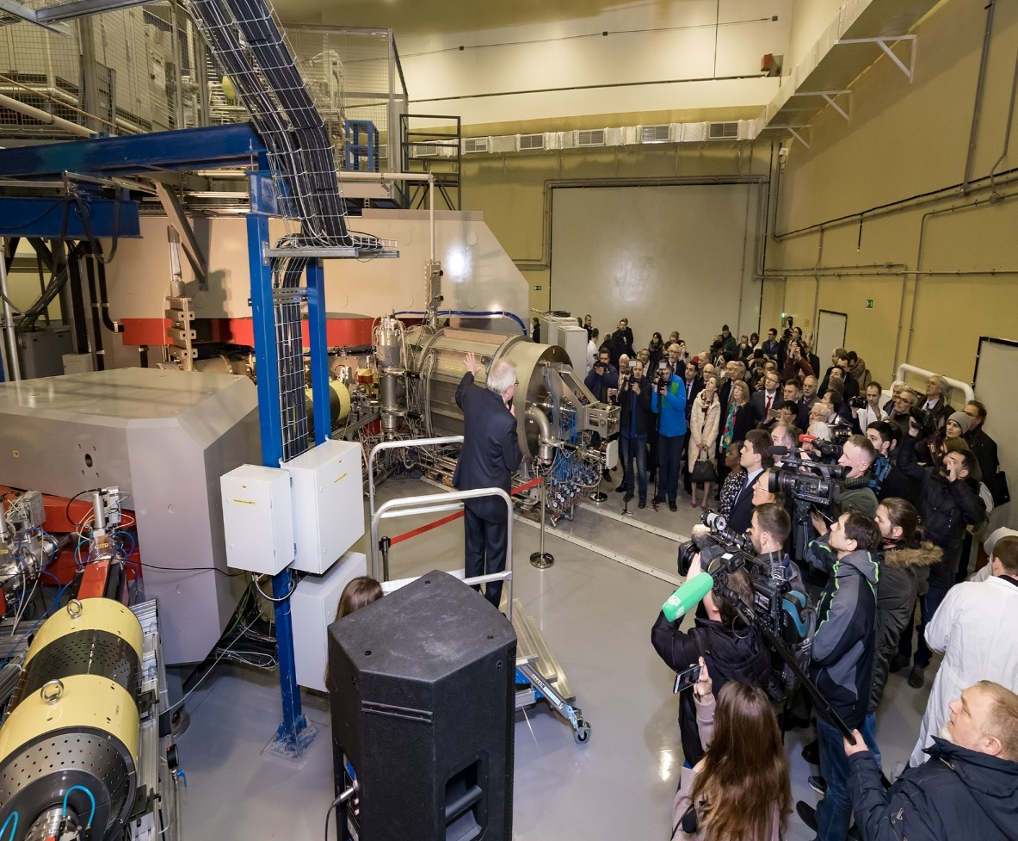
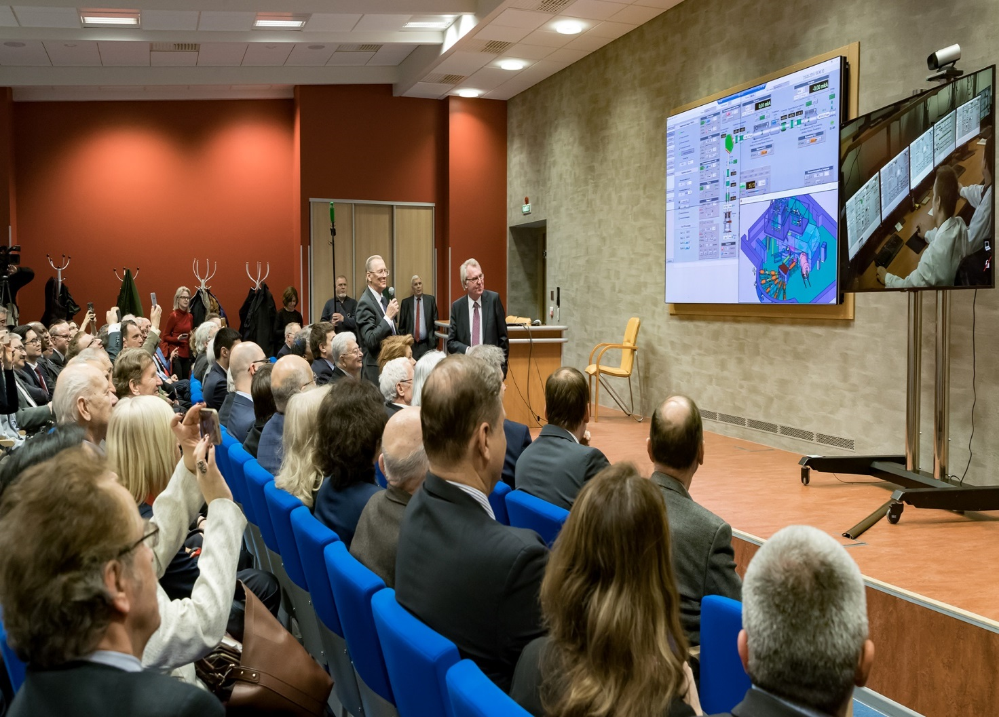
Opening of the SHE Factory building and DC-280
March 25, 2019

Slide 3
What was realized since the beginning of 2019
The air leak in the N1 RF resonator was found and eliminated, vacuum in the DC-280 chamber was improved from 2÷3·10⁻⁷ Torr to 7÷9·10⁻⁸ Torr.
The maximal intensity of 6 pμA was registered for ₄₀Ar⁺⁷ (designed is 10 pμA) at acceleration efficiency of 41,6% (designed is 50%)

Slide 4
Future plans
In September-October- transportation of ⁴⁰Ar⁺⁷ ion beams to the GFS-2 experimental setup. Acceleration of ⁴⁸Ca⁺⁹. Preparation to first experiments.

Slide 5
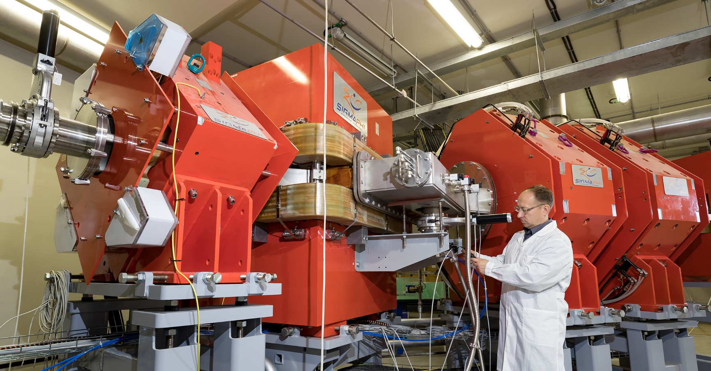

Slide 6
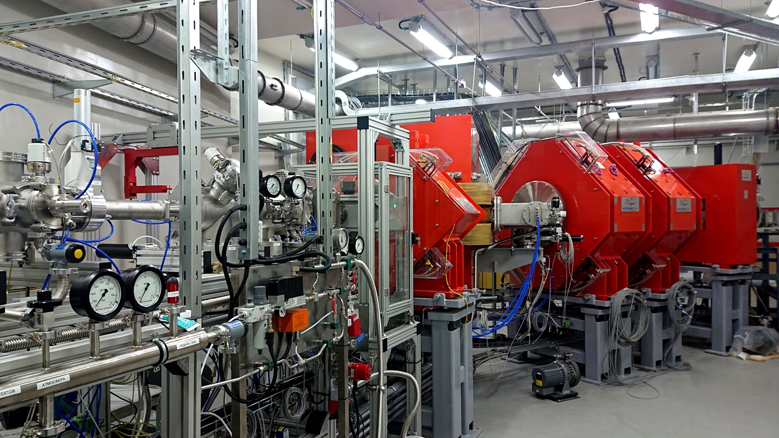
GFS-II

Slide 8
FEDERAL SERVICE FOR SUPERVISION OF CONSUMER RIGHTS PROTECTION AND HUMAN WELFARE
SANITARY-EPIDEMIOLOGICAL CONCLUSION
№ 50.21.01.000.М.000008.03.19 March 19, 2019
USING OF DEVICES PRODUCING IONIZING RADIATION:
ECR ION SOURCE DECRIS-PM:
production of multicharged ions from He up to Xe
CYCLOTRON DC-280:
intensity of extracted ion beams up to 1.5E14
energy range 4 – 8 MeV/A
ions range 4 < A/Z < 7.5
number of beam lines - 5
The conclusion is valid until March 19, 2024

Slide 9
FEDERAL SERVICE FOR SUPERVISION OF CONSUMER RIGHTS PROTECTION AND HUMAN WELFARE
SANITARY-EPIDEMIOLOGICAL CONCLUSION
№ 50.21.01.000.М.000008.03.19 March 19, 2019
USING OF DEVICES PRODUCING IONIZING RADIATION:
ECR ION SOURCE DECRIS-PM:
production of multicharged ions from He up to Xe
CYCLOTRON DC-280:
intensity of extracted ion beams up to 1.5E14
energy range 4 – 8 MeV/A
ions range 4 < A/Z < 7.5
number of beam lines - 5
The conclusion is valid until March 19, 2024

Slide 10
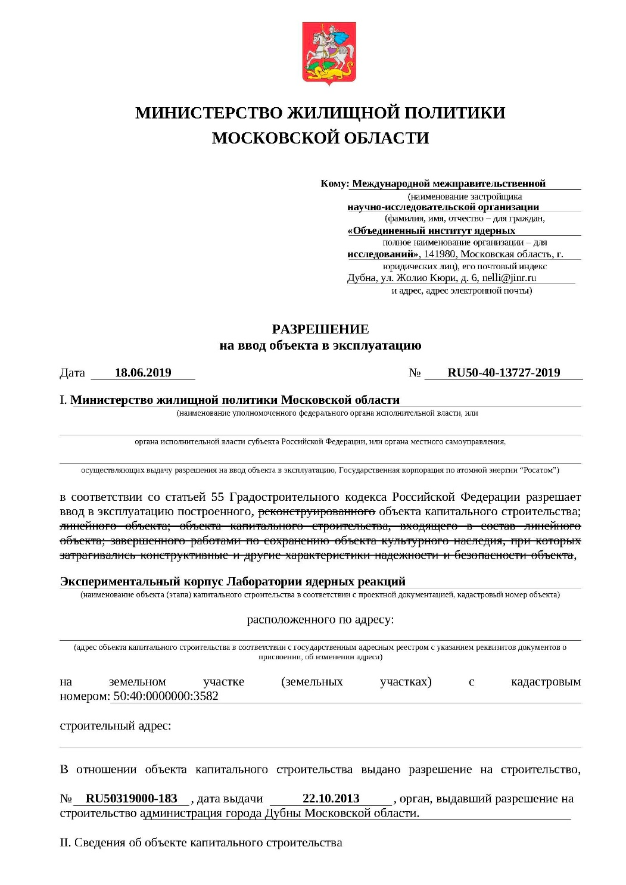
MINISTRY OF HOUSING POLICY
OF THE MOSCOW REGION
PERMISSION
to commission the facility
June 18, 2019 №RU50-40-13727-2019
Ministry of Housing Policy of the Moscow Region permits in accordance with Article 55 of the Town Planning Code of the Russian Federation, the commissioning of the Experimental building for the Laboratory of nuclear reactions.

Slide 11
FEDERAL SERVICE FOR SUPERVISION OF CONSUMER RIGHTS PROTECTION AND HUMAN WELFARE
SANITARY-EPIDEMIOLOGICAL CONCLUSION
№ 50.21.01.000.М.000008.03.19 March 19, 2019
USING OF DEVICES PRODUCING IONIZING RADIATION:
ECR ION SOURCE DECRIS-PM:
production of multicharged ions from He up to Xe
CYCLOTRON DC-280:
intensity of extracted ion beams up to 1.5E14
energy range 4 – 8 MeV/A
ions range 4 < A/Z < 7.5
number of beam lines - 5
The conclusion is valid until March 19, 2024

