Slide 1
Programme Advisory Committee for Nuclear Physics
49-th meeting
22–23 January 2019
Marek Lewitowicz

Slide 2
Programme Advisory Committee for Nuclear Physics
49th meeting, 22–23 January 2019
1. Opening of the meeting M. Lewitowicz
2. Implementation of the recommendations of the previous PAC meeting M. Lewitowicz
3. Information on the Resolution of the 124rd session of the JINR Scientific Council (September 2018) M. Itkis
and on the decisions of the JINR Committee of Plenipotentiaries (November 2018)
4. Concepts of new neutron source at the Frank Laboratory of Neutron Physics and programme of experiments E. Lychagin
5. Status of the Factory of Superheavy Elements
5.1. DC-280 cyclotron I. Kalagin
5.2 Separators A. Popeko
5.3 Programme of Day-1 experiments at the SHE Factory V. Utyonkov
6. Status of the GALS set-up S. Zemlyanoy
7. General discussion
8. Meeting of the PAC members with the JINR Directorate (closed discussion)
9. Scientific report: “Charged-current neutrino-nucleon reactions in the supernova neutrino-sphere” A. Dzhioev
10. Poster presentations by young scientists
11. General conclusion on the poster presentations
12. Proposals for the agenda of the next PAC meeting (closed discussion)
13. Preparation of the PAC recommendations
14. PAC recommendations
15. Closing of the meeting

Slide 3
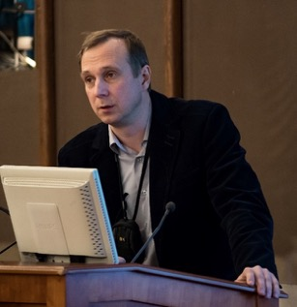
Concepts of new neutron source at the Frank Laboratory of Neutron Physics and programme of experiments
Main parameters of the source:
Average thermal neutron flux density Φ_{n} not less than 10¹⁴ n/(cm²⋅s)
Instantaneous flux in pulse Φ >10¹⁶ cm⁻²⋅s⁻¹
Pulse width 200 ÷ 300 μs and 20 ÷ 30 μs (the pulse width is limited from shortest side using target with multiplication)
Repetition rate 10-30 Hz
Egor Lychagin
Two initial concepts of the source:
“Neptun”
“Pluton”
100 kW proton LINAC
E.P. Shabalin, V.L. Aksenov, G.G. Komyshev, A.D. Rogov “Highly Intense Pulsed Neutron Source Based on Neptunium” JINR Preprint P13-2017-57 (in Russian)
http://flnph.jinr.ru/images/content/Books/Blok.pdf (in English)
Vinogradov A.V., Pepelyshev Yu.N., Rogov A.D., Sidorkin S.F. “High-flux pulsed neutron source driven by a proton accelerator for beam research” JINR Preprint Р-13-2018-40 (in Russian)

Slide 4
An agreement has been signed between JINR and the Chief Designer (NIKIET) for developing the two conceptual projects of the source during 2019.
Nowadays situation:
Reactor “Neptun”
Superbooster “Pluton”
with
neptunium fuel
an average power of ~10 MW
modulation reactivity by void
sodium coolant
pulse width about 200 μs
+ does not need an accelerator
- there is no possibility to produce
“short” pulse (only cutting by choppers)
- needs developing a new type of fuel
with
plutonium fuel
proton linac at 100kW
an average power of ~10 MW
modulation reactivity by reflector water coolant
pulse width about 50-200 μs
+ has an accelerator allowing to extend the scientific program
+ allows to vary pulse width
- the accelerator looks as a “weak link” at the system
The PAC recommends that FLNP continue developing both concepts of the new neutron source, compare their parameters and cost between each other also with those of other existing or projected neutron sources, and formalize this activity under a specific theme of the Laboratory.
The PAC also notes that a broader discussion on the possible nuclear physics programme for the new source with other laboratories is needed taking into account that the proton accelerator is considered to be included in one of the source options.
The PAC recommends exploration of proposed neutron techniques and methods at the IBR-2 reactor.
The Scientific Council notes the in-progress development of two possible concepts for the future neutron source at JINR

Slide 5
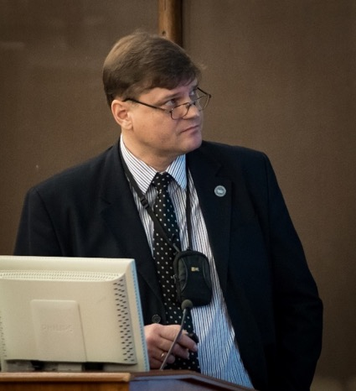
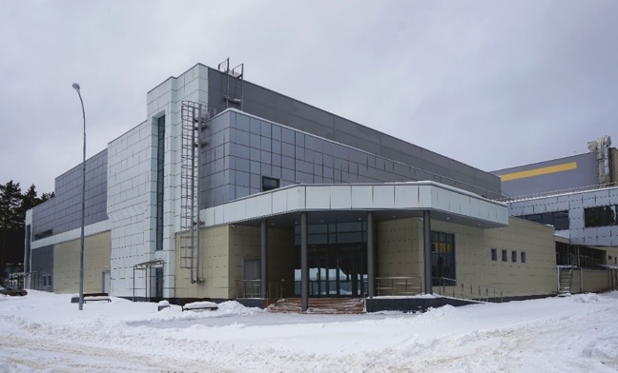
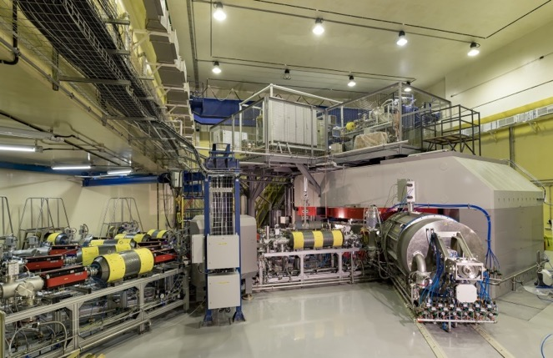
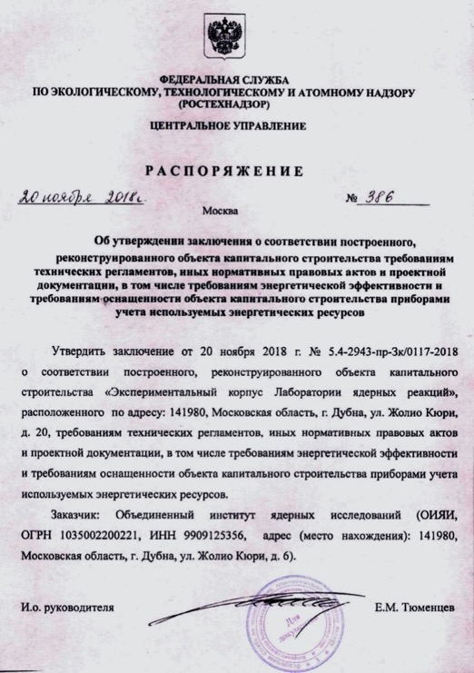
Status of the Factory of Superheavy Elements: DC-280 cyclotron
The construction of the experimental building of the SHE Factory has been completed.
SHE factory building 2018
Igor Kalagin
A certificate of compliance of the constructed object with the requirements of technical regulations by the Federal Environmental, Industrial and Nuclear Supervision Service of Russia (Rostekhnadzor) has been obtained.
Complex commissioning work has been conducted.

Slide 6
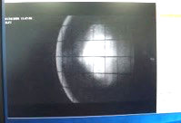
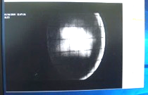
Status of the Factory of Superheavy Elements: DC-280 cyclotron
On 26 December 2018, the first beam of accelerated krypton ions was produced inside the DC-280 cyclotron.
Ion beam: ₈₄Kr⁺¹⁴
Current at radius of 1700 mm was up to 4 µA at injection current of 31 µA
ILF1
ILF2
On 17 January 2019, the first beam was successfully accelerated and extracted from the cyclotron.
Transmission factor 18.2%÷27.3% at the extracted beam intensity of 2÷3 μA
In the first quarter of 2019, it is planned:
to continue the work at DC-280 to obtain heavy-ion beams of design parameters,
to complete the commissioning work for the GFS-2 separator,
to initiate the implementation of the experimental programme on the synthesis and study of the properties of SHE at the Factory.

Slide 7

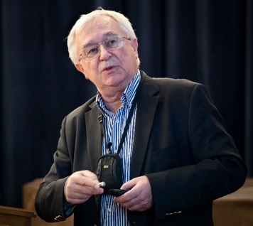
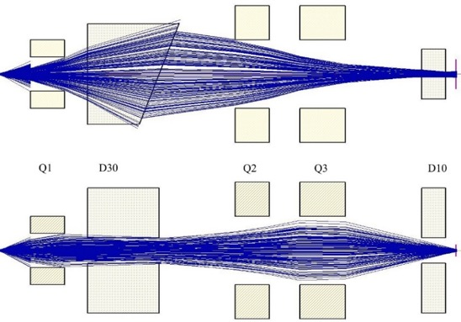
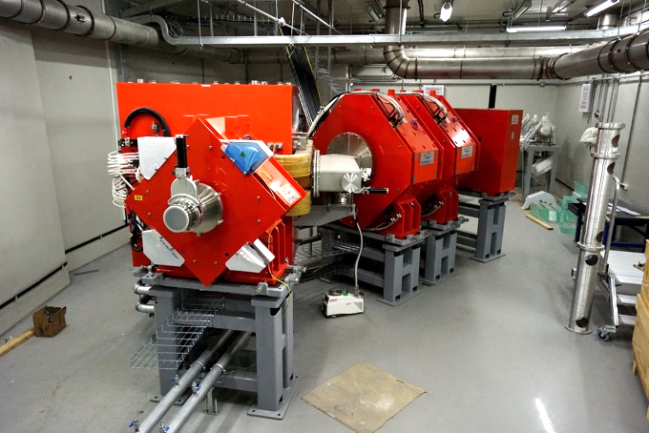
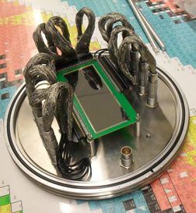
Status of the Factory of Superheavy Elements: Separators GFS-2 and GFS-3
GFS-II separator
Andrey Popeko
Assembled on 12.06.2018,
vacuum chamber tested
Are ready:
Rotating window
Target block Ø150
Signal cables
To be delivered in spring 2019:
Beam line lenses
Target block Ø240
Detector chamber
Detectors & Data Taking Systems
under testing

Slide 8
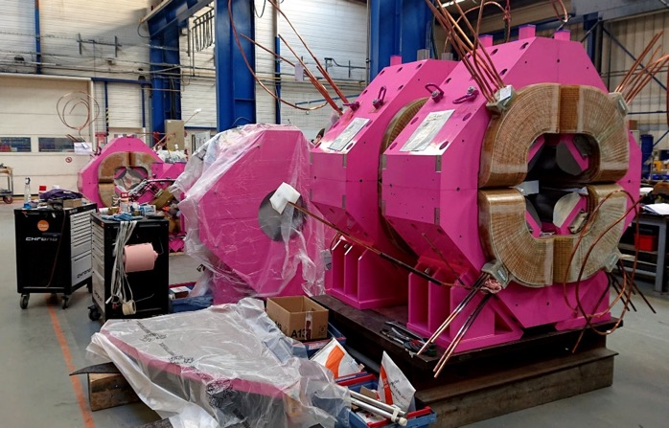
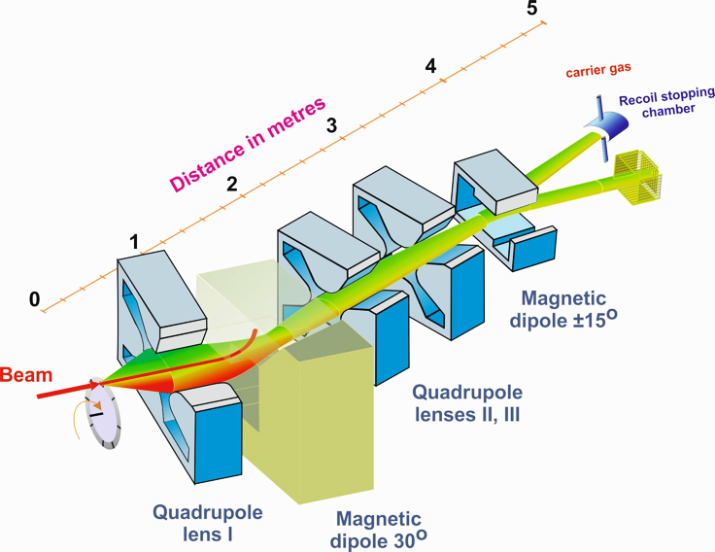
Status of the Factory of Superheavy Elements: Separators GFS-2 and GFS-3
Gas-filled pre-separator GFS-3 (QVDHQHQVD)
chemistry;
fusion and multi-nucleon transfer reactions;
mass-spectrometry and nuclear spectroscopy;
laser spectroscopy of heavy atoms.
17.12.2018
GFS-3:
installation – May 2019
launching - 2020
The PAC recognizes efforts made by the Laboratory in order to prepare for the commissioning of the SHE Factory as well as the progress in the construction of GFS-2, appreciates this work, and supports its continuation. The PAC expects a report about the in-beam tests on the performance of the GFS-2 separator and on the optimal conditions of operation at the next meeting.

Slide 9
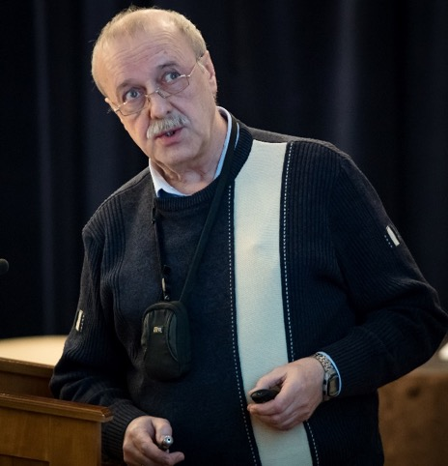
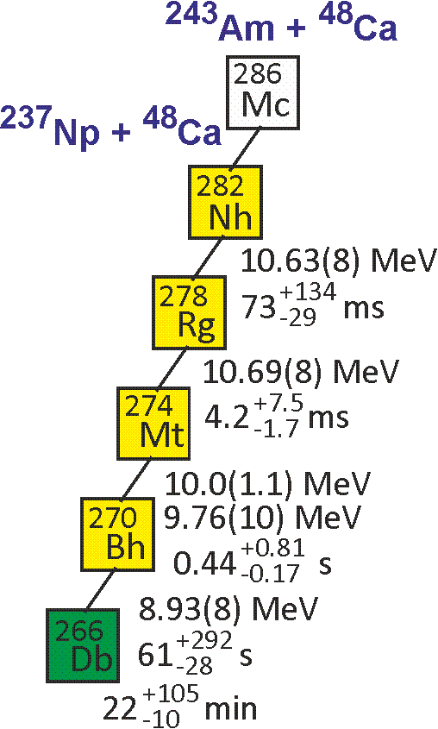
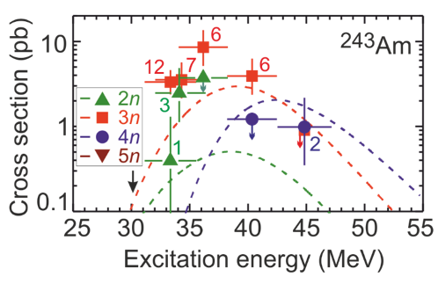
Status of the Factory of Superheavy Elements: Programme of Day-1 experiments at the SHE Factory
At the first stage, in order to characterize the experimental set-up, a set of test experiments will be carried out, using fusion reactions
^{nat}Yb+⁴⁰Ar→Ra, ^{nat}Yb+⁴⁸Ca →Th, ¹⁷⁰Er+⁵⁰Ti →Th, and ^{206,208}Pb+⁴⁸Ca →No
Cross section ~10⁸⁻⁹ pb
Adjustment of optical elements Q_{v}, D, Q_{h}, Q_{v}, D
Transmission
…
Vladimir Utyonkov
First experiments at SHE Factory ²⁴³Am + ⁴⁸Ca test reaction
Cross section ≈10 pb
σ=8.5 pb, h_{t}=0.5 mg/cm², ε_{coll}=0.6, I_{beam}=5 pμA → ≈17/day
Excitation function for the 2n-evaporation channel
- Observation of α decay of ²⁸¹Rg
Excitation function for the 3n-evaporation channel
- Two decay times of ²⁷⁶Mt
- Level of cross section for the pxn channel
- Level of EC branch for ²⁸⁸Mc and ²⁸⁴Nh
5n-evaporation channel: new isotope ²⁸⁶Mc & descendants

Slide 10
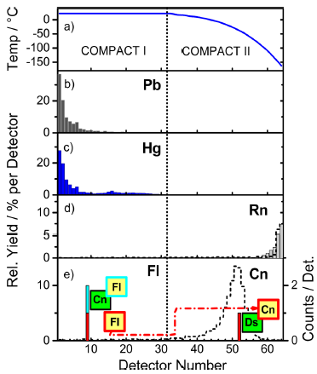
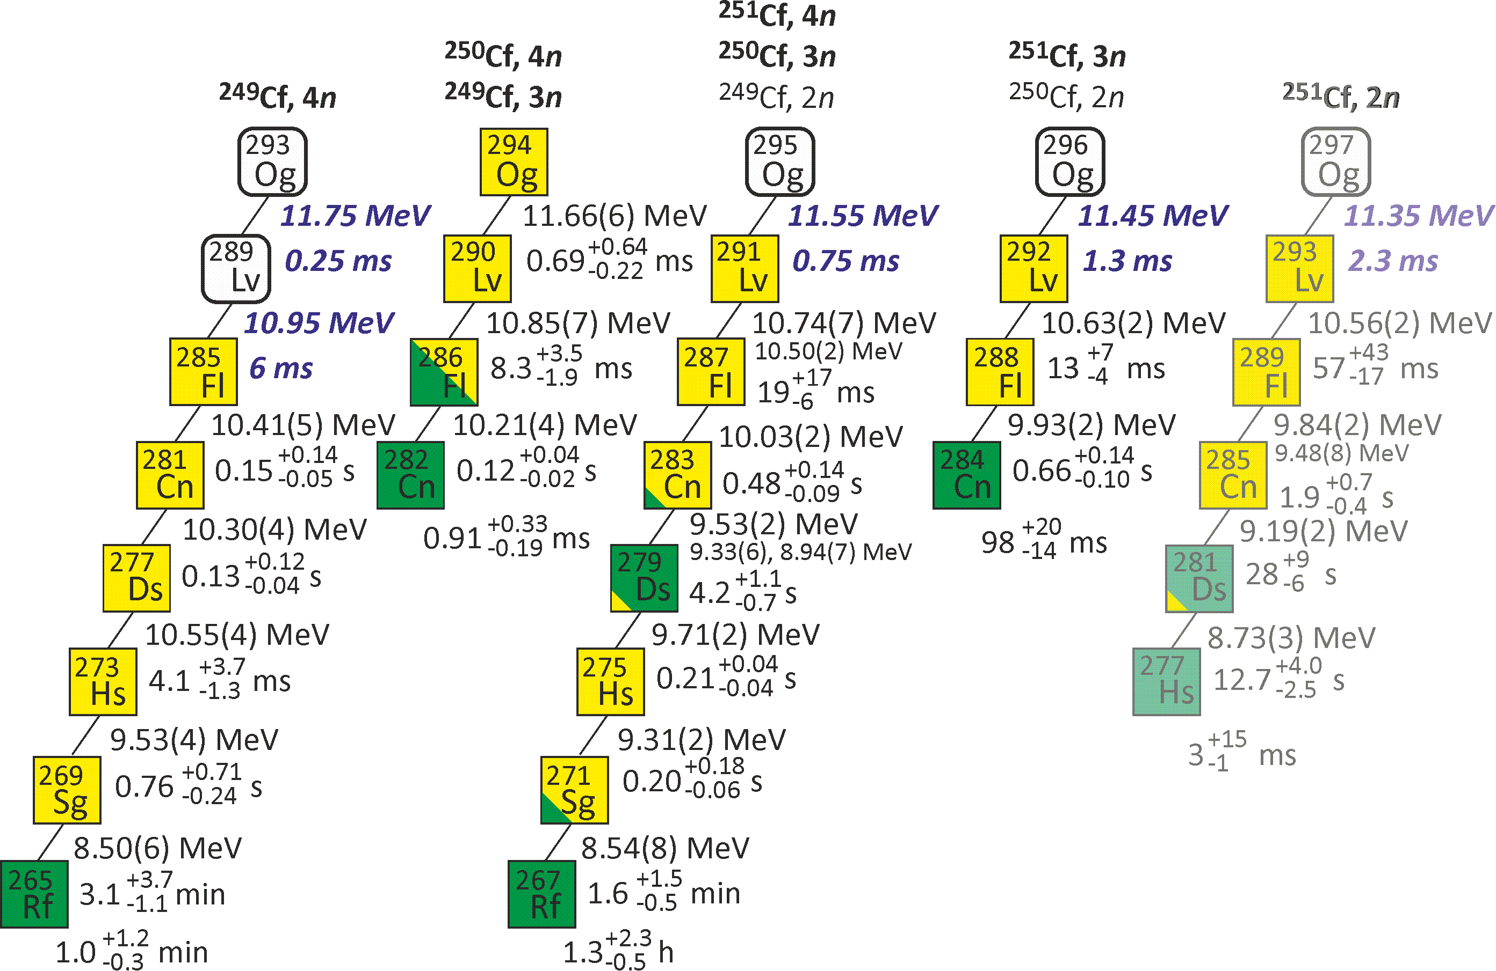
Status of the Factory of Superheavy Elements: Programme of Day-1 experiments at the SHE Factory
V. Utyonkov
3. First experiments at SHE Factory ²⁴²Pu + ⁴⁸Ca test reaction – chemical properties
Is flerovium a metal or a noble gas?
Cross section ≈8 pb (3n – 3.6 pb, 4n – 4.5 pb)
σ=8 pb, h_{t}=0.5 mg/cm², ε_{coll}=0.6, I_{beam}=5 pμA →
≈16/day ×ε_{chem}
A. Yakushev et al., Inorg. Chem. 53, 1624 (2014)
4. First experiments at SHE Factory
²⁴⁹⁻²⁵¹Cf+⁴⁸Ca – synthesis of the heaviest Og isotopes

Slide 11
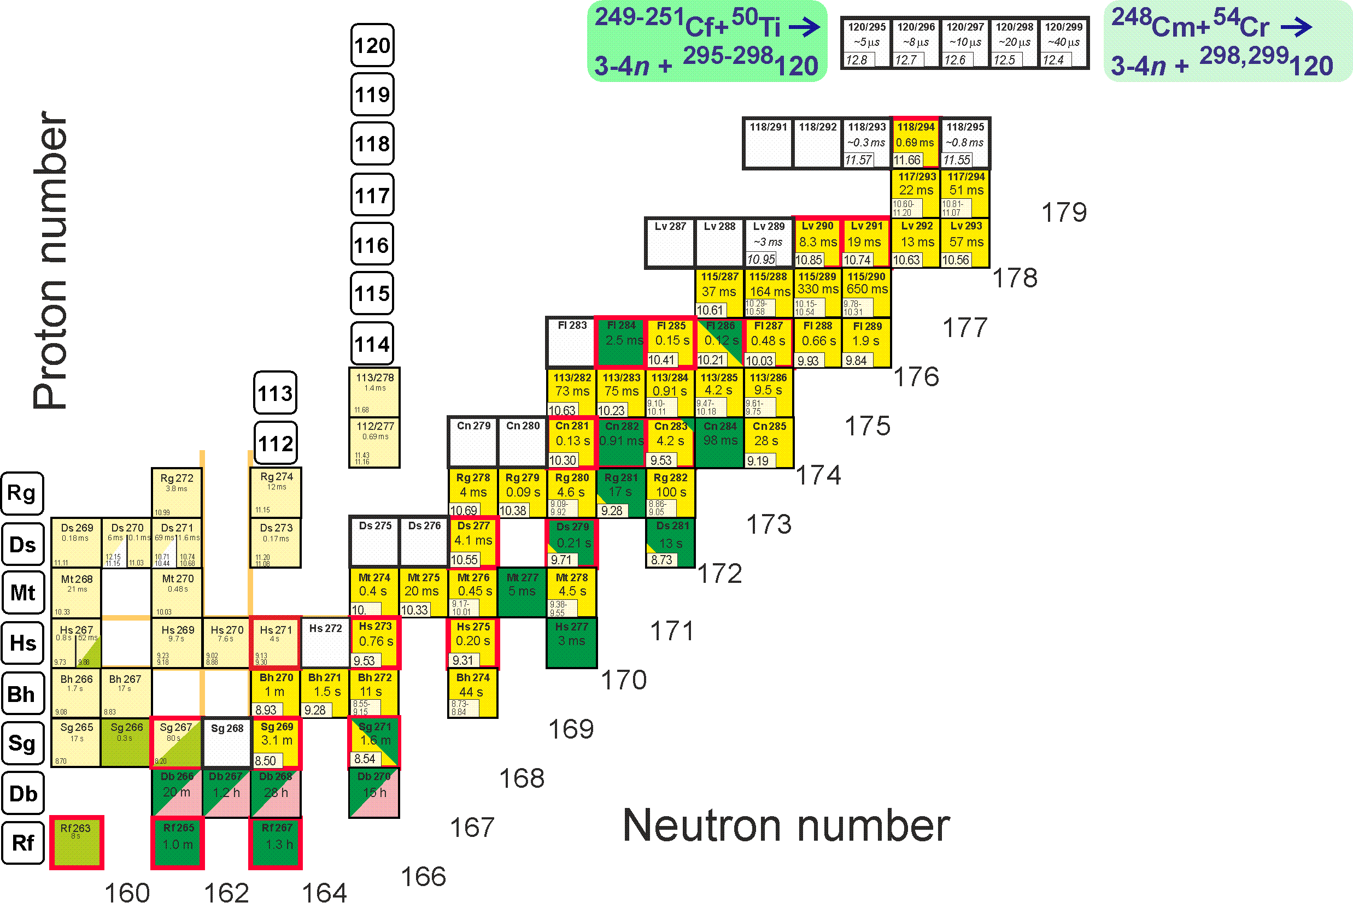
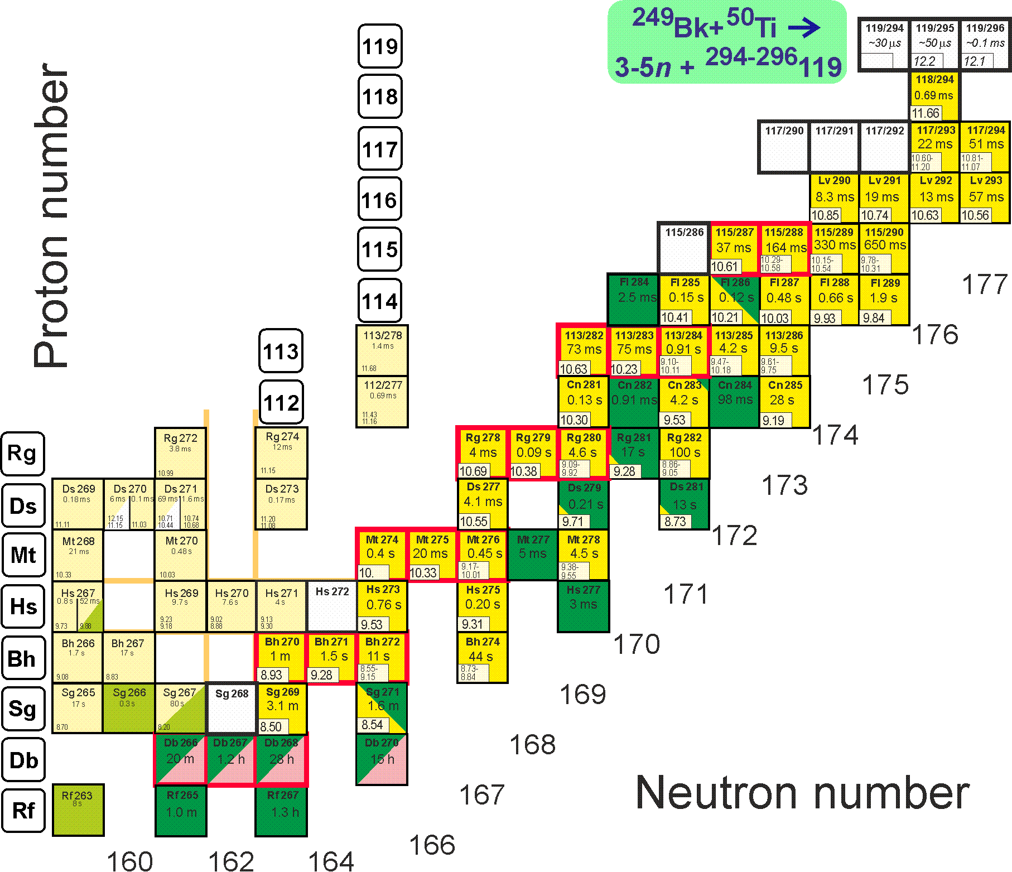
Status of the Factory of Superheavy Elements: Programme of Day-1 experiments at the SHE Factory
Synthesis of new element 120
Synthesis of new element 119
σ=50 fb, h_{t}=0.3 mg/cm², ε_{coll}=0.6, I_{beam}=3 pμA → ≈1 event per month
²⁴⁹Bk(⁵⁰Ti,3-4n)^{295,296}119
²⁴⁹Cf(⁵⁰Ti,3-4n)^{295,296}120
²⁵¹Cf(⁵⁰Ti,3-4n)^{297,298}120
²⁴⁸Cm(⁵⁴Cr,3-4n)^{298,299}120
Notwithstanding these remarkable achievements, starting with a completely new set-up there will certainly arise unexpected problems which should be solved before the first production runs can start. The removal of all problems will need time which has to be provided so that all follow-up experiments will profit from this preparation.
Therefore, at the next meeting the PAC expects a more detailed schedule of the phases of the experimental programme towards Day-1 experiment to be presented, taking into account potential challenges related to unforeseen problems in the commissioning and risk analysis.
The PAC supports the programme leading to first experiments at the SHE Factory.

Slide 12
Status of the Factory of Superheavy Elements
In the first quarter of 2019, it is planned:
to continue the work at DC-280 to obtain heavy-ion beams of design parameters,
to complete the commissioning work for the GFS-2 separator,
to initiate the implementation of the experimental programme on the synthesis and study of the properties of SHE at the Factory.
General PAC recommendation
PAC congratulates the FLNR staff on the successful start-up of the DC-280 cyclotron and recommends that the Directorates of JINR and FLNR concentrate their efforts to complete all commissioning work, including the DC-280 cyclotron and the GFS-2 separator, and to prepare for the test experiments.
The PAC approves the programme of first experiments at the SHE Factory.
The PAC requests, for the next meeting, a submission of detailed reports and/or presentations on the SHE Factory prepared by FLNR well in advance of the meeting in order to allow PAC members to prepare the full referee reports in due time.

Slide 13
Recommendations of the Scientific Council
Status of the Factory of Superheavy Elements &
Programme of Day-1 experiments at the SHE Factory
The Scientific Council notes the production of the first beam of accelerated heavy ions at the DС-280 cyclotron, which indicates the emergence of JINR’s new basic facility as the core part of the Factory of Superheavy Elements.
The Scientific Council thanks the PAC for Nuclear Physics for its initiative to follow up on the construction work for the Factory of Superheavy Elements (SHE factory) and notes the significant progress achieved by the Flerov Laboratory of Nuclear Reactions for this major project.
The Scientific Council recognizes the efforts made by the Laboratory in order to prepare for the commissioning of the SHE Factory as well as the progress in constructing new facilities for the SHE Factory, in particular, the GFS-2 gas-filled separator, appreciates this work, and supports its continuation.
The Scientific Council congratulates the FLNR staff on the successful start-up of the DC-280 cyclotron and recommends that the Directorates of JINR and FLNR concentrate their efforts to complete all commissioning work, including the DC-280 cyclotron and the GFS-2 separator, and to prepare for the test experiments. The Scientific Council endorses the programme of first experiments at the SHE Factory.

Slide 14
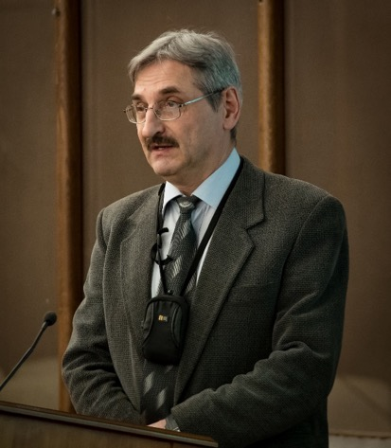
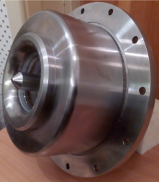
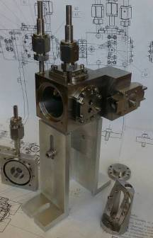
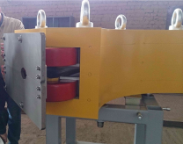
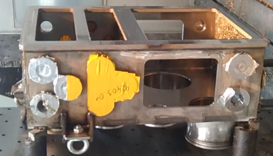
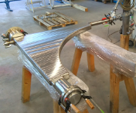
Status of the GALS set-up
Gas Cell Based Laser Ionization & Separation Setup
The aim: (by separating stopping and laser ionization chambers)
Increase laser ionization efficiency at high cyclotron beam current
Increase selectivity (collection of survival ions)
Sergey Zemlyanoy
Main parts is ready for installation:
Front end system:
Mass-separator:
Working conditions:
cyclotron – DC
Ion collector – DC
Lasers – transverse or longitudinal

Slide 15
Status of the GALS set-up
Work plan
 | Laser system |  |  | Front end system |  |  | Pump station |  |  | Gas purification |  |  | Separator, detection
 | preparation | mounting | commissioning | preparation | mounting | commissioning | preparation | mounting | commissioning | preparation | mounting | commissioning | preparation | mounting | commissioning
2017
2018
2019
2020
2021 | starting experiments
The PAC endorses the proposed programme of actions necessary for the start-up of the GALS separator. However, the group would need more manpower including postdocs and PhD students in order to ensure that this project delivers within shorter time than presented. Furthermore, the PAC expects a detailed progress report to be presented at its future meeting.

Slide 16
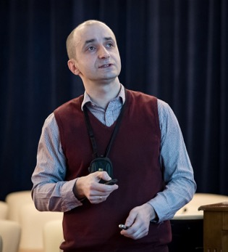
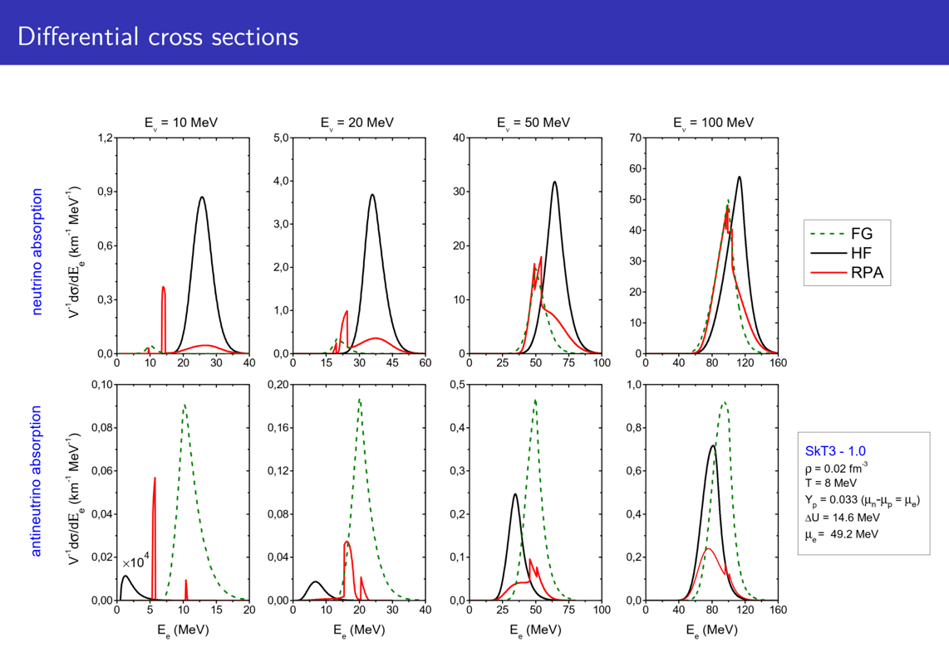
Scientific reports
The PAC heard with interest the excellent report on
“Charged-current neutrino-nucleon reactions in the supernova neutrino-sphere”
Alan Dzhioev
The neutrino and antineutrino opacities due to charged-current reactions near neutrino-sphere have been studied by applying the Skyrme-RPA.
The opacities are found to be quite sensitive to the difference between neutron and proton mean-field potentials and RPA correlations.
One expects that RPA particle-hole correlations increase the efficiency of neutrino heating and favour the supernova explosion.
The PAC supports continuation of these research activities.
Notes:
FG non-interacting Fermi Gas

Slide 17
Poster session
The PAC appreciated the high quality of presentations of new results and proposals by young scientists in the field of nuclear physics research.
The best posters selected are:
  “Upgrade of the GERDA experiment” presented by Nadezhda Rumantseva
  “Pygmy and Giant dipole resonances in ^{48,50}Ca and ^{68,70}Ni” presented by Nikolay Arsenyev
  “New systems based on extracting sorbents for the purification of low-background materials” presented by Genko Marinov
The PAC recommended the poster “Upgrade of the GERDA experiment” for presentation at the session of the Scientific Council in February 2019.
The Scientific Council followed with interest the reports by young scientists, selected by the PACs for presentation , in particular ,“Upgrade of the GERDA experiment” and thanks Nadezhda Rumyantseva (DLNP). The Scientific Council welcomes such selected reports in the future and looks forward to the Management enhancing the visibility of and empowering female scientists at JINR.

Slide 18
THANK YOU FOR YOUR ATTENTION!

Slide 19
The Scientific Council notes the production of the first beam of accelerated heavy ions at the DС-280 cyclotron, which indicates the emergence of JINR’s new basic facility as the core part of the Factory of Superheavy Elements.
The Scientific Council thanks the PAC for Nuclear Physics for its initiative to follow up on the construction work for the Factory of Superheavy Elements (SHE factory) and notes the significant progress achieved by the Flerov Laboratory of Nuclear Reactions for this major project.
The Scientific Council recognizes the efforts made by the Laboratory in order to prepare for the commissioning of the SHE Factory as well as the progress in constructing new facilities for the SHE Factory, in particular, the GFS-2 gas-filled separator, appreciates this work, and supports its continuation.
In the first quarter of 2019, it is planned to continue the work at DC-280 to obtain heavy-ion beams of design parameters, to complete the commissioning work for the GFS-2 separator, and to initiate the implementation of the experimental programme on the synthesis and study of the properties of SHE at the Factory. At the first stage a set of test experiments will be carried out. They will be aimed at achieving the design parameters of the GFS-2 separator, using fusion reactions of rareearth elements with ⁴⁰Ar, ⁴⁸Ca, ⁵⁰Ti ions accelerated at the DC-280 cyclotron. In this set of experiments, it is necessary to study the transmission of GFS-2 at different thicknesses of the target, the resistance of targets to an increased beam intensity and accumulated dose, the clearing of background reaction products, etc.
The first commissioning experiments on SHE will concern the synthesis of moscovium isotopes in the ⁴⁸Ca + ²⁴³Am reaction and at a later stage the study of the chemical properties of Fl and Cn. The programme will further be focused on preparing and conducting experiments on the synthesis of elements 120 and 119 in the reactions of ⁵⁰Ti beam with ^{249–251}Cf and ²⁴⁹Bk targets respectively. (S. Dmitriev comments)
The Scientific Council congratulates the FLNR staff on the successful start-up of the DC-280 cyclotron and recommends that the Directorates of JINR and FLNR concentrate their efforts to complete all commissioning work, including the DC-280 cyclotron and the GFS-2 separator, and to prepare for the test experiments. The Scientific Council endorses the programme of first experiments at the SHE Factory.

