Slide 1
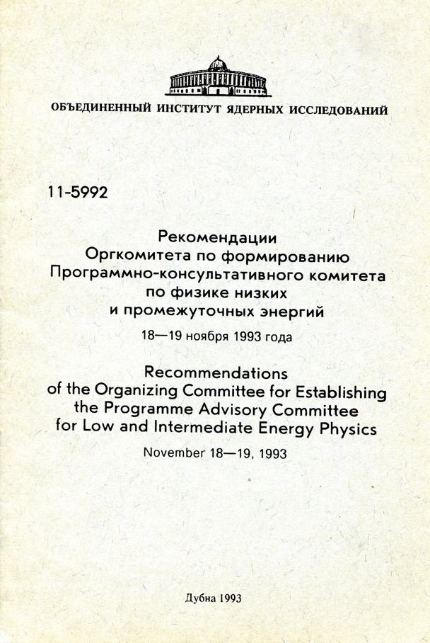
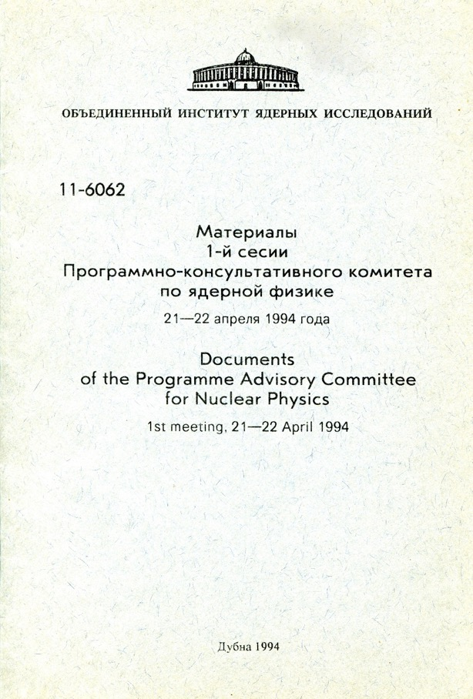
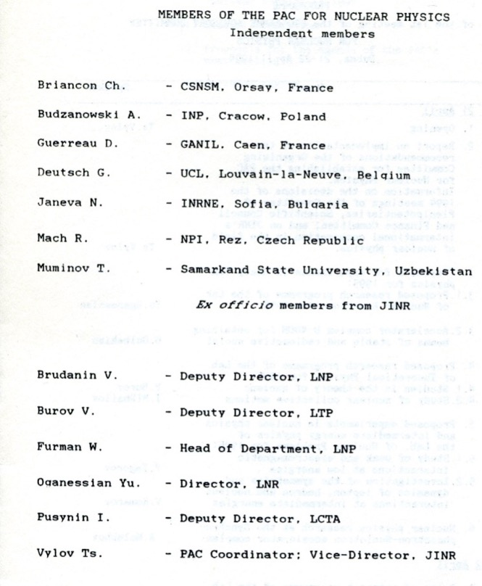
Programme Advisory Committee for Nuclear Physics
50th meeting, 24–25 June 2019
Notes:
International committee, 7 external members + 6 ex-officio (13 total)

Slide 2
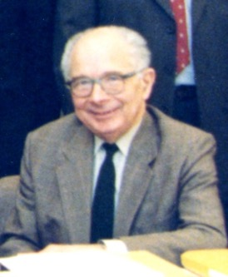
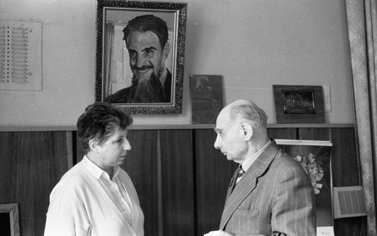
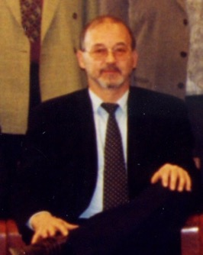
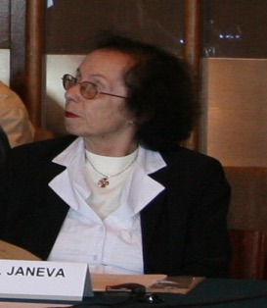
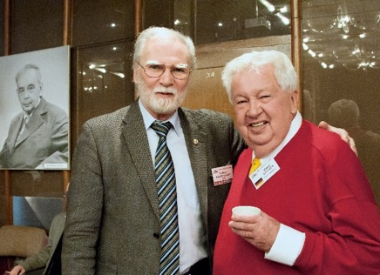
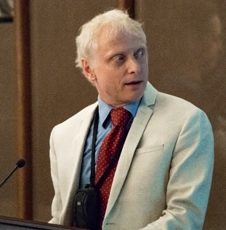
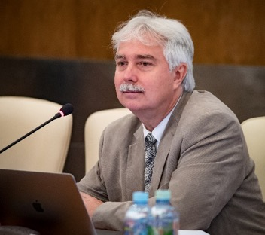
Chairpersons of the PAC for Nuclear Physics since 1994
Prof. A. Budzanowski
1994 – 1995
Prof. J. Deutsch
1995 – 1998
Prof. Chantal Briancon
1998 – 2001
Prof. N. Rowley
2001 – 2005
Prof. Natalia Janeva
2005 – 2006
Prof. Walter Greiner
2007 – 2015
Prof. Fabrice Piquemal
2015 – 2017
Prof. Marek Lewitowicz
Since 2017

Slide 3
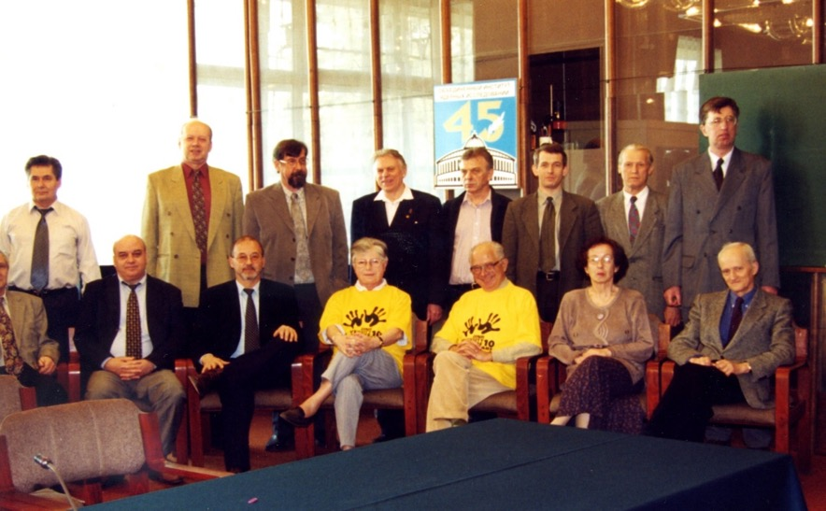
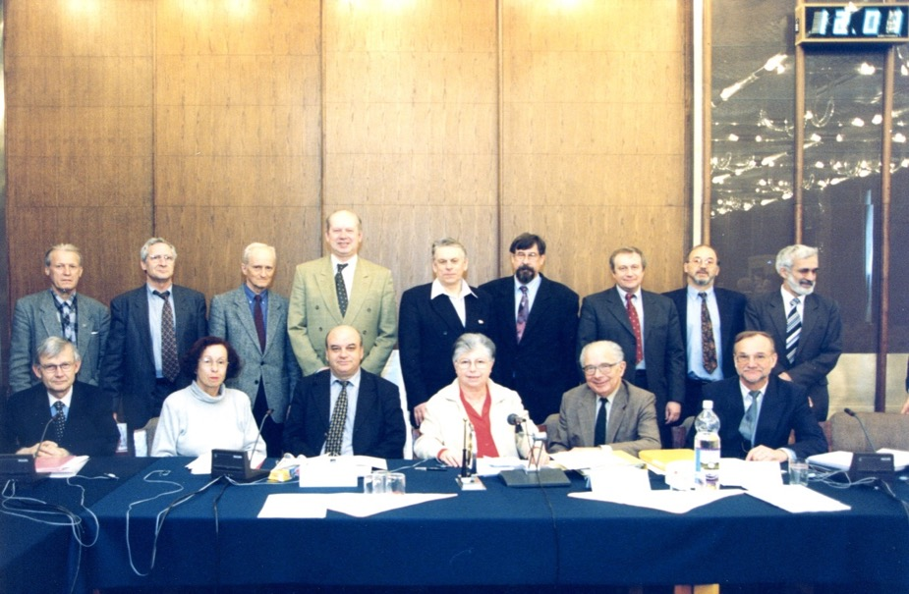
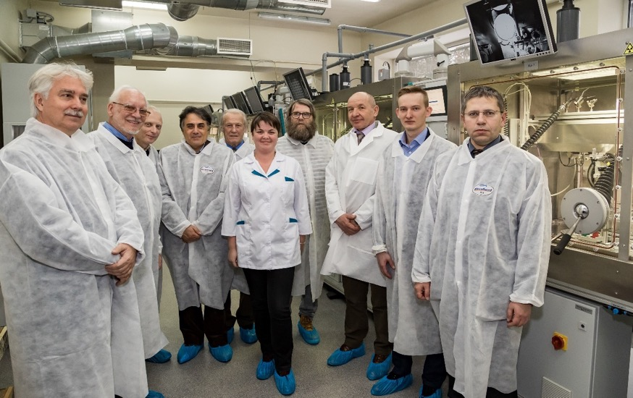
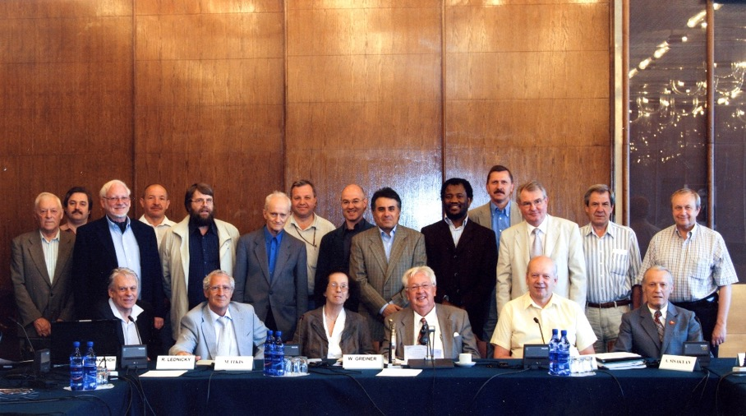
Independent members of PAC for Nuclear Physics

Slide 4
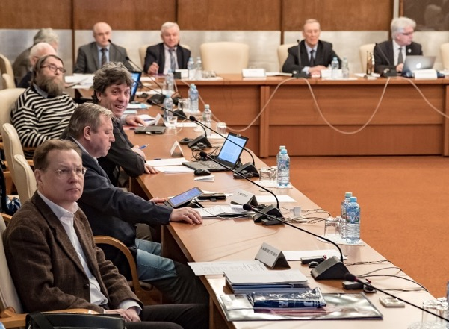
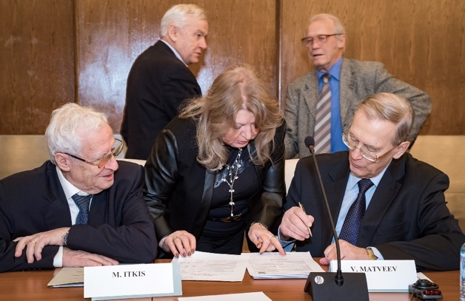
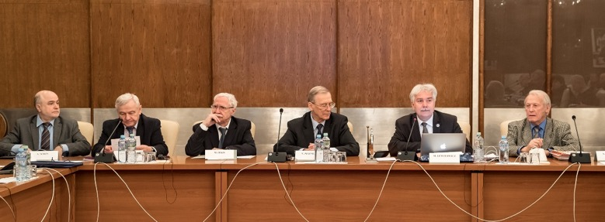
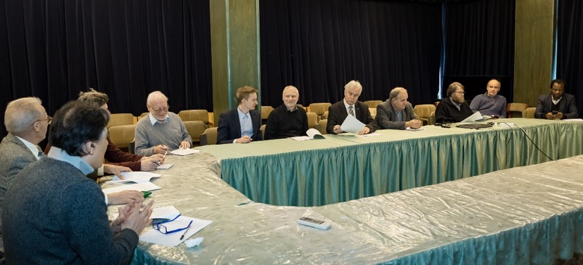
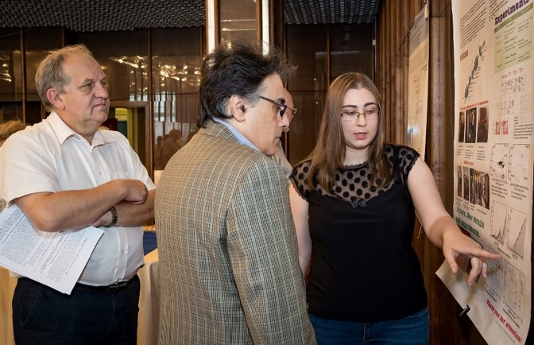
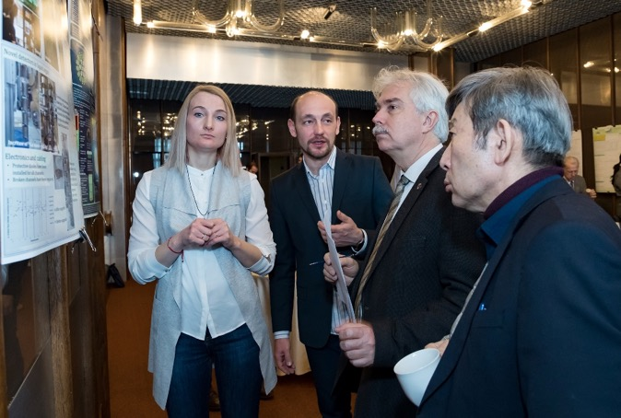
Working moments

Slide 5
Role of the JINR Programme Advisory Committee for Nuclear Physics
The PAC for Nuclear Physics has overseen the following directions of JINR development:
low and intermediate energy physics,
heavy ion physics,
nuclear physics with neutrons,
the theory of the atomic nucleus,
neutrino physics (joint sessions with PAC for PP),
educational program.
The PAC for Nuclear Physics elaborate its recommendations for the JINR Directorate, which were carried out at the meetings of the JINR Scientific Council.
The PAC evaluates nuclear physics related 2-year plans (until 2003) and seven-year planning of scientific research at JINR
In particular, the PAC for Nuclear Physics reviews, approves and monitors the implementation of the projects of IRENA, DRIBs, SHE Factory, and the DLNP neutrino programs.

Slide 6
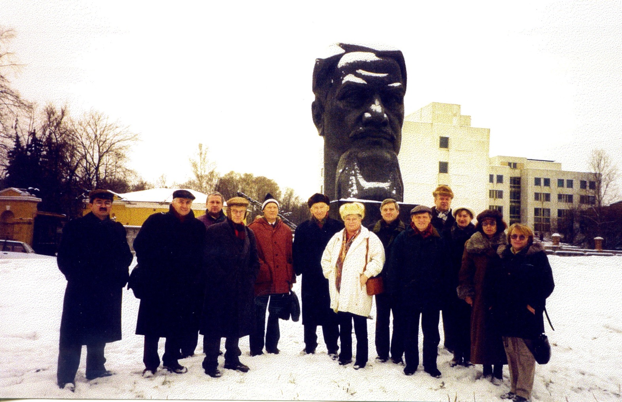
Visit to “Kurchatov Institute”

Slide 7
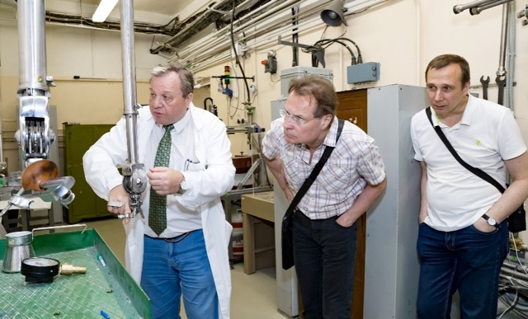
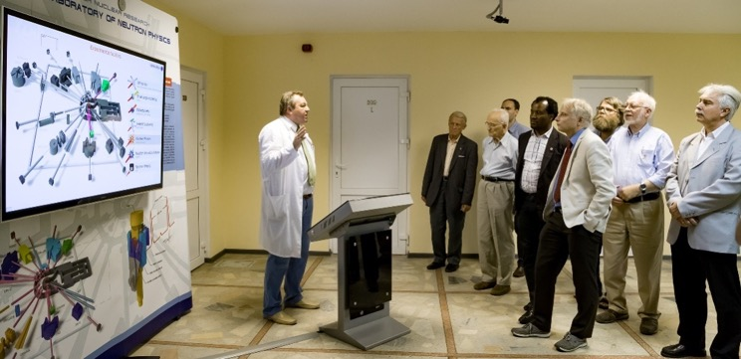
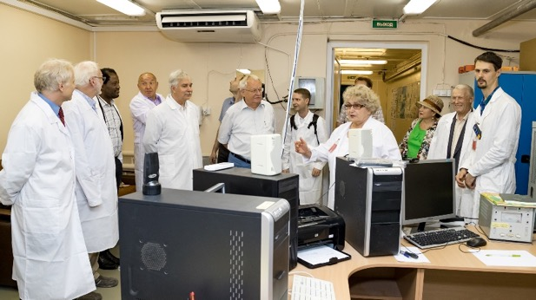
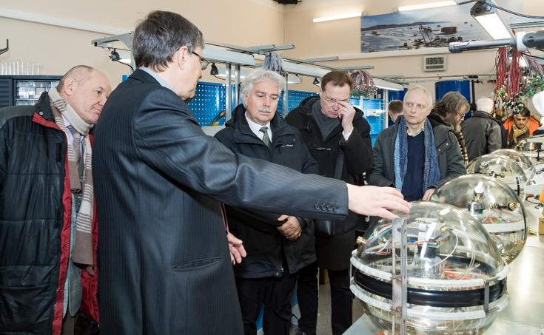
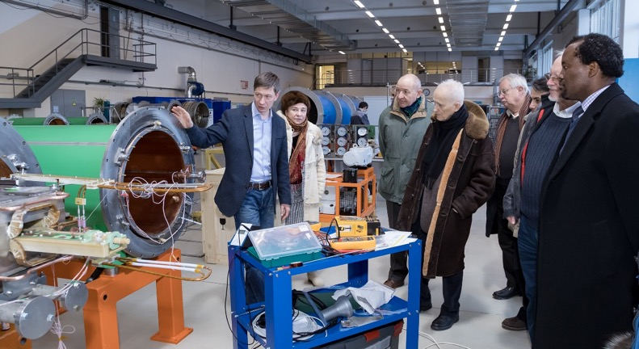
Visits to FLNP, DLNP and VBLHEP
Frank Laboratory of Neutron Physics
Veksler and Baldin Laboratory of High Energy Physics
Dzhelepov Laboratory of Nuclear Problems

Slide 8
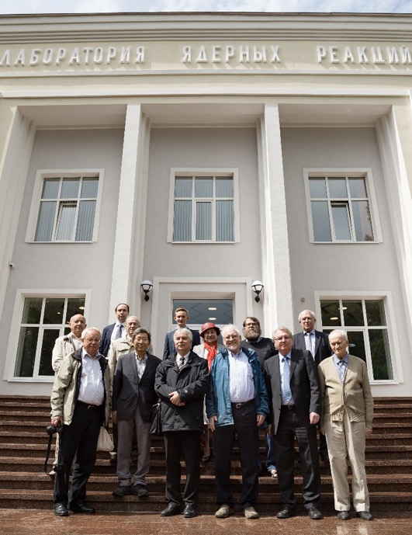
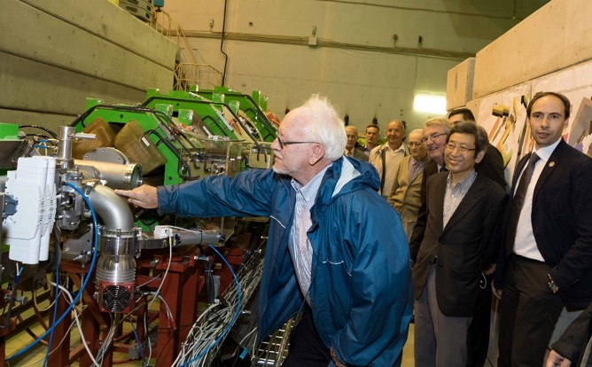
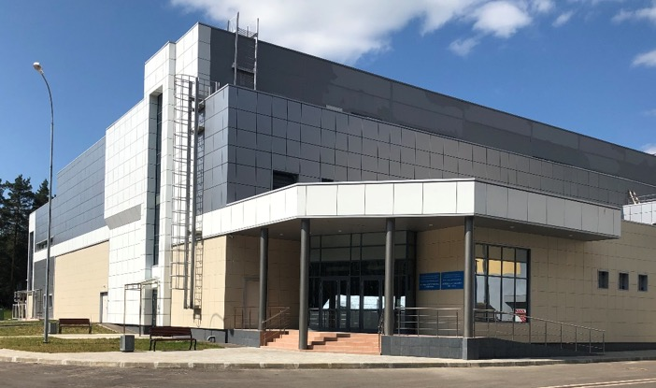
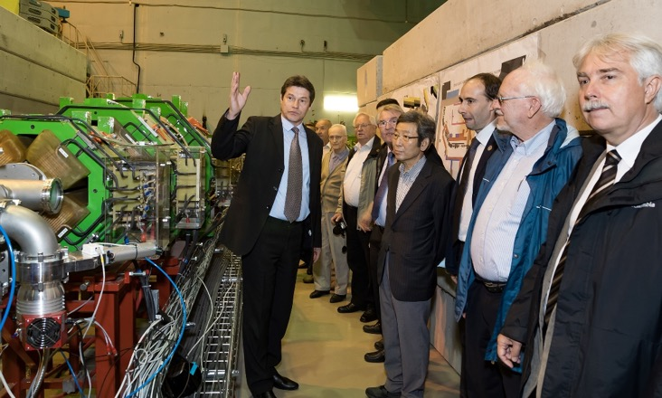
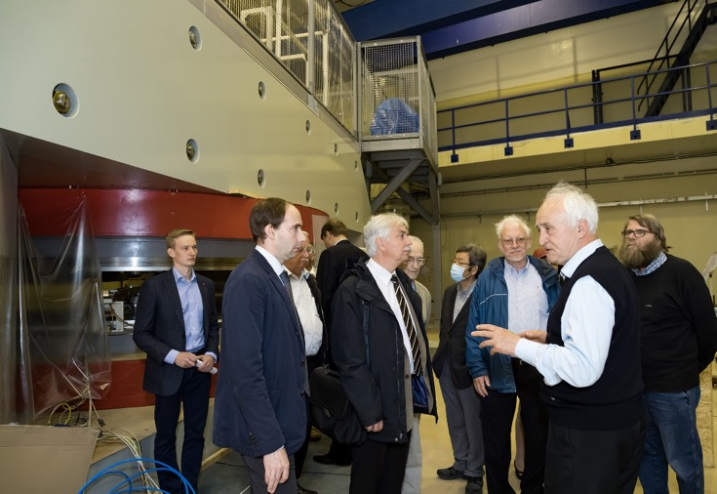

Visit to FLNR
SHE factory
ACCULINA-2

Slide 9
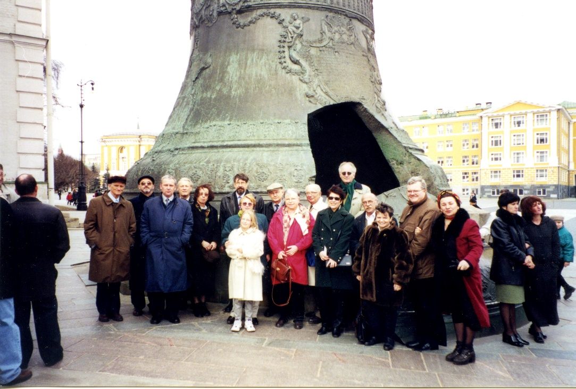
Excursion to Moscow

Slide 10
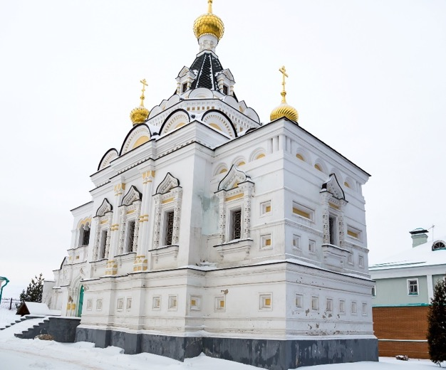
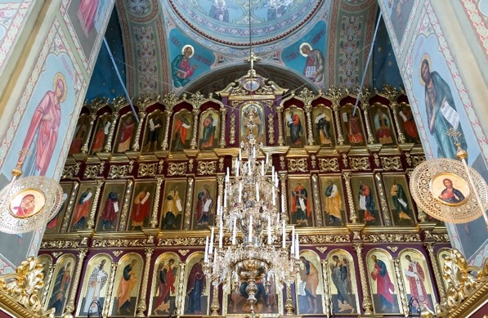
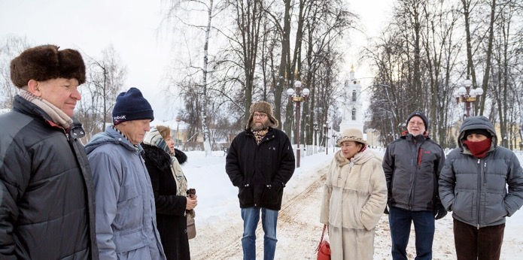
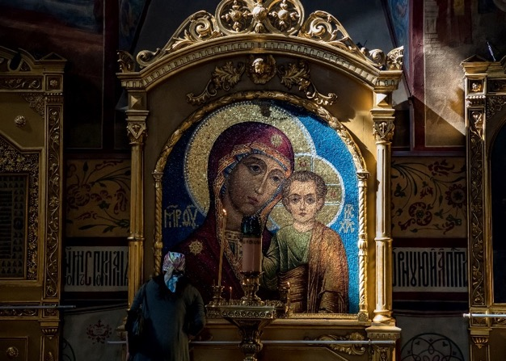
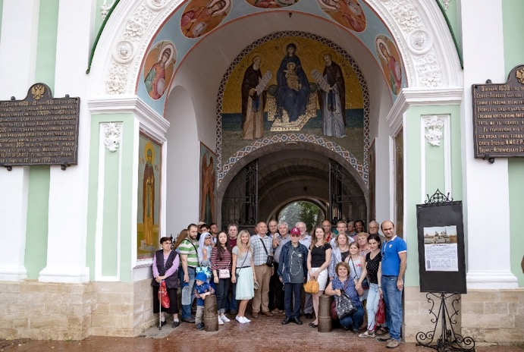
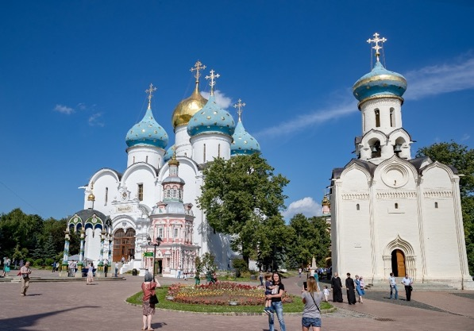
Excursions to Dmitrov and Sergiyev Posad
Dmitrov
Sergiyev Posad

Slide 11
Independent PAC members:
Christian Beck - IPHC, Strasbourg, France
Sigurd Hofmann * - GSI, Darmstadt, Germany
Guinyun Kim - KNU (Kyungpook National University), Daegu, South Korea
Alexey Korsheninnikov* - Kurchatov Institute, Moscow, Russia
Marek Lewitowicz (Chair) - GANIL, France
Adam Maj* - IFJ-PAN, Kraków, Poland
Valery V. Nesvizhevsky - ILL, Grenoble, France
Vladimir Ostashko - INR, Kiev, Ukraine
Claude Petitjean - PSI, Villigen, Switzerland
Fabrice Piquemal - CENBG, Bordeaux, France
Ivan Štekl - IEAP CTU, Czech Republic
Emanuele Vardaci* - UN, Naples, Italy
Zeblon Z. Vilakazi - University of the Witwatersrand, Johannesburg, South Africa
* not present at this meeting

Slide 12
Ex officio PAC members appointed by the JINR:
Nikolay Antonenko - Deputy Director, BLTP
Vadim Bednyakov - Director, DLNP
Sergey Dmitriev - Director, FLNR
Mikhail Itkis - Vice-Director, JINR
Valery Shvetsov - Director, FLNP
Nikolay Skobelev - Scientific Secretary of the PAC
Tatiana Strizh - Deputy Director, LIT
Notes:
International committee, 13 external members + 7 ex-officio (20 total)

Slide 13
Programme Advisory Committee for Nuclear Physics
50th meeting, 24–25 June 2019
Monday, 24 June 2019
10.00 | 1. | Opening of the meeting | M. Lewitowicz
 | 2. | Implementation of the recommendations of the previous PAC meeting | M. Lewitowicz (20 min.)
 | 3. | Information on the Resolution of the 125th session of the JINR Scientific Council (February 2019) and on the decisions of the JINR Committee of Plenipotentiaries (March 2019) | M. Itkis (20 min.)
 | 4. | Report on the theme “Information and Computing Infrastructure of JINR” and proposal for its extension Referees: Z. Vilakazi, I. Stekl, V. Bednyakov, I. Golutvin | Т. Strizh (20 min. + 5 min.)
11.30 | Coffee break
11.50 | 5 | First results of the experiments with the ACCULINNA-2 fragment separator 20' Referees: A. Korsheninnikov, C. Beck, E. Vardaci | A. Fomichev (20 min. + 5 min.)
 | 6 | Proposal for the opening of a new project "Construction of a prototype of the initial section of a high-current heavy-ion linear accelerator aimed at producing intense radioactive ion beams for basic research" Referees: A. Korsheninnikov, S. Hofmann, M. Lewitowicz, A. Maj | L. Grigorenko (20 min. + 5 min.)
13.00 | Lunch break

Slide 14
Programme Advisory Committee for Nuclear Physics
50th meeting, 24–25 June 2019
Monday, 24 June 2019
13.00 | Lunch break
15.00 | 7. | Report on the theme “Investigations of Neutron Nuclear Interactions and Properties of the Neutron” and its project. Proposals for extension of the theme and project:
 |  | 7.1 Project TANGRA Referees: G. Kim, V. Ostashko, C. Petitjean, V. Egorov, A. Popov | Yu. Kopatch (20 min. + 5 min.)
 |  | 7.2 Report on the theme "Investigations of Neutron Nuclear Interactions and Properties of the Neutron" Referees: V. Nesvizhevsky, G. Kim, F. Piquemal, A. Barabanov, O. Shcherbakov 5' | E. Lychagin (25 min. + 5 min.)
 |  | 7.3 Letter of intent to open a new project: "Construction of a prototype of the set-up for measurement of the neutron lifetime using the time-of-flight method" Referees: V. Ostashko, V. Nesvizhevsky, C. Petitjean | V. Kuznetsov (10 min. + 5 min.)
 |  | 7.4 Letter of intent to open a new project: "Construction of a prototype of the polarized nuclear target" Referees: V. Nesvizhevsky, A. Maj, F. Piquemal | V. Novitsky (10 min. + 5 min.)
16.30 | 8. | Poster presentations by young scientists Coffee break (together with poster presentations) | 40 min.
 | 9. | Closed discussion of the poster presentations
17.20 | 10. | Information about the proposal for the opening of a new theme "Development of the Conceptual Design of a New Advanced Neutron Source at JINR" | V. Shvetsov (20 min.)
 | 11. | Progress report on the E&T&RM project and proposal for its extension Referees: I. Stekl, E. Vardaci, Z. Vilakazi, G. Kim, A. Kievitskaya, Yu. Titarenko | A. Baldin (20 min.+5 min.)
 | 12. | General discussion | 30 min.
 | 13. | Announcement of the authors of the best poster presentations | M. Lewitowicz
19.00 | Reception

Slide 15
Programme Advisory Committee for Nuclear Physics
50th meeting, 24–25 June 2019
Tuesday, 25 June 2019
9.30 | 14. | Meeting of the PAC members with the JINR Directorate (closed discussion)
10.00 | Coffee break
10.20 | 15. | Report on the project "GDH & SPASCHARM & NN: Study of the nucleon spin structure in strong and electromagnetic interactions" and proposal for its extension 20’ Referees: C. Petitjean, F. Piquemal, C. Beck, E. Vardaci, V. Ladygin, V. Pavlov 5' | Yu. Uzikov (20 min. + 5 min.)
 | 16. | Scientific report "Transverse momentum distributions of hadrons in the Tsallis nonextensive statistics" | A. Parvan (20 min.)
Closed session:
11.10 | 17. | Proposals for the agenda of the next PAC meeting
 | 18. | Preparation of the PAC recommendations
13.00 | 19. | PAC recommendations
13.20 | 20. | Closing of the meeting
14.00 | 21. | Visit to the Laboratory of Information Technologies | T. Strizh, N. Skobelev (2 h.)

