Slide 1
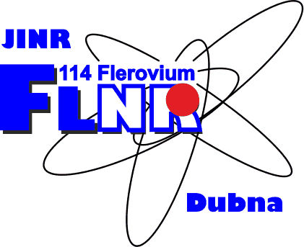
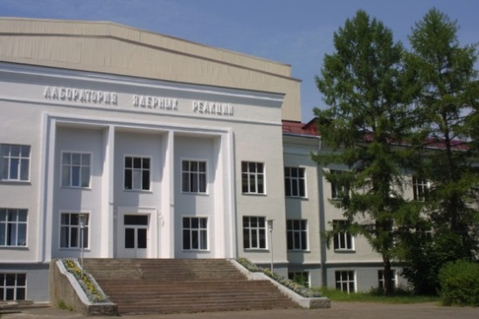
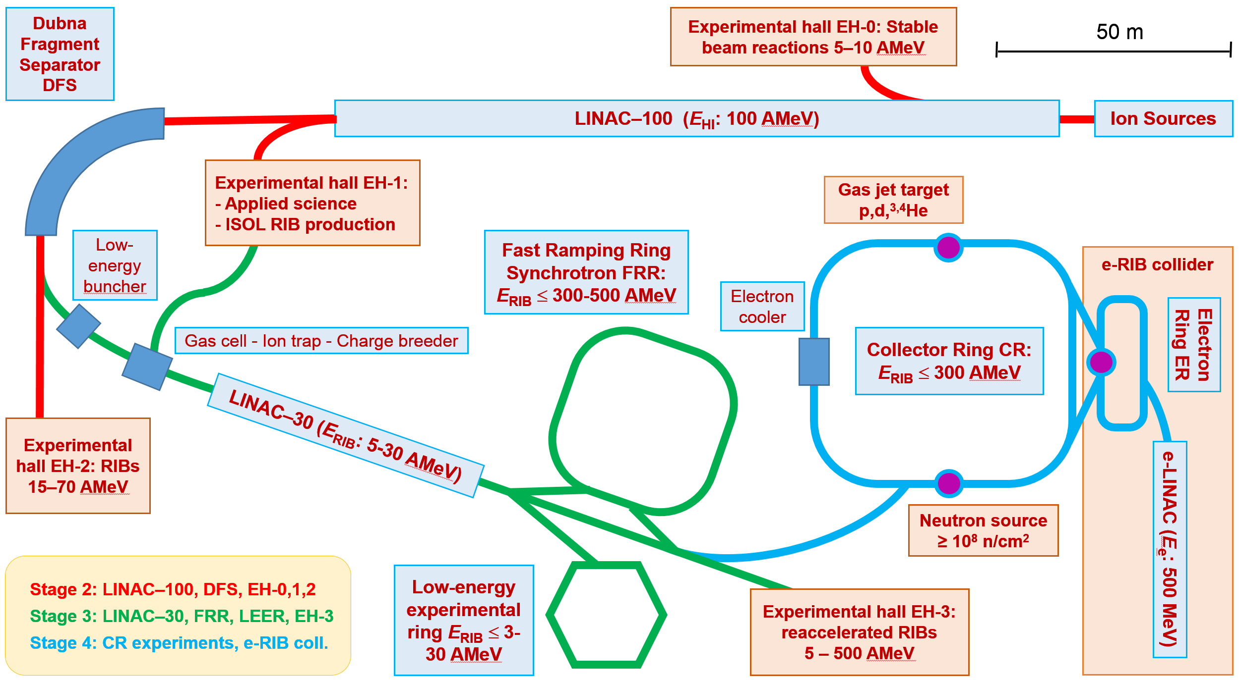
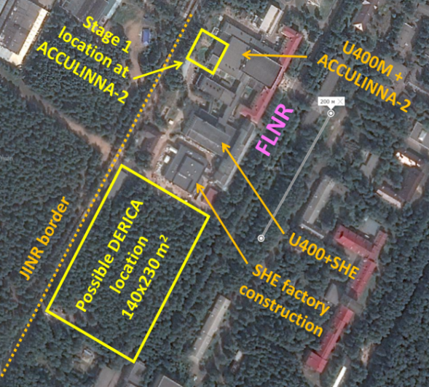
Construction of a prototype of the initial section of a high-current heavy-ion linear accelerator aimed at producing intense radioactive ion beams for basic research
Leonid Grigorenko
Flerov Laboratory of Nuclear Reactions, JINR, Dubna
http://aculina.jinr.ru/ derica.php
50th meeting of the Program Advisory Committee for Nuclear Physics, Dubna, Russia, June 24-25, 2019

Slide 2
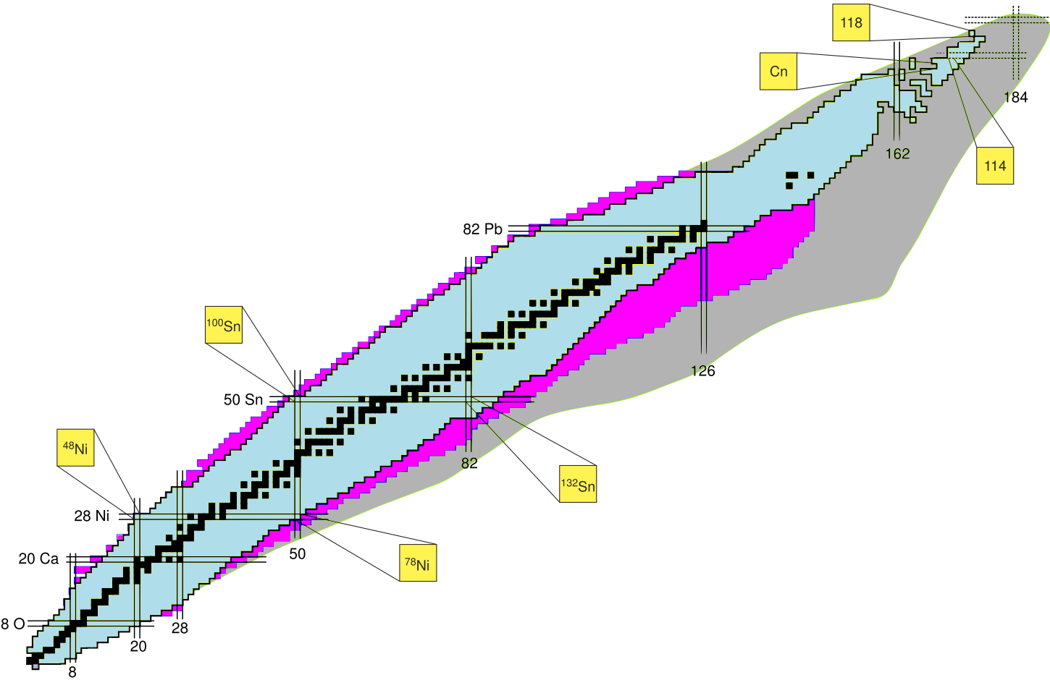
Mid-range planning prospects
“Factory of superheavy elements”
Stage: commissioning
Near future
Facility based on upgraded U-400M + ACCULINNA-2 Stage: first full scale experiments in fall 2018/spring 2019, repair/upgrade U-400M starts in summer 2020
Near future

Slide 3
Long-range planning prospects
“Factory of superheavy elements”
Stage: commissioning
Near future
???
Long-time prospects
Facility based on upgraded U-400M + ACCULINNA-2 Stage: first full scale experiments in fall 2018/spring 2019, repair/upgrade U-400M starts in summer 2020
Near future

Slide 4
To limit universality To go to “underdeveloped” fields
Huge increase in the scale of modern and prospective RIB facilities:
Starting price tag 1-2 G€
Scale increase – (i) RIB production increase via primary beam energy increase and (ii) universality of RIB facility
Is it possible to have world competitive RIB program with modest investment scale?

Slide 5
Empty “ecological niche”
Underdeveloped field: storage ring physics with RIBs
Empty field: studies of RIBs in electron-RIB collider
Studies of electromagnetic formfactors of exotic nuclei in e-RIB collider
Isochronous mass spectromentry
RIB storage ring
Precision reaction studies on internal gas jet target
electron storage ring
Atomic physics studies with striped ions
Etc….
Radioactivity studies with striped ions

Slide 6
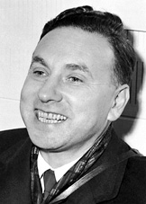
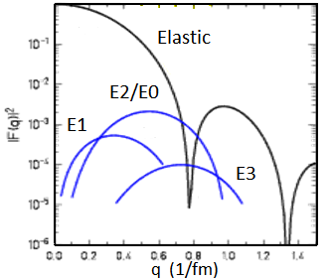
Electron scattering
Robert Hofstadter 1915-1990,
1961 Nobel Prize "for his pioneering studies of electron scattering in atomic nuclei and for his consequent discoveries concerning the structure of nucleons.."
After masses, the radial properties are the most important characteristics of nuclei
First Born approximation, fast electrons, relatively light nuclei электроны, достаточно легкие ядра
Charge formfactor, charge radius
Electromagnetic probe is the most reliably studied - Electron scattering
- Experiments in traps – “static” EM characteristics -> derivation of r_{ch}
- Electron scattering – differenttial characteristics

Slide 7
Status of charge radii studies – broad field for exploration
900 measured for 3100 known nuclear-stable isotopes
Some isotopic chains are well studied – some not at all
Somewhere driplines is nearly achieved – somewhere very far
Systematics demonstrate complicated dynamical effects in the isotopic chains, especially near the driplines

Slide 8
DERICA – Dubna Electron-Radioactive Isotope Collider fAcility
Project emphasis
Reaccelarated RIBs, storage ring physics including e-RIB collider
Basic facility
High-current superconducting HI cw-LINAC-100

Slide 9
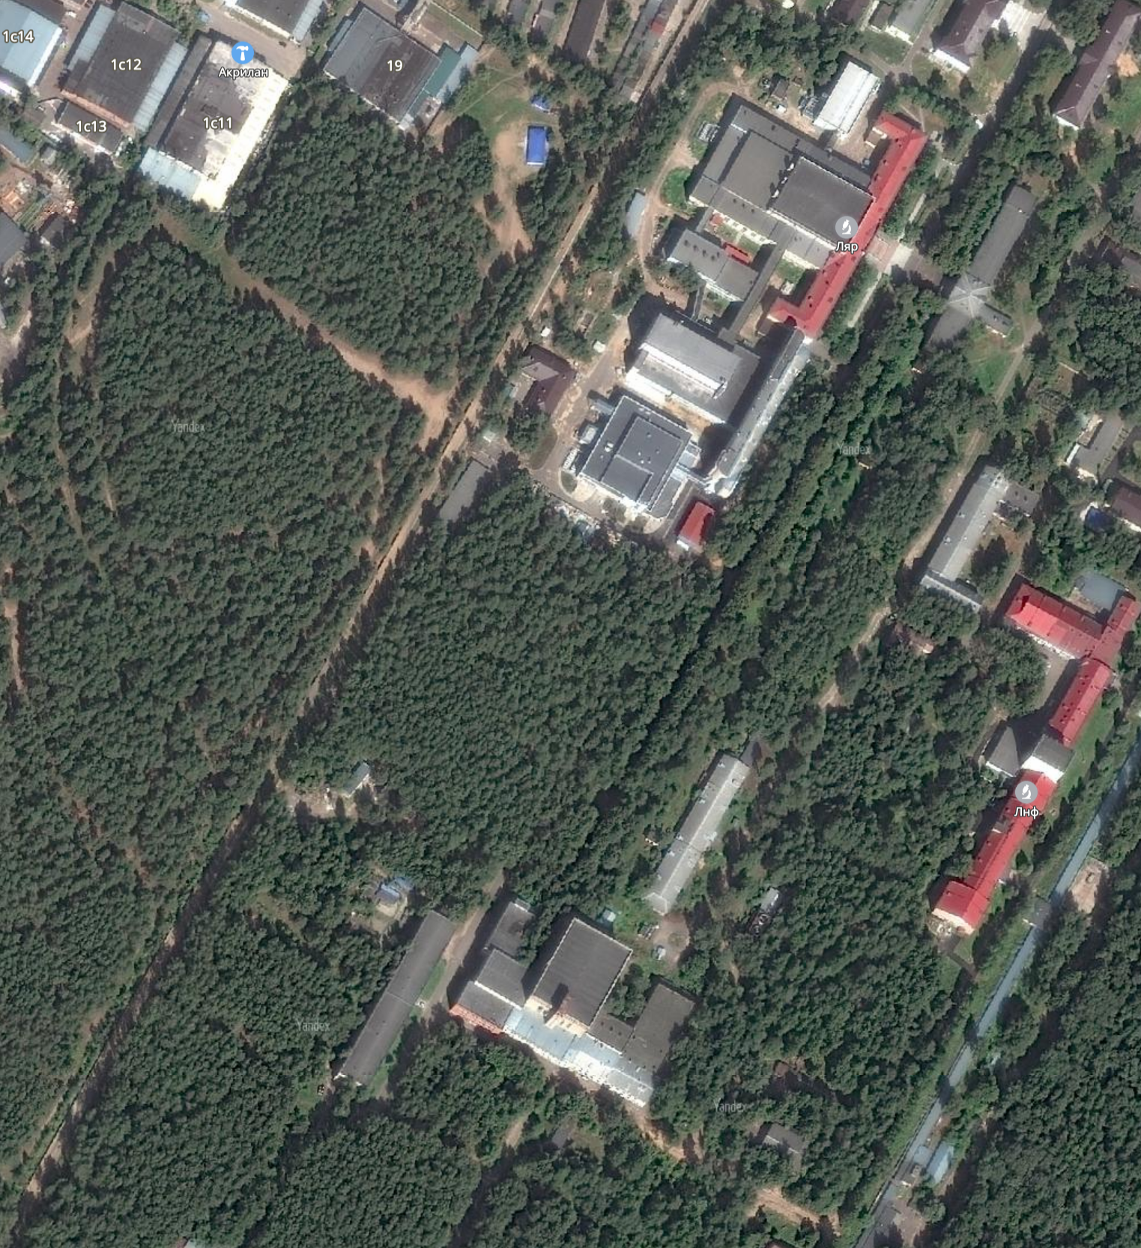
Possible DERICA location
Sufficient free place
U-400M +
ACCULINNA-2
U-400 + SHE
Considerable possibilities for upgrade
Possible DERICA
location
130 x 240 m²
SHE Factory
JINR border

Slide 10
Primary beams at modern and prospective RIB factories
RIBF (RIKEN) 370 AMeV FAIR (Darmstadt) 1800 AMeV FRIB (MSU) 240 AMeV RAON (S.Korea) 200 AMeV HIAF (China) 800 AMeV
No way to compete in primary beam energies
DERICA strategy for RIB production
Focus efforts on HIGH INTENSITY of primary beams with relatively MODEST ENERGIES ~100-160 AMeV
Advantages of relatively low-energy RIBs:
- Easier to study direct reactions
at 20-70 AMeV
- Easier to work with stopped beams
The first challenge of the project – to construct record high-current (e.g. Ca beam ~3 emA, U beam ~1 emA) ~30 pmA heavy-ion superconducting cw-LINAC

Slide 11
Advantages of the proposed facility
Unusual facility layout
Ordinary approach 1:
ISOL RIB production ->
problem to reaccelerate RIBs
Ordinary approach 2:
In-flight RIB production ->
Problem to stop/cool RIBs
DERICA approach:
In-flight RIB production + RIB “cooling” in gas cell + reaccelerated RIBs up to 500 AMeV
Staged development
- Continuity and flexibility of the research program
- Low technological risks
- Highly upgradable facility design
Unique opportunities
- World most intense RIBs for direct reaction studies at intermediate (20-70 AMeV) energies - Reaccelerated RIBs up to 500 AMeV
- e-RIB collider experiment

Slide 12
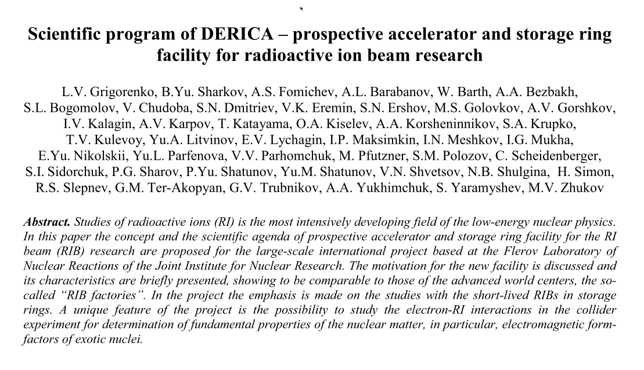
Letter of Intent:
Russian review journal Physics-Uspekhi (2019)
http://aculina.jinr.ru/derica.php

Slide 13
Public visibility of the project
« ECT* workshop on “Probing exotic structure of short-lived nuclei by
electron scattering”, July 16 – 20, 2018
« 41 European Cyclotron Progress Meeting, Dubna, Russia, September 3 – 5, 2018
« EXON 2018, Petrozavodsk, September 10 – 14, 2018
« General meeting of the Physical Section of RAS November 12, 2018
« Technical Meeting on Novel Multidisciplinary Applications with Unstable Ion Beams and Complementary Techniques , IAEA Headquarters, Vienna, Austria, December 10–14, 2018
« Nuclear Physics section of RAS meeting, JINR, Dubna, March 14 – 15, 2019
« NUPECC meeting, Dubna, Russia, June 20 – 21, 2019
April 26, 2018. The is project is submitted to Russian Ministry of Education and Science on the call for «Proposals to build “megascience”-class facilities on the territory of Russian Federation» as joint JINR-BINP venture
In September 2018 evaluation by Russian Academy of Sciences positioned DERICA in the top of the proposals list.

Slide 14
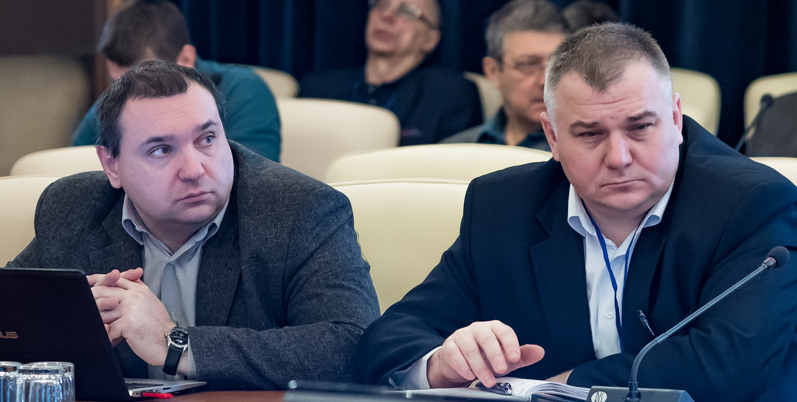
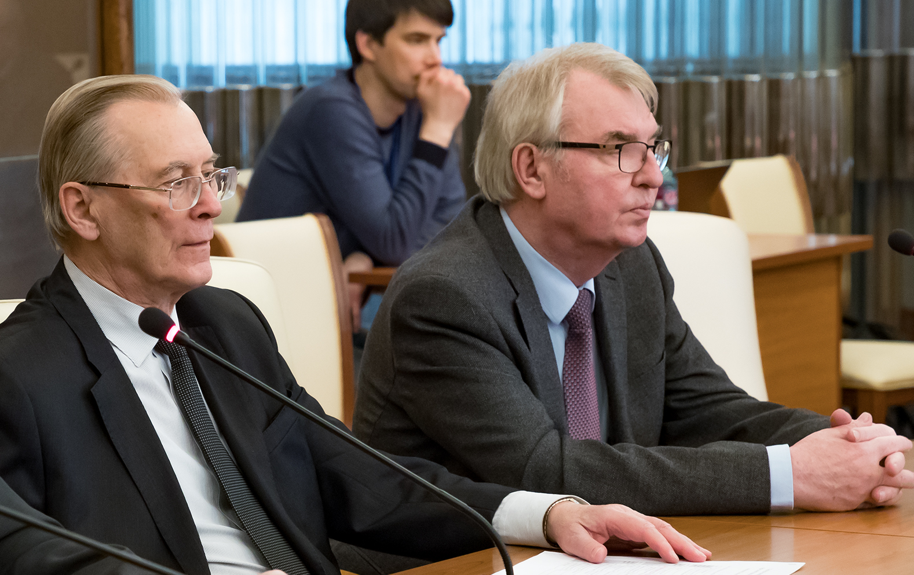
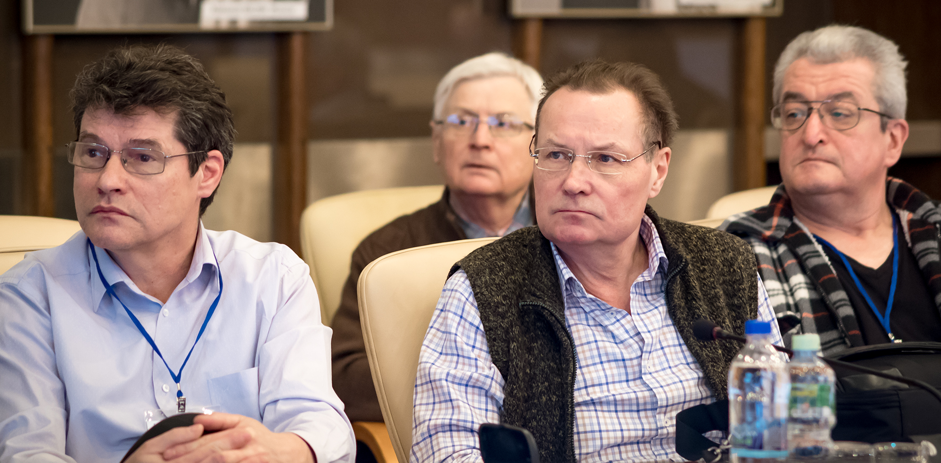
LINAC-100
DERICA workshop February 7-8, JINR
Declaration of most urgent task
To start development of the “front end” for LINAC-100 immediately
Support by JINR directorate for 2019
- Resources allocated: 650 k$
New research project at JINR for 2020-2021
- Decision to be made by JINR PAC 24-25 June 2019
- Expected resources 2020: 1400 k$ - 2021: 1450 k$
Expected output by the end 2021
- TDR + prototypes for LINAC-100 - CDR for DERICA

Slide 15
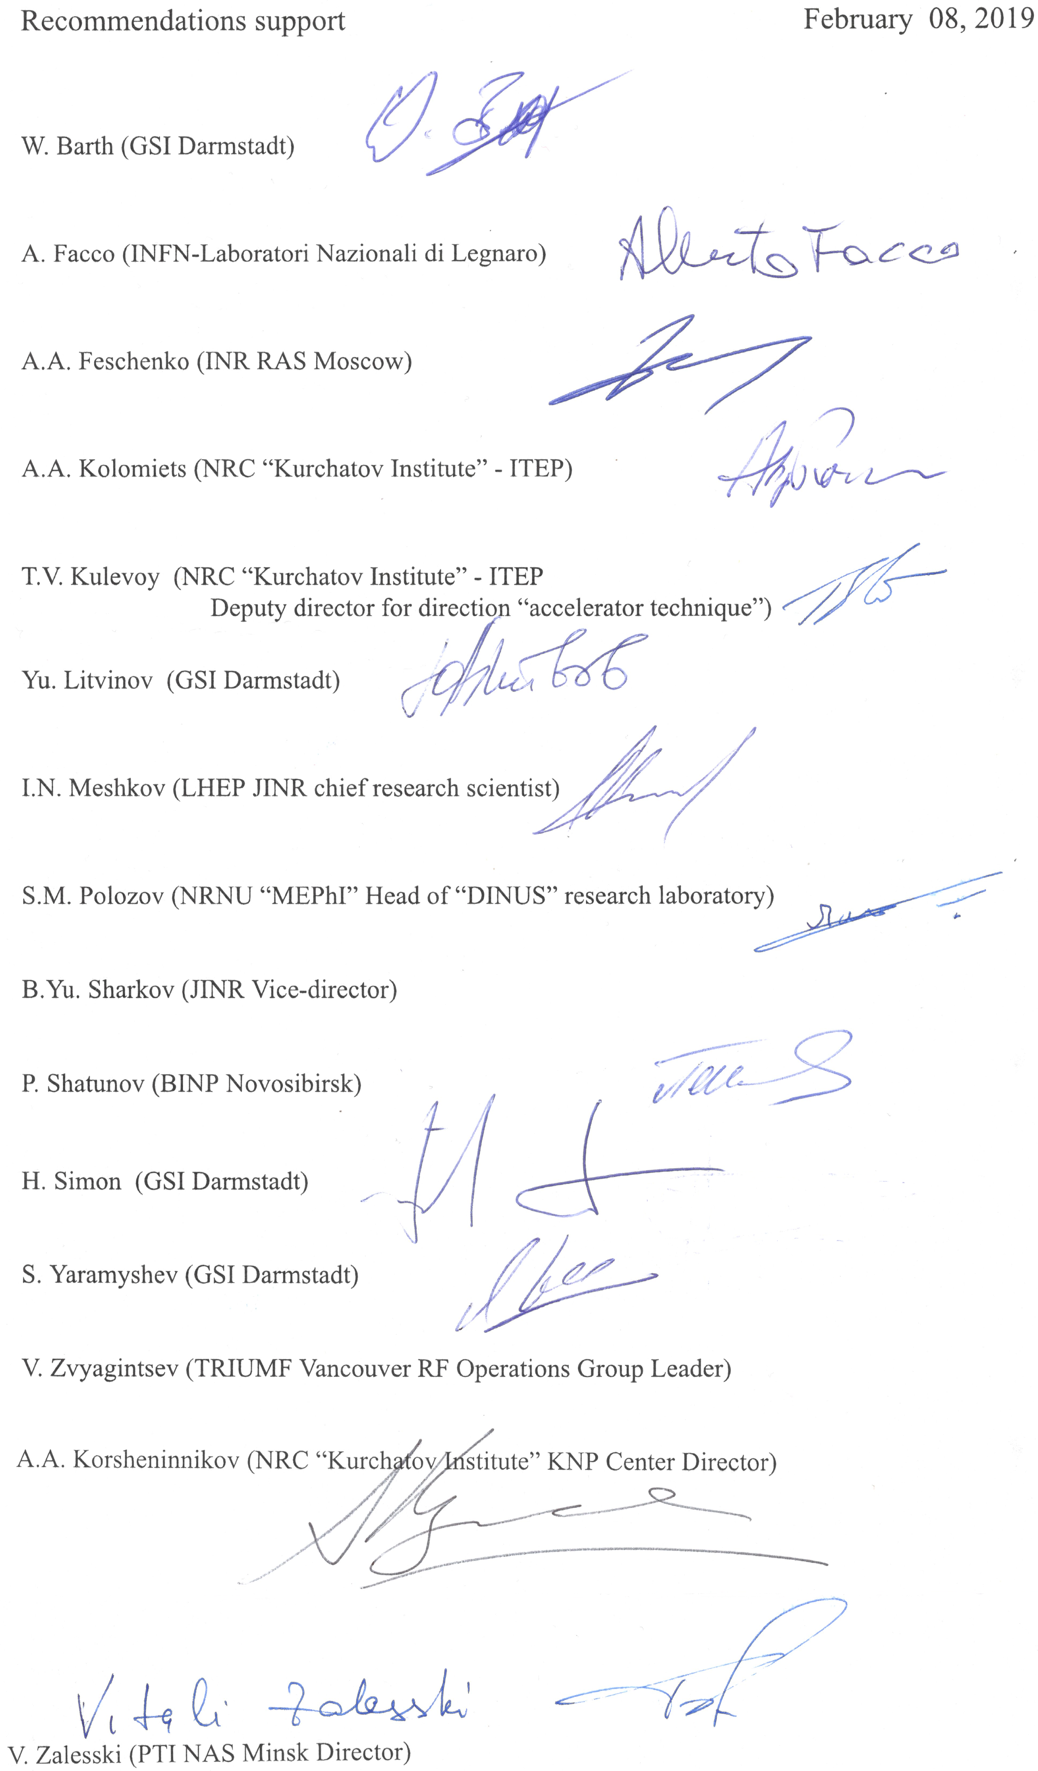
Recommendations
DERICA workshop February 7-8, JINR
The expert board of the technical meeting recommends to initiate the development of the technical design for the high-current heavy-ion cw-LINAC and fragment-separator DFS conjugated to it. The R&D works for the prospective LINAC “front end” (new generation 28 GHz ECR ion source and RFQ) should be started ASAP as this is the most long-term development in the LINAC construction. It is recommended to conduct simultaneously the conceptual design studies for the prospective storage-ring and collider DERICA facility. The design has to be developed in such a way that guarantee upgradeability of the LINAC-50+DFS to the “full format” of the DERICA facility.

Slide 16
LINAC-100 working plans
LINAC-100 concept
– Front-end: 1 (universal A/Z~3-8) or 2 (A/Z~3 + A/Z~6-8)
– Ratio of warm/cryogenic parts to be decided
– “Acceleration tactics” – A/Z, strippers, etc. MEPhI + ITEP + GSI
Prospective ECR ion source 28 GHz
– Design FLNR – Magnetic system NIIEFA – RF system IAP Nizniy Novgorod
Prototyping front-end for LINAC-100
– Test ECR на for current ~ 3-5 mА FLNR + NIIEFA
– Up to 3 sections of RFQ VNIITF
– Test assembly ECR + LEBT + RFQ FLNR + ITEP + INR Troitsk
By the end 2021: TDR for LINAC-100, front-end prototype, prototype parts for ECR-28

Slide 17
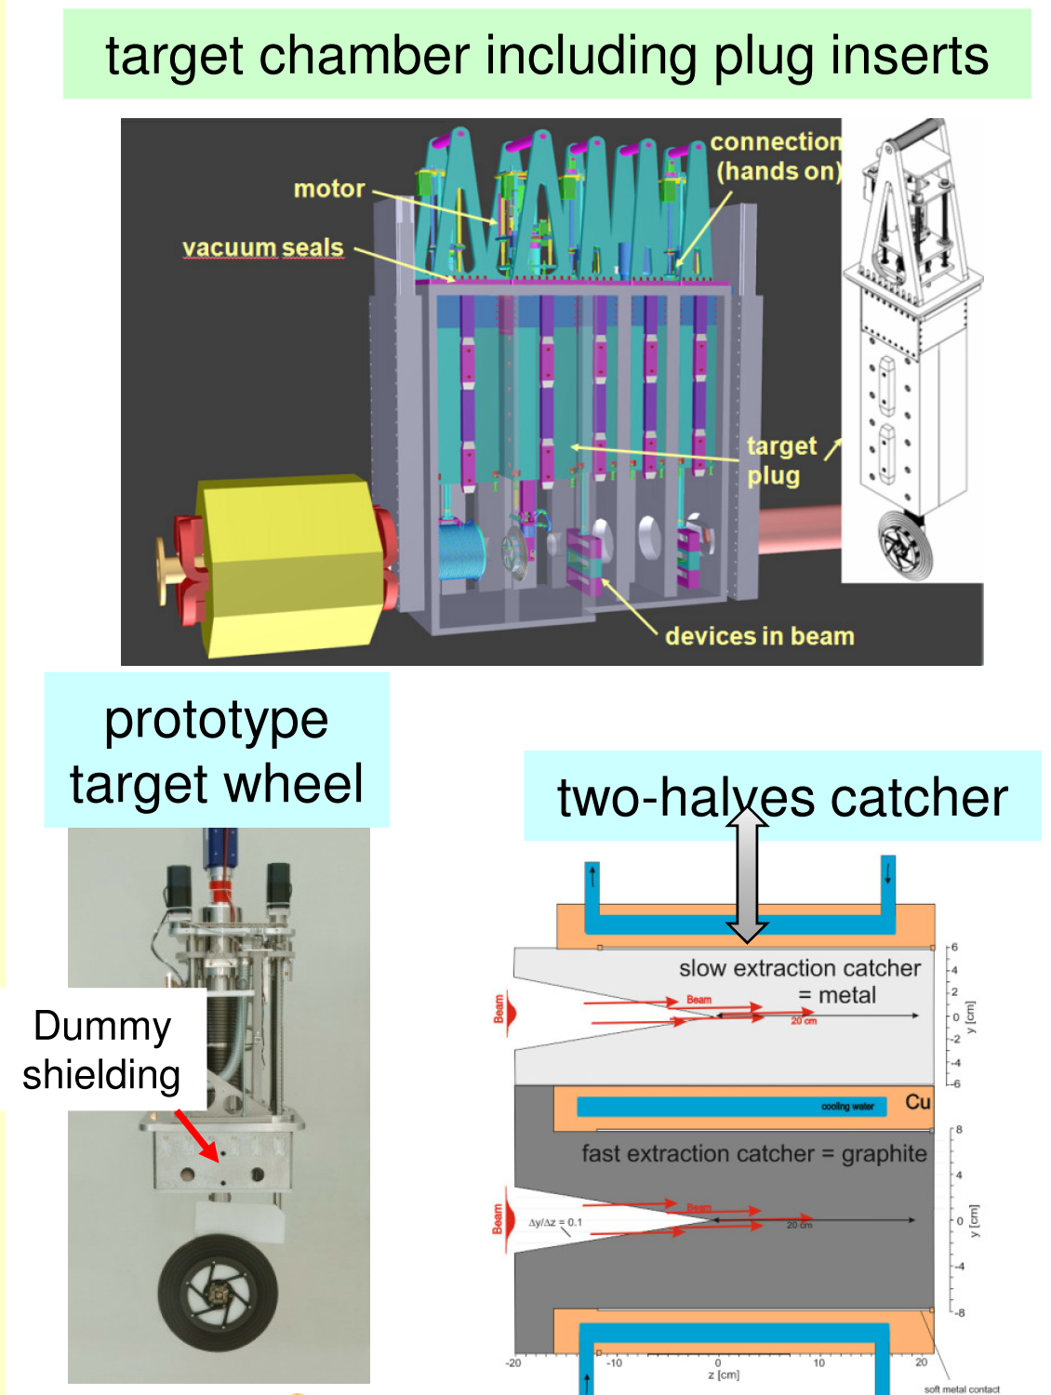
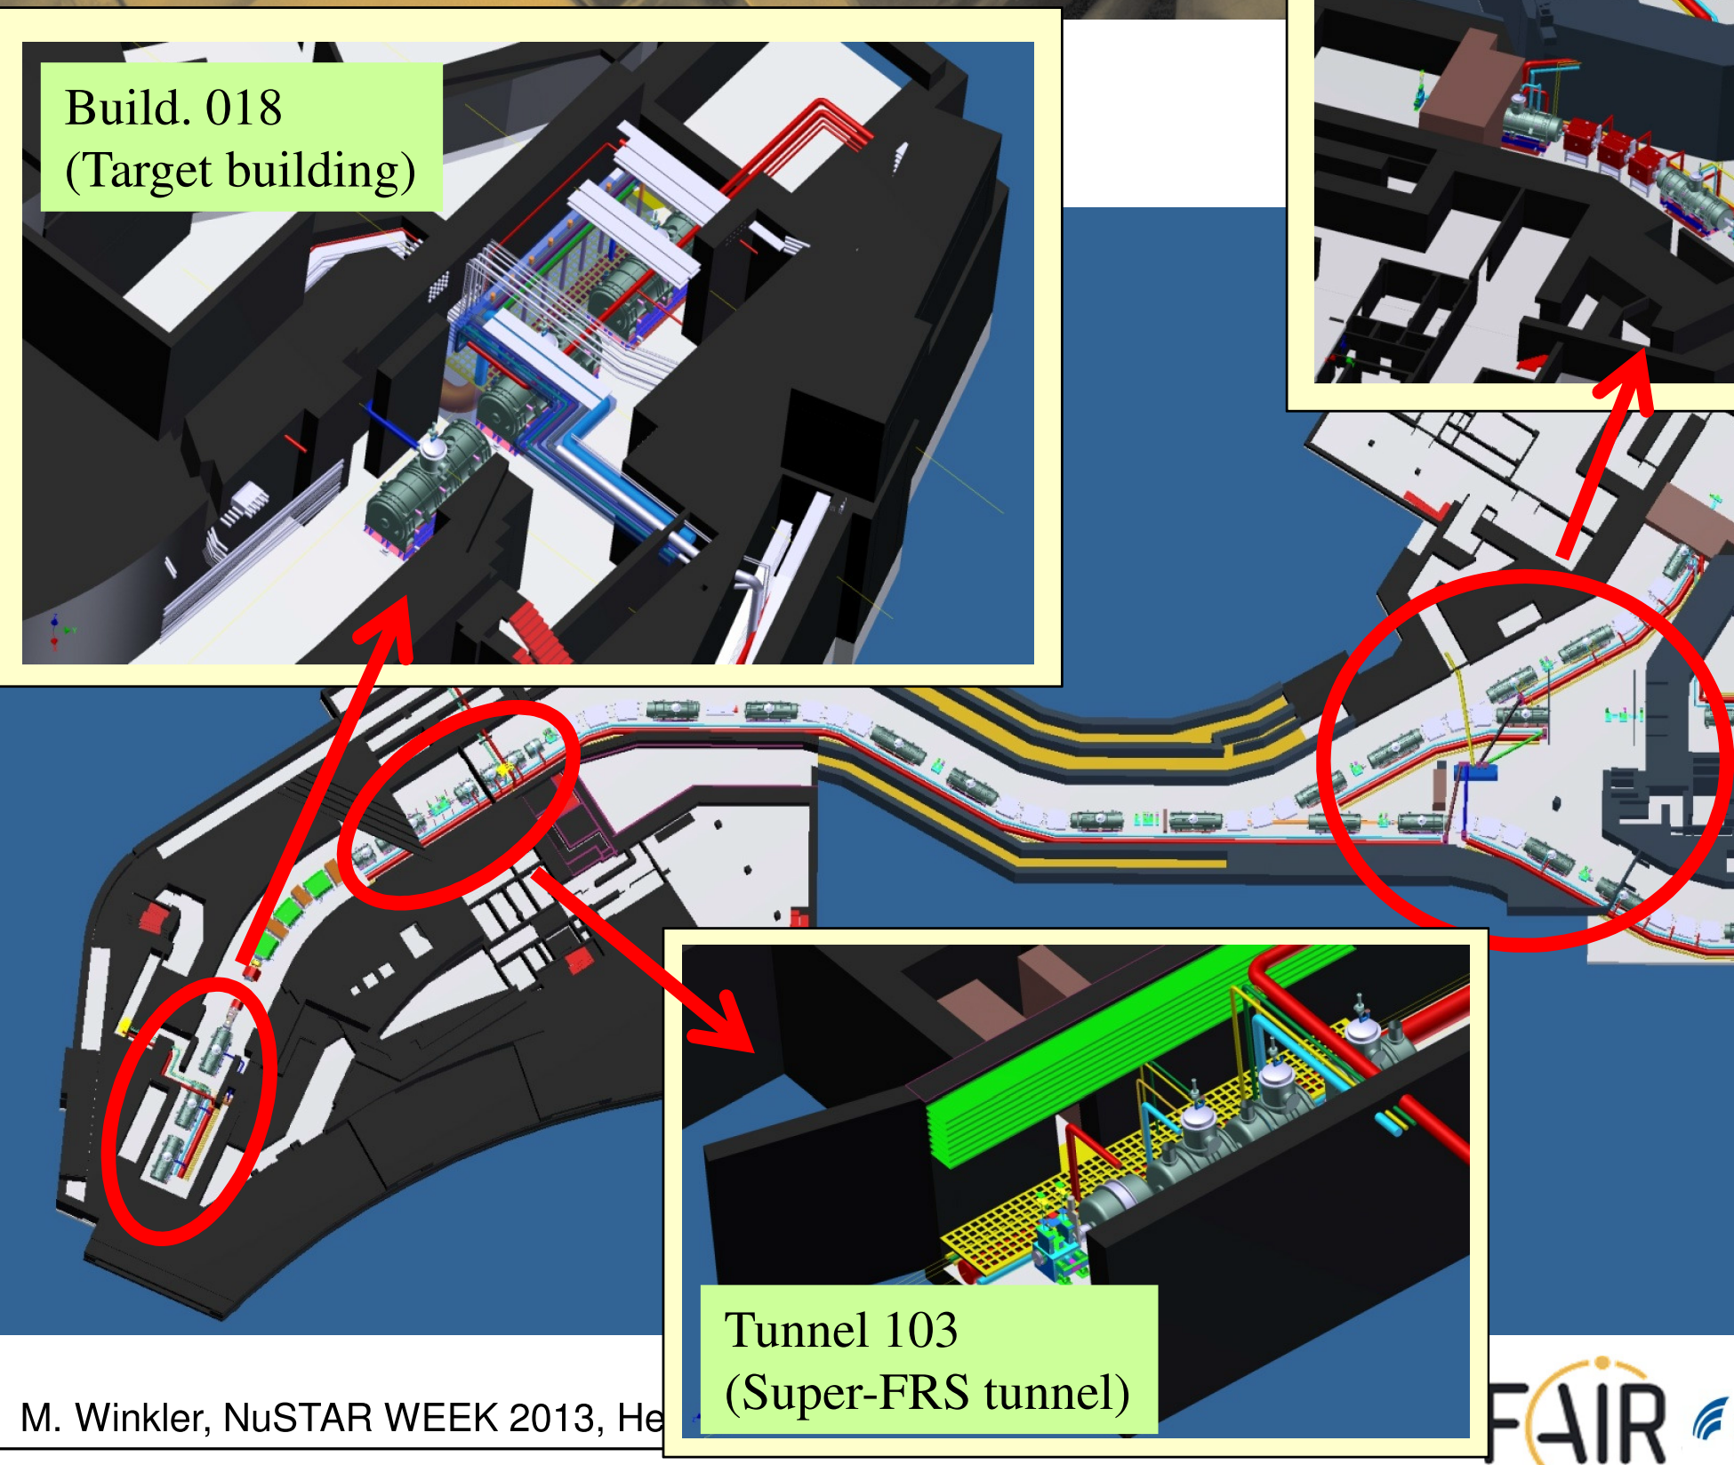
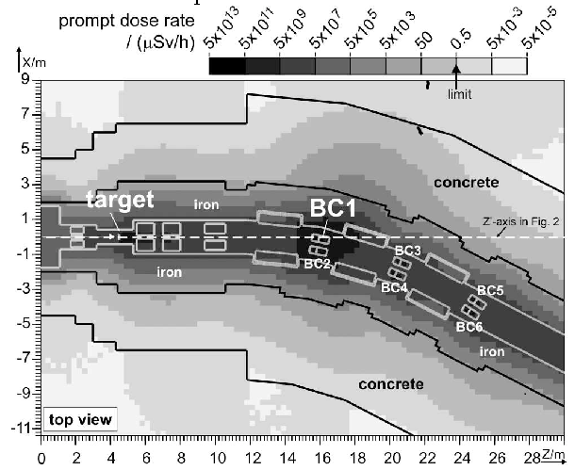
Challenge of DFS – DERICA Fragment separator
DERICA, DFS
- Ca beam ~3 emA ~250 pμA 1500 kW beam
- U beam ~1 emA ~30 pμA 600 kW beam
FAIR, SuperFRS
U beam ~1500 AMeV
план: ~1 pμA реальность: ~200 pnA
By the end of 2021 CDR for production target, radiation shielding and DFS are ready

Slide 18
Challenge of ring branch
Low-energy storage ring
– Energies 3-30 AMeV – Shape – probably «hexagon» (???)
Fast ramping synchrotron FRR
– Injection ~30 AMeV, extraction 100-500 AMeV (???)
High-energy storage ring
– Energies 100-500 AMeV (???) – Shape – probably «square» (???)
e-RIB collider facility
– е-LINAC – electron storage ring
– collision point (???) – electron spectrometer (???)
By the end of 2021 BINP Novosibirsk produce major part of CDR for the ring branch

Slide 19
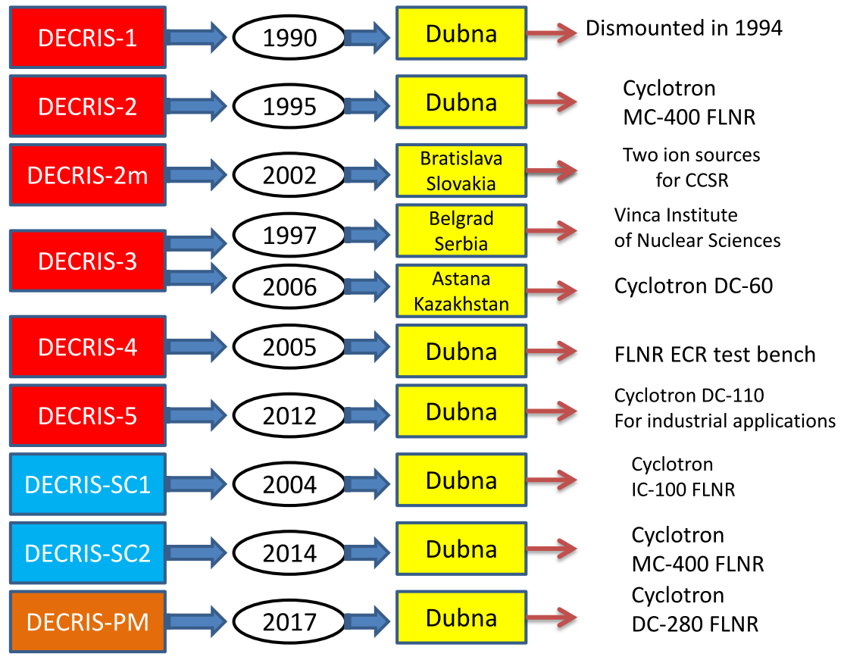
By A. Efremov

Slide 20
By A. Efremov

Slide 21
By T. Kulevoy
Layout of normal conducting part of LINAC for DERICA
IS+LEBT
A/Z ≤ 7
CW Input current=1 mA
Input transverse emittance ε=1 π·mm·mrad
E_{smax}=1.5 Kp
V_{k} / ε ≥ 6
R_{b} /R_{a} ≤ 0.75, R_{b} – beam radius; R_{a} – aperture radius
Transport (N_{out} /N_{inj}) = 100%
Transmission (N_{out} (accel)/N_{inj}) = 100%

Slide 22
By T. Kulevoy
Main parameters of NC linac

Slide 23
By V. Zaleski

Slide 24
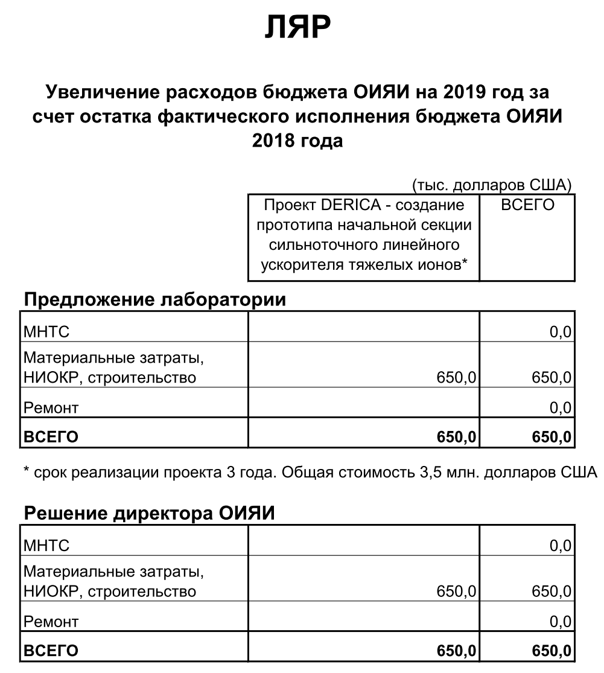
Support for 2019
FLNR
- 2019 budget increase via JINR budgetary funds return for 2018.
- Development of the front-end prototype for high-current heavy ion cw-LINAC
650 k$

Slide 25
Contracts
MEPhI
Development of the superconducting part for accelerator-driver LINAC-100 for DERICA project
3900 rub
ITEP
Simulations of beam dynamics and electrodynamics of resonators for normal-conducting cw-RFQ for DERICA project
6650 rub
INR Troitsk
Development of the bunch diagnostics setup for prototype front-end of the high-current heavy-ion linear accelerator
1900 rub

Slide 26
Contracts
IAI RAS St.-Pitersburg
Development of the ion-optical scheme for DERICA fragment-separator
1590 rub
NIIEFA St.-Pitersburg
Calculations and design of magnetic system for 28 GHz ECR ion source
??? rub
IAP RAS Nizniy Novgorod
Radio-frequency power supply for 28 GHz ECR ion source
??? rub
VNIITF Snezhinsk
Prototype RFQ technical design and preparation for production
??? rub
BINP Novosibirsk
CDR for DERICA ring branch
??? rub

Slide 27
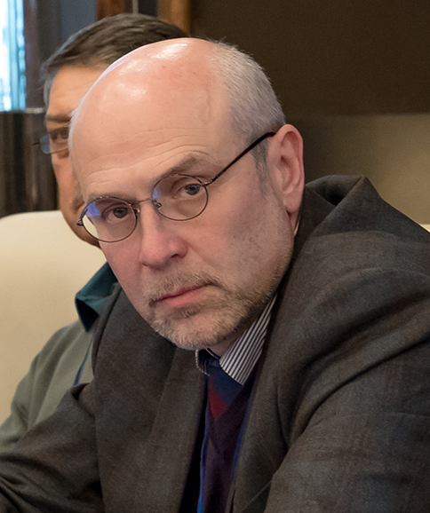
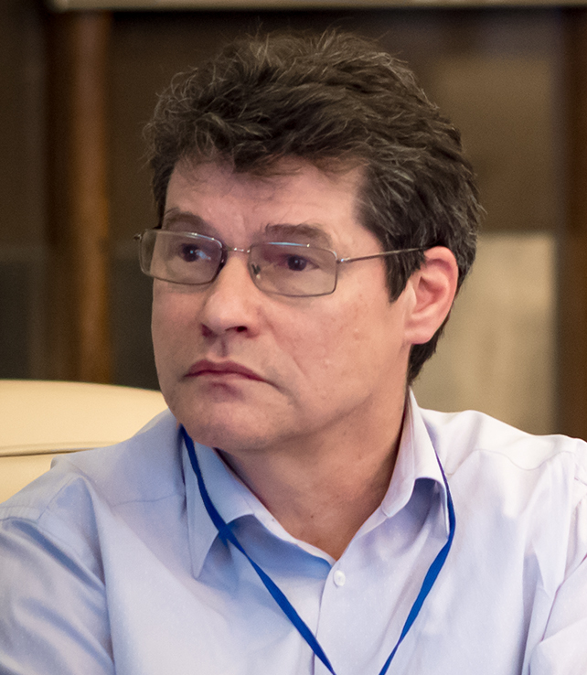
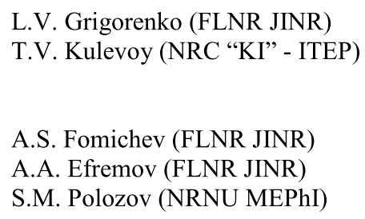
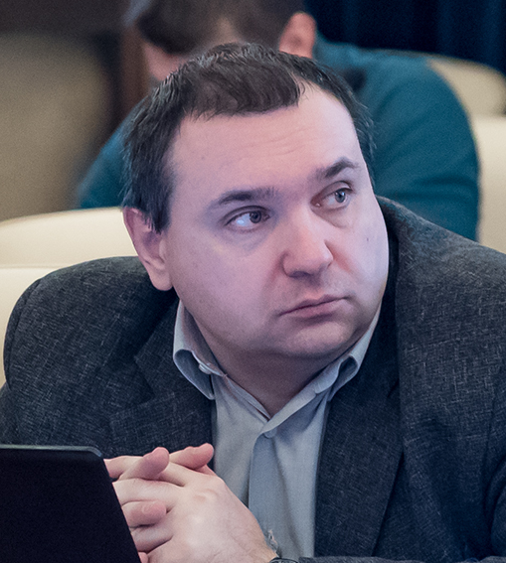
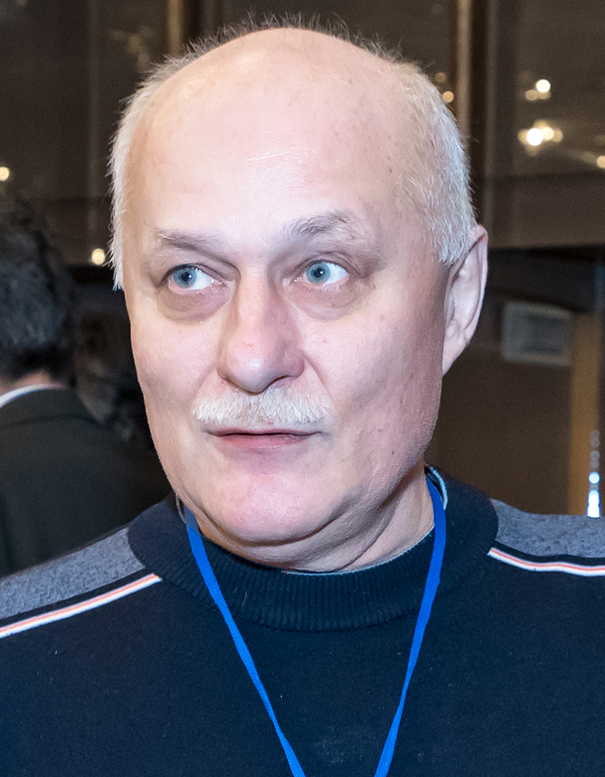
Proposal for the opening of a new project

Slide 28
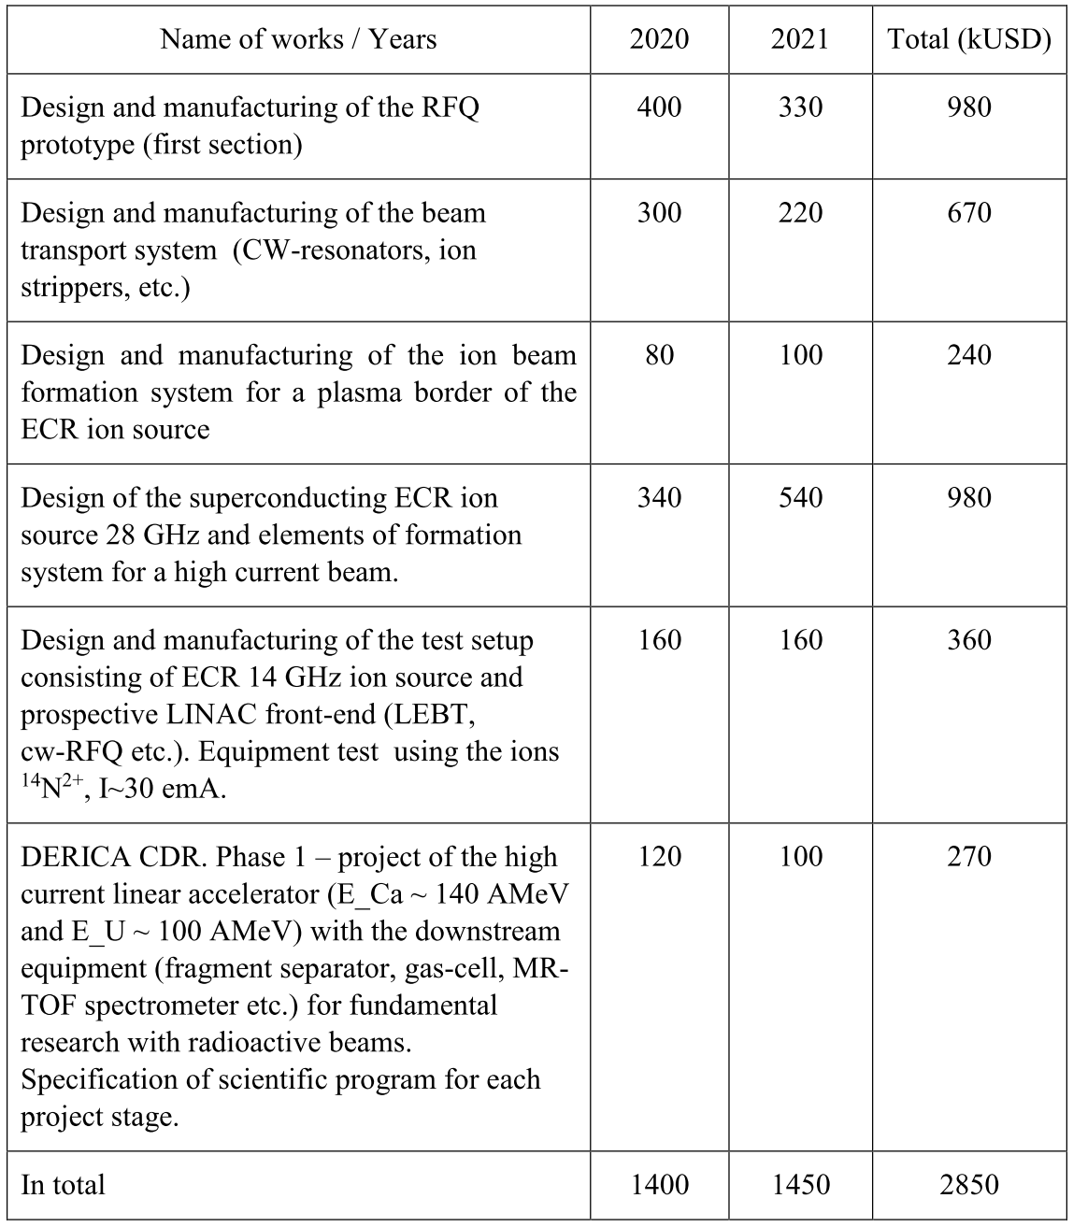
Budget request
for 2019-2020
2020
1400 k$
2021
1450 k$

Slide 29
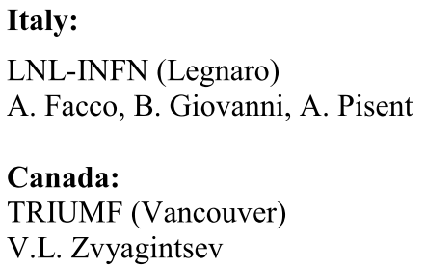
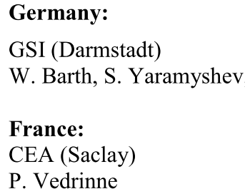
Collaboration
In-house
LINAC

Slide 30
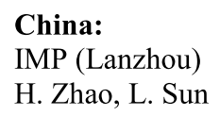
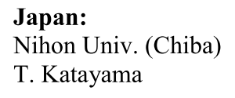
Collaboration
RFQ production
ECR ion source
Fragment separator
Ring branch

Slide 31
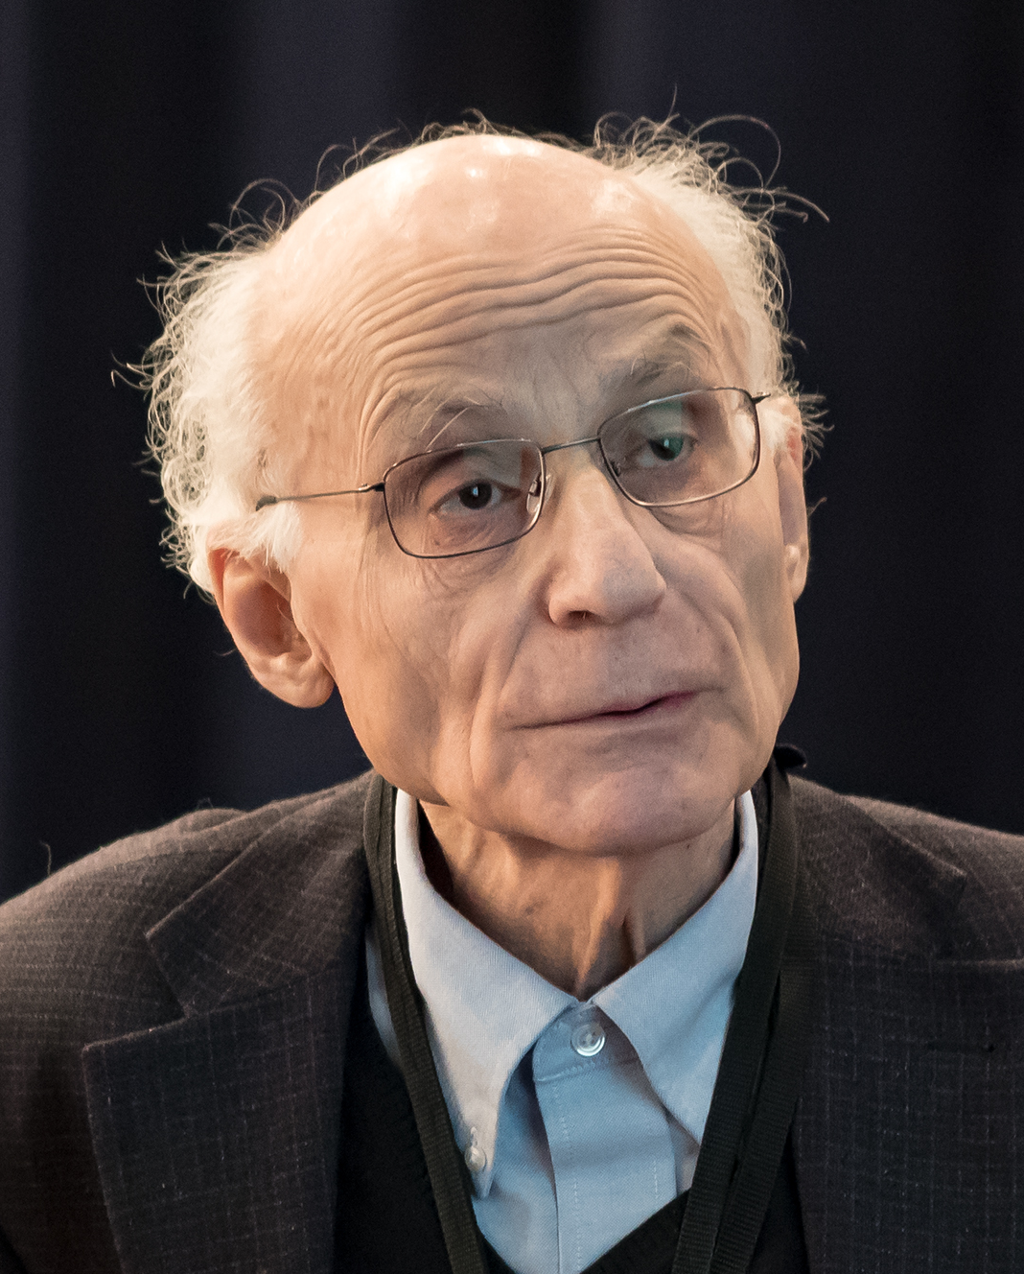
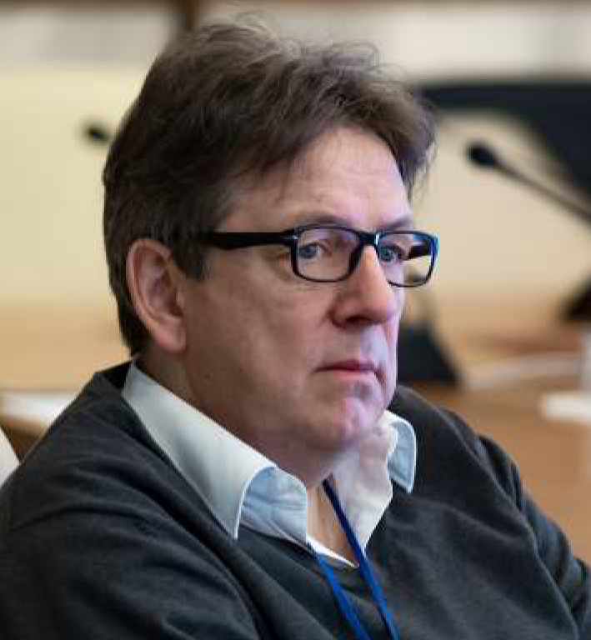
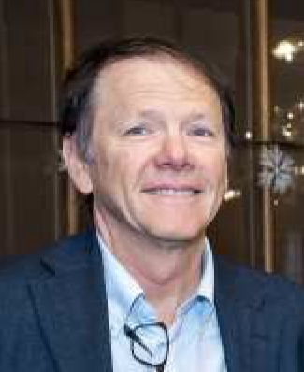
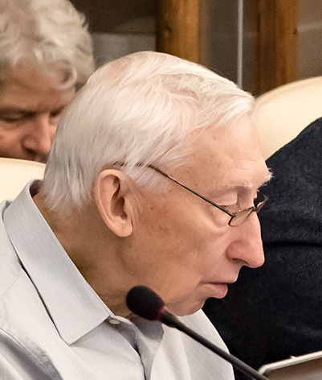
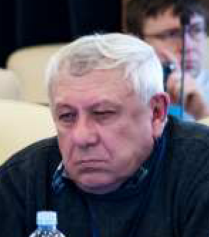
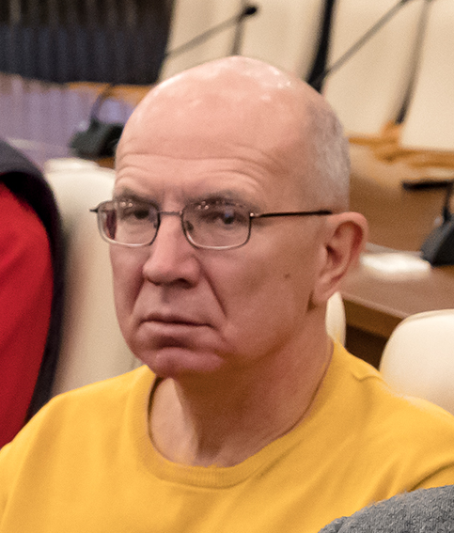
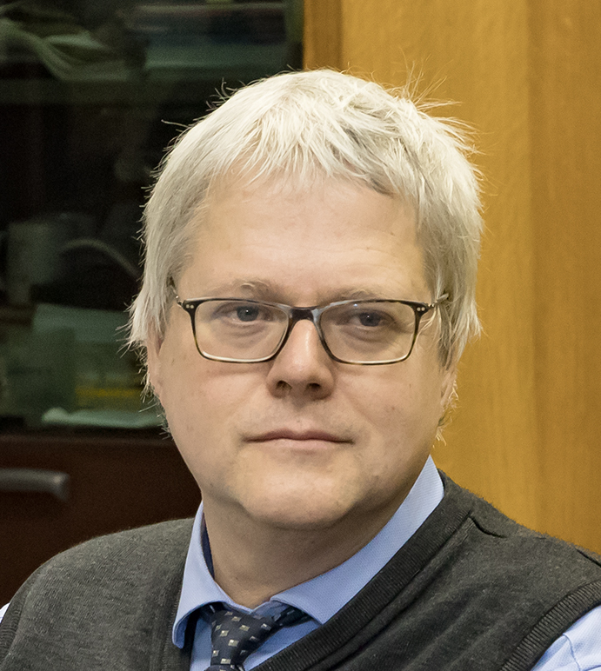
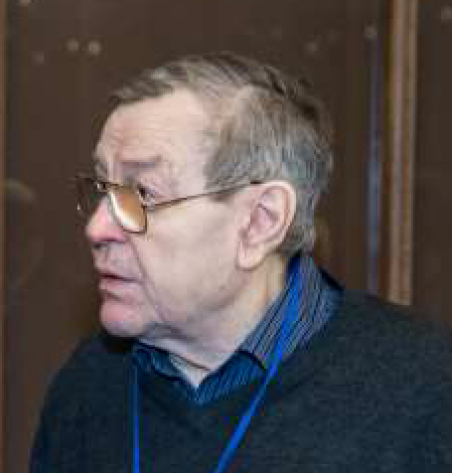
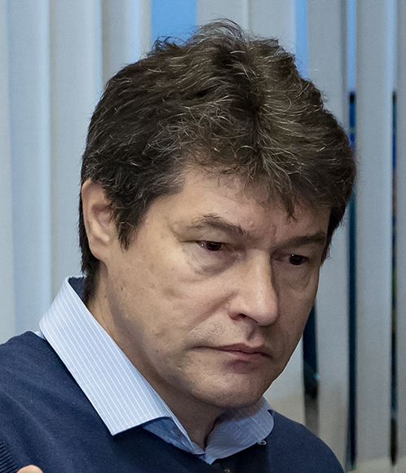
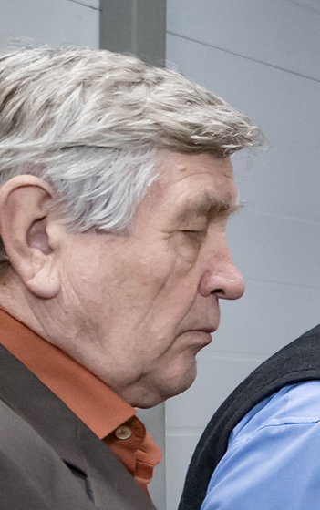
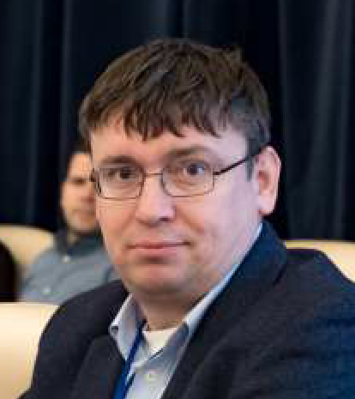
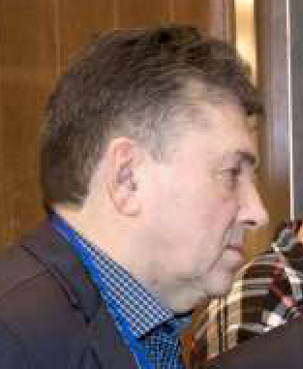
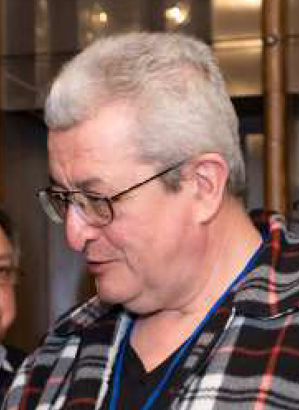
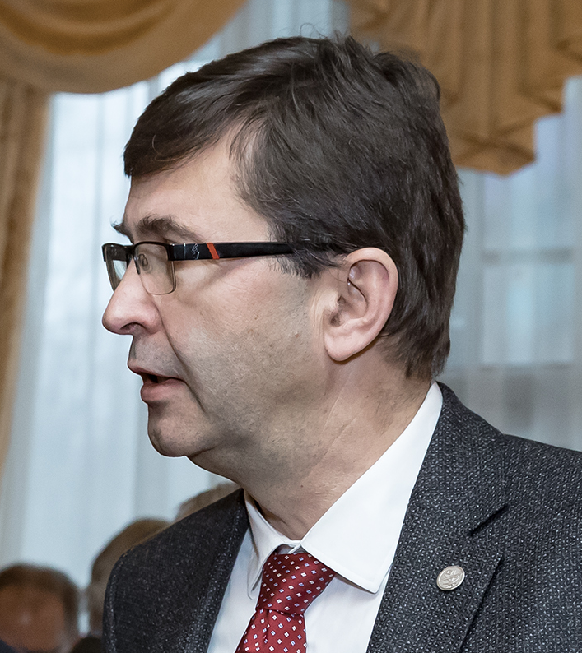
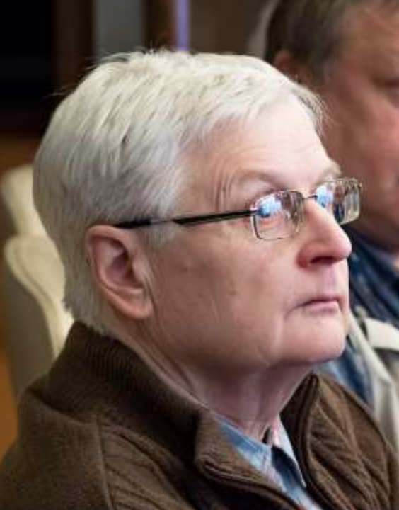
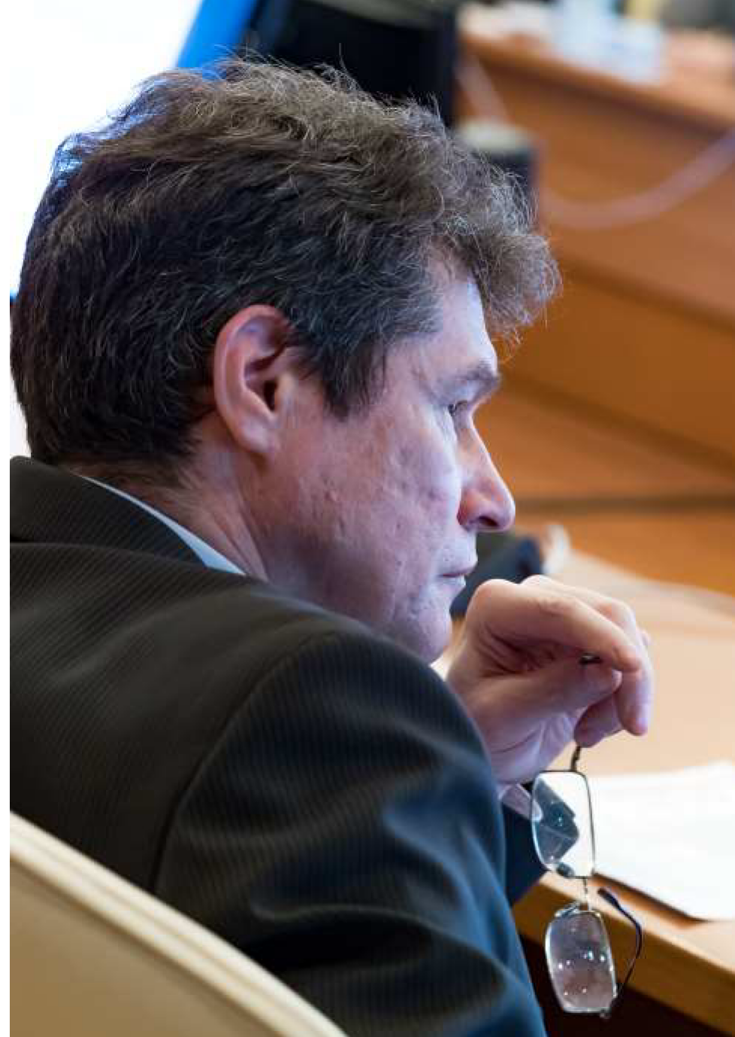
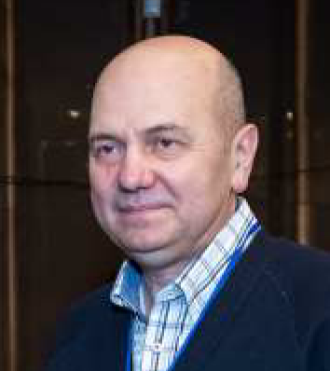
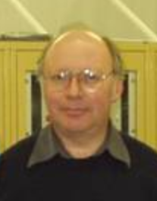
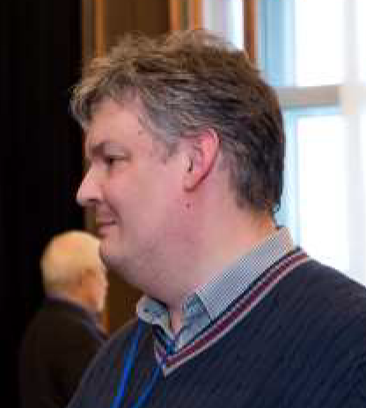
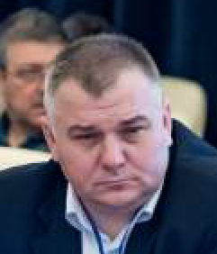
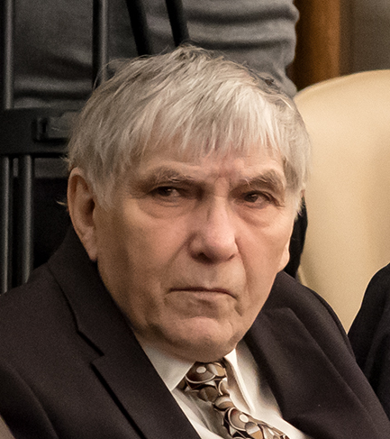
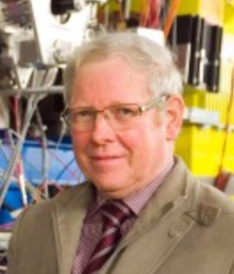
Experts

Slide 32
LINAC-100 + DFS
A realistic option to replace aging
U-400M cyclotron and give bright future to existing RIB program at FLNR (aim – at least factor 100 in beam intensities)
DERICA
In certain sense it is not a project with well defined end point, but a strategy for the low-energy nuclear physics development in JINR and its member states for 15-30 years
PROPOSAL
to support project: “Construction of a prototype of the initial section of the high-current heavy-ion linear accelerator for the production of intense radioactive ion beams for basic research”

Slide 33
RESERV

Slide 34
DERICA stage 2
New scientific opportunities emerging on each stage
LINAC-100 - focus on intensity of primary beam
LINAC-100 design aim Ca – 3 emA U – 1 emA
Direct reactions with RIBs at intermediate energies (30-80 AMeV)
Aim to get record intensitis of 30-80 AMeV RIBs

Slide 35
Primary beams at modern and prospective RIB factories
RIBF (RIKEN) 370 AMeV FAIR (Darmstadt) 1800 AMeV FRIB (MSU) 240 AMeV RAON (S.Korea) 200 AMeV HIAF (China) 800 AMeV
No way to compete in primary beam enegies
DERICA strategy for RIB production
Focus efforts on HIGH INTENSITY of primary beams with relatively MODEST ENERGIES ~100-160 AMeV
Advantages of relatively low-energy RIBs:
- Easier to study direct reactions
at 20-70 AMeV
- Easier to work with stopped beams
The first challenge of the project – to construct record high-current heavy-ion superconducting cw-LINAC

Slide 36
DERICA stage 3.1
New scientific opportunities emerging on each stage
Reactions with post-accelerated RIBs near Coulomb barrier (5-7 AMeV) or at intermediate energies (20-30 AMeV)
Low-energy storage ring
Stopped RIBs – decay, spectroscopy, physics in traps

Slide 37
DERICA stage 3.2
New scientific opportunities emerging on each stage
Syncrotron up to 300-500 AMeV
Direct reactions with post-accelerated RIBs up to 300-500 AMeV

Slide 38
DERICA stage 4.1
New scientific opportunities emerging on each stage
Experiments at high-energy storage ring

Slide 39
DERICA stage 4.2
New scientific opportunities emerging on each stage
e-RIB collider experiments

Slide 40
DERICA – с небес на землю
1 или 2 начальных секции
Шикана и «поляна» для апгрейда
1 или 2 стрипера
DFS и Low-energy buncher
Начинать строить LINAC-100 не понимая как должна расположиться DERICA крайне рисковано
Необходим минимальный НИР по всему проекту DERICA
Газовая система и постускорение
«поляна» для колец

