Slide 1
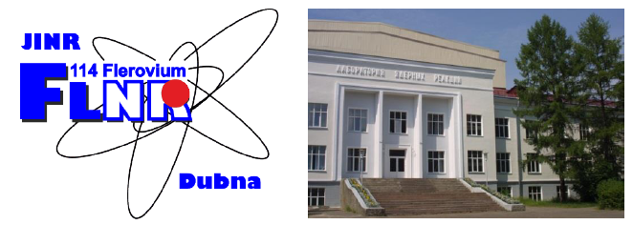
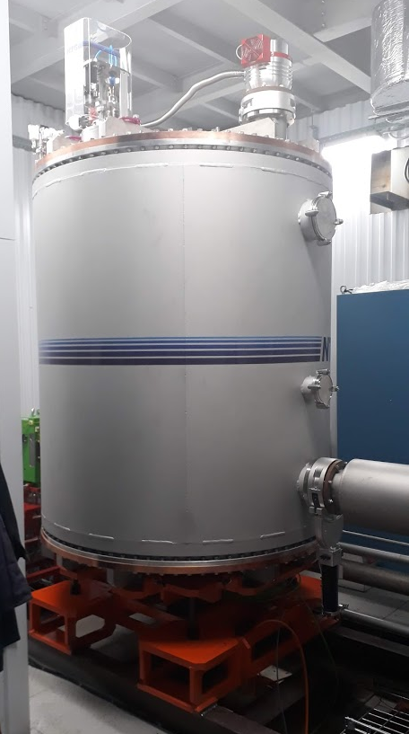
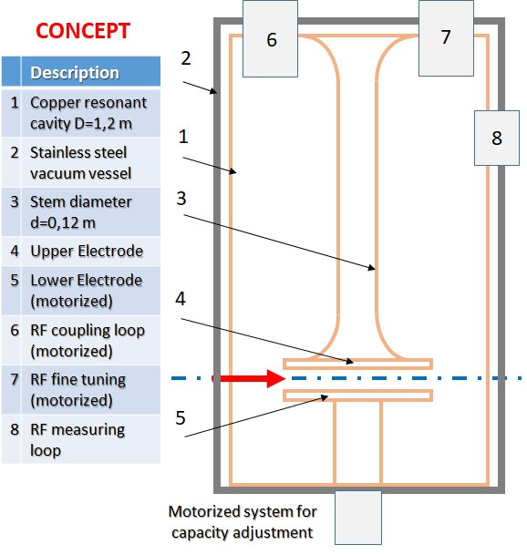
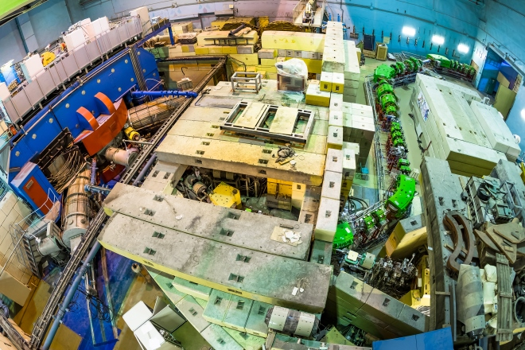
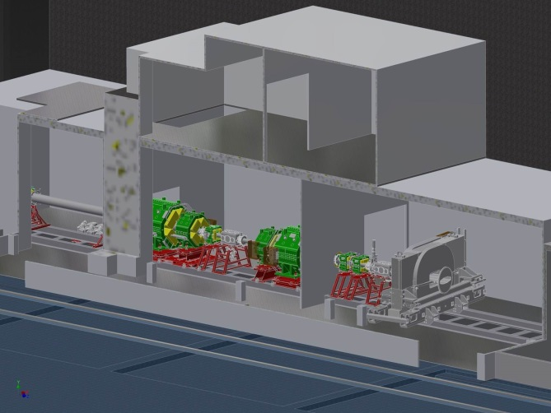
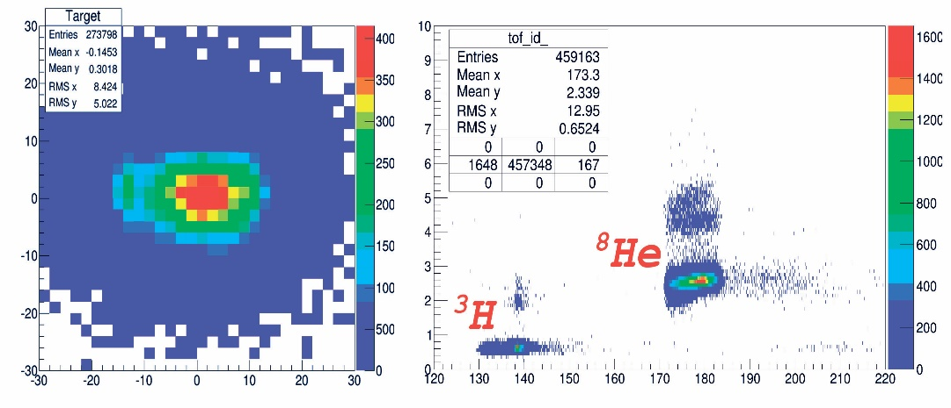

First experiments with RIBs at ACCULINNA-2
fragment separator
A. Fomichev / M. Golovkov
Tritium target complex
D2
D1
F2
F3
Magnet of zero degree
spectrometer
F4
F5
Cyclotron U-400M
RF-kicker
F1
I ~ 10⁵ pps, E ~ 26 AMeV, P > 90%, Ø ~17 mm
June 11, 2019
50th PAC meeting, June 24, 2019

Slide 2
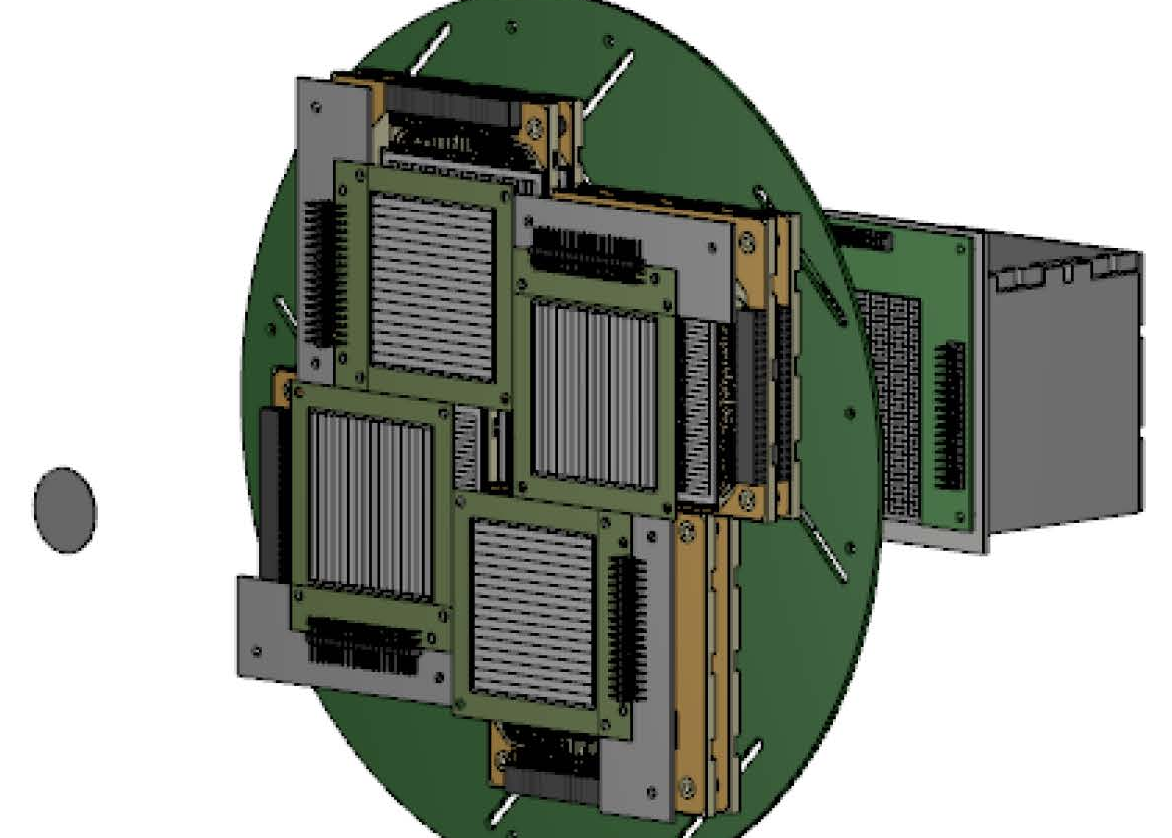
⁸He(d,³He)⁷H - scheme of the 1-st flagship experiments
November 2018: 10 days, two ³He-telescopes installed at 17 deg.
April 2019: 12 days, four ³He-telescopes installed at 15 deg.
³He-tel.
³H-tel.
⁸He 26 AMeV
&
¹⁰Be 44 AMeV
¹⁰Be(d,³He)⁹Li
Δθ ~ 0.5 deg.
ΔE < 2%
* Expected energy resolution for the ⁷H missing mass spectra was about 1.1 MeV
** Efficiency of ³He-³H coincidence was about 65% (Nov.2018) and 75% (Apr.2019)

Slide 3
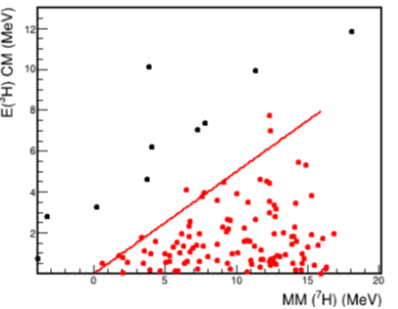
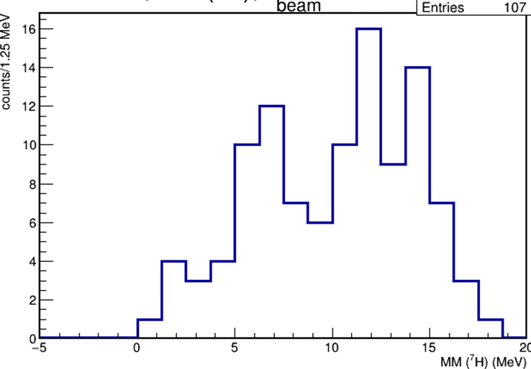
⁸He(d,³He)⁷H – preliminary results, energy distributions (Nov. 2018)
E ~ 6.5(5) MeV
Г ~ 2.0(5) MeV
Key advantage
of ³H detection is
the kinematical
triangle !!
⁷H_{g.s.} ?

Slide 4
⁸He(d,³He)⁷H – dependence on triton energy and angle (Nov. 2018)
Missing mass spectrum of ⁷H for the ⁸He(d,³He)⁷H
reaction at 26 AMeV obtained in coincidence with tritons (E_{t} > 65 MeV). Blue dashed curve means the t+4n five body phase volume and the peak at 6.5 MeV. Green doted curve shows experimental setup efficiency (a.u.).
Data for the ⁸He(d,³He)⁷H reaction at 42 AMeV by E.Yu. Nikolskii et al., Phys.Rev. C 81, 064606 (2010). Coincidence with tritons obtained without energy selection.
Correlations in ⁷H c.m.s.
ΔE < 2%; Δθ ~ 0.5 deg.
3/2+;5/2+
⁷H_{g.s.}
ΔE ~ 1.1 MeV
Events/1.5 MeV Events/0.3 MeV Events/1.25 MeV E_3H (MeV
Theoretical calculations for [s²_{1/2} p²_{3/2}]₀ valence neutron configuration for different E_{T}
ΔE ~ 1.9 MeV
Bezbakh A.A., Chudoba V., Krupko S.A., et al.
arXiv: 1906.07818v1 [nucl-ex] 18Jun2019

Slide 5
⁸He(d,³He)⁷H – preliminary summary (Nov. 2018)
The indications for the ⁷H g.s. at 2.0(5) MeV are found in the measured energy and angular distributions.
Quite a low population cross section of ~10 µb/sr was obtained for ⁷H g.s. Attempts to observe ⁷H g.s. in the same reaction at E < 3 MeV were reported early [M.S. Golovkov et al., AIP Conf. Proc. 912, 32 (2007); E.Yu. Nikolskii et al., Phys. Rev. C 81, 064606 (2010)] and the cross-section values dσ/dΩ < 20 µb/sr and ~ 30 µb/sr were obtained respectively.
For the first time, the ⁷H excited state is observed at E_{T} ~ 6.5(5) MeV with Г ~ 2.0(5) MeV. It’s probably a mix of 3/2+ and 5/2 states, built upon the 2+ excitation of valence neutron, or one of the doublet states.
The data with more statistics (April 2019, under analysis now) will clarify the mentioned above statements.

Slide 6
⁹Li(d,p)¹⁰Li → n+⁹Li /the 2-d flagship experiment, March 2019/
¹⁰Li was studied many times using:
reactions with pions [Amelin et al., Yad. Fiz. (1990) 52; Chernyshev et al., EPJA (2013) 49]
knock-out reactions [Thoennessen et. al., PRC 59 (1999); Simon et. al., NPA 791 (2007); Aksyutina et. al., PLB 666 (2008); Smith et.al., NPA 940 (2015) 235]
transfer reactions [Jeppesen et. al., Physics Letters B 642 (2006); Cavallaro et. al., J. Phys.: Conf. 590 (2015); PRL 118 (2017) 012701]
¹¹Li+¹²C → ¹⁰Li+X
E=264 AMeV
¹²B+Be → ¹⁰Li+2p
E=71 AMeV
⁹Li+d → ¹⁰Li+p
E=11 AMeV
dσ/dΩ, mb/MeV
* data & interpretation for the low-energy spectra are still contradicted
** p-⁹Li-n coincidences were proposed for the ⁹Li(d,p)¹⁰Li

Slide 7
Scheme of ¹⁰Li and ⁷He runs via ⁹Li(d,p) and ⁶He(d,p) reactions
ΔE ~ 200 keV
ΔE ~ 600 keV
Combine mass
Missing mass
Invariant mass

Slide 8
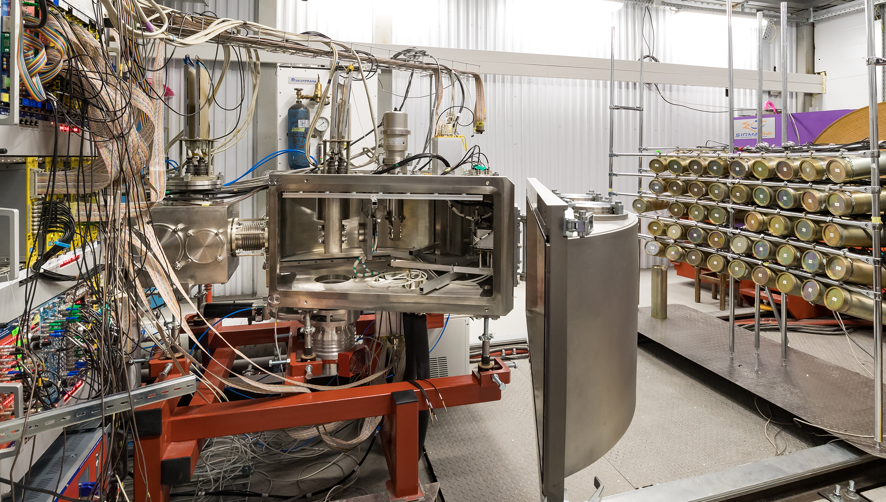
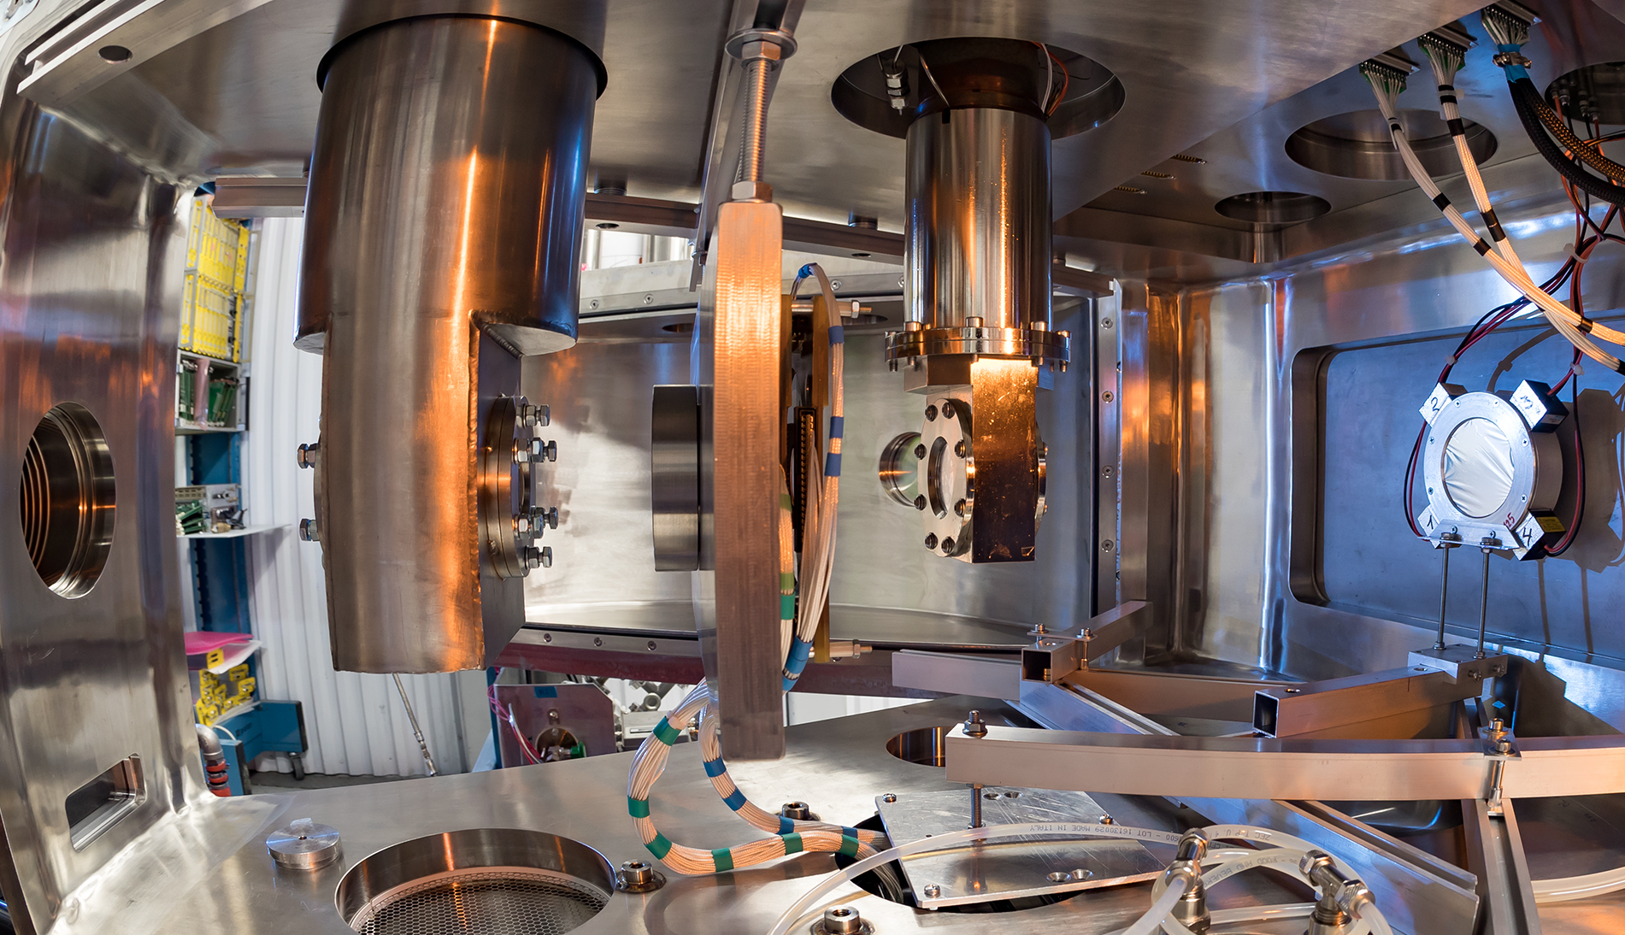

⁹Li(d,p)¹⁰Li → n+⁹Li
setup layout
Neutron array (44 modules)
stilbene 80 mm x 50 mm +
PMT ETE-9822B
D₂ target
MWPC
DSSD
ToF detector (EJ-212 125 μ + 4 PMTs R7600)
Exit window (steel 180 μ)

Slide 9
⁹Li(d,p)¹⁰Li → n+⁹Li
preliminary results
Cavallaro et. al., PRL 118 (2017) 012701 – left panel;
Cavallaro et. al., J. Phys.: Conf. 590 (2015) – right panel;
This work – bottom panels. The splitting of the p-wave resonance on 1⁺,2⁺ doublet is obviously seen.
dσ/dΩ
p-⁹Li
coincidences
E=11 AMeV
p-⁹Li-n
coincidences
E=29 AMeV
Counts / 100 keV
Counts / 100 keV
E, MeV
E, MeV

Slide 10
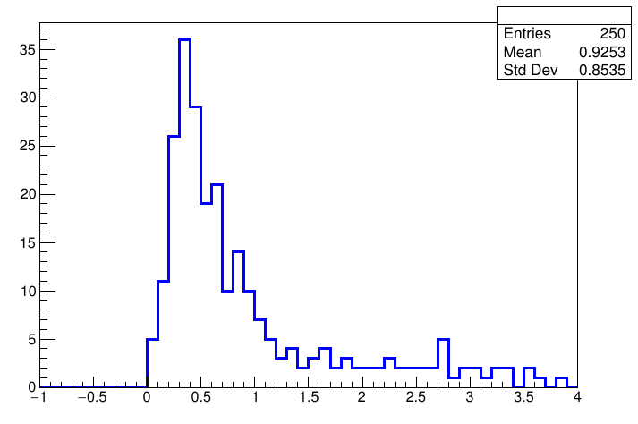
⁹Li(d,p)¹⁰Li → n+⁹Li – preliminary summary
The combined mass method (p-⁹Li-n coincidences) is very promising for ¹⁰Li study and could be applied for other isotopes (^{7,9}He, ^{10,11,12}Li etc.).
Higher statistics and better quality for neutron detection will help to clarify the ¹⁰Li low energy spectrum in more detail. These measurements are scheduled on the fall 2020.
p-⁶He-n
coincidences
Counts / 100 keV
ΔE ~ 250 keV
(FWHM)
⁶He+d → ⁷He+p
E(⁷He), MeV

Slide 11
Summary and outlook
First experiments at ACCULINNA-2 fragment separator commissioned in 2017 were performed and the obtained results demonstrate the high potential of this facility.
In 2018/19 experimental program with RIBs has been focused on ⁷H as a product of the reaction d(⁸He,³He)⁷H → t + 4n + ³He.
Low-lying states of ¹⁰Li populated in the reaction d(⁹Li,p)¹⁰Li → n + ⁹Li was also studied via registration of proton in coincidence with ⁹Li and neutrons. The method is very promising for the study ^{7,9}He, ¹⁰⁻¹²Li and others systems.
The possible proposals of day-two experiments are under analysis:
search for ²⁶S and ²⁵P unbound isotopes as the products of the ²⁸S(p,t) and ²⁸S(p,⁴He) reactions (with the use RF-kicker);
spectroscopy of ⁸C in the reaction ⁹C(p,d);
multi-nucleon transfer reactions on heavy targets induced by RIBs at ~ 5 MeV/n aimed on the production nuclei with atomic numbers 95<Z<110.

Slide 12
Thanks for your attention

Slide 13
⁸He(d,³He)⁷H – preliminary results, angle distributions (Nov. 2018)
The center-of-mass angular distributions calculated with the use of the FRESCO code for the ²H(⁸He,³He)⁷H reaction channels leading to the formation of ⁷H in the three states. Calculation results obtained for the 1/2+, 5/2+, and 3/2+ states are shown with the solid (a), dashed (b) and dotted
(b) curves, respectively. The angular distributions presented for the 5/2+ and 3/2+ states were obtained assuming the entrance-channel two-step transition through the ⁸He 2+ excitation. The angles of the five events associated with population of the ground state candidate are indicated by arrows in (a). The gray histogram in (b) shows the angular distribution of events in the 5 − 8 MeV energy bin around the E_{T} = 6.5 MeV position of excited states. Green dotted and dash-dotted curves associated with right axis show experimental setup efficiency for the ⁷H registration with E_{T} equal 2 and 6.5 MeV respectively.
Systematics of the lowest excited states for the isotones with closed p_{3/2} neutron subshell. The typical energies for excited states are E* ~ 3.5 – 4.5 MeV. In the case of E_{T} ~ 2 MeV for ⁷H g.s. it gives E* ~ 4.4 MeV, that fitting well the systematics.

Slide 14
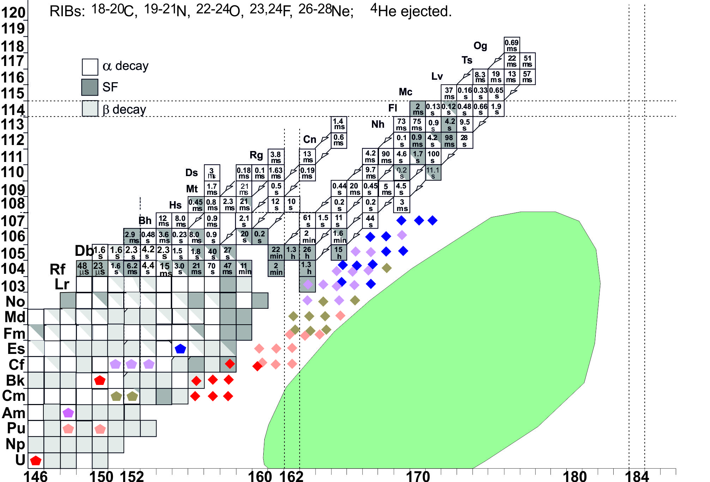
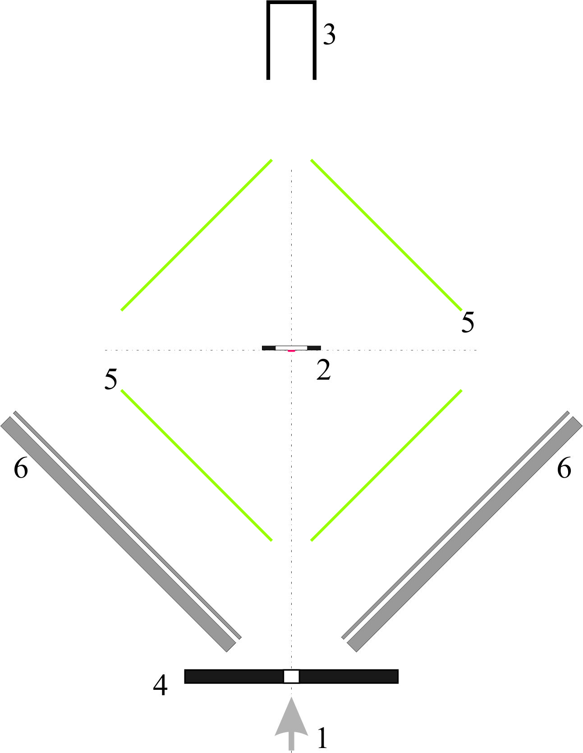
Multi-nucleon transfer reactions on heavy targets induced by RIBs at ~ 5 MeV/n allow one to produce nuclei with atomic numbers 95<Z<110 and neutron numbers approaching N=172.
Beam.
Target (0.1 mg/cm²).
FC (or beam monitor).
Collimator (or MWPC).
Fission-fragment detectors (30-μ plastics).
ΔE-E telescopes to detect ⁴He, ⁸B, ¹²C, ¹⁶O ions ejected within a solid angle of 2 sr.
Proton number
²⁶⁰Cf
Neutron number

Slide 15
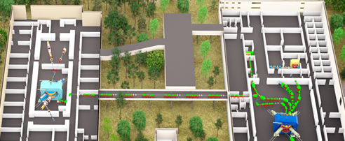
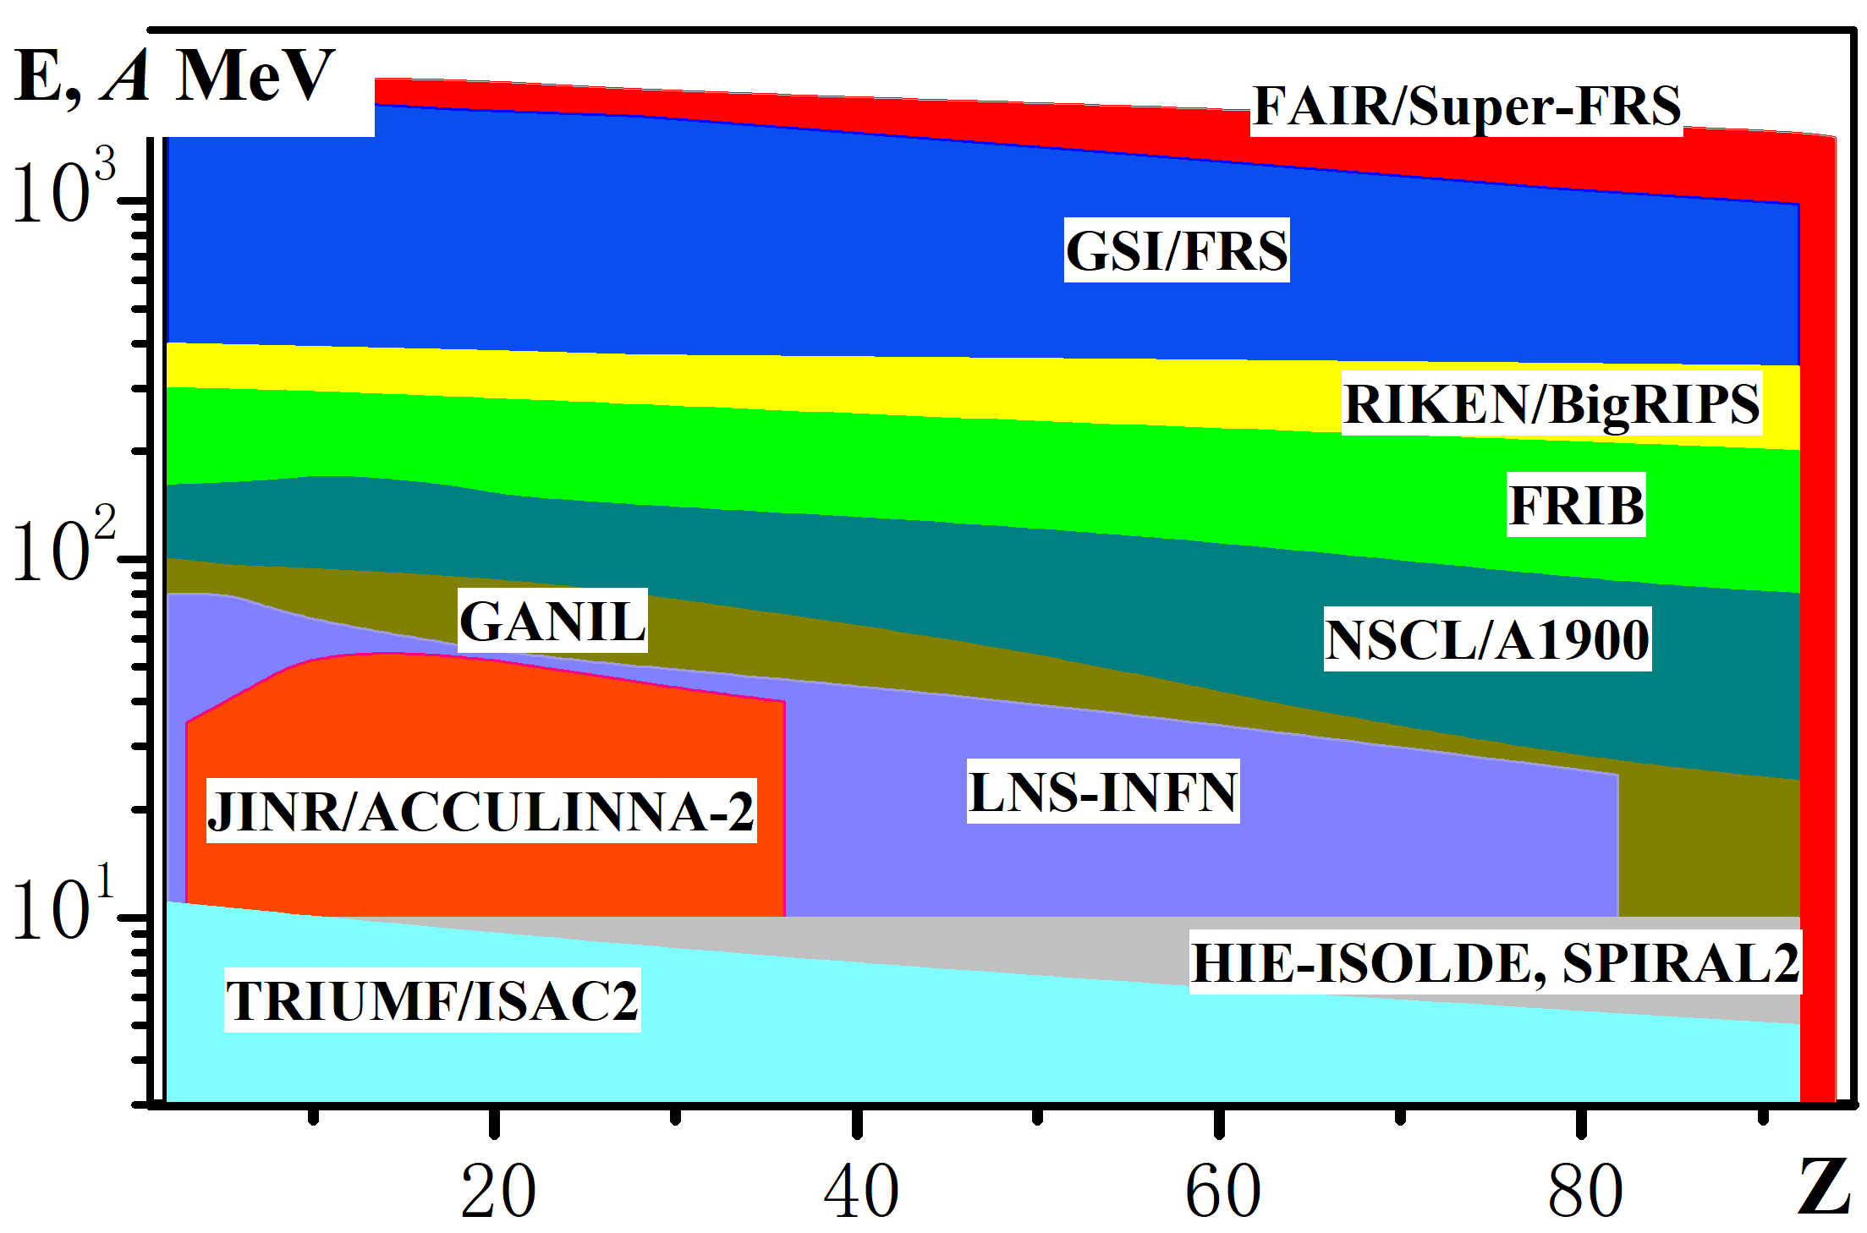
Main parameters of the Dubna RIBs complex
^{6,8}He @ 25÷35 АМeV
^{9,11}Li @ 30 AMeV
¹⁸Ne @ 35 AMeV
^{26,27}S @ 38 АMeV
In-flight separation
⁶He @ 10 АMeV
ISOL method
U-400
I, pμA
8
5
2
1
0.2
⁶Li @ 46 АMeV
¹¹B@ 33 АMeV
¹⁵N @ 50 АMeV
²⁰Ne @ 53 AMeV
³²S @ 52 АMeV
⁷Li @ 33 АMeV
U-400M

Slide 16
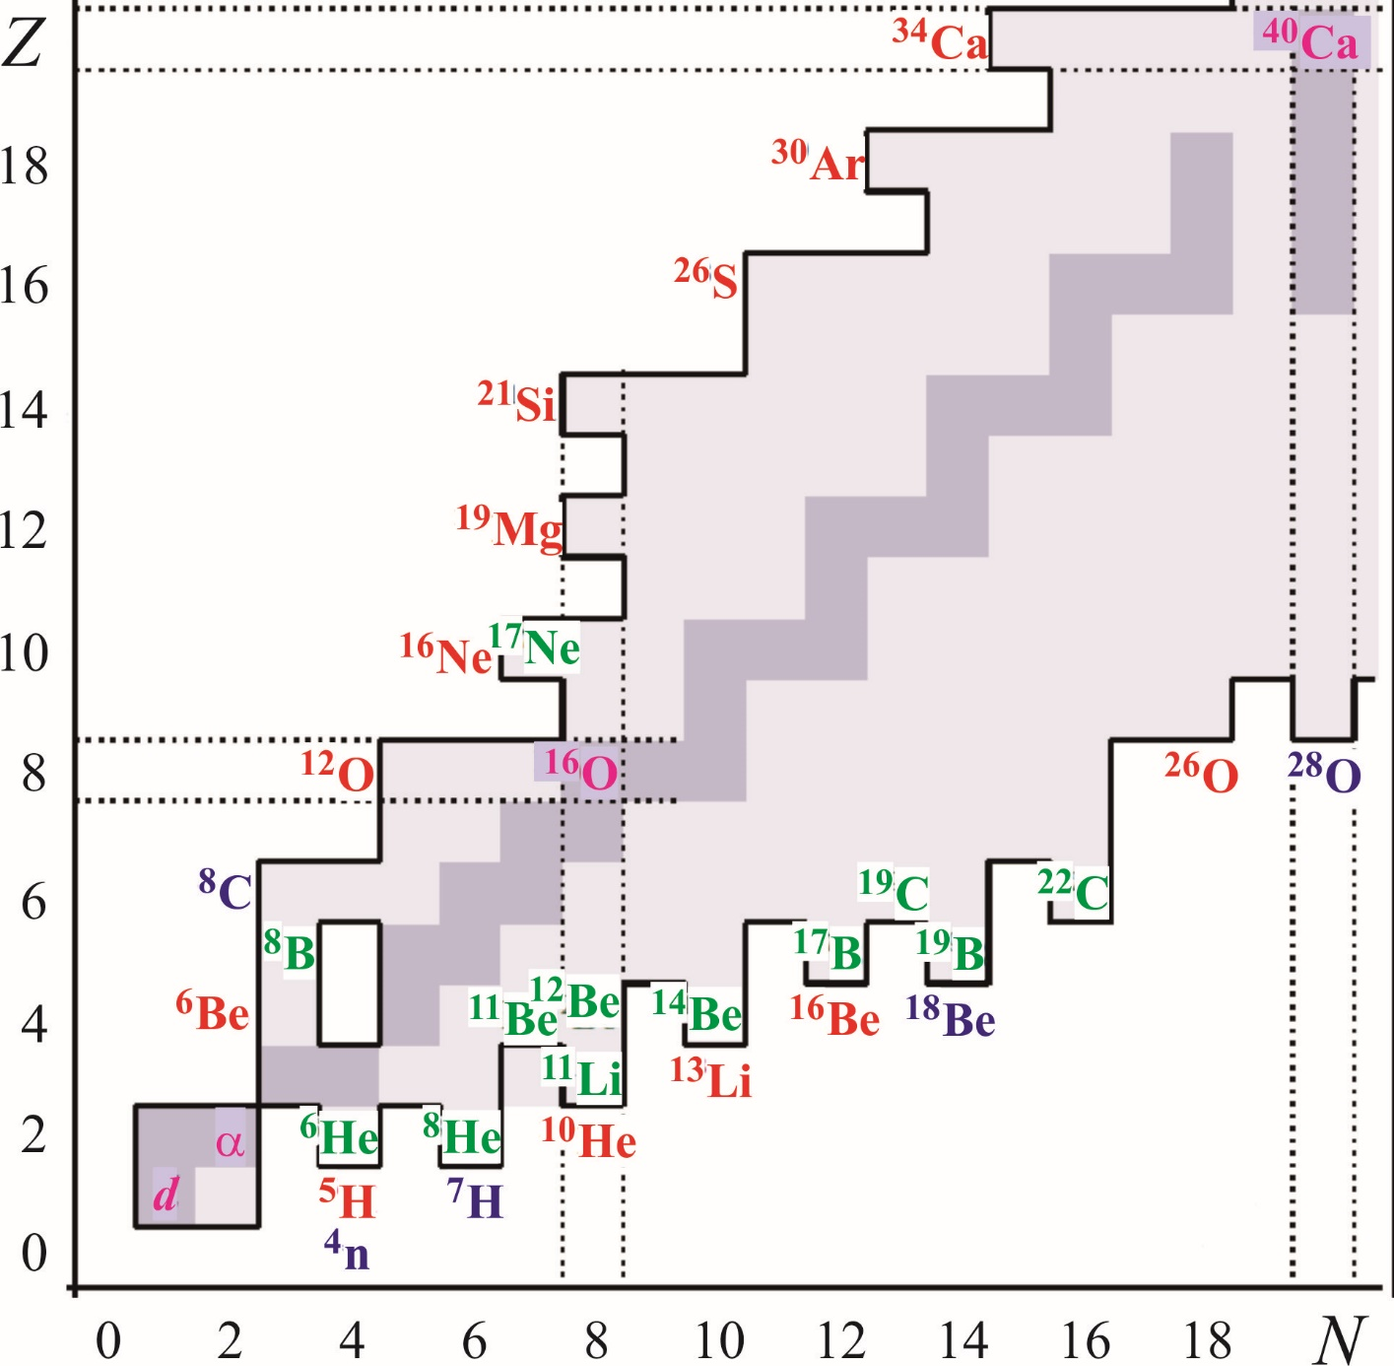
Sphere of interests for ACCULINNA-2 near drip-lines
Key instruments and methods:
Exotic and intensive primary beams
(¹¹B, ¹⁵N, ¹⁸O, ³²S, ³⁶S, ³⁶Ar, ⁴⁸Ca)
Exotic targets with a thickness 0.3÷15.0 mg/cm²
(³H, ¹⁰Be, ¹⁴C)
Exotic detectors for charged and neutral particles (optical TPC, neutron wall, scintillator arrays based on CsI, LaBr₃, etc., Si-telescopes, active target, HPGe array)
Exotic addition stage for beam purification
(RF-kicker, Zero degree spectrometer)
In perspective: stopping of RIB in gas-cell and post-acceleration by LINAC, implantation to
MR-ToF spectrometer, laser spectroscopy

