Slide 1
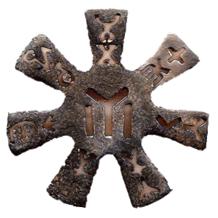



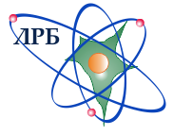






Report and Proposal for Extension of the Project TANGRA (TAgged Neutrons & Gamma-Rays)
“Design and development of the tagged neutron method for determination of the elemental structure of materials and nuclear reaction studies”
Theme: 03-4-1128-2017/2019
“Investigations of neutron nuclear interactions and properties of the neutron”
Project Leader: Yu.N. Kopatch
(Deputy): V.M. Bystritsky †

Slide 2
TANGRA in 2017 - 2019
Participants:
Frank Laboratory of Neutron Physics, JINR, Dubna, Russia
Veksler and Baldin Laboratory of High Energy Physics, JINR, Dubna, Russia
Dzhelepov Laboratory of Nuclear Problems, JINR, Dubna, Russia
Laboratory of Radiation Biology, JINR, Dubna, Russia
N.L. Dukhov All-Russian Automation Research Institute, Moscow, Russia.
Institute for Nuclear Research and Nuclear Energy, BAS, Sofia, Bulgaria
Institute of Geology and Geophysics, ANAS, Baku, Azerbaijan
Institute of Chemistry of the ASM, Chisinau, Republic of Moldova
Institute Ruđer Bošković, Zagreb, Croatia
New project members
Lomonosov Moscow State University, SINP, Moscow, Russia.
Banaras Hindu University, Varanasi 221005, India
Xi'an Jiao Tong University, Xi'an, China
University of Alexandria, Alexandria, Egypt
Horia Hulubei IFIN-HH, Bucharest, Romania
L.N.Gumilyov Eurasian National University, Nur-Sultan, Kazakhstan

Slide 3
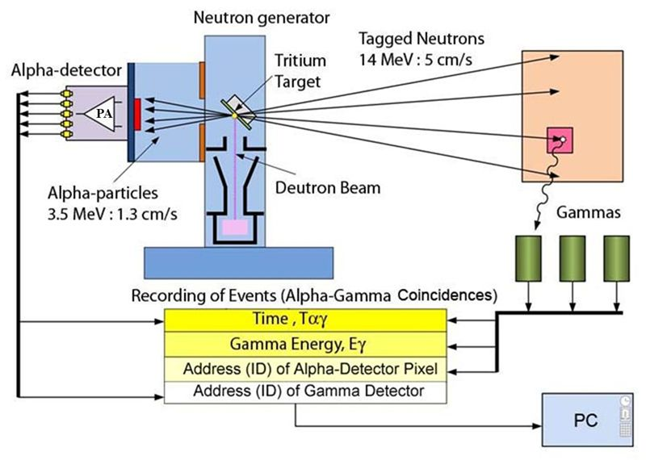
Tagged neutron method (TNM)
D + T → ⁴He (3.5 МeV) + n (14.1 МeV)
Main parameters of ING-27
Maximum neutron flux | 5.10⁷ s⁻¹
Neutron energy | 14.1 MeV
Operation mode | Continuous
Maximum accelerating voltage | 80 kV
Power supply | 200 ± 10V DC
Maximum power consumption | 30 Wt

Slide 4
Main results obtained in 2017-2019:
A facility was created consisting of ING-27 tagged neutron generator and 22 NaI(tl)-crystal based or 18 BGO-crystal based gamma-ray detector arrays;
The physical characteristics of the gamma-detectors and the optimal geometry of the whole detector system were determined;
The position of the tritium target and the directions of the tagged neutron beams were determined using a two-dimensional silicon strip fast neutron detector;
The γ-ray detector response function was determined for the NaI(Tl) and BGO detectors;
The angular anisotropy of gamma-ray emission in the inelastic scattering reactions of 14.1-MeV neutrons on various nuclei was measured and calculated;
The gamma-spectra from inelastic scattering of 14.1-MeV neutrons on samples, using a HPGe detector, were measured.

Slide 5
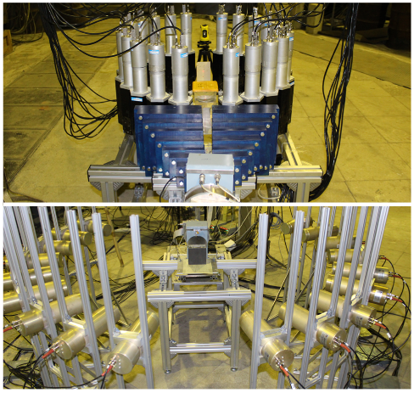
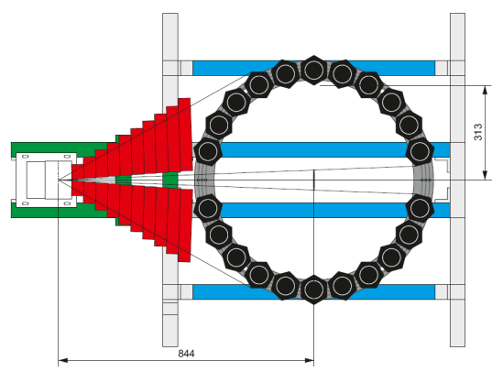
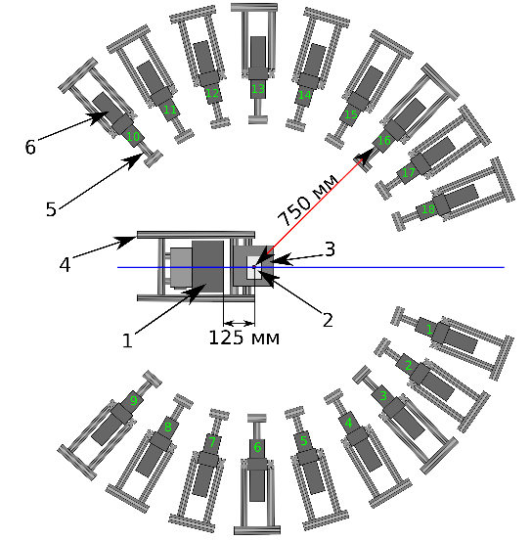
Main results obtained in 2017-2019:
Two types of the experimental setup
Stage I: 22 NaI detectors
Stage II: 18 BGO detectors
Physical shielding of the detectors
Electronic “shielding”: using coincidence to select useful events

Slide 6
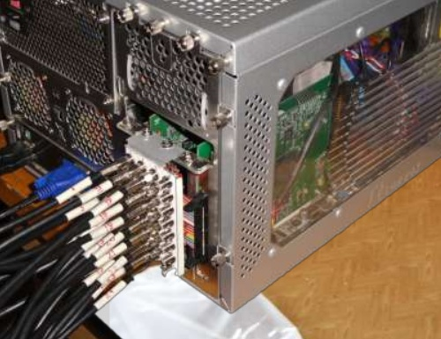
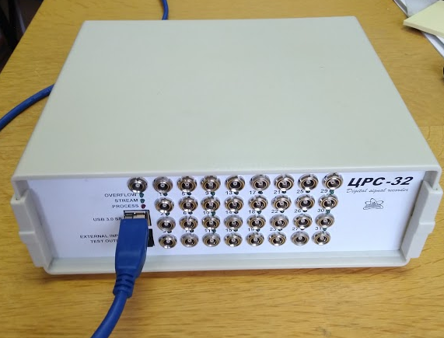
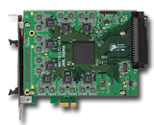
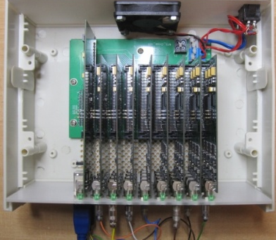
Main results obtained in 2017-2019:
Two types of data acquisition system (DAQ)
ADCM-32/64
AFI Electronics
ЦРС-32
Alpatov S.V.
100 MHz sampling
PC-integrated
using PCI-e bus
<10⁵ event/sec
200 MHz sampling
USB-3 connection
~10⁵ event/sec for each input channel
can work with HPGe detectors

Slide 7
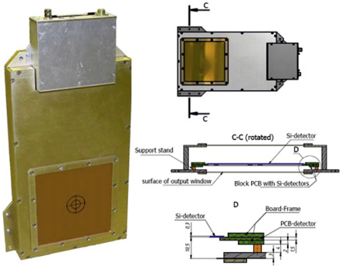
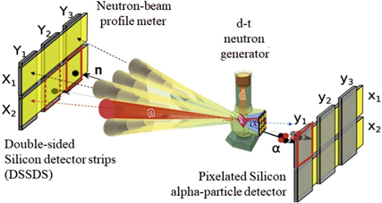
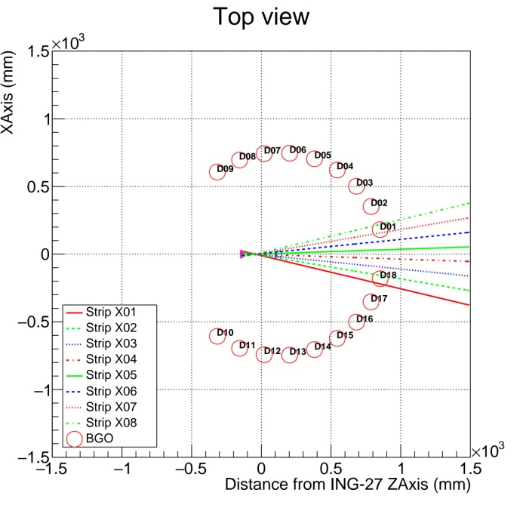
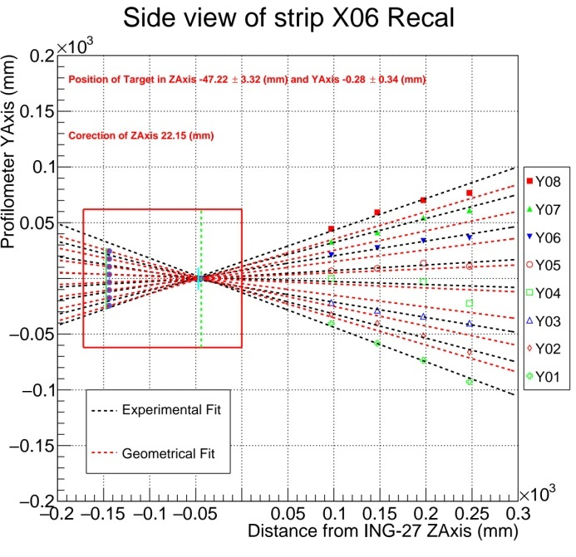
Main results obtained in 2017-2019:
Neutron beam profile measurements

Slide 8
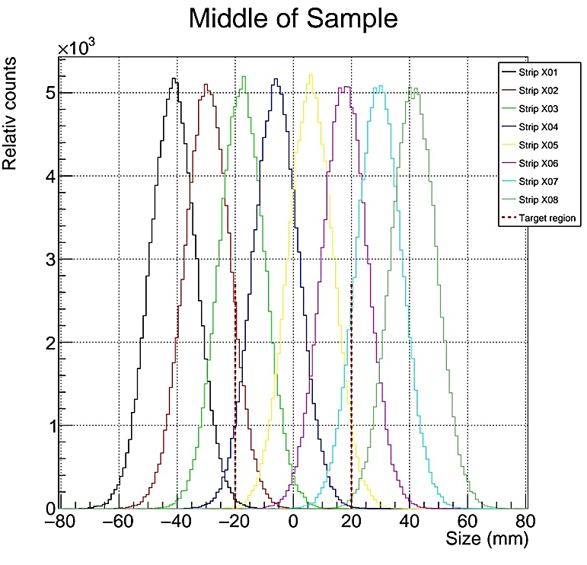
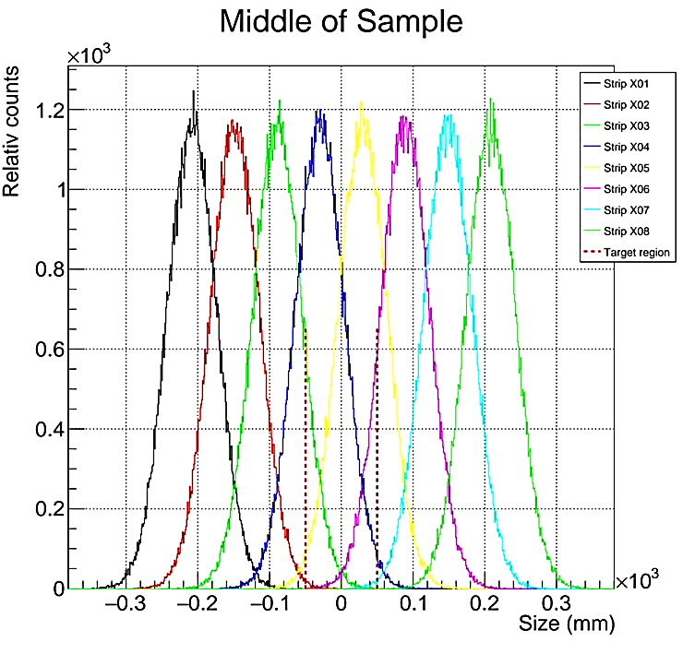
Main results obtained in 2017-2019:
Neutron beam profile measurements
Sample location
Sample location

Slide 9
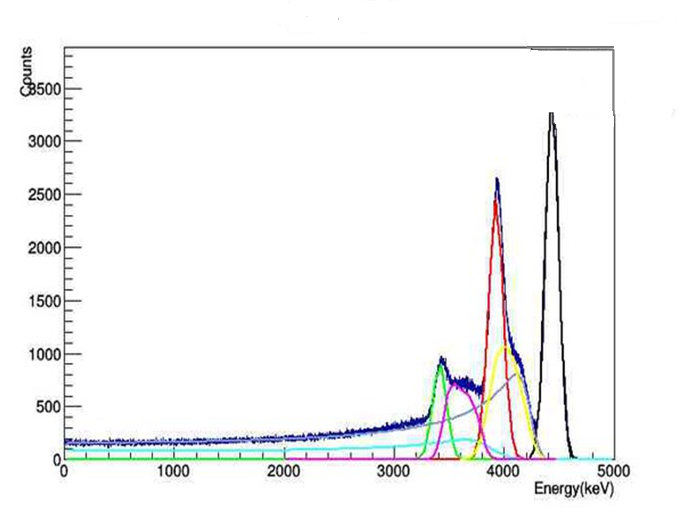
Main results obtained in 2017-2019:
Determination of the γ-ray detectors response function
(see poster of D. Grozdanov)
Full energy absorption peak
single escape peak
Compton components from single and double escape peaks
double escape peak
Single and multiple Compton continuum

Slide 10
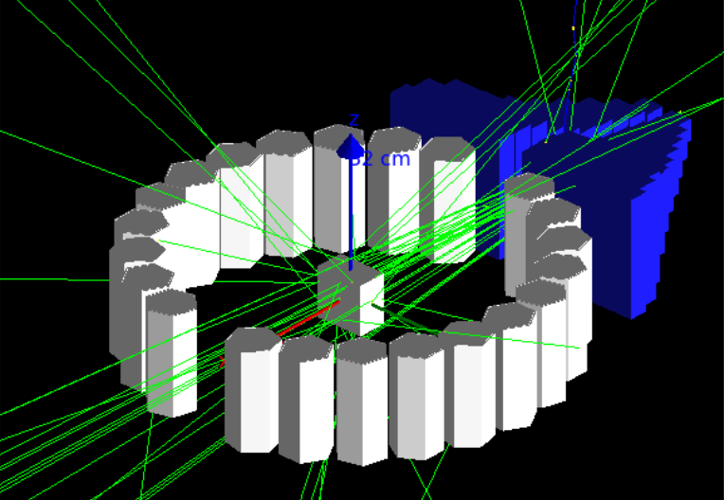
Main results obtained in 2017-2019:
Development of the data analysis procedure
Calculations of geometrical corrections and optimal dimensions of the samples using GEANT4 simulation toolkit

Slide 11
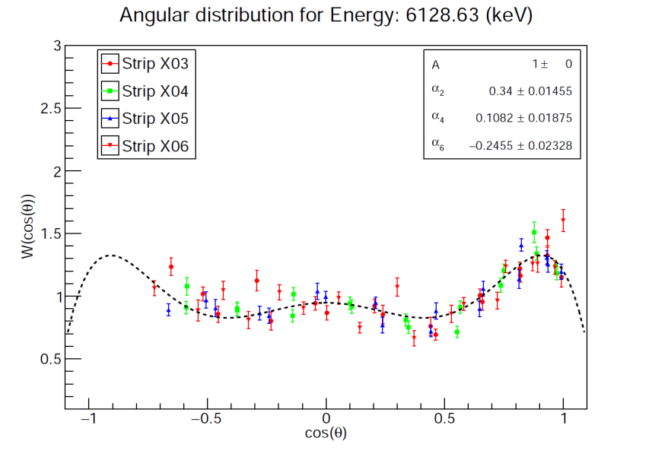
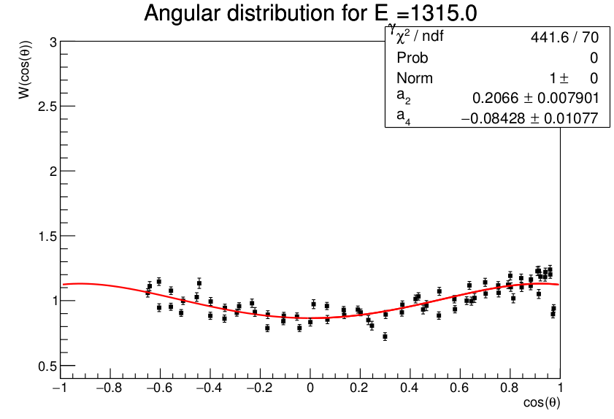
Main results obtained in 2017-2019:
Measurements of angular distributions of γ-rays in the inelastic scattering of 14.1 MeV neutrons
Angular distributions of γ-rays are measured for the following targets/elements:
C, Si, O, Bi, Al, Pb, Fe, Ti, Sn, Zn, Mn, Mg, K, Ca, Na, Cl, N, Ni, P.
¹⁶O
⁴⁸Ti
The data are in the process of analyzing.
For some elements additional measurements are foreseen.

Slide 12
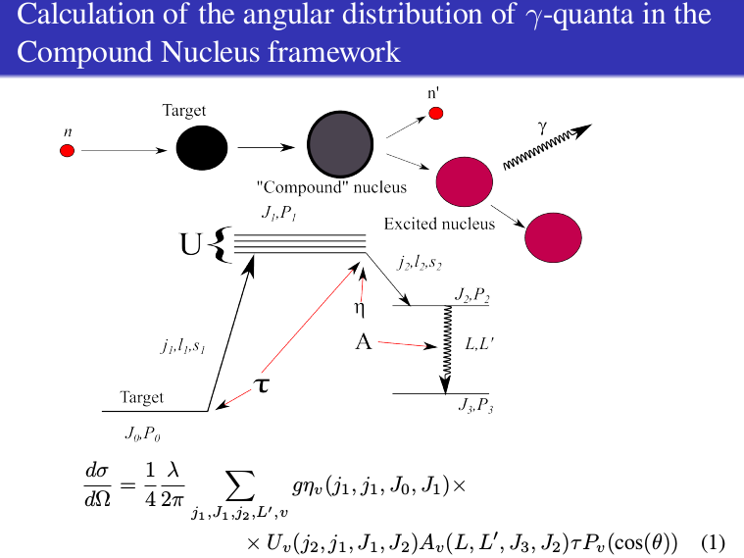
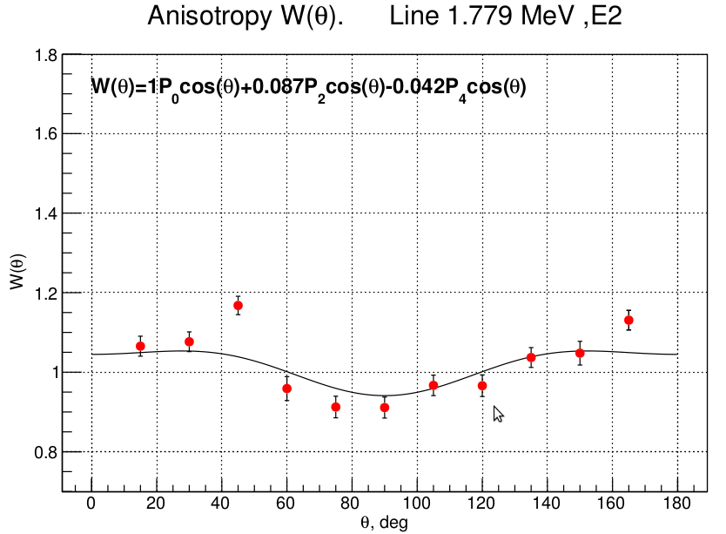
Main results obtained in 2017-2019:
Calculations of the angular anisotropy in the inelastic scattering on 14.1 MeV neutrons on nuclei
N.Fedorov, reported at ISINN-25, May 22-26 2017, Dubna
N.Fedorov, Master Thesis, 2017
Comparison of the results of calculations with experimental data for ²⁸Si, E_{γ} = 1.779 MeV, transition E2

Slide 13
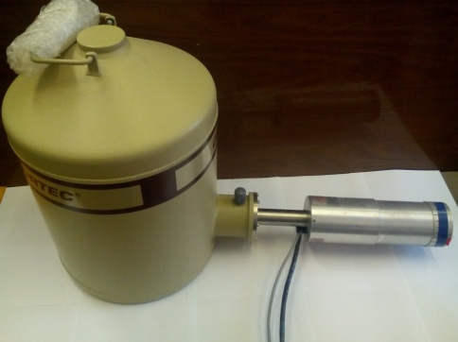
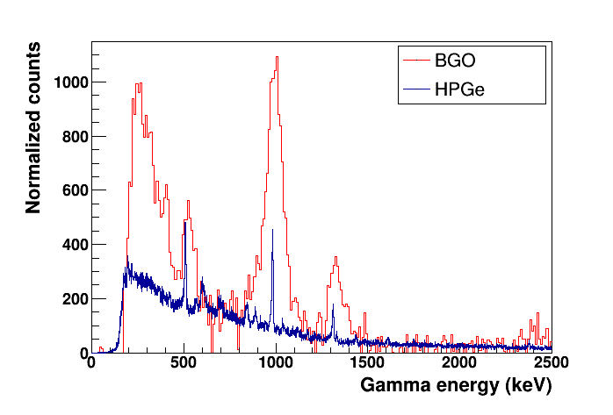
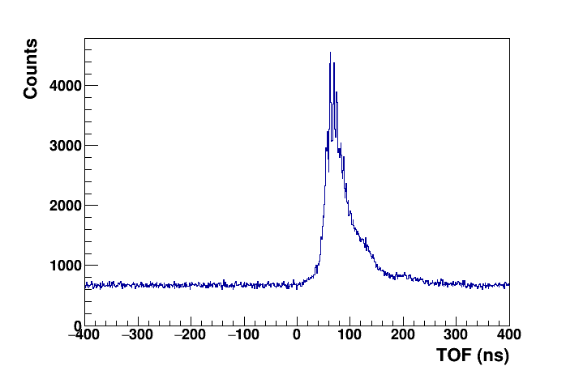
Main results obtained in 2017-2019:
Measurements of the γ-ray yields using HPGe detector
(see the poster of N. Fedorov)
BGO detectors
HPGe detector with shielding
Energy spectra for Ti(n,n'γ) obtained with BGO and HPGe detectors using TNM
TOF spectrum from HPGe
983 keV (2⁺→0⁺) ⁴⁸Ti
TOF gate
1312 keV (4⁺→2⁺) ⁴⁸Ti

Slide 14
Main results obtained in 2017-2019:
List of main publications
TANGRA – an experimental setup for basic and applied nuclear research by means of 14.1 MeV neutrons, Ivan Ruskov, Yury Kopatch et al, European Physics Journal – Web of Conferences, eISSN:2100-014X, 146, 03024-03027, 2017
Neutron beam profilometer on the base of double-sided silicon strip detectors, N.I.Zamyatin et al, TANGRA collaboration, Nuclear Instruments and methods in physics research, 898, 46-52, 2018
Measurements of the gamma-quanta angular distributions emitted from neutron inelastic scattering on 28Si, N.A. Fedorov et al, European Physics Journal – Web of Conferences, eISSN:2100-014X, 177, 5, 2018
Elemental Analysis of Engine Parts of the Proton Rocket Carrier with Resonance Neutrons, D. N. Grozdanov et al, Physics of Particles and Nuclei Letters, ISSN:1547-4771, eISSN:1531-8567, 15, 5, 537–540, 2018
Measurement of Angular Distributions of Gamma Rays from the Inelastic Scattering of 14.1-MeV Neutrons by Carbon and Oxygen Nuclei, D. N. Grozdanov et al, Physics of Atomic Nucei, ISSN:1063-7788, eISSN:1562-692X, 81, 5, 588–594, 2018
Determination of Moisture Content in Coke with 239Pu–Be Neutron Source and BGO Scintillation Gamma Detector, D. N. Grozdanov, Physics of Particles and Nuclei Letters, ISSN:1547-4771, eISSN:1531-8567, 15, 2, 157–163, 2018
“Определение функции отклика детектора NaI для гамма – квантов с энергией 4,43МэВ, образующихся при неупругом рассеянии нейтронов с энергией 14,1МэВ на ядрах углерода”, Дабылова С.Б, Копач Ю.Н., Грозданов Д.Н., Вестник Международного университета природы, общества и человека «Дубна», 1(37), 3-12, 2017
Исследование неупругого рассеяния нейтронов с энергией 14.1 МэВ на ядрах кислорода и кремния, Н. А. Федоров и др., Ученые записки физического факультета Московского государственного университета, 2, 1820205, 2018
Gamma-ray imaging with a time-modulated random coded aperture, Dongming Wang et al, Review of Scientific Instruments, 90, ‎American Institute of Physics‎ (AIP), 2019, ISSN:0034-6748 (Print), 1089-7623 (Electronic), DOI:10.1063/1.5050211, 015107-1-015107-7. SJR:0.58
+ 10 conference reports

Slide 15
Main results obtained in 2017-2019:
Educational program
During the whole period of project realization:
2 PhD Theses were prepared and defended
11 Master and Bachelor Theses were prepared and defended
4 PhD Theses are currently being prepared
more than 20 students from the Student Summer Programs worked on the TANGRA facility
International cooperation
PhD students geography:
1 from China (defended)
1 from Egypt (defended)
1 from Russia
1 from Bulgaria
1 from Kazakhstan
1 from Azerbaijan

Slide 16
Plans for 2020-2022
1 | Measurement of characteristic gamma-spectra for various elements. Creation of database for identification of elements. | 2020, I | 2020, IV
2 | Construction of a prototype of a setup for elemental analysis using TNM and high-resolution detectors. | 2020, I | 2021, IV
3 | Experiments on the measurement of cross-sections of (n,2n), (n, n′) reactions. | 2021, I | 2022, III
4 | Experiments to measure angular correlations of gamma-ray and neutron emission in reactions of inelastic neutron scattering by light nuclei. Processing of the experimental data. | 2020, I | 2022, IV
5 | Development of a theoretical model to describe angular correlations in inelastic scattering of fast neutrons. | 2021, I | 2022, IV
6 | Development of a technique of searching for diamonds in kimberlite ores using the tagged neutron method. Design and development of 1024-pixel neutron generator (VNIIA). | 2020, I | 2022, IV
7 | Studies of the Martian soil model. | 2020, I | 2022, IV

Slide 17
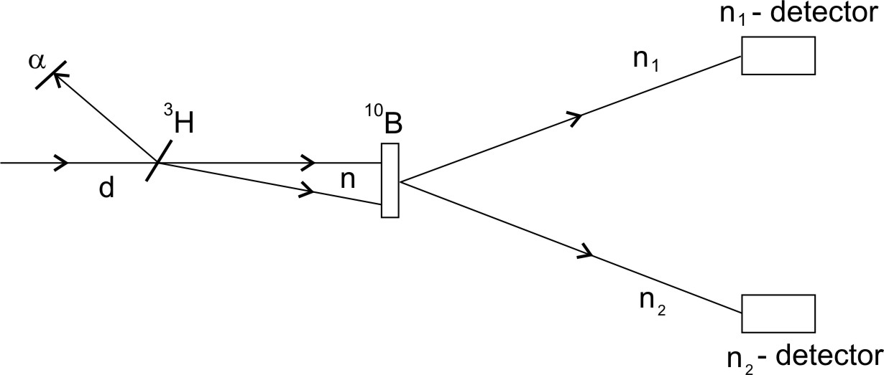
Plans for 2020-2022
Investigation of the (n,2n`) and (n,n`) – reactions using the tagged neutron method
1st stage: 2 neutron detectors
2nd stage: up to 32 neutron detectors
n₁
Ing-27
n₂
Investigation of the reaction ¹⁰B(n,2n)⁹B → p + ⁸Be.
Aim: Obtaining information about the low-lying levels of the unstable nucleus ⁹B
Method: Measurement of the energies of two neutrons using time of flight and calculation of missing-mass spectrum for ⁹B.

Slide 18
Plans for 2020-2022
Development of theoretical models describing angular correlations in the inelastic scattering on 14.1 MeV neutrons on nuclei
N.Fedorov, reported at ISINN-25, May 22-26 2017, Dubna
N.Fedorov, Master Thesis, 2017
TALYS calculations: up to 50% contribution of the direct processes

Slide 19
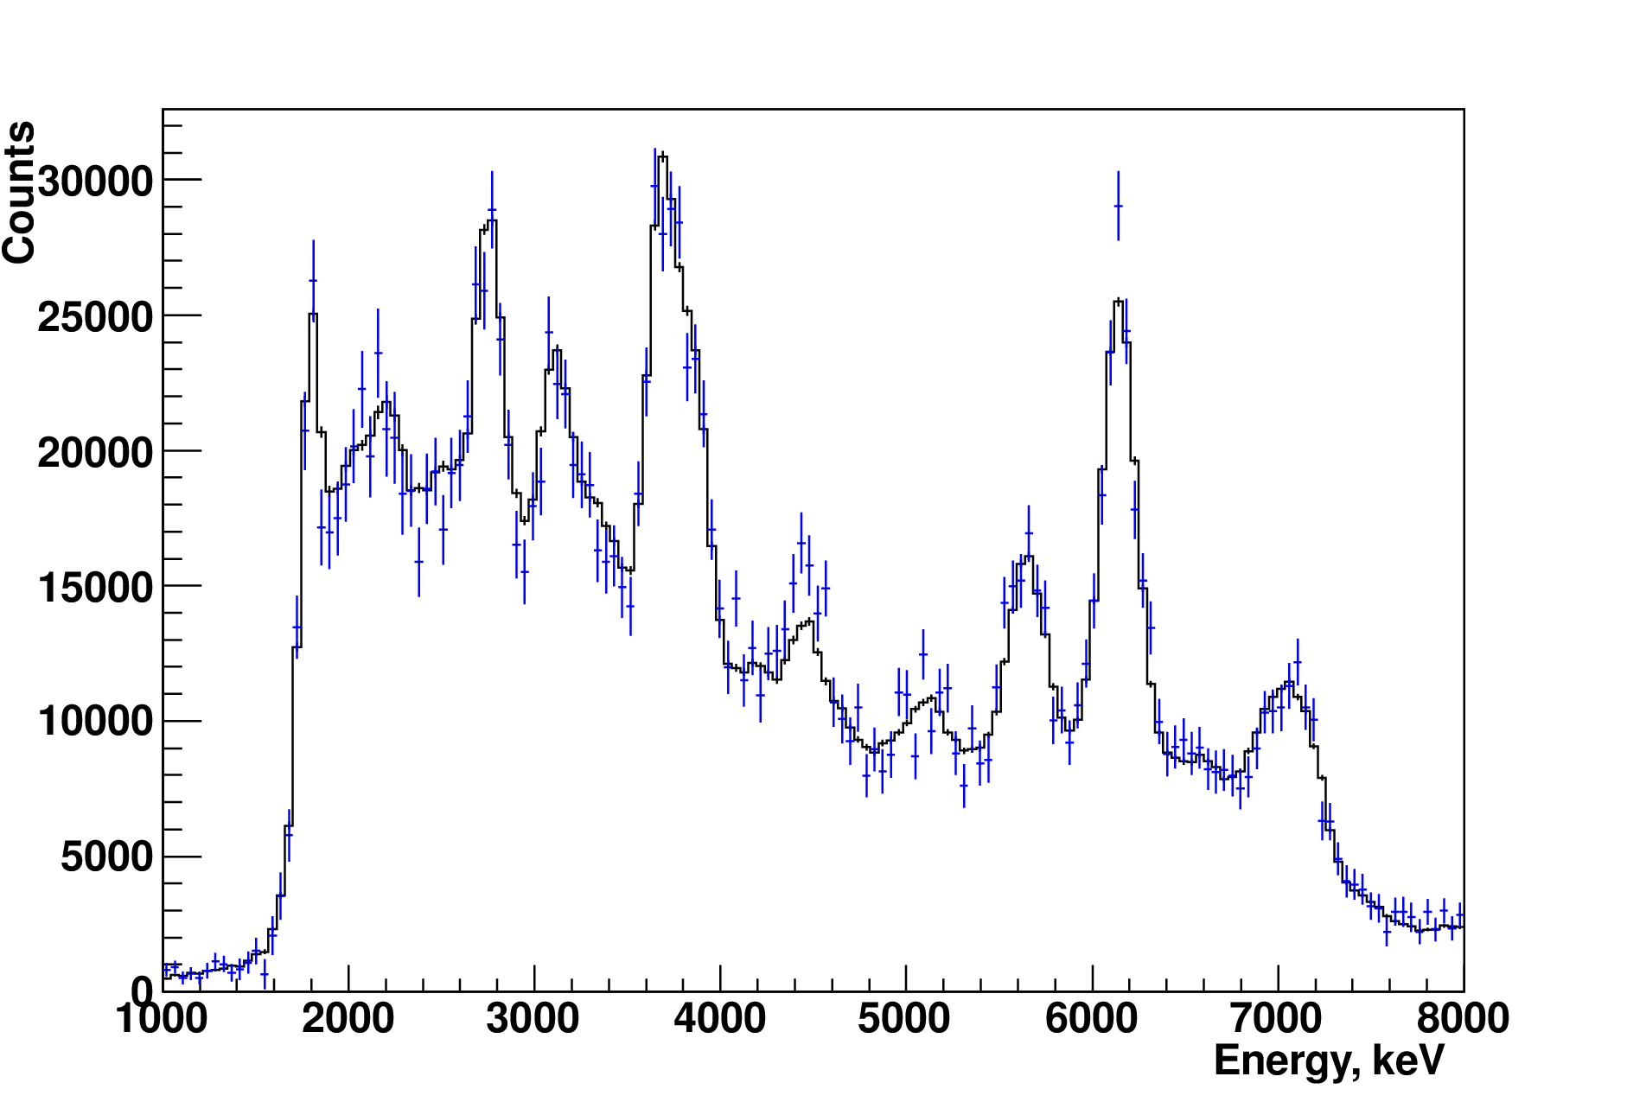
Plans for 2020-2022
Development of a technique of searching for diamonds in kimberlite ores using the tagged neutron method – in collaboration with “DIAMANT, ltd”
¹²C peak
Current throughput of the diamond detection facility with 192-pixell Ing-27: ~1000 kg of ore per hour
Aim: 30 tons/hour
Design and development of 1024-pixel neutron generator (VNIIA).

Slide 20
Required resources in 2020-2022
Description of units and systems, resources, funding sources |  |  | Cost of units (k$). | Proposals of the Laboratory for distribution of funds and resources.
 |  |  |  | 2020 | 2021 | 2022
Main units and equipment | Construction of a prototype of a setup for elemental analysis using TNM and high-resolution detectors |  | 200 | 80 | 80 | 40
 | Purchase of neutron detectors |  | 120 | 40 | 40 | 40
 | Development of digital electronics |  | 130 | 30 | 30 | 70
 | Purchase of targets |  | 30 | 10 | 10 | 10
 | Supply of neutron generator (VNIIA) |  | 100
 | Travel expenses |  | 90 | 30 | 30 | 30
Required resources | Norm-hour | FLNP workshops | 600 | 200 | 200 | 200
 |  | Design bureau | - | - | - | -
 |  | Reactor | - | - | - | -
Funding sources | Budget | Theme 1128 | 570 | 190 | 190 | 190
 | VNIIA |  | 100

Slide 21
Summary
The project aimed at the experimental investigations in the field of basic and applied nuclear physics using tagged neutron beam is proposed to be extended in the framework of the theme 1128 (FLNP) with participation of 4 JINR laboratories and 11 external institutes.
Total funding of 570 k$ is requested for 3 years.
A large part of the equipment including ING-27 neutron generator (contribution by VNIIA) is already available.
Good experience of the teams participating in the project assures its successful realization.

Slide 22
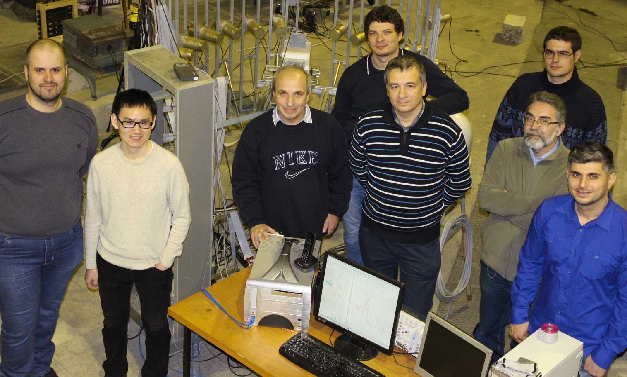
Thank you for your attention

